Slide 1
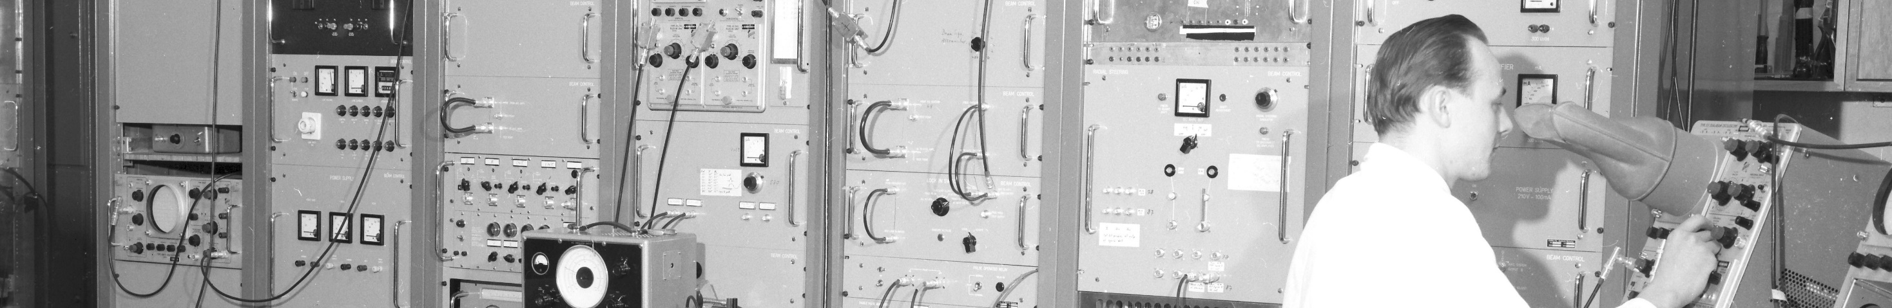
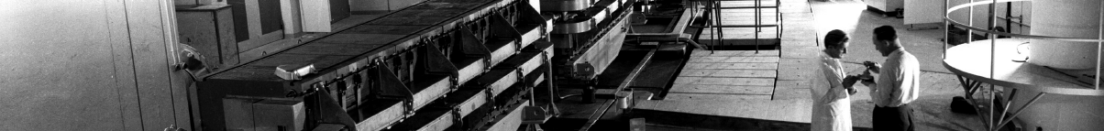
PS Report week 23
Many thanks
to the PS OP and coordination teams as well as all equipment experts and support teams!
A. Lasheen SY-RF-BR

Slide 2
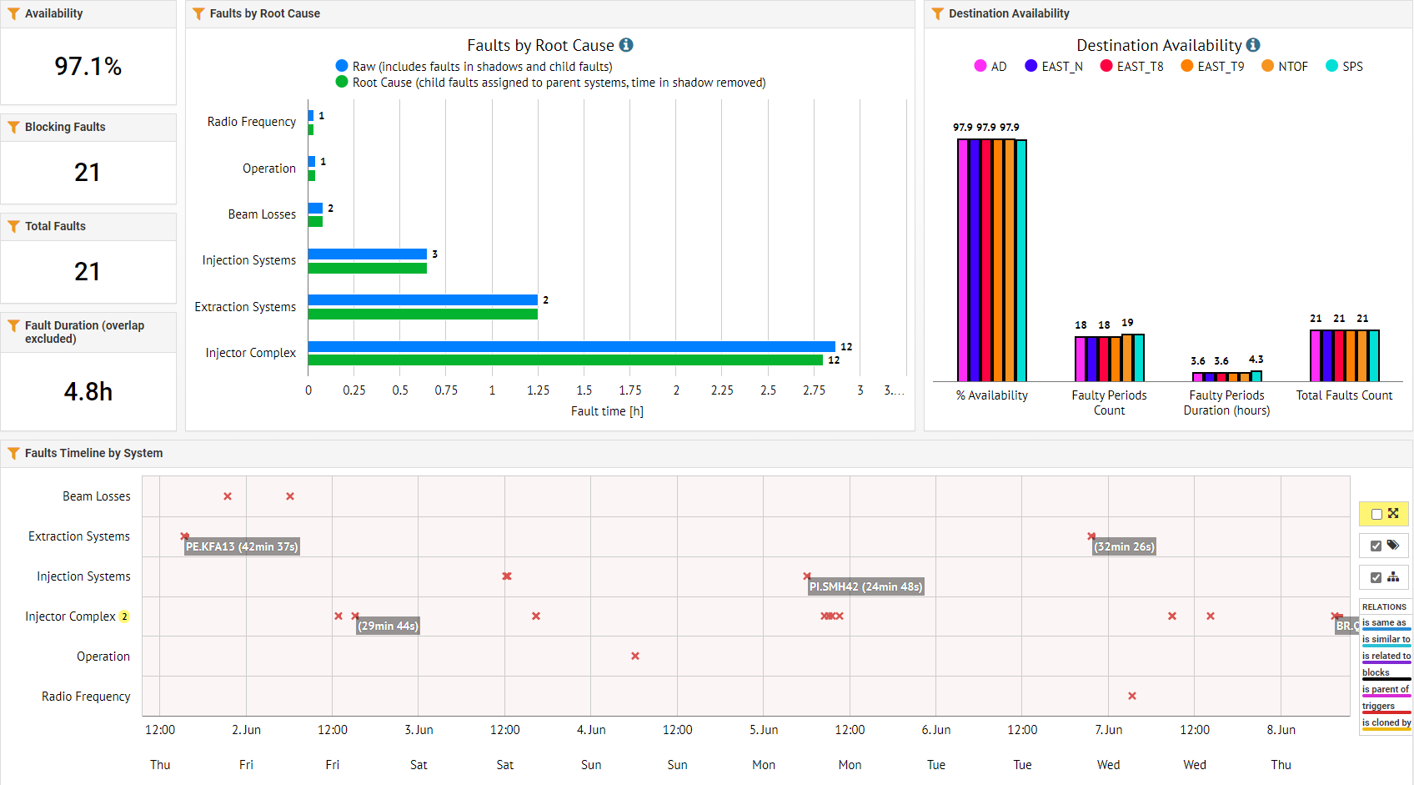
Beam availability W23
A. Lasheen SY-RF-BR

Slide 3
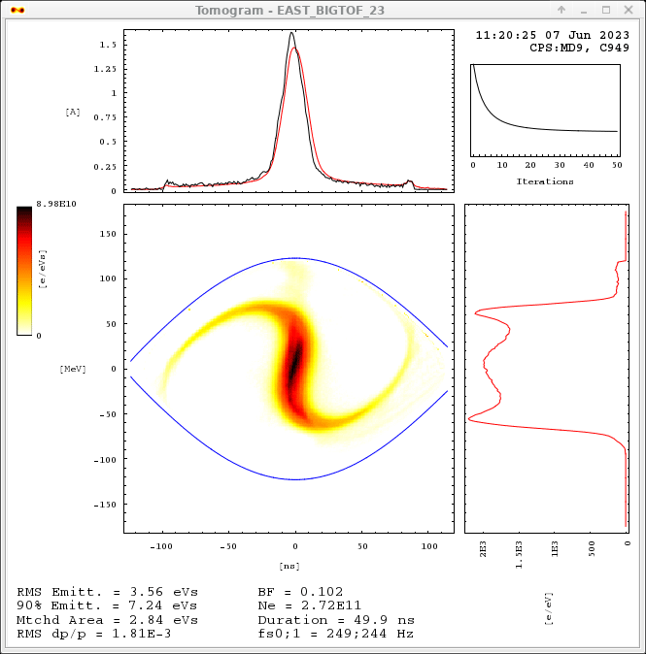
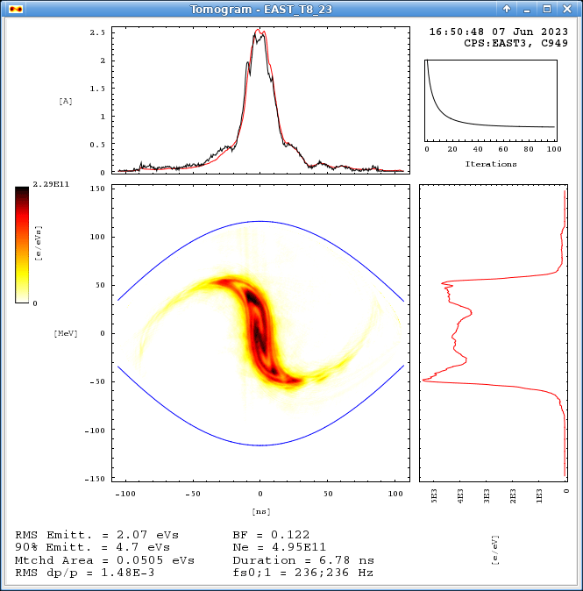
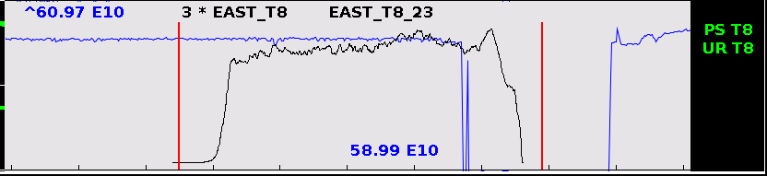
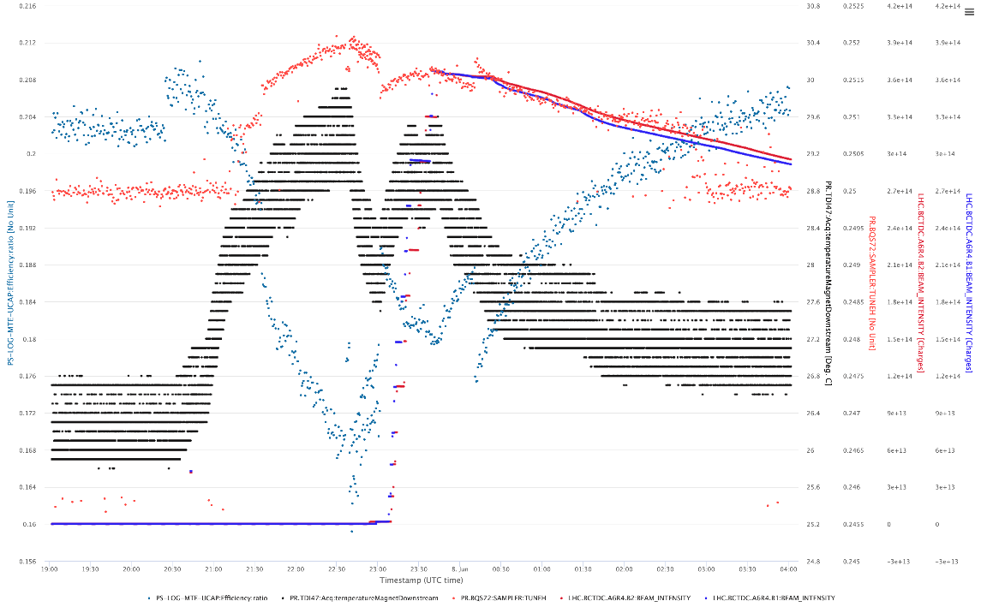
Parasitic TOF 28ns
Main issues and activities
Parasitic BIGTOF
Excellent availability from the PS this week
TOF
  Dedicated cycle with 28ns bunch length at extraction ready.
EAST + Parasitic TOF
  High intensity parasitic TOF adjusted to 570e10 p+. EAST bunch blown-up in the longitudinal plane but still in good shape. Spill quality to be verified.
  Parasitic TOF with 28ns at extraction degrades the longitudinal beam quality, but still gives good spill. Important losses in the PS with good beam quality delivered to experiment. Further optimization in the ring to be done.
SFTPRO
  Correlation between the PS temperature increase, LHC filling supercycle and degradation of beam SFTPRO beam in the PS identified.
Spill T8
Black > MU47 temperature
Blue -> MTE Efficiency
Red -> H Tune at C710
MTE efficiency vs. temperature with ++ LHC cycles
A. Lasheen SY-RF-BR
https://be-op-logbook.web.cern.ch/elogbook-server/GET/showEventInLogbook/3781514

Slide 4
Status of operational beams
Fixed target beams | Status | Comment
SFTPRO (core only) | Operational | Sent to SPS at 50 ∙ 10¹⁰ p/p
SFTPRO (5 turn extraction) | Operational | Available up to 1.5 ∙ 10¹³ p/p
AD | Operational | Available up to 1.5 ∙ 10¹³ p/p ; Beam delivered to AD
TOF | Operational | 850 ∙ 10¹⁰ p/p and (28-)40 ns bunch length at extraction
EAST | Operational | Beam slow extracted to T9, N targets and to IRRAD, Fast extraction and parasitic TOF
LHC-type beams | Status | Comment
LHCPILOT, LHCINDIV | Operational
LHC25 (3bp, 72b) | Operational | Sent to SPS at 2.4 ∙ 10¹¹ p/b; Pushed up to 2.6 ∙ 10¹¹ p/b
LHC25 (2bp, 12b to 48b) | Operational | Sent to SPS at 1.9 ∙ 10¹¹ p/b; Pushed up to 2.6 ∙ 10¹¹ p/b
LHC25 BCMS (48b) | On hold | OK at 1.4 ∙ 10¹¹ p/b; Pushed up to 2.3 ∙ 10¹¹ p/b
LHC25 8b4e (56b) | Operational | Pushed up to 2.1 ∙ 10¹¹ p/b
AWAKE | Operational
HiRadMat | Operational | Single bunch AWAKE-like prepared at 2um transverse emittance
ILHC (1b), ILHC (4b)
A. Lasheen SY-RF-BR

Slide 5

PS Coordinator for week 23 – Alexandre Lasheen
PS Coordinator for week 24 – Benoit Salvant
Questions and Comments
9:00 live meeting at the CCC on Wednesday/Friday
Zoom link to follow the meeting on remote: https://cern.zoom.us/j/9372114100?pwd=L29BcmlHUENCdFBRSytXYVcrM1B4Zz09
Meeting ID : 937 211 4100
Passcode: 525463
A. Lasheen SY-RF-BR

