Slide 1
Guidelines for Dept Rep
- Quest Continuous Process
HR-TA
24/05/2023

Slide 2
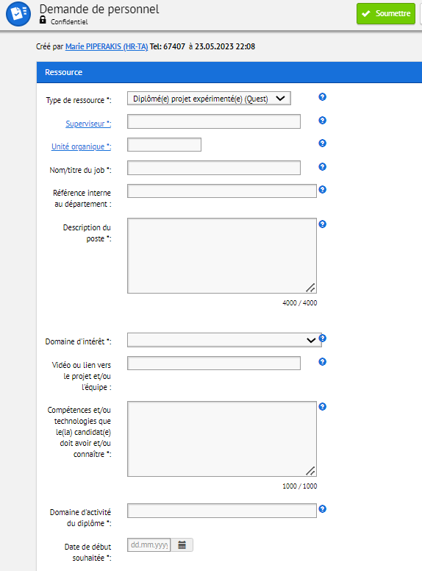

Approve the Personnel Request (PRQ) within EDH
After the financial approval stage, you can review the PRQ’s fields – which will be used for the publication and have to be attractive and clear for external candidates (with limitation in the use of specific CERN abbreviations/acronyms).
You will have to approve the PRQ, which will go to the last review by HR-TA before the publication.
In case of doubt, please contact your main HR-TA partner

Slide 3
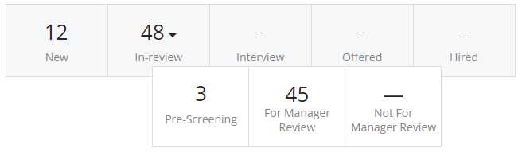


Access to eligible candidate pools
Your HR-TA partner will provide you access to the positions with SmartRecruiters links, like for supervisors. (If you don't or would like to give access to another colleague, please contact your HR-TA partner).
After minimum 3 weeks of publication and potential sourcing (possibility to extend to a maximum of 3 months), your HR-TA partner will share with the supervisors the eligible pools of candidates below the “For Manager Review” tabs.
The supervisors will take time to exchange with candidates using individual remote/phone interviews.
1
2
Please remind to supervisors to keep in mind the diversity balance both in terms of gender and underrepresented countries, by using the Screening Questions section of SmartRecruiters with “Gender" and "Nationality” filters.

Slide 4
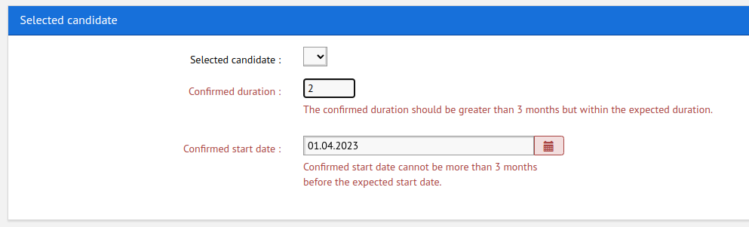

Selection and hiring
The declared supervisor (only) will use again the PRQ to enter the name, confirmed start date and duration.
Your HR-TA partner will take care of the contract and come back to supervisors in case of issues (candidate withdrawal, change of date needed, etc. ....)
When hiring confirmed, your HR-TA partner will close the PRQ and organize the onboarding of the new hire.
In case of lack of interesting candidates, it is possible to extend the publication (maximum 3 months) or cancel the PRQ to not pursue the recruitment process.
If you are aware about interesting unselected candidates, please feel free to share them with colleagues who may be interested.
If no selection are made on the PRQ within the 3 months maximum deadline, the PRQ will automatically be rejected.

