Slide 1
Update on e-cloud studies
L. Mether
for the e-cloud team
Acknowledgements: G. Iadarola, R. De Maria

Slide 2
Outline
Filling schemes for Run 4
Coherent tune shift from e-cloud

Slide 3
Achievable performance for HL-LHC
Best case scenario:
  No new heat load limitation w.r.t. Run 3 and no limitation from beam stability
Possible degradation scenario:
  Only high-load half-cells in a sector with low cryo capacity, e.g. further degradation in S78 by ~28% (all half-cells → worst today) and no limit from beam stability
Worst case scenario:
  With even further degradation, or beam stability limitations, we fall back on 8b+4e
→ Agreed to use filling scheme with ~2200 bunches as a baseline for Run 4 scenarios
Scenario | Beam | N. bunches | 8b4e ratio | S78 heat load [W/hc] | Requires surface treatment | Int. lumi [fb⁻¹/year]
Baseline 200 | 5x48 b | 2748 | 0 | > 310 | Yes | 320
Best case | Hybrid | 2320 | 47% | 190 | No | 270
Degraded | Hybrid | 2110 | 70% | 190 | No | 245
Scenario | Beam | N. bunches | 8b4e ratio | S78 heat load [W/hc] | Requires surface treatment | Int. lumi [fb⁻¹/year]
Baseline 200 | 5x48 b | 2748 | 0 | > 310 | Yes | 320
Best case | Hybrid | 2320 | 47% | 190 | No | 270
Scenario | Beam | N. bunches | 8b4e ratio | S78 heat load [W/hc] | Requires surface treatment | Int. lumi [fb⁻¹/year]
Baseline 200 | 5x48 b | 2748 | 0 | > 310 | Yes | 320
Scenario | Beam | N. bunches | 8b4e ratio | S78 heat load [W/hc] | Requires surface treatment | Int. lumi [fb⁻¹/year]
Baseline 200 | 5x48 b | 2748 | 0 | > 310 | Yes | 320
Best case | Hybrid | 2320 | 47% | 190 | No | 270
Degraded | Hybrid | 2110 | 70% | 190 | No | 245
Worst case | 8b+4e | 1972 | 100% | < 190 | No | 230
* Bunch number estimates based on current best-fit SEY model (uniform SEY)
8b+4e-ratios including empty slots (4e)
Luminosities assuming µ=200, n_{b}=2.3 x 10¹¹ p, L_{lev}= 5-7.5e-34 cm⁻² s⁻¹

Slide 4
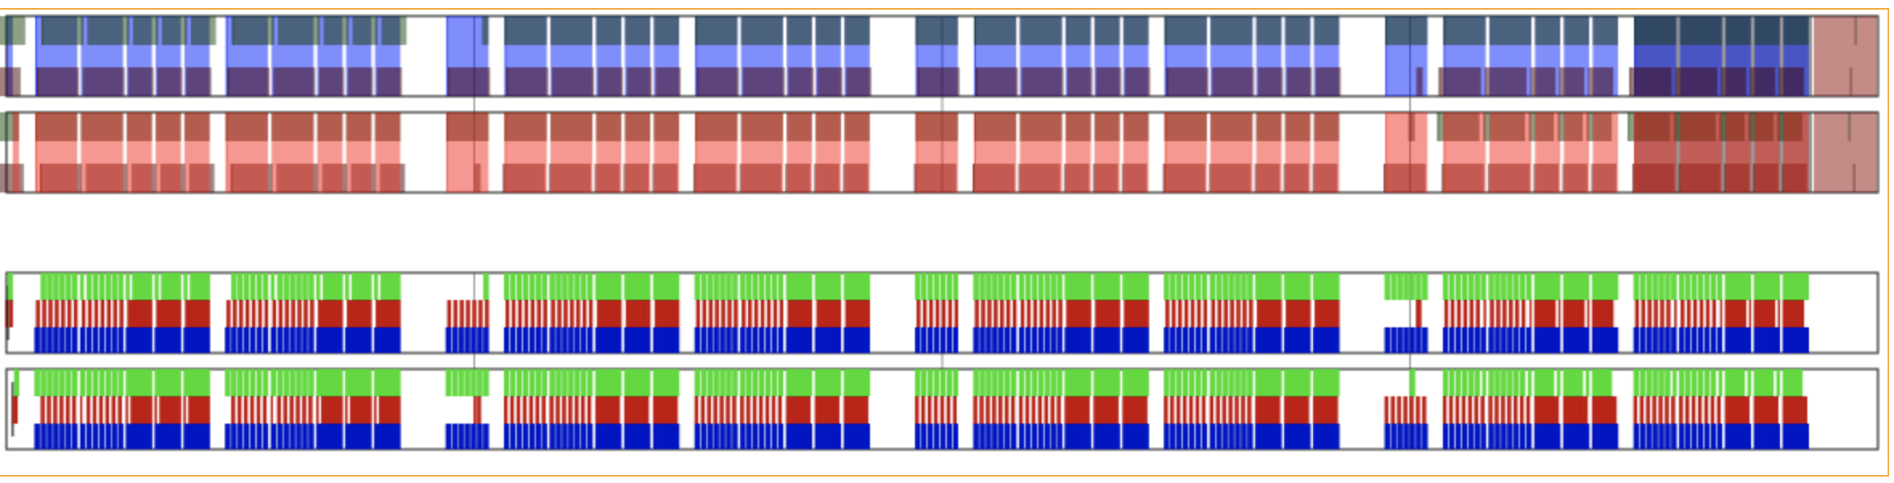


Filling schemes for Run 4
Baseline filling scheme for Run 4 with 2228 bunches, with 58% 8b+4e (incl. gaps)
25ns_2228b_2216_1686_2112_hybrid_8b4e_2x56b_25ns_3x48b_12inj
Collisions
  ATLAS/CMS: 2216
  ALICE: 1686 (76.1%)
  LHCb: 2112 (95.3%)
  12b non-colliding in ATLAS/CMS
Base unit:
2$×$8b+4e
3$×$48b

Slide 5
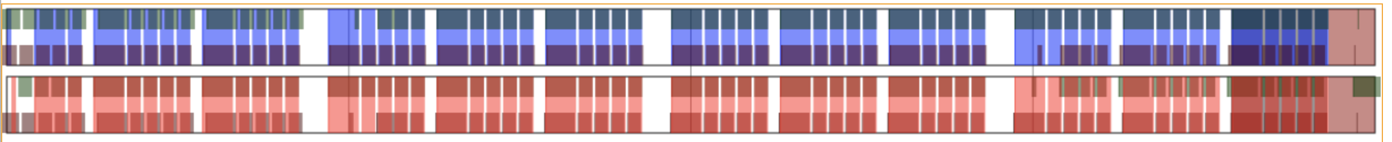
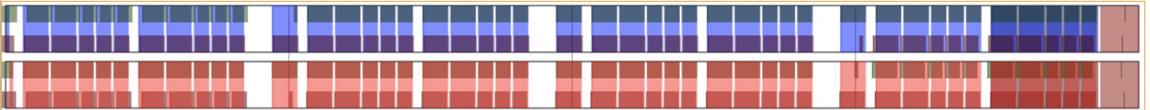
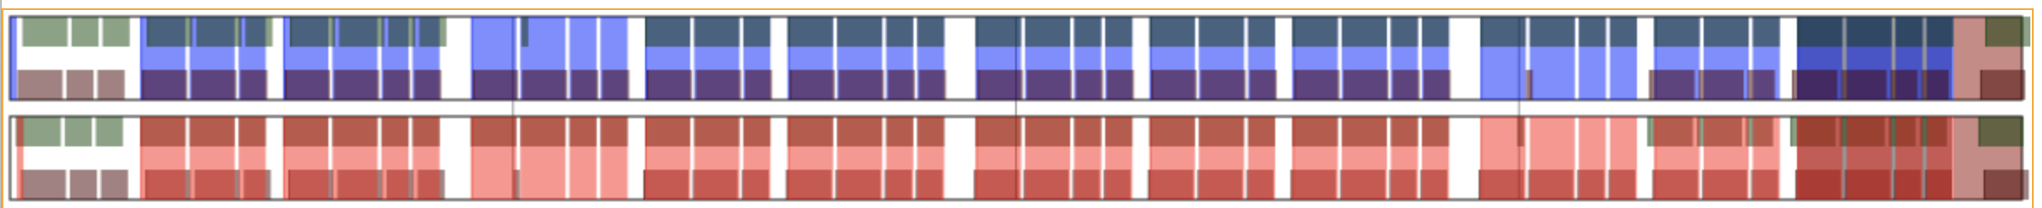






Filling schemes for Run 4
Rough filling schemes for best case and degraded scenarios, for comparison
Base unit:
1$×$8b+4e
4$×$36b
Best case scenario
2304b, 40% 8b+4e
Base unit:
2$×$8b+4e
3$×$48b
Baseline
2228b, 58% 8b+4e
Base unit:
2$×$8b+4e
2$×$48b
Degraded scenario
2108b, 69% 8b+4e

Slide 6
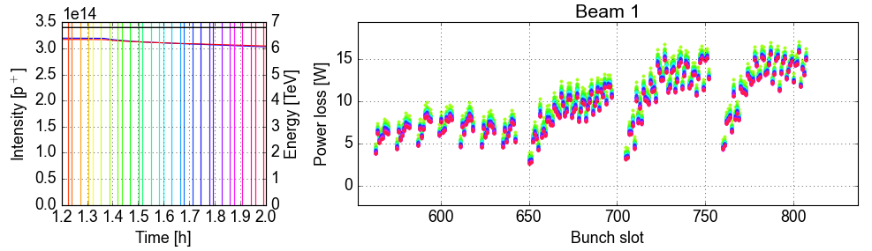
Run 4 intensity ramp-up
The planned strategy for the Run 4 intensity ramp-up is to work with hybrid schemes
Allows to run with reasonably high intensity from the start, even though the beam screens will be strongly deconditioned, as in 2015 and 2022
Aim to start with moderate intensity around 1.5e11 p/b and gradually increase the bunch intensity as scrubbing progresses
  The baseline filling scheme is a good candidate also for the intensity ramp-up
  (a rough estimate for a suitable scheme was 2300b, with ~50% 8b+4e)
  Should be beneficial for scrubbing to have several trains of 48 bunches
56b 8b+4e
3 x 48b

Slide 7
Outline
Filling schemes for Run 4
Coherent tune shift from e-cloud

Slide 8
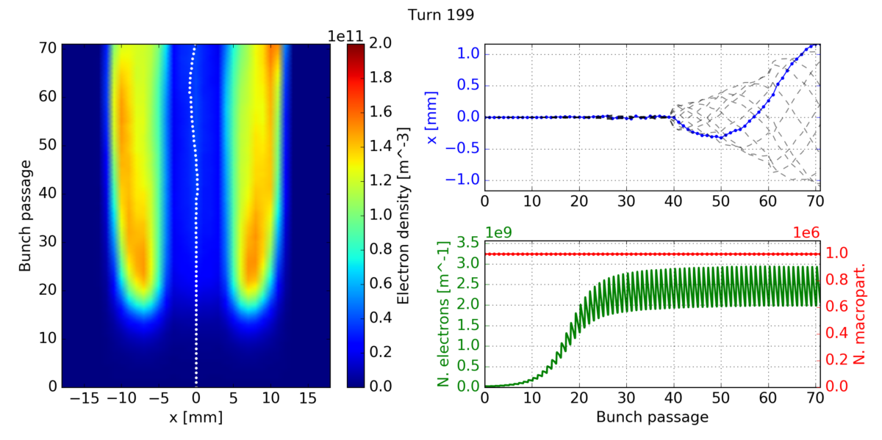
Coherent tune shifts from e-cloud
RF feedback with betatron comb filter can effectively mitigate the impedance of the crab cavity fundamental mode, but requires tunes to be well controlled to within 5e-3
L. Giacomel at Special Joint HiLumi WP2/WP4 Meeting, March 2023
Coherent tune shifts from e-cloud have been estimated with self-consistent coupled-bunch simulations on the CERN HPC cluster
  First studies on arc dipoles presented at WP2 meeting in November 2020
  New studies on arc quadrupoles and further results for dipoles included here
Dipole

Slide 9
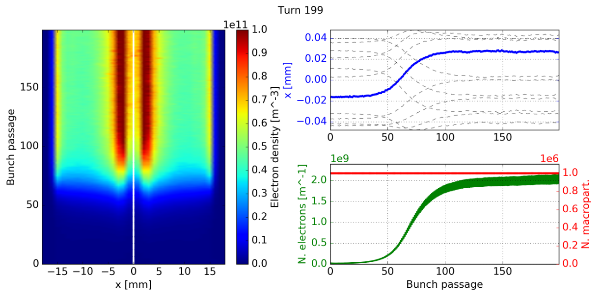
Simulation parameters
The strength of electron cloud effects depends on the secondary emission yield of the surface, which is not precisely known
  Considered SEY = 1.5 in all arcs, for a conservative estimate
Considered collision energy (7 TeV) and bunch intensity 2.3e11 p/b, since the comb filter is expected to be needed primarily in beam mode ‘Flat top’
Simulated a single train of 200 bunches to allow for the e-cloud to reach saturation
Quadrupole

Slide 10
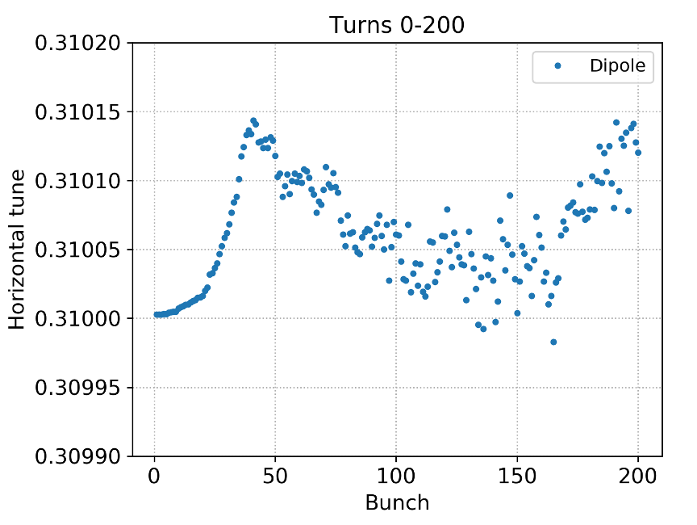
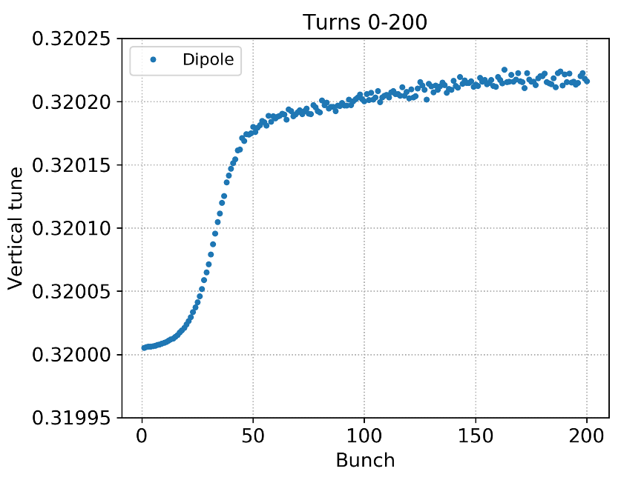
Tune shift from dipoles
The tune shift from the arc dipoles stays below 2.5e-4
  The vertical tune shift is slightly larger than the horizontal, but the order of magnitude is the same in both planes

Slide 11
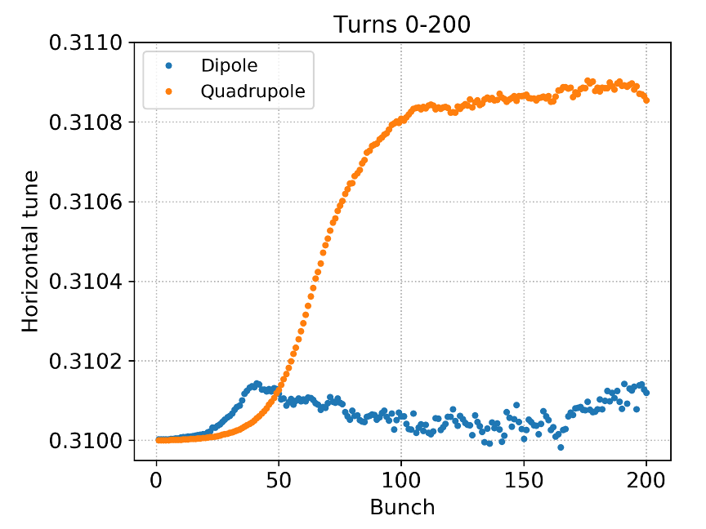
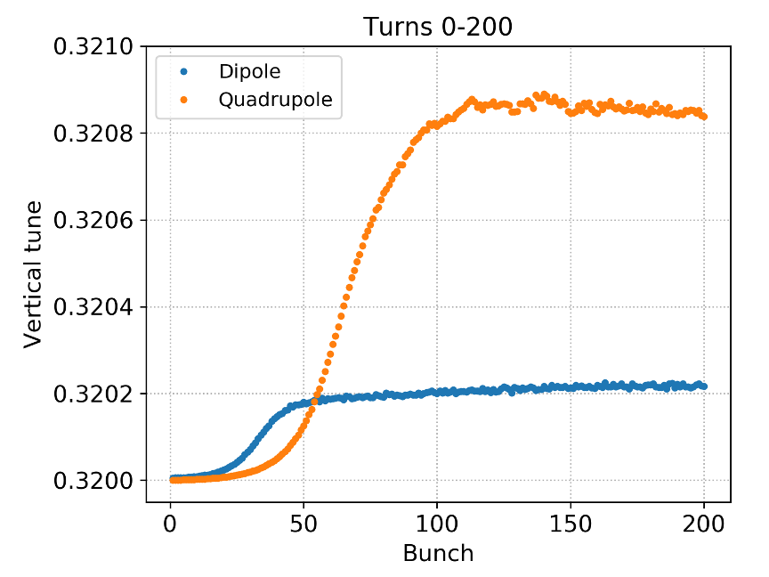
Tune shift from quadrupoles
The tune shift from the arc dipoles stays below 2.5e-4
The tune shift from the arc quadrupoles is significantly larger, just below 1e-3
  The tune shift is very similar in both transverse planes, as expected from the symmetry of the magnetic field

Slide 12
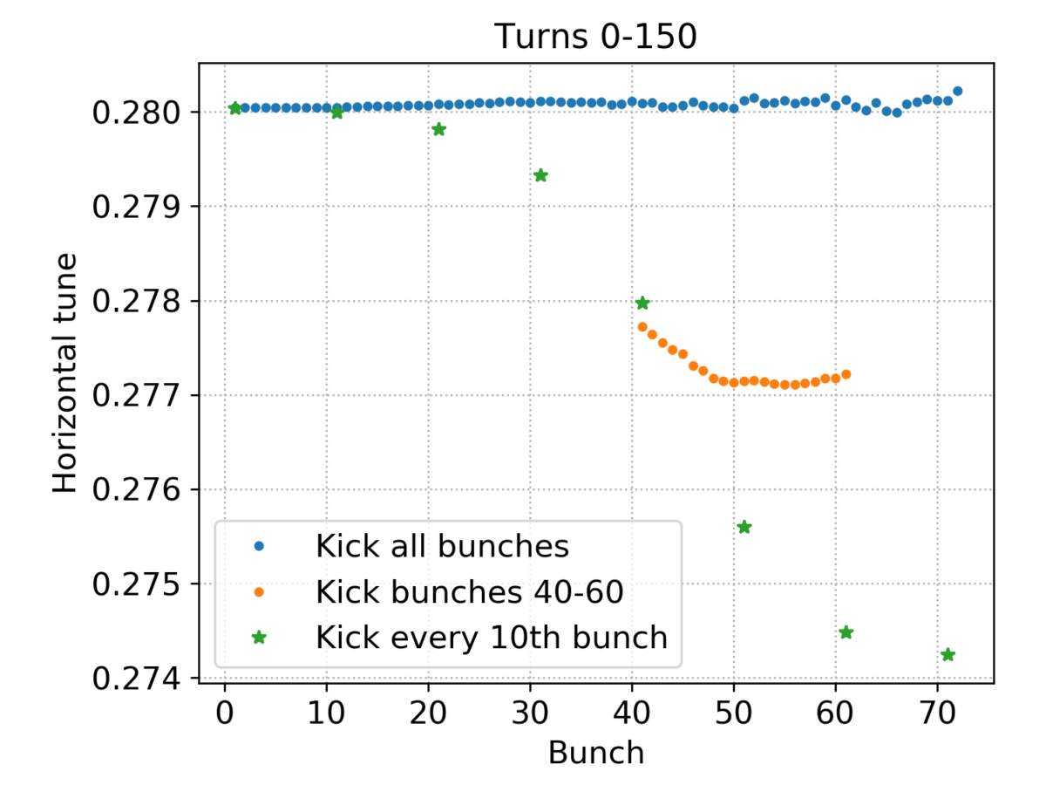
Effect of kick pattern
Previous studies from 2020 showed that, in dipoles, the horizontal tune shift depends significantly on the pattern of kicked bunches along the train
450 GeV, 1.1e11 p/b
When the full train is kicked
(as in the simulations above),
the dipole stripes follow the displacement of the beam and are merely shifted in the beam chamber

Slide 13
Effect of kick pattern
Previous studies from 2020 showed that, in dipoles, the horizontal tune shift depends significantly on the pattern of kicked bunches along the train
450 GeV, 1.1e11 p/b
When individual bunches are kicked, they are moved relative to the stripes created by the previous bunches and feel a force that is de-focusing and can be significantly stronger

Slide 14
Effect of kick pattern
Previous studies from 2020 showed that, in dipoles, the horizontal tune shift depends significantly on the pattern of kicked bunches along the train
Since the individually kicked bunches give the largest tune shift, included in simulation study
450 GeV, 1.1e11 p/b
When a consecutive sub-train of bunches is kicked, a flattening of the tune shift is observed along the sub-train, as could be expected as the stripes adjust to the displacement

Slide 15
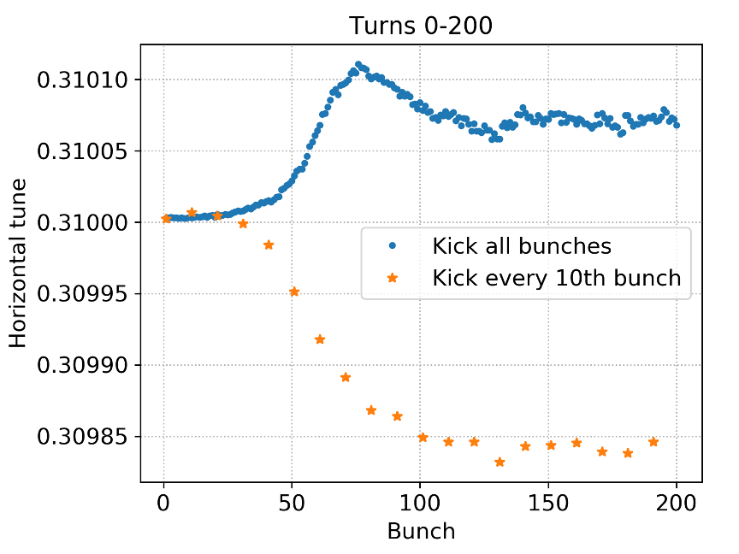
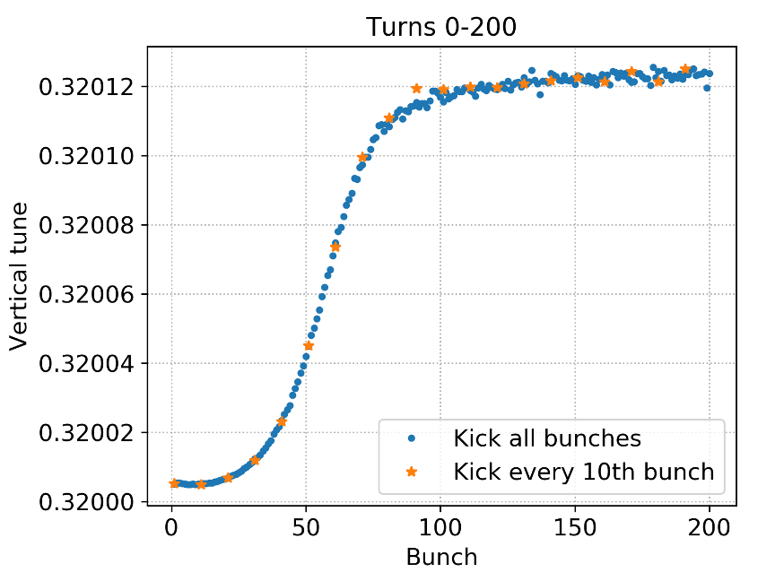
”Single bunch” tune shift from dipoles
With 2.3e11 p/b at flat top, the effect of kicking individual bunches is moderate: the magnitude of the horizontal tune shift is enhanced by a factor ~1.5
No impact of kick pattern on the vertical tune shift

Slide 16
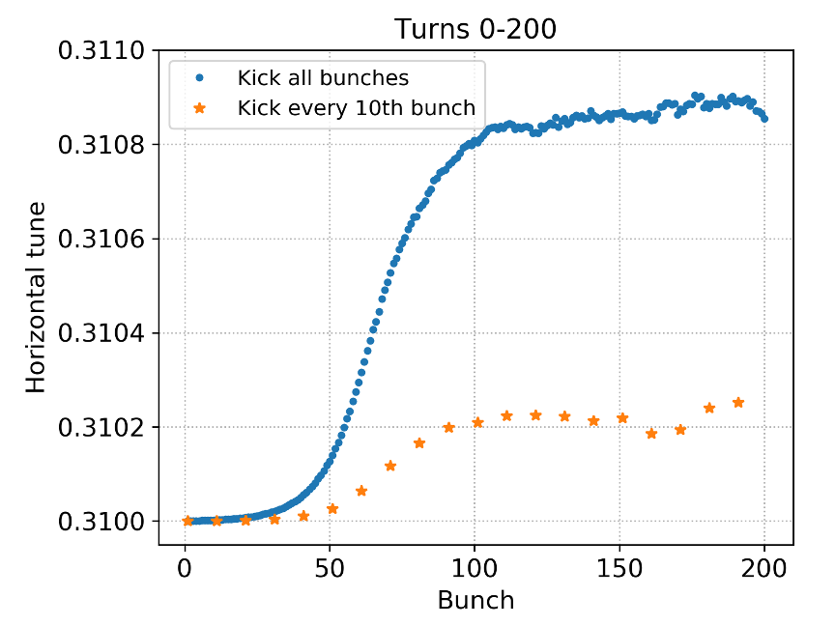
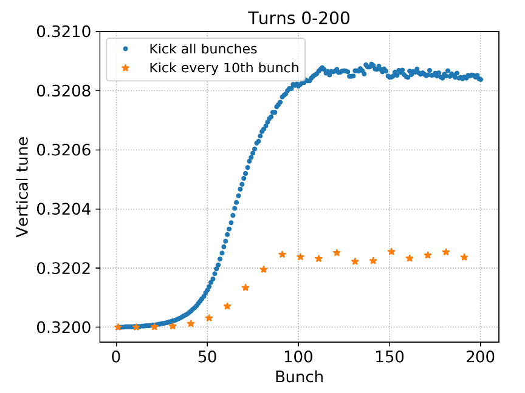
”Single bunch” tune shift from quadrupoles
Contrary to the dipoles, in the quadrupoles, individually kicked bunches receive a smaller tune shift than bunches that are “centred” in the e-cloud
  The tune shift stays positive also for individually kicked bunches
Since the quadrupoles dominate the total tune shift, overall the tune shift is smaller for individually kicked bunches

Slide 17
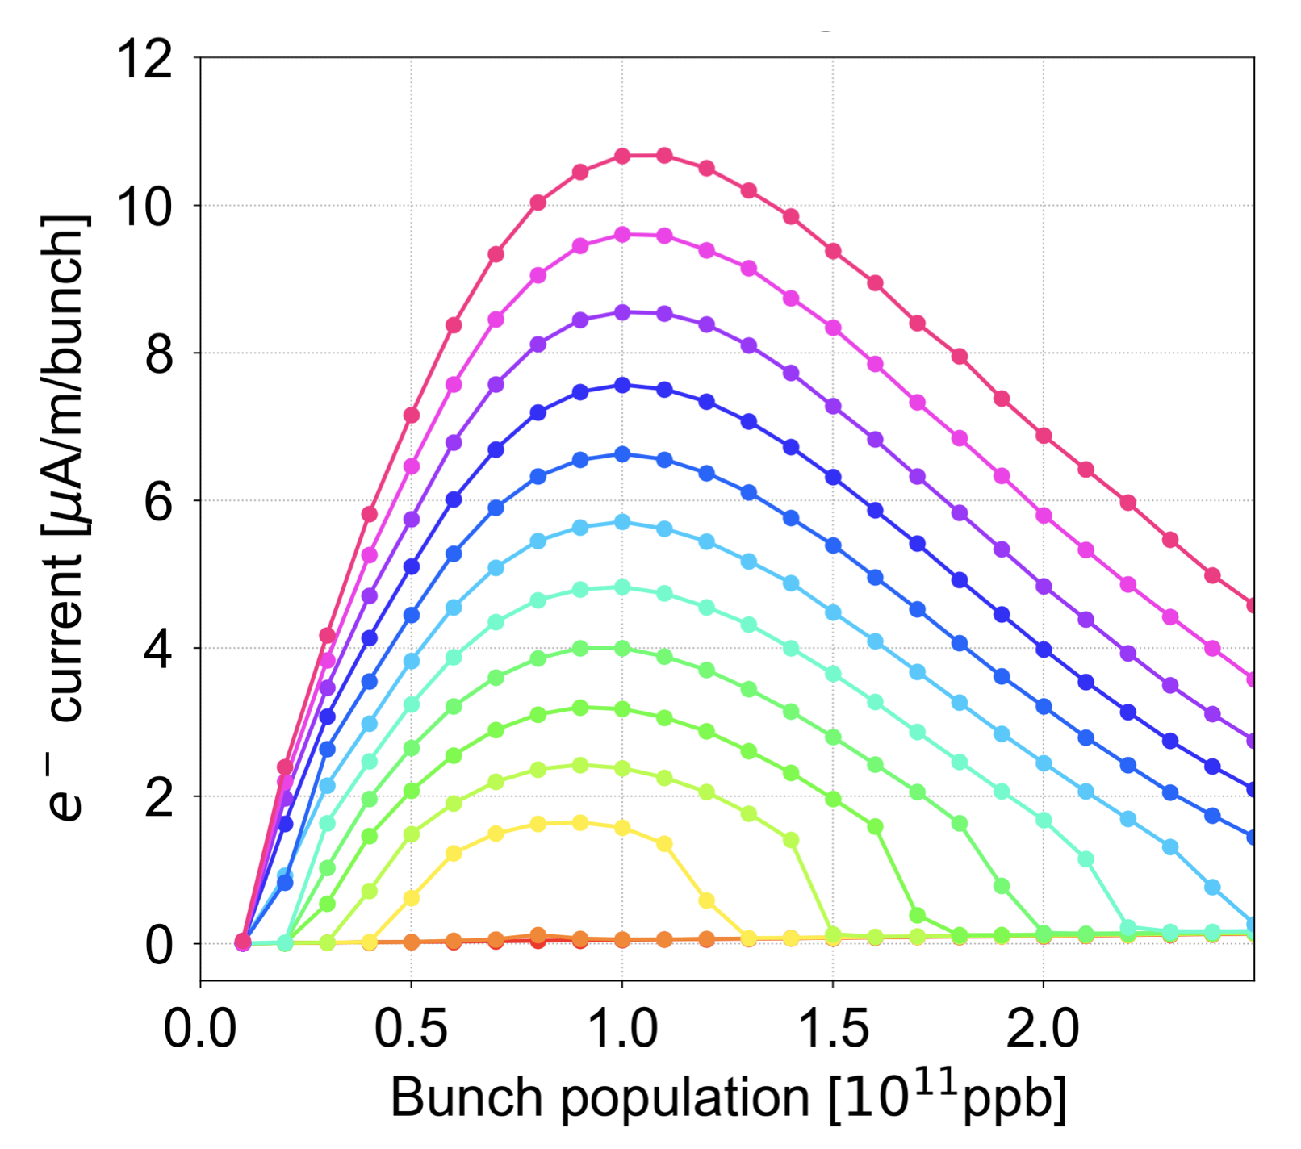
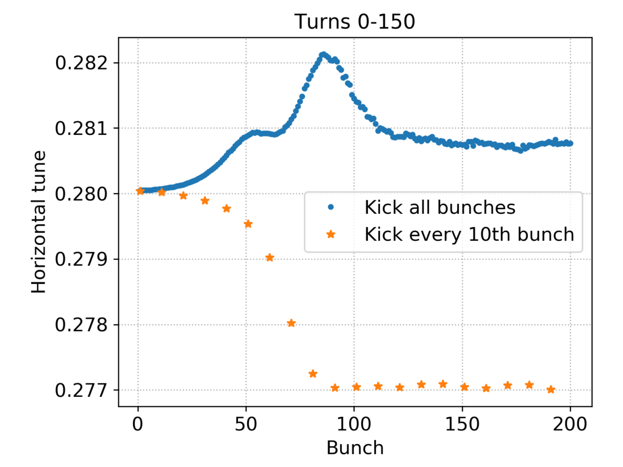
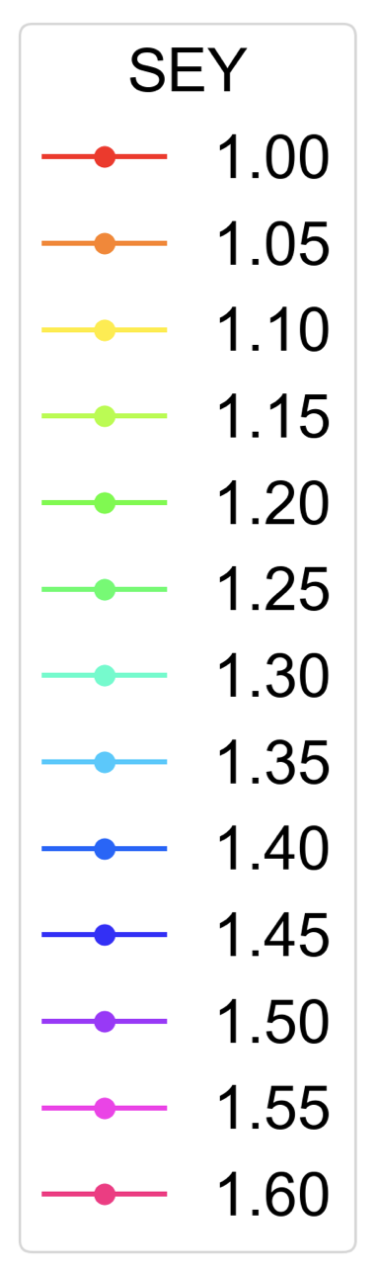
Conclusion and outlook
The tune shift from arc dipoles and quadrupoles at “Flat top” is at most around 1e-3
  Within the tolerance of the comb filter mitigation
If mitigation is needed also during collisions or at injection further studies are necessary
The tune shift in quadrupoles may be larger with lower bunch intensity, due to the non-monotonic scaling of the electron density
Tune shifts at injection can be larger than at flat top, e.g., up to 3e-3 for individually kicked bunches in dipoles
Possible impact also on Run 4 ramp-up strategy
Scan in bunch intensity and SEY ongoing to evaluate effect

Slide 18
Thank you for your attention!

Slide 19
Spare Slides

Slide 20
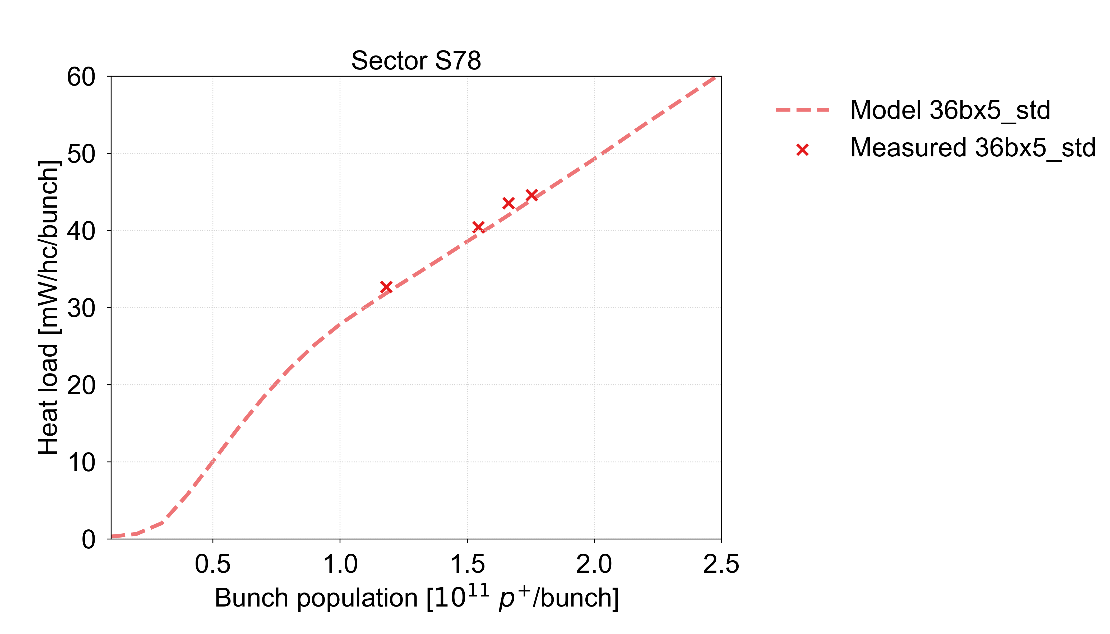

Model uncertainty
Despite the good agreement between models and measurements, there is an intrinsic uncertainty in our SEY fit model
We know that the SEY is not uniform within individual half-cells, but with a single heat load measurement per half-cell we cannot reconstruct a more complex SEY model
  Effort to improve fitting method based on recent non-trivial observations of heat load scaling with intensity and bunch train pattern ongoing
→ for future estimates
Uniform SEY
High SEY only in dipoles
For current estimates, we take a conservative approach
S78 average SEY estimate: 1.36
S78 average SEY estimate: 1.54
Simulations with enhanced photoemission

Slide 21
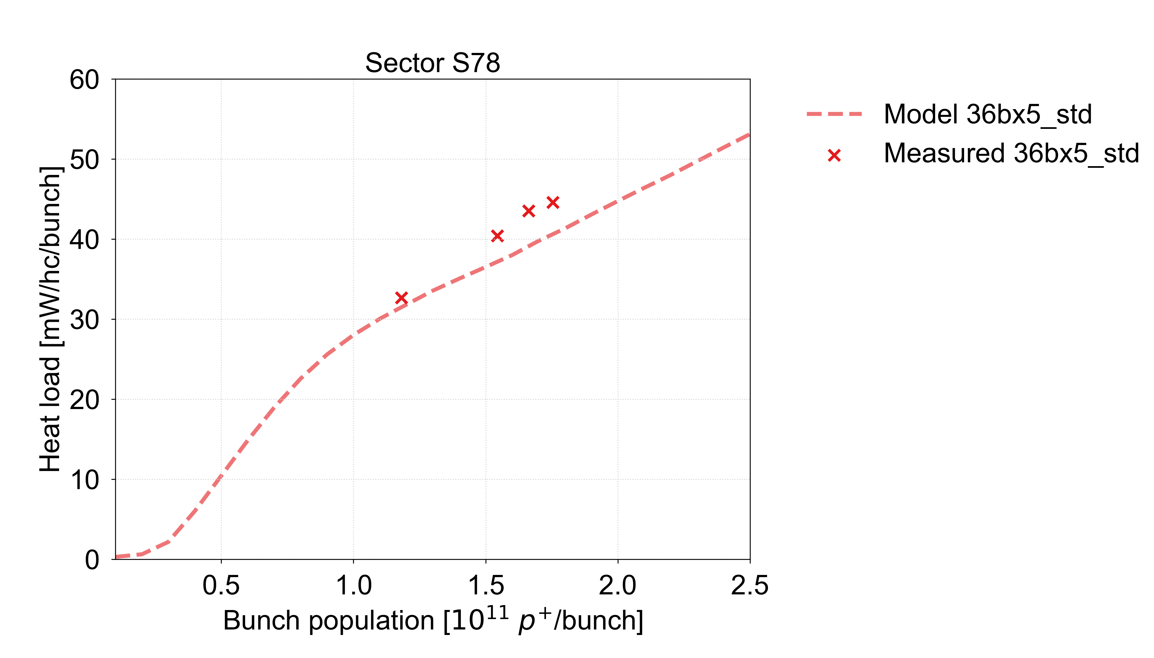
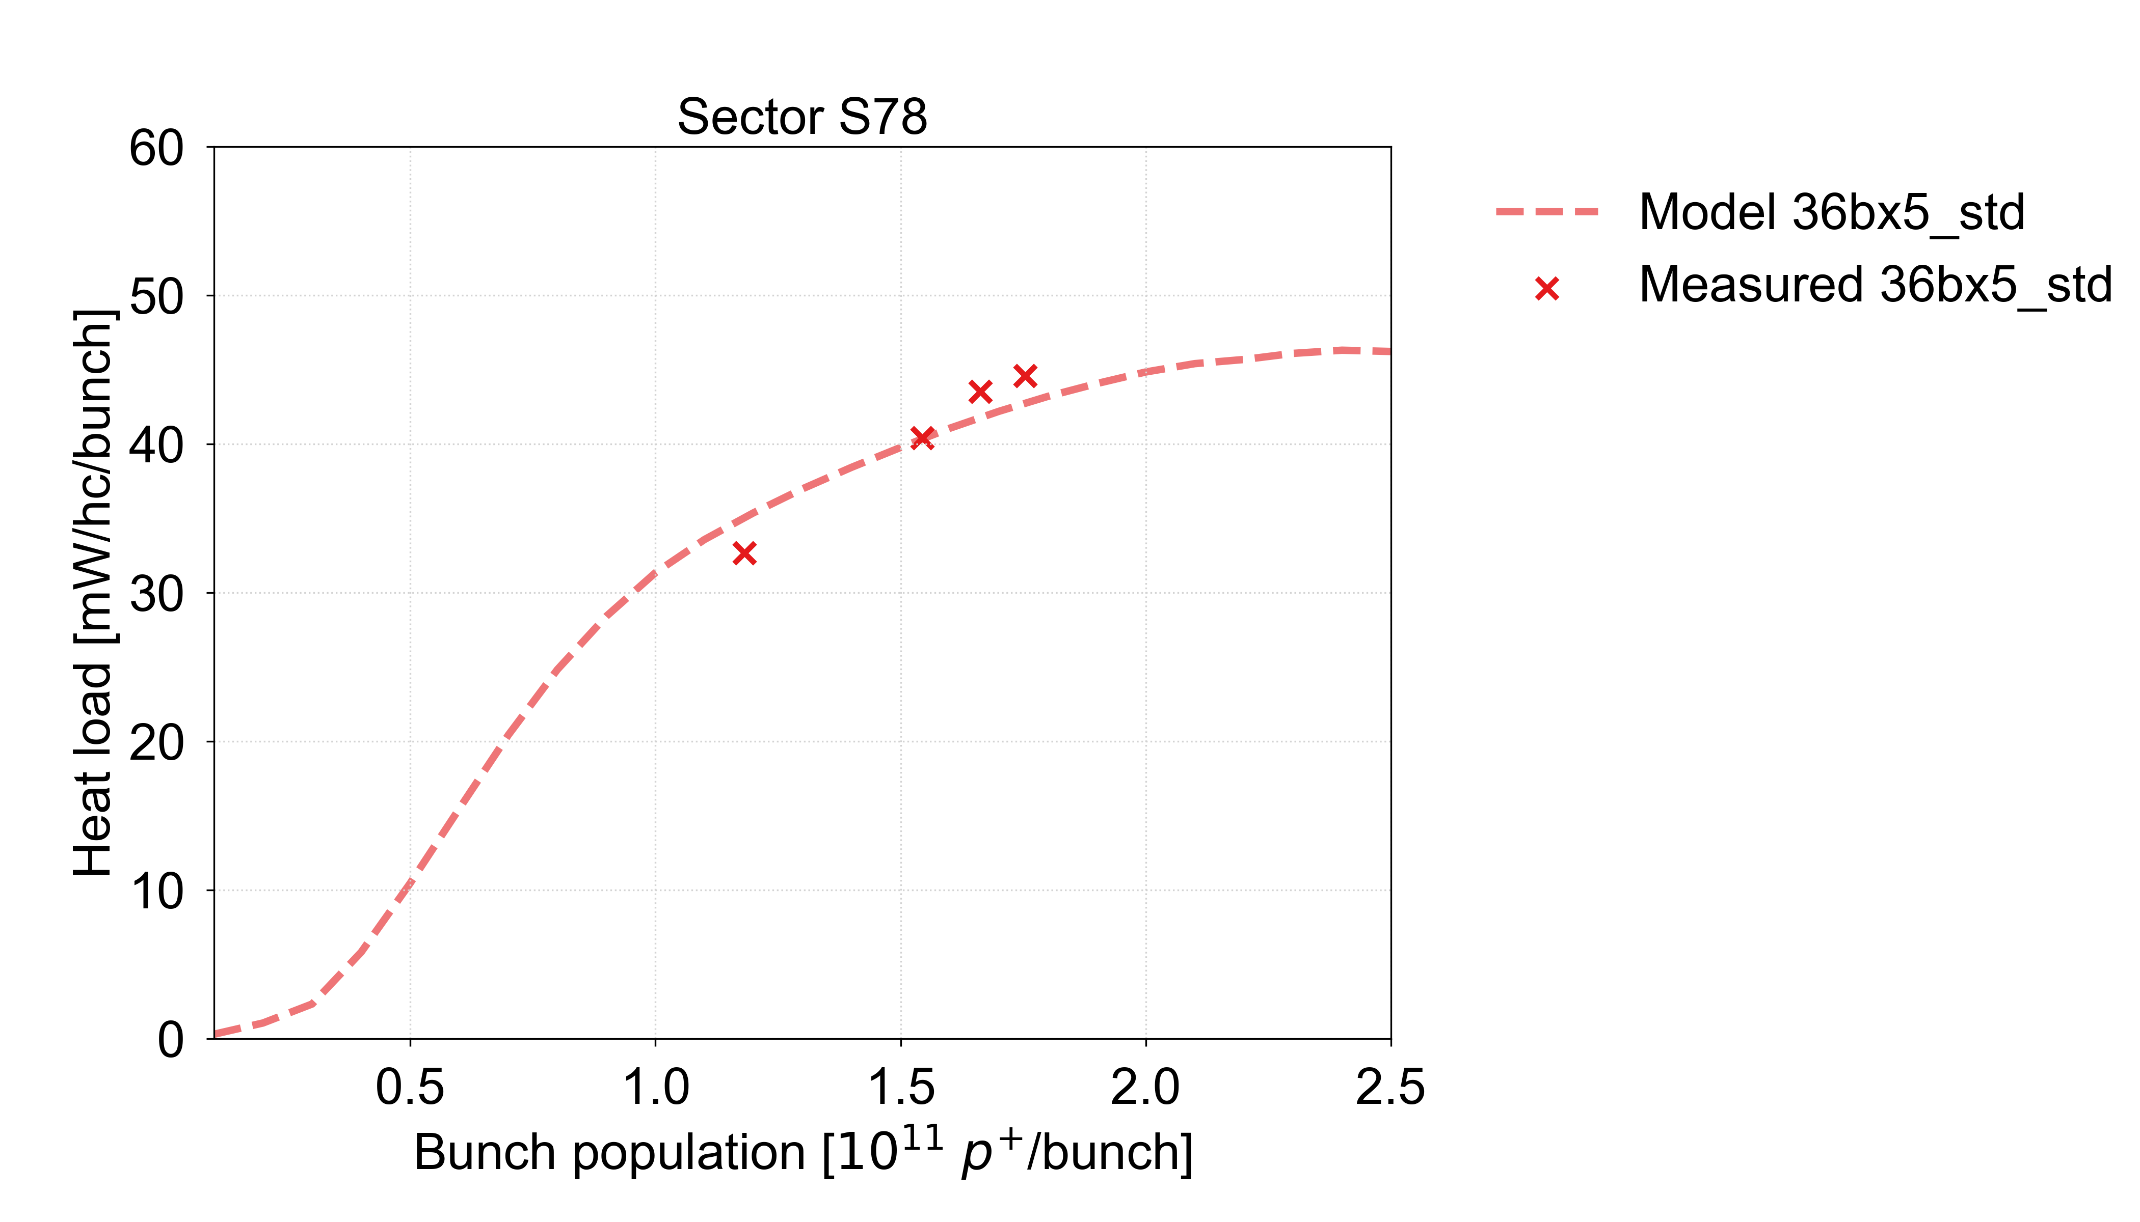
Model uncertainty
Despite the good agreement between models and measurements, there is an intrinsic uncertainty in our SEY fit model
We know that the SEY is not uniform within individual half-cells, but with a single heat load measurement per half-cell we cannot reconstruct a more complex SEY model
  Effort to improve fitting method based on recent non-trivial observations of heat load scaling with intensity and bunch train pattern ongoing
→ for future estimates
Uniform SEY
High SEY only in dipoles
For current estimates, we take a conservative approach
S78 average SEY estimate: 1.43
S78 average SEY estimate: 1.56
Simulations with 2018 photoemission model

Slide 22
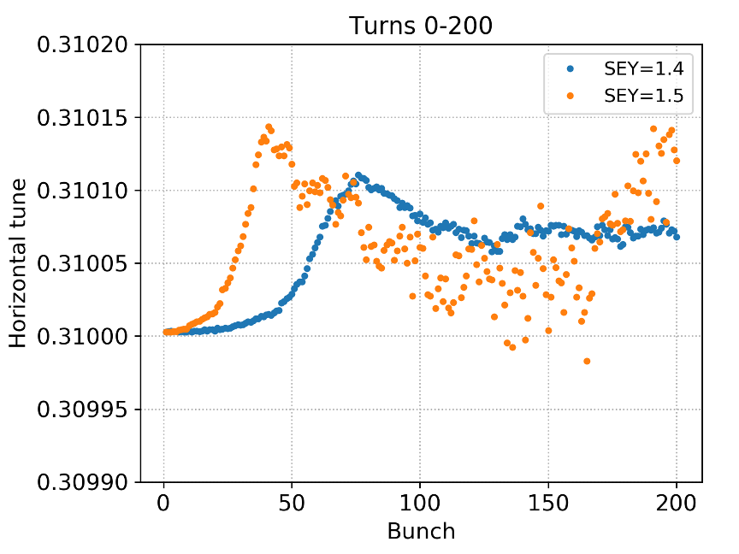
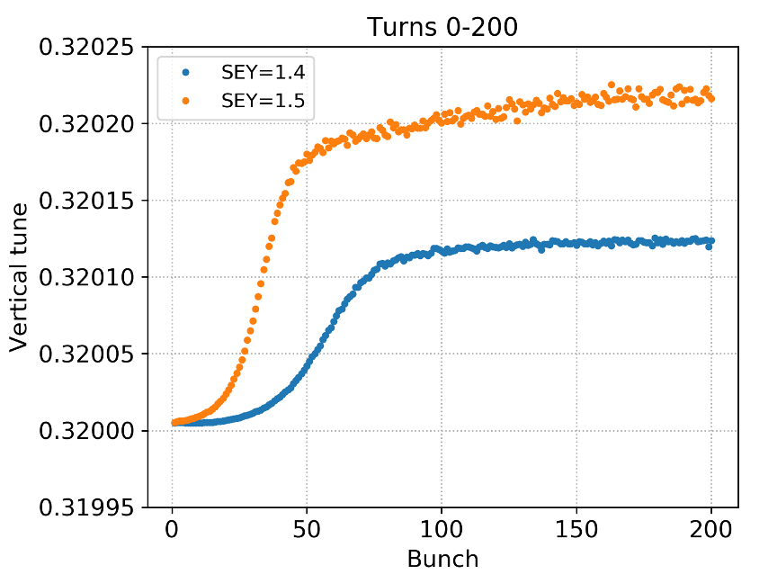
SEY dependence
The magnitude of the tune shift in the dipoles depends on the SEY
  A factor of 1.5-2 going from SEY = 1.4 to SEY = 1.5
  In line with the corresponding change in electron density

Slide 23
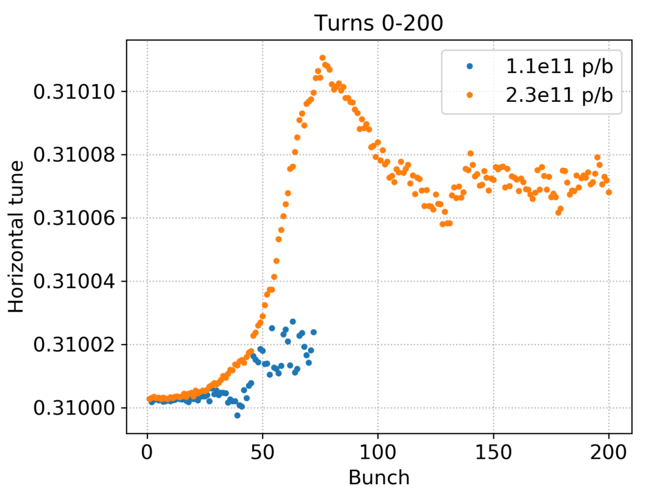
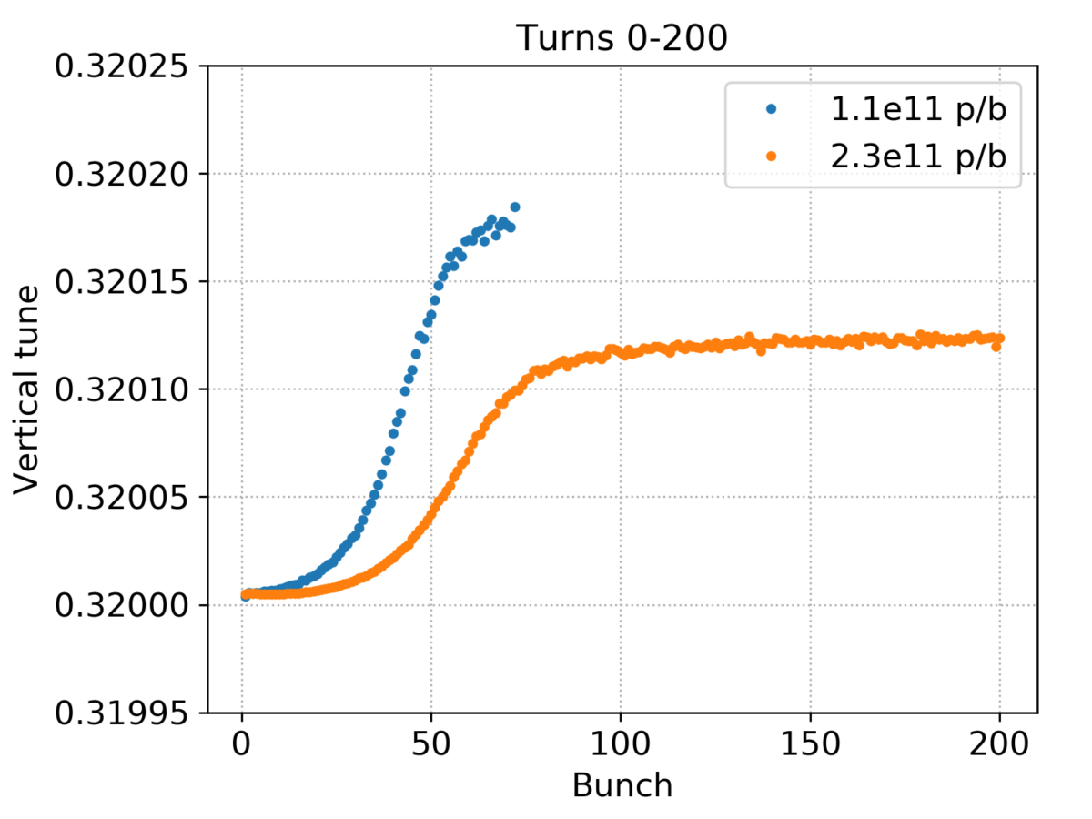
Intensity dependence
Comparison between bunch intensity 1.1e11 and 2.3e11 p/b at 7 TeV
  In horizontal, the tune shift for HL-LHC is an order of magnitude larger
  In vertical, the tune shifts are of similar magnitude, but slightly larger for 1.1e11 p/b

