Slide 1
Considerations on LHCb operation scenarios and luminosity
R. De Maria

Slide 2

Introduction
LHCb upgrade optics and luminosity option discussed here
https://indico.cern.ch/event/790856/contributions/3368526/
The talk discussed about:
Horizzontal vs Crossing external angle
Crossing plane rotation during ramp
Discussion in beam screen rotation
Tilted external angle to fully compensate spectrometer
Back-up: flat optics in the β*_{x}=β*_{y}/2.
Today in the HL baseline:
V crossing baseline for LHCb at β*=1.5cm
Crossing plane rotation during ramp

Slide 3
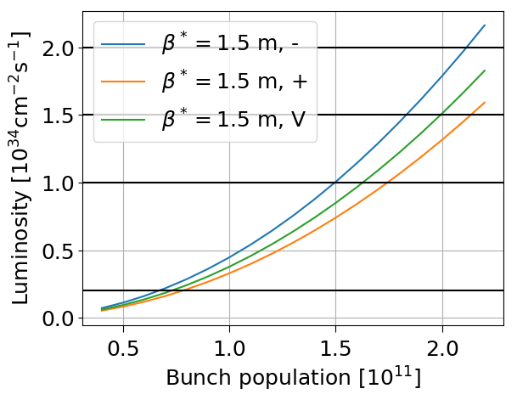
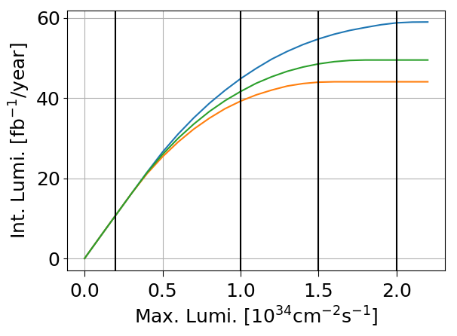
Tentative scenarios for LHCb – Phase II
β* [m] | Xing plane / Ext. Crossing / Spec. Polarity | Peak Luminosity [10³⁴]
1.5 | H/±200 /- | 2.16
1.5 | H/±150/+ | 1.59
1.5 | V/±160/+ or - | 1.8
β* [m] | Xing plane | Int. Lumi [fb⁻¹/year] | Int. Lumi [fb⁻¹/year]
1.5 | H | 43 | 50
1.5 | V | 43 | 50
Assuming same ∫L for both polarities.
No significant advantage of designing the detector for 2 10³⁴ cm⁻²s⁻¹.
43 fb⁻¹ sufficient to reach a target of 300 fb⁻¹ (triplet lifetime) in Run 5, Run 6 (~6 years of operations).
Beam screen rotation not needed for these configurations, small crossing angle also better for dose at constant luminosity.

Slide 4
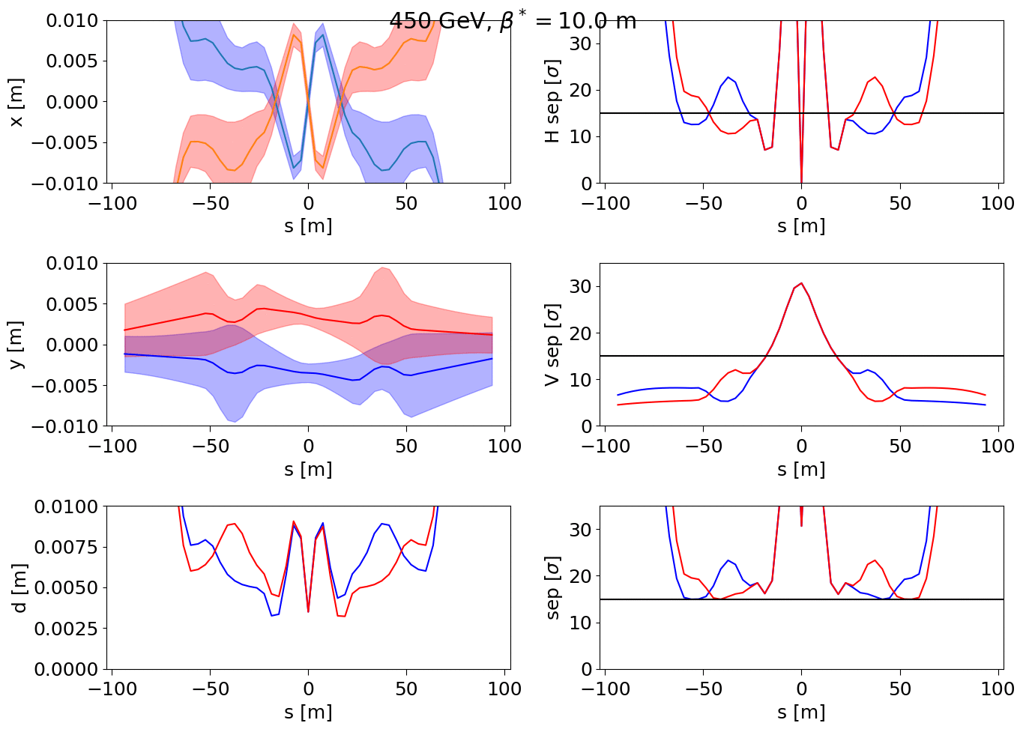
Ramp and squeeze: Vertical crossing
Crossing: -170 µrad → -160 µrad [2→7 TeV]
Separation: -3.5 mm → -1 mm [2→7 TeV]
Crossing plane: 0 → 90° [from 2→7 TeV]
V Angle offset: -40 µrad → 0 [from 2→7 TeV]
β*: 10 m → 1.5 m [from 2→7 TeV]
Complex gymnastic, tilted crossing introduced coupling, beam instabilities observed in 2012
Now baseline!

Slide 5
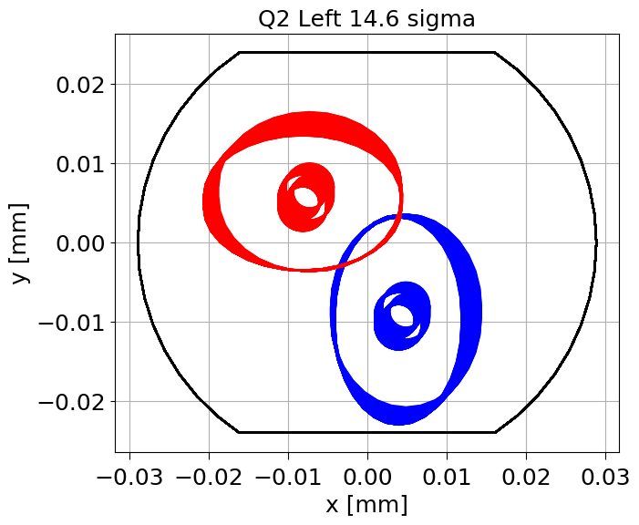
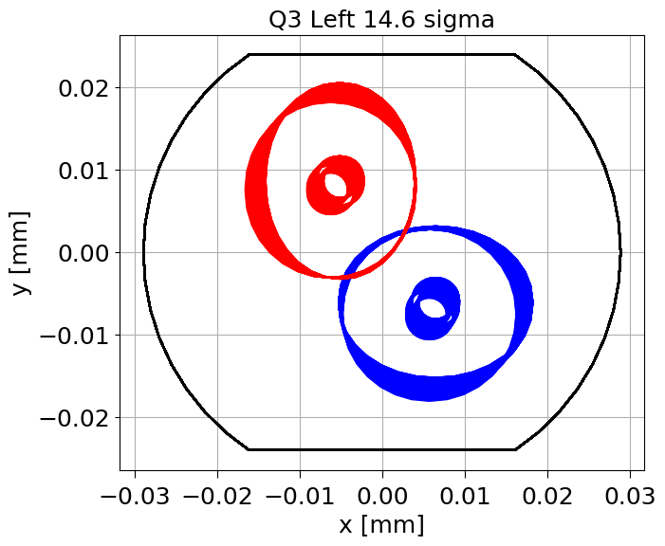
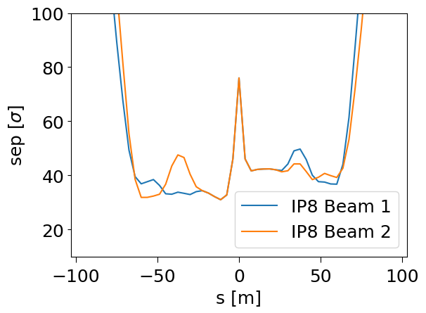
Tilted Crossing angle: Example
 | Spect. | Ext H | Ext V | IP H | IP V
T, Neg | +135 | -135 | +160 | 0 | +160
T, Pos | -135 | +135 | +160 | 0 | +160
- half crossing angle [μrad],
- neglecting small tilt between LHCb and machine.
- 1 mm half separation
Minimum β* = 2.0 m -> Int. Lumi = 34 [fb⁻¹/year ]
β* cannot be reduced to allow additional BB separation.
Beam screen cannot be tilted from injection constraints.
Bunch dependent DA/stability simulation needed to validate coupling effects.
Not transparent for the machine (need requalification after swap, not for monthly swap)
Tilted crossing not compatible with all requirements

Slide 6
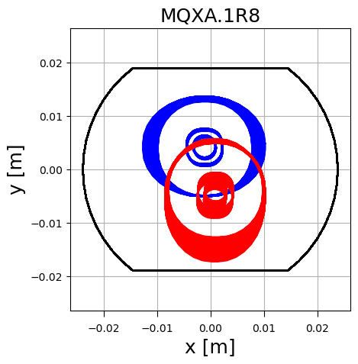
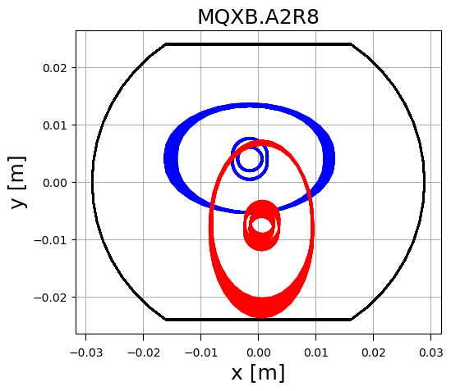
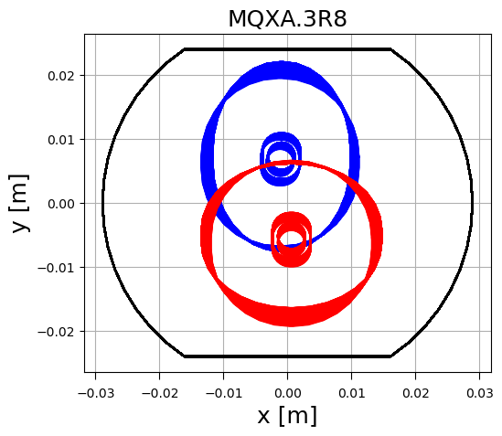
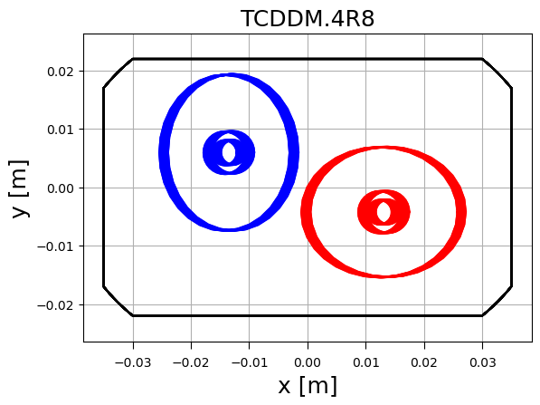
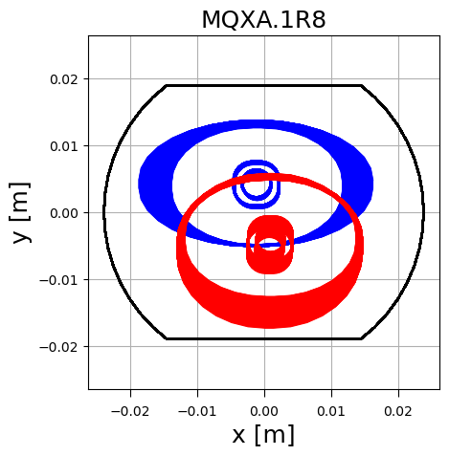
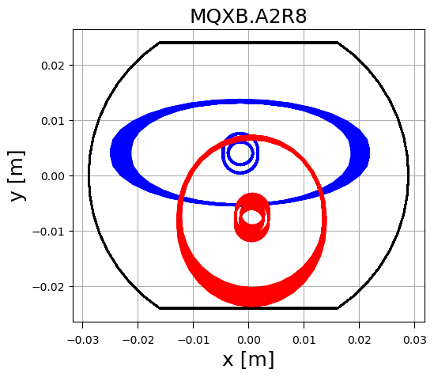
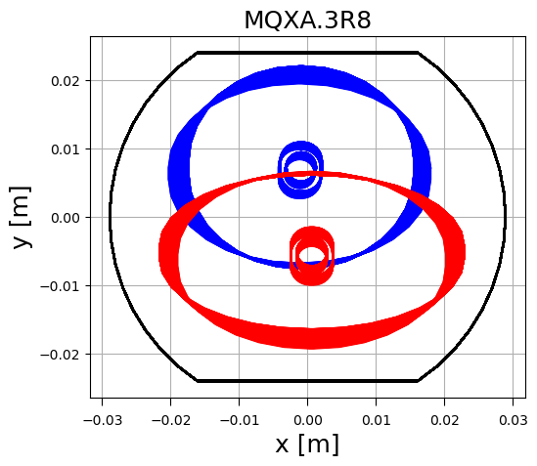
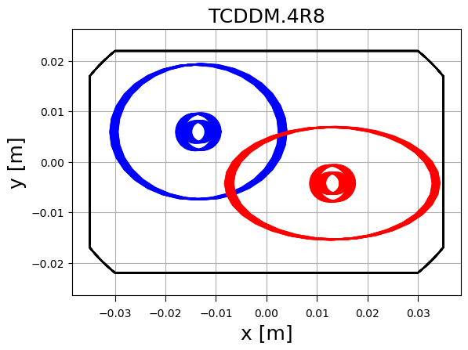
Flat option, aperture
β*=1.5/1.5m,
V, 170 murad
Envelopes at 14.6σ
β*=0.5/1.5 m,
V, 170 murad
Round optics has margin in the horizontal plane to allow smaller β*.
β*_{y} and crossing angle to be re-optimized based on DA results.

Slide 7
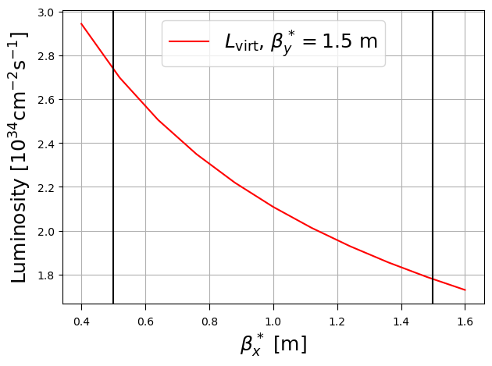
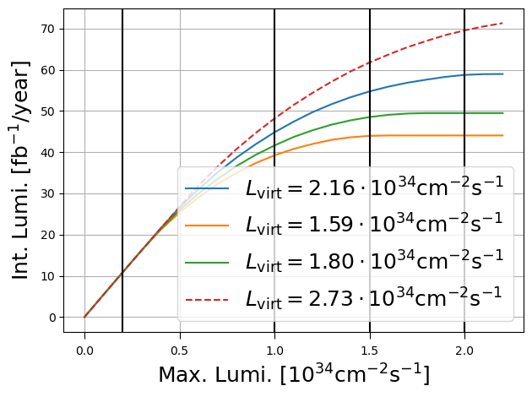


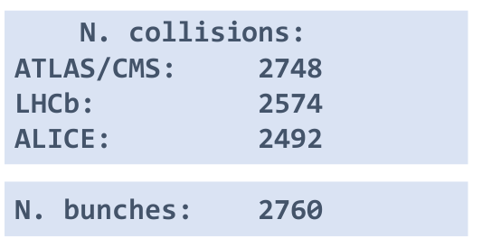
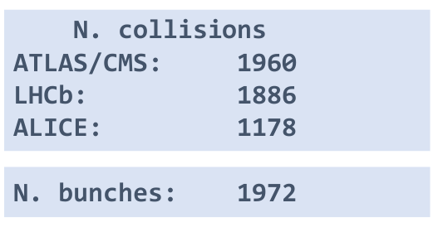
Flat option, luminosity
Virtual luminosity increase with flat. Still large gain going from 1.0 to 1.5 10³⁴ .
But:
Dynamic aperture not fully validated yet with LHCb at 1.5 10³⁴ with round optics and flat optics more challenging.
Estimates based on nominal filling scheme which today is unfeasible due to e-cloud: potential 73% reduction of integrated luminosity at constant pile-up with 8b+4e filling scheme
Summary:
Flat option can increase integrated luminosity, but DA is still unproven.
E-cloud issues have a strong impact on integrated luminosity, designing for large pile-up can mitigate the luminosity loss.

Slide 8
Back-up

Slide 9
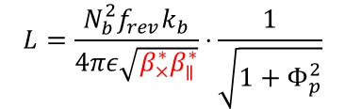


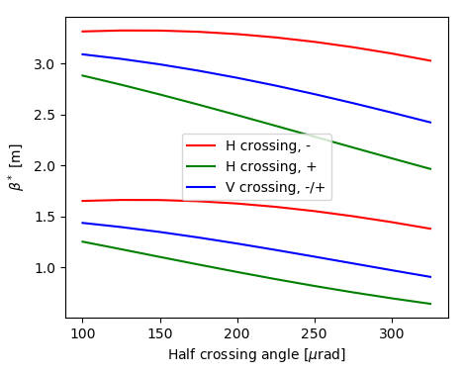
Aperture and crossing angle
Protons per bunch |  | 2.2 10¹¹
Number of Bunches |  | 2572 (2374)
R.M.S. bunch length |  | 7.61 (9.0) cm
+/- LHCb Polarity |  | B_{y}<0 / B_{y}>0
1 10³⁴ cm⁻²s⁻¹
baseline
Minimum β* is constrained by optics flexibility.
Maximum external crossing angle is limited by orbit corrector strengths
For a given β*:
  Aperture constrain maximum crossing angle.
  Beam-beam effects (i.e. beam lifetime) constrain min crossing angle.
Beam-beam effects
Orbit corrector limitations
Aperture limitations
2 10³⁴ cm⁻²s⁻¹
Optics limitations

Slide 10
Ramp and squeeze: Horizontal crossing
H Crossing: -170 µrad → -220 µrad [2 → 7TeV]
V Separation: -3.5 mm → -1 mm [2 → 7TeV]
V Angle offset: -40 µrad → 0 [2 → 7TeV]
β*:10 m → 1.5 m [2 → 7TeV]

Slide 11
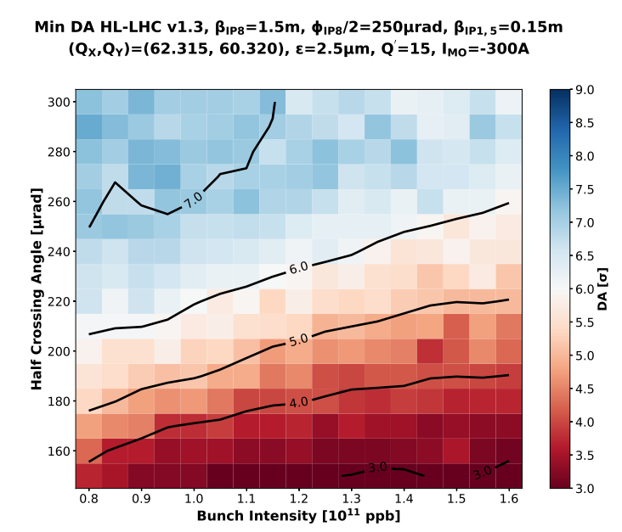
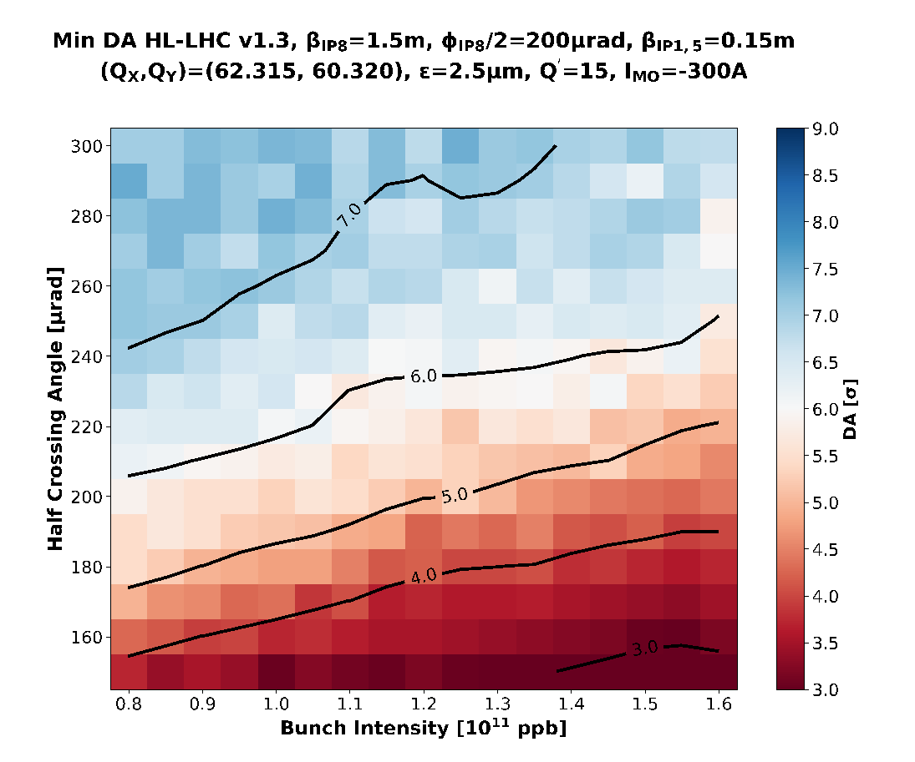
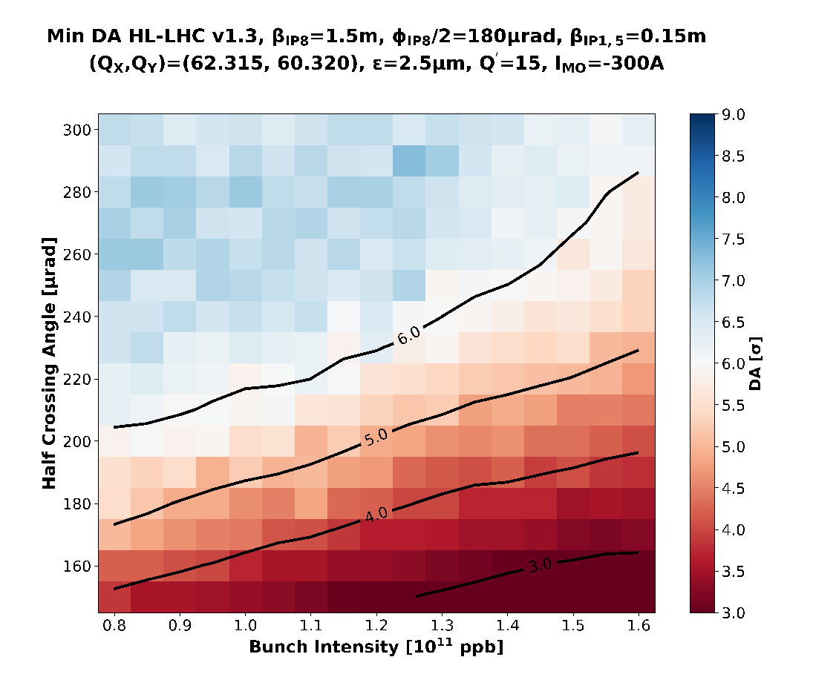
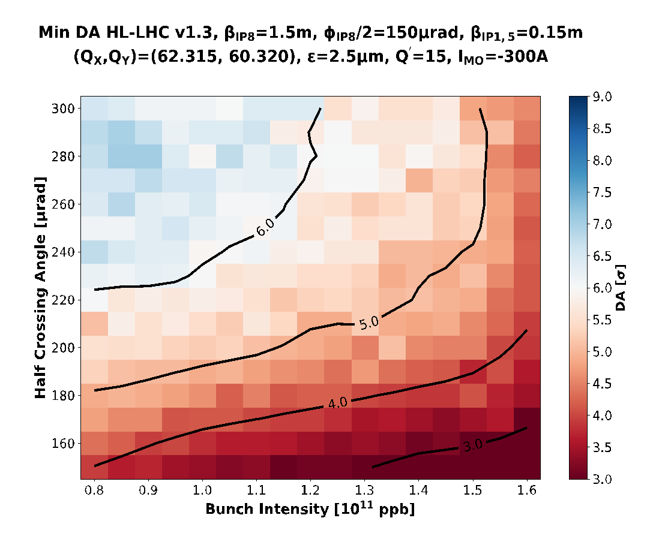
Beam-beam effects, Horizontal Crossing
Parameter scan at the end of Atlas/CMS levelling vs LHCb external angle
-250 μrad, Neg, 1∙10³⁴ cm⁻²s⁻¹
-200 μrad, Neg, 1∙10³⁴ cm⁻²s⁻¹
-180 μrad, Neg, 1∙10³⁴ cm⁻²s⁻¹
-150 μrad, Neg, 1∙10³⁴ cm⁻²s⁻¹
N. Karastathis

Slide 12
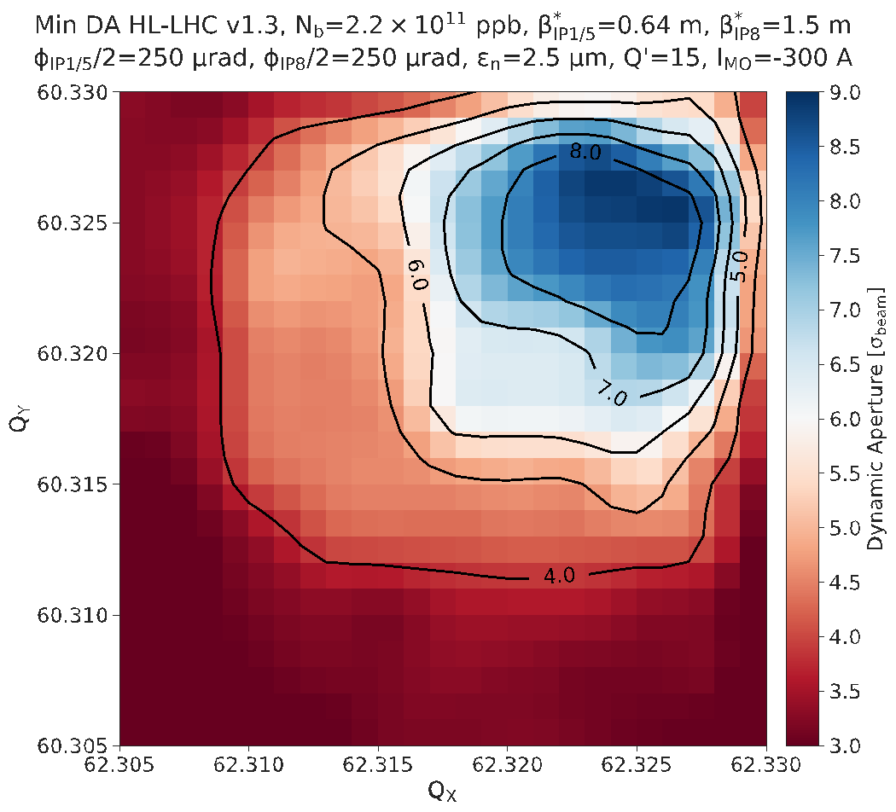
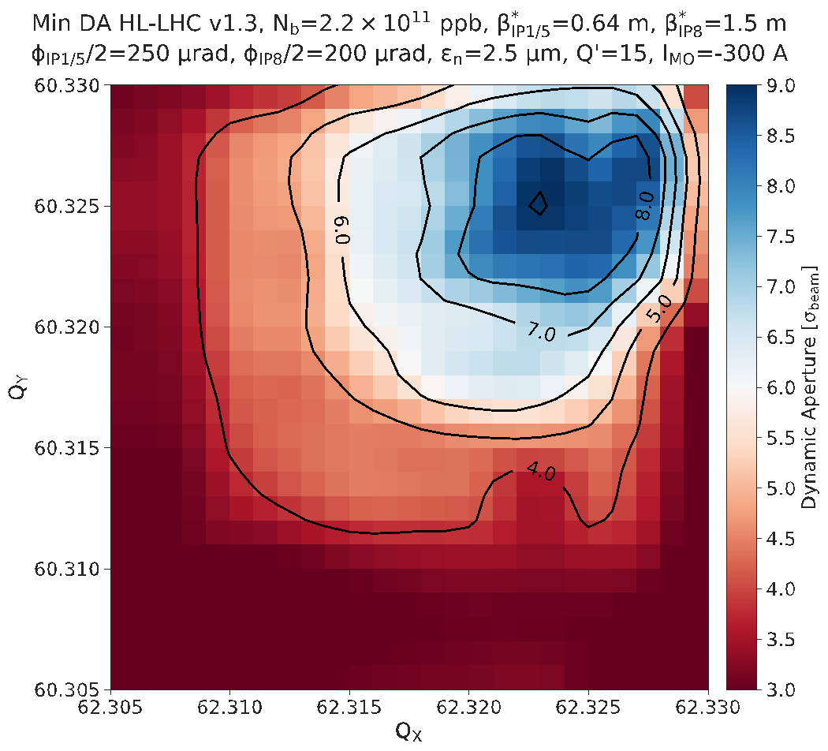
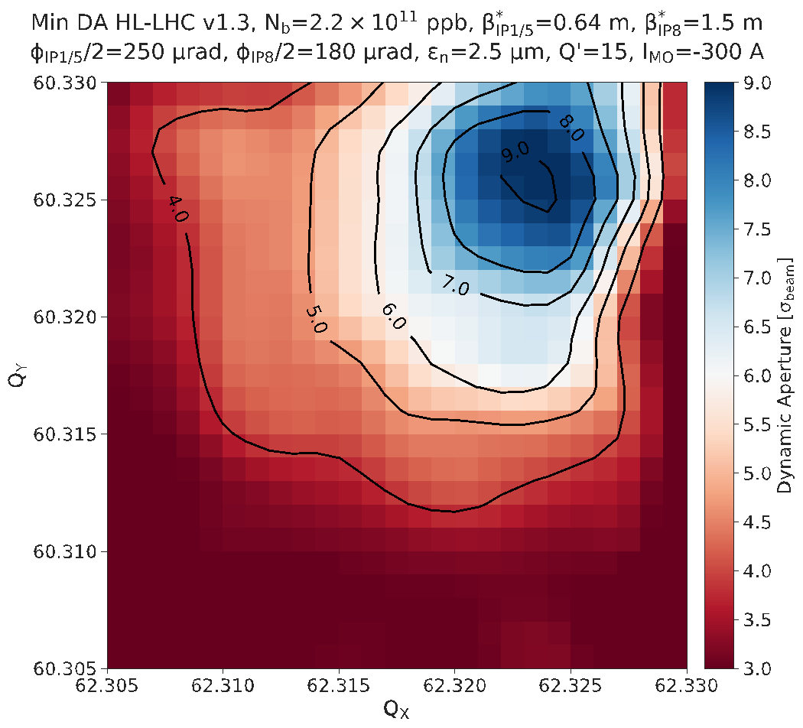
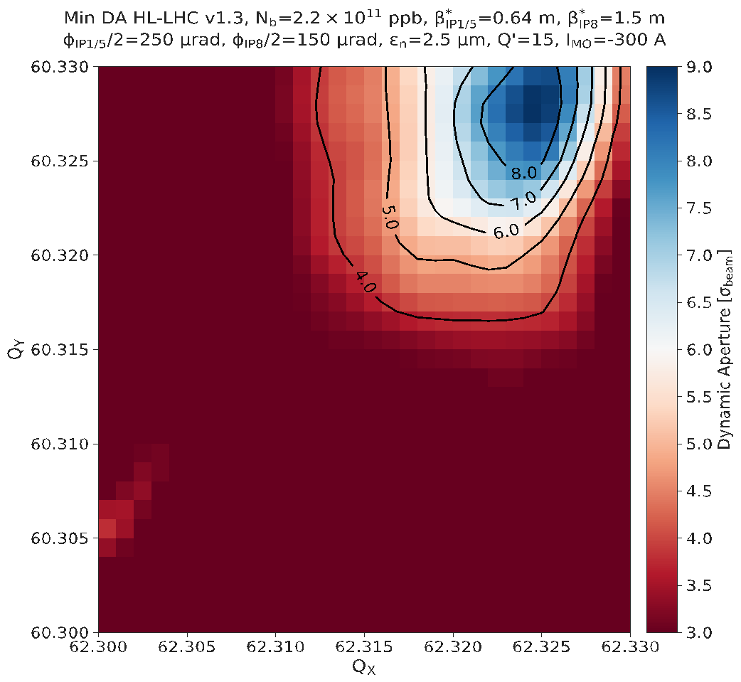
Beam-beam effects, Horizontal Crossing
Tune scan at the beginning of Atlas/CMS levelling vs LHCb external angle
-250 μrad, Neg , 1∙10³⁴ cm⁻²s⁻¹
-200 μrad, Neg , 1∙10³⁴ cm⁻²s⁻¹
-180 μrad, Neg , 1∙10³⁴ cm⁻²s⁻¹
-150 μrad, Neg , 1∙10³⁴ cm⁻²s⁻¹
N. Karastathis

Slide 13
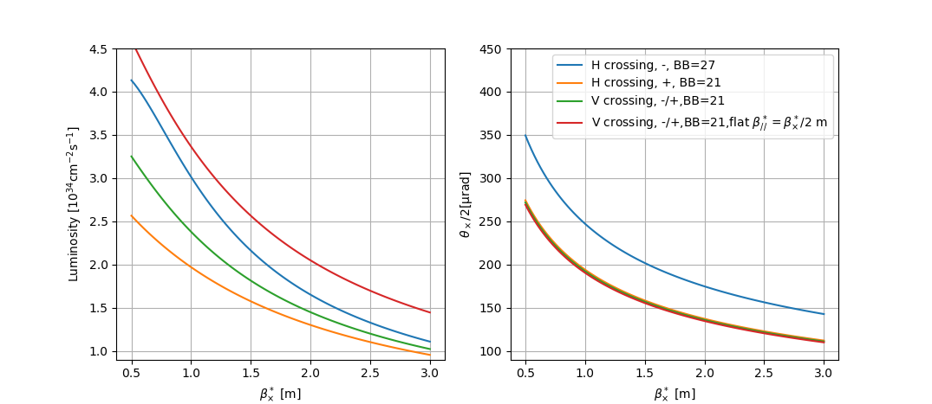
Flat optics

Slide 14
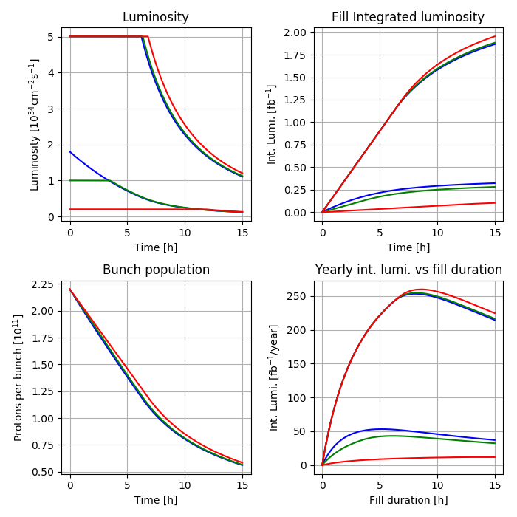
Example of Luminosity evolution
Atlas/CMS
Atlas/CMS
Case with LHCb virtual luminosity of 1.8 10³⁴ cm⁻²s⁻¹
with three levelling scenarios.
LHCb
LHCb
NB:
No levelling possible at 1.8 10³⁴ cm⁻²s⁻¹
Machine
Atlas/CMS
LHCb

Slide 15
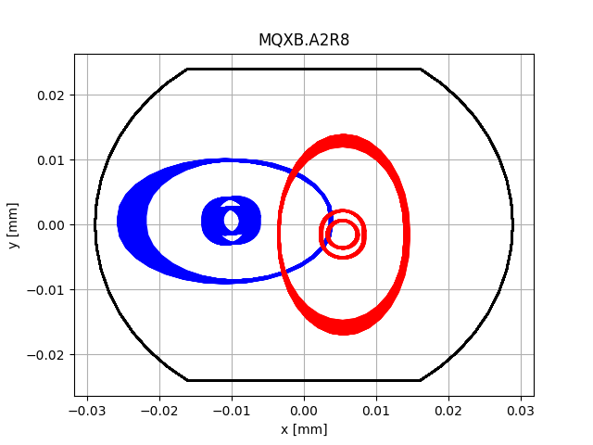
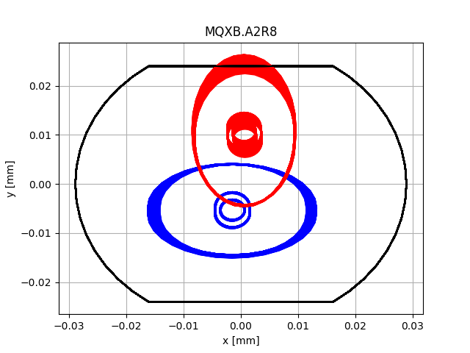
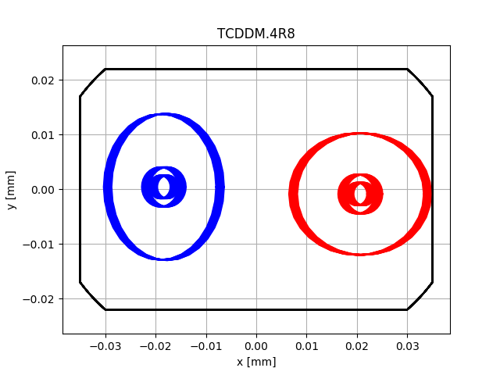
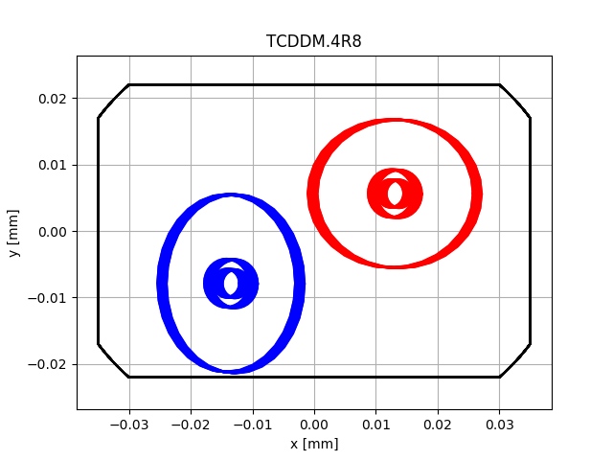
Aperture limitations in collision
Maximum half external crossing angle as function of β*
β* [m] | H¹ [µrad] | H² [µrad] | V³ [µrad] | V^{1,4} [µrad]
1.5 | -225 | -275 | ±165 | ±235
2 | -265 | -310 | ±205 | ±270
3 | -310 | -310 | ±250 | ±310
¹ with present TCDDM
² without present TCDDM
³ crossing plane can be rotated during the ramp (difficult to setup)
⁴ if beam screen is rotated, introducing strong limitations during the ramp
Aperture in the triplet is not symmetric (H=57.8 mm, V=48 mm) and cannot be rotated easily.
TCDDM needed for D1 protection
Current aperture bottleneck for Beam 2 H and Beam 1 V.
H crossing
V crossing
H crossing
V crossing
Compatible with previous scenarios and still aperture margin for β*//.
Beam screen rotation not needed so far in V crossing, and, if it would, the issues are at injection..

Slide 16
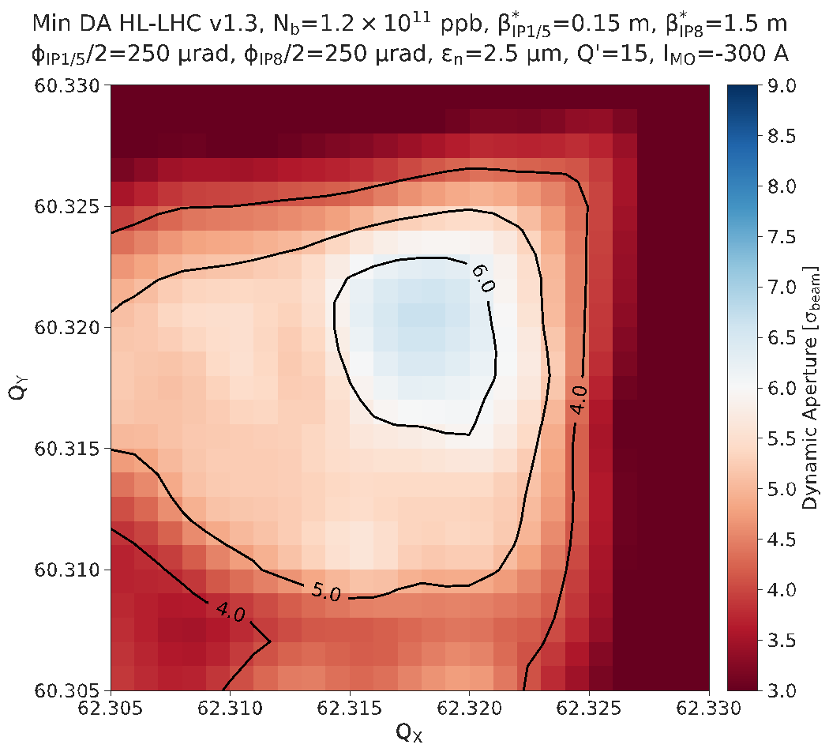
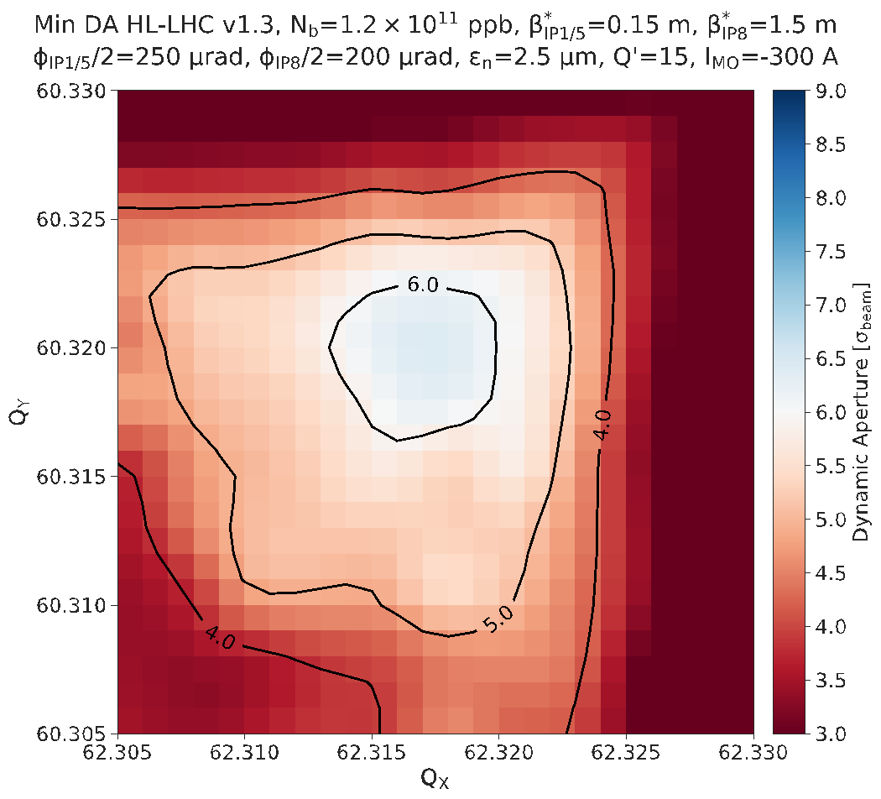
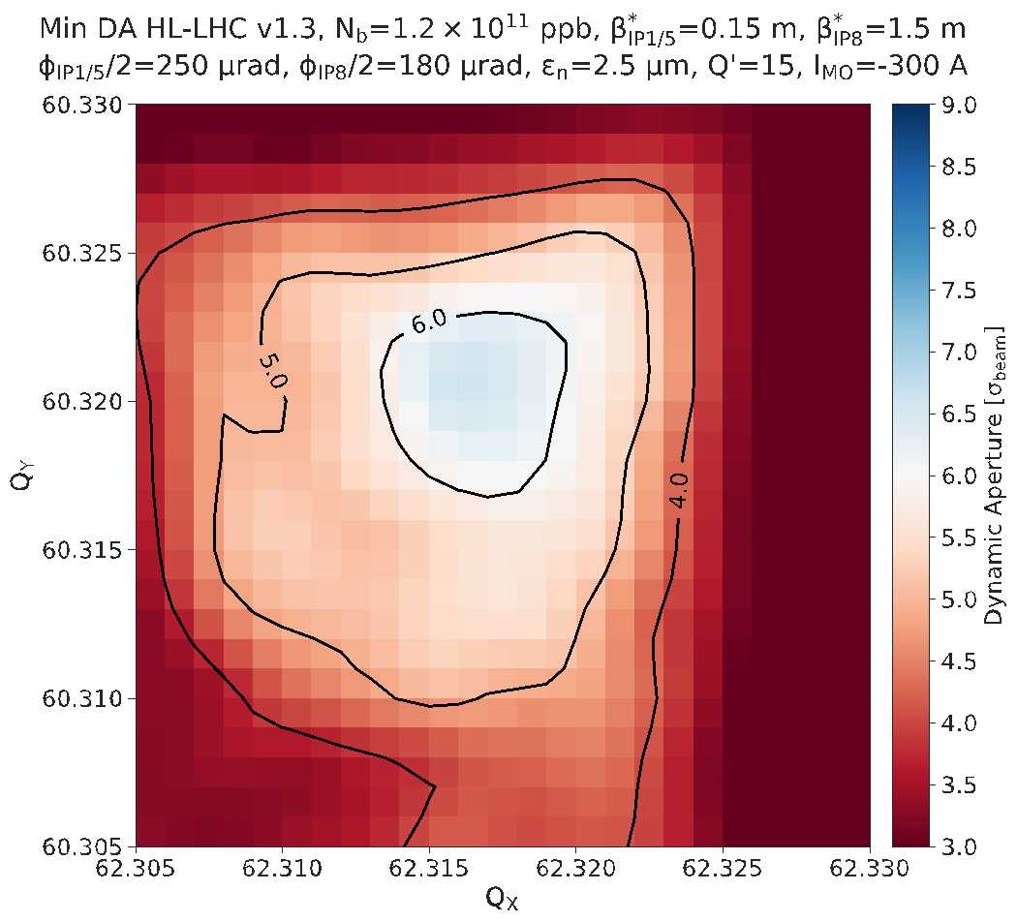
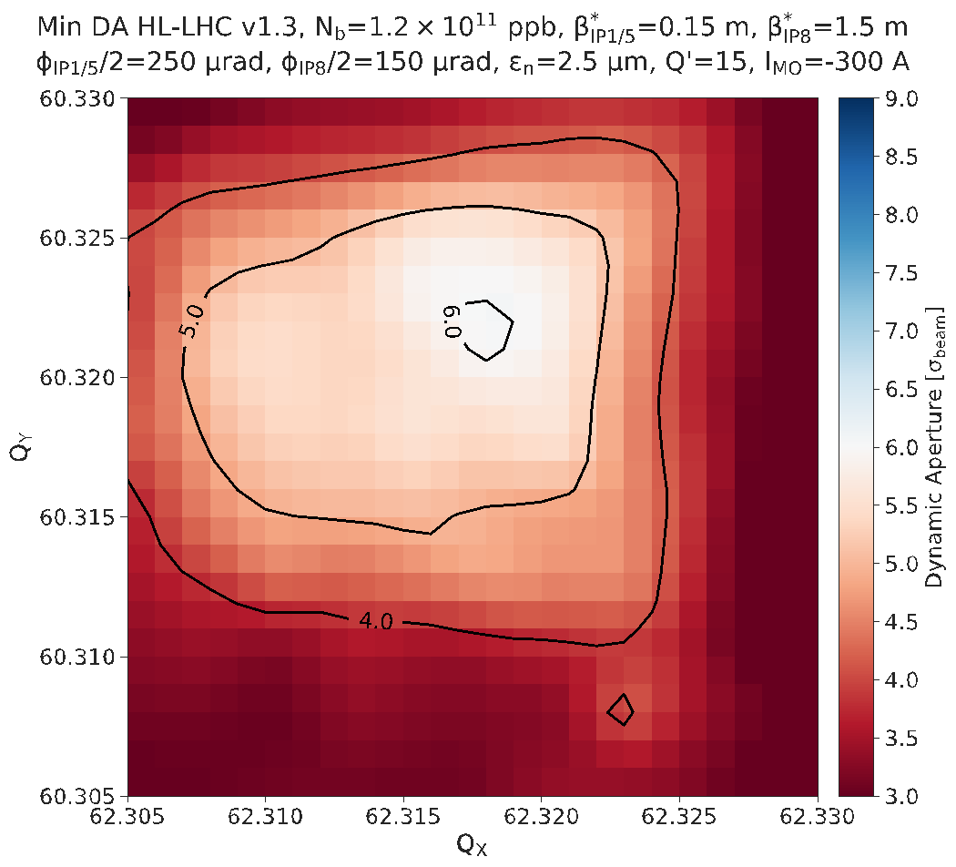
Beam-beam effects, Horizontal Crossing
Tune scan at the end of Atlas/CMS levelling vs LHCb external angle
-250 μrad, Neg, 1∙10³⁴ cm⁻²s⁻¹
-200 μrad, Neg, 1∙10³⁴ cm⁻²s⁻¹
-180 μrad, Neg, 1∙10³⁴ cm⁻²s⁻¹
-150 μrad, Neg, , 1∙10³⁴ cm⁻²s⁻¹
N. Karastathis

Slide 17
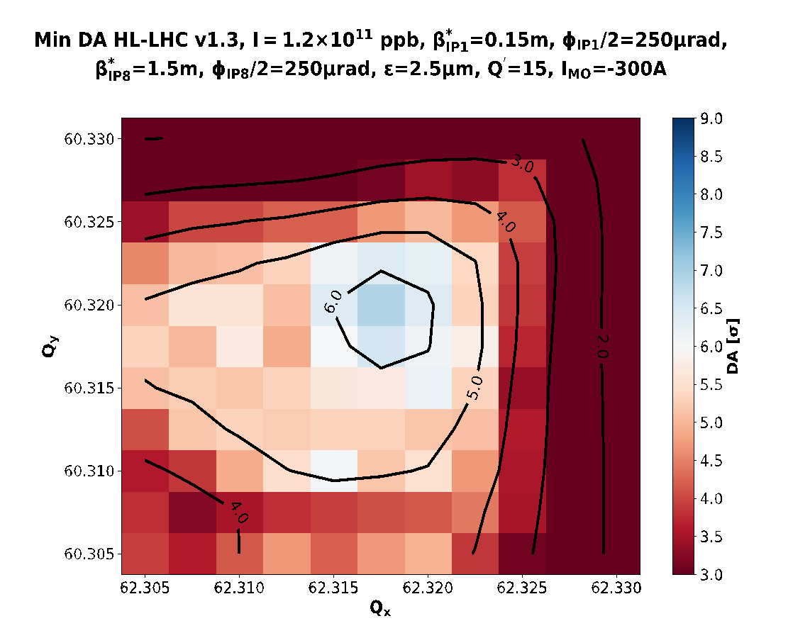
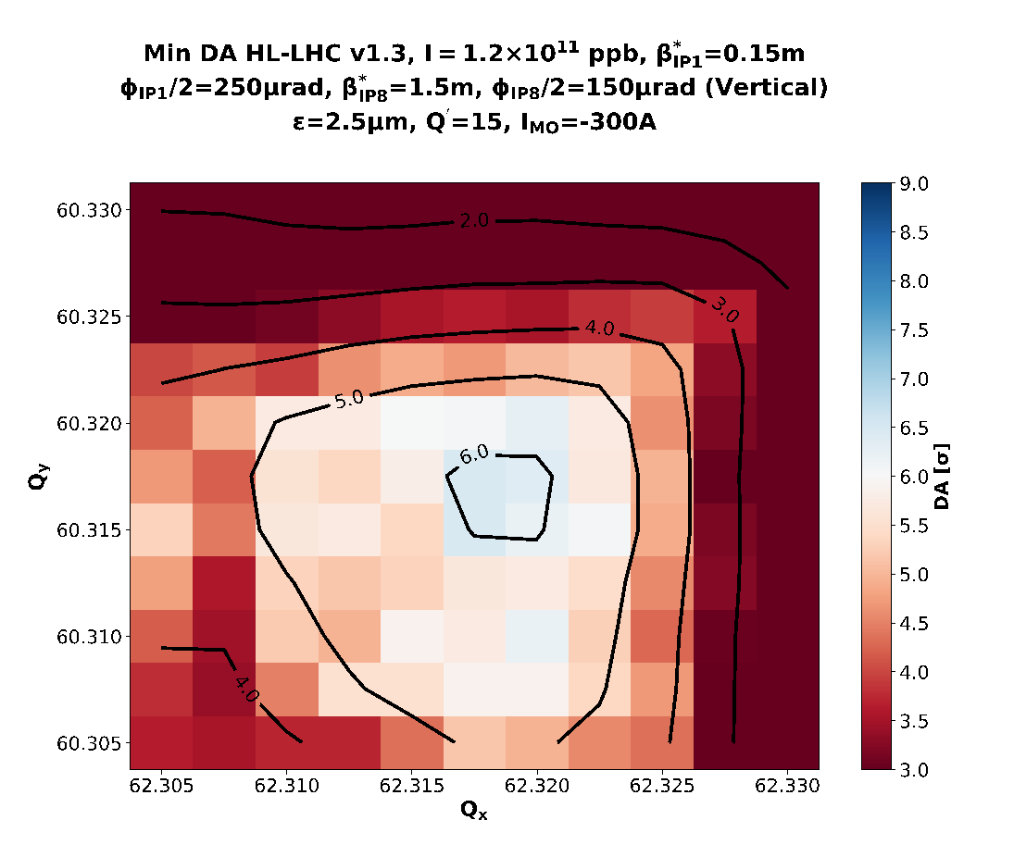
Beam-beam effects, Vertical Crossing
250μrad – H, 1∙10³⁴ cm⁻²s⁻¹
150μrad – V, 1∙10³⁴ cm⁻²s⁻¹
A vertical external half crossing angle of 150 μrad is expected to behave similarly to H crossing (210 μrad half crossing angle)
  Smaller tunable range w.r.t H crossing. Different working point.
  Rotation of the crossing angle in 2012 had several issues: long commissioning and instabilities.

Slide 18
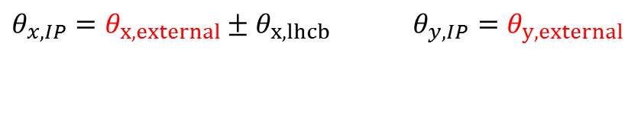
Tilted Crossing angle
The effective crossing angle changes in both horizontal and vertical crossing angle scenarios.
H, Neg | +135 | -250 | 0 | -115 | 0
H, Pos | -135 | -250 | 0 | -375 | 0
V, Neg | +135 | 0 | +160 | +135 | +160
V, Pos | -135 | 0 | +160 | -135 | +160
half crossing angle [μrad],
neglecting small tilt between LHCb and machine.
A tilted external crossing could compensate the spectrometer, but:
It would require a new machine validation every time the sign is reversed. No switch during the year, without compromising physics time.
The additional horizontal angle reduces aperture, therefore larger β* and lower integrated luminosity
Tilted crossing angle introduces large bunch-dependent coupling that can be only mitigated to larger crossing angle (larger β* and lower integrated luminosity)

Slide 19
Conclusions
Tentative scenarios for LHCb Phase II have been further studied for β*=1.5 m and 1∙10³⁴ cm⁻²s⁻¹:
Horizontal external crossing angle for both spectrometer polarities:
  Change of amplitude of the total crossing angle at each polarity swap.
  Reducing the angle to 220 μrad half crossing should be possible at 1∙10³⁴ cm⁻²s⁻¹.
  Need to repeat studies for 1.5 and 2 ∙ 10³⁴ cm⁻²s⁻¹.
  Reduced crossing angle for one polarity possible, but only if polarity is not reversed during the run to avoid physics time loss.
Vertical external crossing angle (160 μrad half crossing) for both spectrometer polarities
  Change of plane of the total crossing angle at each polarity swap
  Crossing angle gymnastic to be simulated and possibly tested in the machine
  Need to repeat studies for 1.5 and 2 ∙ 10³⁴ cm⁻²s⁻¹.
Tilted external crossing angle:
  Reduced luminosity w.r.t the other scenario due to larger β* (e.g. 2 m).
  Bunch dependent coupling effects needs to be studied carefully.

Slide 20
Backup

Slide 21
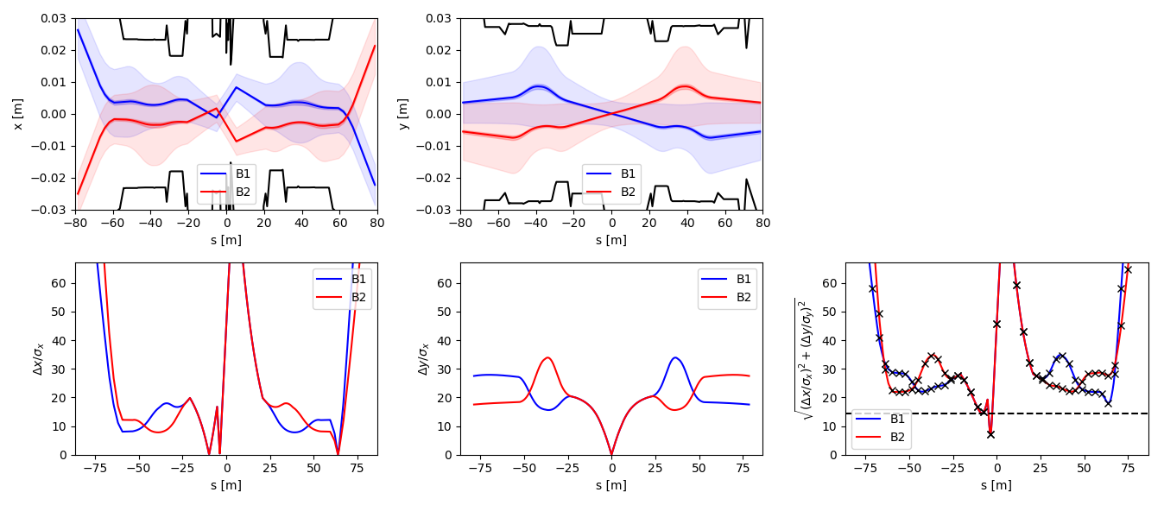
Constraints at injection
Vertical crossing with critical issues
Neg. Spec., 1000 GeV
Rotated beam screen
-170 µrad, +3.5 mm
Close encounter moves with energy and needs strict control of the orbit during the ramp.

Slide 22
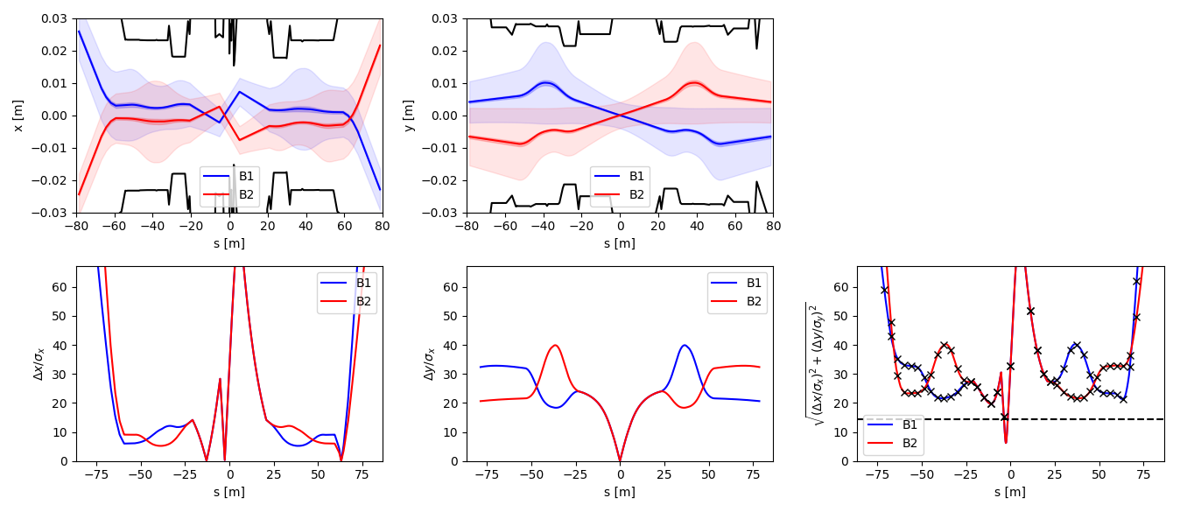
Constraints at injection
Vertical crossing with critical issues
Neg. Spec., 1000 GeV
Rotated beam screen
-200 µrad, +2.0 mm
Close encounter moves with energy and needs strict control of the orbit during the ramp.

Slide 23
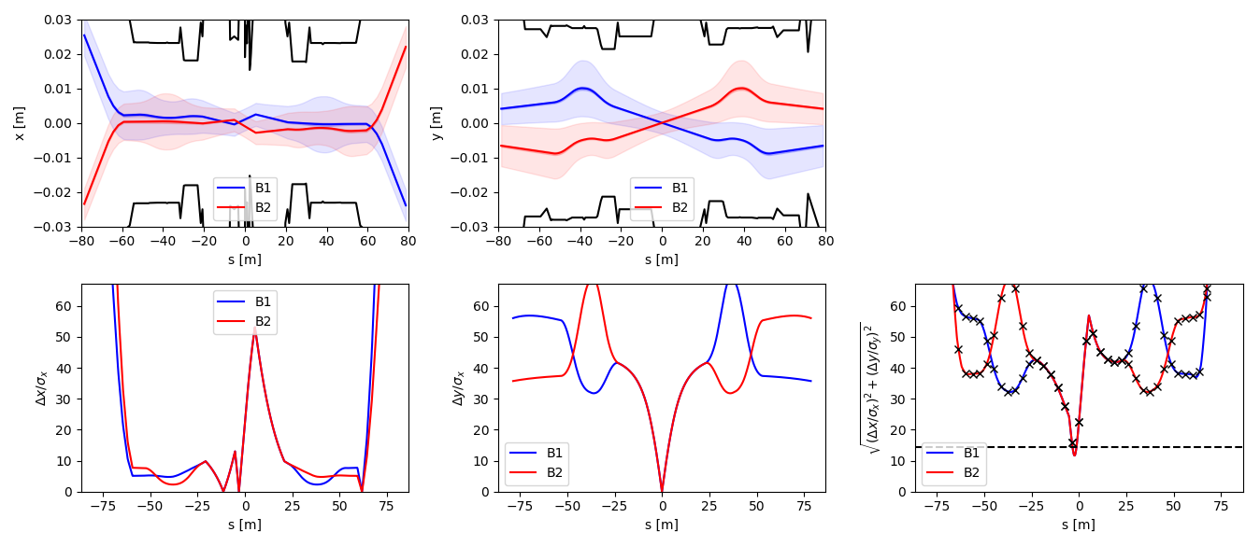
Constraints at injection
Vertical crossing with critical issues
Neg. Spec., 3000 GeV
Rotated beam screen
-200 µrad, +1 mm
Close encounter moves with energy and needs strict control of the orbit during the ramp.

Slide 24
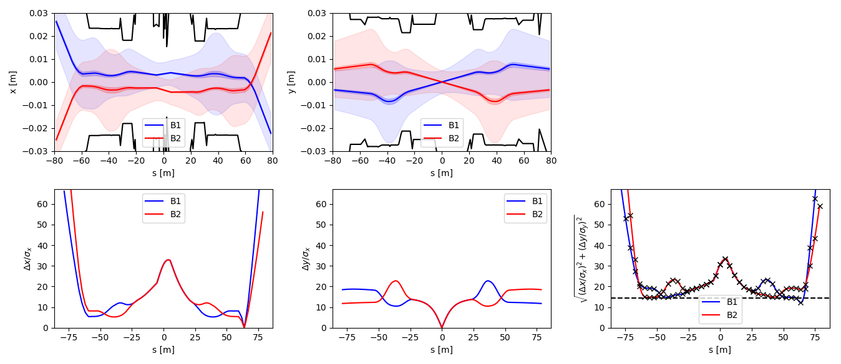
Constraints at injection
Vertical crossing with ramped spectrometer
Neg. Spec., 450 GeV
Rotated beam screen
and ramped spectrometer
Vertical crossing is straightforward if spectrometer could be ramped with energy.

Slide 25
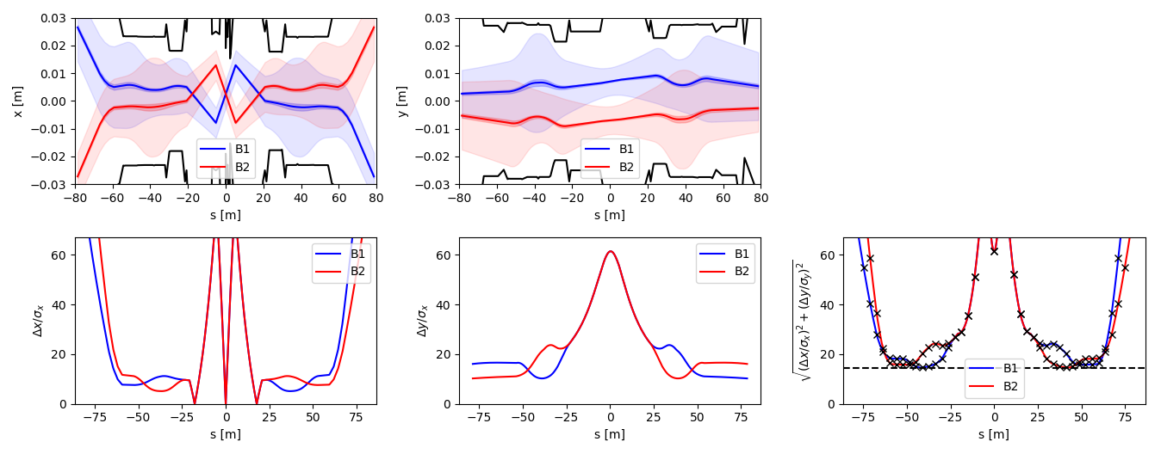
Constraints at injection
Horizontal crossing with extreme conditions
Pos. spec., 450 GeV
Rotated beam screen
-120 µrad, +7.0 mm
80 µrad (bias)
1.5 mm offset
This solution is more robust at injection, but uses about 3 times the typical orbit corrector at injection. As energy increase separation, offset and bias would need to be reduced quickly. Needs validation from injection protection issues.

Slide 26
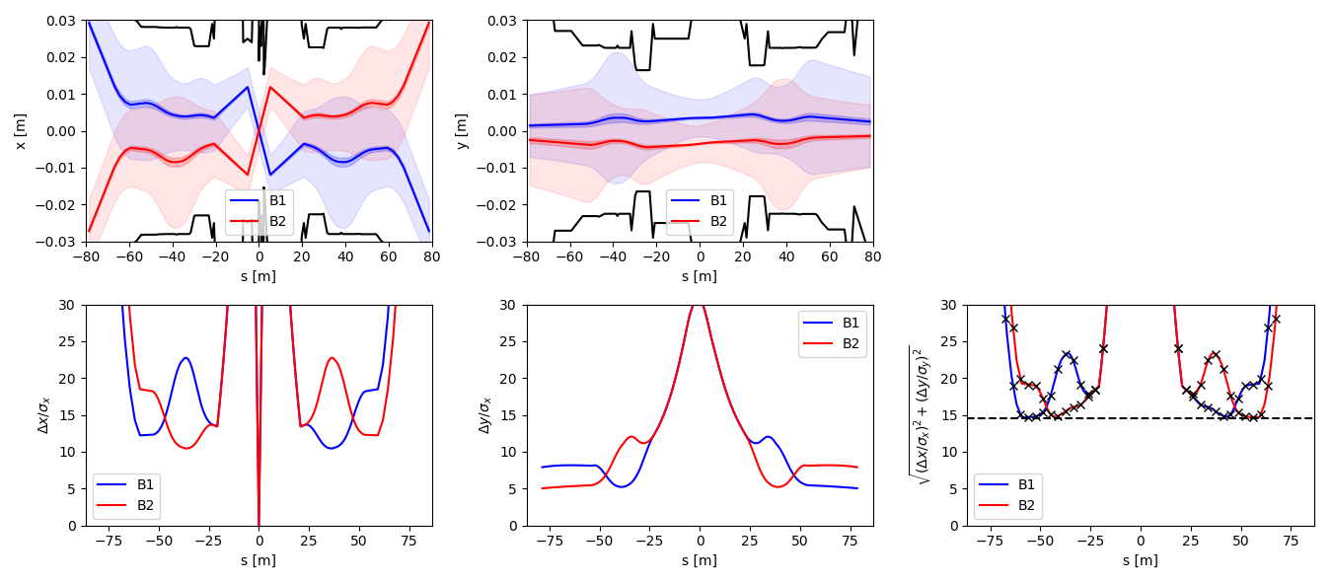
Constraints at injection
Baseline Horizontal crossing.
Pos. Spec., 450 GeV
-170 µrad, +3.5 mm
As the LHC, but with double the intensity in HL-LHC
This needs to be still validated.

Slide 27
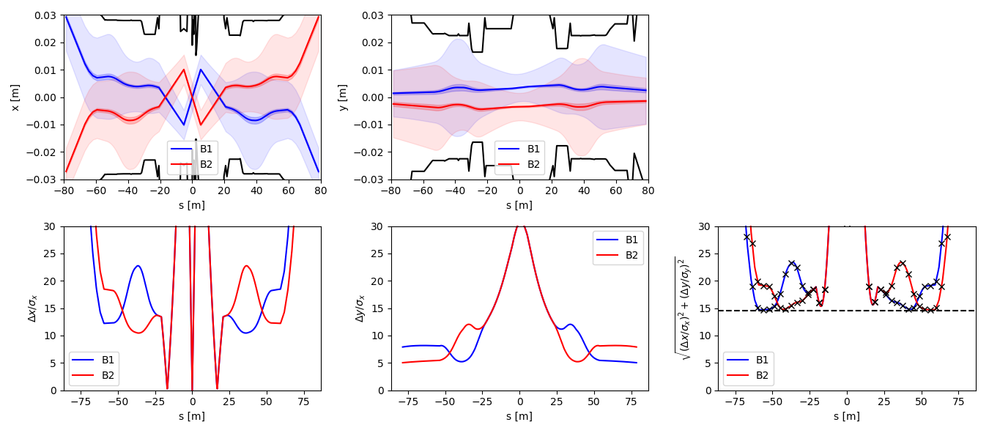
Constraints at injection
Baseline Horizontal crossing.
Neg. Spec., 450 GeV
-170 µrad, +3.5 mm
As the LHC, but with double the intensity in HL-LHC
This needs to be still validated.

Slide 28
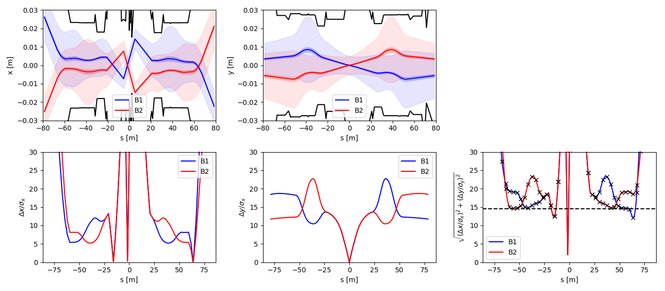
Constraints at injection
Vertical crossing with critical issues
Neg. Spec., 450 GeV
Rotated beam screen
-170 µrad, +3.5 mm
Additional close encounters, in particular close to the IP.
Not compatible with different ion species runs (e.g. Lead – Ion).
Not compatible with present orbit tolerance specifications for p-p.

Slide 29
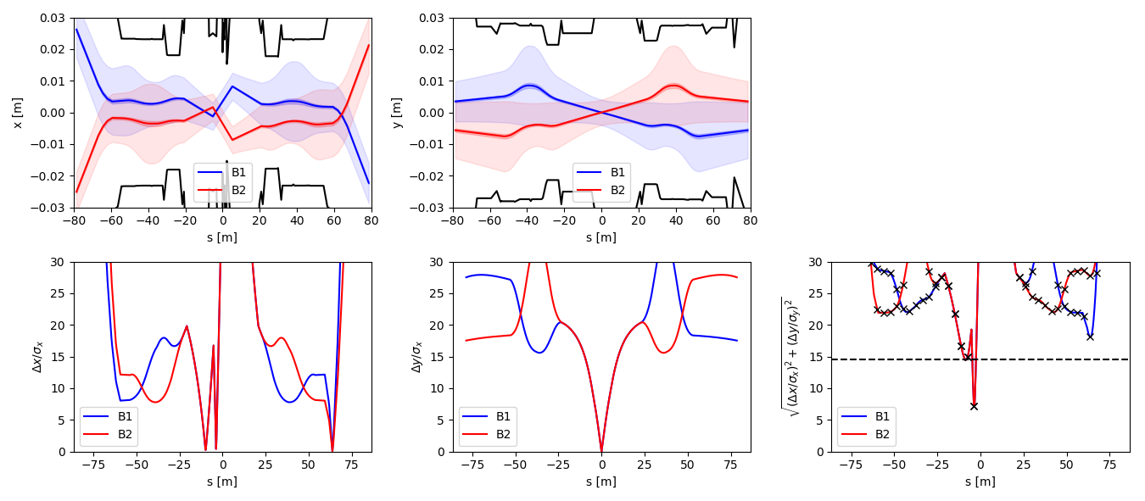
Constraints at injection
Vertical crossing with critical issues
Neg. Spec., 1000 GeV
Rotated beam screen
-170 µrad, +3.5 mm
Close encounter moves with energy and needs strict control of the orbit during the ramp.

Slide 30

Constraints at injection
Vertical crossing with critical issues
Neg. Spec., 1000 GeV
Rotated beam screen
-200 µrad, +1 mm
Close encounter moves with energy and needs strict control of the orbit during the ramp.

Slide 31

Constraints at injection
Vertical crossing with critical issues
Neg. Spec., 3000 GeV
Rotated beam screen
-200 µrad, +1 mm
Close encounter moves with energy and needs strict control of the orbit during the ramp.

Slide 32

Constraints at injection
Vertical crossing with ramped spectrometer
Vertical crossing, -
450 GeV
Rotated beam screen
and ramped spectrometer
Vertical crossing is straightforward if spectrometer could be ramped with energy.

Slide 33

Constraints at injection
Horizontal crossing with extreme conditions
Neg. Spec., 450 GeV
Rotated beam screen
-120 µrad, +7.0 mm
80 µrad (bias)
1.5 mm offset
This solution is more robust at injection, but uses about 3 times the typical orbit corrector at injection. As energy increase separation, offset and bias would need to be reduced quickly. Do we need this?

Slide 34


Peak and Integrated luminosity
Estimates for 2.5 µm/γ and 2524 colliding bunches based on scaling from nominal scenario (assuming 250 µm external crossing angle and 9 cm RMS bunch lengths) .
Large impact of spectrometer polarity on luminosity.

Slide 35

Beam-beam effects, Horizontal Crossing
Spectrometer polarity has an impact of minimum external crossing angle.
Tentative IR8 external half crossing angle with horizontal crossing:
  -200 μrad with Neg. polarity (-65 μrad half crossing angle)
  -150 μrad with Pos. polarity (-285 μrad half crossing angle)
- 200 μrad
“Bad”(Neg) Polarity
-150 μrad
“Good”(Pos.) Polarity

Slide 36




End of leveling (lhcb/alice=-1)
-250 μrad, Neg.
-200 μrad, Neg.
-180 μrad, Neg.
-150 μrad, eg.

Slide 37




Start of collisions (lhcb/alice=-1)
-250 μrad, Neg.
-200 μrad, Neg.
-180 μrad, Neg.
-150 μrad, Neg.

Slide 38


L=2E33 | On_x8=250| β*=3m | lhcb=+1

