Slide 1


Measurement of (Interference) Fragmentation Functions in e⁺e⁻
and Di-Hadron Correlations at SIDIS and p+p
Anselm Vossen
for the
Collaboration
Transversity 2011
Veli Lošinj, Croatia, 29 August - 2 September 2011
arXiv:1104.2425
PRL 107, 072004(2011)

Slide 2
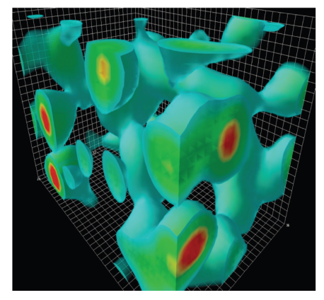







Motivation & Outline
Hadrons
$$\vec{S}$$
Quark
Transverse spin dependent fragmentation functions are necessary to extract quark transversity
Interference Fragmentation Function best way to extract transversity in p+p
→Opens new kinematic domain of high x_{Bj} and z
In SIDIS: Di-hadron Correlations provide independent approach to extract transversity with some theoretical advantages
Measurement of Interference and Collins Fragmentation Functions at
Results from di-hadron correlations at
Planned Measurements at
Outlook: Unpolarized and more “exotic” Fragmentation functions
Notes:
Right now the best way to measure transversity is in semi inclusive processes, where we measure hadrons in the final state to probe the spin state of the fragmenting quark. For this we have to know the spin dependentfragmentation functions, in other words how we can get from the distribution of hadrons back to the quark spin.
One new way is the iff, which allows us to measure transversity in pp relatively easy which of course is important to access high x, z. But also in Sidis it provides and independent approach to transversity with some theoretical advantages.
I want to show you our new results from belle for the FF and collins and show you the impressive results that we already have from sidis and pp experiments as well as an outlook to planned measurement. And of course I will give you some idea what else we will measure at belle
Make point early on that IFF is beneficial in sidis and pp (look up corresponding talks)
Compass: Christopher Braun, Di 11:35, 9:40, John Koster, 10:10, STAR, Bacchetta (11:05 Mo), Jlab (Mi, 9:25)
Babar results?

Slide 3
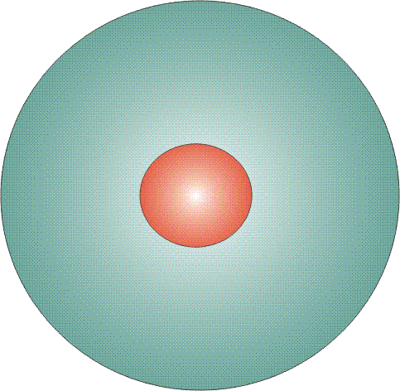
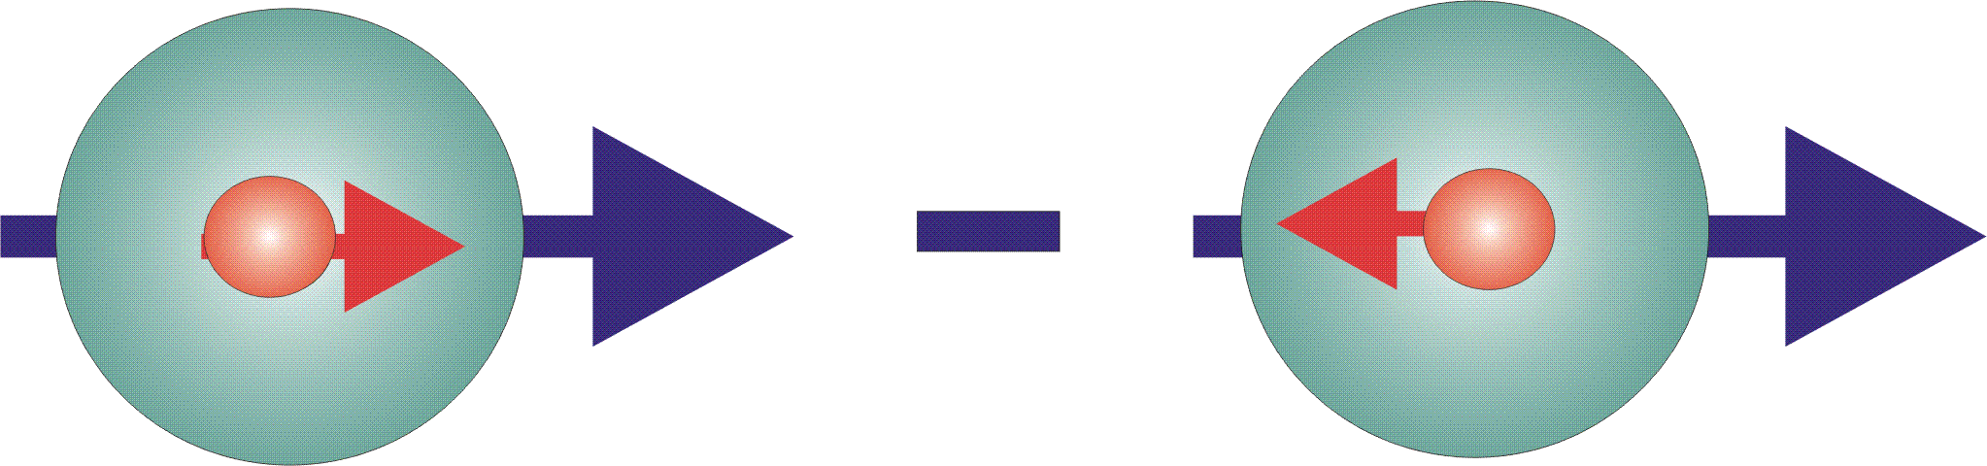

Parton Distribution Functions
The three leading order, collinear PDFs
q(x)
f₁^{q} (x)
unpolarized PDF
quark with momentum x=p_{quark}/p_{proton} in a nucleon
well known – unpolarized DIS
Δq(x)
g₁^{q}(x)
helicity PDF
quark with spin parallel to the nucleon spin in a longitudinally polarized nucleon
known – polarized DIS
transversity PDF
quark with spin parallel to the nucleon spin in a transversely polarized nucleon
Δ_{T}q(x)
h₁^{q}(x)
chiral odd, poorly known
Cannot be measured inclusively
Extract from semi-inclusive
measurements

Slide 4
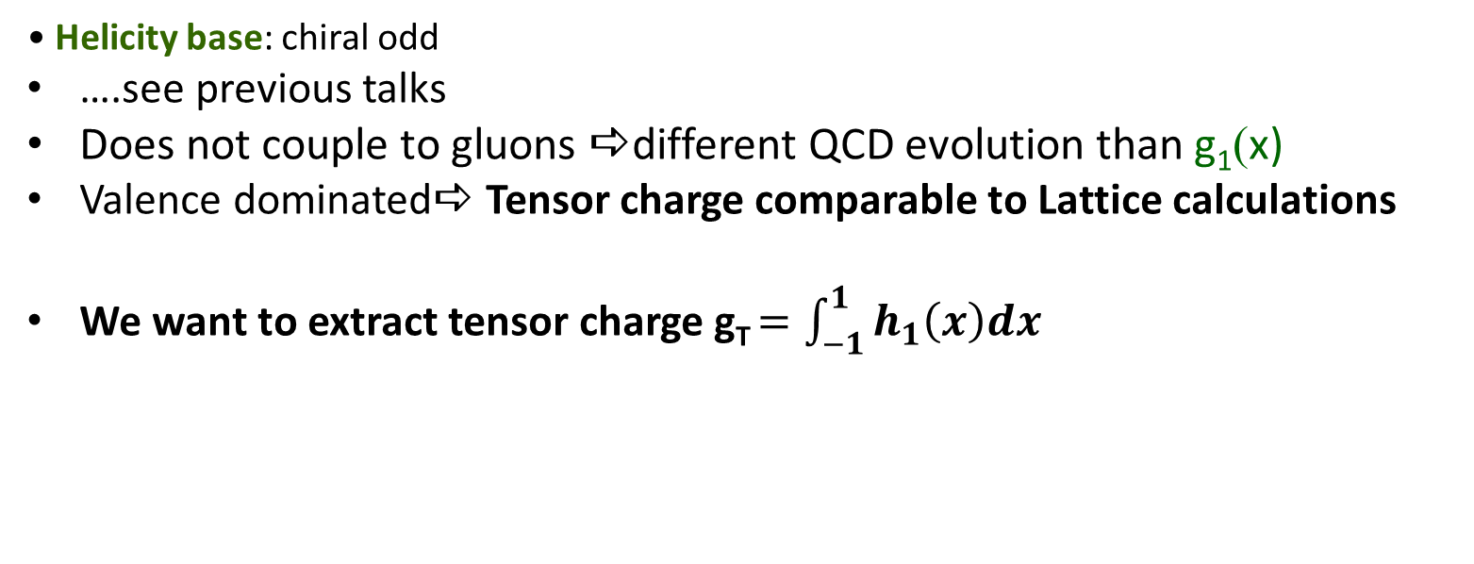
Transversity is Chiral Odd
Transversity base:
γ
γ
γ
γ
γ
_
γ
↑
↑
↓
↓
_
=
+
_
↑
↑
+
↑
↑
Difference in densities for ↑, ↓ quarks
in ↑ nucleon
Helicity base: chiral odd
….see previous talks
Does not couple to gluons adifferent QCD evolution than g₁(x)
Valence dominateda Tensor charge comparable to Lattice calculations
We want to extract tensor charge g_{T} $=\int_{−1}^{1}{h_{1}\left(x\right)dx}$

Slide 5
Chiral odd Fragmentation Functions
Collins effect
_
+
γ∗
γ∗
_
+
q
N
+
_
: Collins FF

Slide 6
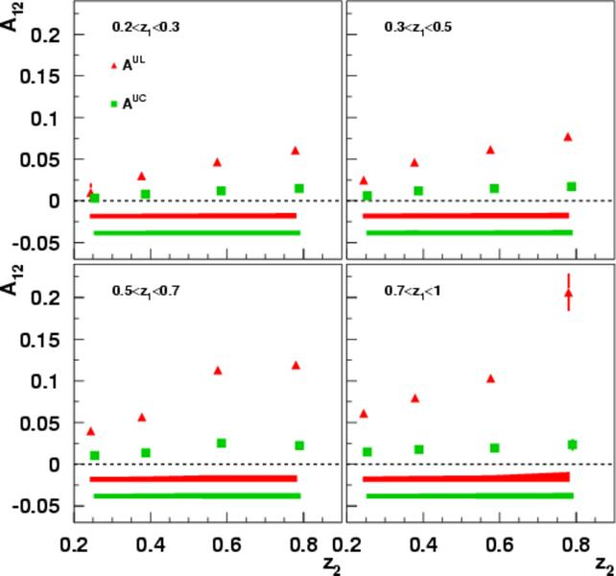
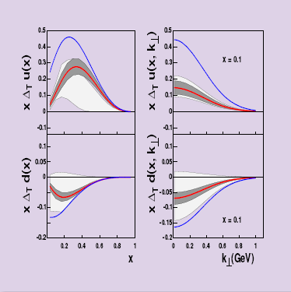
Belle Fragmentation Function Measurement makes first Extraction of Transversity possible!
Belle 547 fb⁻¹ data set (Phys.Rev.D78:032011,2008.)
Together with
HERMES, COMPASS
First, still model dependent transversity
Extraction :
Alexei Prokudin, DIS2008, update of Anselmino et al: hep-ex 0701006
Extraction of double ratios unlike sign over like sign A^{UL} and unlike over all pairs A^{UC}
Gives different combinations of favored and unfavored fragmentation functions
Not direct extraction of Collins Fragmentation function : Only from global fit

Slide 7
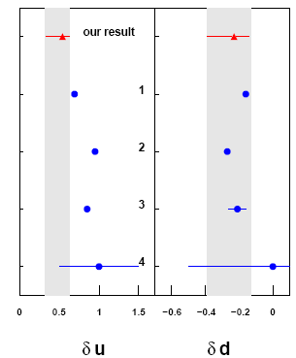
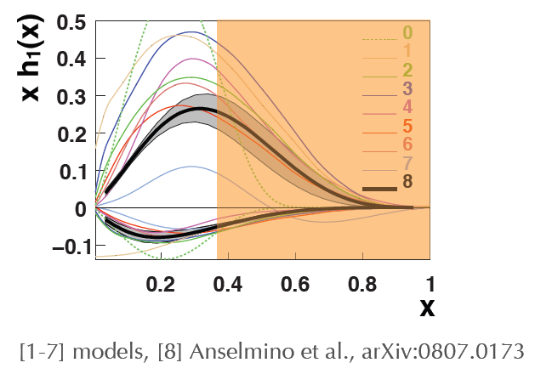
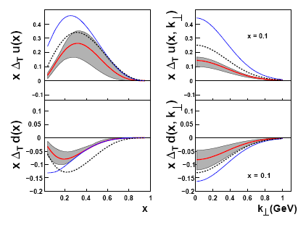
First global analysis from Hermes proton-, Compass deuterium Collins asymmetries and Belle data
Not probed by SIDIS
A. Prokudin
A. Bacchetta
3: Lattice, Goekeler, PLB627 05
Phys.Rev.D75:054032,2007,
update in Nucl.Phys.Proc.Suppl.1
91:98-107,2009
First results available, still open questions from evolution of Collins FF and transverse momentum dependence
More data available now
Cross check using interference fragmentation functions needed
Wider kinematic reach needed

Slide 8
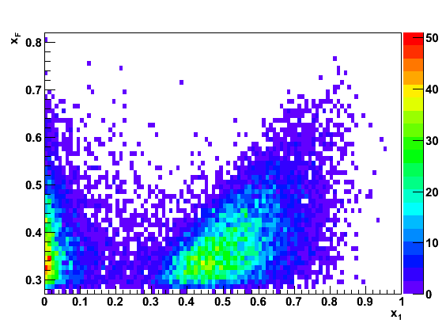
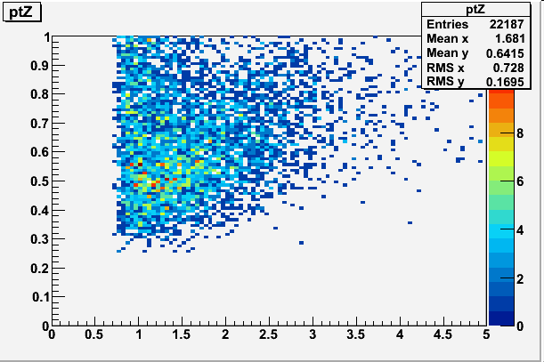
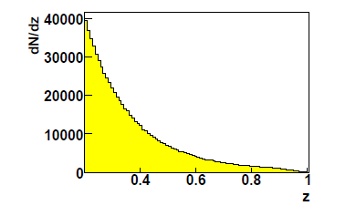
p+p increased kinematic reach in x_{Bj}, z
Kinematic reach of SIDIS data
Kinematic reach in p+p for single pions at 3<eta<4 (RHIC@200GeV)
Relative hadron momentum z for p+p (3<eta<4) collisions and SIDIS (COMPASS), only single hadron, di-hadron z₁+z₂ ‘less different’
x_{F}
P_{T}
x_{Bj}
P_{T}
z
Mean z: 0.64
p_{t}
But Collins measurement hard (see STAR Talk Nikola Poljak)
and theoretically hard to interpret (fact. Breaking)

Slide 9
Chiral odd Fragmentation Functions
Interference Fragmentation Function
L_{z}
L_{z}-1
_
+
γ∗
γ∗
_
+
q
N
+
_

Slide 10
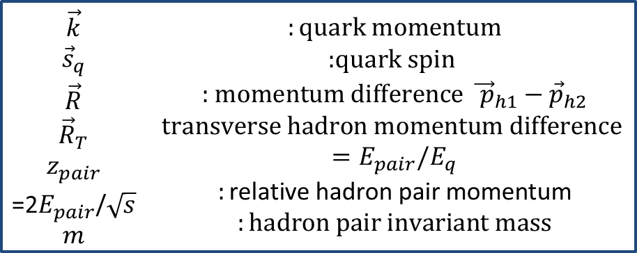
Interference FF in Quark Fragmentation
q
Interference Fragmentation Function:
Fragmentation of a
transversely polarized
quark q into two spin-less
hadron h1, h2 carries an
azimuthal dependence:
$$\begin{matrix}\begin{aligned}\vec{k} \\ {\vec{s}}_{q} \\ \vec{R} \\ {\vec{R}}_{T} \\ z_{pair} \\ \text{=}\text{2}E_{pair}\text{/}\sqrt{s} \\ m\end{aligned} & \begin{aligned}:\text{quark} \text{momentum} \\ \text{:}\text{quark} \text{spin} \\ \text{: }\text{momentum} \text{difference}{ \vec{ p}}_{h1}{− \vec{p}}_{h2} \\ \text{transverse} \text{hadron} \text{momentum} \text{difference} \\ =E_{pair}/E_{q} \\ :\text{relative} \text{hadron} \text{pair} \text{momentum} \\ :\text{hadron} \text{pair} \text{invariant} \text{mass}\end{aligned}\end{matrix}$$
Notes:
10

Slide 11
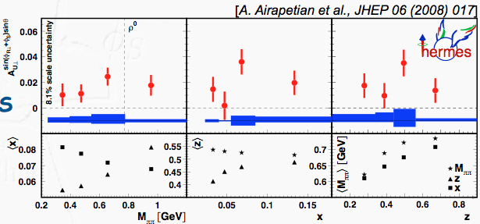
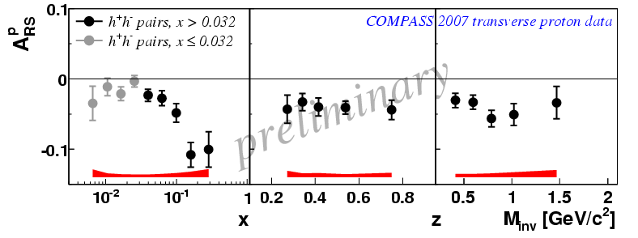
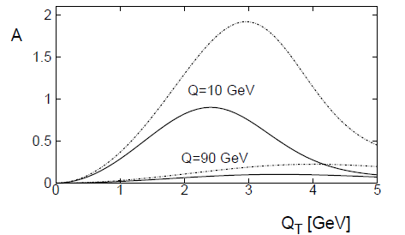
Interference FF vs. Collins Effect
Independent Measurement
Effect persists with transverse momentum integrated
  Collinear factorization
    No assumption about k_{t} in evolution
    evolution known, collinear scheme can be used
    Universal function: directly applicable to semi-inclusive DIS and pp
First experimental results from HERMES, COMPASS, PHENIX and now Belle
Sudakov suppression in Collins case
Favorable in proton-proton collisions: no other contributions (no Sivers): Disentangle sources of large transverse spin asymmetries
D. Boer, Nucl.Phys. B806:23, 2009
In p+p:
No jet reconstruction necessary,
better systematics: “Easier” measurement

Slide 12
Spin Dependent FF in e⁺e⁻ : Need
Correlation between Hemispheres !
Quark spin direction unknown: measurement of
Interference Fragmentation function in one hemisphere is not possible
sin φ modulation will average out.
Correlation between two hemispheres with
sin φ_{Ri} single spin asymmetries results in
cos(φ_{R1}+φ_{R2}) modulation of the observed di-hadron
yield.
Measurement of azimuthal correlations for di-pion pairs
around the jet axis in two-jet events!
Notes:
12

Slide 13
Measuring di-Hadron Correlations
In e⁺e⁻ Annihilation into Quarks
Interference effect in e⁺e⁻
quark fragmentation
will lead to azimuthal
asymmetries in di-hadron
correlation measurements!
Experimental requirements:
Small asymmetries ➔
very large data sample!
Good particle ID to high
momenta.
Hermetic detector
Observable:cos(φ_{R1}+φ_{R2})
modulation measures
electron
q₁
φ_{R2}
z₂
φ_{R1}
q₂
z₁
quark-2
spin
quark-1
spin
z_{1,2} relative pion pair
momenta
positron
Notes:
13

Slide 14
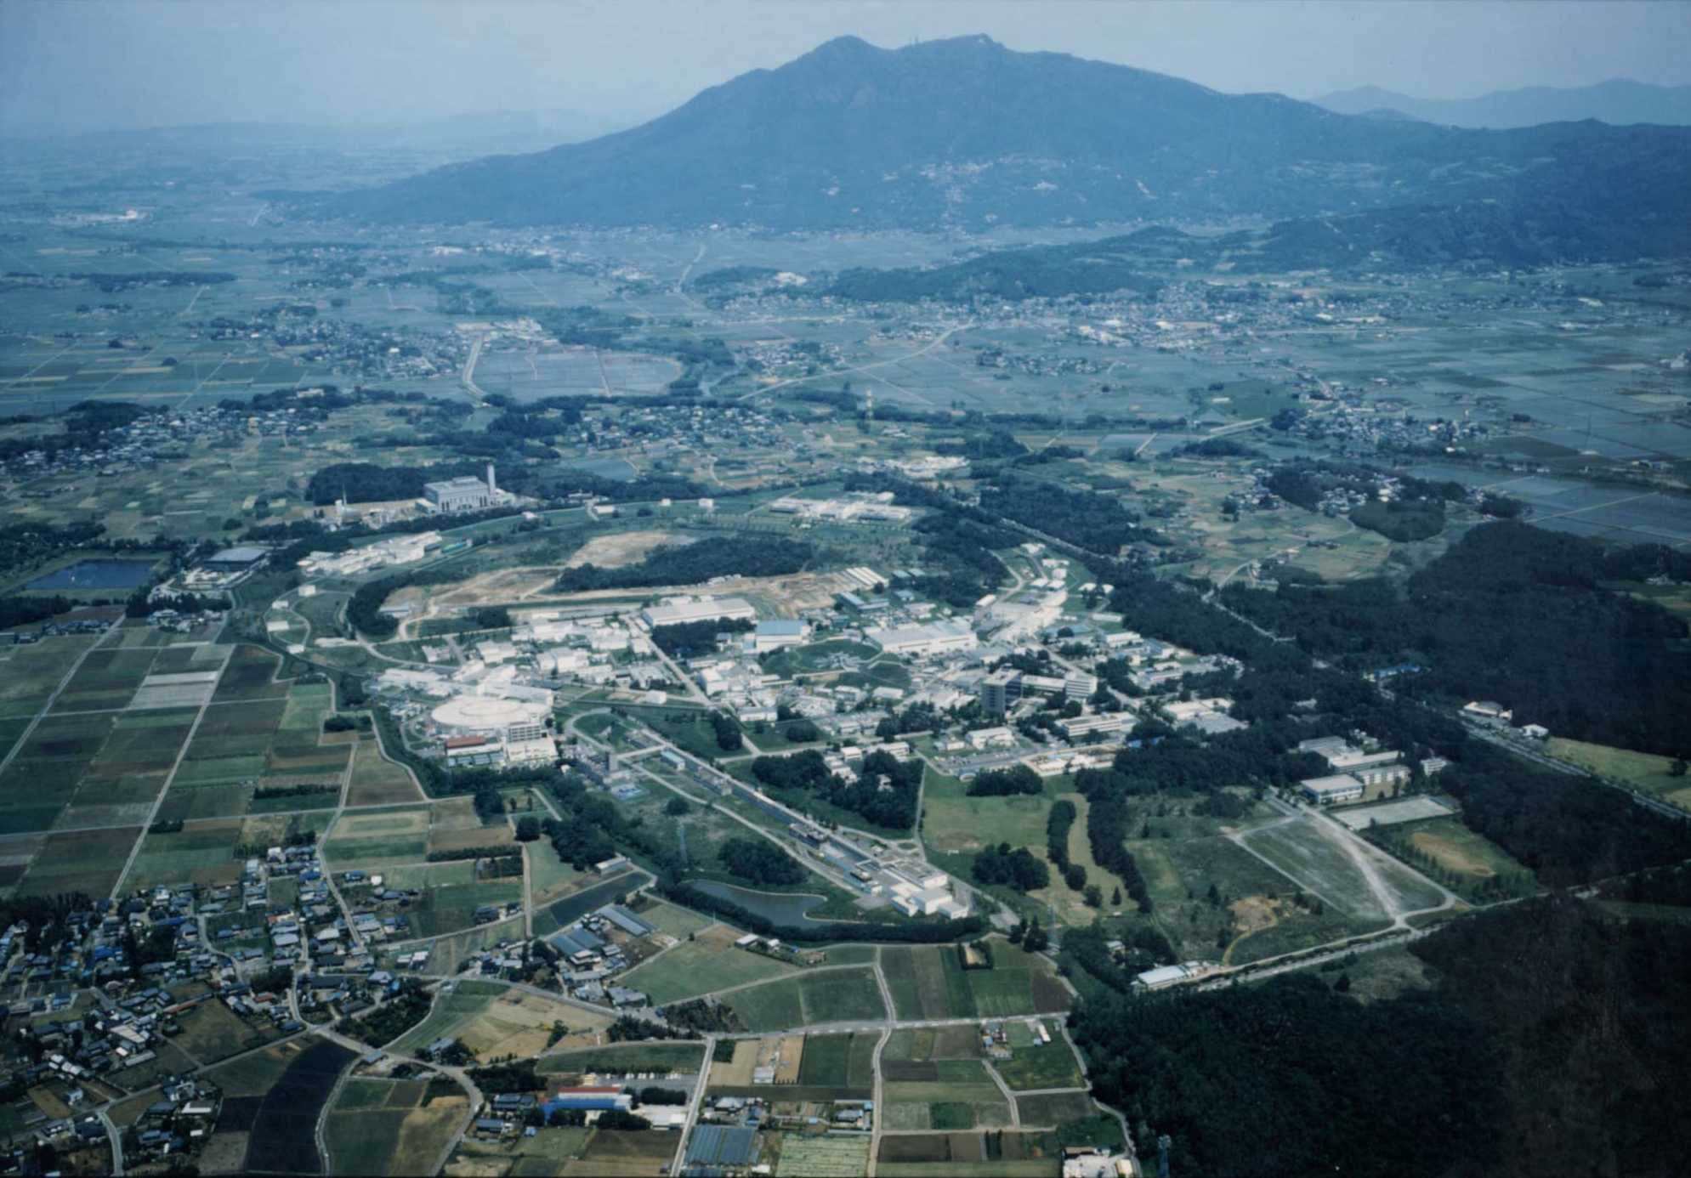
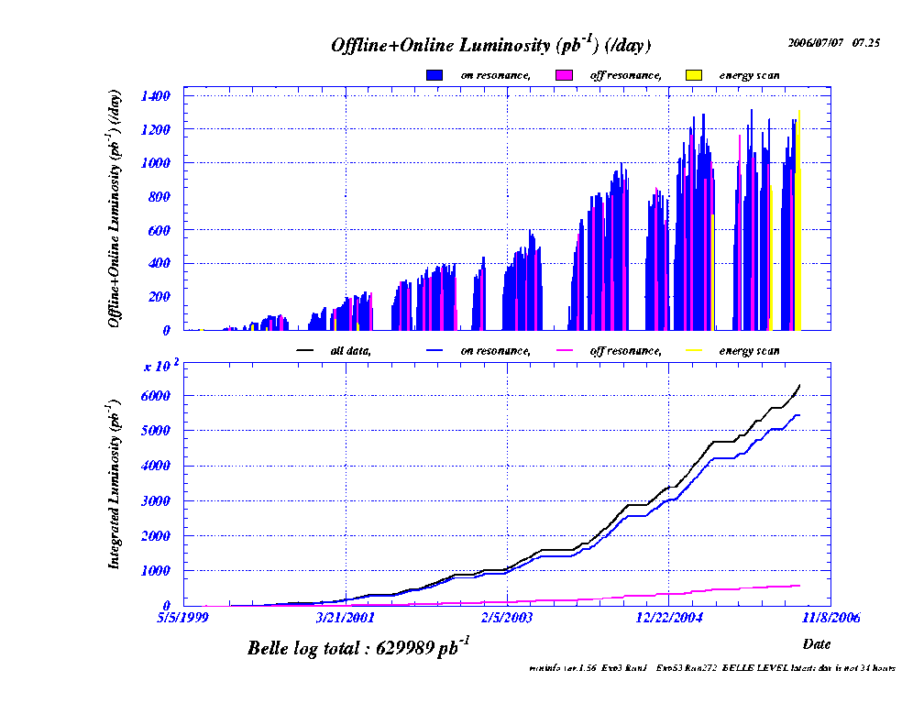
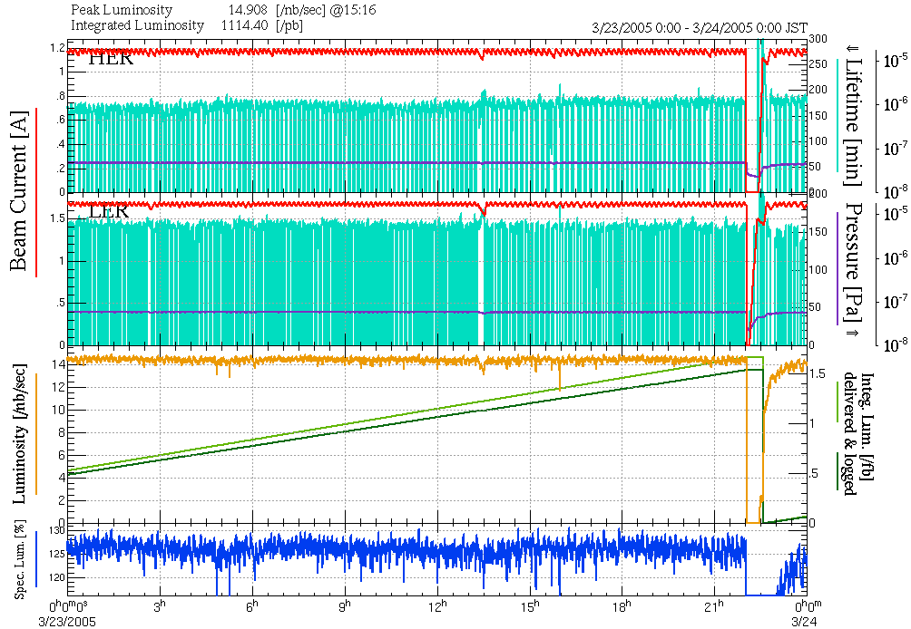
KEKB: L>2.11 x 10³⁴cm⁻²s⁻¹ !!
Asymmetric collider
8GeV e⁻ + 3.5GeV e⁺
√s = 10.58GeV (Υ(4S))
e⁺e⁻→Υ(4S)→B‾B
Off-resonance production:
10.52 GeV
e⁺e⁻→q‾q (u,d,s,c)
Integrated Luminosity: > 1000 fb⁻¹
>70 fb⁻¹ => continuum
Belle detector
KEKB
14
Notes:
14

Slide 15
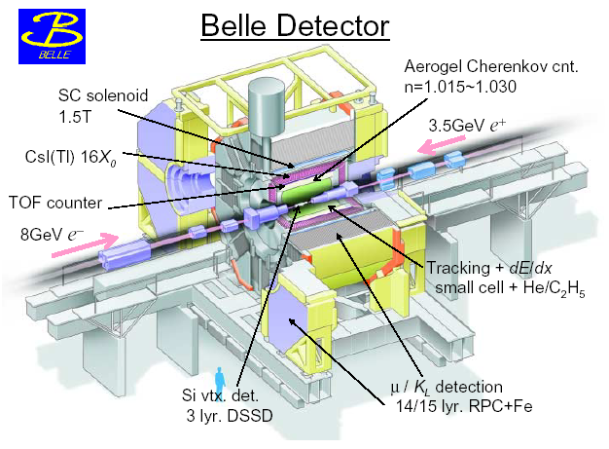
He/C₂H₆
Large acceptance, good tracking and particle identification!
Notes:
15

Slide 16
Cuts and Binning
Similar to Collins analysis, full off-resonance and on-resonance data
(7-55): ~73 fb⁻¹ + 588 fb⁻¹
Visible energy >7GeV
PID: Purities in for di-pion pairs > 90%
Same Hemisphere cut within pair (π⁺π⁻), opposite hemisphere between pairs
All 4 hadrons in barrel region: -0.6 < cos (θ) <0.9
Thrust axis in central area: cosine of thrust axis around beam <0.75
Thrust > 0.8 to remove B-events → < 1% B events in sample
z_{had1,had2}>0.1
z₁ = z_{had1}+z_{had2} and z₂ in 9x9 bins
m_{ππ1} and m_{ππ2} in 8x8 bins: [0.25 - 2.0] GeV
New: Mixed binning
Notes:
16

Slide 17
Systematic Errors
Dominant:
  MC asymmetry + its statistical error (up to % level)
Smaller contributions:
  PID: per mille level
  higher moments: sub per mille level
  axis smearing
  mixed asymmetries: per mille level

Slide 18
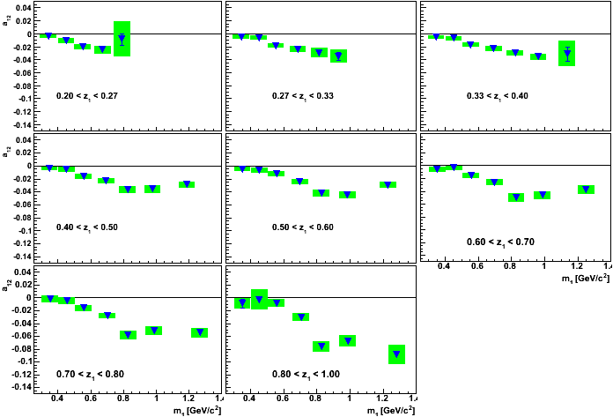
(z₁x m₁) Binning
arXiv:1104.2425
PRL 107, 072004(2011)

Slide 19
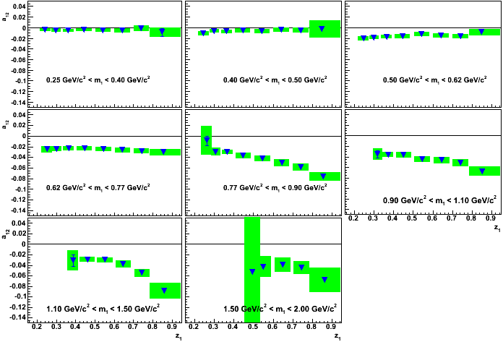
(m₁x z₁) Binning
arXiv:1104.2425
PRL 107, 072004(2011)

Slide 20
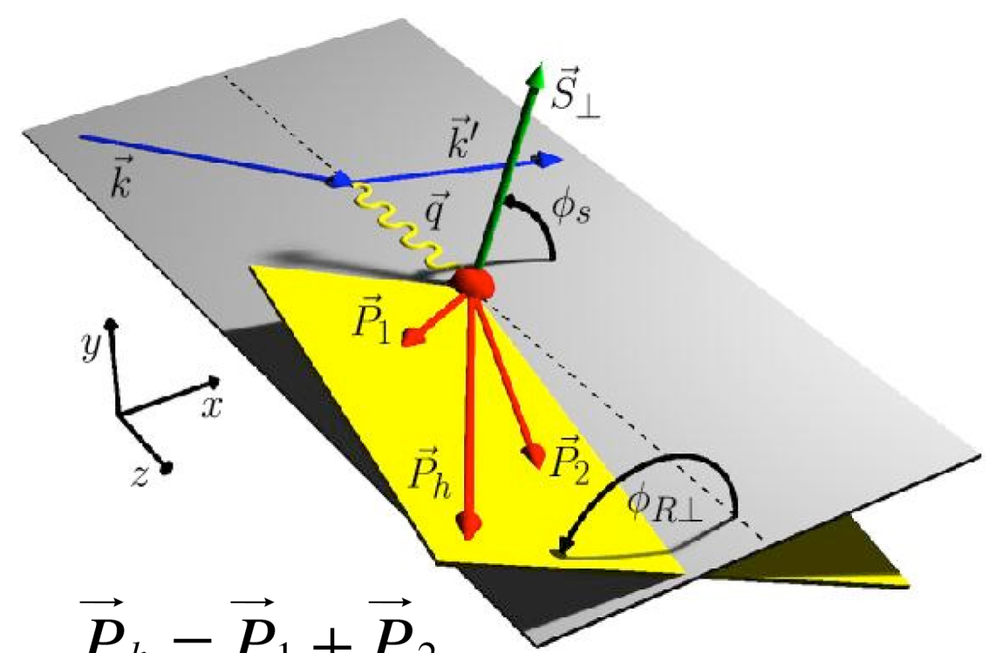

Di-Hadron Correlations in DIS
Interference ff
Armine Rostomyan, Tue 10:15,
Christopher Braun, Tue 11:35, 9:40,
Plans at Jlab @ 12GeV: Volker Burkert Fr. 11:05

Slide 21
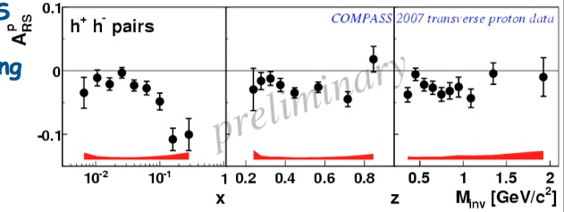
Hermes and Compass results on the proton
… look different still, but …

Slide 22
Good agreement after correction for experiments conventions
Proton
HERMES values scaled with 1/D_{nn}

Slide 23
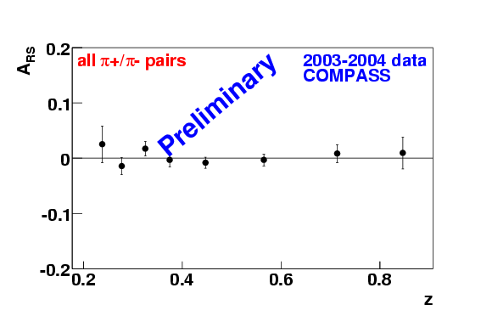
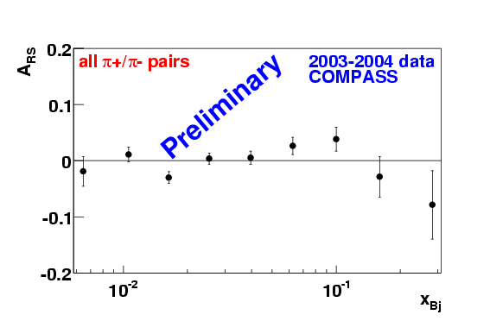
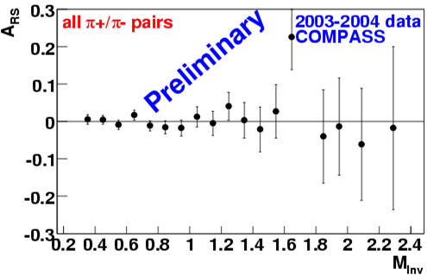

Compass measured also (very small) asymmetries from Deuterium
Deuteron
Direct product!
No assumption needed!

Slide 24
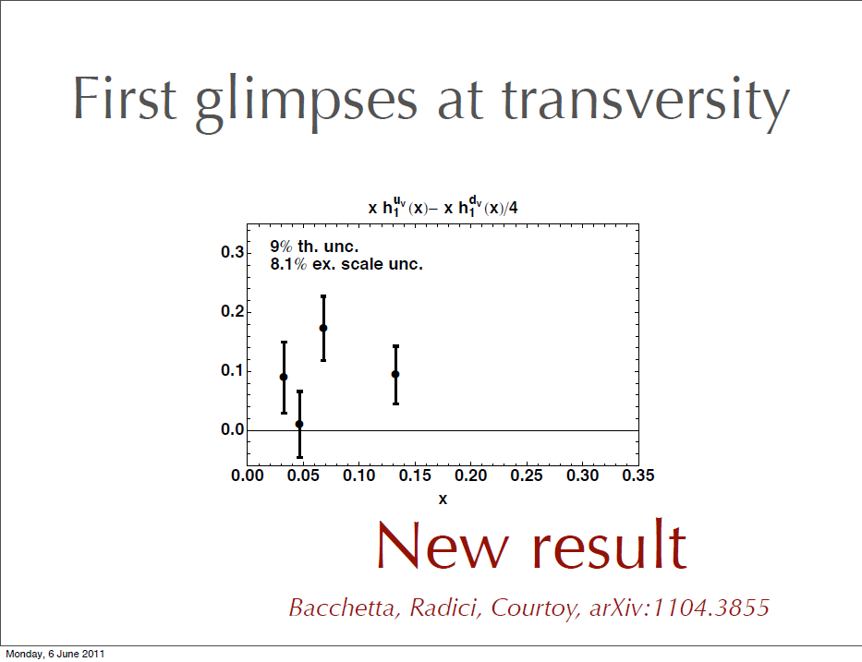
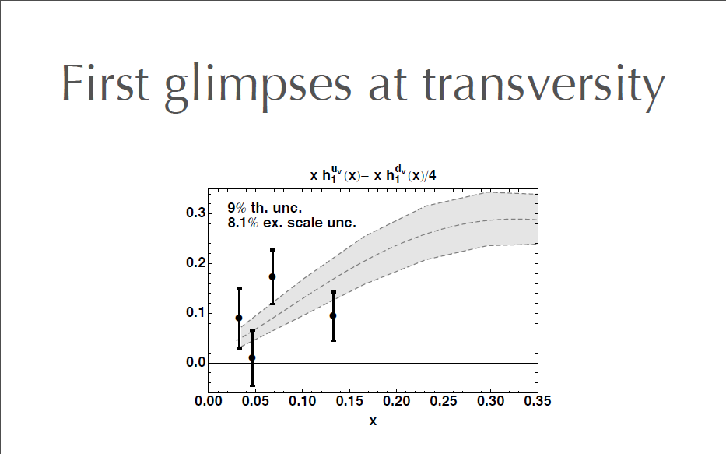
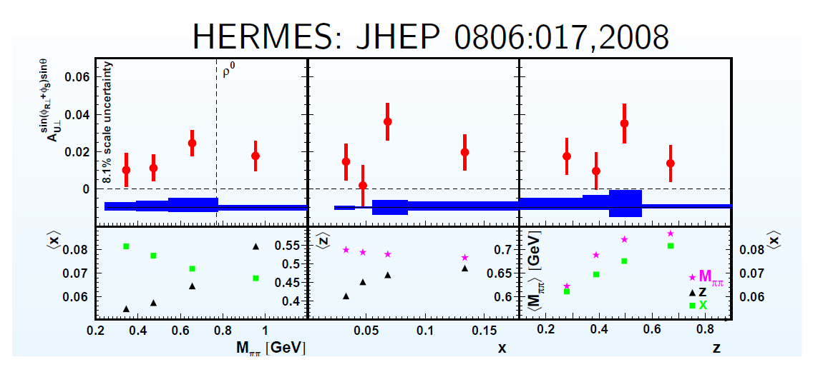

First transversity extraction from HERMES and Belle IFF data
Alessandro Bacchetta at RHIC DY workshop May 2011:
SIDIS asymmetries A_{UT} are $∝H_{}^{⊥}∙h_{1}$
Collinear Framework: Point by Point extraction possible!
Bacchetta, Radici, Courtoy, arXiv:1104.3855

Slide 25
First transversity extraction from HERMES and Belle IFF data
Alessandro Bacchetta at RHIC DY workshop May 2011:
Early studies indicate little effect of evolution in Collins function,
Preliminary data by Compass and PHENIX not used
Collinear Framework: Point by Point extraction possible!
Bacchetta, Radici, Courtoy, arXiv:1104.3855

Slide 26
First transversity extraction from HERMES and Belle IFF data
Alessandro Bacchetta at RHIC DY workshop May 2011:
Consistent with Extraction by Anselmino et.al.
Collinear Framework: Point by Point extraction possible!
Bacchetta, Radici, Courtoy, arXiv:1104.3855

Slide 27
Interference Fragmentation Function in p-p
φ_{S}-φ_{R}
X
c
a
b
X
φ_{S}
: Angle between polarisation vector and event plane
φ_{R}
: Angle between two hadron plane and event plane

Slide 28
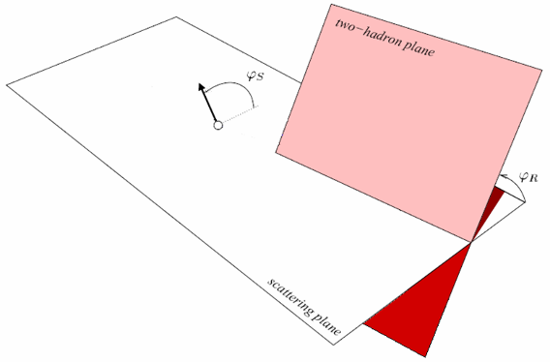
Definition of Vectors and Angles
Bacchetta and Radici, PRD70, 094032 (2004)

Slide 29
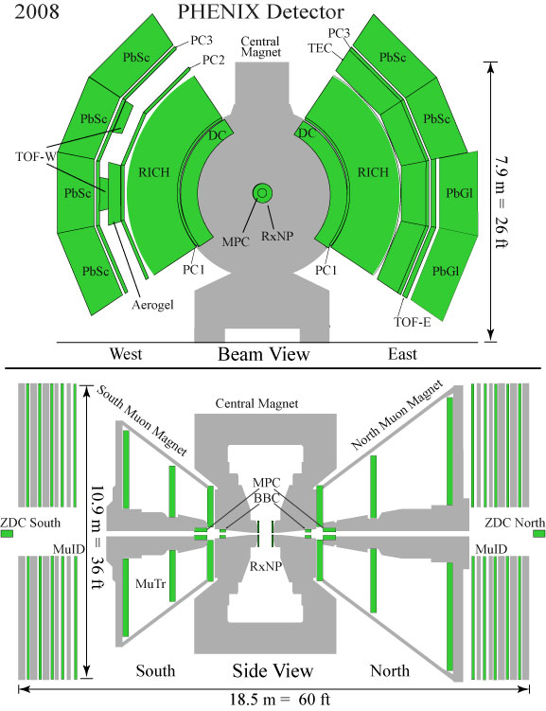
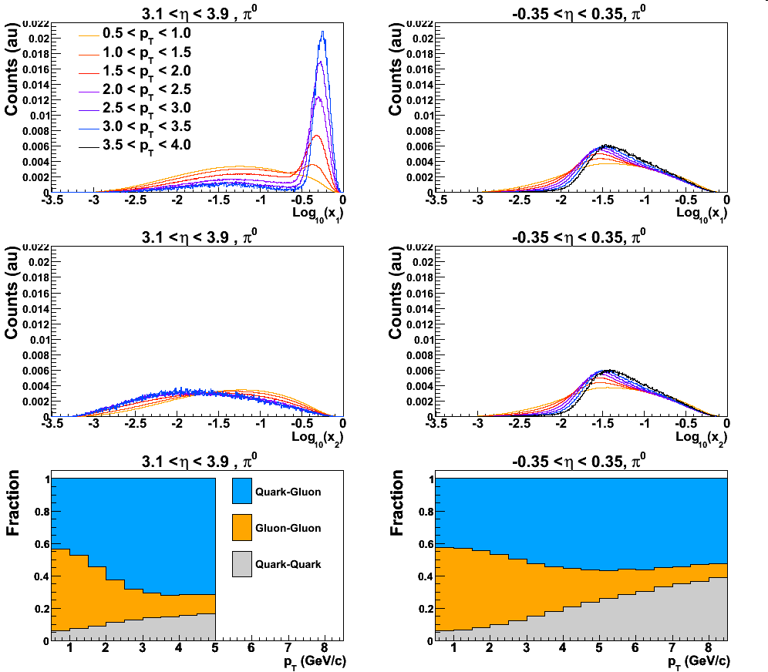
PHENIX Detectors used for IFF Analysis
@RHIC, 200 GeV p+p
Use 2 separate spectrometer arms at central rapidity,
|η| < 0.35
Azimuthal coverage: 90° + 90°
Electromagnetic Calorimeters
  PbSC + PbGl
  High granularity Δη×Δφ=0.01×0.01
Tracking of charged particles
  Drift chamber, pad chambers
Results: John Koster, Wed. 9:40
Little p_t dependence of x at mid rapidity, low x

Slide 30
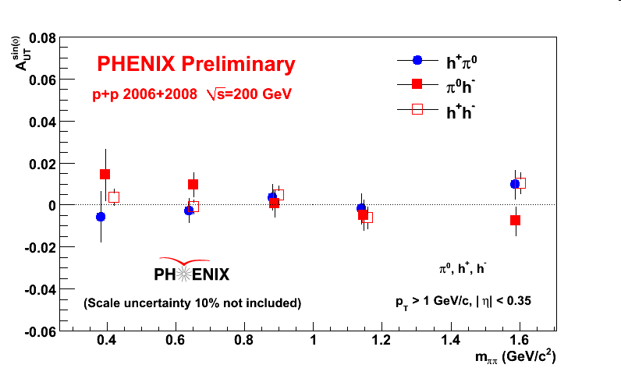
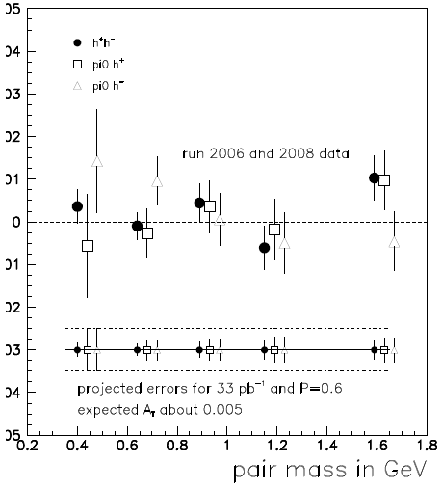
vs Invariant Mass of the Pair
First measurement of IFF in pp
Results and Projections
From run 12+13

Slide 31
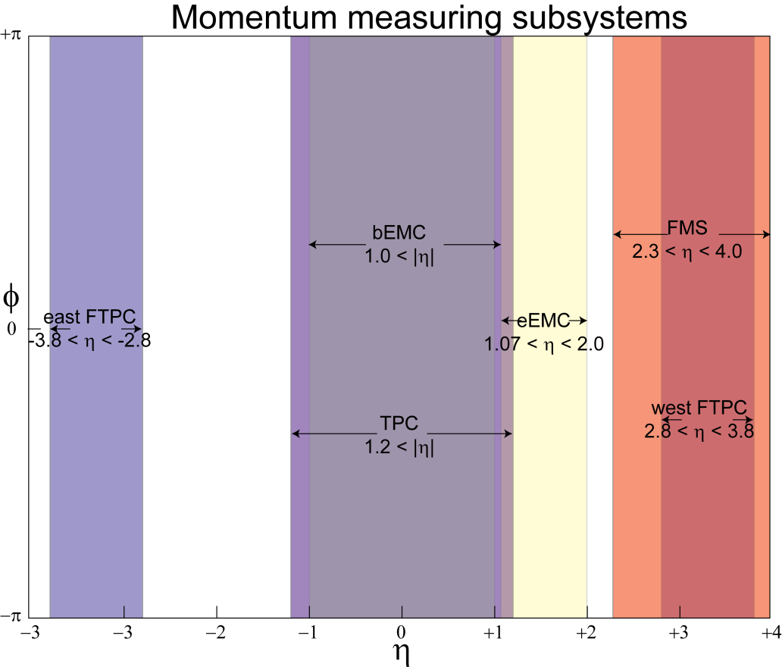
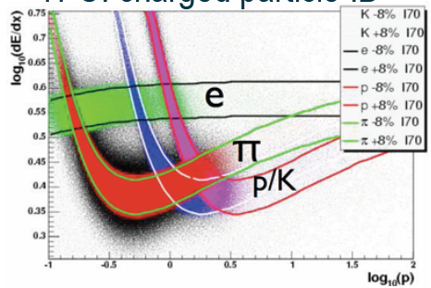
Di-Hadron correlations measurements at
Di-Hadron correlations measurements with current detector
  Need different charged hadrons
  π⁰ in Barrel and Endcap, π⁺ /π⁻ inTPC
Full azimuth spanned with nearly contiguous electromagnetic calorimetry from -1<η<4
⇒ approaching full acceptance detector
PID (Barrel) with dE/dx, in the future: ToF pi/K separation up to 1.9 GeV

Slide 32
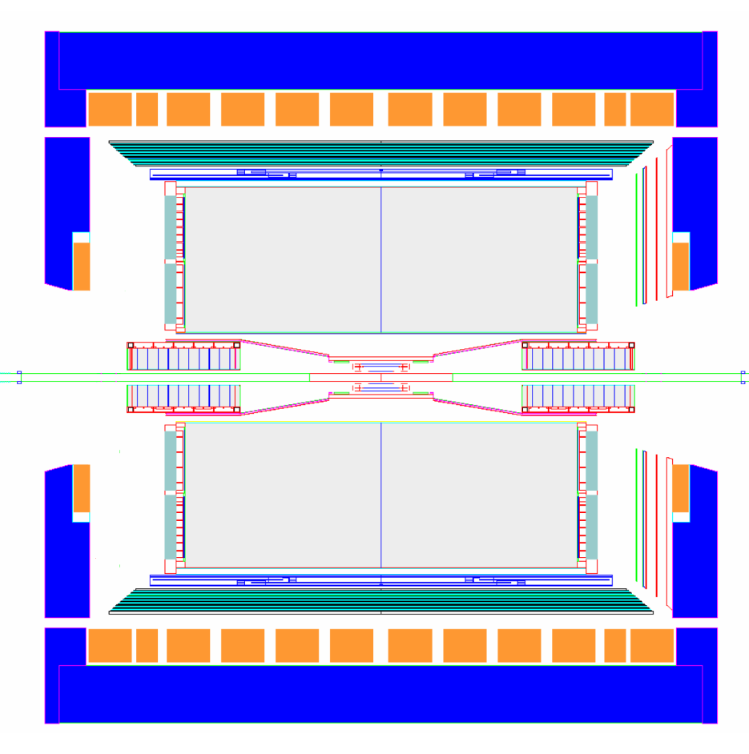
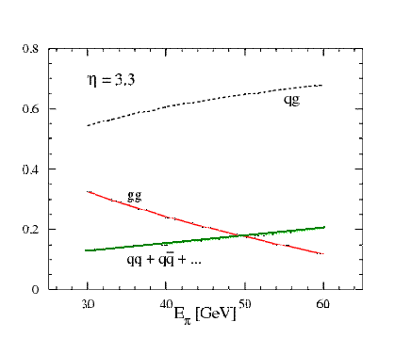
One Scenario for a STAR forward upgrade
proton
nucleus
~ 6 GEM disks
Tracking: 2.5 < η < 4
FMS
Transverse spin effect dominated by valence quarks accessed in forward direction
Forward instrumentation optimized for p+A and transverse spin physics
  Charged Tracking upgrade covering FMS will enable di-hadron measurements and jet measurements
  Star decadal plans calls additionally for PID (e.g. RICH) and pi0/gamma separation (preshower)

Slide 33
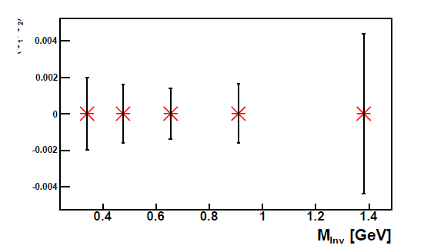
Projections for Belle Measurements of IFF Channel: (π⁺π⁰) (π⁺π⁰) relevant for p+p
Errors one order of magnitude smaller than average asymmetry in (π⁺π⁻)
a₁₂
Hadron pair in second hemisphere:
0.77 GeV <M_{inv}< 1.2 GeV
0.002
0
-0.002
-0.004
(580 fb⁻¹ integrated luminosity)
Notes:
33

Slide 34
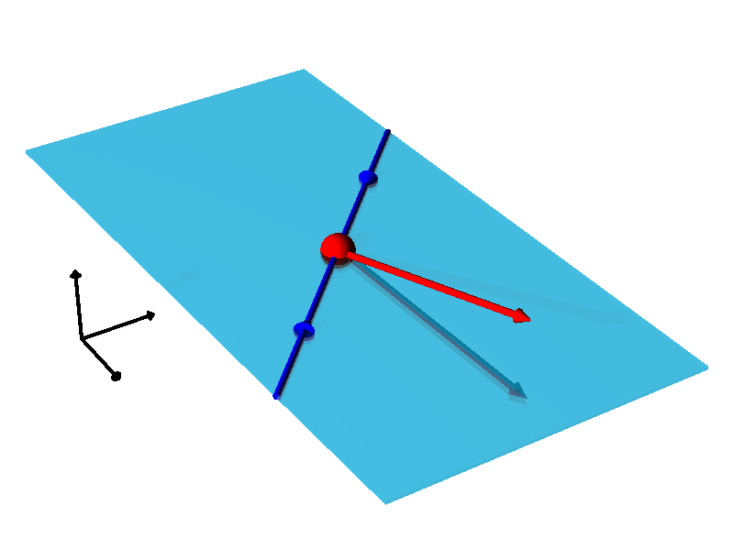
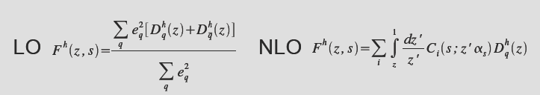
Unpolarized Fragmentation functions
Process:
e⁺ e⁻→hX
At leading order sum of unpolarized fragmentation functions from quark and anti-quark side
e⁻
h
e⁺

Slide 35
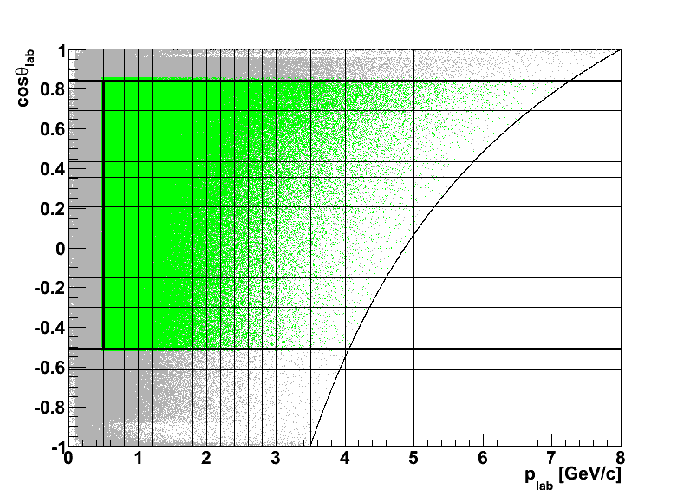
Unpolarized Fragmentation Functions at
Precision Measurement of unpolarized FFs important for almost all extractions of PDFs
But this is a hard measurement, at Belle
  Extensive systematic studies for PID effects: calibration & deconvolution/ correction
  further corrections for momentum smearing, acceptance effects, ….
PID correction:
~
^
^
~
PID correction by inversion
of PID probability matrix.
Nj = P Ni
Ni = P⁻¹ Nj :
p_{lab} > 0.5 GeV/c
ToF forward geometry acceptance limit
filling matrix of PID probabilities for each single bin from real data calibration
p( e -> e)
~
p( µ -> e)
~
p( π -> e )
~
p( K -> e )
~
p( p -> e )
~
p( µ -> µ)
~
p( π -> µ )
~
p( K -> µ )
~
p( p -> µ )
p( e -> µ)
~
[P]ij _{(plab, cosθlab)} =
~
p( µ -> π)
~
~
p( π -> π )
p( K -> π )
p( p -> π )
p( e -> π)
~
~
~
p( µ -> K)
~
~
p( π -> K )
p( K -> K )
p( p -> K )
p( e -> K)
~
~
~
p( µ -> p)
~
~
~
p( e -> p)
~
p( π -> p )
p( K -> p )
p( p -> p )
~
pion w z = 1.0
ToF backward geometry acceptance limit
scatter plot: e, μ, π, K and p tracks from 4e+05 events

Slide 36
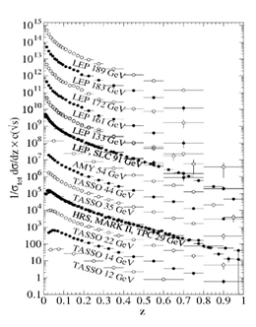
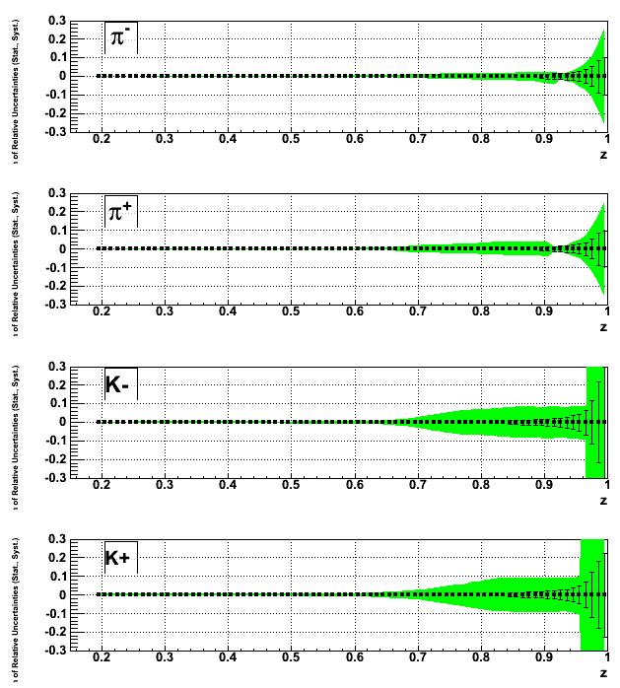
Projections: Unpolarized Fragmentation Functions-
Measurement will give precision data set for low Q² and high z:
Projected relative statistical and systematic uncertainties
e+e- -> h+- X data
In the future: include k_t dependence and measure di-hadron FFs
needed for transversity extraction from di-hadron correlations

Slide 37
Summary and Outlook
Interference Fragmentation can be used to measure transversity in di-hadron correlations in p+p
  First Belle and PHENIX results
  More measurements at STAR, Belle and PHENIX planned
  Relatively easy measurement in proton-proton collisions
  Access high x, z necessary to extract tensor charge
In SIDIS transversity can be accessed in an independent way and in the collinear framework
  COMPASS and HERMES results
  First extraction of transversity in collinear framework
Theory Calculations for pi⁰/pi^{+/-} and p+p underway
Measurement of pi⁰/pi^{+/-} at Belle and Phenix/STAR
Jlab with 12 GeV upgrade plans to measure IFF
Belle plans to measure related quantities:
  Collins Asymmetries for vector mesons
  Collins Asymmetries for Kaons
  di-hadron unpolarized FF: e.g. needed for denominator
  P-odd fragmentation functions
  Lambda FFs
  …
Unpolarized Fragmentation Function Measurement at Belle near completion
Unpolarized and Collins FF measurements at BaBar: Isabella Garzia (next talk)

Slide 38
Belle Fragmentation activity
 | RIKEN/RBRC | Illinois | Indiana | Titech
Unpol FFs e⁺e⁻→hX: e⁺e⁻→(hh)X, (h)(h)X,hhX: Unpol k_{T} dependence: | Neutral hadrons: (π⁰ ,η⁰) John Koster Charged di-hadrons: Ralf Seidl | Charged hadrons (π,K,P): Martin Leitgab Martin Leitgab
Collins FFs e⁺e⁻→(h)(h)X: k_{T} dependence: | ππ⁰ : John Koster πρ⁰: Ralf Seidl ππ: Ralf Seidl ππ⁰ : John Koster | πK,KK: Francesca Giordano Francesca Giordano | πρ±: ?
Interference FF: e⁺e⁻→(hh)(hh)X | Charged ππ : Ralf Seidl |  | Charged ππ: Anselm Vossen ππ⁰ : Anselm Vossen | Charged πK, KK: Nori-aki Kobayashi
Local P : (polFF,SSA) : Jet-jet asy: |  |  | Anselm Vossen
Black: about to start
Green: ongoing
Grey: finished

Slide 39

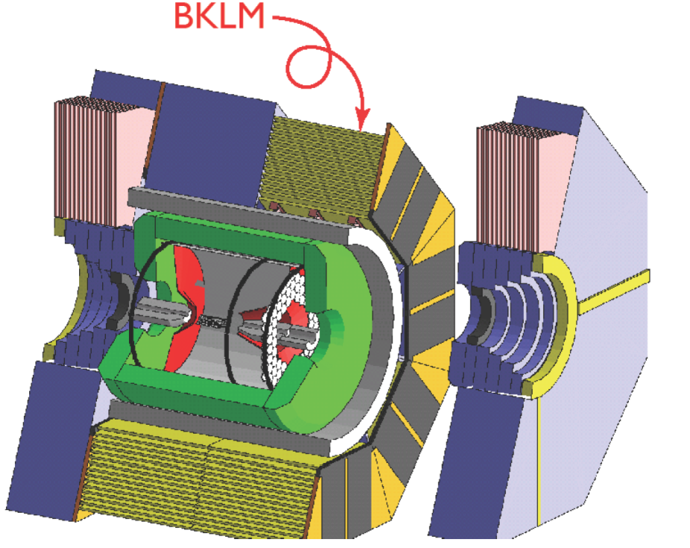
Upgrade to
Belle II is a significant upgrade to Belle and will sample 2 orders of magnitude higher luminosity
High precision data will enable measurement of
  P-odd FFs
  Transverse momentum dependent FFs
  Charm suppression possible
IU develops FEE for Barrel KLM detector crucial for high precision FF measurement of identified particles

Slide 40


Slide 41
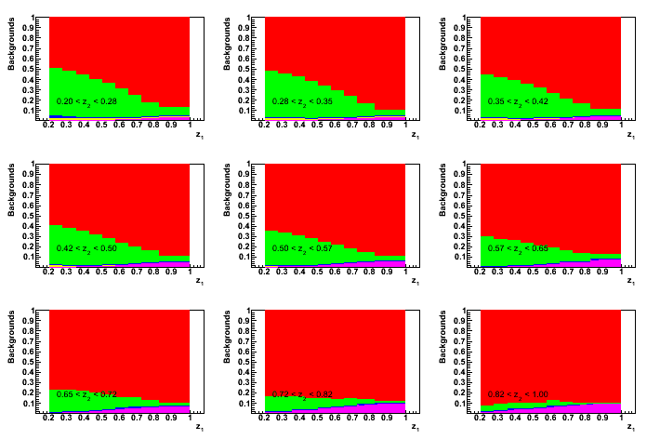
Subprocess contributions (MC)
9x9 z₁ z₂ binning
tau contribution (only significant at high z)
charged B(<5%, mostly at higher mass)
Neutral B (<2%)
charm( 20-60%, mostly at lower z)
uds (main contribution)

Slide 42
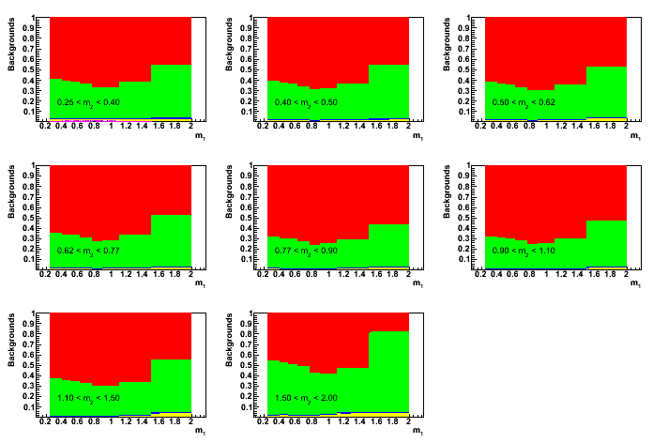
Subprocess contributions (MC)
Data not corrected for
Charm contributions
8x8 m₁ m₂ binning
charged B(<5%, mostly at higher mass)
Neutral B (<2%)
charm( 20-60%, mostly at highest masses)
uds (main contribution)
Charm Asymmetries in simulated data consistent with zero!
To be checked with charm enhanced sample
42

Slide 43
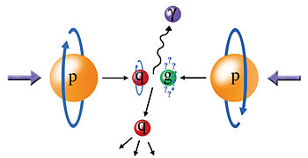

Combined Analysis:
Extract Transversity Distributions
?
e⁺e⁻
~ CFF(z₁) x CFF(z₂)
~ IFF(z₁) x IFF(z₂)
Factorization
+
Evolution
SIDIS
~ δq(x) x CFF(z)
~ δq(x) x IFF(z)
Transversity, δq(x)
Tensor Charge
pp → jets
~ G(x₁) x δq(x₂) x CFF(z)
pp → h⁺ + h⁻ + X
~ G(x₁) x δq(x₂) x IFF(z)
pp → l⁺ + l⁻ + X
~ δq(x₁) x δq(x₂)
Theory
Lattice QCD: Tensor Charge
Notes:
43

Slide 44


Transversity properties
Helicity flip amplitude
Chiral odd
Since all interactions conserve chirality one needs another chiral odd object
Does not couple to gluons adifferent QCD evolution than Δq(x)
Valence dominateda Comparable to Lattice calculations, especially tensor charge
Positivity bound:
Soffer bound:

Slide 45

Zero tests: MC
No opening cut
Opening cut>0.7
Opening cut >0.8
A small asymmetry seen due to acceptance effect
Mostly appearing at boundary of acceptance
Opening cut in CMS of 0.8 (~37 degrees) reduces acceptance effect to the sub-per-mille level
P_{h}
45

Slide 46


Slide 47

Results incl. sys. errors: (z₁x z₂) Binning

Slide 48

(m₁x m₂) Binning

Slide 49


Transversity dq(x)
Transverse spin information at leading twist
Measure dq X Interference Fragmentation functions
Transversity extraction will become possible with Interference Fragmentation Function - BELLE has shown first observation of IFF asymmetries
Exploring analysis with hadrons in forward region

Slide 50


Comparison to Theory Predictions
Initial model description by Bacchetta,Checcopieri, Mukherjee, Radici : Phys.Rev.D79:034029,2009.
Leading order,
Mass dependence : Magnitude at low masses comparable, high masses significantly larger (some contribution possibly from charm )
Z dependence : Rising behavior steeper
However: Theory contains parameters based on HERMES data which already fail to explain COMPASS well

Slide 51
Transversity from di-Hadron SSA
Physics asymmetry
Unpolarized
quark distribution
Known from DIS
Hard scattering
cross section
from pQCD
Transversity
to be extracted
IFF + Di-hadron FF
measured in e+e-

Slide 54

QED, QCD Preserve Helicity
QED and QCD interactions (and SM weak interactions) conserve helicity:
Cannot measure h₁ inclusively
γ
γ
_
+
_
+
Helicity base: chiral odd
Need chiral odd partner => Fragmentation function

Slide 55
Collins Extraction of Transversity: model dependence from Transverse Momentum Dependences!
transversity
Collins FF
quark pdf
hadron FF
k┴ transverse quark momentum in nucleon
p┴ transverse hadron momentum in fragmentation
Anselmino, Boglione, D’Alesio,
Kotzinian, Murgia, Prokudin, Turk
Phys. Rev. D75:05032,2007
The transversse momentum dependencies are unknown and
difficult to obtain experimentally!

Slide 56

Why is transversity so difficult to measure?
Chiral odd: Inclusive asymmetries suppressed
  Cannot be measured inclusively
  Instead: Use semi inclusive asymmetries
  Measure transverse polarisation of fragmenting quarks
–
Alexei Prokudin, DIS2008, update of Anselmino et al: hep-ex 0701006

Slide 57

Measuring Light Quark Fragmentation Functions on the ϒ(4S) Resonance
e⁺e⁻→qq̅, q∈uds
4s
“off”
e⁺e⁻→cc̅
small B contribution (<1%) in high thrust sample
>75% of X-section continuum under
ϒ (4S) resonance
73 fb⁻¹ ➔ 662 fb⁻¹
0.5 0.8 1.0
57
Notes:
57

Slide 58

Zero tests: Mixed Events
False Asymmetries consistent with zero

Slide 59
Positivity and soffer bound

Slide 60

Interference Fragmentation–thrust method
ϕ₂−π
e⁺e⁻➔ (π⁺π⁻)_{jet1}(π⁻π⁺)_{jet2}X
Find pion pairs in opposite hemispheres
Theoretical guidance by papers of Boer,Jakob,Radici[PRD 67,(2003)] and Artru,Collins[ZPhysC69(1996)]
Early work by Collins, Heppelmann, Ladinsky [NPB420(1994)]
transverse spin projection
θ
π−ϕ₁
Model predictions by:
Jaffe et al. [PRL 80,(1998)]
Radici et al. [PRD 65, (2002)]
60
Notes:
60

Slide 61
Definition of Vectors and Angles
Bacchetta and Radici, PRD70, 094032 (2004)

Slide 62


2. Unpolarized Fragmentation Functions-
Current Extractions
62/ 15
NLO pQCD fits of e⁺e⁻ annihilation, SIDIS and pp data with uncertainties (global analysis): de Florian, Sassot, Stratmann (DSS), Phys. Rev. D 75,114010 (2007)
Little constraint on gluon fragmentation functions- remedied by precision measurement at low Q²

