Slide 1
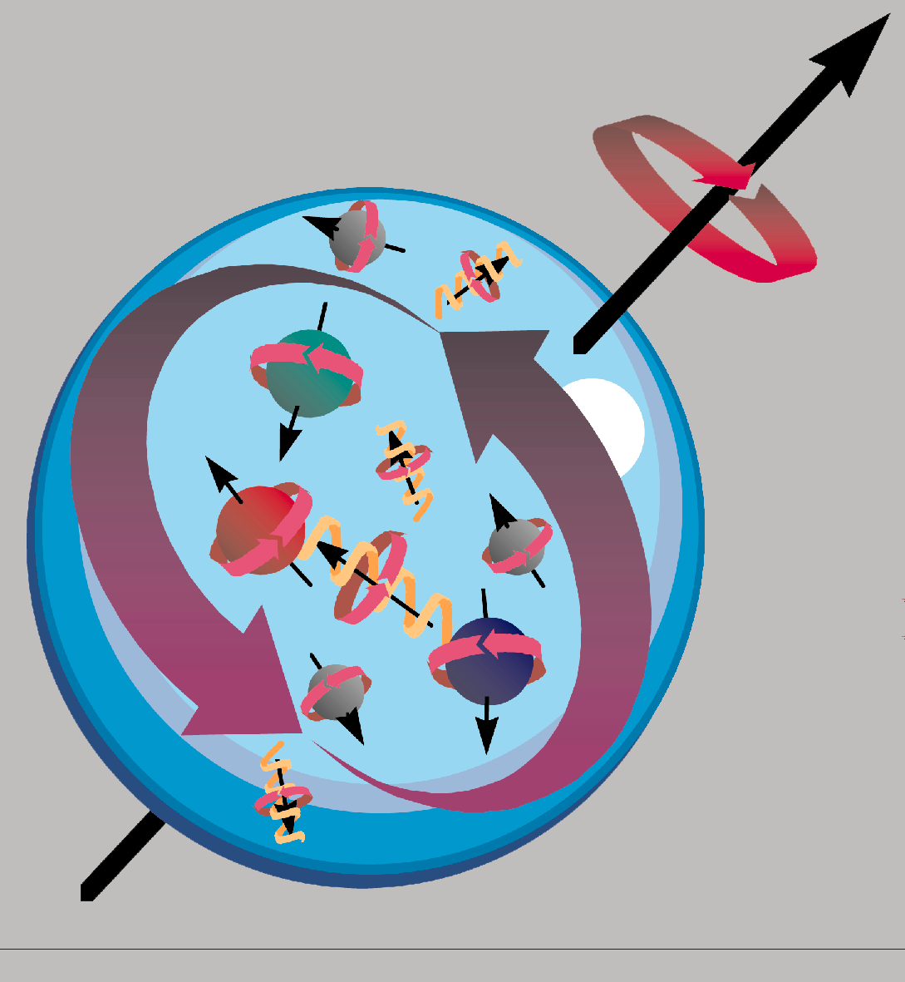

Delia Hasch
DVCS & hard exclusive meson prod.
-- experimental review --
a very brief introduction
prerequisites and methods
from low to high x : selected results
perspectives
all details tomorrow:
F. X. Girod
S. Yaschenko
N. D’Hose
V. Burkert
TRANSVERSITY 2011, Losinj, Croazia, Aug 29 - Sep 02, 2011

Slide 2
[slide by L. Pappalardo]

Slide 3
3D imaging of the nucleon & OAM
Wigner distribution (‘mother function’):
C. Lorce [tomorrow]
W(x,r,k_{T})
FT
TMD (x,k_{T})
spin-orbit
correlations
GPD(x, ξ,t)
2+1D imaging;
access to OAM
→ (model dependent) relations between TMDs & GPDs:
[Burkardt 2002]
[Burkardt, Hwang 2003]
[Diehl, Haegeler 2005]
ecc.

Slide 4

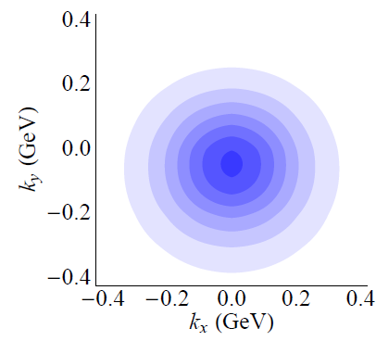
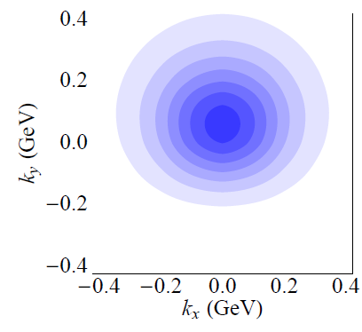
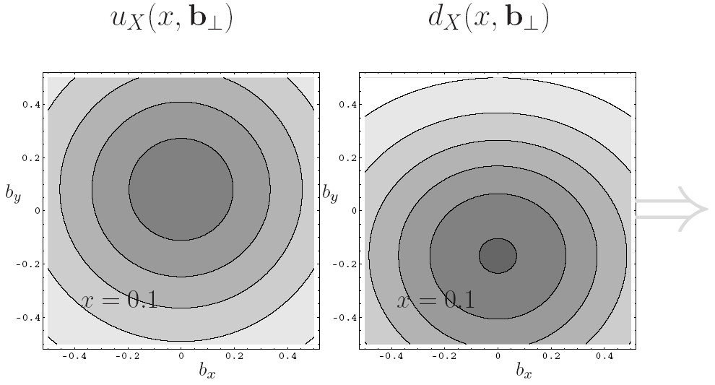
nucleon tomography
[transversely polarised nucleon]
TMDs GPDs
[model calculation by B. Pasquini, F. Yuan]
[model calculation by M. Burkardt]
Sivers TMD
--in transverse momentum coordinates--
← model dependent relation →
GPD E
--in impact parameter coordinates--

Slide 5
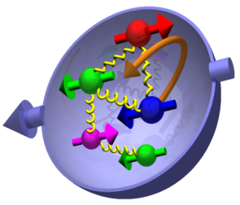
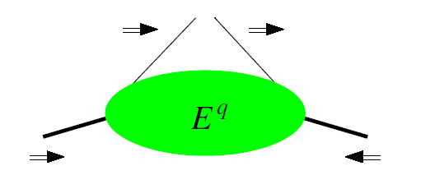
relations to OAM
GPDs TMDs
[plot: courtesy B. Musch]
ΔL=1
proton helicity flipped while quark helicity is conserved
requires orbital angular momentum
ΔL=1
ΔL=2
require interference of nucleon wave fct.s with different units OAM
→ spin-orbit correlation

Slide 6
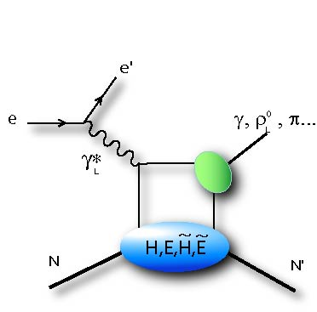
how to measure GPDs ?
Q²
Q²>>, t<<
appear in factorisation theorem for hard exclusive processes
t

Slide 7
how to measure GPDs ?
Q²
Q²>>, t<<
appear in factorisation theorem for hard exclusive processes
t
spin ½ target:
4 leading-tw, chiral even q & g GPDs: H, H conserve nucleon helicity
E, E involve nucleon helicity flip
+ 4 chiral odd GPDs → connection to transversity
~
~

Slide 8
how to measure GPDs ?
Q²
Q²>>, t<<
appear in factorisation theorem for hard exclusive processes
t
DVCS: most clean process, (some) flavour dependent info from p & n target
~
~
→ H, H, E, E

Slide 9
how to measure GPDs ?
Q²
Q²>>, t<<
appear in factorisation theorem for hard exclusive processes
t
DVCS: most clean process, (some) flavour dependent info from p & n target
~
~
→ H, H, E, E
DVMP: flavour decomposition; gluons:
VM → H, E
~
~
PS → H, E

Slide 10
how to measure GPDs ?
Q²
Q²>>, t<<
appear in factorisation theorem for hard exclusive processes
t
DVCS: most clean process, (some) flavour dependent info from p & n target
~
~
→ H, H, E, E
DVMP: flavour decomposition; gluons:
VM → H, E
factorisation only for σ_{L}
meson distribution amplitude needed
large NLO & power corrections
~
~
PS → H, E
BUT:

Slide 11
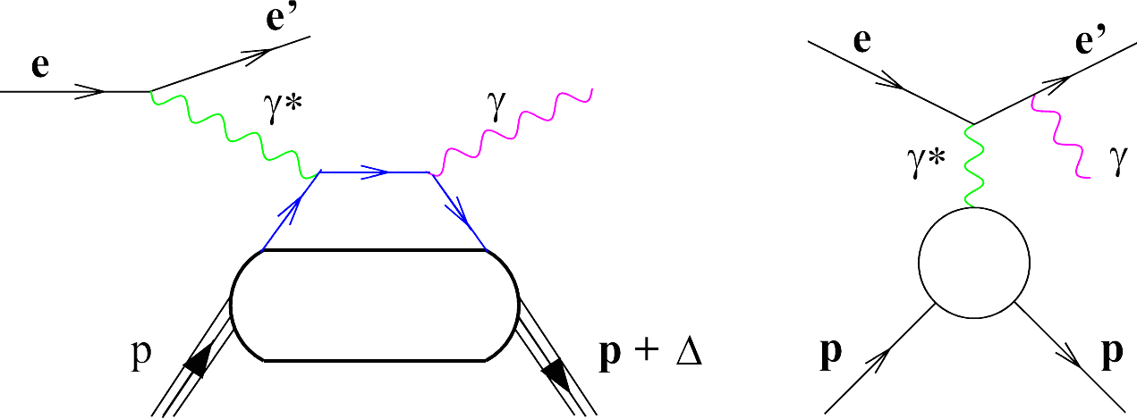
Deeply virtual Compton Scattering
DVCS Bethe-Heitler

Slide 12
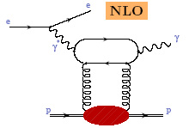
Deeply virtual Compton Scattering
DVCS Bethe-Heitler
@H1&Zeus
DVCS ≈ Bethe-Heitler
→ bilinear in GPDs
LO sea quarks + NLO gluons

Slide 13
Deeply virtual Compton Scattering
DVCS Bethe-Heitler
@H1&ZEUS
DVCS ≈ Bethe-Heitler
@HERMES / JLab
DVCS << Bethe-Heitler
→ bilinear in GPDs
→ linear in GPDs

Slide 14
how to measure GPDs ?
Q²
Q²>>, t<<
appear in factorisation theorem for hard exclusive processes
t
DVCS: most clean process, (some) flavour dependent info from p & n targets
DVMP: flavour decomposition; gluons
BUT:
ρ⁰ | 2u+d, 9g/4
ω | 2u−d, 3g/4
φ | s, g
ρ⁺ | u−d
J/ψ | g
factorisation only for σ_{L}
meson distribution amplitude needed
large NLO & power corrections

Slide 15
constraints of GPDs
Q²
Q²>>, t<<
appear in factorisation theorem for hard exclusive processes
PDFs :
form factors:
t
... ecc.
nucleon helicity flip → don’t appear in DIS
+ Lorentz invariance: polynomiality
+ lattice calculations

Slide 16
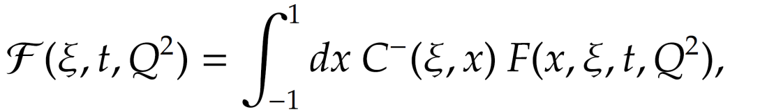
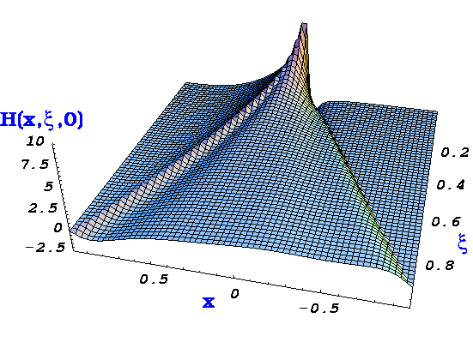
extracting GPDs: caveats
Compton Form Factor (CFF)
x is mute variable (integrated over), needs deconvolution
→ apart from ‘cross over’ trajectory (x=±ξ) GPDs not directly accessible
extrapolation t → 0 model dependent
cross section & beam charge asymmetry ~ Re(T^{DVCS})
beam or target spin asymmetries ~ Im(T^{DVCS})
→ x scan of GPDs from Q² evolution: EIC

Slide 17
the ideal experiment for measuring hard exclusive processes
Q²>>, t<<
high & variable beam energy
Q²
ensure hard regime
wide kinematic range
L/T separation for ps meson prod.
high luminosity
small cross sections
fully differential analysis
t
hermetic detectors
ensure exclusivity
… doesn’t exist (yet)…

Slide 18
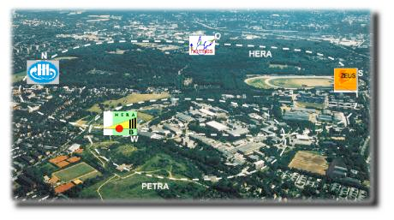



experimental prerequisites
polarised 27GeV e+/e−
unpolarised 920GeV p
HERA till 2007
≈full event reconstruction
polarised 27GeV e+/e−
long+transv polarised p, d targets unpolarised nuclear targets
missing mass technique
2006/7 data taken with recoil det.

Slide 19
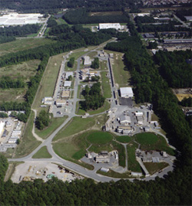
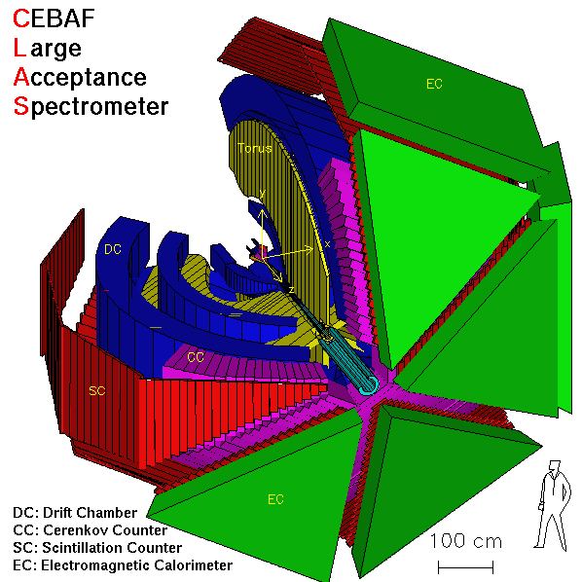
experimental prerequisites
polarised 27GeV e+/e−
unpolarised 920GeV p
HERA till 2007
≈full event reconstruction
polarised 27GeV e+/e−
long+transv polarised p, d targets unpolarised nuclear targets
CEBAF
missing mass/energie technique
2006/7 data taken with recoil det.
highly polarised, high lumi 6GeV e−
long polarised effective p, n targets
missing mass/energie technique
Hall-A

Slide 20
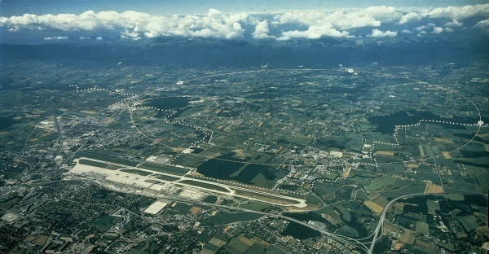

experimental prerequisites
polarised 27GeV e+/e−
unpolarised 920GeV p
HERA till 2007
≈full event reconstruction
polarised 27GeV e+/e−
long+transv polarised p, d targets unpolarised nuclear targets
CEBAF
missing mass/energie technique
2006/7 data taken with recoil det.
highly polarised, high lumi 6GeV e−
long polarised effective p, n targets
missing mass/energie technique
Hall-A
CERN
highly polarised, 160GeV μ
long+transv polarised effective p, d targets
→ COMPASS-II with recoil det.
missing mass/energie technique

Slide 21
low → high x
10⁻³
10⁻¹
0.2-0.5
x_{B}
HERA collider
HERMES / JLab
10⁻⁴ < x_{B} < 0.02
0.02 < x_{B} < 0.4 / 0.1 < x_{B} < 0.6
sea quarks & gluons
(gluons) (valence) quarks

Slide 22
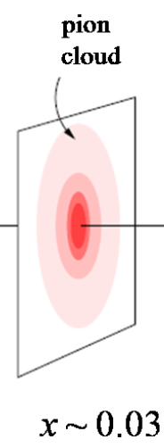
low → high x
10⁻³
10⁻¹
0.2-0.5
x_{B}
HERA collider
COMPASS
HERMES / JLab
10⁻⁴ < x_{B} < 0.02
0.02 < x_{B} < 0.4 / 0.1 < x_{B} < 0.6
sea quarks & gluons
(gluons) (valence) quarks

Slide 23
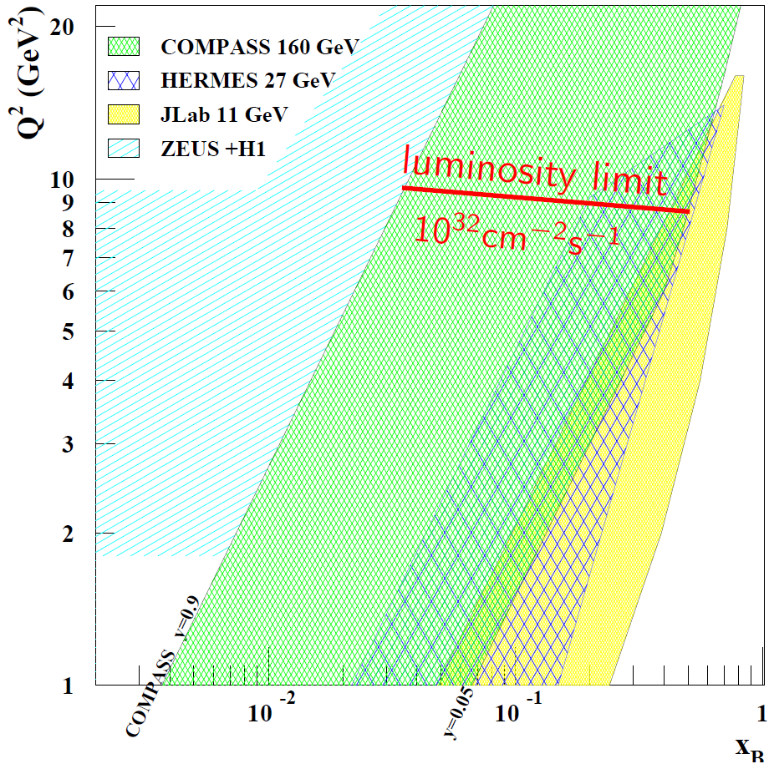
low → high x
10⁻³
10⁻¹
0.2-0.5
x_{B}
HERA collider
COMPASS
HERMES / JLab
10⁻⁴ < x_{B} < 0.02
0.02 < x_{B} < 0.4 / 0.1 < x_{B} < 0.6
sea quarks & gluons
(gluons) (valence) quarks

Slide 24
exclusivity
@ the HERA collider experiments
≈ hermetic detector
→ p escapes through beam pipe
LPS: p tagged control sample

Slide 25

exclusivity
@ the HERA collider experiments
LPS: p tagged data sample
e-sample: BH control sample
e+e-, J/ψ bg-sample
γ-sample: BH+DVCS
(BH+DVCS) - BH

Slide 26
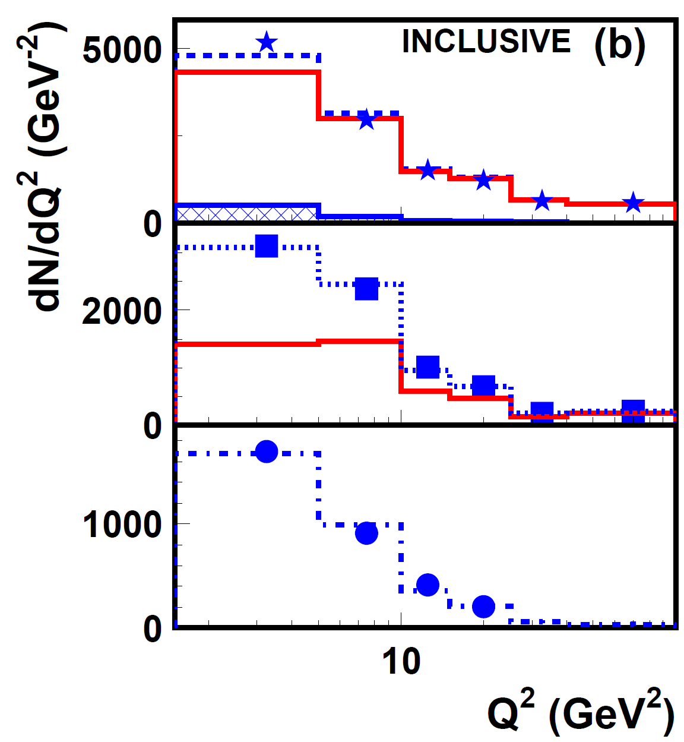
exclusivity
@ the HERA collider experiments
full data sample
e-sample: BH control sample
e+e-, J/ψ bg-sample
γ-sample: BH+DVCS
(BH+DVCS) - BH

Slide 27

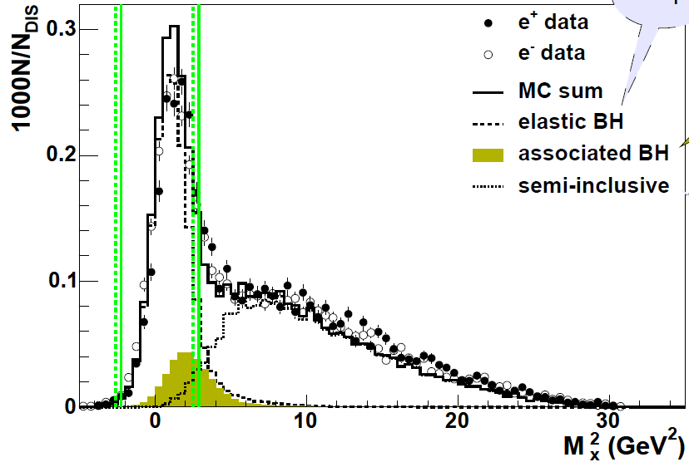
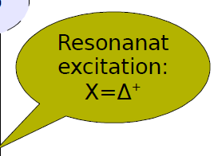
exclusivity
fixed target: via missing mass / energy
(ep → e’ γ X)
part of the signal
subtracted
very well understood

Slide 28
exclusivity
fixed target: via missing mass / energy
(ep → e’ γ X)
with p detection &
Δ⁺ ID: transition GPDs
talk by S. Yaschenko

Slide 29
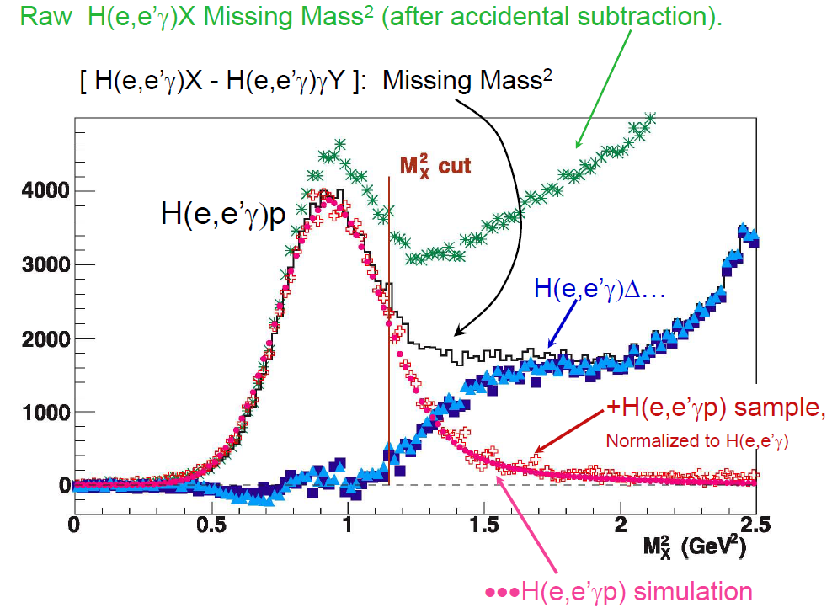
exclusivity
fixed target: via missing mass / energy
(ep → e’ γ X)
part of the signal
subtracted
very well understood
Hall-A

Slide 30
results on (off) the menu
data over wide kinematic range: HERA-collider → COMPASS → HERMES → JLab
VM production → H, E
low x: gluon imaging
high x: quarks & gluons ; role of NLO & power corrections
low W data from Jlab (→ X. Girod, tomorrow)
~ ~
ps meson production → H, E
role of transverse photons: CLAS π⁰,π⁺ A_{LU}, HERMES π⁺ A_{UT}, cross sec.
relation to transversity: H_{T} → h₁ from π⁰ A_{UT}
~ ~
DVCS → H, E, H, E ... the golden channel & most rich plate
nuclear modification of DVCS ampllitudes: HERMES
models & GPDs
hunting the OAM

Slide 31
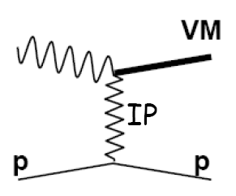
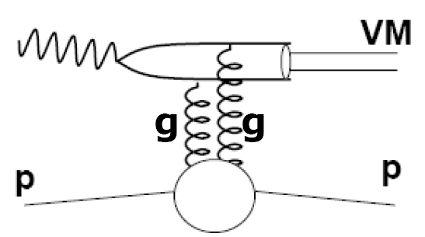
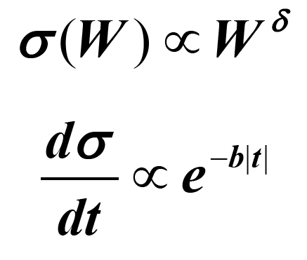
VM production @low x
W & t dependences: probe transition from soft to hard regime
soft hard
expect δ to increase from ~0.2 to ~0.8
b to decrease from ~10 to ~4-5 GeV²

Slide 32
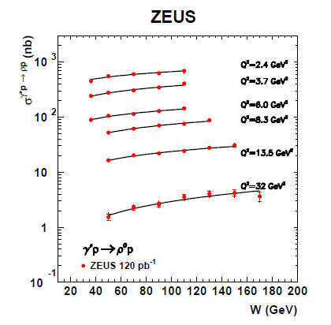
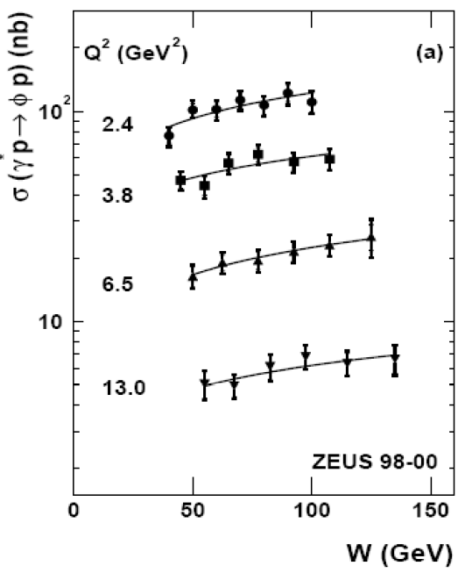
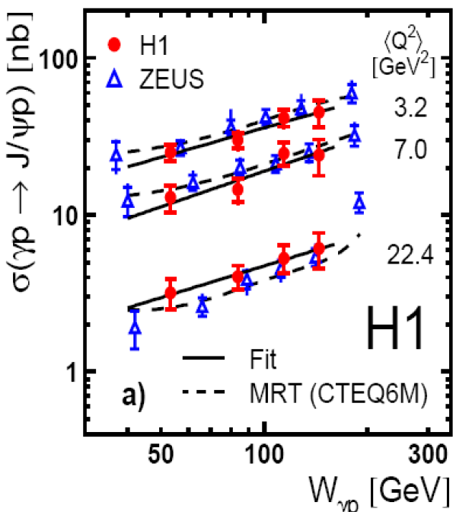
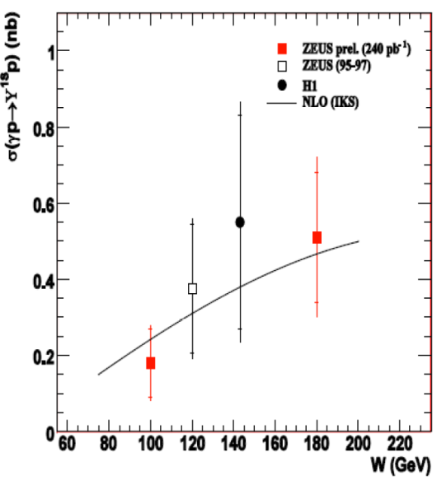
VM production @low x
W dependence: probe transition from soft to hard regime
ρ
φ
J/Ψ
Υ
two ways to set a hard scale:
large Q²
mass of produced VM
universality: ρ and φ at large Q²+M² similar to J/Ψ , Y

Slide 33
VM production @low x
t dependence: probe transition from soft to hard regime
ρ
φ
J/Ψ
Υ
σ ~ e^{−b|t|}
universality of b slope parameter
→ point like configurations dominate

Slide 34
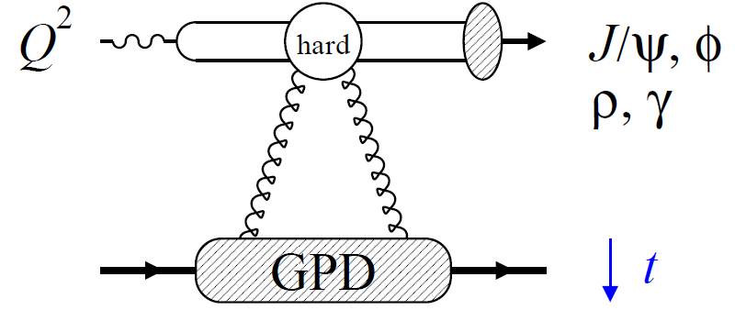
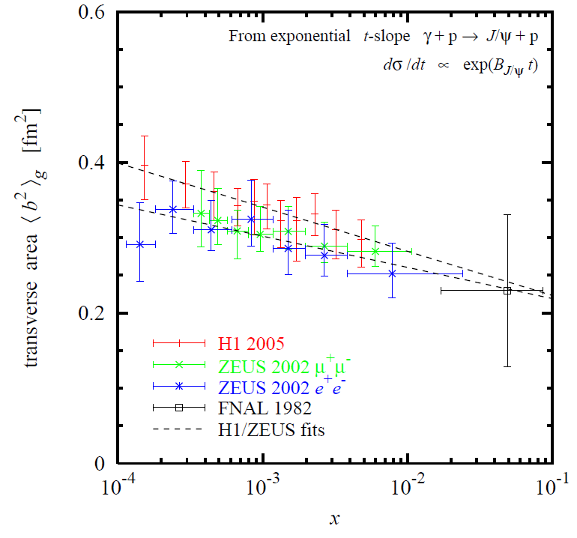

gluon imaging: J/ψ
[Frankfurt, Strikman, Weiss (2011)]
FT → average impact parameter

Slide 35
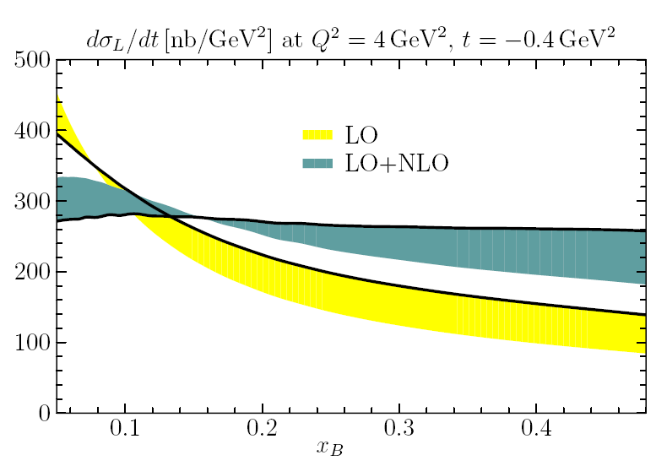
VM production from low → high x
10⁻³
10⁻¹
0.2-0.5
x_{B}
HERA-collider COMPASS / HERMES / Jlab
g+(sea) g+(sea)+q_{v} (ρ,ω) q_{v} (ρ,ω)
NLO corrections to VM production are large: [M. Diehl, W. Kugler (2007)]
ρ⁰ cross section @typical kinematics of COMPASS / HERMES / JLab12

Slide 36
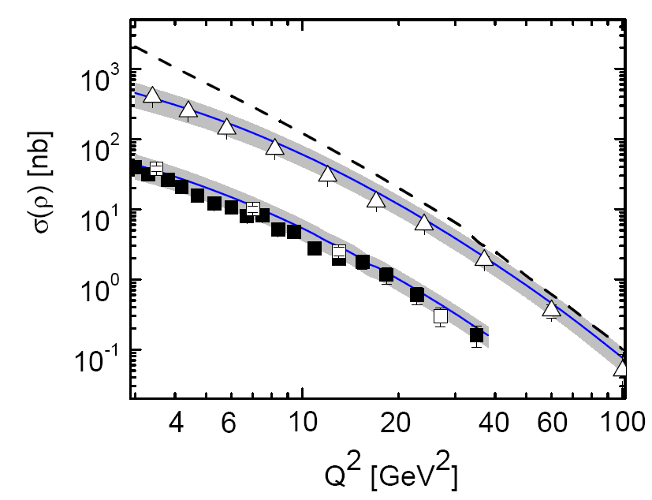
VM production from low → high x
10⁻³
10⁻¹
0.2-0.5
x_{B}
HERA-collider COMPASS / HERMES / Jlab
g+(sea) g+(sea)+q_{v} (ρ,ω) q_{v} (ρ,ω)
... despite, LO GPD model (handback fact.; DD ansatz): [S. Goloskokov, P. Kroll (2007, 2010)]
+ power corrections:
ρ⁰
W = 90 GeV
Zeus
H1
LO GPD
W = 75 GeV
+ power correction

Slide 37
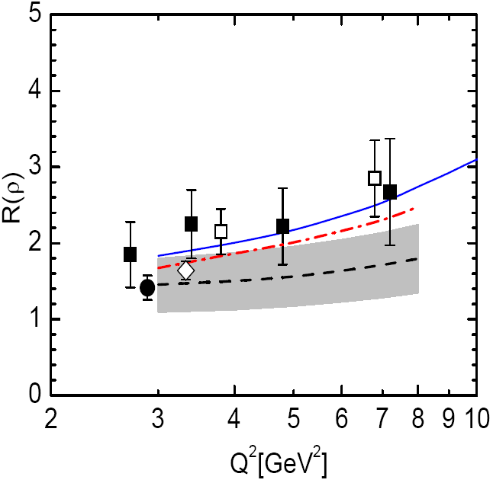
VM production from low → high x
10⁻³
10⁻¹
0.2-0.5
x_{B}
HERA-collider COMPASS / HERMES / Jlab
g+(sea) g+(sea)+q_{v} (ρ,ω) q_{v} (ρ,ω)
... despite, LO GPD model (handback fact.; DD ansatz): [S. Goloskokov, P. Kroll (2007, 2010)]
+ power corrections:
ρ⁰
Zeus
H1
Compass
Hermes
W = 90 GeV
W = 10 GeV
W = 5 GeV

Slide 38
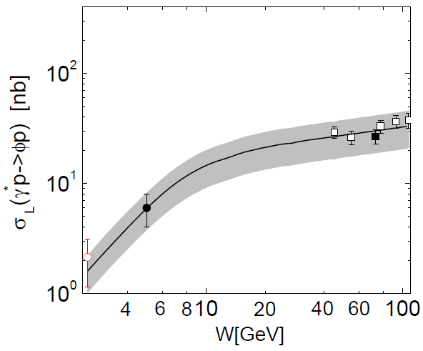
VM production from low → high x
10⁻³
10⁻¹
0.2-0.5
x_{B}
HERA-collider COMPASS / HERMES / Jlab
g+(sea) g+(sea)+q_{v} (ρ,ω) q_{v} (ρ,ω)
... despite, LO GPD model (handback fact.; DD ansatz): [S. Goloskokov, P. Kroll (2007, 2010)]
+ power corrections:
ρ⁰
Zeus
H1
H1, ZEUS
φ
Compass
Hermes
E665
HERMES
CLAS
W = 90 GeV
W = 10 GeV
W = 5 GeV
Q² = 3.8 GeV²

Slide 39
Deeply Virtual Compton Scattering
→
DVCS cross sections @ low x
t slope provides absolute normalisation
FT → average impact parameter

Slide 40
DVCS cross section
[PLB659(2008)]
t slope measurement provides absolute normalisation

Slide 41
DVCS cross section
[PLB659(2008)]
t slope measurement provides absolute normalisation
Zeus
(p’ tagged events)
[JHEP05(2009)]
universality of slope parameter: pointlike configurations dominate

Slide 42
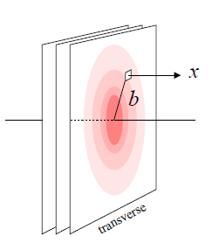
DVCS cross section
[PLB659(2008)]
t slope measurement provides absolute normalisation
Zeus
(p’ tagged events)
[JHEP05(2009)]
universality of slope parameter: pointlike configurations dominate
FT → average impact parameter
@ x_{B}=10⁻³
<Q²>=8.0 GeV²
@ x_{B}=10⁻³
[courtesy of C. Weiss]

Slide 43
sea quark & gluon imaging
→ remember J/ψ
universality of slope parameter: pointlike configurations dominate
FT → average impact parameter
@ x_{B}=10⁻³
<Q²>=8.0 GeV²
@ x_{B}=10⁻³
[courtesy of C. Weiss]

Slide 44

Hall-A
DVCS interference term
→ bilinear in GPDs → linear in GPDs

Slide 45
Hall-A
DVCS interference term
→ bilinear in GPDs → linear in GPDs
isolate interference term:
different beam charges: e⁺ e⁻ (only @HERA, upcoming @COMPASS)
polarisation observables
Δσ_{UT}
beam target
U, L U, L, T
Unpolarised, Longitudinally, Transversely polarised

Slide 46
Hall-A
DVCS interference term
→ bilinear in GPDs → linear in GPDs
isolate interference term:
different beam charges: e⁺ e⁻ (only @HERA, upcoming @COMPASS)
polarisation observables
Δσ_{UT}
Δσ_{C}, Δσ_{LU}
H
H
H, E
Δσ_{UL}
~
beam target
U, L U, L, T
Δσ_{UT}, Δσ_{LU}
_{neutron}
@kinematics of current fixed target exp.

Slide 47

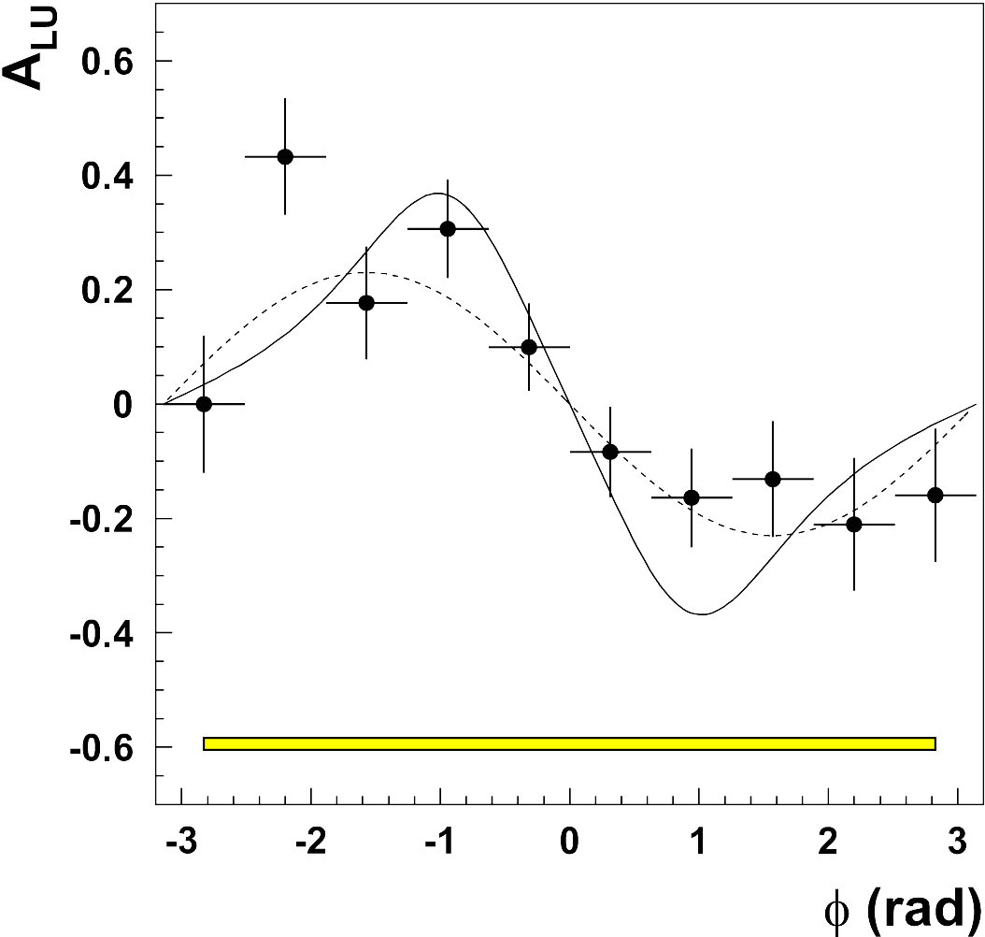
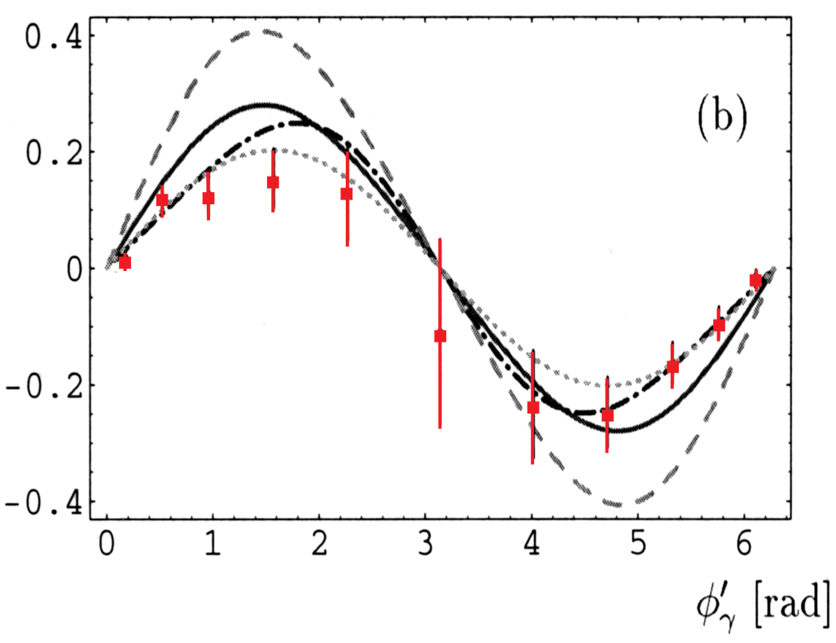
first DVCS signals
-- interference term --
[PRL87(2001)]
A_{LU}
→ sinφ dependence indicates dominance of handback contribution

Slide 48
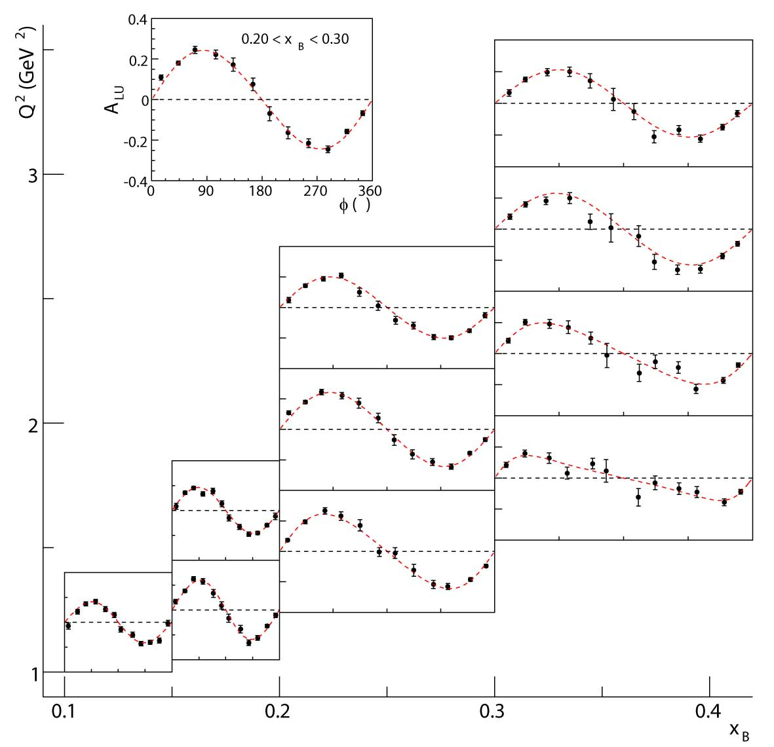
call for high statistics
JLab-e1: DVCS beam-spin asymmetry [PRL100(2008)]

Slide 49
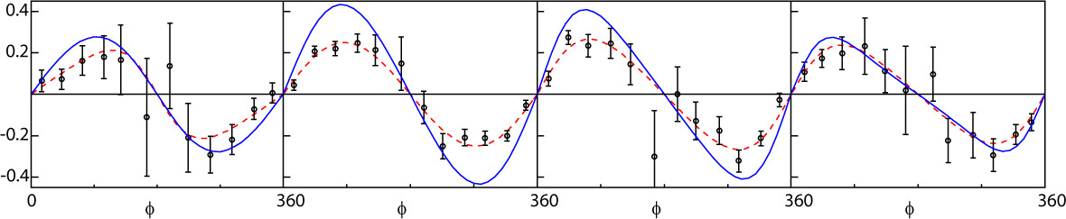
call for high statistics
JLab-e1: DVCS beam-spin asymmetry [PRL100(2008)]
3D analysis in x, Q², t
<-t> = 0.18 GeV²
<-t> = 0.30 GeV²
<-t> = 0.49 GeV²
<-t> = 0.76 GeV²

Slide 50
call for high statistics
JLab-e1: DVCS beam-spin asymmetry [PRL100(2008)]
Hall-A
... cross section from interference term
talk by X. Girod

Slide 51


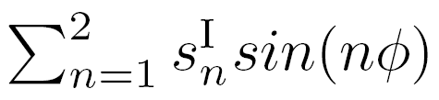
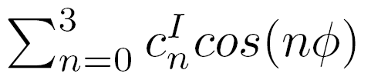
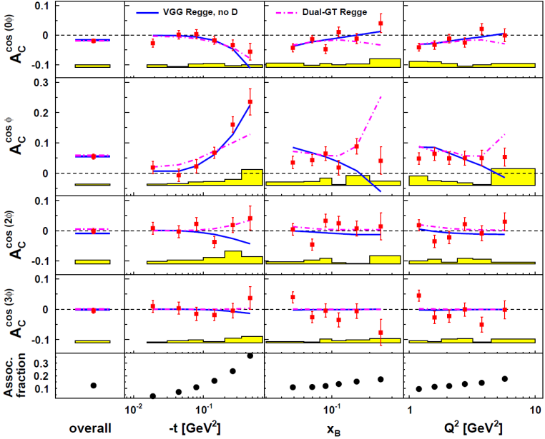
call for new analysis methods
combined analysis of charge & polarisation observables
→ separation of interference & DVCS² amplitudes

Slide 52
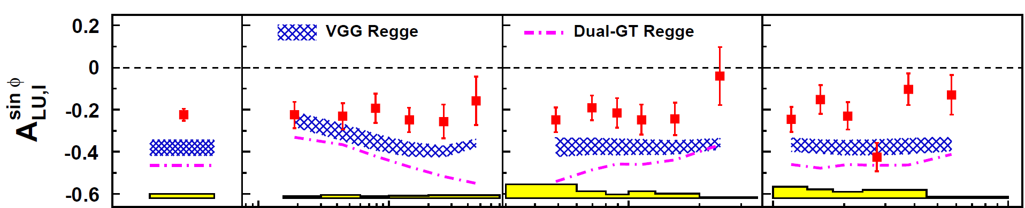
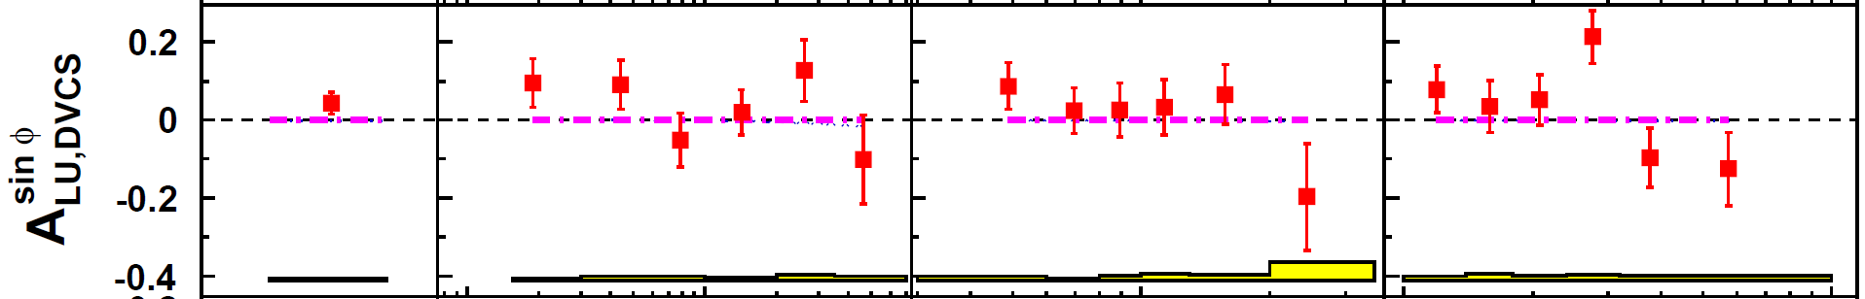
call for new analysis methods
combined analysis of charge & polarisation observables
→ separation of interference & DVCS² amplitudes
beam-spin asymmetry [JHEP11(2009)]
GPD models: DD [VGG(1999)]
minimal-dual [GT(2007)]
more, recent results
talk by S. Yaschenko

Slide 53

call for new analysis methods
combined analysis of charge & polarisation observables
→ separation of interference & DVCS² amplitudes
beam-charge asymmetry [JHEP11(2009)]
GPD models: DD, no D-term [VGG(1999)]
minimal-dual [GT(2007)]
more, recent results
talk by S. Yaschenko

Slide 54
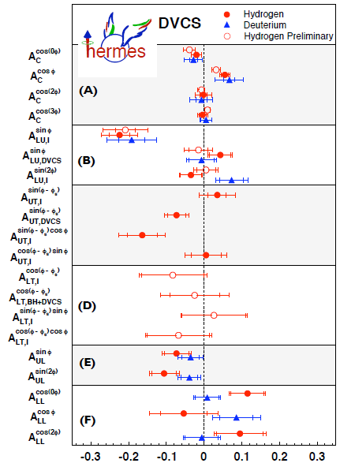
call for completeness
charge asymmetry
beam-spin asymmetry
transverse target spin asymmetry
transverse-target double-spin
longitudinal target spin asymm.
longitudinal-target double-spin
Re (H)
Im (H)
Im (H-E)
Re (H-E)
Im (H)
Re (H)
Hall-A
~
~

Slide 55
towards GPDs
recent developments (beyond VGG(1999)...)
Goloskokov, Kroll (2007):
→ LO GPD model using DD, regge t dep., power corrections
→ fit to exclusive meson production data

Slide 56
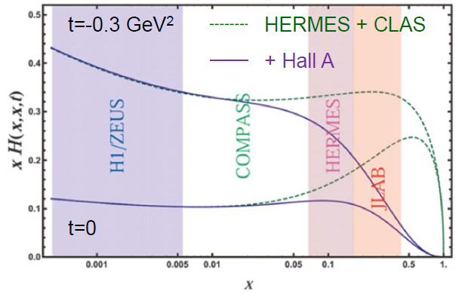
towards GPDs
recent developments (beyond VGG(1999)...)
Goloskokov, Kroll (2007):
→ LO GPD model using DD, regge t dep., power corrections
→ fit to exclusive meson production data
Kumericki, Müller (2010):
→ partial wave expansion of GPDs, regge t dep., dispersion relations
→ fit to DVCS data

Slide 57
towards GPDs
recent developments (beyond VGG(1999)...)
Goloskokov, Kroll (2007):
→ LO GPD model using DD, regge t dep., power corrections
→ fit to exclusive meson production data
Kumericki, Müller (2010):
→ partial wave expansion of GPDs, regge t dep., dispersion relations
→ fit to DVCS data
Goldstein, Hernandez,Liuti (2010):
→ quark-diquark model of GPDs, Regge ansatz for low x region & t dep.
→ fit to DVCS data
talk by S. Liuti [tomorrow]

Slide 58
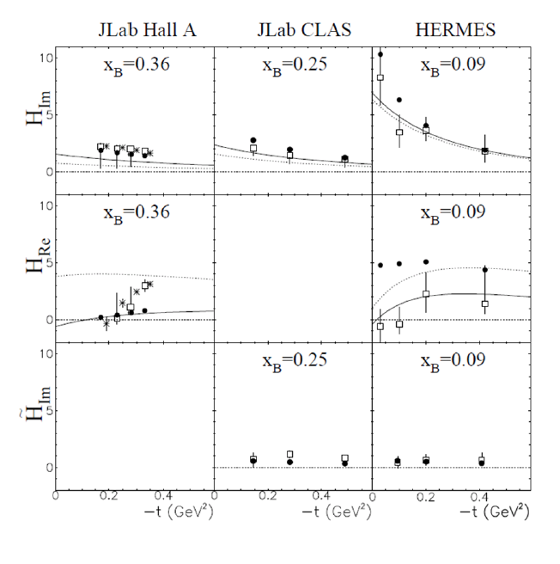
towards GPDs
recent developments (beyond VGG(1999)...)
Goloskokov, Kroll (2007):
→ LO GPD model using DD, reggezised t dep., power corrections
→ fit to exclusive meson production data
Kumericki, Müller (2010):
→ partial wave expansion of GPDs, reggezised t dep., dispersion relations
→ fit to DVCS data
Guidal 2011
Goldstein, Hernandez,Liuti (2010):
→ quark-diquark model of GPDs, Regge ansatz for low x region & t dep.
→ fit to DVCS data
VGG 1999
talk by S. Liuti [tomorrow]
Guidal (2011):
→ model independent extraction of CFF (GPD extr. requires model ansatz)
→ kinematic fitting of DVCS data (per experiment)

Slide 59
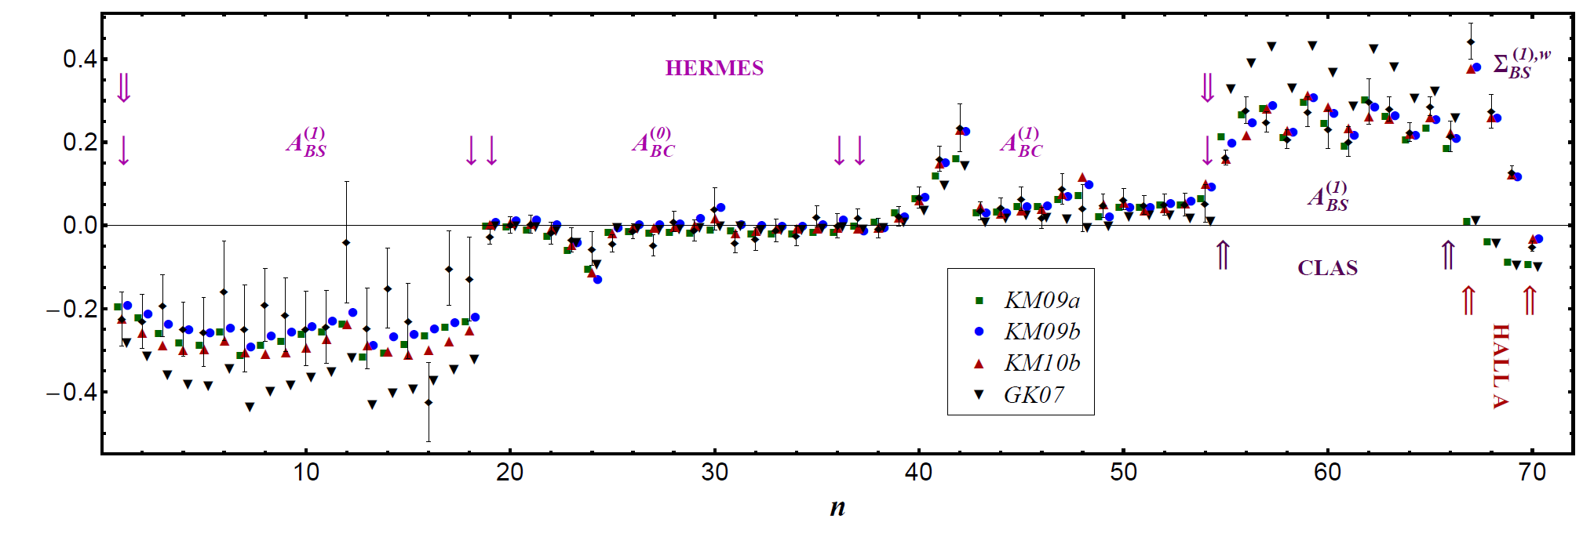
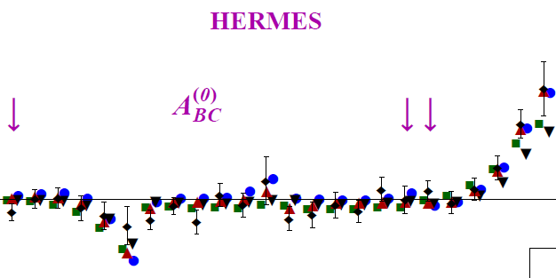
towards global analysis of GPDs
-- employ all available exclusive data (DVCS & meson production) --
GK (2007) comparison to KM09,10

Slide 60
hunting the OAM
attempts to constrain J^{q}
→ GPD models: J^{q} free parameter in ansatz for E
observables sensitive to E :
pDVCS: A_{UT} → HERMES
nDVCS: A_{LU} → HallA
meson prod. A_{UT}: ρ⁰ → HERMES, COMPASS
...also ω, φ, ρ⁺, K^{*0}

Slide 61

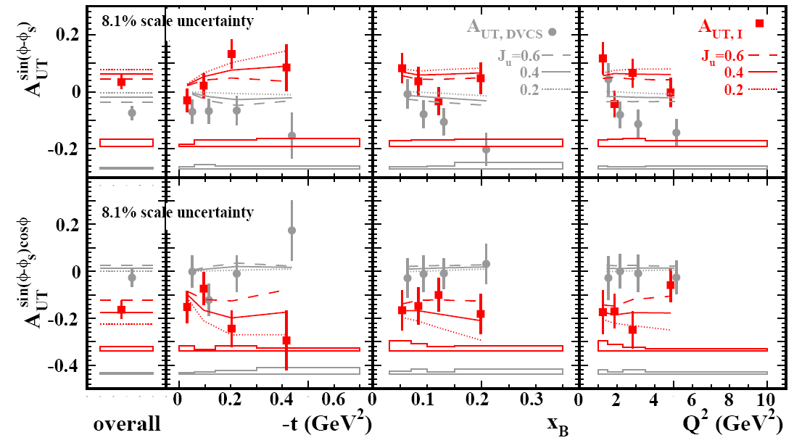
hunting the OAM
-- pDVCS : transverse target-spin asymmetry --
→ GPD models: J^{q} free parameter in ansatz for E
[JHEP06(2008)]
[VGG]

Slide 62

hunting the OAM
-- nDVCS : beam-spin cross section difference --
→ GPD models: J^{q} free parameter in ansatz for E
Hall-A

Slide 63
hunting the OAM
-- ρ⁰ : transverse target-spin asymmetry --
after the full glory of SDME extractions [formalism by M. Diehl (2007)]
[PLB679(2009)]
long.pol: 0
transv.pol: ±1

Slide 64
hunting the OAM
-- ρ⁰ : transverse target-spin asymmetry --
after the full glory of SDME extractions [formalism by M. Diehl (2007)]
[PLB679(2009)]
[GPD model:
Ellighaus et al. (2004)]
long.pol: 0
transv.pol: ±1
more data coming: COMPASS, JLab12 with transv. Target
more models: Goloskokov, Kroll

Slide 65
conclusions & perspectives
10⁻³
10⁻¹
0.2-0.5
x_{B}
HERA collider
COMPASS
HERMES / JLab
10⁻⁴ < x_{B} < 0.02
0.02 < x_{B} < 0.4 / 0.1 < x_{B} < 0.6
sea quarks & gluons
(gluons) (valence) quarks
increasing amount and precision of experimental data
progress in model calculations, plenty of room for more work...

Slide 66
conclusions & perspectives
10⁻³
10⁻¹
0.2-0.5
x_{B}
HERA collider
HERMES / JLab
JLab12GeV
Compass
EIC
increasing amount and precision of experimental data
progress in model calculations, plenty of room for more work...
bright future for GPD studies:
talks by V. Burkert, N. D’Hose, F. Maas
JLab12
COMPASS-II with recoil
EIC/ENC (mapping of GPDs from Q² evolution)

