Slide 1
X-Box Update
14.06.2023

Slide 2
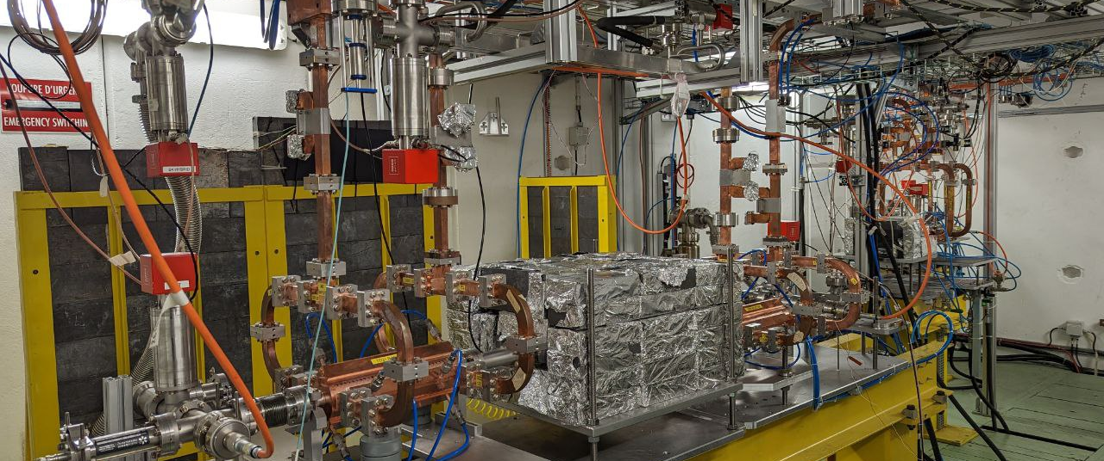
X-Box 2: TD31 N3 N4

Slide 3
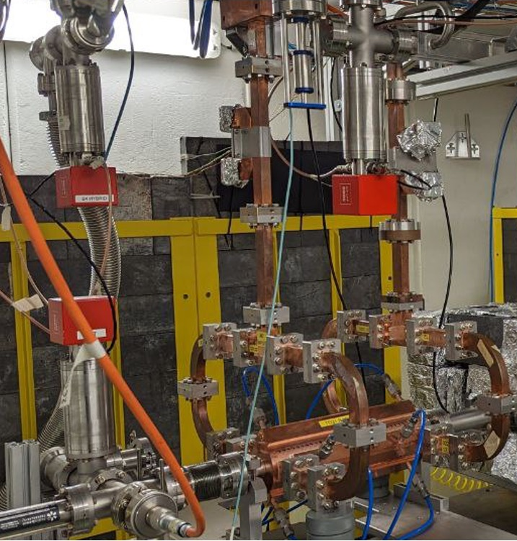
X-Box 2 TD31 N3 N4: Structure A
Restarted 05.06.2023
Currently up to 50MW

Slide 4
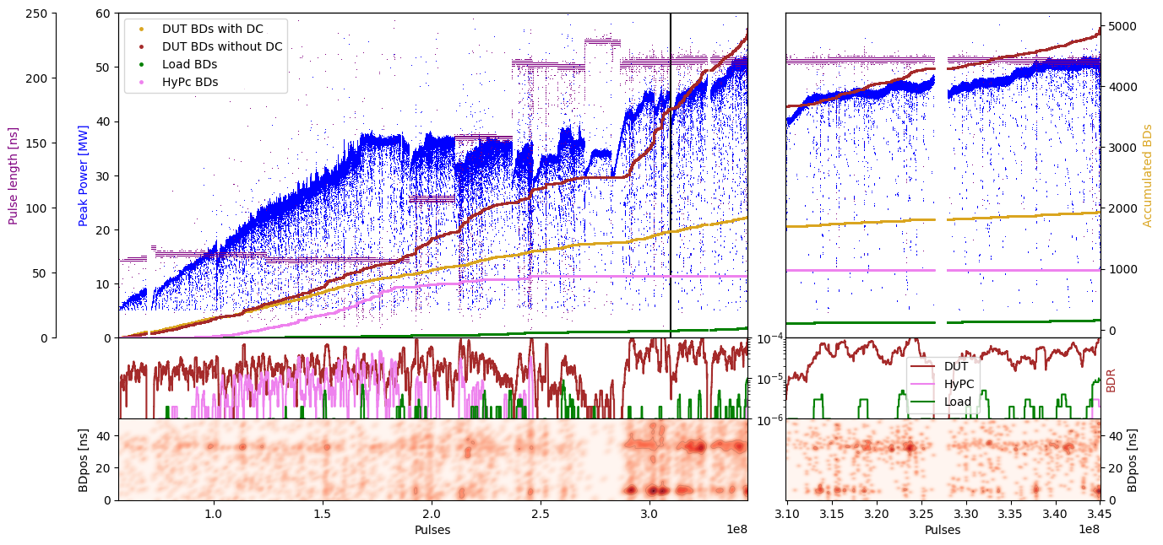
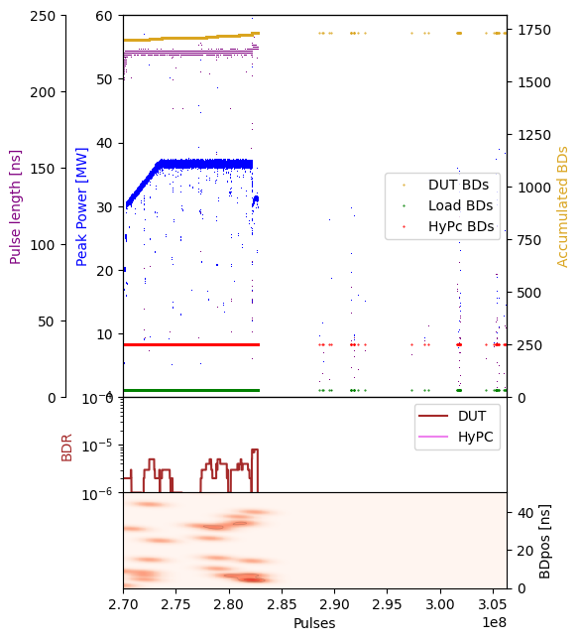
X-Box 2: TD31 N3 N4 Structure A – Peak Power

Slide 5
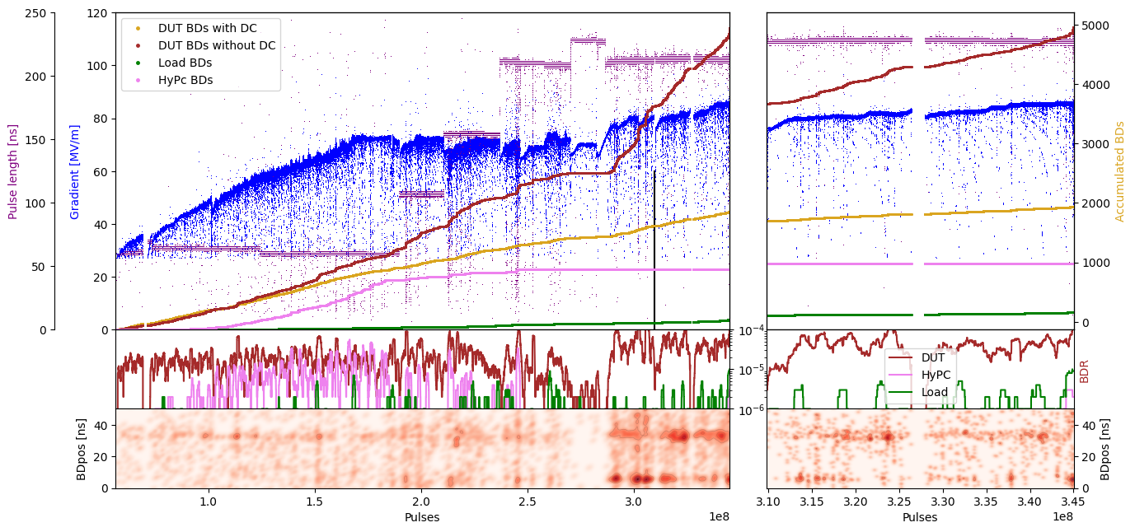
X-Box 2: TD31 N3 N4 Structure A – Gradient

Slide 6
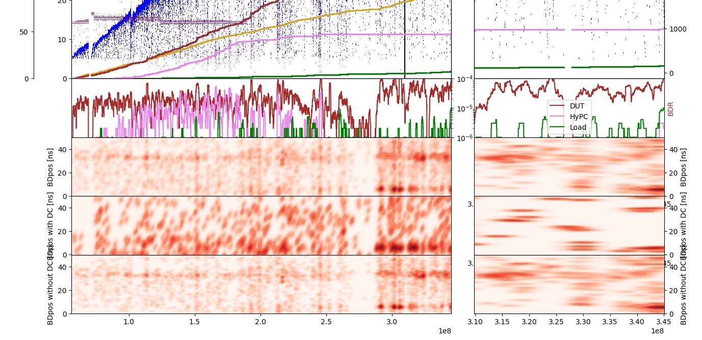
X-Box 2: TD31 N3 N4 Structure A – Pos

Slide 7
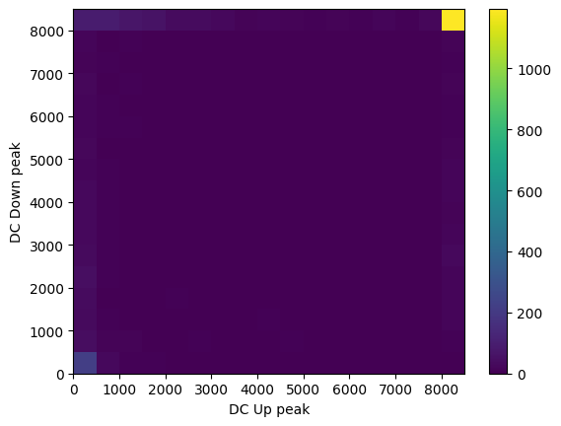
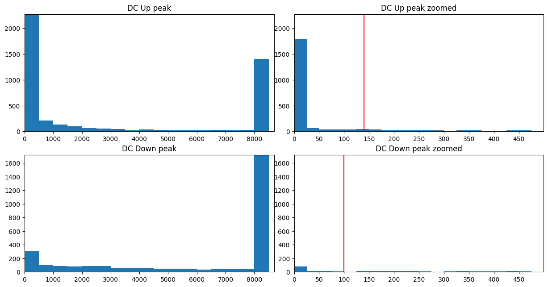
X-Box 2: DC Histogram

Slide 8
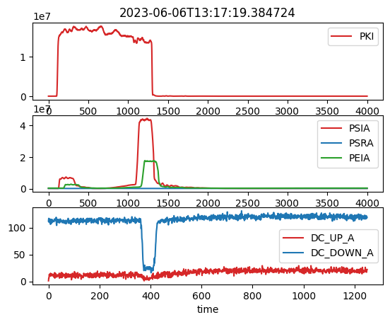
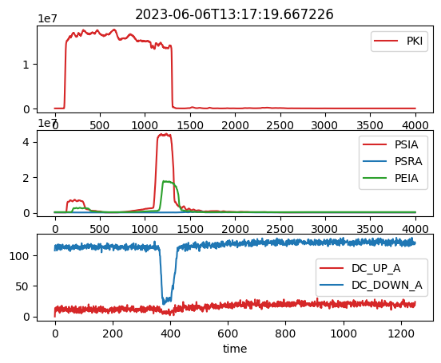
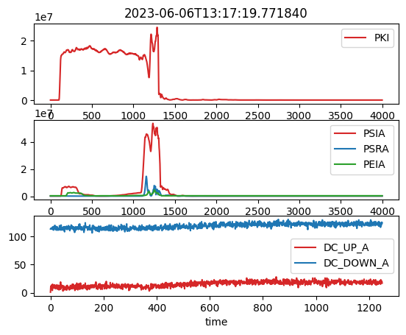
X-Box 2: 06. June 2023 Pulse 313636962
Log 0
Log 1
Log 2

Slide 9

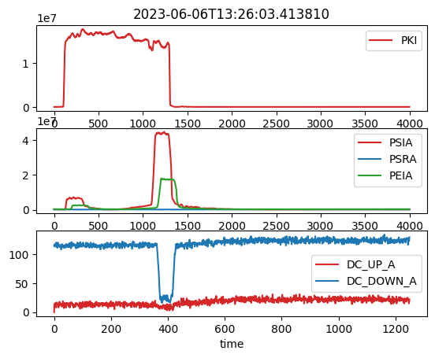
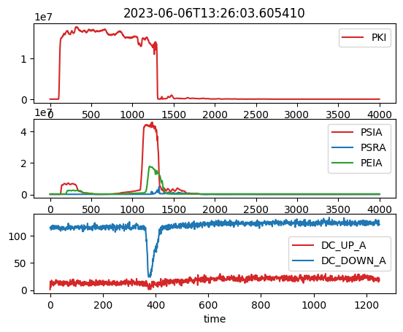
X-Box 2: 06. June 2023 Pulse 313657497
Log 0
Log 1
Log 2

Slide 10


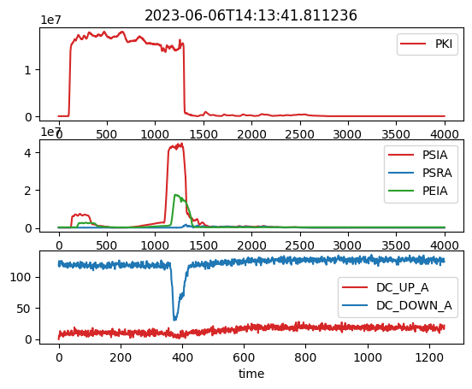
X-Box 2: 06. June 2023 Pulse 313798416
Log 0
Log 1
Log 2

Slide 11
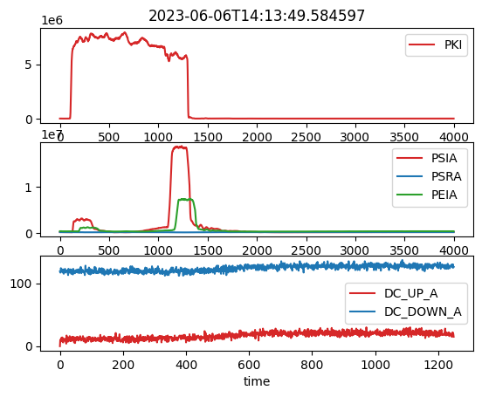
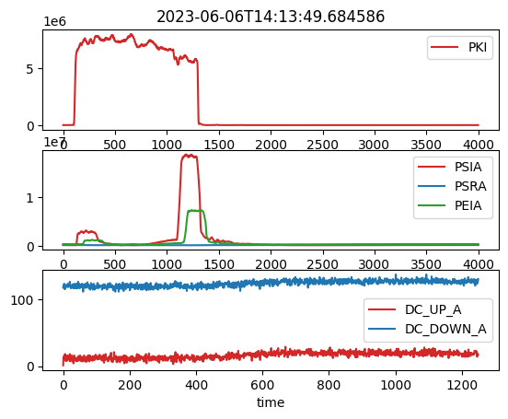
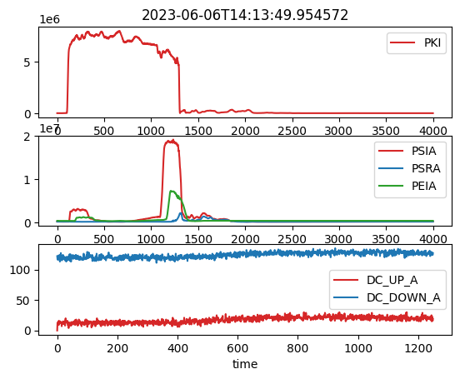
X-Box 2: 06. June 2023 Pulse 313798640
Log 0
Log 1
Log 2

Slide 12
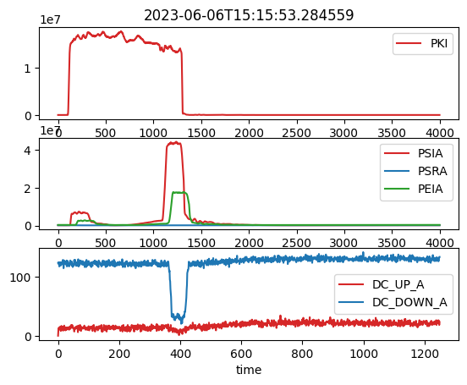

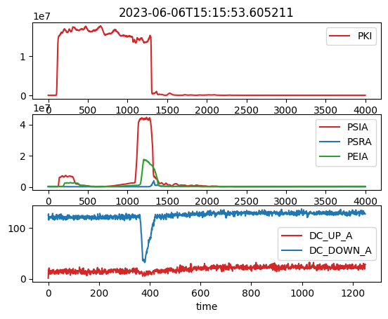
X-Box 2: 06. June 2023 Pulse 313983633
Log 0
Log 1
Log 2

Slide 13


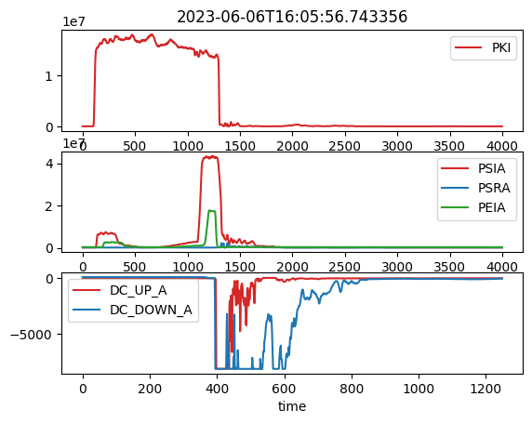
X-Box 2: 06. June 2023 Pulse314132985
Log 0
Log 1
Log 2

Slide 14

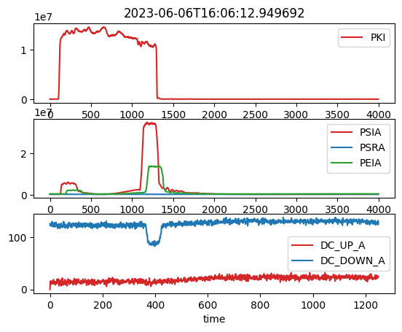
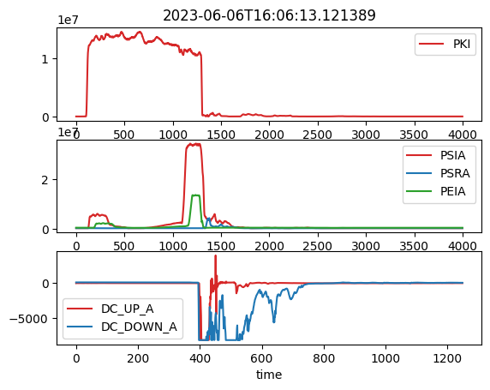
X-Box 2: 06. June 2023 Pulse314133551
Log 0
Log 1
Log 2

Slide 15
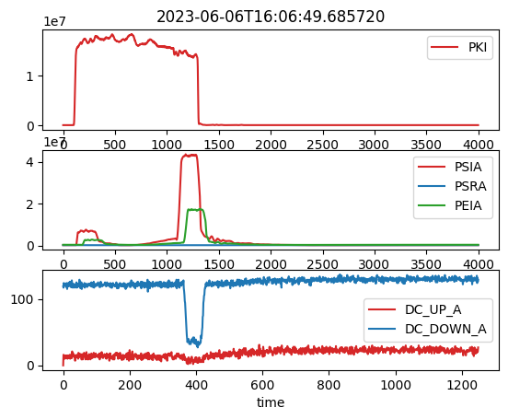

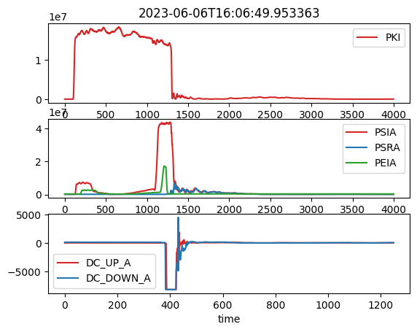
X-Box 2: 06. June 2023 Pulse 314135207
Log 0
Log 1
Log 2

Slide 16

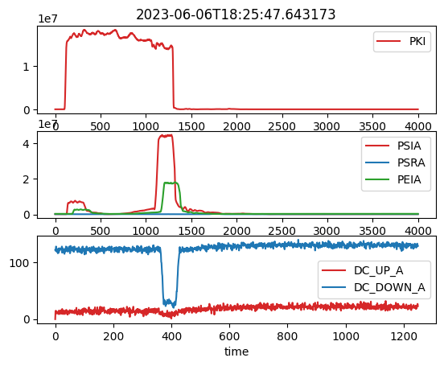
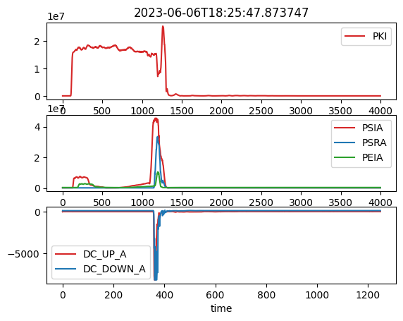
X-Box 2: 06. June 2023 Pulse 31458942
Log 0
Log 1
Log 2

Slide 17
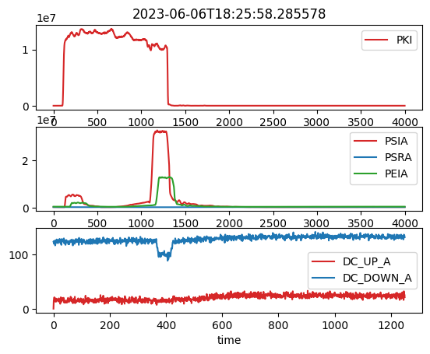

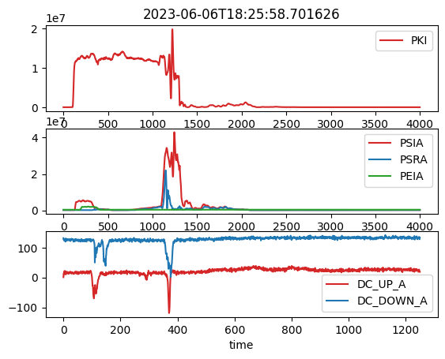
X-Box 2: 06. June 2023 Pulse 314549440
Log 0
Log 1
Log 2

Slide 18
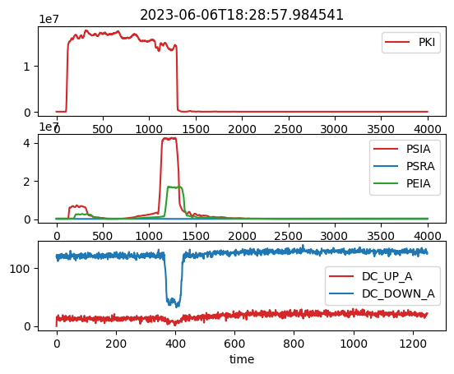

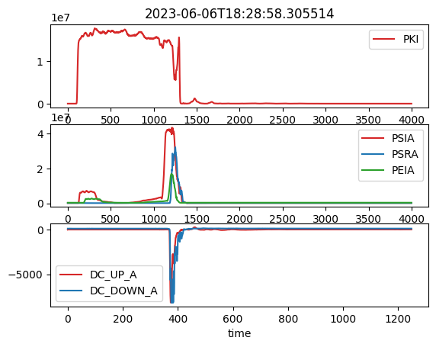
X-Box 2: 06. June 2023 Pulse 314556044
Log 0
Log 1
Log 2

Slide 19
X-Box 2: 06. June 2023 13:17:19
Log 0
Log 1
Log 2

Slide 20
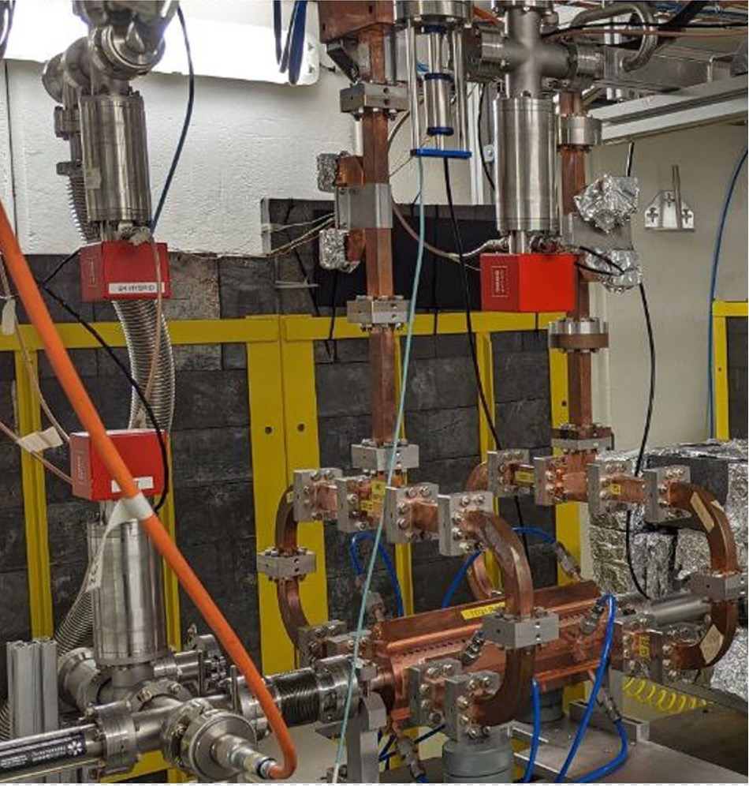
X-Box 2 TD31 N3 N4: Structure B
Shut down

Slide 21
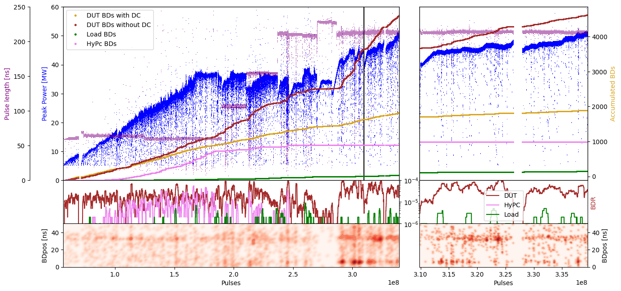
X-Box 2: TD31 N3 N4 Structure B – Peak Power

Slide 22
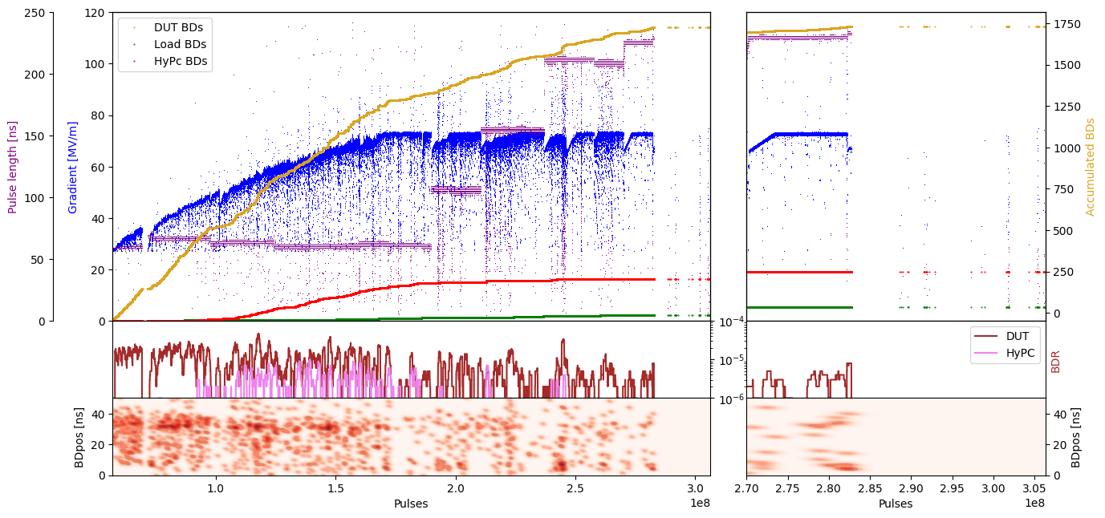
X-Box 2: TD31 N3 N4 Structure B – Gradient

Slide 23
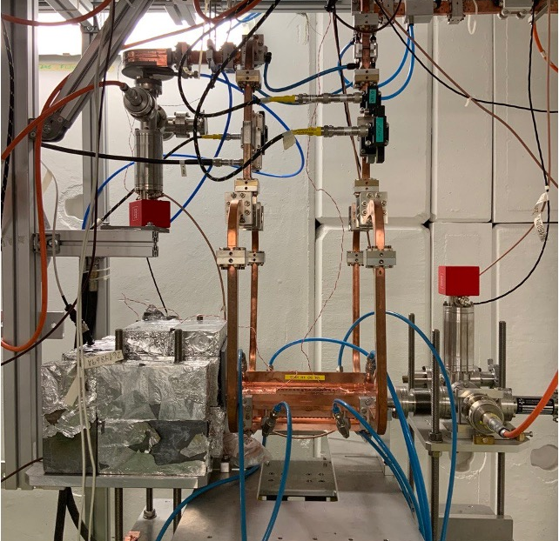
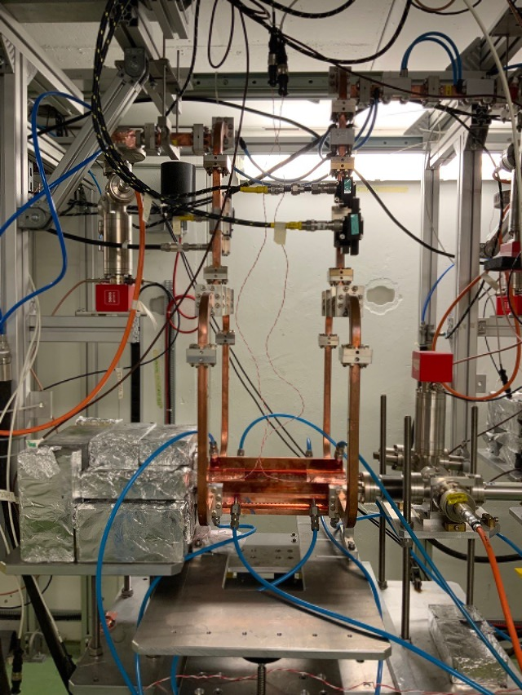
X-Box 3: TD31

Slide 24
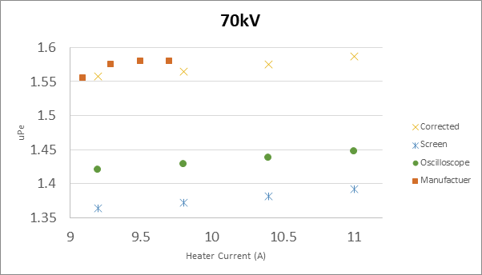
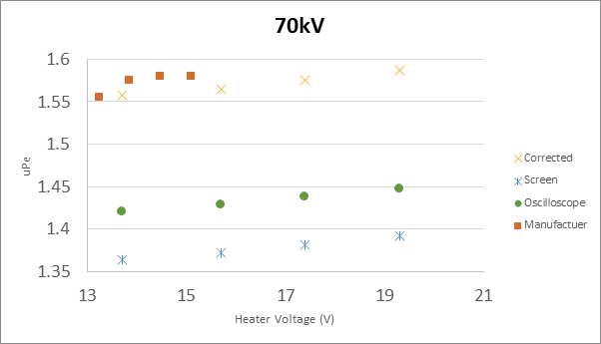
High Efficiency Klystron ER37117 TUBE1
Measurement campaign
Measurements at 70kV (CANON configuration)
Sweep up to current value of 11A, saturation point not found
Calculated uPe differs from Canon value by an 8.4%

Slide 25
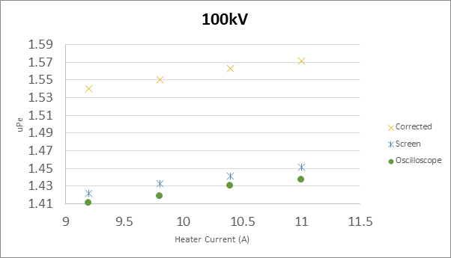
High Efficiency Klystron ER37117 TUBE1
Measurement campaign
Measurements at 100kV
Sweep up to current value of 11A, saturation point not found

Slide 26
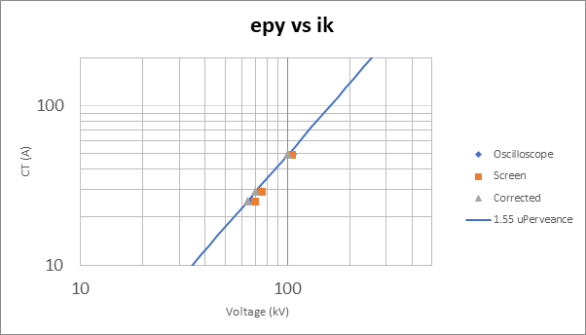
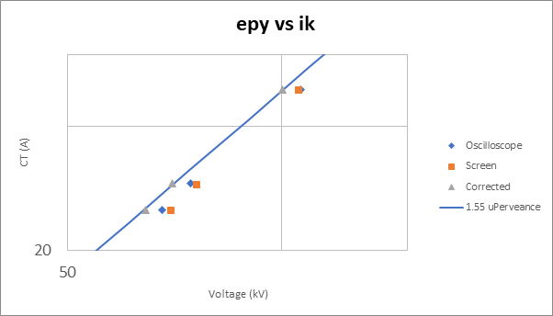
High Efficiency Klystron ER37117 TUBE1
Measurement campaign
Klystron output: voltage vs current curves

Slide 27
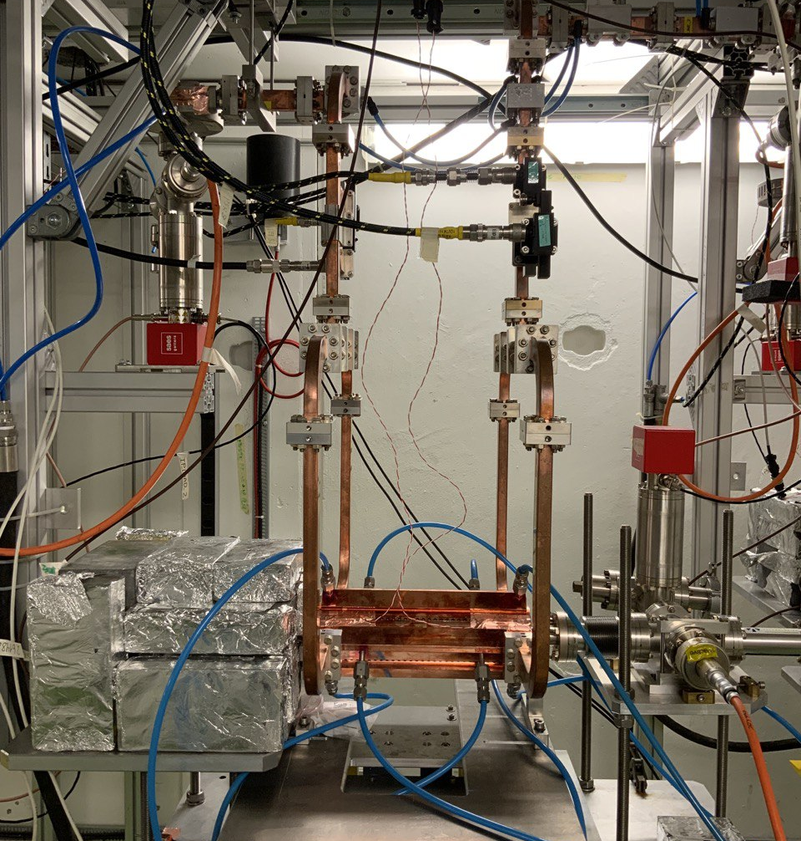
X-Box 3 Line 1: TD31 N1
Shut down

Slide 28
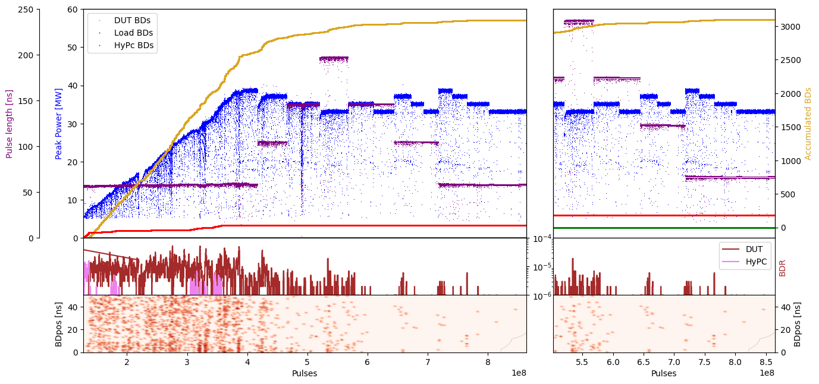
X-Box 3 Line 1: TD31 N1 – Peak Power

Slide 29
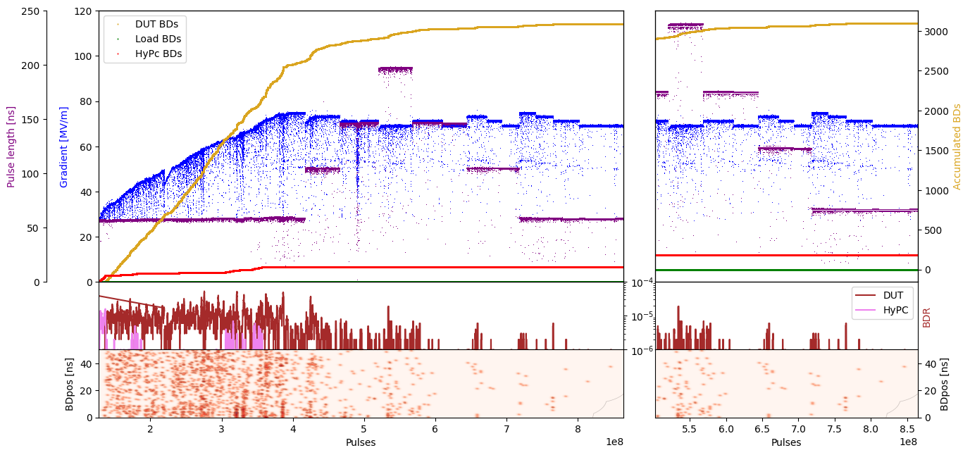
X-Box 3 Line 1: TD31 N1 – Gradient

Slide 30
X-Box 3 Line 2: TD31 N2
Shut down

Slide 31
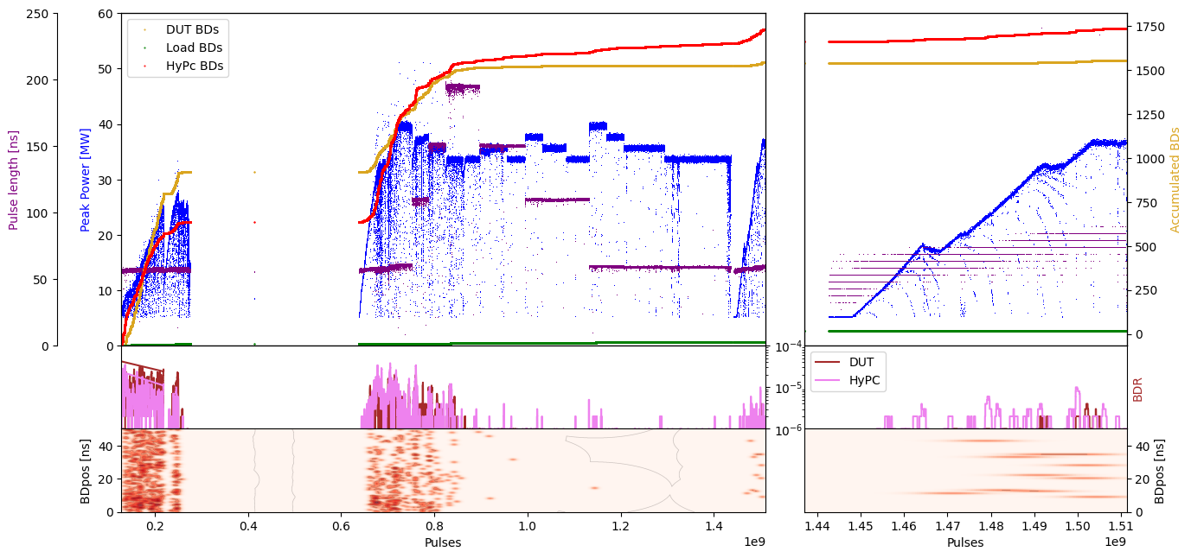
X-Box 3 Line 1: TD31 N2 – Peak Power

Slide 32
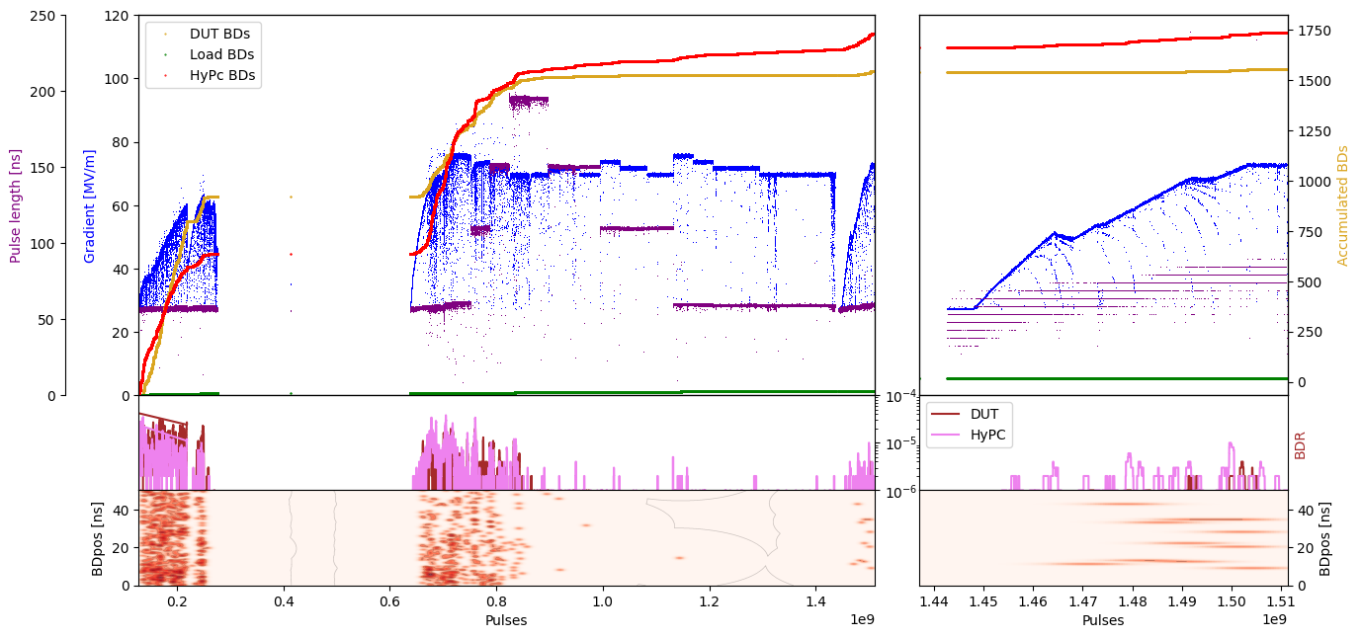
X-Box 3 Line 1: TD31 N2 – Gradient

