Slide 1
X-Box Update
21.06.2023

Slide 2
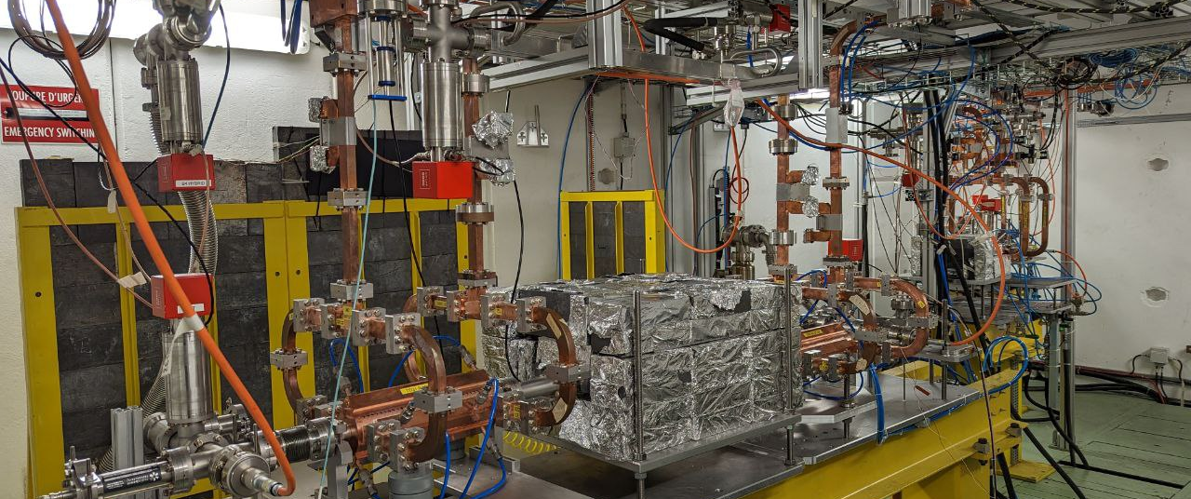
X-Box 2: TD31 N3 N4

Slide 3
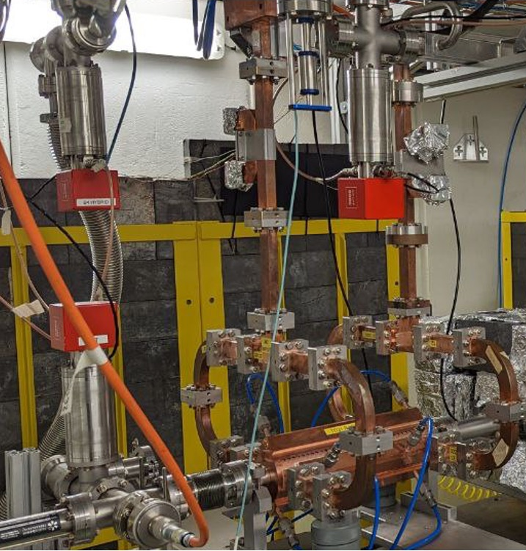
X-Box 2 TD31 N3 N4: Structure A
Restarted 05.06.2023
Currently up to 50MW

Slide 4
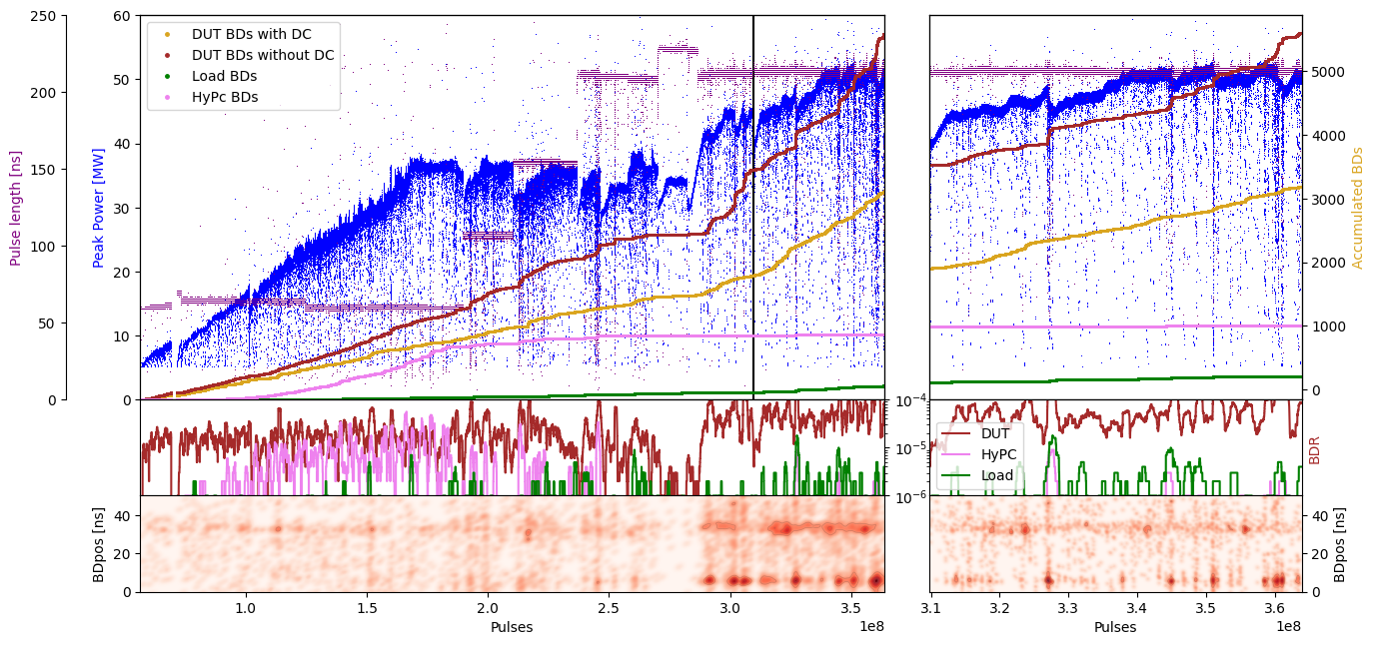
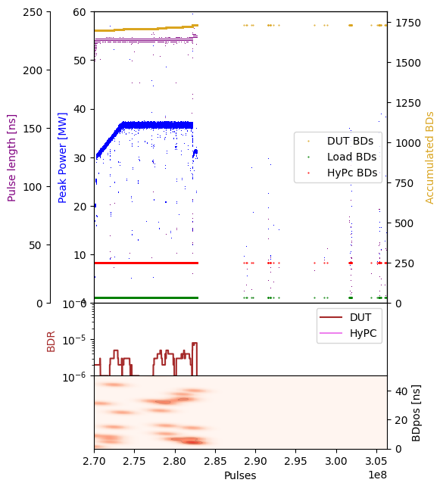
X-Box 2: TD31 N3 N4 Structure A – Peak Power

Slide 5
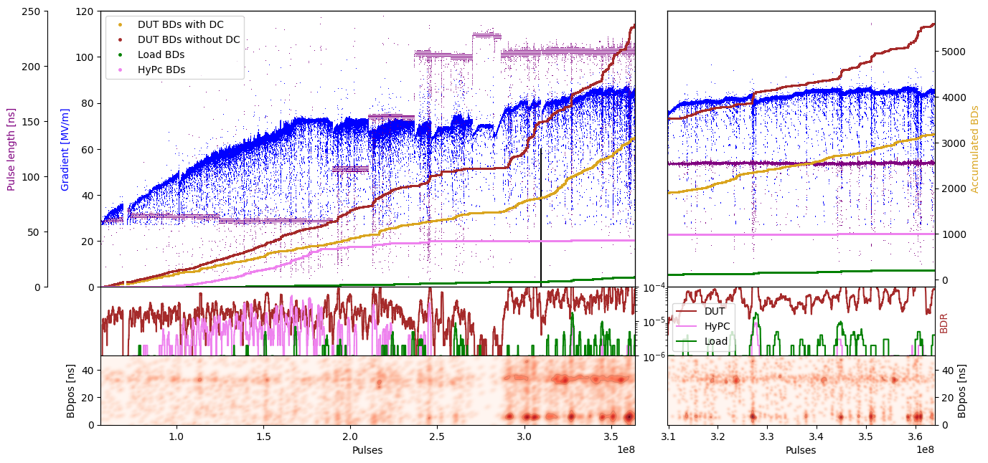
X-Box 2: TD31 N3 N4 Structure A – Gradient

Slide 6
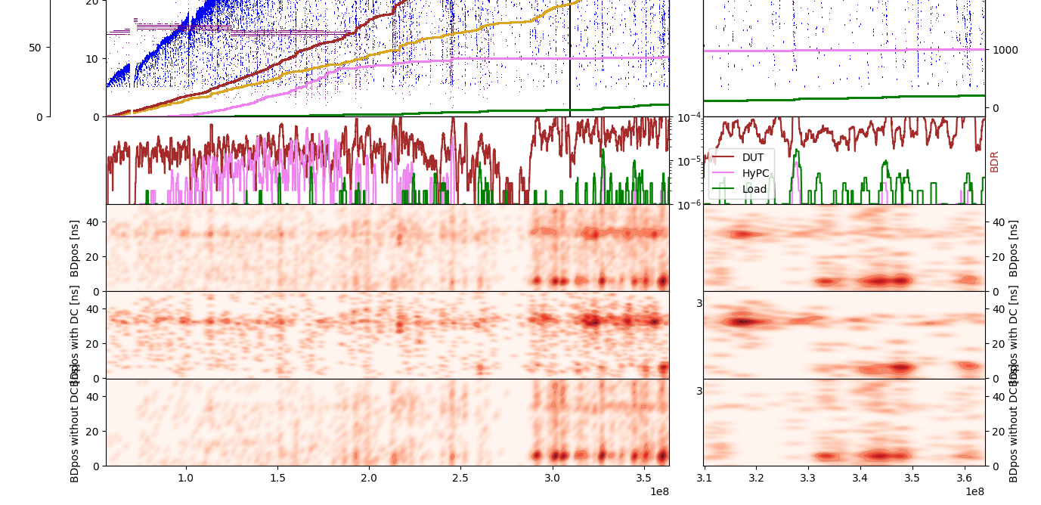
X-Box 2: TD31 N3 N4 Structure A – Pos

Slide 7
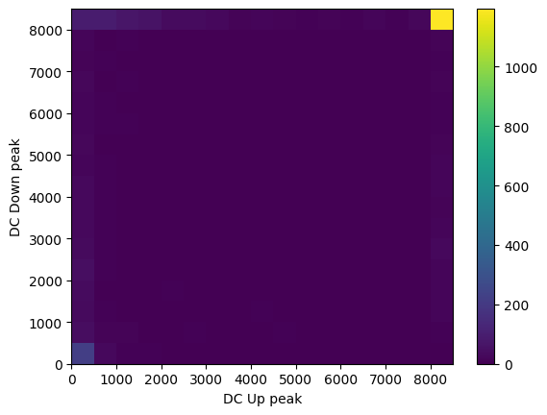
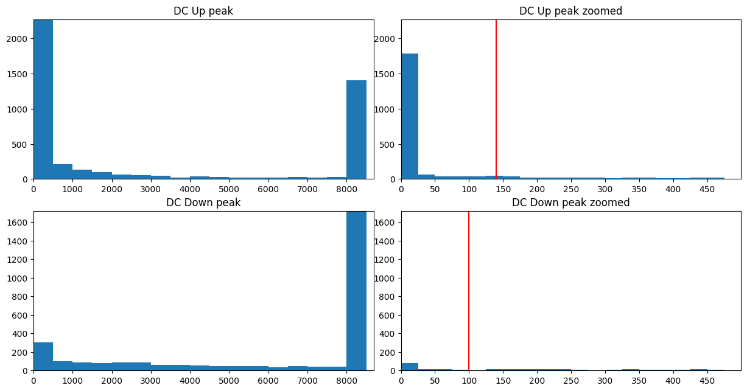
X-Box 2: DC Histogram

Slide 8
X-Box 2: 06. June 2023 13:17:19
Log 0
Log 1
Log 2

Slide 9
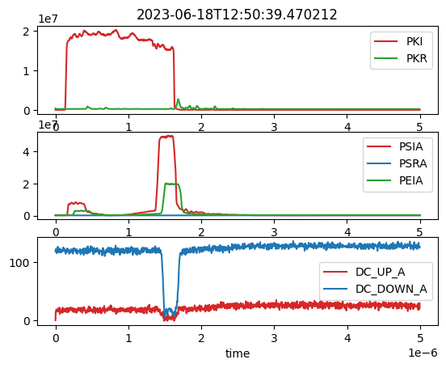
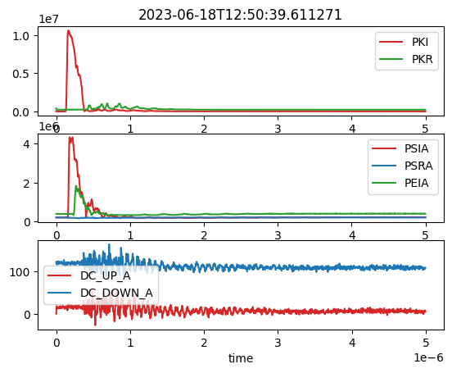
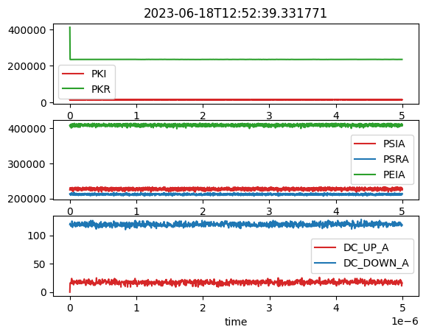
X-Box 2: 18. June 2023 Pulse 363871027
Log 1
Log 2
Log 3

Slide 10
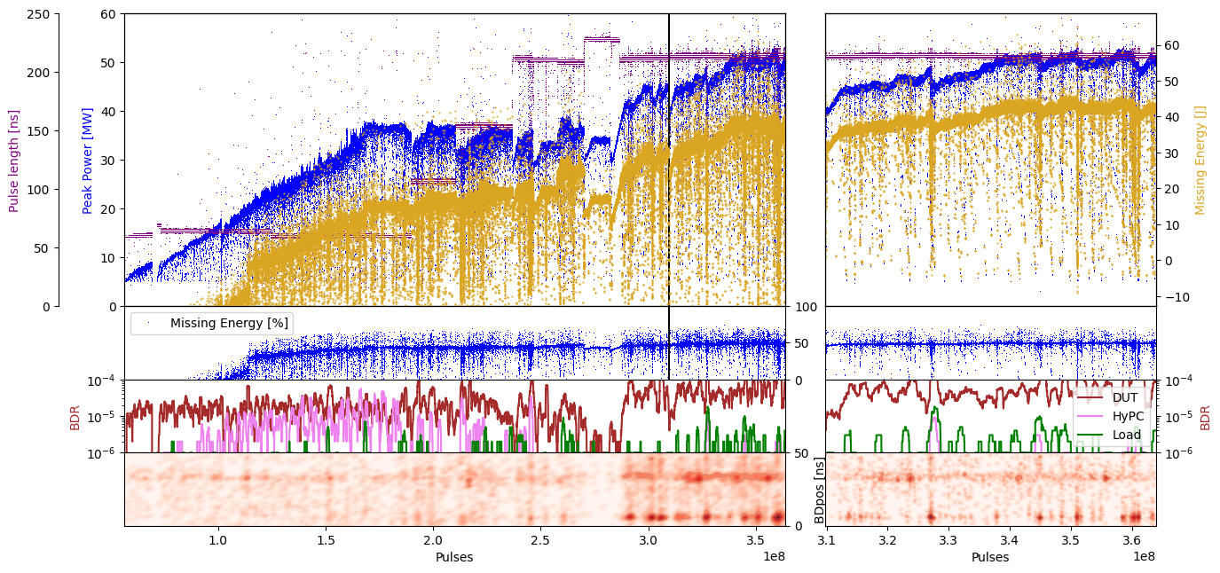
X-Box 2: TD31 N3 N4 Structure A – Missing Energy

Slide 11
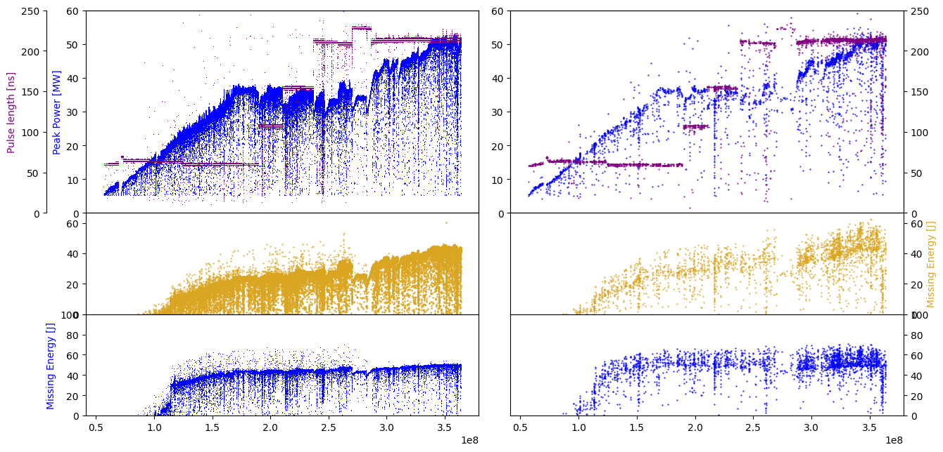
X-Box 2: TD31 N3 N4 Structure A – Missing Energy

Slide 12
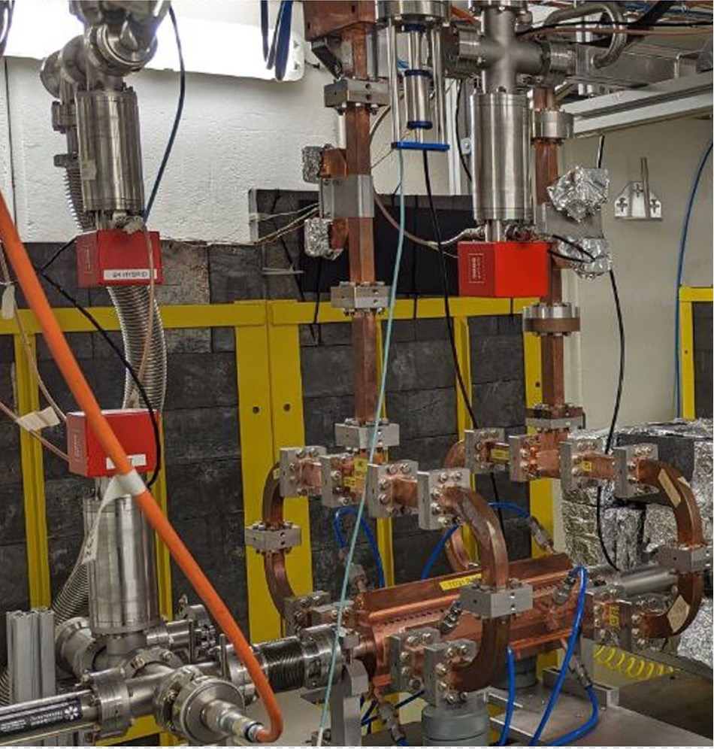
X-Box 2 TD31 N3 N4: Structure B
Shut down

Slide 13
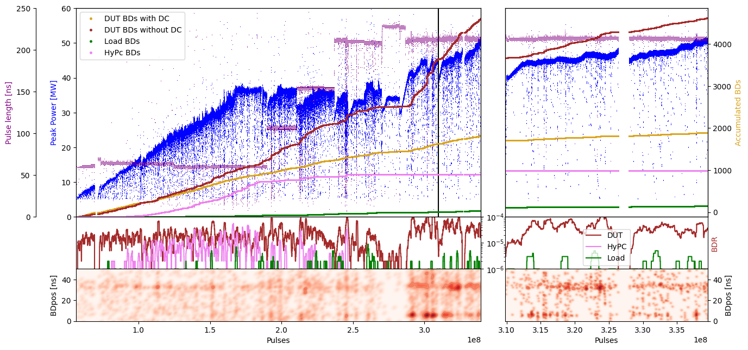
X-Box 2: TD31 N3 N4 Structure B – Peak Power

Slide 14
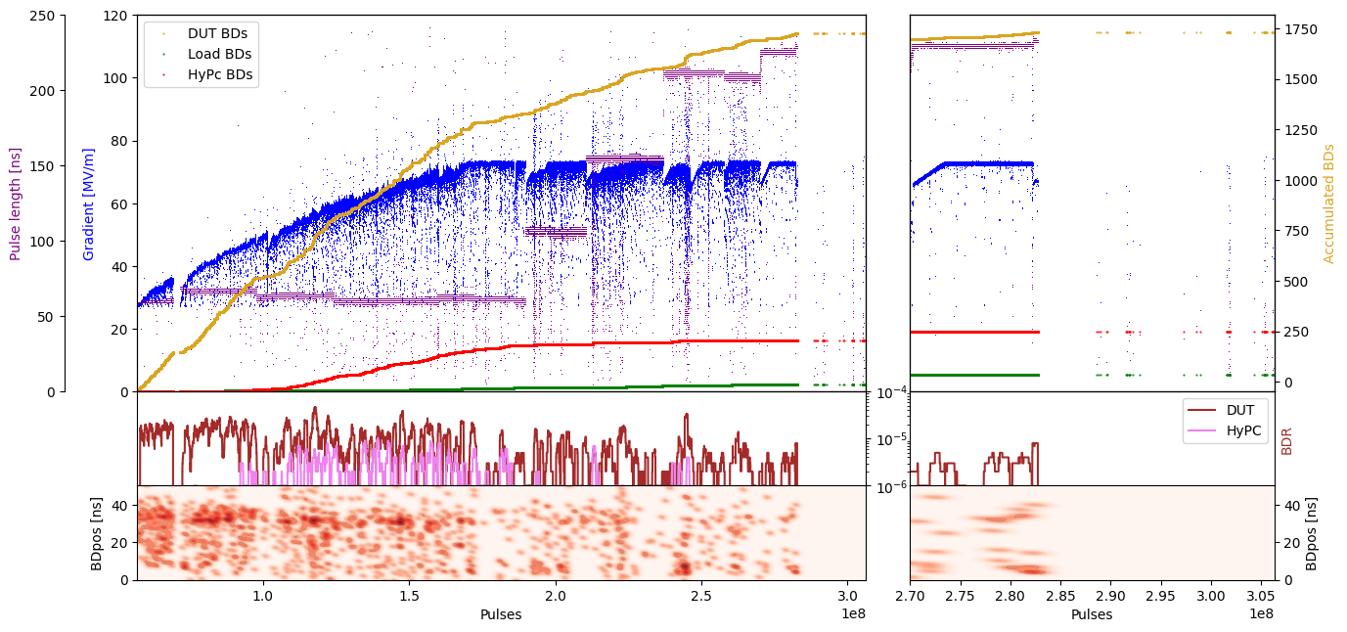
X-Box 2: TD31 N3 N4 Structure B – Gradient

Slide 15
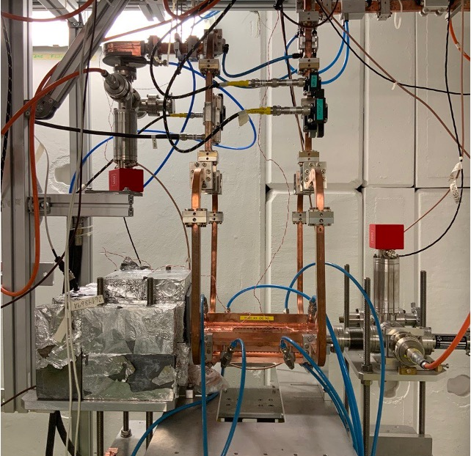
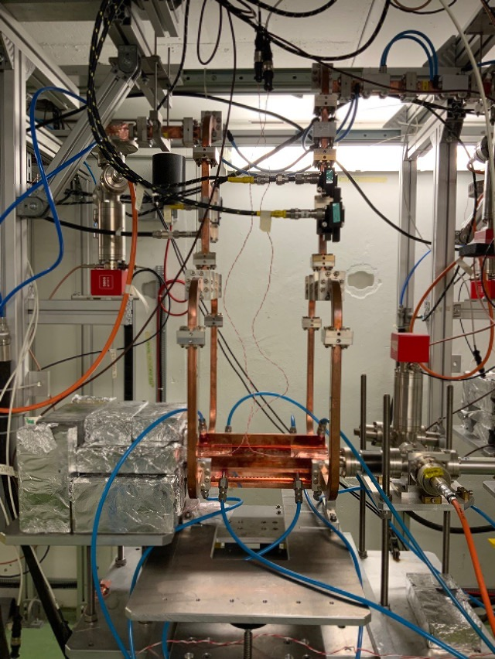
X-Box 3: TD31

Slide 16
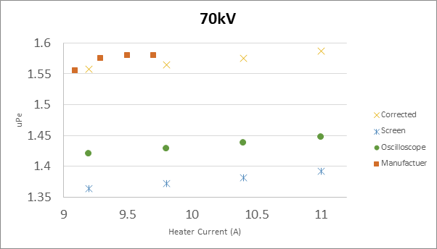
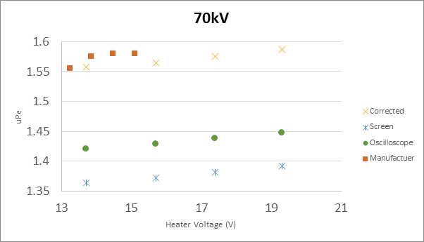
High Efficiency Klystron ER37117 TUBE1
Measurement campaign
Measurements at 70kV (CANON configuration)
Sweep up to current value of 11A, saturation point not found
Calculated uPe differs from Canon value by an 8.4%

Slide 17
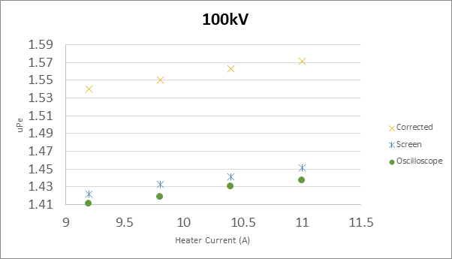
High Efficiency Klystron ER37117 TUBE1
Measurement campaign
Measurements at 100kV
Sweep up to current value of 11A, saturation point not found

Slide 18
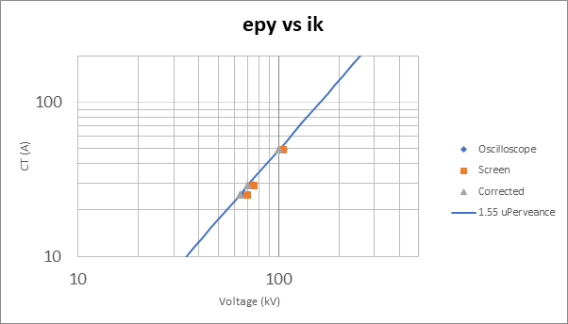
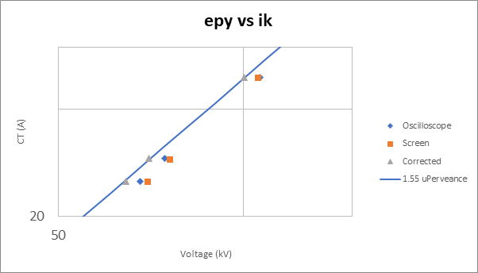
High Efficiency Klystron ER37117 TUBE1
Measurement campaign
Klystron output: voltage vs current curves

Slide 19
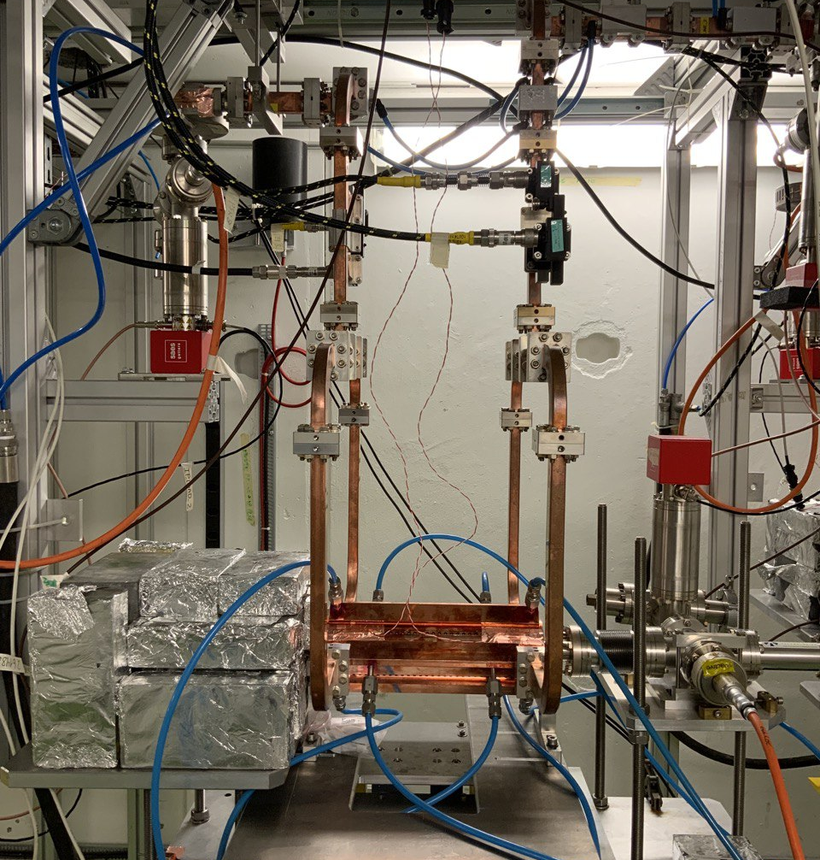
X-Box 3 Line 1: TD31 N1
Shut down

Slide 20
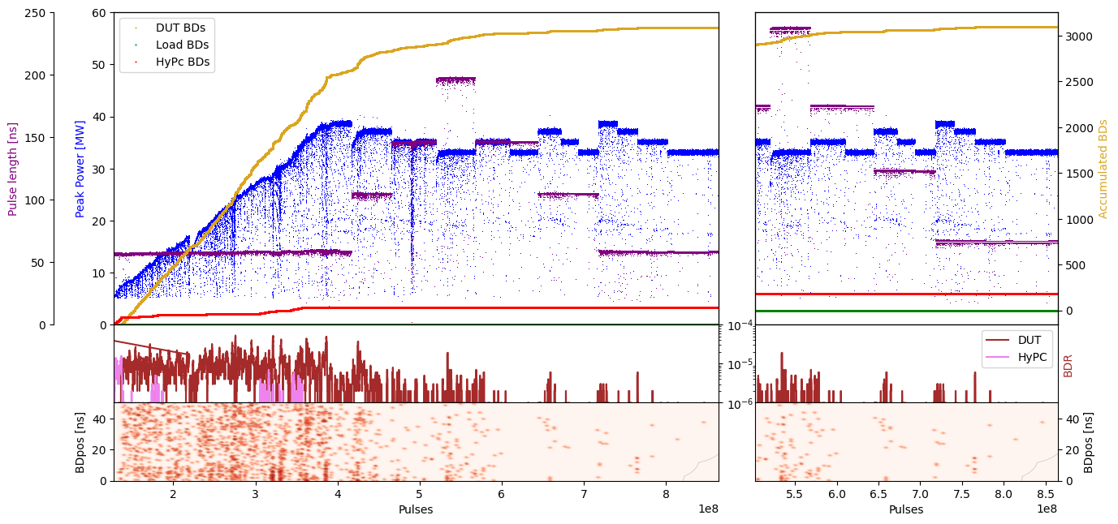
X-Box 3 Line 1: TD31 N1 – Peak Power

Slide 21
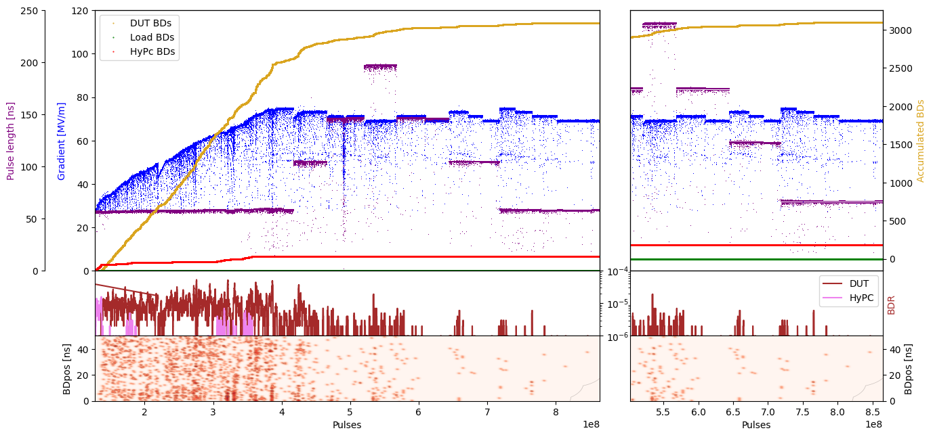
X-Box 3 Line 1: TD31 N1 – Gradient

Slide 22
X-Box 3 Line 2: TD31 N2
Shut down

Slide 23
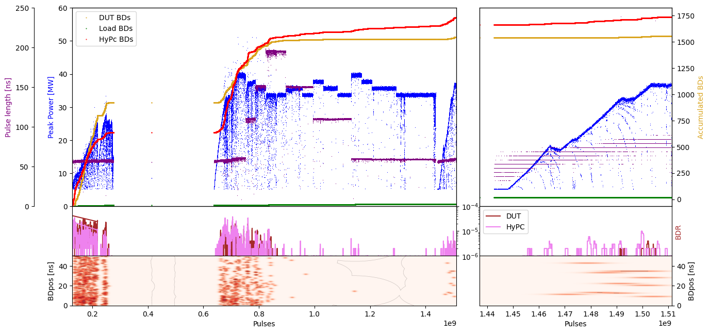
X-Box 3 Line 1: TD31 N2 – Peak Power

Slide 24
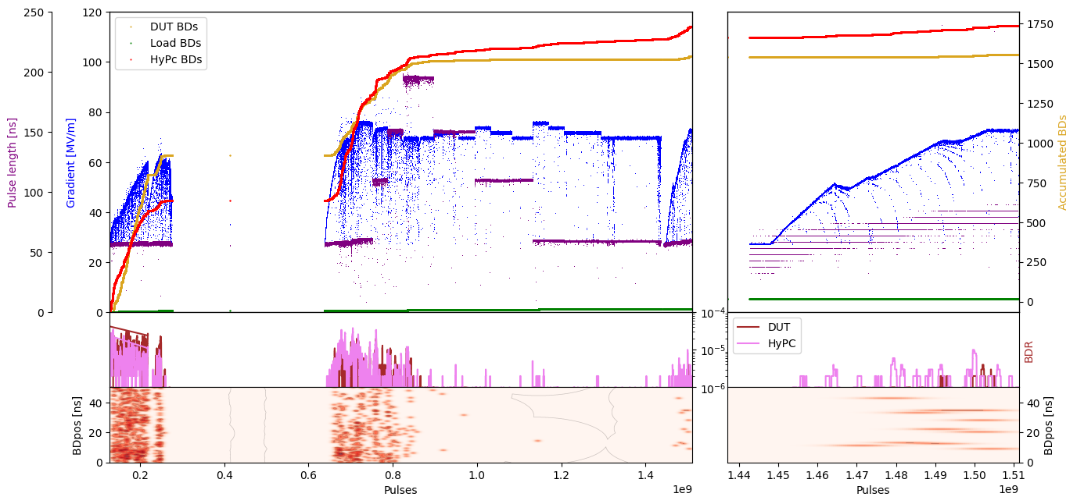
X-Box 3 Line 1: TD31 N2 – Gradient

