Slide 1



ARM benchmarking
Dr. Emanuele Simili ScotGrid F2F Meeting 20 June 2023
Notes:
f2fedi

Slide 2
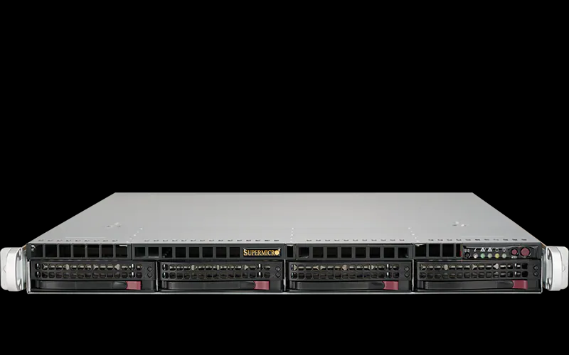
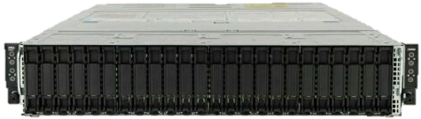
Tested Hardware
AMD48c / AMD96ht: Single AMD EPYC 7003 series (GIGABYTE)
CPU: x86 AMD EPYC 7643 48C/96HT @ 2.3GHz (TDP 225W)
RAM: 256GB (16 x 16GB) DDR4 3200MHz
HDD: 3.84TB Samsung PM9A3 M.2 (2280)
ARM80c: Single socket Ampere Altra (GIGABYTE)
CPU: ARM Q80-30 80C @ 3GHz (TDP 210W)
RAM: 256GB (16 x 16GB) DDR4 3200MHz
HDD: 3.84TB Samsung PM9A3 M.2 (2280)
2xAMD32c / 2xAMD64ht: Dual Socket AMD EPYC 7513 series Processors (DELL)
CPU: 2 * x86 AMD EPYC 7513, 32C/64HT @ 2.6GHz (TDP 200W)
RAM: 512GB (16 x 32GB) DDR4 3200MHz
HDD: 3.84TB SSD SATA Read Intensive
ARM128c: Single Socket Ampere Altra Max (SuperMicro)
CPU: ARM Q128-28 @ 2.8GHz (TDP 250W)
RAM: 512GB (64 x 8GB) DDR4 ???MHz
HDD: ~2TB SSD SATA Read Intensive

Slide 3
HEP-Score workloads

Slide 4
#!/bin/bash
EXPORT_DIR="/tmp"
EXPORT_JSON="ipminfo.json"
EXPORT_CSV="ipminfo.csv"
SAMPLING="5"
# Regular expression to test for floats
re='^[0-9]+([.][0-9]+)?$'
# Set sampling frequency (minimum is 1 sec)
if [ $# -ge 1 ]; then
if [[ ${SAMPLING} =~ $re ]] ; then
SAMPLING=$1
fi
fi
#echo "Sampling = ${SAMPLING}"
# Main loop: exports metrics every ${SAMPLING} seconds
while true
do
# Trick to keep the exporter synchronised: sleep & ... wait
sleep ${SAMPLING} &
# Set the time-stamp
DATE=$(date +"%F")
TIME=$(date +"%T")
# CPU usage (total %) & Check for floating point number (or NaN)
CPUSE=$(top -bn1 | grep "Cpu(s)" | sed "s/.*, *\([0-9.]*\)%* id.*/\1/" | awk '{print 100 - $1}')
if ! [[ ${CPUSE} =~ $re ]] ; then
CPUSE="NaN"
else
CPUSE="${CPUSE}"
fi
# Memory usage (total GB) & Check for floating point number (or NaN)
MEMUSE=$(free -tm | awk 'FNR == 2 {printf("%.2f"), $3/1024}')
if ! [[ ${MEMUSE} =~ $re ]] ; then
MEMUSE="NaN"
else
MEMUSE="${MEMUSE}"
fi
# CPU Frequency (GHz) & Check for floating point number (or NaN), requires 'kernel-tools'
FREQ=$(cpupower frequency-info -f | grep "current CPU frequency:" | awk '{print $4 / 1000000}')
if ! [[ ${FREQ} =~ $re ]] ; then
FREQ="NaN"
else
FREQ="${FREQ}"
fi
# IPMI Power Consumption output & Check for floating point number (or NaN), requires 'ipmitool'
IPMIQUERY=$(ipmitool dcmi power reading | grep "Instantaneous power reading:")
arr=($IPMIQUERY)
POWER=$(echo ${arr[3]})
POWEX=${POWER}
if ! [[ ${POWER} =~ $re ]] ; then
POWER="NaN"
POWEX="${POWER}"
else
POWER="${POWER}"
fi
## Print to json file (overwrite):
cat > $EXPORT_DIR/$EXPORT_JSON <<EOF
{
"date_yyyymmdd": "$DATE" ,
"time_hhmmss": "$TIME" ,
"cpu_usage_percent": "$CPUSE" ,
"memory_usage_gb": "$MEMUSE" ,
"cpu_frequency_ghz": "$FREQ" ,
"ipmi_power_watt": "$POWER"
}
EOF
#echo "${WHEN} , ${CPUSE} , ${POWER} , ${MEMUSE} , ${FREQ} , ${GPUSMI}"
## For backward compatibility, let's dump values in the old CSV standard as well
if [ ! -z "$EXPORT_CSV" ]; then
echo "${DATE} , ${TIME} , ${CPUSE} , ${POWER} , ${MEMUSE} , ${FREQ} , ${GPUSMI}" > "$EXPORT_DIR/$EXPORT_CSV"
fi
wait
done
IPMI script

Slide 5
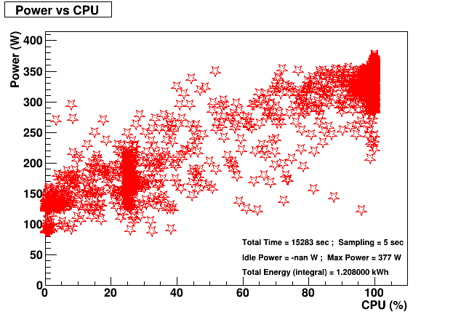
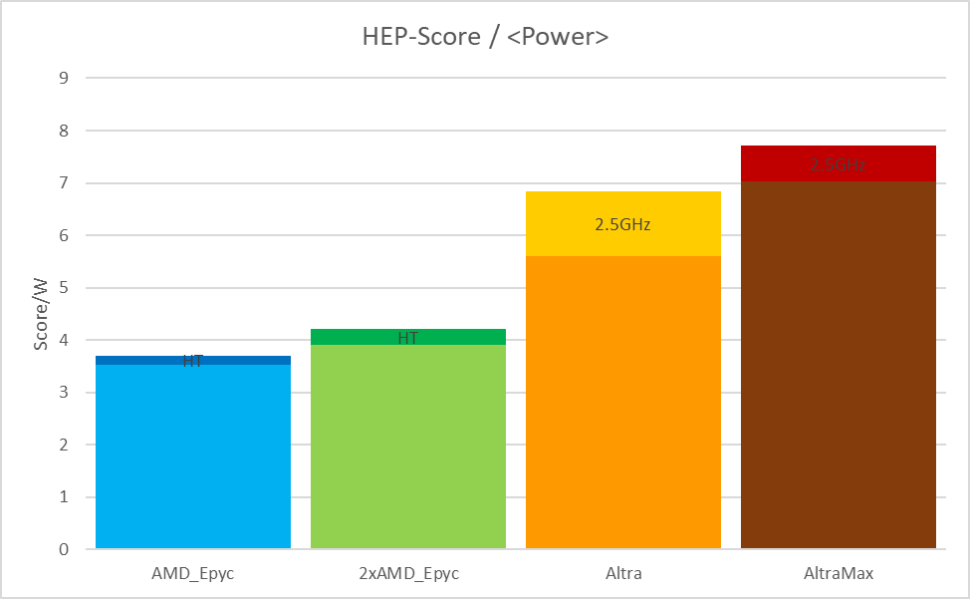
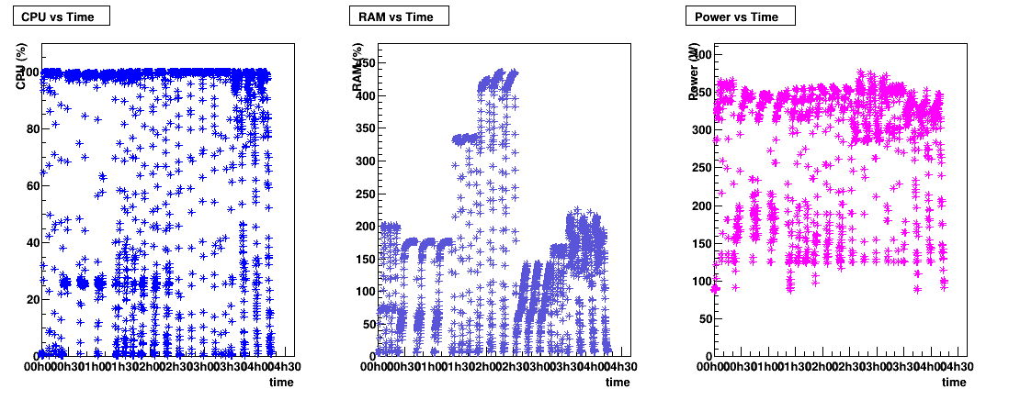
IPMI collection & analysis
jdump.sh
jget.sh + Job
IPMI
/tmp/ipmidump.json
ipmi_runtime.csv
(root’s crontab)
(user’s script)
{
"date_yyyymmdd": "$DATE" ,
"time_hhmmss": "$TIME" ,
"cpu_usage_percent": "$CPUSE" ,
"memory_usage_gb": "$MEMUSE" ,
"cpu_frequency_ghz": "$FREQ" ,
"ipmi_power_watt": "$POWER"
}
Excel
ipmi2root.C
(ROOT script)

Slide 6
Results (see excel …)

