Slide 1

Emergency Stop Testing
EP Department

Slide 2
AUL Testing
Why is it important to test local emergency stops (AUL)?
The AUL is an item of safety equipment, it allows anyone to cut the electrical power in an emergency, but…
Every year I have found at least one equipment failure during routine tests! This means that the AUL button may not cut the power as expected, which would be a major problem in an emergency.
I help experiments and TSO’s with this process. I can also help with AUL removal if the use of your space has changed: Lab -> Office, AUL no longer required, no more tests.
You can see the current status of testing and links to test reports via EDMS 2909528.

Slide 3
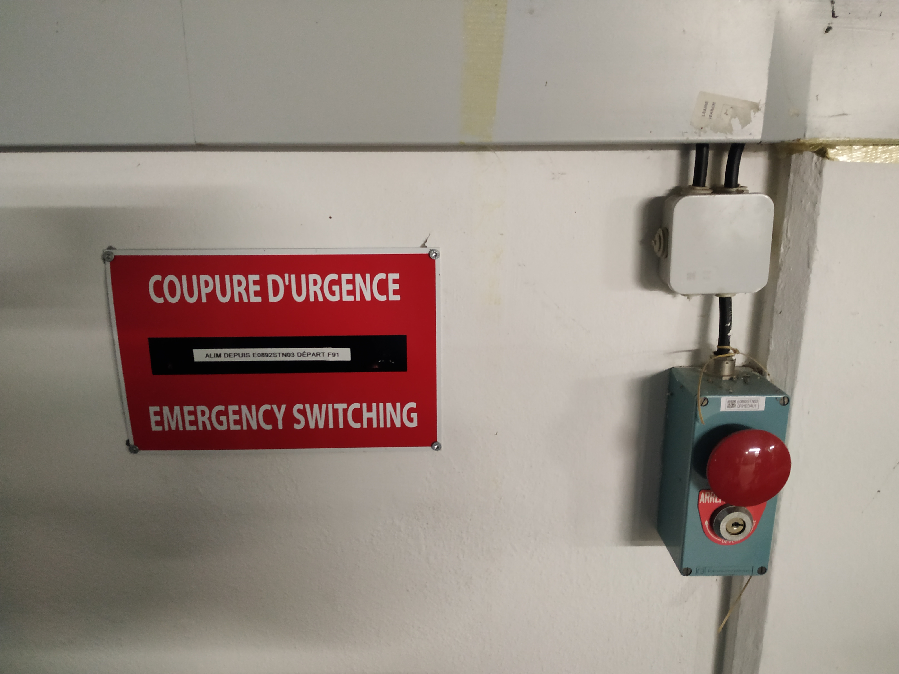
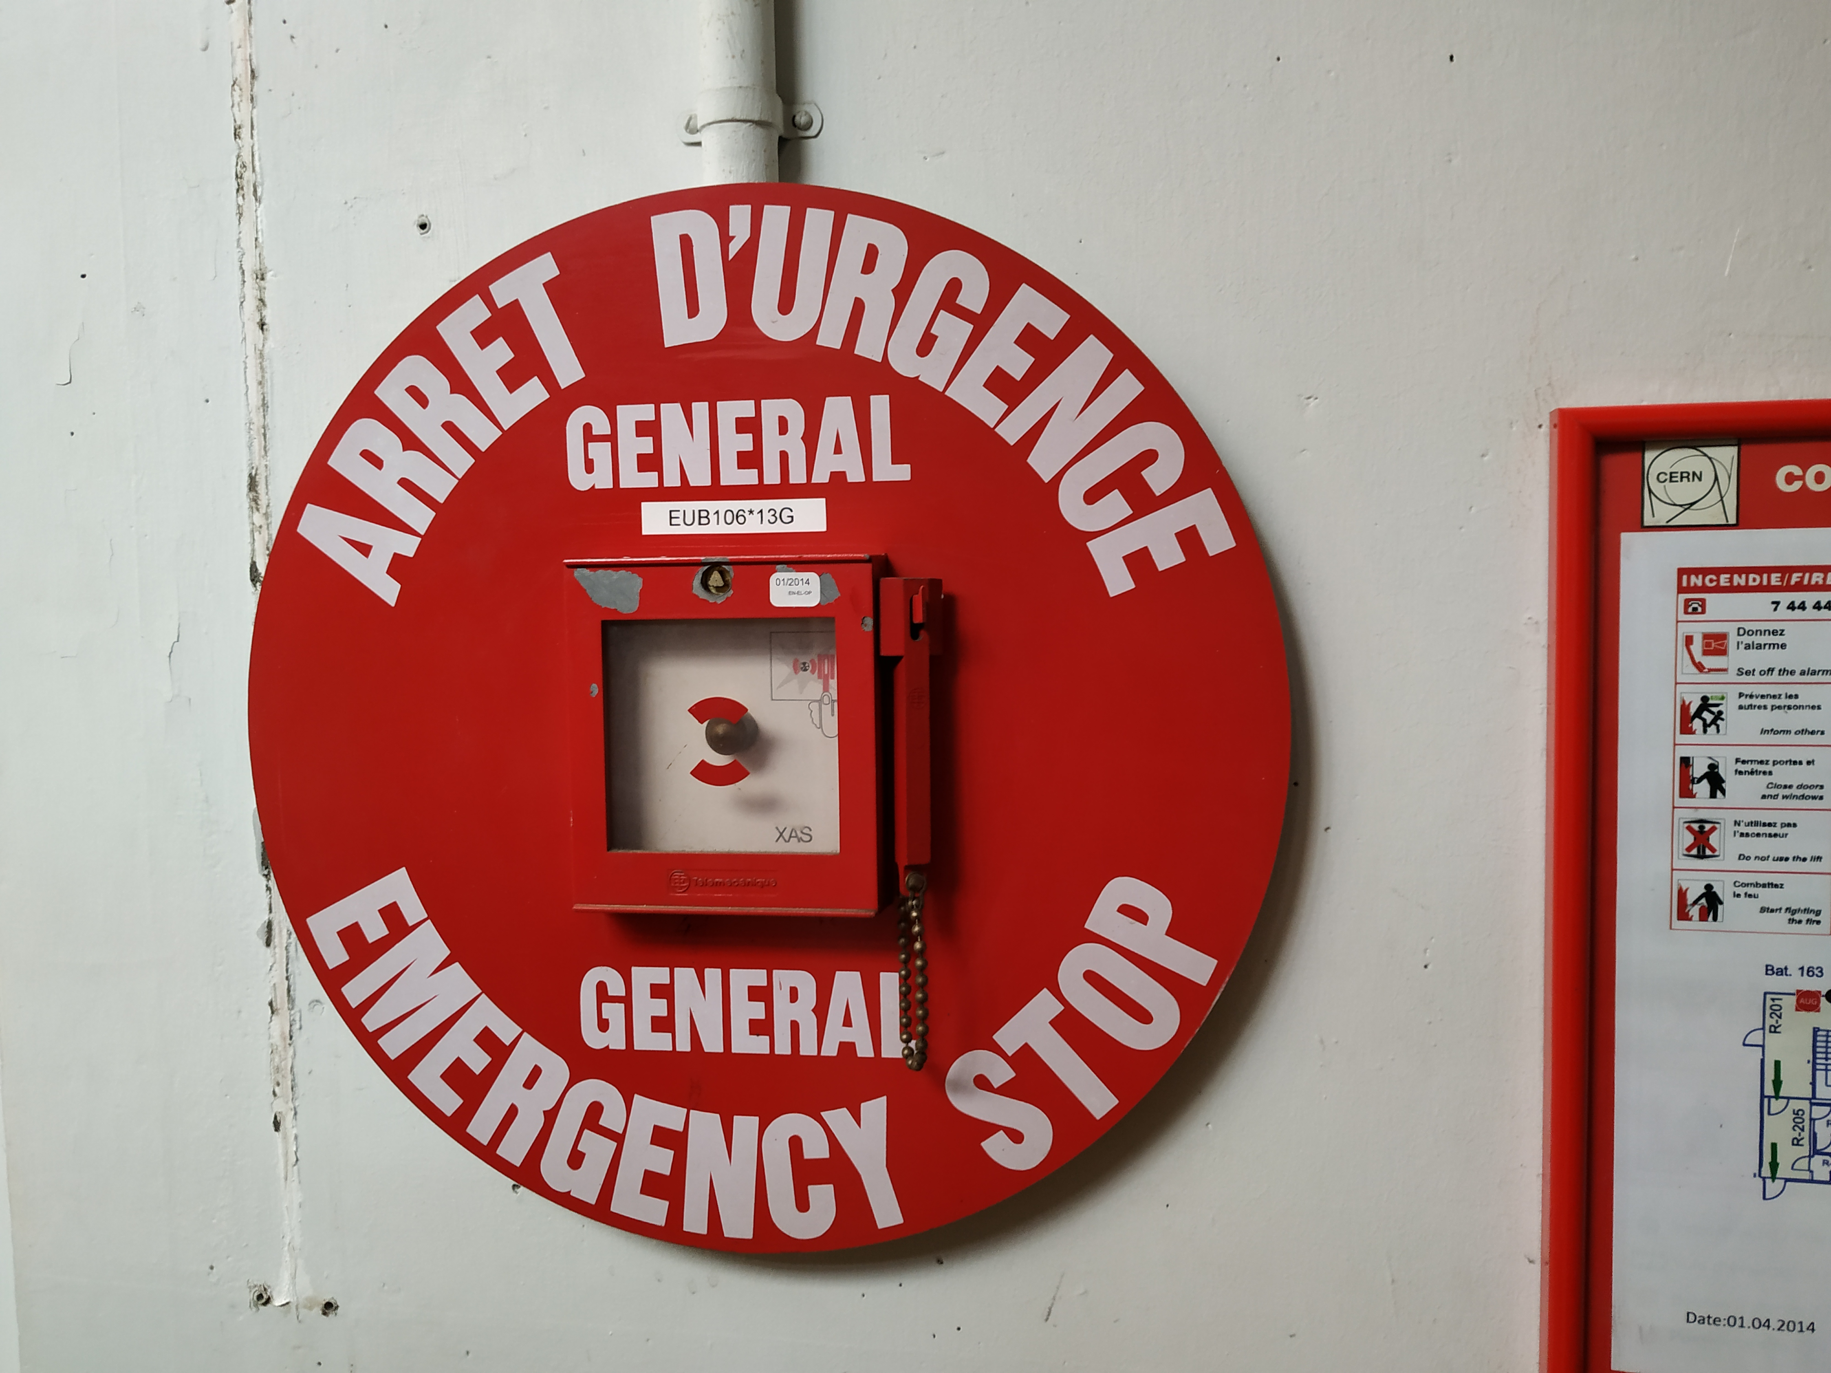
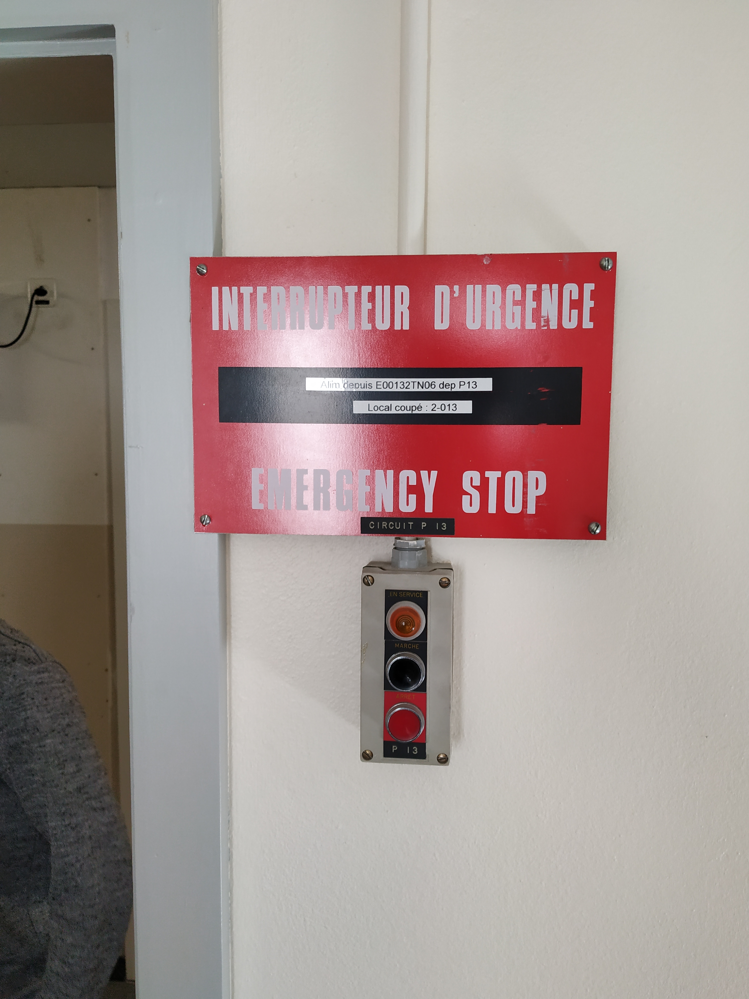
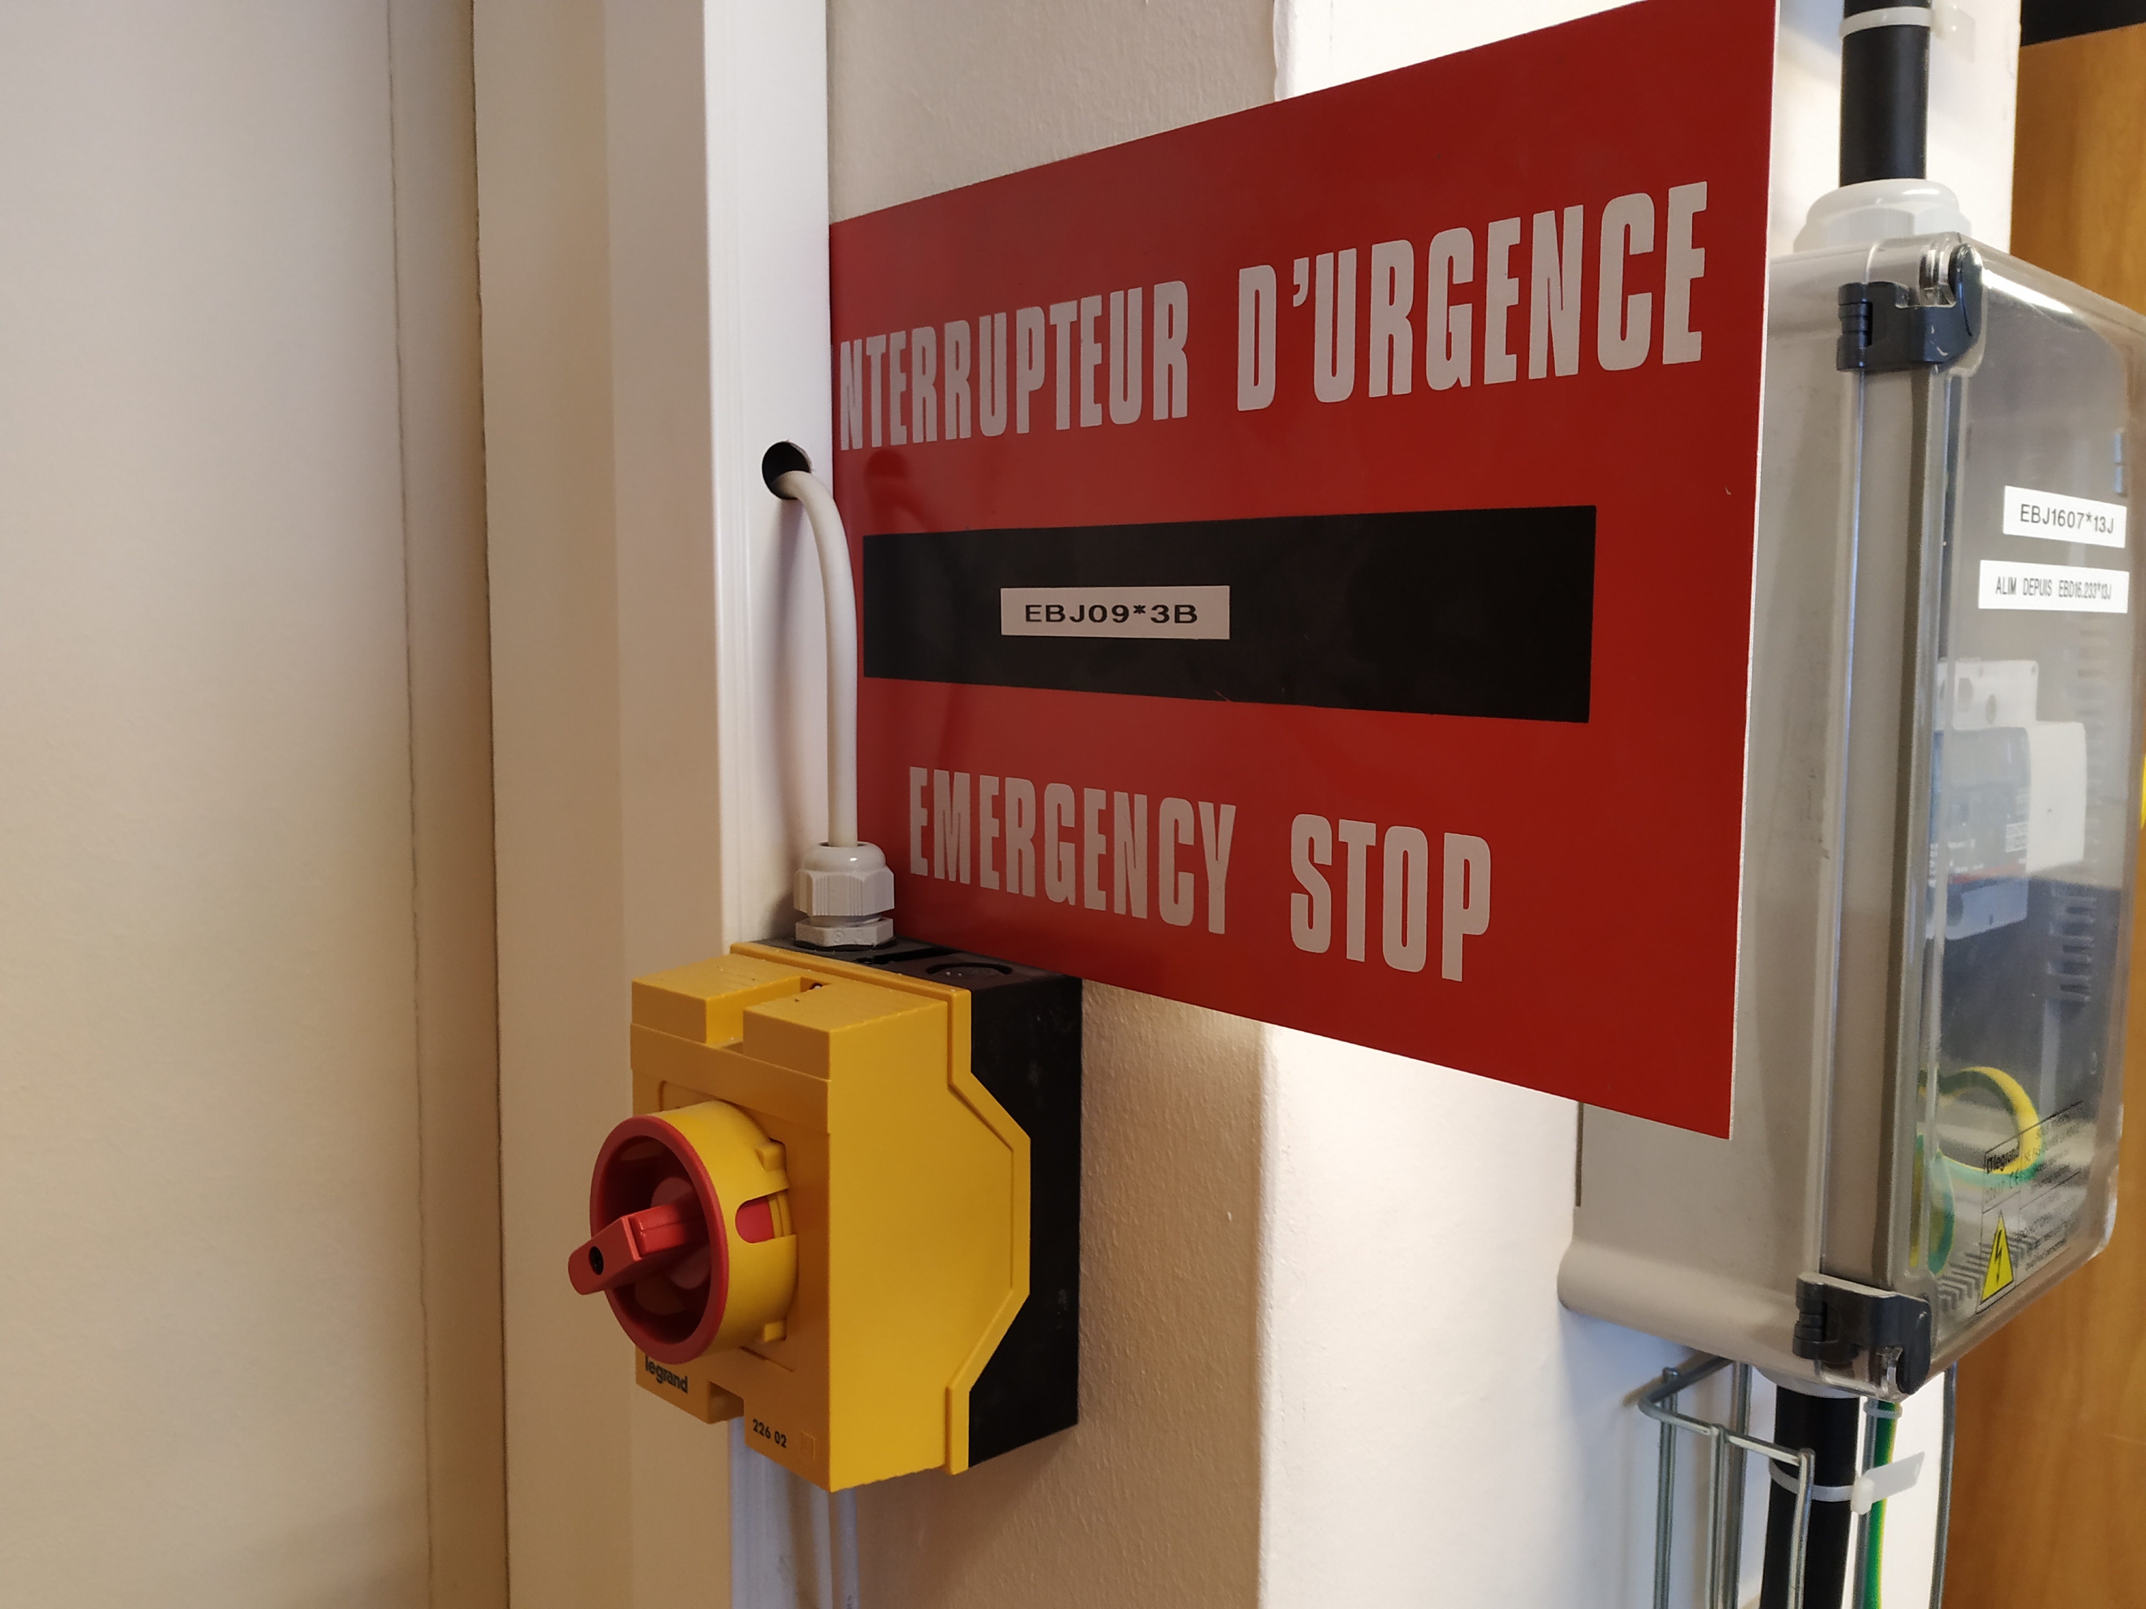
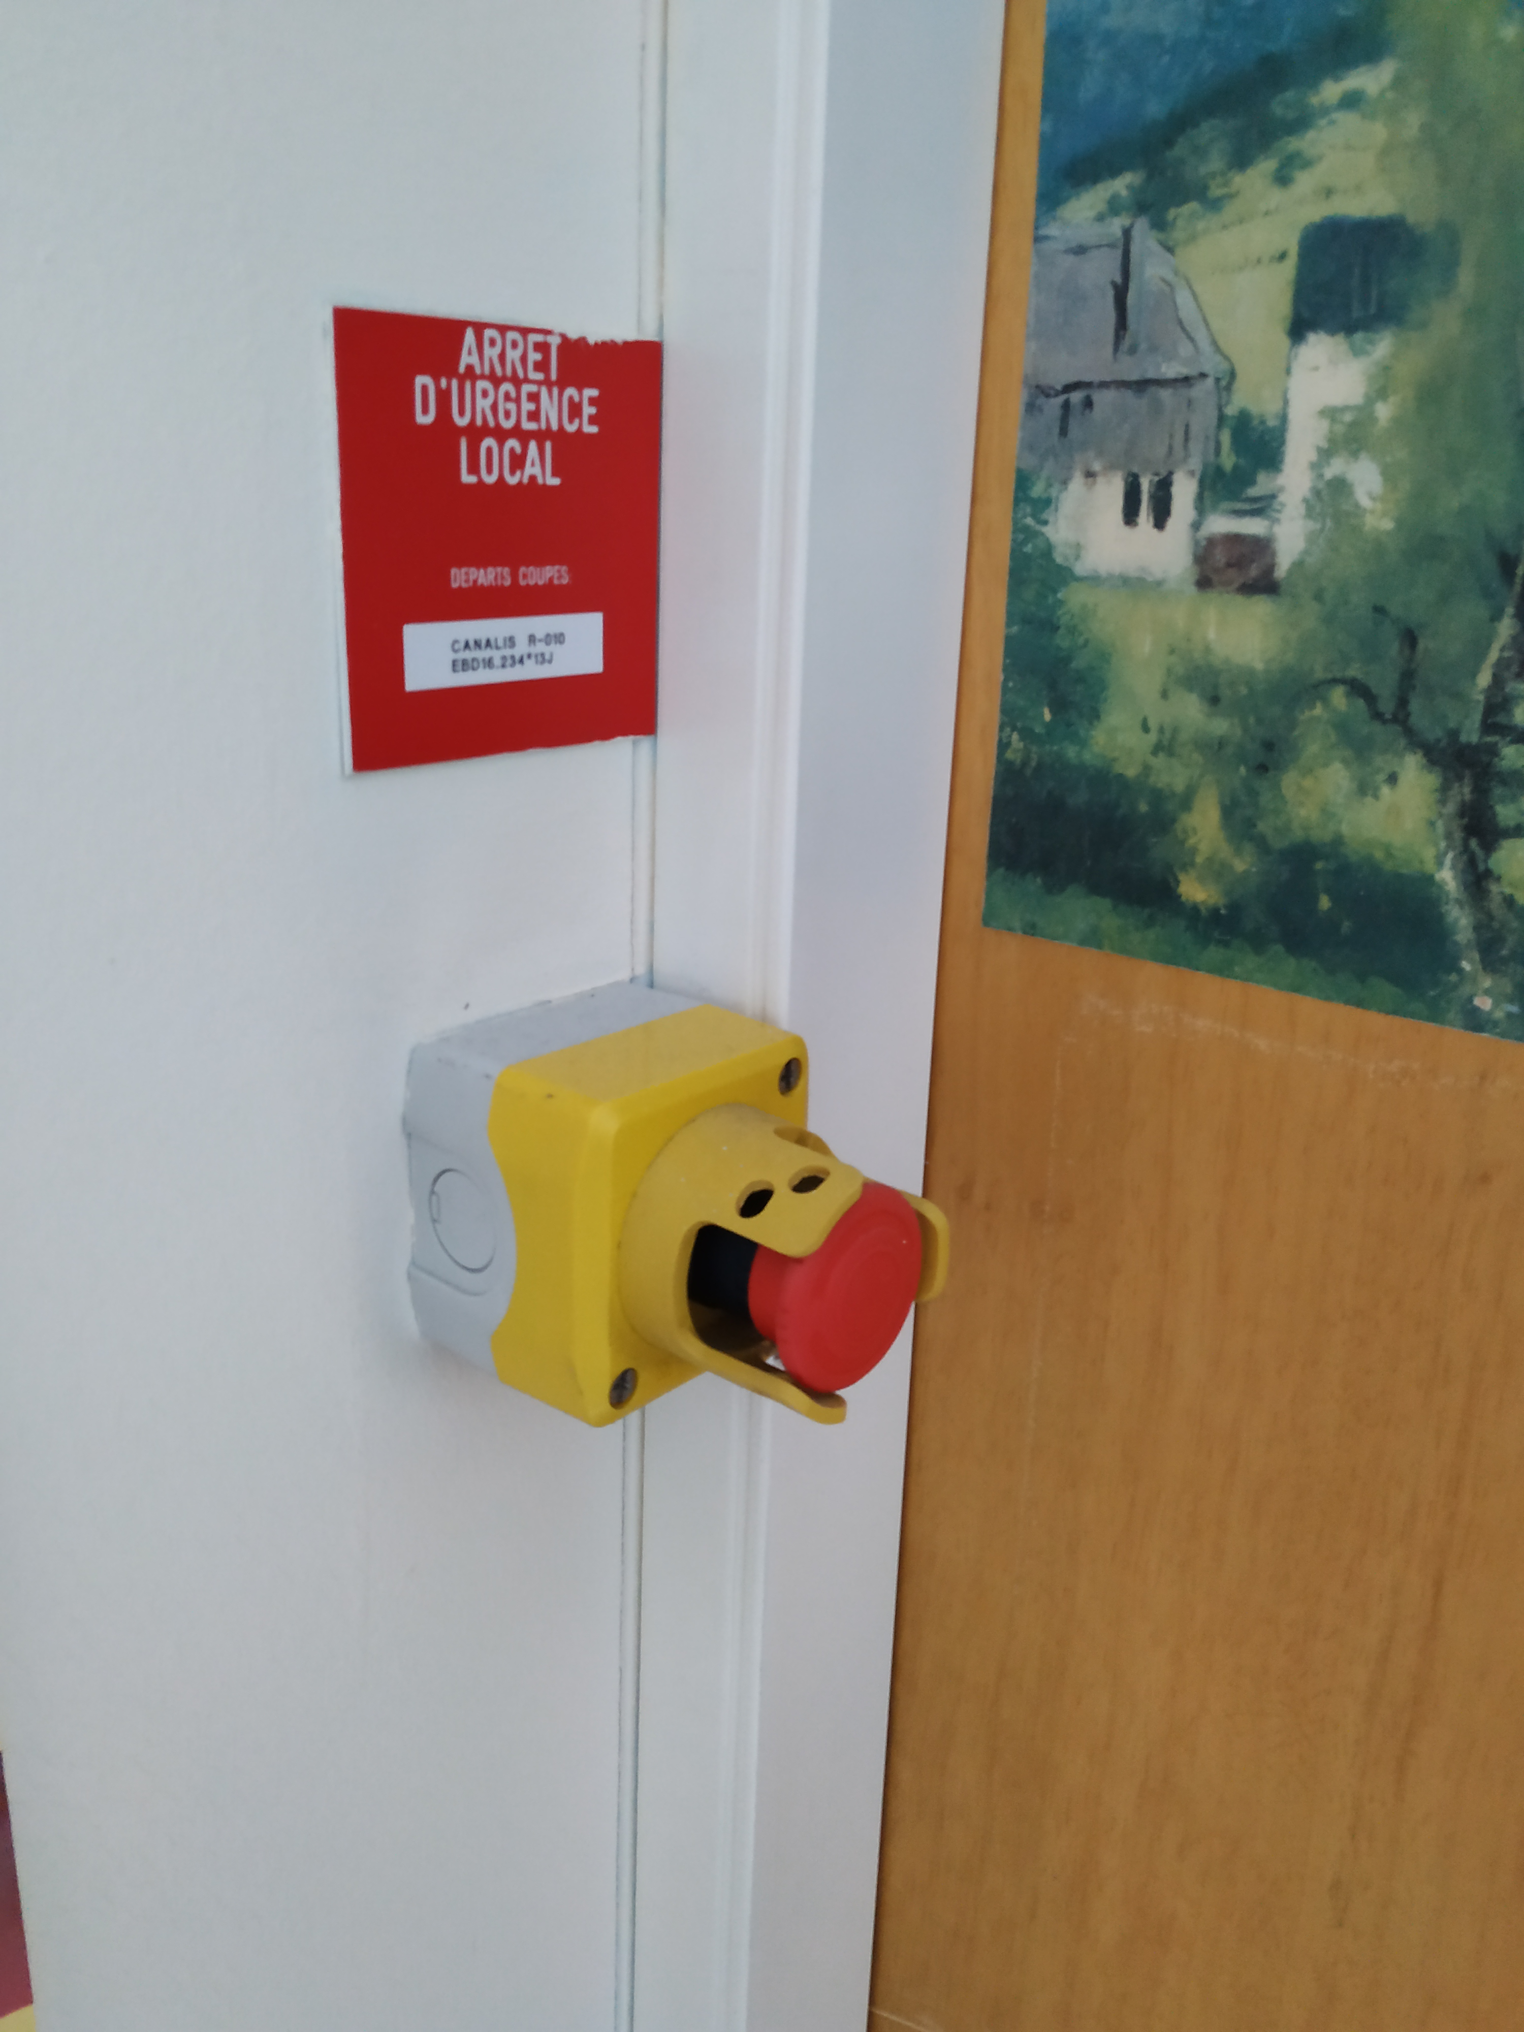
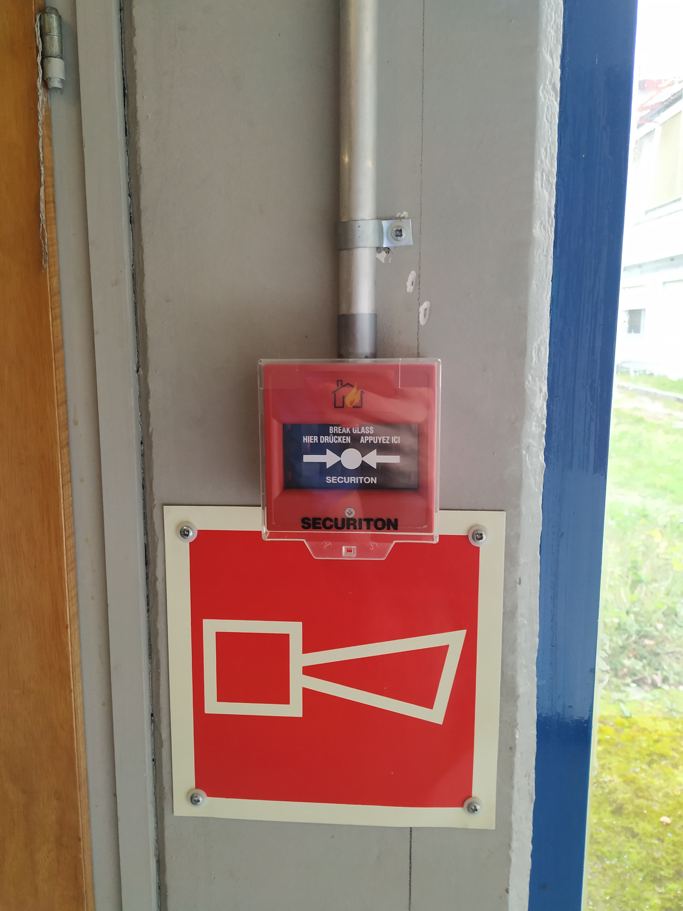
AUL Testing - Reminder
AUG EN-EL
AUL TSO
Coupure d’urgence (mechanical switch)
No test required! But still a good idea if you can…
Evacuation Alarm BE-ICS
If in doubt, ask me!

Slide 4
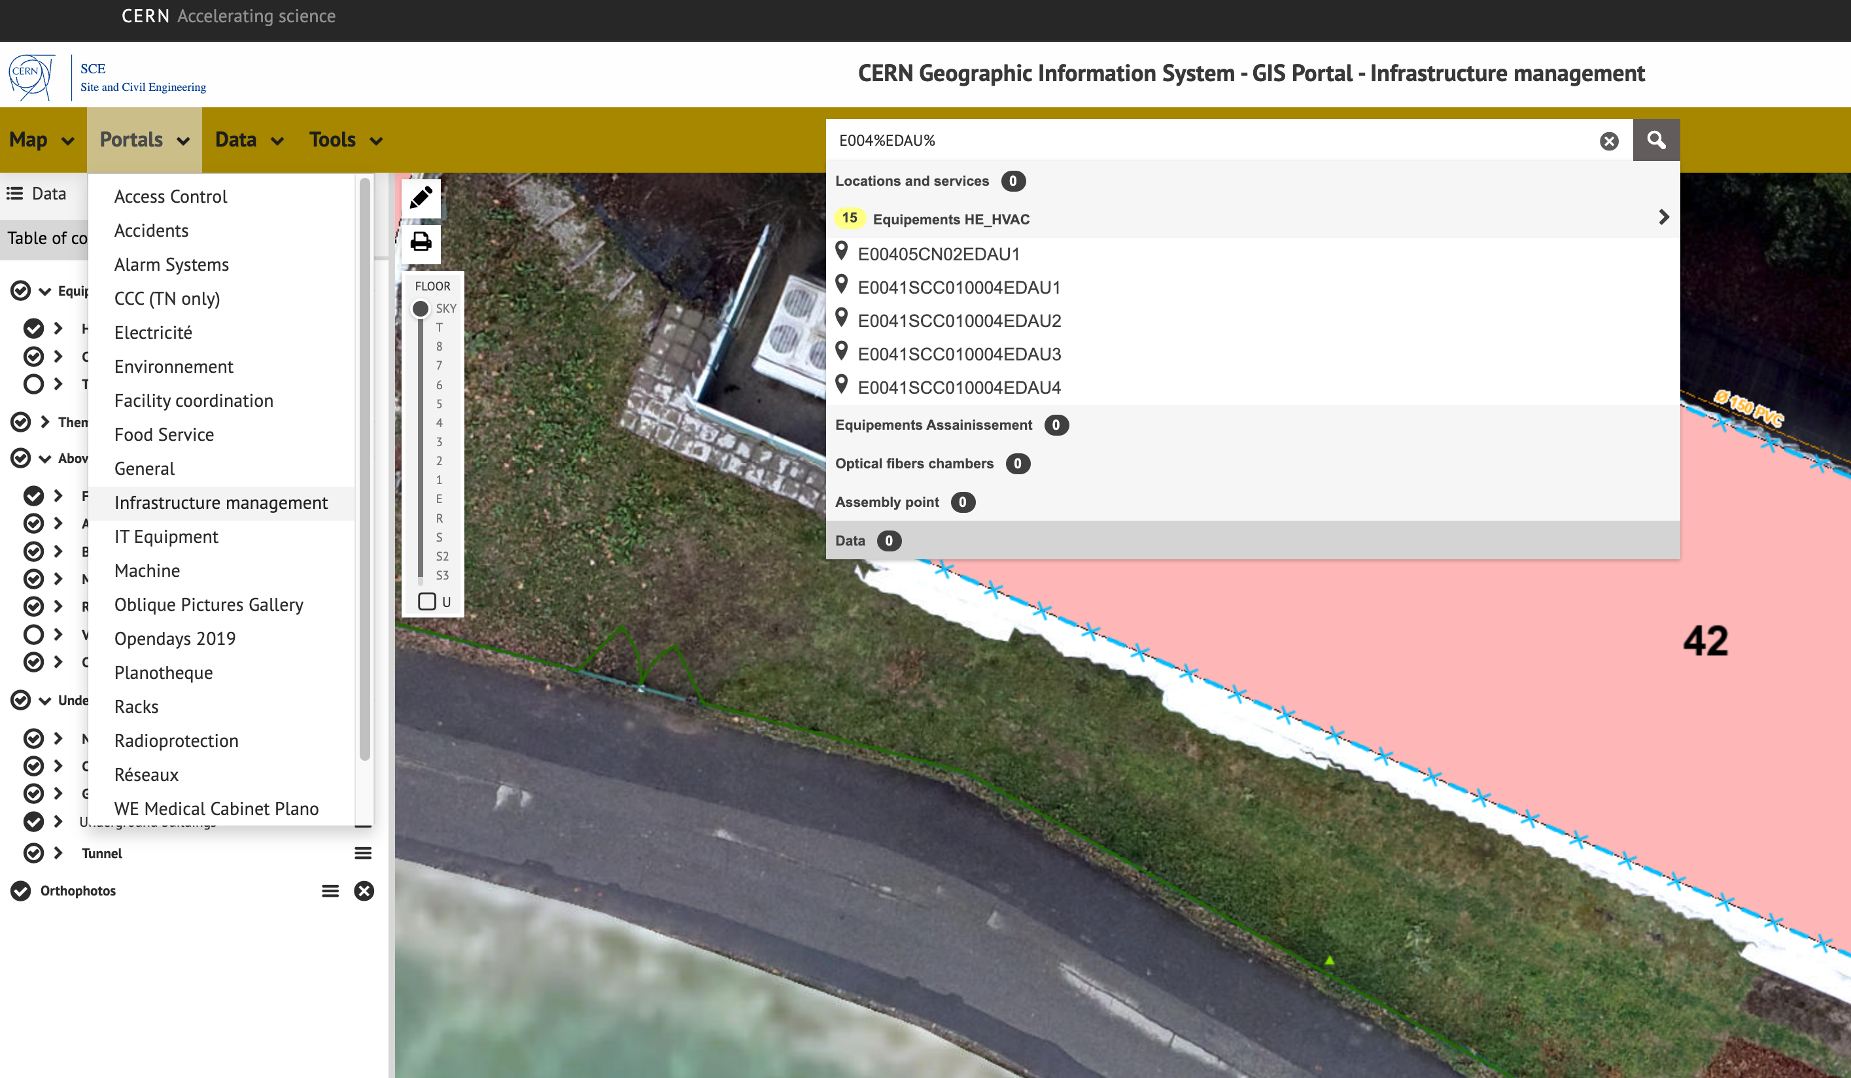
AUL Databases
Efforts are underway with SCE and EN/EL to standardize how AUL are registered in databases (EAM).
Currently:
Machine buildings (EN/EL) – not registered in EAM
Tertiary buildings (SCE) – high percentage registered in EAM
Find my AUL: GIS|Infrastructure management, E%+Building Number+ %EDAU%

Slide 5
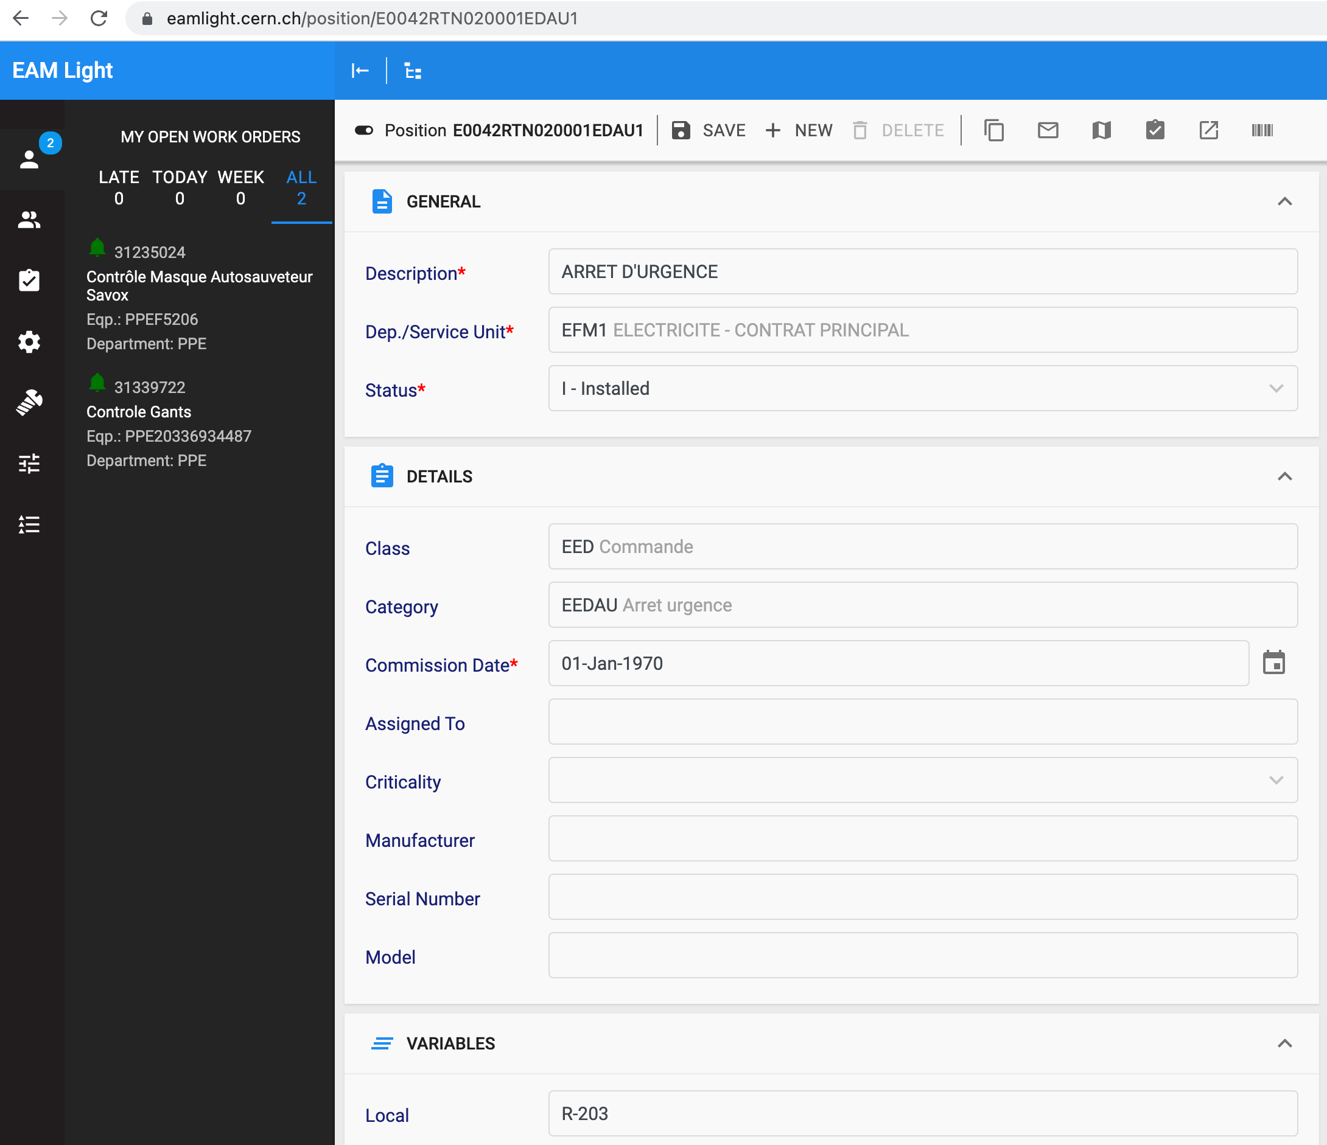
How to check in EAMLight
Only works for Tertiary Buildings right now (SCE)
Input the following search string:
E%+Building number + %EDAU%
It will return any AUL listed in your building.
You can locate them in GIS via the map button.

Slide 6
The AUL test process:
Identify AUL buttons, and if possible affected circuits
Identify means of reset (habilitation electrique required if entering a switchboard)
Inform occupants
Push buttons, verify correct function and labels.
Reset button and circuit breakers.
Document in EDMS.
Most buttons at CERN (90%+) act on MN coils within the switchboard, a habilitation electrique is needed in this case; call me and I will assist you!
You may also need a special key to reset the button – I have one!
I will also inform SCE or EN/EL so they are available if something goes wrong (e.g. power doesn’t come back on)

