Slide 1

Safety Incident Management
EP Department

Slide 2
2021 - SIM Rule and Guideline
SR-SIM Responsibility in matters of Safety Incident Management (SIM) at CERN: https://edms.cern.ch/ui/file/2583792/LAST_RELEASED/SR-SIM_EN.pdf
SG-SIM-0-0-1 Implementation of the Safety regulation SR-SIM (Guideline): https://edms.cern.ch/ui/file/2668488/LAST_RELEASED/SG-SIM-0-0-1_EN.pdf
Definition:
Safety Incident: an unintended event or situation that has non-negligible, negative consequences or potential consequences from the point of view of Safety
Replace the A2 code
i.e. unsafe situations, near misses or accidents

Slide 3
Incident Declaration
From the rule SR-SIM:
Any person that is involved in-, witnessing or that becomes otherwise aware of a Safety Incident shall:
  promptly notify it to the appropriate CERN services if immediate action is required; and
  fill in a Safety Incident declaration form within 24 hours from the occurrence or discovery of the Safety Incident, whichever is the earlier.

Slide 4
Incident Declaration
From the rule SR-SIM:
Any person that is involved in-, witnessing or that becomes otherwise aware of a Safety Incident shall:
  promptly notify it to the appropriate CERN services if immediate action is required; and
  fill in a Safety Incident declaration form within 24 hours from the occurrence or discovery of the Safety Incident, whichever is the earlier.

Slide 5
Incident Declaration
From the rule SR-SIM:
Any person that is involved in-, witnessing or that becomes otherwise aware of a Safety Incident shall:
  promptly notify it to the appropriate CERN services if immediate action is required; and
Call Fire Brigade at +41 227674444 in case of emergency or if immediate action is required
In addition, it is strongly suggested to contact further Safety Officers/services as:
DSO/LEXGLIMOS (very important! We can help you with the coordination of the actions to be done)
Equipment or Location Responsible
…

Slide 6
Incident Declaration
From the rule SR-SIM:
Any person that is involved in-, witnessing or that becomes otherwise aware of a Safety Incident shall:
  promptly notify it to the appropriate CERN services if immediate action is required; and
  fill in a Safety Incident declaration form within 24 hours from the occurrence or discovery of the Safety Incident, whichever is the earlier.

Slide 7
Incident Declaration
From the rule SR-SIM:
Any person that is involved in-, witnessing or that becomes otherwise aware of a Safety Incident shall:
  promptly notify it to the appropriate CERN services if immediate action is required; and
  fill in a Safety Incident declaration form within 24 hours from the occurrence or discovery of the Safety Incident, whichever is the earlier.
Even if 24h already passed, it is important that the declaration is done ASAP
The incident declaration is done on EDH via the Incident Declaration Form (IDF): https://edh.cern.ch/Document/General/IncidentDeclaration (Attention: IDF is the new A2 form!)

Slide 8
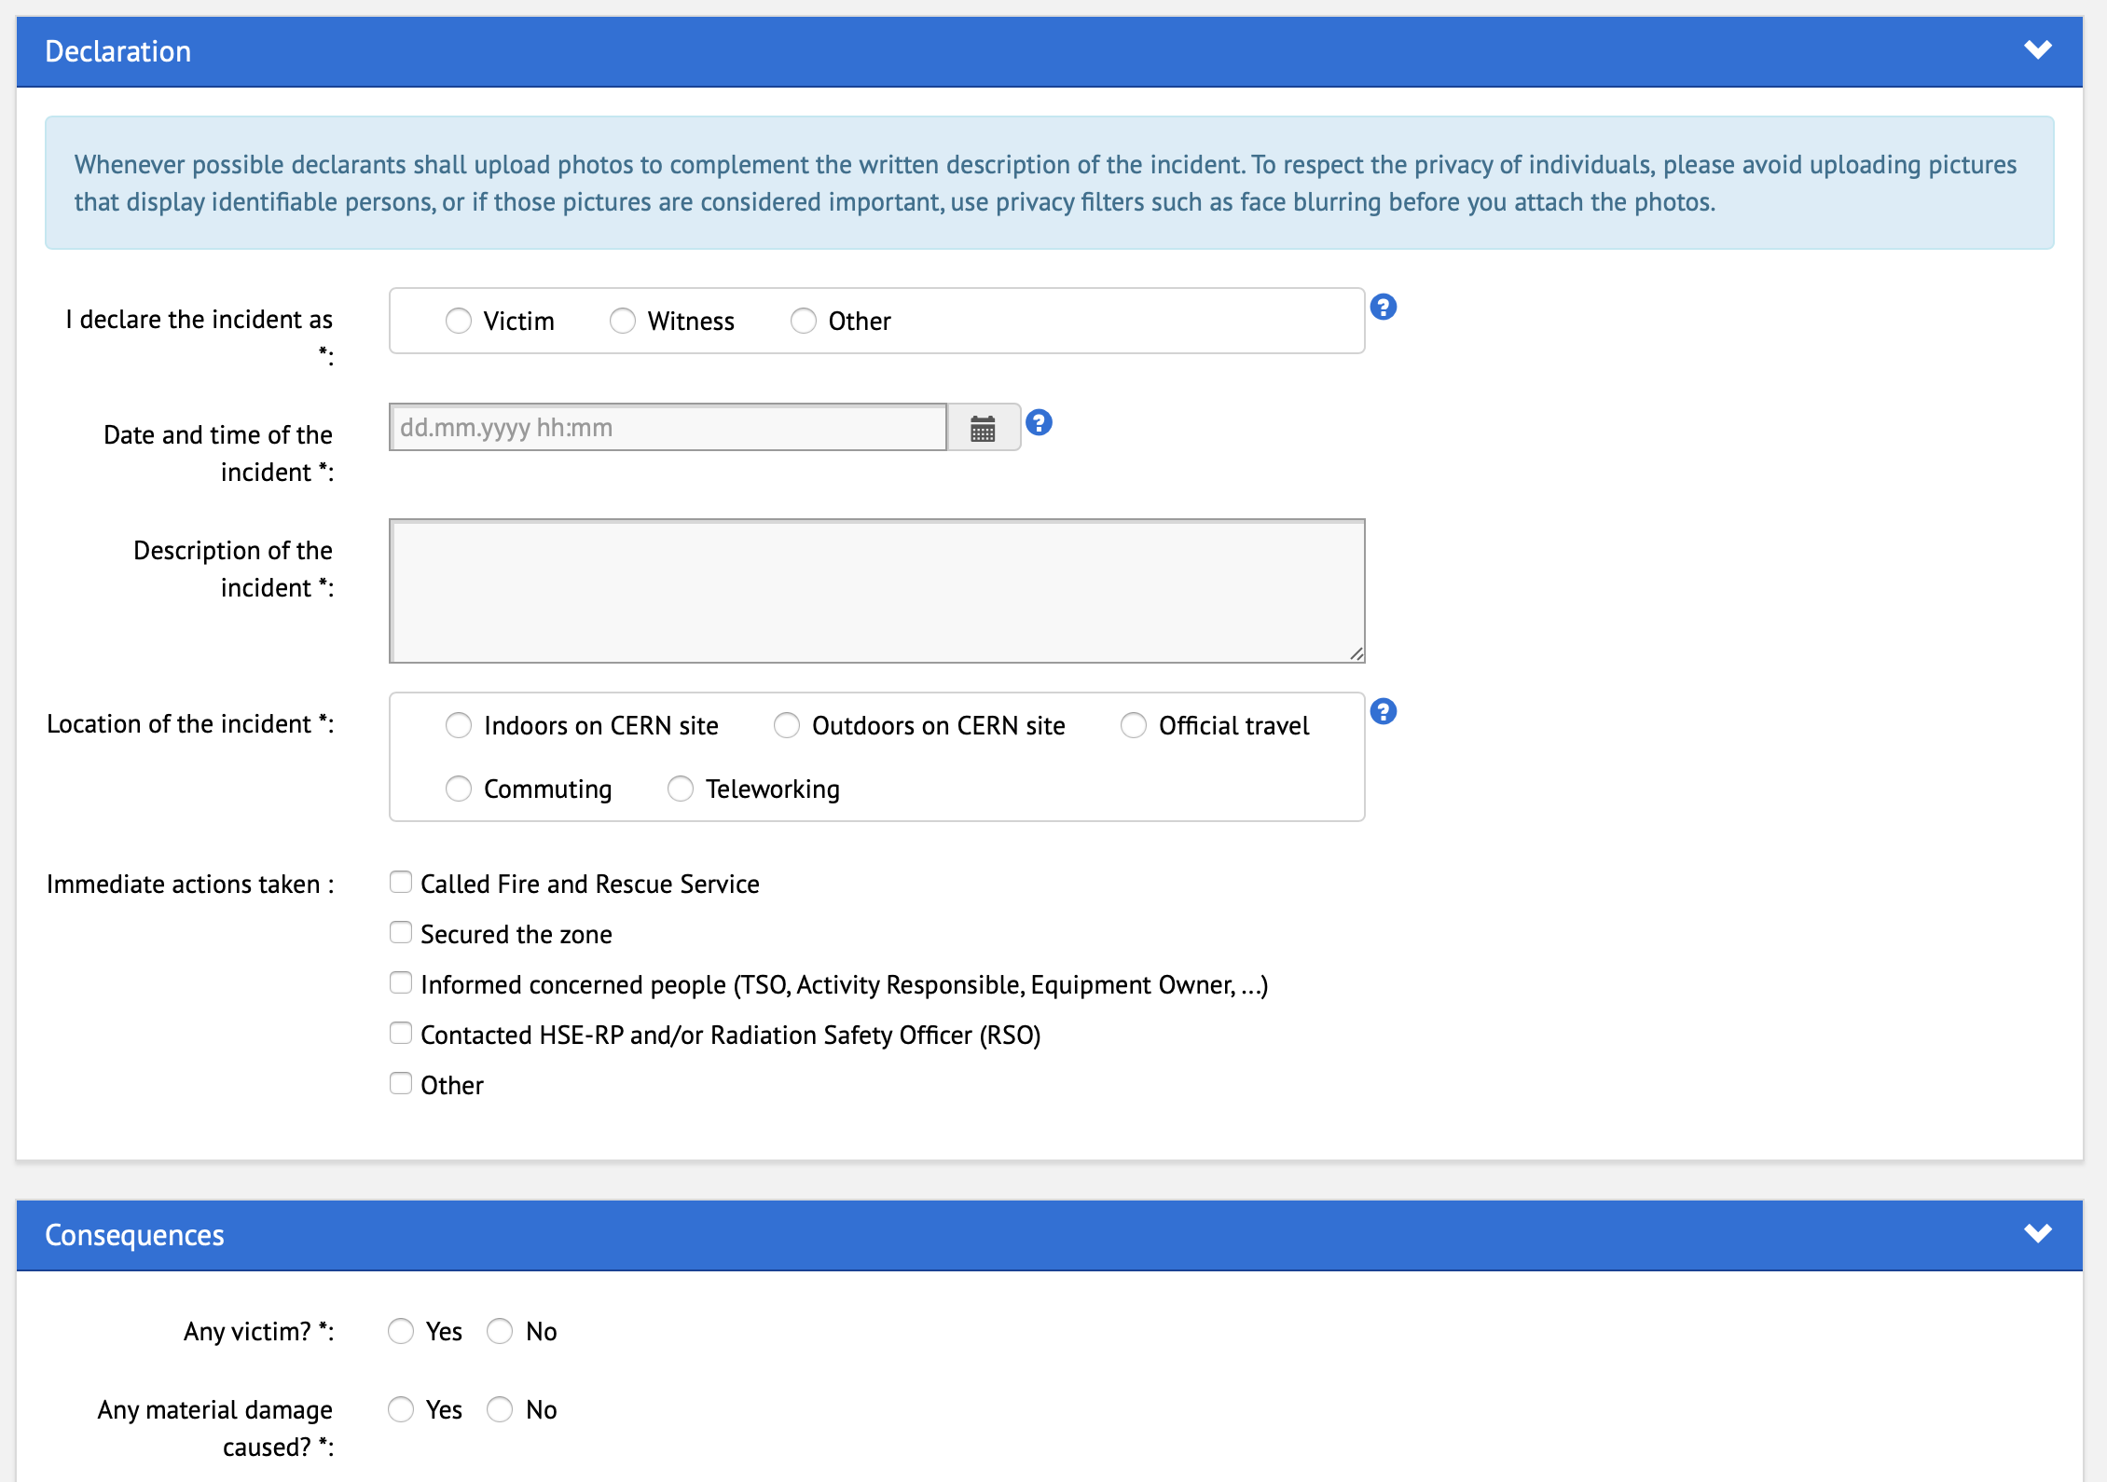
It is good practise to attach pictures or layouts
Contact us if you have any questions about how to fill it!

Slide 9
Classification and analysis
Safety Incidents shall be classified as either minor, serious or major in order to determine the procedure for their analysis and subsequent follow-up. Accidents giving rise to absence from work, trips and falls shall be classified at least as serious.
The classification is done by the related DSO/LEXGLIMOS.
Depending on the classification, a different procedure for the analysis (more/less detailed) is followed.
A member of the DSO Office or LEXGLIMOS (in the case of Large Experiments) will perform the incident analysis, in collaboration with HSE and the stakeholders involved (according to the specific classification).
It is important that the people involved are available for meetings on site/discussions in order to progress in the analysis and define the appropriate safety measures and actions.
The TSO is always involved!

Slide 10
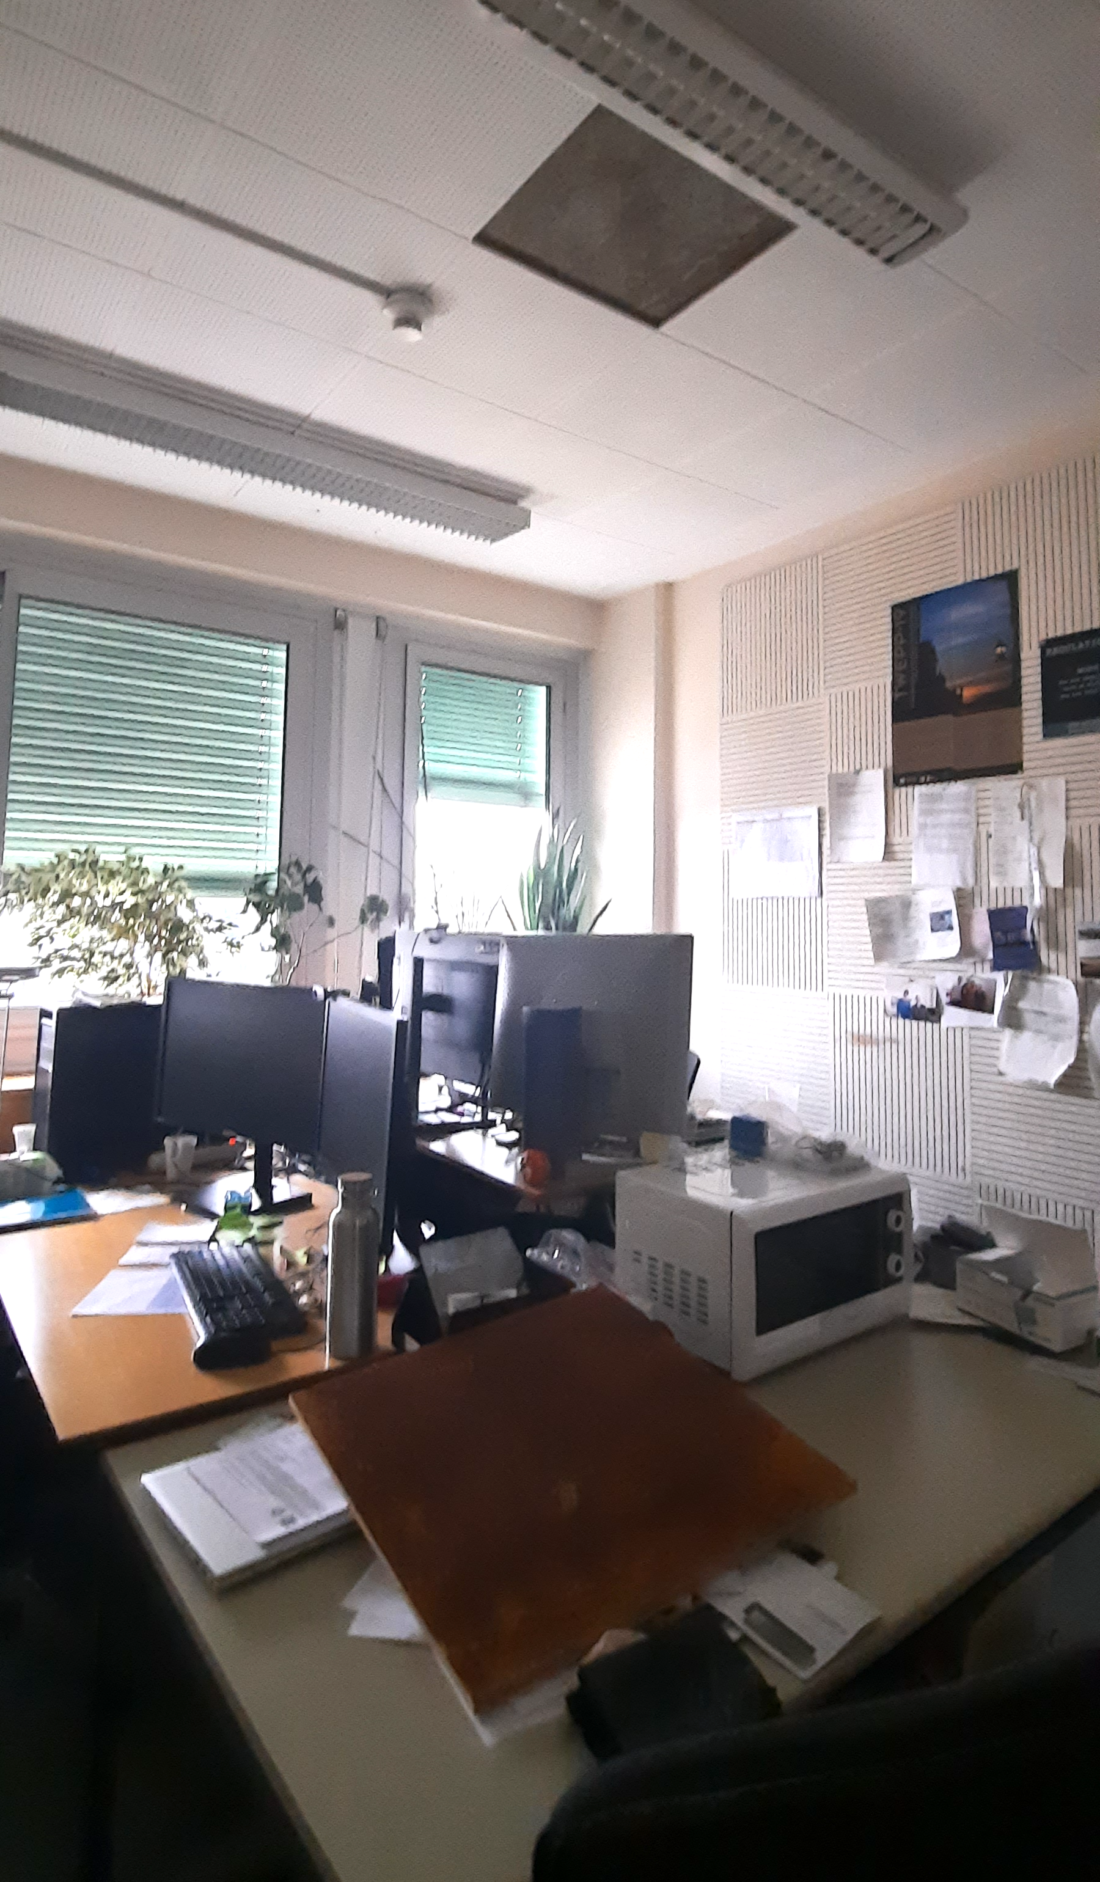
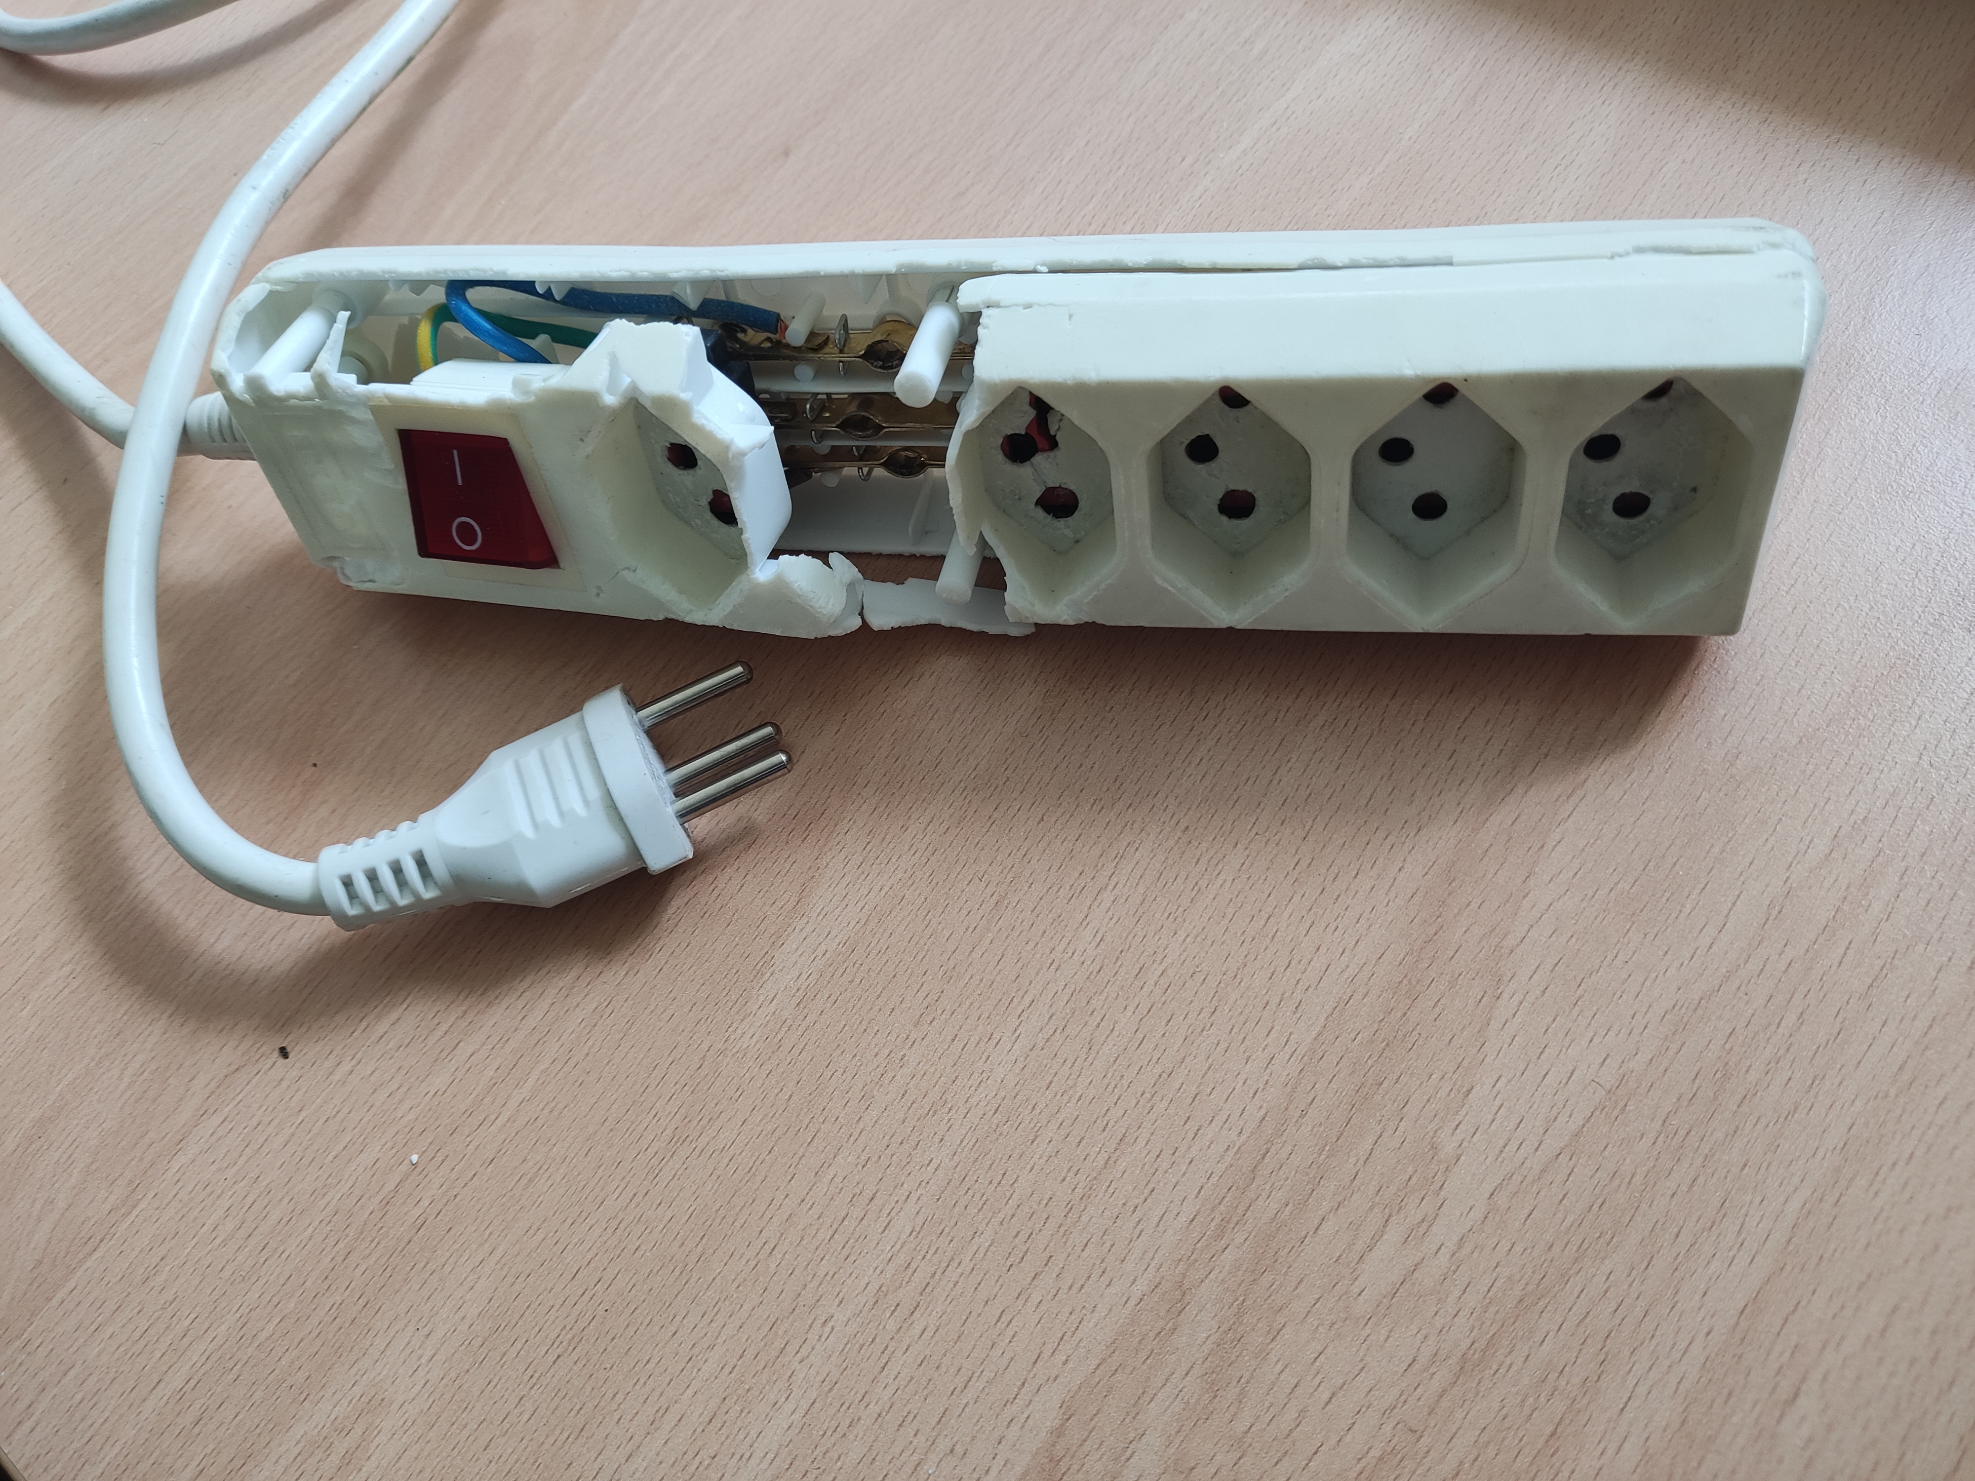
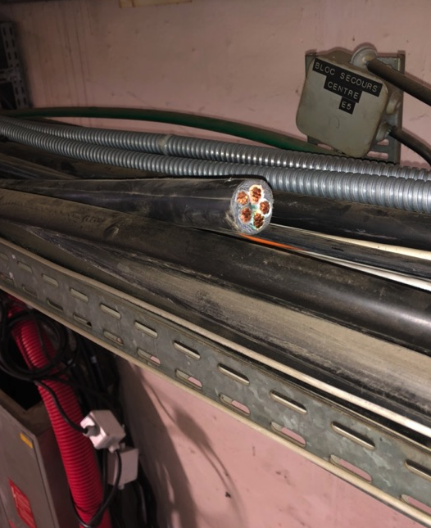
Common incidents in a building
The most common incidents in a building include:
Tile of false ceiling falling down inside offices
Trips and falls (especially in winter, in the absence of carpet at the entrance doors)
Electrical ones, as broken plugs, cut/damaged cables
Broken multi-plug
Cut cable under tension
Tile fell down on desk

Slide 11

Avoiding accidents
If you spot any dangerous situation (or even if you only have the doubt), contact the EP Safety Office - we will come an have a look with you
Check the latest periodical inspection of your building to make sure the remarks have been solved (mainly for the priority 1 and 2)
The TSOs receive the incidents reports and, periodically from HSE, the list of incidents happening at CERN - it is possible to visualise the list of open actions related to incidents in your building and check their status
Always alert the EP Safety Office in case of any doubt!

Slide 12
Thank you!
Any questions?

