Slide 1

Overview of electrical test on HL-LHC prototype diode stack
Introduction (Giorgio)
Summary of electrical test at 300K/77K (Giorgio)
Overview of electrical at SM18 (300K/4 K) (Gerard)
Conclusion
G. D’Angelo
2023-06-09

Slide 2
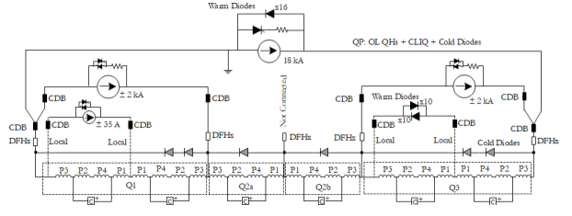
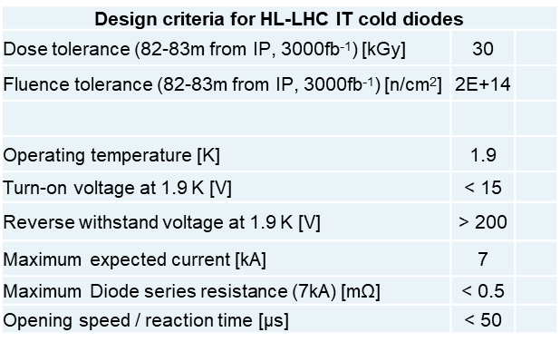
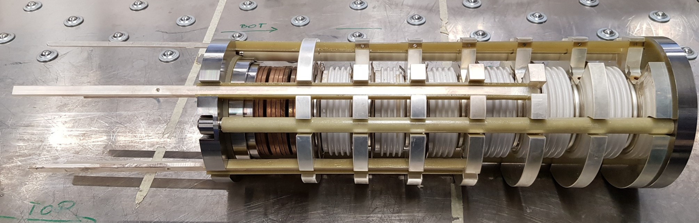
Introduction
Recall of electrical criteria for HL-LHC diodes:
The HL-LHC Proto1 is equipped with standard LHC diodes, to be used in HL-LHC string only. For HL-LHC, the specific very thin base diodes (same dimensions, more radiation tolerant), will be used.
Standard LHC diode press-packs (6)
Prototype HL-LHC diode stack

Slide 3
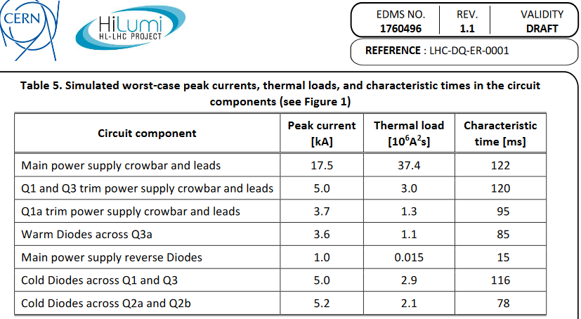
Circuit parameters
Electrical parameters of the circuit: worst case scenario with peak current of 7kA to 18kA for ~130 ms, MIIts <40 (Quench Protection studies from E. Ravaioli, EDMS 1760496).

Slide 4
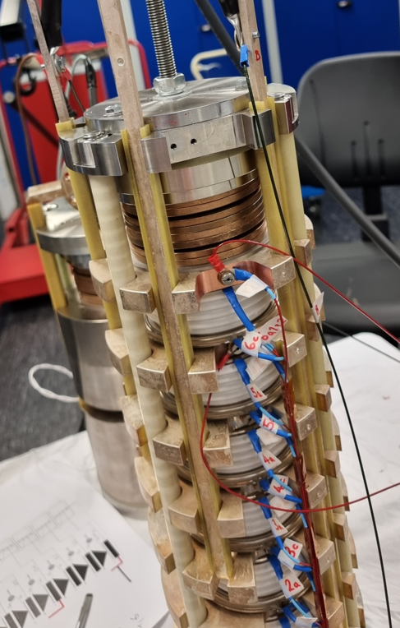
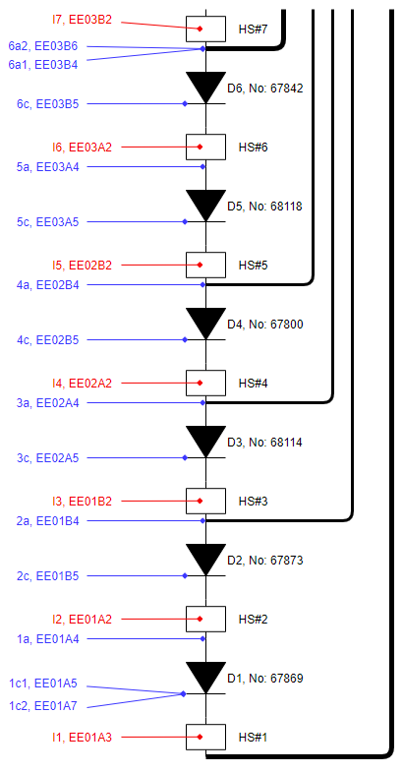
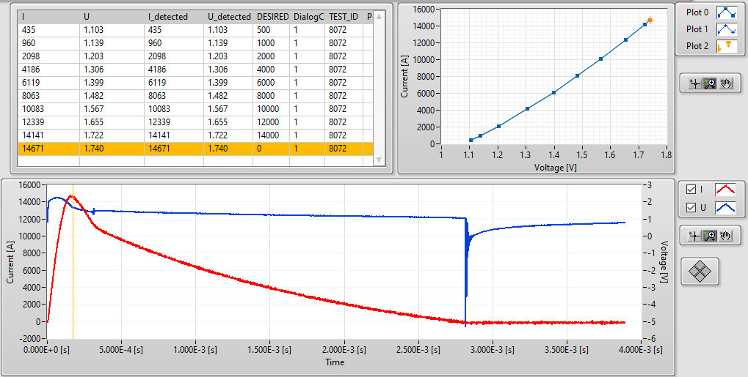
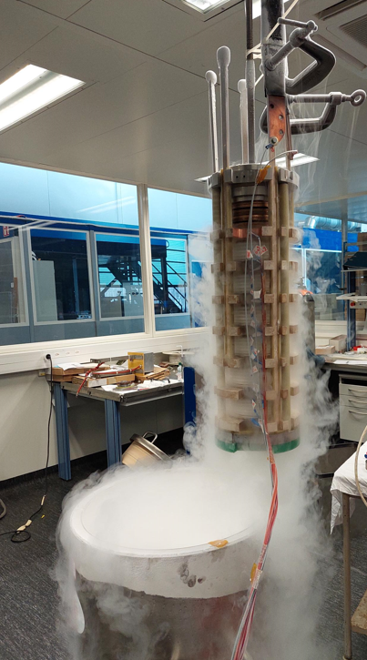
HL-LHC diode stack: electrical tests 300/80 K
The prototype stack was instrumented as for series production and standard set of measurements were performed, at 300K and 80K (LN2), in MPE lab.
Forward current measurement, up to 14.5kA:
Example of diode 67842, at 77K
Schematic of HL-LHC diode stack

Slide 5
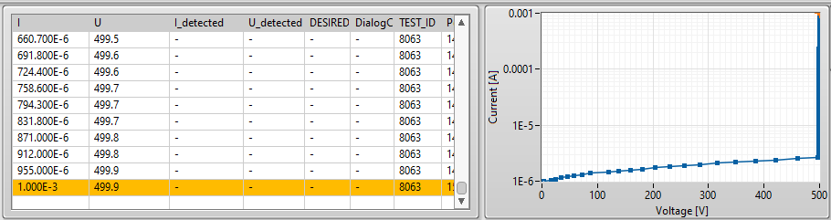
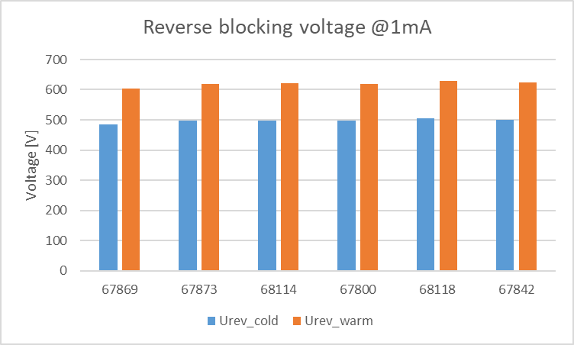
HL-LHC diode stack: electrical tests 300/80K
Reverse blocking voltage @1mA:
Example of diode 67842, at 77K
Schematic of HL-LHC diode stack

Slide 6
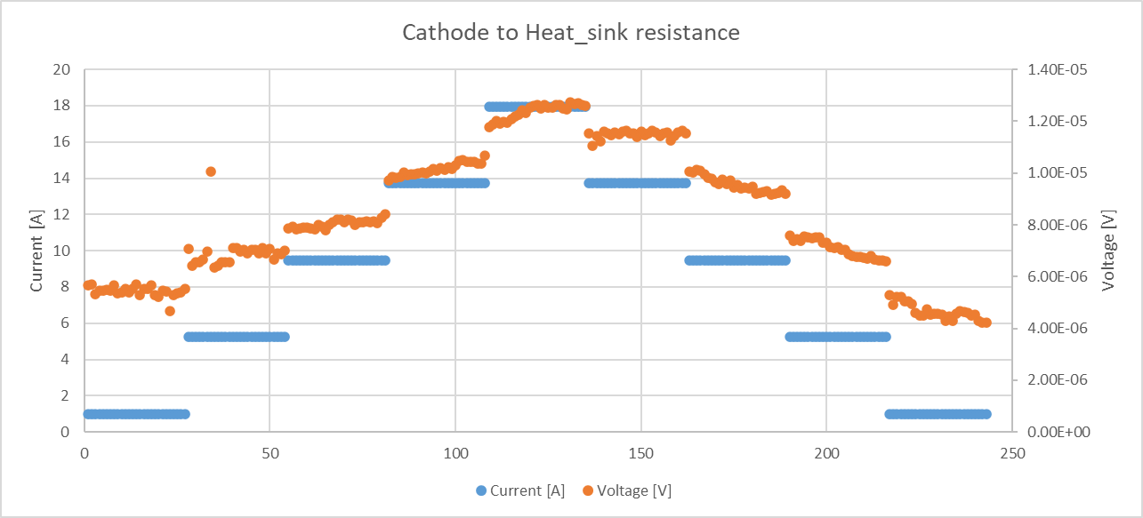
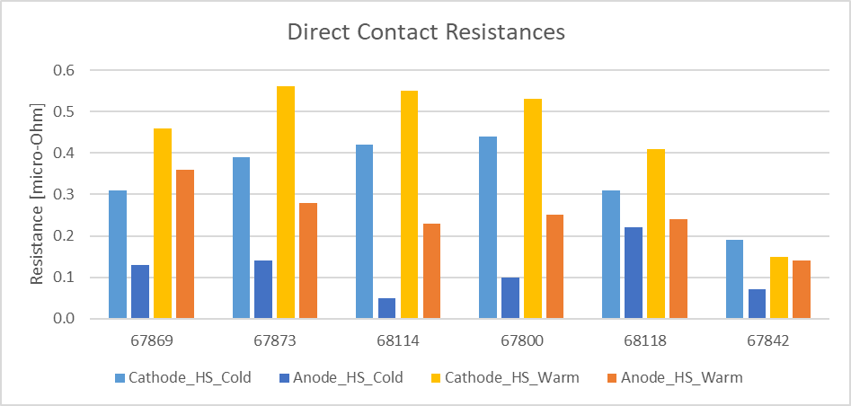
HL-LHC diode stack: electrical tests 300/80K
Direct Contact Resistance: between diodes and heat sinks, < 1 uOhm
Example of diode 67842, at 77K
Schematic of HL-LHC diode stack

Slide 7
HL-LHC diode stack: electrical tests 300/4 K, in SM18
The HL-LHC diode stack was prepared for cold test in SM18 and transported there.
Additional instrumentation was installed on the first prototype to monitor temperature profile during powering tests.
The goal of the test is to validate electrical performance of the stack at 4K, with high current pulses and thermal load:
  Verify thermal load of the stack vs temperature excursion
  Verify diode characteristics (Ufwd, Urev)
  Monitor contact resistances
See slides/reports from Gerard for overview of cold tests in SM18

Slide 8
HL-LHC diode stack: electrical tests 300/4 K, in SM18
See slides/reports from Gerard for overview of cold tests in SM18

Slide 9
Conclusions
The prototype HL-LHC diode stack, equipped with LHC standard diodes (same dimensions and similar electrical performances), with series instrumentation, has been tested at 300K and LN2. The electrical performance shows that the diode stack is mechanically sound.
The electrical test at 4K showed very good performance w.r.t. to high current pulses and thermal load:
  Current pulses of ~7.5 kA for more than 1 s.
  Thermal load of about 50 Miits with temperature excursion < 60K
  Electrical parameters of the diodes in line with LHC standard diodes.
The proto1 was submitted to more severe conditions as it will be used in IT string without any problem. Therefore, it could be used, as it is in the IT String.

Slide 10
Thank you for your attention !

Slide 11
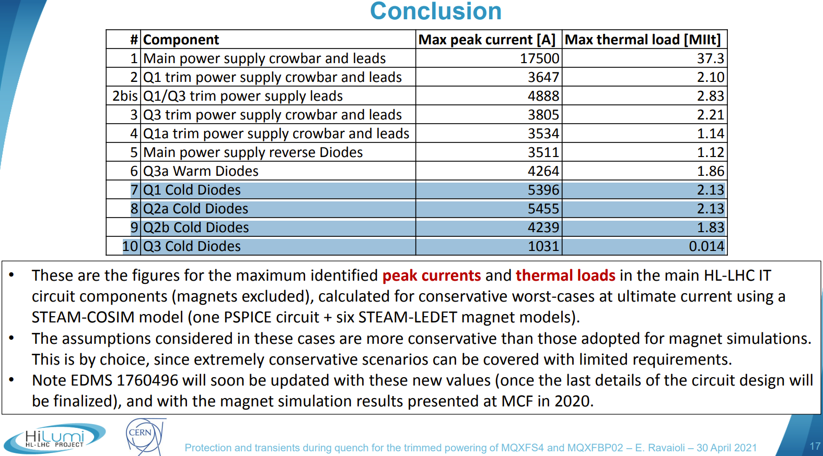
Circuit parameters, E. Ravaioli
Electrical parameters of the circuit: worst case scenario with peak current of 7kA to 18kA for ~130 ms, MIIts <40 (Quench Protection studies from E. Ravaioli, EDMS 1760496).

Slide 12
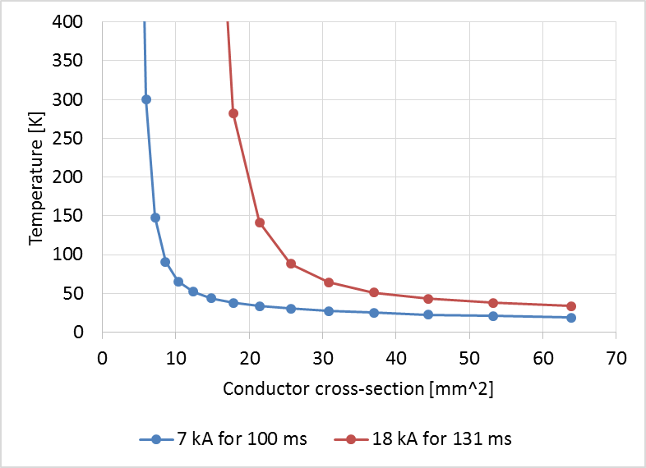
MQXF – Dimensioning of the cross-section of the Cold-Diode bus bar
Assumptions for Cold Diode worst considered case
Initial temperature: 4 K
Copper with RRR=100
0 magnetic field [no magneto-resistivity]
Case 1: Worst considered case:
worst-case that can realistically occur.
Peak current: 7 kA
Thermal load: 4.9 MIIt
Equivalent time, i.e. Thermal load / (Peak current)^2 : 100 ms
Recommended Cu cross-section: at least 20 mm²
Case 2: Diode carrying the full 18 kA during the magnet discharge:
case where the diode needs to carry the full current for the entire magnet discharge time. One cannot see an operational scenario when this could happen, but since the cold diodes are dimensioned for this case, it is considered.
Peak current: 18 kA
Thermal load: 42.5 MIIt
Equivalent time, i.e. Thermal load / (Peak current)^2 : 131 ms
Recommended Cu cross-section: at least 45 mm²

