Slide 1


The Availability Challenge:
Targets, shortfalls and game-changing opportunities
The Availability Challenge:
Targets, shortfalls and game-changing opportunities
Jack Heron
Acknowledgements: Lukas Felsberger, Jan Uythoven, Daniel Wollmann, Felix Rodriguez Mateos
8th June 2023

Slide 2

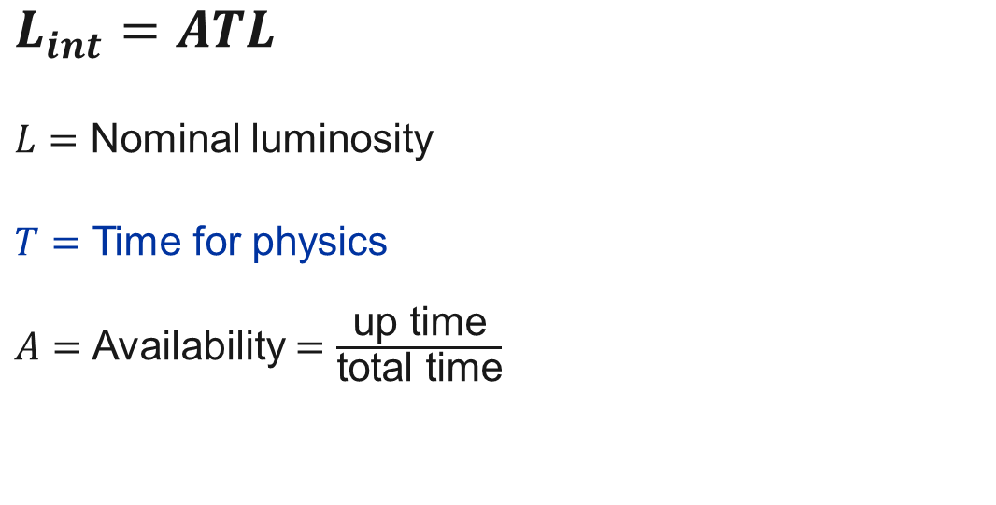
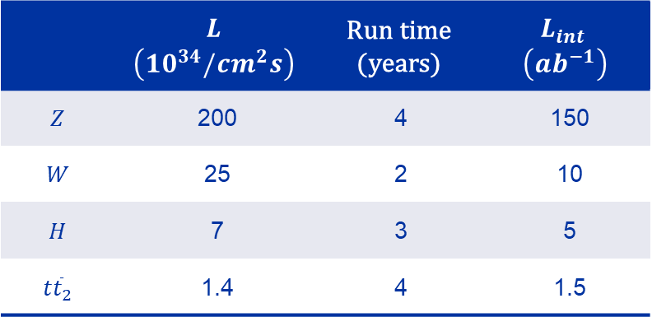
Availability and Integrated Luminosity
Integrated Luminosity:
FCC-ee Availability Requirement:
365 days
−120 (extended shutdowns)
− 30 (annual commissioning)
− 20 (machine development)
− 10 (technical stops)
185 days for physics
$$L_{int}=ATL$$
$L=$ Nominal luminosity
$T=$ Time for physics
$A=$ Availability $=\frac{\text{up} \text{time}}{\text{total} \text{time}}$
Goals:
 | $$L$$ $$\left(10^{34}/cm^{2}s\right)$$ | $$\text{Run} \text{time}$$ $$\text{(}\text{years}\text{)}$$ | $$L_{int}$$ $$\left(ab^{−1}\right)$$
$$Z$$ | 200 | 4 | 150
$$W$$ | 25 | 2 | 10
$$H$$ | 7 | 3 | 5
$$t{\overline{t}}_{2}$$ | 1.4 | 4 | 1.5
$$A_{FCC}≥80\%$$
A. Abada et al. “FCC-ee: The Lepton Collider: Future Circular Collider Conceptual Design Report Volume 2”, European Physical Journal: Special Topics, Vol. 228, No. 2, June 2019, pp. 377

Slide 3
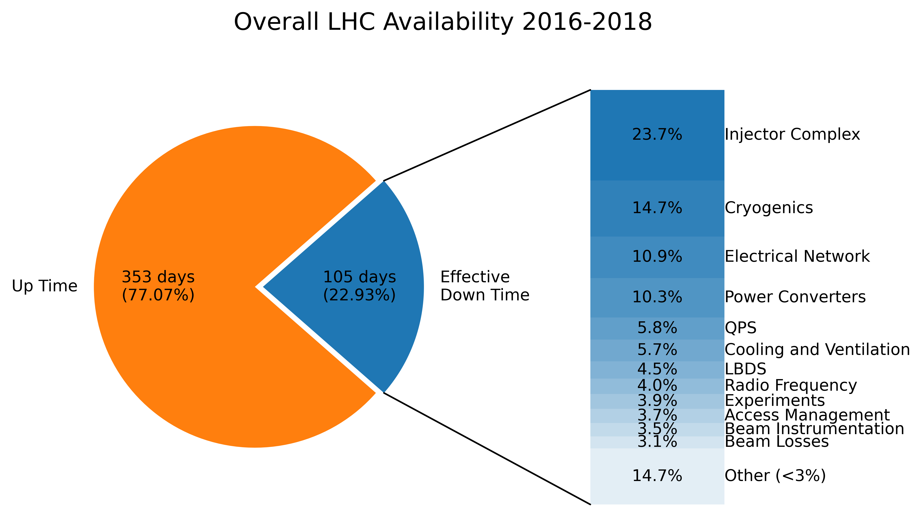
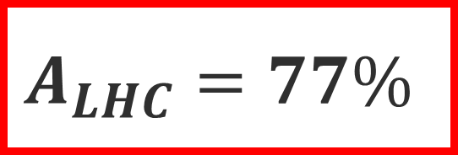
LHC Availability in Run 2 (2016-2018)
$$A_{LHC}=77\%$$
  Down time scales with number of components:
  For example:
  FCC-ee has orders of magnitude more components!
 | LHC | FCC-ee
Dipoles | 1232 | 2900 – 11600
RF cavities (accelerating) | 16 | 140 – 1232
“Accelerator Fault Tracker”, https://aft.cern.ch/
J. Bauche, et al., “FCC-ee Main Dipole Length Considerations (from the Magnet Point of View)”, FCC Week 2021, 26th March 2021.

Slide 4
Three-step approach
1. Targets
2. Shortfalls
  To reach overall 80% availability:
  “RF availability must be above…”
  “Top-up booster must be above…”
  …
  Based on current designs & similar systems:
  “RF Availability will likely be…”
  “Top-up booster will likely be…”
  …
3. Opportunities
  Where do we fall short?
  What can we do about this?
  Solution 1…
  Solution 2…

Slide 5
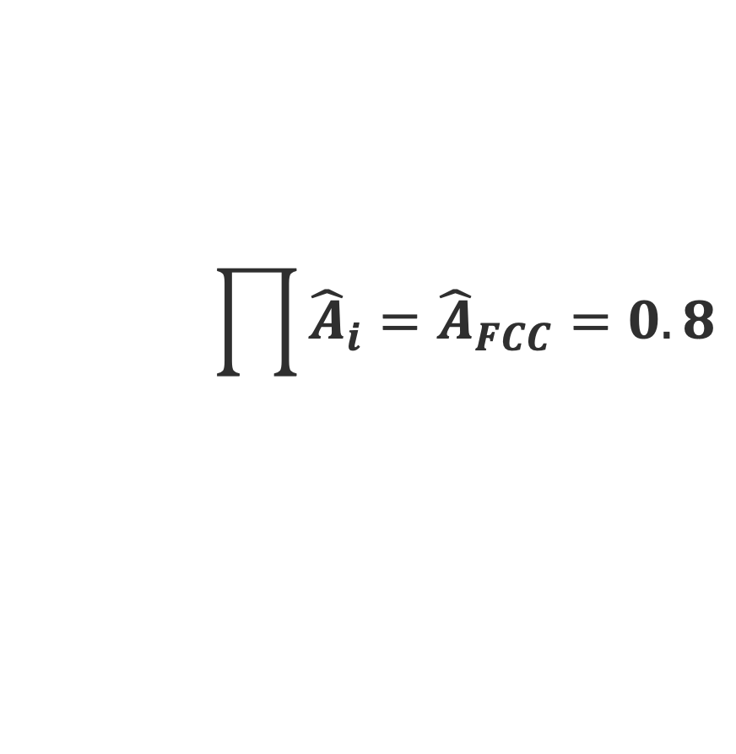
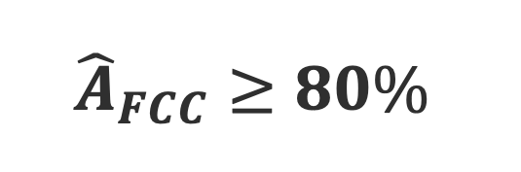
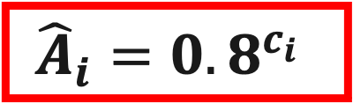
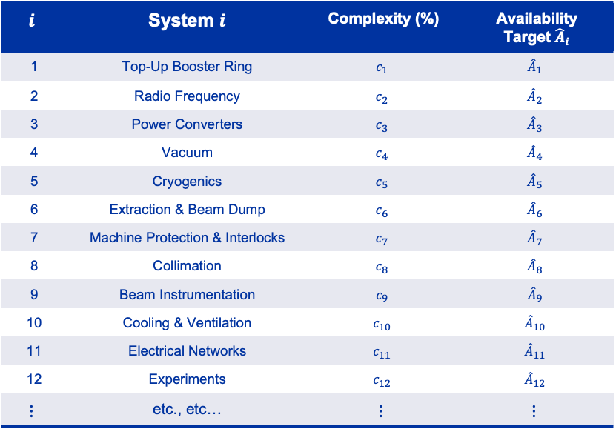

1. Targets ${\hat{A}}_{i}$
Allocate availability according to the “complexity” of assuring it.
$${\hat{A}}_{FCC}≥80\%$$
$$i$$ | System $i$ | Complexity (%) | Availability Target ${\hat{A}}_{i}$
1 | Top-Up Booster Ring | $$c_{1}$$ | $${\hat{A}}_{1}$$
2 | Radio Frequency | $$c_{2}$$ | $${\hat{A}}_{2}$$
3 | Power Converters | $$c_{3}$$ | $${\hat{A}}_{3}$$
4 | Vacuum | $$c_{4}$$ | $${\hat{A}}_{4}$$
5 | Cryogenics | $$c_{5}$$ | $${\hat{A}}_{5}$$
6 | Extraction & Beam Dump | $$c_{6}$$ | $${\hat{A}}_{6}$$
7 | Machine Protection & Interlocks | $$c_{7}$$ | $${\hat{A}}_{7}$$
8 | Collimation | $$c_{8}$$ | $${\hat{A}}_{8}$$
9 | Beam Instrumentation | $$c_{9}$$ | $${\hat{A}}_{9}$$
10 | Cooling & Ventilation | $$c_{10}$$ | $${\hat{A}}_{10}$$
11 | Electrical Networks | $$c_{11}$$ | $${\hat{A}}_{11}$$
12 | Experiments | $$c_{12}$$ | $${\hat{A}}_{12}$$
$$⋮$$ | etc., etc… | $$⋮$$ | $$⋮$$
$$\prod{{\hat{A}}_{i}={\hat{A}}_{FCC}=0.8}$$
$${\hat{A}}_{i}=0.8^{c_{i}}$$
Higher complexity $⟹$ Lower target
$$c_{1}>c_{2}>…>c_{N} ⟹ {\hat{A}}_{1}<{\hat{A}}_{2}<…<{\hat{A}}_{N}$$
Notes:
Mention how this was done for the FCC-hh some years ago

Slide 6


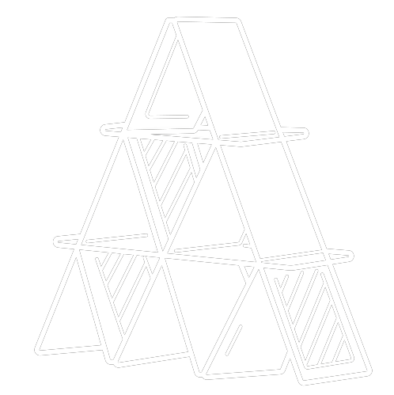





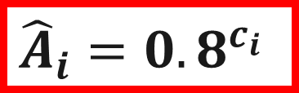

1. Targets ${\hat{A}}_{i}$
Seven scores define complexity $c_{i}$
System $i$ :
Input from 20 accelerator experts:
“Generalist” profile
Diverse backgrounds
Repair Time
Criticality
Intricacy
Liability
Complexity $c_{i}$
$${\hat{A}}_{i}={0.8}^{c_{i}}$$
Technical Maturity
Performance Time
Environment
O. Rey Orozco et al. “Availability Estimation Methods based on System Complexity”, CERN, Geneva, Switzerland, July 2017.
A. Apollonio et al. “Conclusions on FCC Availability Studies”, FCC Week 2018, Amsterdam, Netherlands.
A. Silvestri et al. “A new method for reliability allocation: Critical Flow Method”, Lecture Notes in Mechanical Engineering, Vol. 20, pp. 249-261, Jan 2015.
S. M. Seyed-Hosseini et al. “Reprioritization of failures in a system failure mode and effects analysis by decision making trial and evaluation laboratory technique”, Reliability Engineering and System Safety, Vol. 91, No. 8, pp. 872-881, 2006.

Slide 7
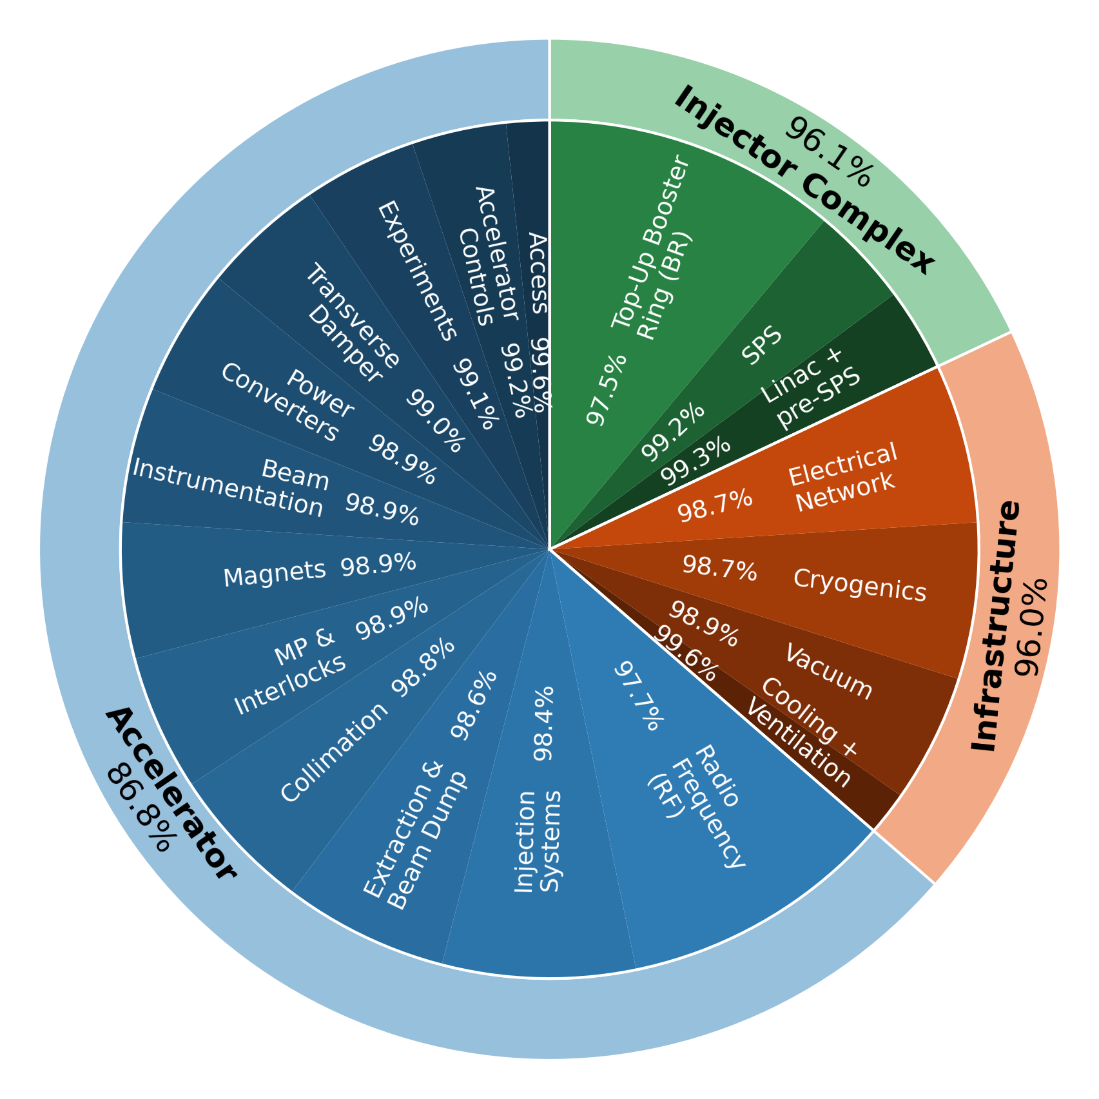
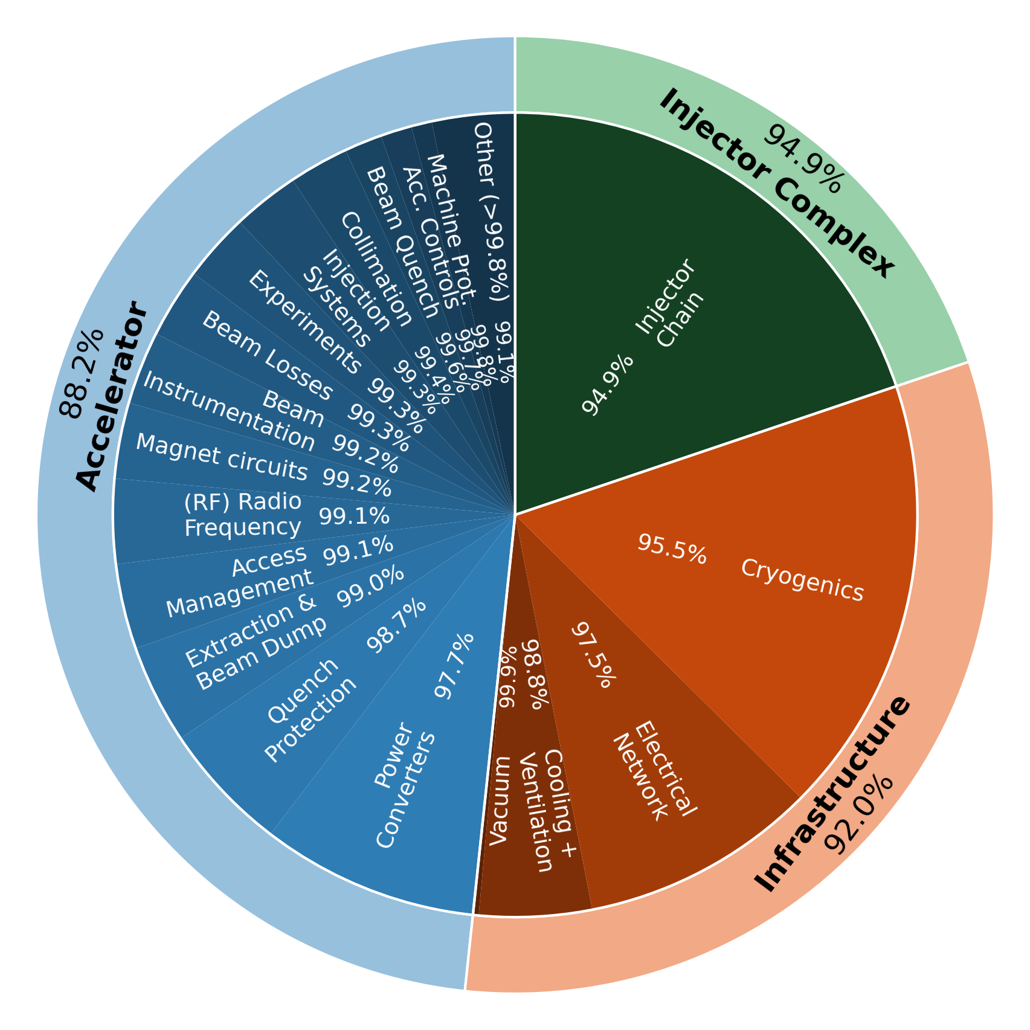
1. Targets ${\hat{A}}_{i}$
FCC-ee (targets)
LHC (achieved)

Slide 8
Three-step approach
1. Targets
2. Shortfalls
  To reach overall 80% availability:
  “RF availability must be above 97.7%”
  “Top-up booster must be above 97.5%”
  …
  Based on current designs & similar systems:
  “RF Availability will likely be…”
  “Top-up booster will likely be...”
  …
3. Opportunities
  Where do we fall short?
  What can we do about this?
  Solution 1…
  Solution 2…

Slide 9
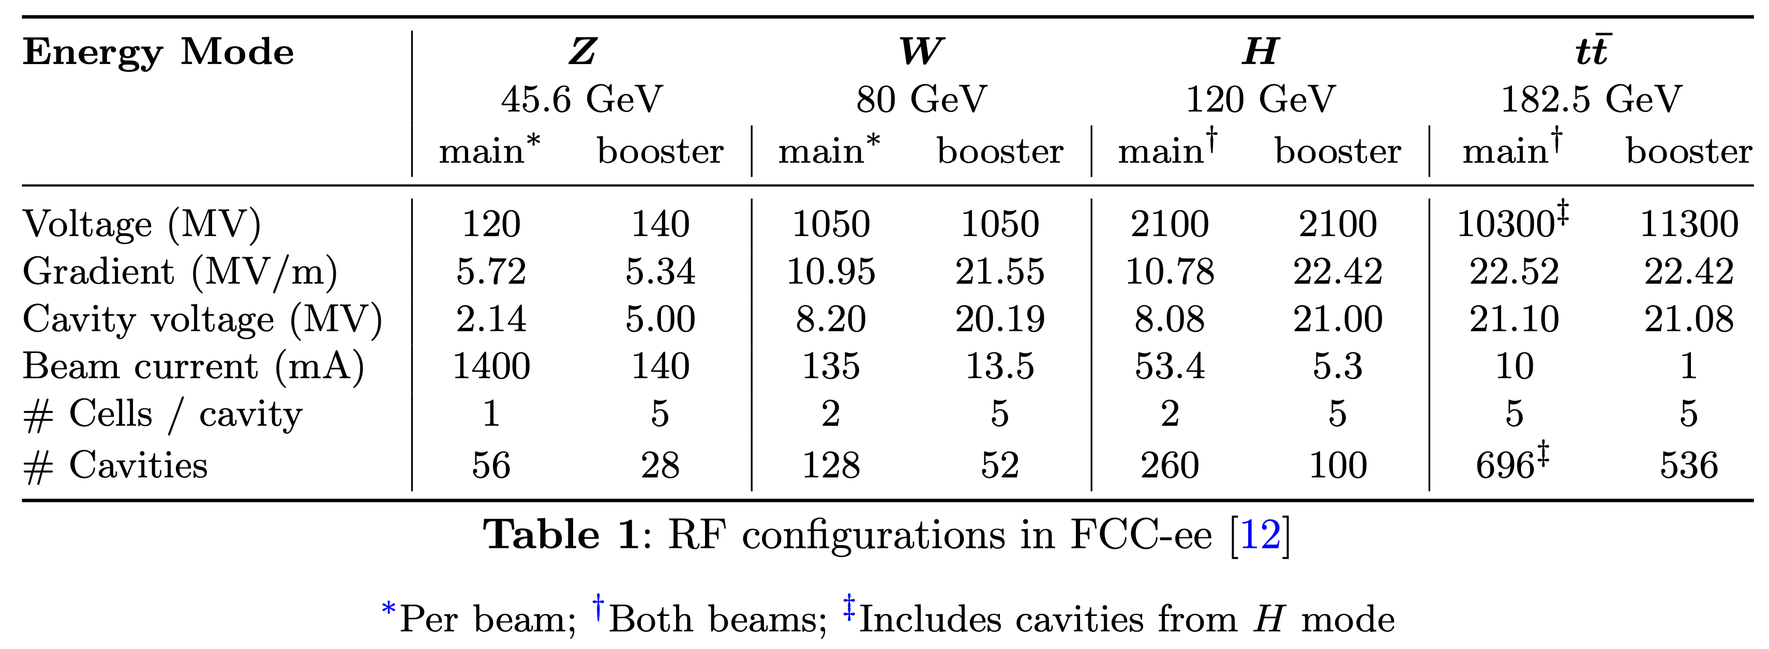


2. Shortfalls
Radio Frequency
(RF)
$Z, W$
$H, t\overline{t}$
High current, low voltage
140-308 cavities
RF trip = beam loss
Low current, high voltage
360-1232 cavities
10% voltage redundancy

Slide 10



2. Shortfalls
Technology Department
Machine Protection
Controls & Beam Studies
TE-MPE-CB
https://gitlab.cern.ch/availsim4/
Monte Carlo Simulation:
Phase Transitions:
States:
Default
Main RF failure
Available, no luminosity
Unavailable
Repair complete
Booster RF failure
Available, luminosity
Set Up
(10 min)
Fill
(5 min)
Adjust
(10 min)
Physics + Top-Up
Burn Off
10 min
5 min
10 min
Until Failure
60 min (or until Repair)
Down for Repair
(until repair)
Until Repair

Slide 11
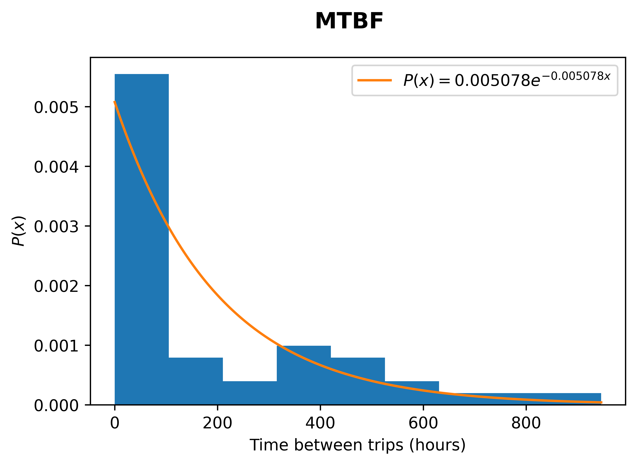
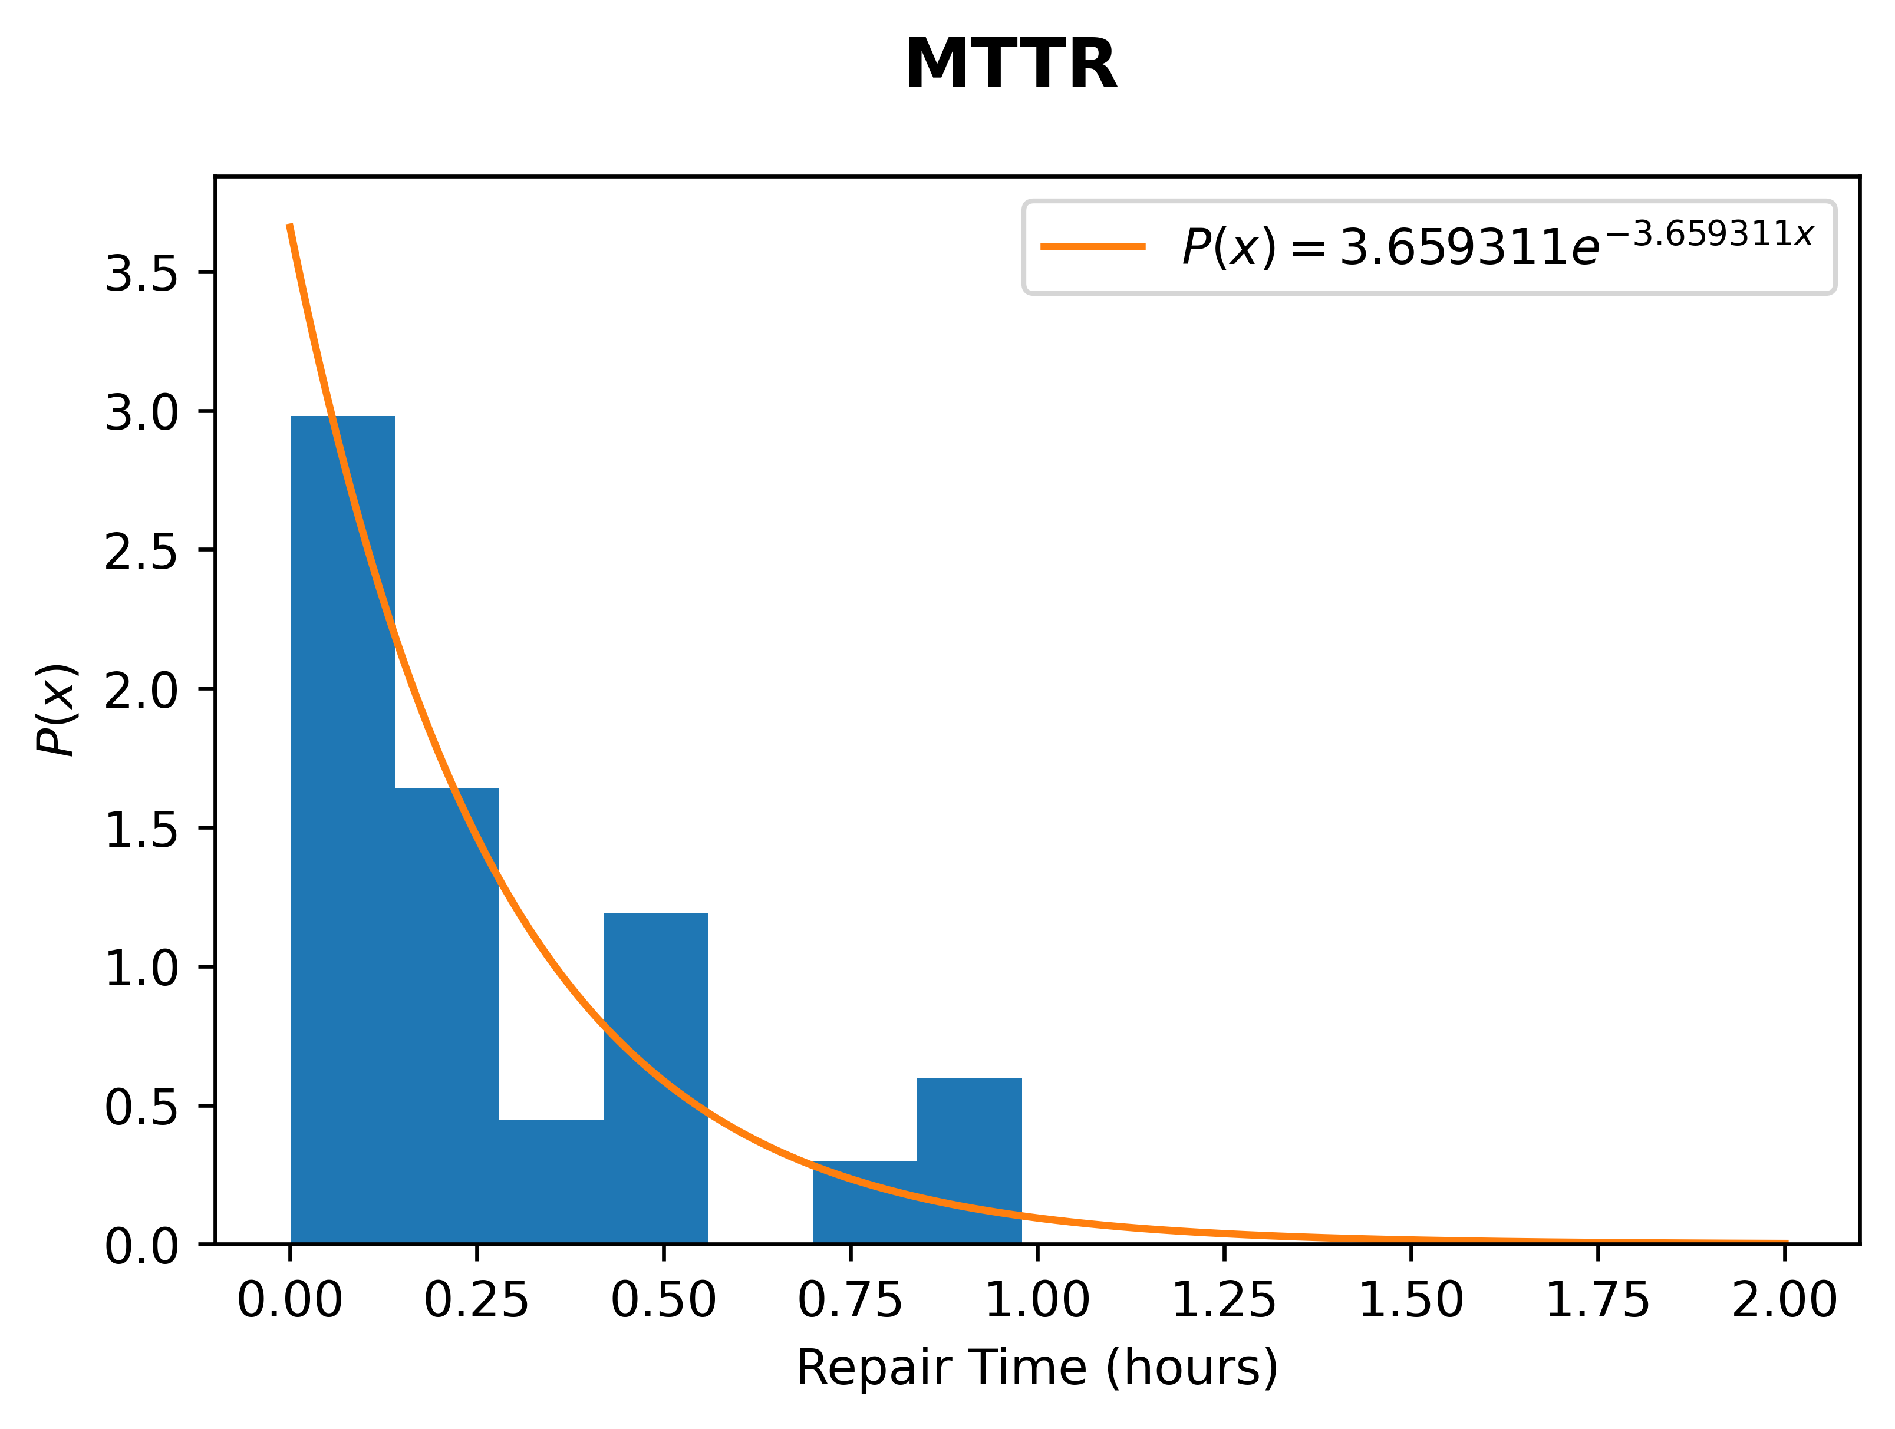
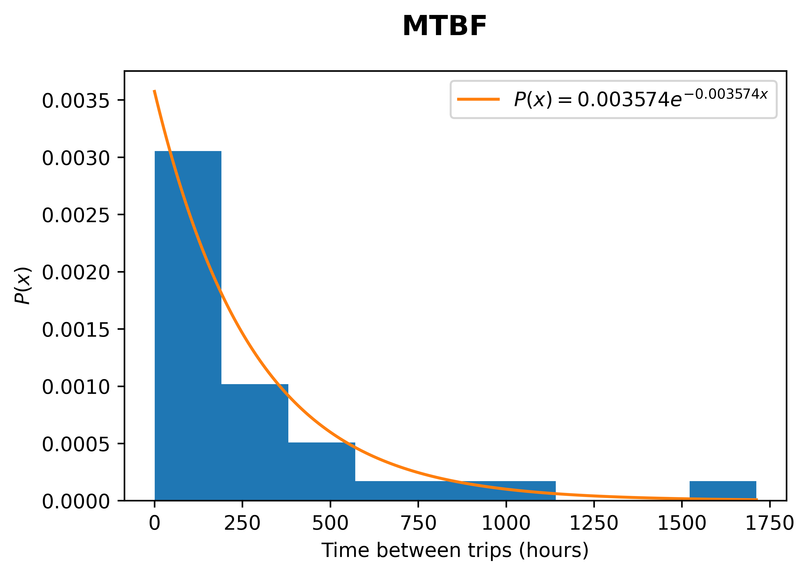
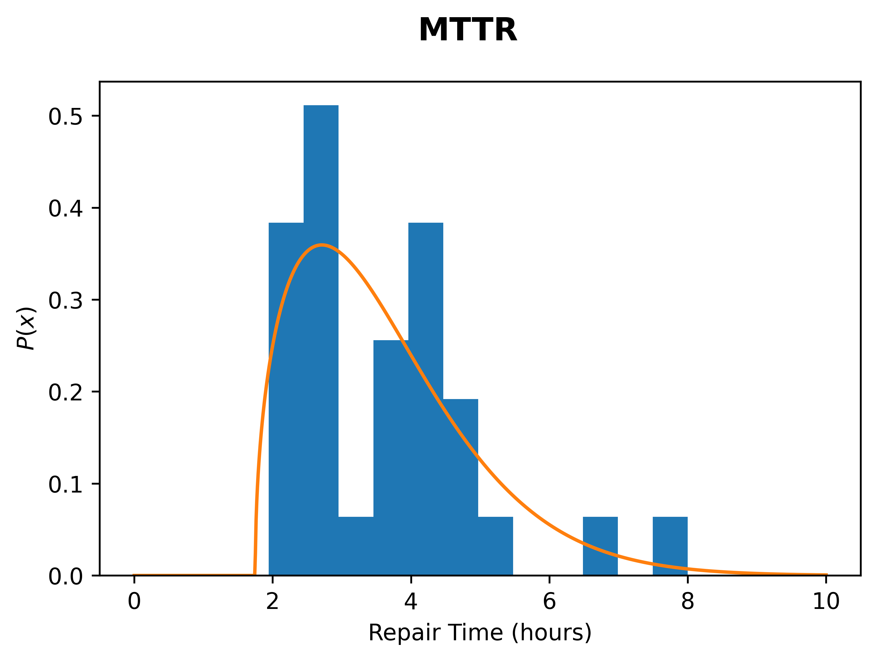
2. Shortfalls
94 RF Faults in LHC Run 2
Repair
< 1h
> 1h
Short Faults
Long Faults
Mean time before failure (MTBF)
Mean time to repair (MTTR)
Mean time before failure (MTBF)
Mean time to repair (MTTR)
Attempts to fix by remote reset
Drive time
(45 min)
  Repair achieved without human intervention
  E.g. by remote reset
  Achievable while beam is running
  Requires human intervention
  Add a 45 minute drive time for FCC-ee
  Must wait until system is “down for repair”

Slide 12
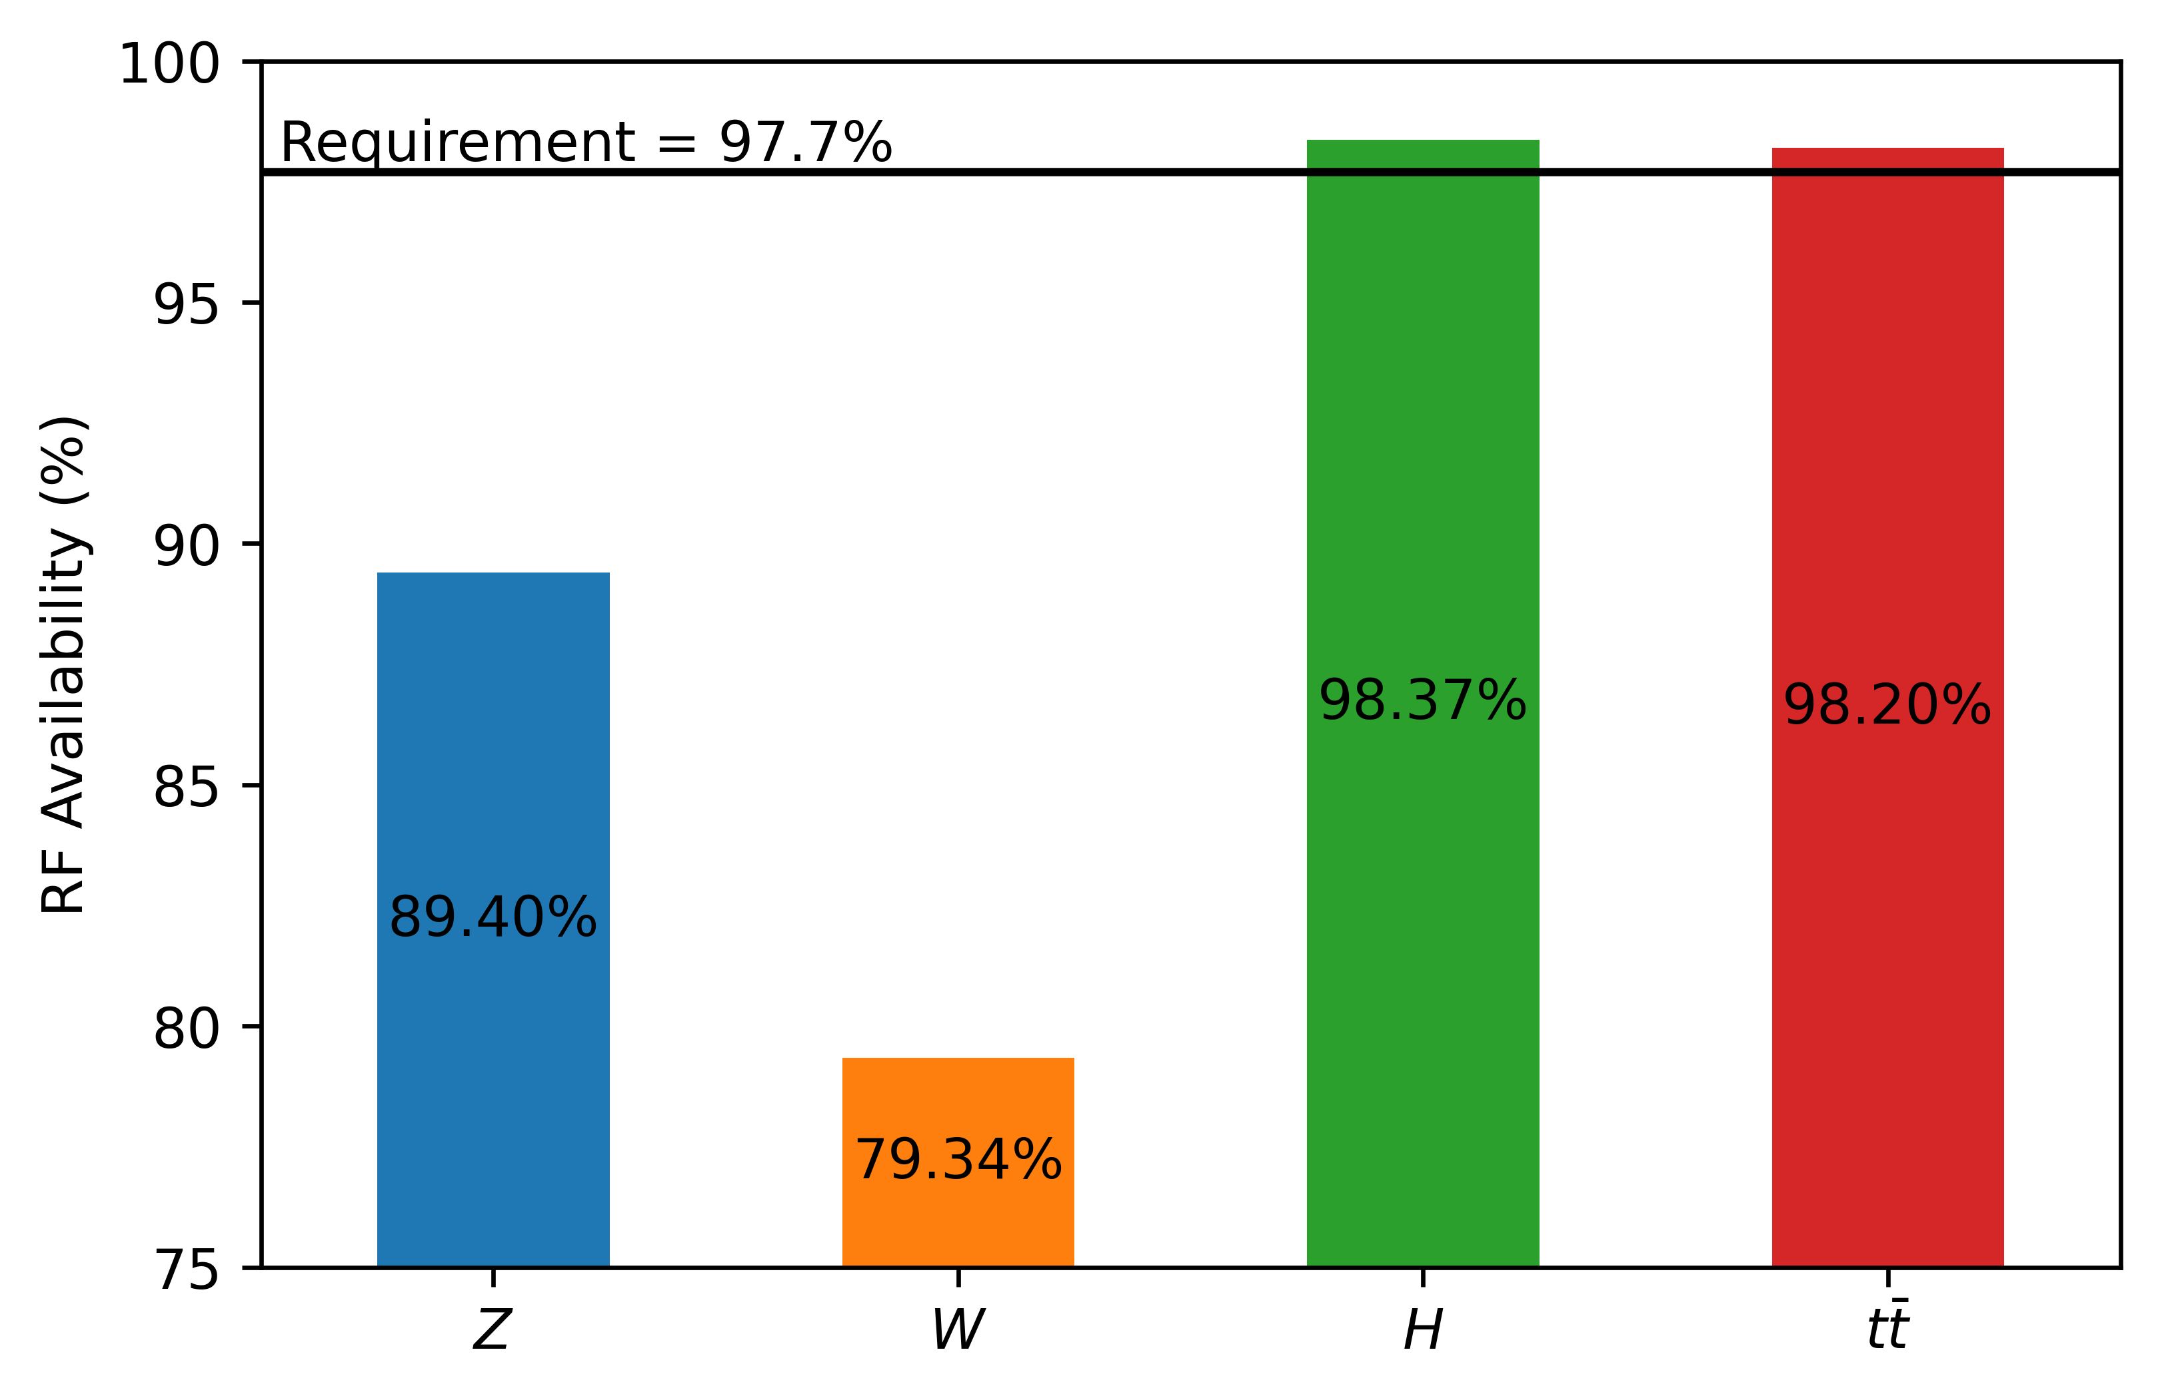




2. Shortfalls
FCC-ee
RF only
$$N_{cav}=360$$
$$N_{cav}=1232$$
$$N_{cav}=140$$
$$N_{cav}=308$$
No redundancy
10% redundancy

Slide 13
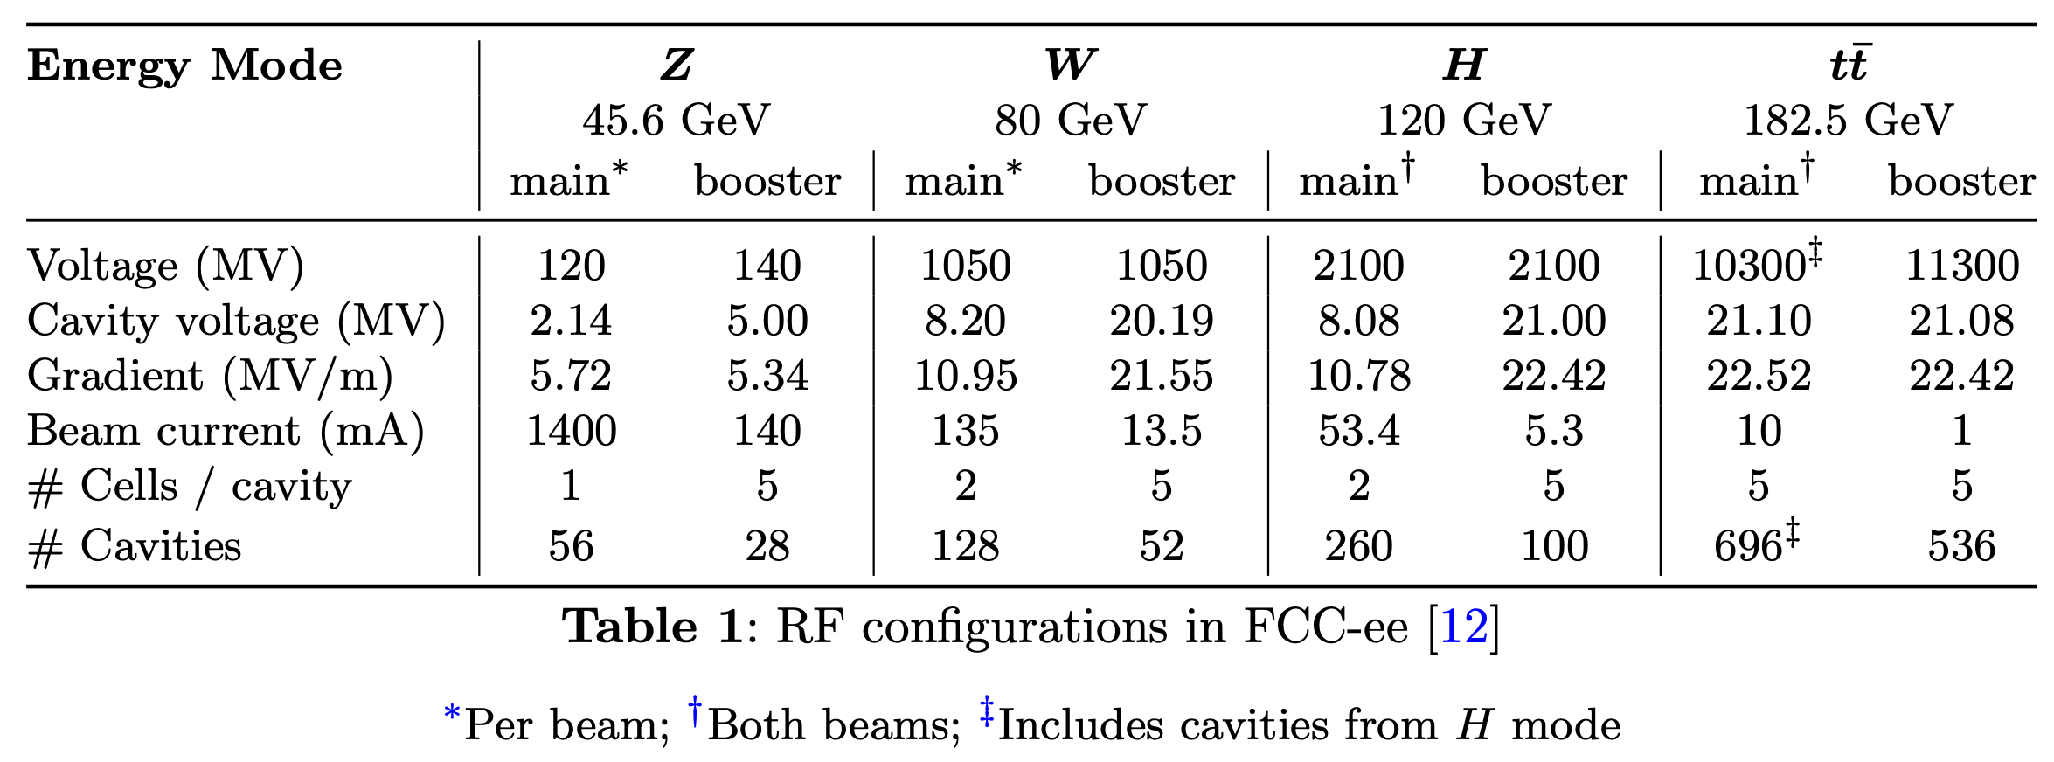
2. Shortfalls
FCC-ee:
KEK-B:
Gradient (MV/m) 6
Beam Current (mA) 1400
KEK-B RF is more similar to FCC-ee in Z,W modes
RF System fault statistics
 | MTBF (days) | Number of cavities | MTBF / cav (days) | Reliability (LHC equivalent)
LHC (Run 2, 2016-2018) | 5 | 16 | 80 days | 1
KEK-B (1999-2007) | 2 | 8 | 16 days | 0.2
If we use KEK-B fault statistics, FCC-ee availability is 5 times worse!
Y. Morita, et al. “KEKB Superconducting Accelerating Cavities and Beam Studies for Super-KEKB” in Proceedings of IPAC 2010, Kyoto, Japan, pp. 1537.
K. Nakanishi, et al. “SRF Systems for KEKB and SuperKEKB” in Proceedings of the 62nd ICFA Advanced Beam Dynamics Workshop on High Luminosity Circular e+e- Colliders (eeFACT2018), Feb. 2019, pp. 256

Slide 14
Three-step approach
1. Targets
2. Shortfalls
  To reach overall 80% availability:
  “RF availability must be above 97.7%”
  “Top-up booster must be above 97.5%”
  …
  Based on current designs & similar systems:
  “RF Availability will likely be 89 & 79%”
  “Top-up booster will likely be...”
  …
3. Opportunities
  Where do we fall short? RF system in Z & W modes
  What can we do about this?
  Solution 1…
  Solution 2…

Slide 15
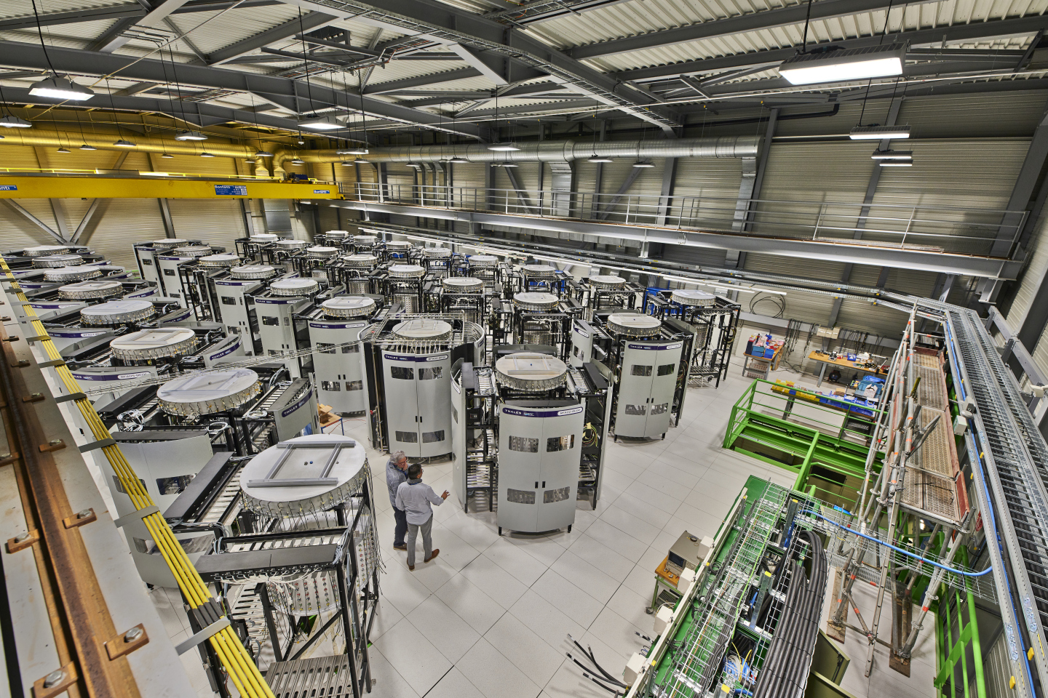
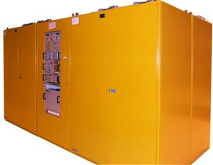
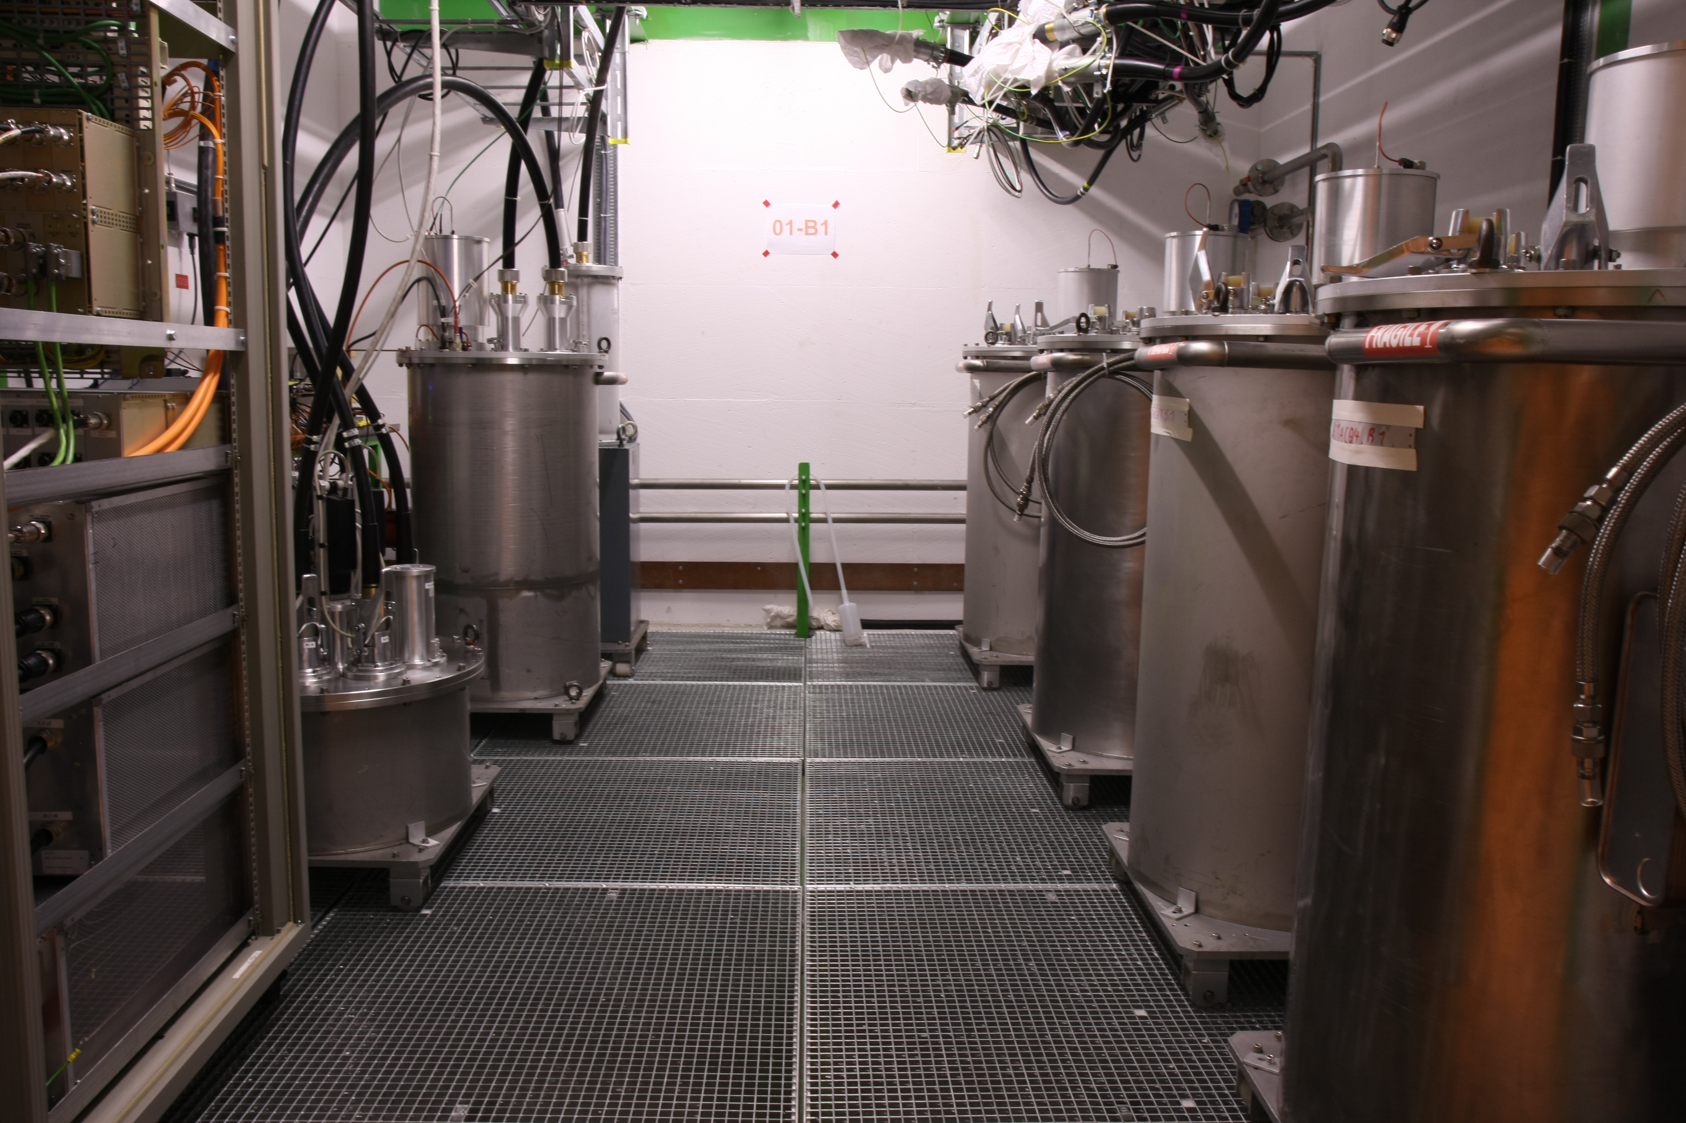
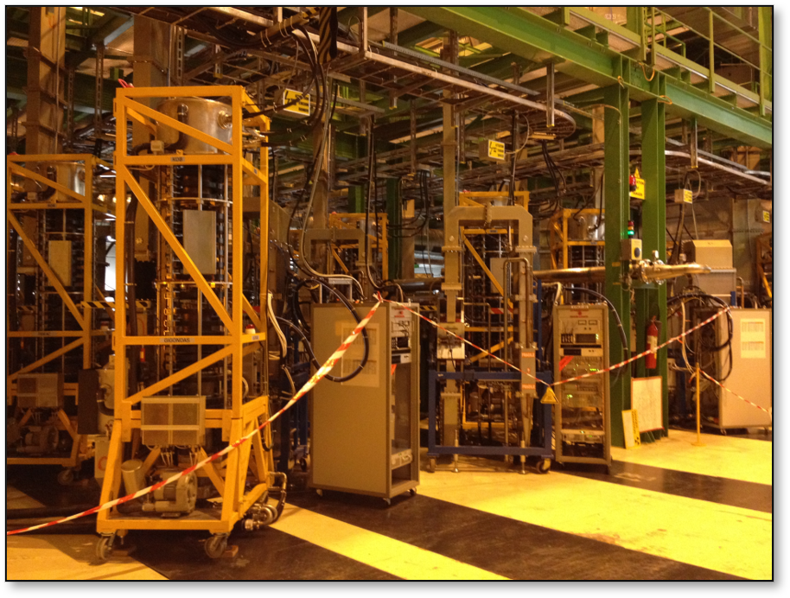
3. Opportunities
Increase reliability
    MTBF per cavity circuit
    Hardware approach
    E.g. Solid State Power Amplifiers (SSPAs) vs Klystrons
SPS SSPA Towers
16 towers (1280 SSPAs) = 1.6 MW
LHC Klystron Assembly
Power Converter
4 klystrons = 1.2 MW
L. Felsberger, A. Apollonio, T. Cartier-Michaud, E. Montesinos, J.C. Oliveira, J. Uythoven, “Availability Modeling of the Solid-State Power Amplifiers for the CERN SPS RF Upgrade” in 12th International Particle Accelerator Conference (JACoW Publishing, Campinas, SP, Brazil, 2021), pp. 2308–2311.
J. Cai, I. Syratchev, G. Burt, “Two Stage High Efficiency Klystron for FCC-ee” in FCC Week 2021.
HV bunker

Slide 16
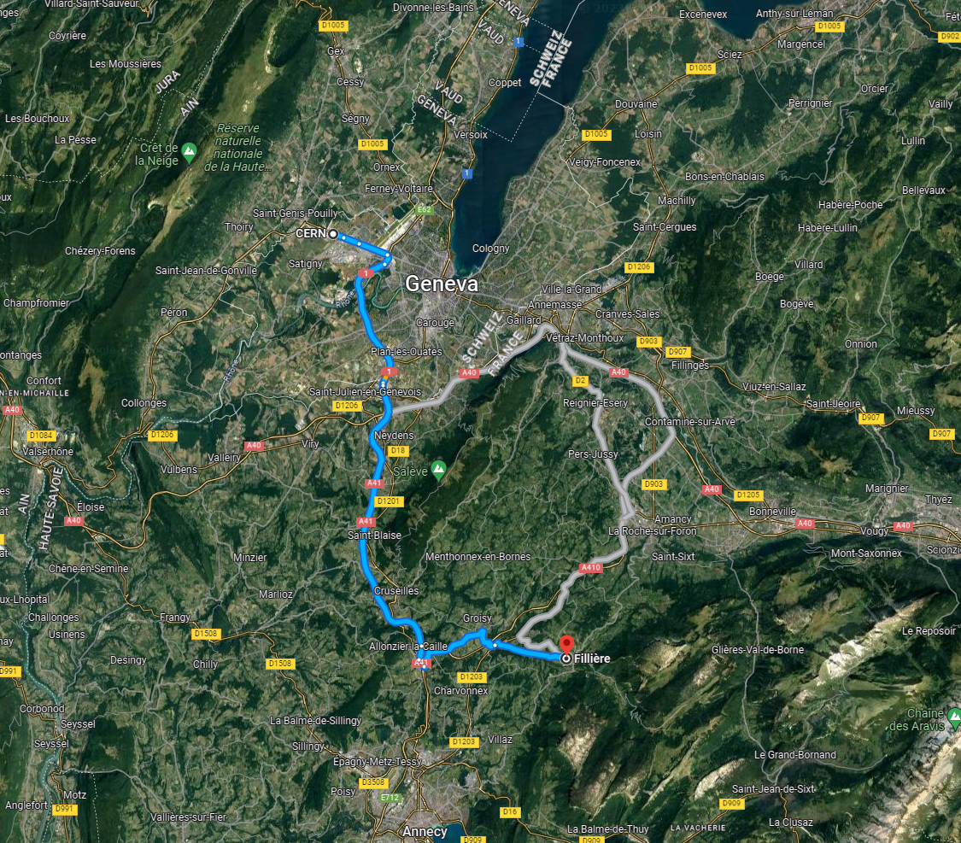
3. Opportunities
LHC
Drive time
  45 min – 1h+
Reduce / anticipate
    Scatter teams of technicians
    Helicopter transport
    Robot Maintenance (slide 17)
    Late-stage prognostics (slide 18)
FCC
Drive time
45min – 1h+

Slide 17
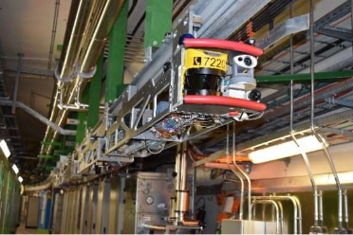
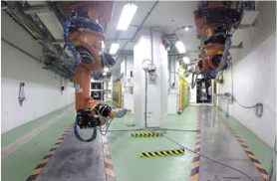
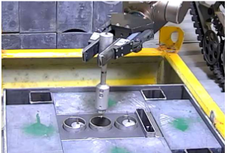
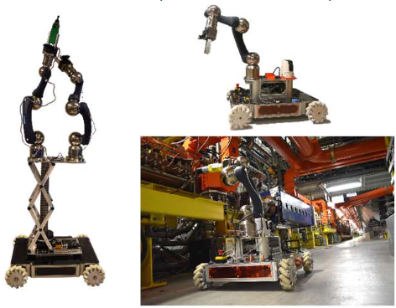
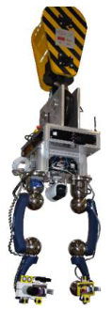
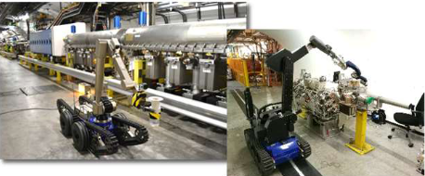
3. Opportunities
Train Inspection Monorail (TIM) for inspection & RP measurements in LHC
ISOLDE & MEDICIS robots for target exchange
Radioactive samples fine handling
Robot Maintenance
Repair more faults while the beam is running
“Short” : “Long” fault ratio
(also eliminates drive time)
CRANEbot for accessing complicated areas
CERNbot for inspection and telemanipulation
Telemax & Teodor for inspection and telemanipulation
M. Di Castro, et al. “Robotic Solutions for the Inspection and Remote Maintenance of Particle Accelerators”, FCC Week 2023

Slide 18
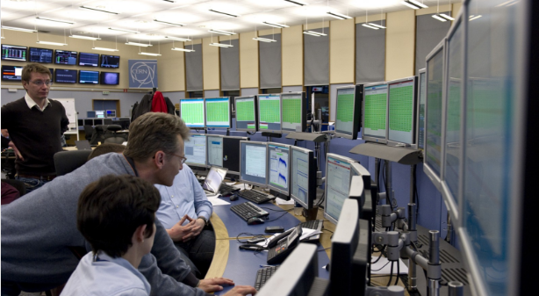
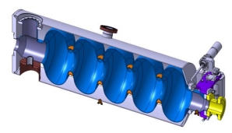
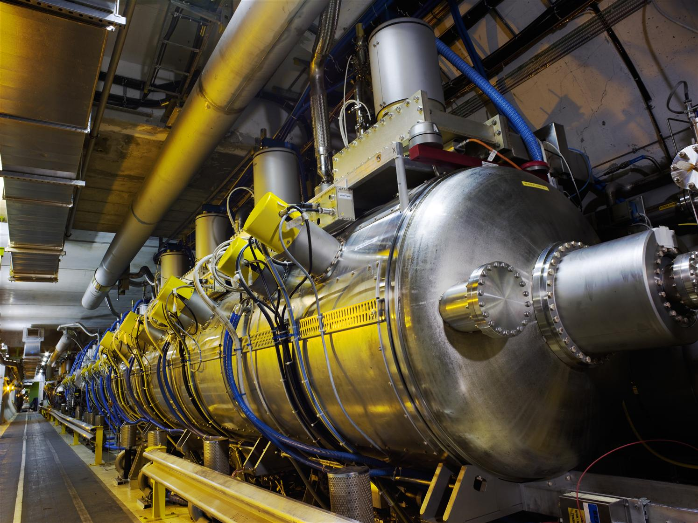
3. Opportunities
Fault Prediction
Identify and diagnose a deterioration in health
Repair / replace relevant components before the fault occurs
Also prevents child faults & collateral damage
Physical models (“white box”)
E.g. X-ray monitoring for cavity degradation
Statistical models (“black box”)
E.g. unsupervised anomaly detection
Applied to Long faults only.
Control Center
Health insights:
Performance
Efficiency
Anomalies
Actions:
Testing
Maintenance
Replace parts
Digital Twin
Physical System
Virtual models of system + processes
Analysis of sensor data
Sensor data
(performance, health, events)
Physical system
Sensors

Slide 19
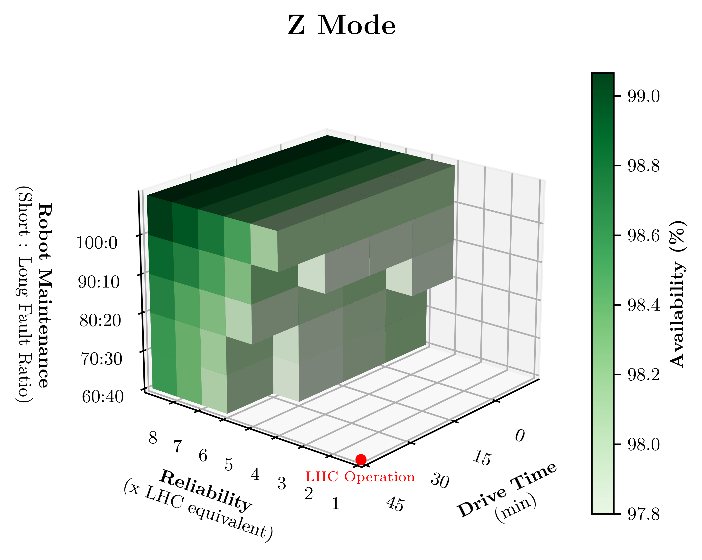
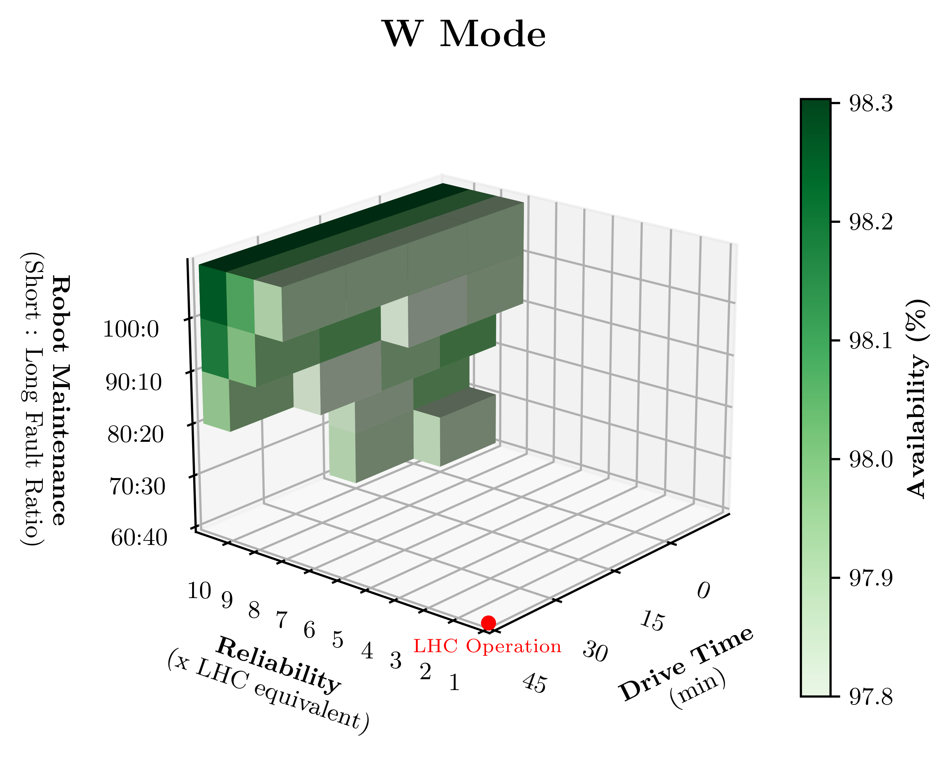
Results

Slide 20
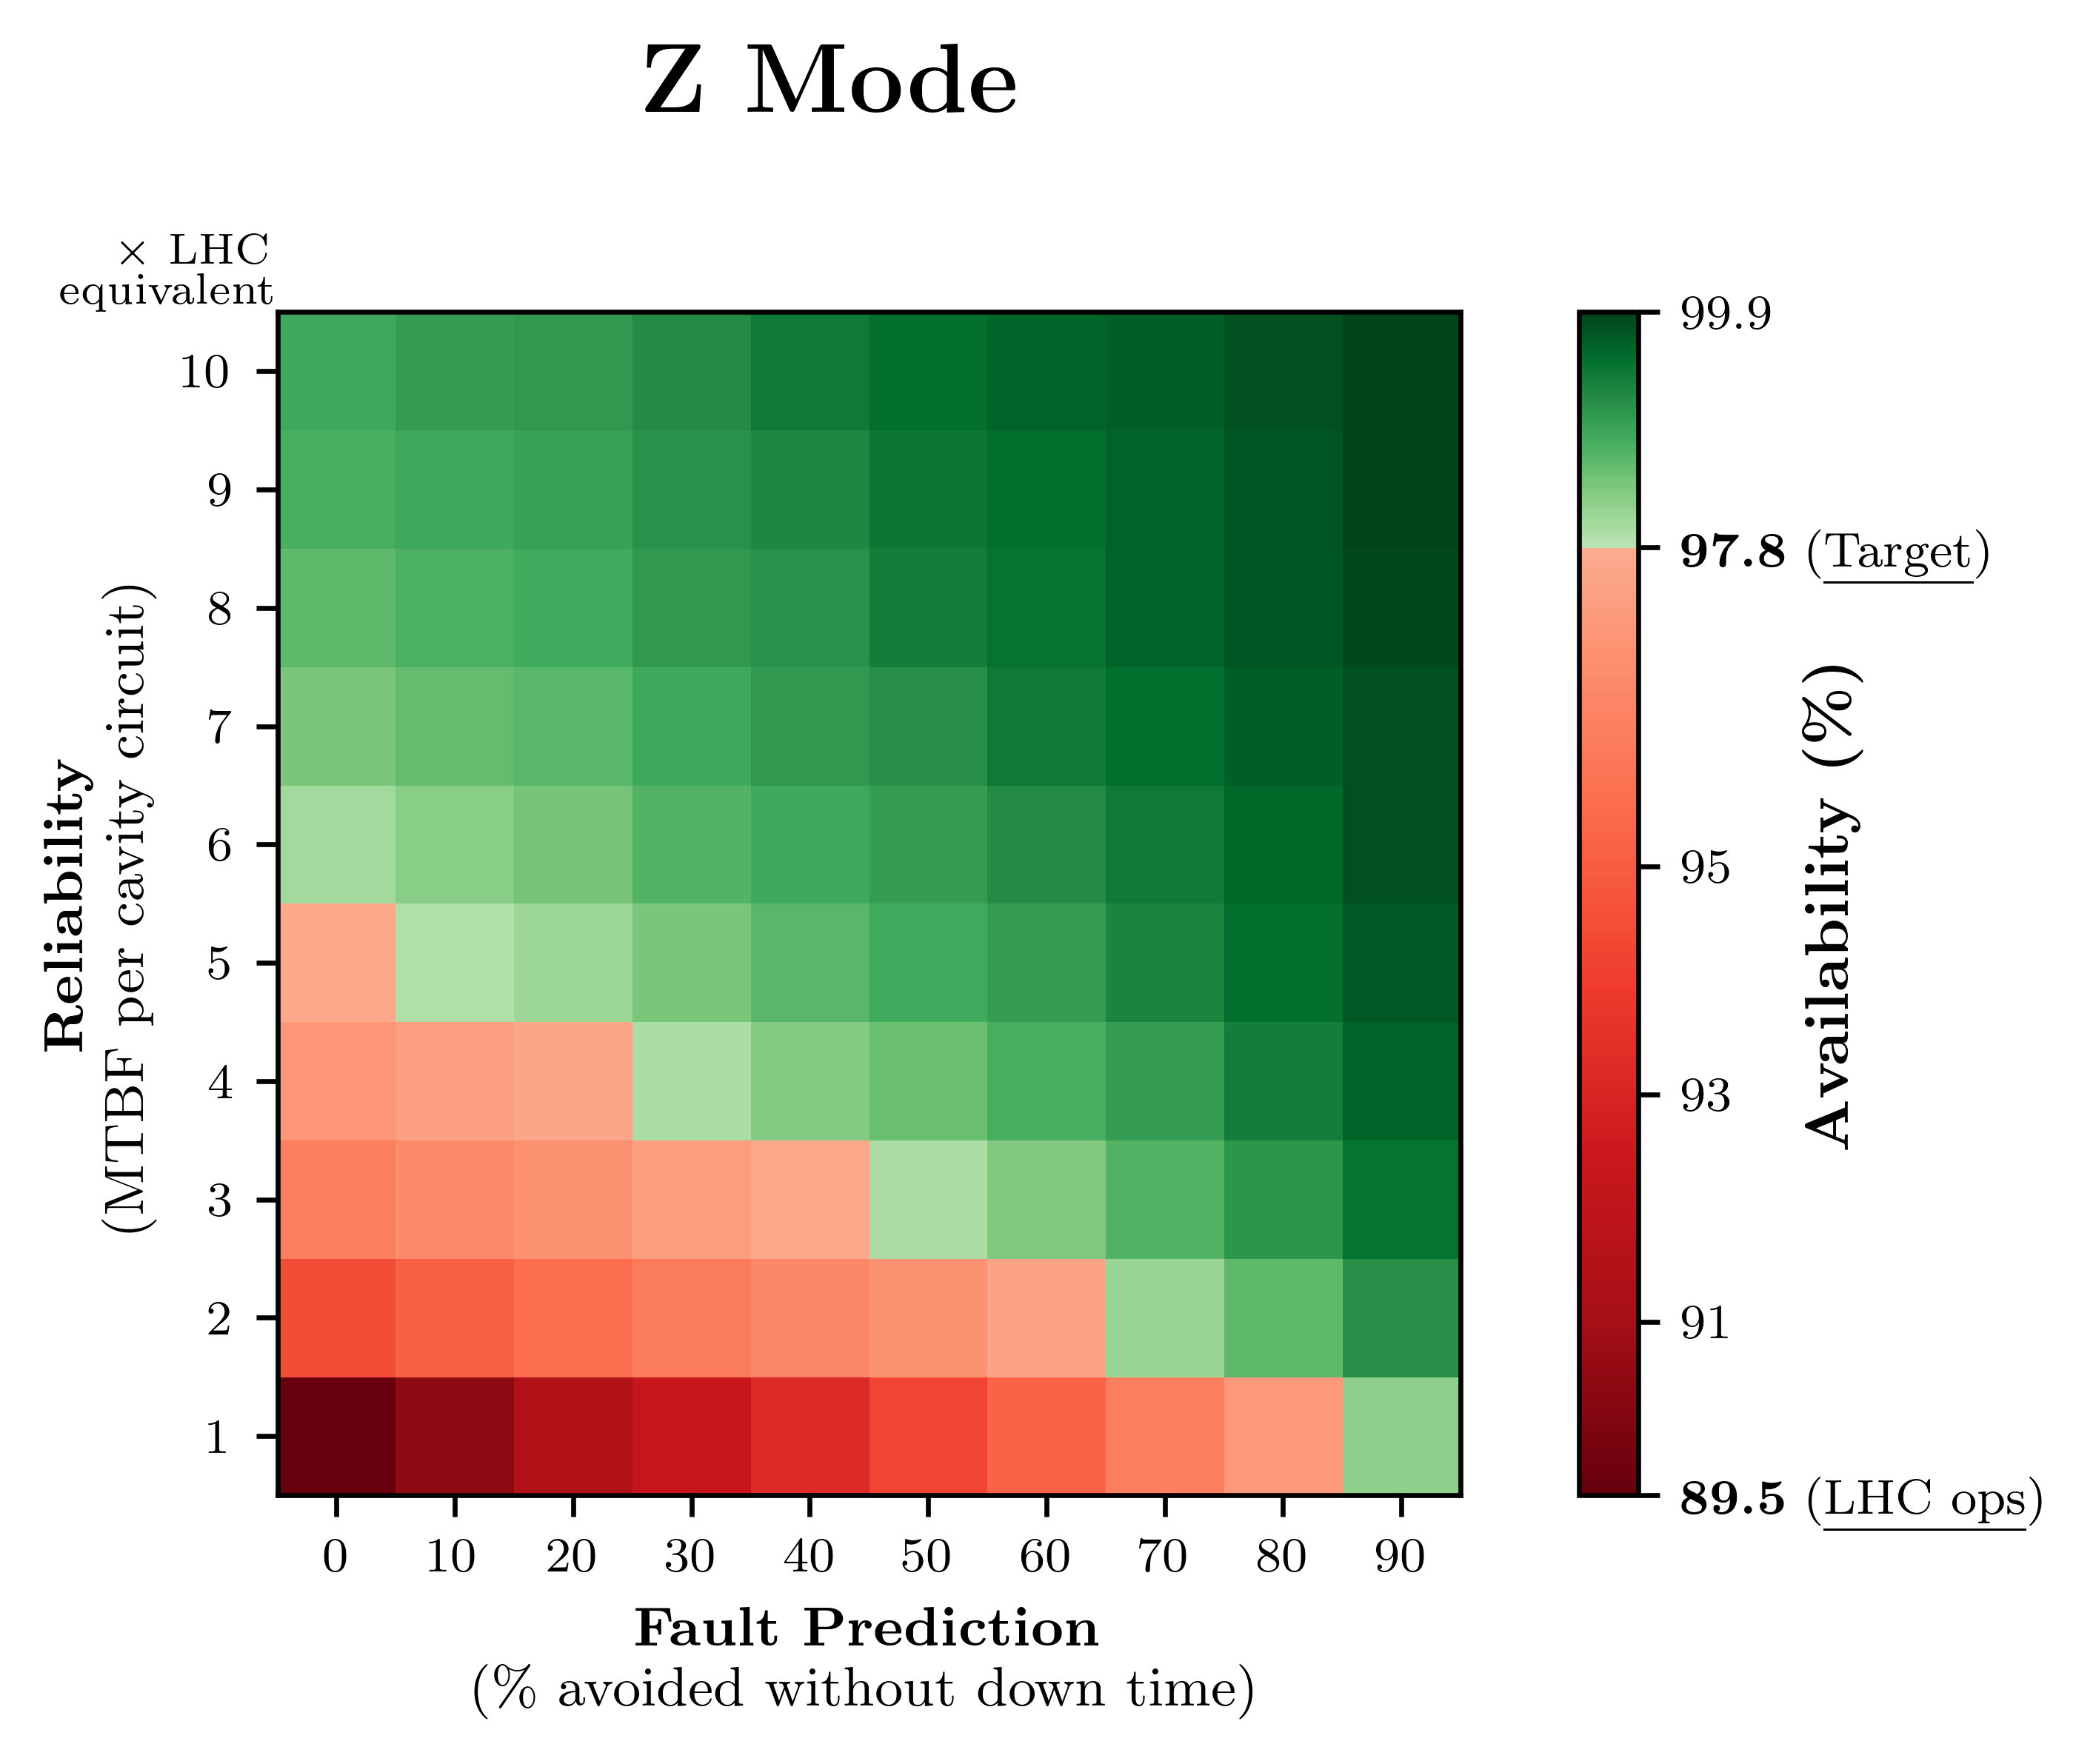
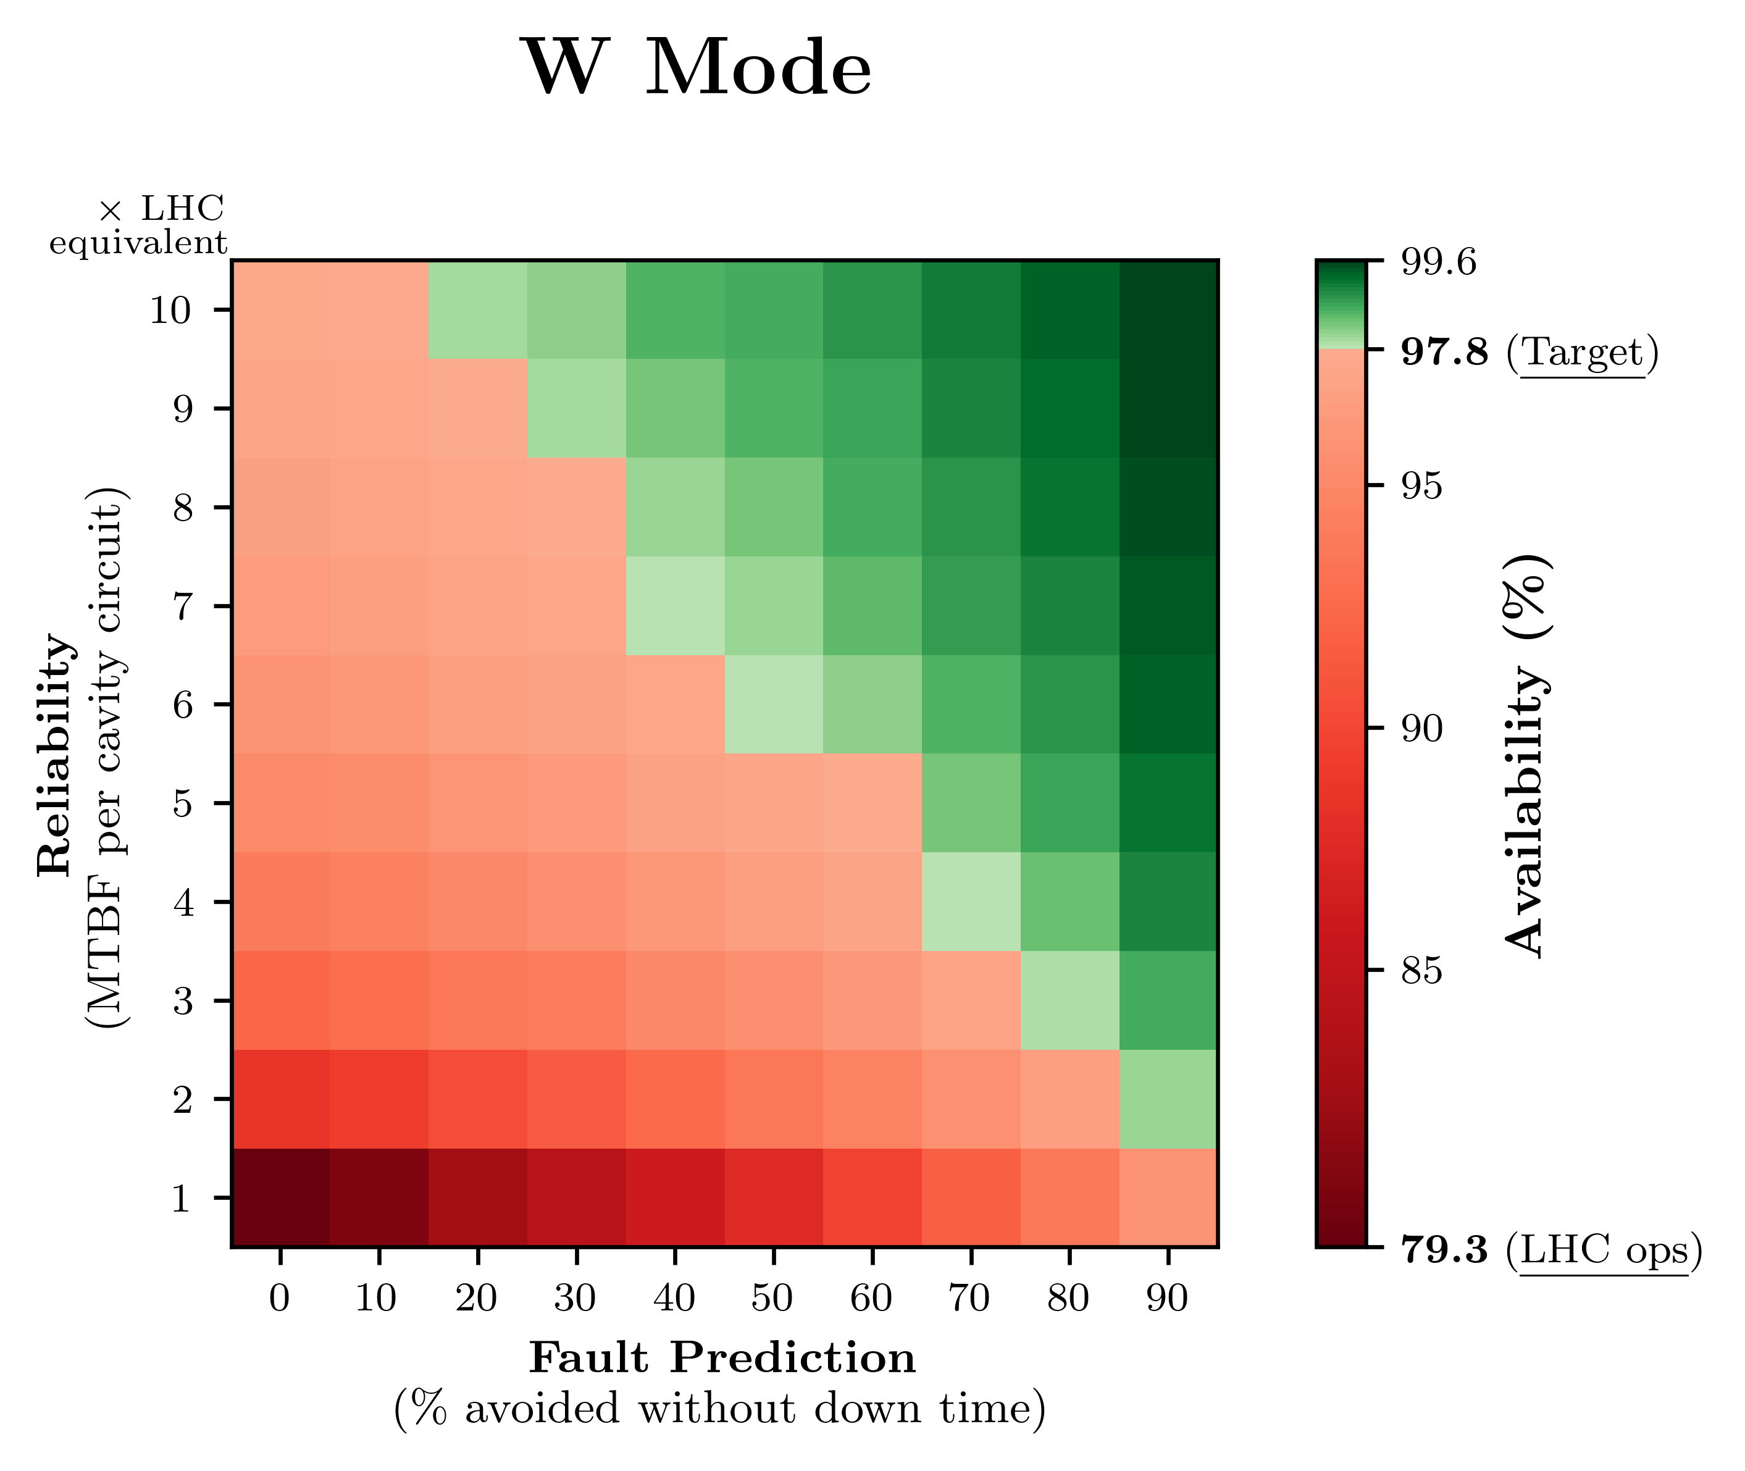
Results

Slide 21
Summary
FCC-ee Availability Requirements:
Targets: Availability requirements defined at system level (for the first time!)
  Scaled according to complexity of availability assurance
Shortfalls: Projected RF availability in Z & W modes (according to LHC data) is worryingly low.
  Even worse if we look at more similar systems e.g. KEK-B
Opportunities: Four solutions are analysed
  Increase reliability (pure hardware approach)
  Reduce / anticipate drive time
  Robot Maintenance
  Fault prediction
FCC-ee Projected Availability assuming LHC operation and maintenance paradigm:

Slide 22
Conclusions
The availability challenge is real.
A seismic shift in operation & maintenance paradigm is required.
Most compelling solutions for RF:
  Reliability per cavity circuit
  Fault Prediction
Reliability per cavity circuit must improve significantly.
Fault prediction is potentially game-changing.

Slide 23
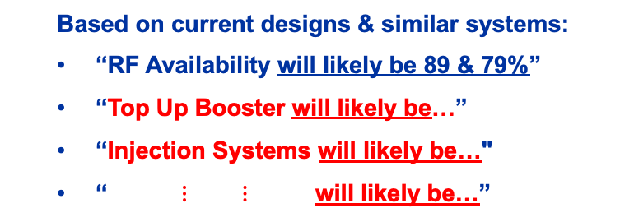
Outlook
1. Targets
2. Shortfalls
  Top-Up Booster:
  To reach overall 97.5% availability:
  “RF availability must be above…”
  “Power converters must be above…”
  Also breakdown of other systems.
  Based on current designs & similar systems:
  “RF Availability will likely be 89 & 79%”
  “Top Up Booster will likely be…”
  “Injection Systems will likely be…"
  “ $⋮$ $⋮$ will likely be…”
3. Opportunities
  Where do we fall short? RF system in Z & W modes
  What can we do about this?
  Can we avoid losing beam on RF trips?
  Scope for reliability & fault prediction

