Slide 1
HEARTS WP Leaders Meeting #3
27 June 2023
https://indico.cern.ch/event/1295647/
Pablo Lopez, WP1
CERN

Slide 2
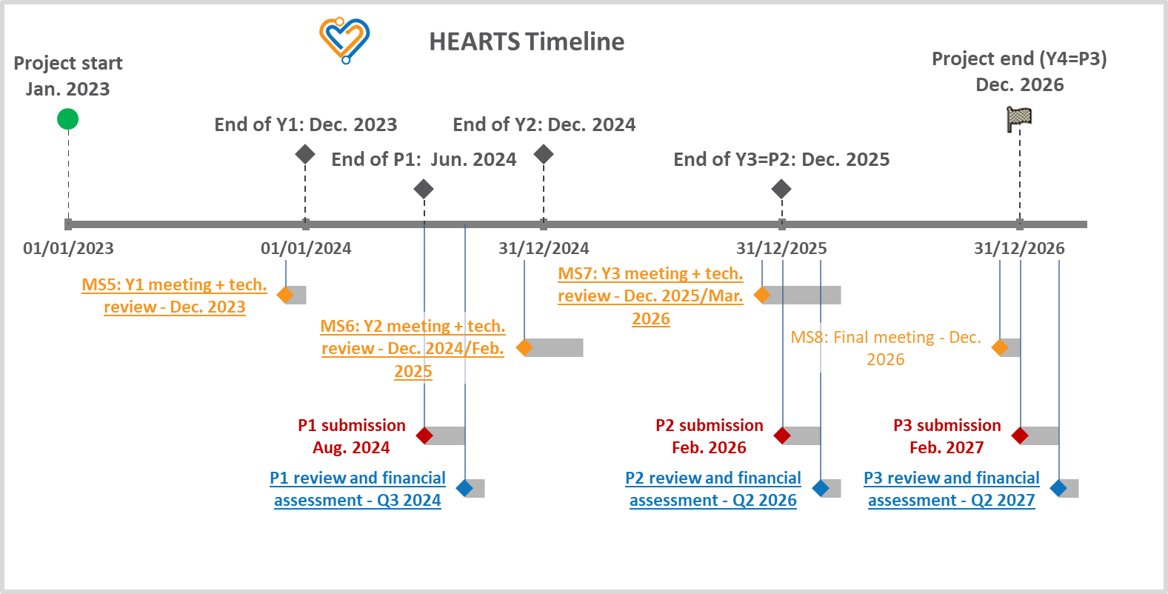
HEARTS Timeline

Slide 3
WP1 Milestones and Deliverables (1)
Reached milestones since the last WP Leaders meeting:
None.
Upcoming milestones in 2023:
MS4: Appointment of the Advisory Panel (M6 = June 30)
MS5: 1st HEARTS annual meeting and interim technical review (M12 or December 31)

Slide 4
WP1 Milestones and Deliverables (2)
Reached deliverables since the last WP Leaders meeting:
None.
Upcoming deliverables in 2023:
None.
The next WP1 deliverable is D1.1 (Assessment of high-energy heavy ion operation in CHARM during CERN proton physics periods) due in June 2024.
Note: The D2.1 and D5.1 reports are publicly available on EDMS and the website.

Slide 5
WP1 Implementation Status and Plans
Recent achievements:
2nd Project Office meeting was held on June 21. → The minutes will soon be available.
Short-term plans until the end of Summer:
Finalise the Advisory Panel NDA signature process (3/6 are currently completed).
Complete the Grant Agreement amendment process with the PO (last reminder sent on June 14).
Define the 1st annual meeting’s structure and set the date with the PO, the GB and WP Leaders. → either end of November, December 2023 or early January 2024. Suggestion: have a one-day (two afternoons, in order to include US-based AP members) fully virtual event structured per WPs + discussion on first the year’s achievements and prospects for the next year/the future.
Complete the formalisation of University of Oldenburg and University of Wollongong’s involvement in the Consortium as Associate Partners.
Distribute digital collaboration tools guidelines among HEARTS members.

