Slide 1


Optical readout studies of MPGDs with different gases and wavelength shifters
Juha Nummi
Florian Brunbauer
Francisco Garcia

Slide 2
Outline
Basic principles of Micro Pattern Gaseous Detectors (MPGD)
Motivation of my studies
Measurement setup
Light yield measurements
Scintillation studies
Influence of wavelength shifter on spatial resolution

Slide 3
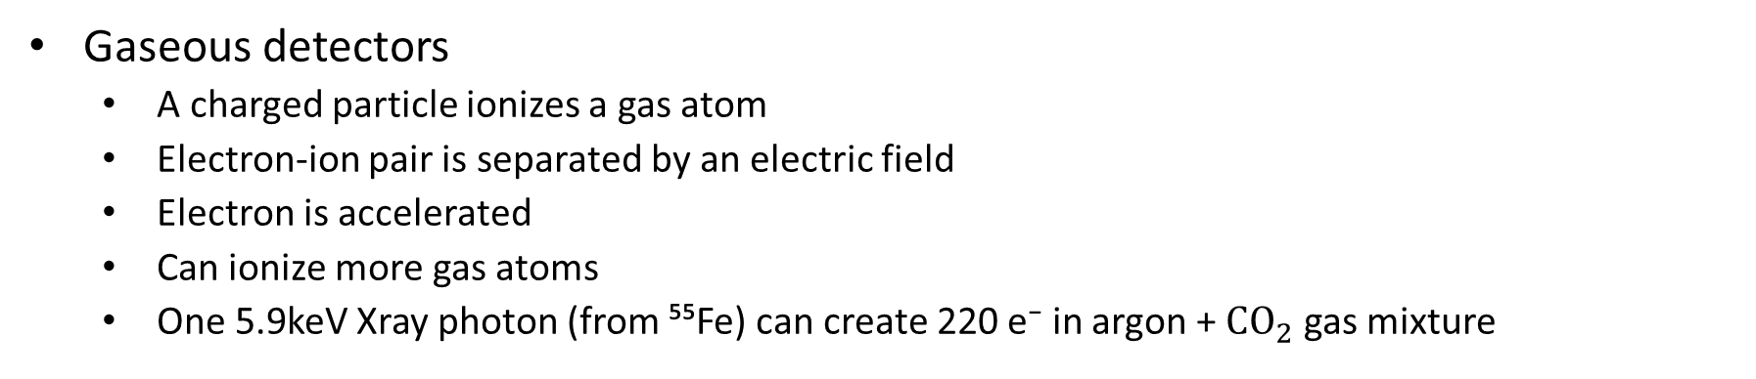
Introduction
Gaseous detectors
  A charged particle ionizes a gas atom
  Electron-ion pair is separated by an electric field
  Electron is accelerated
  Can ionize more gas atoms
  One 5.9keV Xray photon (from ⁵⁵Fe) can create 220 e⁻ in argon + $CO_{2}$ gas mixture
Charged particle
Gas volume
-
-
Ionization
Electron
Ion
Gas atom
+
+

Slide 4
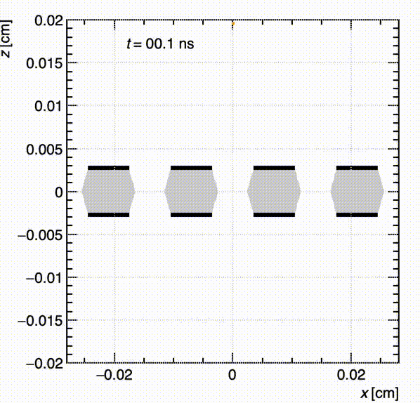
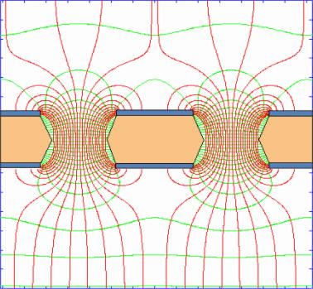
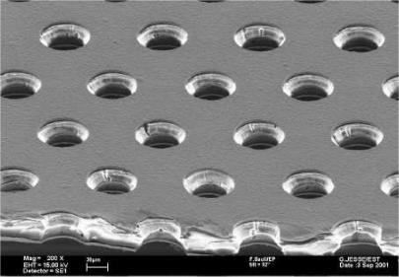
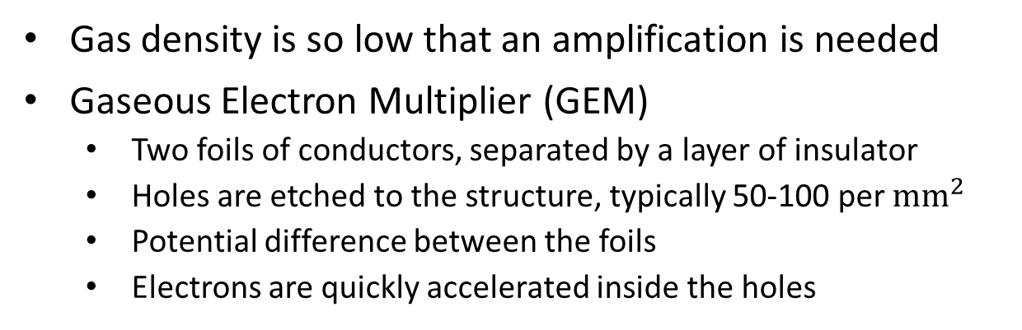
Introduction
Gas density is so low that an amplification is needed
Gaseous Electron Multiplier (GEM)
  Two foils of conductors, separated by a layer of insulator
  Holes are etched to the structure, typically 50-100 per $mm^{2}$
  Potential difference between the foils
  Electrons are quickly accelerated inside the holes
30-50μm
Copper
Polyimide
Copper
-
50-70μm
Electron
Ion
+

Slide 5
Introduction
Scintillation
  After an ionization, atoms and molecules remain in excited states in many cases
  Transition to the ground state can lead to an emission of a photon
Particle
Photon

Slide 6
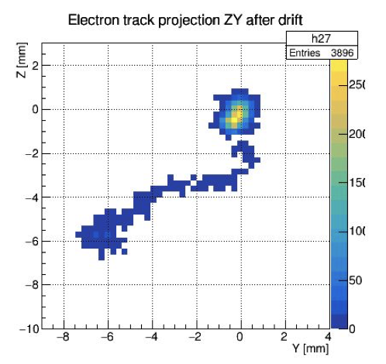
Motivation
Most common readout format is electronic
  Fast
  Not accurate enough in some cases
Optical readout with commercially available cameras (CCD/CMOS)
  Pixelated readout
  Tunable magnification
  Low framerate
  Photons in visible wavelength range are needed
Many noble gases scintillates in ultraviolet wavelength range
Simulated electron & nuclear recoil
MIGDAL collaboration, RD51 CM, 2020

Slide 7
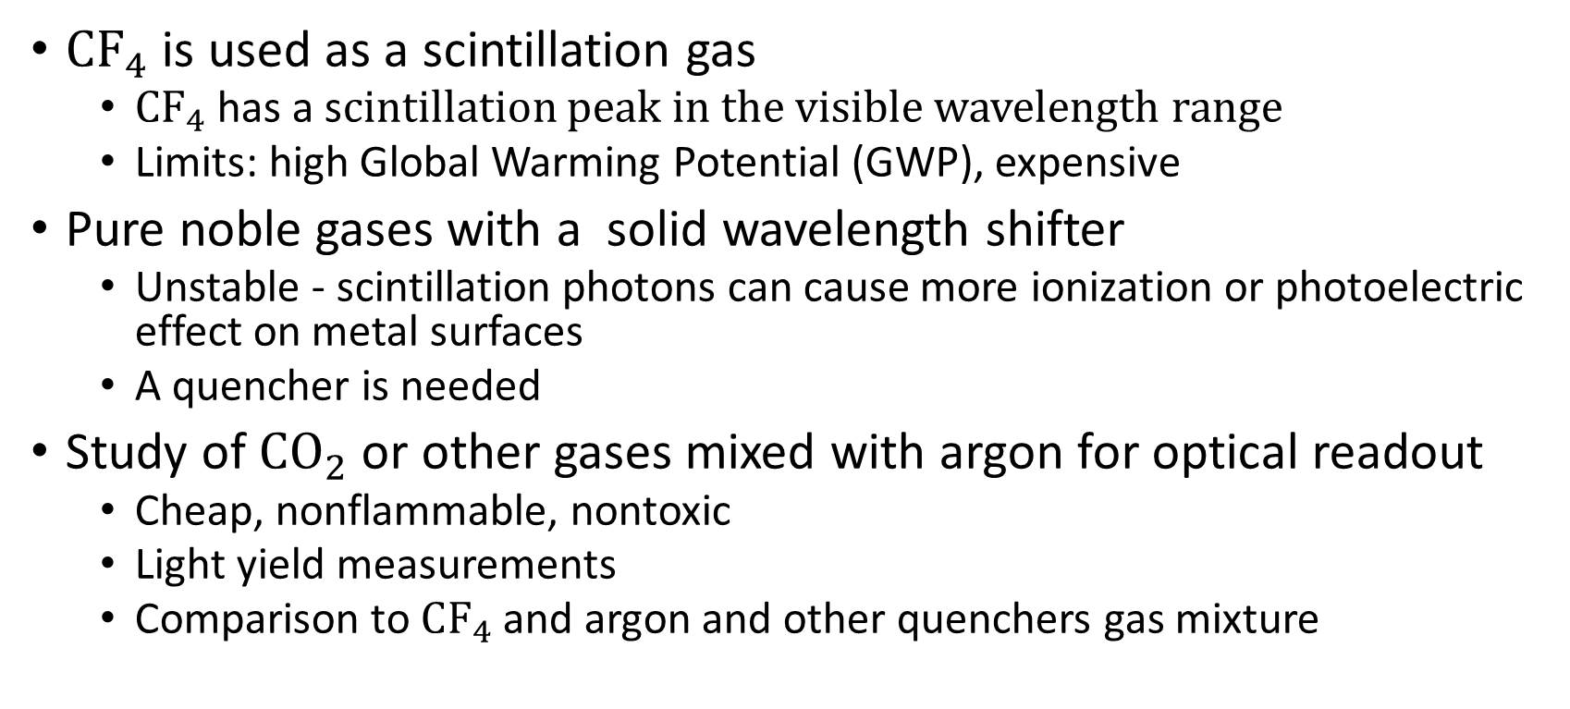
Motivation
$CF_{4}$ is used as a scintillation gas
  $CF_{4}$ has a scintillation peak in the visible wavelength range
  Limits: high Global Warming Potential (GWP), expensive
Pure noble gases with a solid wavelength shifter
  Unstable - scintillation photons can cause more ionization or photoelectric effect on metal surfaces
  A quencher is needed
Study of $CO_{2}$ or other gases mixed with argon for optical readout
  Cheap, nonflammable, nontoxic
  Light yield measurements
  Comparison to $CF_{4}$ and argon and other quenchers gas mixture

Slide 8
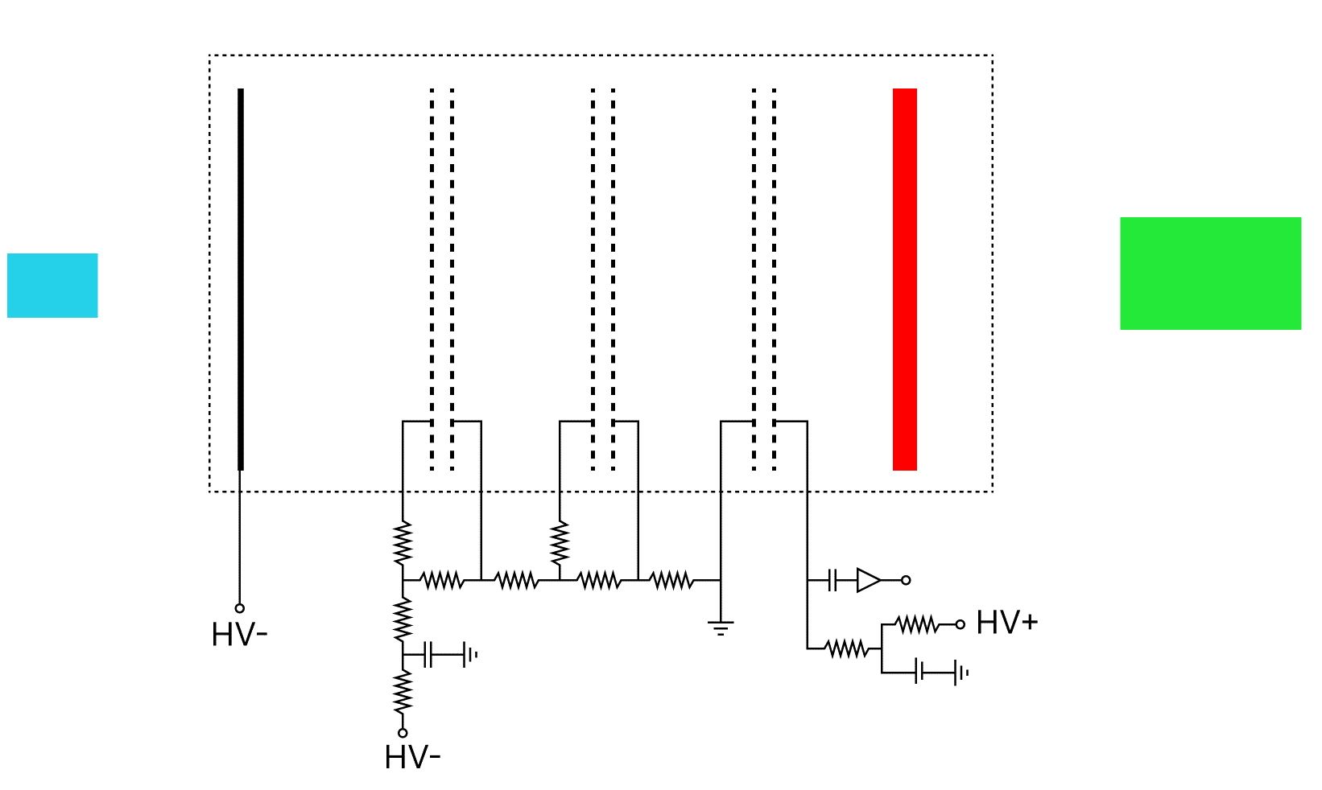
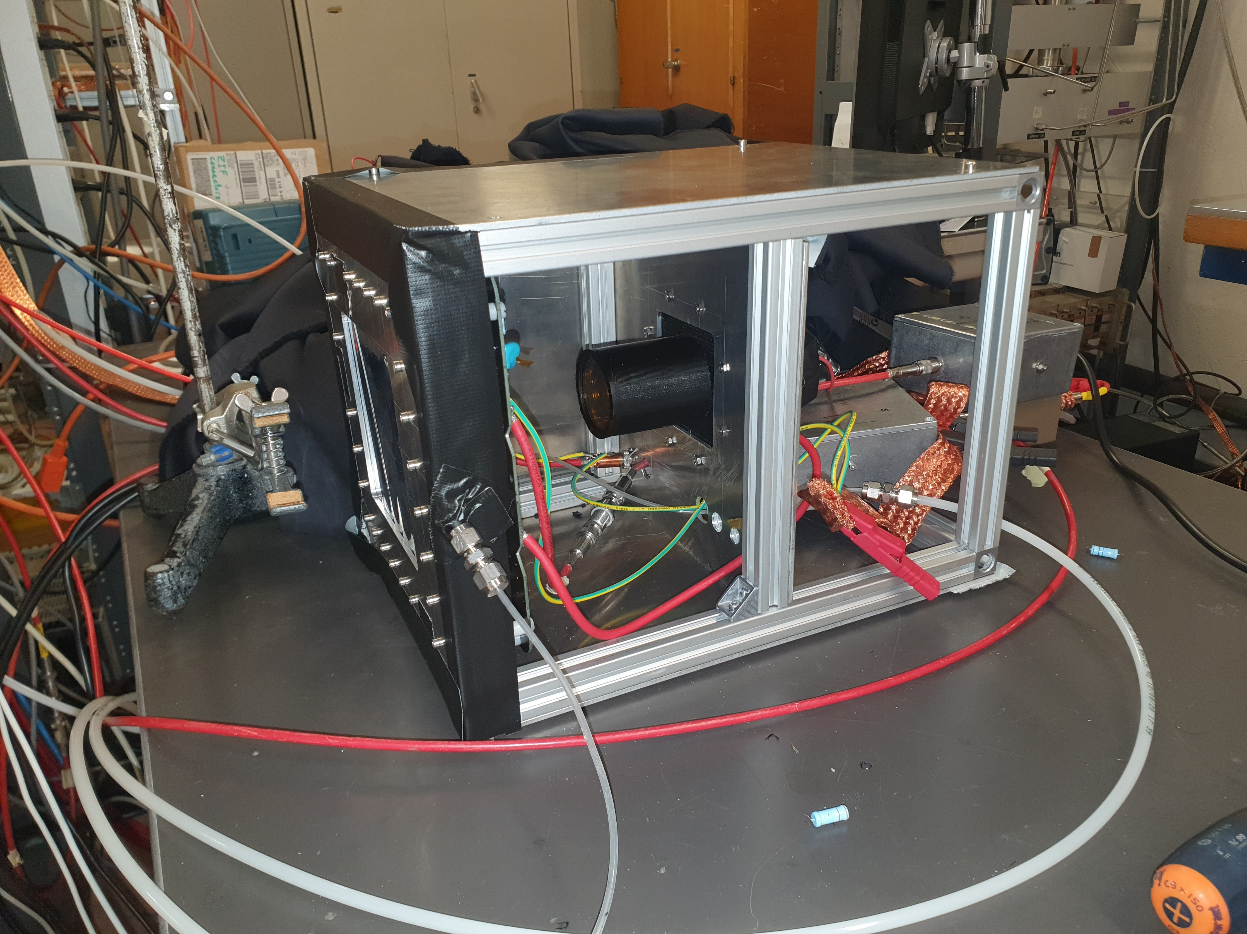
Setup
PMT/Camera
Triple GEM
Electronic signal is read from the bottom of the last GEM
Optical readout with a photomultiplier tube (PMT)
Wavelength shifter can be installed
Wavelength shifter
Cathode
GEMs
X-ray source
Electronic readout
X-ray source holder
PMT

Slide 9
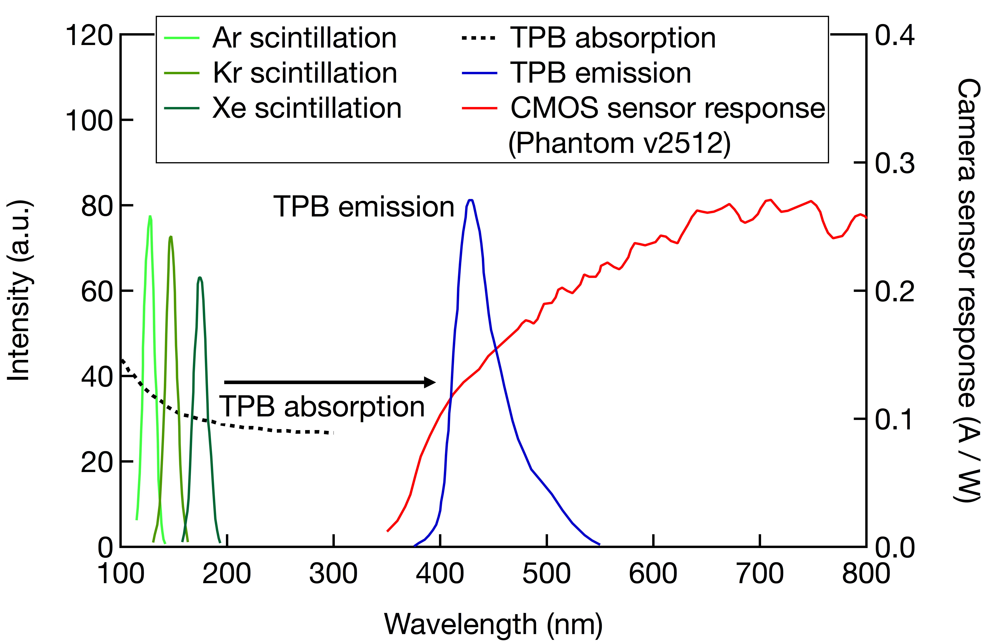
Light yield measurements
⁵⁵Fe x-ray source
Wavelength shifter: TPB (Tetraphenyl butadiene)
Light yield measurements in 4 cases:
Ar/CO₂ 70/30 | Ar/CF₄ 80/20
With TPB | With TPB
Without TPB | Without TPB
Adapted from https://doi.org/10.1016/j.phpro.2012.02.455

Slide 10
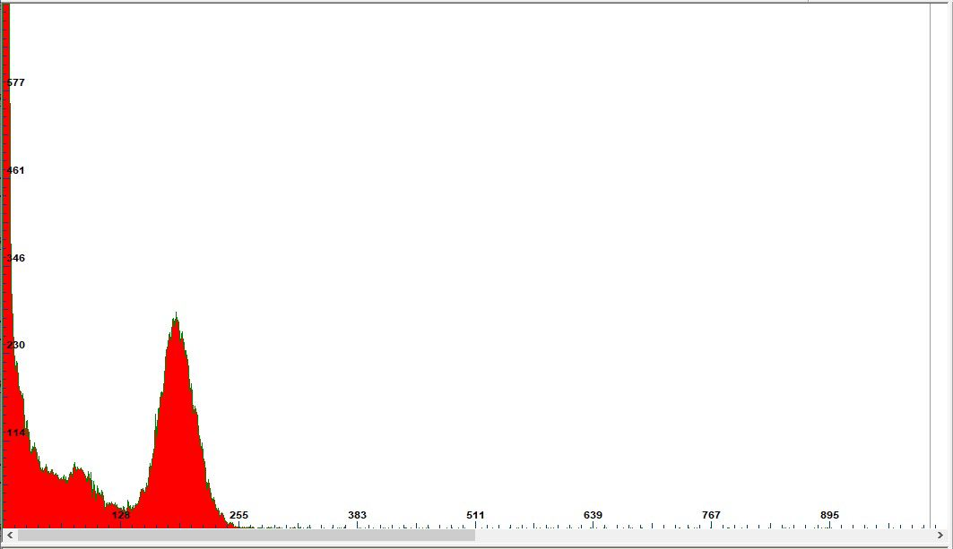
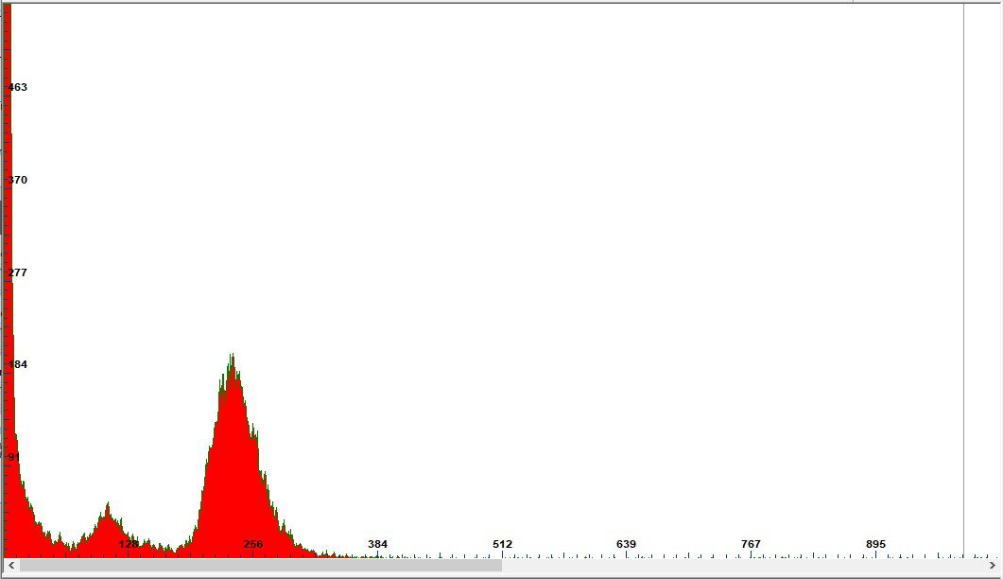
Electronic readout
Effective gain on the GEMs ≈ 1.2E+05
Peaks at 5.9 keV and 3 keV
Ar/CF₄
Ar/CO₂

Slide 11
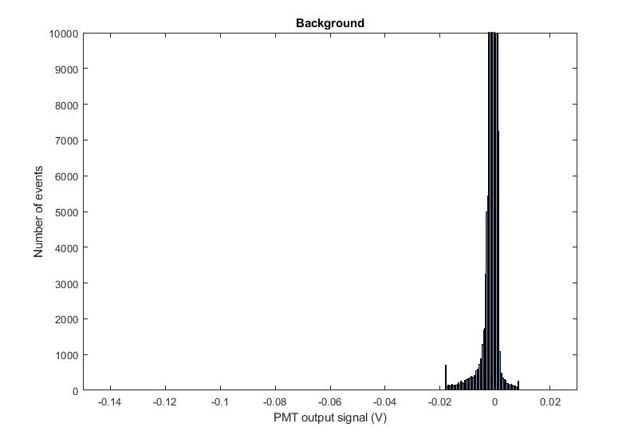
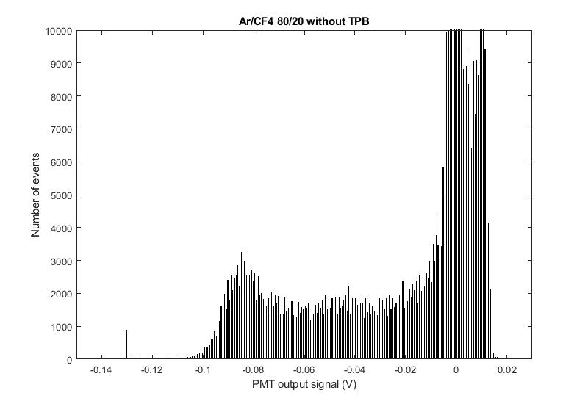
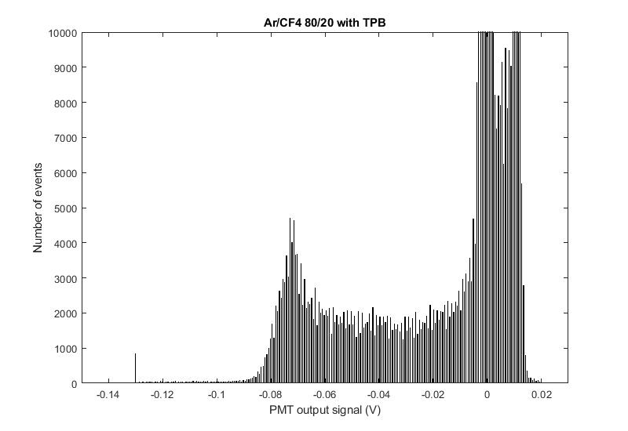
Optical readout: Ar/CF₄
Effective gain on the GEMs ≈ 1.2E+05
Gain on the PMT ≈ 1E+05

Slide 12
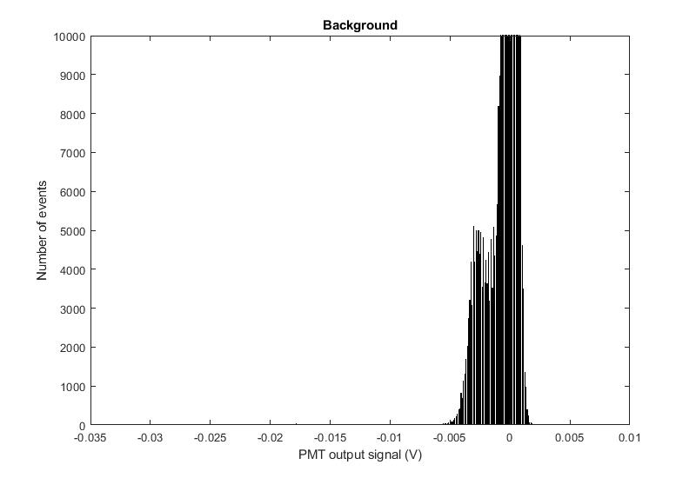
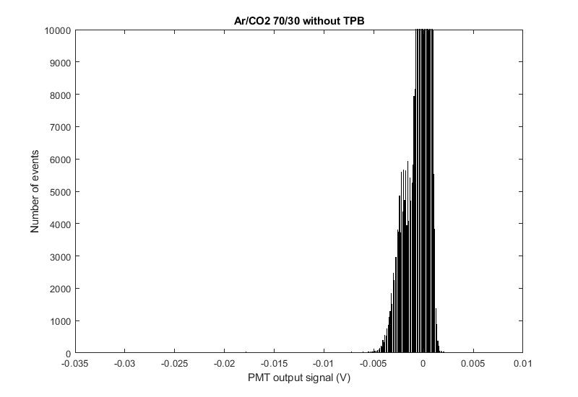
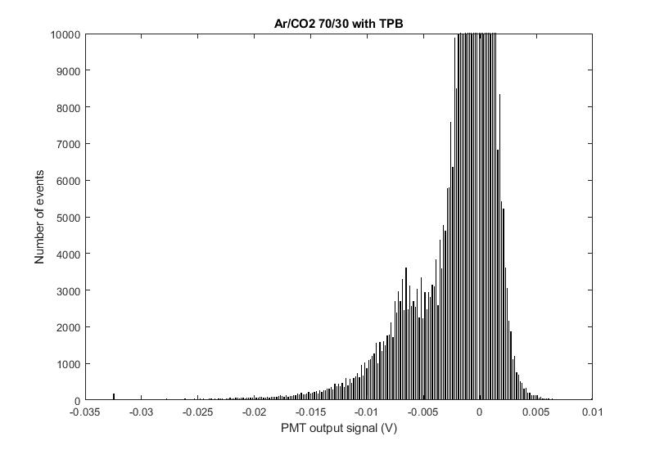
Optical readout: Ar/CO₂
Effective gain on the GEMs ≈ 1.2E+05
Gain on the PMT ≈ 1E+06
No clear peak

Slide 13
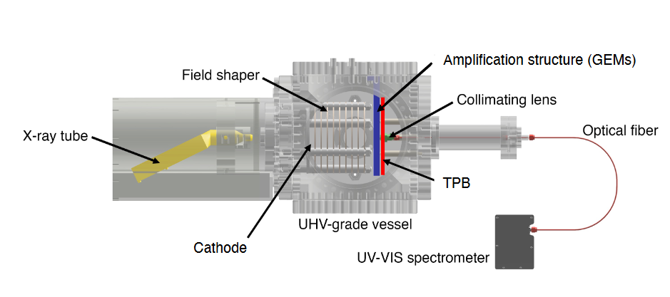
Scintillation studies
Setup
Single glass GEM
Current is read at the bottom of the GEM
300mbar pressure
Scintillation spectrum measurements
With both gas mixtures

Slide 14
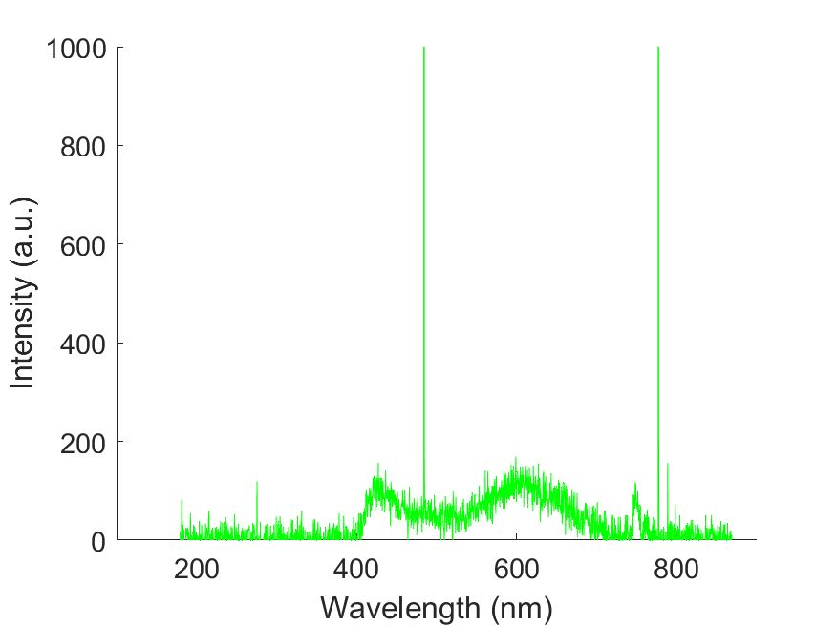
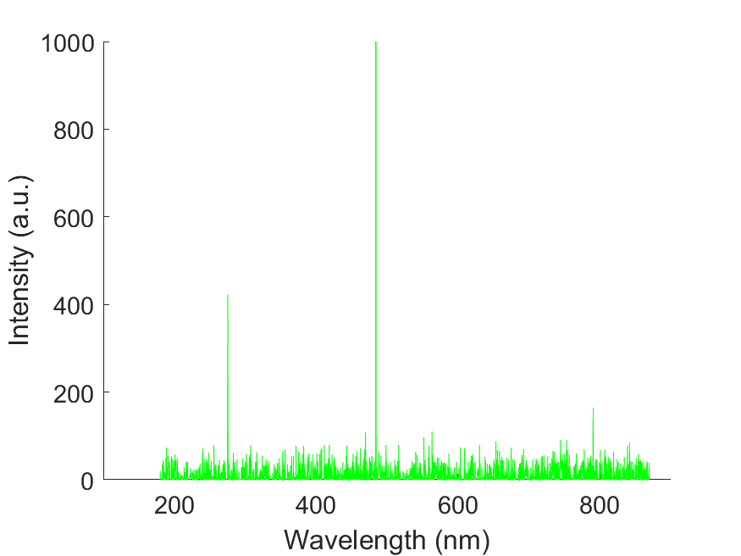
Scintillation studies
Two peaks with Ar/CF₄
No indication of photons with Ar/CO₂
Ar/CF₄ 80/20
Ar/CO₂ 70/30
CF₄ scintillation
TPB emission

Slide 15
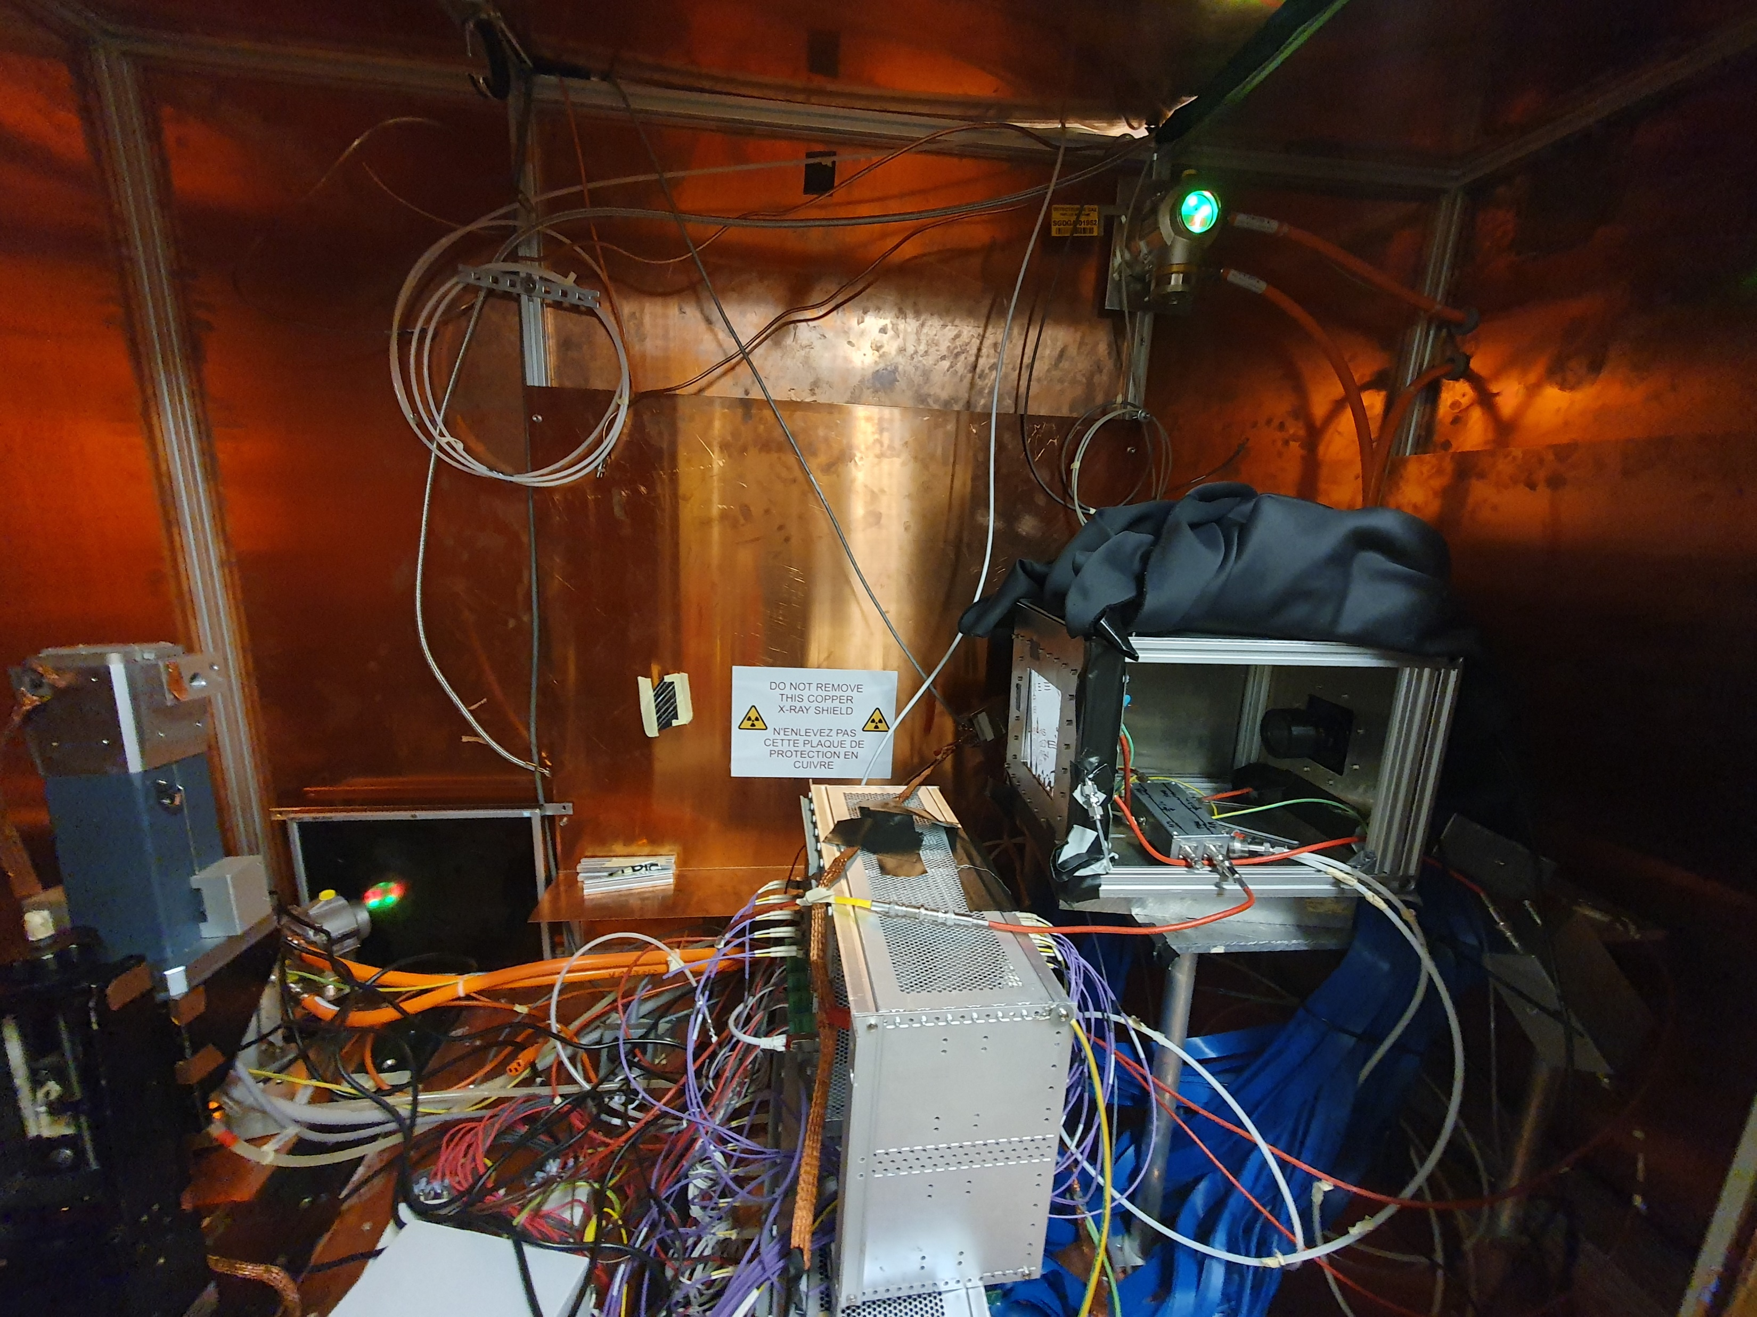
Spatial resolution studies
Spatial resolution measurements
With and without TPB
Results only with Ar/CF₄ gas
X-ray tube
Camera
Multiplication structure

Slide 16
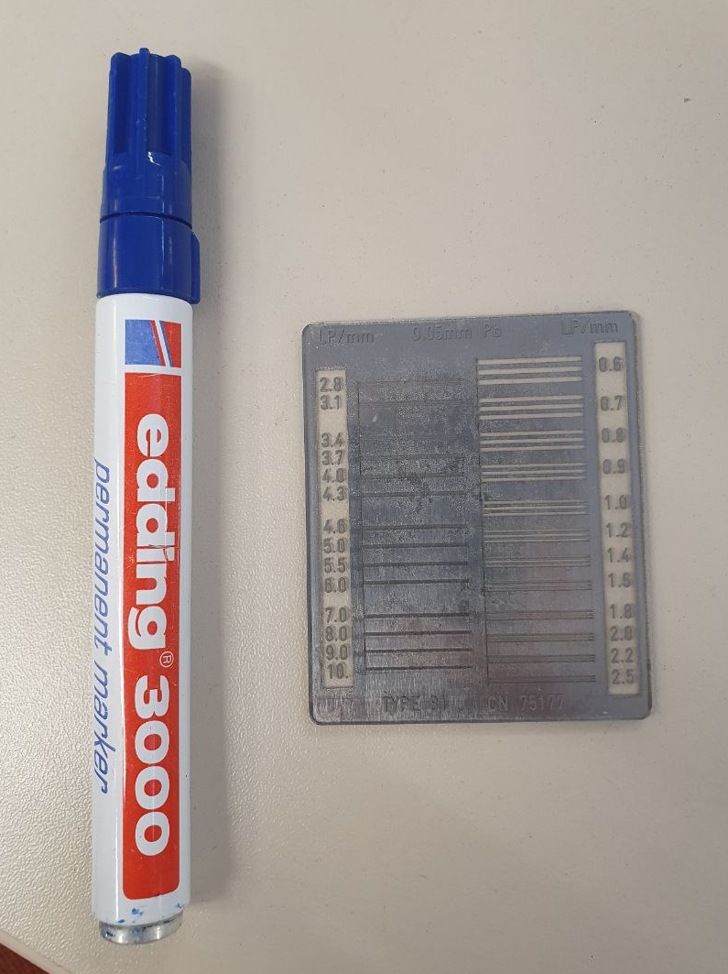
Spatial resolution studies
The position of the TPB affects to the resolution
Cathode
GEMs
TPB
Camera

Slide 17
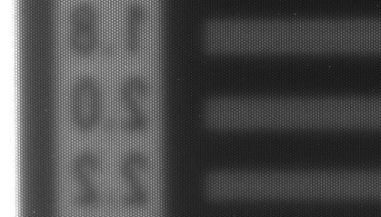
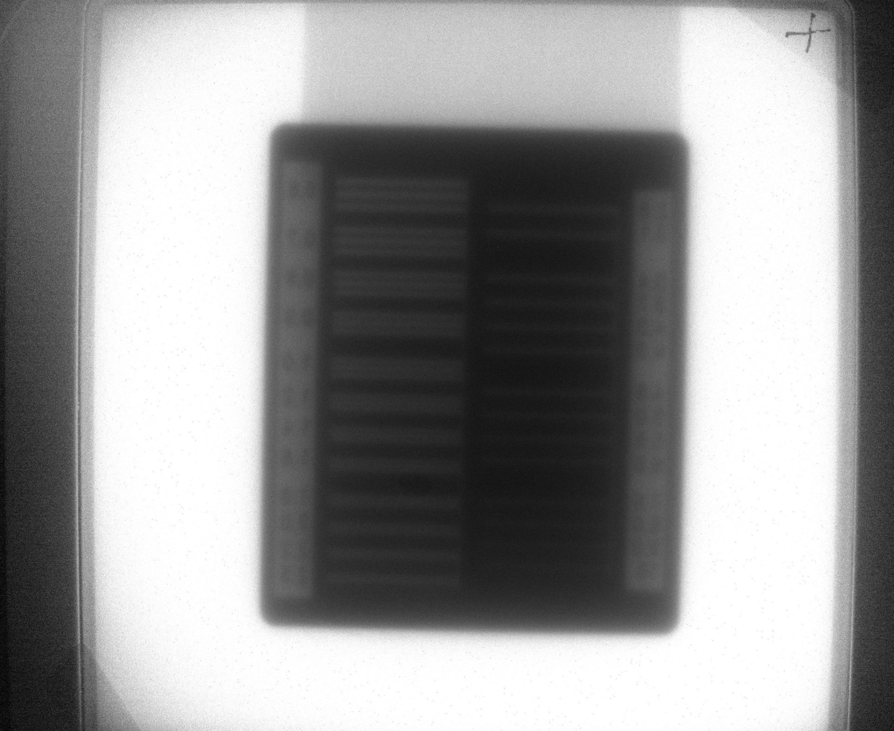
Spatial resolution measurements with Ar/CF₄ gas
Resolution is worse with TPB
With TPB
Without TPB

Slide 18
Outlook
Scintillation studies to confirm the light wavelength range with different gases
Studies on how the position of the TPB affects the spatial resolution

Slide 19
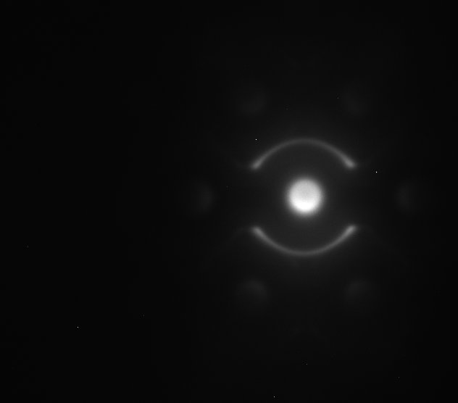
Backup
Image of a single GEM hole

