Slide 1




Development of monitoring system for DAQ servers
CERN Summer student programme 2023
Presentation by : Nechirawan Mohammed
Supervised by: Adam Abed Abud
22 Aug 2023

Slide 2



Who am I?
Nechirawan Mohammed from Erbil (Kurdistan Region of Iraq)
Theoretical Cosmology
Shahid Beheshti University-Tehran

Slide 3
Outline
Introduction to DUNE
ProtoDUNE
Project Overview
Monitoring Ping, Andrew File System (AFS), and CernVM File System (cvmfs)
My contribution
Conclusion

Slide 4
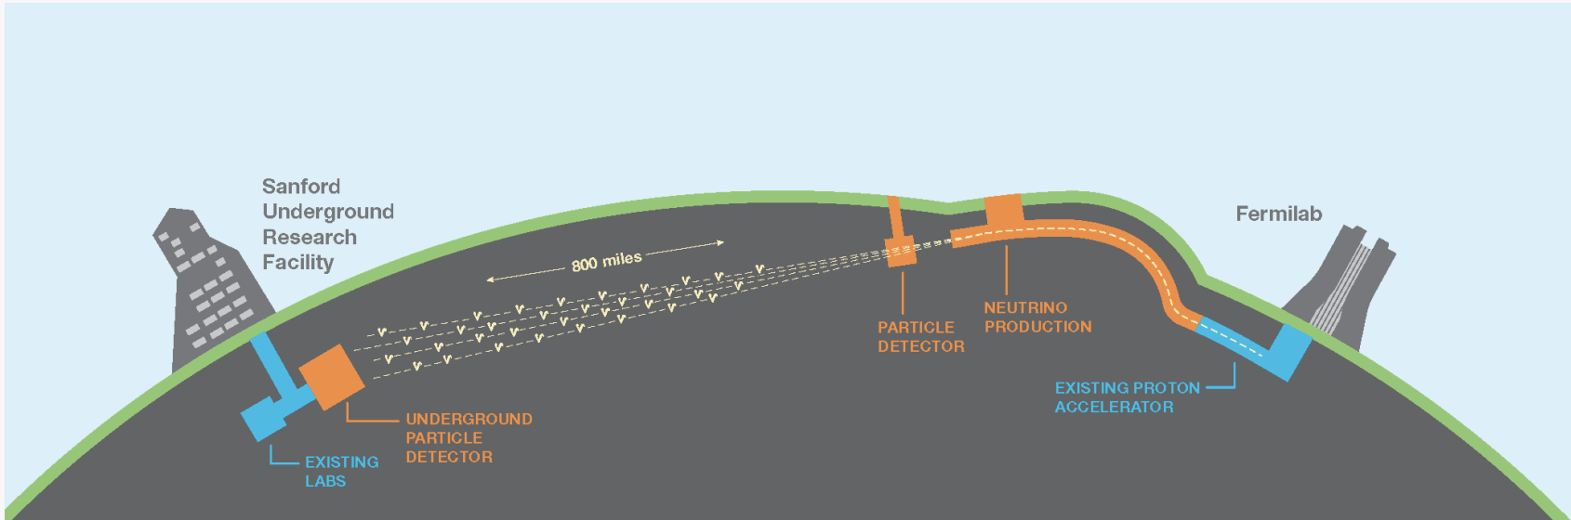
Deep underground neutrino experiment (DUNE)
Liquid Argon time projection chamber
Fermilab Accelerator generate intense neutrino beam
4 Far detector modules (1.48 Km underground) in Sanford
Detector size (14 x 14 x 62) m³
Wide physics programme
Accelerotor based neutrino physics
Supernovae neutrino studies
Proton decay

Slide 5
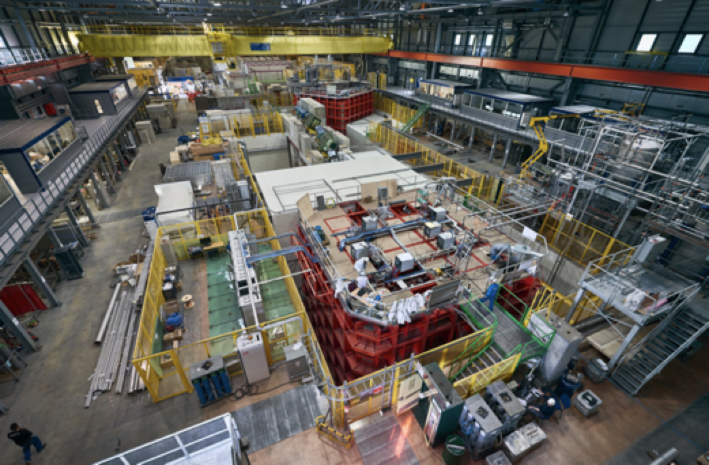

ProtoDUNE
Two prototype far detectors at CERN
The first started taking data in Sep 2018
Detector size (6 x 6 x 6) m³
5% of DUNE

Slide 6
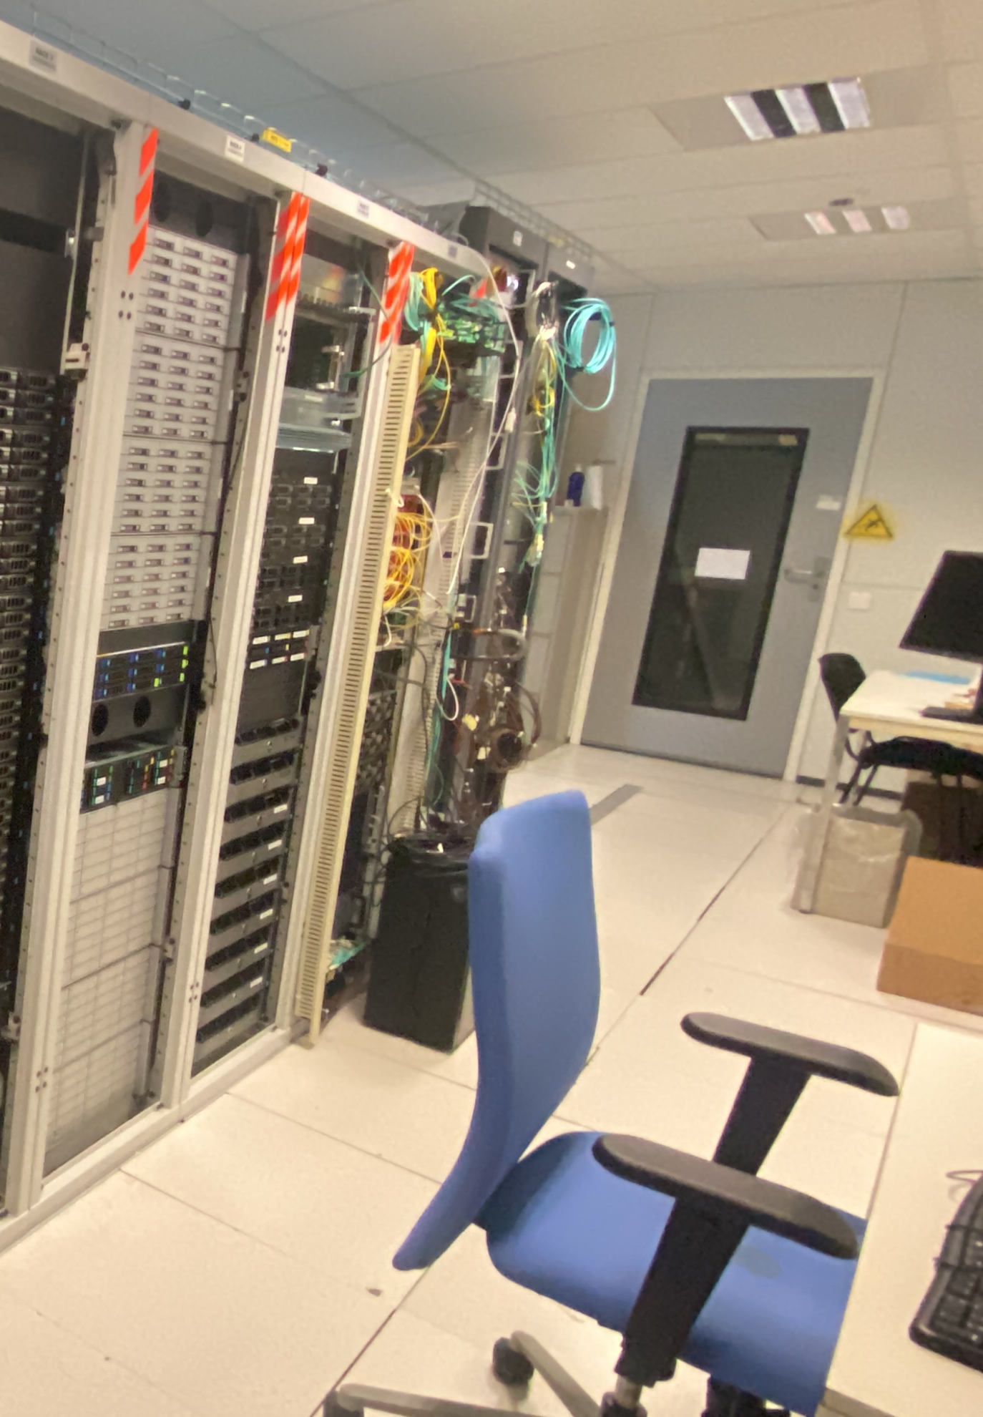
ProtoDUNE DAQ room
Safety, power control, UPS
Network file system,
Run control, monitoring,
readout
Triger
Disk arrays
Timing
Storage servers
Disk arrays

Slide 7
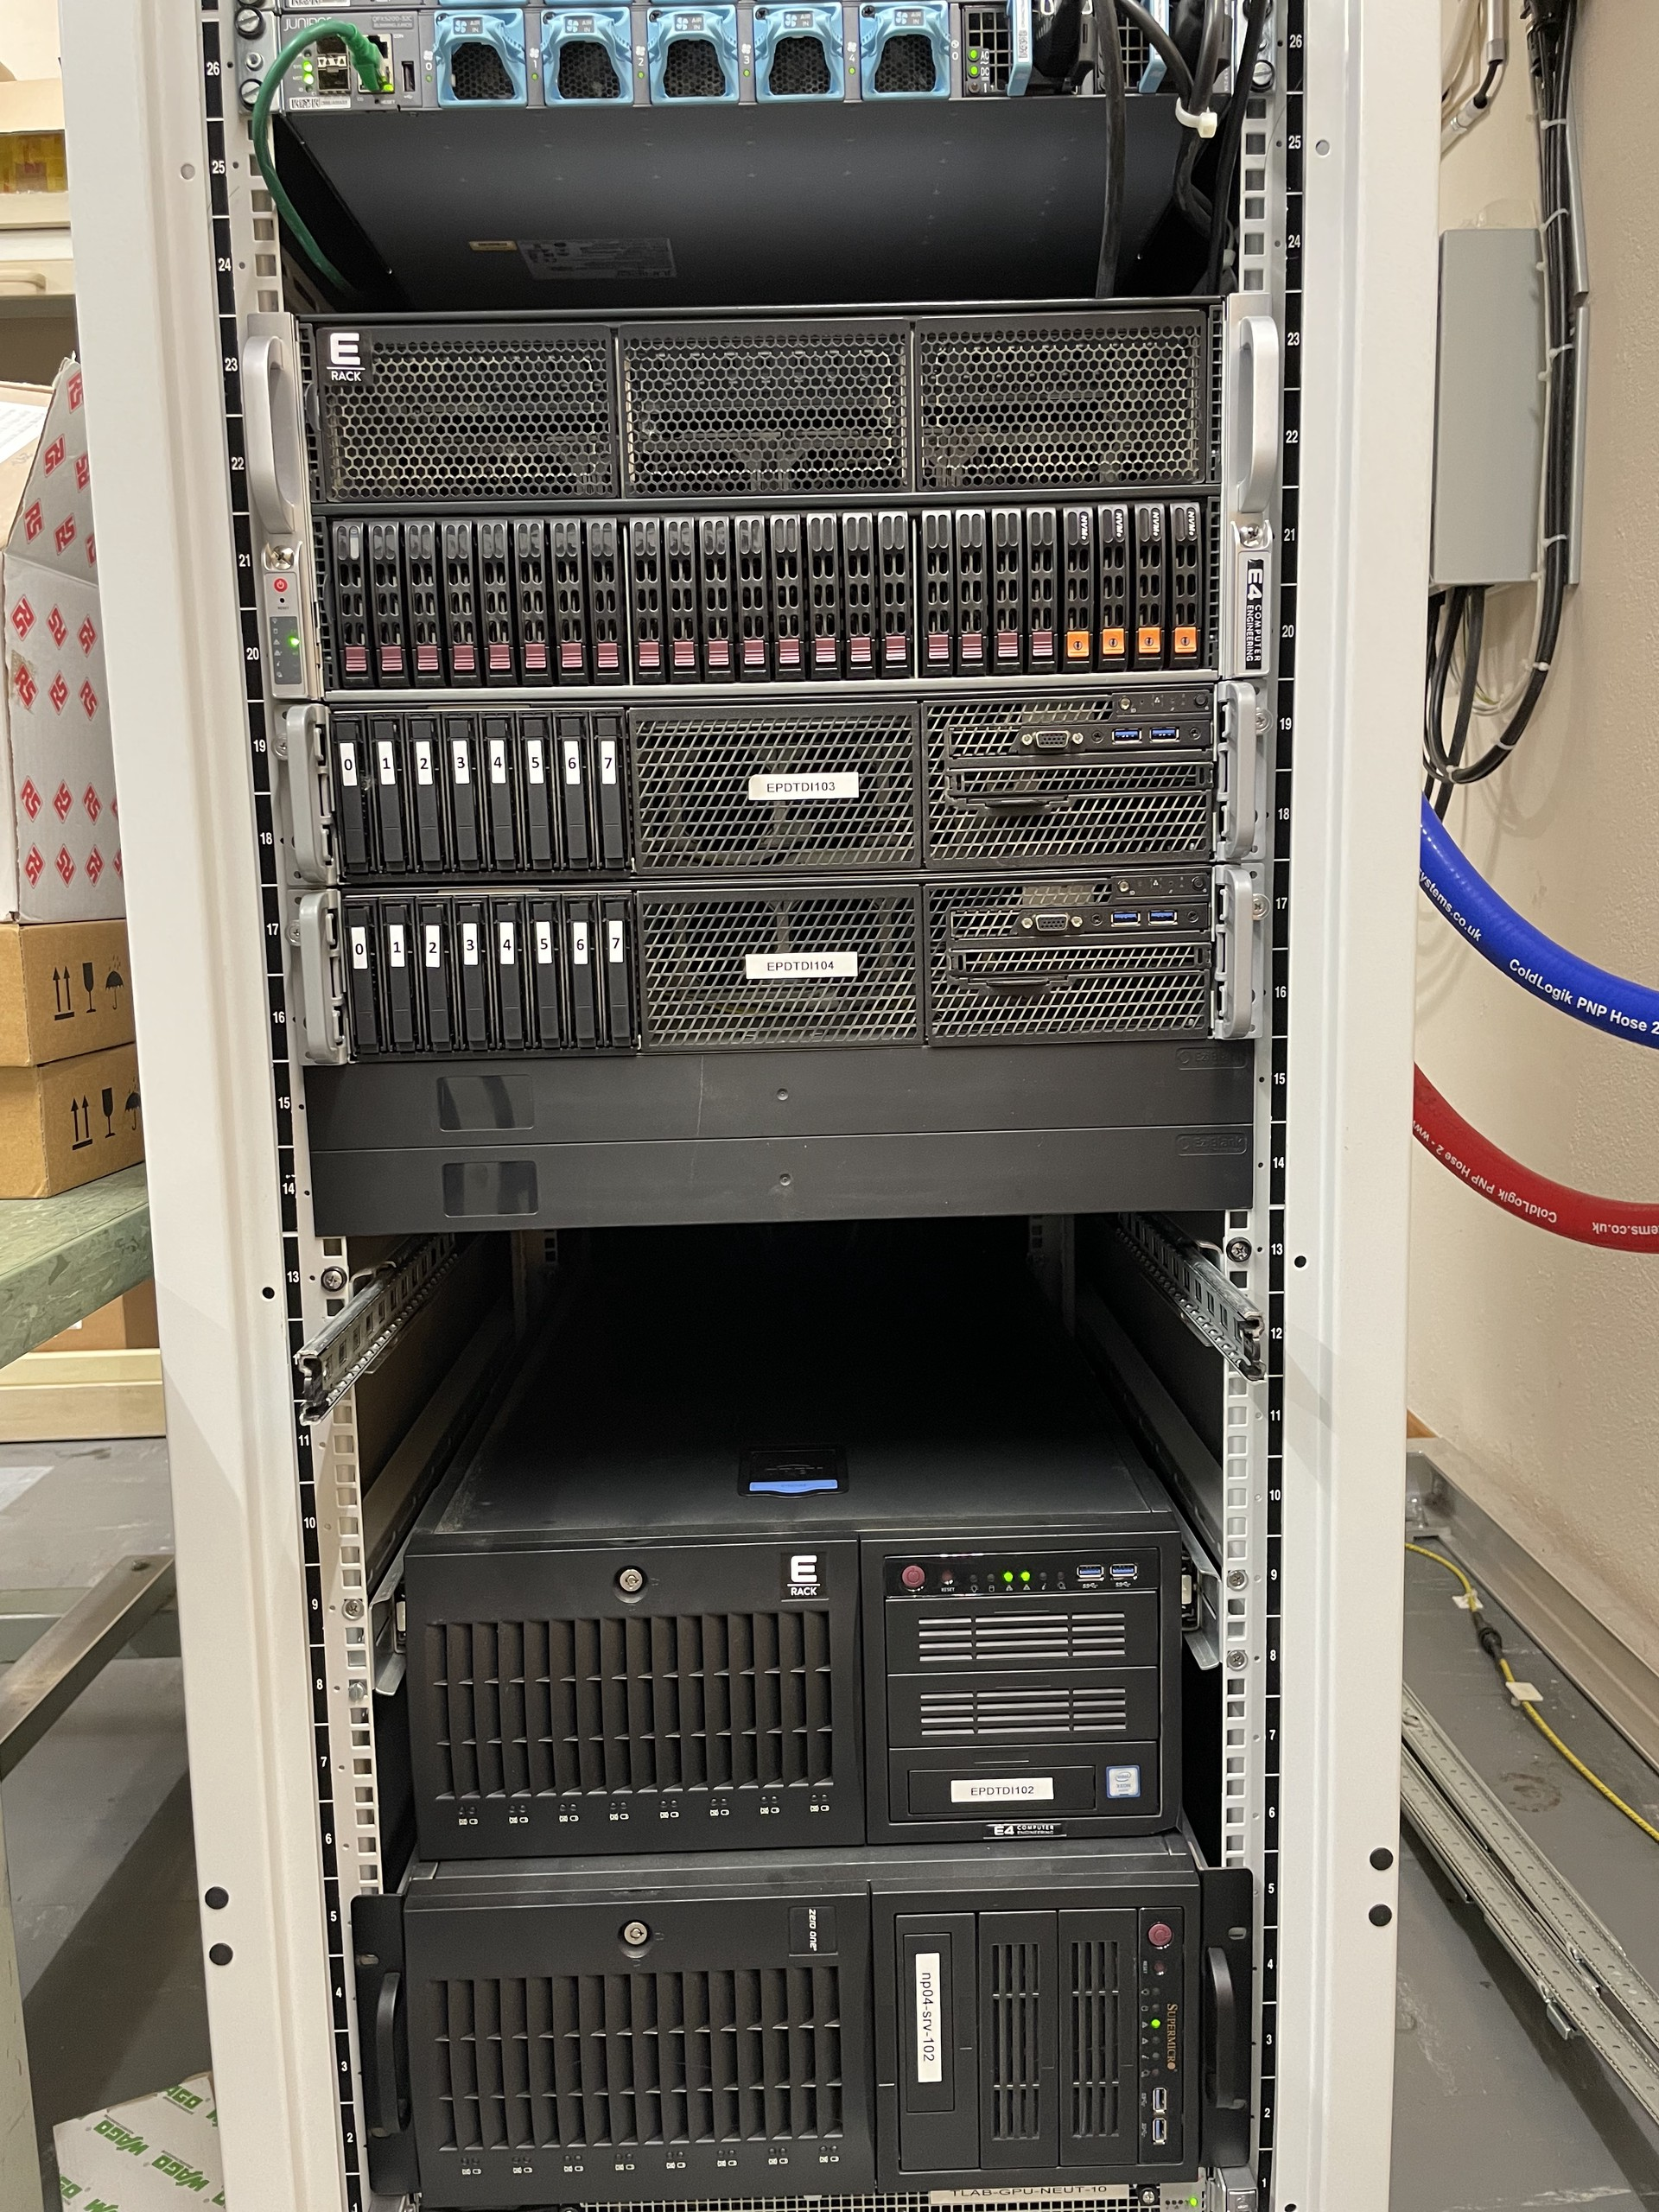
EP-DT-DI DAQlab
Located in building 0021 R-0069
11 machines used for development by Detector Interface section
Mainly used for DAQ development
E.g.: (Proto)DUNE, NA61, NA62 experiments
Both software and firmware development
Temperature monitoring available and alarm based alerting system

Slide 8
Project description
Developing a web-based application to monitor the status of a list of servers and assess the availability of different services
Functionality:
Checks server status using ICMP ping and SSH
Verifies AFS and CVMFS availability
Potentially including other services
Benefits:
Quick assessment of server statuses to support System Administrators
E.g. In case of power cut
Visual representation with color coding

Slide 9
What are Ping - AFS – CVMFS ?

Slide 10
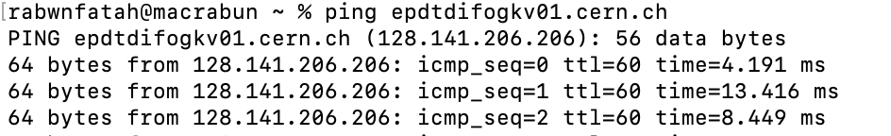
Ping Monitoring
The ping monitoring feature provides a real-time indication of the servers’ status, enabling administrators to quickly identify potential issues
Functionality:
ICMP Echo Requests
Response Time
Online Status

Slide 11


Andrew File System (AFS):
AFS is a distributed network file storage system designed for sharing files and data across multiple machines
Features:
Distributed File System
Secure Access
Organized Structure
CERN Virtual Machine File System (CVMFS) :
CVMFS is optimized for scientific computing environments, distributing software and data to researchers
Features:
Global Distribution
Immutable File System
Caching files on the user’s machine

Slide 12
My contribution
The web application has been develop using the following python modules
Python's modules offer modular and structured programming by encapsulating functions, classes, and variables in standalone chunks of code
Flask (Creating a web application )
Socket (Check server’s availability)
Paramiko (SSH connection)
Getpass (Secure passwords)
Subprocess (Checking the status of the servers)

Slide 13
My contribution
Logic and Workflow:
Give a Server List
enter your username & password
Check server status
Check SSH Connectivity
Check File System AFS & CVMFS
Compilation of the result and rendering
Show up the result on a web page

Slide 14
My contribution
Up
Check AFS
Down
Up
Check CVMFS
Down
Up
etc
Connect SSH
Using Paramiko
Down
Up
server
Check Ping
Exception
Authentication Exception
N/P
Down
AFS & CVMFS
N/A

Slide 15
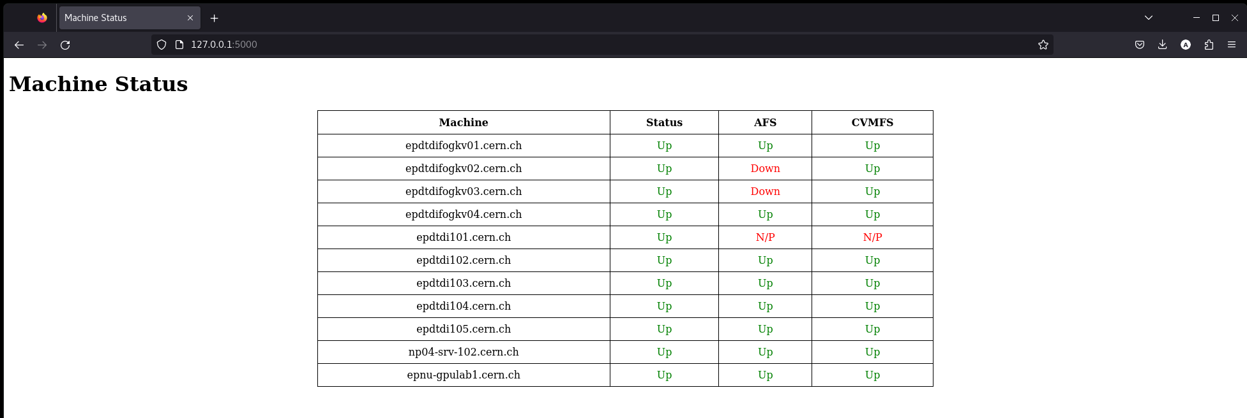
Display
The results are displayed on a web page as shown:

Slide 16
Conclusion
The provided Python code sets up a Flask web application to monitor the status of a list of servers
It utilizes various libraries, such as
Subprocess for checking the status of the servers
paramiko for SSH interactions
Flask for web rendering
The application checks server connectivity, SSH availability, and the status of AFS and CVMFS file systems
The results are displayed on a web page, allowing users to quickly assess the health of the listed servers
Outlook:
Extend the services to monitor(e.g. server metrics monitoring, etc.)
Hyperlink to remote web control of the servers (IPMI)
Improving the code to give the status of the servers continuously

Slide 17

Thank you for your attention

