Slide 1




Climate Change:
Evidence, Effects, and Actions
CERN Greek National Teacher Program 2023
Olga
Laura

Slide 2
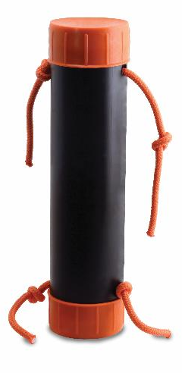
Black Box
Building and Revising Scientific Models
Notes:
(About 10-15 min) Using the Black Box:
-Demonstrate the box by pulling several strings
-Ask the participants to draw what they think is happening using their whiteboards
-Ask 3-4 people with different ideas to come up at the same time. Test their models, if they work, give their boards a checkmark
-Explain how nature can be described using models. We test these model/theories until they are proven wrong. At that point, they need to be thrown out or revised. Several, different models are capable of describing the same thing.
-Shake the Black Box. Show how some of the drawn models fail, while others survive.
-It is important to build vocabulary such as “predict, observe, model, etc.”

Slide 3
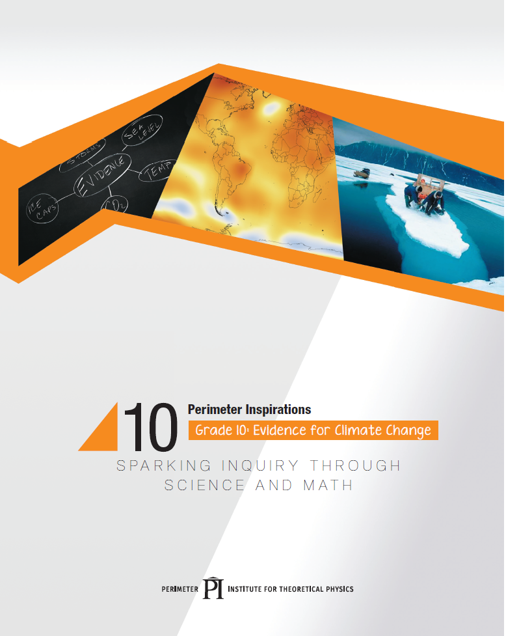
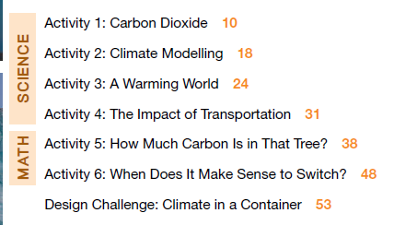
resources.perimeterinstitute.ca

Slide 4
Questions
What questions about climate change do you hear the most?
What is the question that you are most worried about being asked?
What is the question you have always wanted to ask?

Slide 5
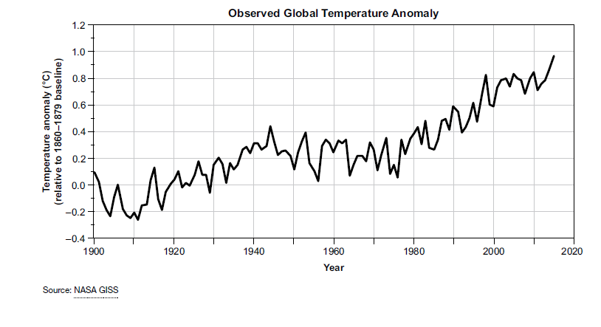
Earth is getting warmer

Slide 6
“World just got its first real taste of life at 1.5 degrees Celsius above preindustrial times.”
- The Washington Post
August 3, 2023
https://www.washingtonpost.com/climate-environment/2023/08/03/july-blows-away-temperature-records-testing-key-climate-threshold/
Notes:
https://www.washingtonpost.com/climate-environment/2023/08/03/july-blows-away-temperature-records-testing-key-climate-threshold/

Slide 7
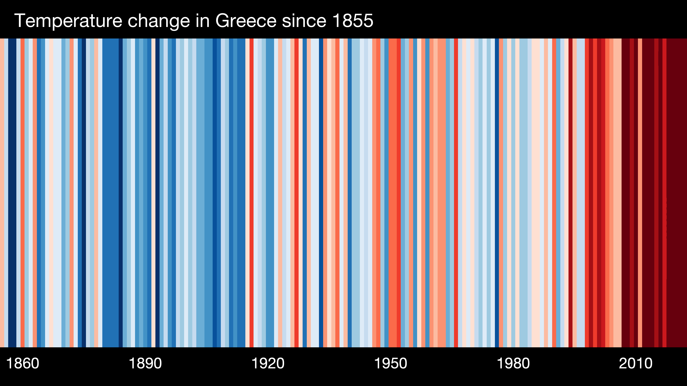
Greece (1855 – 2022)
Notes:
https://showyourstripes.info/
Berkeley Earth, NOAA, UK Met Office, MeteoSwiss, DWD
Shows anomaly from 20th century average

Slide 8
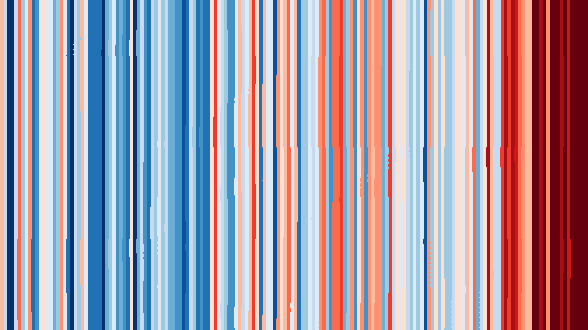
Greece (1855 – 2022)
Notes:
https://showyourstripes.info/
Berkeley Earth, NOAA, UK Met Office, MeteoSwiss, DWD
Shows anomaly from 20th century average

Slide 9
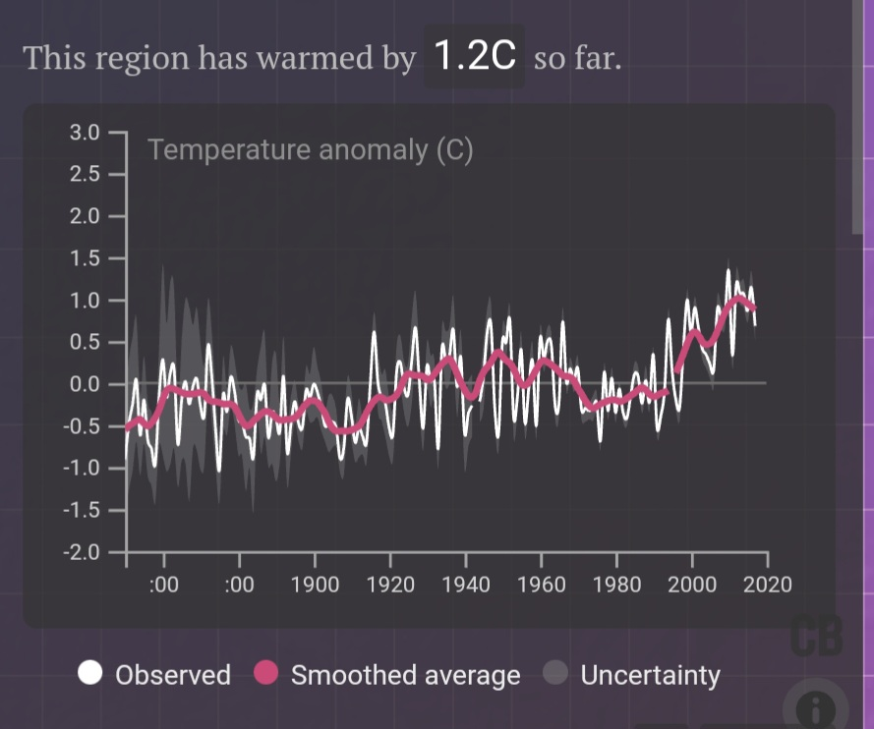
Athens is getting warmer
https://www.carbonbrief.org/mapped-how-every-part-of-the-world-has-warmed-and-could-continue-to-warm
Notes:
Data taken from Carbon Brief (https://www.carbonbrief.org/mapped-how-every-part-of-the-world-has-warmed-and-could-continue-to-warm) Interactive Map
Based on Berkeley Earth degree by degree avg temperature. Both historical and future temperatures are shown relative to a 1951-1980 baseline period.
Discuss with your neighbours. What are the reasons that you have heard for rising temperatures?

Slide 10


A few degrees may not seem like much…
37ºC = healthy
39ºC = sick
Notes:
Students might think that 2 degrees isn’t much but…

Slide 11
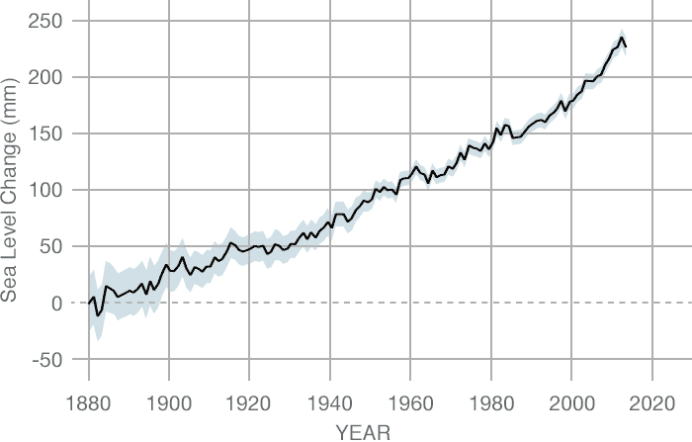
Sea Levels are rising
CREDIT: CSIRO
Notes:
Data source: Coastal tide gauge records.
Credit: CSIRO
https://climate.nasa.gov/vital-signs/sea-level/

Slide 12
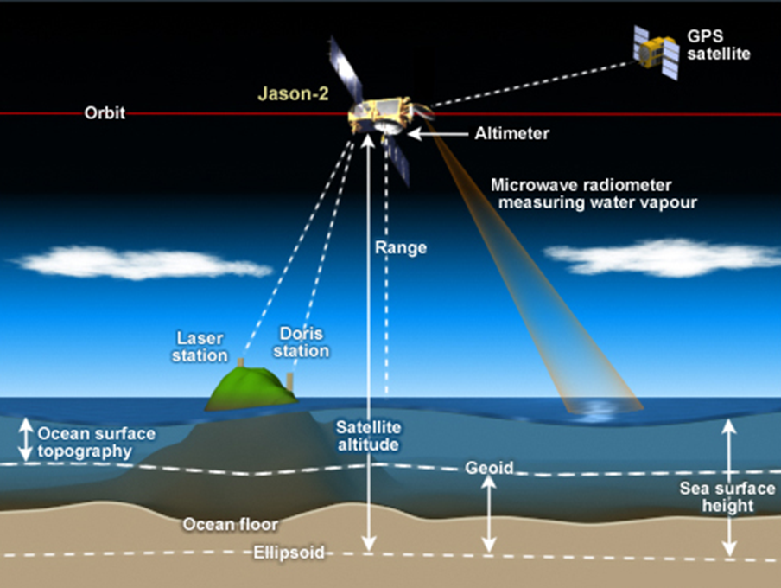
Satellite Altimetry: Measuring Sea Level
Notes:
Distribute the Satellite Altimetry card. Quick explanation for one way to measure sea levels is to bounce radar signals between satellites and sea surface

Slide 13
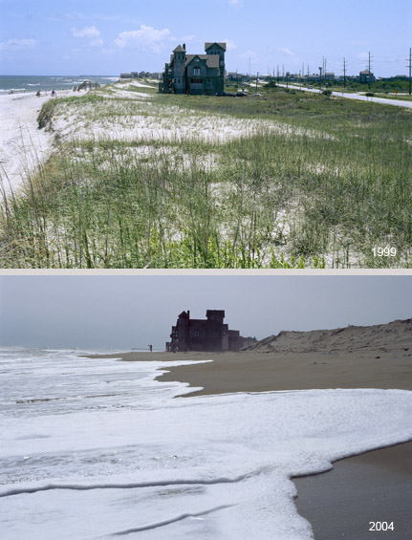
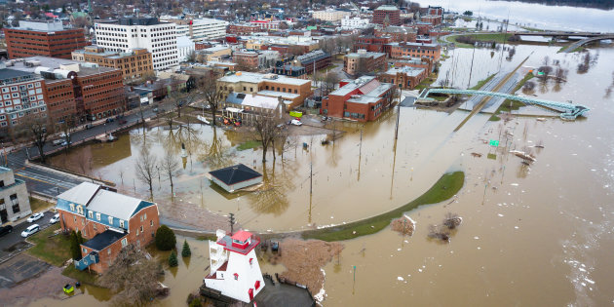
A few centimetres may not seem like much…
Notes:
Students might think that 20 cm is that big of a deal but…

Slide 14
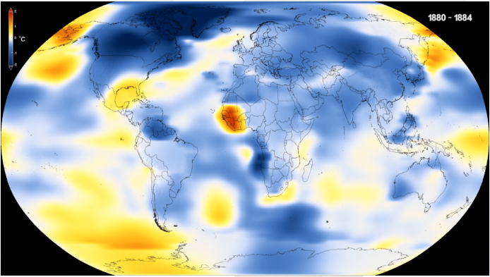
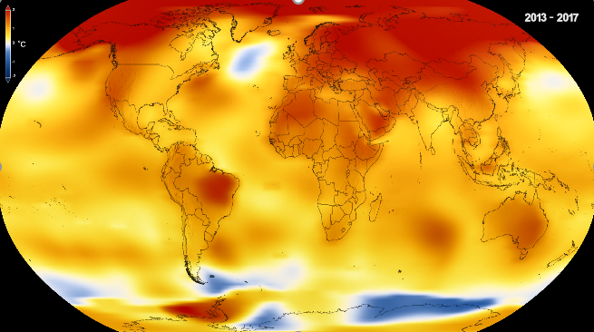
The question is: Why?
1880 2017
And what can we do about it?
Notes:
Discuss with neighbours about reasons that you have heard for the rise in temperature

Slide 15

A Climate Change demo

Slide 16
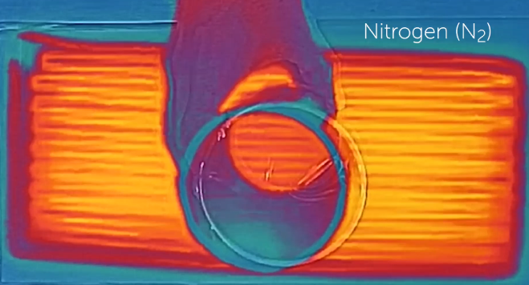
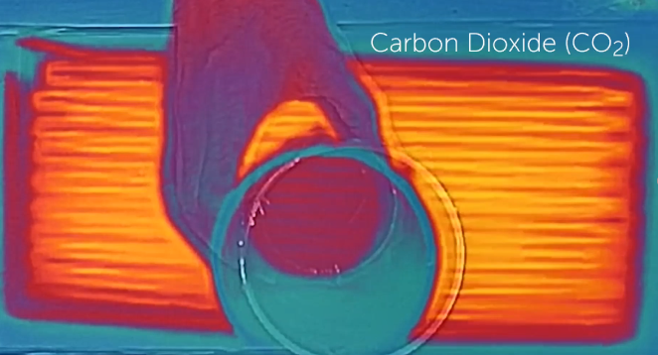
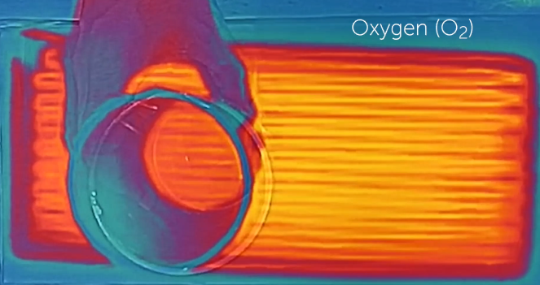
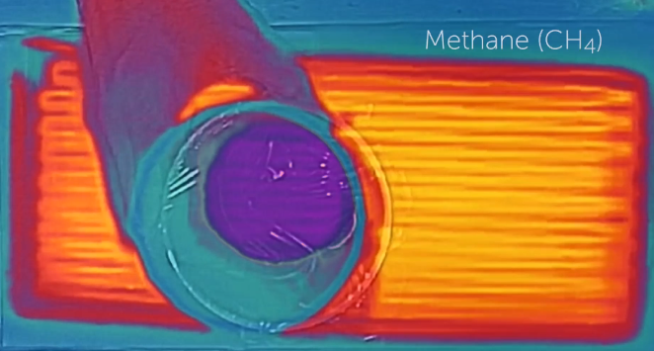
Which gases are transparent to infrared radiation?

Slide 17

Keeling Curve https://keelingcurve.ucsd.edu/
Measurement of the concentration of CO₂ in the atmosphere
Continuous record at Mauna Loa since 1958
(August 18, 2023)
Notes:
Now that we have established the physical mechanism by which carbon dioxide (and other GHGs) absorb heat we need to establish whether CO2 levels are increasing.
I am going to make a BOLD prediction. CO2 levels are about to drop noticeably. WHY?

Slide 18
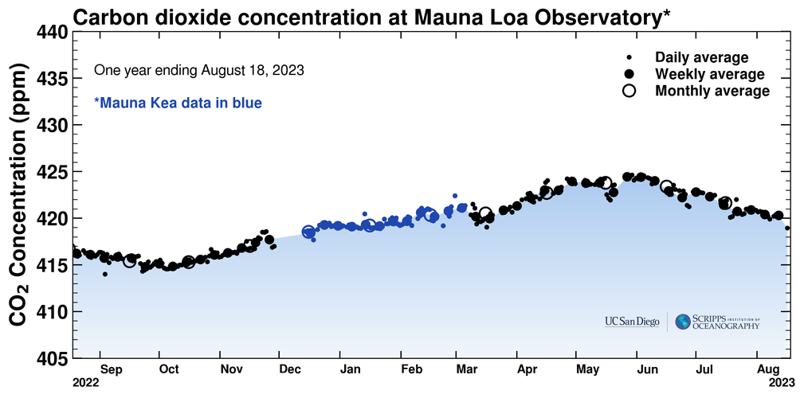
One month
Notes:
https://scripps.ucsd.edu/programs/keelingcurve/wp-content/plugins/sio-bluemoon/graphs/mlo_one_month.png
What do you notice?

Slide 19
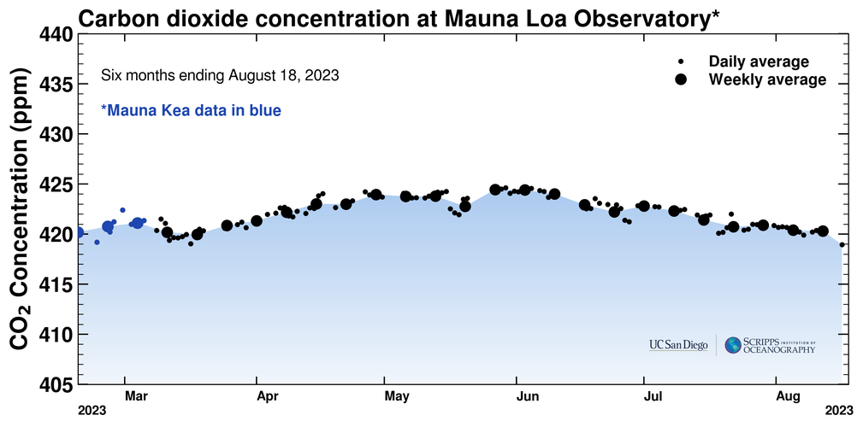
six months
Notes:
https://scripps.ucsd.edu/programs/keelingcurve/wp-content/plugins/sio-bluemoon/graphs/mlo_six_months.png
What do you notice?

Slide 20
1 year
Notes:
https://scripps.ucsd.edu/programs/keelingcurve/wp-content/plugins/sio-bluemoon/graphs/mlo_one_year.png
What do you notice?
Every spring the CO2 levels drop at plants in the Northern Hemisphere wake up and begin to absorb CO2 as they green up and grow.

Slide 21
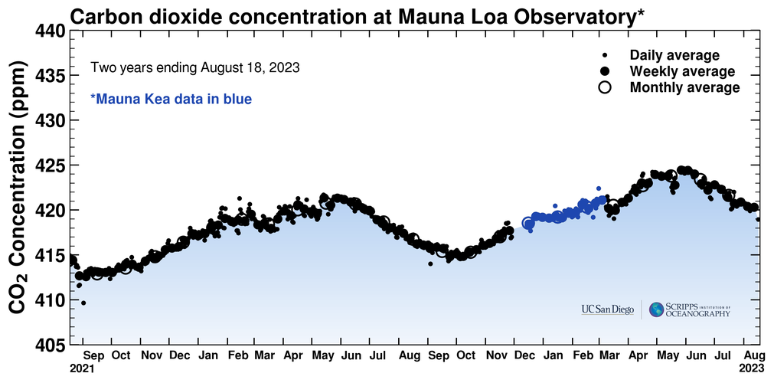
Last two years
Notes:
https://scripps.ucsd.edu/programs/keelingcurve/wp-content/plugins/sio-bluemoon/graphs/mlo_two_years.png
What do you notice?
Compare Sept 2016 and Sept 2017. Compare May 2017 and May 2018.
What causes this cycle?
Nature is full of cycles: El Nino, Solar Activity, etc. (recent Texas storm happens about once every 10 years)

Slide 22
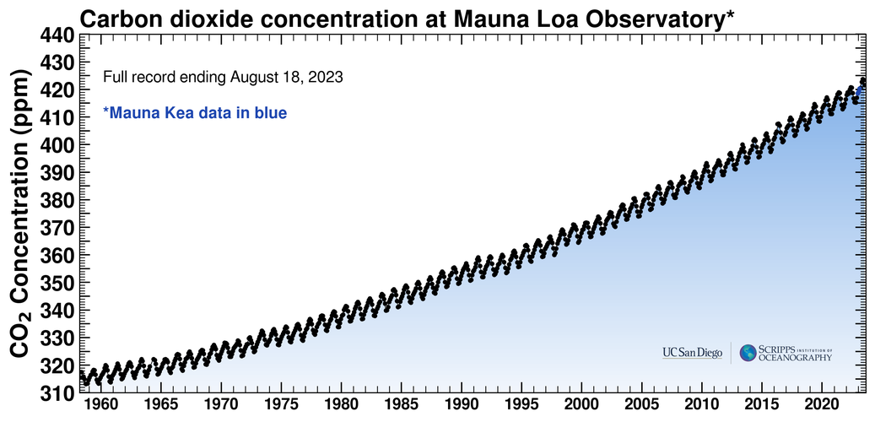
Full record
Notes:
https://scripps.ucsd.edu/programs/keelingcurve/wp-content/plugins/sio-bluemoon/graphs/mlo_full_record.png
What do you notice?
Consider what you saw in the video about how carbon dioxide interacts with IR light. What does this imply about the energy in the atmosphere.

Slide 23
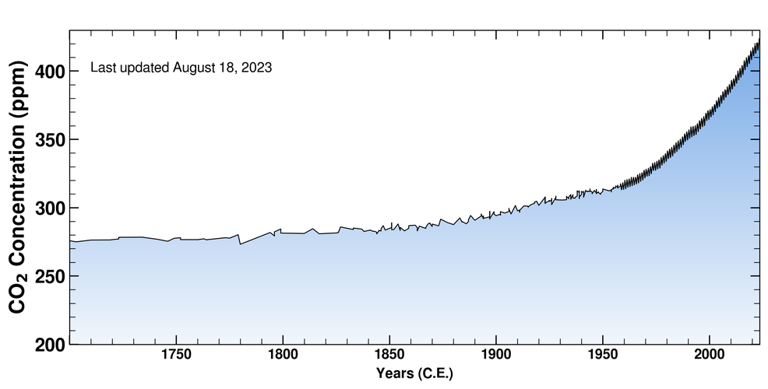
1700 - present
August 18, 2023.
Ice-core data before 1958. Mauna Loa data after 1958.
Notes:
https://scripps.ucsd.edu/programs/keelingcurve/wp-content/plugins/sio-bluemoon/graphs/co2_800k_zoom.png
This graph combines Mauna Loa data with ice core measurements. What do you notice? What historical events coincide with the change in CO2 levels?

Slide 24
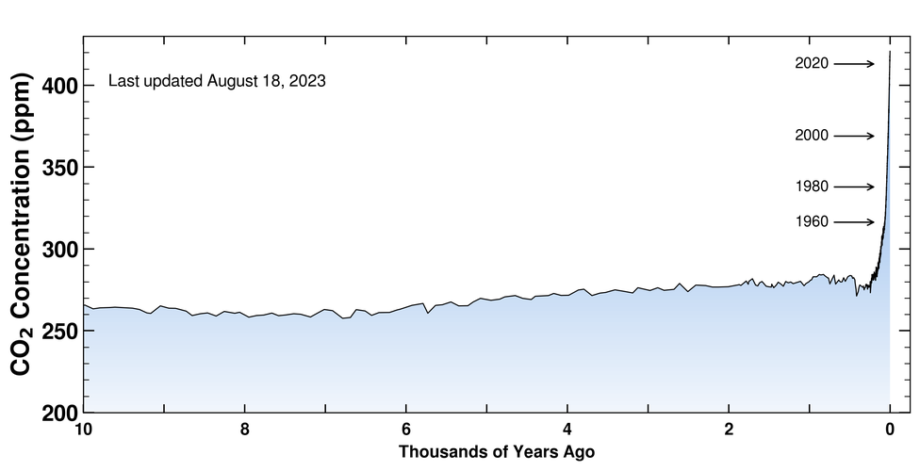
Last 10,000 years
August 18, 2023.
Ice-core data before 1958. Mauna Loa data after 1958.
Notes:
https://scripps.ucsd.edu/programs/keelingcurve/wp-content/plugins/sio-bluemoon/graphs/co2_10k.png
Ice core data take use back 10 000 years. The total amount of carbon on Earth has not changed since Earth formed 4.5 billion years ago. Why is carbon only a problem now?

Slide 25
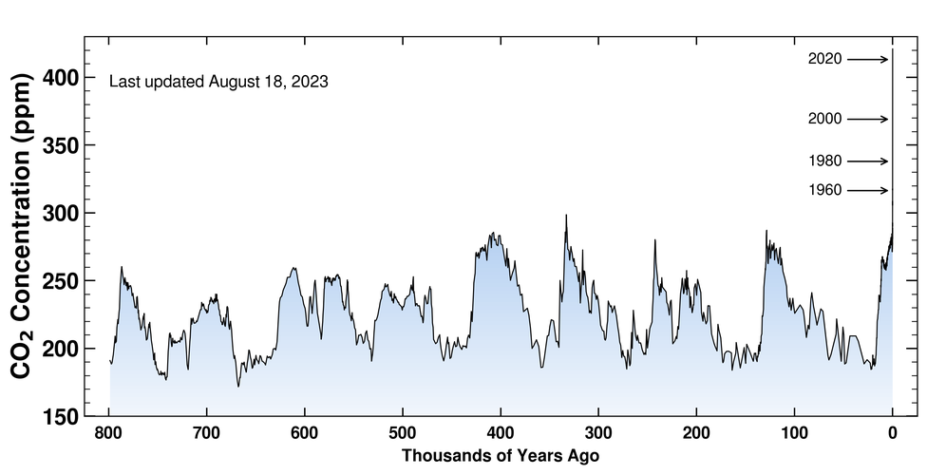
Last 800,000 years
THIS IS US
August 18, 2023.
Ice-core data before 1958. Mauna Loa data after 1958.
Notes:
https://scripps.ucsd.edu/programs/keelingcurve/wp-content/plugins/sio-bluemoon/graphs/co2_800k.png
Climate deniers often say that Earth’s climate has cycles and we are in another cycle. How is this true and how is this false?
Some people will also say that CO2 levels have been much higher in the past, which is kind of true. CO2 levels were much higher millions of years ago, before humans were on the scene.

Slide 26

Greenhouse gases, like CO₂ and methane, absorb infrared radiation.
August 18, 2023.
Ice-core data before 1958. Mauna Loa data after 1958.
CO₂ levels have been increasing since industrial revolution
Notes:
We know that CO₂ interacts with infrared radiation which means less heat leaves the planet.
So now we know that CO₂ levels are increasing and that it is NOT part of a natural cycle.

Slide 27
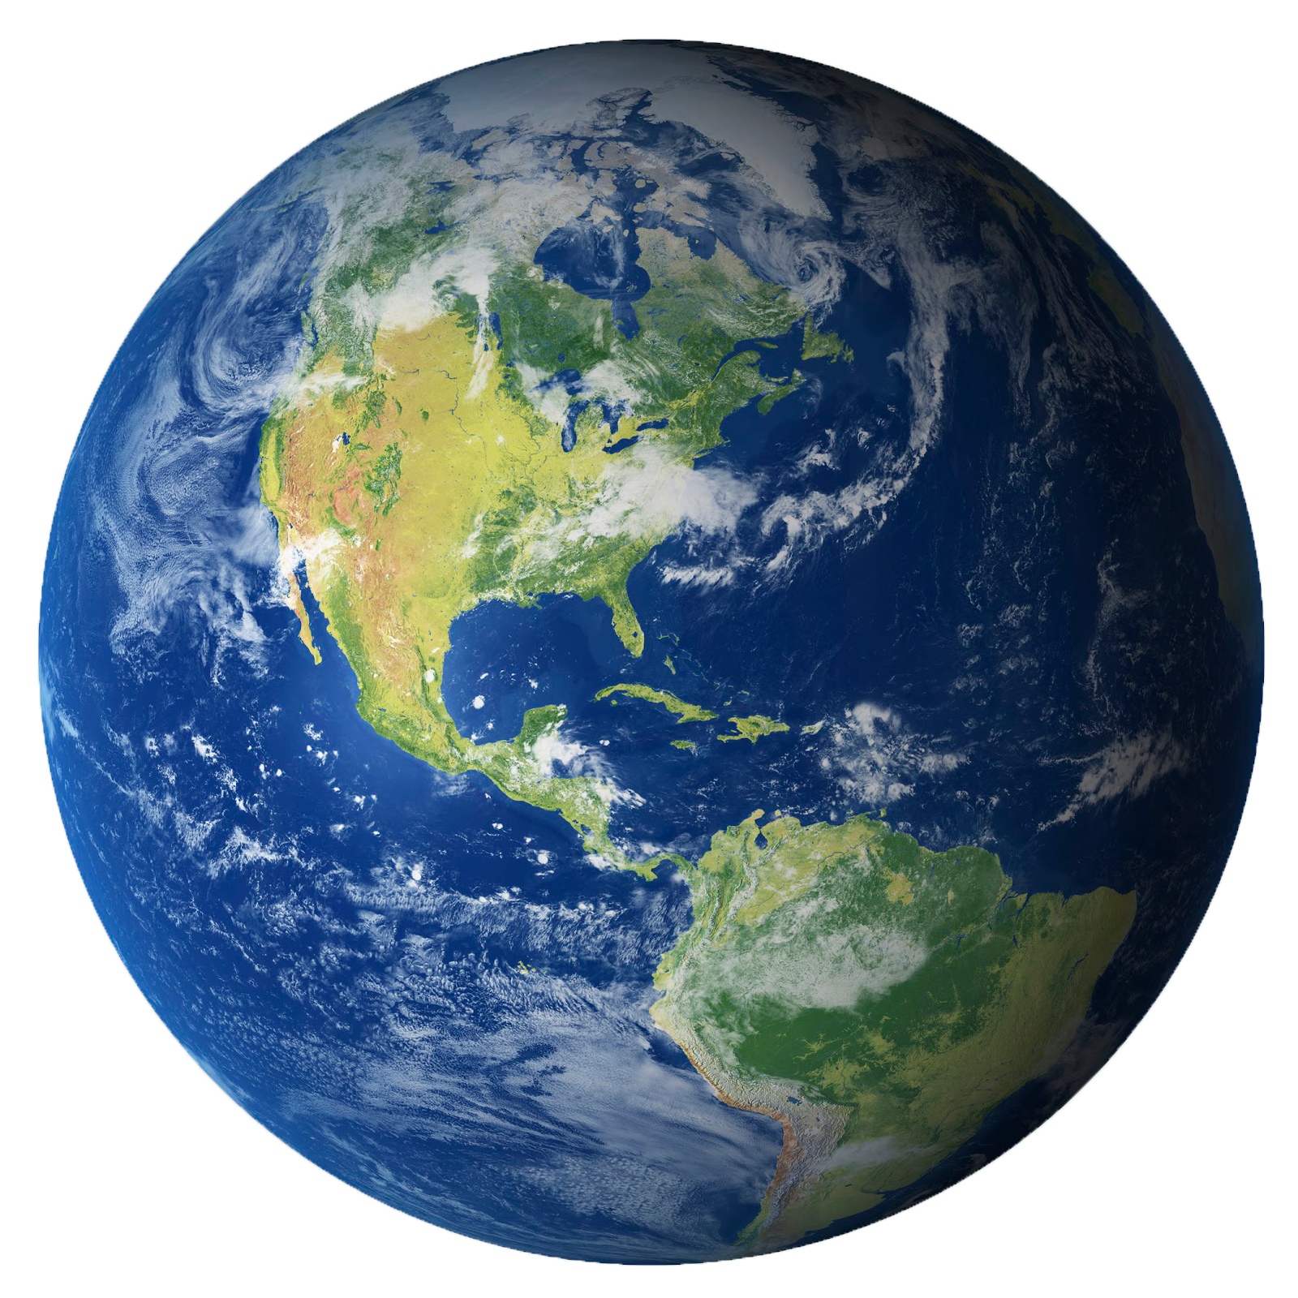
How do these observations relate to the Earth?
Notes:
The implications
How does this relate to the Earth?

Slide 28
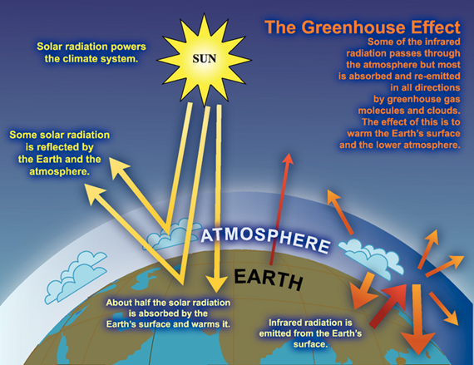

Earth’s atmosphere traps heat
Notes:
Earth’s atmosphere traps heat; analogy isn’t strong… don’t push it!
Image source
International Panel on Climate Change 2007b: The image is described as an “idealized model of the natural greenhouse effect”
https://wg1.ipcc.ch/publications/wg1-ar4/faq/wg1_faq-1.3.html

Slide 29


Heat
Predict
Observe
Explain
Apply
Notes:
Heat
Predict
Observe
Explain
Apply

Slide 30
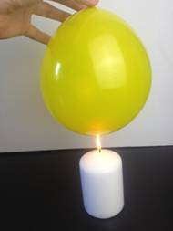
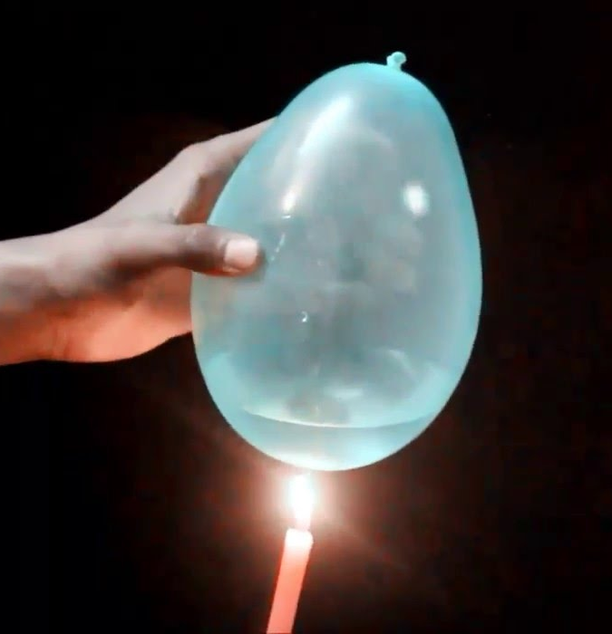
Predict: What happens to the balloons?
air
water
Will the balloons pop at the same time? If not, which will pop first? Why?
Notes:
What happens to the balloons?
How does this relate to the Earth?

Slide 31
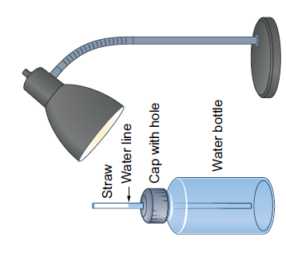
Predict: What happens when water heats up?
Will the water level rise, fall or stay the same?
Why?
Notes:
What happens when water heats up?
How does this relate to the Earth?

Slide 32
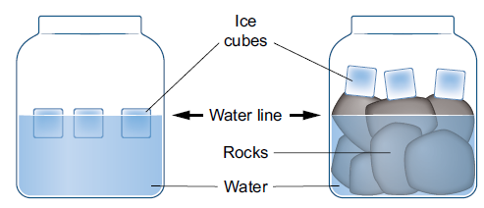
Predict: What happens when ice melts?
What will happen to the water level in each container? Why?
Notes:
What happens when ice heats up?
How does this relate to Earth?

Slide 33
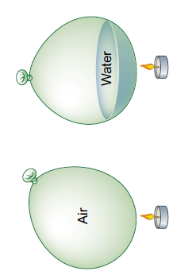
Make your 3 predictions and explanations!
Popping time
Water level
Water level

Slide 34
Observe and Explain
water

Slide 35
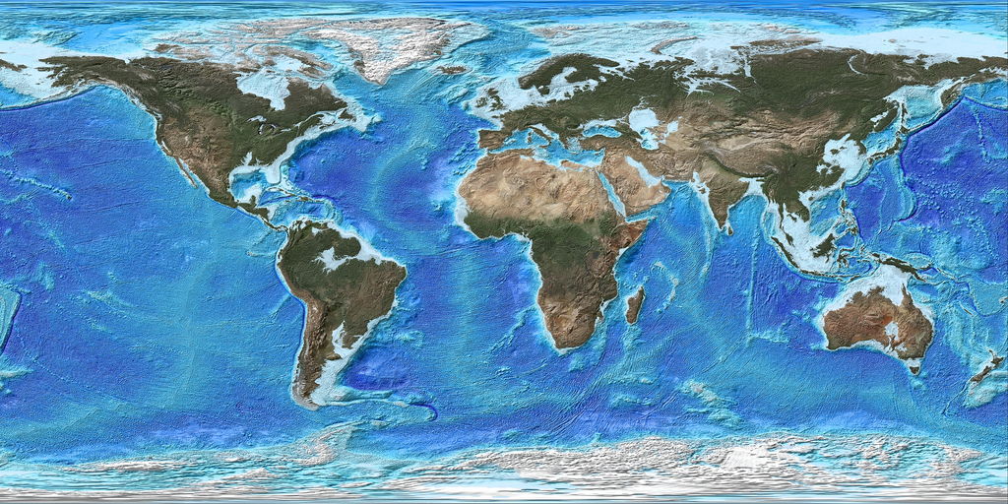
Apply:
70% of the Earth is covered by water
Notes:
70% of the Earth is covered by water

Slide 36
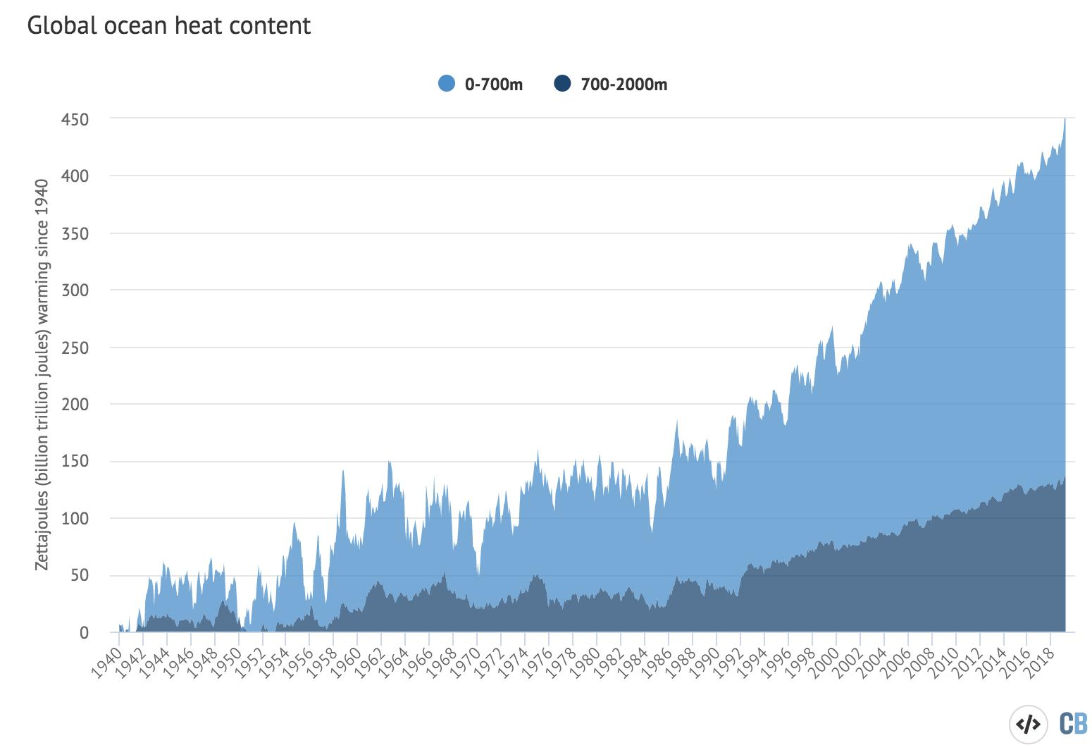
Oceans are hotter

Slide 37
What happens when water heats up?
Notes:
What happens when water heats up?
How does this relate to the Earth?

Slide 38
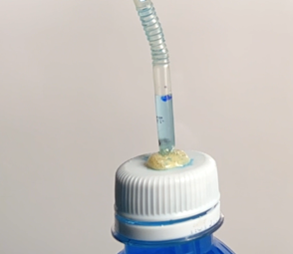
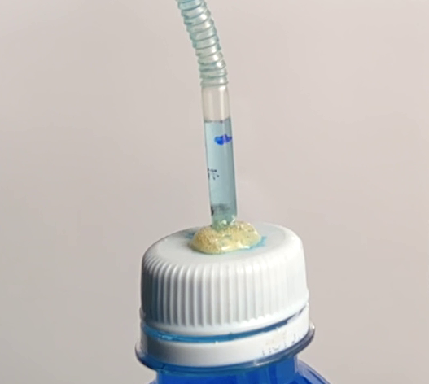

How does this relate to the Earth?
Notes:
What happens when water heats up?
How does this relate to the Earth?

Slide 39
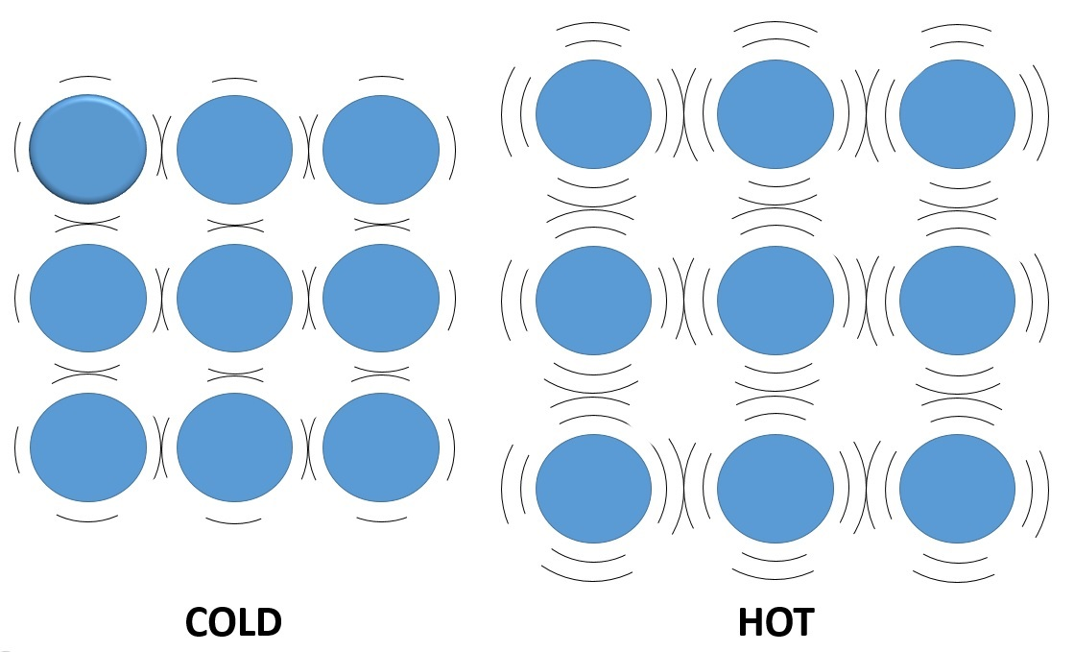
Thermal Expansion of Water

Slide 40
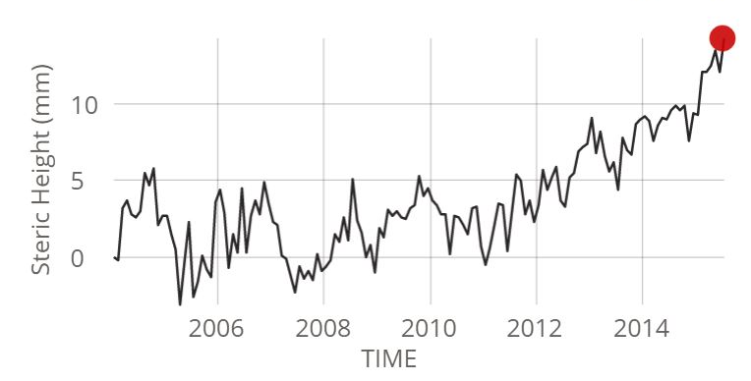
Apply:
Measuring the Ocean’s Volume

Slide 41
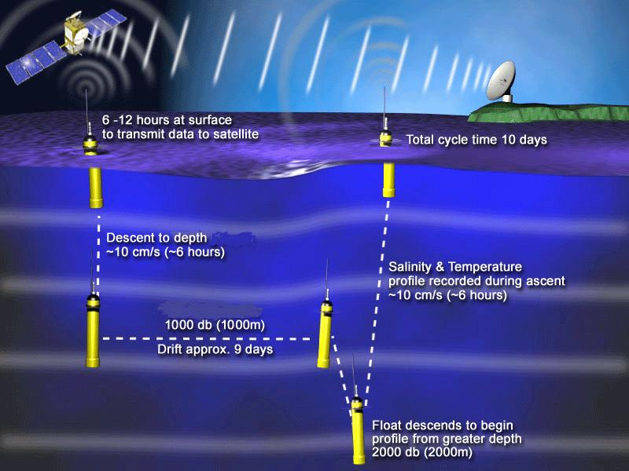
ARGO: Measuring the Ocean’s Volume
Notes:
ARGO measures salinity and temperature at two different depths

Slide 42
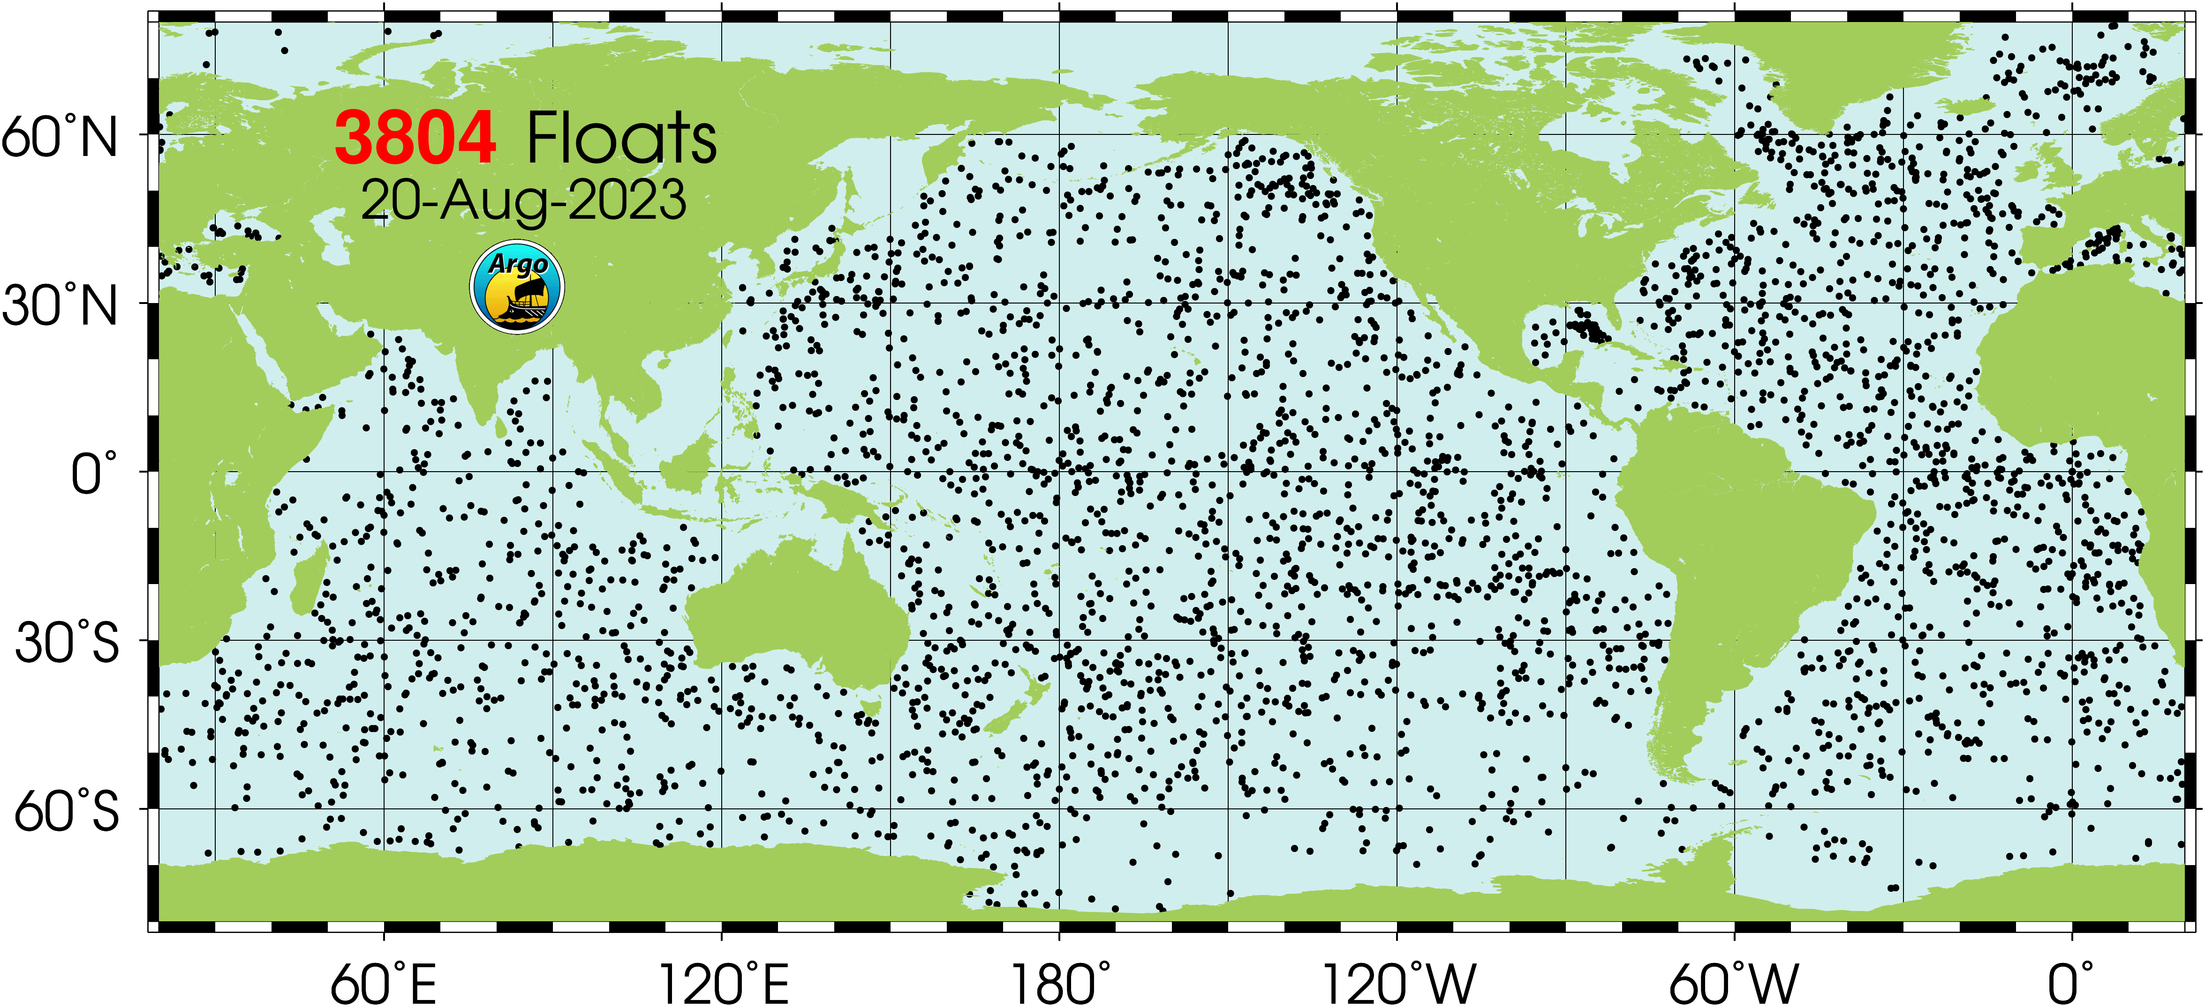
ARGO: Measuring the Ocean’s Volume
Notes:
Almost 4000 probes spread around the globe

Slide 43
Observe and Explain

Slide 44
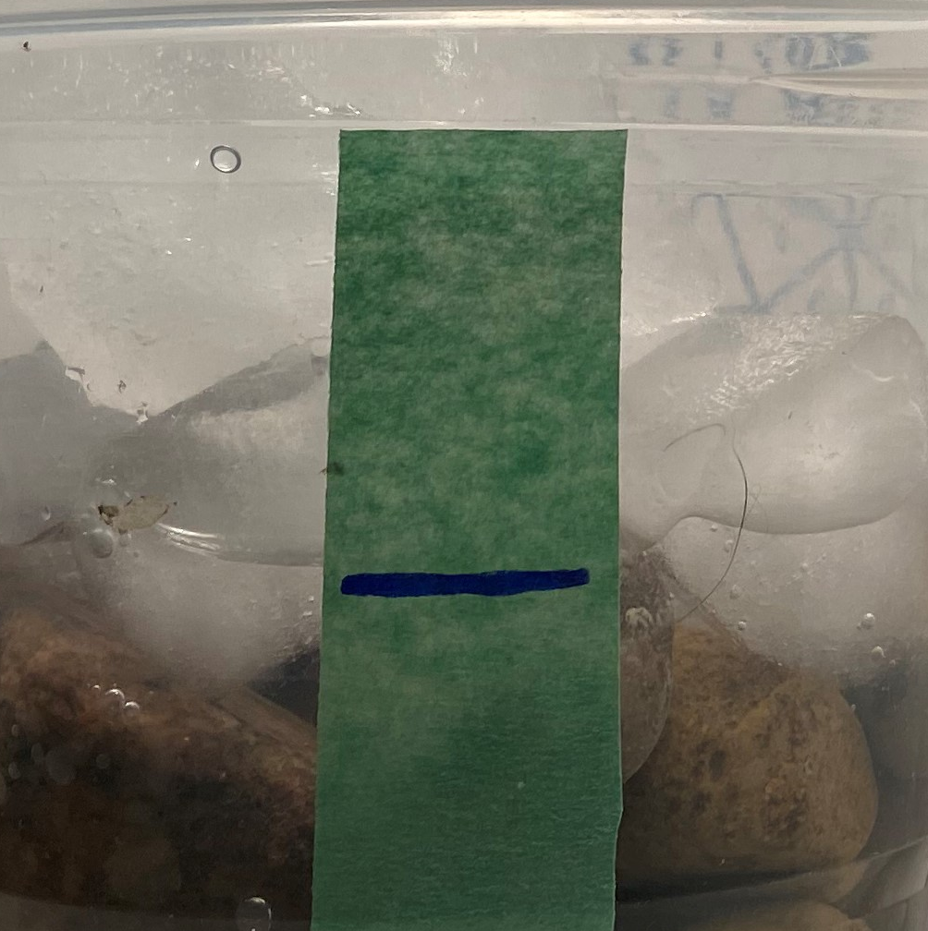
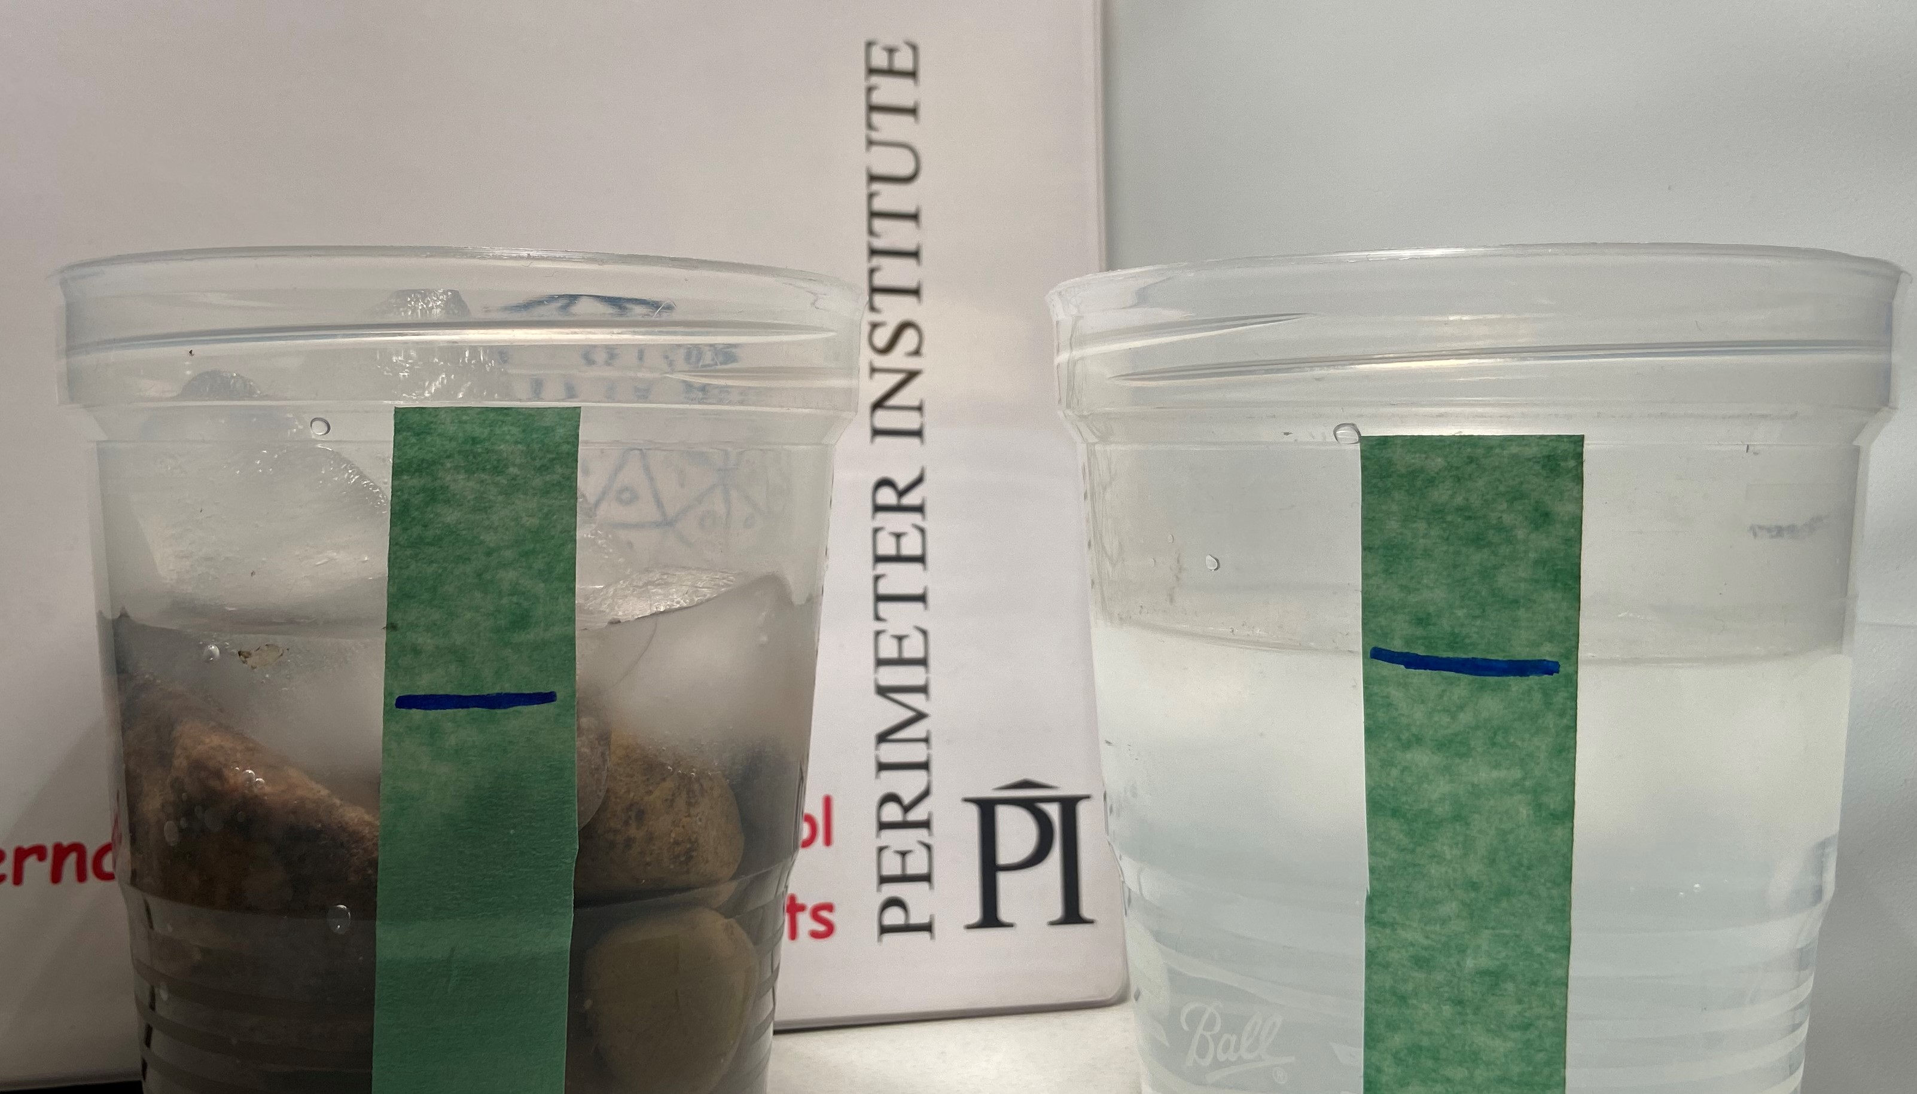
How does this relate to the Earth?
Notes:
What happens when ice heats up?
How does this relate to Earth?

Slide 45
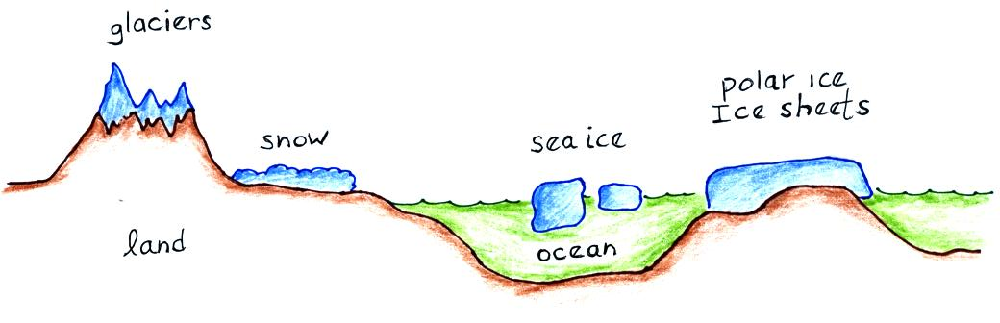
Apply:
Land Ice vs Sea Ice
Notes:
Land ice vs Sea Ice

Slide 46
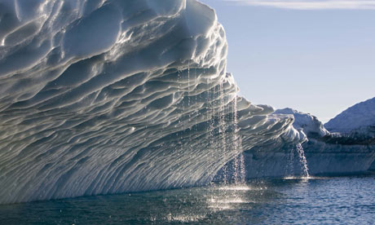
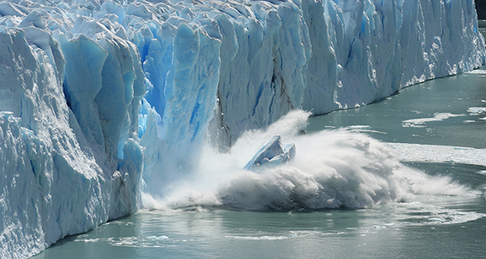
A melting iceberg does not cause a direct change in sea level
A melting glacier adds water to the ocean and causes a direct change in sea level
Notes:
A melting ice berg does not cause a direct change in sea level
A melting glacier adds water to the ocean and causes a direct change in sea level

Slide 47
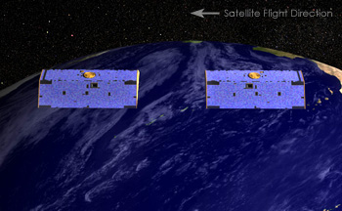
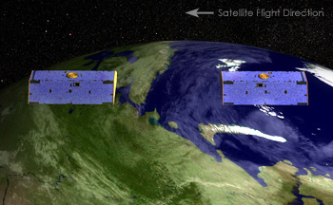
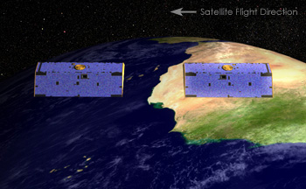
GRACE: Measuring Land Ice Mass
Notes:
Two satellites orbiting 220 km apart. Exact separation is measured using microwaves and GPS.
As lead satellite approaches more mass it accelerates slightly and moves away from trailing satellite.
GRACE can map out gravitational anomaly (and therefore mass) with great precision.

Slide 48
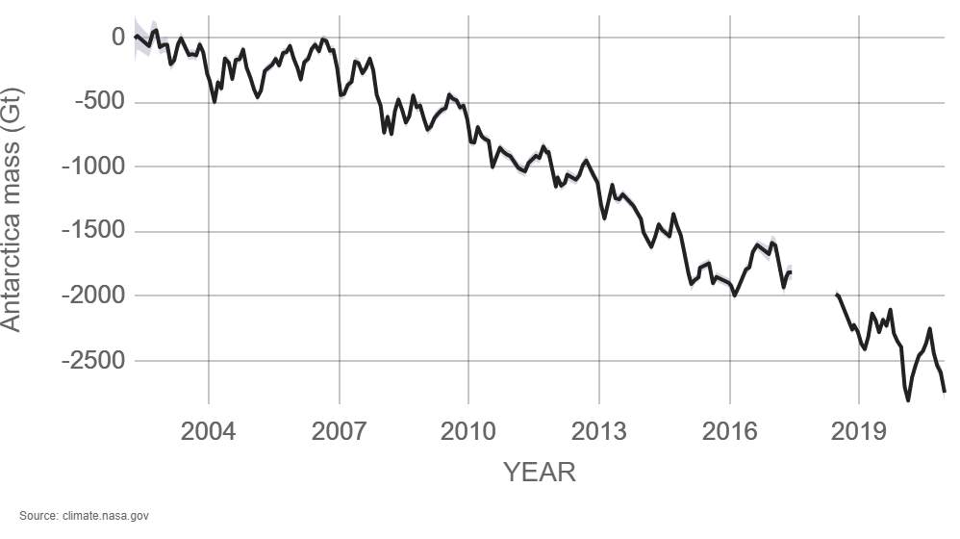
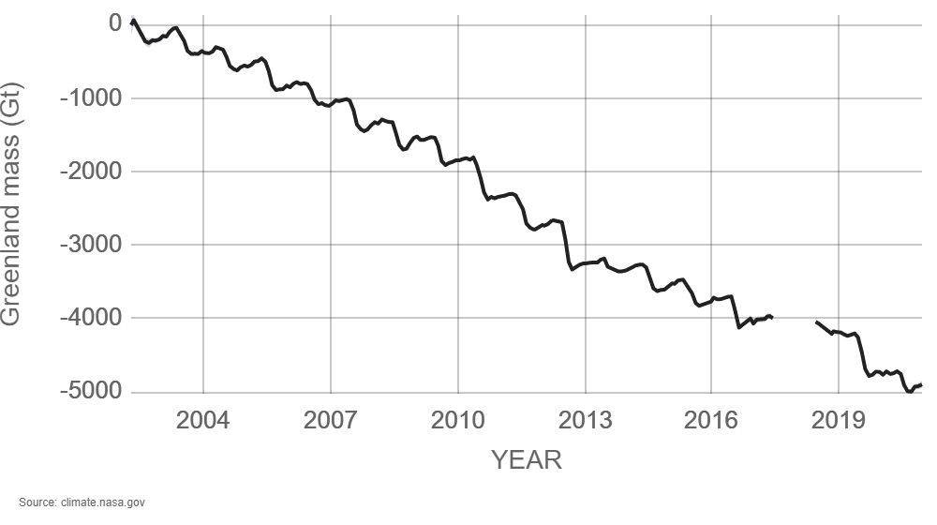
Antarctica ice mass is decreasing at 150 Gt per year
> 420 Gt per year!
Greenland ice mass is decreasing at 278 Gt per year
Notes:
Distribute/inspect GRACE postcard
Antarctica ice mass is decreasing at 150 Gigatonnes per year
Greenland ice mass is decreasing at 278 Gigatonnes per year
https://climate.nasa.gov/

Slide 49
Satellite Altimetry: Measuring Sea Level

Slide 50

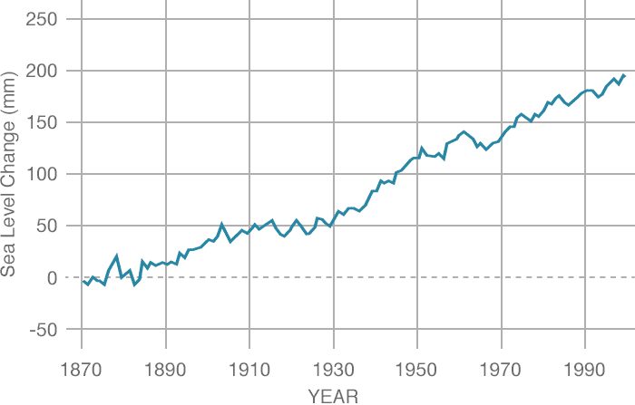
Measuring the Height of the Sea

Slide 51




Sea Level Budget
Notes:
When we combine the sea level rise determined by ARGO (Thermal expansion) and GRACE (Added meltwater) we get the total observed sea level rise.

Slide 52


What’s causing the warming?
Notes:
What’s Causing the Warming?

Slide 53
Examine your graph
Look for patterns in the data.
Are there cycles? Trends? Exceptions?
Briefly describe three patterns that you notice.
2. What questions do you have about the data?
Notes:
6 Expert groups. (Each group is given a different forcing factor)
Examine your data…
1. Look for patterns in the data. Are there cycles? Are there trends? Are there exceptions? Briefly describe three patterns that you notice.
2. What questions do you have about the data?

Slide 54
Examine all the data
Arrange the factors from largest to smallest contributor.
Which ones are positive forcings?
Which ones are anthropogenic?
Predict the overall temperature and share your prediction with the facilitator.
Notes:
JIGSAW groups of 6. (One from each forcing group)
Examine all the data
Put the factors in order from largest to smallest contributor.
Which ones are positive forcings?
Which ones are anthropogenic?
Predict the overall temperature & share your predict with the facilitator.

Slide 55

It’s not solar variation

Slide 56

It’s not ozone depletion

Slide 57

It’s not volcanoes

Slide 58

Forcing factors
Notes:
https://science2017.globalchange.gov/chapter/2/
ERF = Effective Radiative Forcing
Time evolution in effective radiative forcings (ERFs) across the industrial era for anthropogenic and natural forcing mechanisms. The terms contributing to cumulative totals of positive and negative ERF are shown with colored regions. The terms are labeled in order on the right-hand side with positive ERFs above the zero line and negative ERFs below the zero line. The forcings from black-carbon-on-snow and contrail terms are grouped together into a single term in the plot. Also shown are the cumulative sum of all forcings (Total; black dashed line) and of anthropogenic-only forcings (Total Anthropogenic; red dashed line). Uncertainties in 2011 ERF values are shown in the original figure (Myhre et al. 2013, Figure 8-18). See the Intergovernmental Panel on Climate Change Fifth Assessment Report (IPCC AR5) Supplementary Material Table 8.SM.8 for further information on the forcing time evolutions. Forcing numbers are provided in Annex II of IPCC AR5. The total anthropogenic forcing was 0.57 (0.29 to 0.85) W/m² in 1950, 1.25 (0.64 to 1.86) W/m² in 1980, and 2.29 (1.13 to 3.33) W/m² in 2011. (Figure source: Myhre et al. 2013, Figure 8-18; © IPCC, used with permission).

Slide 59

Effects of climate change
Increased flooding
Notes:
The Effects of Climate Change
Rising sea levels
86 mm since 1993
https://climate.nasa.gov/vital-signs/sea-level/
By 2050 over 300 million people will face chronic flooding and by 2100 land occupied by 200 million will be permanently underwater.
https://www.climatecentral.org/news/report-flooded-future-global-vulnerability-to-sea-level-rise-worse-than-previously-understood

Slide 60


Effects of climate change
More extreme weather events
Notes:
The Effects of Climate Change
More extreme weather events
https://climate.nasa.gov/effects/
Climate change is a “threat multiplier”. It makes events bigger, stronger, deeper. Old records are becoming the norms.
Heat waves get hotter and last longer.
Drought conditions persist.
Rainfall/snow is more intense.

Slide 61

More heat waves
Notes:
The Effects of Climate Change
More heat waves
A tropical night means temperatures do not fall below 20C overnight.
Almost 600 people died in BC during the weeklong heatwave at the end of June 2021
https://www.cbc.ca/news/science/nighttime-temperatures-climate-change-1.6112778
The 11 Deadliest Heat Waves in World History
1) Europe, 2003: 71,310
2) Russia, 2010: 55,736
3) France/Belgium, 2015: 3,685
4) India/Pakistan, 2015: 3,477
5) Europe, 2006: 3,418
6) India, 1998: 2,541
7) U.S. and Canada, 1936: 1,693
8) India/Pakistan/Bangladesh, 2003: 1,472
9) U.S., 1980: 1,260
10) U.S./Canada, 2021: 1037
11) India, 2002: 1,030

Slide 62

Effects of climate change
More intense wildfires
Notes:
The Effects of Climate Change
More intense wildfires.
The actual severity is hard to measure. Fires become highly publicized when they happen near populations.
https://www.ucsusa.org/sites/default/files/legacy/assets/documents/global_warming/ucs-ca-wildfires-1.pdf
Wildfires burn longer, wider, and faster.

Slide 63

Effects of climate change
Thawing permafrost
Notes:
The Effects of Climate Change
Thawing permafrost
https://blogs.ei.columbia.edu/2018/01/11/thawing-permafrost-matters/

Slide 64

Notes:
The Effects of Climate Change
Organic matter that has been frozen for hundreds or thousands of years
https://www.carbonbrief.org/guest-post-the-irreversible-emissions-of-a-permafrost-tipping-point

Slide 65

Effects of climate change
Shifting Ecosystems
Notes:
The Effects of Climate Change
Shifting Ecosystems
Marine organisms are migrating North and Deeper
Planting season has shifted meaning pollinators are no longer in synch with plants
All ecosystems are affected
Biodiversity Factsheet: https://www.ipcc.ch/report/ar6/wg2/about/factsheets

Slide 66


Effects of climate change
Spreading diseases
Notes:
The Effects of Climate Change
Mosquitoes and Ticks are examples of changing vector-borne diseases
https://www.canada.ca/en/health-canada/services/climate-change-health.html

Slide 67

Economic costs of climate change
Notes:
Economic Costs of Climate Change
https://fortune.com/longform/insurance-industry-climate-change-swiss-re-reinsurance/
Swiss Re is the world’s largest reinsurer. The predict that climate change will cause global GDP to decrease by about 14% if we stay on our current track.
https://www.swissre.com/risk-knowledge/mitigating-climate-risk/no-action-climate-change-not-option.html

Slide 68


Social costs of climate change
Notes:
The Effects of Climate Change
Displaced peoples
Current prediction is 150-200 million climate change refugees by 2050
In January 2020, the UN Human Rights Committee ruled that "refugees fleeing the effects of the climate crisis cannot be forced to return home by their adoptive countries."

Slide 69

Climate Change
It’s real…
It’s us…
It’s serious…
And the window of time to prevent dangerous impacts is closing fast.
Katharine Hayhoe, Texas Tech

Slide 70

Notes:
I think we need a portfolio approach to address climate change, and not put all of our greenhouse eggs in one solutions basket. I’d focus on several issues to start, including enhancing energy conservation, scaling up renewable electricity generation, reducing food waste, shifting diets to less damaging foods, improving agricultural systems, electrifying transport where possible and using sustainable fuels where not, constructing and retrofitting buildings for extreme energy efficiency, and electrifying heating and cooling systems. We should also target methane, and so-called super-pollutants, as soon as possible, to help us buy time to do the rest.
And we should look for ways to remove greenhouse gas emissions (especially those emissions that will take time to eliminate at the source) through the development of safe carbon sinks. I strongly recommend natural carbon sink solutions, like replanting forests, increasing “carbon farming” on agricultural lands, and restoring coastal ecosystems, as an excellent “no regrets” strategy to start.
Jonathon Foley (globalecoguy.org)

Slide 71
“We basically have three choices: mitigation, adaptation, and suffering. We’re going to do some of each. The question is what the mix is going to be. The more mitigation we do, the less adaptation will be required and the less suffering there will be.”
John Holdren (climate expert)
Notes:
(responding to IPCC 4 in 2007 )

Slide 72

Mitigation: Sources and Sinks
Reducing GHGs at the source
  Renewables
  Plant-based diet
  EVs
Enhancing carbon sinks
  Reforestation
  Carbon Capture and Sequestration
  Direct Air Capture
Notes:
First large scale project captures 4000 tons per year at a cost of about $800 per ton which is equivalent to 870 cars.

Slide 73

Project Drawdown Top 10
2.0°C by 2100 | 1.5°C by 2100
Reduced Food Waste | Onshore Wind Turbines
Health and Education for Girls/Women | Utility-Scale Solar Photovoltaics
Plant-Rich Diets | Reduced Food Waste
Refrigerant Management | Plant-Rich Diets
Tropical Forest Restoration | Health and Education for Girls/Women
Onshore Wind Turbines | Tropical Forest Restoration
Alternative Refrigerants | Improved Clean Cookstoves
Utility-Scale Solar Photovoltaics | Distributed Solar Photovoltaics
Improved Clean Cookstoves | Refrigerant Management
Distributed Solar Photovoltaics | Alternative Refrigerants
Notes:
This table provides the detailed results of the Plausible Scenario, which models the growth solutions on the Drawdown list based on a reasonable, but vigorous rate from 2020-2050. Results depicted represent a comparison to a reference case that assumes 2014 levels of adoption continue in proportion to the growth in global markets.
https://drawdown.org/solutions/table-of-solutions

Slide 74

Adaptation
Adjusting to the current and future effects of climate change. A few centimetres may not seem like much…
The coastline of Mykonos could move 150m inland as the sea level rises.
Notes:
Mean sea level in the Mediterranean is expected to rise at the rate of 5 cm/decade. In particular sea level will rise about 50 cm by the year 2100 (with an uncertainty range of 20-86 cm). The Nile Delta, Venice and Thessaloniki appear to be the more sensitive areas in the Mediterranean.

Slide 75

Recognize that this is a complex issue
Inter-generational conflict
Racial inequality
Defence Mechanisms
Hopelessness
Shame
Anxiety
Notes:
Use chat function to have teachers voice reactions that they have observed in the classroom before revealing this list (not exhaustive by any means)

Slide 76

Climate Anxiety
Notes:
10,000 young people (16-25 Yr) from 10 countries
From: https://www.nature.com/articles/d41586-021-02582-8

Slide 77




What good will personal actions do?
Notes:
As teachers we have a responsibility to be role models.
That means following through and showing our students what it looks like.
When my students see me on the bus or my colleagues biking up the hill to school they know we are committed.

Slide 78
Simple actions you can take:
Talk about Climate Change
Reduce your own personal footprint
  Transportation and energy choices
  Carbon offsets
  Dietary choices
Lobby for systemic change
  Political, social, economic

Slide 79

Keeling Curve activity
Notes:
https://scripps.ucsd.edu/programs/keelingcurve/wp-content/plugins/sio-bluemoon/graphs/mlo_full_record.png
What do you notice?
Consider what you saw in the video about how carbon dioxide interacts with IR light. What does this imply about the energy in the atmosphere.

Slide 80

Climate Modeling activity
Notes:
What’s Causing the Warming?

Slide 81

Impact of Transportation activity
Notes:
Students consider the impact of transportation (personal and commercial)
Discuss various scenarios to consider some of the issues surrounding transportation.

Slide 82

Math: How Much Carbon in that Tree?
Notes:
Use trig to determine height of tree. Measure circumference at chest height. Calculate amount of carbon stored in tree.
Students also do a simple carbon footprint calculation.

Slide 83

Math: Comparing Costs
Notes:
Comparing the cost to buy and operate electric vehicles with gas vehicles.

Slide 84





Resources
Notes:
Kathrine Hayhoe is a Canadian climate scientist in Texas. Follow her on Twitter and YouTube.
SkepticalScience is a fantastic website/app with a huge amount of climate information. They had an app but it seems to have been removed from Google Play Store.
https://www.carbonbrief.org/ is an excellent environmental website with lots of good, current data and analysis.
https://climate.nasa.gov/ is the official NASA Climate site
https://www.climateprediction.net/ is a large citizen science project running climate models on individual computers.

Slide 85
Thank You! - Ευχαριστώ!!
www.perimeterinstitute.ca
Olga Michalopoulos
omichalopoulos@gmail.com
Laura Pankratz
laurapankratz@uniserve.com

