Slide 1




The Mystery of Dark Matter
CERN Greek National Teacher Program 2023
Olga
Laura

Slide 2
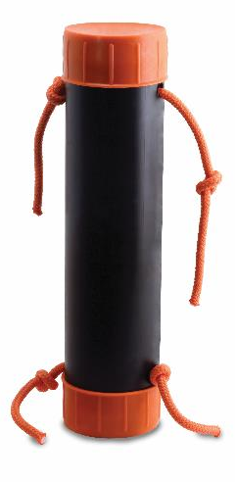
Black Box
Building and Revising Scientific Models
Notes:
(About 10-15 min) Using the Black Box:
-Demonstrate the box by pulling several strings
-Ask the participants to draw what they think is happening using their whiteboards
-Ask 3-4 people with different ideas to come up at the same time. Test their models, if they work, give their boards a checkmark
-Explain how nature can be described using models. We test these model/theories until they are proven wrong. At that point, they need to be thrown out or revised. Several, different models are capable of describing the same thing.
-Shake the Black Box. Show how some of the drawn models fail, while others survive.
-It is important to build vocabulary such as “predict, observe, model, etc.”

Slide 3
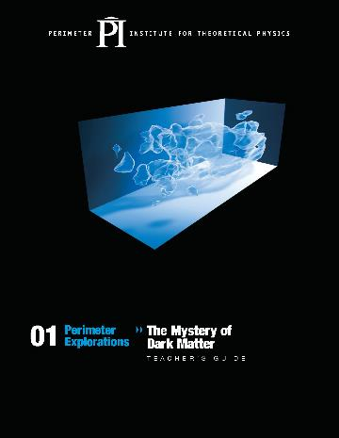
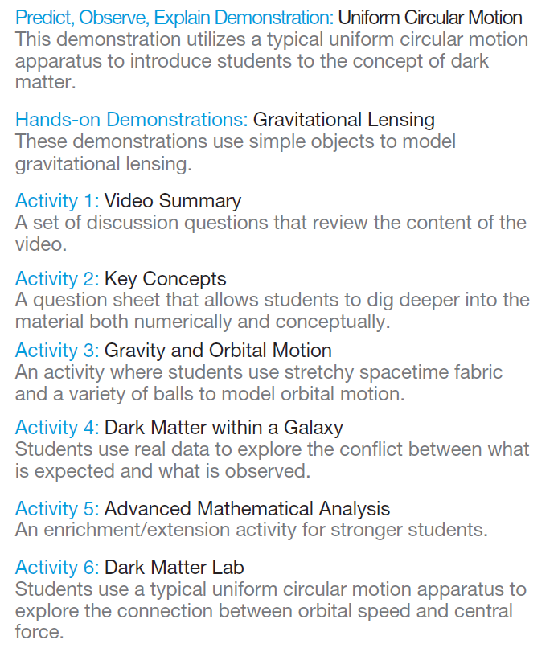

resources.perimeterinstitute.ca

Slide 4
Uniform Circular Motion Activity
speed
Predict
Observe
Explain
How are mass and speed connected in circular motion?
mass
Notes:
Uniform Circular Motion (5-7 min)
-Begin by asking the participants to use their white boards to predict what happens to velocity as mass changes (PEOE). Ask them to explain their reasoning using diagrams, metaphors, etc.
-After the PEOE, get the students to complete the lab portion (18-20 min) of the activity. Make sure the participants get to the point where they must predict the weight of the unknown mass.
-Use some time at the end to explain the effectiveness of group work, and the ability to collaborate, communicate, and strategize.

Slide 5
Uniform Circular Motion Activity
Objective:
Determine the mass of an unknown item.
Collect data for one mass per group.
Plot a graph of speed² vs mass on a collaborative spreadsheet.

Slide 6
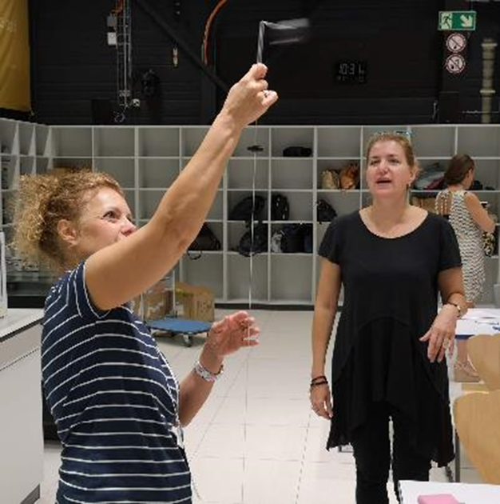
Uniform Circular Motion Activity
Collaborative version:
Set radius = 60 cm
Use assigned masses
Record period for 10 orbits
Compare results
Report results

Slide 7
Uniform Circular Motion Results
# of washers | 10 Orbits (s)
8
10
12
14
16
How is the orbital speed related to the mass of the washers?

Slide 8
Uniform Circular Motion Results
Notes:
Right click on graph, select Edit data
Enter new times into chart and update plot

Slide 9

Connecting standard classroom physics to Cutting-Edge Dark Matter
Notes:
Do the LED demo. One kit with small mass and LED on rubber stopper. Another kit with much greater mass and LED on stopper. Pick two members of audience who feel confident in their abilities and have them spin the stoppers with the lights off. Ask the audience to identify which star is orbiting more mass.

Slide 10
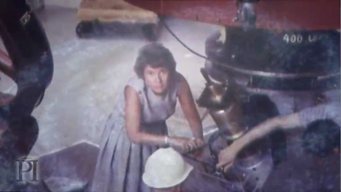
Vera Rubin’s
Discovery
Notes:
The remainder of this section are video clips to use. Choose the ones that will complement your presentation. Ensure that the connections are made between circular motion, and dark matter.

Slide 11
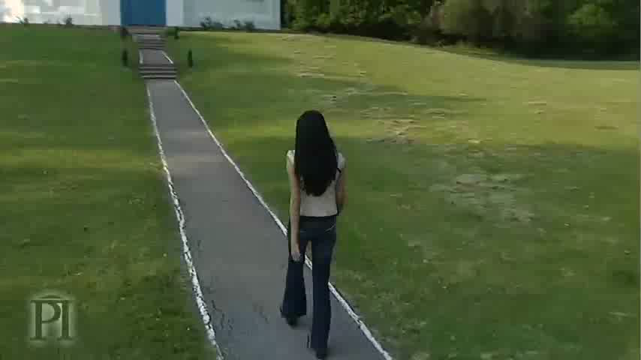
Notes:
We’ll show you a clip from the video that highlights just what Rubin observed. She looked at Andromeda and saw stars moving

Slide 12
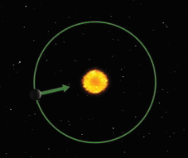
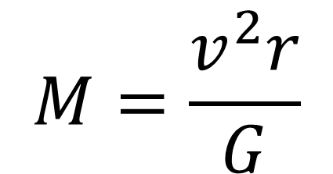
Orbital Speed Depends on the Mass of the Central Object
$$M=\frac{v^{2}r}{G}$$
Notes:
We can scale up what we found with the circular motion apparatus to a galaxy. The principles are the same.

Slide 13
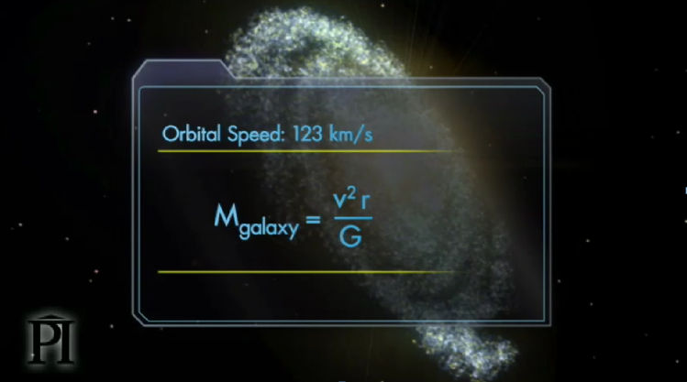
Extend this to galaxies

Slide 14
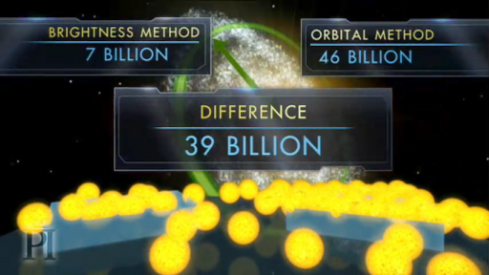
Triangulum is More Massive Than it Looks

Slide 15


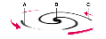
Brightness Mass
Orbital Mass

Slide 16
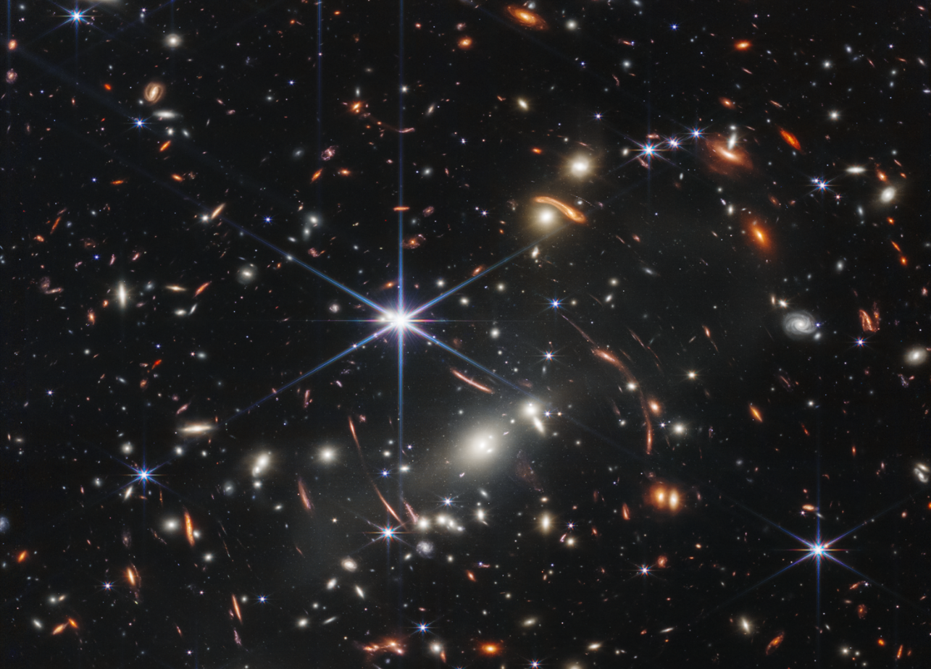
The same discrepancy happens in all* galaxies
Notes:
Background image is the JWST Deep Field image.
* There are some anomalous galaxies that do not show the same discrepancy. These ultra-diffuse galaxies were only observed in 2018 using the HST

Slide 17
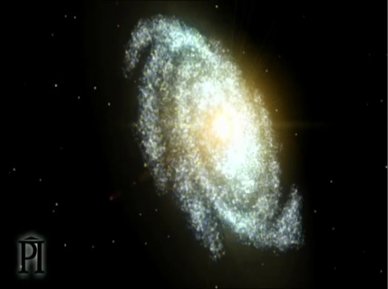
Old View

Slide 18
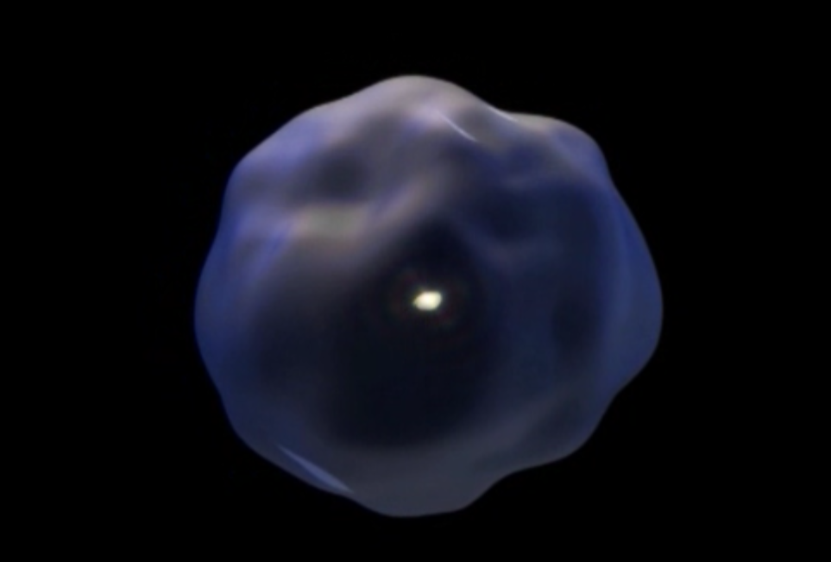
New View
Notes:
We now know that surrounding the stars in the centre of the galaxy is a blob of dark matter that extends ten times farther our & has 10 times more mass.
The stars are just the tip of the iceberg.
This is a radical change. On a par with realizing the Earth orbits around the Sun. Arguably, the greatest advance in our understanding of the universe in the last half a century.

Slide 19
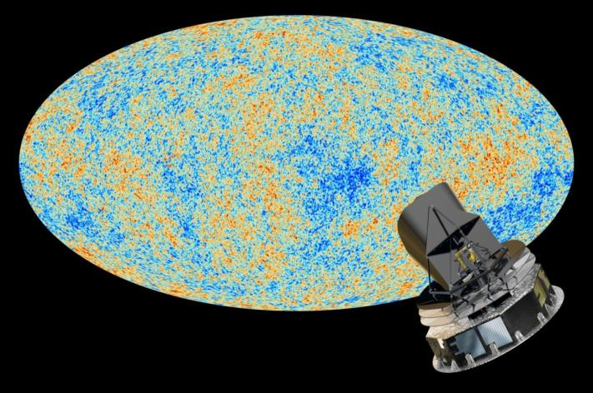
Dark Matter
26.8%
Normal Matter
4.9%
Dark Energy
68.3%
Notes:
Planck results from observations of the CMB (4-year survey fro 2009-2013)
Adds confidence to L-CDM model, from WMAP
Dark Energy Survey, started in 2012 and ending in 2018
Year 1, August 2017 results:
DES in the Chilean Andes to reduce precipitation, light pollution, and tau (optical density of the atmosphere)

Slide 20
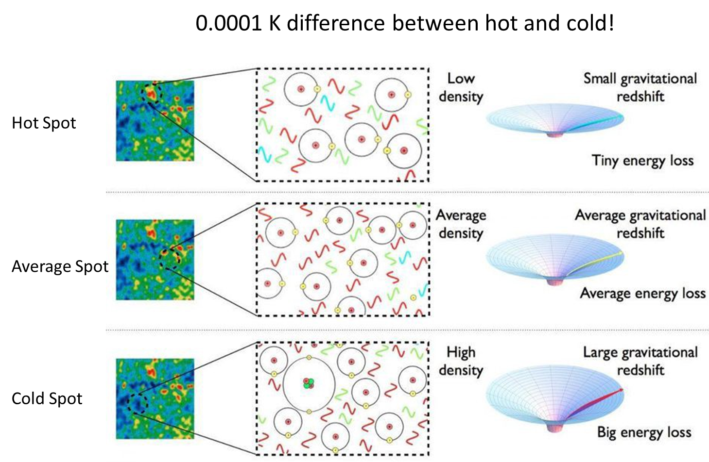

Slide 21
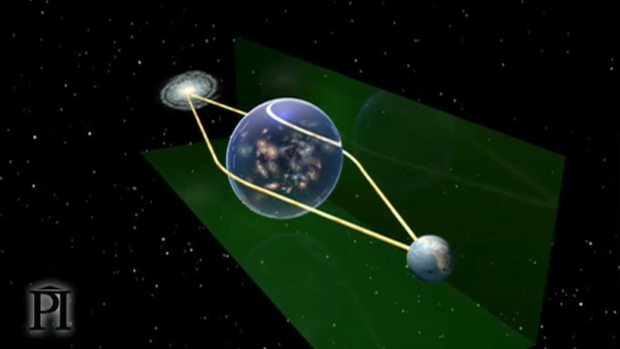
Gravitational Lensing
Notes:
Gravitational Lensing (About 10 min)
-Participants will complete the plate and wine glass activity from the teacher’s manual. This activity is also complemented with a video clip.

Slide 22

Bullet Cluster
Most of the baryonic matter
Mass map from lensing

Slide 23
Competing Theories For Dark Matter
Particle that hasn’t been discovered yet
Cold Dark Matter
Fermions
Bosons
WIMPS
Axions
Electrons
Photons
Sterile neutrinos
Axion-like
Particle
Quarks

Slide 24
How to Look for Dark Matter Particles
Direct detection: wait for it to hit a detector
Indirect detection: look for other signatures
Particle colliders: make it

Slide 25
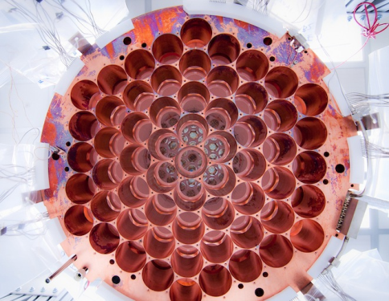
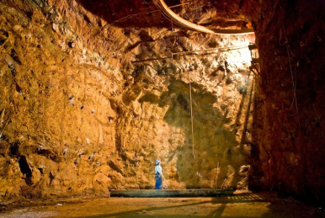
LUX- Large Underground Xenon Detector
Homestake Mine, South Dakota
Notes:
Homestake Mine in Lead South Dakota – first neutrinos from sun detected here
LUX, like most direct dark matter searching experiments, uses the wait-until-something-hits-me principle. The detector is composed of an extremely large number of atoms sitting around, increasing the probability that dark matter slams into them. In the case of LUX, these atoms are xenon, a very stable element that doesn’t undergo any pesky chemical reactions that could screw with results.
The idea is that a dark matter particle might whoosh by a xenon atom, knocking off an electron, which LUX would detect as an increase in charge. Alternatively, a dark matter particle could slam right into a xenon atom, kicking up one of its electrons to a higher orbit. When that electron returned to ground state, it would release a photon, creating a tiny flash of light that one of LUX’s 122 photomultiplier detectors could spot.
The LUX experiment was designed to look for weakly interacting massive particles, or WIMPs, the leading theoretical candidate for a dark matter particle. If the WIMP idea is correct, billions of these particles pass through your hand every second, and also through the Earth and everything on it. But LUX did not detect anything which rules out many theories of dm

Slide 26
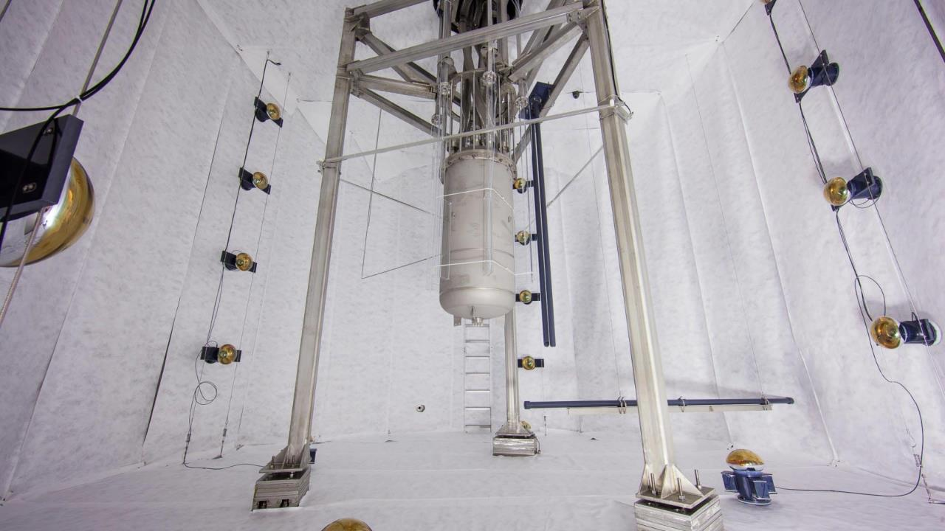
LUX update (2017)
With roughly fourfold improvement in sensitivity for high WIMP masses relative to our previous results, this search yields no evidence of WIMP nuclear recoils. arXiv:1608.07648v3
Notes:
The mass-dependent shape of the resulting limits can be explained by the effect of the mass on the detection probability. Lower mass particles will produce less of a signal in the detector due to their lower energy, making them harder to see. On the other hand, higher mass particles would have a lower flux through the detector since the observed gravitational physics of dark matter would require less of them.
Large underground Xenon dark matter experiment = LUX
370 kg of liquid xenon
Releases photons when WIMPs are incident on it.

Slide 27
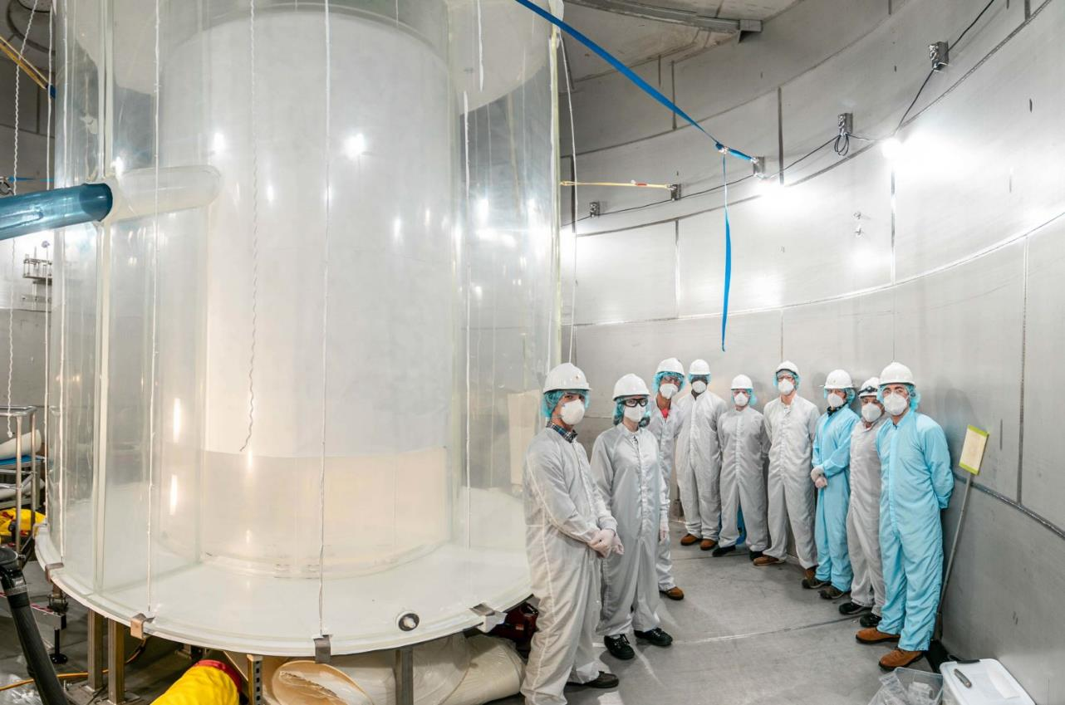
LUX-ZEPLIN (LZ) update (2022)
A profile-likelihood ratio analysis shows the data to be consistent with a background-only https://arxiv.org/abs/2207.03764
Notes:
The mass-dependent shape of the resulting limits can be explained by the effect of the mass on the detection probability. Lower mass particles will produce less of a signal in the detector due to their lower energy, making them harder to see. On the other hand, higher mass particles would have a lower flux through the detector since the observed gravitational physics of dark matter would require less of them.
Large underground Xenon dark matter experiment = LUX
370 kg of liquid xenon
Releases photons when WIMPs are incident on it.

Slide 28
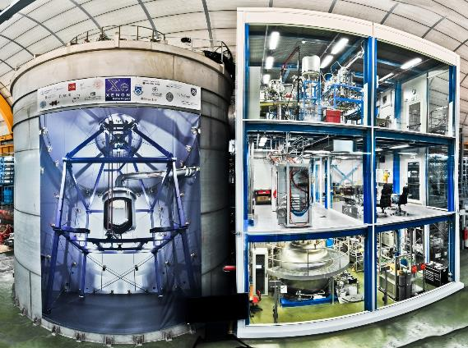
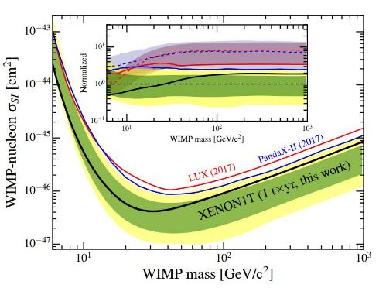
XENON1T most sensitive measurement yet (2018)
No significant excess over background is found. arxiv.org/abs/1805.12562
Image credit: Roberto Corrieri and Patrick De Perio
Notes:
http://www.xenon1t.org/
XENON1T just released data further constraining WIMP window. No significant events were recorded over 279 days using an active target of 1300 kg of xenon.

Slide 29
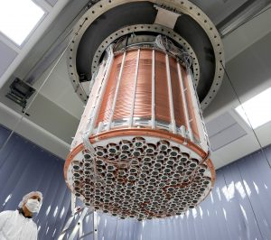
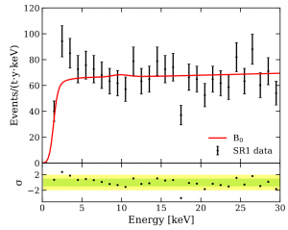
XENON1T – electronic recoil excess (2020)
An excess is observed at low energies that is consistent with a solar axion signal, a bosonic dark matter signal with a mass of 2.3 keV/c2, a solar neutrino signal with enhanced magnetic moment, or a possible tritium background. arxiv.org/abs/2006.09721
Notes:
XENON1T observed more electron recoils than expected (283 instead of 230).
Could be solar axions!
More likely the result of trace tritium decays.
Only ~3.5sigma so still not a ‘discovery’

Slide 30
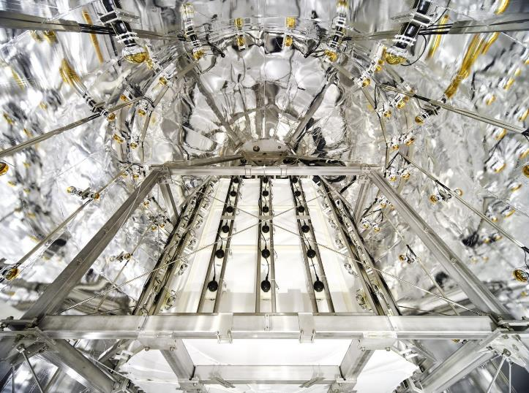
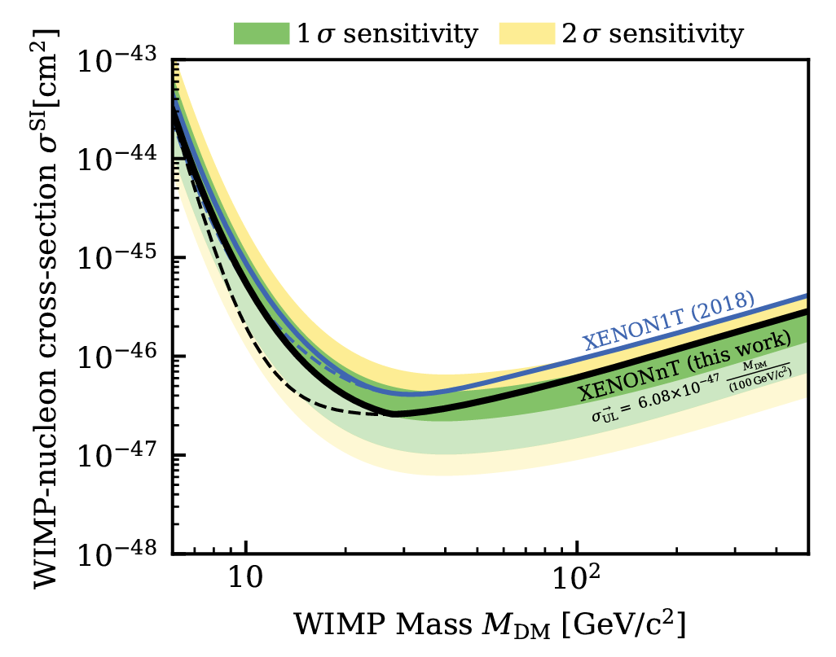
XENONnT – (2023)
A blind analysis of nuclear recoil events with energies between 3.3keV and 60.5keV finds no significant excess. https://arxiv.org/abs/2303.14729
Notes:
XENON1T observed more electron recoils than expected (283 instead of 230).
Could be solar axions!
More likely the result of trace tritium decays.
Only ~3.5sigma so still not a ‘discovery’

Slide 31
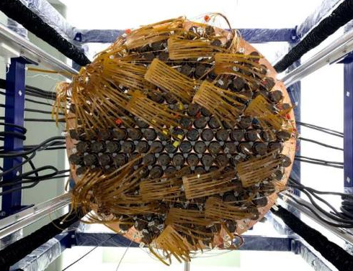
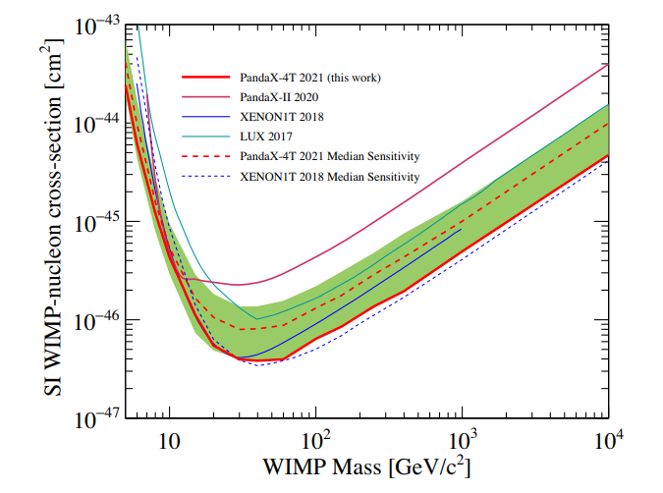
PANDAX- 4T (2021)
No dark matter candidates are identified above expected background. arxiv.org/abs/2107.13438

Slide 32
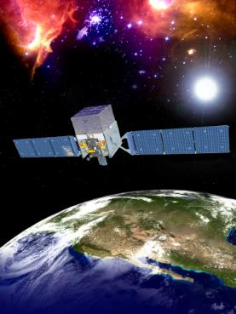
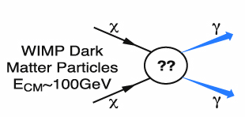
FERMI
Detects ɣ-rays
DM particle annihilation
Notes:
Dark matter candidates such as weakly interacting massive particles are predicted to annihilate or decay into Standard Model particles, leaving behind distinctive signatures in gamma rays, neutrinos, positrons, antiprotons, or even antinuclei. Indirect dark matter searches, and in particular those based on gamma-ray observations and cosmic-ray measurements, could detect such signatures.

Slide 33
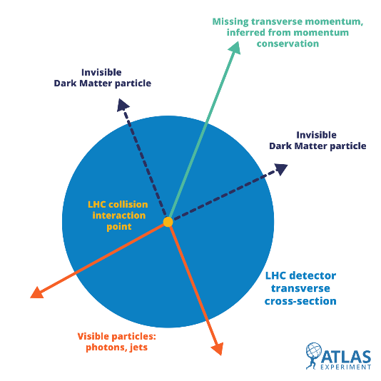
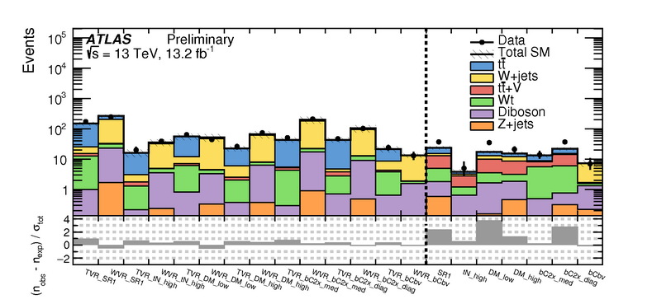
LHC
Notes:
ATLAS data (black points) are compared to the contribution expected from known particles (the filled histograms) in a number of control selections where no signal is expected (left of the dashed line) as well as in a number of selections where a supersymmetric signal, if it exists, would be enhanced (right of the dashed line). The statistical compatibility is reported on the lower panel, where a value above 5 in the signal selections would indicate a discovery.

Slide 34
Problems for Particle Dark Matter
We haven’t found anything yet
Missing Satellite galaxy problem
Not a great match in detail for galaxy rotation curves

Slide 35

Empty-Handed?
Notes:
More websites to check out for the most recent data/discoveries/theories:
https://www.sciencedaily.com/news/space_time/dark_matter/
https://www.sciencedaily.com/releases/2023/06/230612114635.htm
https://www.sciencedaily.com/releases/2023/06/230614220651.htm
https://www.sciencedaily.com/releases/2023/06/230613110102.htm
https://www.nature.com/articles/s41550-023-01981-3
https://www.google.com/search?q=sn+zwicky&oq=sn+zw&aqs=chrome.1.69i57j0i512l2j0i22i30j0i15i22i30j0i22i30j0i22i30i625j0i22i30l3.1113680168j0j15&sourceid=chrome&ie=UTF-8&safe=active&ssui=on

Slide 36
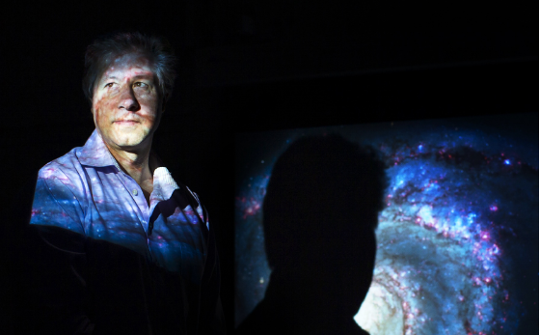
Modified Gravity Theories
Notes:
Could modified gravity be back on the table
Discuss verlinde and stacey mcgaugh work

Slide 37
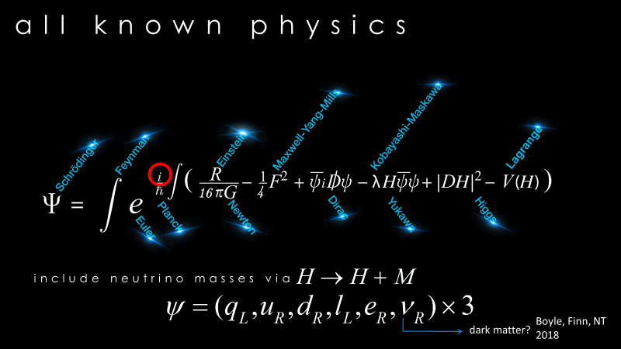
Sterile Neutrinos
Notes:
Dark Matter has been in the model all along…neutrinos!

Slide 38
Lots of new possibilities…
Dark EM
Fuzzy balls
Mirrorverse
???
Notes:
Dark Matter has been in the model all along…neutrinos!

Slide 39
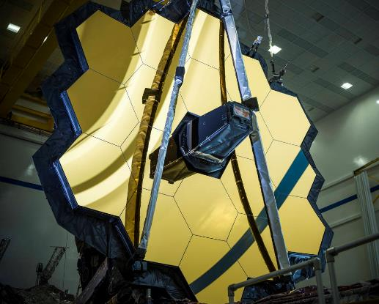
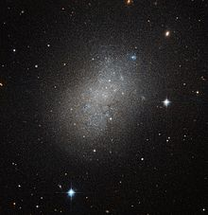
Looking for CDM
Dark Matter Dominated Dwarf Galaxies
Notes:
Looking for small dark matter haloes

Slide 40
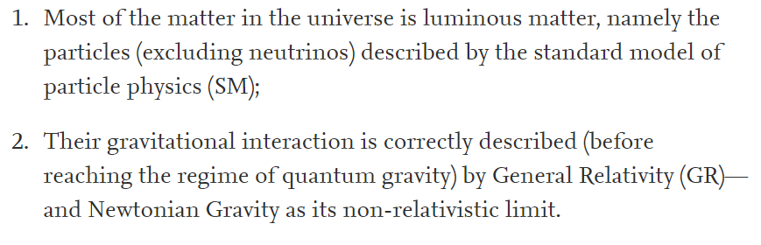
Moving beyond the
Dark Matter vs Modified Gravity debate
DM
MG
Notes:
Is it matter or spacetime?

Slide 41
Dark Matter
Works well on cosmological scales
Does not work well in detail for galaxy rotation curves (small scale problems)
We haven’t found it

Slide 42
Modified Gravity
Predicts galaxy rotation curves very well
Does not predict well or ignores the data from CMB or gravitational wave data

Slide 43

Stalemate

Slide 44
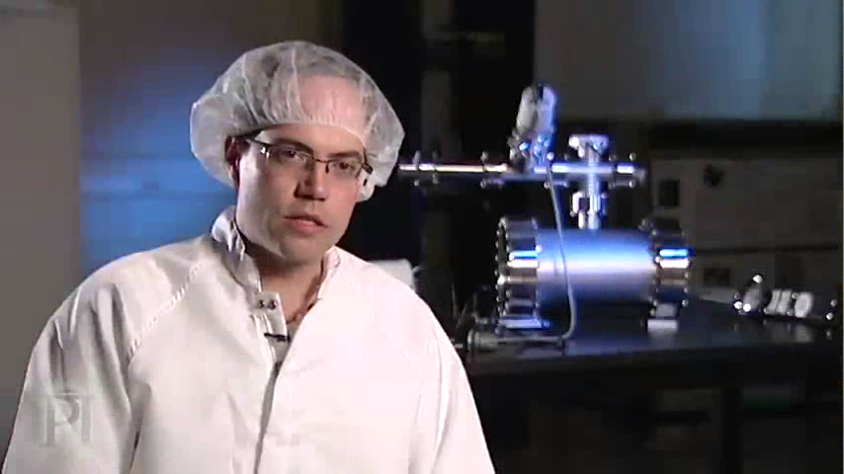
Current Status of Dark Matter
Notes:
Video

Slide 45
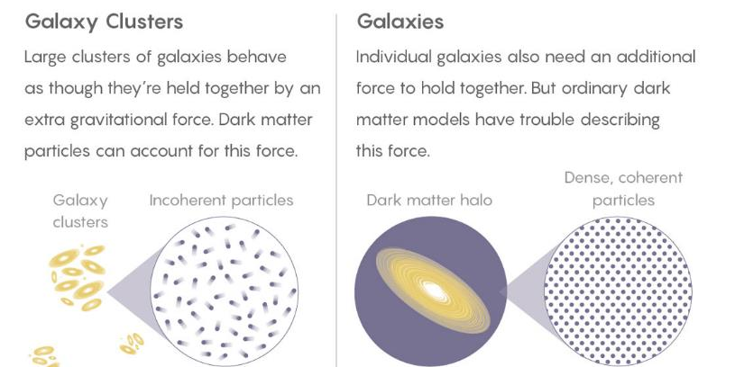
Superfluid Dark Matter
Credit: Quanta Magazine

Slide 46
Thank You! - Ευχαριστώ!!
www.perimeterinstitute.ca
Olga Michalopoulos
omichalopoulos@gmail.com
Laura Pankratz
laurapankratz@uniserve.com

