Slide 1
Oι ανιχνευτες σωματιδιων του LHC ειναι απο τις εντυπωσιακοτερες μηχανες...
(LHC is the most impressive machine ever built)
...και ισως προσφερονται σαν πιθανες ιδεες για μετρησεις με τους μαθητες σας and will be possibly a great way to attract students in STEM activities)
(https://www.mycloud.ch/s/S00CA3ADC5EB87832A4A2D2BF2BFB58126F8B438C91 )

Slide 2
https://www.mycloud.ch/s/S00CA3ADC5EB87832A4A2D2BF2BFB58126F8B438C91
The ones that have their own laptops must install the following(the CERN laptops have them, but then they stay at CERN…):
Arduino IDE 2.1.1
Arduino IDE libraries:
AHT20 1.0.1 by Dvarrel (https://github.com/dvarrel/AHT20)
BMP180MI 1.0.1 by Gregor Christandl https://bitbucket.org/christandlg/bmp180mi
LM75A Arduino Library 1.0.1 by M2M Solutions AB (https://github.com/m2m-solutions/M2M_LM75A)

Slide 3
Το CERN ειναι το μερος που «παιρνουν σαρκα και οστα» τρια πραγματα:
1. Γινεται βασικη ερευνα για να επιβεβαιωσει η απορριψει τα μοντελα που
περιγραφουν το συμπαν και την εξελιξη του. Η ερευνα αυτη απαιτει την
δημιουργια, συντηρηση, και λειτουργια οργανων που μπορουν να δωσουν
δεδομενα σε στατιστικα ικανες ποσοτητες για τις παραπανω μελετες.
2. Η δημιουργια/εξελιξη και χρηση τεχνολογιας ειναι δεδομενη και η εκφραση
«τεχνολογια αιχμης » ειναι σχεδον κενη διοτι το προσωπικο του CERN δημι-
ουργει διαρκως τεχνολογια για να κανει δυνατη την πραγματοποιηση του
πρωτου στοχου. Η τεχνολογια αυτη εχει ξεκιναει απο το πραγματικο βαρυ
hardware (τροποι χτησιματος και στηριξης) μεχρι το πιο αφαιρετικο software
(ποιος δεν ξερει το WEB!).
3. Οι ανθρωποι δουλευουν πραγματικα μαζι και αποδεικνυουν, με συγχωρειτε
για την παραφραση το:
«Εξ ανθρὠπου τα χείρω...Kαι εξ ανθρὠπου τα κρείττω»
Ετσι, ειναι το μερος που οι νεοι ανθρωποι λατρευουν να δουλευουν ΜΑΖΙ,
και ειναι το μερος που λατρευει τους νεους ανθρωπους.
Γι' αυτό εισαστε και ειμαστε εδω.....

Slide 4
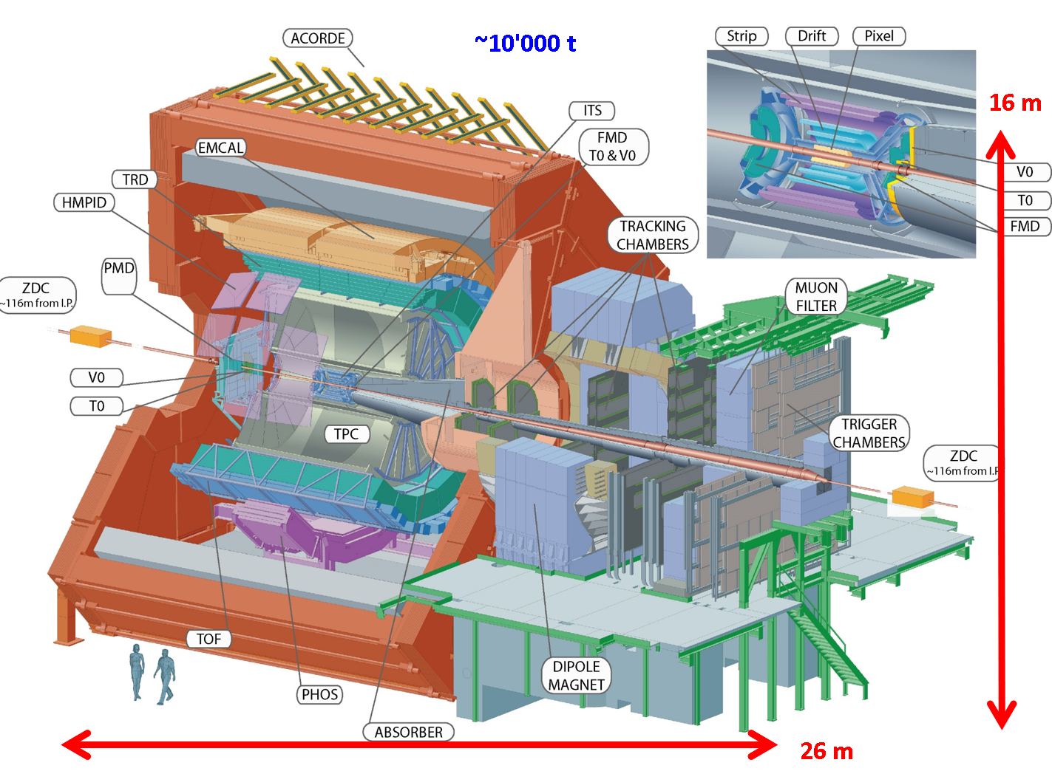
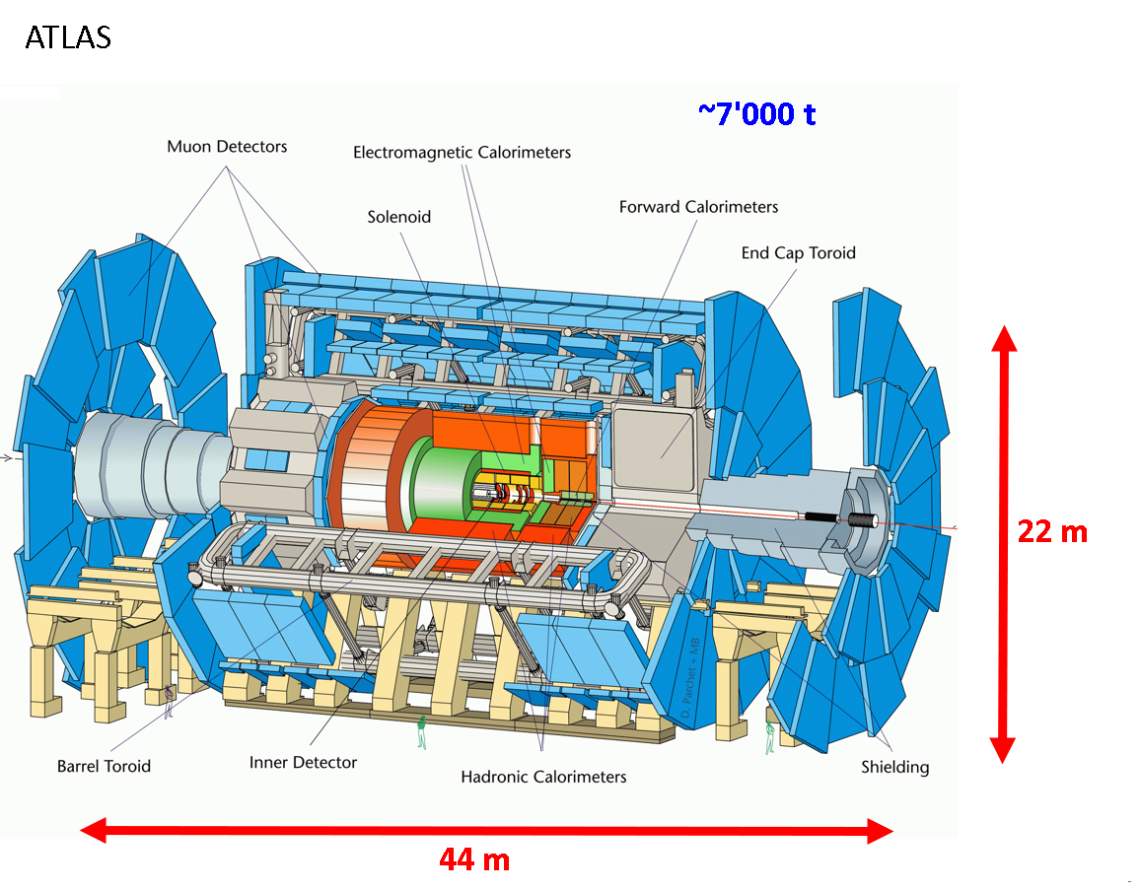
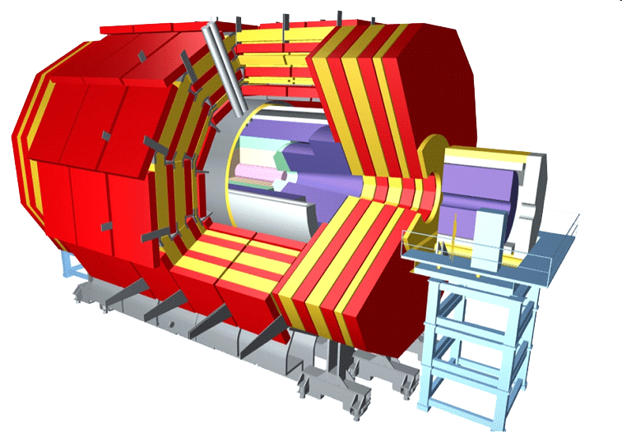
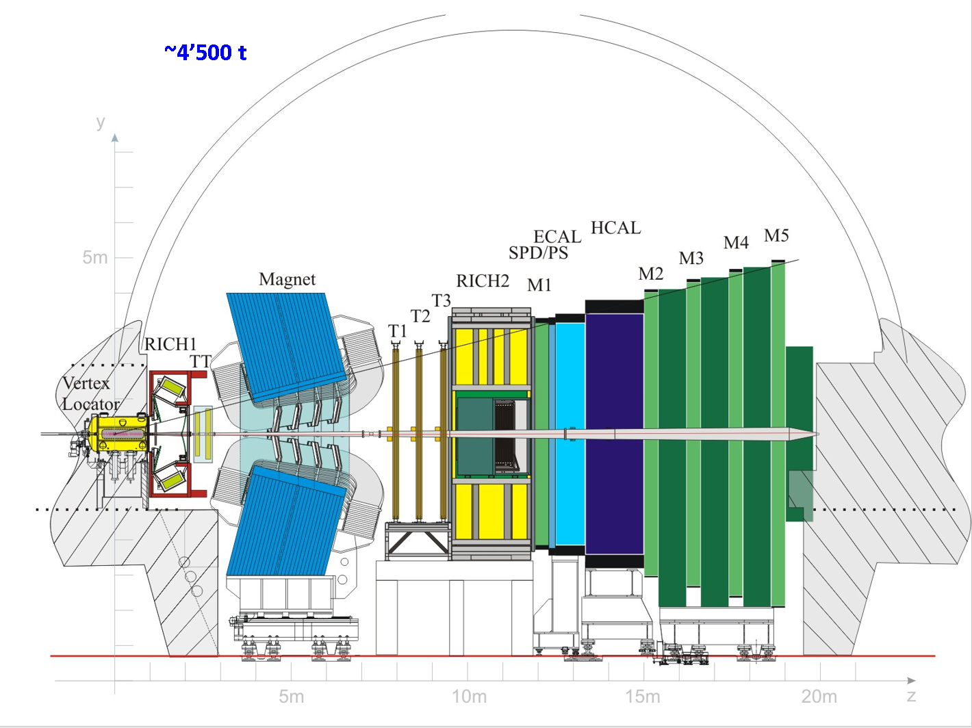
ATLAS
ALICE
What do the detectors “do”:
1. They force the particles created during collisions to interact with matter losing energy via different, well parametrized, processes.
2. They record, practically taking pictures of the whole process.
3. Their construction and operation is such that they can perform adequately for providing the statistics and resolution required.
LHCb
14’000 t
CMS
15m
21m

Slide 5
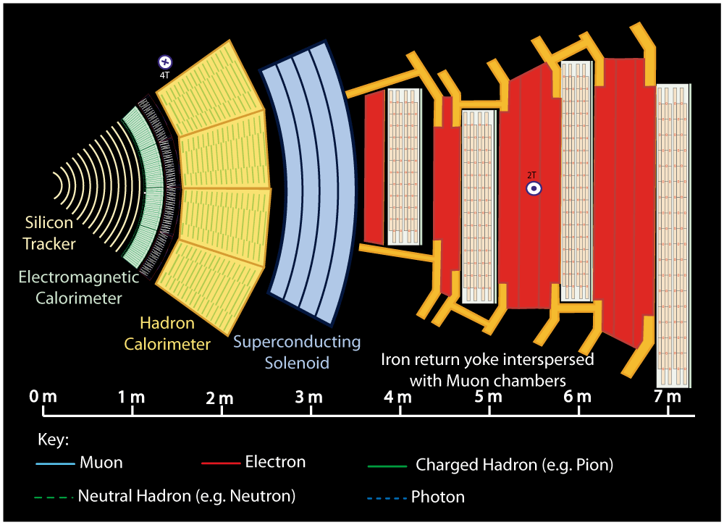
Notes:
Buttons. Click on any particle type to display the relevant slide with animations. Clicking again will return to this slide.
Recommend putting this slide in the middle of your presentation and putting the other 5 slides at the end.
If you have any difficulties, contact David.Barney@cern.ch

Slide 6
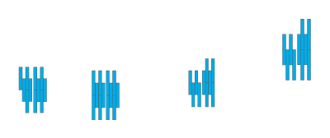


Notes:
Muon: passing through CMS, bending in the field (both ways, depending on when it is inside or outside of the solenoid) leaving hits in the Tracker layers and the muon chambers before escaping completely

Slide 7
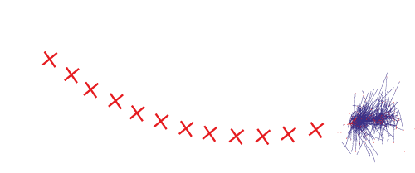
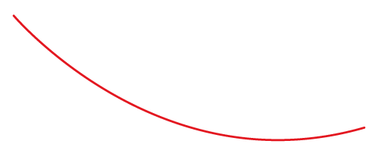

Notes:
Electron: Bending in the magnetic field, leaving hits in the tracker layers and being “stopped” by the electromagnetic calorimeter

Slide 8
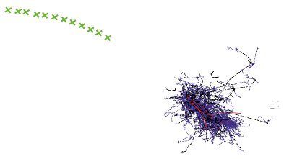
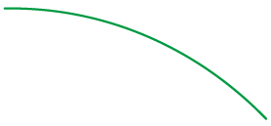

Notes:
Charged hadron: Bends in the magnetic field and leaves signals in the tracker layers; passes through the electromagnetic calorimeter leaving essentially no signal, and is “stopped” by the hadron calorimeter

Slide 9
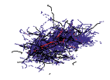

Notes:
Neutral hadron: Does not bend in the magnetic field and does not leave any signal in the tracker layers; passes through the electromagnetic calorimeter leaving essentially no signal, and is “stopped” by the hadron calorimeter

Slide 10

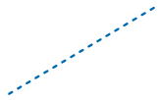

Notes:
Photon: passes through the tracker without bending in the magnetic field or leaving hits, is “stopped” by the electromagnetic calorimeter

Slide 11
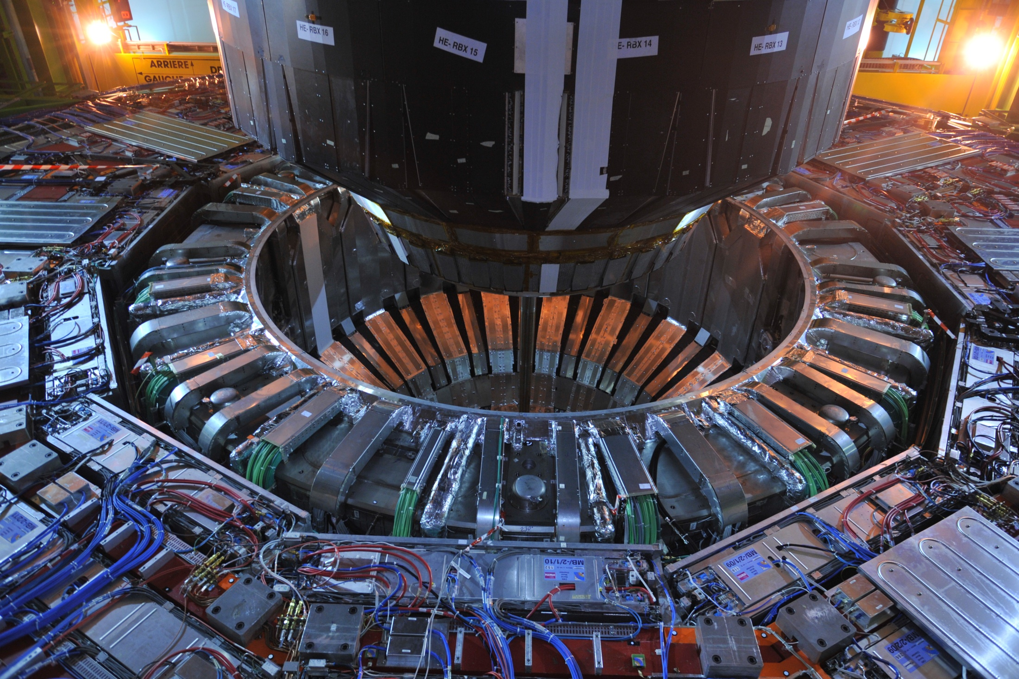
Notes:
Χρειαζεται ακριβεια mm στο ανοιγμα και κλεισιμο του ανιχνευτη-need mm precisions for the closing of the detector…how do you do this without sensors??

Slide 12
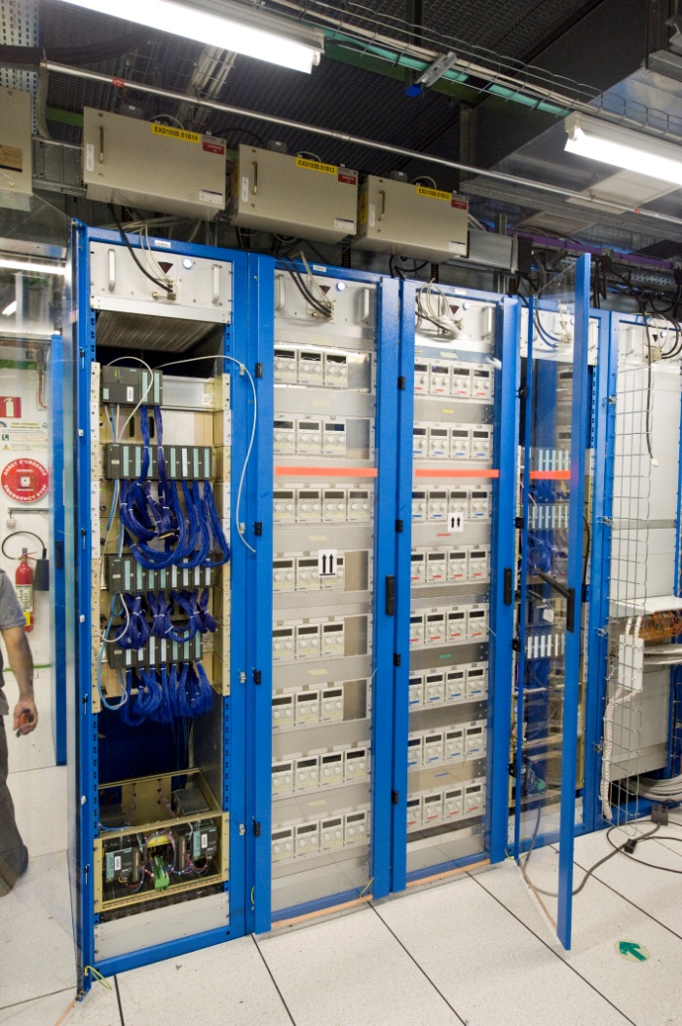
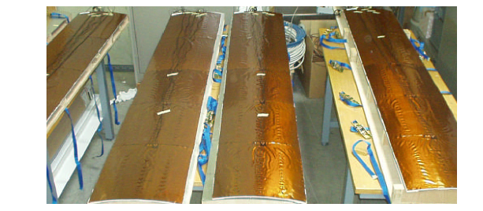
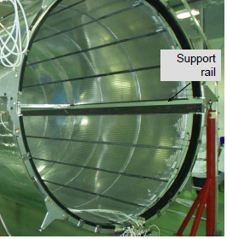
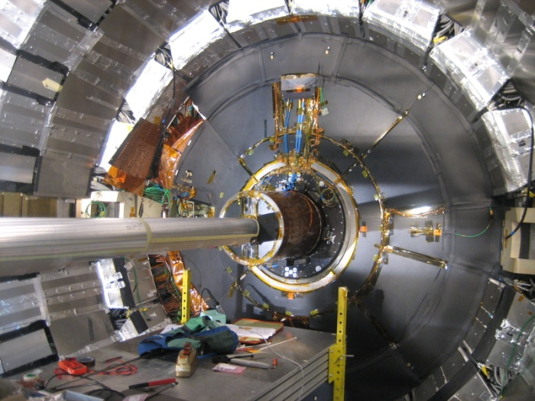
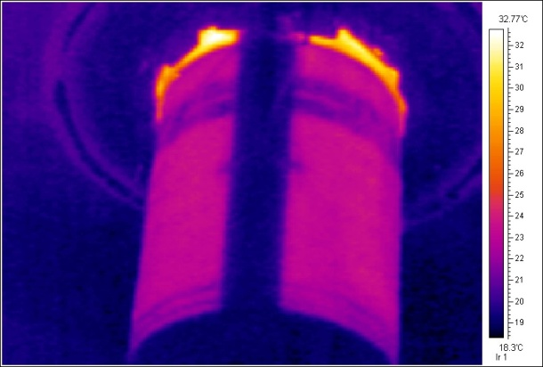
Smart insulator systems( ~ (-20 -40)⁰C to ~ +17(+9)⁰C ECAL)
Notes:
Feedback control ενα μειγμα βιομηχανικων εφαρμογων στον κοσμο της ερευνας

Slide 13
Movement control systems (subdetectors weigh up to 2 tons, how do you move them without sensors when opening/closing the detector?)
…but finding a sensor and readout system for “us” because of magnetic field and radiation is very difficult (we manage) but not for you that you can pretend doing the same thing with your students using easier to have equipment….
Collar
shielding
Rotation
shielding
HF body
HF-plug
R5
R2
Z2
R4
CASTOR
R1
R3
R4
Z3
Z1
CASTOR
table
Z4
X1
Collar
platform
Z5
R6
HF
T2
R6
Z3
HF
platform
Raisers
tower

Slide 14
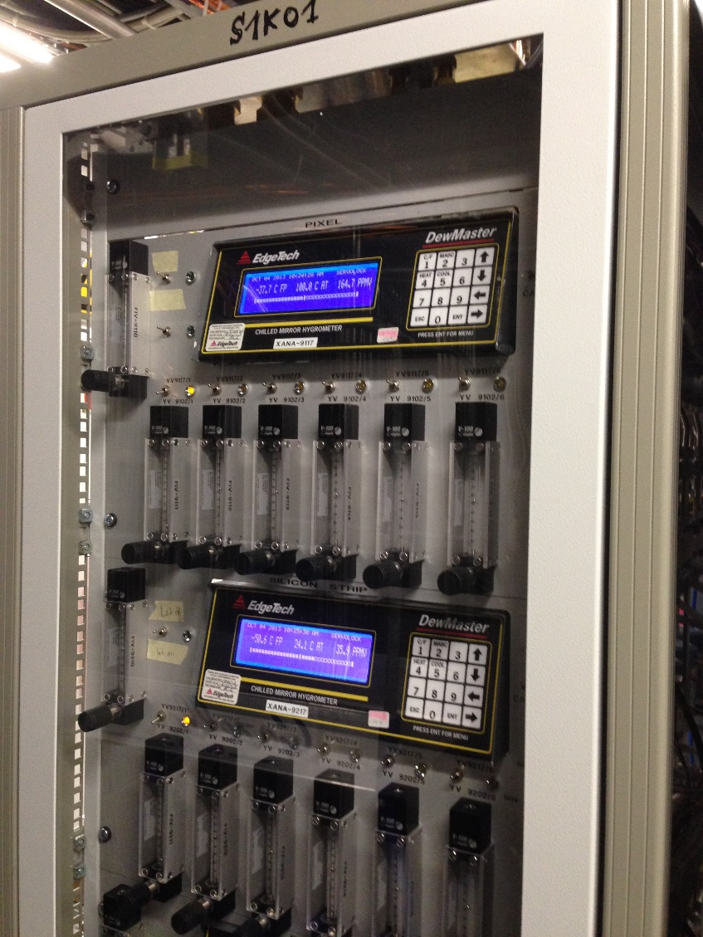
Environmental control and monitoring systems(dry air, Nitrogen, temperature)
Dewpoint problem for all systems that are cooled
below ~13 deg C…

Slide 15
Η πλατφορμα-ecosystem(software+hardware+sensors, κοινοτητα) Arduino
https://www.arduino.cc/εχει δωσει τεραστια ωθηση στην μετρηση, σε ολα τα εργαστηρια,
τις σχολικες ταξεις και τα ανωτερα ιδρυματα. Το Arduino hardware ειναι προσιτο και
απευθυνεται και σε μη ειδικους. Το περιβαλλον προγραμματισμου ειναι πολυ πιο φιλικο και τα εργαλεια που παρεχονται διευκολυνουν την χρηση της πλατφορμας απο ολους.
Στην αρχη τα Arduino προγραμματιζονταν σε C++ μεσα στο περιβαλλον Arduino.ide. Αυτο
Το περιβαλλον βοηθαει φοβερα στον προγραμματισμο αλλα το προβλημα της γλωσσας
παραμενει διοτι η C++ δουλευεται απο ειδικους μονον. Οταν ομως τα Arduino αρχισαν να
χρησιμοποιουνται στα σχολεια υπηρξαν διαφορες προσπαθειες για απλες γλωσσες
προγραμματισμου (graphical –Scratch και Blockly). Οι γλωσσες αυτες δεν μπορουν να
χρησιμοποιηθουν σε ολο το φασμα δυνατοτητων του Arduino και απαιτουν πολλες φορες
ειδικες εκδοσεις του hardware. Επισης, η εκμαθηση τους για μαθητες που προσβλεπουν σε
Τεχνικο/επιστημονικο μελλον προσφερουν μια κακη προπαιδευση.
Στο μεταξυ, η γλωσσα προγραμματισμου Python (https://micropython.org/ ) εκανε την επανασταση (μια ακομα!) στον χωρο προγραμματισμου, με διαρκως περισσοτερους οπαδους-εφαρμογες. Στην Python (διερμηνευμενη γλωσσα) ο κυκλος προγραμματισμου ειναι πολυ πιο συντομος και αμεσος.
Η Python μεταφυτευτηκε στο Arduino hardware σαν μPython και ειναι μια γλωσσα που
παρεχει την δυνατοτητα πληρους αξιοποιησης της πλατφορμας και παρα πολλα ηλεκτρονικα κομματια παρεχουν το software ετοιμο. Επιπλεον ειναι η ιδανικη γλωσσα να επιδειξουμε σε μαθητες που εχουν τεχνολογικες/επιστημονικες ανησυχιες.

Slide 16

Το Arduino και το προγραμμα LED blink
Η πραγματικη επανασταση του συστηματος Arduino ειναι ολα τα επιπεδα αφαιρεσης αναμεσα στην δουλεια της CPU και στα ηλεκτρονικα κομματια , (I/O pins).
Where before you would need to manipulate the registers with cryptic instructions such as
DDRD = 0b11111111; // declaring port D as output, because we know the LED is connected to port D, pin 0
PORTD |= 0b10000000; // pin 0 of port D set HIGH, all other pins left unchanged, this is an OR operation
_delay_ms(1000); // delay of one second
PORTD &= 0b01111111; // pin 0 of port D set LOW, all others left unchanged, this is an AND operation
now you can achieve the same result with more meaningful and understandable instructions:
pinMode(LED_BUILTIN, OUTPUT); // we do not need to remember which port and pin the LED is connected to
digitalWrite(LED_BUILTIN, HIGH); // turn the LED on (HIGH is the voltage level), no need to manipulate bits
delay(1000); // wait for a second
digitalWrite(LED_BUILTIN, LOW); // turn the LED off (LOW is the voltage level), again no bit manipulation needed

Slide 17
Αναλυση προγραμματος
void setup() {
pinMode(LED_BUILTIN, OUTPUT);
}
void loop() {
digitalWrite(LED_BUILTIN, HIGH);
delay(1000);
digitalWrite(LED_BUILTIN, LOW);
delay(1000
}
The setup() function is executed only once, at the beginning of the program. In this case, it handles the mechanisms needed to make the pin the on-board LED is connected to an output (so we can turn the LED on and off)
The loop() function, instead, is supposed to keep running "forever". In this case, it makes the LED pin take a HIGH value (+5 V) so the LED turns on, waits for 1 second, makes the LED pin take a LOW (0 V) value so the LED turns off, then waits 1 more second before ending and restarting again, and again, and again...

Slide 18
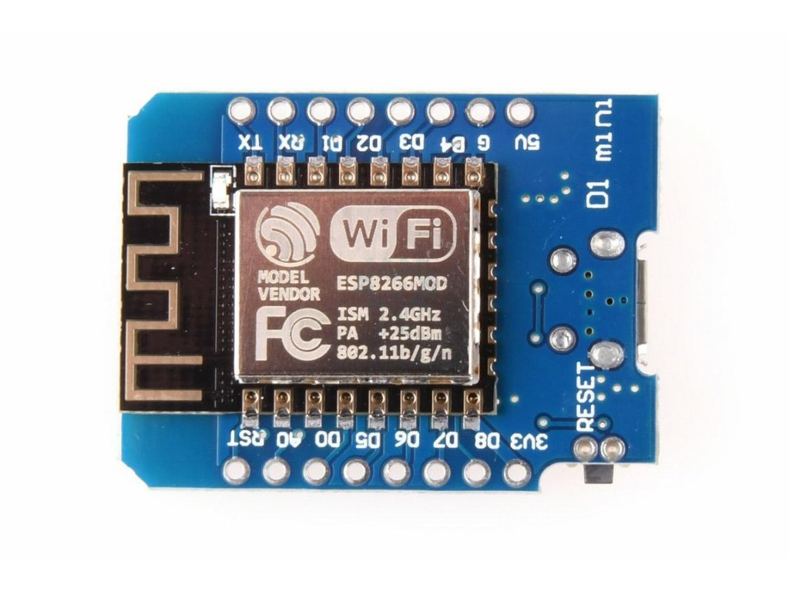
Το ιδιο "blinky" παραδειγμα σε MicroPython
We can now try the LED blink example in MicroPython: in Thonny, create a new file (click on the blank page icon) and type in the following, being very careful to respect the indentation (use the Tab key "-->"):
    import time
    from machine import Pin
    ledpin = machine.Pin(2, Pin.OUT)
    while(True):
    ledpin.on()
    time.sleep(0.5)
    ledpin.off()
    time.sleep(0.5)

Slide 19
Τι συμβαινει στο"blinky" προγραμμα;
These two lines are similar to #include <library.h> in C/C++
here we define the LED pin
now we loop forever
turn the pin to 1 (LED off)
wait half a second
turn the pin to 0 (LED on)
wait half a second
import time
from machine import Pin
ledpin = machine.Pin(2, Pin.OUT)
while(True):
ledpin.on()
time.sleep(0.5)
ledpin.off()
time.sleep(0.5)

Slide 20
Οι αισθητηρες που θα χρησιμοποιησουμε μετρανε ο,τι χρειαζομαστε και με
τους ανιχνευτες
Θερμοκρασια
Αποσταση
Υγρασια
ροη
πιεση
Και ο,τι αλλο….
Η διαφορα ειναι οτι εσεις μπορειτε να χρησιμοποιητε ψηφιακους αισθητηρες...
εμεις ΟΧΙ.
Παρακατω βλεπετε αισθητηρες που χρησιμοποιουνται καθημερινα απο ολους μας....

Slide 21
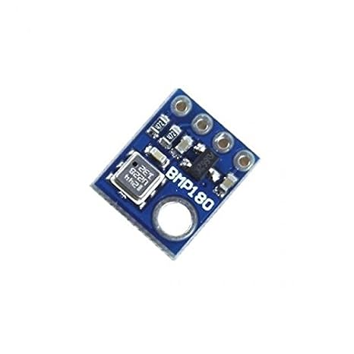
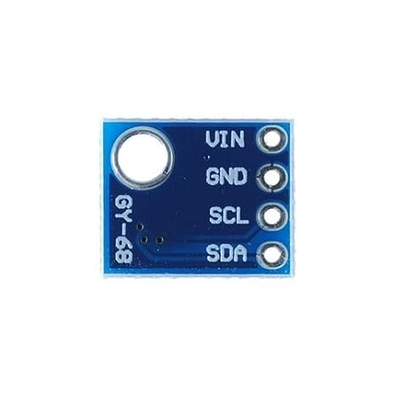
Ο αισθητηρας BMP180 (θερμοκρασια, πιεση)
3V3
G
D1
D2

Slide 22
BMP180 (Bosch):
VIN: power voltage, 3.3 V - pin "3V3" on CPU board;
GND: power return, GND - pin "G" on CPU board;
SCL: input I2C clock line (ρυθμος επικοινωνιας!)- pin "D1" on CPU board, GPIO 5;
SDA: input/output I2C data line - pin "D2" on CPU board, GPIO 4;
measures Temperature between 0 and 65 C, pressures between 300 and 1100 hPa (corresponding to +9000 and -500 m relative to sea level)

Slide 23
Arduino βιβλιοθηκες για αισθητηρες!
Πολλες!
Another great strength of the Arduino "system" is the availability of "libraries" to handle many, many types of hardware. From the Arduino IDE, under "Tools", select "Library Manager" and enter, for example, BMP180. Scroll down until you find "BMP180MI" and click on "Install". After a short while, you will have this library available to call in your programs. Most libraries also come with example programs you can open, read, modify and play with. The BMP180 is not an exception. Similarly, you can search for AHT20 and install a library for the AHT20 (and AHT21) sensor, and an example program, or search for LM75A to get a library for the LM75A sensor, with examples.

Slide 24
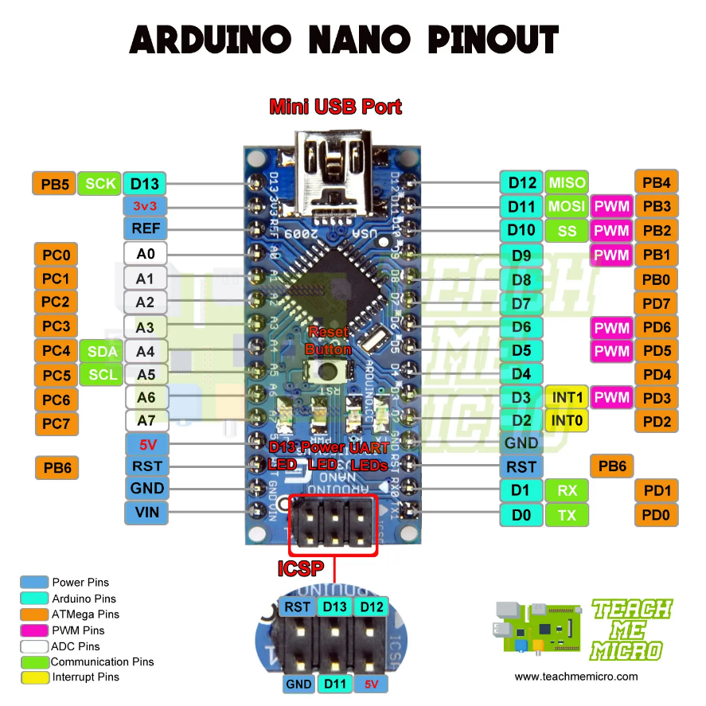
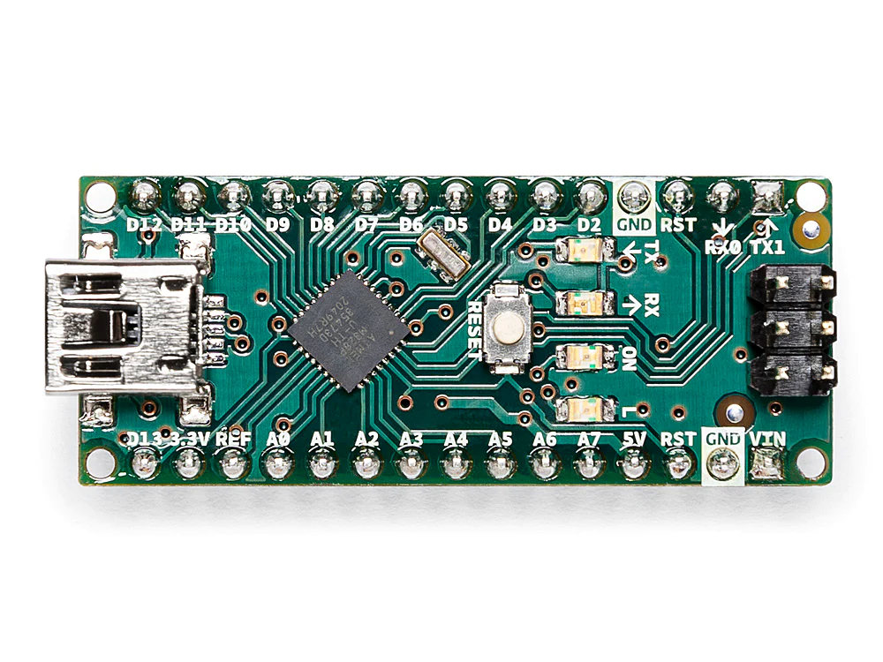
Arduino Nano pinout: which pins can do what

Slide 25
Beyond the Arduino IDE: MicroPython https://micropython.org/

Slide 26
Why MicroPython?
MCU speeds and memory are increasing every year
easier to write and read than C/C++
easier to test than C/C++
available on a large number of microcontroller families
large selection of modules (libraries) available
easier access to IoT protocols
exception handling is superior
complex data types (lists, dictionaries...) are immediately available

Slide 27
Why NOT MicroPython?
less efficient (interpreted vs compiled) both in terms of CPU cycles and of memory. This is less often a problem than one would think, as many programs spend large amounts of time "waiting" for an event in an idle loop.
errors can remain undiscovered until the buggy section of code is executed, while in the case of compiled code syntax errors are found at compilation. Logical errors, on the other hand...
cannot run on the "smallest" (and usually least expensive) systems with limited resources.

Slide 28
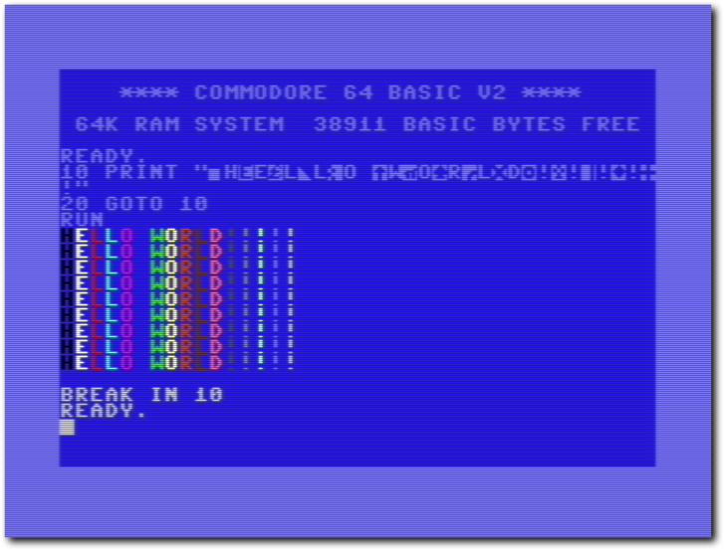
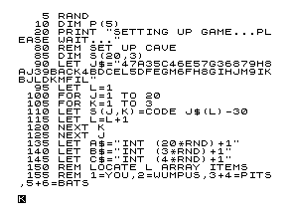
Interpreted vs Compiled
Already in 1952, interpreters were used to ease programming
in 1958, John McCarthy began developing a LISP interpreter
by the early 1970s, BASIC was used on mainframe computers
in the mid 1970s, the advent of microcomputers caused an explosive growth of BASIC, followed by Eiffel, JavaScript, Lua, MATLAB, Perl, PHP, R, Ruby, VBScript...

Slide 29
Why interpreted?
The software development cycle is faster, since any modifications to the code do not require a compilation of the source code.
An interpreted program can be distributed as source code without the need for recompilation, and apart from architecture-dependent features, does not need any adaptation to the new system.
Once you are satisfied with your MicroPython script, you can just save it in the microcontroller's filesystem as "main.py" and it will be run avery time the microcontroller starts up.

Slide 30
Hardware and Software
Hardware:
  D1 Mini (ESP8266) CPU board (https://www.wemos.cc/en/latest/d1/d1_mini.html);
  BMP180 (Temperature and Pressure) sensor board;
Software:
  Thonny IDE (https://thonny.org/);
  MicroPython firmware (https://micropython.org/download/esp8266/);
  BMP180 MicroPython module (https://github.com/micropython-IMU/micropython-bmp180)
  Optional: esptool (https://github.com/espressif/esptool/releases);

Slide 31
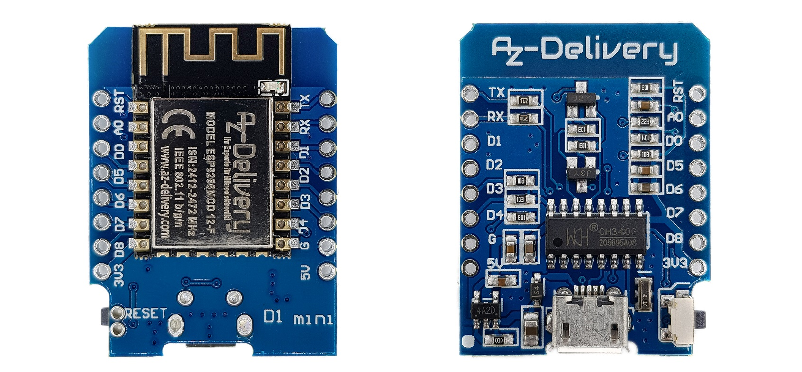
The CPU board: ESP8266 with 4 MBytes Flash

Slide 32
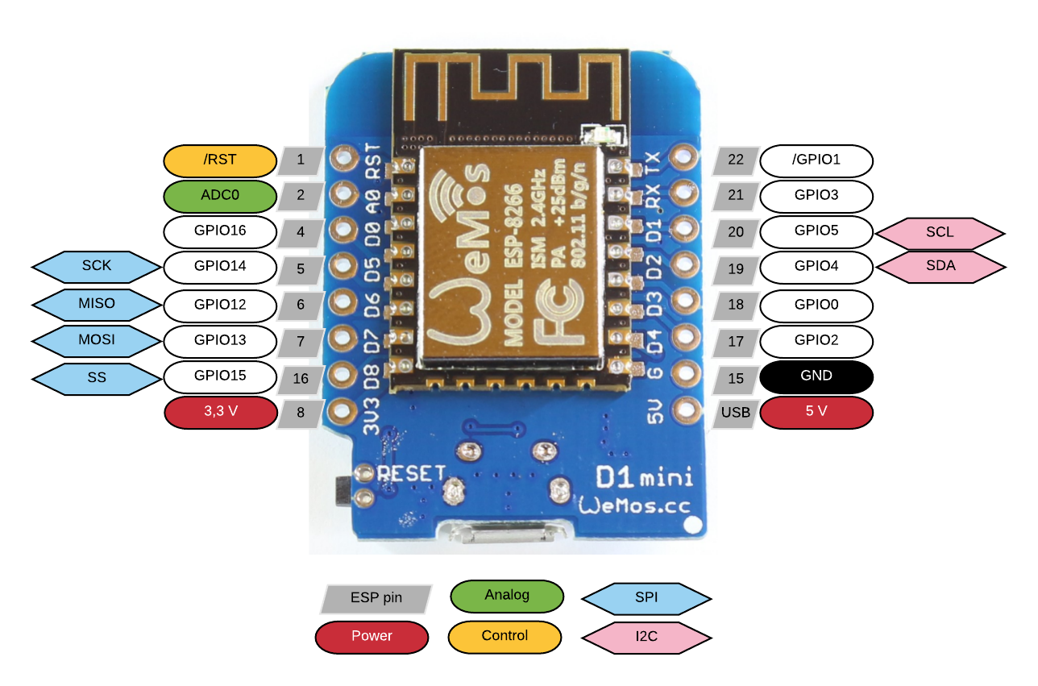
The CPU board pins and their functions
Note that pins have more than one denomination, depending whether you are using the Arduino IDE or MicroPython to program the CPU. In MicroPython, the GPIOxx number is used, so GPIO4 will be "Pin 4".
The board has an LED, connected to GPIO pin 2 (also D4) so that the LED will be ON if the pin outputs 0, and off if the pin outputs 1.

Slide 33
Which are the best pins to use?
Label | GPIO | Serial | SPI | I2C | Other | Comment | Input | Out
D0 | 16 |  |  |  | Wakeup | HIGH at boot | No interrupt | OK
D1 | 5 |  |  | SCL |  |  | OK | OK
D2 | 4 |  |  | SDA |  |  | OK | OK
D3 | 0 |  |  |  | FLASH | boot fails if LOW | Pulled up | OK
D4 | 2 | TXD1 |  |  | Board LED | boot fails if LOW | Pulled up | OK
D5 | 14 |  | CLK |  |  |  | OK | OK
D6 | 12 |  | MISO |  |  |  | OK | OK
D7 | 13 | RXD2 | MOSI |  |  |  | OK | OK
D8 | 15 | TXD2 | CS |  |  | boot fails if HIGH | Pulled down | Maybe
TX | 1 | TXD0 |  |  |  | HIGH at boot | Maybe | NO
RX | 3 | RXD0 |  |  |  | boot fails if LOW | NO | Maybe
A0 | 0 |  |  |  | ADC |  | Analog | NO

Slide 34
Installing firmware with Thonny 4.1.2
The newest (as of today) version of Thonny can even fetch your firmware for you, and allows you to specify more parameters for the upload of firmware to your microcontroller...

Slide 35
The "blinky" example
We can now try the LED blink example in MicroPython: in Thonny, create a new file (click on the blank page icon) and type in the following, being very careful to respect the indentation (use the Tab key "-->"):
    import time
    from machine import Pin
    ledpin = machine.Pin(2, Pin.OUT)
    while(True):
    ledpin.on()
    time.sleep(0.5)
    ledpin.off()
    time.sleep(0.5)

Slide 36
What is going on in our "blinky" program?
import time
from machine import Pin
ledpin = machine.Pin(2, Pin.OUT)
while(True):
ledpin.on()
time.sleep(0.5)
ledpin.off()
time.sleep(0.5)
These two lines are similar to #include <library.h> in C/C++
here we define the LED pin
now we loop forever
turn the pin to 1 (LED off)
wait half a second
turn the pin to 0 (LED on)
wait half a second

Slide 37
Another program: I2C scanner
from machine import Pin
i2c = machine.I2C(scl=Pin(5), sda=Pin(4))
print('Scanning i2c bus...')
devices = i2c.scan()
if len(devices) == 0:
print("No i2c devices found!")
else:
print('found:', len(devices), 'i2c devices')
for device in devices:
print("Decimal address: ", device, " | Hexadecimal address: ", hex(device))
Similar to #include<machine/Pin.h>
Declare an I2C interface on GPIO pins 5 and 4
Create a list of all devices present on the I2C bus
If the list has zero length, so no elements, it means no devices were found, so print a disappointed message
If the list is not empty, print the number of devices found, then for each element of the list print the I2C address that generated a positive response

Slide 38
The I2C bus
The I2C was designed by Philips in the 1980s for communications between integrated circuits on the same circuit board. However, it is not limited to this, and many digital sensors make use of it for their readout, since it requires few lines and can connect multiple sensors.
We will use I2C-based sensors in this lecture.
The main characteristics are:
  only two bus lines needed, SDA (Serial DAta) and SCL (Serial CLock)
  synchronous bus, so no strict baud rate requirements exist
  multi-master system, with provisions for arbitration and collision detection
  each device on the bus is addressable by its own unique address

Slide 39
The BMP180 Sensor board
3V3
G
D1
D2

Slide 40
BMP180:
VIN: power voltage, 3.3 V - pin "3V3" on CPU board;
GND: power return, GND - pin "G" on CPU board;
SCL: input I2C clock line - pin "D1" on CPU board, GPIO 5;
SDA: input/output I2C data line - pin "D2" on CPU board, GPIO 4;
measures Temperature between 0 and 65 C, pressures between 300 and 1100 hPa (corresponding to +9000 and -500 m relative to sea level)

Slide 41
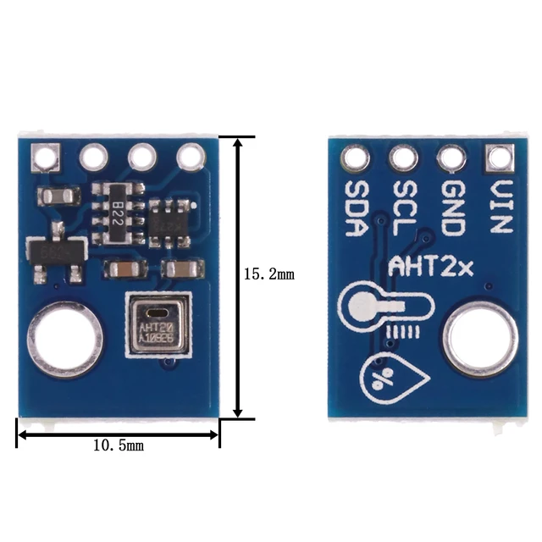
The AHT21 Sensor board

Slide 42
AHT21:
VIN: power voltage, 3.3 V - pin "3V3" on CPU board;
GND: power return, GND - pin "G" on CPU board;
SCL: input I2C clock line - pin "D1" on CPU board, GPIO 5;
SDA: input/output I2C data line - pin "D2" on CPU board, GPIO 4;
measures Temperature between -40 and 120 C, relative humidity between 0 and 100 %

Slide 43
What if there IS no existing software module?
Suppose you find a new sensor for which nobody has published a module yet. How difficult is it to develop your own software?
The LT75 is a temperature sensor with a digital output that becomes active when the temperature exceeds a programmable threshold. It is an I2C slave and contains four registers:
  Temperature, 9 bits encoded over 2 bytes, read-only (address 0)
  Configuration, 8 bits (address 1)
  Hysteresis, 9 bits encoded over 2 bytes (address 2)
  Threshold, 9 bits encoded over 2 bytes (address 3)
We can start by simply reading the temperature register.

Slide 44
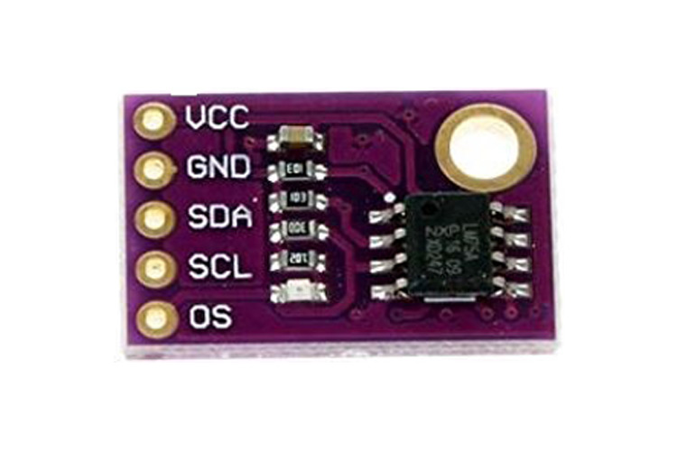
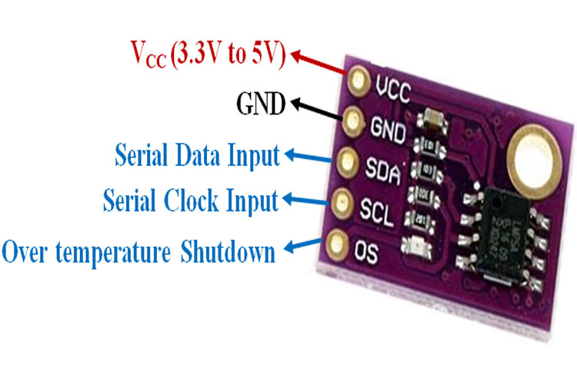
The LM75A sensor board and its connections
On the back, the module allows you to change three bits of the I2C address. Leave them unconnected for now.

Slide 45
The quick and dirty code (but we have a module for the LM75a... feel free to try it)
# WARNING! Ugly code! But it does work...
from machine import I2C, Pin
# Create an instance of the I2C bus with the right pin numbers
i2c = I2C(scl=Pin(5), sda=Pin(4))
# Create a 2-byte buffer for storing the temperature measurement
tbuffer = bytearray(2)
# Read two bytes from the temperature register into the newly created buffer. The LM75 address is 0x48
i2c.readfrom_mem_into(0x48, 0, tbuffer)
# Convert 9 bits to a temperature value. The integer part is in tbuffer[0] and the 0.5 in the MSB of tbuffer[1]
temperature = (tbuffer[0]) + (tbuffer[1] >> 7) / 2
print(temperature)

Slide 46
Python and executing actions at a given time
MicroPython has extensions which allow the easy use of most features of the microcontrollers it runs on, and this includes the timers. It is possible to create a Timer (which can in some cases be virtual - with no corresponding hardware timer in the CPU) with a given period (or just a single execution after a specific delay), and associate with it a so-called "callback function" to be executed when the Timer runs out (the period has expired). In the next example, we will use two, to schedule the readout of temperature and relative humidity from the AHT21 sensors every 5 and 30 seconds respectively.

Slide 47
import time
import micropython
from machine import Pin, I2C, Timer
import ahtx0
i2c = I2C(scl=Pin(5), sda=Pin(4))
aht = ahtx0.AHT10(i2c)
t1 = Timer(1)
t1.init(mode = Timer.PERIODIC, period = 5000, callback = lambda t : micropython.schedule(print, f'T = {aht.temperature:.1f} C'))
t2 = Timer(2)
t2.init(mode = Timer.PERIODIC, period = 30000, callback = lambda t : micropython.schedule(print, f'RH = {aht.relative_humidity:.2f} %'))

Slide 48
Explaining the Timer listing (1)
import time
import micropython
from machine import Pin, I2C, Timer
import ahtx0
i2c = I2C(scl=Pin(5), sda=Pin(4))
aht = ahtx0.AHT21(i2c)
These lines contain the code we already used to prepare the readout of the AHT21 sensor:
include the necessary modules (libraries)
setup the I2C bus
create an AHT21 object

Slide 49
Explaining the Timer listing (2)
t1 = Timer(1)
t1.init(
mode = Timer.PERIODIC,
period = 5000,
callback = lambda t : micropython.schedule(print, f'T = {aht.temperature:.1f} C')
)
Create a Timer object with id = 1
Set it up so that it runs in periodic mode (restarts immediately after expiring), with a period of 5000 milliseconds, and with an anonymous callback function that requests that the Python system print "as soon as possible" the (formatted) temperature value.
The same happens for humidity.

Slide 50
Explaining the Timer listing (3)
A few pythonic notes:
  we should NOT specify directly print() as the callback function since it would be executed in Interrupt mode. Better to ask Python to print "as soon as possible" but outside of Interrupt mode, using the micropython.schedule() call.
  Since the callback functions are not really useful for anything else, we do not need to give them a name, but we can create them as anonymous using the "lambda" notation. n Python, a lambda function is a small, anonymous function that can take any number of arguments, but can have only one expression. Perfect here.
  f'T = {aht.temperature:.1f} C' is a string containing a format specification, namely the value of the temperature with exactly one decimal digit.

Slide 51
More callback functions
It is also possible to associate a callback function with an interrupt caused by an event on an input (or even an output) pin. Then the CPU could execute any kind of main loop without the need to check the pin while stil responding (and quickly) to the arrival of a signal.
In the following example, a callback function (that prints the number of the pin) is associated with an interrupt generated by a falling edge (1 to 0) on pin 4 (D2). In the main loop, pin 5 (D1), defined as an output, changes value regularly, printing "Pin(5)" every time a falling edge is generated. By connecting pin 5 to pin 4, the program starts printing additionally "Pin(4)" just after "Pin(5)", with no evident instruction to do so.

Slide 52
Pin callback example
from machine import Pin
import time
p0 = Pin(5, Pin.OUT)
p1 = Pin(4, Pin.IN)
p1.irq(handler = lambda p : print(p), trigger = Pin.IRQ_FALLING)
while True:
p0.value(0)
time.sleep(0.5)
p0.value(1)
time.sleep(4.5)

Slide 53
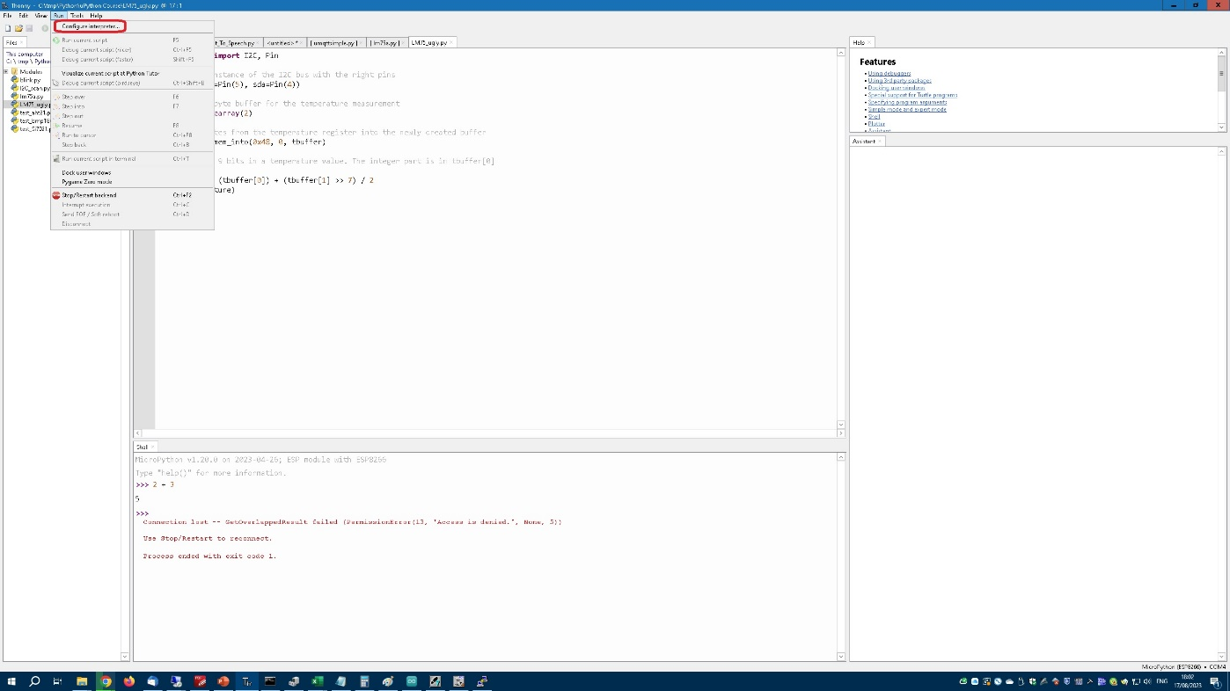
Using Thonny to install the ESP8266 firmware

Slide 54
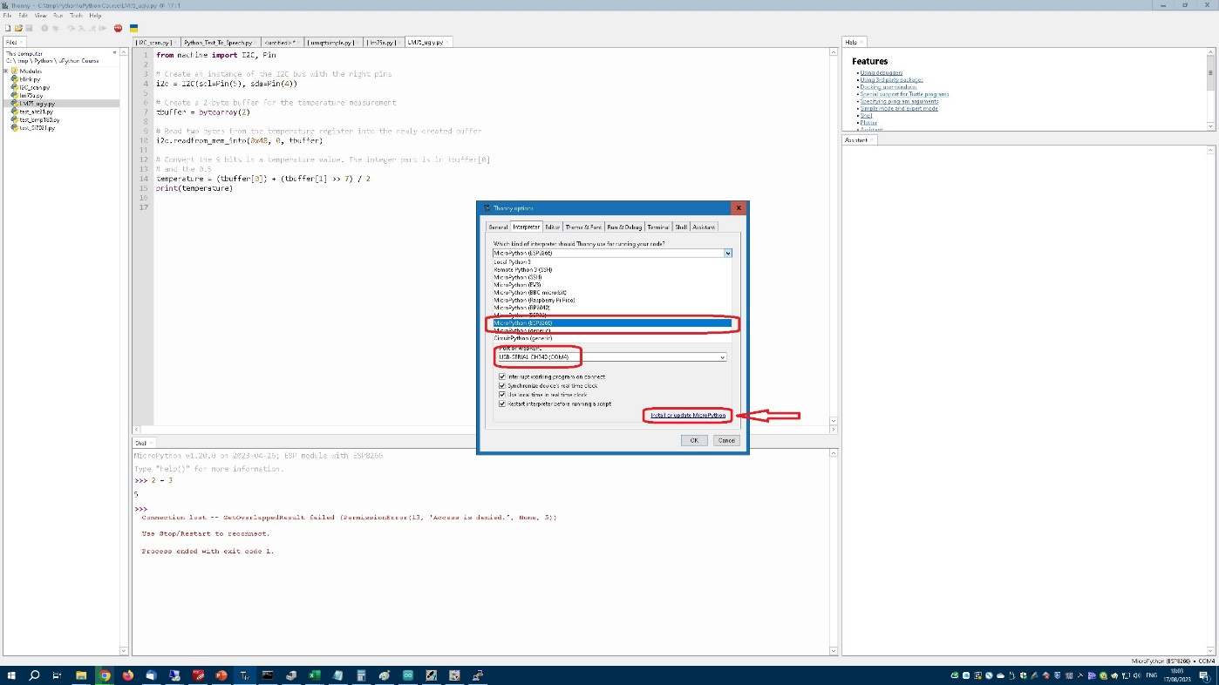
1. Select the CPU and the port

Slide 55
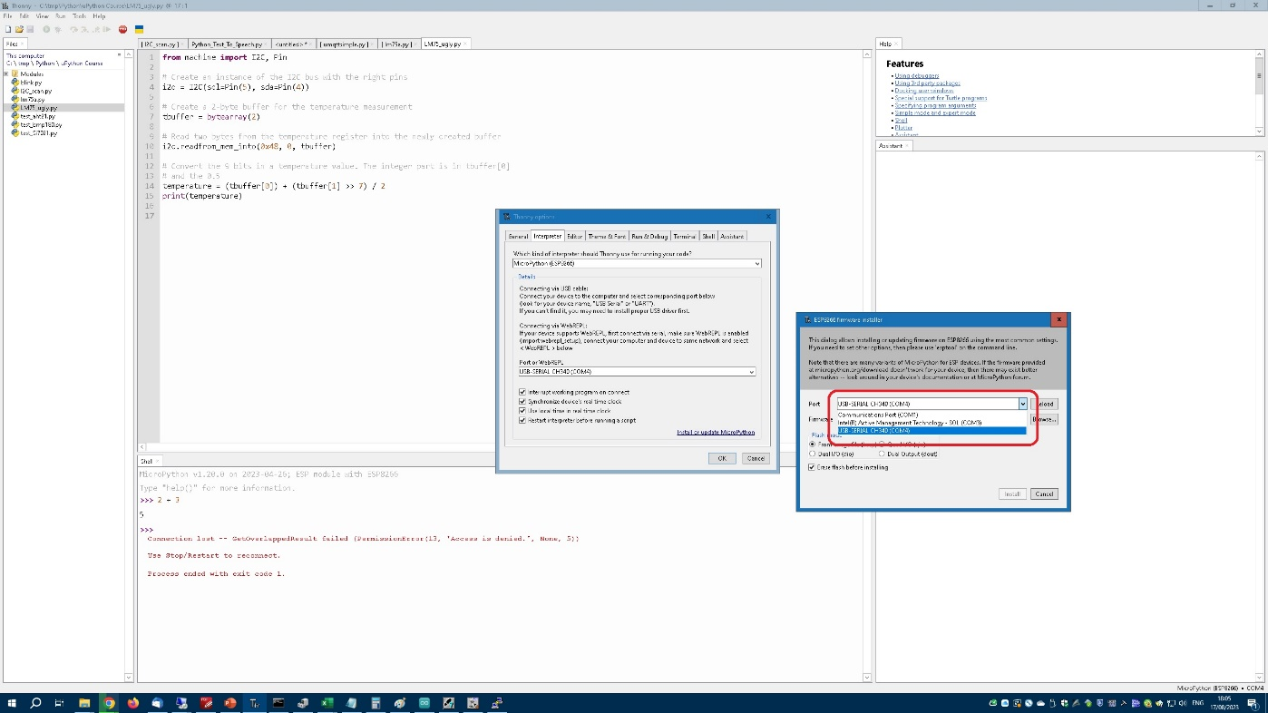
2. Find the firmware on your computer

Slide 56
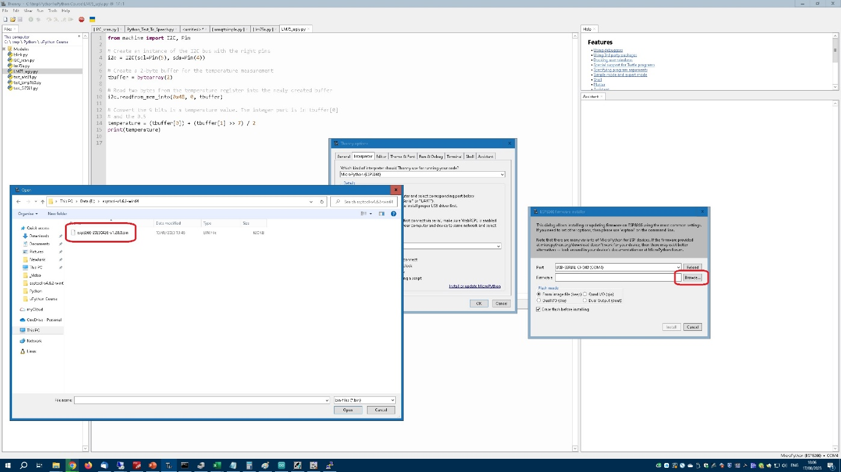
3. Select the firmware binary

Slide 57
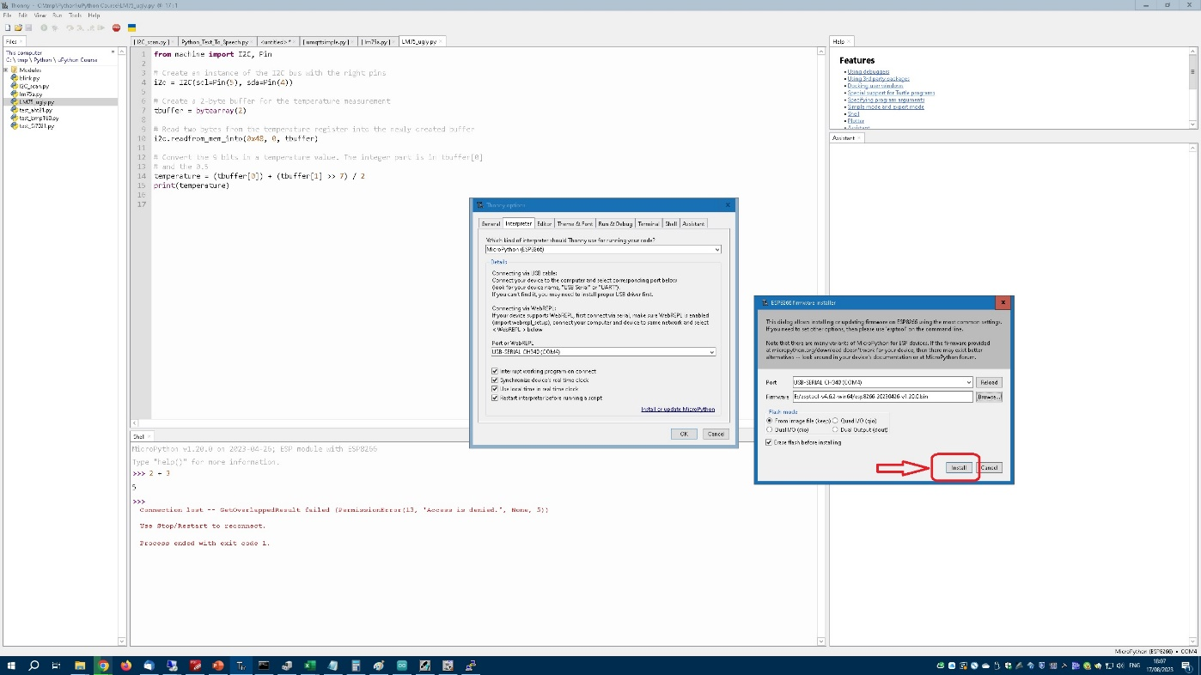
4. Start the installation (it will take some time)

Slide 58

5. Once done, close the pop-ups

Slide 59
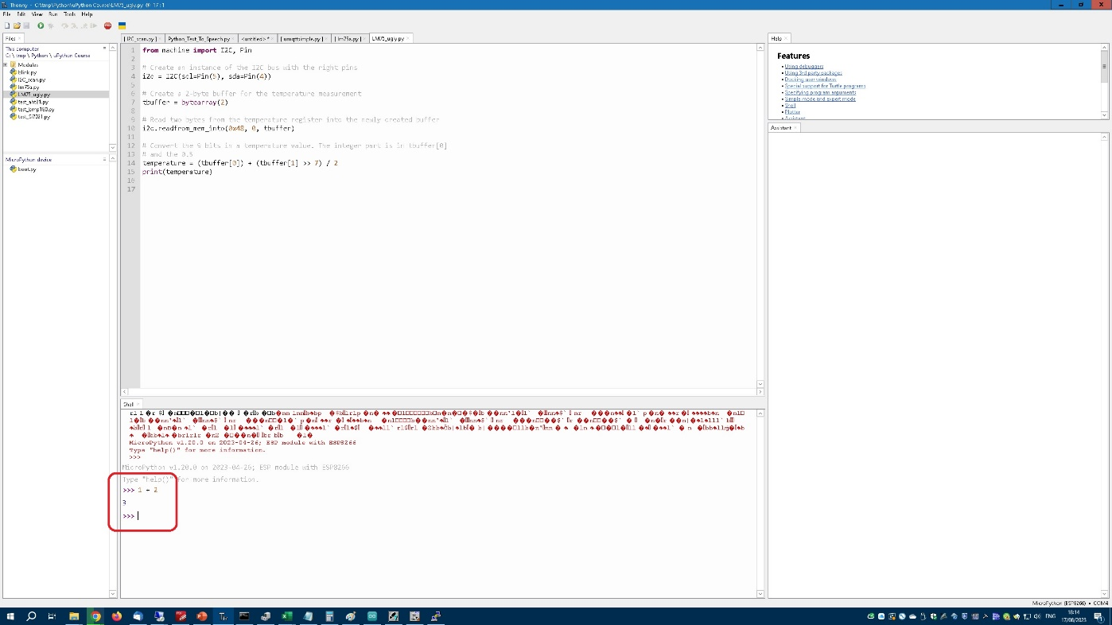
6. Finally, test that you have a working setup

Slide 60
USB connection with your PC
D10-D11-D13 “Drive” digital outputs
A0-A5 Read analog
values
D2-D3 Read digital inputs
5V power. For (almost) every sensor
GROUND!
Your reference!

Slide 61
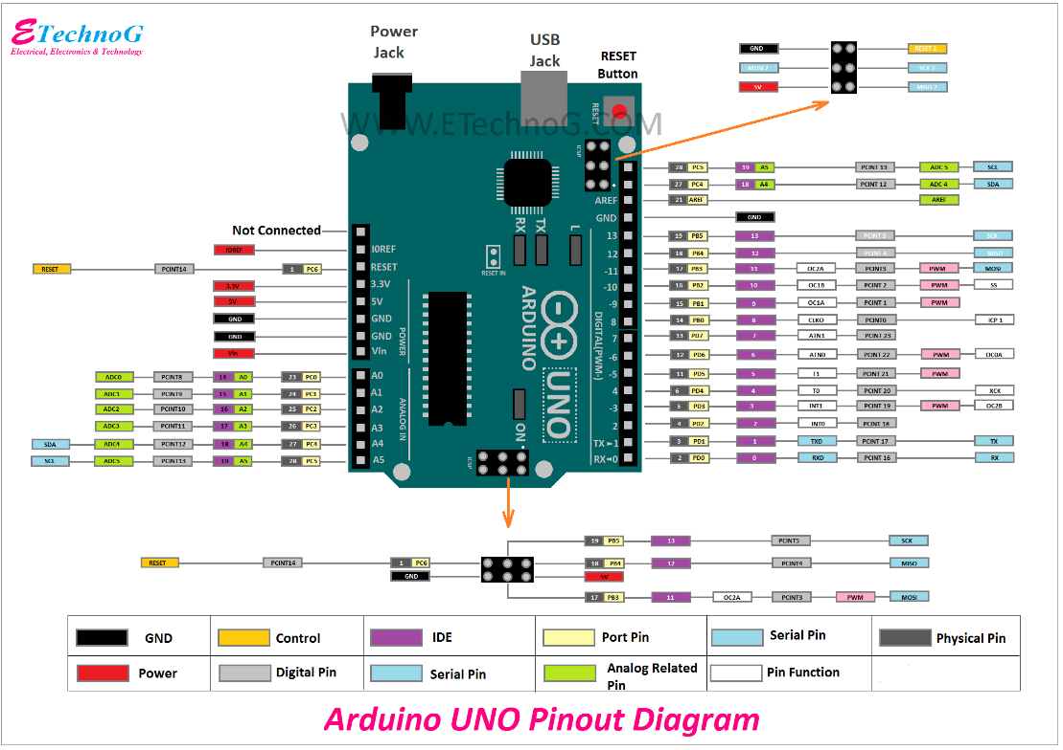
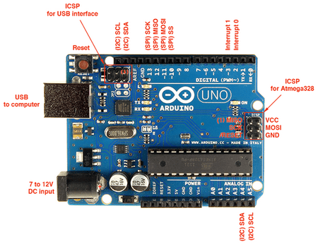
Arduino UNO pinout

Slide 62
How do we connect our sensors? BMP180
The BMP180 sensor board has four pins. We can connect them to our Arduino Nano as follows:
VIN is the power supply for the sensor, which MUST be 3.3V and NOT 5V (otherwise you will destroy it). So, we need to connect it to the "3v3" pin of the Nano.
GND is the power return, and it goes to one "GND" pin of the Nano (there are two available).
SCL is the Serial CLock signal needed to read the sensor, and it needs to be connected to the "SCL" pin of the Nano, which is also called and labeled "A5".
SDA is the Serial DAta line used to read the sensor, and it needs to be connected to the SDA line of the Nano, which is also called and labeled "A4".

Slide 63
Connections, in detail
VIN
SDA
SCL
GND

Slide 64
Arduino UNO version of the connections:
You can totally ignore the explanations for the pins you are not interested in, or check them out for the future...
Note that the pins are located in different positions.
VIN
GND
SDA
SCL

Slide 65
Connecting the AHT21 sensor board
(αισθητηρας υγρασιας+θερμοκρασιας)
The AHT21 board also has four pins, in fact they are the same as for the BMP180 board but are not placed in the same positions, rather the other way around, so please be careful. You can disconnect the Arduino UNO from USB, disconnect the BMP180 board one wire at a time and reconnect each wire to the AHT21 immediately.
Write down which color wires you are using for which signal, and try to keep the association between signal and wire color always the same, and you will prevent trouble.

Slide 66
Connecting the LM75 board
The LM75 board seems to have one more connection, the one labeled "OS", but we do not really need it. It is an output that the LM75 makes active whenever the temperature exceeds a set limit (so it can be used as a thermostat).
In fact, ignoring "OS", the connections are similar to those for the AHT21, except for the exchange of SCL with SDA (this is an annoying fact, but there is no "standard" way of connecting these boards, as every producer feels free to locate the pins wherever it is more convenient. For him, not for us).

Slide 67
Arduino and LED blink program
The real innovation that the Arduino "system" brought is the layer of abstraction between the inner workings of the CPU and the access to the resources, such as I/O pins. Where before you would need to manipulate the registers with cryptic instructions such as
DDRD = 0b11111111; // declaring port D as output, because we know the LED is connected to port D, pin 0
PORTD |= 0b10000000; // pin 0 of port D set HIGH, all other pins left unchanged, this is an OR operation
_delay_ms(1000); // delay of one second
PORTD &= 0b01111111; // pin 0 of port D set LOW, all others left unchanged, this is an AND operation
now you can achieve the same result with more meaningful and understandable instructions:
pinMode(LED_BUILTIN, OUTPUT); // we do not need to remember which port and pin the LED is connected to
digitalWrite(LED_BUILTIN, HIGH); // turn the LED on (HIGH is the voltage level), no need to manipulate bits
delay(1000); // wait for a second
digitalWrite(LED_BUILTIN, LOW); // turn the LED off (LOW is the voltage level), again no bit manipulation needed

Slide 68
Let us analyze the LED blink program
void setup() {
pinMode(LED_BUILTIN, OUTPUT);
}
void loop() {
digitalWrite(LED_BUILTIN, HIGH);
delay(1000);
digitalWrite(LED_BUILTIN, LOW);
delay(1000
}
The setup() function is executed only once, at the beginning of the program. In this case, it handles the mechanisms needed to make the pin the on-board LED is connected to an output (so we can turn the LED on and off)
The loop() function, instead, is supposed to keep running "forever". In this case, it makes the LED pin take a HIGH value (+5 V) so the LED turns on, waits for 1 second, makes the LED pin take a LOW (0 V) value so the LED turns off, then waits 1 more second before ending and restarting again, and again, and again...

Slide 69
Arduino (sensor) Libraries
Another great strength of the Arduino "system" is the availability of "libraries" to handle many, many types of hardware. From the Arduino IDE, under "Tools", select "Library Manager" and enter, for example, BMP180. Scroll down until you find "BMP180MI" and click on "Install". After a short while, you will have this library available to call in your programs. Most libraries also come with example programs you can open, read, modify and play with. The BMP180 is not an exception. Similarly, you can search for AHT20 and install a library for the AHT20 (and AHT21) sensor, and an example program, or search for LM75A to get a library for the LM75A sensor, with examples.

Slide 70
Arduino Nano pinout: which pins can do what

Slide 71
Arduino UNO pinout

Slide 72
How do we connect our sensors? BMP180
The BMP180 sensor board has four pins. We can connect them to our Arduino Nano as follows:
VIN is the power supply for the sensor, which MUST be 3.3V and NOT 5V (otherwise you will destroy it). So, we need to connect it to the "3v3" pin of the Nano.
GND is the power return, and it goes to one "GND" pin of the Nano (there are two available).
SCL is the Serial CLock signal needed to read the sensor, and it needs to be connected to the "SCL" pin of the Nano, which is also called and labeled "A5".
SDA is the Serial DAta line used to read the sensor, and it needs to be connected to the SDA line of the Nano, which is also called and labeled "A4".

Slide 73
Connections, in detail
VIN
SDA
SCL
GND

Slide 74
Arduino UNO version of the connections:
You can totally ignore the explanations for the pins you are not interested in, or check them out for the future...
Note that the pins are located in different positions.
VIN
GND
SDA
SCL

Slide 75
Connecting the AHT21 sensor board
The AHT21 board also has four pins, in fact they are the same as for the BMP180 board but are not placed in the same positions, rather the other way around, so please be careful. You can disconnect the Arduino UNO from USB, disconnect the BMP180 board one wire at a time and reconnect each wire to the AHT21 immediately.
Write down which color wires you are using for which signal, and try to keep the association between signal and wire color always the same, and you will prevent trouble.

Slide 76
Connecting the LM75 board
The LM75 board seems to have one more connection, the one labeled "OS", but we do not really need it. It is an output that the LM75 makes active whenever the temperature exceeds a set limit (so it can be used as a thermostat).
In fact, ignoring "OS", the connections are similar to those for the AHT21, except for the exchange of SCL with SDA (this is an annoying fact, but there is no "standard" way of connecting these boards, as every producer feels free to locate the pins wherever it is more convenient. For him, not for us).

