Slide 1

WP5 progress report
ITS3
Tuesday 13th June 2023
WP5 collaboration

Slide 2
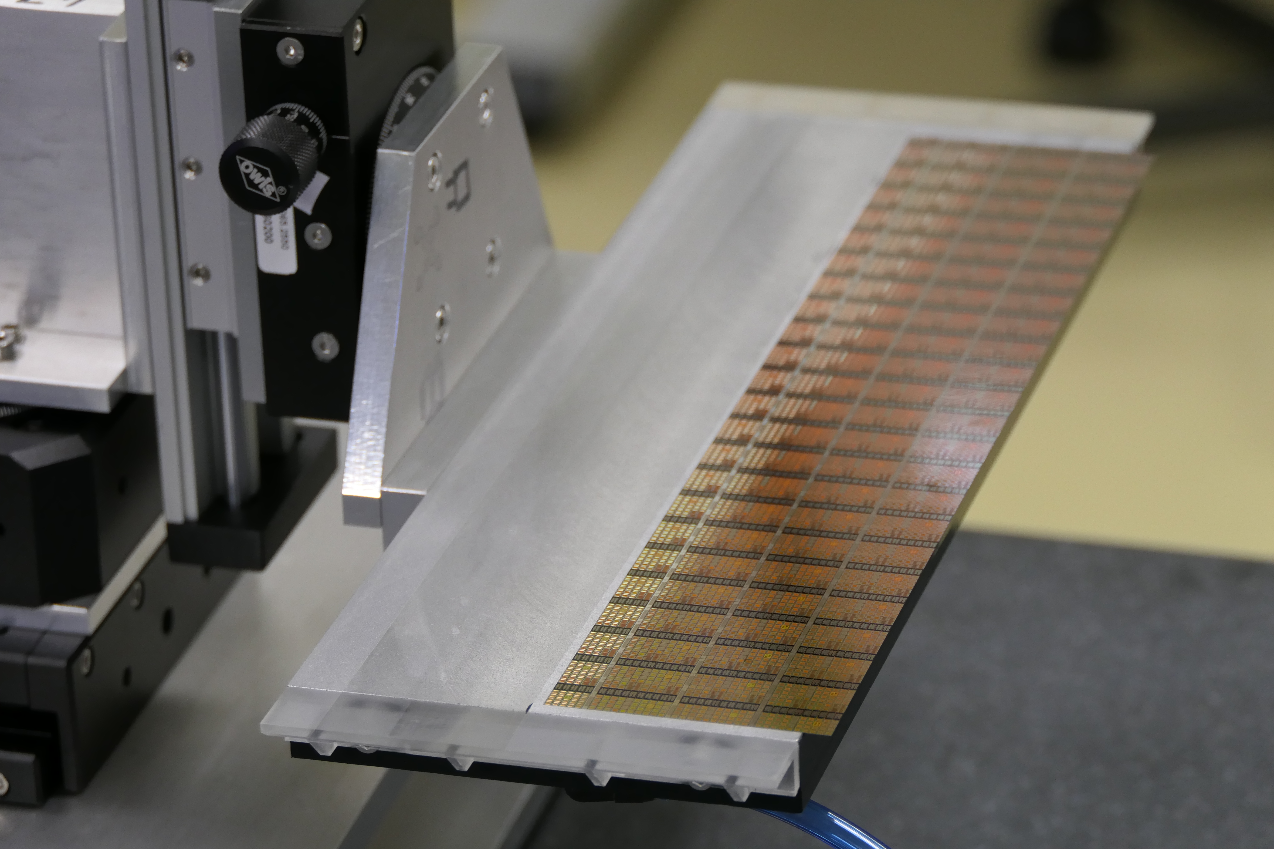
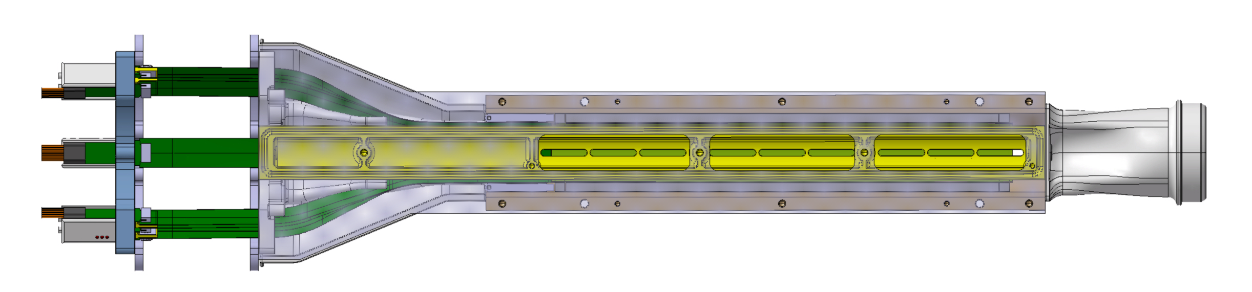
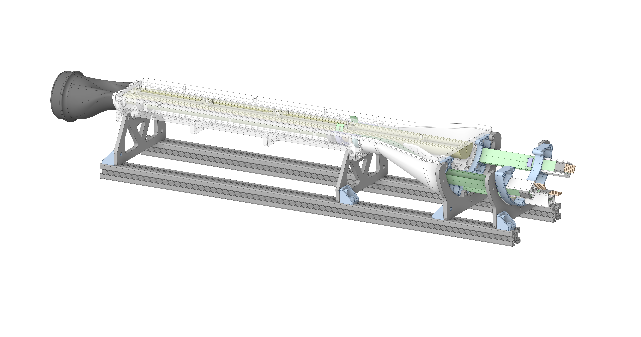
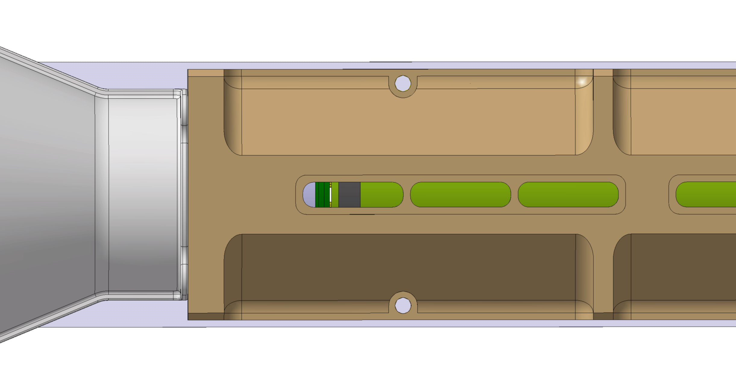
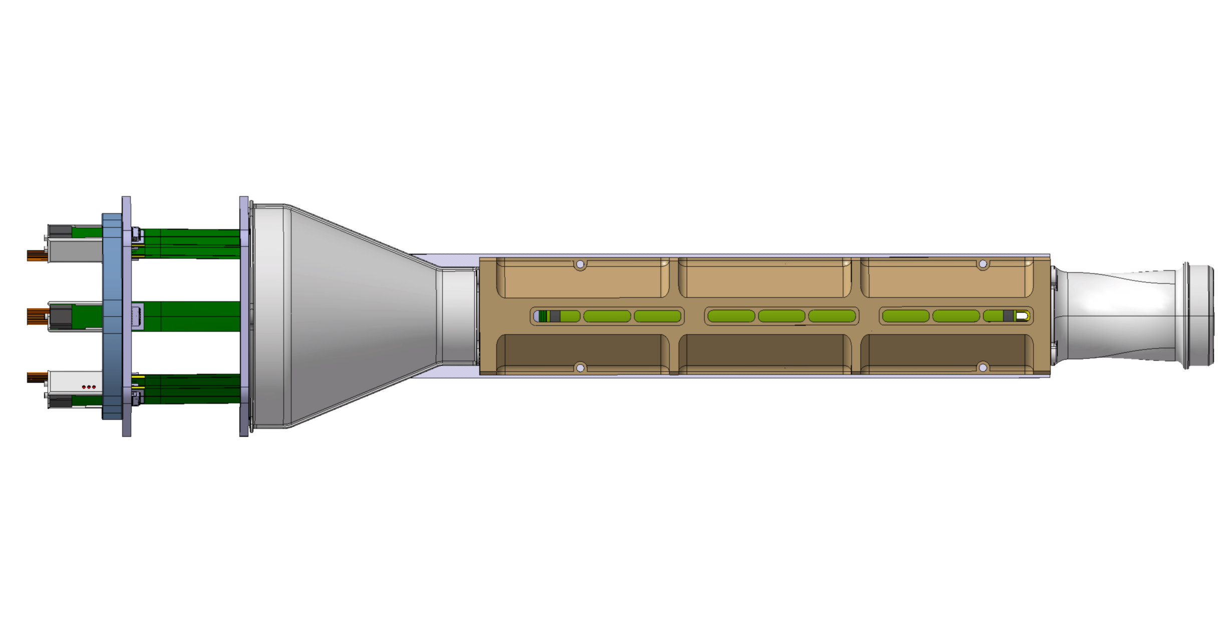
BBM4 bending
Bending and integration of a real wafer size sensor (L0 size, 50um thin, MLR1 65 nm tech.)
Wire-bonding integrity under airflow speed 4-8m/s (optical inspect)
Vibration measurements (identify natural frequencies real sensor)
@Pieter
Top view
MLR1 central piece
Glass window
Bottom view
Max 12 mm

Slide 3
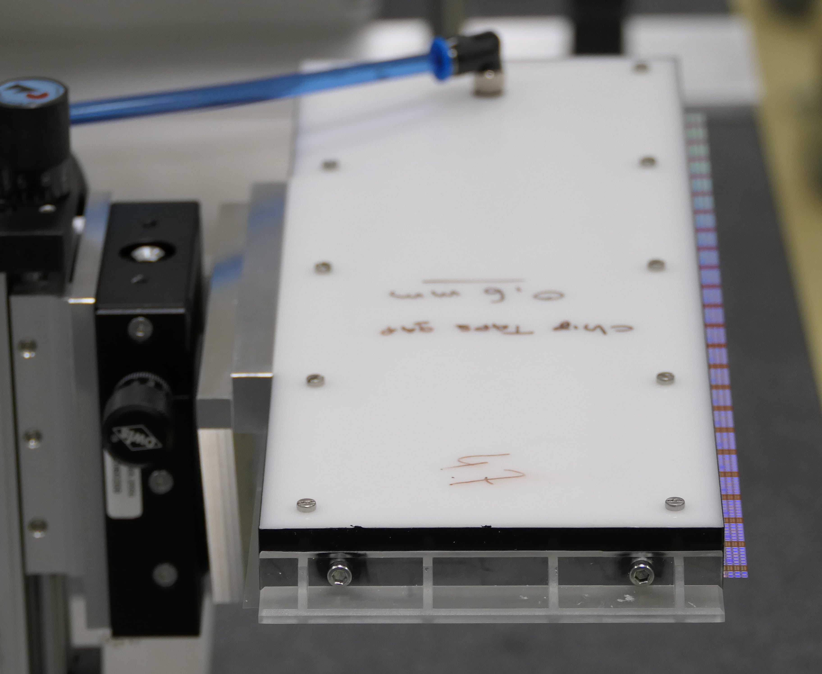
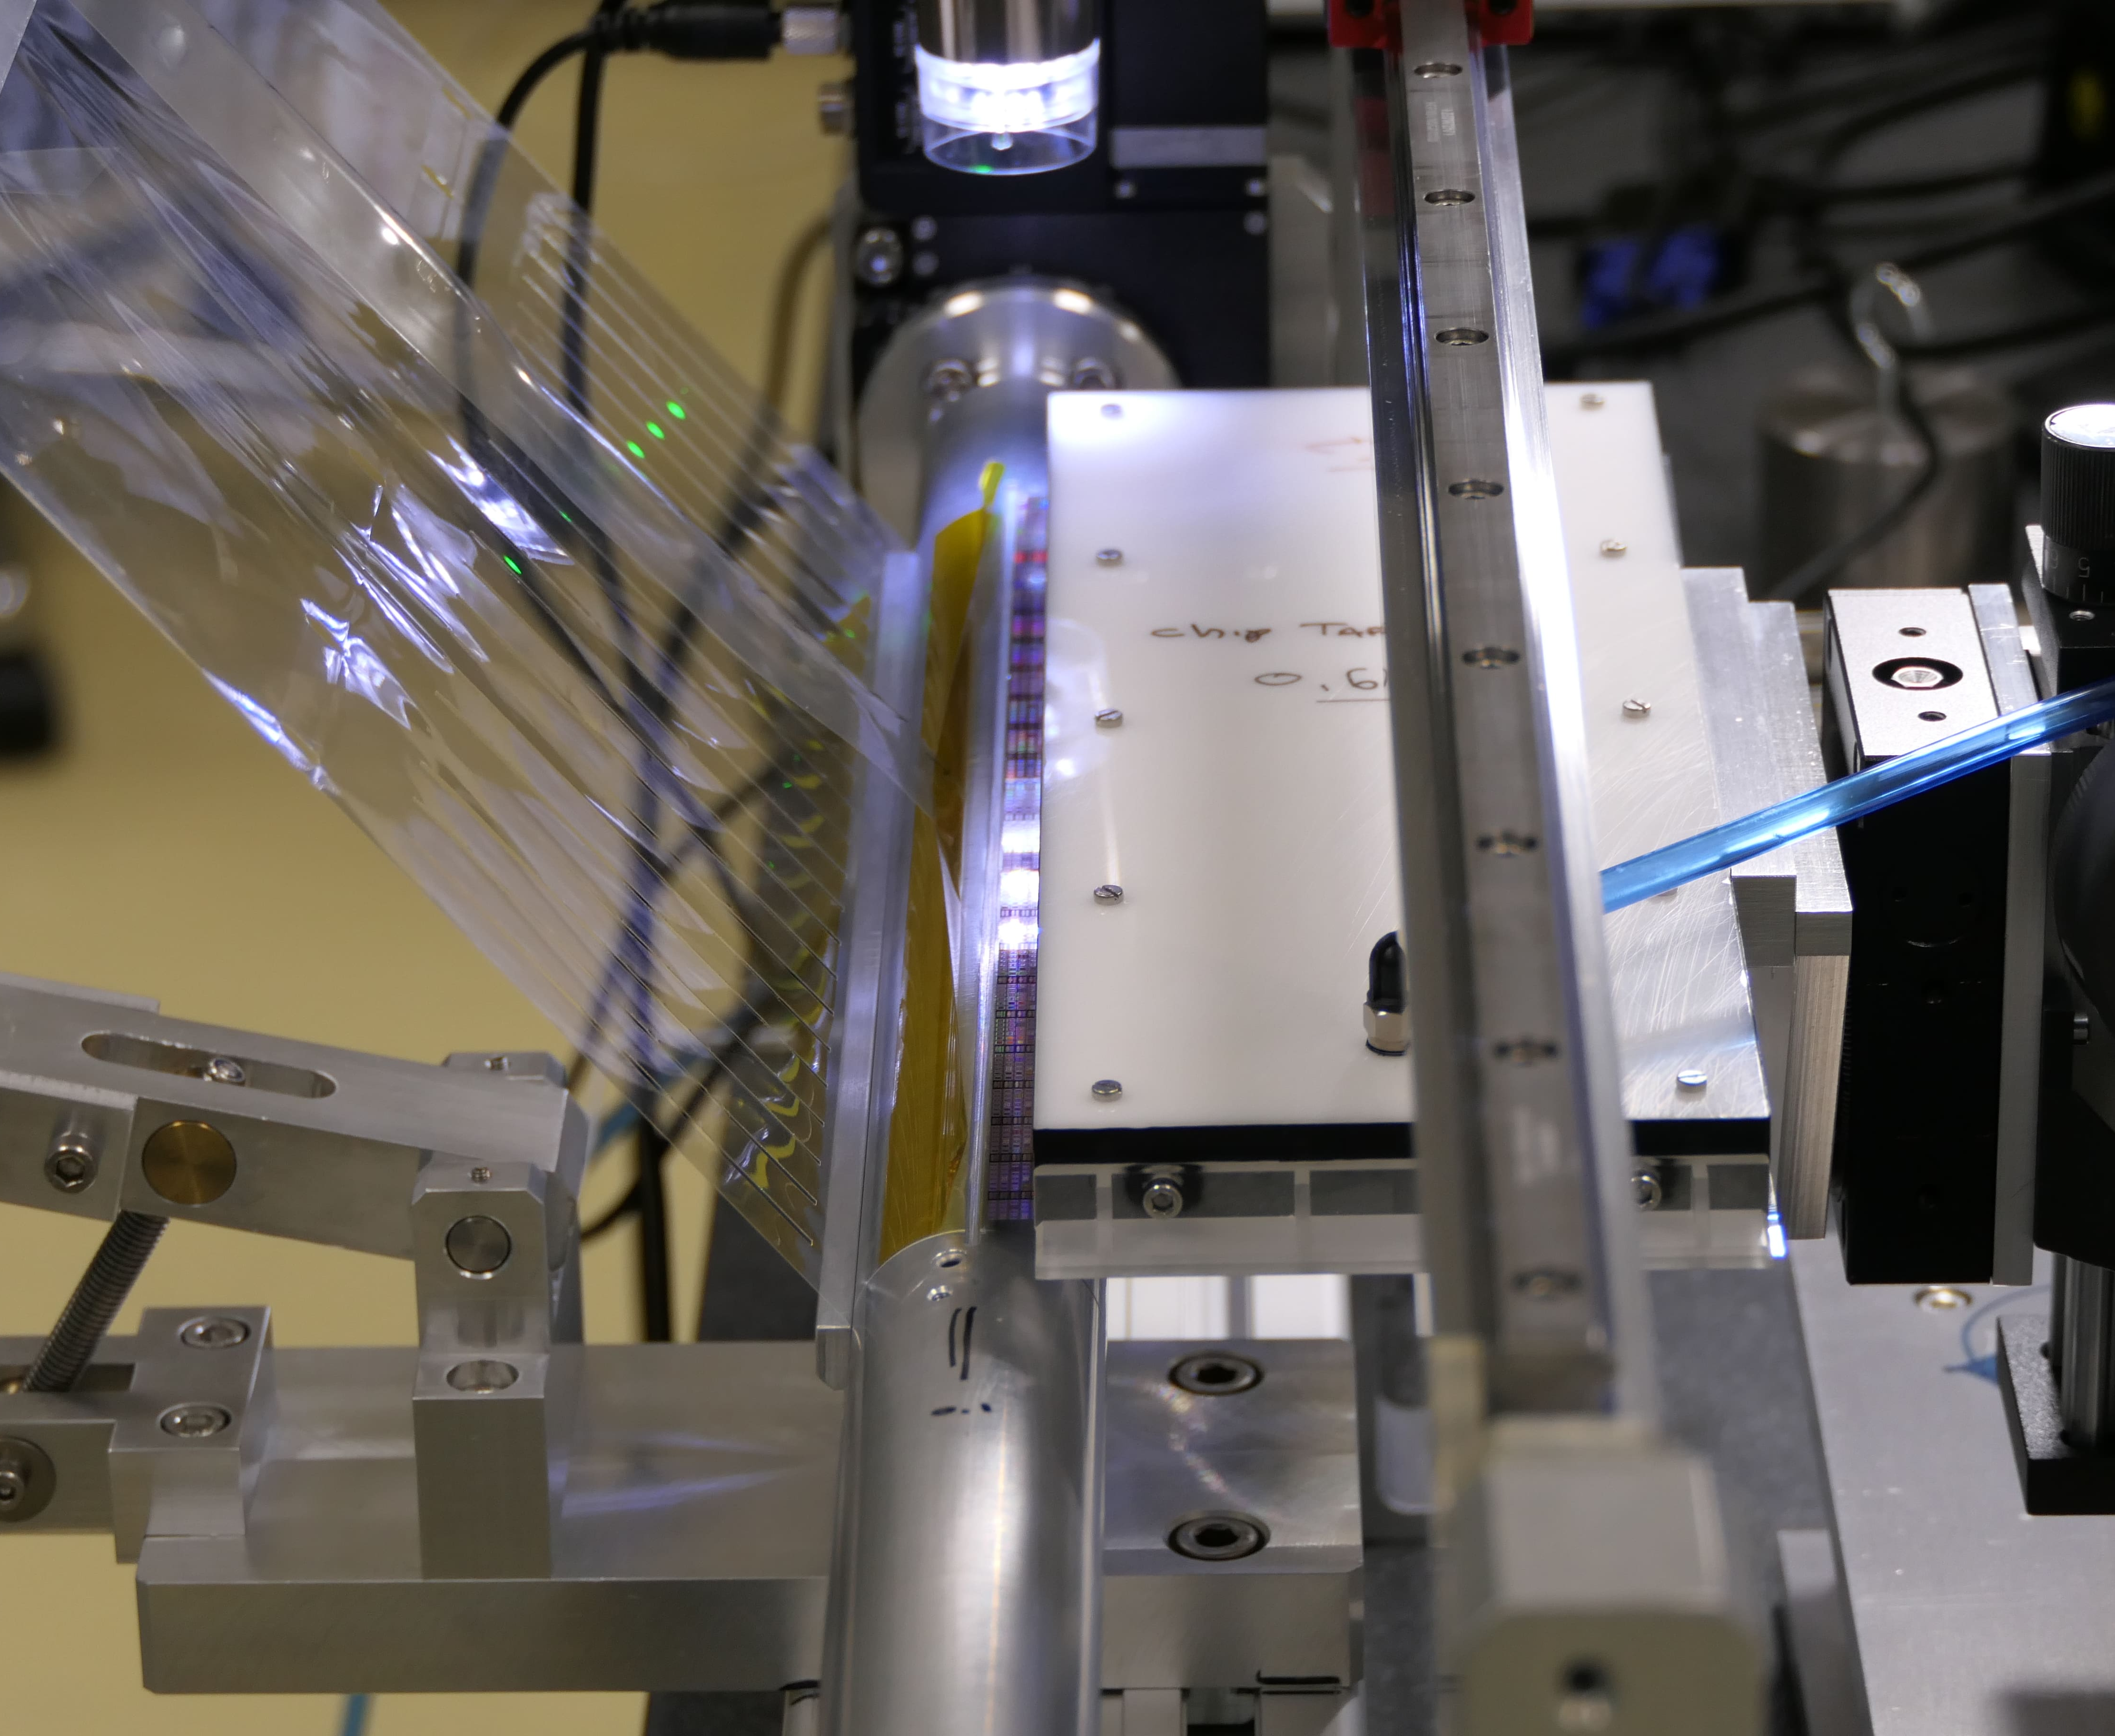
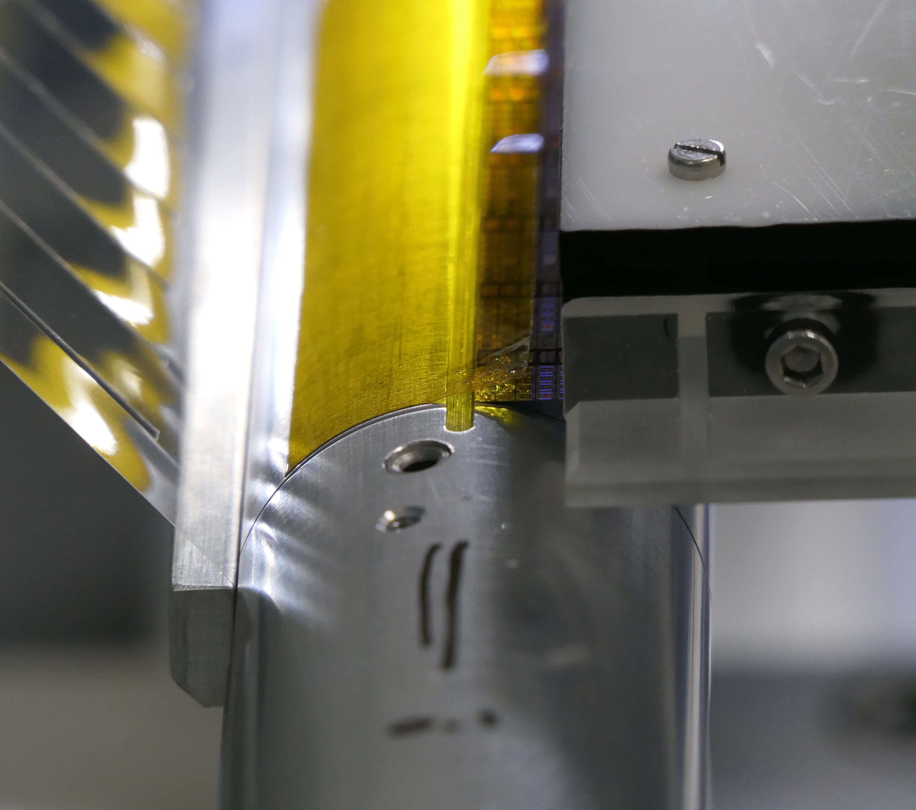
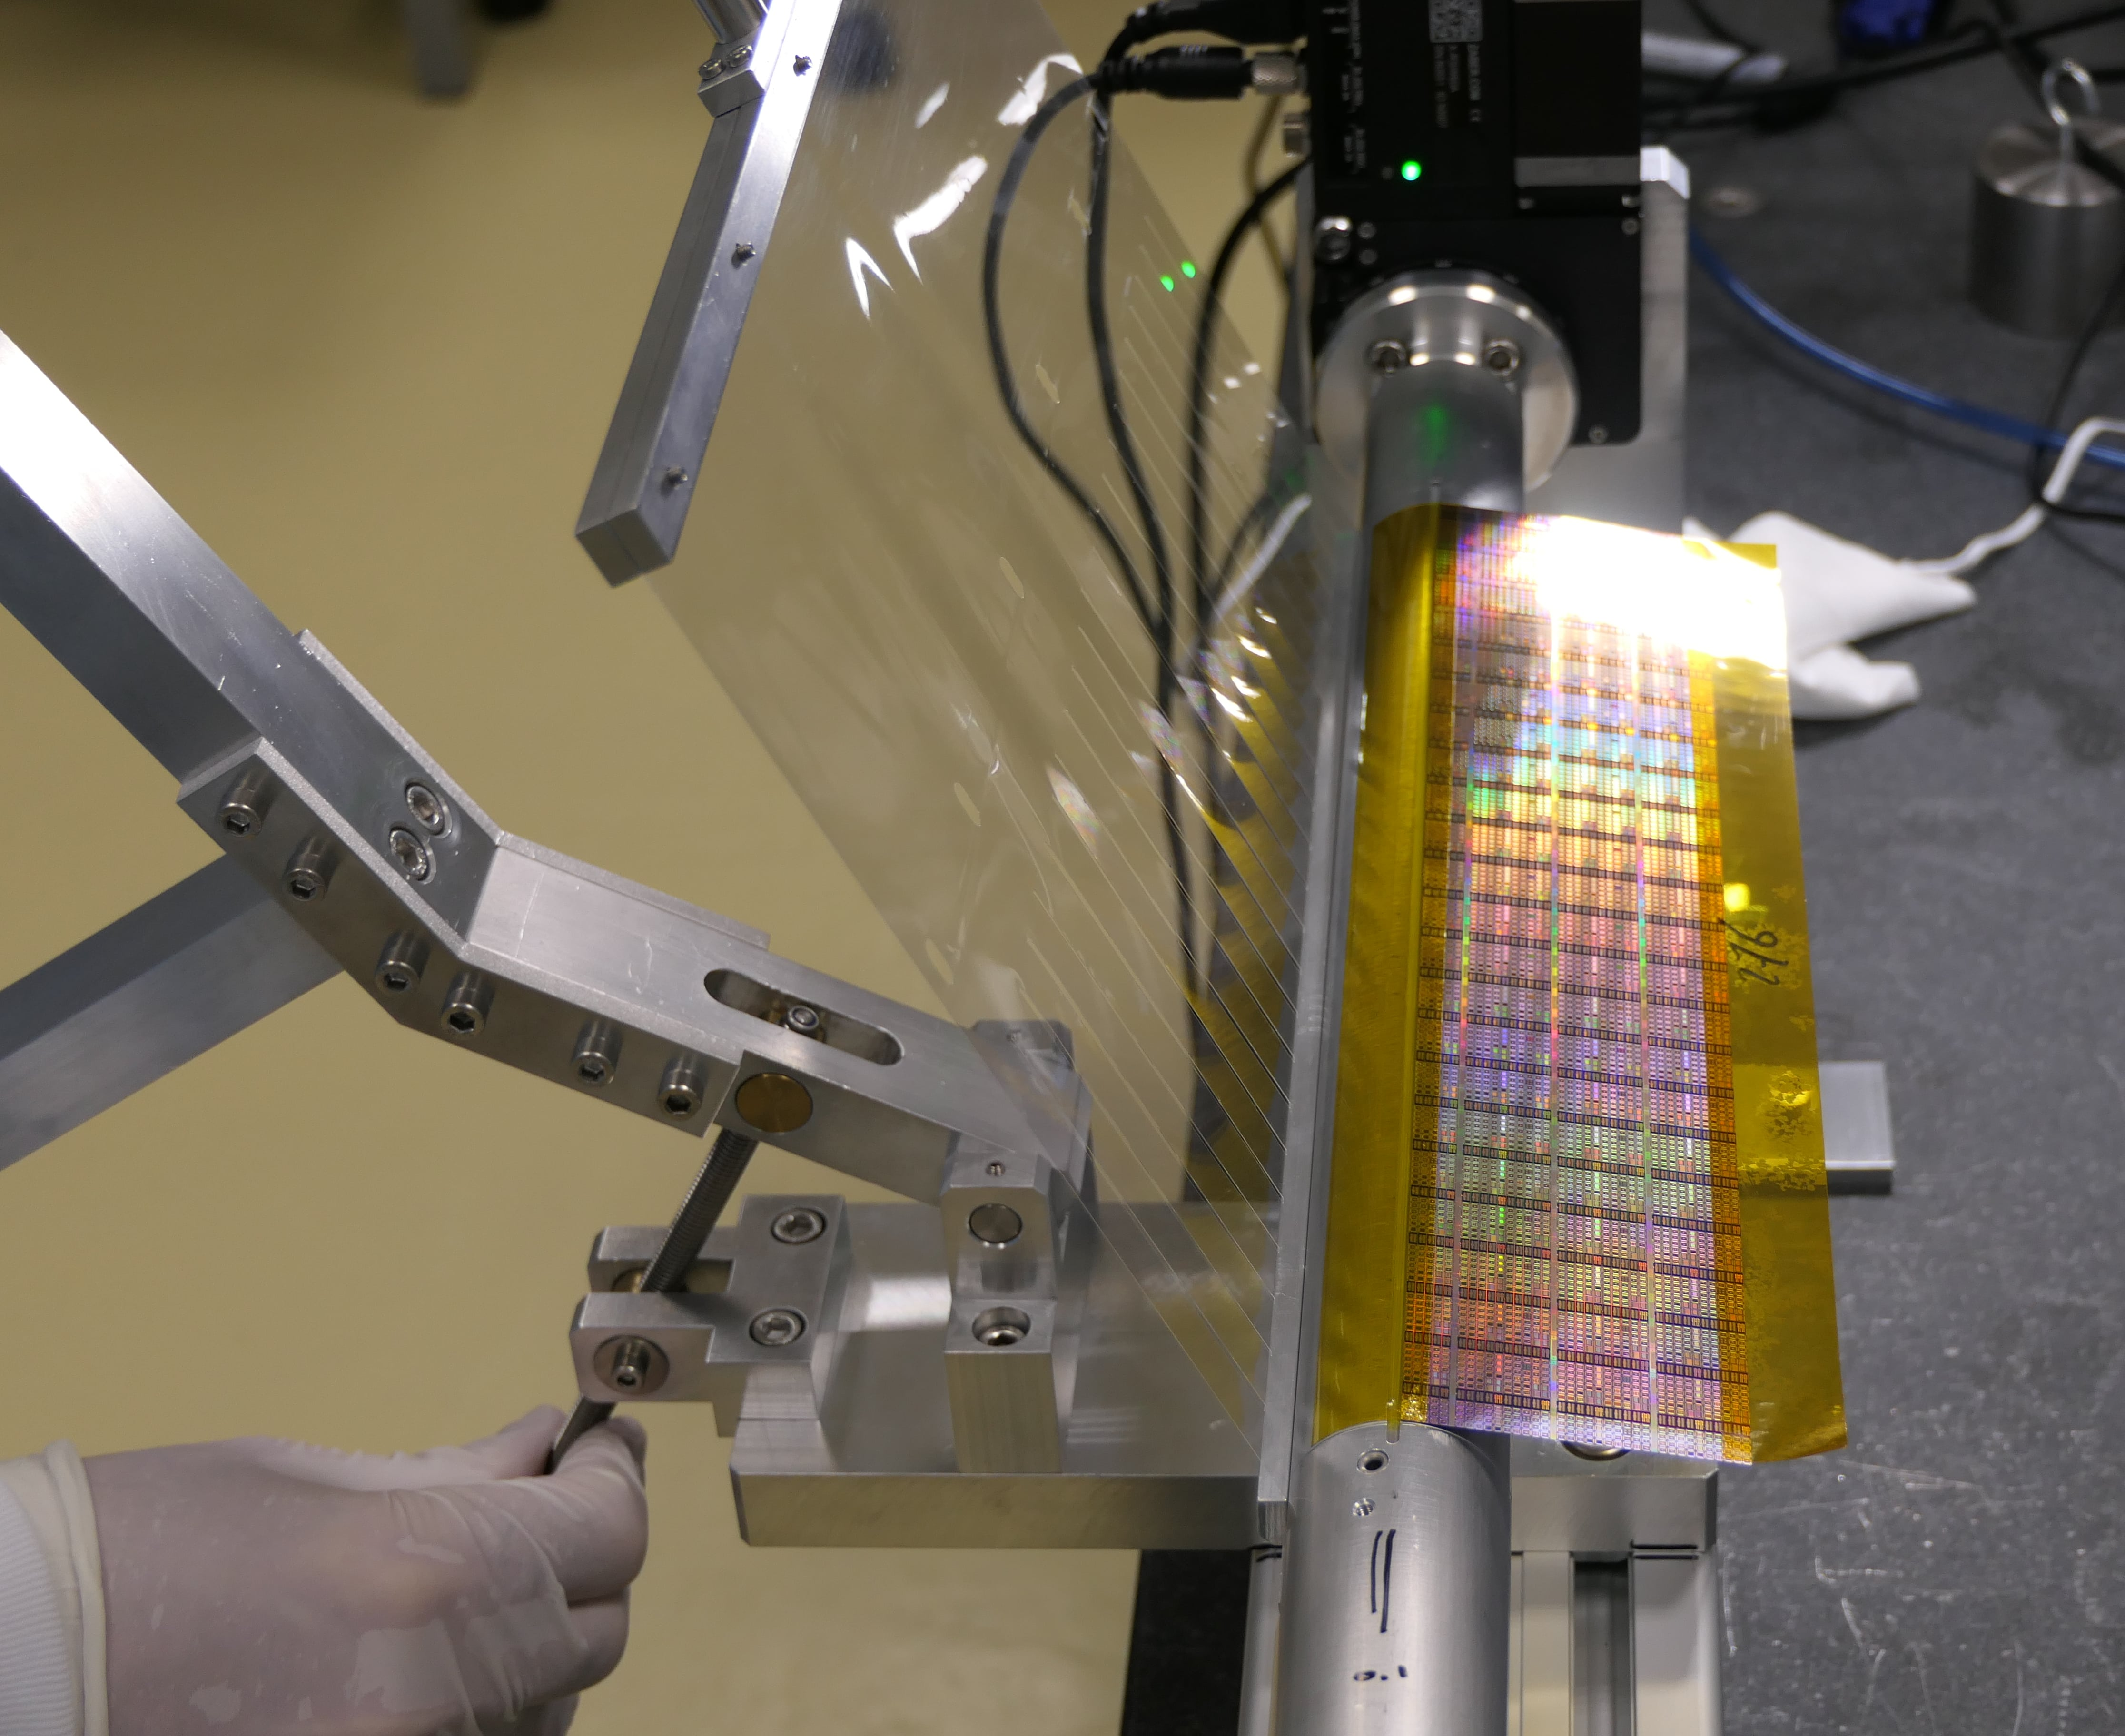
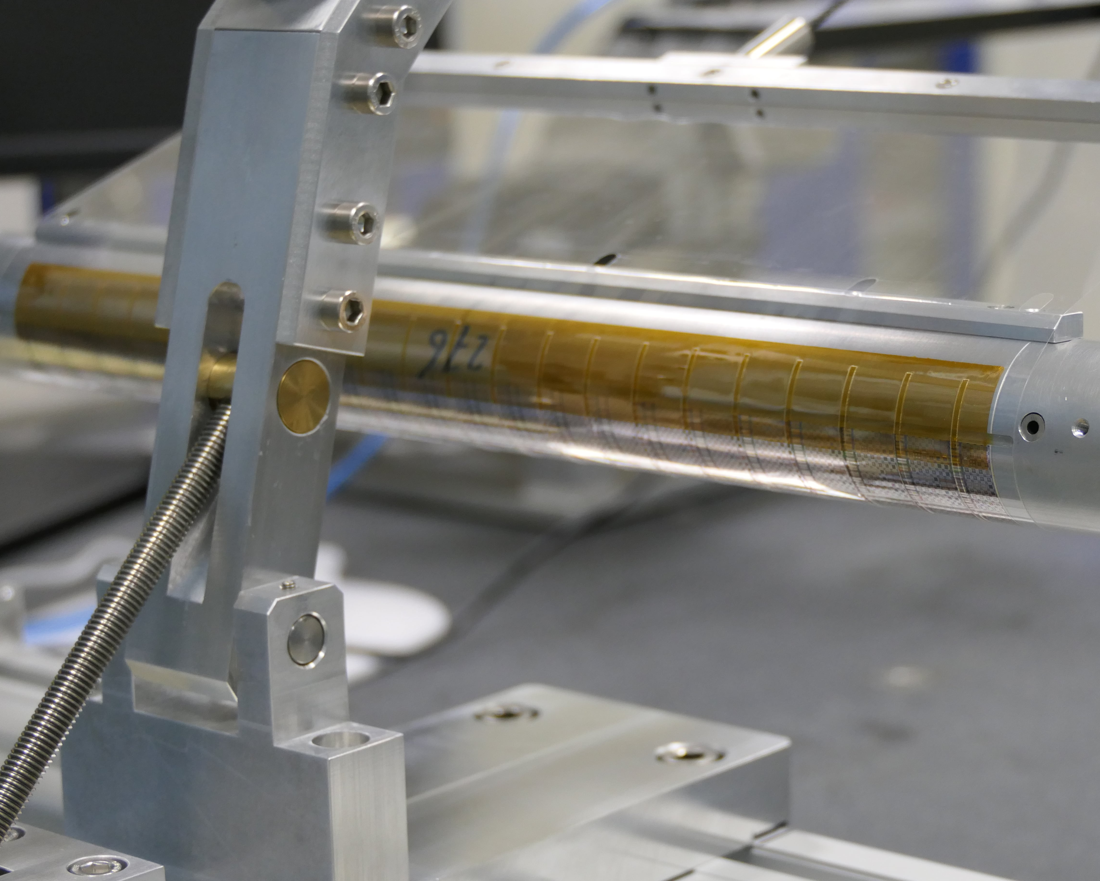
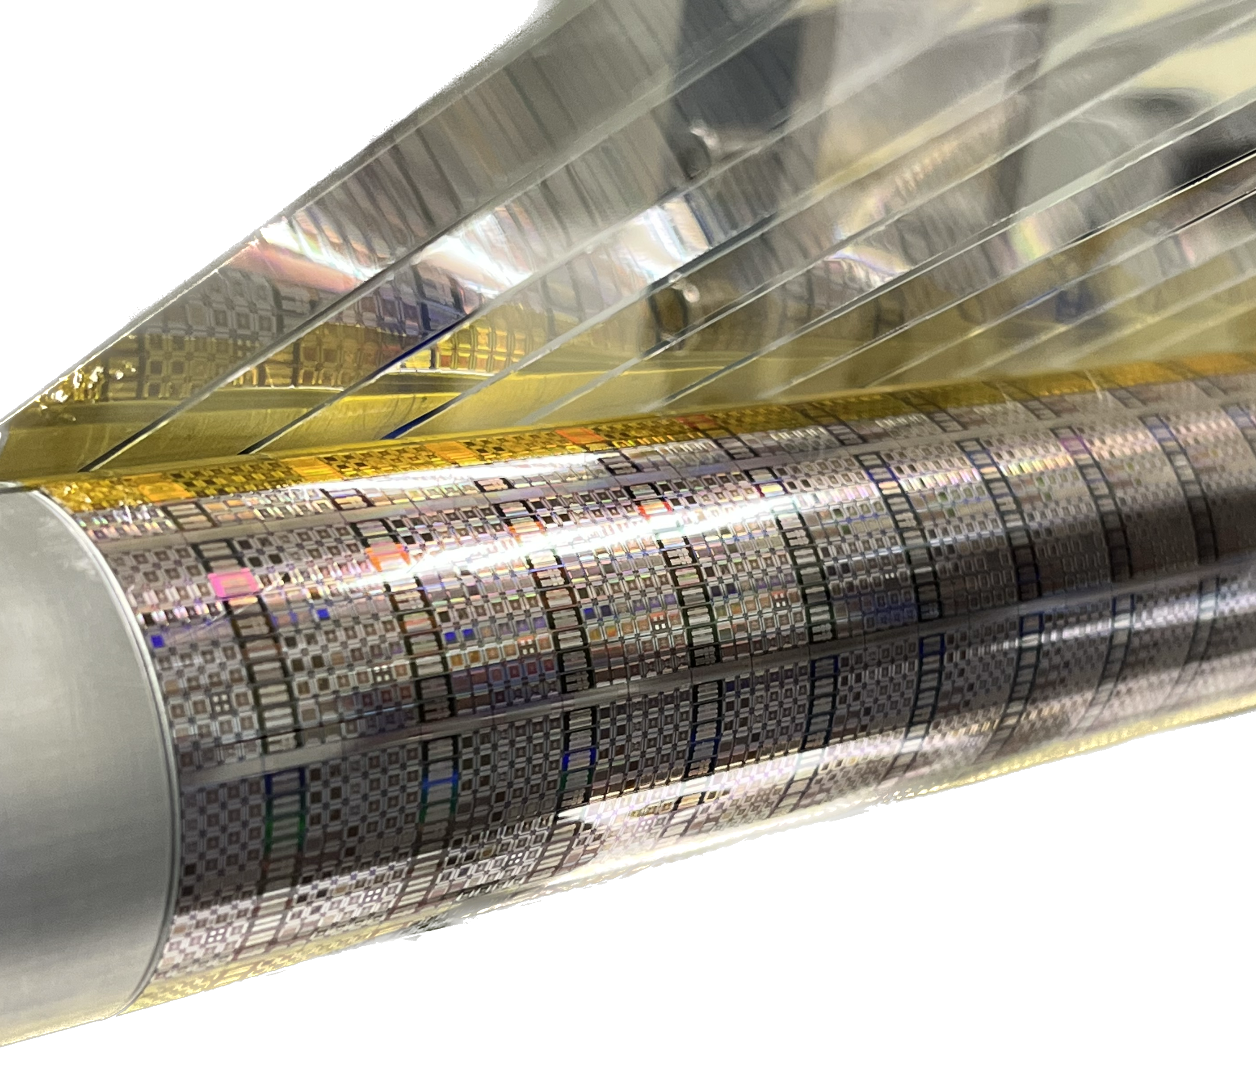
BBM4 bending (11/5/2023 >1 month)
@Pieter, Antoine
Silicon sensor
(electronics side)
Mylar
Vacuum table
Silicon sensor
Vacuum table
Kapton tape
Kapton tape
Mandrel (L0)
Mandrel (L0)
Placement of the sensor in the vacuum table
Alignment with the mandrel
Contact between the kapton tape and the sensor
Mylar
Kapton tapes
Silicon sensor
(electronics side)
Mandrel (L0)
Start of the bending procedure
End of the bending procedure
Removal of the mylar foil

Slide 4
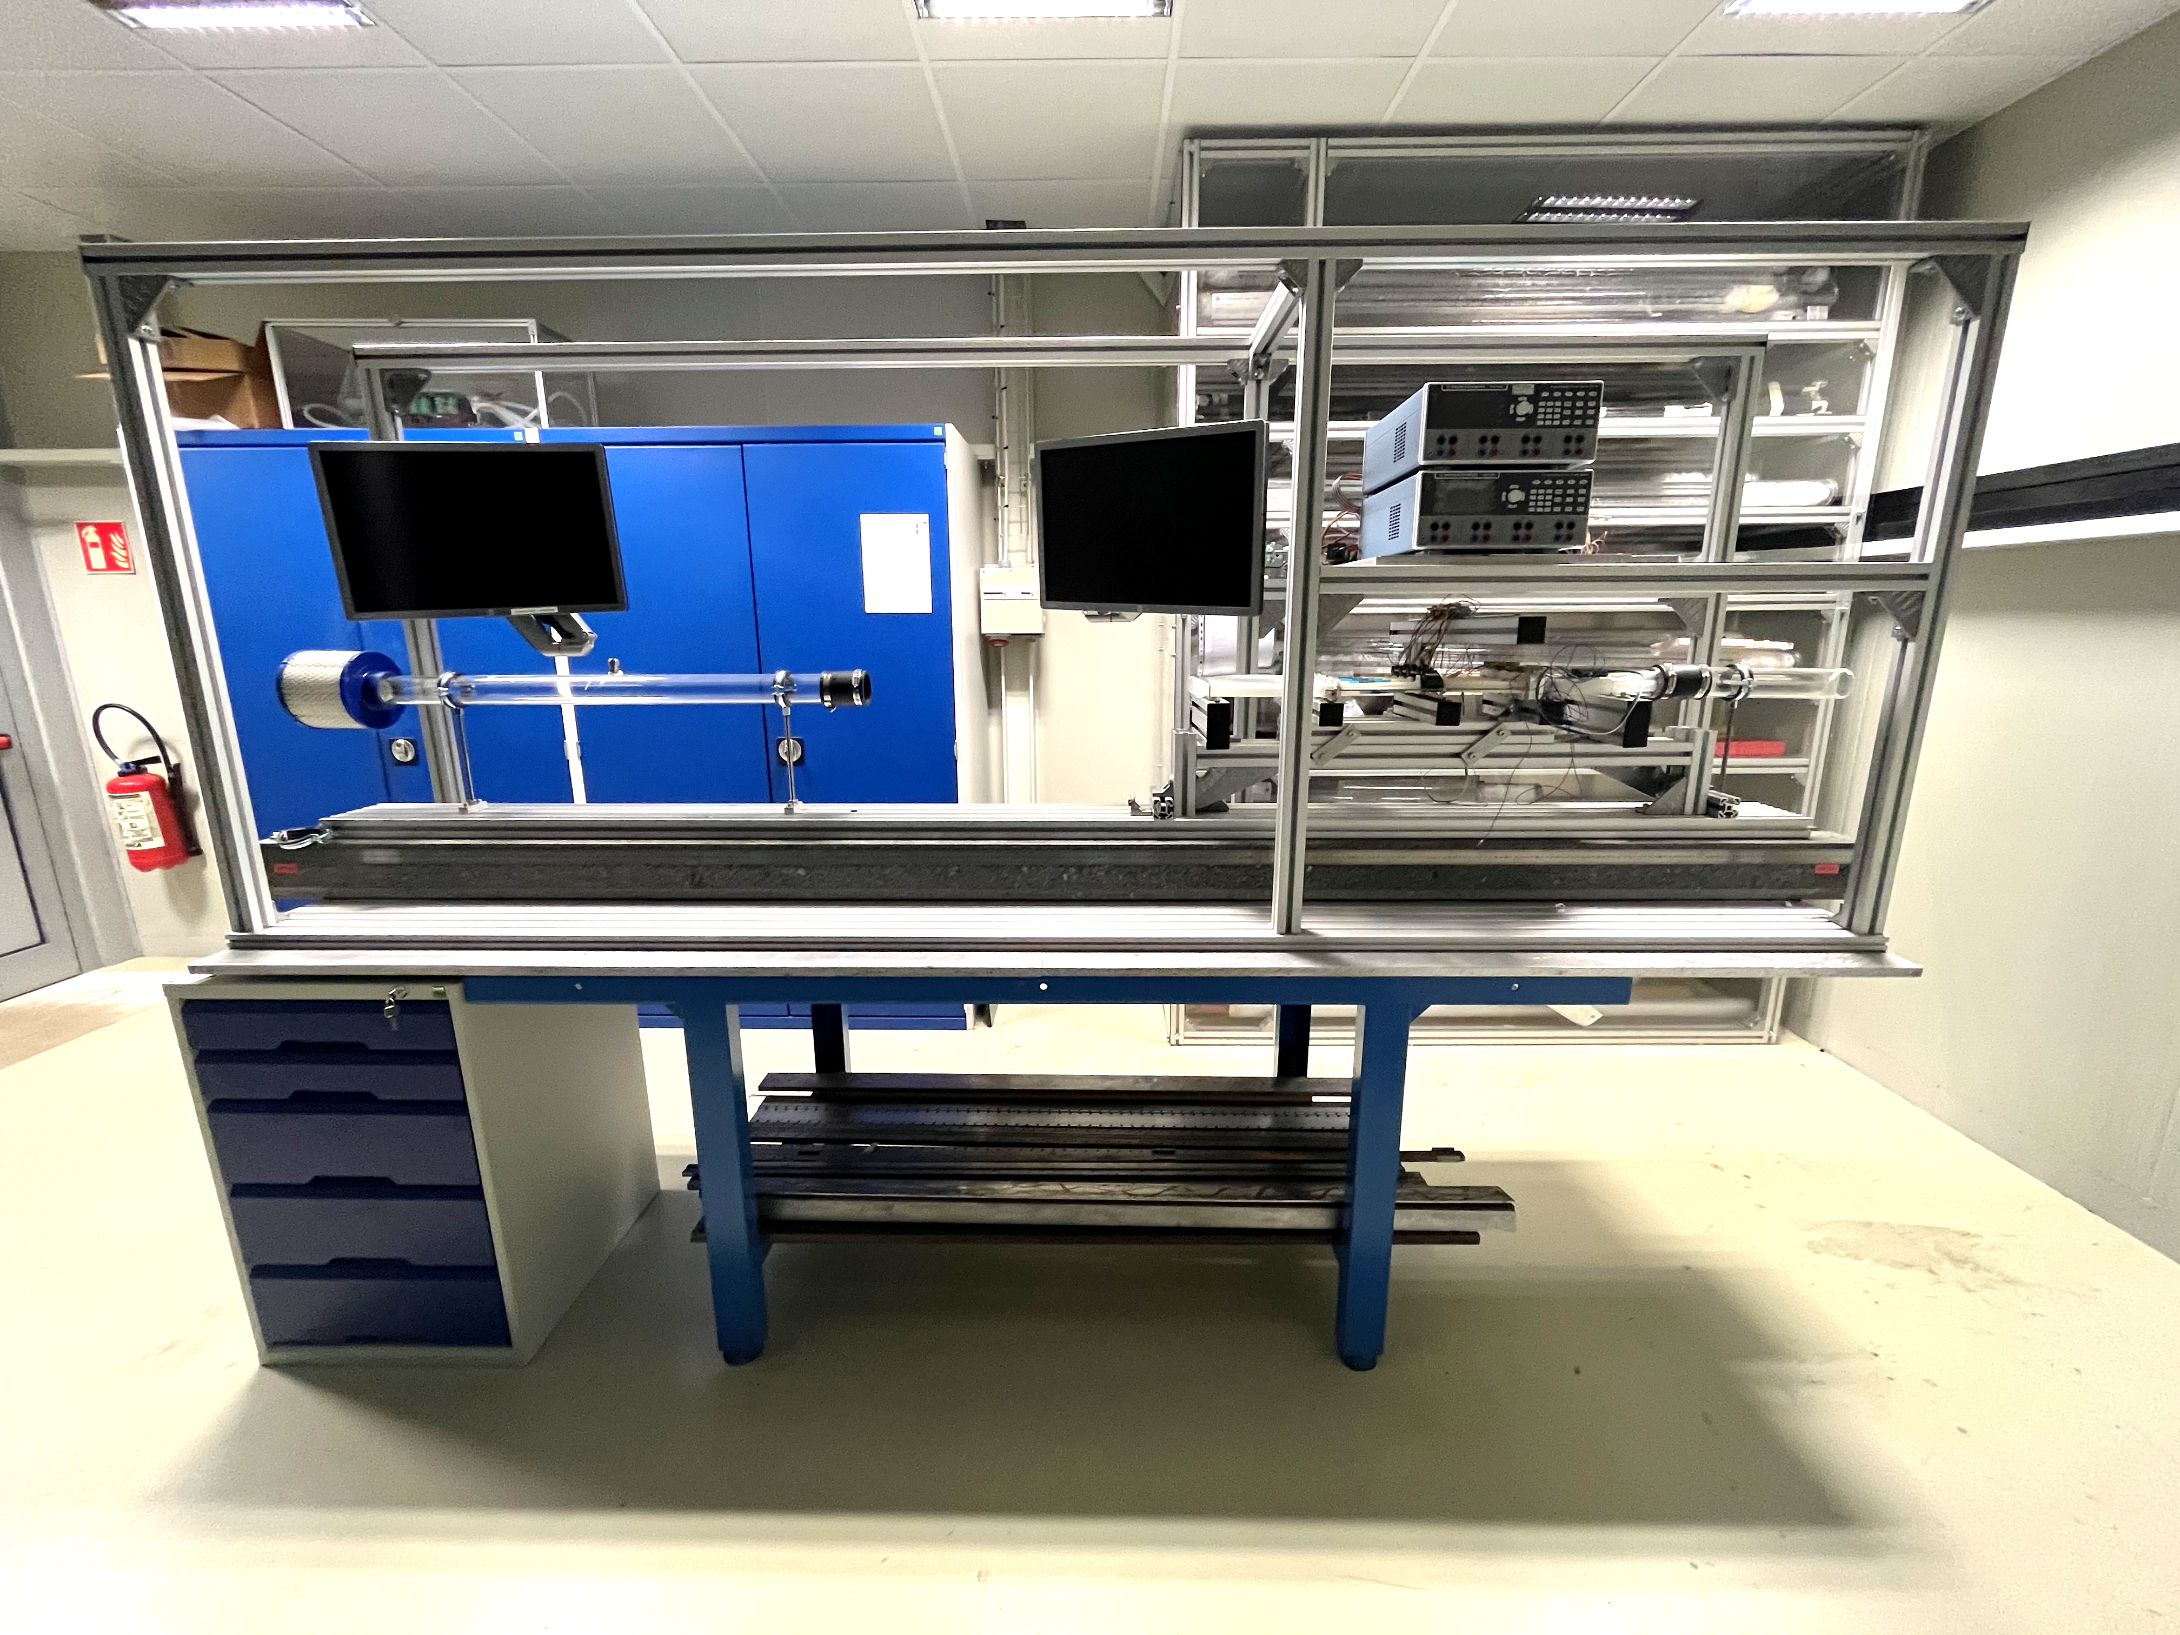
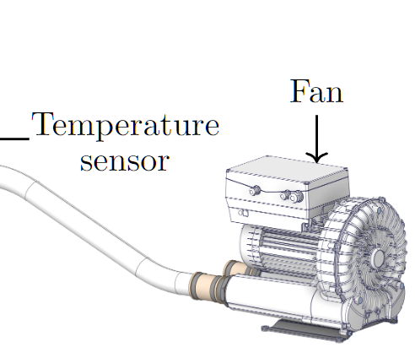
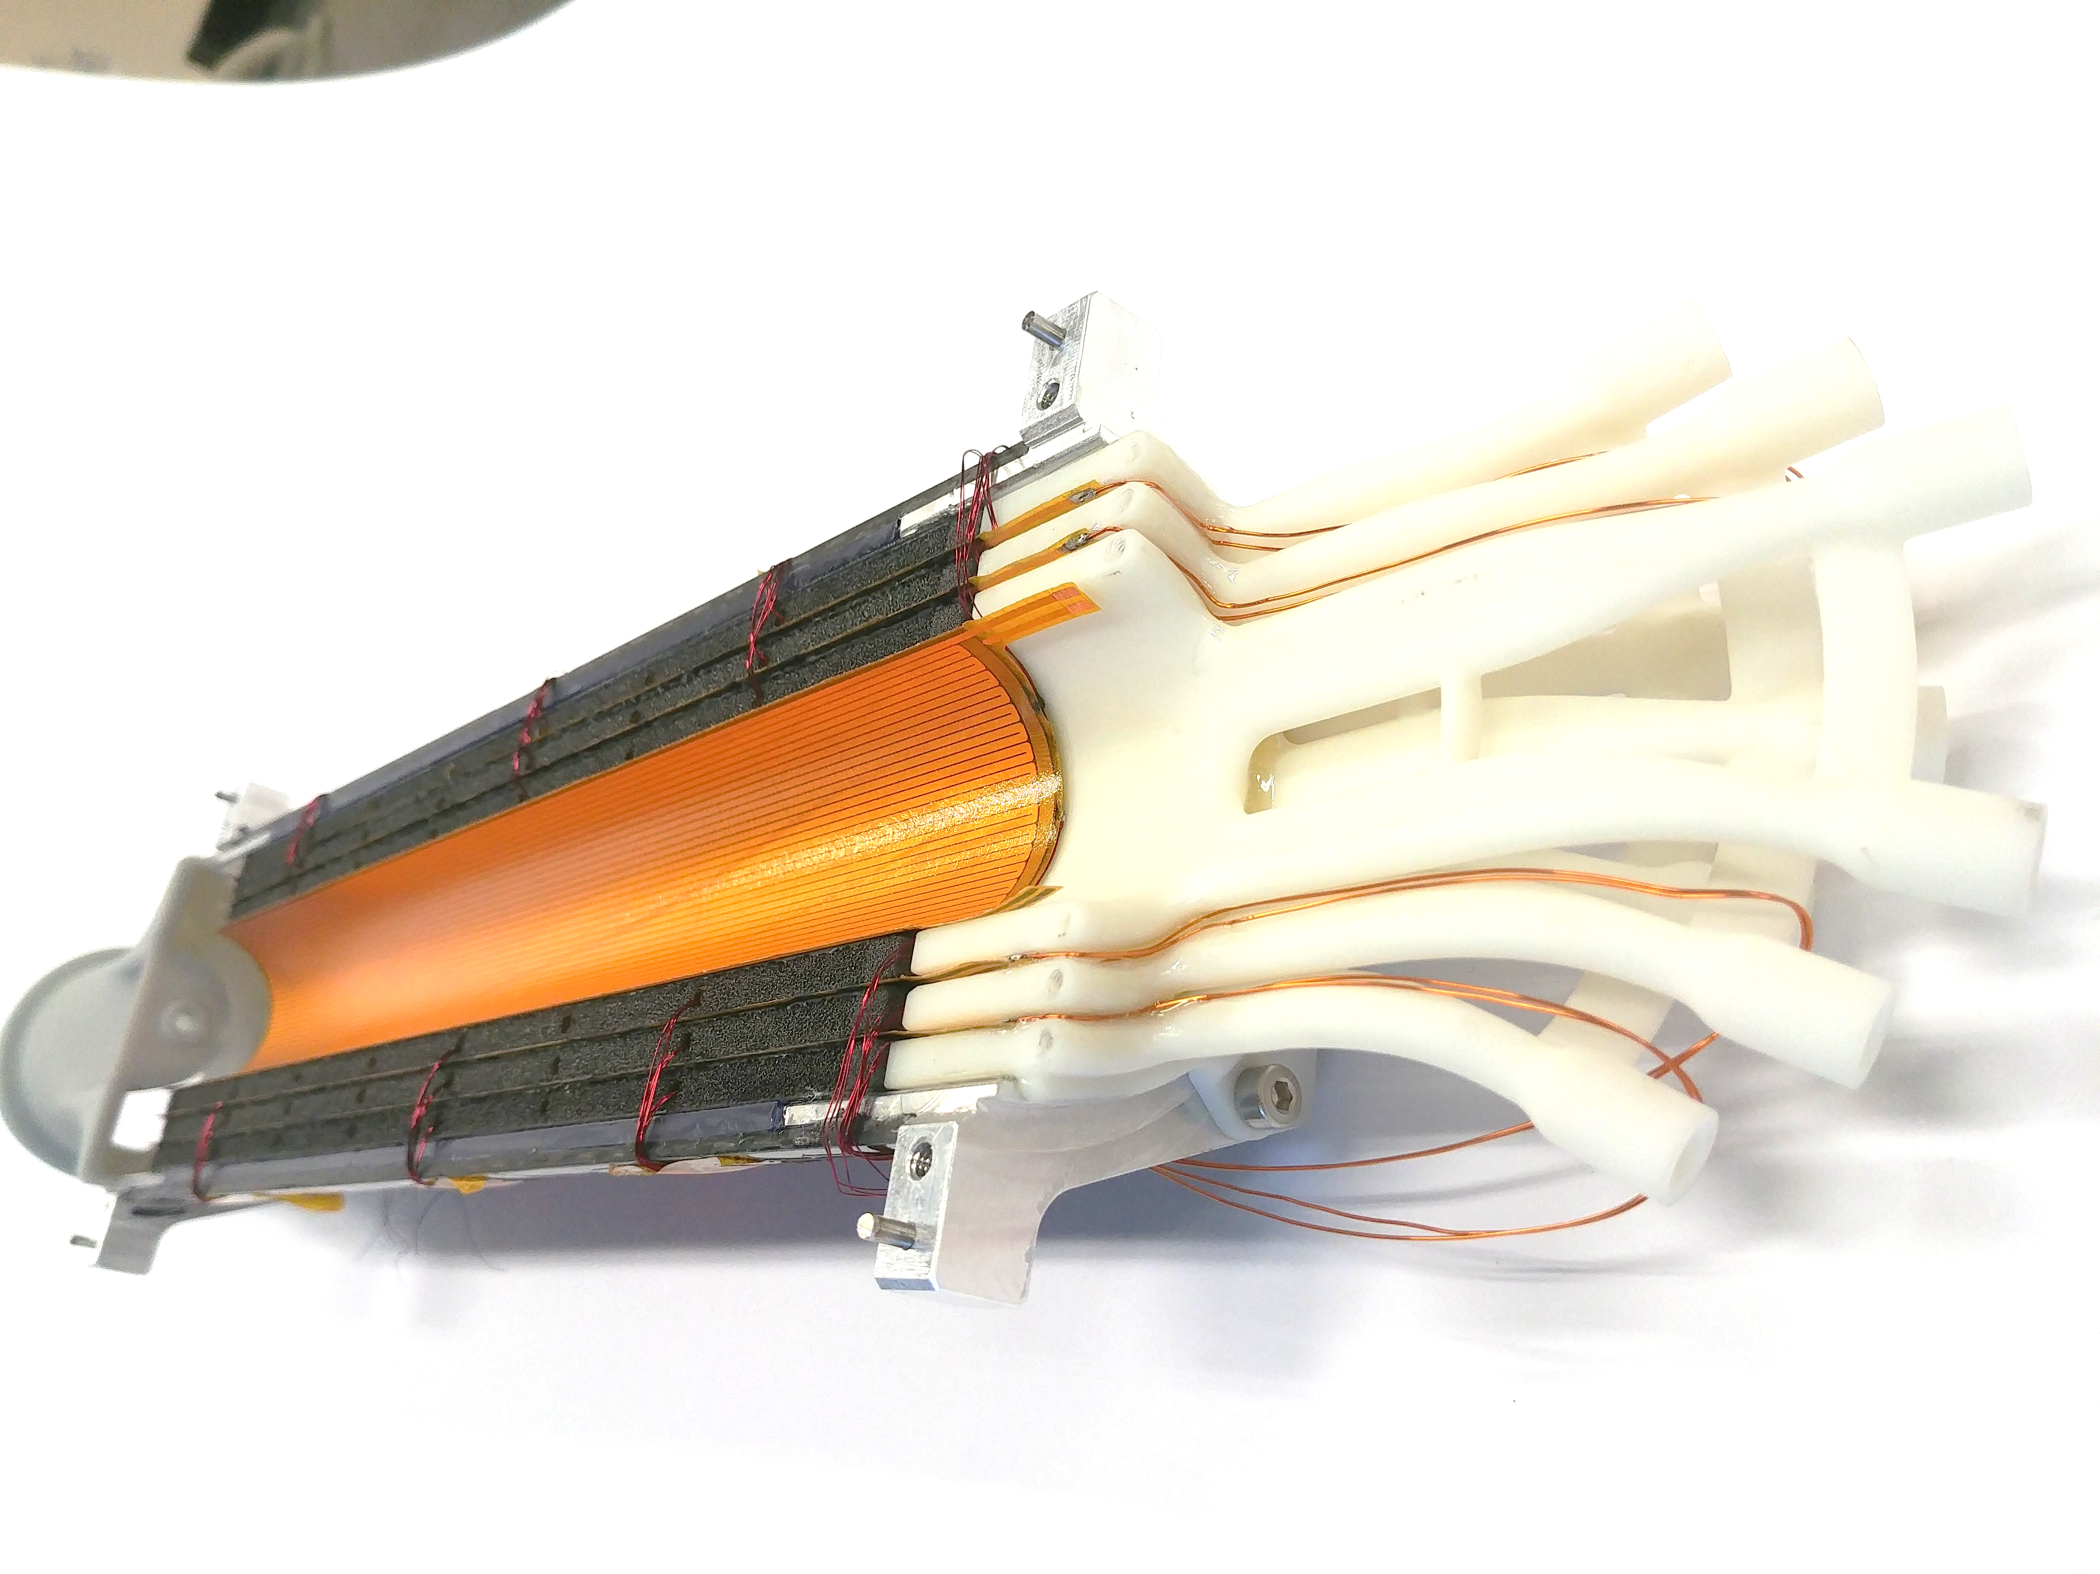
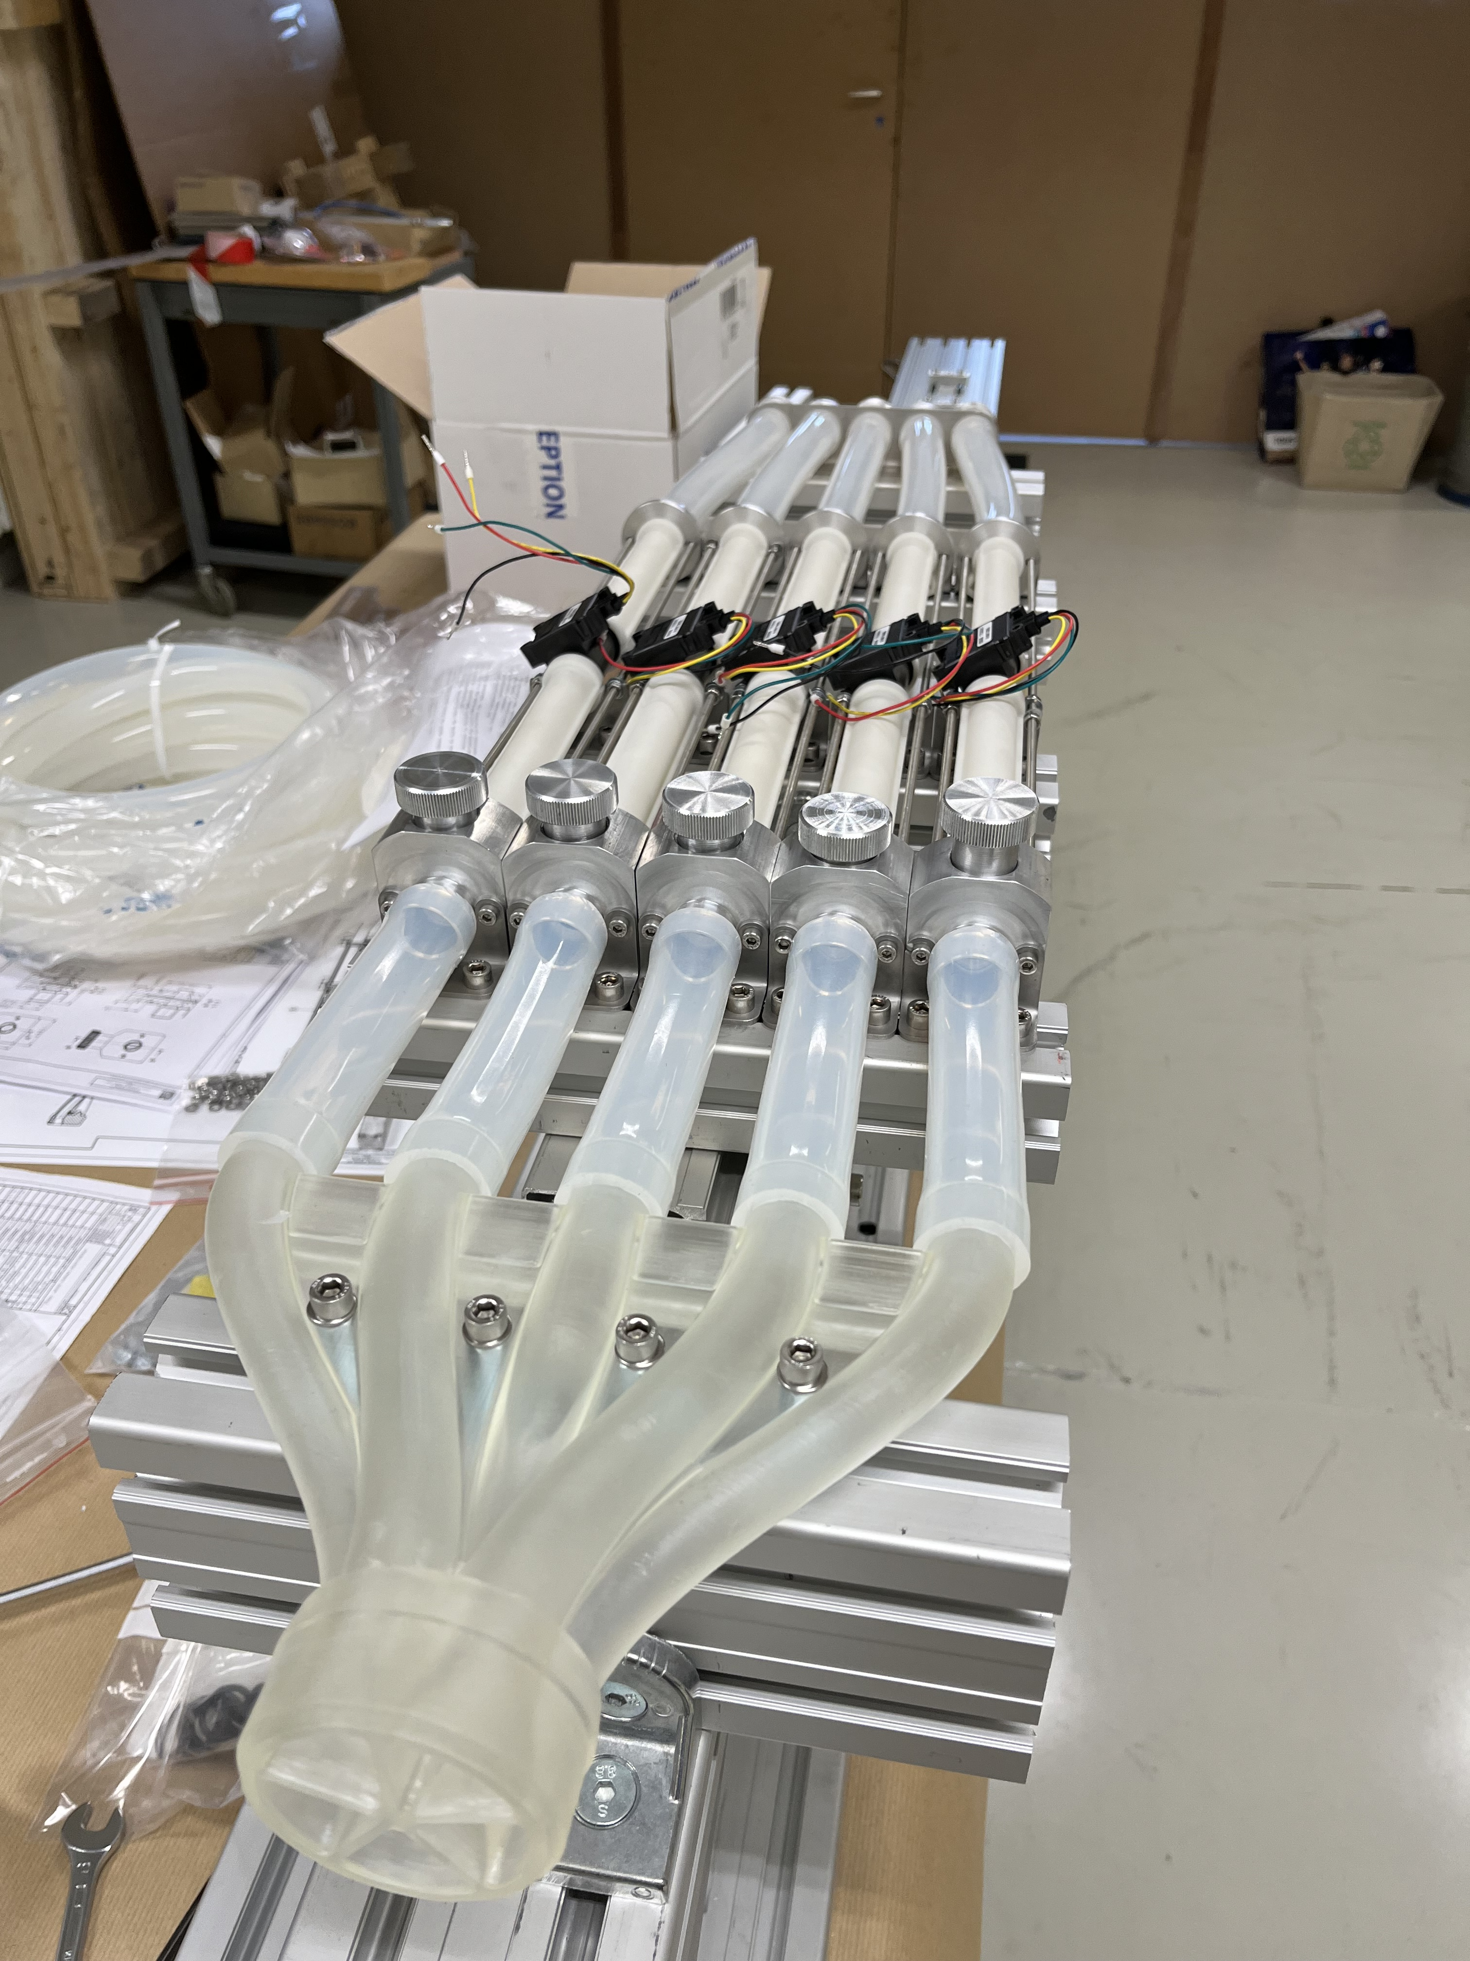
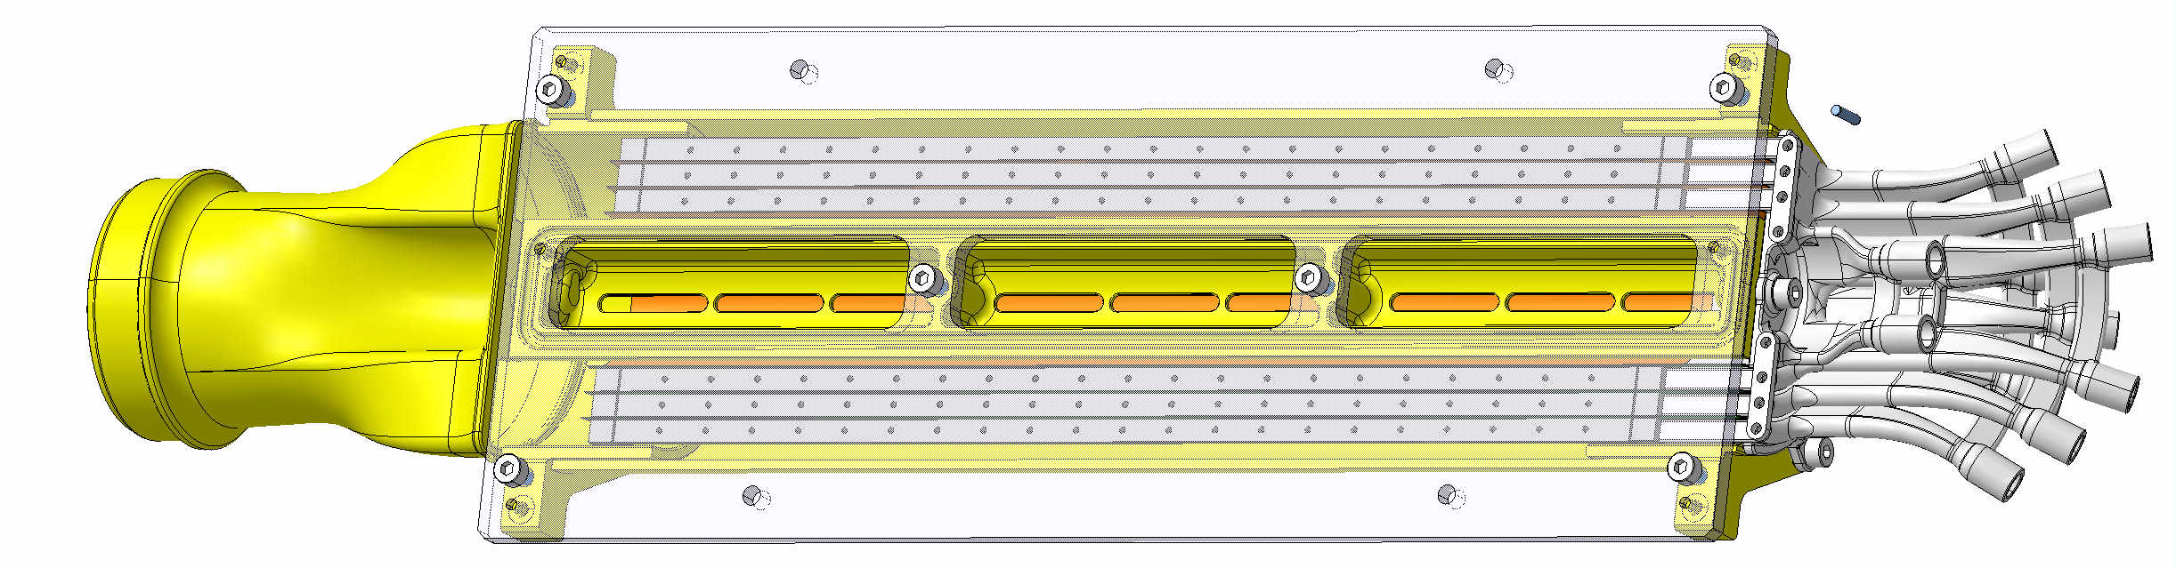
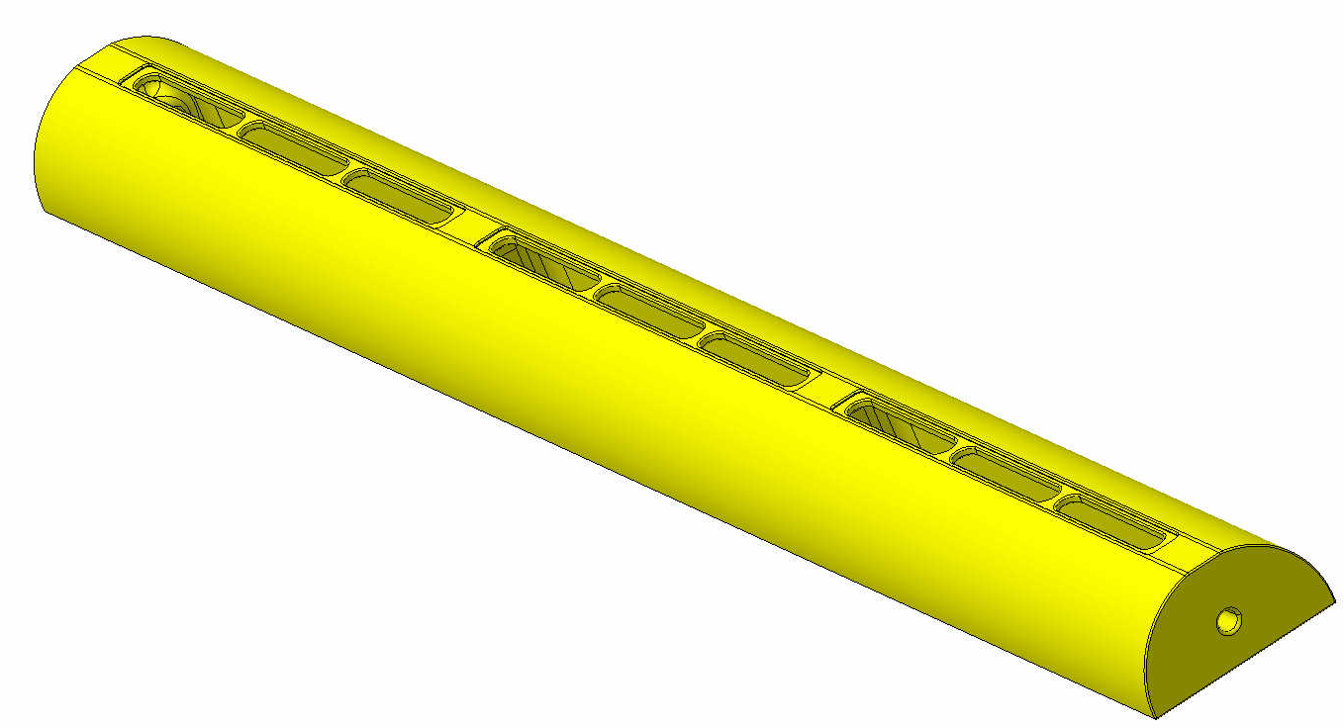
ONGOING and NEXT
Upgrade of the wind-tunnel ongoing
@Philippe, Cedric, Fabio, Pieter
Fan outside the lab
Prototype
Upgrade of BBM3 ongoing
Present airflow control system
Upgrade under consideration:
-new chiller (vortex system)
@Pieter, Antoine
BBM4 assembly NEXT
wire-bonding and mechanics gluing
End of June (DSF closed 19/6 – 28/6)
All assembly parts (almost) ready
BP with window for the
displacement sensor,
For vibration measuring of layer0
Upgrade under consideration:
-new valves, air flow and pressure sensors

