Slide 1
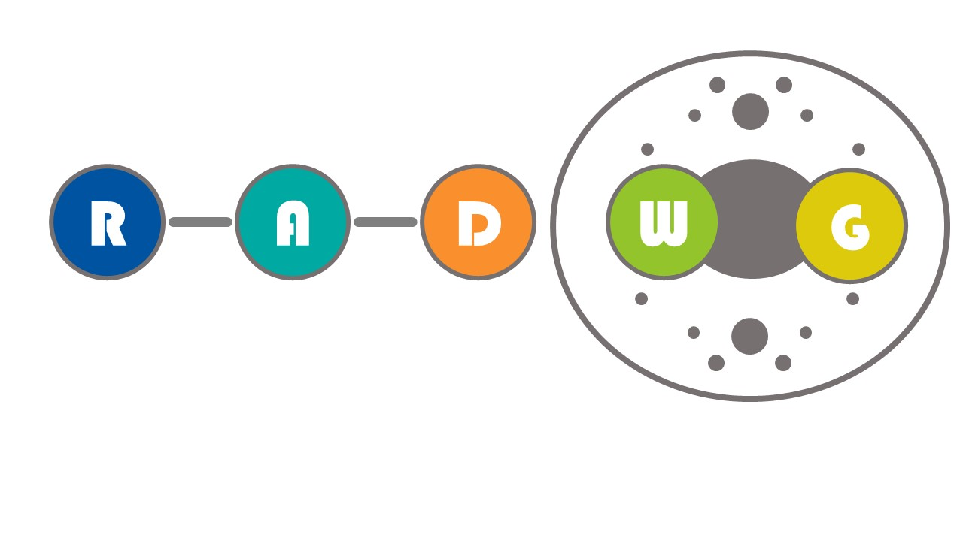
RADWG Workshop (15/06/23)
Salvatore Danzeca BE-CEM-EPR
Manoel Barros Marin SY-BI-BP
on behalf of the RADWG

Slide 2
AGENDA
Introduction
Activities Overview by Rudy Ferraro
MCWG activities and recap for the HL-LHC levels (Giuseppe Lerner, SY-STI)
Status and News about IRRAD, CHARM and CC60 (Federico Ravotti et al., BE-CEM & EP-DT)
CERN Radiation-Hardened ASIC Power Devices (Stefano Michelis, EP-ESE)
Last results on Voltage Regulator & DCDC Converters (Rudy Ferraro, BE-CEM)
Status of Vacuum Radiation Tolerant Systems (Sara M. Goncalves Soares, TE-VSC)
Open Questions

Slide 3
Common order for radiation tolerant DC/DC converters
  bPOL12 end of life expected soon… See Stefano’s presentation
  RADWG organising a common order
  Input from equipment groups required
      Number of pieces required
      Modules vs Chip on board
      Etc.
  Further discussion needed

Slide 4
THANK YOU

