Slide 1
RADWG Activities Overview
Rudy Ferraro (BE-CEM-EPR)
RadWG Workshop – 15th June, 2023

Slide 2
Radiation Test Service
BE-CEM-EPR provides, the service of radiation testing of electronic components supporting the Radiation Working Group (RadWG)
The RadWG supports the accelerator sector equipment groups for the assessment of radiation tolerance of electronic equipment to be installed in radiation exposed areas.
It is as a forum for electronic engineers to discuss
design practices
radiation tests
radiation induced failures in the accelerators.
The RadWG is one of the pillars of the CERN Radiation Hardness Assurance process
RADWG Activities Overview by R. Ferraro (BE-CEM-EPR )

Slide 3
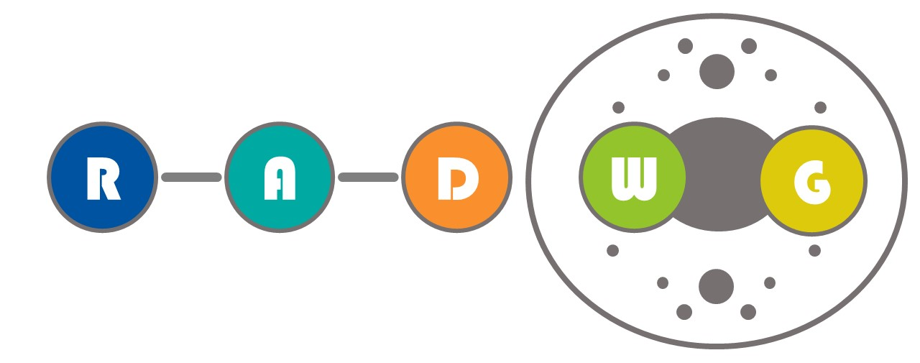

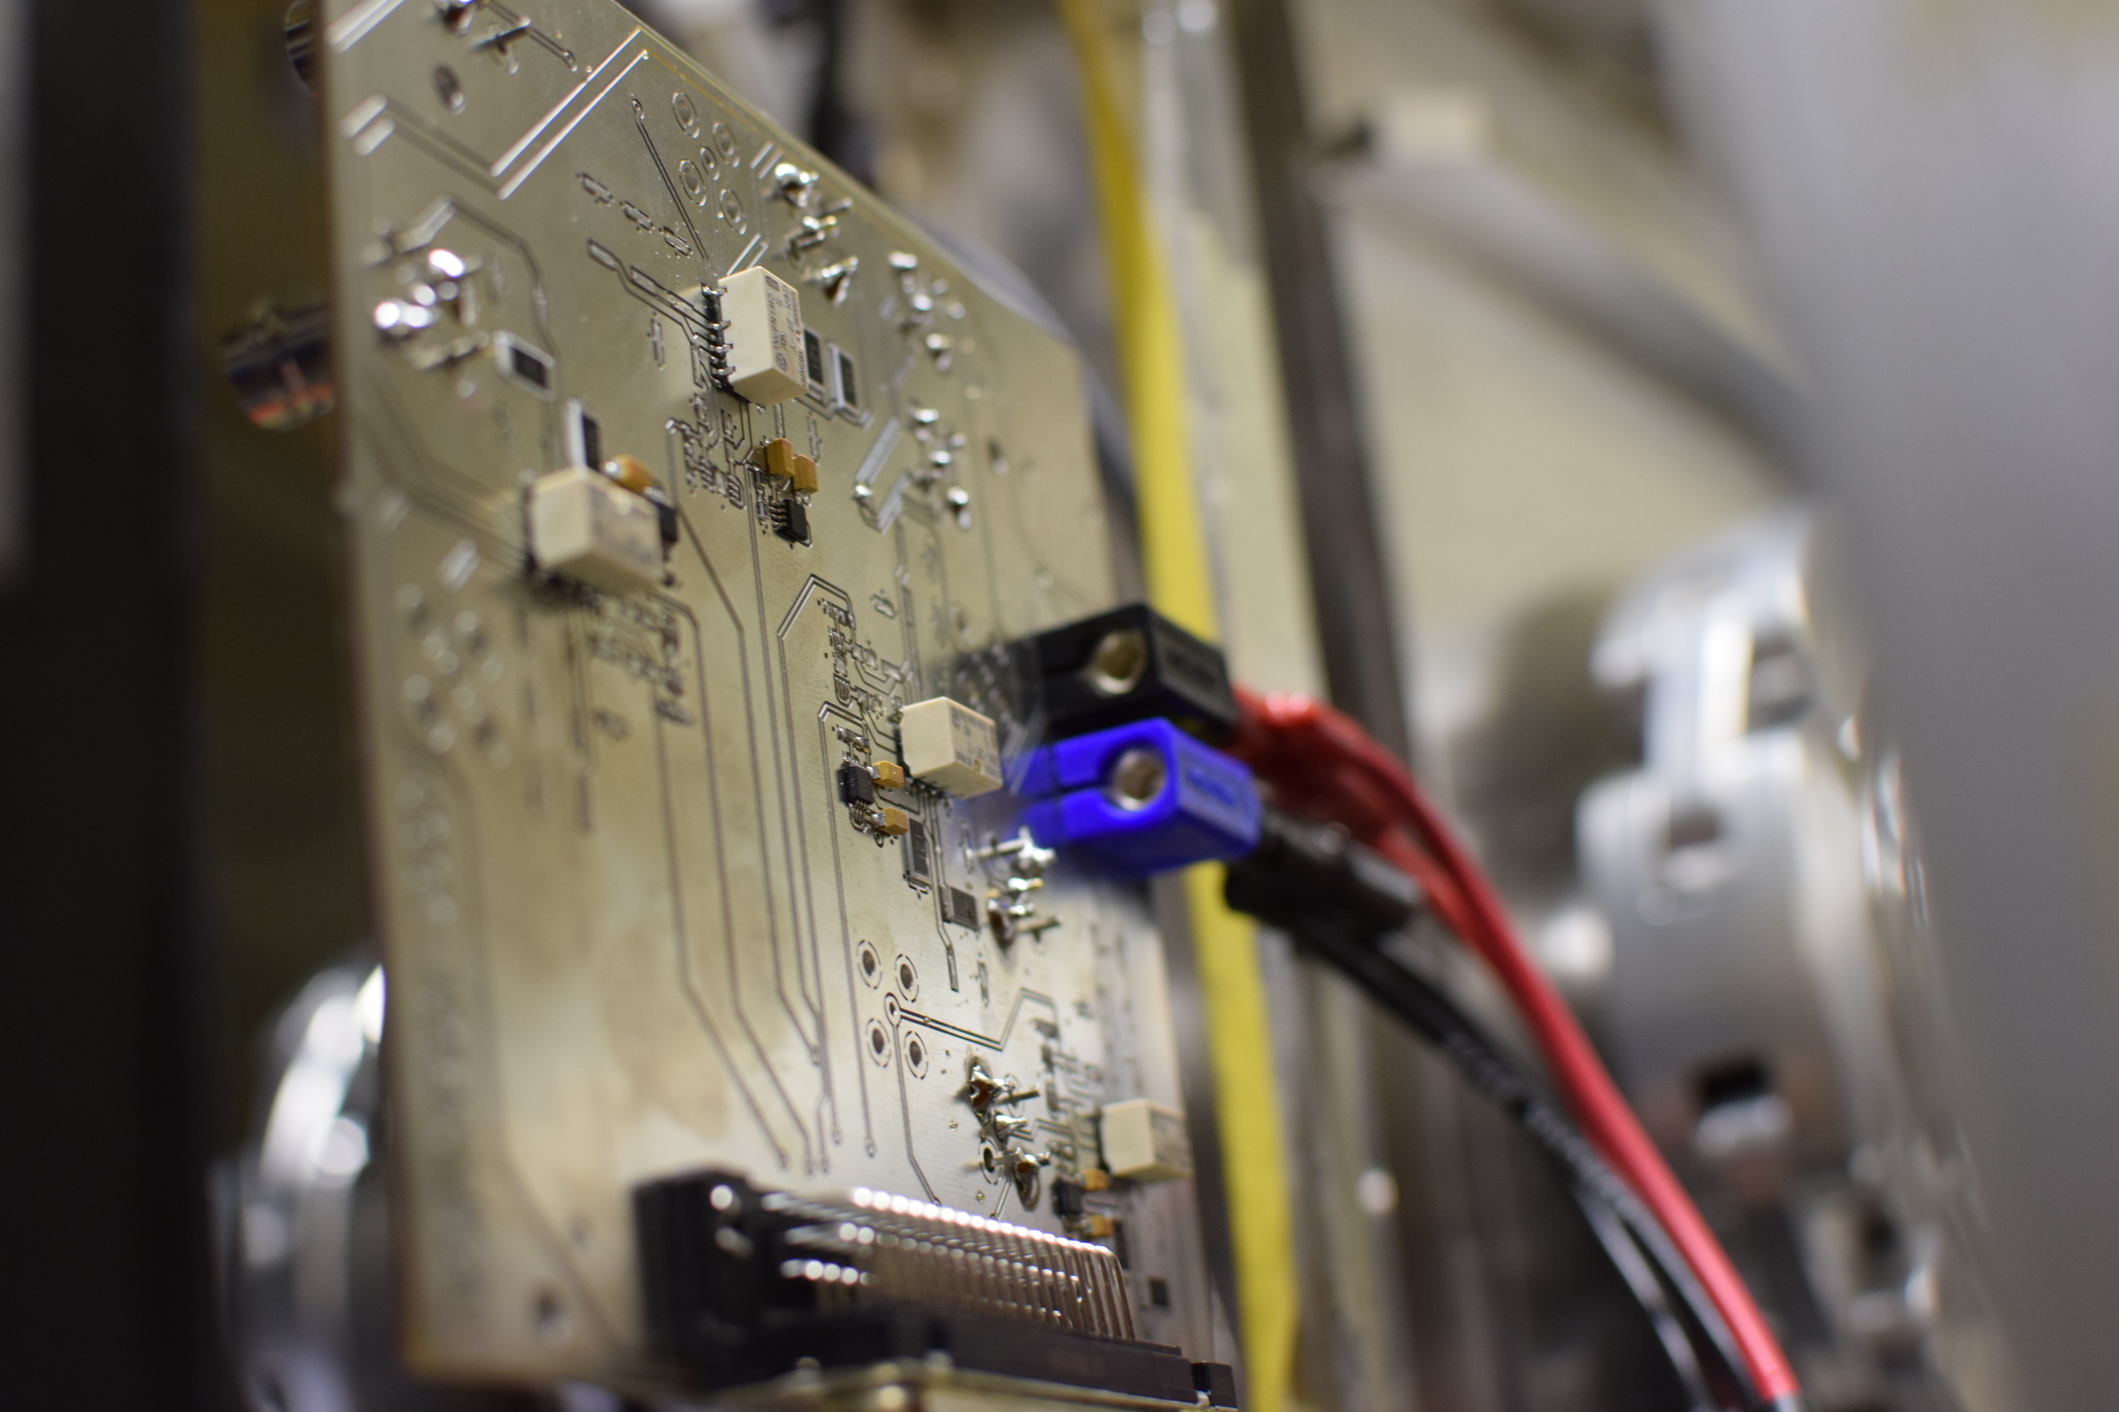
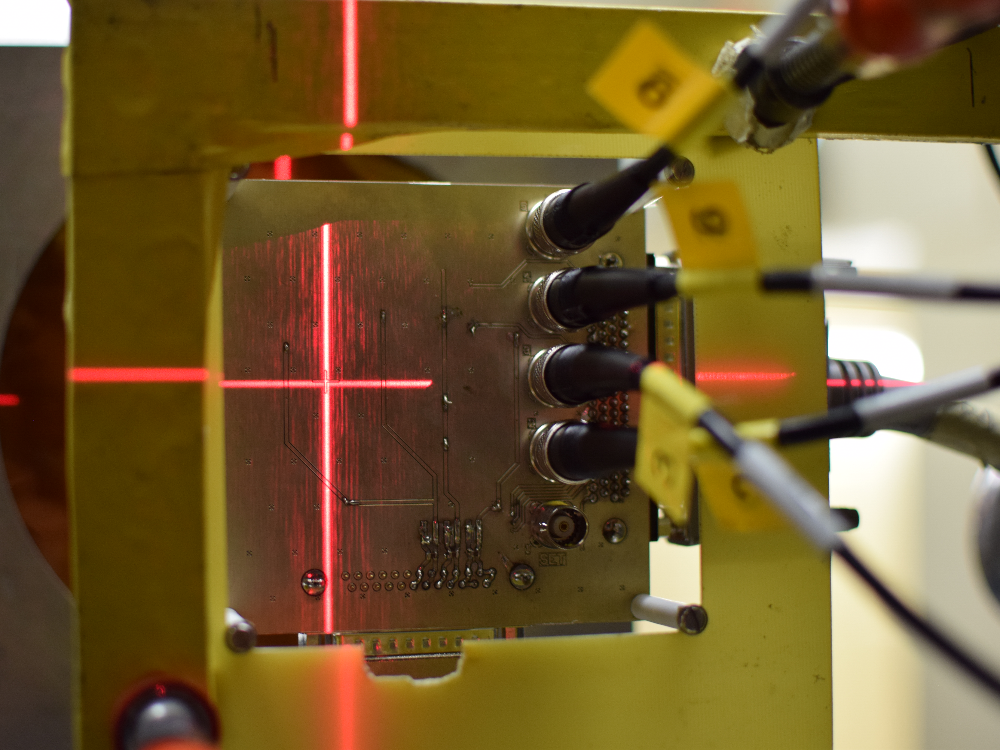
Radiation test service – BE-CEM-EPR
Request collection
The requests for radiation testing are collected and processed selecting the most suitable methodology and facilities
Database and Publication
The results are collected, stored and in EDMS and published in the RADWG database to allow an easy research of the best candidates for the new radiation tolerant designs
01
Test planning and structure
06
02
Each component/system is analyzed, and all the possible radiation effects are taken into account for planning the test and structure it
Result analysis
The results are analyzed during and after the tests for each component considering the end application and the possible operational issues
Board and instrumentation preparation
05
03
For each component a dedicated set of test board is prepared and the associated instrumentation is chosen to face the complexity of the radiation test
04
Testing
The test are carried out at CERN facilities such as CHARM or Co60 and in external facilities. The transport, personnel and instrumentation are selected considering the peculiar aspect of each facility
RADWG Activities Overview by R. Ferraro (BE-CEM-EPR )

Slide 4
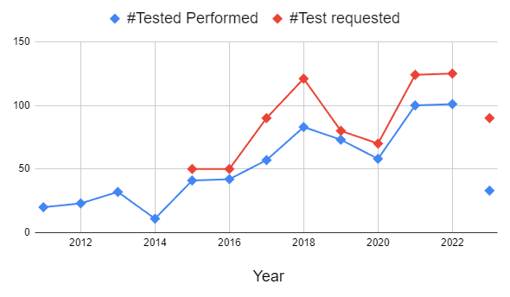
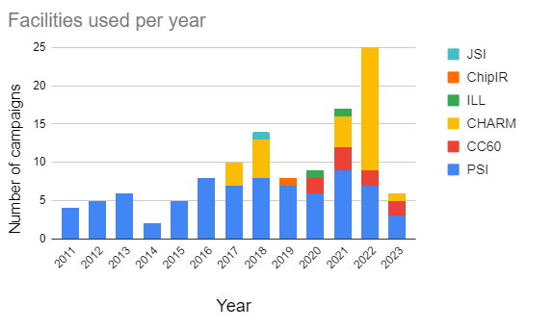
2023 In Number
90 component test request for 2023 (so far)
31 components tested (so far)
5 Radiation campaigns done (3*PSI, 2*CC60)
Compare to previous year we are in the high range of components tested per month
5 more PSI campaigns are planned, together with regular CHARM tests
We will probably test more components this year than the previous years
RADWG Activities Overview by R. Ferraro (BE-CEM-EPR )

Slide 5
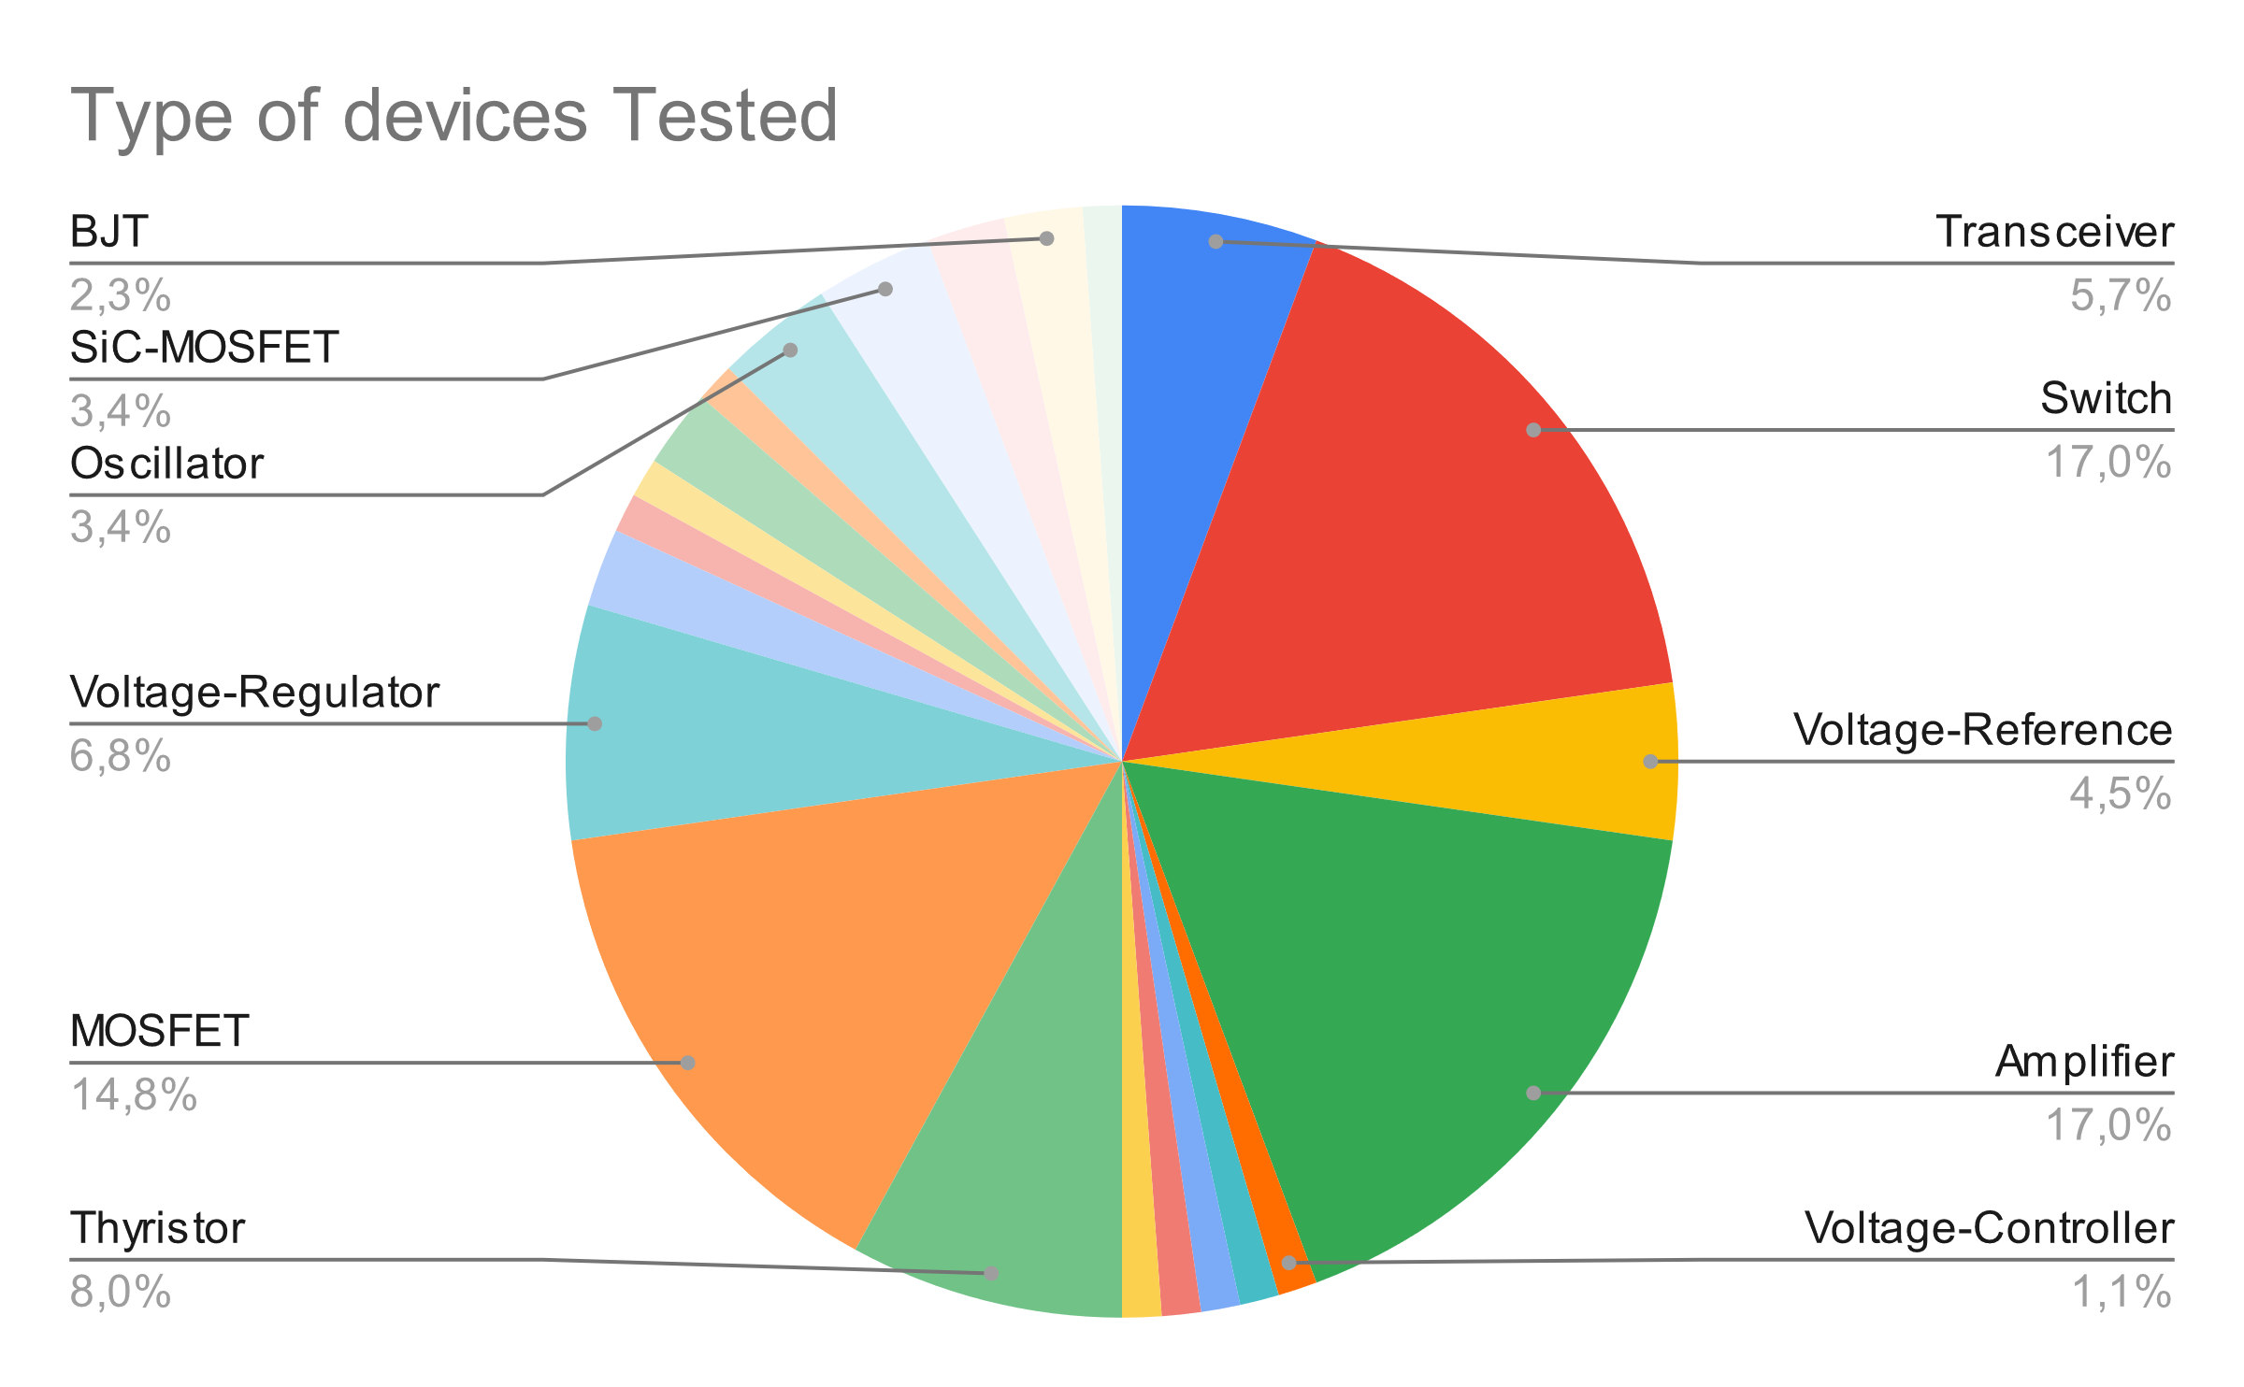
Test Service Status: Requests per type
Total requests: 90 [not only references but also #lots]
RADWG Activities Overview by R. Ferraro (BE-CEM-EPR )

Slide 6
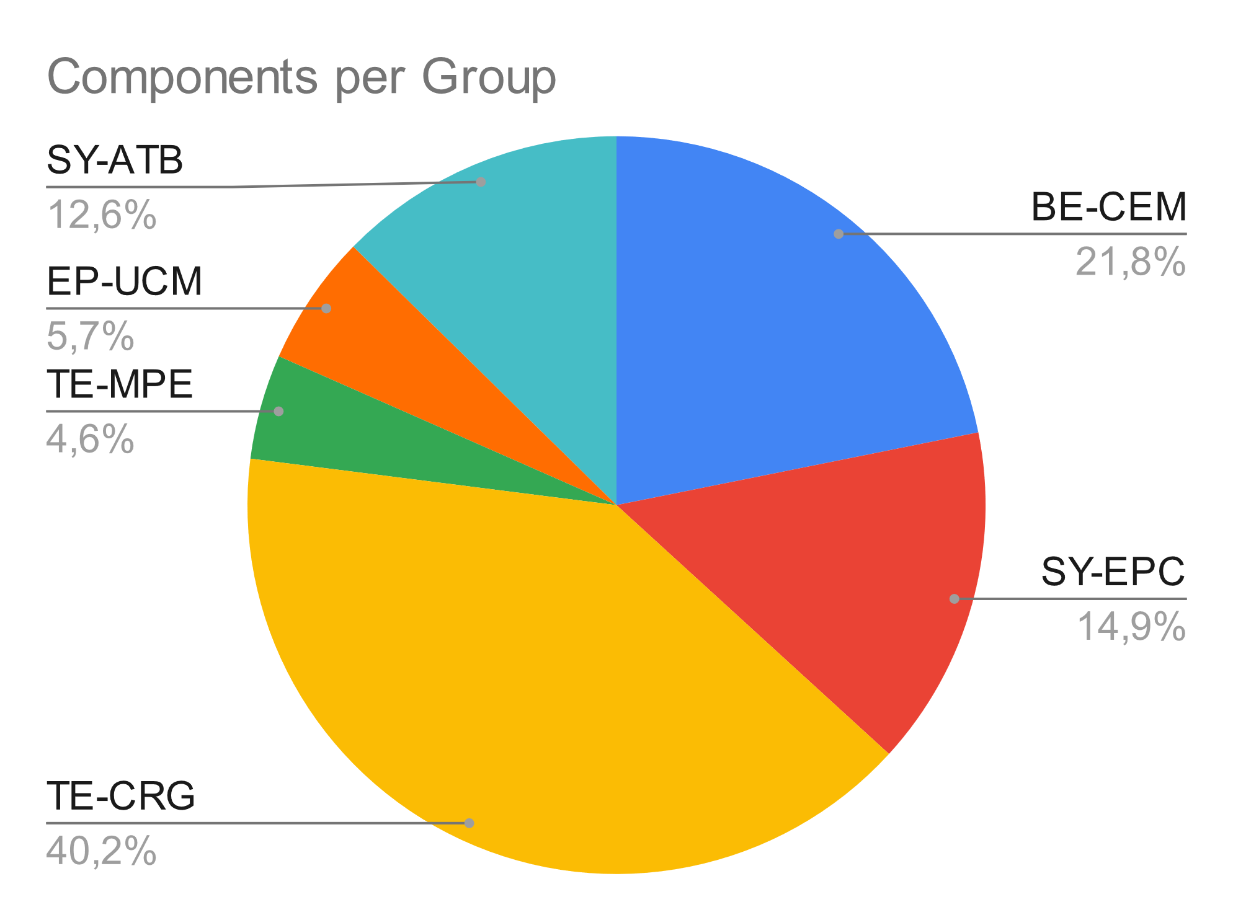
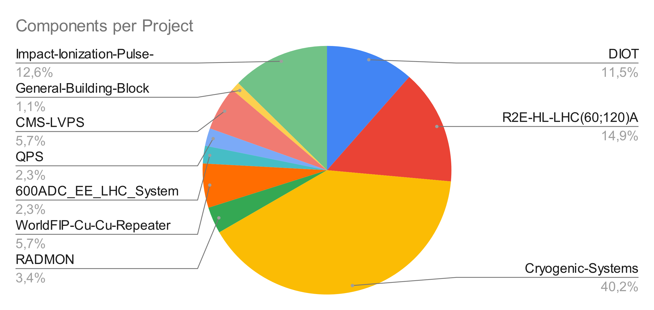
Test Service Status: Requests per group/project
*Cryogenic Systems components are few part references but a lot of different lots
RADWG Activities Overview by R. Ferraro (BE-CEM-EPR )

Slide 7
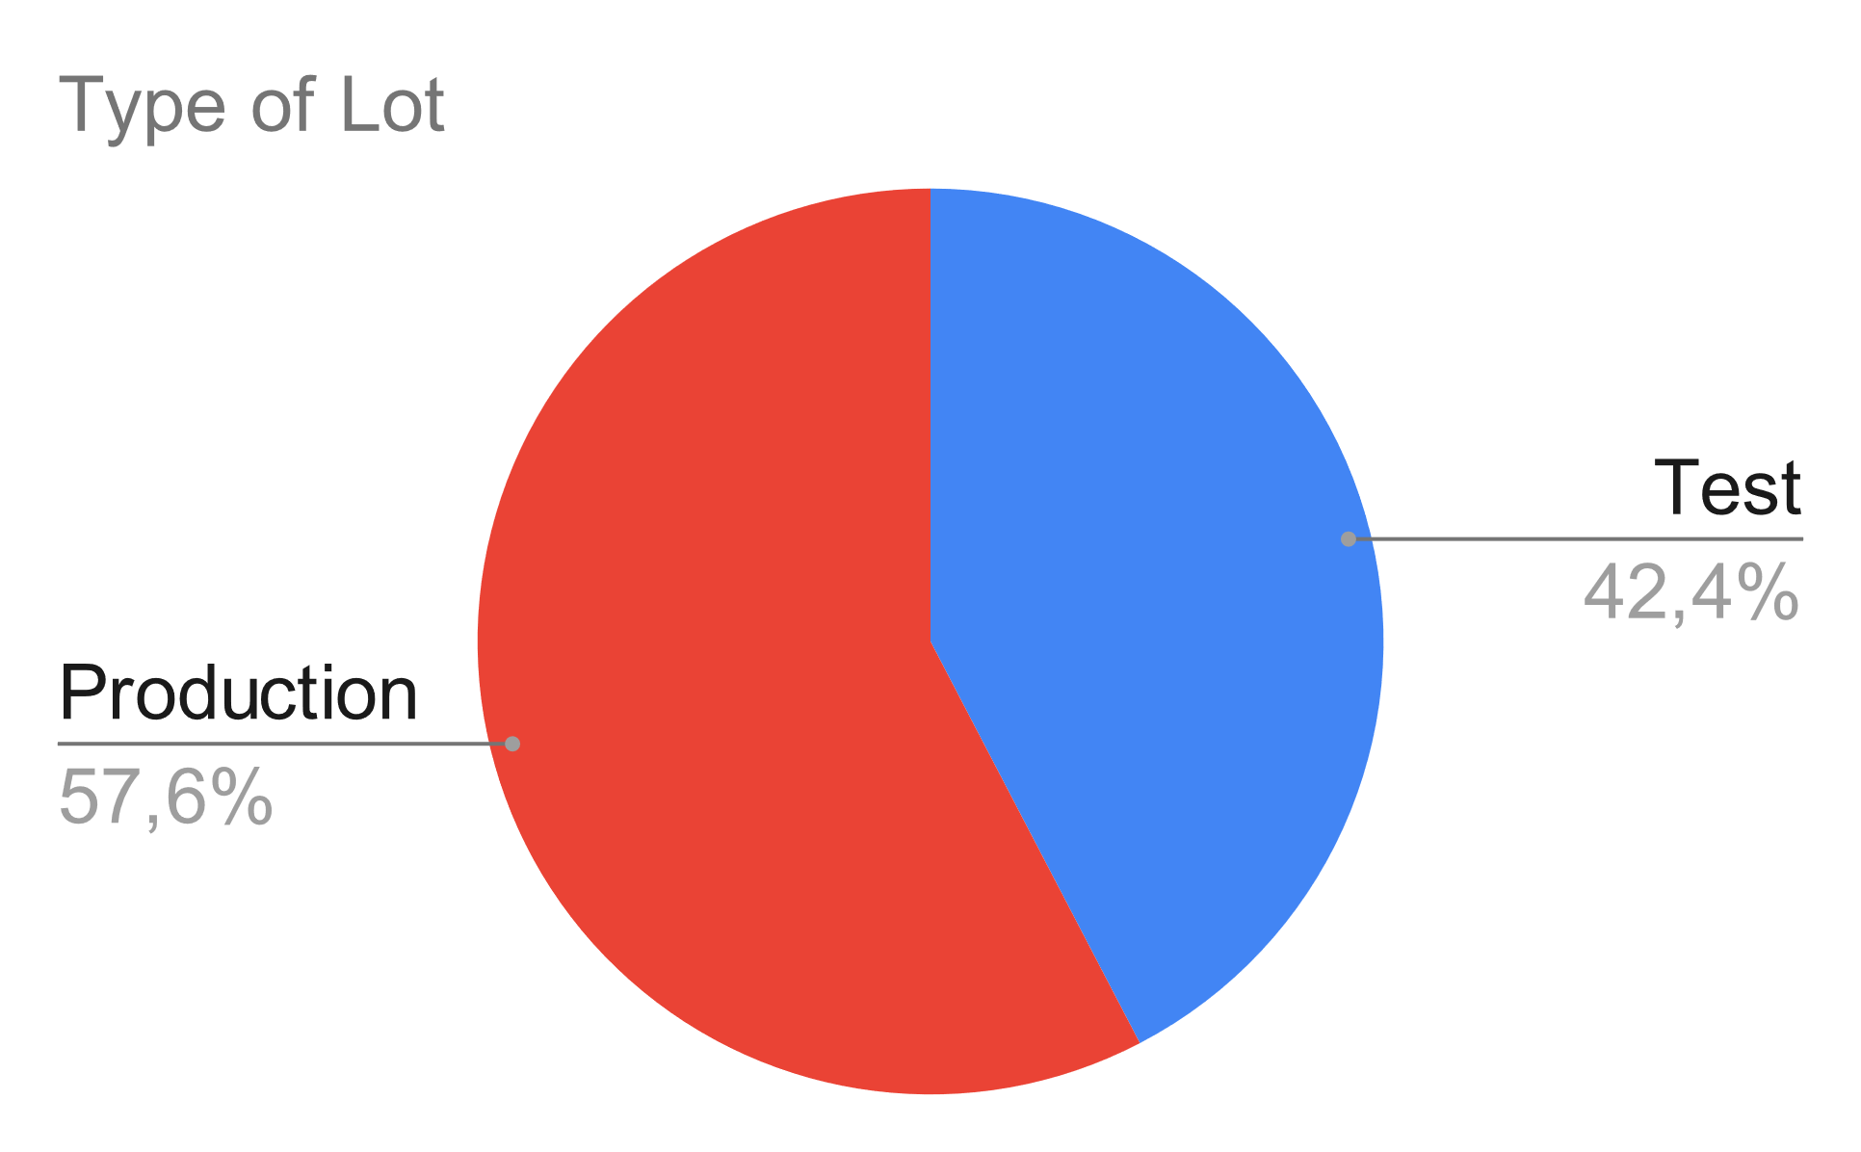
Test Service Status: Requests per lot type
Distribution of the type of lots:
Quite balanced between new test and production lot qualification
RADWG Activities Overview by R. Ferraro (BE-CEM-EPR )

Slide 8
PSI 2023 Test Status: 24 devices tested so far
March 3-6 (7DUTs)
May 13-14
August 26-27
October 21-22
FCA36N60NF x2 lots (SiC MOS – TE-CRG)
ISO7763FQDWRQ1 (Isolator – TE-CRG)
ISO124U x3 lots (Isolator – TE-CRG)
TCA9406 (I2C Transceiver – TE-CRG)
DS2401+ (1-Wire – SY-EPC)
CY62157EV30 (SRAM – BE-CEM)
INA146UA (Opamp – BE-CEM)
SN74LVC16T245DGG (Transceiver – BE-CEM)
PCA9615 (I2C Transceiver – BE-CEM)
( RD3P130SP (MOSFET – SY-EPC ))
We still have available slots for this year so don’t hesitate to make requests
CD4066 (Analog Switch BE-CEM)
SM30T12CAY (Thyristor TE-CRG)
SMP75-8 (Thyristor TE-CRG)
SP00800SDT (Thyristor TE-CRG)
SP0080SC (Thyristor TE-CRG)
SM15T12CAY (Thyristor TE-CRG)
LFSPXO018038 (Oscillator BE-CEM)
LFSPXO018041 (Oscillator BE-CEM)
LFSPXO0180xx (Oscillator BE-CEM)
IKW15N120BH6 (IGBT – SY-EPC)
ISO124U x1 lot (Isolator – TE-CRG)
= Production Lot
= Test Lot
April 1-2 (9 DUTs)
July 15-16
September 8-10
November 25-26
RADWG Activities Overview by R. Ferraro (BE-CEM-EPR )

Slide 9
CC60 2023 Test Status: 7 devices tested so far
February
April
June
August
DHC600P (HP Contactor – TE-MPE)
TC4S66F,LF (Analog Switch – BE-CEM)
CD4066BM (Analog Switch – BE-CEM)
CD4016BMG4 (Analog Switch – BE-CEM)
No test performed.
74LVCV2G66DC (Analog Switch – BE-CEM)
74HC4066PW (Analog Switch – BE-CEM)
74HC2G66DP (Analog Switch – BE-CEM)
No test performed.
Mars
May
July
September
RADWG Activities Overview by R. Ferraro (BE-CEM-EPR )

Slide 10
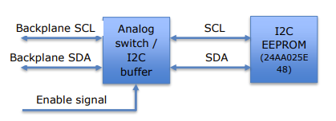





Recent results: Analog Switches (DIOT / BE-CEM)
Objective: Find a good candidate to isolate I2C devices by opening the switch placed on the digital lines, either with I2C translators or analog switches
© From EDMS Test request by filled by DIOT Responsible
Selection / Request
Test Preparation
CC60 Test
PSI Test
EDMS Request
DUT Information:
I2C level translators
Similar devices tested in the past had DD problems and the requested DD levels are quite high
Analog Switches
Pure MOSFET technology, but lifetime is generally low (below 200 Gy) but are immune to DD.
Test Strategy:
Screening of Switches at CC60 to identify best candidate(s)
Test best candidate(s) at PSI against SEEs
Test I2C translators at PSI
Test Results:
Only one switch candidate survived more than 200 Gy
This one will be tested at PSI
I2C Level translator
PCA9306 Tested with success up to 1kGy and 1.7e12 neq.cm²
Second translator was not tested since first one was successful.
Analog Switch:
CD4066 tested with success up to 500 Gy.
From 8 candidates, two were tested with success at PSI, saving beam time for other tests.
Two types of devices requested:
I2C level translator
PCA9306
TCA9406
Analog Switch
74HC4066PW
74HC2G66DP
74LVCV2G66DC
TC4S66F
CD4066BM
CD4016BMG4
Levels: 500 Gy, 7e12 neq/cm²
RADWG Activities Overview by R. Ferraro (BE-CEM-EPR )

Slide 11
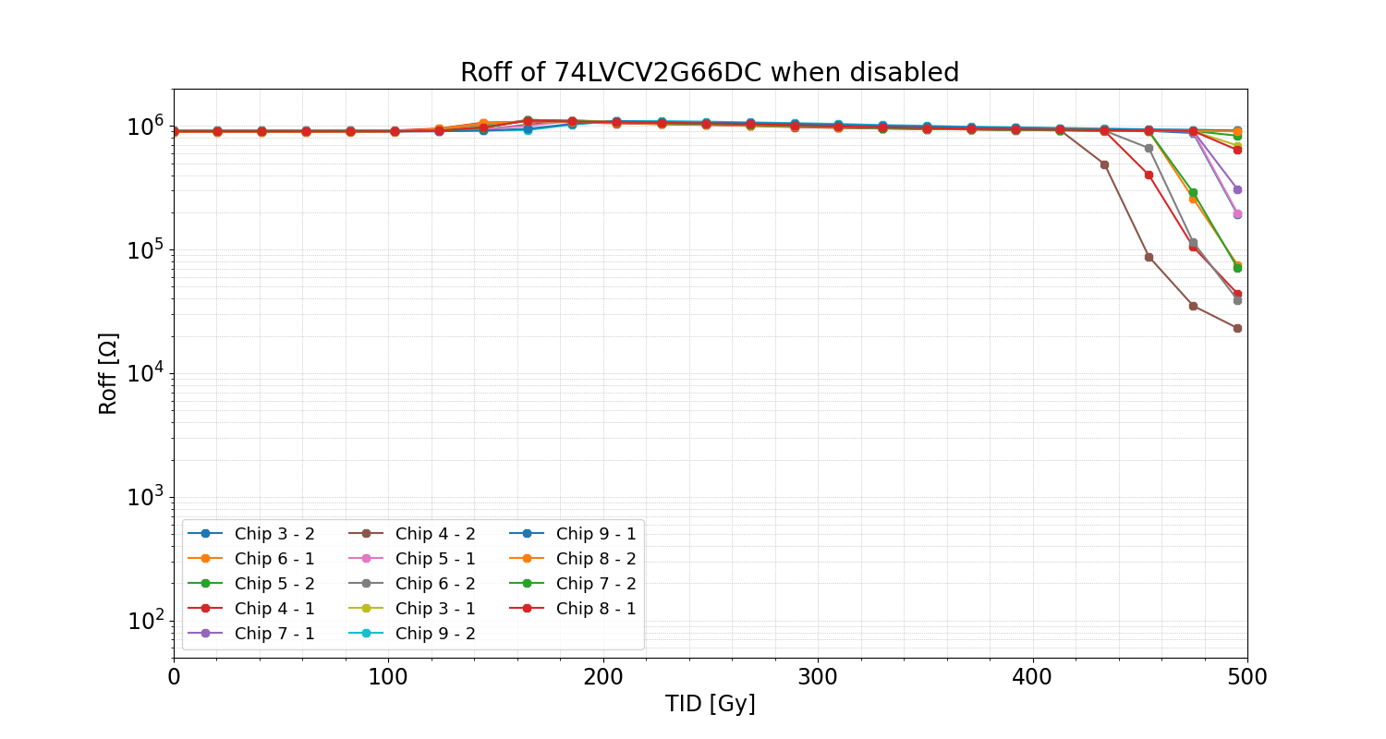
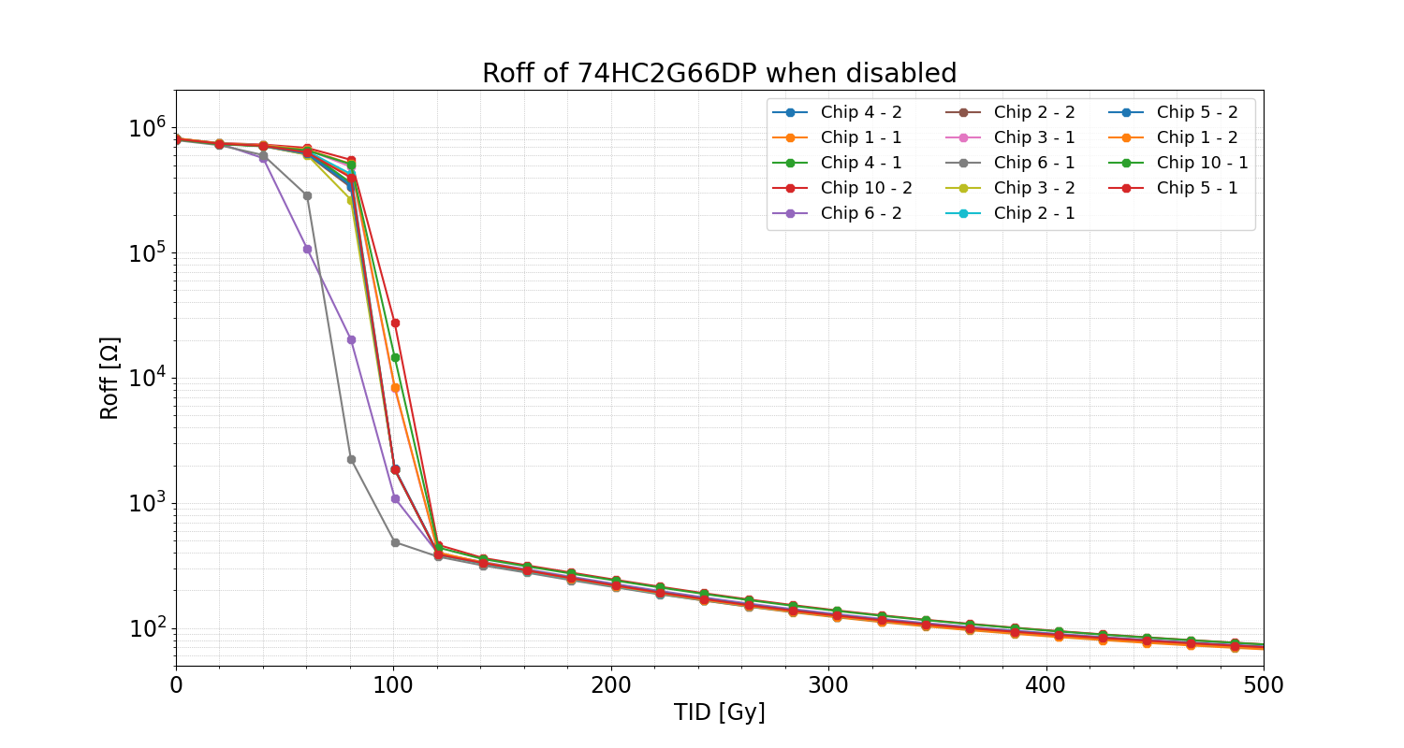
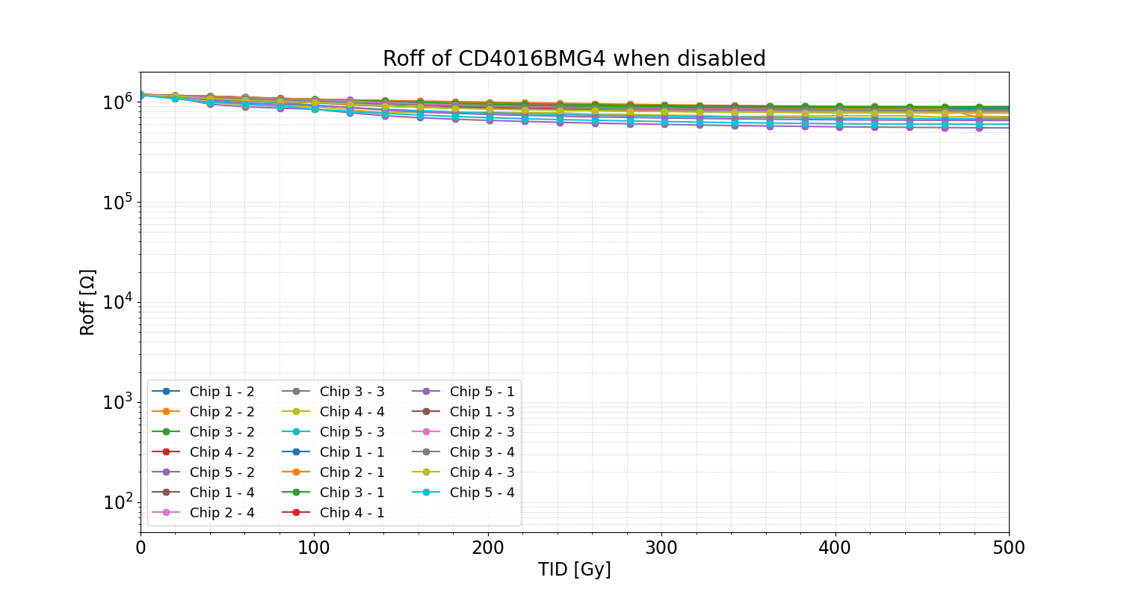
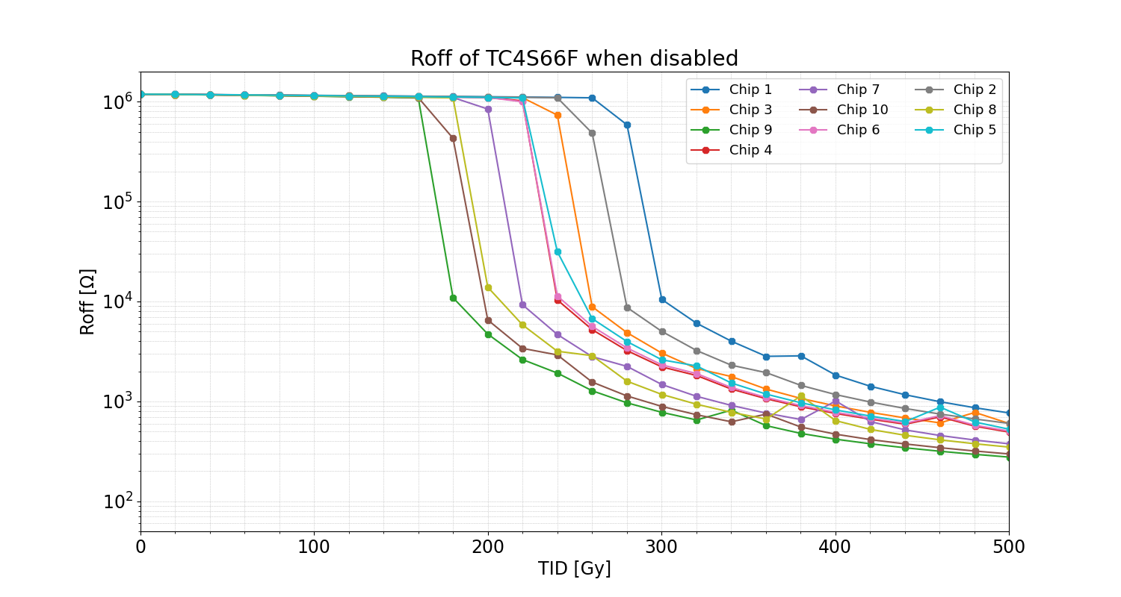
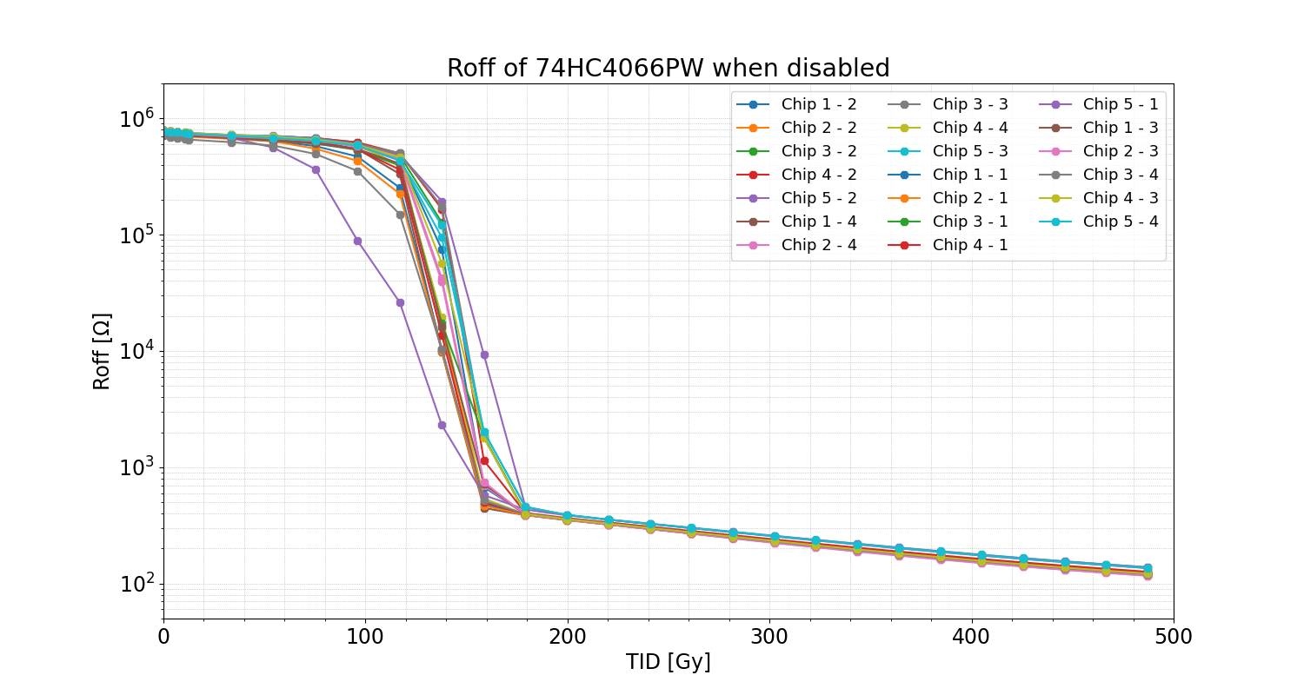
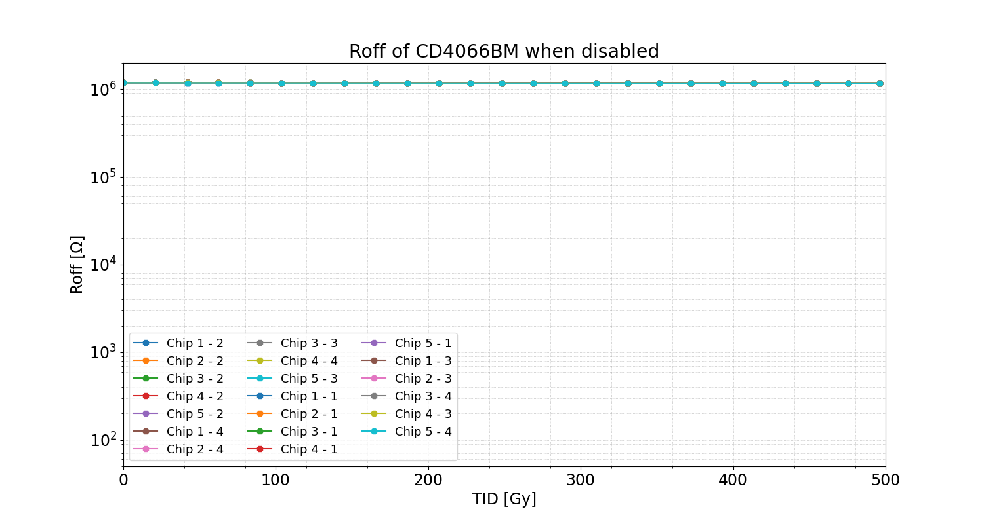
Recent results: Analog Switches (DIOT / BE-CEM)
CC60 Results: Measurement of input-output resistance (weakest parameter) when disable (Roff)
Sudden resistance drop
Sudden resistance drop
Small resistance drop
Negligible change
Sudden resistance drop
Sudden resistance drop
RADWG Activities Overview by R. Ferraro (BE-CEM-EPR )

Slide 12
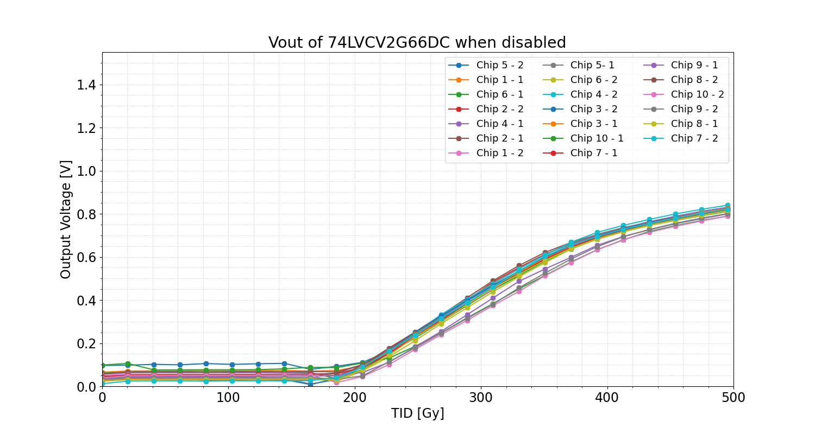
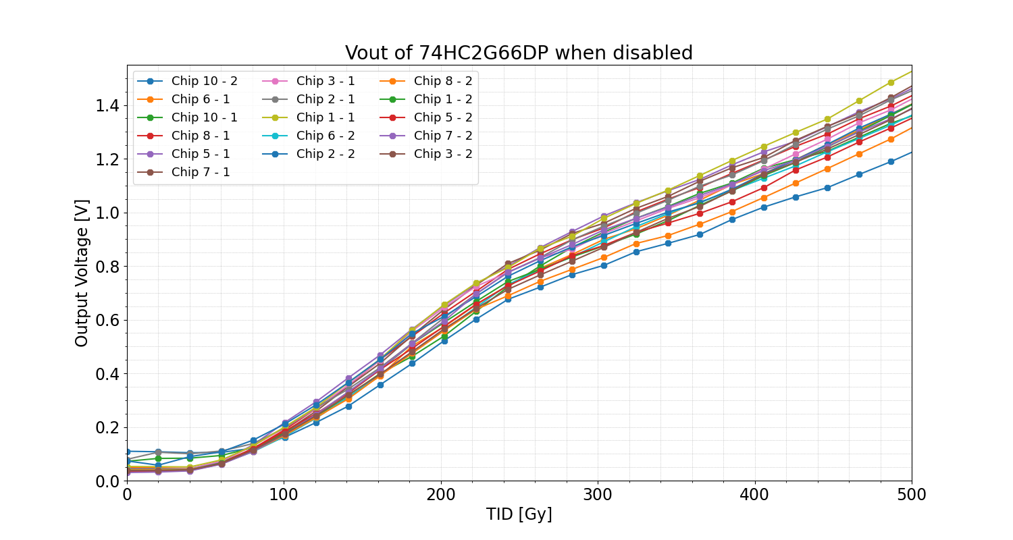
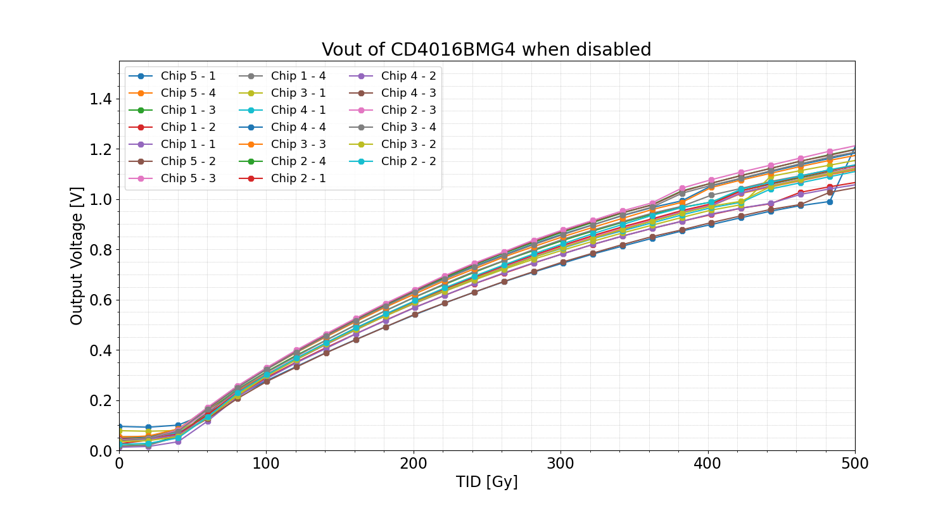
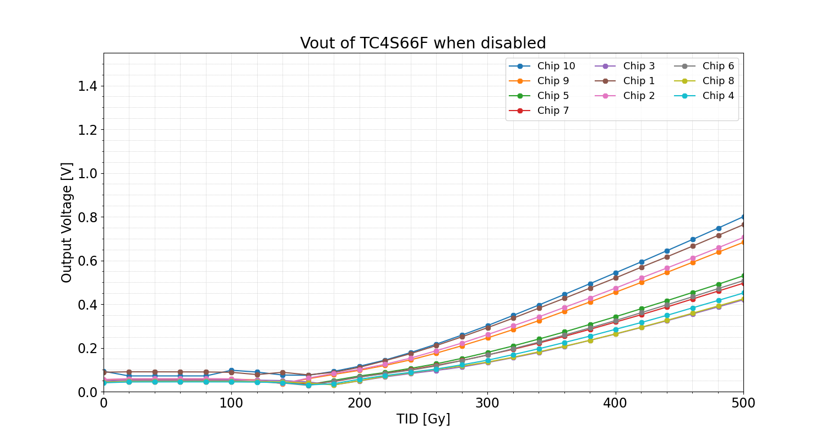
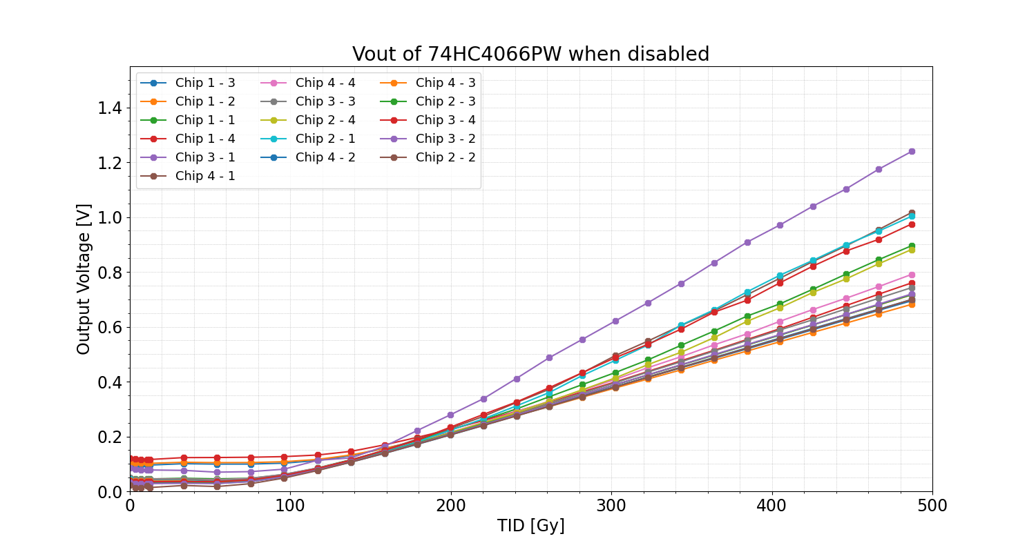
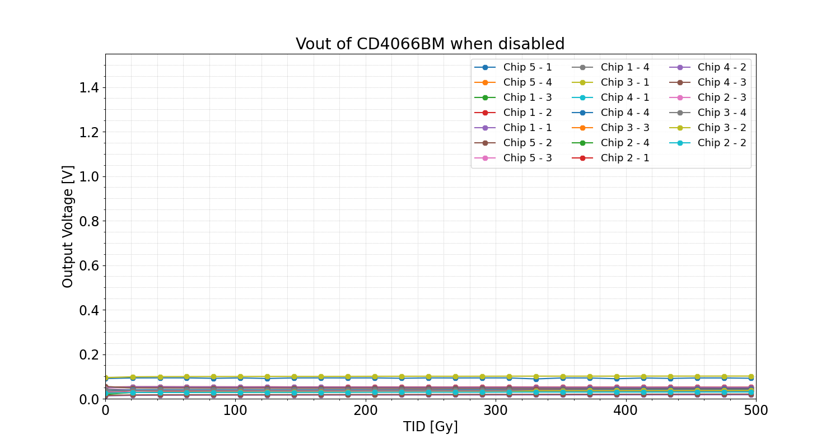
Recent results: Analog Switches (DIOT / BE-CEM)
CC60 Results: Output Voltage when chips are disable and input = 3.3 V
Resistance drop induce increase of the output voltage
No visible change up to 500 Gy
RADWG Activities Overview by R. Ferraro (BE-CEM-EPR )

Slide 13
Recent results: Analog Switches (DIOT / BE-CEM)
CC60 Results: Output Voltage when chips are disable and input = 3.3 V
Resistance drop induce increase of the output voltage
No further considered
No visible change up to 500 Gy
RADWG Activities Overview by R. Ferraro (BE-CEM-EPR )

Slide 14
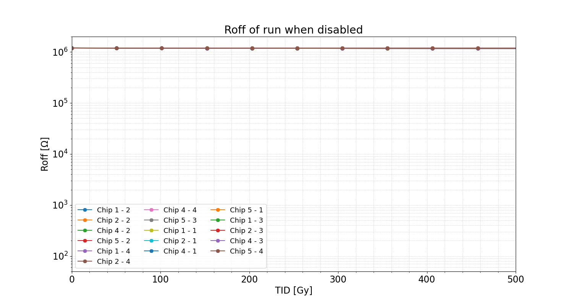
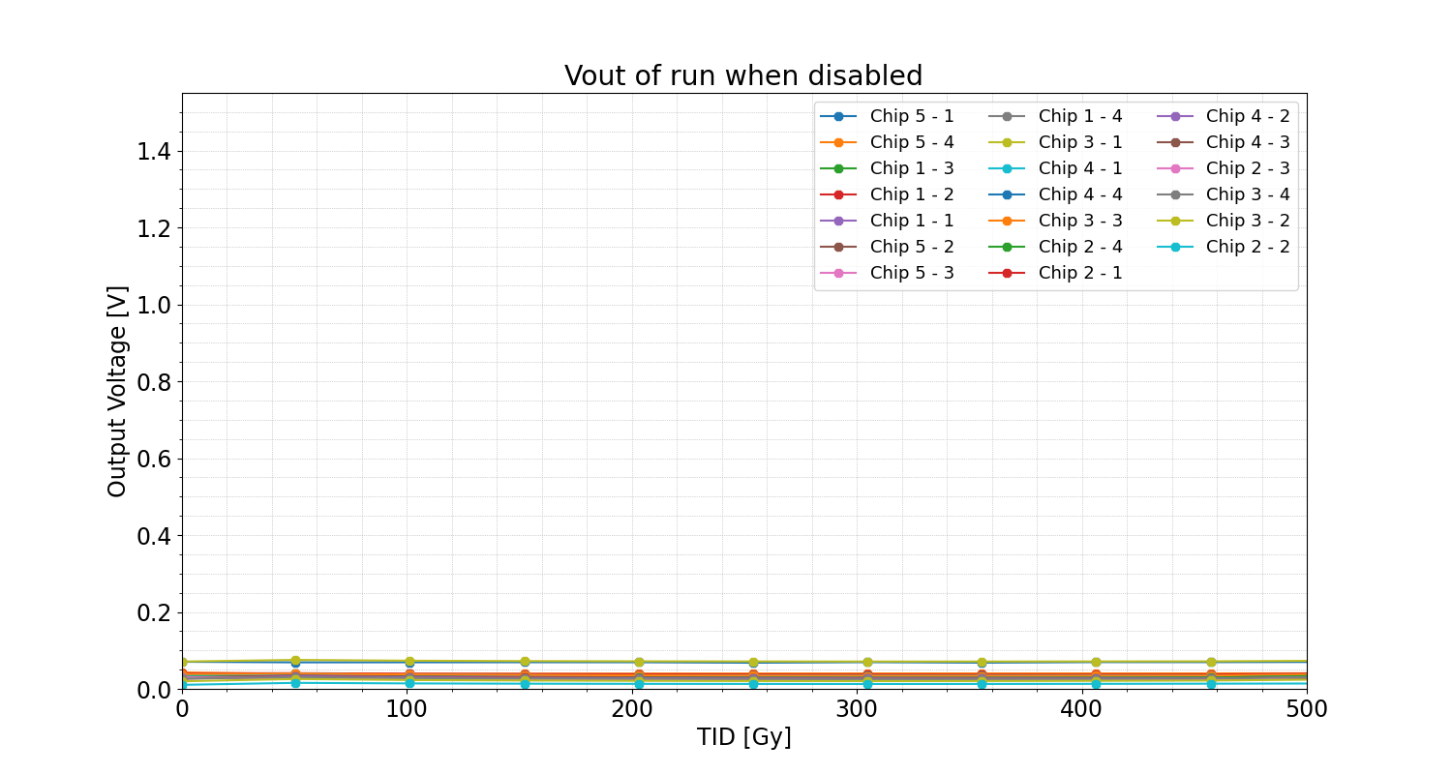
Recent results: Analog Switches (DIOT / BE-CEM)
CC60 Results vs PSI results:
No visible change up to 500 Gy
No visible change up to 500 Gy
Consistent results in both facilities
No visible change up to 500 Gy
No visible change up to 500 Gy
RADWG Activities Overview by R. Ferraro (BE-CEM-EPR )

Slide 15
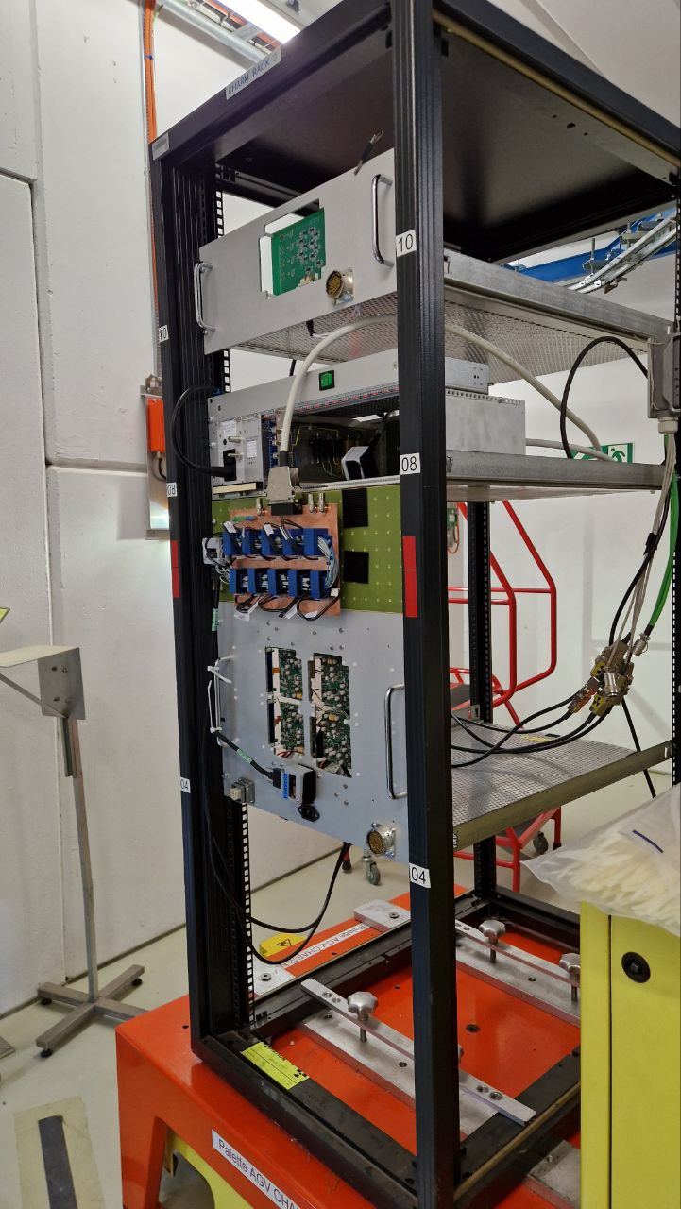
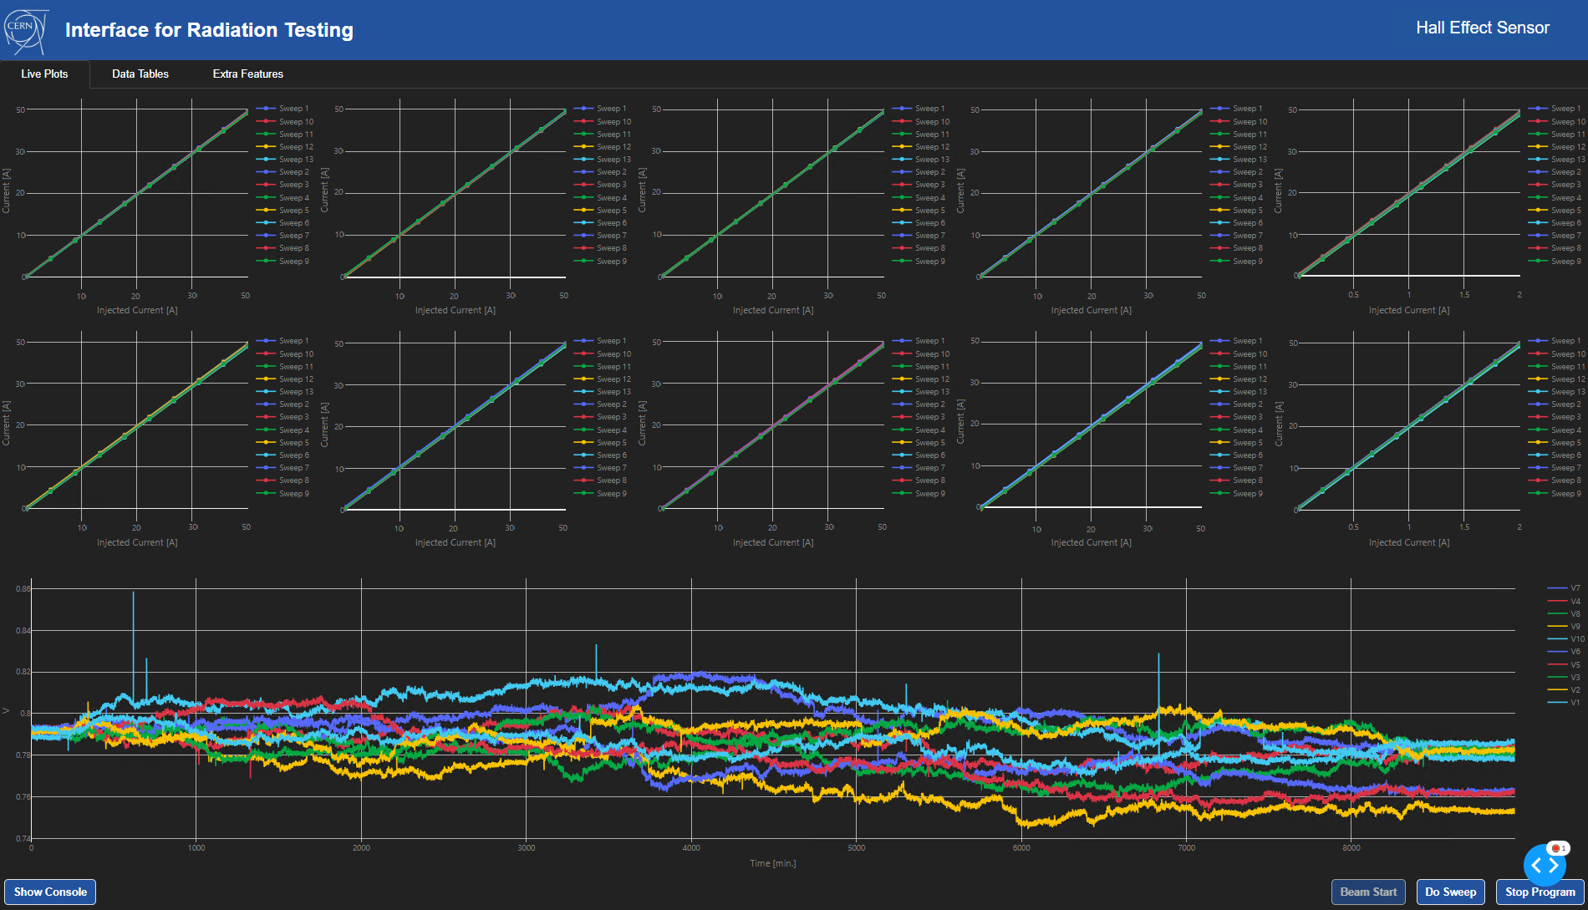
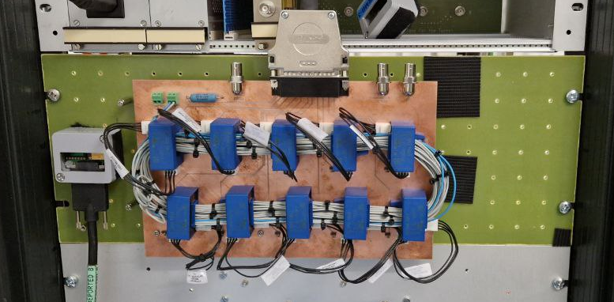
CHARM First 2023 test: HAS-100 (SY-EPC)
DUT: HAS-100 Current Transducer ( Bipolar-based integrated module)
© EPR Radiation Test Python Framework
Calibration Check
(Every 12h)
Fixed Current readings
(Every 12h)
Beam Start (07.06.2023)
Reached Levels:
TID = 405 Gy, DDEF = 3.1 e12 neq.cm²
Beam Start (13.06.2023)
RADWG Activities Overview by R. Ferraro (BE-CEM-EPR )

Slide 16
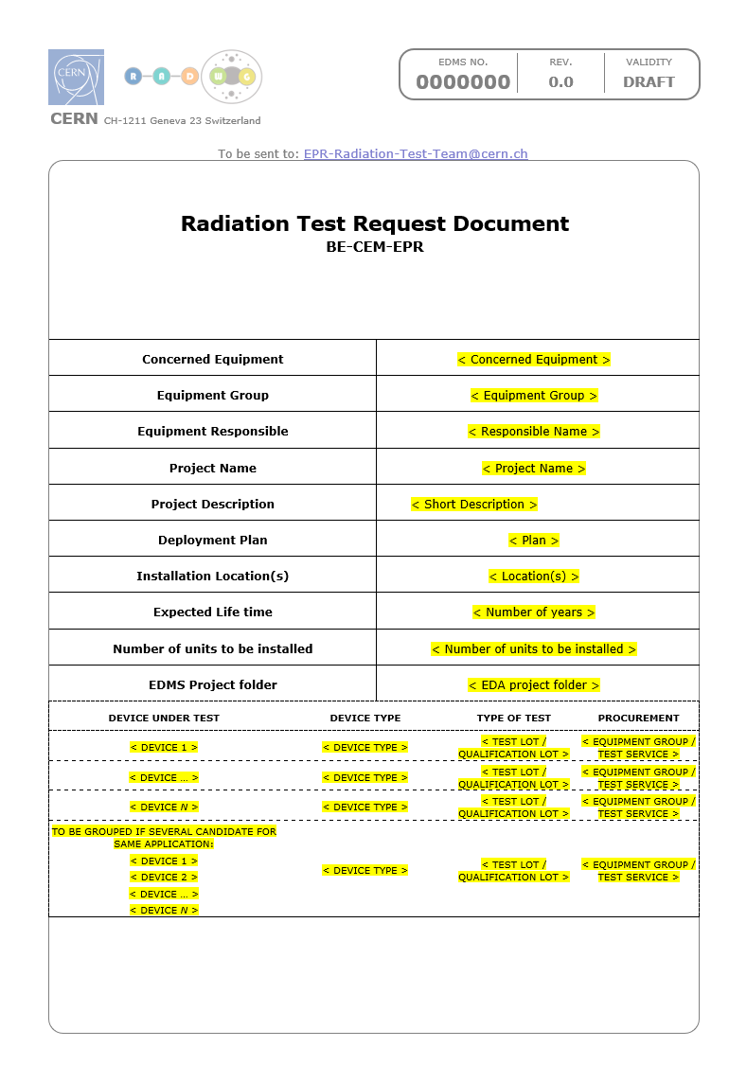
New Test Request Template:
New Test Request document: EDMS 2779784
Contains:
Information about equipment:
Locations, Deployment plan, lifetime, number of units in operation
Information about radiation levels in operation: TID, DDEF, HeH, ThN
Information about DUTs:
Use in the system (schematic)
Parameters of interest
Radiation Design requirements
Maximum tolerated failure rate (SEEs)
Will help us to track better the request and also to prepare better the tests
To be sent to: EPR-Radiation-Test-Team@cern.ch
All request are then put in the following EDMS folder: [link]
RADWG Activities Overview by R. Ferraro (BE-CEM-EPR )

Slide 17
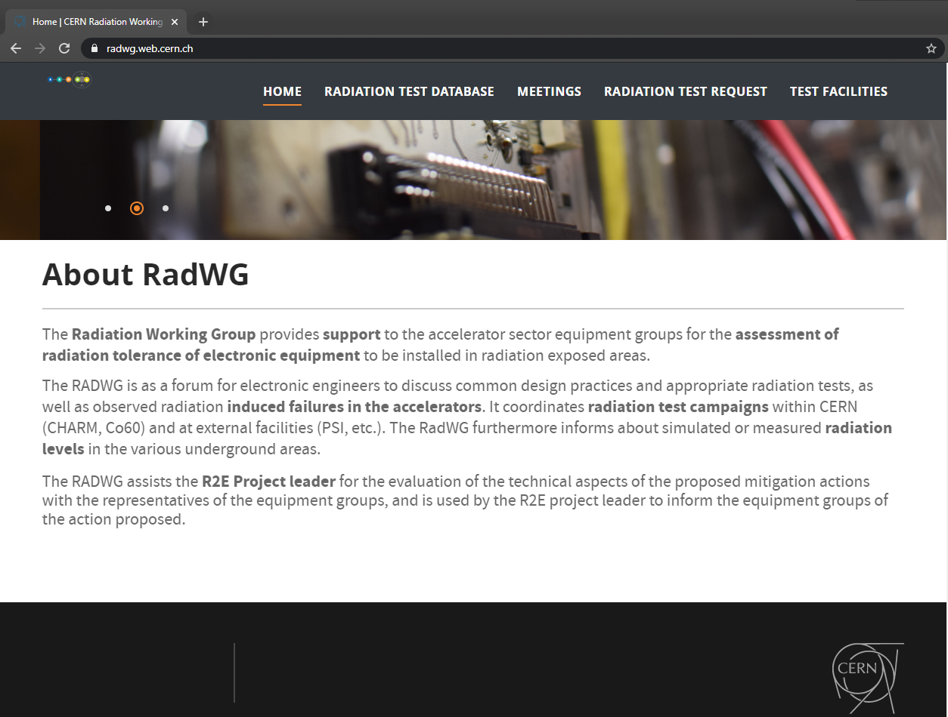
Test results analysis and reporting
The website https://radwg.web.cern.ch/ embeds an User-Friendly database
More than 558 reports from the 2011 up to 2023
225 users subscribed to the mailing list lhc-proj-radwg-members
The service produces reports in a common template for all the components tested
Test reports template ensure a coherent reporting
databases accessible by all the equipment groups
https://radwg.web.cern.ch
RADWG Activities Overview by R. Ferraro (BE-CEM-EPR )

Slide 18
Conclusions
BE-CEM-EPR provides the service of radiation testing of electronic components supporting the Radiation Working Group (RadWG)
High testing activity in 2023
CHARM Tests has restarted
3 PSI campaigns were performed and they are still some spots in the 5 next campaigns for this year
RADWG Activities Overview by R. Ferraro (BE-CEM-EPR )

Slide 19
Thank you for your attention!

