Slide 1

Introduction to Random Matrices: An Analysis of the Gaussian Ensemble.
Graduation Thesis
Supervisor: Dr. Ali Nassar
anassar@zewailcity.edu.eg
Student: Hossam Sabry Hendy
s-hossam.hendy@zewailcity.edu.eg
15/06/2023

Slide 2
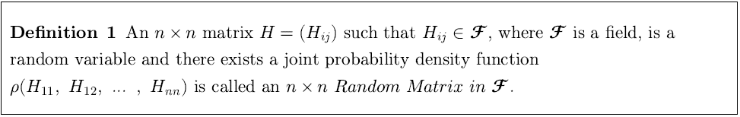
What is a Random Matrix?

Slide 3
Why Random Matrices?
Nuclear Hamiltonian
  Wigner’s proposal.
  Porter and Rosenzweig’s analysis of nuclear data.
The Random Ising model (Even Interaction PDF).

Slide 4
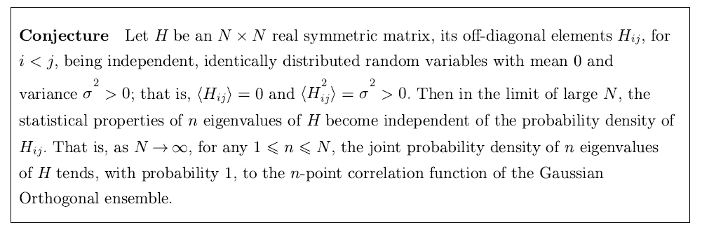
A “Central limit” Theorem?

Slide 5
So, we go Gaussian!

Slide 6
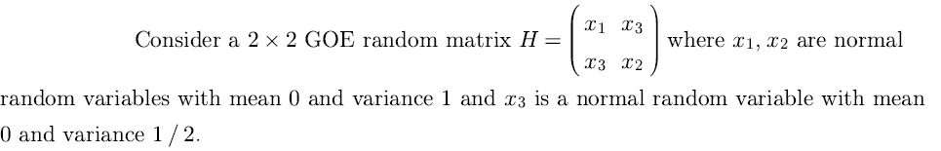
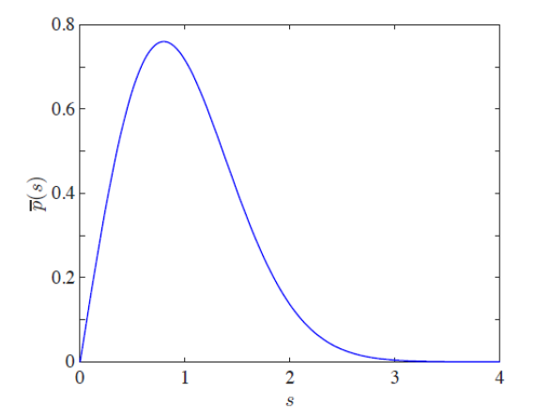

Wigner’s Surmise and Level Repulsion

Slide 7
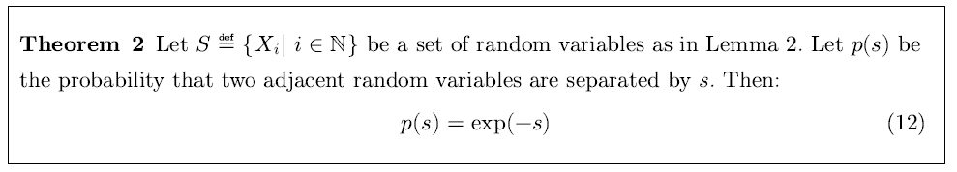
Level spacing for i.i.d. Random variables

Slide 8
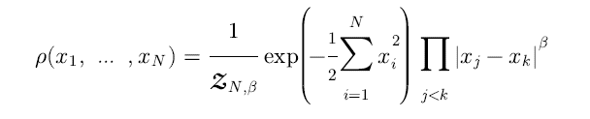
Eigenvalues JPDF for Gaussian Ensembles: confinement and repulsion.

Slide 9
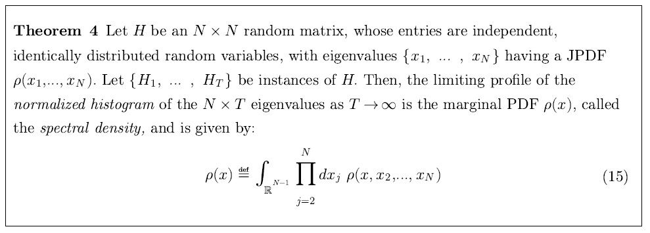
Normalized Histogram and the Marginal PDF

Slide 10
Self-averaging
The link between a large sample and a large matrix.
  A statistical mechanical argument.

Slide 11
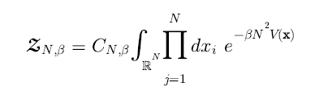
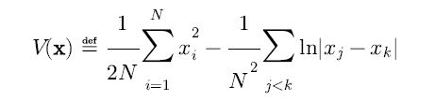
The Coulomb Gas technique

Slide 12
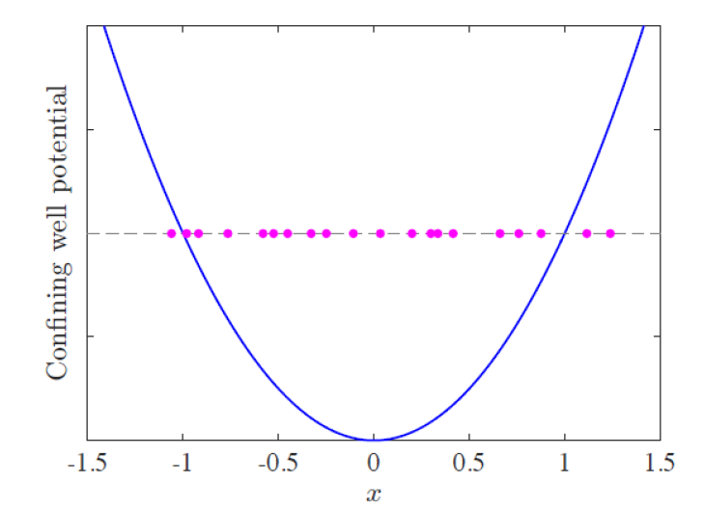
The Coulomb Gas technique

Slide 13
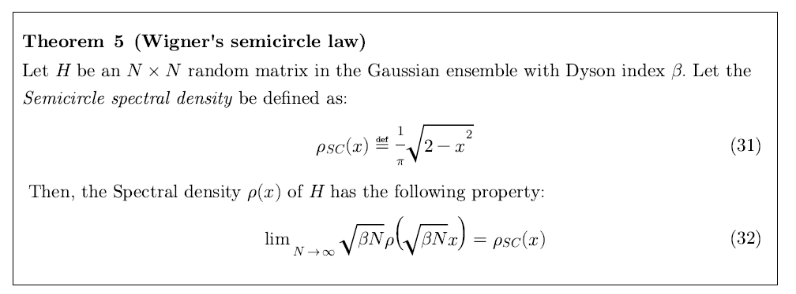
Wigner’s Semicircle Law

Slide 14
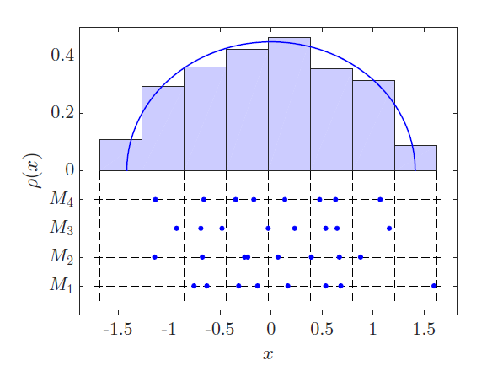
Wigner’s Semicircle Law

Slide 15
From the “Central limit” conjecture to Wigner’s Semicircle law

