Slide 1
On Hawking Radiation and Information Paradox
Supervisor: Dr. Ali Nassar
Student: Youssef Aziz

Slide 2
1. Introduction

Slide 3
1. Introduction
History of Black Holes
Schwarzschild Solution
  Event Horizons
Black hole Thermodynamics
  Bekenstein Entropy
  Energy and entropy, do we have temperature?
Quantum Field Theory
  Thermal Radiation with Planck Distribution
Paradoxes with Both Theories

Slide 4
2. Black Holes

Slide 5
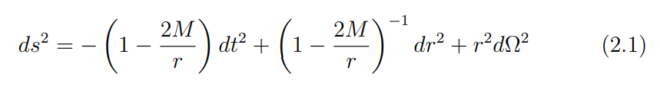

2. Black Holes
Schwarzschild Metric
Null geodesics just outside or just inside the event horizon

Slide 6
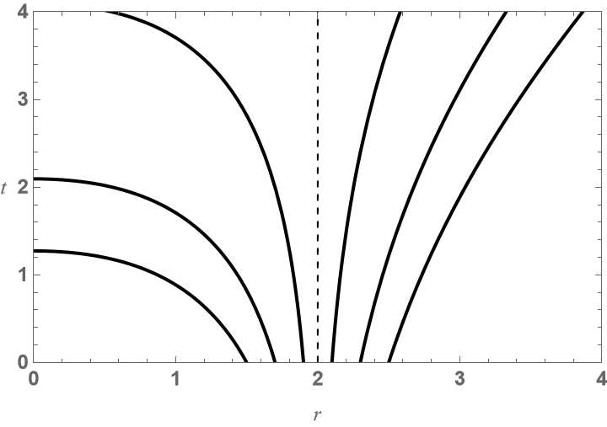
2. Black Holes
Spacetime stretching by Schwarzschild field
Schwinger Effect
  Universality of Gravity

Slide 7
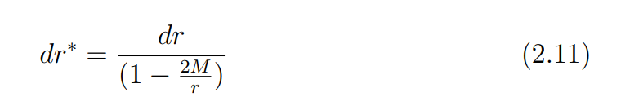
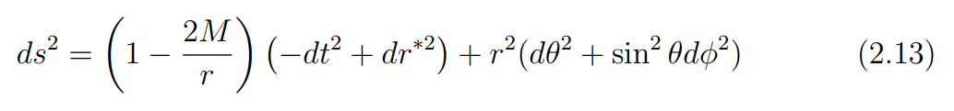
2. Black Holes
2.1 Kruskal Coordinates
Attempt at removing coordinate singularity at r = 2M
Change of coordinates
Metric becomes

Slide 8


2. Black Holes
2.1 Kruskal Coordinates
Null coordinates (advanced and retarded times)
Infalling null geodesics crossing the horizon

Slide 9



2. Black Holes
2.1 Kruskal Coordinates
Smooth coordinates at horizon (Kruskal coordinates)
Outside horizon
At horizon

Slide 10

2. Black Holes
2.1 Kruskal Coordinates
Extended Schwarzschild Metric
Metric invariance under exchange of U and V
  A copy of the region 2M < r < ∞
Extended Regions
  Future and past horizons
  Future and past singularities
Eternal Black hole

Slide 11

2. Black Holes
2.2 More Realistic Black Hole
Collapsing spherical null shell
Birkhoff Theorem
Metric Inside
Metric Outside

Slide 12
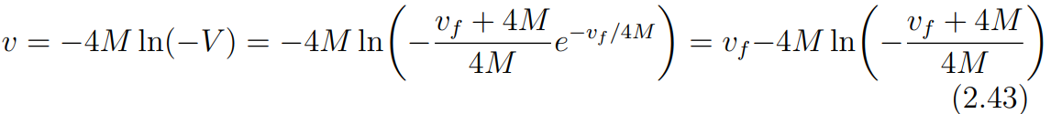

2. Black Holes
2.2 More Realistic Black Hole
2.2.1 Matching The Metrics
Matching radial displacements on null geodesics across the horizon
Relating advanced time coordinates outside
Relating advanced time coordinates inside

Slide 13
3. Quantum Field Theory

Slide 14
3. Quantum Field Theory
QFT to describe matter fields near BH
Quantum Gravity to fully describe what is going on
Static curved background approximation

Slide 15




3. Quantum Field Theory
3.1 Particles in Flat Spacetime
Real scalar field
Equation of Motion
Plane waves solutions
Dispersion relation

Slide 16
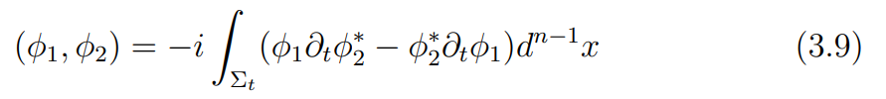
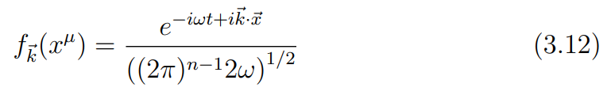

3. Quantum Field Theory
3.1 Particles in Flat Spacetime
Inner product over wave modes
Orthonormal modes
Positive and negative frequency modes

Slide 17
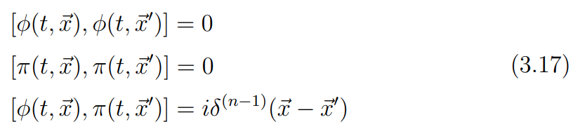
3. Quantum Field Theory
3.1 Particles in Flat Spacetime
Inner products on set
Impose canonical commutation relations

Slide 18
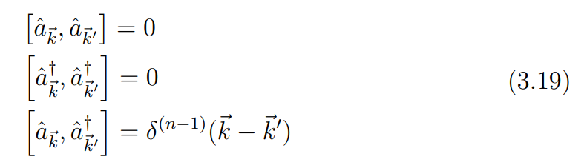
3. Quantum Field Theory
3.1 Particles in Flat Spacetime
Expand field operator
The coefficients have algebraic structure
Creation and annihilation operators

Slide 19



3. Quantum Field Theory
3.1 Particles in Flat Spacetime
We define vacuum state
Particle Excitations (Fock states)
Number operators

Slide 20
3. Quantum Field Theory
3.1 Particles in Flat Spacetime
Is our formalism frame invariant?
Under Lorentz boosts
Positive and negative modes do not mix
Vacuum and number operators are invariant

Slide 21
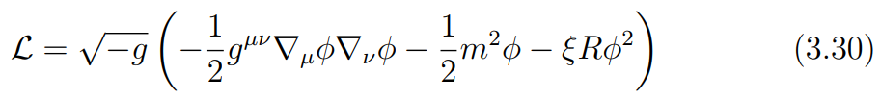

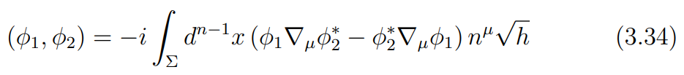
3. Quantum Field Theory
3.2 Particles in Curved Spacetime
We recast our former formalism in coordinate independent form
The Lagrangian in curved spacetime
EOM
Inner product

Slide 22
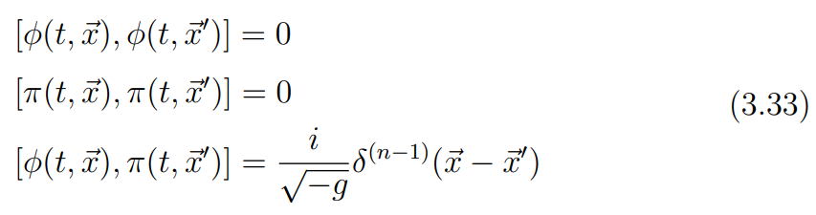

3. Quantum Field Theory
3.2 Particles in Curved Spacetime
We impose the canonical commutation relations
Expand the field operator

Slide 23
3. Quantum Field Theory
3.2 Particles in Curved Spacetime
The coefficients are creation and annihilation operators
We can define vacuum state
We can construct Fock basis and number operators
Are we done?

Slide 24

3. Quantum Field Theory
3.2 Particles in Curved Spacetime
A different observer uses different set of modes
Coefficients are creation and annihilation operators
We repeat the whole construction
Fock basis and number operators may not coincide

Slide 25

3. Quantum Field Theory
2.2 Particles in Curved Spacetime
2.2.1 Bogolubov Transformations
We want to relate wave modes for different observers
The sets are complete, we expand one in terms of the other
Expansion coefficients are matrices (Bogolubov coefficients)

Slide 26
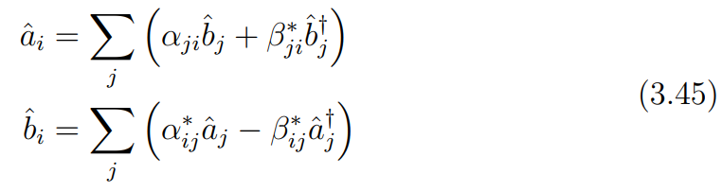

3. Quantum Field Theory
2.2 Particles in Curved Spacetime
2.2.1 Bogolubov Transformations
From inner product
Expectation value of number operator in different basis vacuum

Slide 27
4. Hawking Radiation

Slide 28

4. Hawking Radiation
Simple model (massless scalar field)
Eikonal Approximation
Outgoing solutions at future null infinity
Radial part can be found from EOM

Slide 29
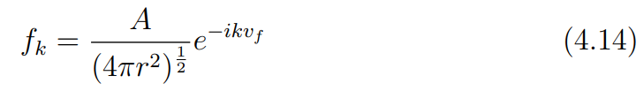

4. Hawking Radiation
Approximations
  Eikonal approximation
  $l$ = 0 modes
  Greybody factor
Incoming modes from past null infinity

Slide 30


4. Hawking Radiation
Waves incoming from past null infinity are scattered
Field operator can be expanded in terms of incident modes
Or scattered modes

Slide 31

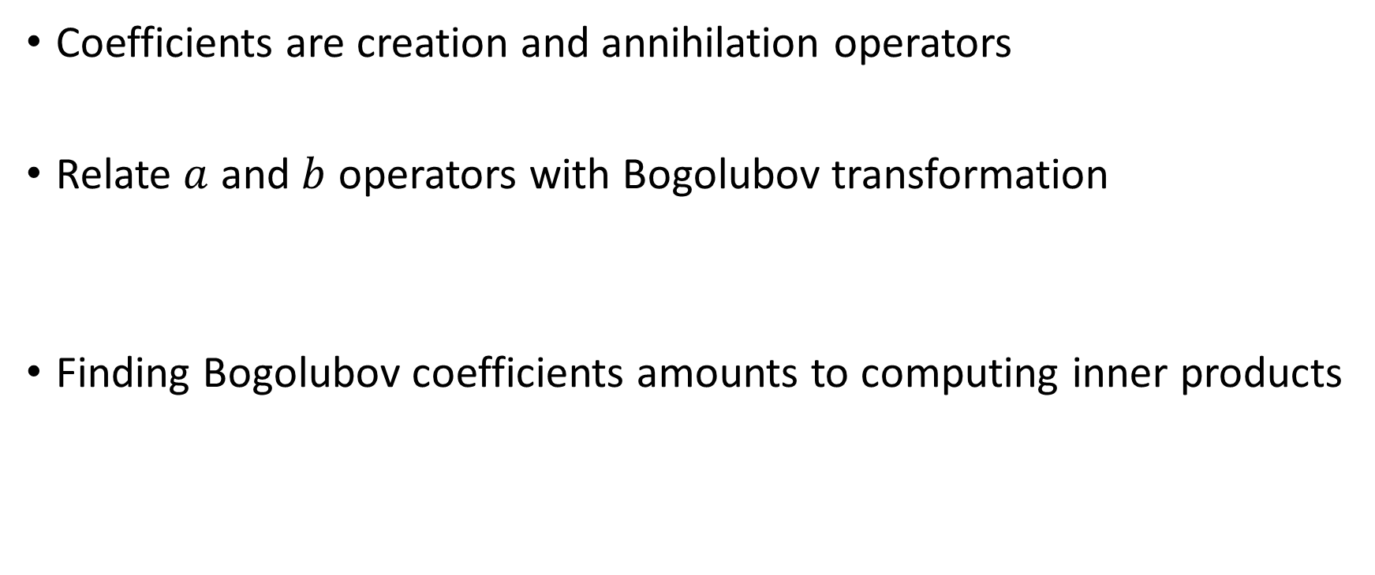
4. Hawking Radiation
Coefficients are creation and annihilation operators
Relate $a$ and $b$ operators with Bogolubov transformation
Finding Bogolubov coefficients amounts to computing inner products

Slide 32

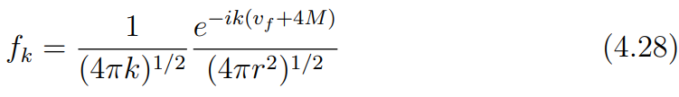

4. Hawking Radiation
4.1 Calculating Bogolubov Coefficients
Inner product in curved spacetime
Normalizing $f$ and $g$
Finally ready to calculate the inner product

Slide 33
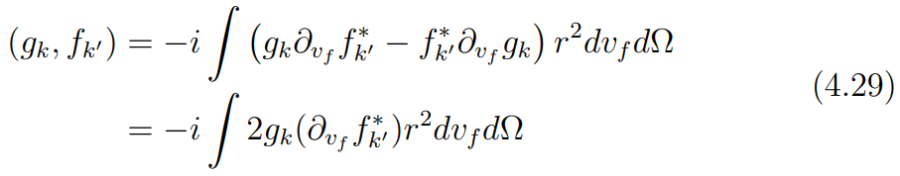
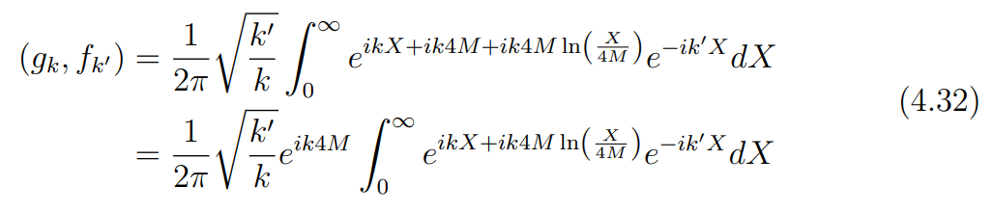

4. Hawking Radiation
4.1 Calculating Bogolubov Coefficients
Take the limit as the hypersurface becomes null
The $α$ coefficient is found to be
But this integral is divergent!

Slide 34
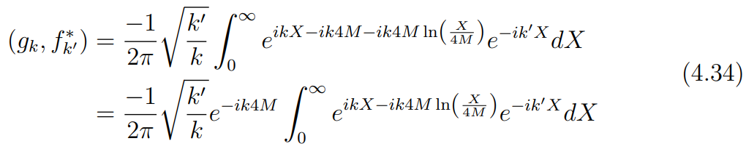

4. Hawking Radiation
4.1 Calculating Bogolubov Coefficients
The divergence comes from using plane wave solutions
  Hawking used wave packets
Instead, we relate $α$ to $β$
The inner product gives

Slide 35
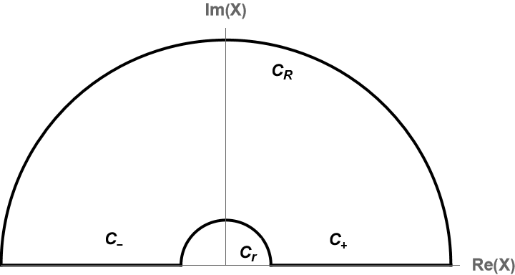

4. Hawking Radiation
4.1 Calculating Bogolubov Coefficients
To relate the two coefficients
  Promote $X$ to a complex variable
  Do a contour integral
From complex analysis
  The integral vanishes
  $C_{r}$ and $C_{R}$ vanish

Slide 36
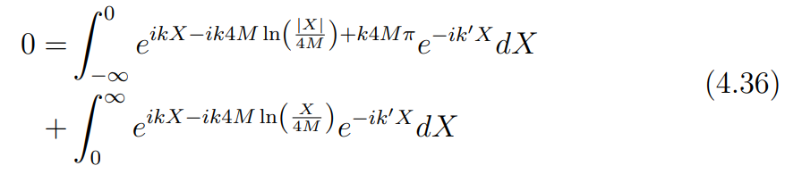
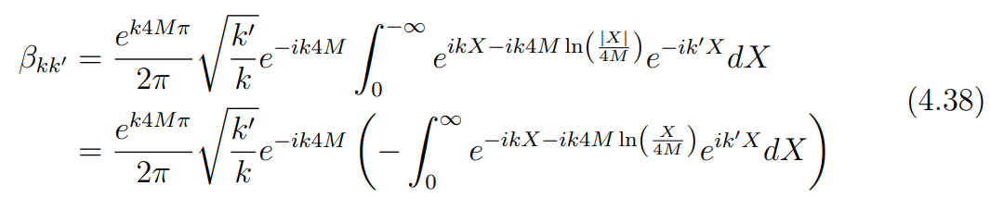

4. Hawking Radiation
4.1 Calculating Bogolubov Coefficients
$C_{−}$ and $C_{+}$ are related by
We rewrite $β$

Slide 37



4. Hawking Radiation
4.1 Calculating Bogolubov Coefficients
We find $\left|α\right|$ in terms of $\left|β\right|$ as
Introducing the surface gravity

Slide 38



4. Hawking Radiation
4.1 Calculating Bogolubov Coefficients
Black hole absorptivity
Evaluating the integral
But the last integral is nothing but $\left\langle {\hat{n}}_{b}\right\rangle$

Slide 39
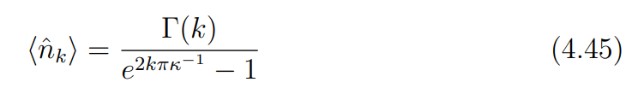
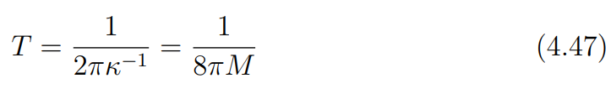
4. Hawking Radiation
4.1 Calculating Bogolubov Coefficients
Hawking Radiation is given by
Planck distribution with temperature

Slide 40

4. Hawking Radiation
4.2 Hawking Temperature by Wick Rotation
Statistical Mechanical Slick Trick
From QM, transition probability amplitudes given by
From Statistical Mechanics the partition function is

Slide 41
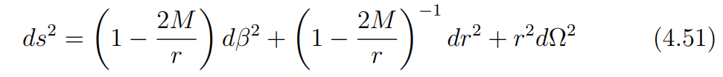
4. Hawking Radiation
4.2 Hawking Temperature by Wick Rotation
Correspondence between temperature and imaginary time
Wick Rotation
Rotated Schwarzschild metric given by

Slide 42


4. Hawking Radiation
4.2 Hawking Temperature by Wick Rotation
Making a change of variables
The metric near the event horizon becomes
Making a change of coordinates

Slide 43

4. Hawking Radiation
4.2 Hawking Temperature by Wick Rotation
We arrive at the following metric
First part describes a flat 2D plane
The polar angle coordinate must be periodic

Slide 44

4. Hawking Radiation
4.2 Hawking Temperature by Wick Rotation
Giving us the correct Hawking temperature

Slide 45
5. Information Loss

Slide 46
5. Information Loss
The results obtained so far contradicts classical GR
We will also find it contradicts Quantum Mechanics

Slide 47

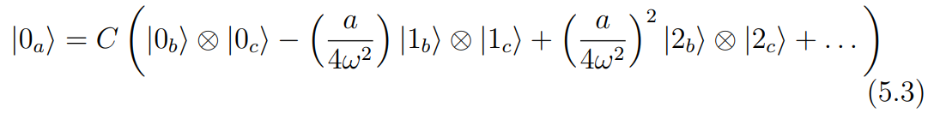
5. Information Loss
The vacuum in past infinity in terms of Fock basis
Expanding the exponential
Entanglement between radiation and particles falling in the BH!

Slide 48

5. Information Loss
5.1 Density Matrix
Entangled particles cannot be factorized to single particle states
Individual particles do not have states of their own
Hawking radiation leads to loss of one of the entangled particles (or more)

Slide 49

5. Information Loss
5.1 Density Matrix
We are faced with the question of defining individual particle states
If we simply choose to delete references to the lost particle
Different choices of the deleted particle basis leads to different states
Measurement probabilities are captured correctly, however!

Slide 50


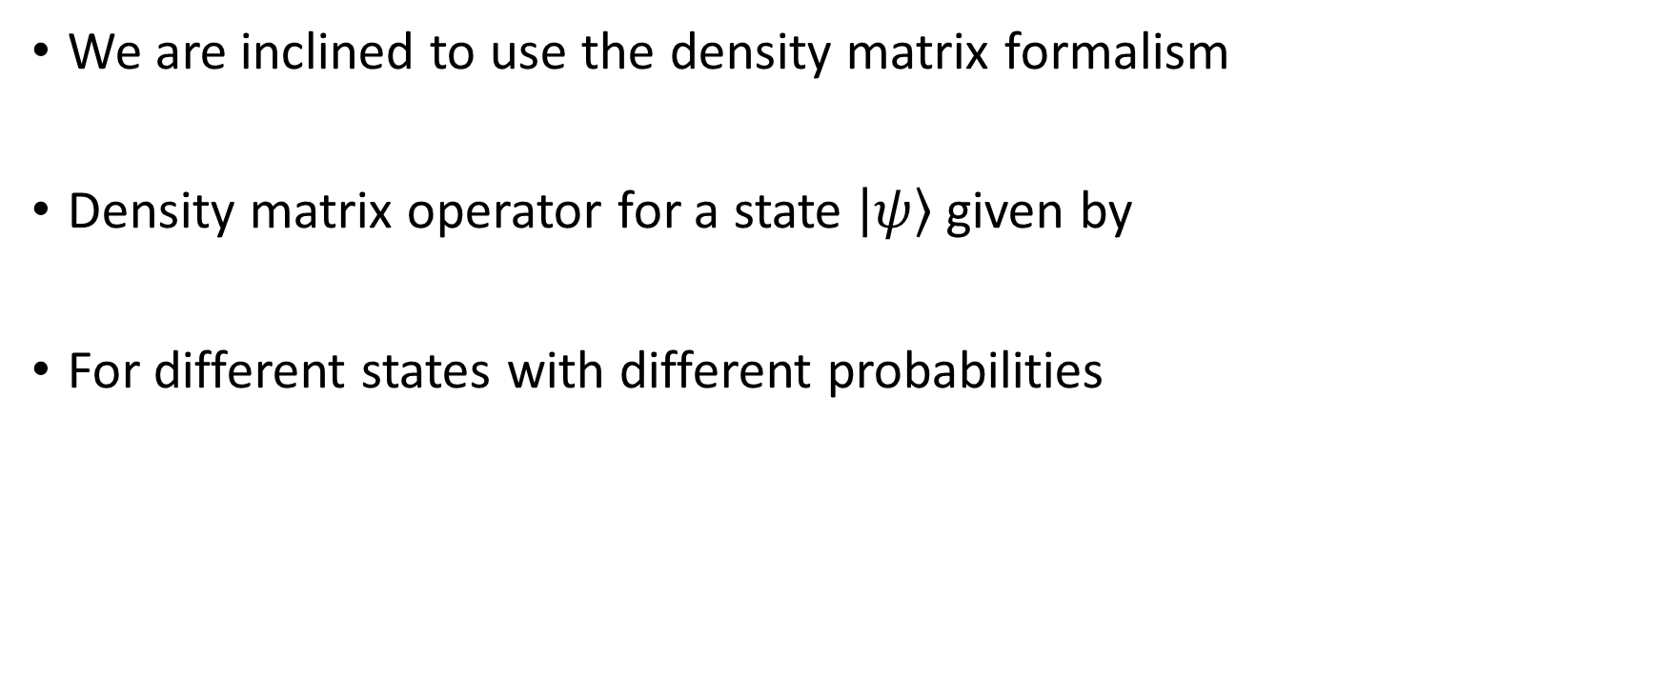
5. Information Loss
5.1 Density Matrix
We are inclined to use the density matrix formalism
Density matrix operator for a state $\left|\left.ψ\right\rangle \right.$ given by
For different states with different probabilities

Slide 51

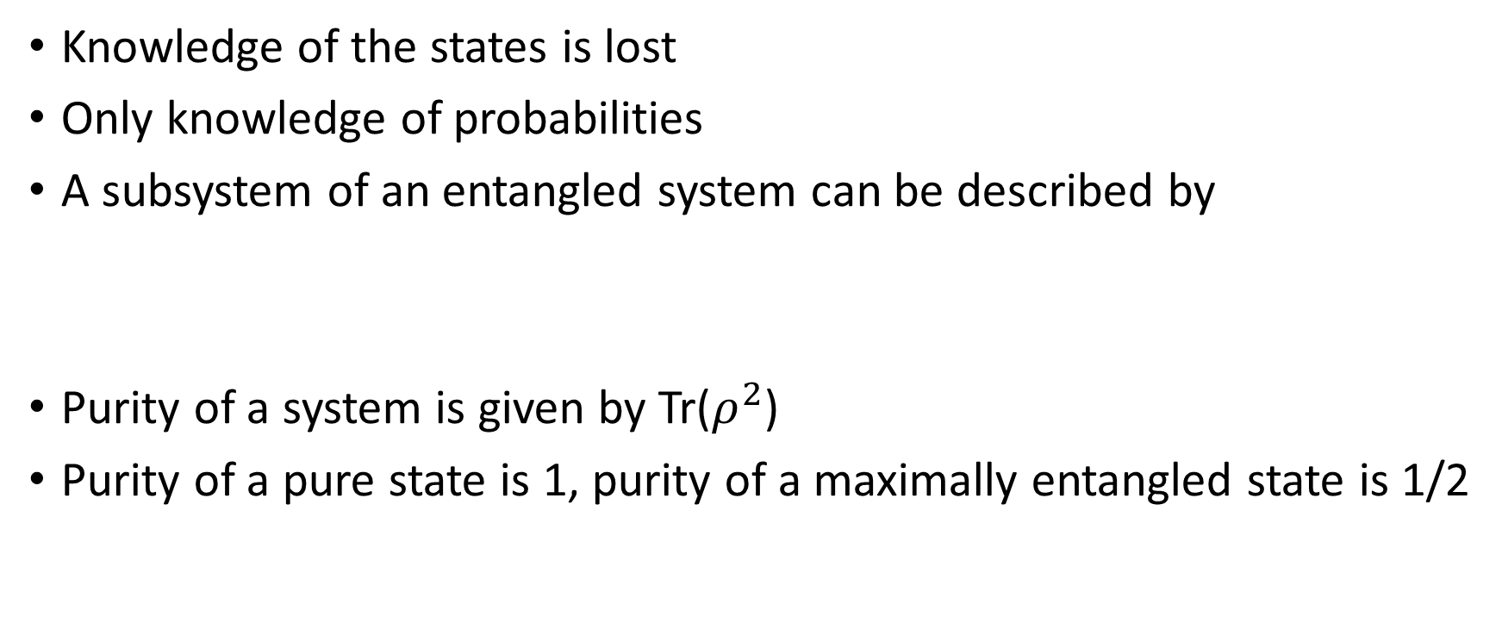
5. Information Loss
5.1 Density Matrix
Knowledge of the states is lost
Only knowledge of probabilities
A subsystem of an entangled system can be described by
Purity of a system is given by Tr($ρ^{2}$)
Purity of a pure state is 1, purity of a maximally entangled state is 1/2

Slide 52
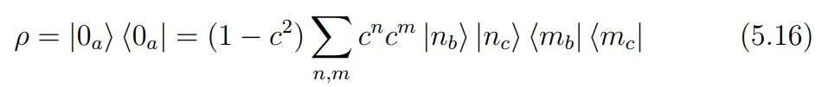
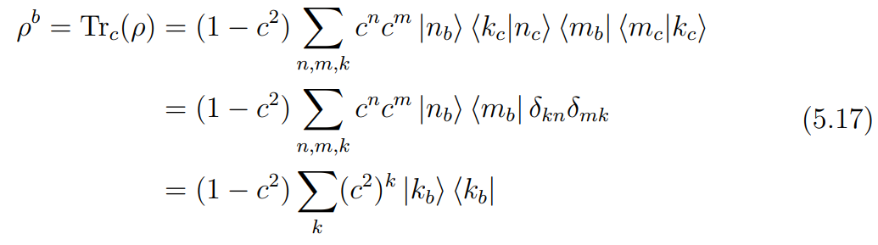
5. Information Loss
5.1 Density Matrix
What is the purity of Hawking radiation?
We normalize the vacuum state then find the density matrix
The reduced density matrix for the radiation is

Slide 53
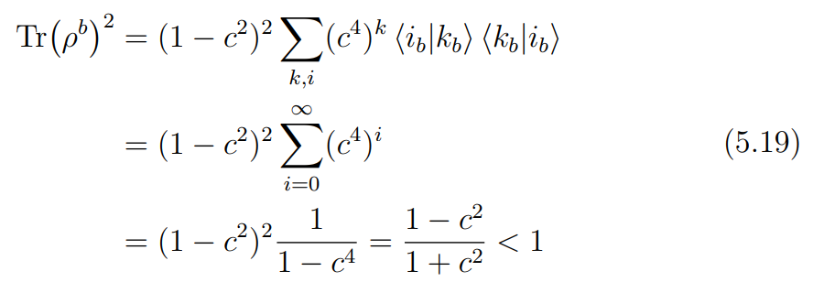
5. Information Loss
5.1 Density Matrix
The purity of this matrix is
The state of the radiation is mixed, we lost information about the state!

Slide 54

5. Information Loss
5.1 Density Matrix
This contradicts QM unitary evolution property
BH evaporation cannot be described by a purely QM process!
Scattering is evolved by $-matrix (non-unitary) instead of S-matrix

Slide 55

6. Conclusion
BH have thermodynamical properties
This leads to contradictions with GR and QM
Information loss leads to non-unitary quantum evolution
  Gravity similarities to statistical mechanics (Universality)
Extending the analysis to rotating and charged BH is possible
Describing BH using a few state variables
  Where did information about initial matter go?

Slide 56
7. References
[1] J D Bekenstein. Black holes and the second law. Lett. Al Nuovo Cimento, 4(15):737–740, August 1972.
[2] S M Carroll. Quantum field theory in curved spacetime. In Spacetime and geometry: An introduction to general relativity. Pearson, Harlow, 2013.
[3] S M Carroll. The schwarzschild solution. In Spacetime and geometry: An introduction to general relativity. Pearson, Harlow, 2013.
[4] S W Hawking. Particle creation by black holes. Commun. Math. Phys., 43(3):199–220, August 1975.

Slide 57
7. References
[5] S W Hawking. Breakdown of predictability in gravitational collapse. Phys. Rev. D Part. Fields, 14(10):2460–2473, November 1976.
[6] Mehran Kardar. Quantum statistical mechanics. In Statistical Physics of Particles, pages 156–180. Cambridge University Press, Cambridge, June 2007.
[7] Samir D Mathur. What exactly is the information paradox? March 2008.
[8] Leonard Parker. Probability distribution of particles created by a black hole. Phys. Rev. D Part. Fields, 12(6):1519–1525, September 1975.

Slide 58
Thank You!

