Slide 1

Exotic Higgs Decays
Ahmed Bastawy
Supervisor: Dr. Ahmed Ali

Slide 2
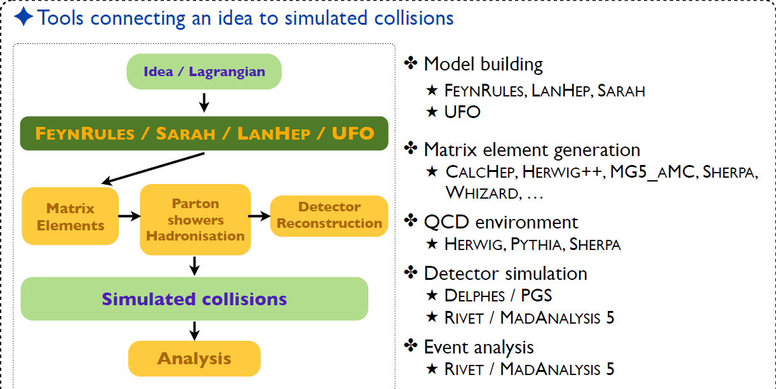
Search Methodology

Slide 3
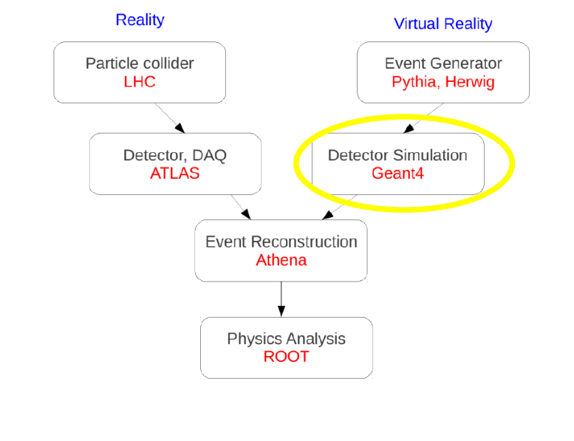
Illustration

Slide 4
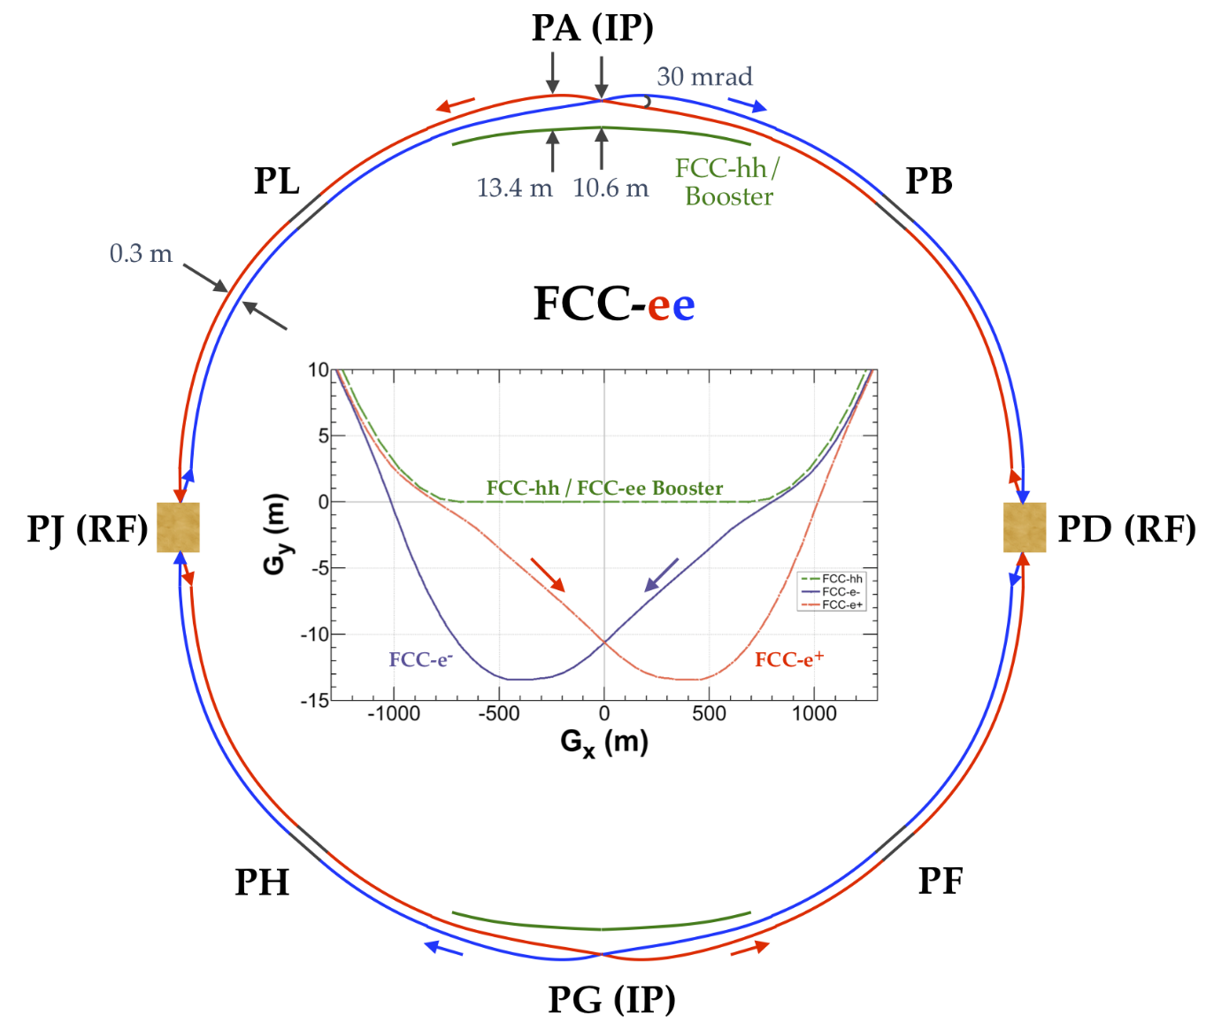
FCC-ee layout

Slide 5
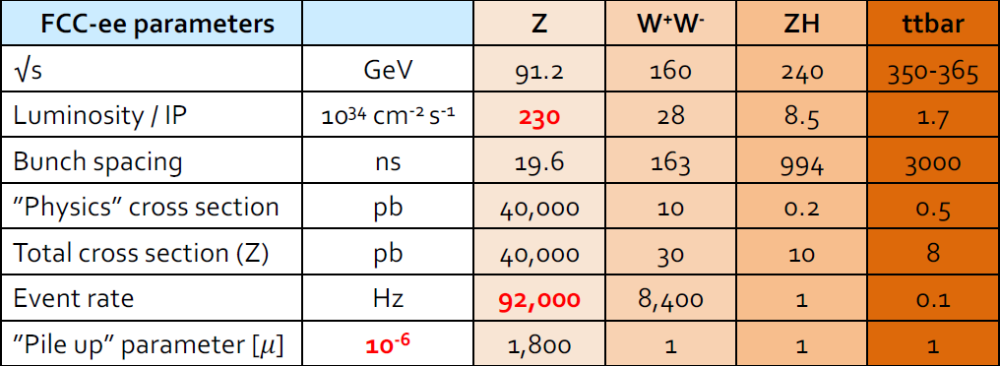
FCC-ee Conditions

Slide 6
Collider Study and New Physics
Experimental motivations:
Dark matter
Neutrino Masses
Experimental Anomalies
Theoretical motivations:
Hierarchy Problem
Quantum Gravity

Slide 7
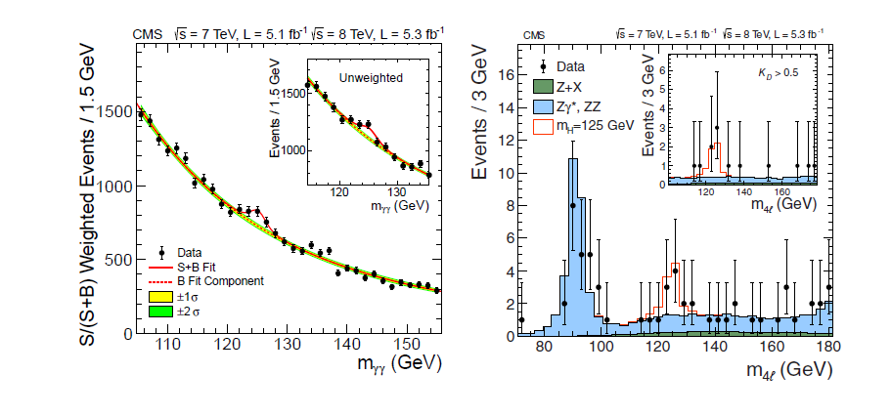
Higgs Boson Discovery and History

Slide 8
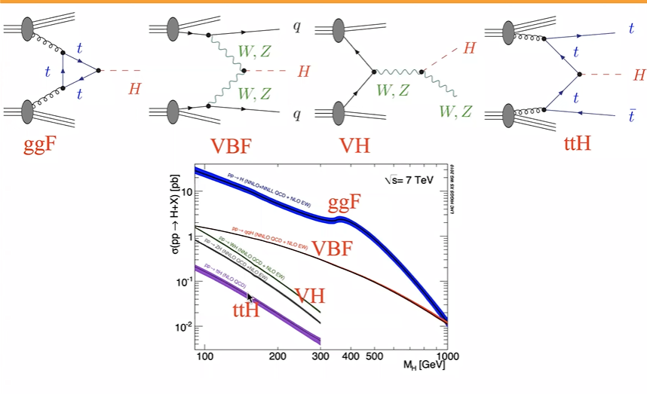
Higgs Production and Decay

Slide 9
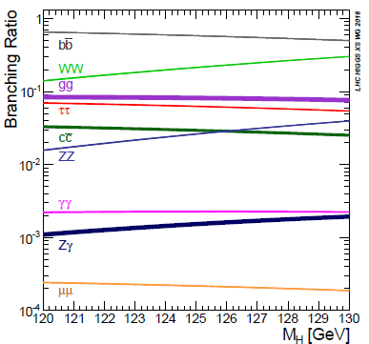
Branching fractions of Higgs

Slide 10
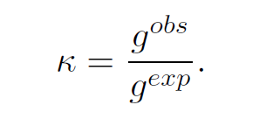

Framework for Data Interpretation

Slide 11
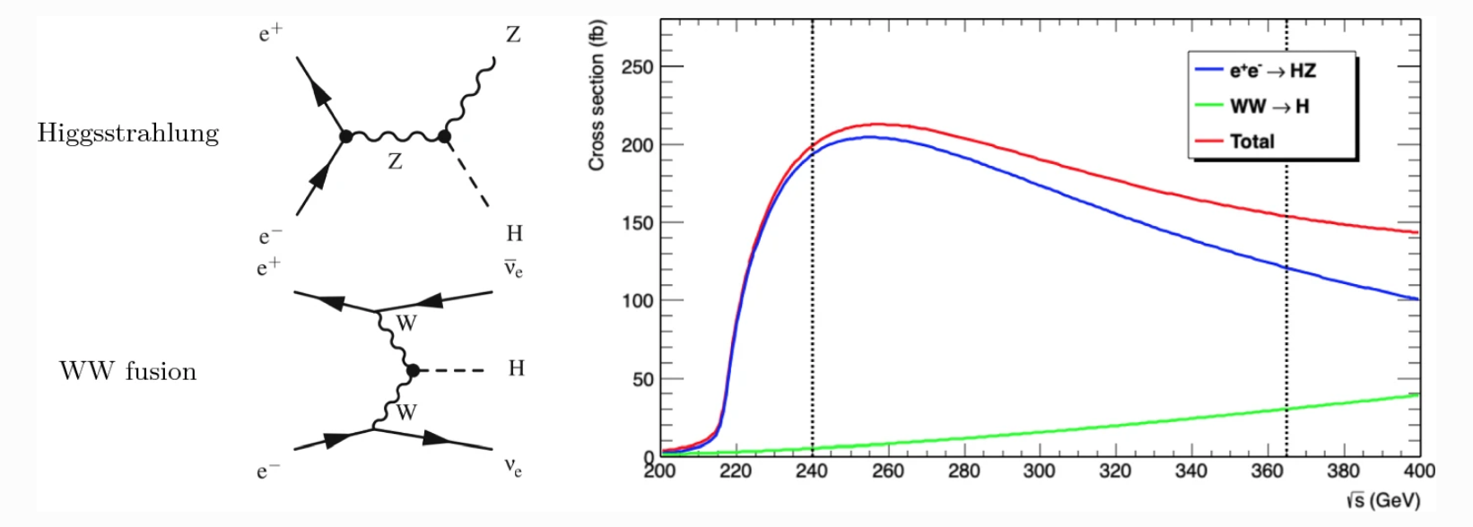
Higgs Precision Measurements at FCC-ee

Slide 12
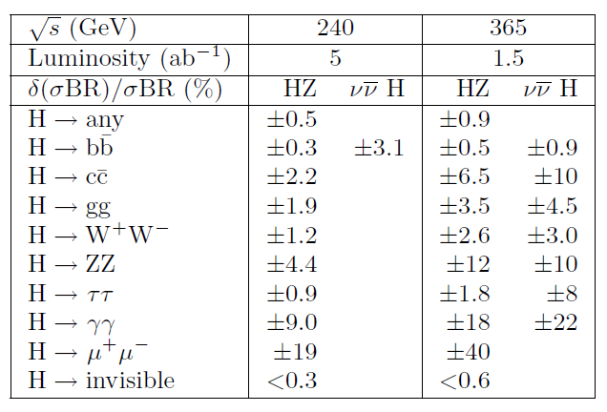
Expected statistical precision

Slide 13
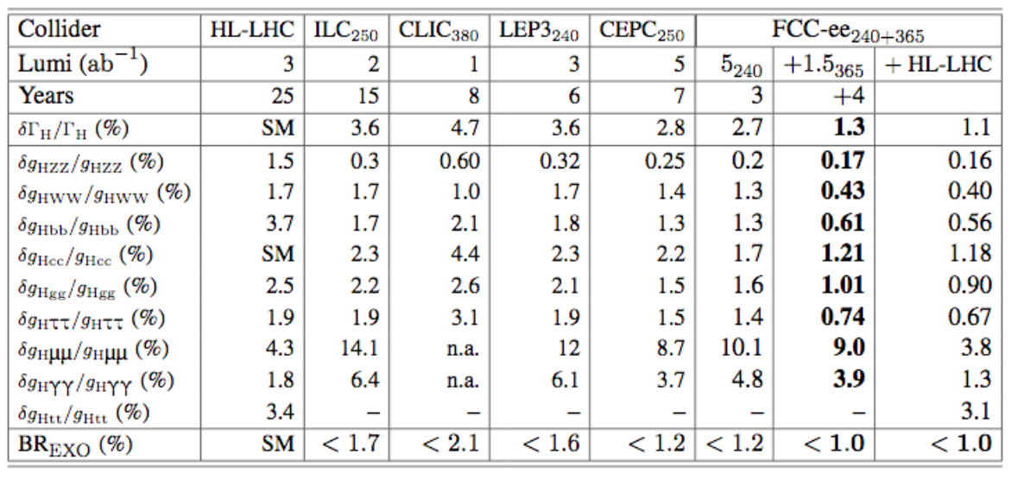
Coupling measurements comparison

Slide 14
Higgs decay to J/ψ and a photon
offers experimentally a clear and clean final state to investigate Yukawa couplings deviations from SM predictions.
Higgs precision measurements of this decay will use as an indication to observe deviations from SM predictions for the Hcc coupling.

Slide 15
References
[1] B. Fuks. (2019). From Lagrangians to events [PDF document]. Available:https://indico.cern.ch/event/829653/contributions/3568497/
[2] Lund University. (2020). Modern Experimental Particle Physics. [Online]. Available: https://www.hep.lu.se/courses/fyst17/
[3] F. Zimmermann. (2019). FCC-ee overview [PDF document]. Available:https://indico.cern.ch/event/763554/contributions/3360902/attachments/1818049/2972300/FCALMarch.
[4] A. Abada et al, ”FCC Physics Opportunities: Future Circular ColliderConceptual Design Report Volume 1,” Eur. Phys. J. C 79:474, 2018.[Online].Available: https://cds.cern.ch/record/2651294/files/CERN-ACC-2018-0056.pdf

Slide 16
[5] F. Kling, “EXOTIC HIGGS DECAYS,” Ph.D. dissertation, Dept. Physics.Univ. THE UNIVERSITY OF ARIZONA,2016. [Online]. Available: https://s3.cern.ch/inspireprodfilesa/a202d9674d8a808d36a4235d08fa7870
[6] S. Mukherjee, “Measurement of the properties of the Higgs boson in CMS experiment at the LHC,” Ph.D. dissertation, Dept.High Energy Physics.Univ. Tata Institute of Fundamental Research, Mumbai,2023. [Online]. Available: https://cds.cern.ch/record/2860805?ln=en
[7]G. Bodwin et al,” Higgs boson decays to quarkonia and the Hccbarcoupling,” PHYSICAL REVIEW D 88, 053003, 2013.[Online]. Available:https://arxiv.org/abs/1306.5770

