Slide 1
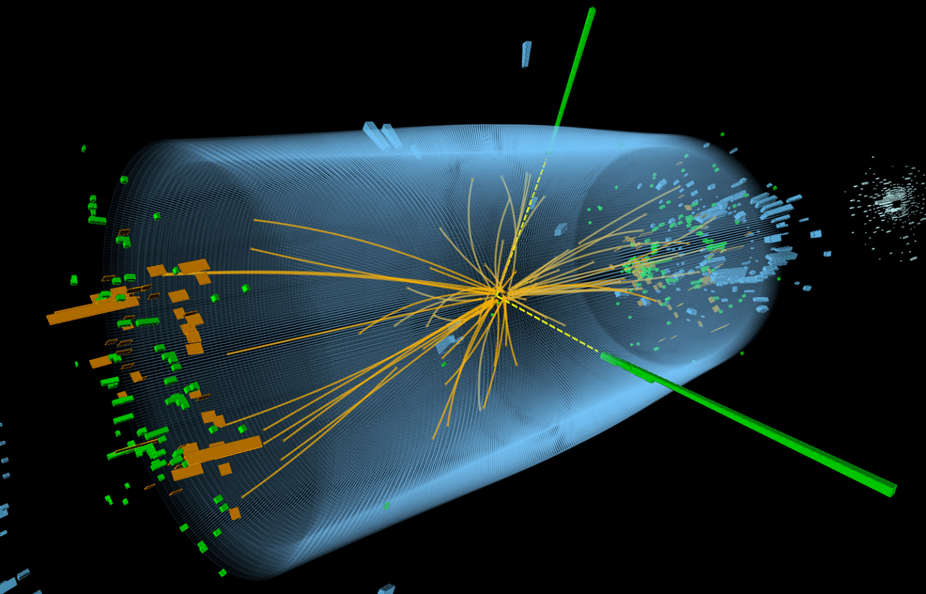


Advanced Particle Tracking in the MATHUSLA Experiment: Harnessing the Power of Non-linear Kalman Filter Algorithm
Submitted by : Ahmed Yahya
Under Supervision : Dr.Ahmed Ali

Slide 2
MATHUSLA Experiment

Slide 3
MAssive Timing Hodoscope for Ultra-Stable neutraL pArticles
Experiment

Slide 4
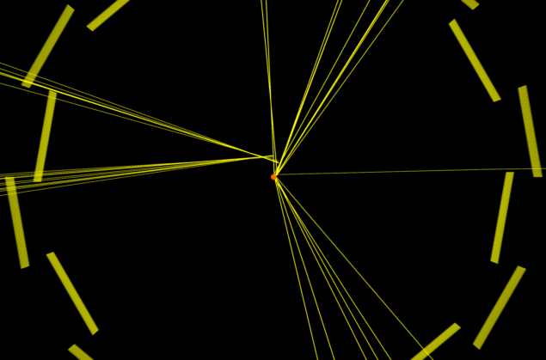
L
Notes:
A simulated CMS collision where a long-lived particle travels a short distance before it decays. Credit: CMS-PHO-EVENTS-2020-002-5

Slide 5
LL
Notes:
A simulated CMS collision where a long-lived particle travels a short distance before it decays. Credit: CMS-PHO-EVENTS-2020-002-5

Slide 6
LLP ..?
Notes:
A simulated CMS collision where a long-lived particle travels a short distance before it decays. Credit: CMS-PHO-EVENTS-2020-002-5

Slide 7
Notes:
A simulated CMS collision where a long-lived particle travels a short distance before it decays. Credit: CMS-PHO-EVENTS-2020-002-5

Slide 8
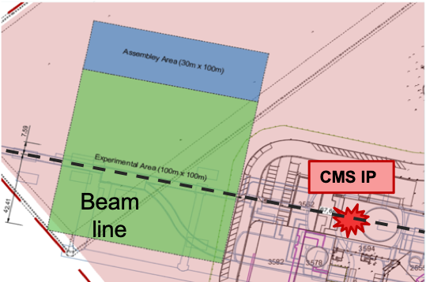
Location
  70 m from the CMS IP
  100 m x 100 m

Slide 9
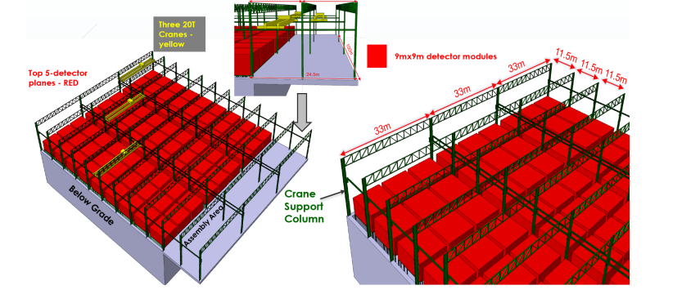

Slide 10
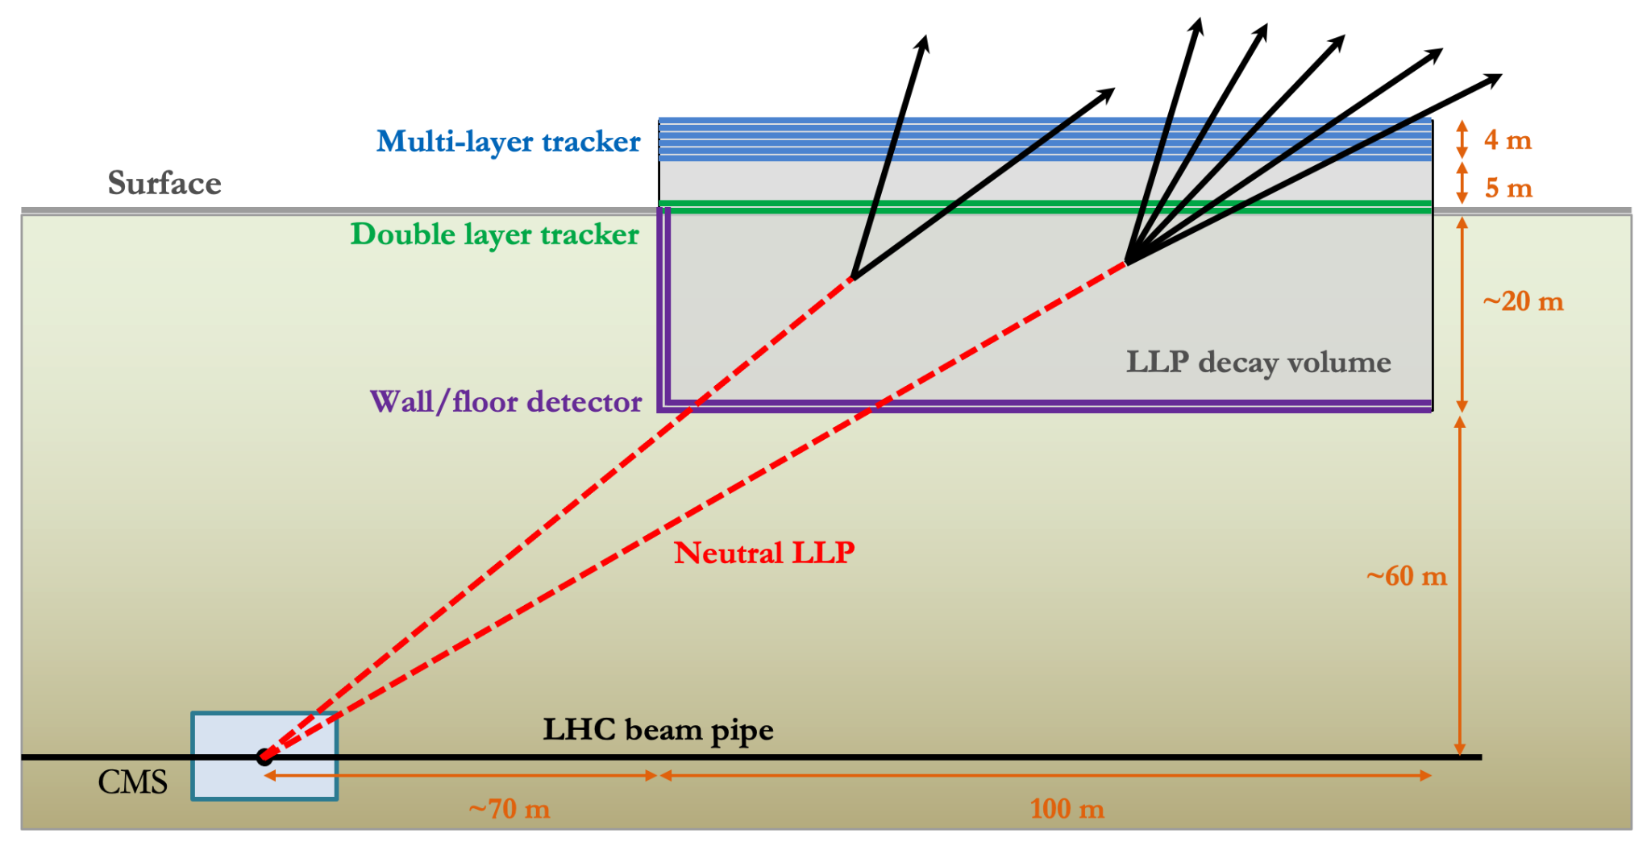

Slide 11
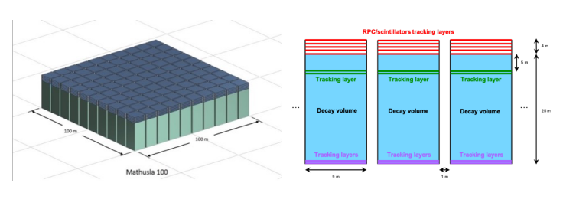

Slide 12
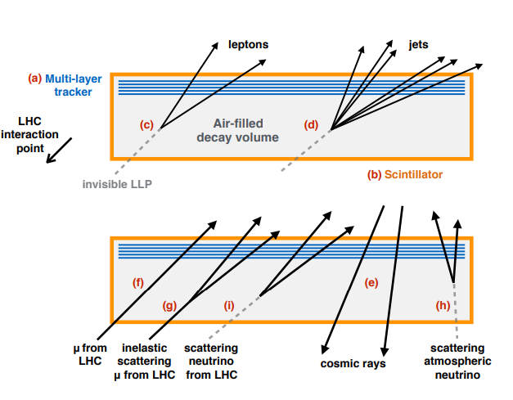

Slide 13
Kalman Filter

Slide 14
Kalman Filter
  The KF was initially brought into particle physics by the DELPHI experiment at CERN’s Large Electron-Positron (LEP) collide

Slide 15
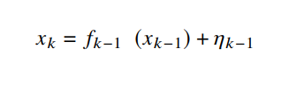
Extended Kalman Filter
  Track fitting with a Kalman filter requires evolving the track state and its associated covariance matrix, as it is propagated through a discrete dynamical system. This can be described by a track state propagation model:
where
• 𝑥_(𝑘−1) and 𝑥_(𝑘) are the track state vector at the states 𝑘 − 1 and 𝑘, respectively
• 𝜂_(𝑘−1) is the vector representing the noise when propagating from state 𝑘 − 1 to state 𝑘, i.e. process noise.
• 𝑓_(𝑘−1) 1 is the track state propagation model from 𝑘 − 1 to state 𝑘, which describes the motion of the particle. It
depends on the kinematics of the particle and the magnetic field

Slide 16
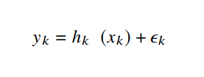
The track state is projected onto the measurement using the measurement projection model:
where,
  𝑦_(𝑘) is the measurement vector at state 𝑘
  𝜖_(𝑘) is the measurement noise vector at state 𝑘
  ℎ_(𝑘) is the measurement projection function from track state to measurement, which depends on the kinematics of the particles and detector geometry

Slide 17
The track state propagation model, f, and the measurement projection model, h, commonly involve nonlinear functions. The process noise 𝜂_(𝑘−1), and measurement noise 𝜖_(𝑘), are assumed to follow Gaussian distributions with mean zero and variances 𝑄_(𝑘) and 𝑉_(𝑘), respectively. It is important to note that while these assumptions are made, the actual distributions of the noise may not necessarily conform to a Gaussian distribution.

Slide 18
Extended Kalman Filter
  EKF counters limitations by linearizing a model utilizing a first-order Taylor expansion.

Slide 19
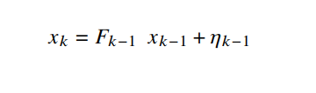
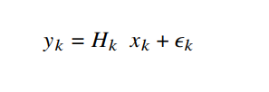
For the Extended Kalman Filter, the 𝑓 and ℎ are approximated with linear models as follows:
where 𝐹_(𝑘−1) is the first-order Taylor expansion of the track propagation function 𝑓 at state 𝑘 − 1, and 𝐻𝑘 is the first order Taylor expansion of the measurement projection function ℎ at state 𝑘. As before, 𝜂 and 𝜖 are the process and measurement noise vectors.

Slide 20
The Extended Kalman Filter (EKF) is executed in three stages:
  Prediction.
  Filtering.
  Smoothing.
During the prediction phase, the track state at state 𝑘 is extrapolated based on the preceding 𝑘 - 1 measurements. The filtering phase leverages the measurement at state 𝑘 to update the anticipated track state at the same state. Lastly, in the smoothing phase, the filtered track state undergoes refinement by contemplating all measurements.

Slide 21
The equations employed to revise the track state vector, 𝑥, and its covariance, 𝐶, are contingent on the distinct implementation of the EKF and the employed mathematical models. These equations amalgamate the predicted track state, the measurement at state 𝑘, and the noise attributes.
The exact mathematical expressions for updating 𝑥 and 𝐶 oscillate based on the specific application and the governing physics.

Slide 22
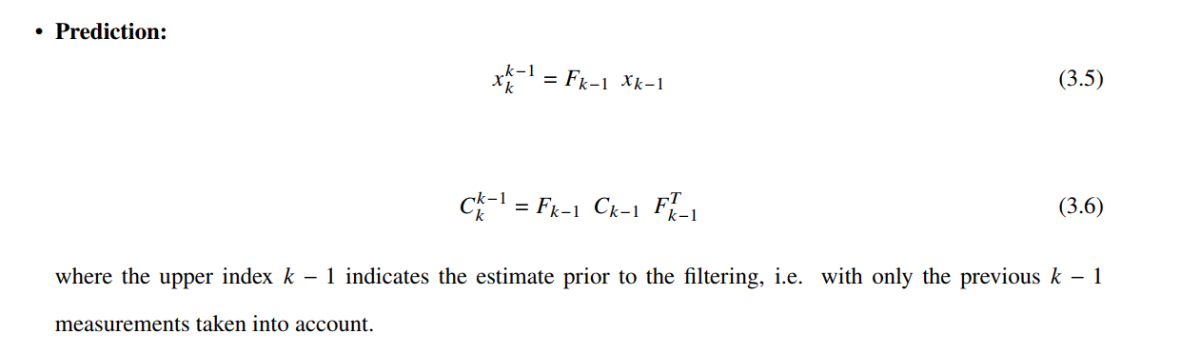

Slide 23
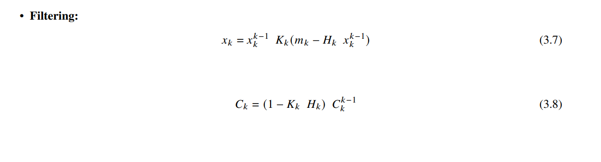
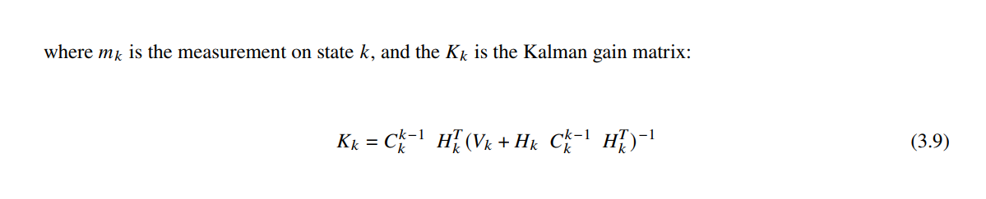

Slide 24
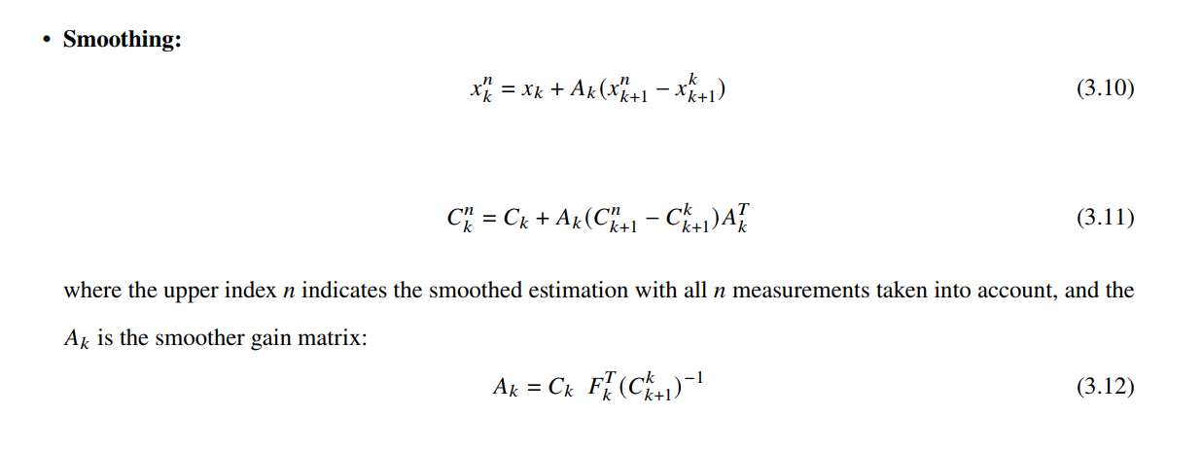

Slide 25
The Implementation of EKF on MATHUSLA experiment
And the Results

Slide 26
This implementation adhered to the steps outlined in section of the Extended Kalman Filter; commencing with seed preparation, followed by prediction, filtering, and concluding with smoothing.
Given the proximity of results yielded by the Kalman Filter and linear fitting at high energy, linear fitting functions were applied to the truth and hit collection data for comparative analysis against reconstructions derived from the Extended Kalman Filter

Slide 27
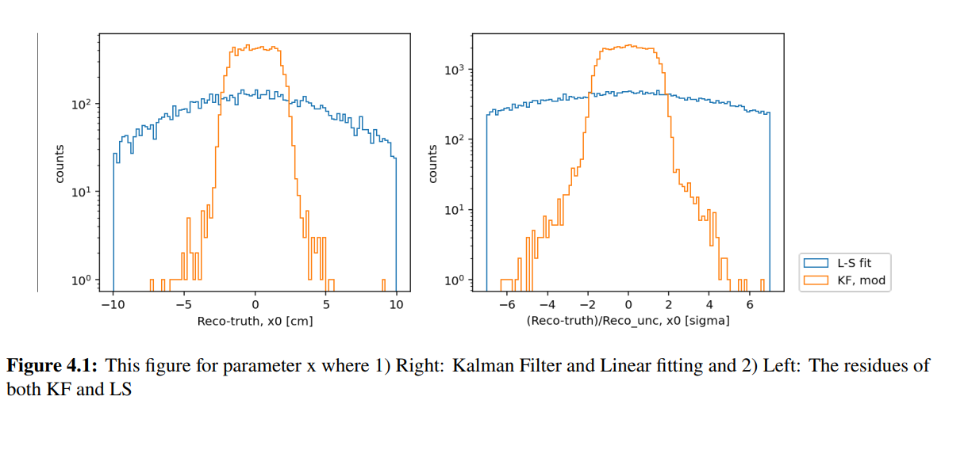

Slide 28
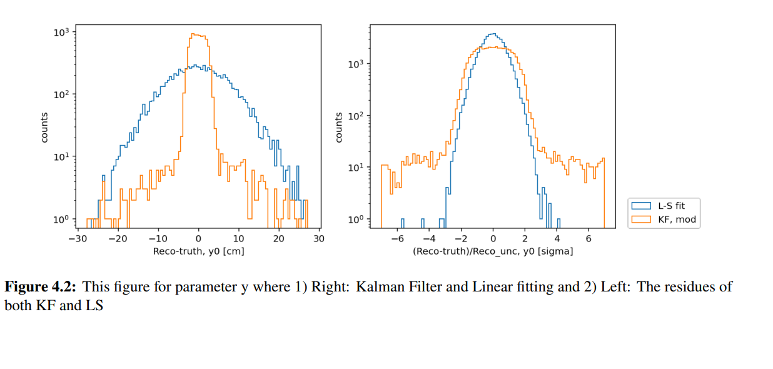

Slide 29
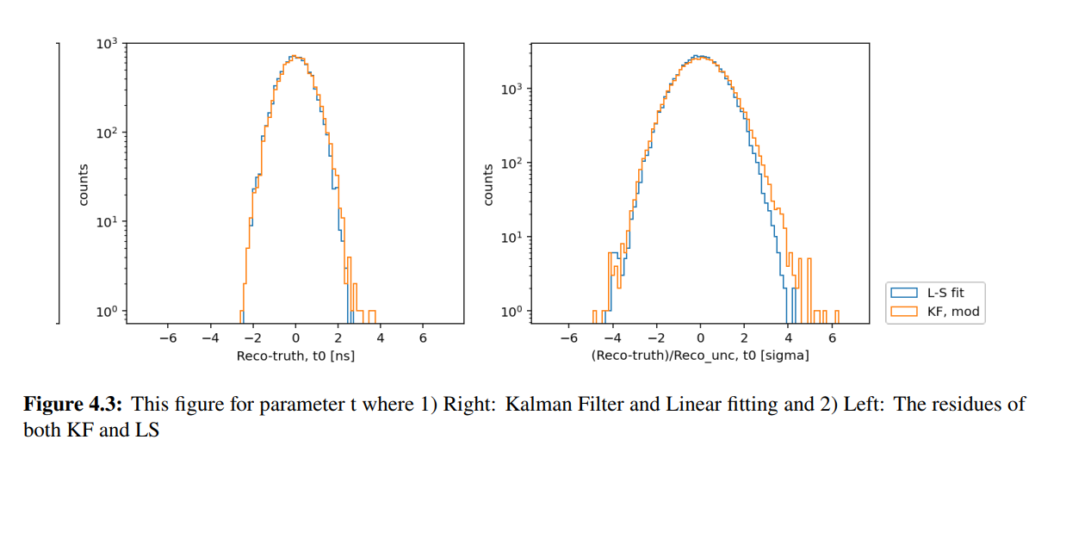

Slide 30
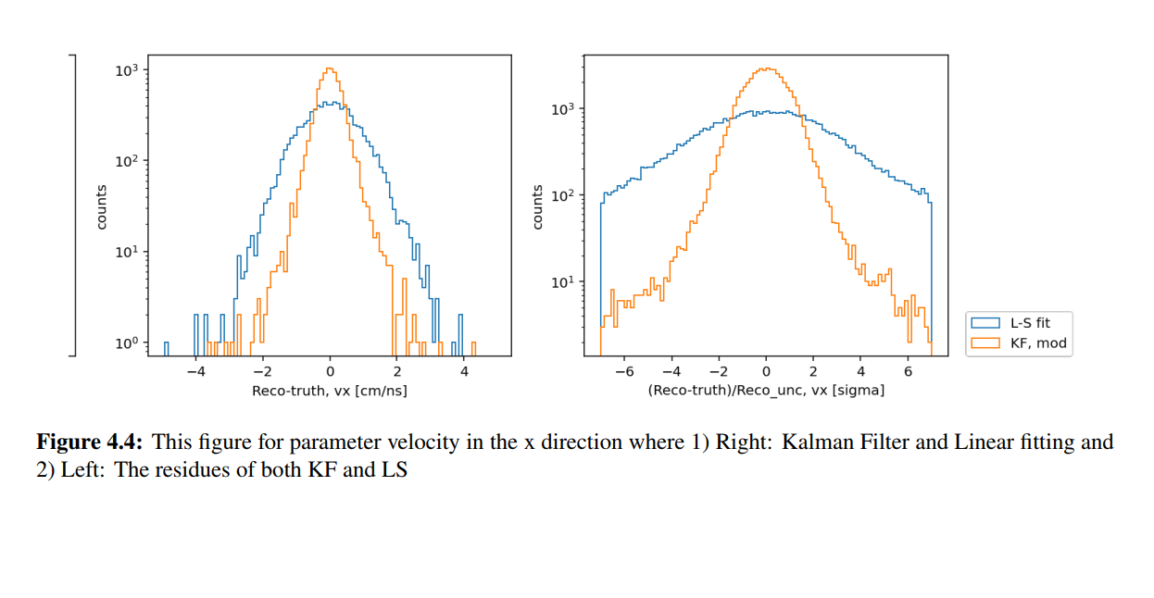

Slide 31
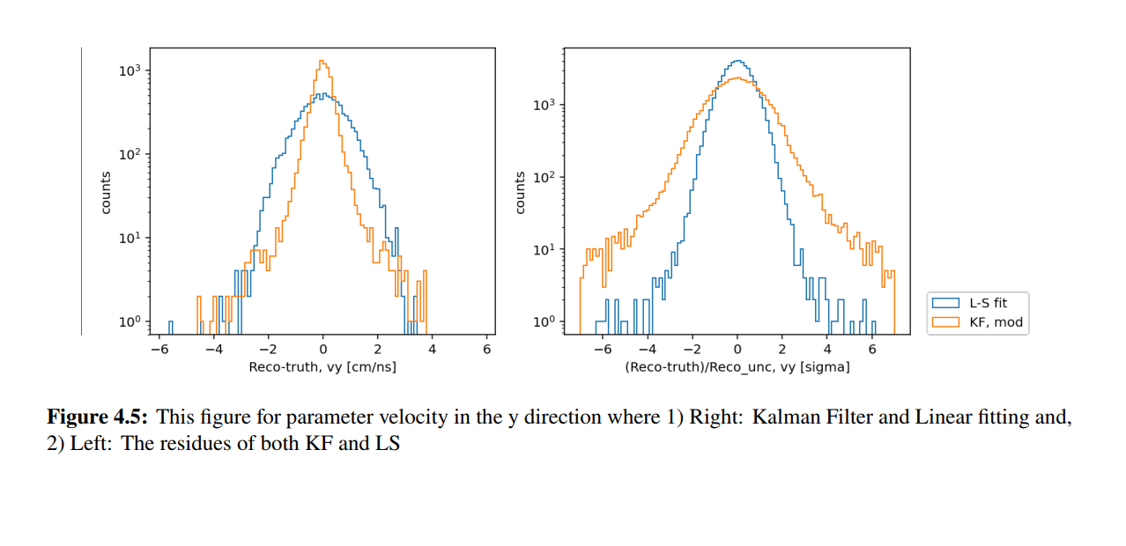

Slide 32
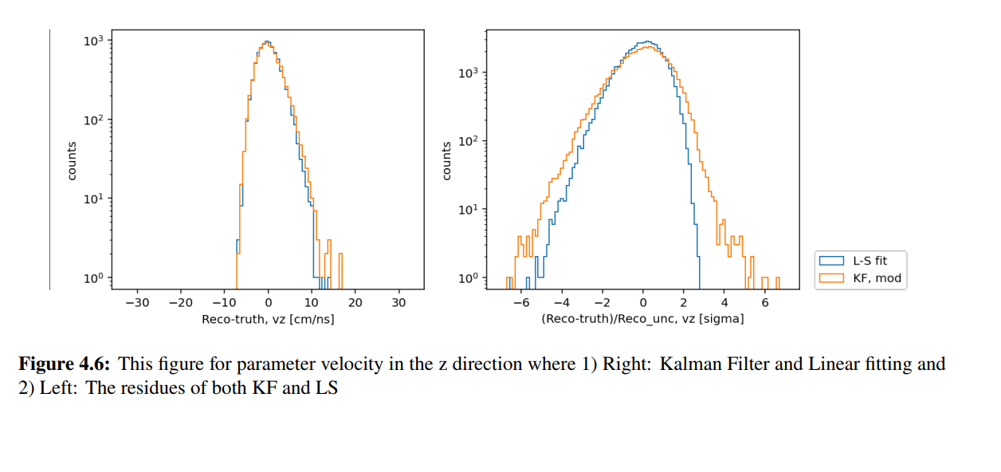

Slide 33
Questions ?!

Slide 34
THANKS

