Slide 1
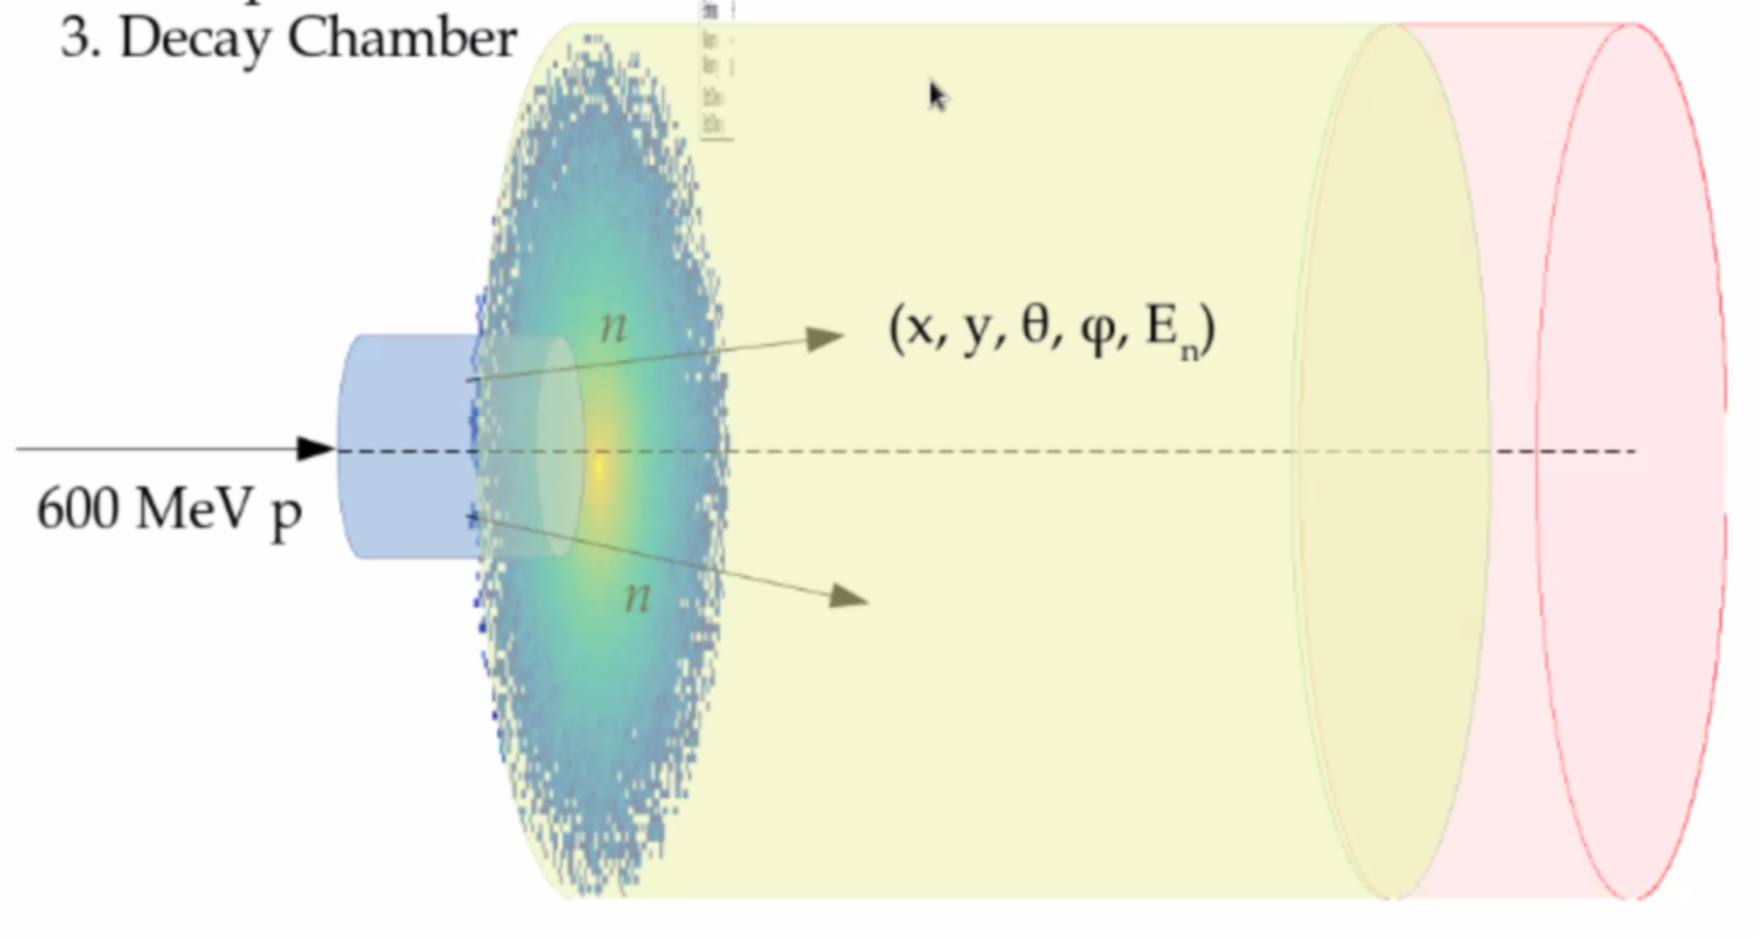
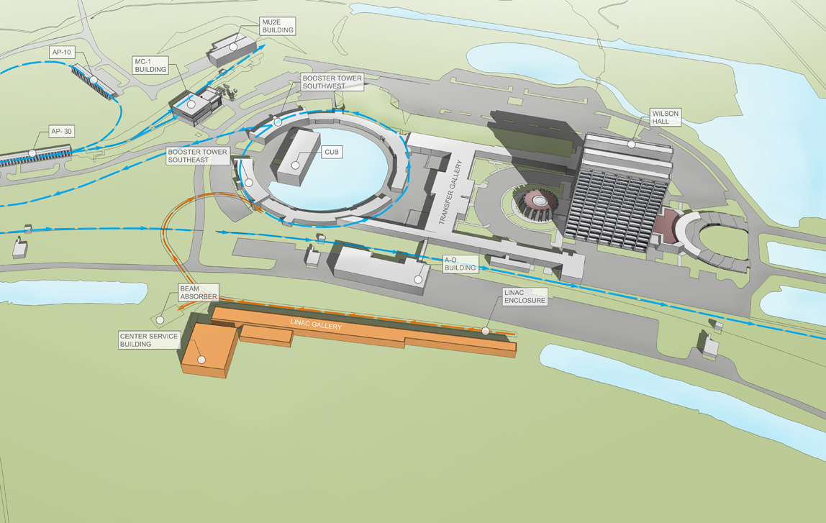
DAMSA
Decay Volume Materials -
Jacob Bogenschuetz

Slide 2
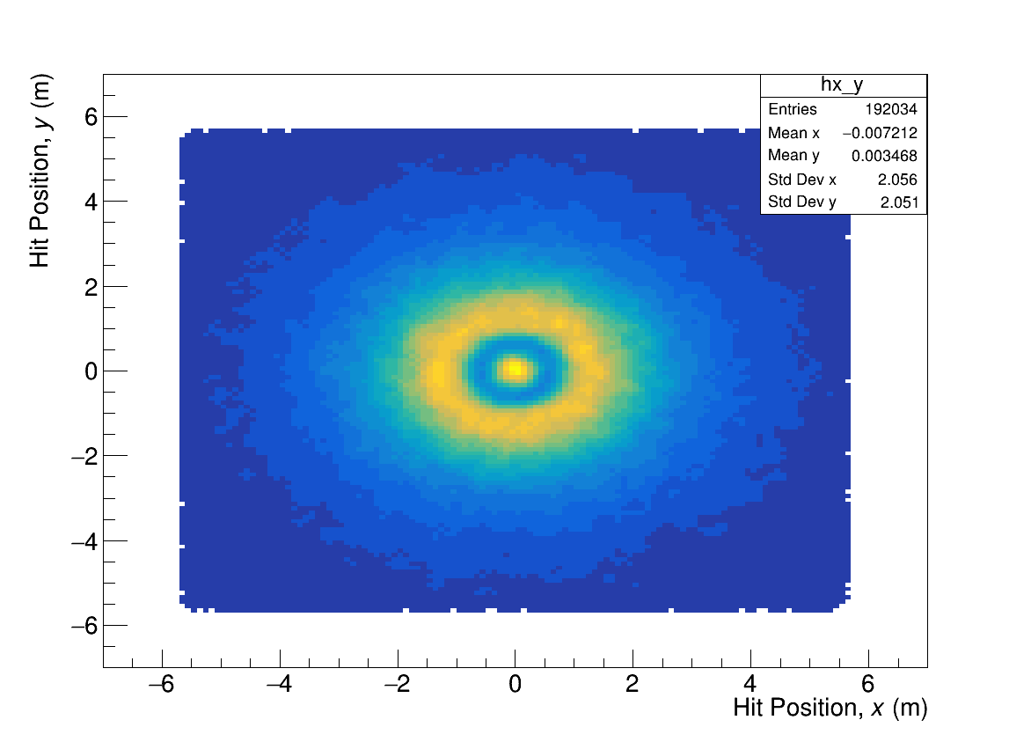
Neutron Distribution
Neutron Distribution
Vacuum Chamber Simulation
Dump
(Neutron Distro Sim)

Slide 3
Configuration effect on Photons/Signal
No Shell
No Volume
PVT
He 1am
Iron Shell
Vacuum
He_VacCore

Slide 4
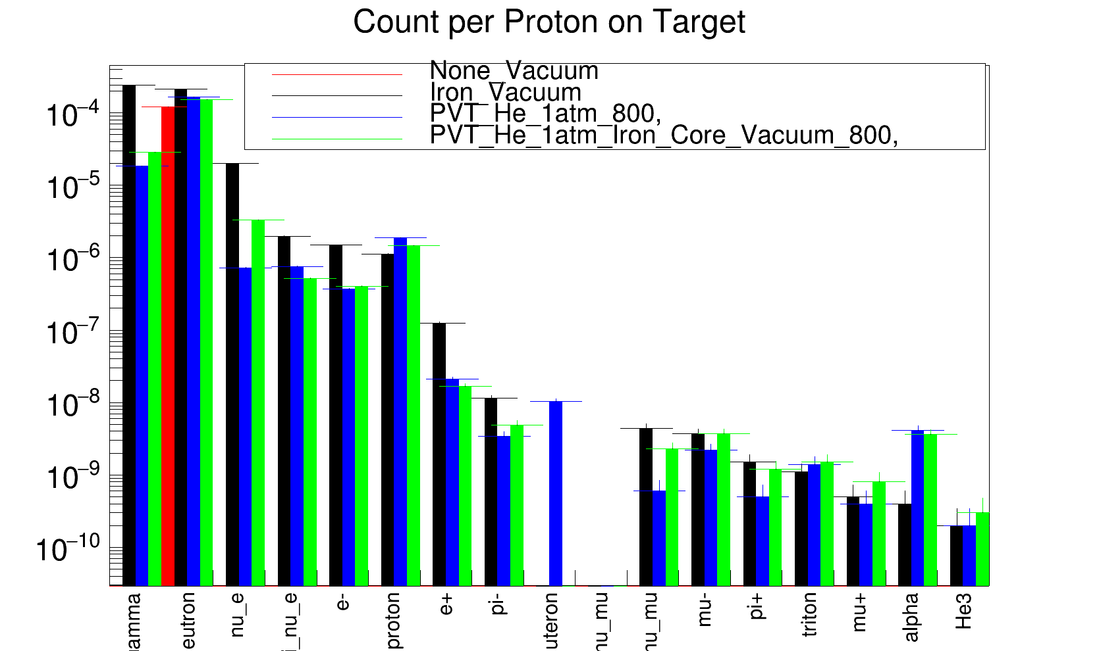
Neutron - Configuration Comparison
None
Iron
PVT
He
VacCore

Slide 5
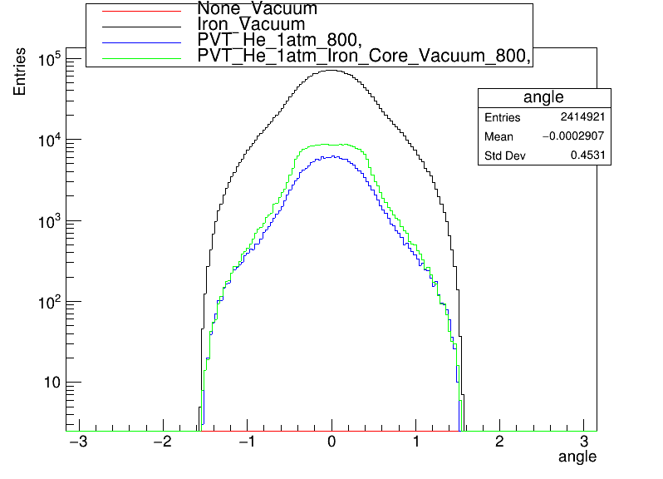
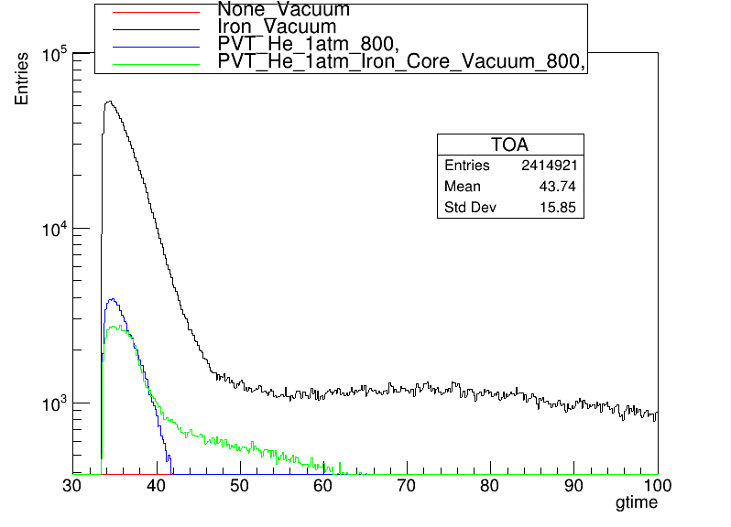
Neutron - Configuration Comparison
None
Iron
PVT
He
VacCore

Slide 6
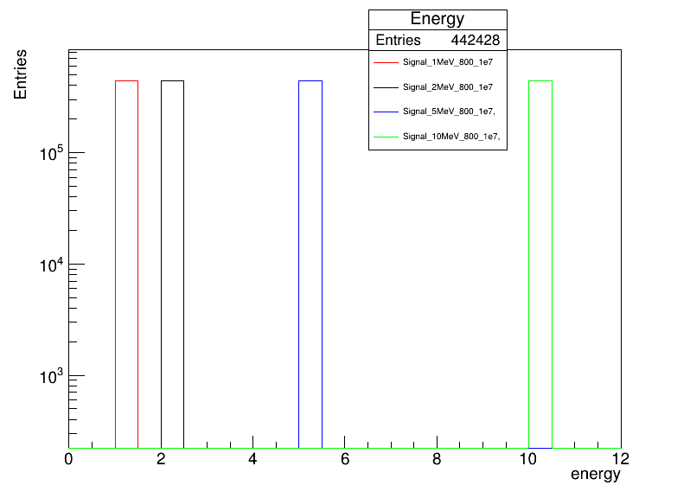
Investigate Signal Integrity
Gaussian Distribution at distinct energies (MeV)->1,2,5,10,20,50,100,200,500
Decay
Volume

Slide 7
Material effect on Photons/Signal
No Shell
No Volume
No Shell
He 1am
Iron Shell (1cm)
Vacuum
PVT Shell (1mm)
Vacuum

Slide 8
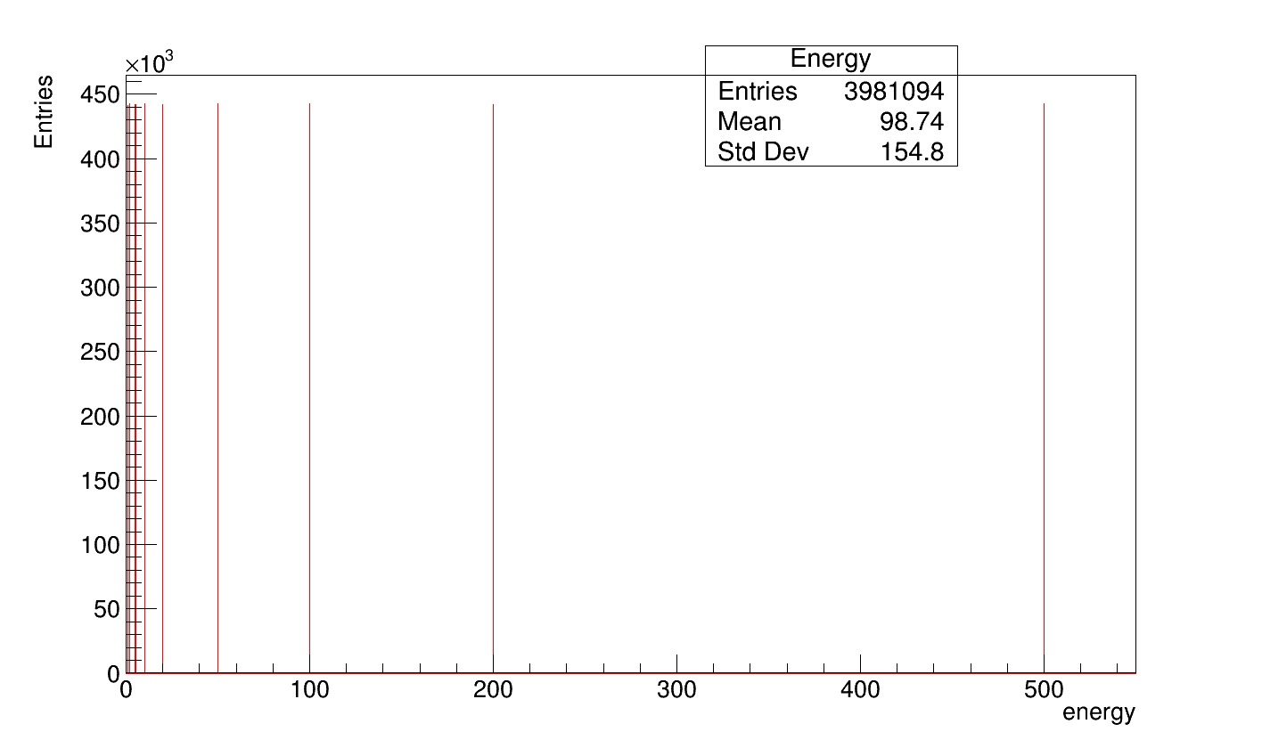
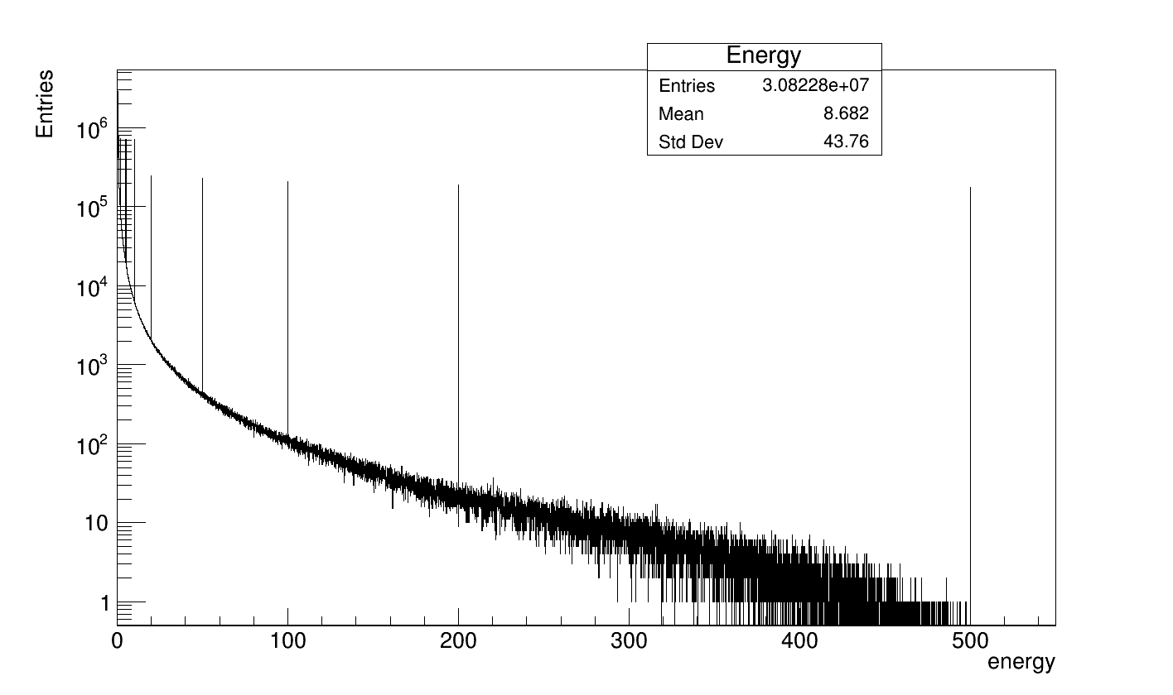
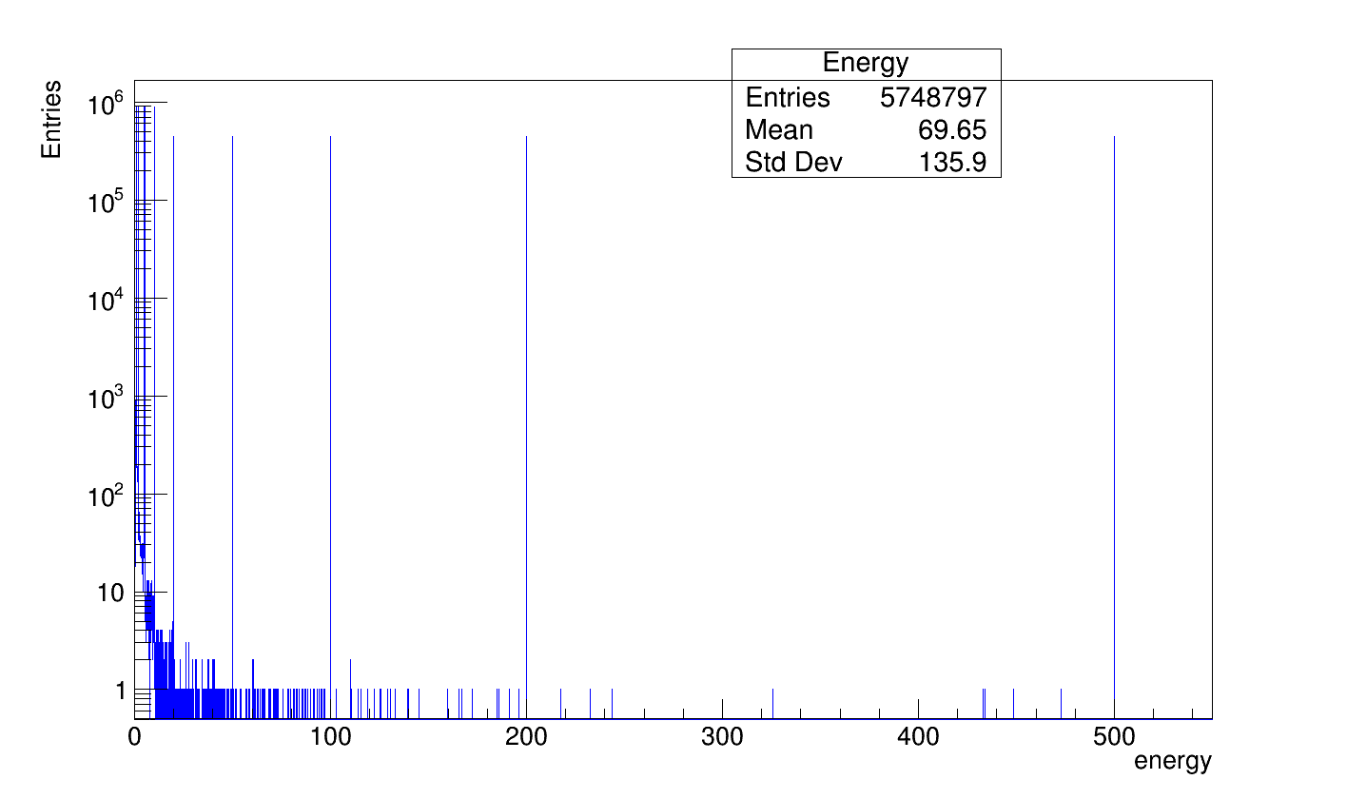
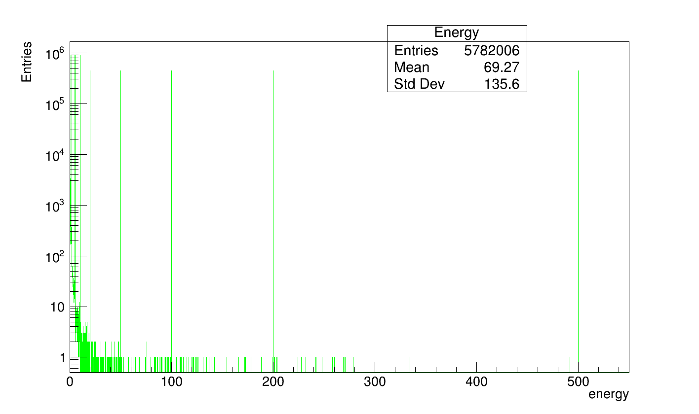
Photon - Signal Attenuation
None
Vacuum
Vacuum (Control)
Iron
Iron (1cm)
Vacuum
None
He
PVT (1mm)
Vacuum
He
PVT

Slide 9
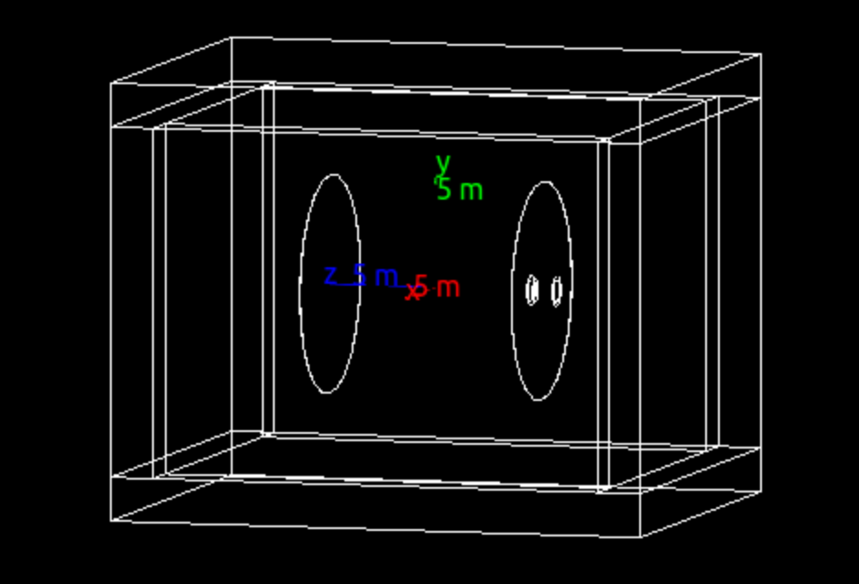

Next Steps
Neutron Background
  Neutron distribution sim sensor area (Jacob/Brian)
McStas/Comsol (Rohit/Brian)
Concrete 20x20x25
Full Sim
Signal Attenuation
  Plan
  Consider ALP as well as photon signal

Slide 10
END

Slide 11
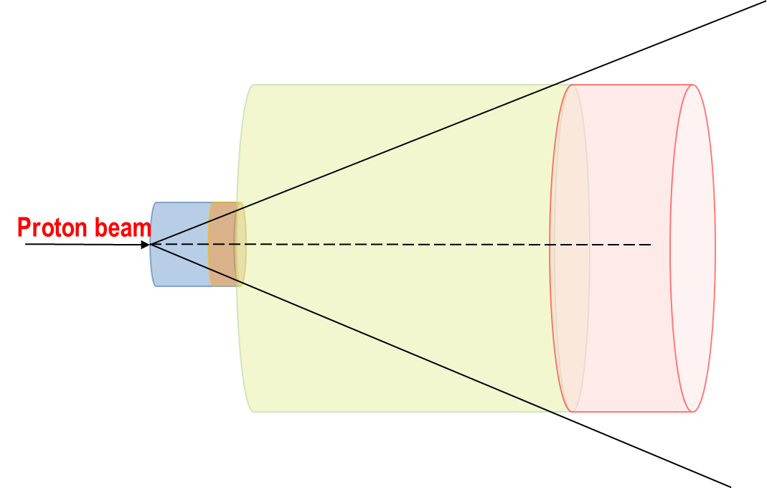

Slide 12
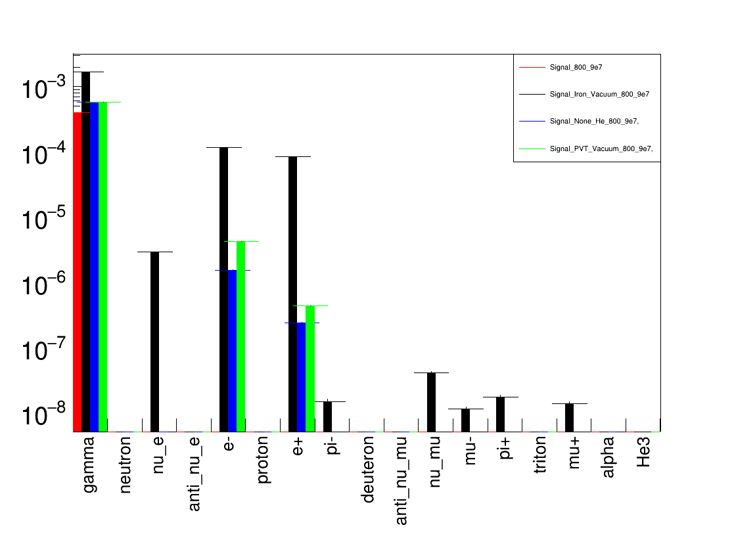
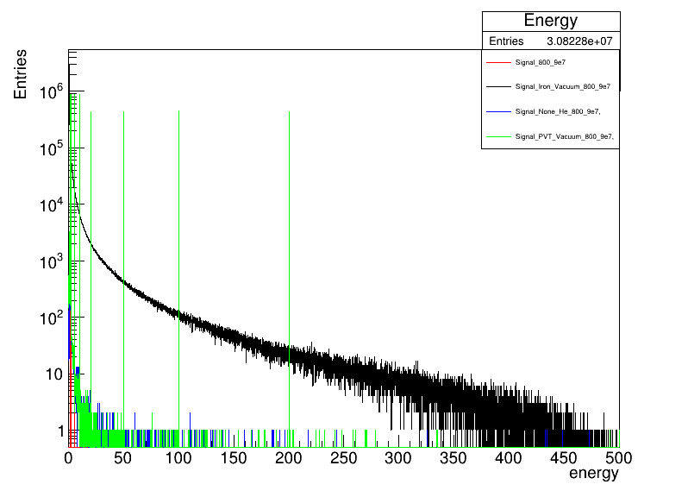
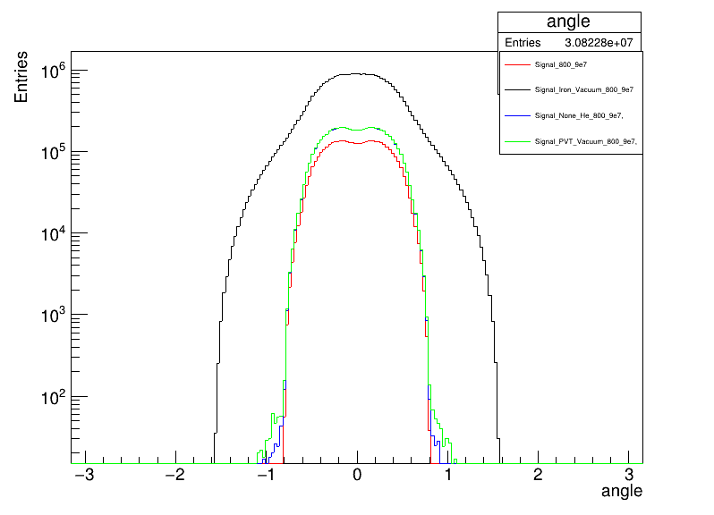
Photon - Material - Particles/Gamma on Volume
None
Vacuum
Iron
Vacuum
None
He
PVT
Vacuum

Slide 13
