Slide 1
Beam Screen FCC-hh test design and test in SM18
C. Petrone
With contributions from: Ruth Diaz Vez, Franco Mangiarotti, Mariano Pentella
FCC-hh beam screen (16 June 2023) · Indico (cern.ch)
CERN, 16th June 2023

Slide 2
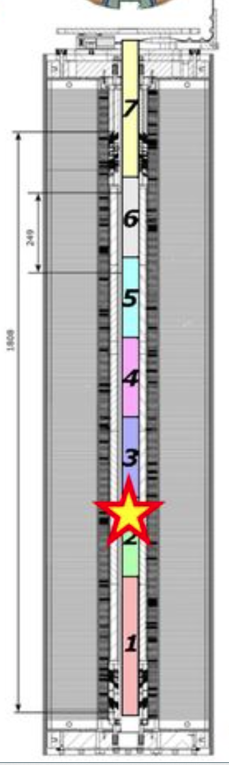
Beam Screen FCC-hh test design and test in SM18: SP107
Equipment Identifier: HCMBHSP001-CR000071
Other Identifier: SP107a
Ambient measurements results EDMS: 1997969
Cold magnetic measurements results EDMS: 2083288

Slide 3
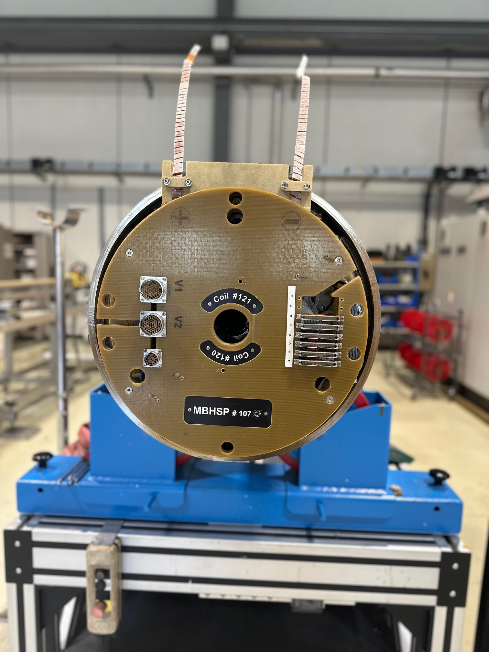
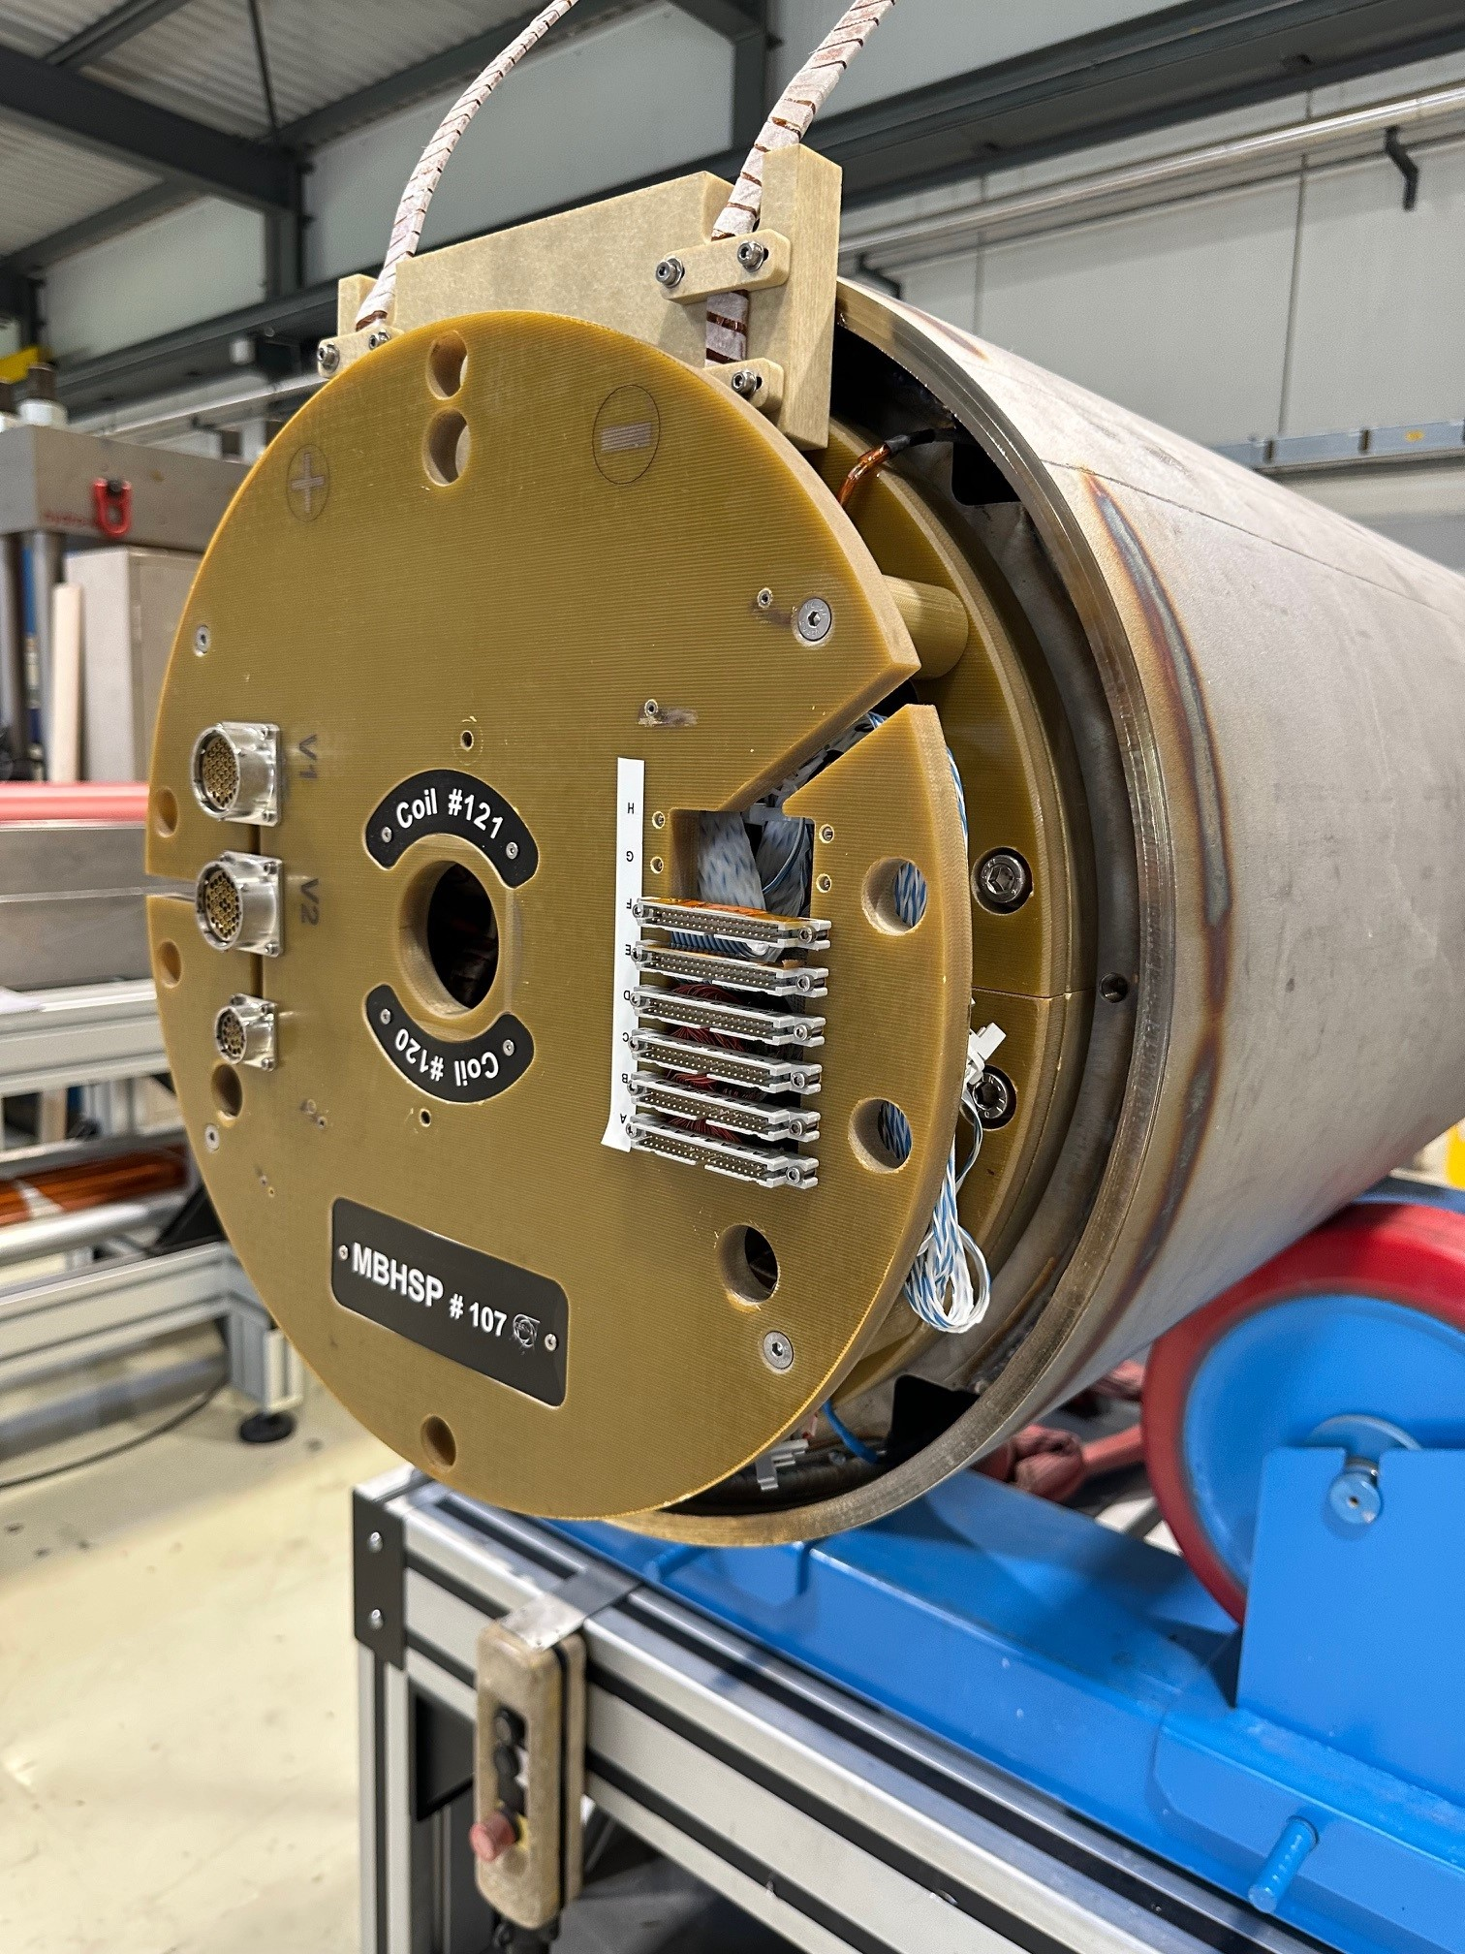
Beam Screen FCC-hh test design and test in SM18: SP107

Slide 4
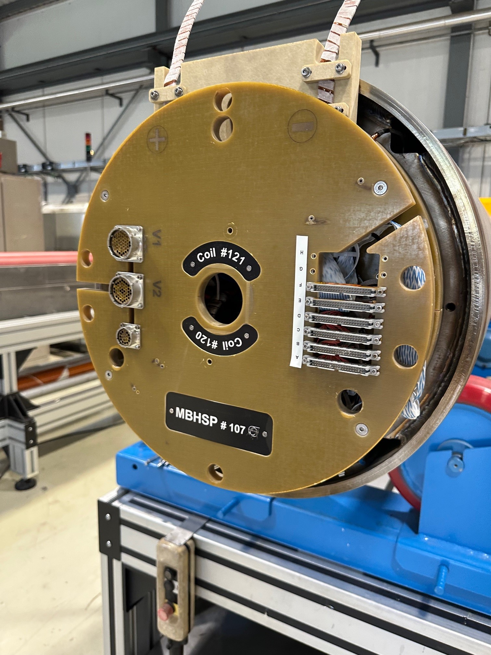
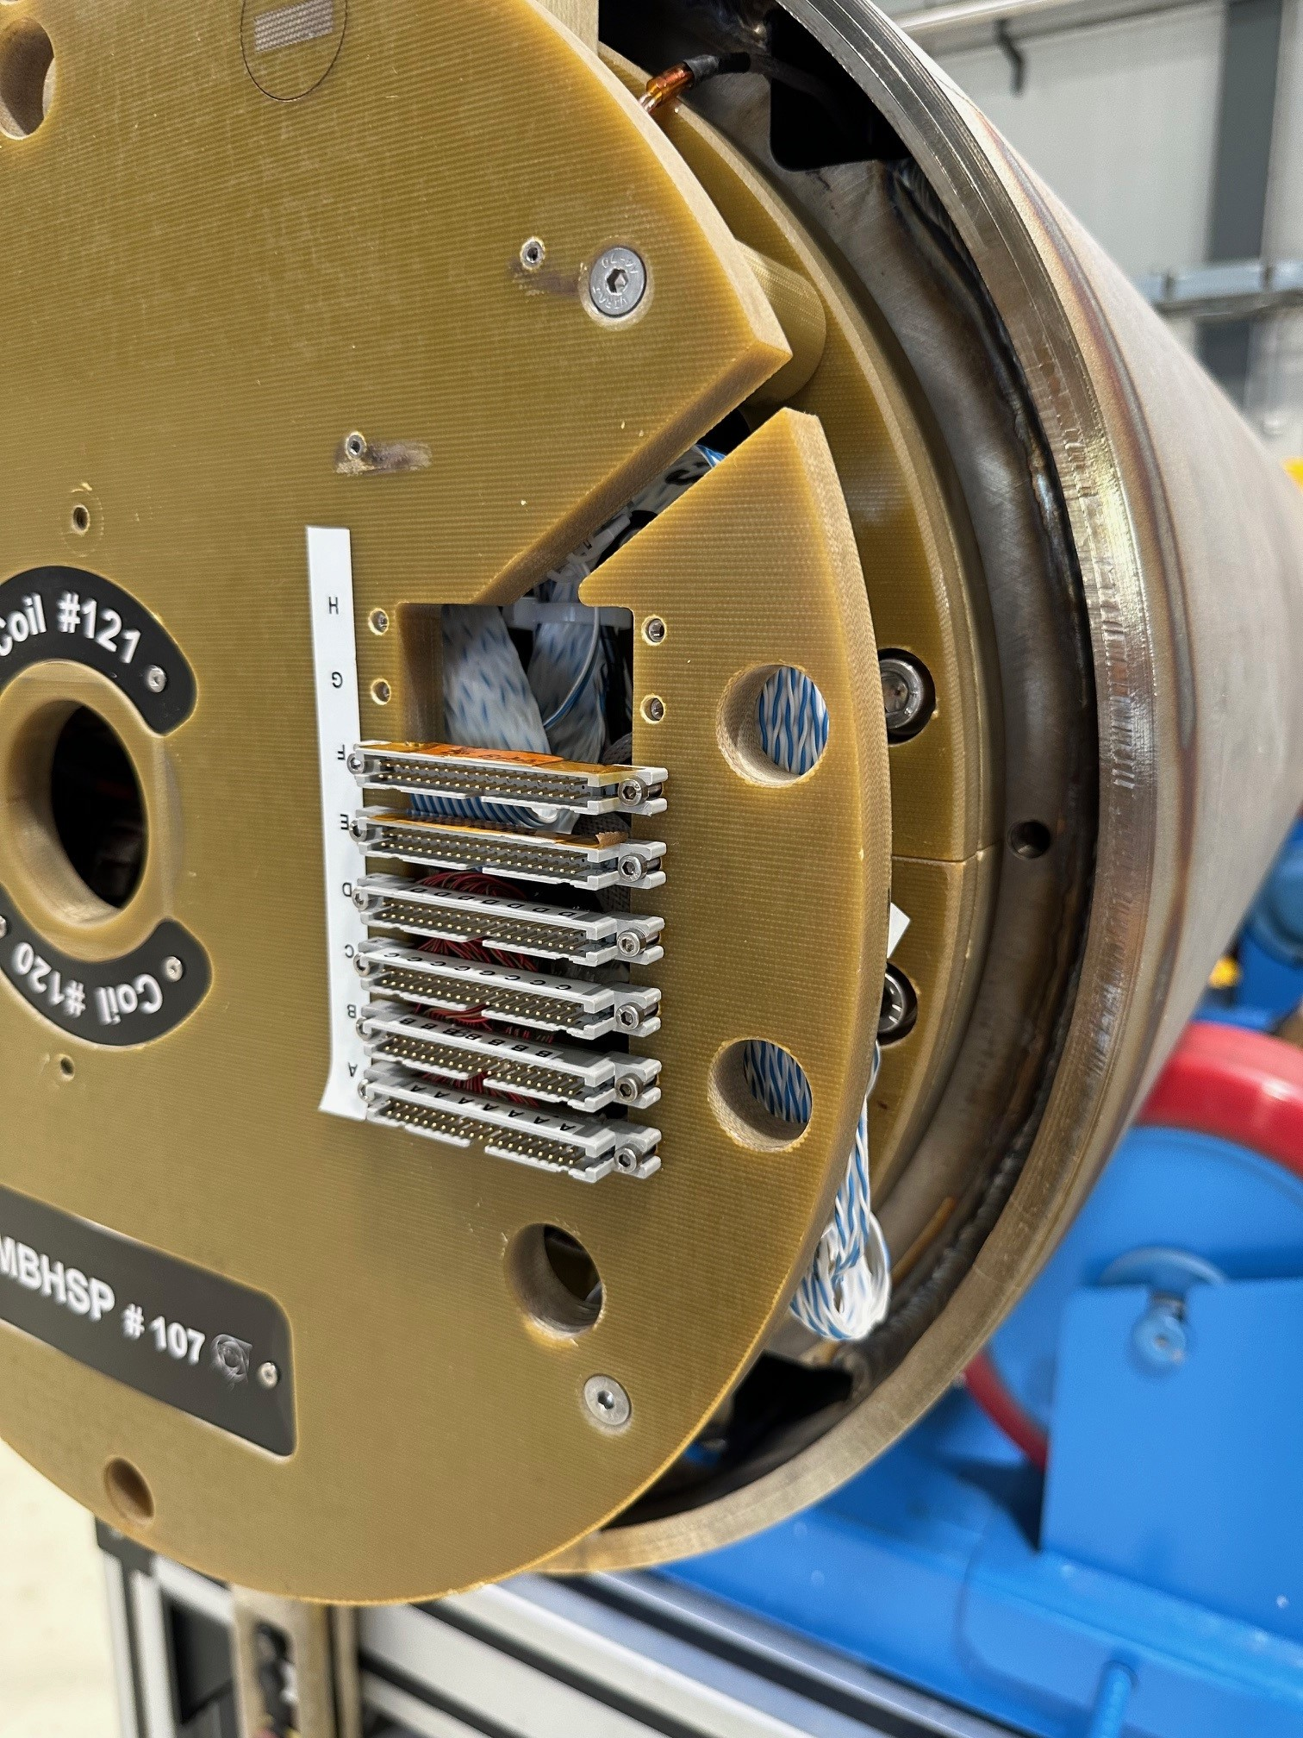
Beam Screen FCC-hh test design and test in SM18: SP107

Slide 5
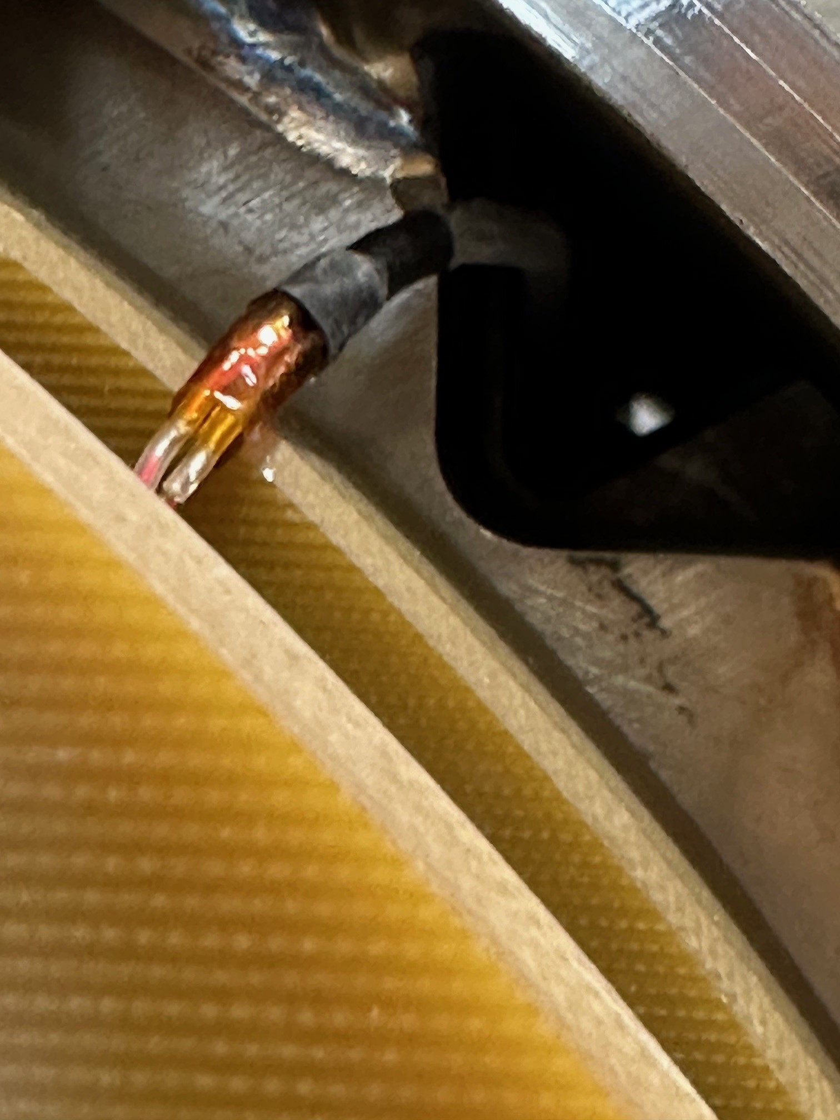
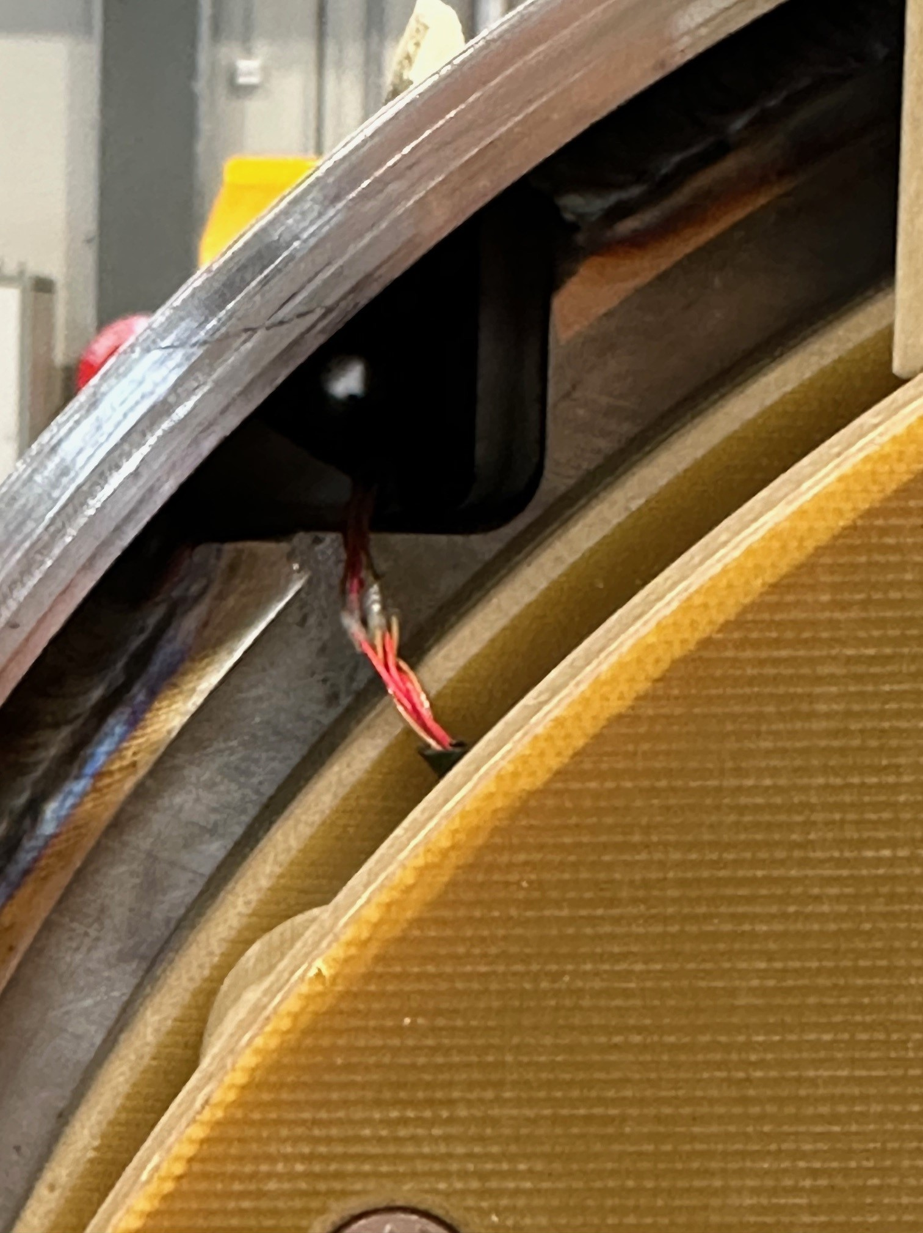
Beam Screen FCC-hh test design and test in SM18: SP107

Slide 6
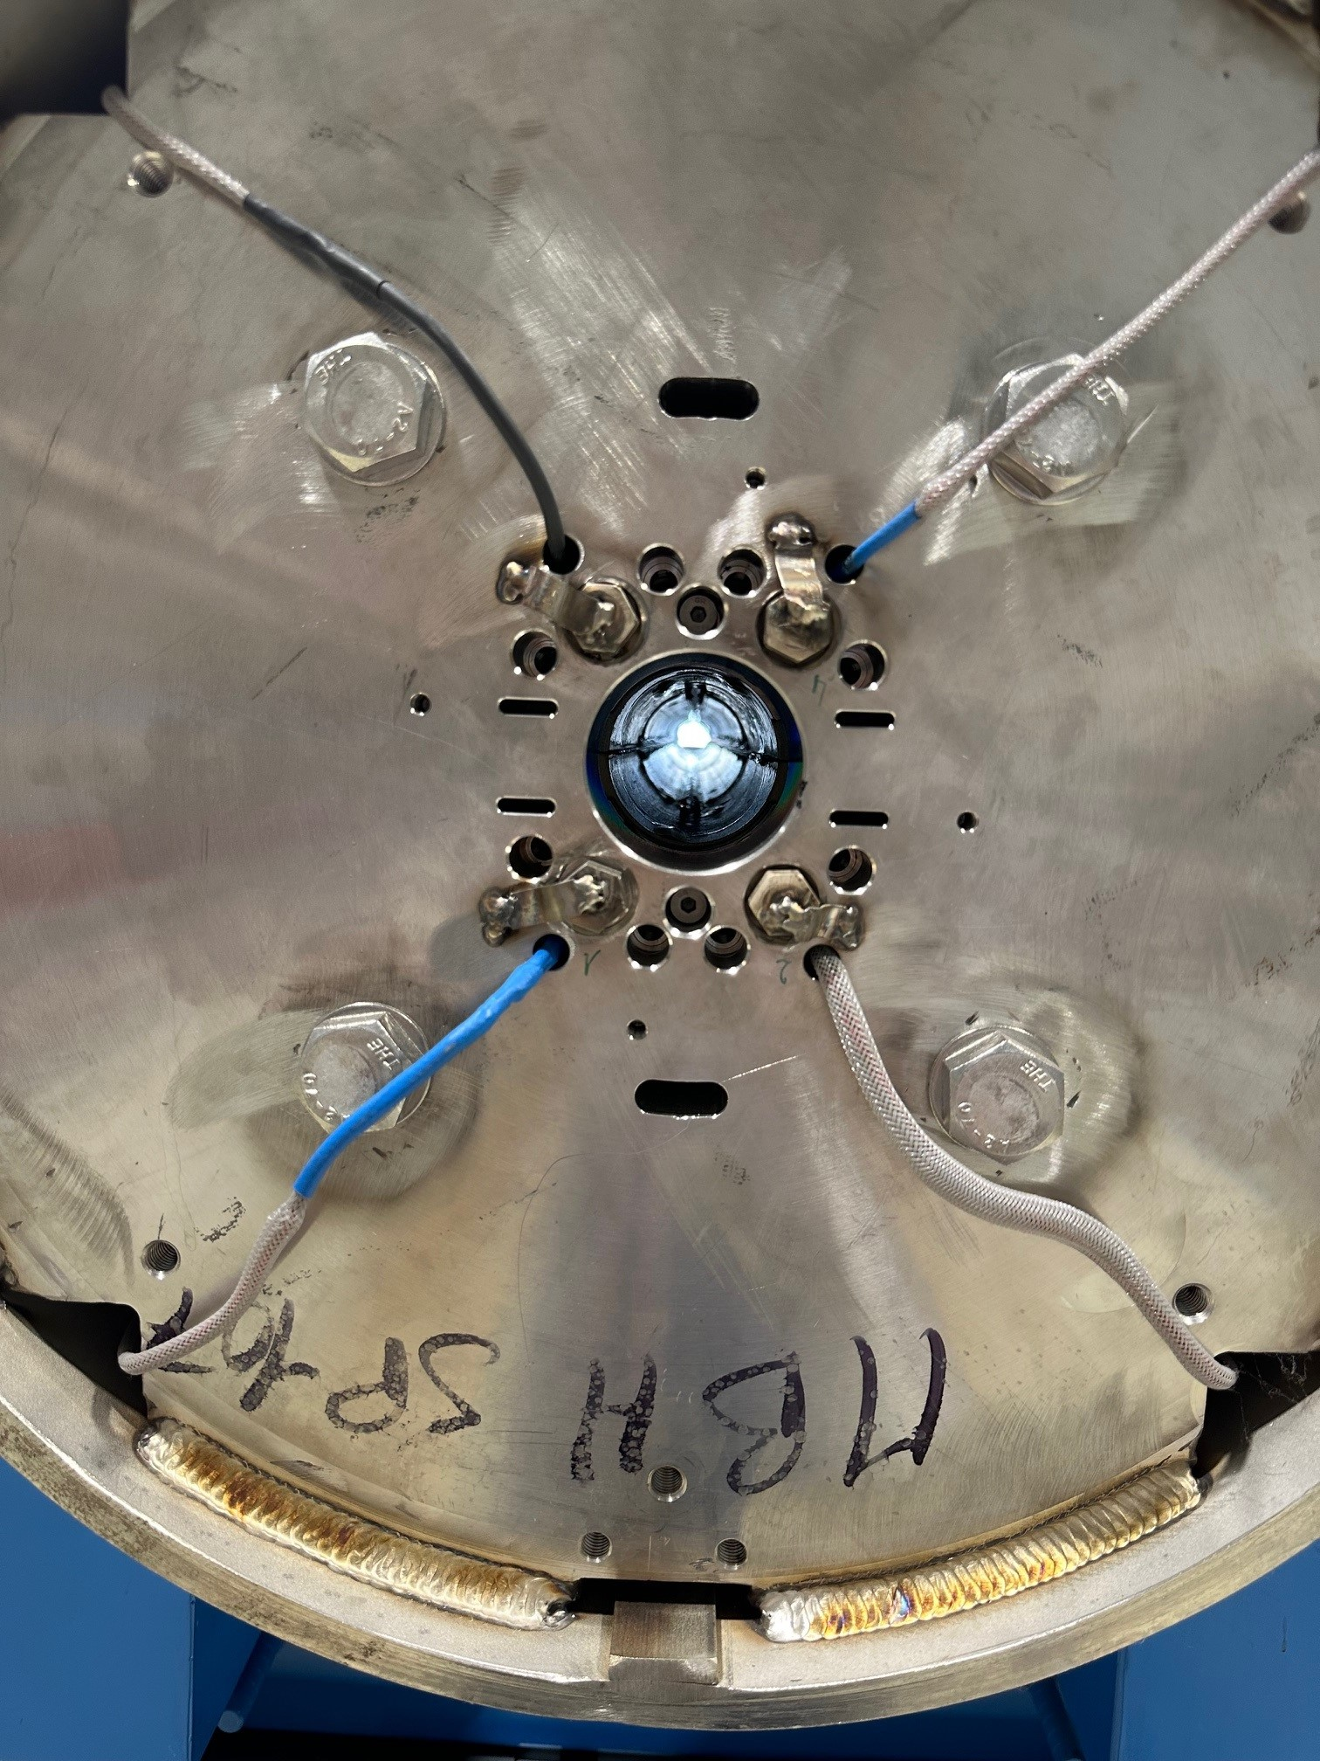
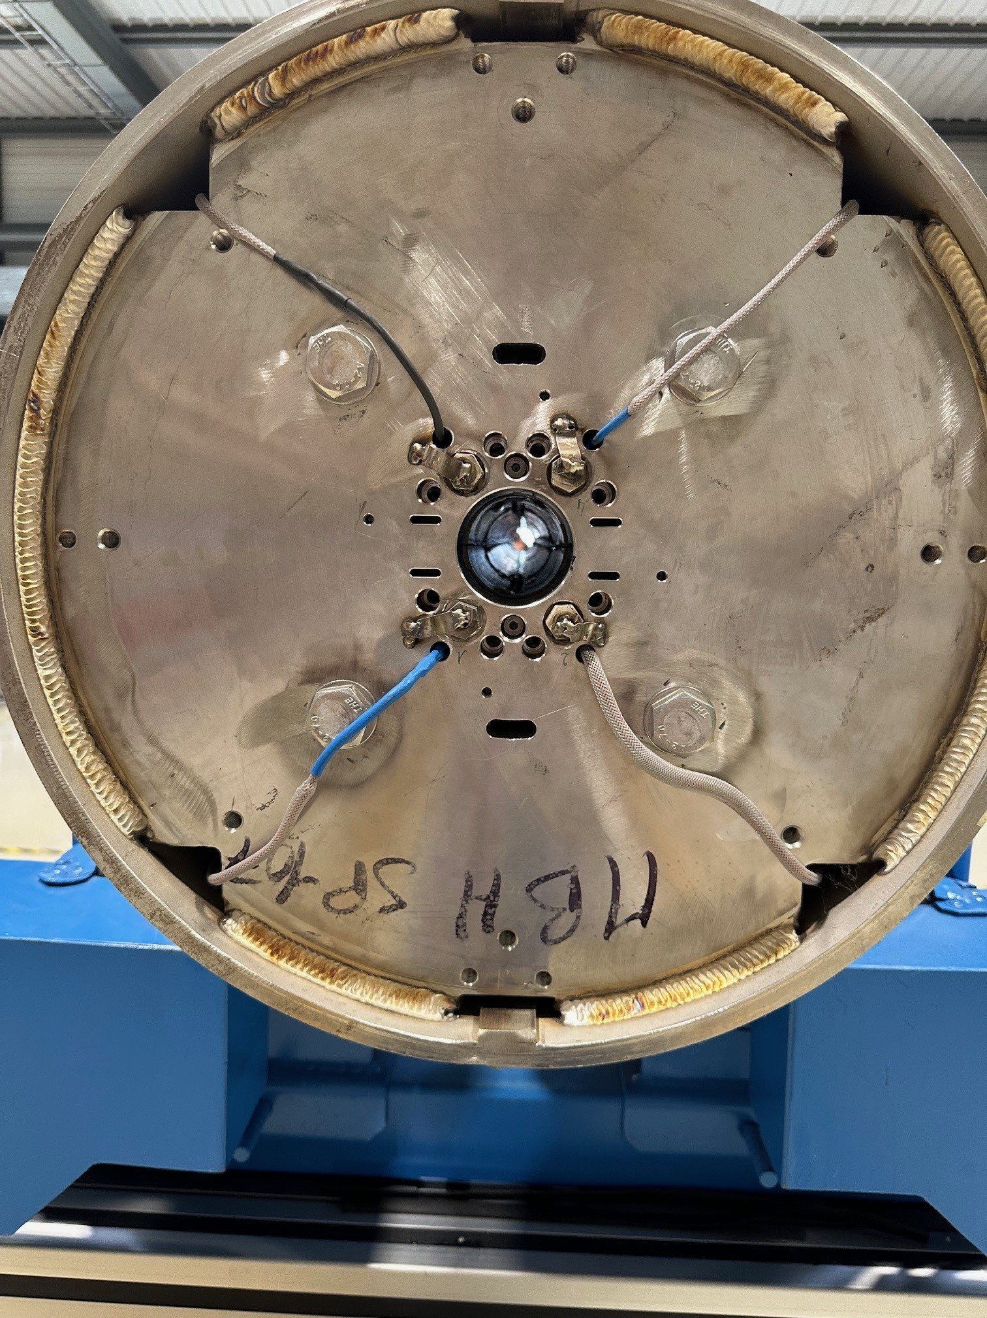
Beam Screen FCC-hh test design and test in SM18: SP107

Slide 7
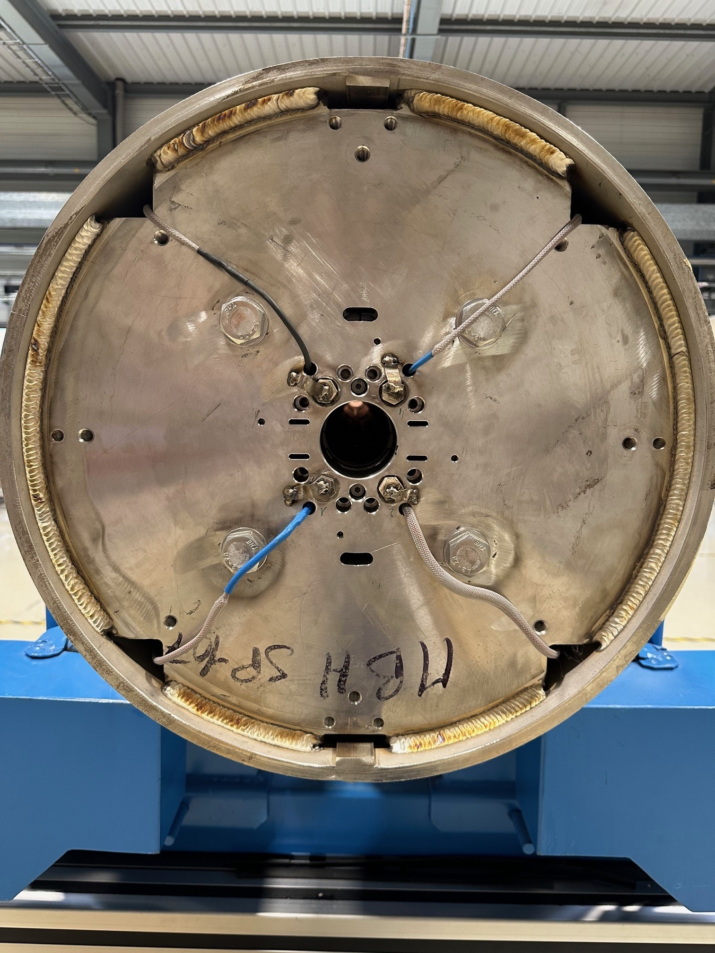
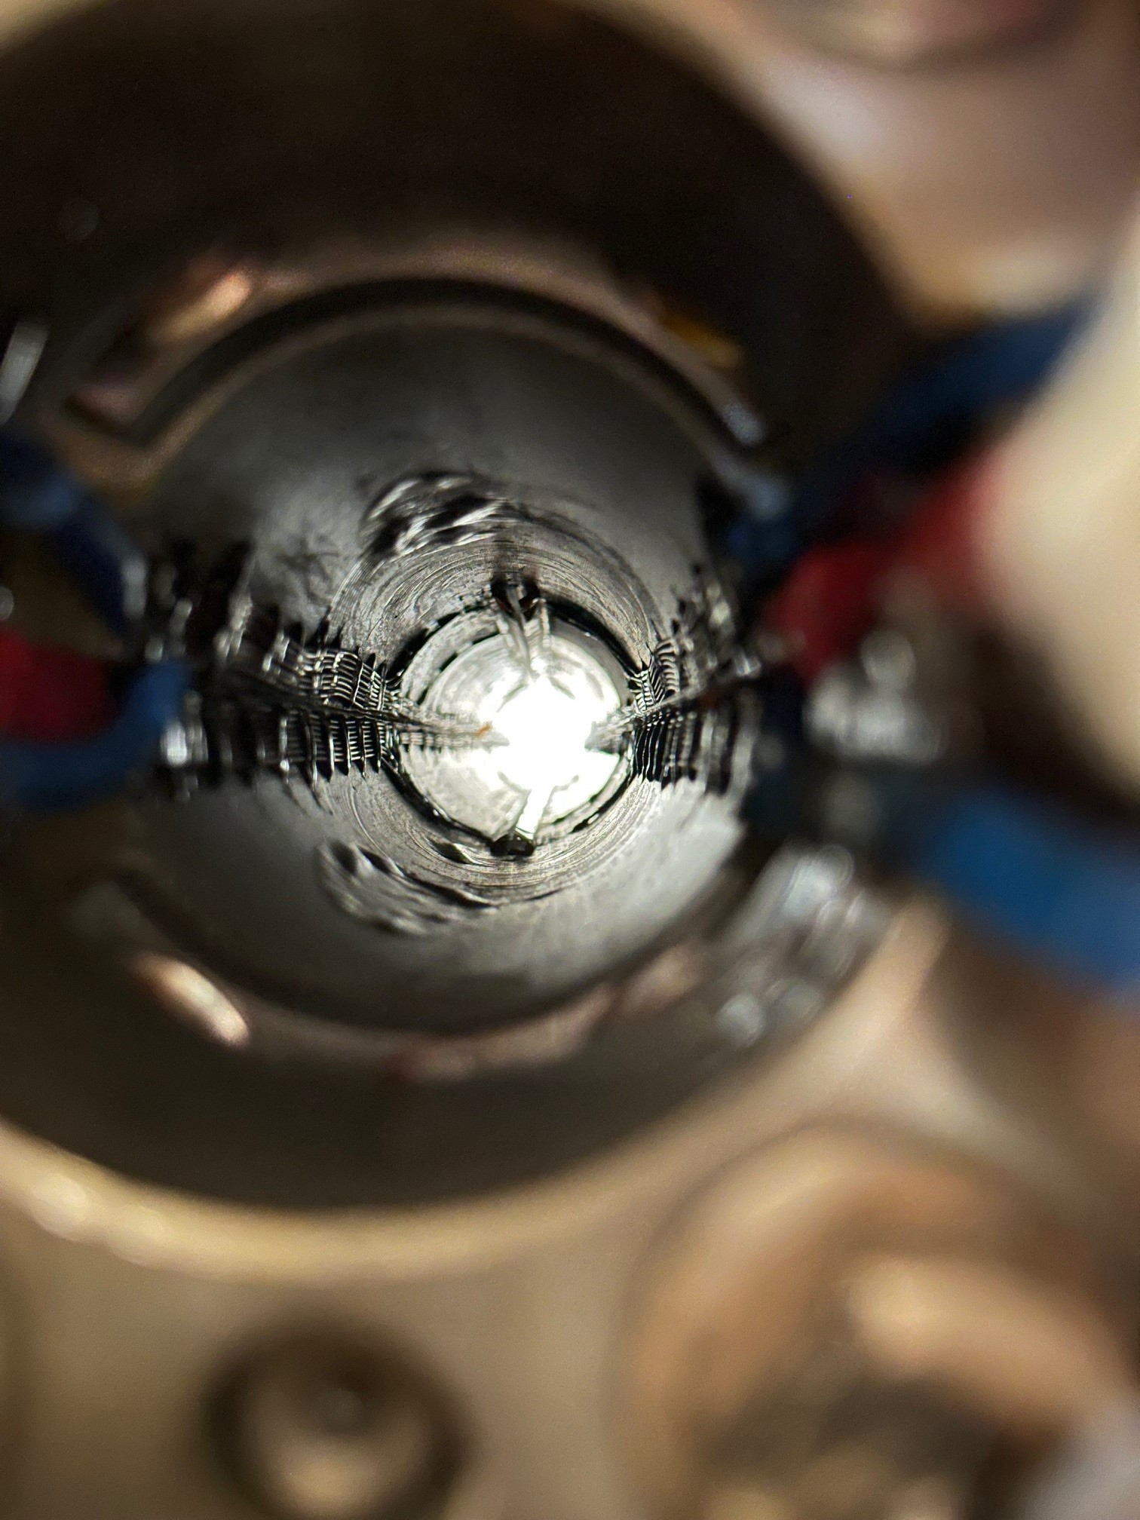
Beam Screen FCC-hh test design and test in SM18: SP107

Slide 8
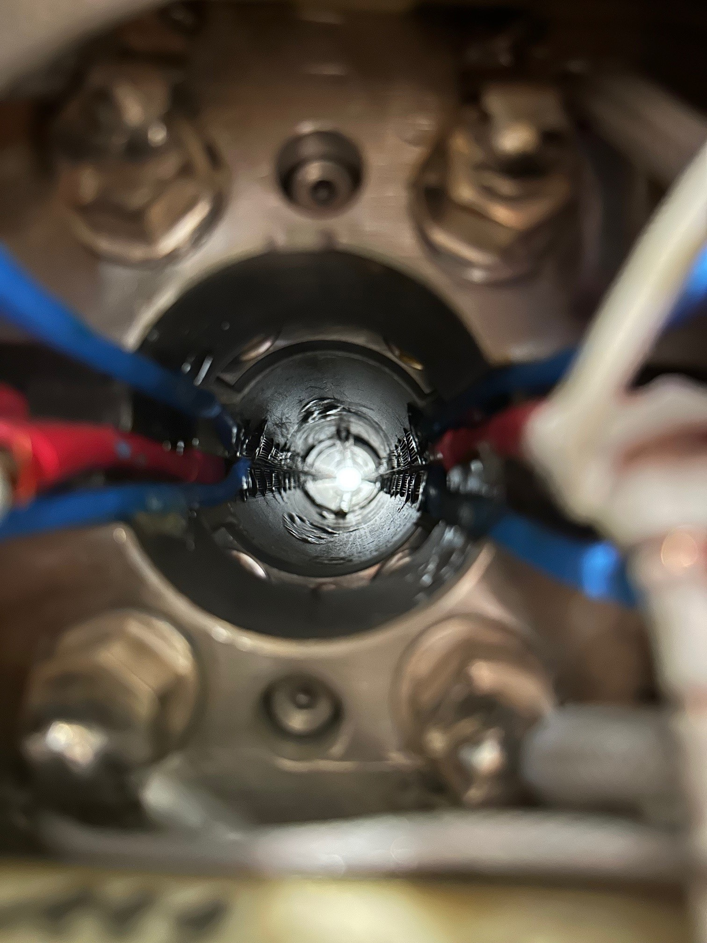
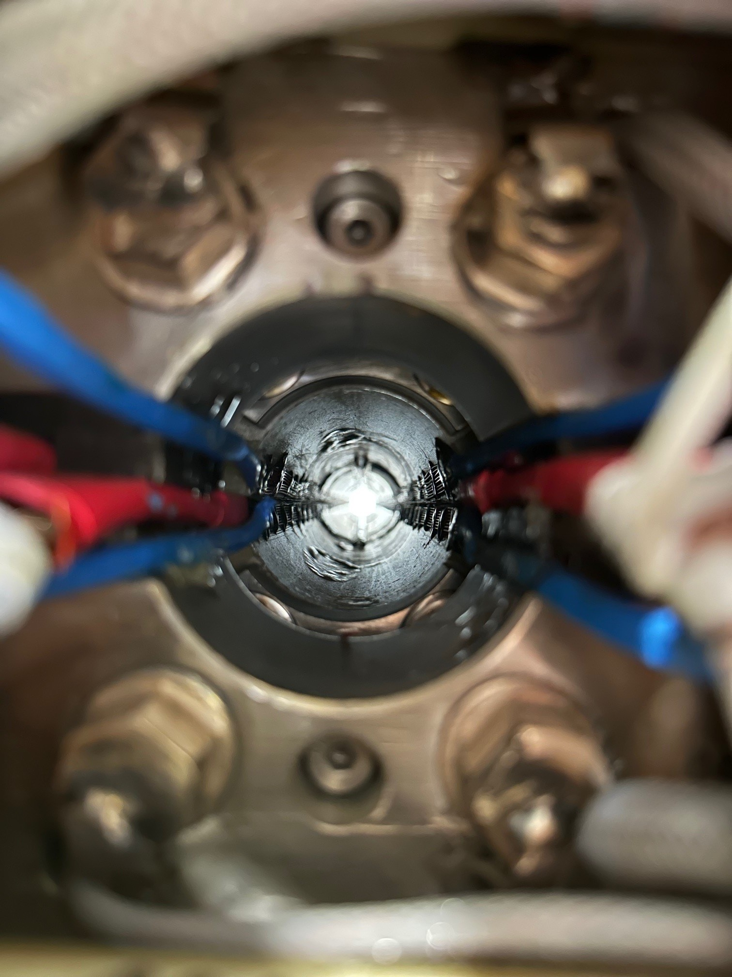
Beam Screen FCC-hh test design and test in SM18: SP107

Slide 9
Beam Screen FCC-hh test design and test in SM18: SP107
Proposal:
Magnetic measurement of the integral (or local) field direction at ambient temperature (w.r.t. gravity?)
Mechanical alignment and fix the FCC beam screen at the G11 plate at room temperature (w.r.t. gravity?)
Do not dismount the mechanical support of the beam screen until the end of the test
How is the magnet supported in the insert?

Slide 10
Thank you

