Slide 1
PU Jack Task Force
P. Bestmann for BE-GM-ASG
June 2023

Slide 2
Overview
Introduction & Motivation
Current status & situation
Responsibilities
Possible solutions
Actions

Slide 3
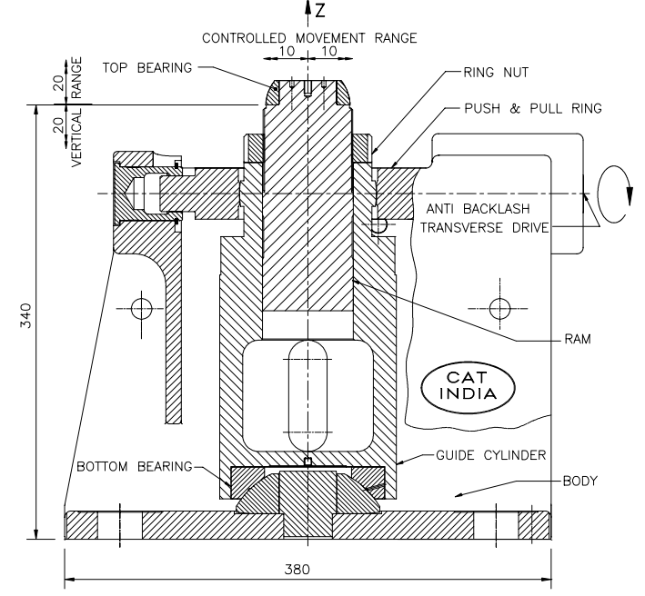
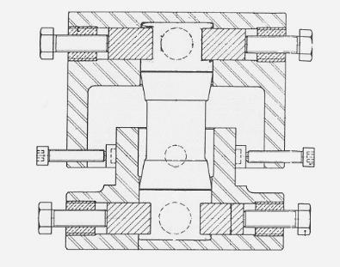
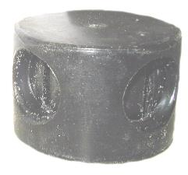
PU jacks
  The PU Jacks have a several advantages
    Very compact and smart system
    Easy & precise alignment
    Cheap, easy maintenance
    Admissible load: 6 tons (PU pads 75 Shore A) / 10 tons (PU pads 90 Shore A)
    Range: ±10 mm vertical / ±8 (4) mm horizontal
    The only issue is the reliability (today)

Slide 4
History
  Last full exchange campaign was done in 2000 and 2003 after having installed non conform PU pastilles.
  A detailed report was issued and a test procedure for all delivered batches defined https://edms.cern.ch/document/402303/2
  Since then, all batches should have been tested…
    In reality this was not done systematically…
    No trace of which batch went in which jack and where…
  The manufacturer A&O was obliged to adapt the composition due to regulations of additives without notifying CERN

Slide 5
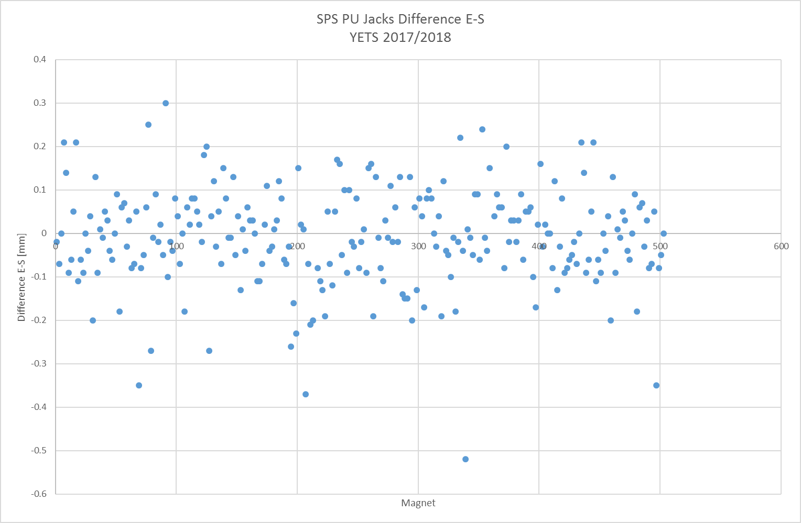
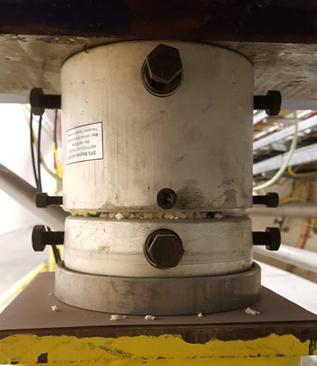
Failing Jacks
  Observed orbit drift in the SPS in August 2016
    2 Jacks of standard quadrupoles failed
  One more case in 2017 and 2018,
  Still no sign for systematic degradation
  Starting investigations
Min -0.52 mm
Max 0.30 mm
Average -0.01 mm
RMS 0.11 mm

Slide 6
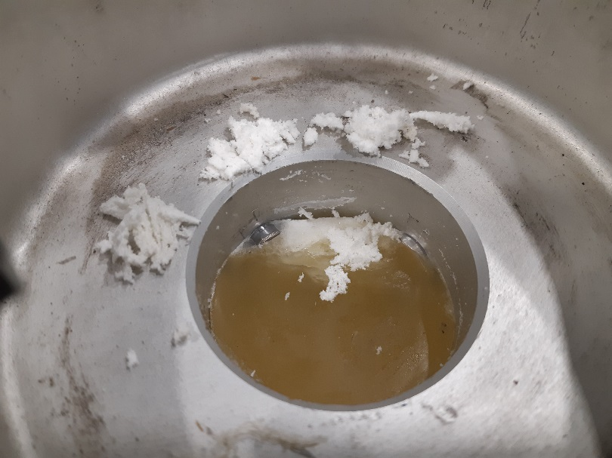
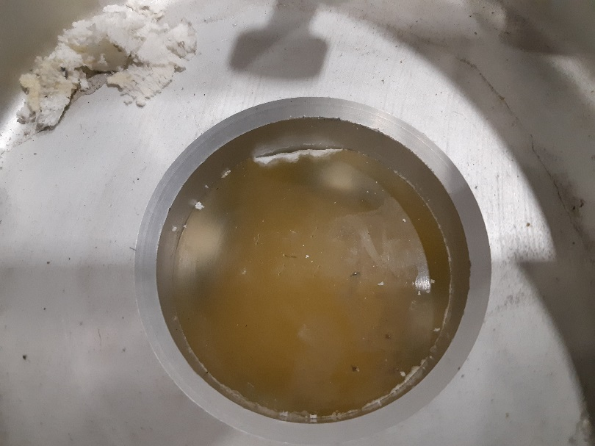
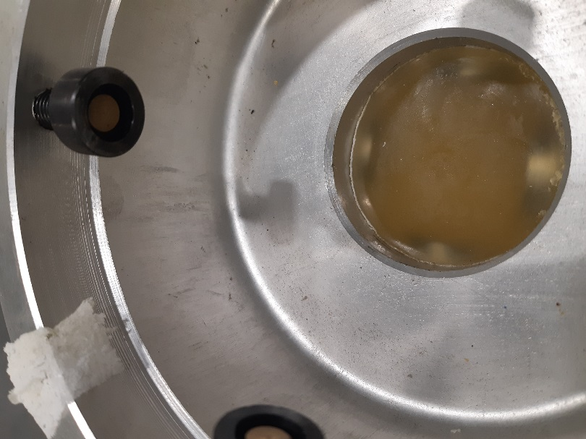
LS2 actions
  Inspection at the start of LS2 showed 9 evident cases of failing jacks
  The LS2 works gave access to jacks from LSS5 and LSS3 for internal inspections
  Many more jacks have been affected et different levels, not visible outside
  Different failure mode than in the past (Chips vs extrusion)
Severely damaged
Significantly damaged
Slightly damaged

Slide 7
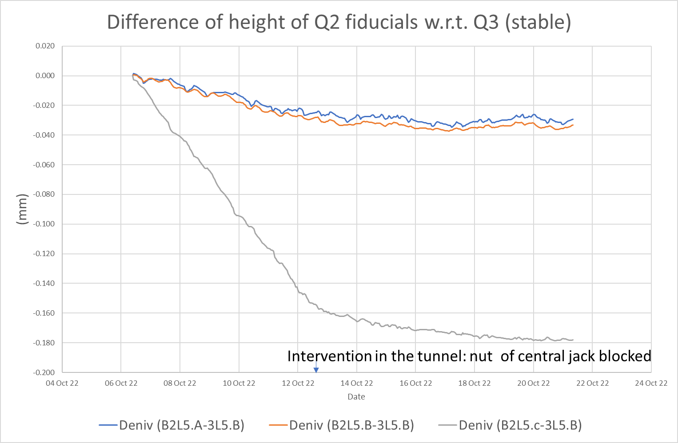
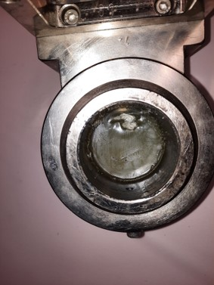
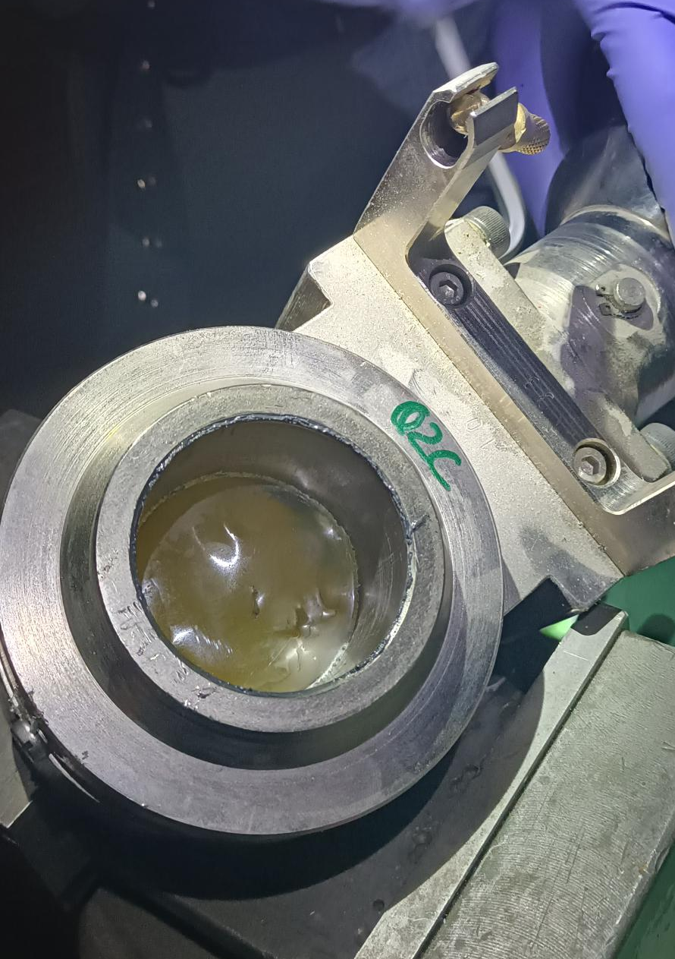
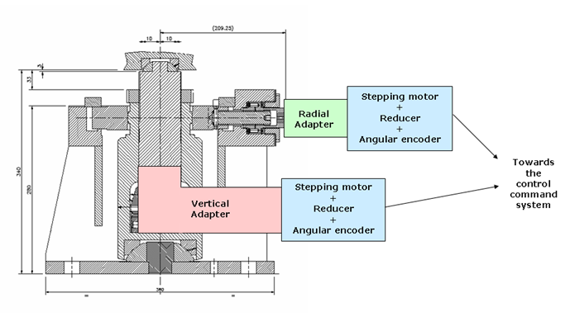
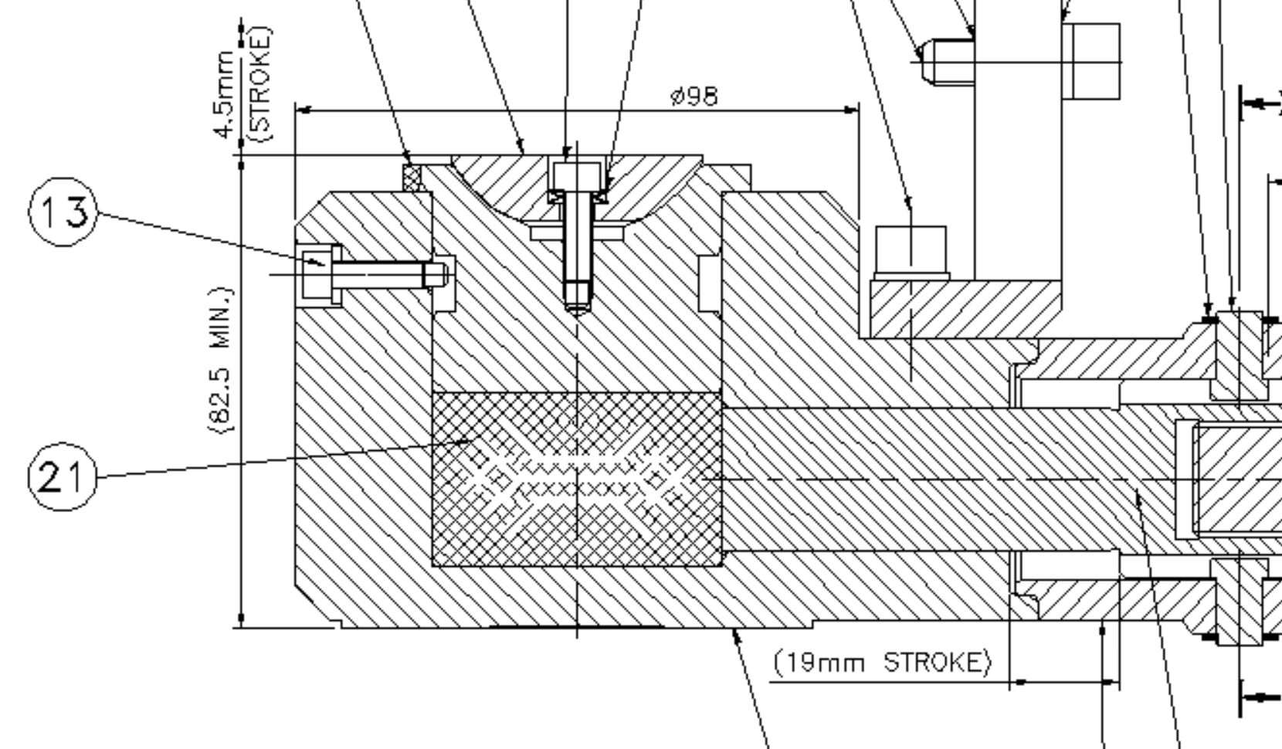
Latest failures in LHC

Slide 8
LS actions
  Two presentations given at the LS2 Commitee
    LS2 COMMITTEE - 35th Meeting (22 March 2019) · Indico (cern.ch)
    LS2 COMMITTEE - 38th Meeting (17 May 2019) · Indico (cern.ch)
  Decision for a complete exchange of all PU jacks in the SPS ring with the best possible material known at that time
  Starting investigations and design for a mechanical solution

Slide 9
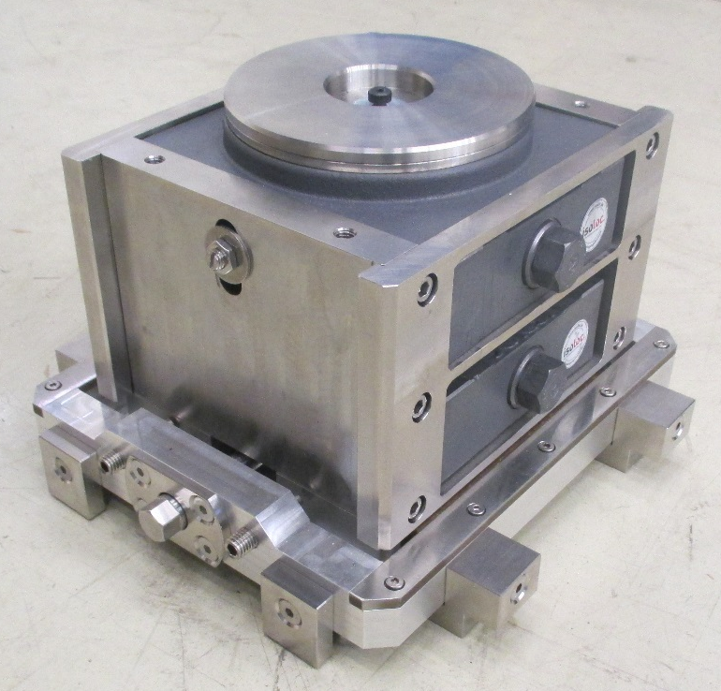
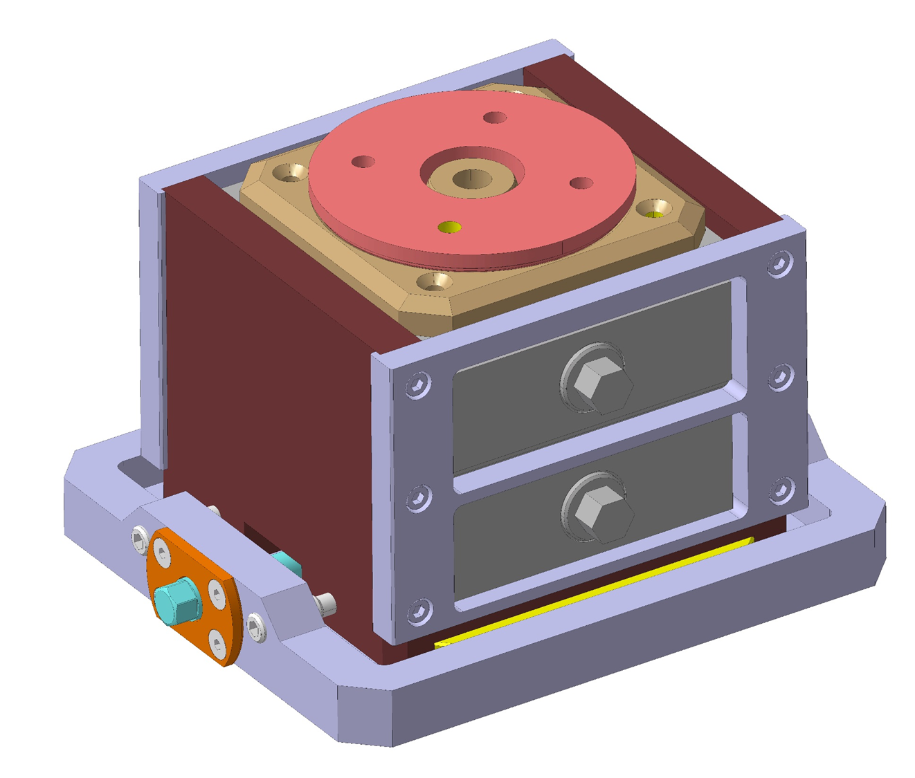
Mechanical jack replacement
Very difficult to combine ±10mm vertical stroke with ± 7mm horizontal stroke in an only 165mm high jack
Very complex and expensive solution
With risk of mechanical problems as well (grease /corrosion)
It was decided to stick to the PU Jack solution

Slide 10
PU pad procurement for LS2
Request of test samples from A&P for LS2 exchanges
Mechanical non-conformities detected on first batch (Polyether and not Polyester!!)
After investigation with the supplier (A+P) it turned out that the formulation of PU had changed since 2013 due to changes in the legislation of hazardous chemicals → CERN not informed of this change
In addition, the casting process and tooling had also been changed recently, what turned out to be the reason of the cracks (material sometimes slightly torn apart from surface during to demolding process)
The supplier proposed alternative PU formulations to avoid the cracks without success and finally stepped back to the initial casting process with the 2013 PU formulation
The latest samples were tested conform and all SPS Jack got replacement pads

Slide 11
Where do we stand today?
No significant progress!
We have no mechanical alternative!
We have failing central jacks in the LHC triplets (different failure mode)!
We need to enhance the specifications to the best possible material, with reliable lifetime!
We need to centralize procurement and Tests!
We need better tracing!
We need to prepare for an exchange of TI2 and TI8 jacks!
We need to purchase around 1500 pastilles only for the NA

Slide 12
Proposal
As many parties are involved, BE-GM proposes to bundle & coordinate the efforts
  Responsibilities remain unchanged
  Coordinate Tests & Research with EMPA and A&P
  Centralize the purchase & tracing strategy
  Installation of monitoring jacks (pre-warning)

Slide 13
What has been done
Enhanced Testing at CERN including IR spectroscopy
Visit at EMPA for independent expertise in Polymer technology
  It turns out that the recent tests done at CERN are exhaustive and fully sufficient
  Experience and thresholds are however missing
  EMPA can help with expertise, but will not certify nor extrapolate results
A&P is still interested to collaborate
  Even if the order are extremely small for their scale
  Meeting to be organized next week
  We need to drill down to the manufacturer!

Slide 14
Next actions
Production & Installation of monitoring jacks
  Jacks in test stand with 120% load, regularly monitored by load cell, inside the machines
Developing reinforced specifications with EMPA and A&P
  Today we specify hardness, color, dimensions and casting process
Defining full test procedure @ CERN
Enhancing material properties
  Simulations to confirm ideal material properties
Study solutions for HL-LHC motorized jacks
  Tests with compatible grease, better sealing, mechanical solution

Slide 15
Next actions
Clearing storage & enhance tracing
  Serial numbers for all jacks
  Associate production batch to individual jacks
  Associate jacks to magnet
Purchase of pastilles for NA
  300 for YETS 23-24
  1000 for LS3
Investigate status of TI2 and TI8
Establishing long-term maintenance intervals

Slide 17
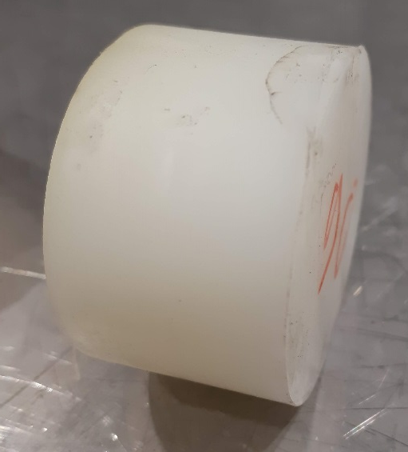
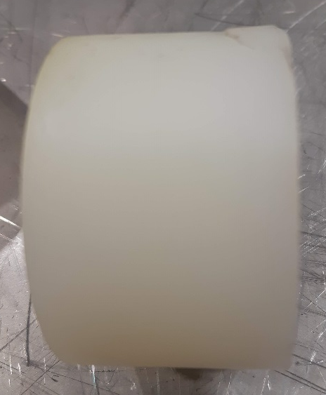
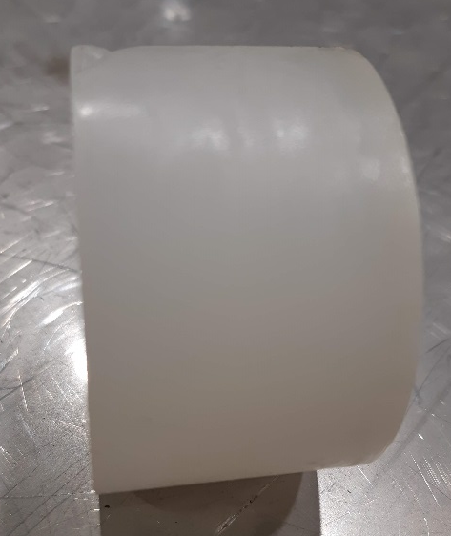
History
When restarting the refurbishment of jacks with pads from latest order (2017), non-conformities of shape and traces of cracks found on some of the pads
Cracks
Deformations

