Slide 1
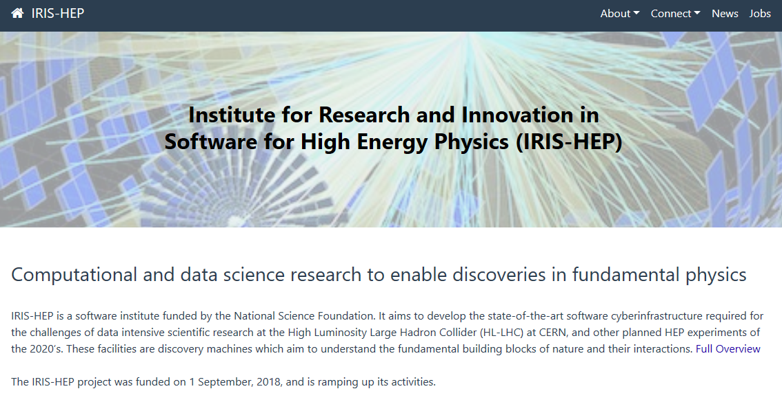

Slide 2


IRIS-HEP Steering Board
Meeting #19
G. Watts
For the IRIS-HEP Executive Board
2024-01-16
“The IRIS-HEP Steering Board represents the Institute’s stakeholders to provide, to the Executive Board, the stakeholder’s input on the priorities, execution, and strategy of the Institute.”

Slide 3
Thank You
Liz Sexton-Kennedy (CERN)
CMS
Tulika Bose (U Wisconson)
US CMS Ops Program
Paolo Calafiura (LBNL)
US ATLAS Ops Program
Patrick Koppenburg (NIKHEF)
LHCb
Simone Campana (CERN)
WLCG
Graeme Stewart (CERN)
HSF
David South (DESY)
ATLAS
Ken Herner (FNAL)
The OSG Council

Slide 4
Welcome
steering-board@iris-hep.org
(you)
exec-board@iris-hep.org
(us)

Slide 5
Next Meeting Dates
Tentative Dates – please let us know:
April 7, 2024
July 2, 2024
Oct 1, 2024
Jan 14, 2025
(did consult the HSF Community Calendar)

Slide 6
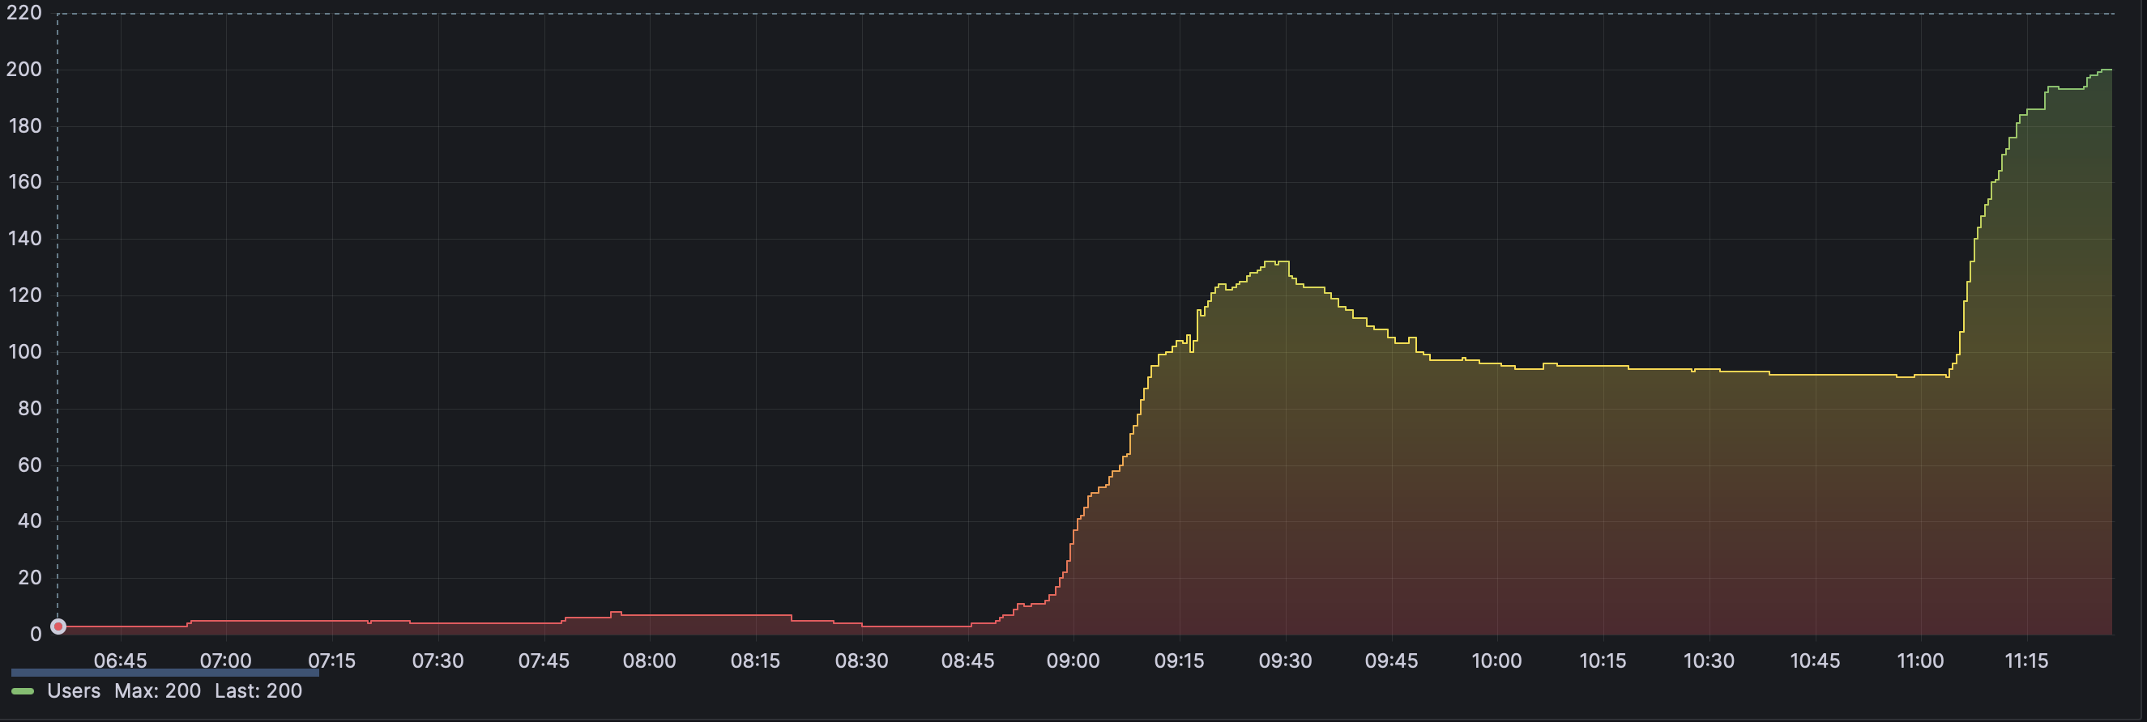
(Very) Quick Updates
1
IRIS-HEP Summer Fellows
3
SSL, Local Binder, and Training Events
The call for projects and mentors will go out shortly.
We can support a number of undergraduate summer students
If you know someone that has a project that aligns with IRIS-HEP – please have them get in touch!
Projects will appear here as we collect them.
That is almost 220 instances of binder-hub running on UChicago’s IRIS-HEP SSL infrastructure
We used some very large container images and GPU’s for some of the training
Seems perfect for an experiment’s training events
  Instructor provided environment
  JupyterHub and bash terminal
  Available by web (low-bandwidth)
We should find a way to keep for self-paced tutorials.
2
US ATLAS & US CMS Summer Meetings
IRIS-HEP will host a 2-day training event at each summer meeting (Seattle, Princeton)
Funds to help get students out to the meeting
Should also help reduce overall costs for students attending.

Slide 7
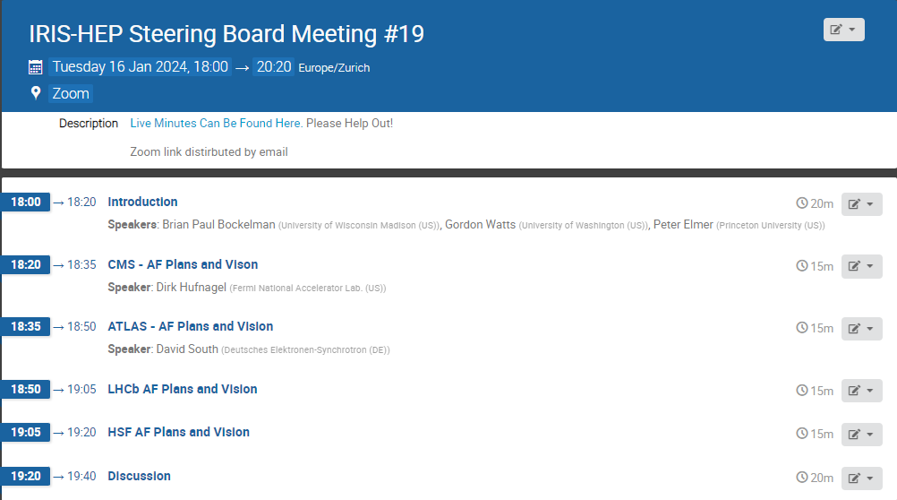
Today
Analysis Facilities
Please use the google doc linked to the agenda to add comments or make any notes you want us to track!

Slide 8

Analysis Facilities
Great deal of interest in the field
Experiments have discussed the topic extensively internally
Experiments have various R&D efforts
HSF has a forum and produced a white paper
IRIS-HEP has R&D activities based around AFs (coffee-casa, for example)
But for all this activity we have not really found a way to work together as a community

Slide 9

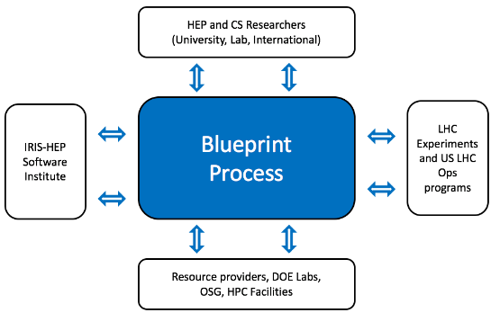
Open Questions
Moving into “Phase 2”
Do we want a community?
Who should be in that community?
What is the goal and role of the community we build?
Where should be pull the leaders from?
Today: Discover some way forward we are all interested in making work.
If some meetings are required, we have funds to make them happen.
For example:
Bringing physicists and computing experts together to decide on what a benchmark HL-LHC analysis.
Bringing a group together to build consensus on a white paper for future R&D.
Supplement an HSF AF meeting.

Slide 10
Questions & Comments?

