Slide 1
AMS-02 JMDC On-Board Application Software Review
Xudong CAI / M.I.T.
Mar. 1, 2011@ KSC

Slide 2
New Changes from the Last Meeting
New data taking procedures which include TDR second step calibration and TAS run.
Changed JBUX space control from space of erase-output pointers to space of input-erase pointers.
Changed to have more flexible control of JBUX pointers include set pointers according to frame time.
Modified new GPS Begin Epoch procedures from Alexei.
Bug fixes and optimization of TTCS, UG control and GTSN monitor tasks.
Optimized circular buffer operations and removed STS-1553 HK buffer. Both STS-1553 and ISS-1553 will share the same buffer because only one will be used at a time.

Slide 3
JBUX Pointers’ Control
JBUX
File System
Old Control Mode
System File Space
New Control Mode
Absolute address
Offset from current location
Offset from the write pointer
Frame time to be located
Erase
Read
(Output)
Space
Control
Write
(Input)
Read
(Output)
Space
Control
Write
(Input)
Absolute address
Offset from current location
Offset from the read pointer
Frame time to be located
Erase

Slide 4
New DAQ Procedures
WISHLIST defines data taking tree to be used, processing mode etc. It is required before using these procedures. The most of the steps are based on it.
Step | Control Counter | Functions
1 | 01 | Stop data taking (stop event polling, trigger, processing mode and read HK data)
2 | 00 | Boot all DSP nodes according to given file ID
3 | 00 | Configure all DSP nodes according to given file ID
4 | 01 | Normal calibration for all sub-detectors
5 | 00 / 01 | Tracker second step calibration (Tracker and JLV1 only)
6 | 02 | TAS run
7 | 01 | Initialize DAQ (Read calibration results, read configuration data, set slave and trigger masks, set processing mode, clear FIFO and read HK data)
8 | 01 | Start Data Taking (Start event polling and start trigger)

Slide 5
DAQ Parameters
1 | 16-bit | Run TAG to be used
2 | 16-bit | Normal calibration trigger rate
3 | 16-bit | Normal calibration wait time (sec)
4 | 16-bit | DAQ Running time (min)
5 | 8-bit | Step 1 Control Counter
6 | 8-bit | Step 2 Control Counter
7 | 8-bit | Step 3 Control Counter
8 | 8-bit | Step 4 Control Counter
9 | 8-bit | Step 5 Control Counter
10 | 8-bit | Step 6 Control Counter
11 | 8-bit | Step 7 Control Counter
12 | 8-bit | Step 8 Control Counter

Slide 6
Normal Calibration Procedures
1 | Start calibration on all xDR nodes
2 | Start calibration on JLV1
3 | Wait for a given time
4 | Check if calibration is completed on all nodes (maximum 16 times)
5 | Stop JLV1 calibration
6 | Stop xDR calibration
7 | Wait for 10ms for stopping
8 | Check if all nodes are stopped.
Trigger Rate
Wait time

Slide 7
Tracker Second Step Calibration Procedures
1 | Reset permanent flag on all TDRs
2 | Start loop for number of parameters
3 | Start TDR second step calibration
4 | Start JLV1 special calibration
5 | Wait for 30 sec.
6 | Stop JLV1 calibration
7 | Stop TDR calibration
8 | End of loop
Delay time between two triggers

Slide 8
TAS Run Procedures and Parameters
1 | Save JLV1 trigger configuration | 12 | Wait number of event or maximum time
2 | Turn on LCTL board | 13 | Stop data taking
3 | Start loop for number of parameter sets | 14 | Turn off currents
4 | Set TDR column | 15 | Disable diode and trigger input
5 | Set JLV1 pulse trigger | 16 | End of loop
6 | Set LDDR trigger input | 17 | Restore JLV1 trigger configuration
7 | Enable diode and set pulse width | 18 | Set TDR to normal mode
8 | Set current to be used | 19 | Turn off all currents
9 | Read diode status and currents | 20 | Disable all LDDR trigger inputs
10 | Initialize data taking | 21 | Disable all LDDR diodes
11 | Start data taking | 11
1 | Trigger frequency to be used | 5 | LDDR number (0 – 4)
2 | Number of event to be collected | 6 | Diode number (0 – 2, 2 for both)
3 | Maximum time to wait for run | 7 | Pulse width in 500ns (0 – 15)
4 | Run TAG to be used | 8 | Current in mA (0 – 140)

Slide 9
AMS-02 Critical Health & Status Data (CHD)
Bit Byte | 7 | 6 | 5 | 4 | 3 | 2 | 1 | 0
0 | Heart Beat
1 | 1553 Frame Counter (ISS and STS)
2 | JMDC ID |  | Software (JAP=1) | Power Step Valid | Master Alert | Power Step
3 | HRDL Light On | HRDL Owner Set | HRDL Owner |  | CQ-List Active | MCT Owner Set | MCT Owner
4 | 1533 RT Active | LRDL Owner Set | LRDL Owner |  | DAQ Running | DAQ Owner Set | DAQ Owner
5 | TMD Valid | TMD Source |  | Time-Mux Data (TMD) ID
6 | Time-Mux Data (TMD) Byte 0
7 | Time-Mux Data (TMD) Byte 1
8 | Time-Mux Data (TMD) Byte 2
9 | Time-Mux Data (TMD) Byte 3

Slide 10
CHD TMD Pages List
ID | Information | ID | Information
0 | Not used | 8 | JAP Command Counters
1 | JROM LRDL Status | 9 | JAP DAQ Status
2 | JROM HRDL Status | 10 | JAP JBUX Status
3 | JAP Debug Info | 11 | JAP Level-3 Trigger Status
4 | JAP Tasks and Buffers Status | 12 | JAP PDS Status
5 | JAP JMDC Status | 13 | JAP GTSN Status
6 | JAP LRDL Status | 14 | JAP TRD Gas Status
7 | JAP HRDL Status | 15 | JAP Tracker Thermal Status

Slide 11
CHD TMD 5: JMDC Status
Bit Byte | 7 | 6 | 5 | 4 | 3 | 2 | 1 | 0
6 | WDT On | Time Set | FTP Active | STDOUT Enabled | CQ-List Running | TQ-List Running | Power Saving Mode
7 | Processor Idle Count
8 | Number of Active Items in CQ-List
9 | Number of Active Items in TQ-List
CHD TMD 6: LRDL Status
Bit Byte | 7 | 6 | 5 | 4 | 3 | 2 | 1 | 0
6 | STS RT 4 Active | STS RT 28 Active | STS Bus Active | STS Active Bus | ISS RT Active | ISS Bus Active | ISS Active Bus | ISS RT Valid
7 | RT to PEP Running | PEP to RT Running | PEP Xfer Failed | ISS RT Address
8 | 1553 RX Error Count (for both ISS and STS)
9 | 1553 TX Frame Count (for both ISS and STS)

Slide 12
CHD TMD 7: HRDL Status
Bit Byte | 7 | 6 | 5 | 4 | 3 | 2 | 1 | 0
6 | HRDL=0 RS422=1 | Output Enabled | HRDL Input | RS422 Input | HRDL Sync | RS422 Sync | Illegal Symbol | RX Off
7 | HRDL-JBUX Output Mode |  | HRDL & RS422 Error Count
8 | HRDL/RS422 RX Frame Count
9 | HRDL/RS422 TX Frame Count
CHD TMD 8: Command Counters
Bit Byte | 7 | 6 | 5 | 4 | 3 | 2 | 1 | 0
6 | HRDL/RS422 Command Count
7 | ISS 1553 Command Count
8 | STS 1553 Command Count
9 | NASA Command Count

Slide 13
CHD TMD 9: DAQ Status
Bit Byte | 7 | 6 | 5 | 4 | 3 | 2 | 1 | 0
6 | Received Events
7 | JMDC Mismatch | DSP Mismatch | DAQ Step Completed | DAQ Procedures Step
8 | Number of items in EQ-List
9 | Average Event Size in 0.1 kB (over 512 events)
CHD TMD 10: JBUX Status
Bit Byte | 7 | 6 | 5 | 4 | 3 | 2 | 1 | 0
6 | JBUX ready | JBUX Full | In Format | In Scanning | Playback On | Input Running | Output Running | Space Control
7 | JBUX Free Space (%)
8 | Reserved
9 | Reserved

Slide 14
CHD TMD 12: PDS Status
Bit Byte | 7 | 6 | 5 | 4 | 3 | 2 | 1 | 0
6 | Bus A On | Bus B On | Reserved
7 | Reserved
8 | Total Watts
9
CHD TMD 13: GTSN Status
Bit Byte | 7 | 6 | 5 | 4 | 3 | 2 | 1 | 0
6 | Number Sensors Over Temperature Alarm (If >15, then =15) |  |  |  | Number Sensors Over Temperature Warning (If >15, then =15)
7 | Number Sensors Under Temperature Alarm (If >15, then =15) |  |  |  | Number Sensors Under Temperature Warning (If >15, then =15)
8 | Highest Temperature
9 | Lowest Temperature

Slide 15
CHD TMD 14: TRD Gas Status
Bit Byte | 7 | 6 | 5 | 4 | 3 | 2 | 1 | 0
6 | P-TRD |  | P-Mix |  | P-CO2 |  | P-Xenon
7 | Pump Off | Valve Disabled | Heater Off | Gas Closed | Closed Gas Segment |  | Gas Drop | Data Invalid
8 | T-V1/2/3 |  | T-PH |  | T-CO2 |  | T-Xenon
9 | T-UG/PD |  | T-BP/Mix |  | T-Can |  | T-V4/6/18
CHD TMD 15: Tracker Thermal Status
Bit Byte | 7 | 6 | 5 | 4 | 3 | 2 | 1 | 0
6 | Tracker Minimum Temperature
7 | Tracker Maximum Temperature
8 | Temp. Warning | Temp. Alarm | TPD Off Sent | TPD Off | Reserved |  |  | Pump Selection
9 | GAC Alarm | LPS Alarm | LLR Alarm | LLW Alarm | PR2 Alarm | PR1 Alarm | TRK Alarm | CAV Alarm

Slide 16
Conclusion
Level-3 Trigger is not included yet.
CAN bypass mode is not added. We will not need it for the first a few years.
NASA commands tested and got checksum error. We have to decide what to do.
No further development is planned except bug fixes.
More TRD Gas control functions and TTCS control functions will be added when we have experiences in space.

Slide 18
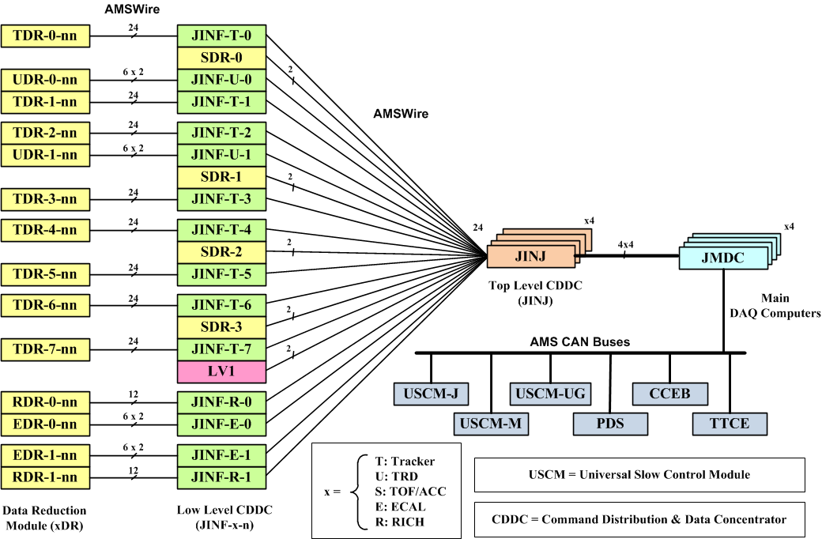
AMS-02 Software and Hardware Relations
JMDC Software
JOS
JROM
JAP
JROM – ROM Monitor
JOS – Operating system
JAP – Application programs
ISS/STS Data Links
AMS Laptop

