Slide 1

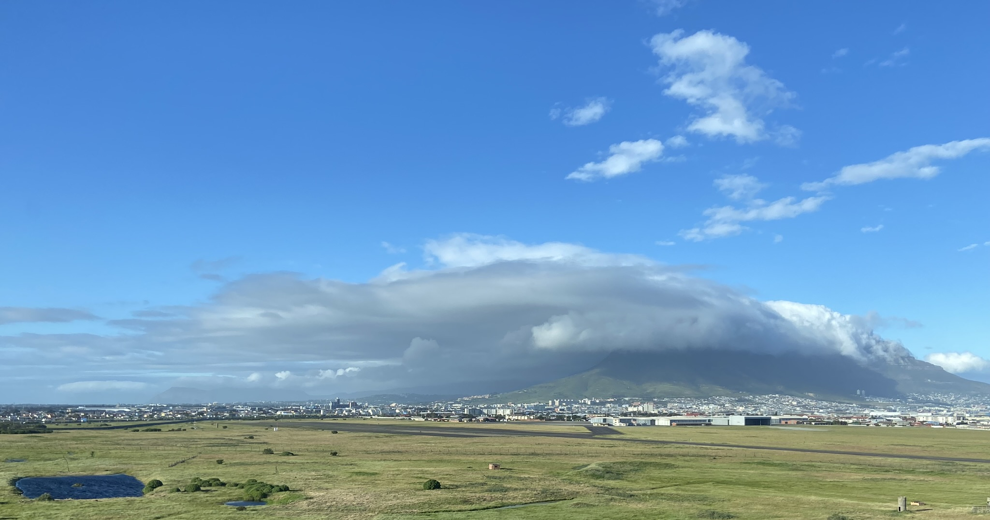
Data Science & Machine Learning
Workshop
Introduction
Manuel GONZALEZ-BERGES (CERN)
Gianluca VALENTINO (University of Malta)
7th October 2023

Slide 2
Some history

Slide 3
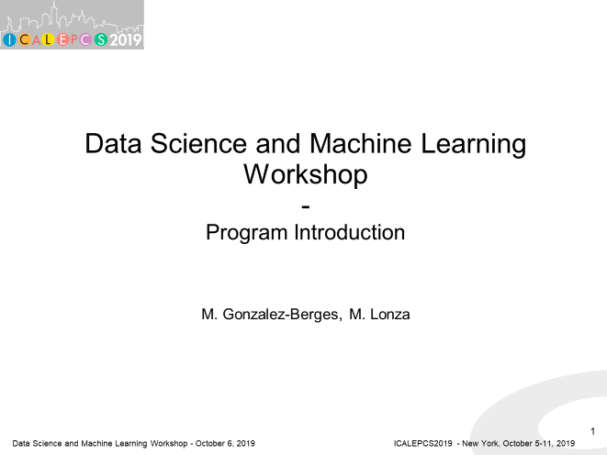
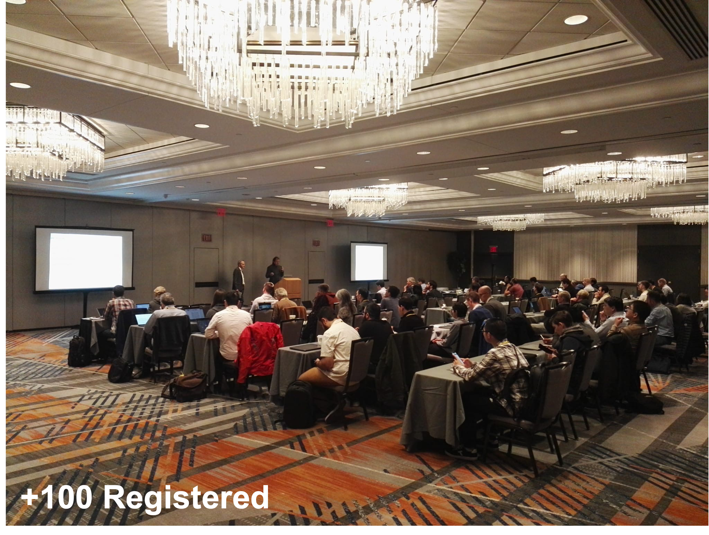
ICALEPCS 2019 – New York

Slide 4
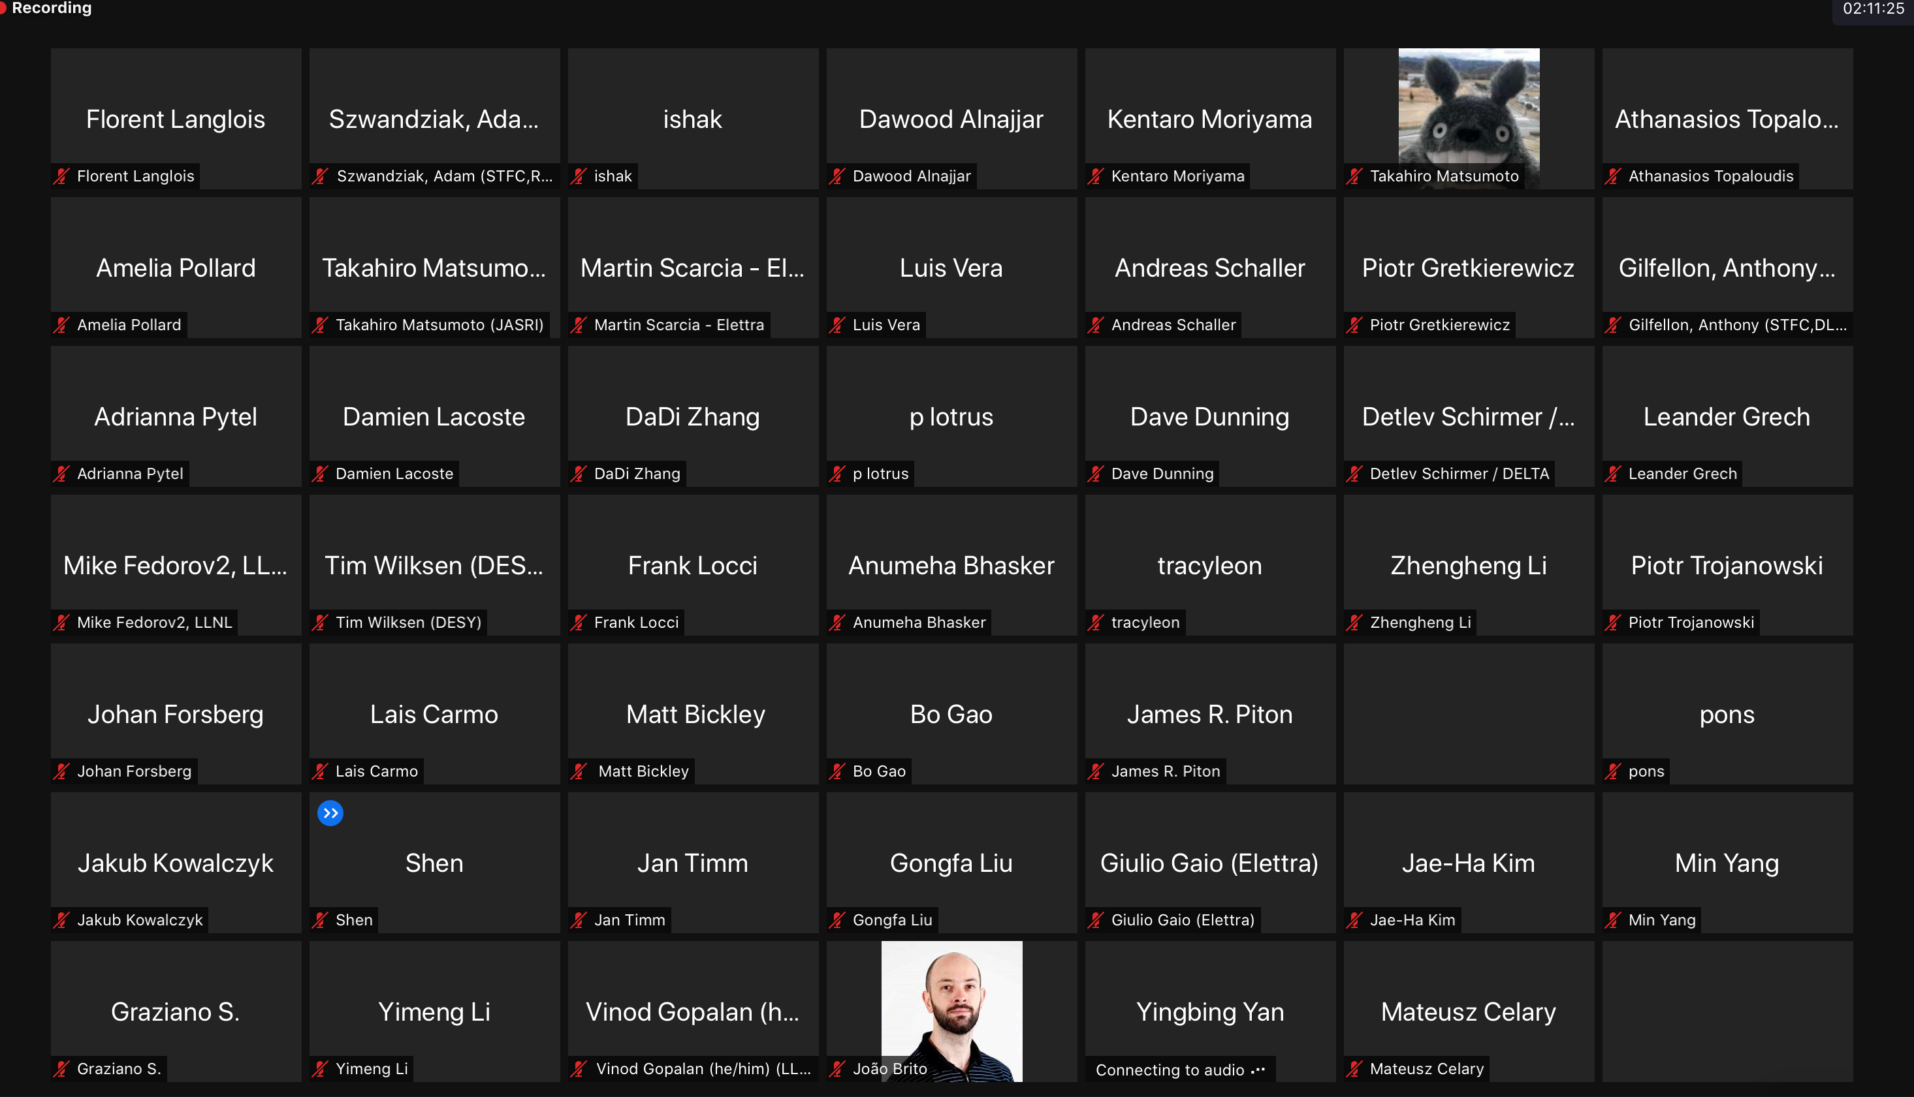
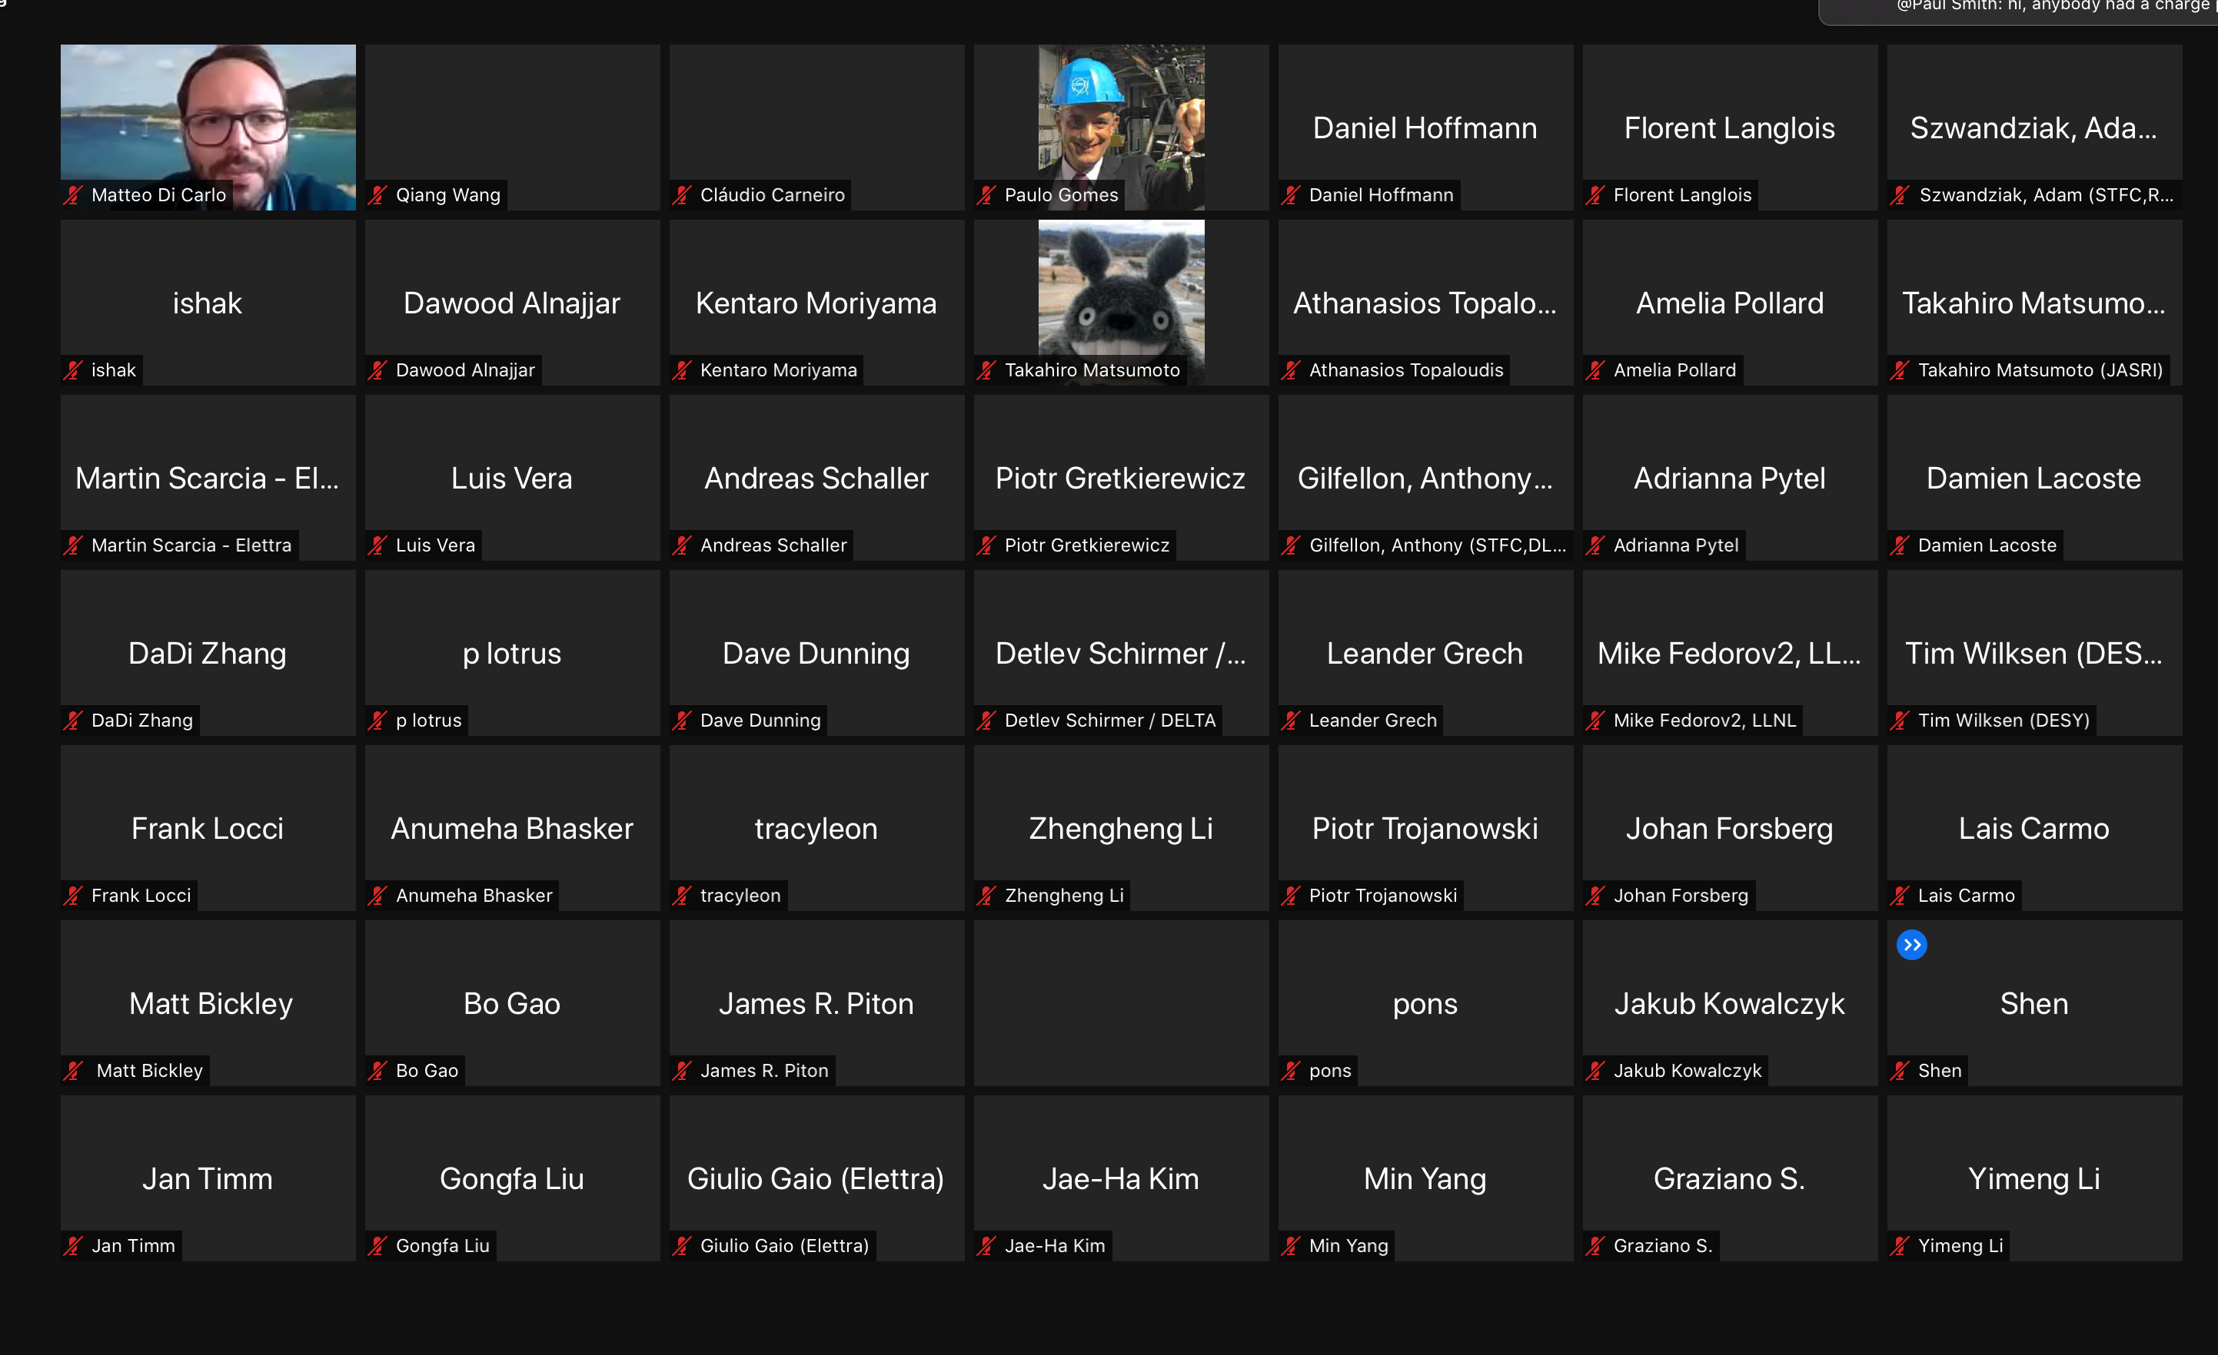
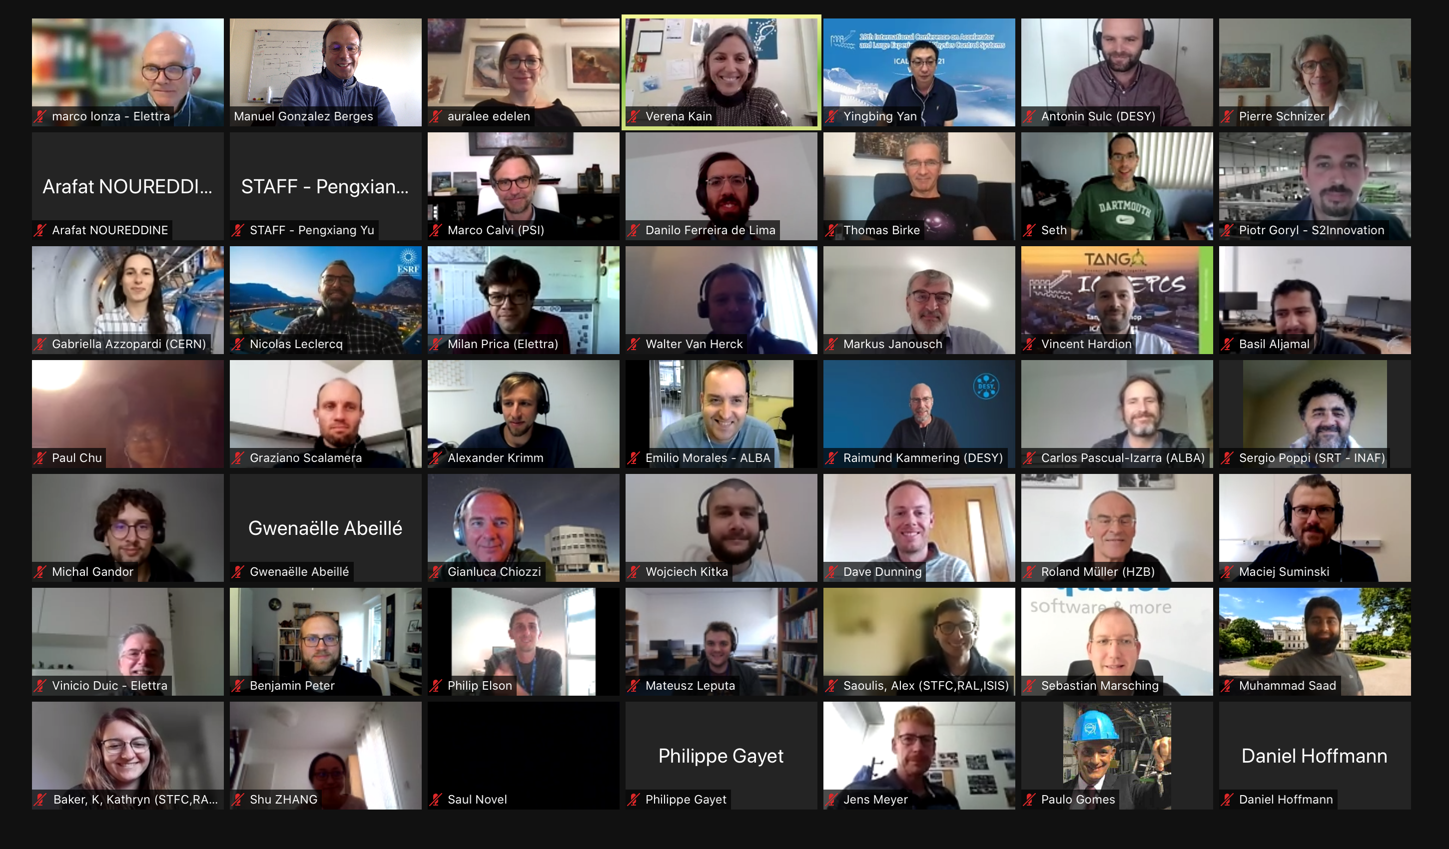
ICALEPCS 2021 - Shangai
130 attendees
( >200 registered)

Slide 5
Tracks with ML related papers
Conferences | Tracks
ICALEPCS 2013 | Knowledge-based Techniques
ICALEPCS 2015 | Feedback Systems, Tuning
ICALEPCS 2017 (first time ML mentioned in descriptions) | Data Analytics Feedback Control and Process Tuning
ICALEPCS 2019 | Data Analytics Feedback Control and Process Tuning Experiment Control
ICALEPCS 2021 | Data Analytics Feedback Control, Machine Tuning & Optimization Experiment Control Timing Systems, Synchronization & Real-Time Apps
ICALEPCS 2023 | Many tracks (~35 papers mention ML) Specially: Artificial Intelligence & Machine Learning

Slide 6
Some concepts

Slide 7

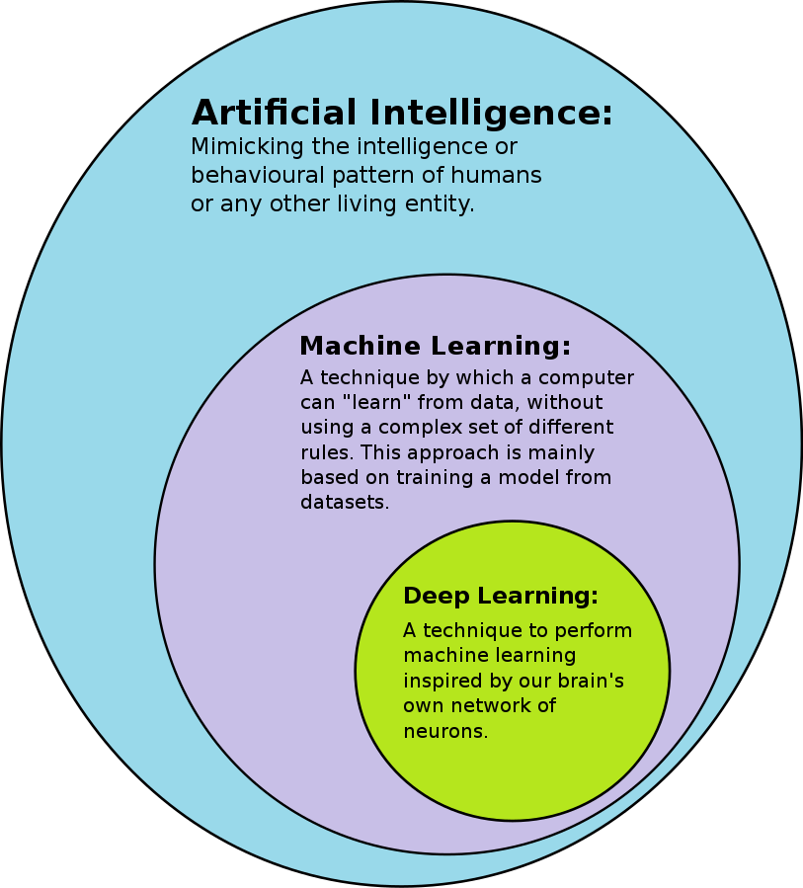
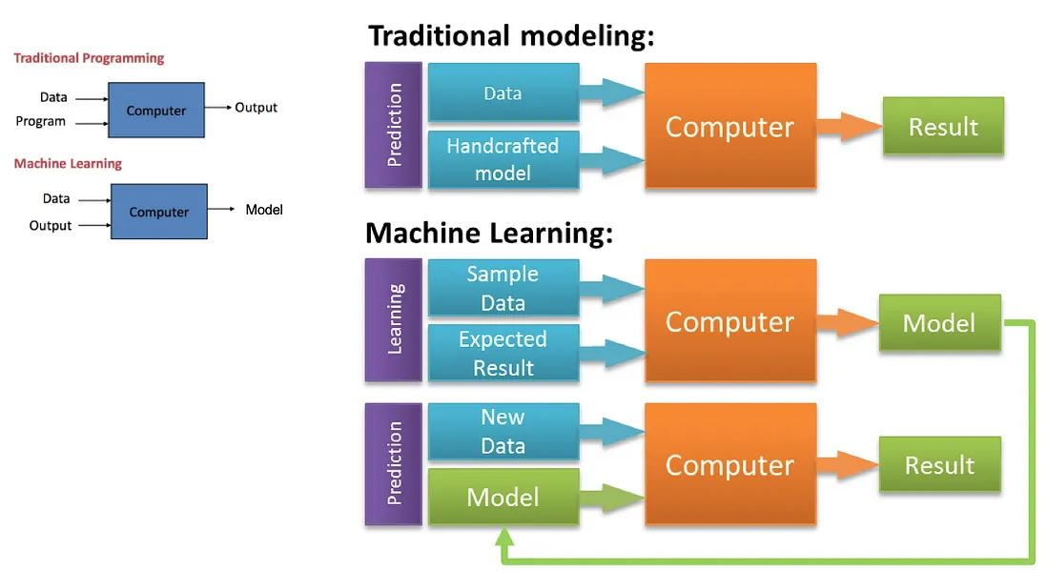
What is Machine Learning?

Slide 8
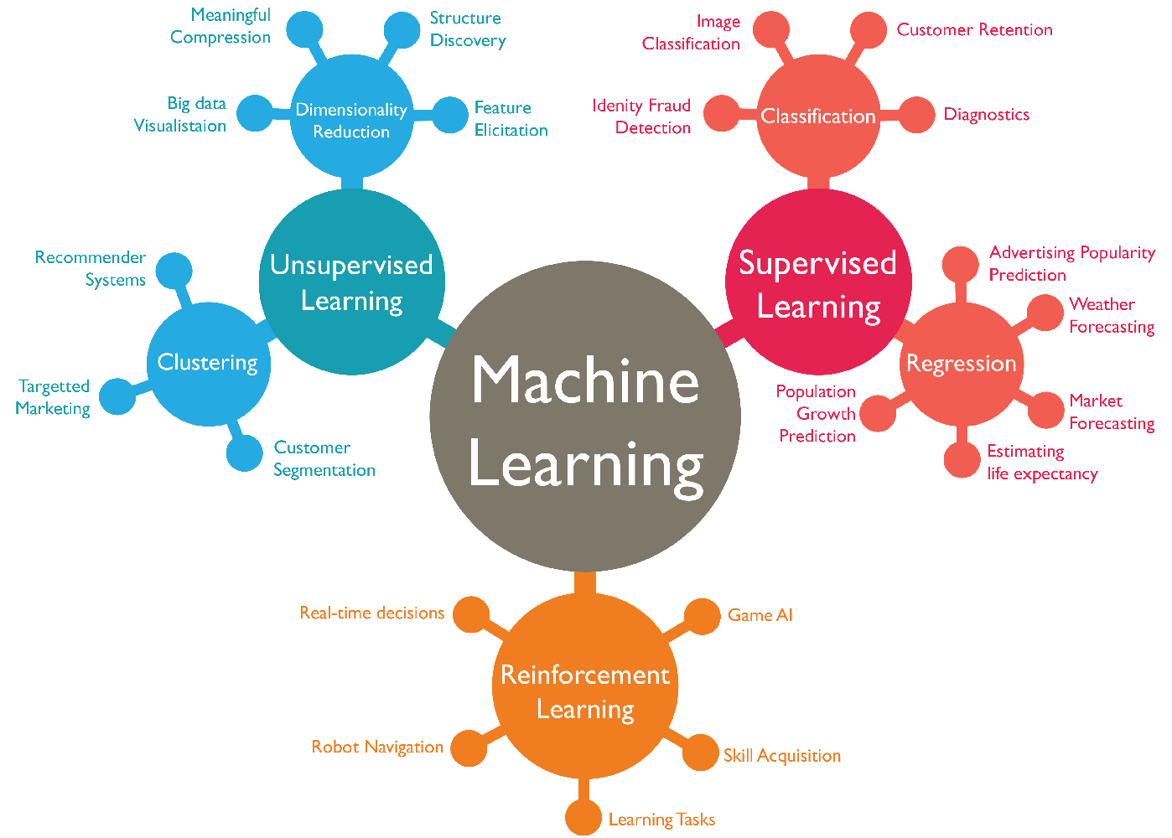
ML types
https://www.linkedin.com/pulse/business-intelligence-its-relationship-big-data-geekstyle/

Slide 9
Workshop Program

Slide 10
Participants
Conference registration ~60
  41 Indico registrations (13 in the last 2 weeks)
Programming level
No knowledge | 1
Beginner programmer | 7
Regular programmer | 22
Expert programmer | 11
DS/ML Experience
New field to me | 17
Some experience | 9
Regular experience | 15

Slide 11
Participants Interests
Anomaly detection
NLP
Computer Vision
Denoising
Predictive Maintenance
Parameter optimization
Advanced control
Calibration
Time series modelling
Real-world applications
etc

Slide 12
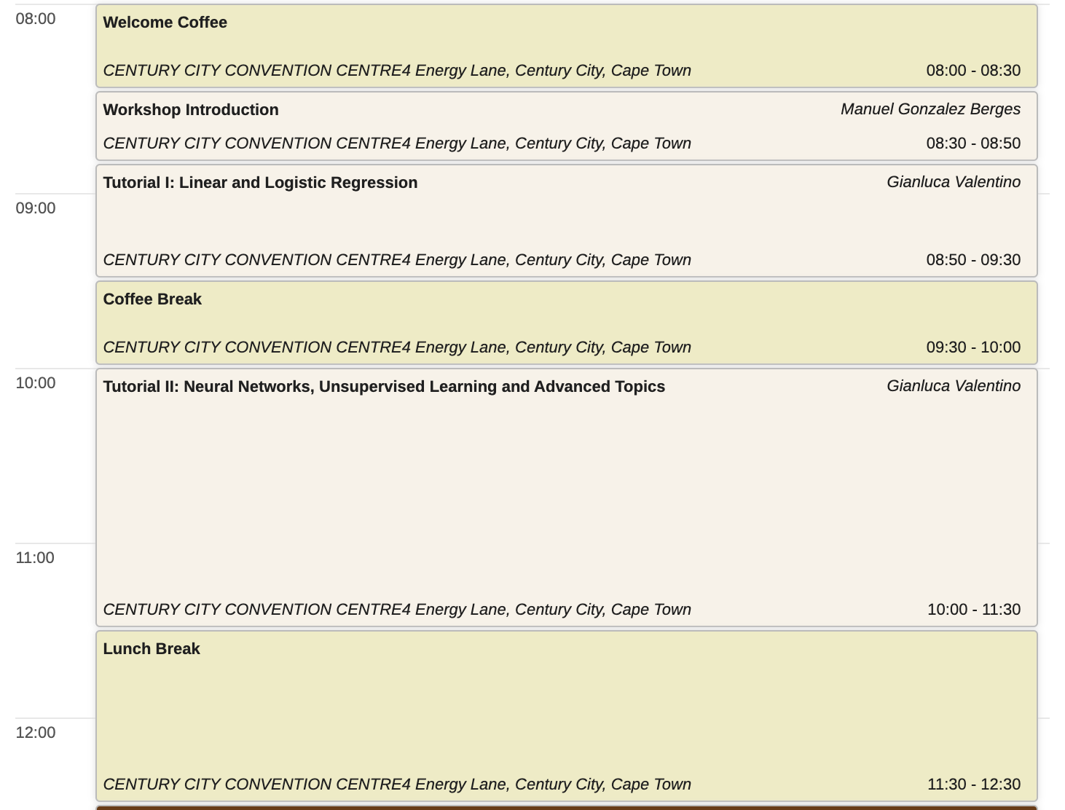
Morning

Slide 13
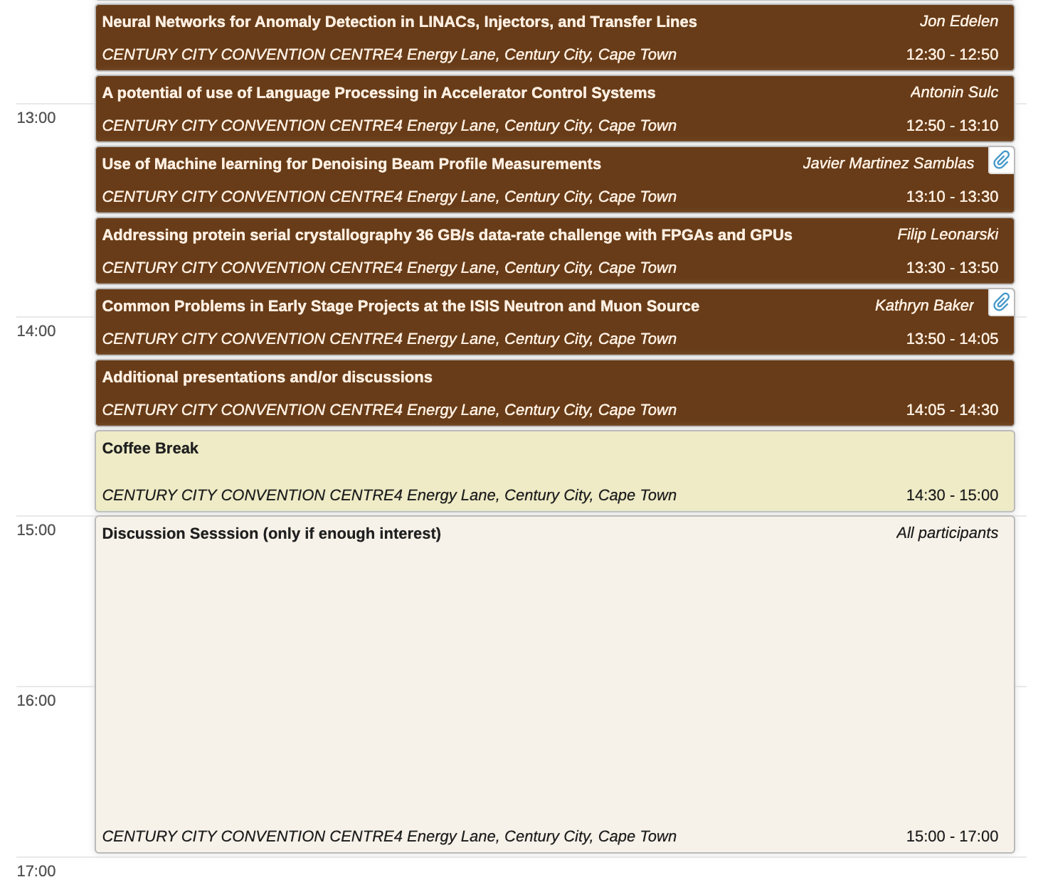
Afternoon

Slide 14
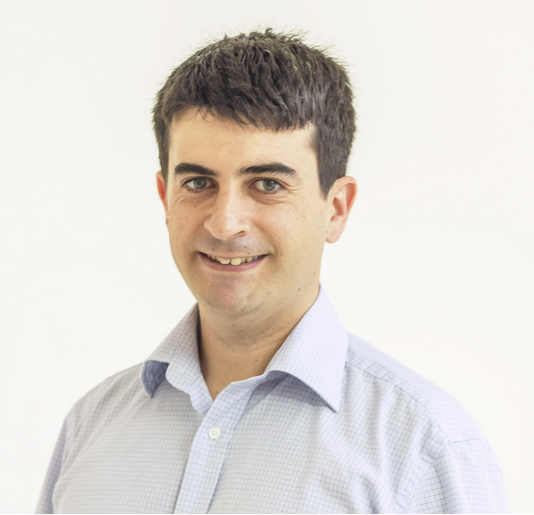

Tutorial Sessions
Prof. Gianluca Valentino is an associate professor at the Department of Communications and Computer Engineering at the University of Malta, where he teaches in machine learning and pattern recognition.
He is involved in several research projects which involve the application of these techniques in various domains, from particle accelerators to earth observation, aerospace and financial data.
He spent six years with the Beams department at CERN, first as a PhD student working to automate the collimator beam-based alignment procedure, and then as a postdoctoral fellow.
He is currently a Visiting Scientist at CERN.
Gianluca Valentino
University of Malta

Slide 15

Exercise

Slide 16
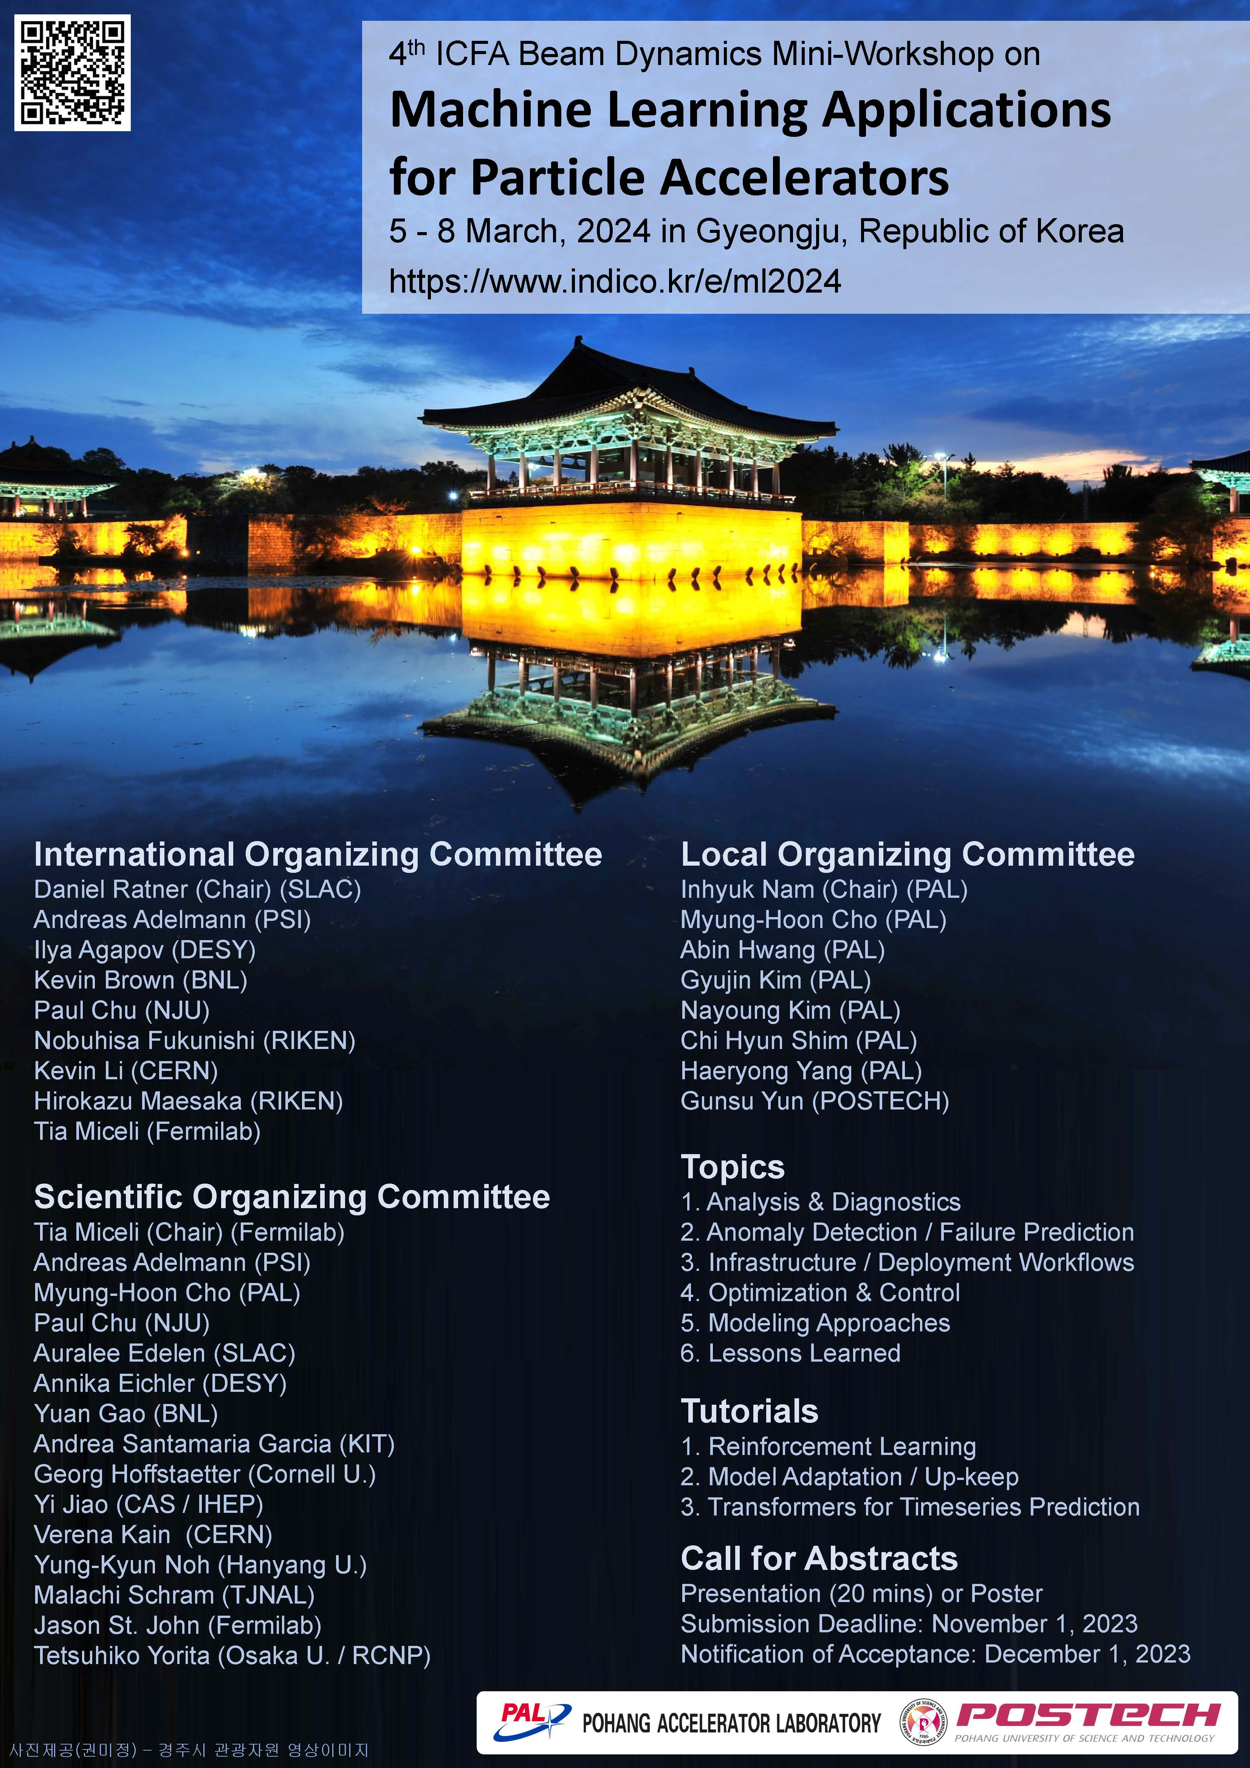

Slide 17
Questions?

