Slide 1

Neural Networks for Anomaly Detection in LINACs, Injectors, and Transfer Lines
Jonathan Edelen, Dan Abell, Evan Carlin, Paul Moeller, Mike Keilman, Rob Nagler (RadiaSoft),
Kevin Brown and Vincent Schoefer (Brookhaven National Laboratory)
Chris Tennant, Brian Freeman, Reza Kazimi, and Daniel Moser (Jefferson Laboratory)
October 7th 2023
ICALEPCS 2023: 3rd Data Science and Machine Learning Workshop
This material is based upon work supported by the U.S. Department of Energy, Office of Science, Office of Nuclear Physics under Award Number DE-SC0019682
Boulder, Colorado USA | radiasoft.net

Slide 2
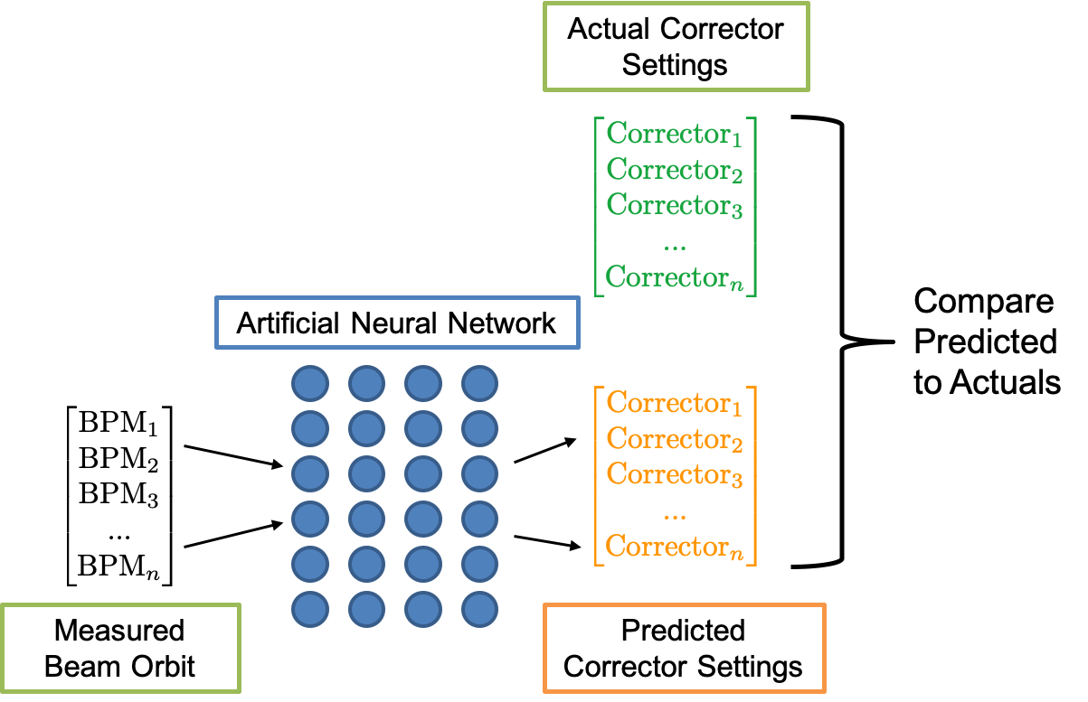
Inverse models for anomaly detection
Inverse models as a diagnostic in a supervised fashion
  Direct comparison between predicted settings and actual settings informs operations of a potential anomaly with that magnet

Slide 3
Inverse models for anomaly detection
Inverse models as a diagnostic in a supervised fashion
  Direct comparison between predicted settings and actual settings informs operations of a potential anomaly with that magnet
Inverse models as a diagnostic in an unsupervised fashion
  Assumptions
    model errors are caused by other beamline elements
    each beam-line element will have a unique error signature

Slide 4
Inverse models for anomaly detection
Inverse models as a diagnostic in a supervised fashion
  Direct comparison between predicted settings and actual settings informs operations of a potential anomaly with that magnet
Inverse models as a diagnostic in an unsupervised fashion
  Assumptions
    model errors are caused by other beamline elements
    each beam-line element will have a unique error signature
Inverse models for tuning
  Minimize error between predicted settings and actual settings by varying quads
  Right: model error as a function of quad strength error

Slide 5
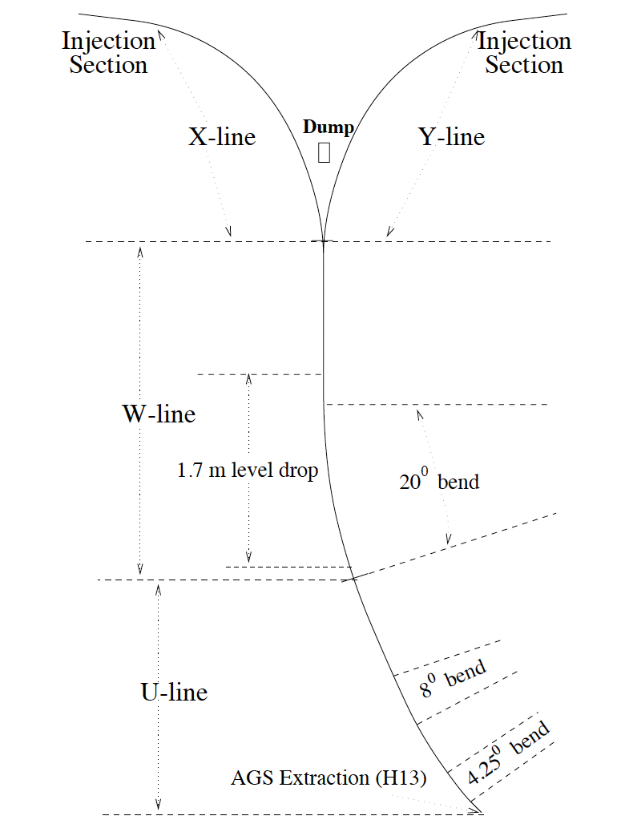
AGS to RHIC transfer line

Slide 6
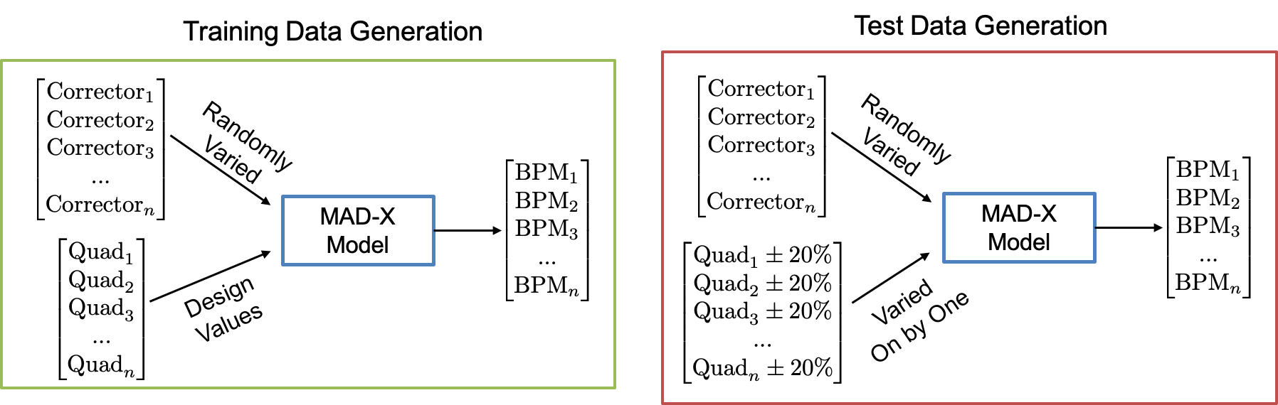
Data generation principles
Varied
One by One

Slide 7
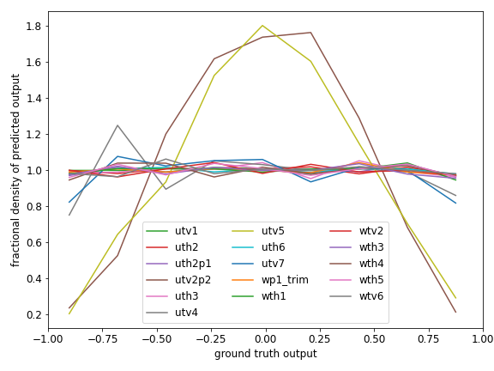
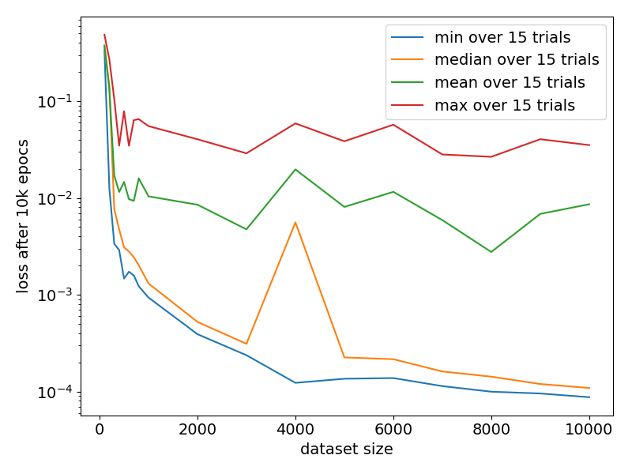
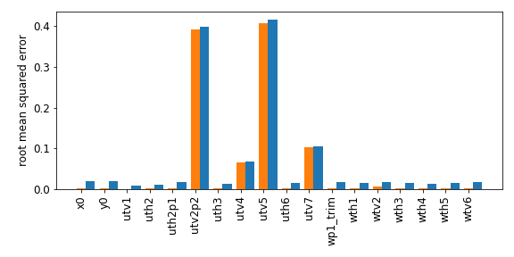
AGS to RHIC transfer line study
Model training for the AGS to RHIC transfer line
  Top Right: Fractional density of model error as a function of ground truth for each magnet
  Bottom Right: RMS error as a function of magnet type
  Bottom: model loss as a function of the dataset size

Slide 8
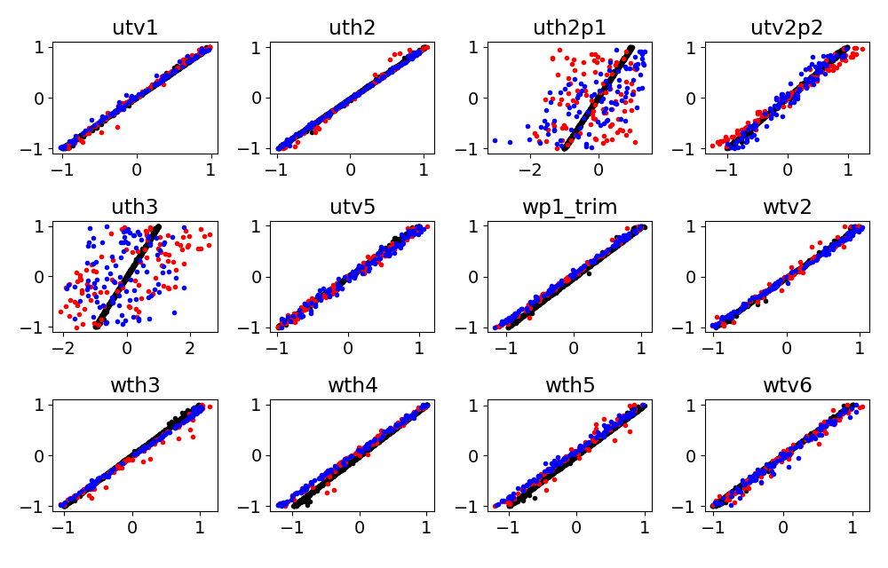
AGS to RHIC transfer line study
Right: Predicted corrector settings vs the ground truth for the validation set
  Black: without quadrupole errors
  Red: a single quadrupole error of -20%
  Blue: a single quadrupole error of +20%

Slide 9
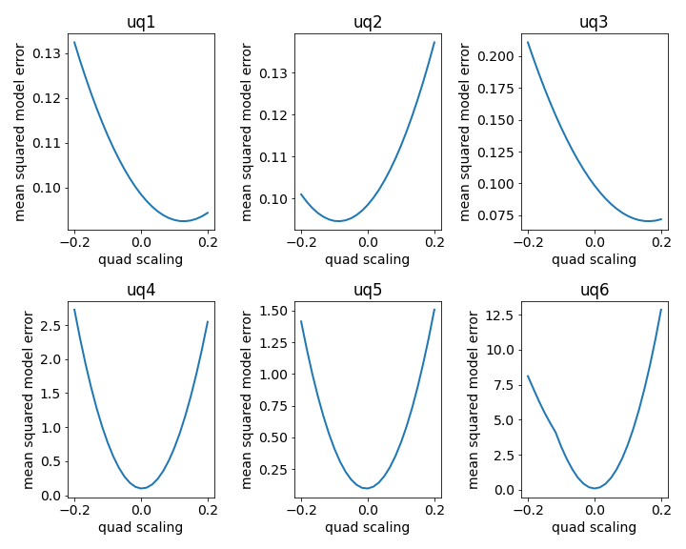
Computing the Model Loss as Quadrupoles are Varied
Model trained for 100k epochs
Individually varied the quads over a range of plus or minus 20% excitation
All quads show sensitivity except uq6
Many quads have minima at 0.0 with some offset
  Longer training time can improve this
  Ensemble methods may be more efficient

Slide 10
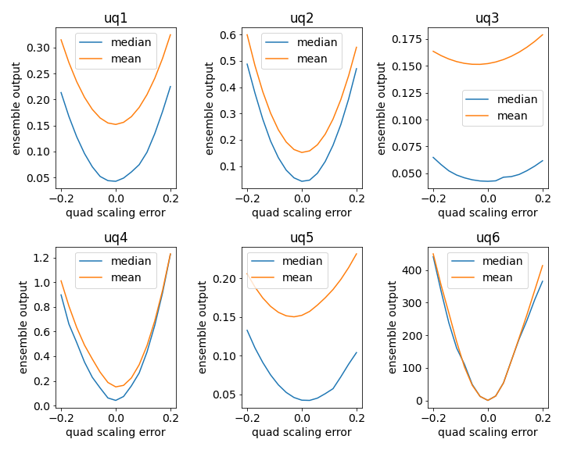
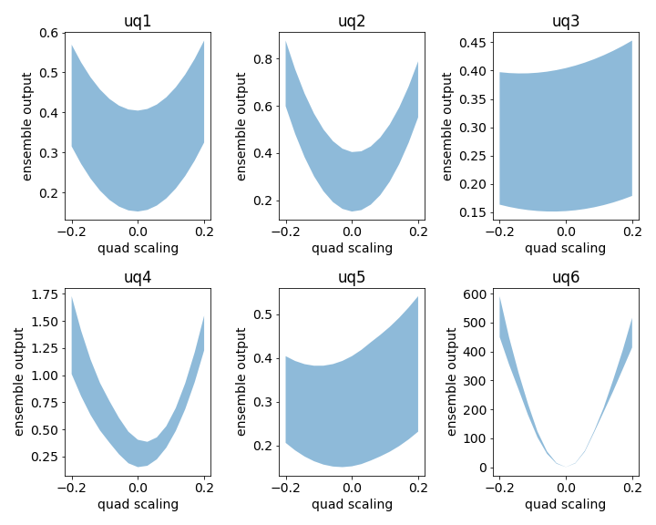
Consider an Ensemble of Models
23 models with random initializations: consider median and mean for output of the ensemble
Examine the ensemble output as you vary the quad strengths
Left: Ensemble output as a function of quad strength variation / Right: Ensemble output with ensemble variance
  Note clearly defined minima at or very close to 1.0 for all cases except uq6
  This is an improvement over slide 16 where some quads do not have well defined minima

Slide 11
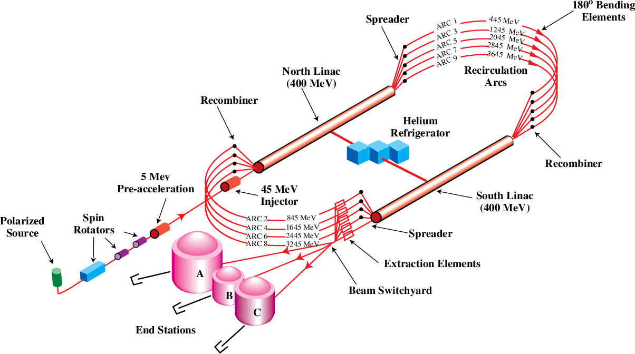
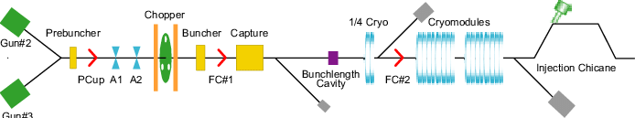
Overview of the CEBAF Injector

Slide 12
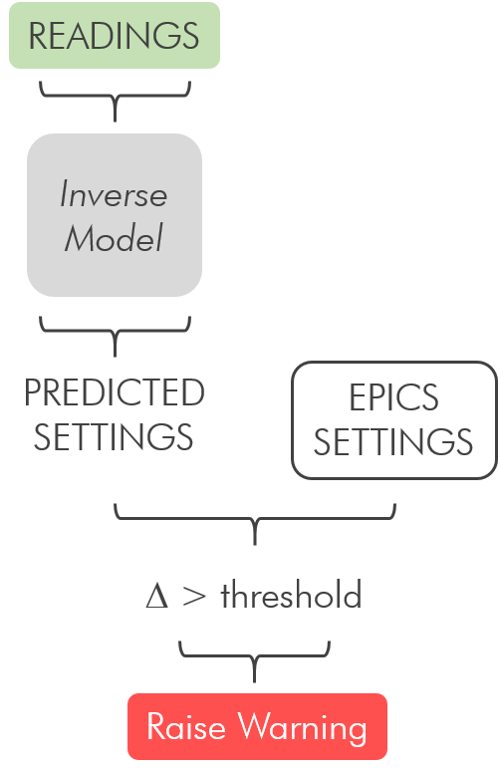
A Smart Alarm System for the CEBAF Injector
Alarm systems typically alert operators when there is a problem with the beam
  Often does not provide much information on what caused the alarm
  Diagnosing the problems is time consuming for operators
Use machine learning to automate the root-cause-analysis effort
  Autoencoders quantify similarities or differences between machine states
  Inverse models use actual measurements to predict settings

Slide 13
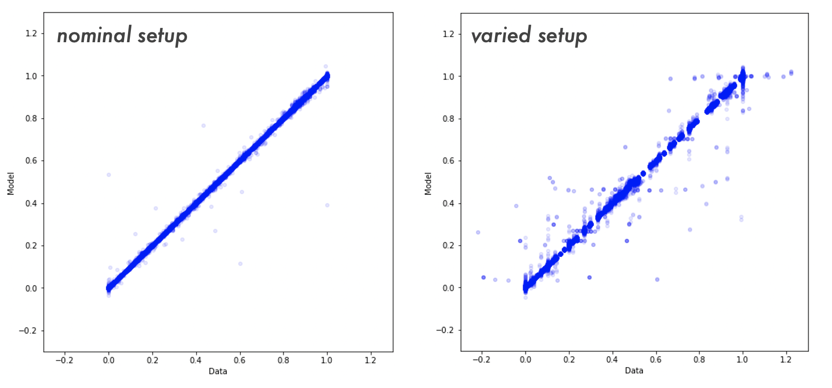
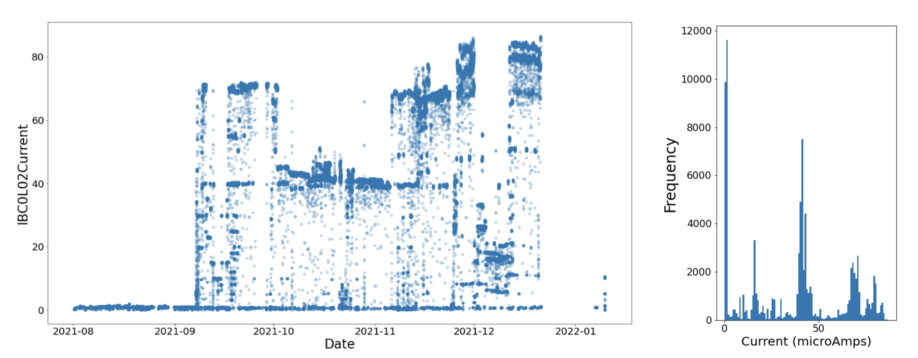
A Smart Alarm System for the CEBAF Injector
Data collected during two different operational modes.
  First during normal operations
  Second during a dedicated machine study where parameters were varied
Neural network inverse model is trained to predict settings from readings
  Left: Model prediction vs the ground truth for the validation data from the nominal setup
  Right: Model prediction vs the ground truth for the test data (study data)

Slide 14
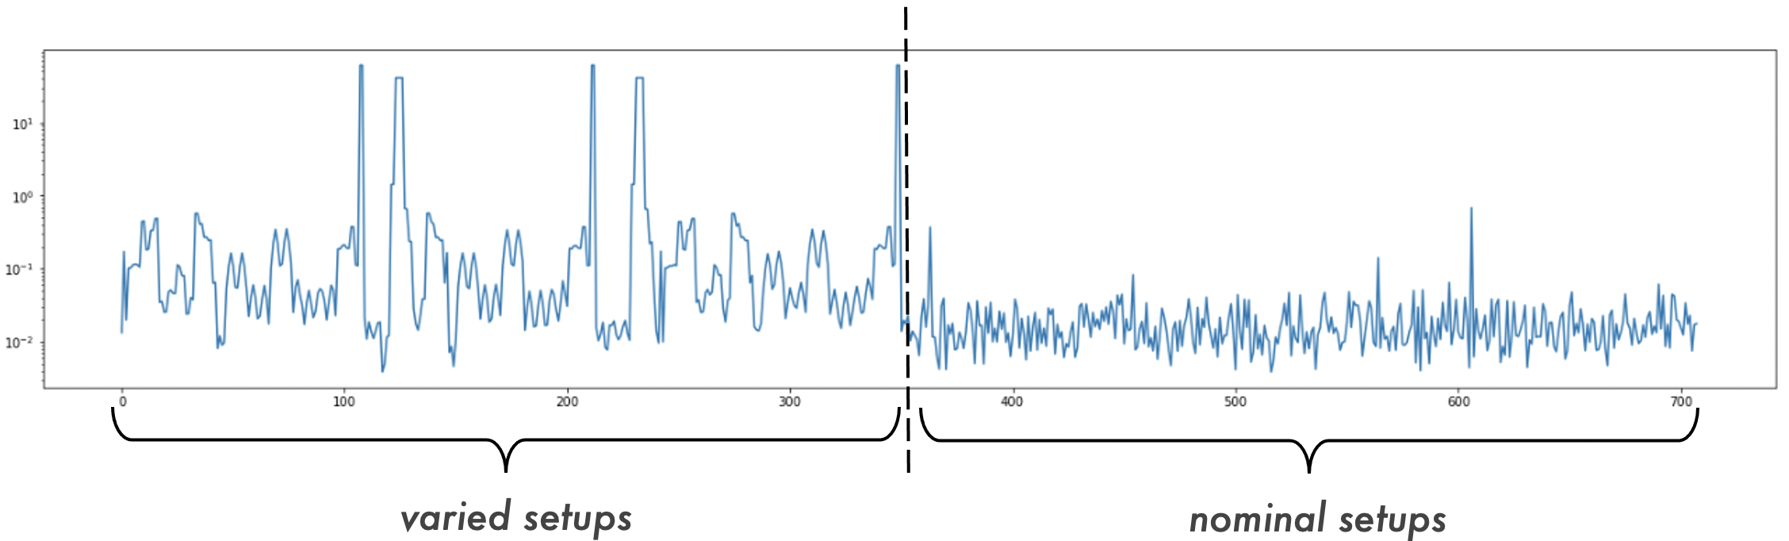
A Smart Alarm System for the CEBAF Injector
RMS error of the predicted settings by parameter for the machine study (left) and the nominal setup (right).
The difference is indicative of the model being able to detect variations in the machine state.
Thresholds for anomaly detection are established based on performance on the nominal setup

Slide 15
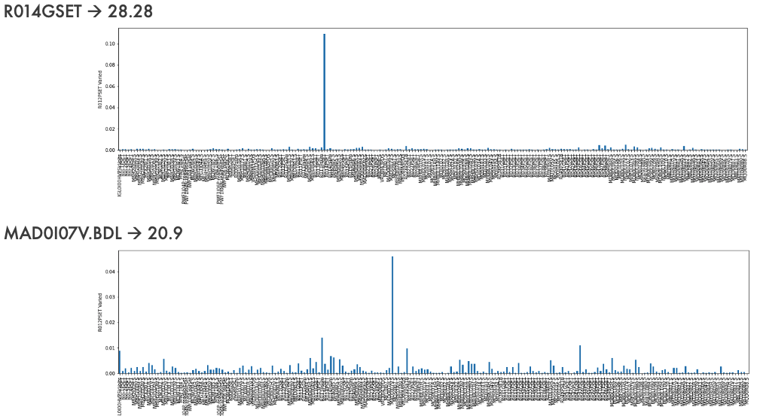
A Smart Alarm System for the CEBAF Injector
Identifying individual errors using the inverse model
  Top: model error is a maximum for R014GSET which is the parameter that changed
  Bottom: model error is maximum for MAD0107V which is the parameter that was changed

Slide 16
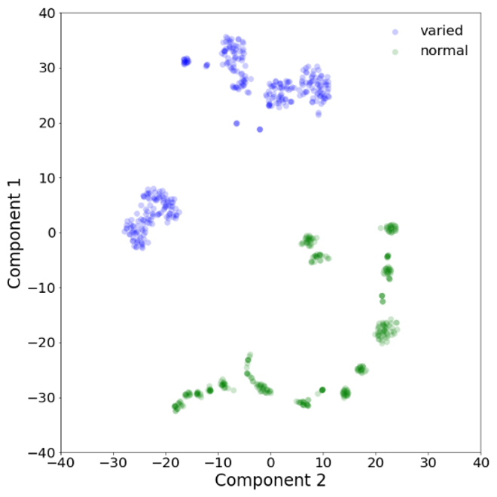
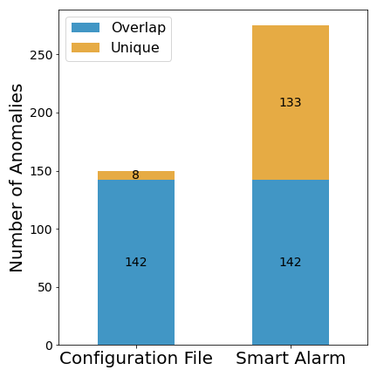
A Smart Alarm System for the CEBAF Injector
Left: T-SNE was used to reduce the dataset dimensionality
  Operational data is shown in green and the study data in blue
  The model correctly flagged the study data as anomalous
  The T-SNE reduction of the data also provides a strong indication that these two datasets are distinct in nature
Right: Comparison with conventional threshold-based alarming.
  Threshold misses numerous configurations that would be undesirable by the user program

Slide 17
Conclusions
Smart alarm system at JLab
  Algorithm development nearing completion, published (https://iopscience.iop.org/article/10.1088/2632-2153/acb98d/meta)
  Many thanks to the efforts of Chris Tennant and the JLab team
Beamline control algorithms at BNL
  Algorithm development nearing completion, publication in preparation.

Slide 18
Disclaimer
This report was prepared as an account of work sponsored by an agency of the United States Government. Neither the United States Government nor any agency thereof, nor any of their employees, makes any warranty, express or implied, or assumes any legal liability or responsibility for the accuracy, completeness, or usefulness of any information, apparatus, product, or process disclosed, or represents that its use would not infringe privately owned rights. Reference herein to any specific commercial product, process, or service by trade name, trademark, manufacturer, or otherwise does not necessarily constitute or imply its endorsement, recommendation, or favoring by the United States Government or any agency thereof. The views and opinions of authors expressed herein do not necessarily state or reflect those of the United States Government or any agency thereof.

