Slide 1
Machine Learning & Data Processing for Beam Profile Measurements
Javier Martínez Samblas, Manuel Gonzalez-Berges
Contributions by:
Glenn Anta, Clara Marie Fleisig, Verena Kain, Mark Mclean, Hampus Sandberg, James Storey
07/10/2023

Slide 2

Outline
Introduction
Noise Removal
Extra Data Processing
Preliminary Results
Conclusions & Future Work

Slide 3
Introduction

Slide 4
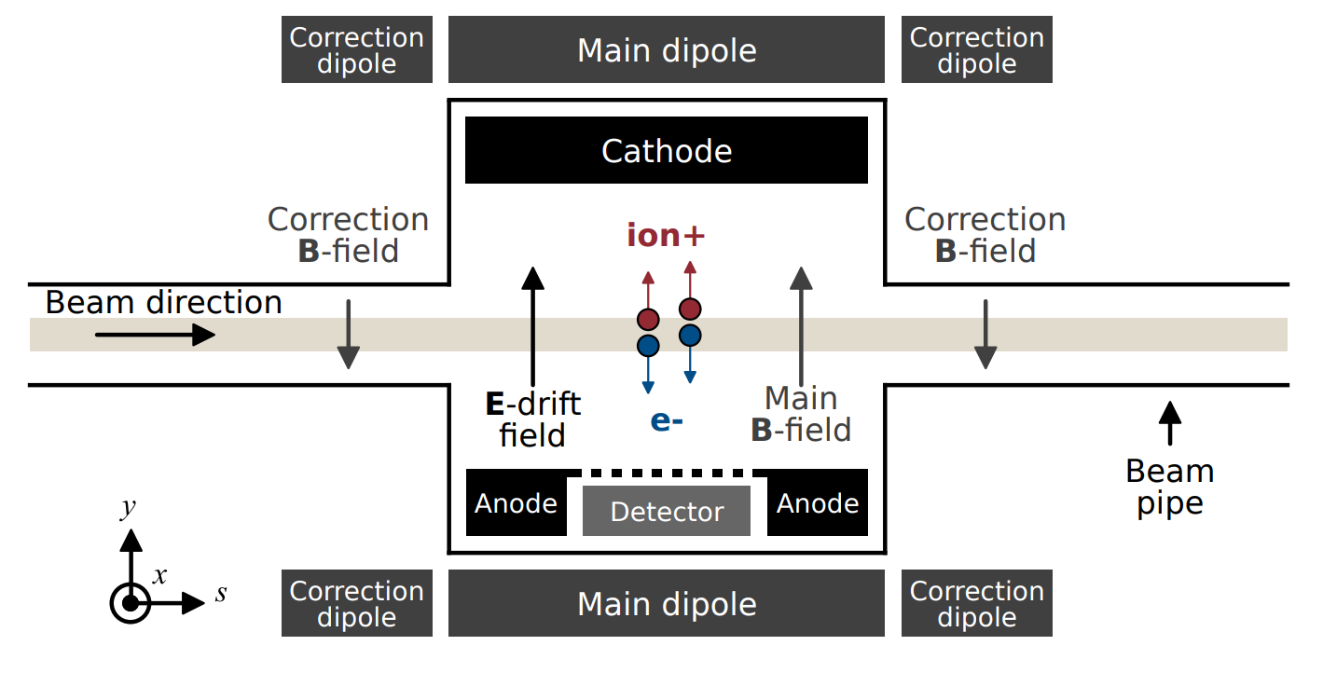
BGI: Beam Gas Ionization
Motivation: “To obtain non-invasive beam profile measurements.”
Source: Commissioning of Timepix3 Based Beam Gas Ionisation Profile Monitors for the CERN Proton Synchrotron (Swann Levasseur)
Notes:
The beam passes. There is a gas. The beam ionizes the gas, the gas loses electrons and the gas atoms convert into positive charged atoms. The electrical field collects the resulting free electrons (ionization electrons).

Slide 5
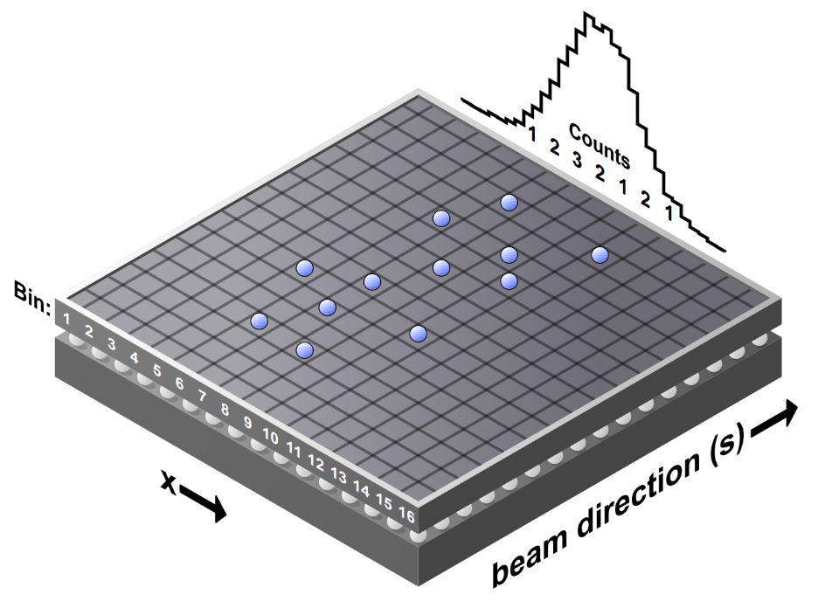
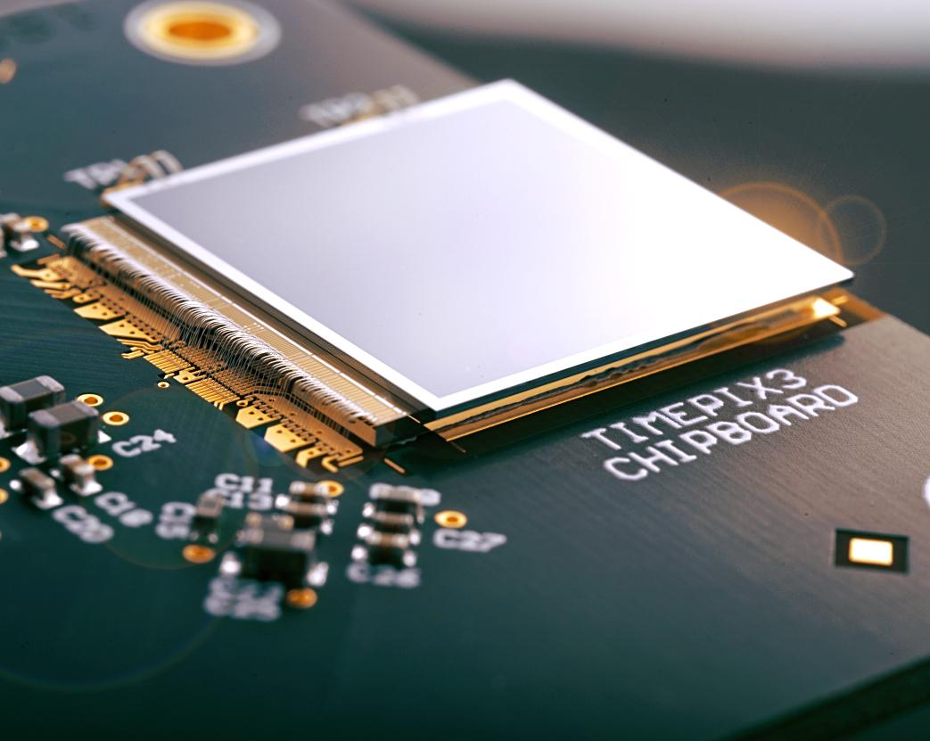
The Detector
ionization
electrons
Timepix3
256x256 px
14x14 mm
Source: Measuring the Beam Profile by Counting Ionization Electrons (Hampus Sandberg)
Notes:
The timepix3 (general purpose integrated circuit) is used in many other applications at CERN (Particle track reconstruction, X-rays imaging).

Slide 6
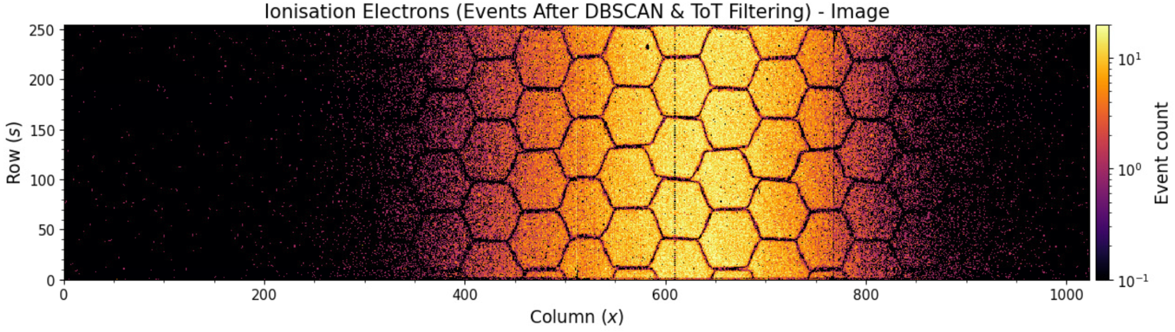
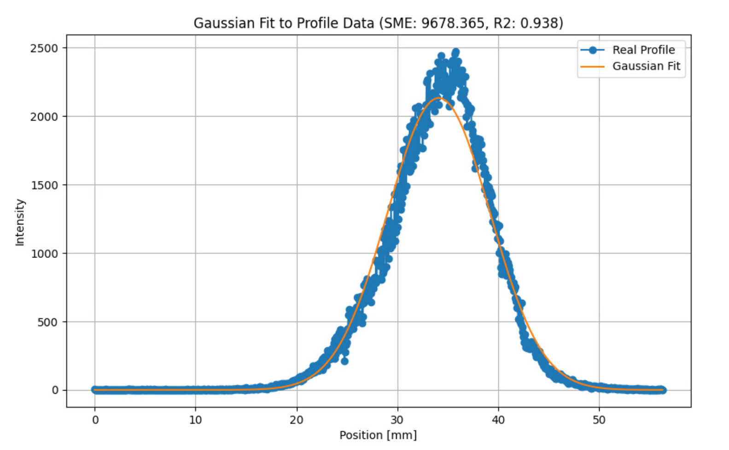
Beam Profile
All Events
256x256
BGIH (horizontal plane)
Sum (project) columns to obtain the beam profile
BGIV (vertical plane)

Slide 7
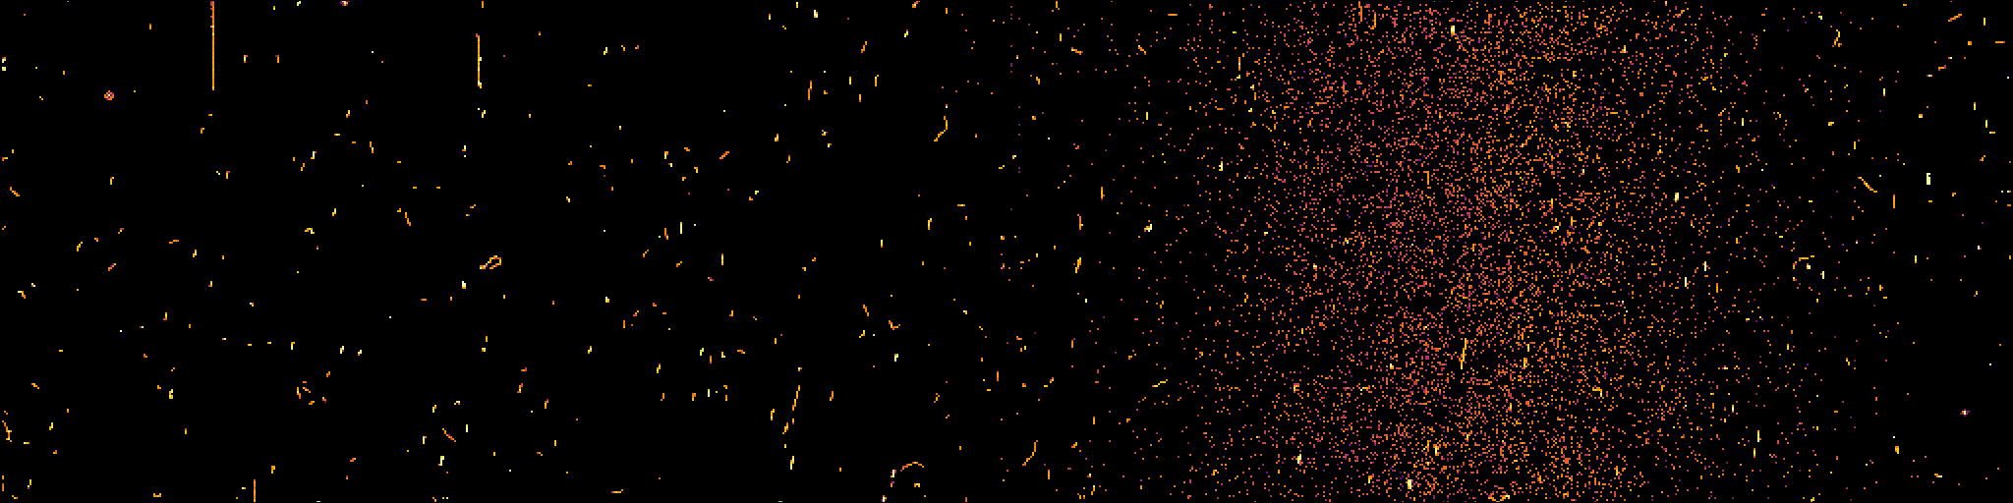
Acquisition Over Time
Acquisitions can actually be considered as a sequence of frames (video) that can be merged based on some predefined integration time 🎥
All Events Video Sequence
Source: https://bgi.web.cern.ch/

Slide 8
2. Noise Removal

Slide 9
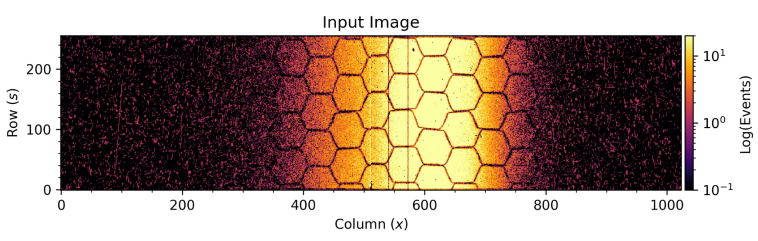
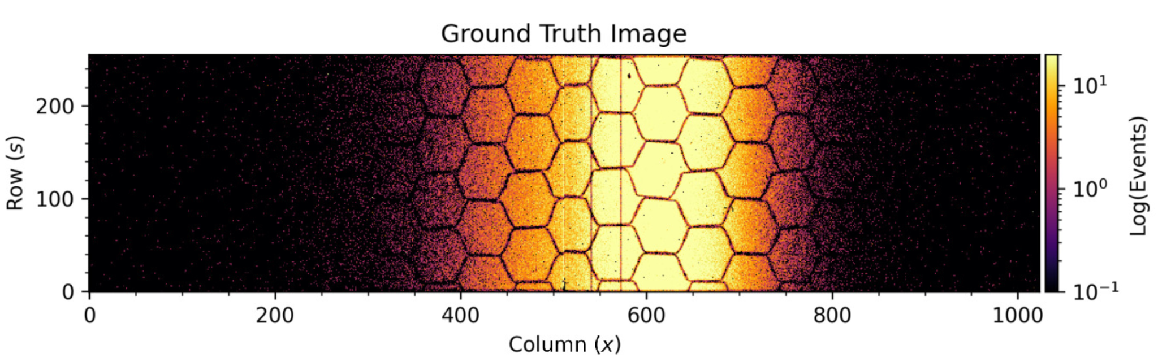
Loss Cleanup
Ionization Electrons
Beam Loss
Noisy Image
Clean Image

Slide 10
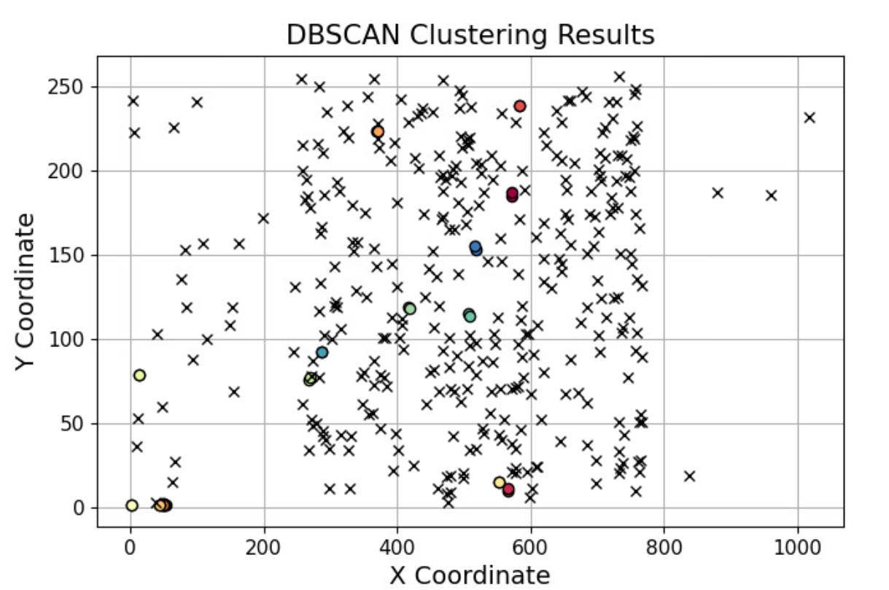
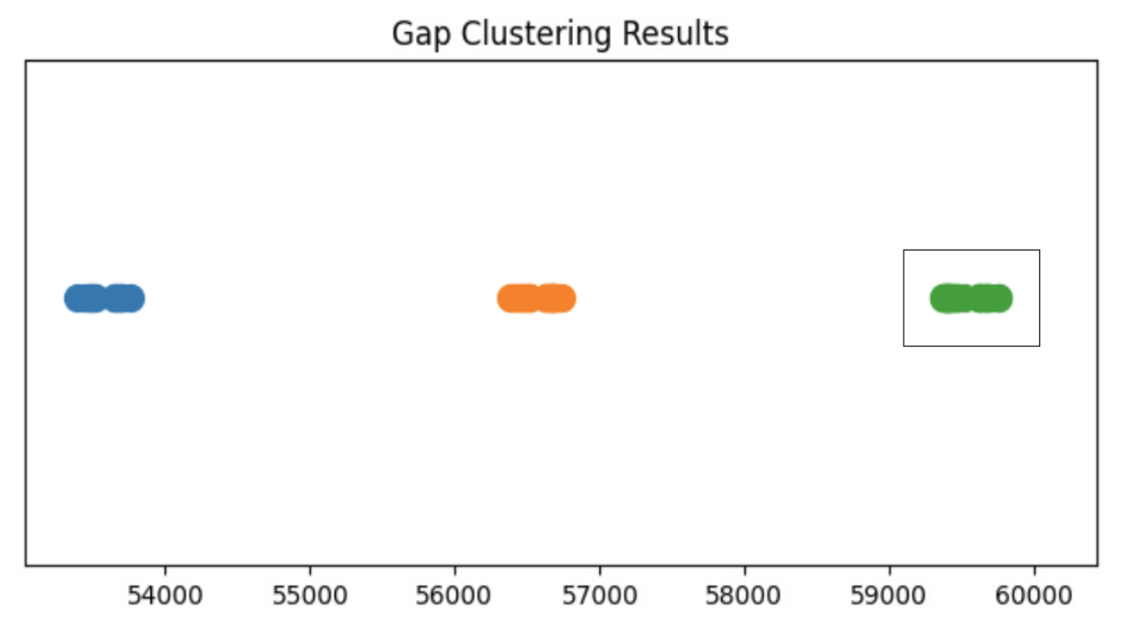

Previous work: DBSCAN Clustering
Expert knowledge: “Beam losses refer to clusters of points that are sufficiently close together at a given time; everything else is signal (ionization electrons).”
SPATIAL CLUSTERING
TIME CLUSTERING
apply spatial clustering to every time cluster found
C1
C2
C3
C3
nanoseconds

Slide 11
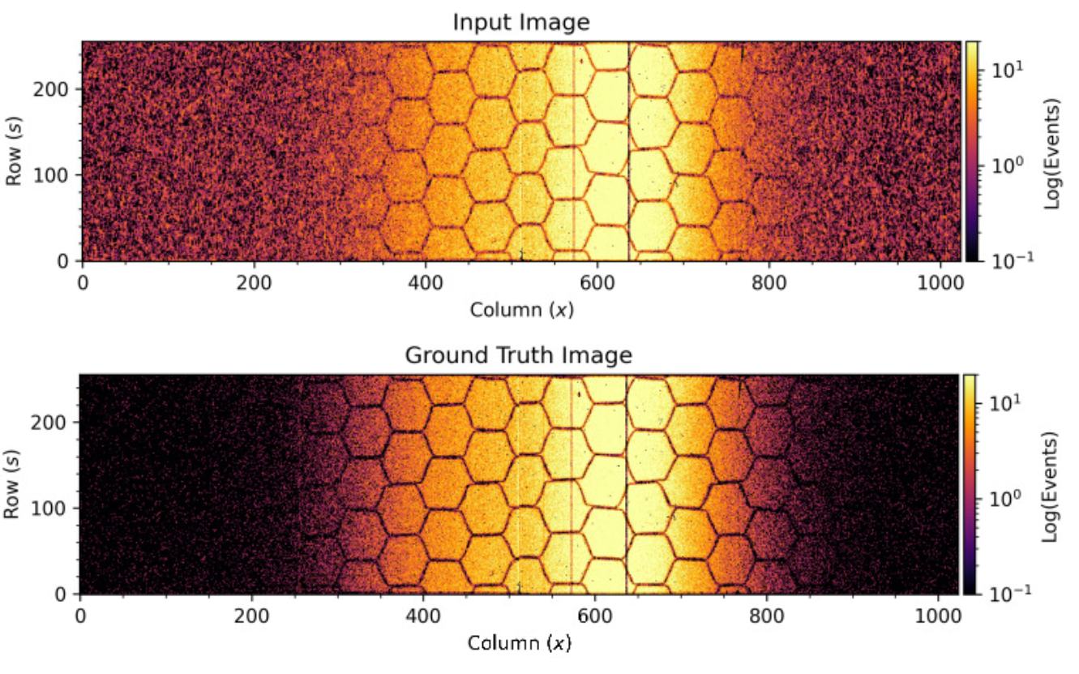
It works but it is too slow…
It takes from 20 to 100 seconds to analyze each acquisition (even with multiprocessing on several CPUs)

Slide 12
How can ML help us?
Unsupervised learning. Trying to directly detect the noise without labeled data.
Supervised learning. Using denoised data as our ground truth.
Self-supervised learning. Creating noisy synthetic images from clean data and train in a supervised way.
Algorithms:
  Traditional methods (e.g. median filtering, wavelet denoising, etc.)
  Autoencoders (our selection / baseline)
  Generative Adversarial Networks (GANs)
  Vision Transformers (ViT)

Slide 13
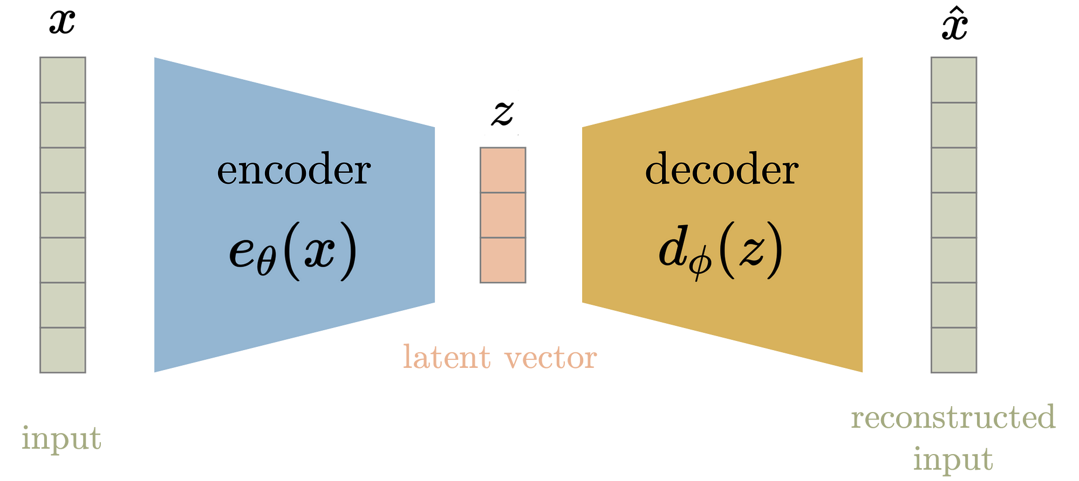
What is an autoencoder?
Source: Difference between AutoEncoder (AE) and Variational AutoEncoder (VAE) (Aqee Anwar) (https://towardsdatascience.com/)
Notes:
You can learn any transformation: image denoising, image shifting, rotations, translations, etc.

Slide 14
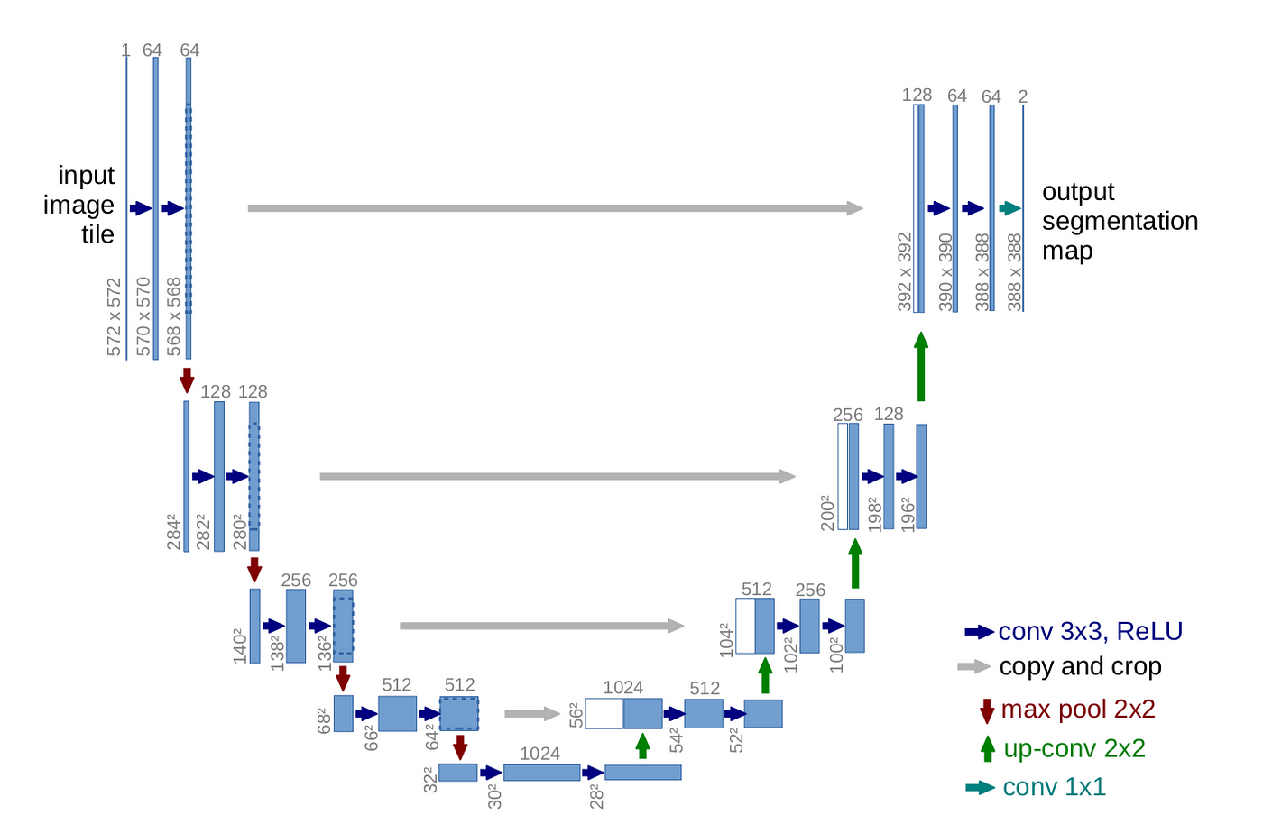
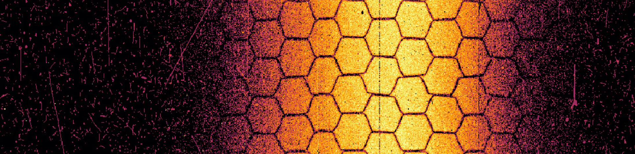
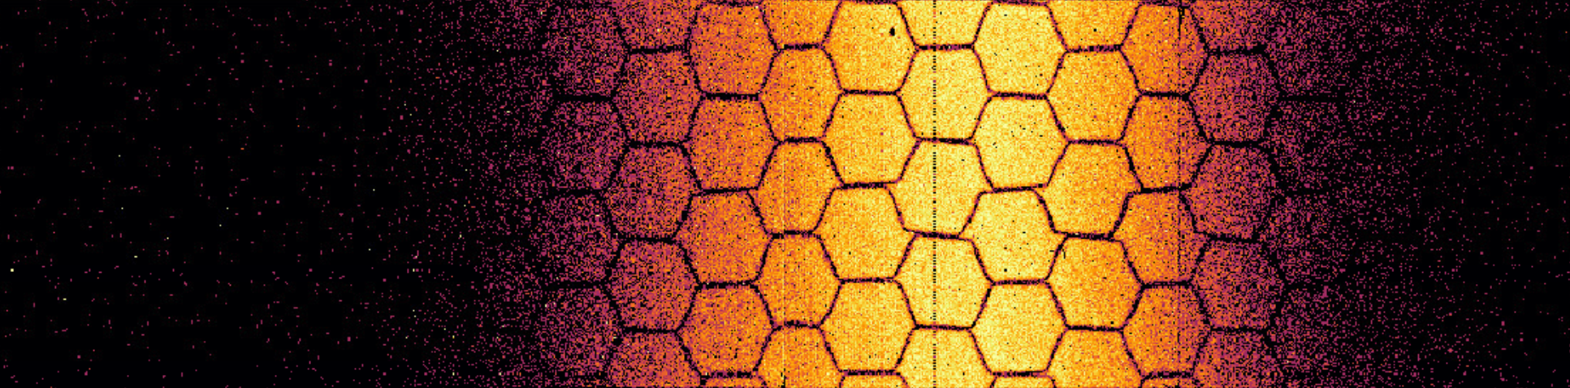
Proposal: using autoencoders to speed up the process
Assumption: "DBSCAN works. Let’s train a neural network in a supervised way to learn the mapping from the noisy to the denoised DBSCAN outputs.”
U-NET
NOISY
DENOISED
Source: U-Net: Convolutional Networks for Biomedical Image Segmentation

Slide 15

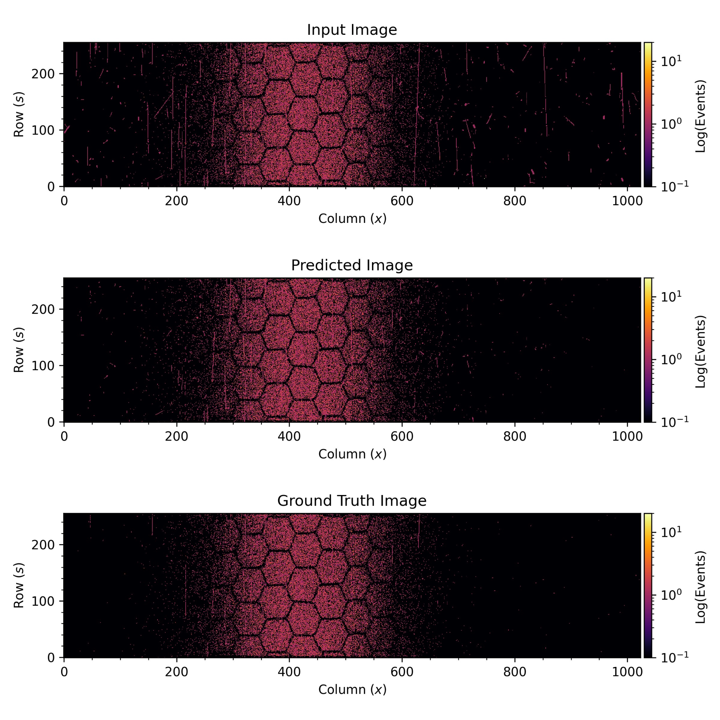
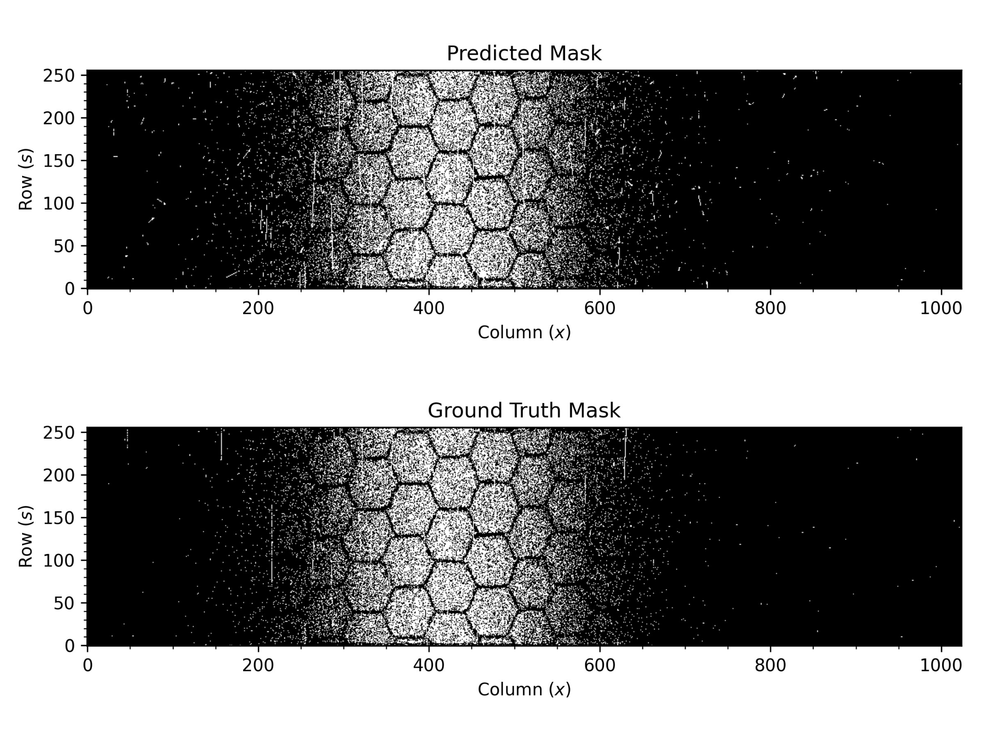
Training Stage
DENOISE USING DBSCAN (SLOW)
DBSCAN OUTPUT
U-NET ARCHITECTURE
binarize
NOISY IMAGE
DENOISED BINARY IMAGE
Notes:
It is like inverted self-supervised actually.

Slide 16
Inference
NOISY IMAGE
FINAL DENOISED OUTPUT IMAGE
Our trained U-NET model
X

Slide 17
Dataset Details
We have analyzed about 1500 image pairs from BGIH 2021 and 2022 data.
Not all of the data is actually valid (e.g. images with detectors OFF, not enough beam or recorded events, bad fits, etc.)
Trained one model on high integration time images (~100 imgs)
Trained another on low integration time images (~350 imgs)
75% training set and 25% validation set
Preprocessing: Min-Max Norm and Log Transformation
LOW INTEGRATION TIME
HIGH INTEGRATION TIME

Slide 18
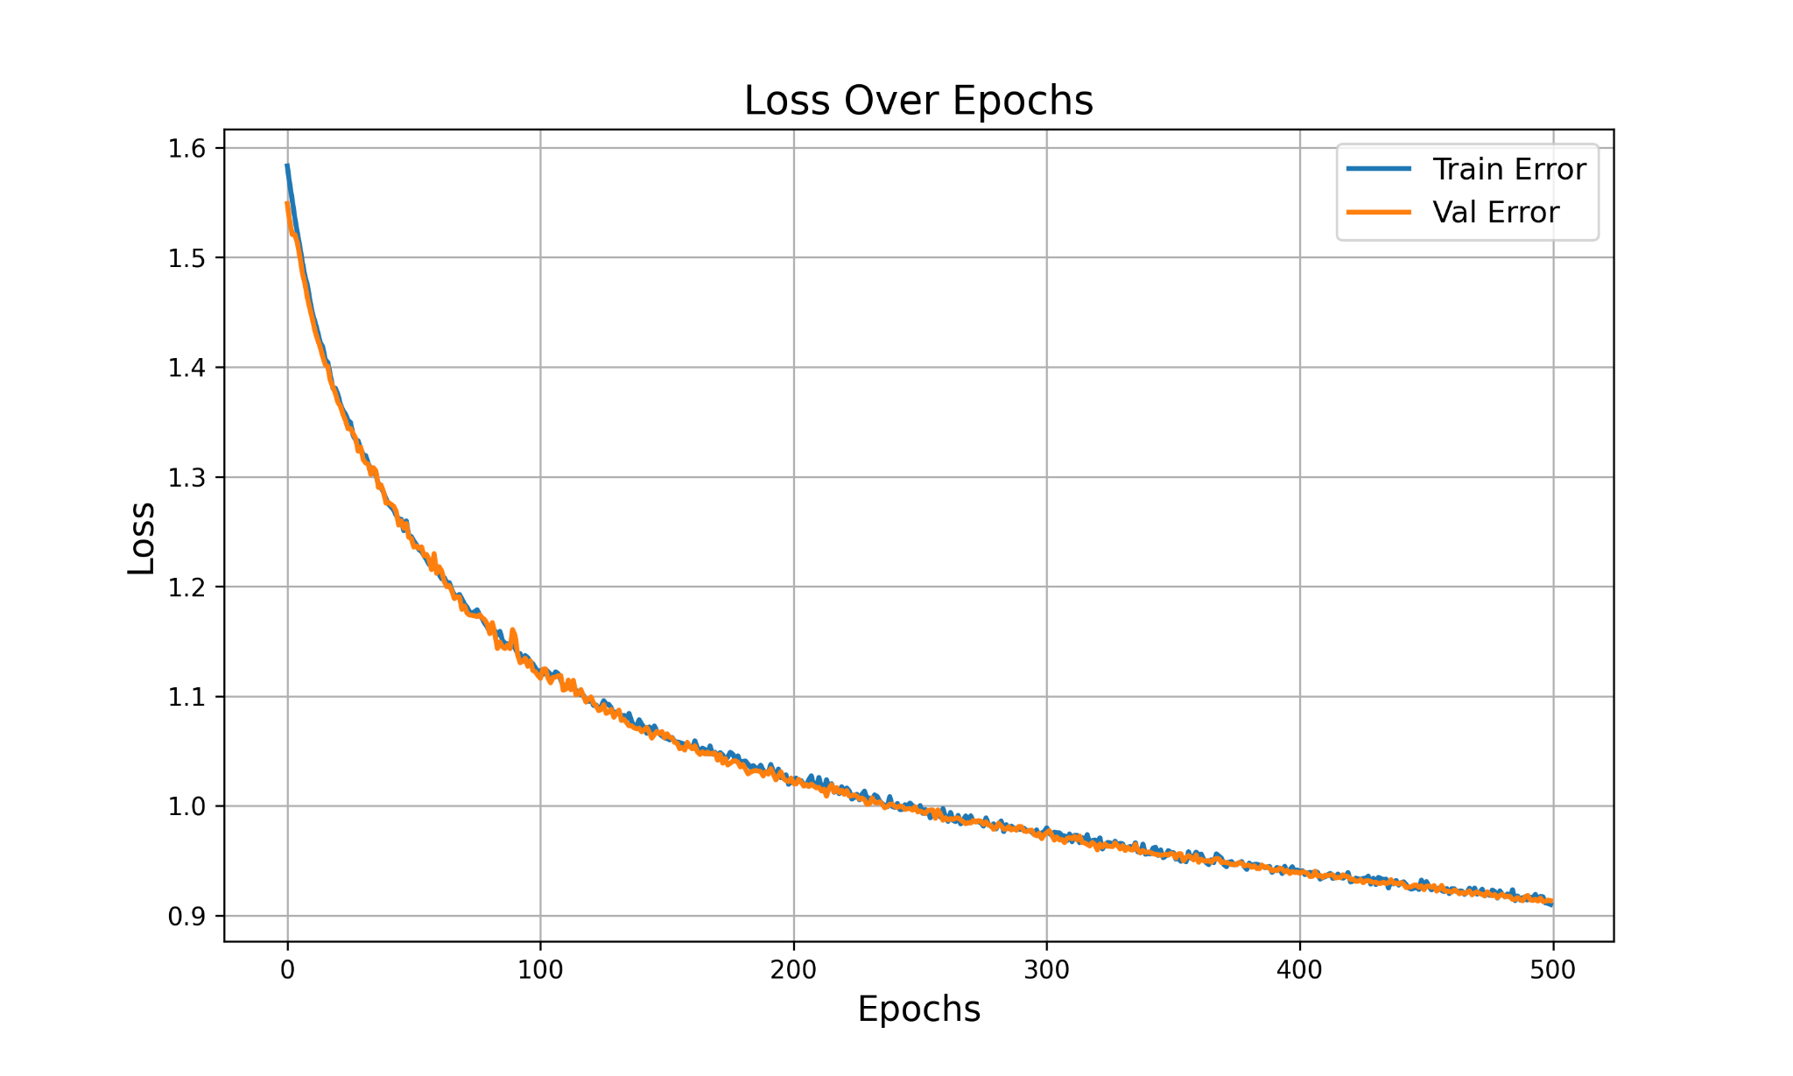
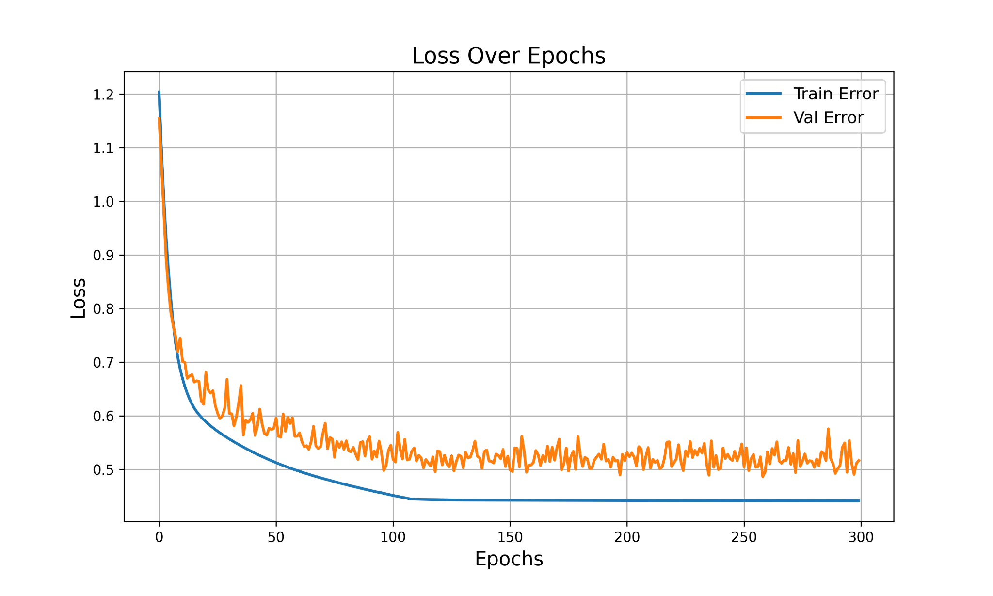
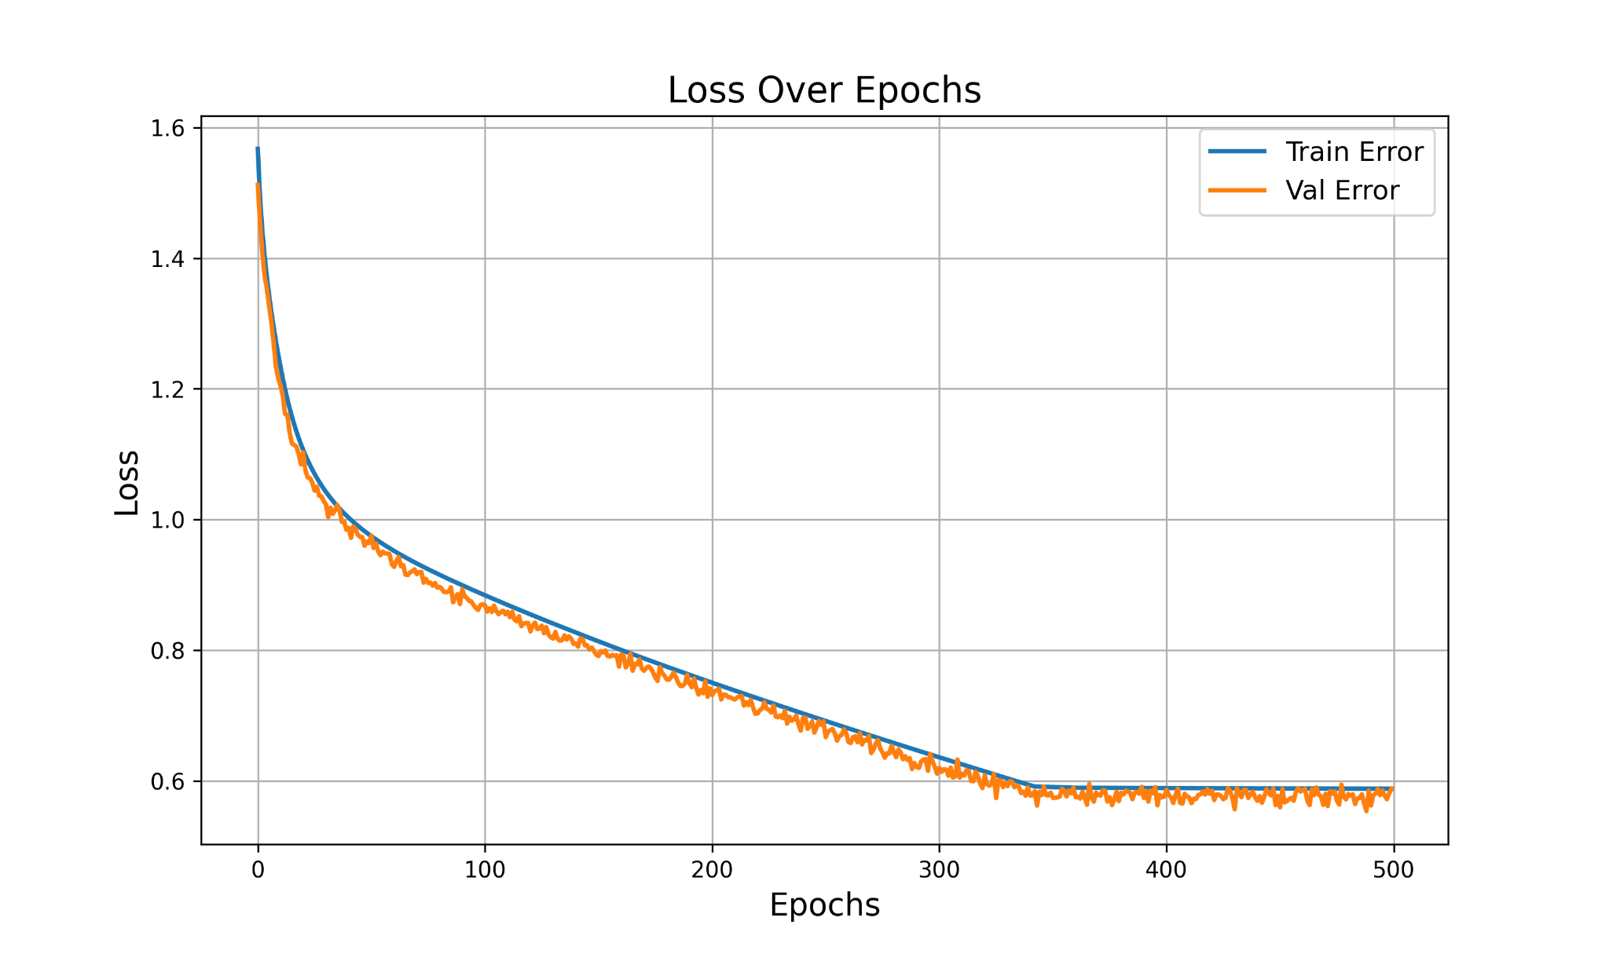
Training Configuration
Our preliminary study shows that it is actually possible to learn the mapping 😊
batch size = 1-8 imgs
lr = 1e-6 to 1e-8 (lr_scheduler)
weight decay = 1e-8
optimizer = AdamW
Loss = Binary Cross Entropy (BCE) + Dice Loss

Slide 19
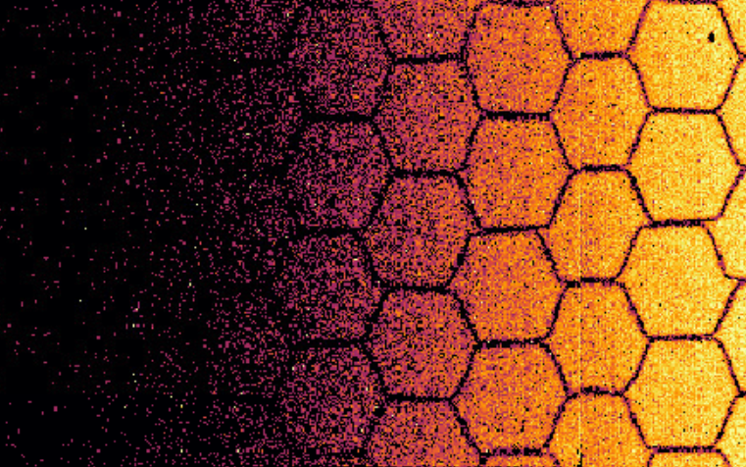
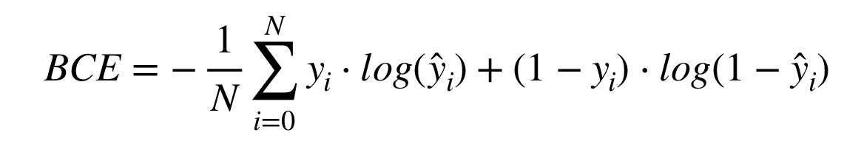
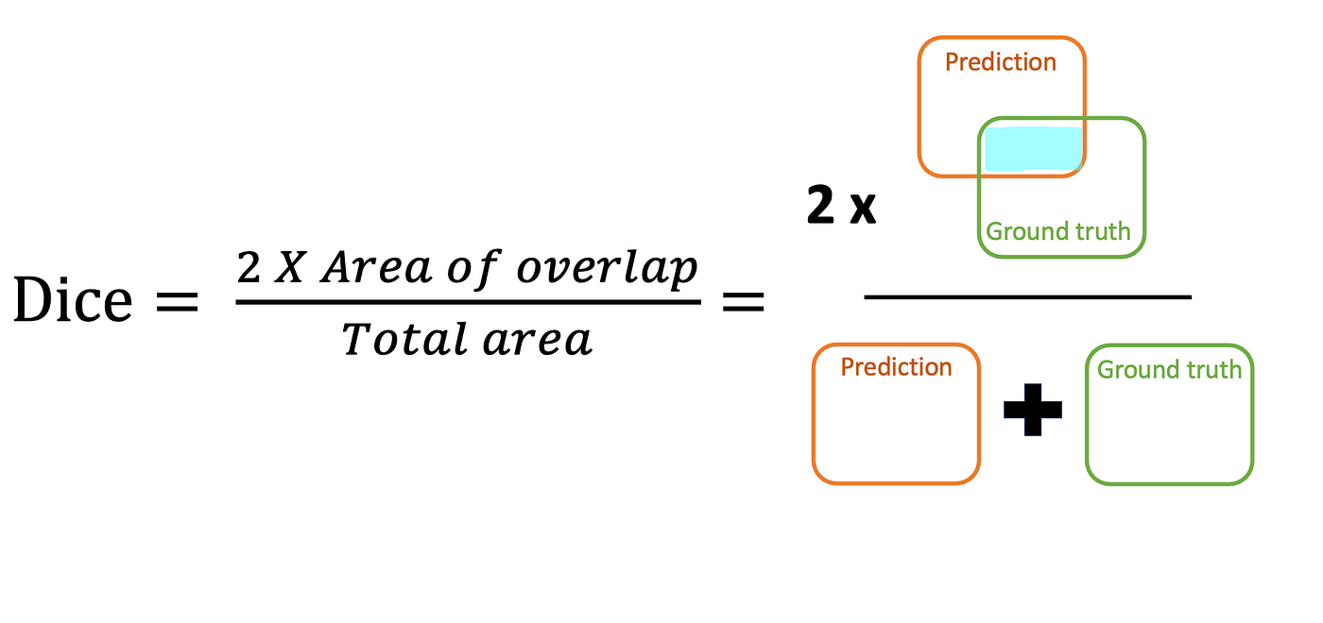
Sum Loss = BCE + Dice Loss
Binary Cross Entropy for pixel-wise accuracy
DL = (1 - Dice Coefficient) for contextual spatial features
Notes:
y_hat is the probability of a pixel belonging to the class (being inside the mask). if y=1 (the pixel belongs to the mask), p = y_hat, loss = -log(p), the loss is small if p is close to 1.

Slide 20
3. Extra Data Processing

Slide 21
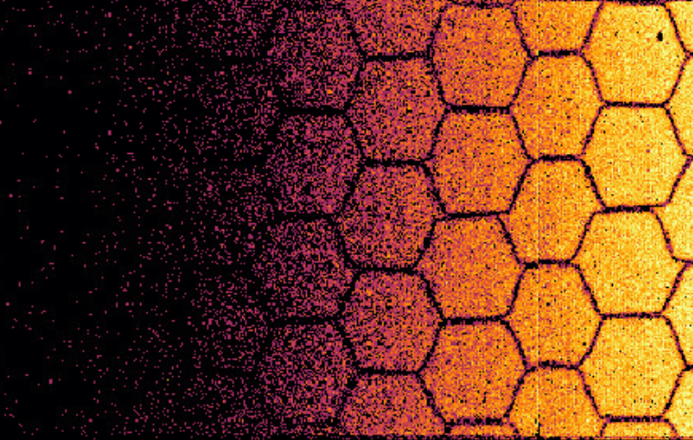
Extra #1: Time Over Threshold (ToT) Filtering
Assumption: "Events with ToT > 20 are likely to be beam loss.”
After DBSCAN
After DBSCAN + ToT Filtering
Highly saturated pixels!
Saturation is gone 😊

Slide 22
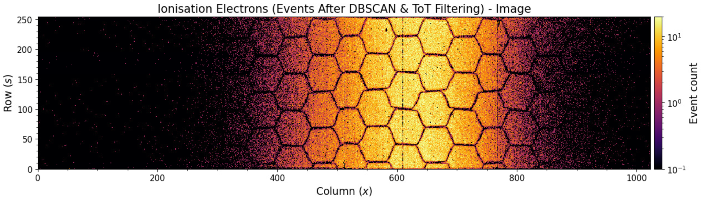
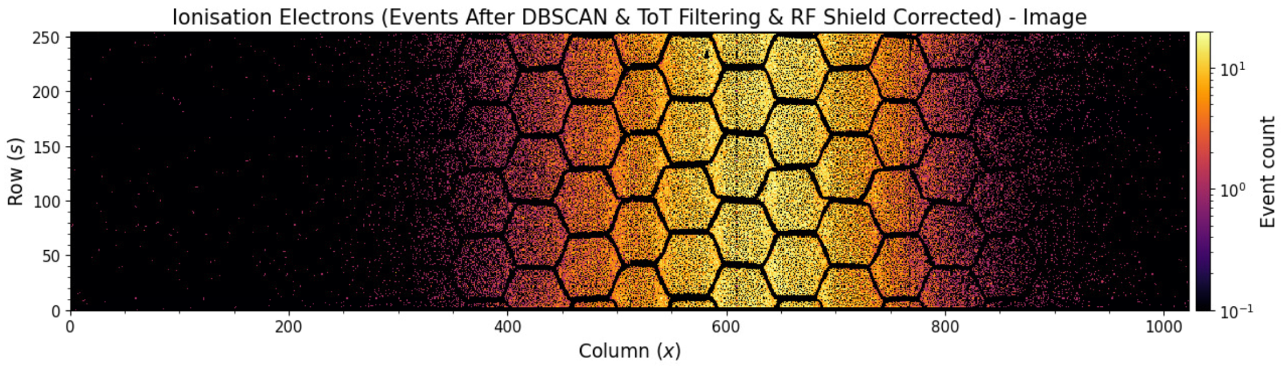
Extra #2: RF Shield Correction
Filter out honeycomb and manually annotated noisy pixels 🐝
The RF Shield helps to remove any kind of electromagnetic interference
But it is annoying for properly calculating the beam profiles
correction

Slide 23
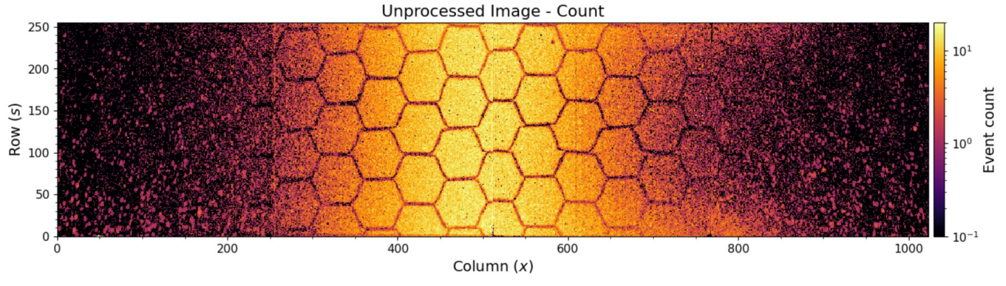
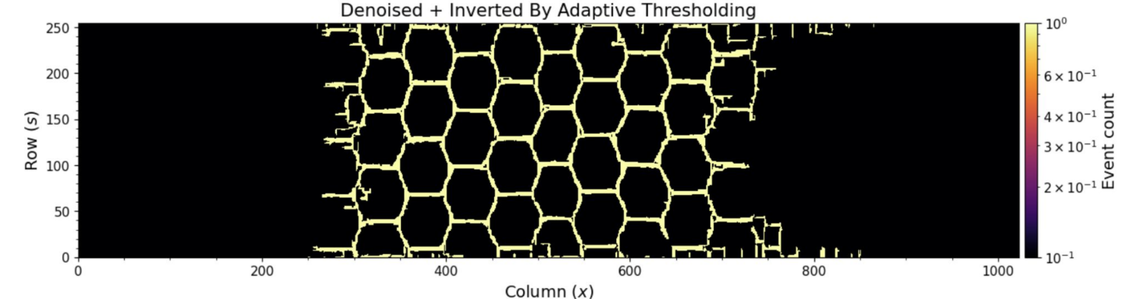
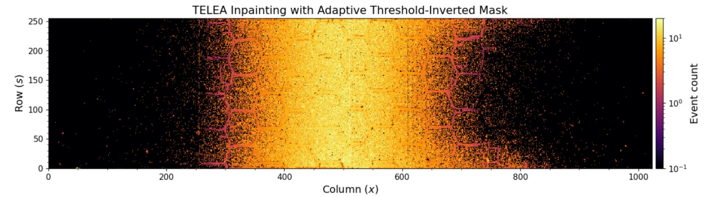
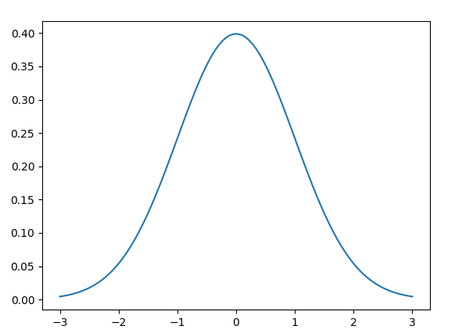
Extra #2: RF Shield Correction
We can also interpolate the honeycomb using TELEA¹ inpainting!
Noisy Image
RF Shield
Denoised and Inpainted
Improves the beam profile
1. Telea, Alexandru (2004). An Image Inpainting Technique Based on the Fast Marching Method. Journal of Graphics Tools. 9.10.1080/10867651.2004.10487596.
Slide courtesy of Glenn Anta

Slide 24
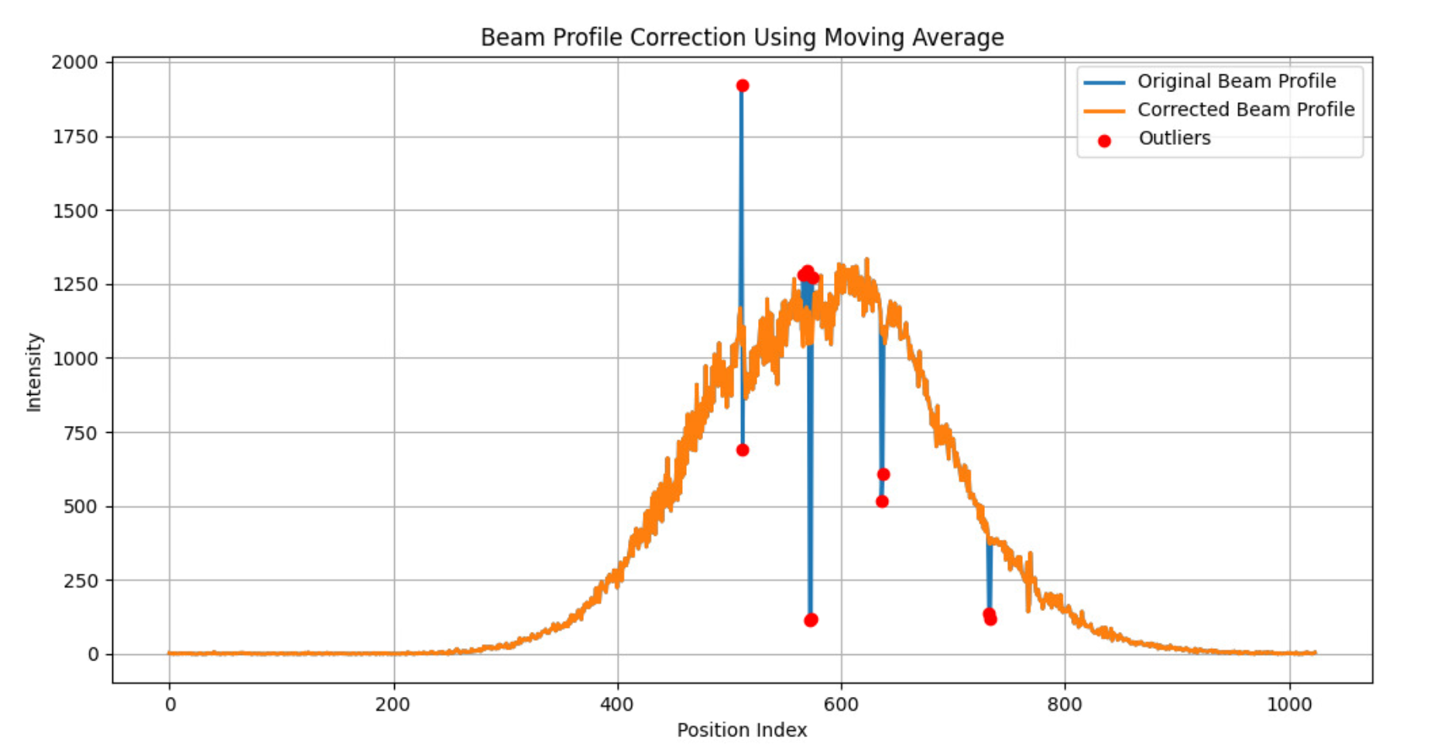
Extra #3: Moving Average Thresholding
Improve the final beam profile by detecting noisy-pixel outliers in a very safe way 😁
removed
and
interpolated

Slide 25
4. Results

Slide 26
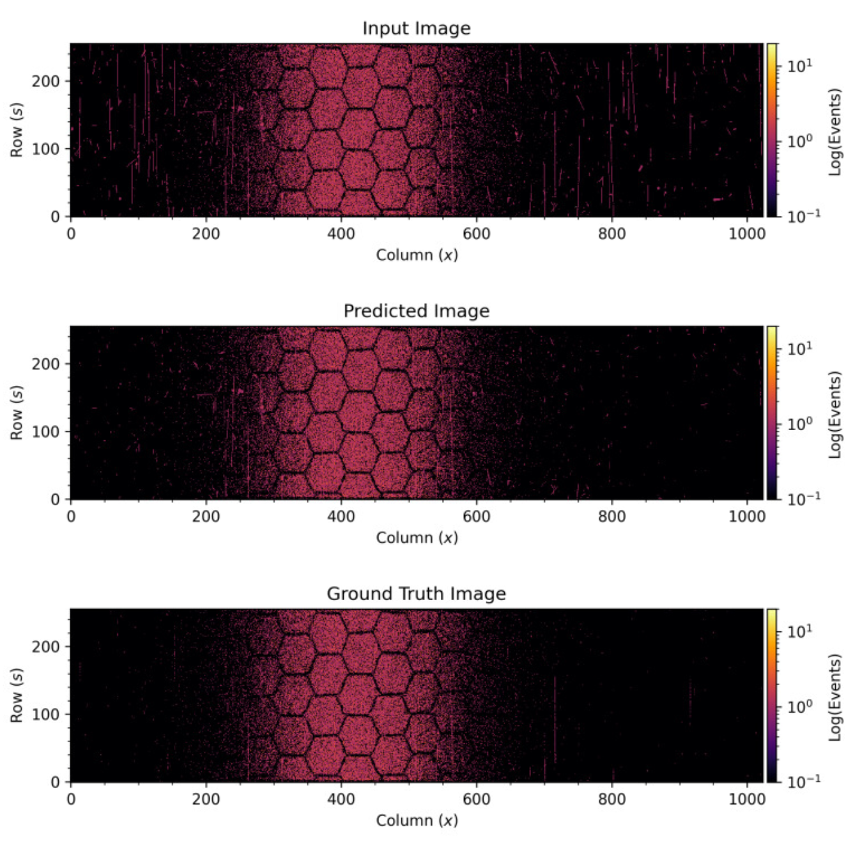

Slide 27
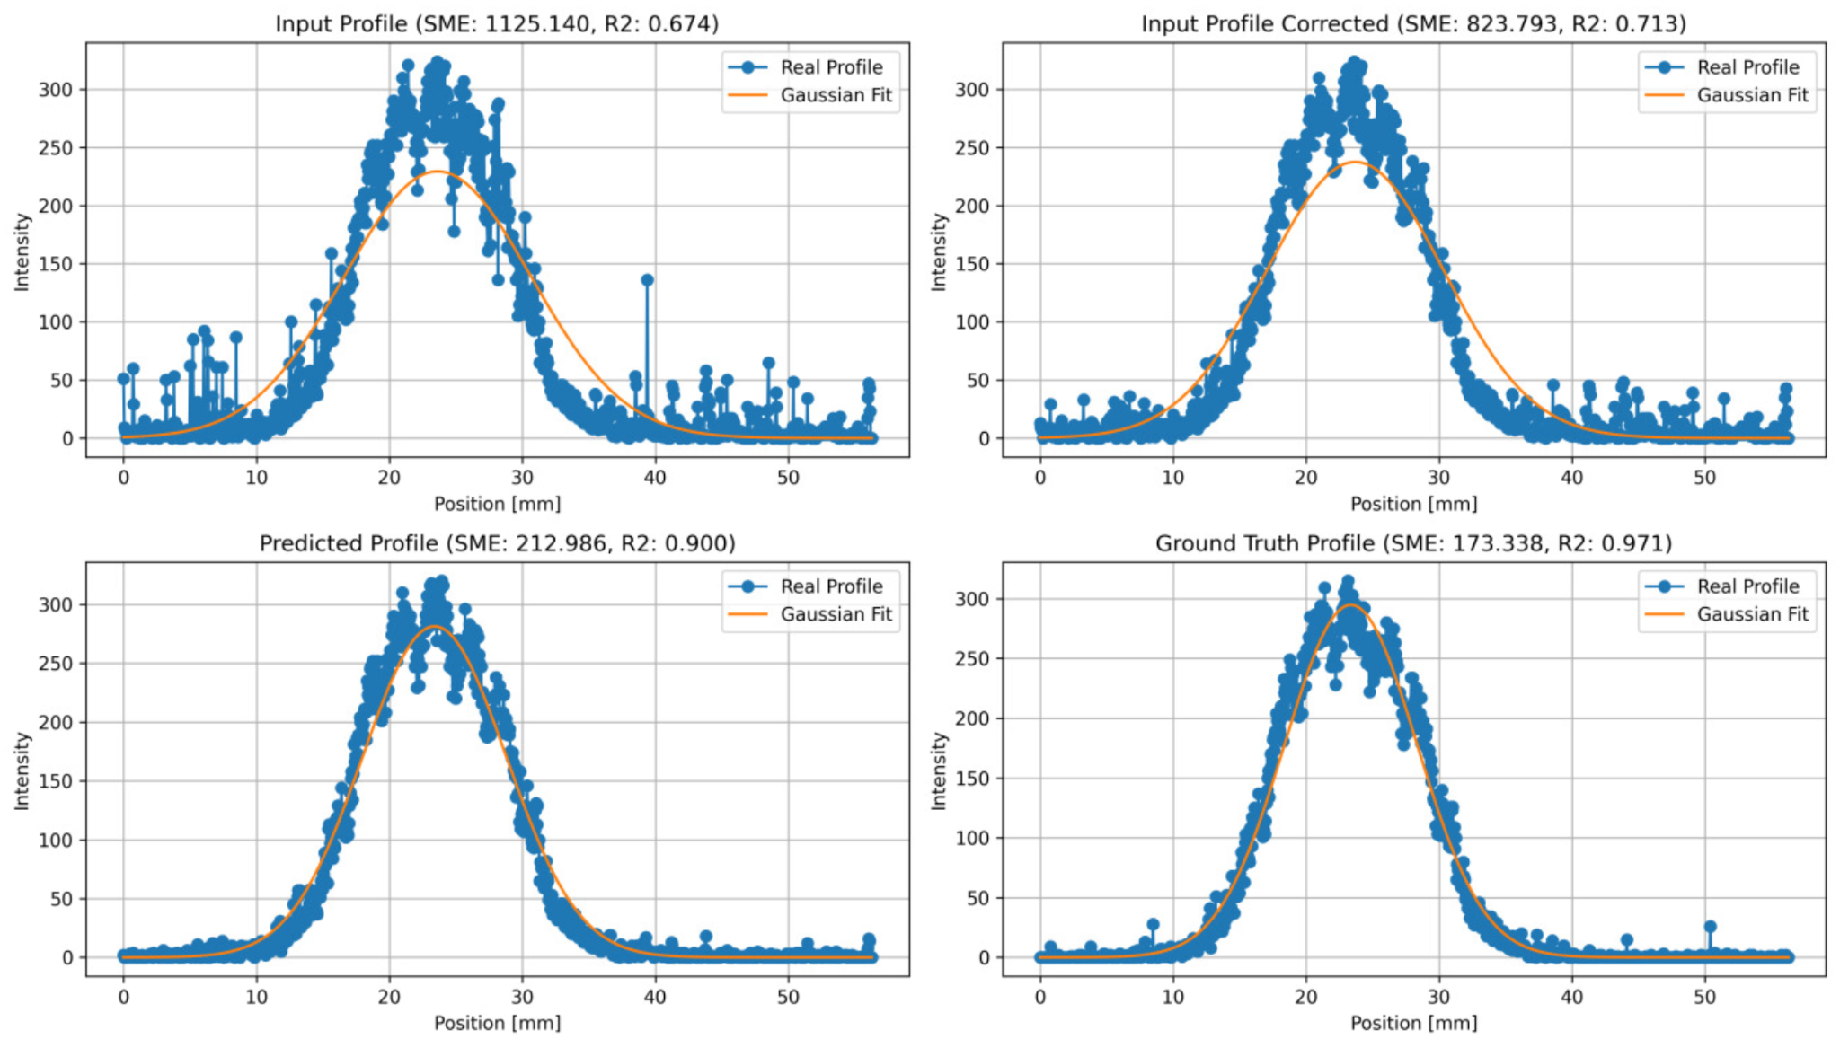
Mov - Avg
Correction
vastly improves R² (coefficient of determination)
Notes:
The coefficient of determination is a statistic that tells us how well the variations of our fit account for the variations of our data. If it is 0 it basically means: very bad fit, if it is 1 it would mean perfect fit.

Slide 28
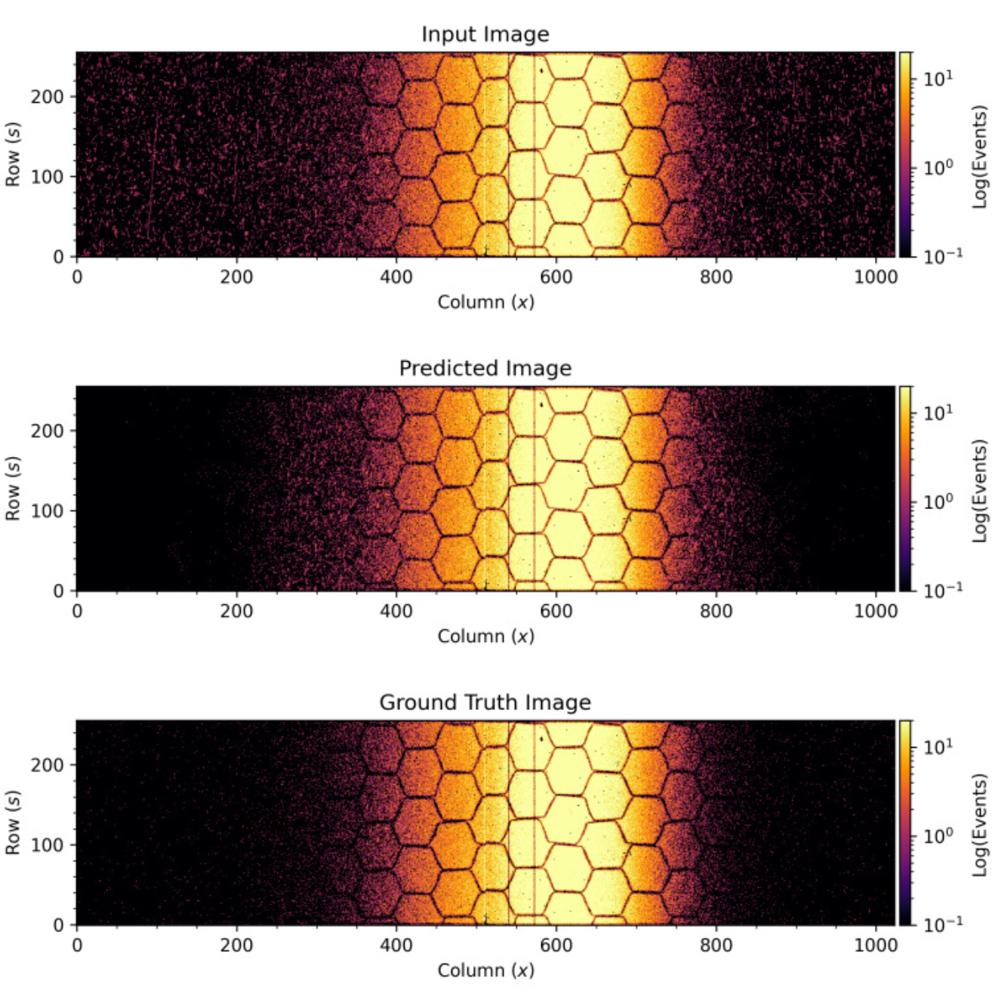

Slide 29
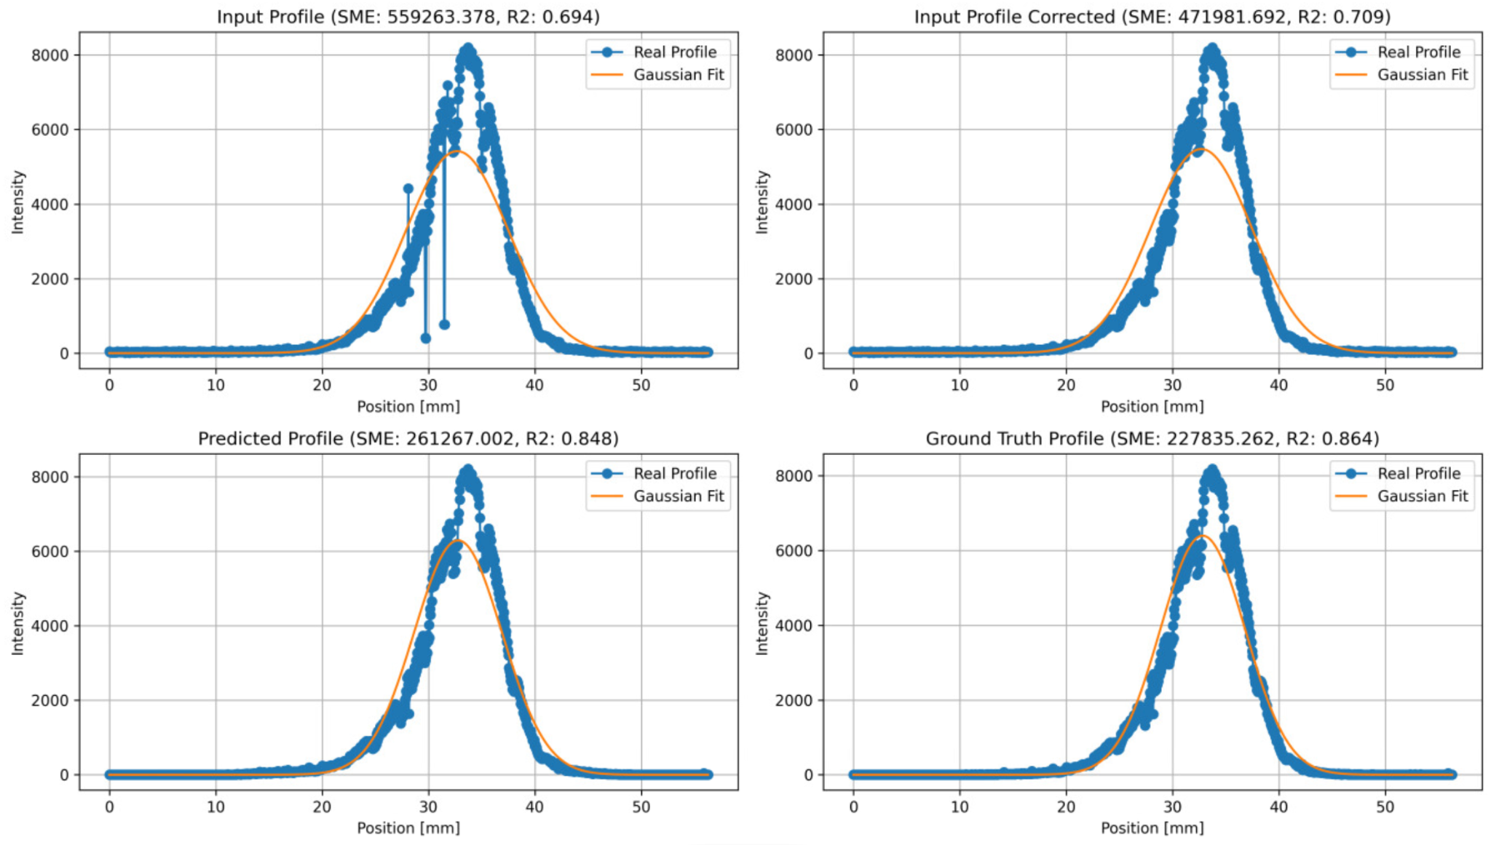

Slide 30
5. Conclusions & Future Work

Slide 31
Good news
DBSCAN is not viable for real-time operational purposes but it is robust and can be used during post-processing and for training ✔️
U-Net has been proven to effectively learn DBSCAN’s mapping ✔️
Standard signal processing techniques (e.g. Mov-Avg Confidence Intervals) can vastly improve the profiles in a safe way ✔️
ToT filtering and honeycomb adjustments are also safe and fast (but it requires manual pixel mask adjustments) ✔️
We have now scripts to easily generate, filter and analyze our image dataset from the raw files (it will be essential for future training and test) ✔️

Slide 32
Known limitations
We need more data and more updated data (right now we only trained on BGIH files from 2021 and 2022) 📖
We need to test the models in actual test data taken from different days and under different conditions or beam types 🌧️
In any case, we need some consensus on integration times, as images differ a lot depending on how many milliseconds we integrate 🤝
We are ruling out time information so profiles will not always be perfect 😔
The ultimate goal would be to use the whole video to obtain the beam profile (e.g. using Transformers) 🤖

Slide 33
Thanks!

Slide 34
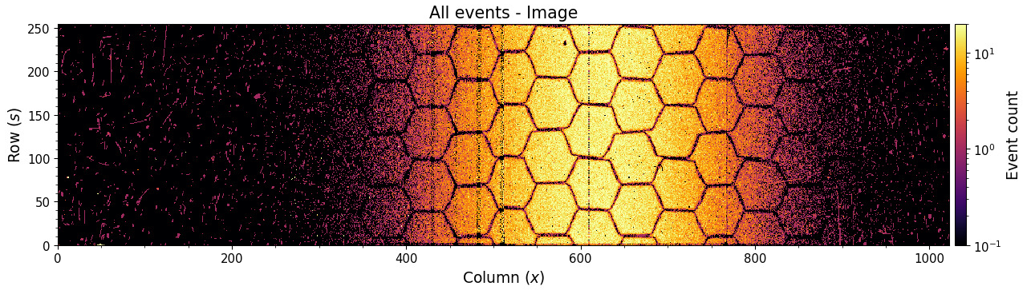
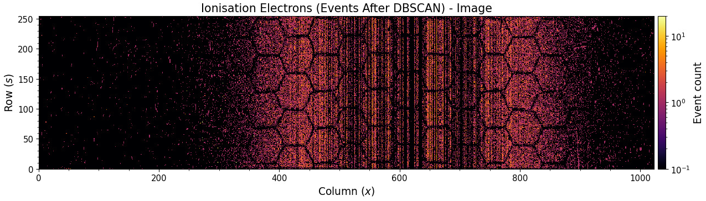
DBSCAN is not perfect: it sometimes fails but it is very rare…

Slide 35
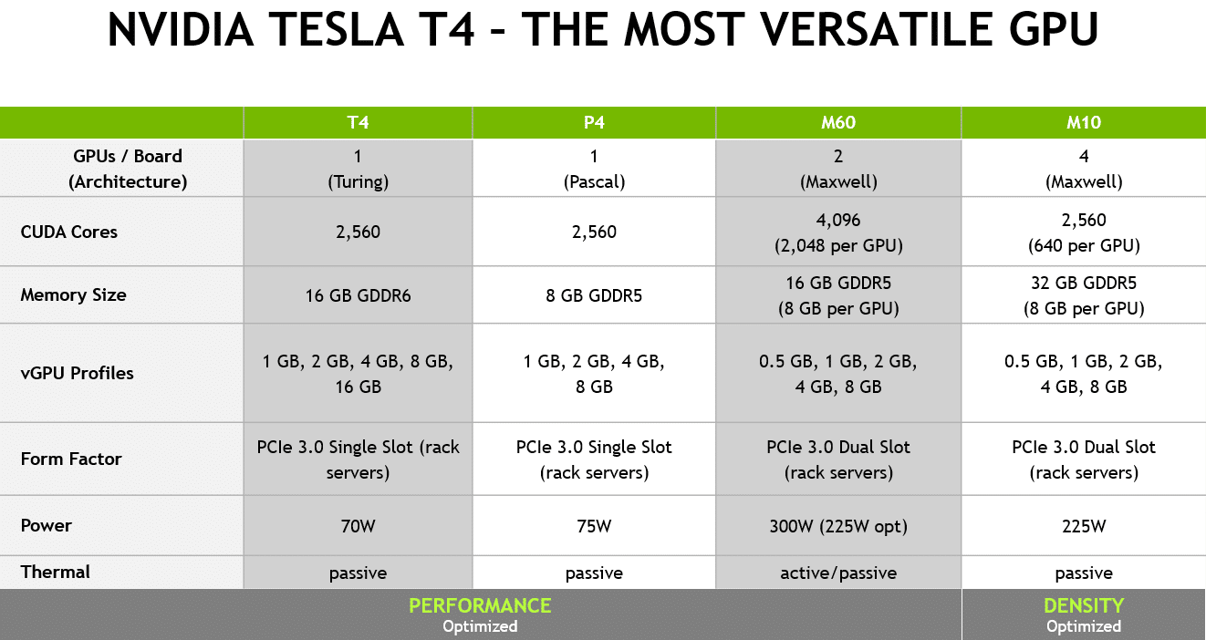
Hardware and GPU Information
The model was trained using CERN’s infrastructure: https://ml.cern.ch
Source: NVIDIA Tesla T4 Powers Next Generation of Virtual Workstations (NVIDIA Blog)

Slide 36
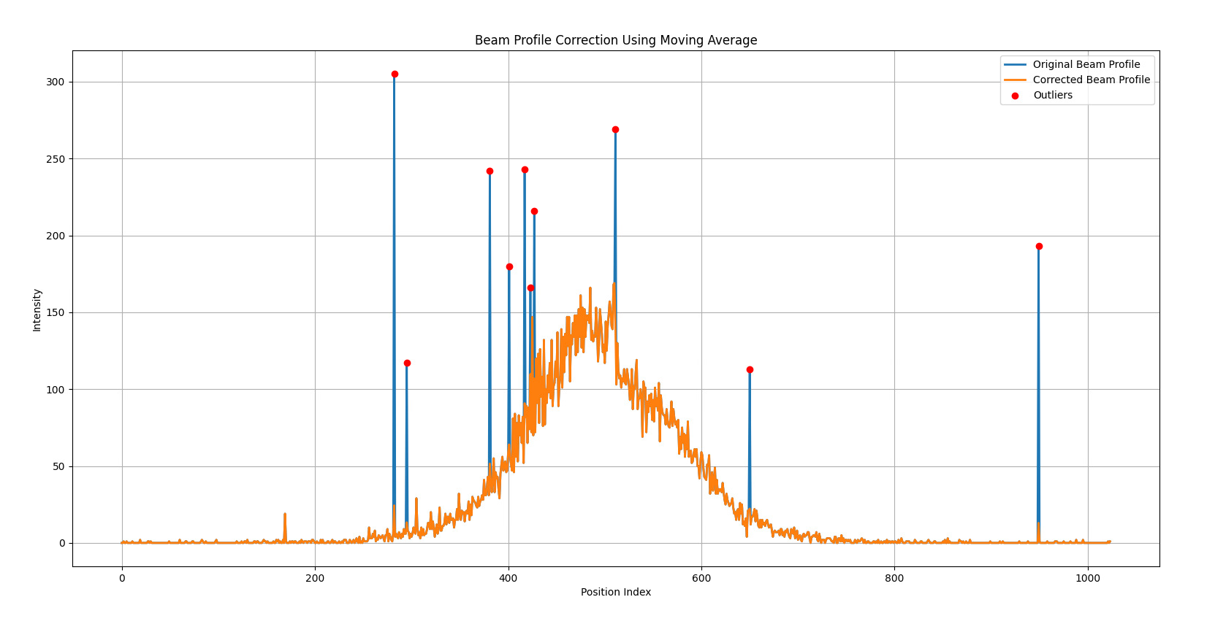
noisy pixels and noisy columns can be easily detected and adjusted

Slide 38
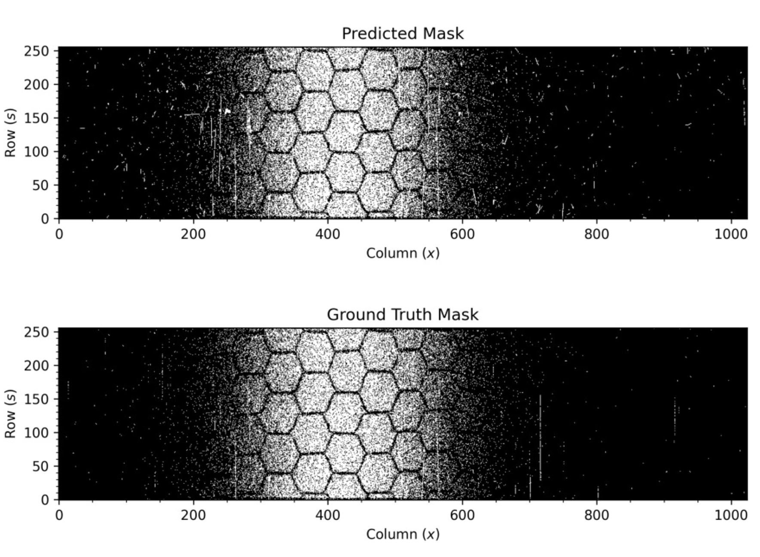

Slide 39
Mov - Avg
Correction

Slide 40
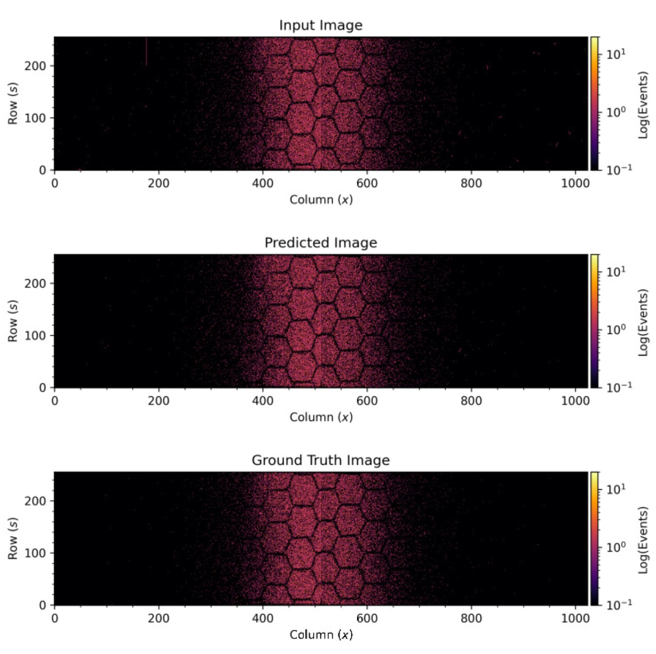

Slide 41
