Slide 1
Magnetic model of the MCBXF orbit correctors for HL-LHC
Agnieszka Chmielińska, Lucio Fiscarelli, Ezio Todesco
WP3 Meeting, 12.07.2023

Slide 2
Part 1: Introduction
Keywords: FiDeL, MCBXF

Slide 3
The FiDeL Model
The Field Description of the LHC (FiDeL) is the magnetic field prediction system that provides a model of the transfer function of magnetic circuits installed in the machine in order to retrieve the current level given the required field
→ indispensable for LHC operation.
The model is based on a physical decomposition of effects that contribute to the total ﬁeld in the aperture of the magnet.
The model uses several levels of approximations, starting from a linear dependance on the current (ideal magnet) and adding correction terms (depending on the magnet type and function) to describe nonlinear effects.
The prediction of the field is based on static (current, ramp-direction dependent) and dynamic (time, ramp-rate dependent) components.

Slide 4


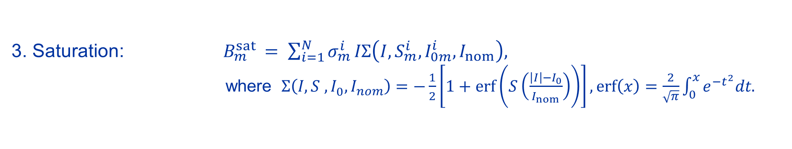
Static components
1. Geometric: $B_{m}^{geo }= γ_{m}^{ }I.$
2. DC Magnetization: $B_{m}^{mag }= μ_{m}^{ }\left|I\right|{\left(\frac{I_{inj }}{\left|I\right|}\right)}^{2−p_{m}}{\left(\frac{I_{c }−\left|I\right|}{I_{c }−I_{inj }}\right)}^{q_{m}}$ ${\left(\frac{{T_{c0 }}^{1.7}−{T_{ }}^{1.7}}{{T_{c0 }}^{1.7}−{T_{meas }}^{1.7}}\right)}^{h_{m}}.$
3. Saturation: $B_{m}^{sat }= \sum_{i=1}^{N}{σ_{m}^{i}}IΣ\left(I, S_{m}^{i},I_{0m}^{i},I_{nom}\right),$
where$Σ\left(I, S_{ }^{ },I_{0}^{ },I_{nom}\right)=−\frac{1}{2}\left[1+\operatorname{erf}\left(S\left(\frac{\left|I\right|−I_{0}}{I_{nom}}\right)\right)\right], \operatorname{erf}\left(x\right)=\frac{2}{\sqrt{π}}\int_{0}^{x}{e^{−t^{2}}dt.}$
4. Residual
Magnetization:
$B_{m}^{res }= ρ_{m}^{ }\left|I\right|{\left(\frac{I_{inj}}{\left|I\right|}\right)}^{r_{m}}$.
More information:
FiDeL Website, https://lhc-div-mms.web.cern.ch/tests/MAG/Fidel/
$$m_{ }^{ }−multipole order$$
  The fitting parameters are implemented in the LHC control system.

Slide 5
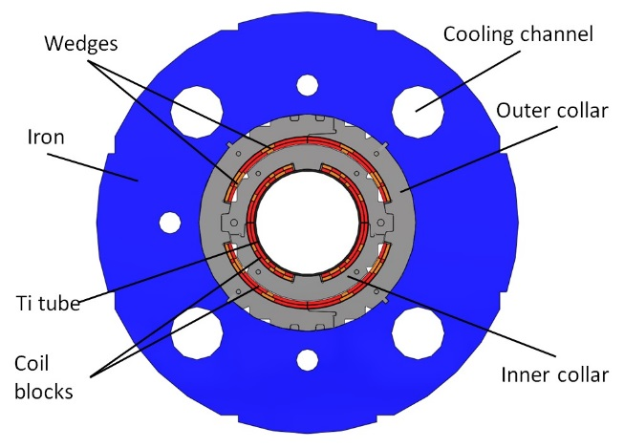
MCBXF B / A
Parameter | Value (B / A)
Aperture (mm) | 150
Magnetic length (m) | 1.2 / 2.2
Int. field (Tm) | 2.5 / 4.5
Current inner (A) | 1755 / 1593
Current outer (A) | 1435 / 1340
This presentation will focus on the MCBXFA version of the magnet.
  Inner coil provides vertical field (main field B1, normal).
  Outer coil provides horizontal field (main field A1, skew).

Slide 6
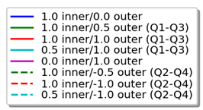
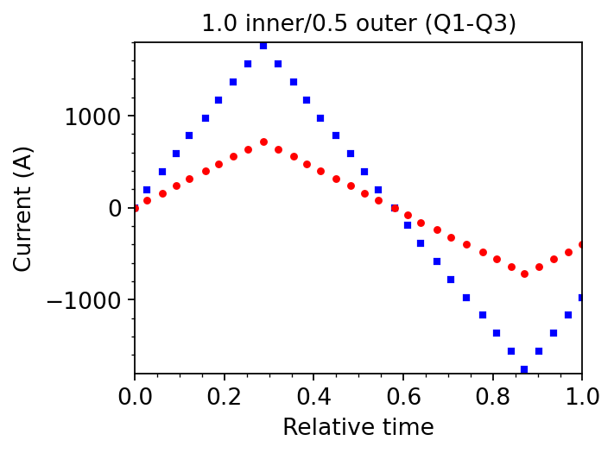
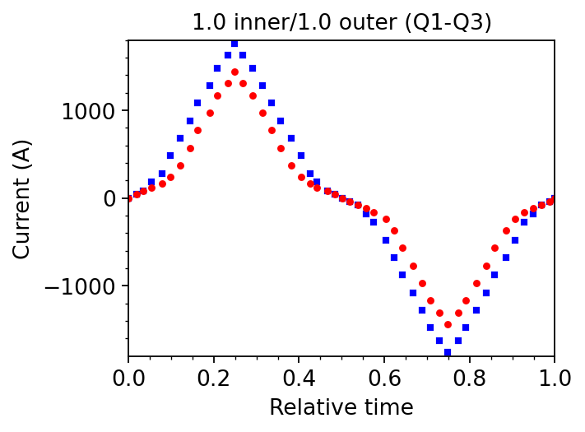
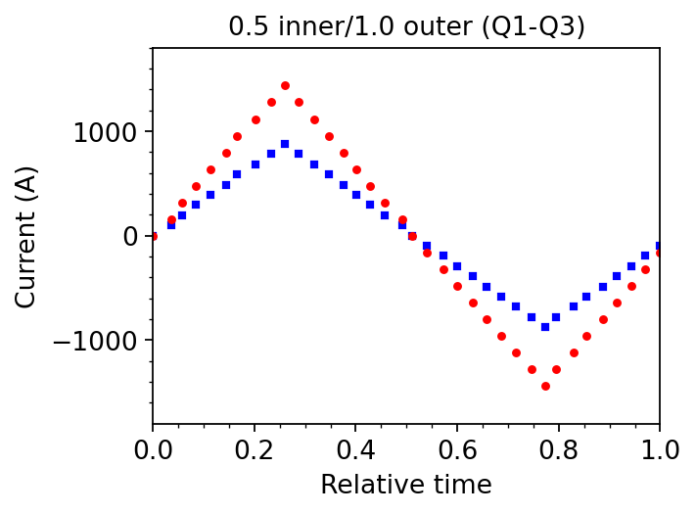
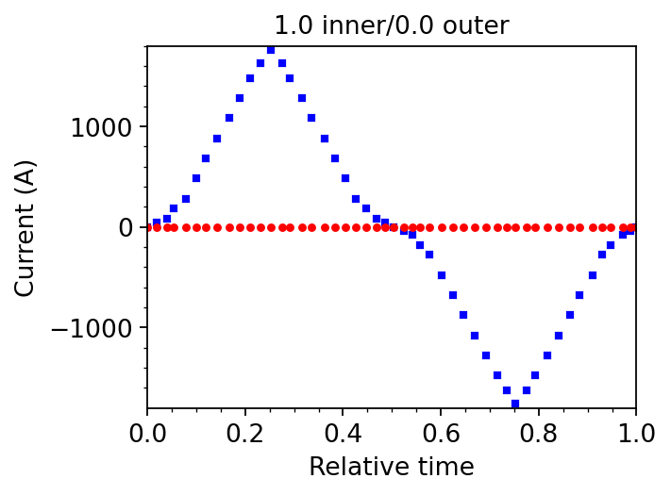
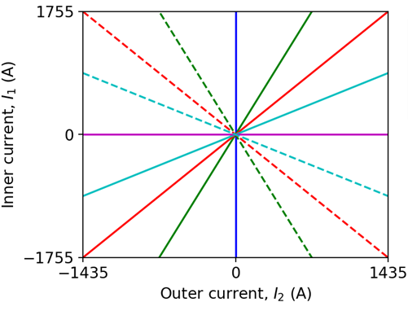
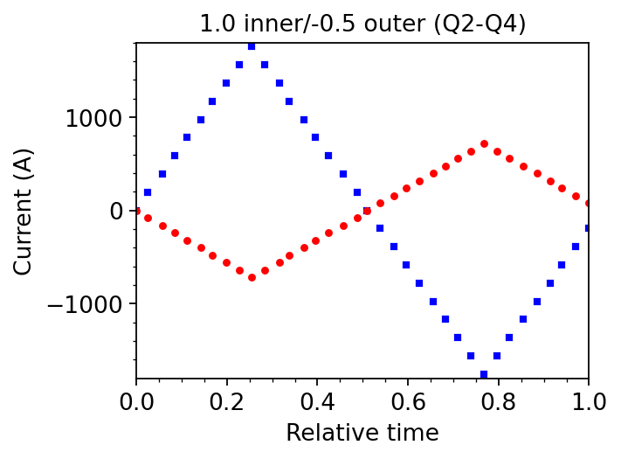
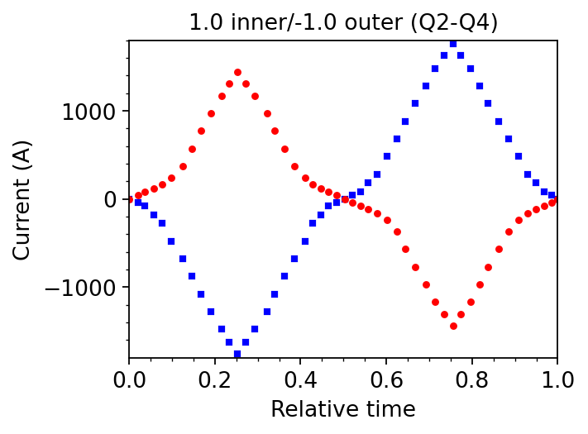
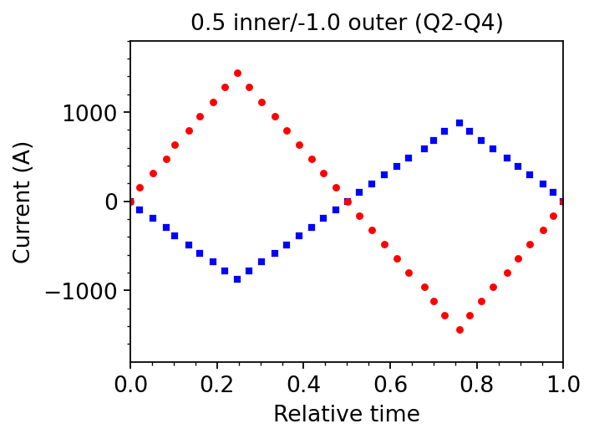
Magnetic model for MCBXF
A series of magnetic measurements was carried out to characterize the magnetic behaviour of the MCBXFB and MCBXFA magnets; including cycles when the inner and outer coils are powered at the same time (combined powering).
Examples of analyzed
powering schemes:
Analyzed magnets:
HCMCBXFA001-E9000001
HCMCBXFB011-E9000001

Slide 7
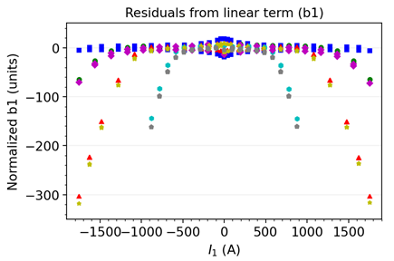
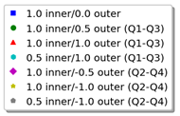
Magnetic model for MCBXF
Example: Residuals from the
geometric term (MCBXFB)
During combined powering, the saturation increases as a function of the current in the inner and outer coil.
Using a single fit for the normal and skew field is not applicable if high accuracy is demanded.
Developing a magnetic model for nested dipoles is challenging and requires a non-standard approach.
To meet operation requirements, we proposed a dedicated model in which saturation varies continuously and monotonically as a function of the current in the inner and outer coil.
    The proof of concept was discussed for MCBXFB (WP3 Meeting, 2.11.2022).
Today we will show that the proposed model also applies to MCBXFA.

Slide 8
Part 3: Proposed model

Slide 9

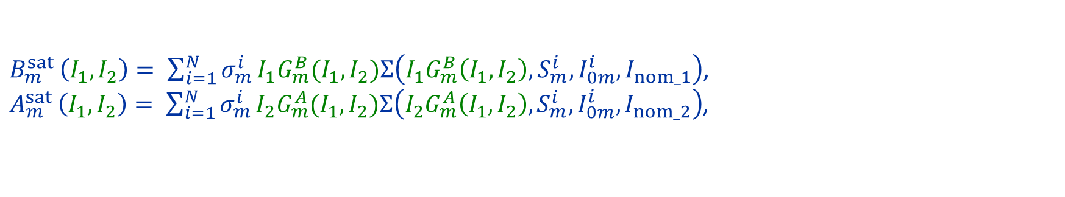
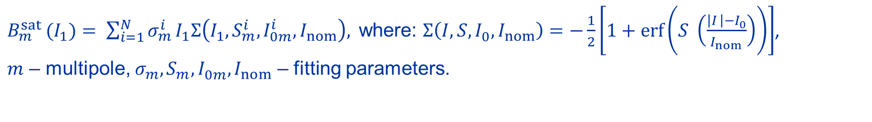
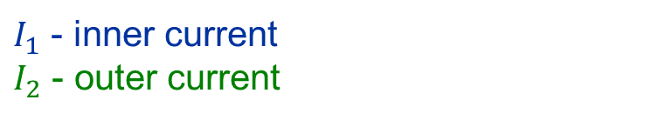
Magnetic model for MCBXF: Saturation component
Original definition:
$B_{m}^{sat }(I_{1})= \sum_{i=1}^{N}{σ_{m}^{i}}I_{1}Σ\left(I_{1}, S_{m}^{i},I_{0m}^{i},I_{nom}\right),$ where: $Σ\left(I, S,I_{0}^{ },I_{nom}\right)=−\frac{1}{2}\left[1+\operatorname{erf}\left(S_{ }^{ }\left(\frac{\left|I_{ }\right|−I_{0}^{ }}{I_{nom}}\right)\right)\right]$,
$m$ – multipole, ${σ_{m}^{ },S}_{m}^{ },I_{0m}^{ },I_{nom}$ – fitting parameters.
Proposal:
$$B_{m}^{sat }\left(I_{1}\right) ↦ B_{m}^{sat }(I_{1},I_{2})$$
$$A_{m}^{sat }\left(I_{2}\right) ↦ A_{m}^{sat }(I_{1},I_{2})$$
$I_{1}$ - inner current
$I_{2}$ - outer current
$B_{m}^{sat }\left(I_{1},I_{2}\right)= \sum_{i=1}^{N}{σ_{m}^{i}}I_{1}G_{m}^{B}(I_{1},I_{2})Σ\left(I_{1}G_{m}^{B}\left(I_{1},I_{2}\right), S_{m}^{i},I_{0m}^{i},I_{nom_1}\right)$,
$A_{m}^{sat }\left(I_{1},I_{2}\right)= \sum_{i=1}^{N}{σ_{m}^{i}}I_{2}G_{m}^{A}(I_{1},I_{2})Σ\left(I_{2}G_{m}^{A}\left(I_{1},I_{2}\right), S_{m}^{i},I_{0m}^{i},I_{nom_2}\right)$,
where${ G}_{m}^{ }\left(I_{1,}I_{2}\right)$ is a function of inner and outer current (determined experimentally).

Slide 10



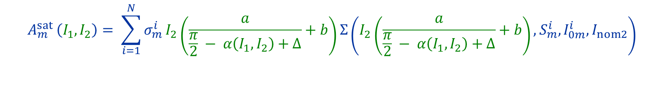


Magnetic model for MCBXF: Saturation component
$$Input:I_{1},I_{2}$$
$$G_{m}^{B}\left(I_{1,}I_{2}\right)$$
$$G_{m}^{B}\left(I_{1,}I_{2}\right)$$
$$B_{m}^{sat }\left(I_{1},I_{2}\right)= \sum_{i=1}^{N}{σ_{m}^{i}}I_{1}\left(\frac{a}{α\left(I_{1},I_{2}\right)+∆}+b\right)Σ\left(I_{1}\left(\frac{a}{α\left(I_{1},I_{2}\right)+∆}+b\right), S_{m}^{i},I_{0m}^{i},I_{nom1}\right),$$
$$G_{m}^{A}\left(I_{1,}I_{2}\right)$$
$$G_{m}^{A}\left(I_{1,}I_{2}\right)$$
$$A_{m}^{sat }\left(I_{1},I_{2}\right)= \sum_{i=1}^{N}{σ_{m}^{i}}I_{2}\left(\frac{a}{\frac{π}{2} − α\left(I_{1},I_{2}\right)+∆}+b\right)Σ\left(I_{2}\left(\frac{a}{\frac{π}{2} − α\left(I_{1},I_{2}\right)+∆}+b\right), S_{m}^{i},I_{0m}^{i},I_{nom2}\right)$$
$$,$$
$where: α\left(I_{1},I_{2}\right)= \tan_{ }^{−1}\left(\frac{|I_{1}|/I_{nom1}}{{|I}_{2}|/I_{nom2}}\right)$

Slide 11
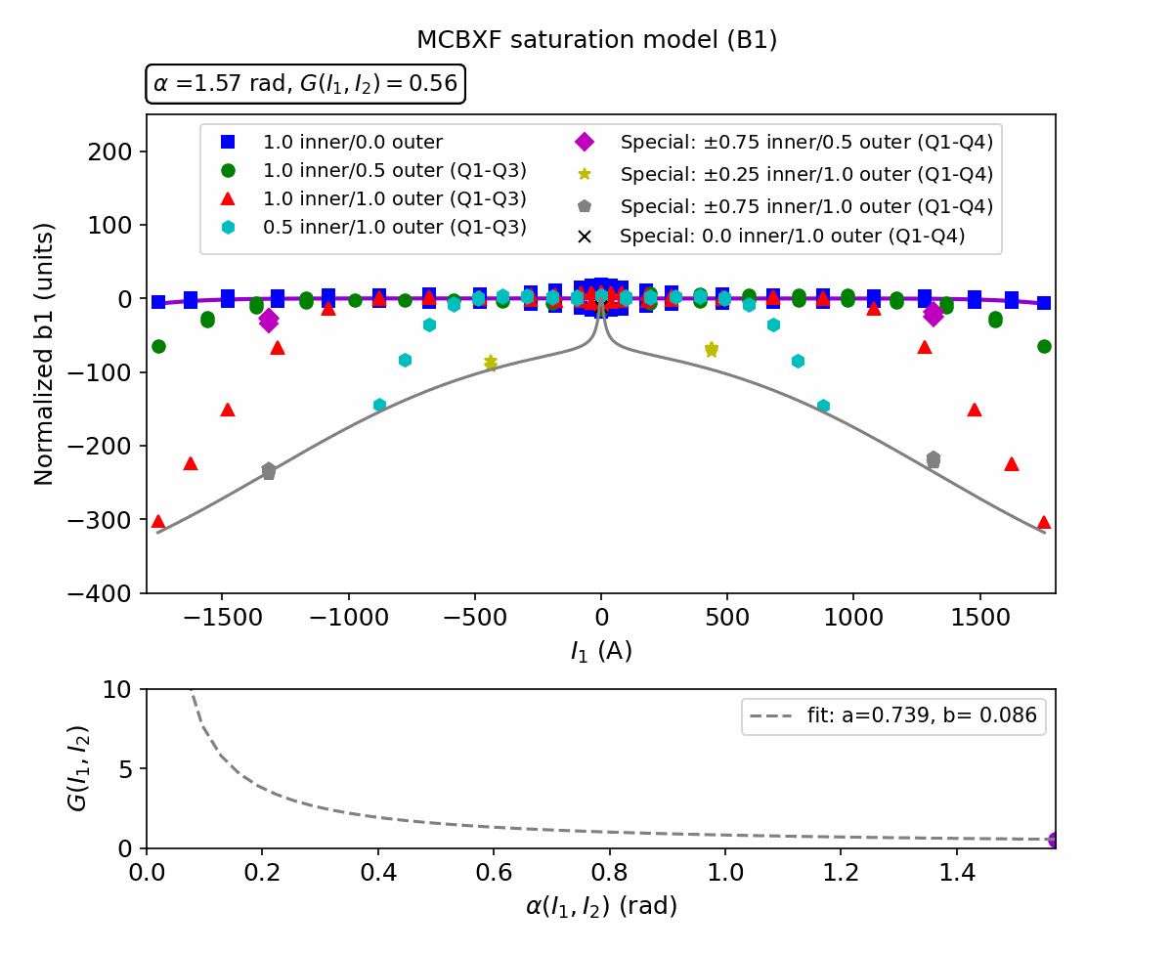
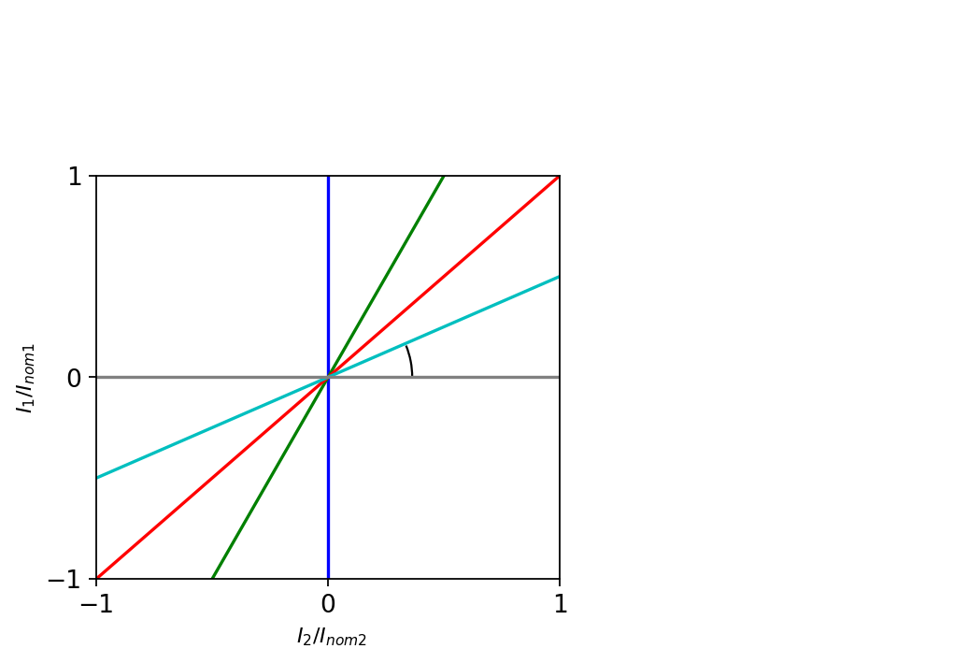

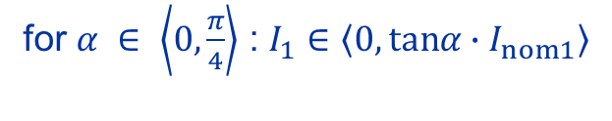


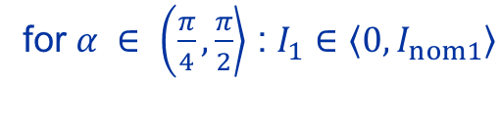
Example 1:
Saturation model for MCBXFB (B1)
Working domain:
for $α ∈ \left\langle 0, \frac{π}{4}\right\rangle$ : $I_{1}∈\left\langle 0,tanα∙I_{nom1}\right\rangle$
for $α ∈ \left(\frac{π}{4}\right., \left.\frac{π}{2}\right\rangle$ : $I_{1}∈\left\langle 0,I_{nom1}\right\rangle$
$$α$$
$$tanα= \frac{I_{1}/I_{nom1}}{I_{2}/I_{nom2}}$$
Boundary line
Boundary line:
$B_{m}^{sat }\left(I_{1},I_{2}=I_{nom2}\right)$ (normalized)

Slide 12
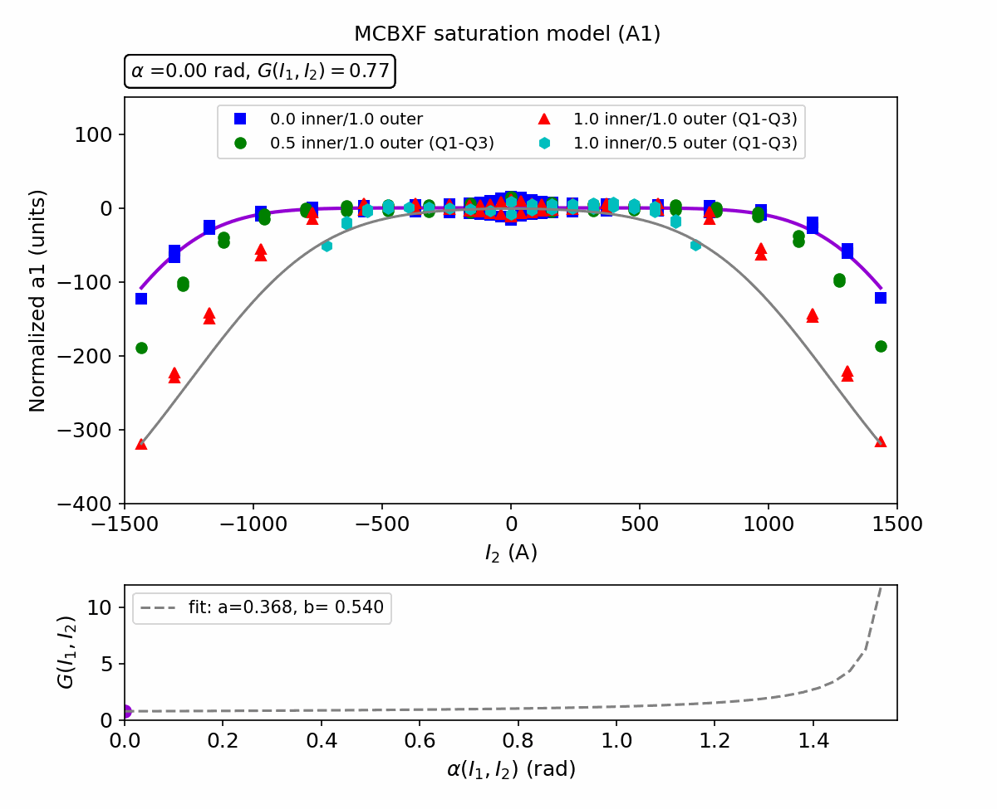
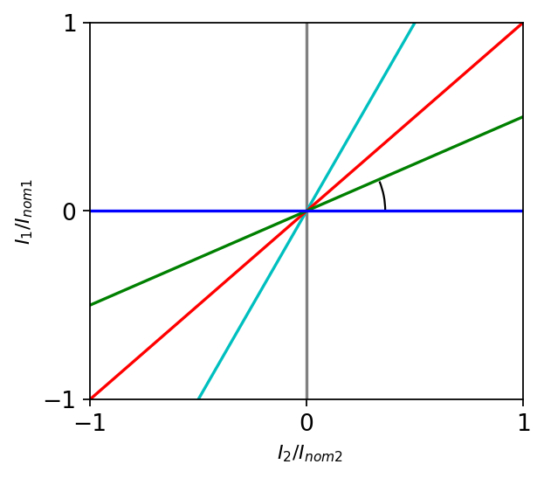




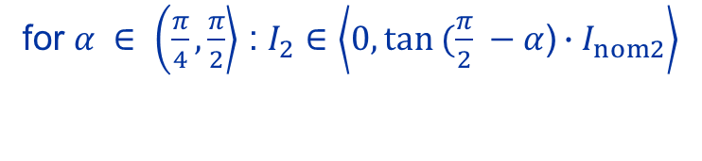
Example 2:
Saturation model for MCBXFB (A1)
Working domain:
for $α ∈ \left\langle 0, \frac{π}{4}\right\rangle$ : $I_{2}∈\left\langle 0,I_{nom2}\right\rangle$
for $α ∈ \left(\frac{π}{4}\right., \left.\frac{π}{2}\right\rangle$ : $I_{2}∈\left\langle 0,tan (\frac{π}{2} −α\text{)}∙I_{nom2}\right\rangle$
$$α$$
Boundary line
$$tan(\frac{π}{2}−α)= \frac{I_{2}/I_{nom2}}{I_{1}/I_{nom1}}$$
Boundary line:
$B_{m}^{sat }\left(I_{1}{=I}_{nom1},I_{2}\right)$ (normalized)

Slide 13
Part 4: Results for MCBXFA
12/07/2023

Slide 14
B1 / A1

Slide 15
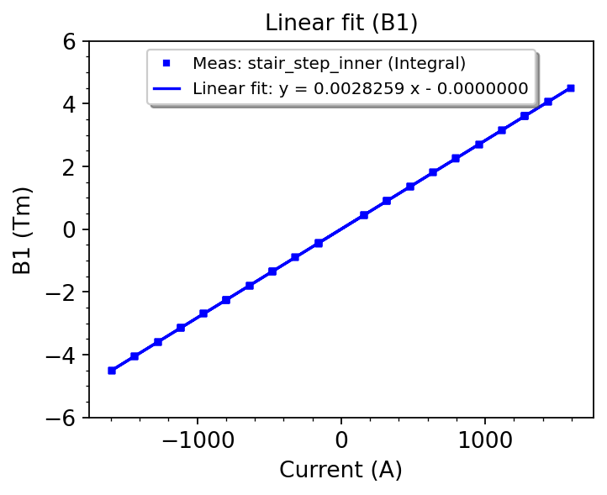
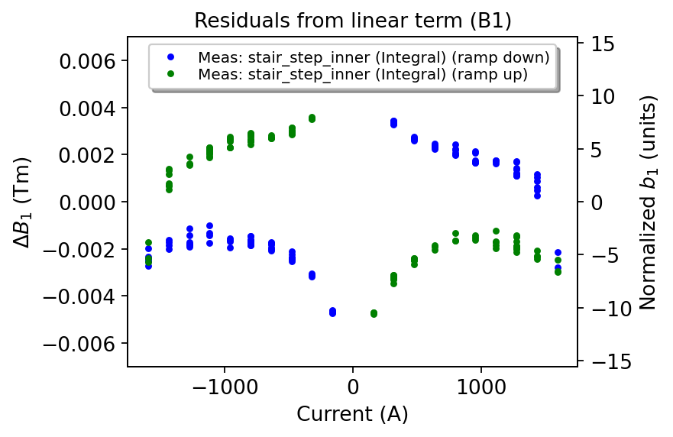
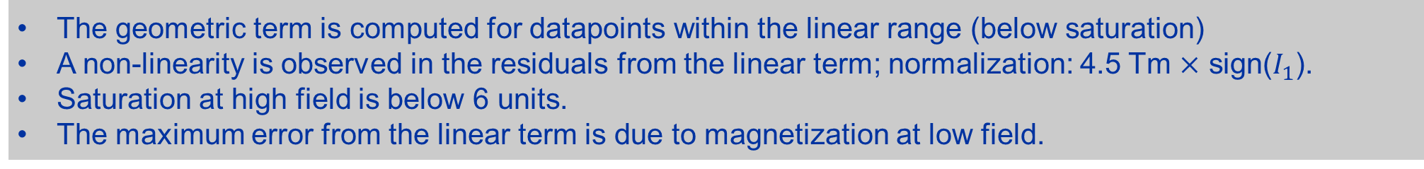
Reference cycle: Geometric term and Residuals (B1)
Reference cycle
The geometric term is computed for datapoints within the linear range (below saturation)
A non-linearity is observed in the residuals from the linear term; normalization: 4.5 Tm $×$ sign($I_{1}$).
Saturation at high field is below 6 units.
The maximum error from the linear term is due to magnetization at low field.

Slide 16
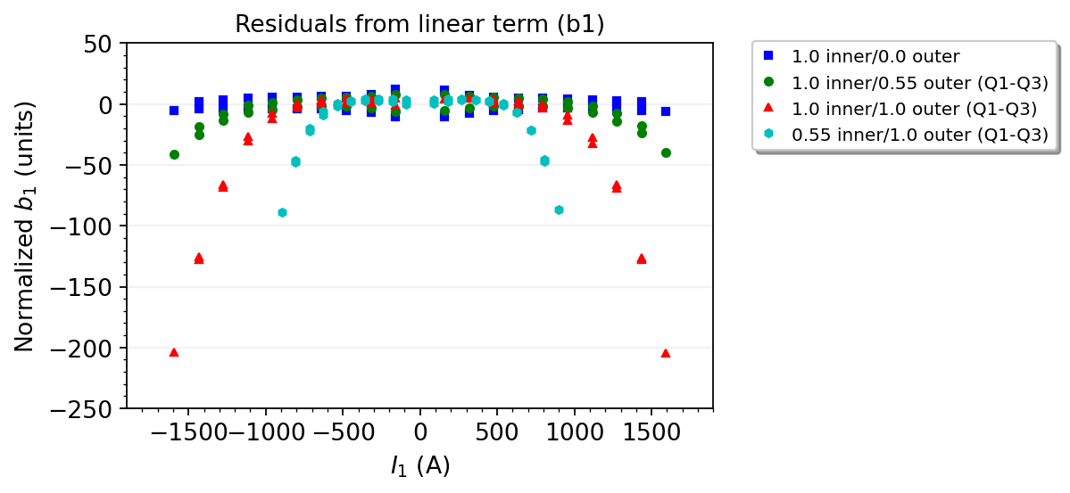
Combined powering: Residuals (B1)
At high field, the saturation increases as a function of current in the outer aperture (up to 205 units).
At low field, the magnetization is within ±10 units with the maximum error for a reference cycle.
12/07/2023

Slide 17
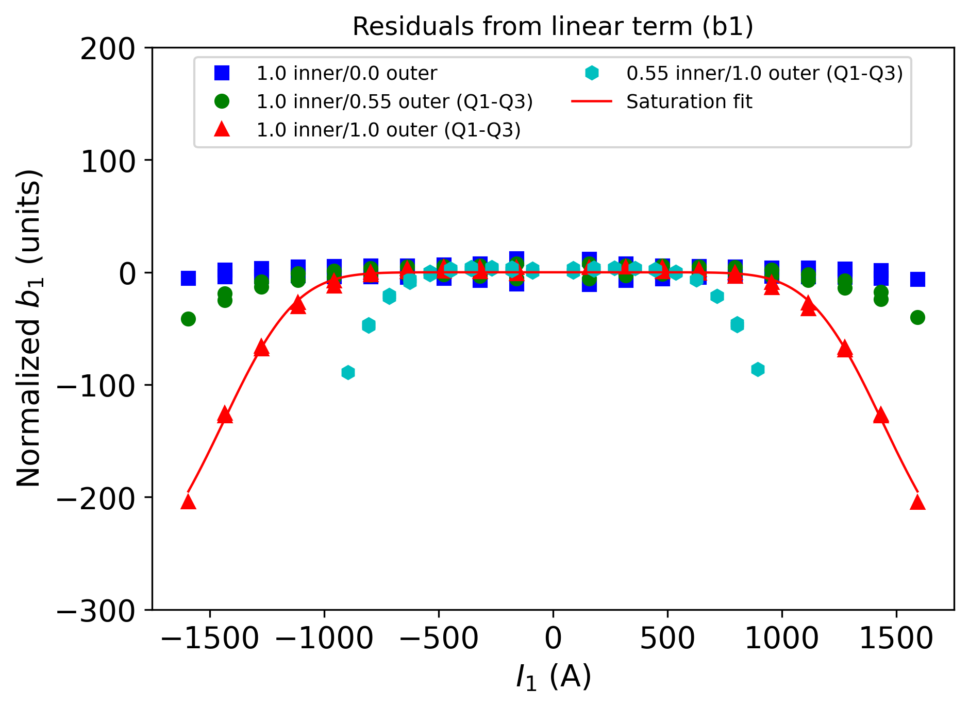
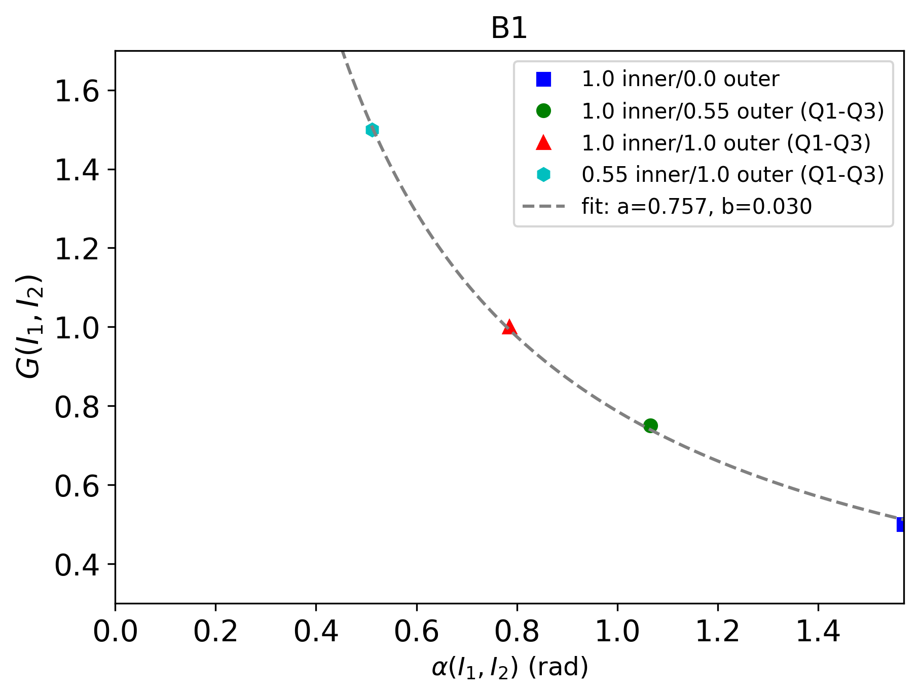


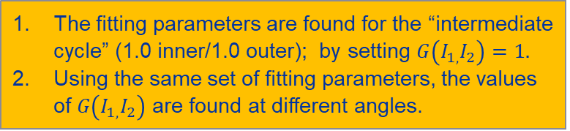

Function $G_{1}^{B}(I_{1},I_{2})$
The fitting parameters are found for the “intermediate cycle” (1.0 inner/1.0 outer); by setting $G\left(I_{1,}I_{2}\right)=1.$
Using the same set of fitting parameters, the values of $G\left(I_{1,}I_{2}\right)$ are found at different angles.
  $$G_{1}^{B}\left(I_{1,}I_{2}\right)=\frac{a}{α\left(I_{1},I_{2}\right)+ ∆}+b$$
with $a=\text{0.}\text{757 }$and $b=\text{0.0}\text{30}$.
  $\text{The} \text{function} G_{1}^{B}\left(I_{1,}I_{2}\right) \text{together} \text{with} \text{the} \text{fitting} \text{parameters} \text{is} \text{determined} \text{from} \text{the} \text{experimental} \text{data}$
  $G_{1}^{B}\left(I_{1,}I_{2}\right)$includes factor $∆=0.001$ to ensure that $B_{m}^{sat }\left(I_{1}=0,I_{2}\right)=0$, since $G\left(I_{1}=0,I_{2}\right)=const.$

Slide 18
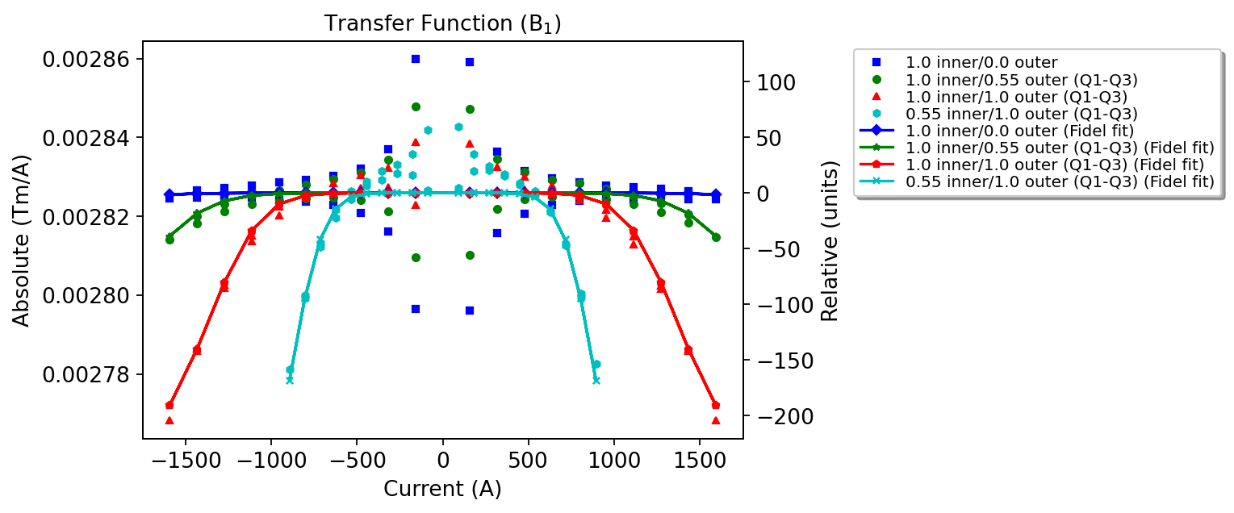
Transfer function (B1)

Slide 19
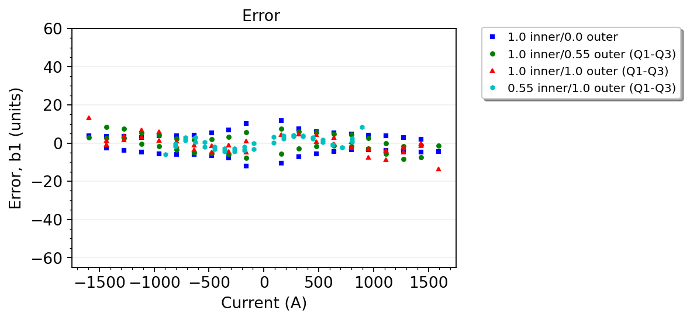
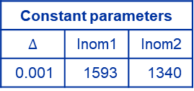
Fitting parameters and modelling error (B1)
Component | Parameter | Value
Geometric | y | 0.0028259
Saturation | sigma1 | 6.6e-05
Saturation | I01 | 1360
Saturation | S1 | 4.7
 | a | 0.757
 | b | 0.030
Constant parameters
$$∆$$ | Inom1 | Inom2
0.001 | 1593 | 1340
The fit is accurate within ±15 units in the entire operating range.

Slide 20
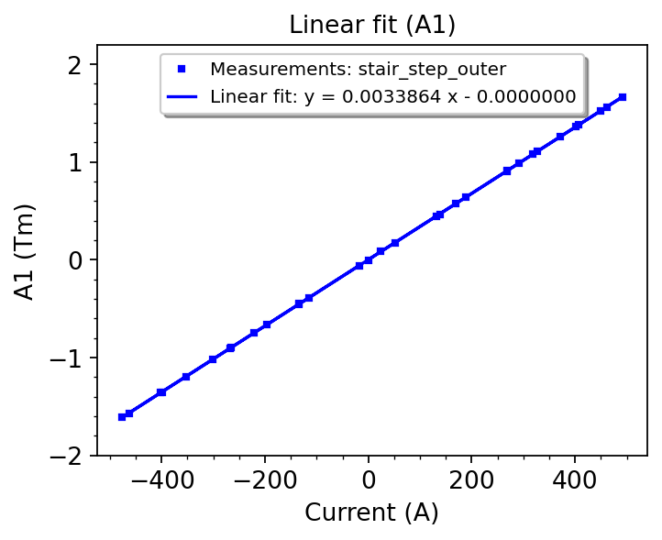
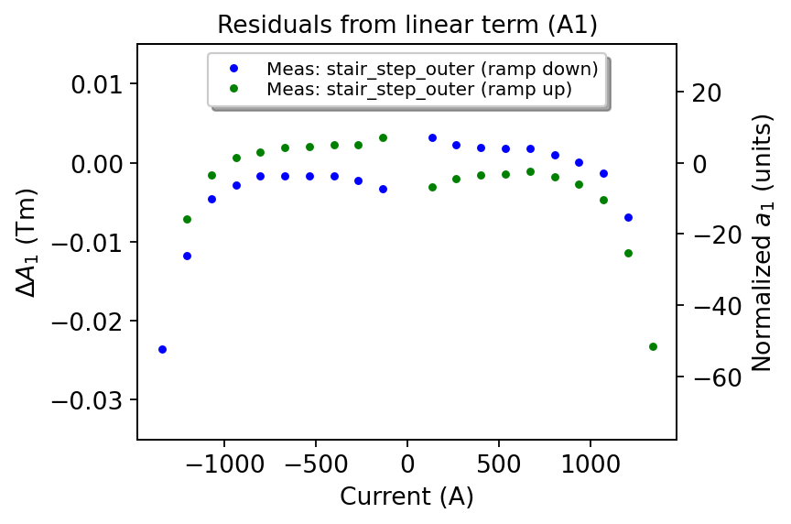
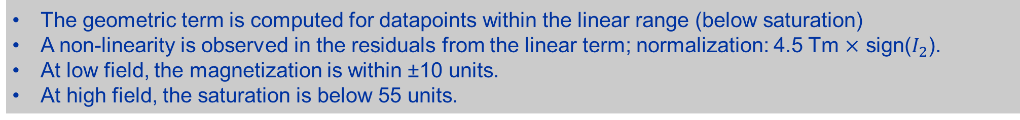
Reference cycle: Geometric term and Residuals (A1)
The geometric term is computed for datapoints within the linear range (below saturation)
A non-linearity is observed in the residuals from the linear term; normalization: 4.5 Tm $×$ sign($I_{2}$).
At low field, the magnetization is within ±10 units.
At high field, the saturation is below 55 units.

Slide 21
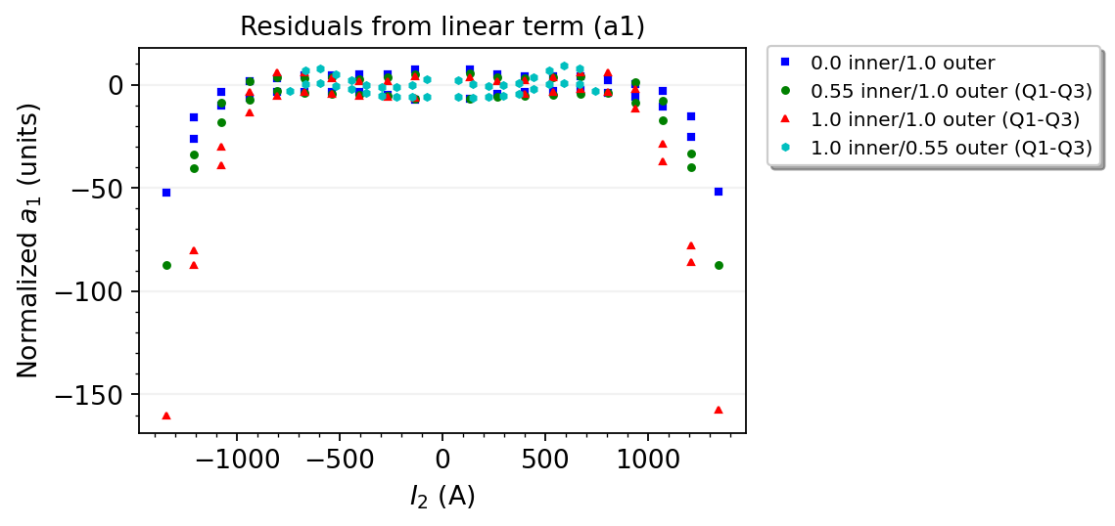
Combined powering: Residuals (A1)
At high field, the saturation increases as a function of current in the inner aperture (up to 160 units).
At low field, the magnetization is within ±10 units with the maximum error for a reference cycle.
12/07/2023

Slide 22
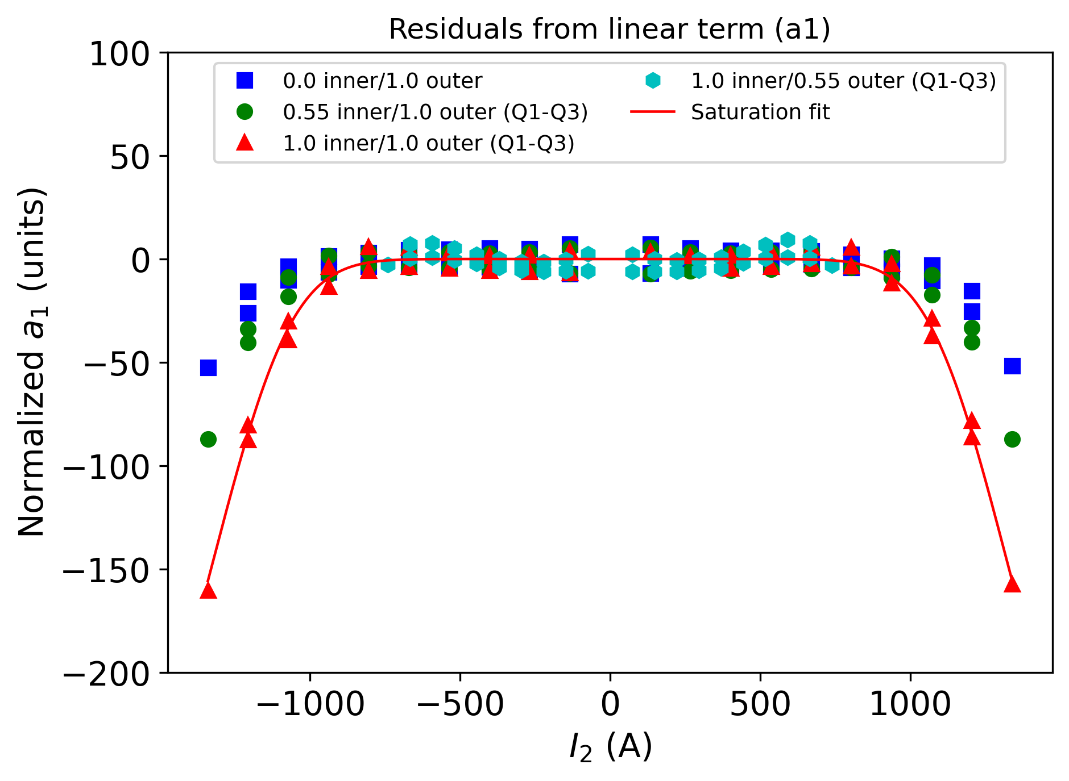
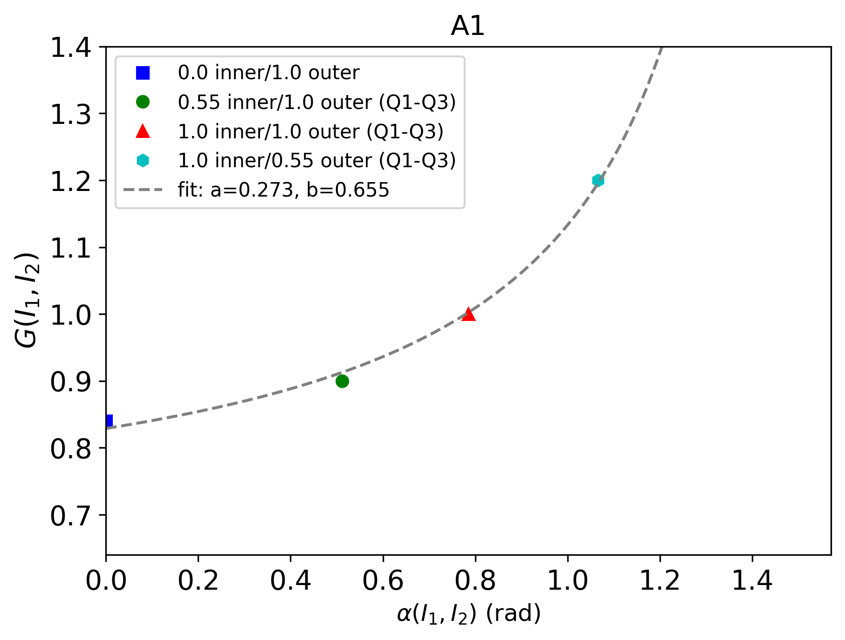
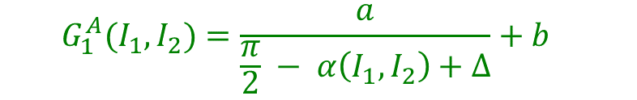
Function $G_{1}^{A}(I_{1},I_{2})$
  $$G_{1}^{A}(I_{1},I_{2})=\frac{a}{\frac{π}{2} − α\left(I_{1},I_{2}\right)+∆}+b$$
12/07/2023

Slide 23
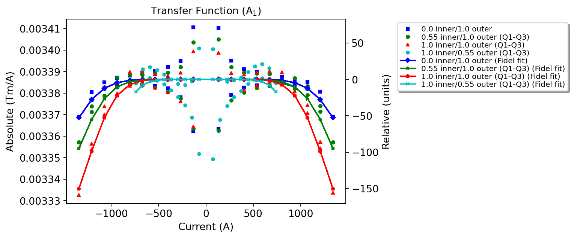
Transfer function (A1)

Slide 24
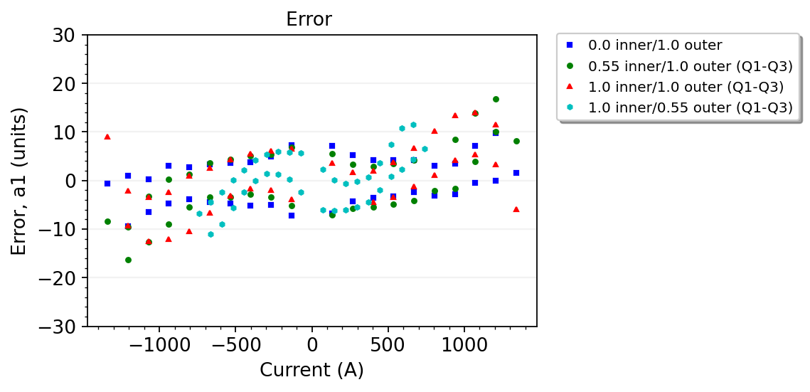
Model parameters and error (A1)
Component | Parameter | Value
Geometric | y | 0.0033864
Saturation | sigma1 | 0.0000800
Saturation | I01 | 1260
Saturation | S1 | 3.9
 | a | 0.273
 | b | 0.655
Constant parameters
$$∆$$ | Inom1 | Inom2
0.001 | 1593 | 1340
The fit is accurate within ±17 units in the entire current range.

Slide 25
B3 / A3

Slide 26
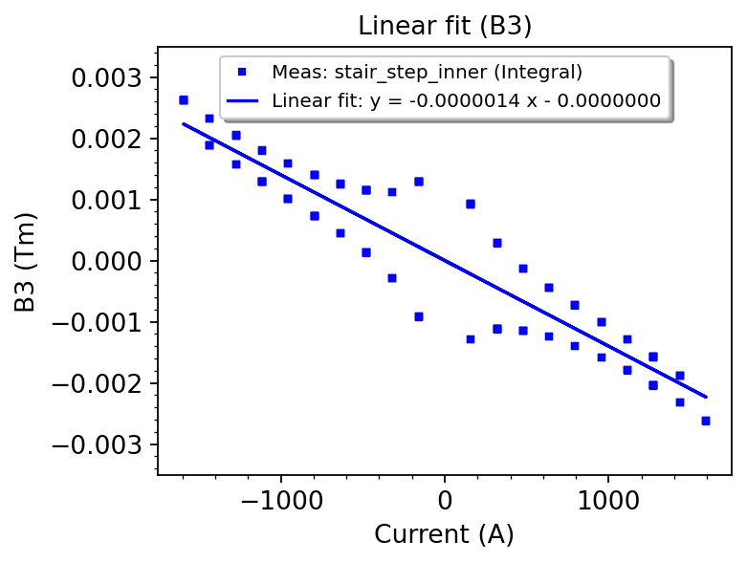
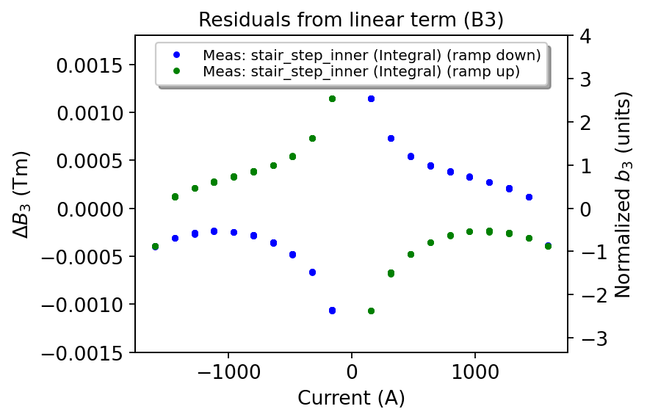
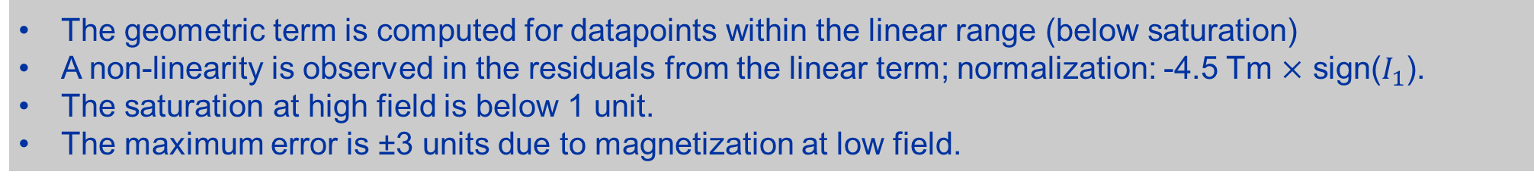
Reference cycle: Geometric term and Residuals (B3)
The geometric term is computed for datapoints within the linear range (below saturation)
A non-linearity is observed in the residuals from the linear term; normalization: -4.5 Tm $×$ sign($I_{1}$).
The saturation at high field is below 1 unit.
The maximum error is ±3 units due to magnetization at low field.

Slide 27
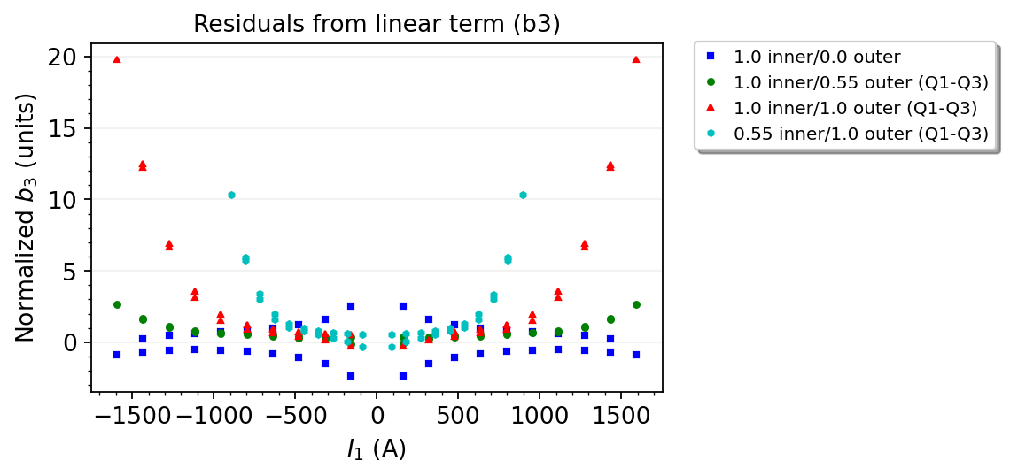
Combined powering: Residuals (B3)
At high field, the saturation increases as a function of current in the outer aperture (up to 20 units).
At low field, the magnetization is within ±3 units with the maximum error for a reference cycle.

Slide 28
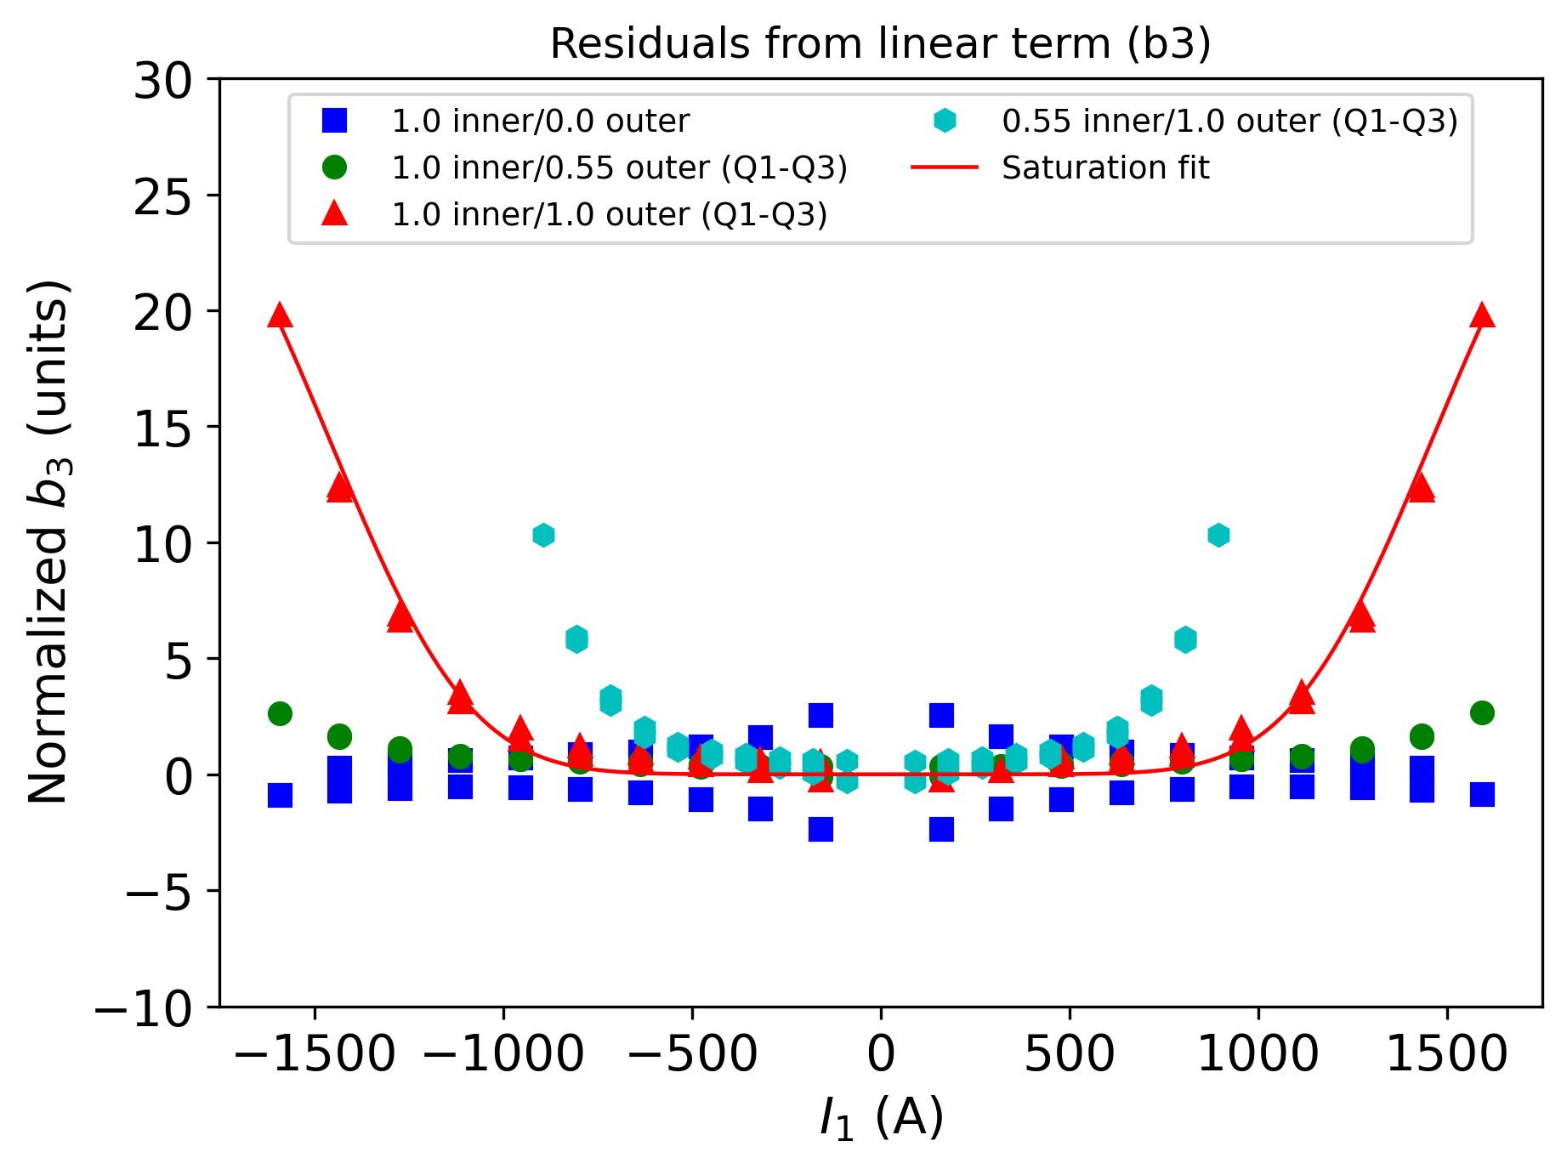
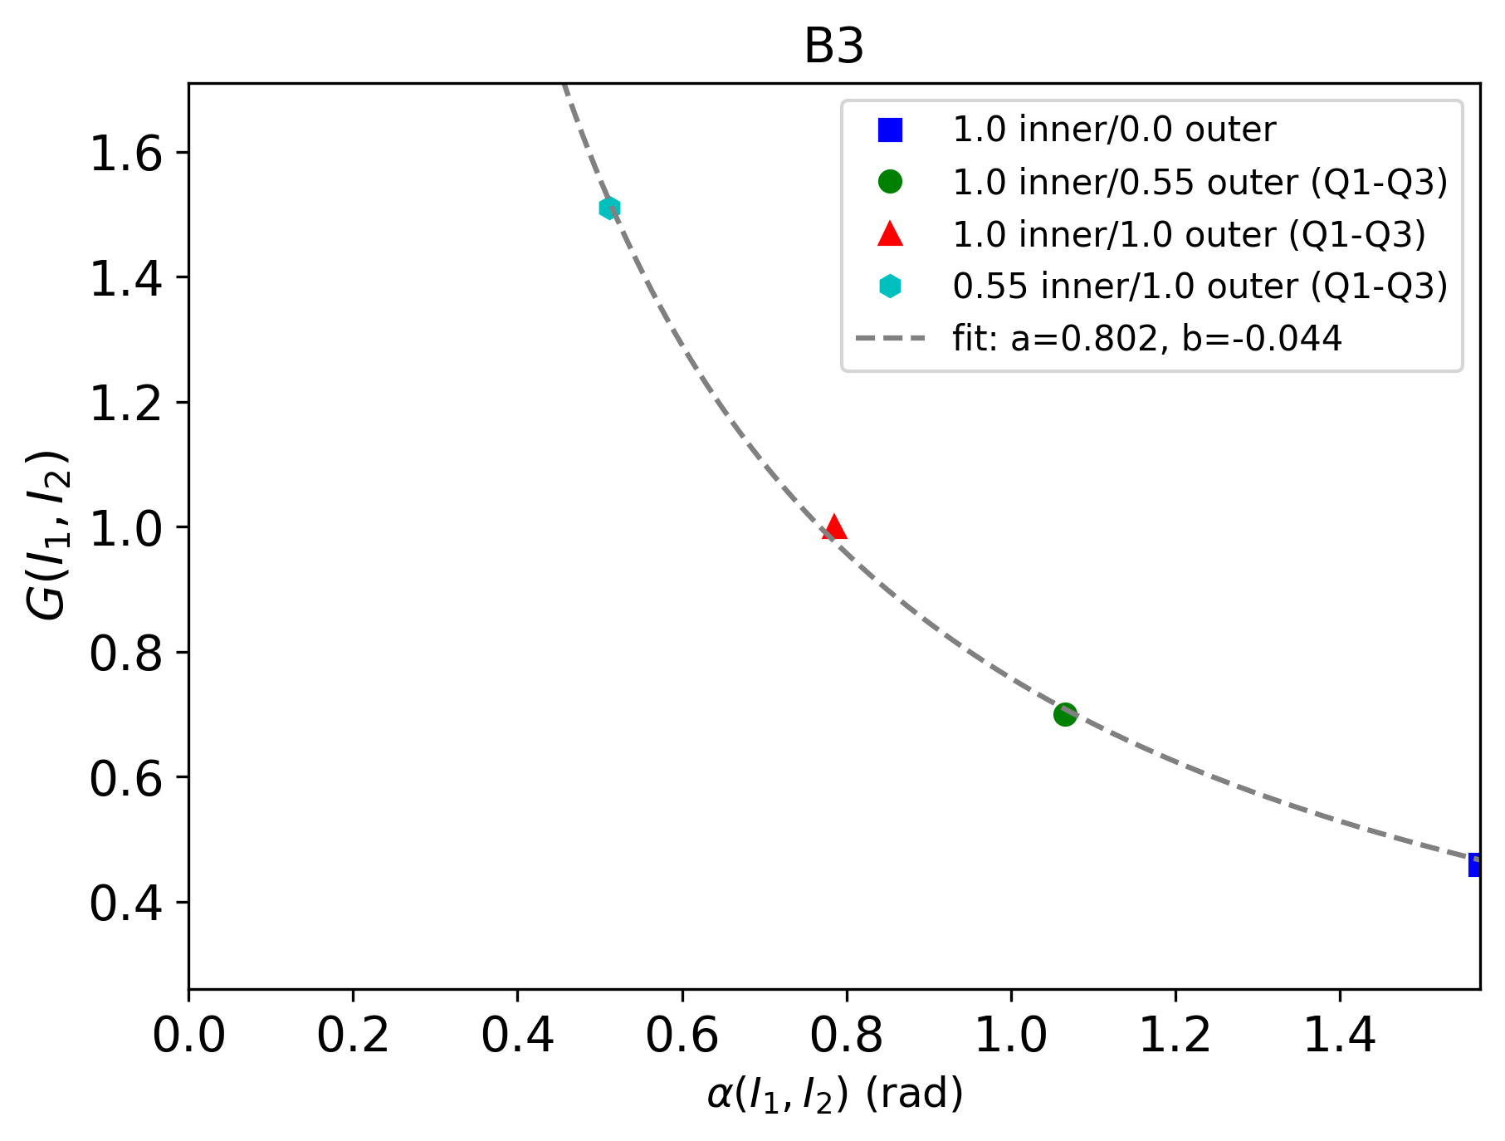


Function $G_{3}^{B}(I_{1},I_{2})$
  $$G_{3}^{B}\left(I_{1,}I_{2}\right)=\frac{a}{α\left(I_{1},I_{2}\right)+ ∆}+b$$

Slide 29
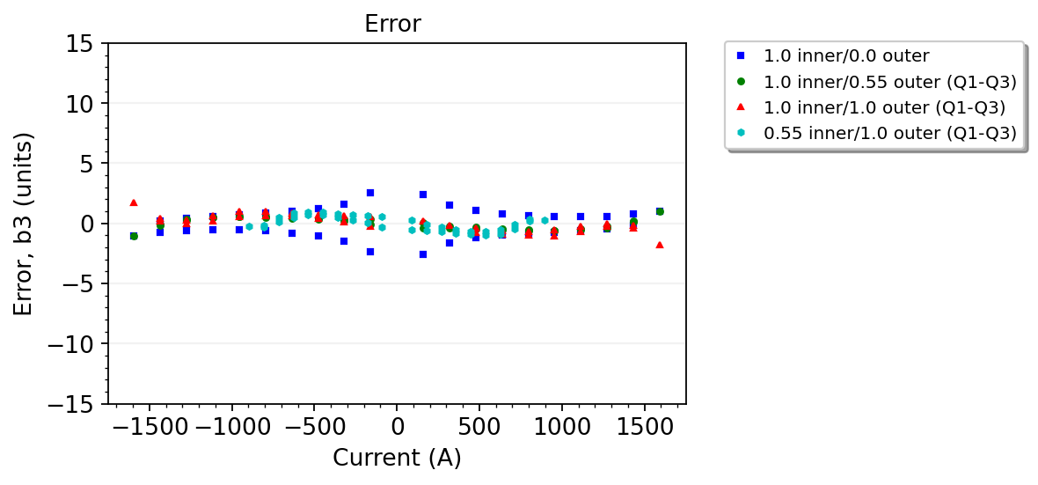
Model parameters and error (B3)
Component | Parameter | Value
Geometric | y | -0.0000014
Saturation | sigma1 | -0.0000068
Saturation | I01 | 1350
Saturation | S1 | 4.0
 | a | 0.802
 | b | -0.044
Constant parameters
$$∆$$ | Inom1 | Inom2
0.001 | 1593 | 1340
The fit is accurate within ±3 units in the entire current range.

Slide 30



Reference cycle: Geometric term and Residuals (A3)
The geometric term is computed for datapoints within the linear range (below saturation)
A non-linearity is observed in the residuals from the linear term; normalization: 4.5 Tm $×$ sign($I_{2}$).
The saturation at high field is below 1 unit.
The maximum error is ±1.5 units due to magnetization at low field.
12/07/2023
Agnieszka Chmielińska | Development of the MCBXF FiDeL Model

Slide 31

Combined powering: Residuals (A3)
At high field, the saturation increases as a function of current in the inner aperture (up to 15 units).
At low field, the magnetization is within ±1.5 units with the maximum error for a reference cycle.
12/07/2023
Agnieszka Chmielińska | Development of the MCBXF FiDeL Model

Slide 32




Function $G_{3}^{A}(I_{1},I_{2})$
  $$G_{3}^{A}(I_{1},I_{2})=\frac{a}{\frac{π}{2} − α\left(I_{1},I_{2}\right)+∆}+b$$
12/07/2023

Slide 33

Model parameters and error (A3)
Component | Parameter | Value
Geometric | y | 0.0000035
Saturation | sigma1 | 0.0000067
Saturation | I01 | 1190
Saturation | S1 | 3.7
 | a | 0.615
 | b | 0.163
Constant parameters
$$∆$$ | Inom1 | Inom2
0.001 | 1593 | 1340
The fit is accurate within ±3 units in the entire current range.
12/07/2023

Slide 34
Part 4: Summary
12/07/2023

Slide 35
Conclusions
The analysis of the experimental data shows saturation is the strongest contribution to the nonlinear effects, and it cannot be modelled in the standard way as the resulting error is expected to be detrimental to machine performance (up to ±200 units for B1/A1 and ±20 units for B3/A3).
To use the MCBXF magnet in operation, a dedicated FiDeL model was developed.
A modified saturation component has been proposed to model the angular dependence of saturation.
The proposed approach involves a low level of complexity: 2 new parameters for each multipole.
12/07/2023

Slide 36
Conclusions
The modelling error meets the requirements for both versions of the MCBXF magnets.
 | MCBXFB | MCBXFA
Multipole | Error [units] | Error [units]
B1 | ±30 | ±15
A1 | ±28 | ±17
B3 | ±4 | ±3
A3 | ±4 | ±3
12/07/2023

