Slide 1
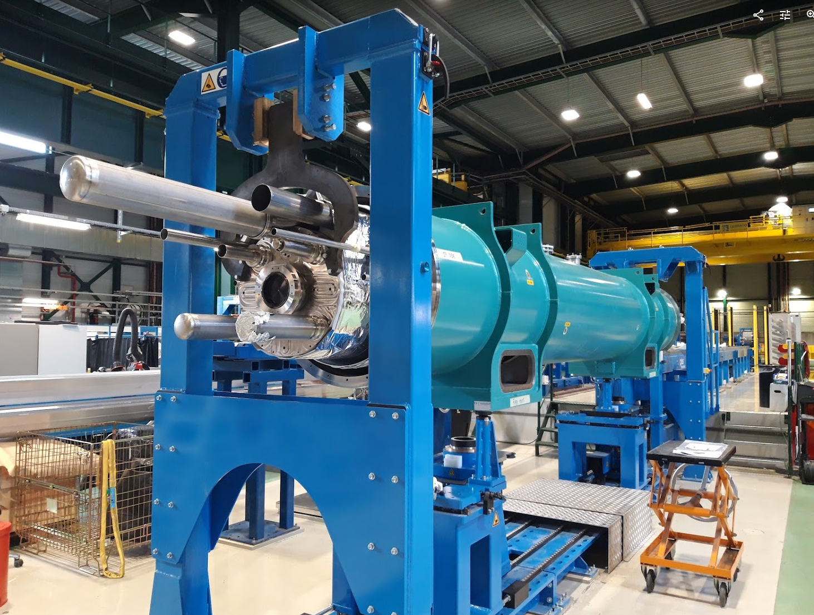
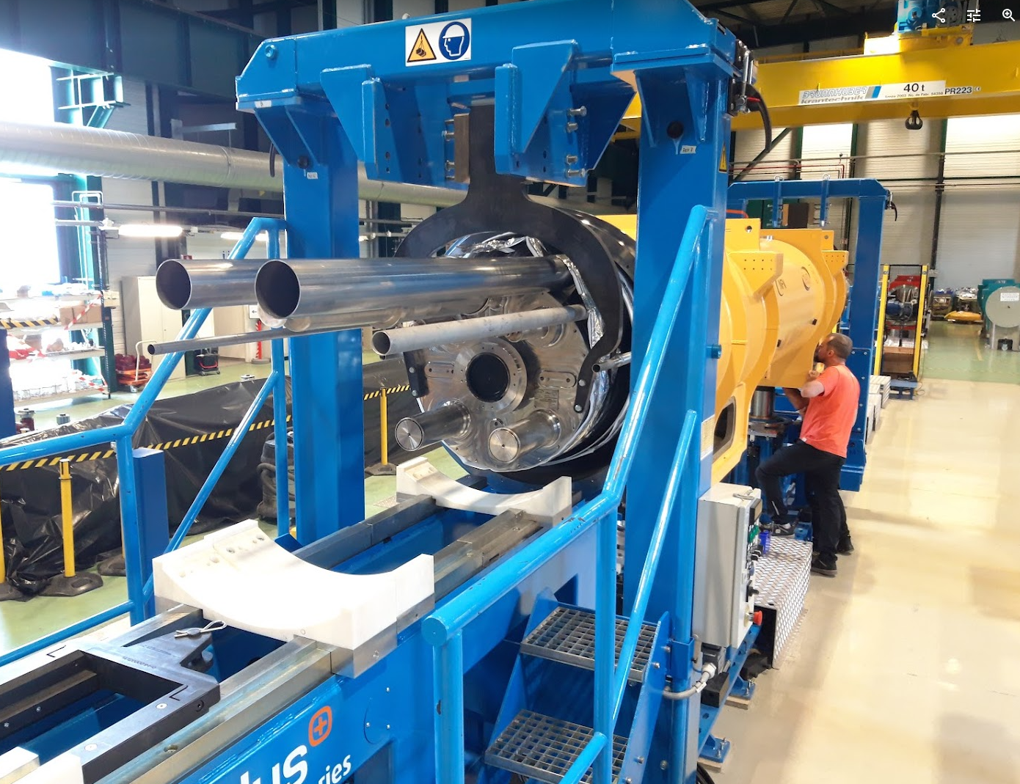

Advancement of cryostating of D1 and CP prototypes
D. Ramos
WP3 Meeting, 12/5/2022, indico event 1296834

Slide 2
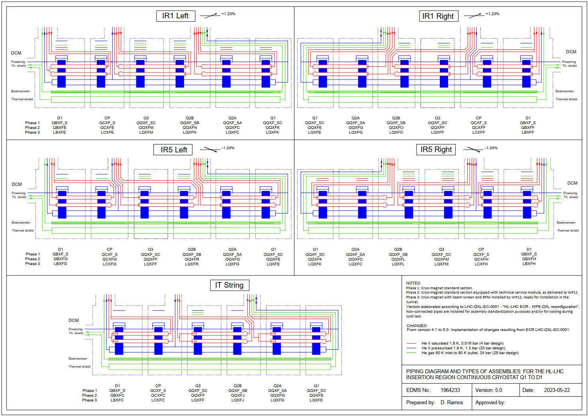

Slide 3
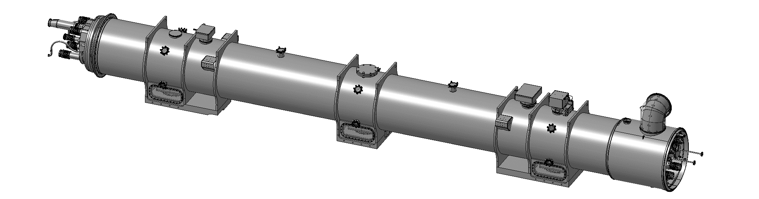
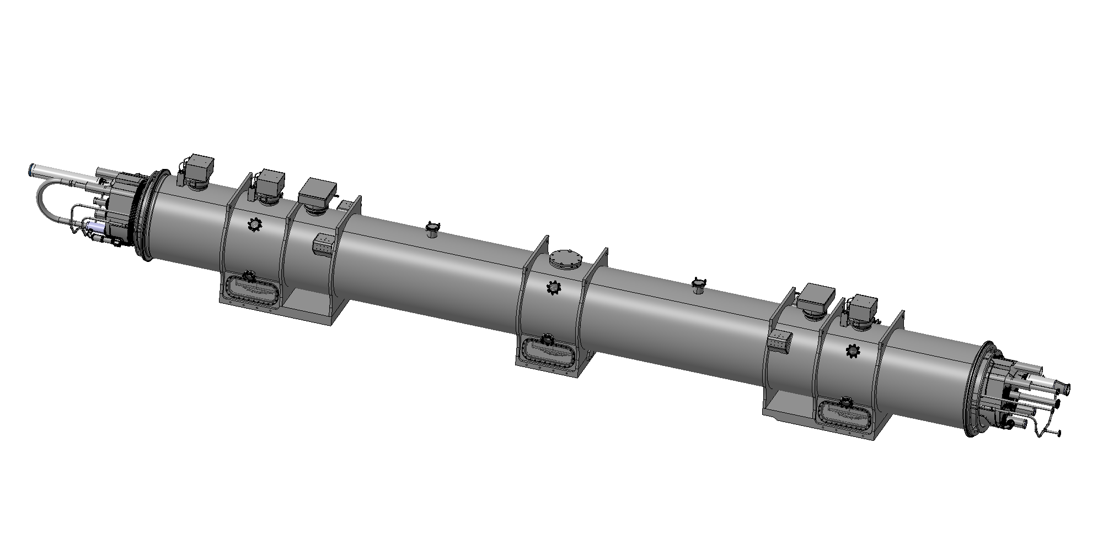
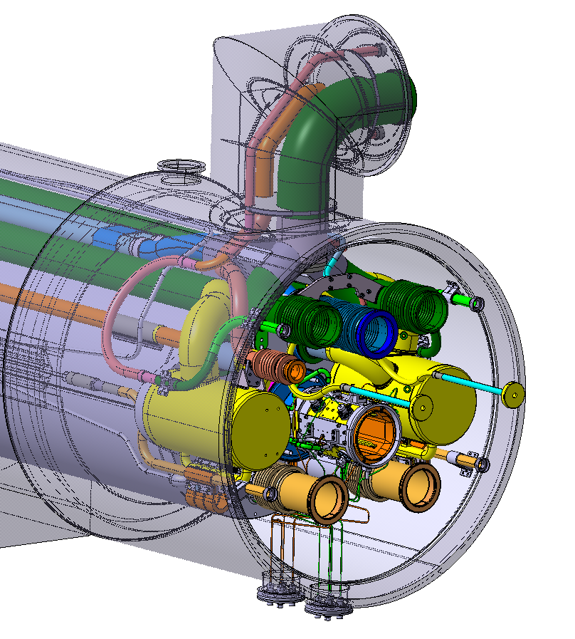
Dealing with many variants: Modular assembly
=
+
Standard section
Cold mass standing on its cold supports inside the main vacuum vessel
Instrumentation feeders
Final alignment and cold mass position monitoring equipment
Ready for magnet cold test
Does not depend on location of installation
Cryogenic and technical service module
Addition of cryogenic connections to the supply line and interconnects to neighbouring magnets
Pipe connections depending on location of installation due to tunnel slope
Beam screen and beam position monitor with its pickup cables

Slide 4
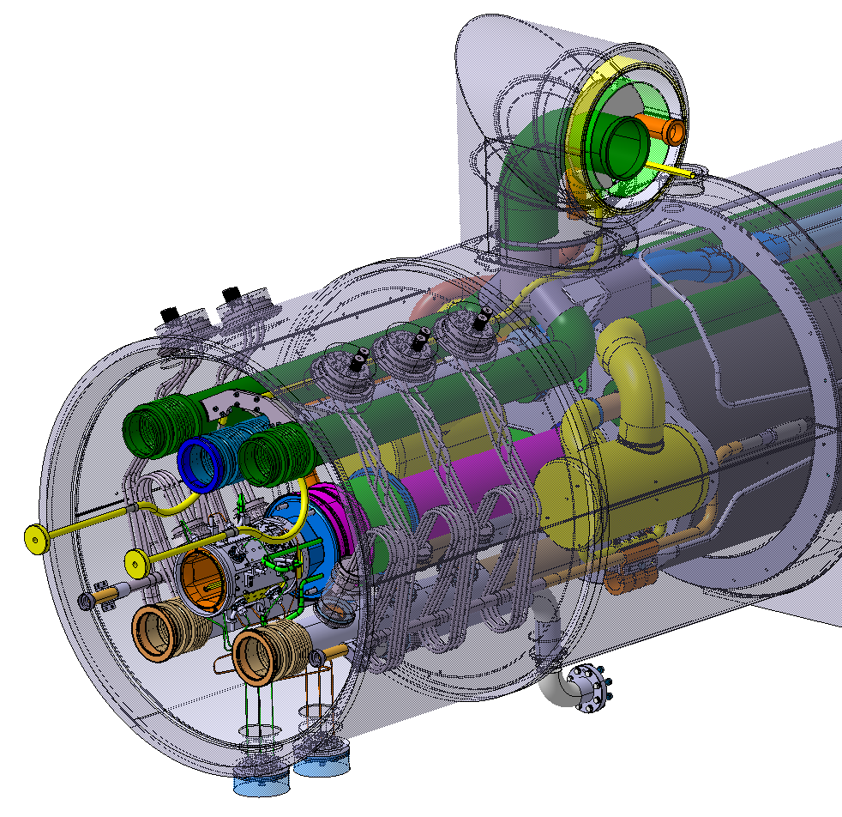
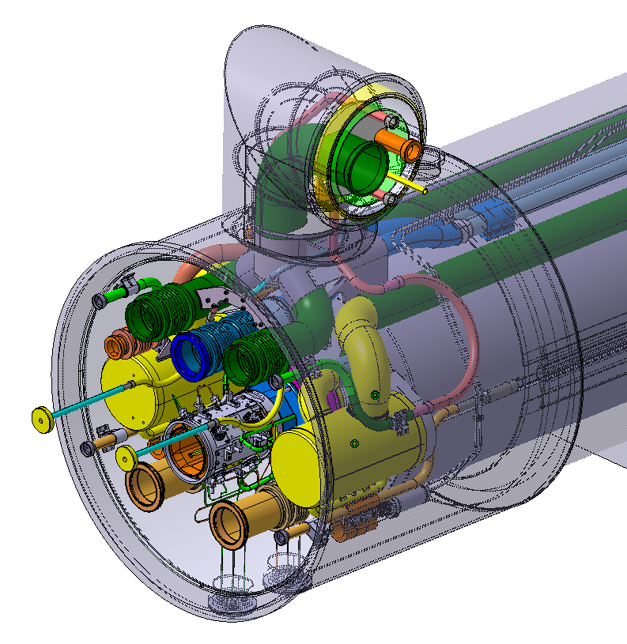
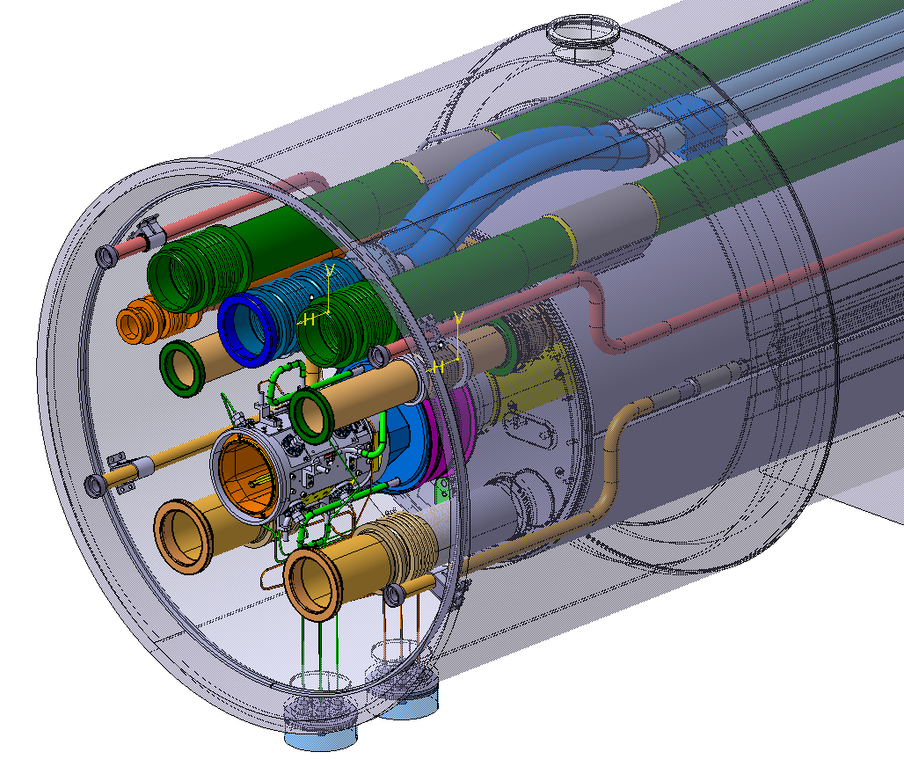
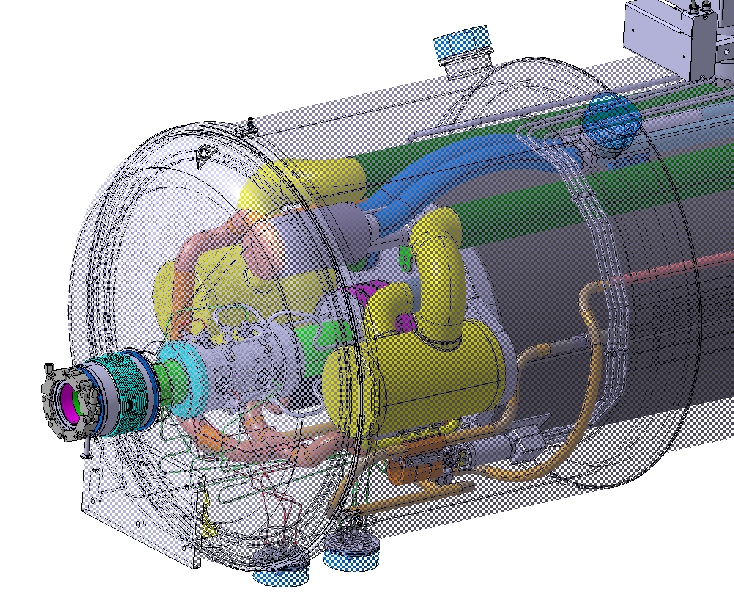
Cryogenic and technical service module
(a few examples)
Simplest configuration Interconnecting lines
BPM and beam screen
Towards interaction point
Return/connection manifolds
He II phase separators with pumping lines
BPM and beam screen
Cold to warm transition on the beam line
At the end of a cooling cell
Interconnecting lines
He II phase separators with pumping lines
BPM and beam screen
Including connection to cryogenic supply line
Special case for CP
Interconnecting lines
He II phase separators with pumping lines
BPM and beam screen
Connection to cryogenic supply line
Additional module with resistive current leads

Slide 5
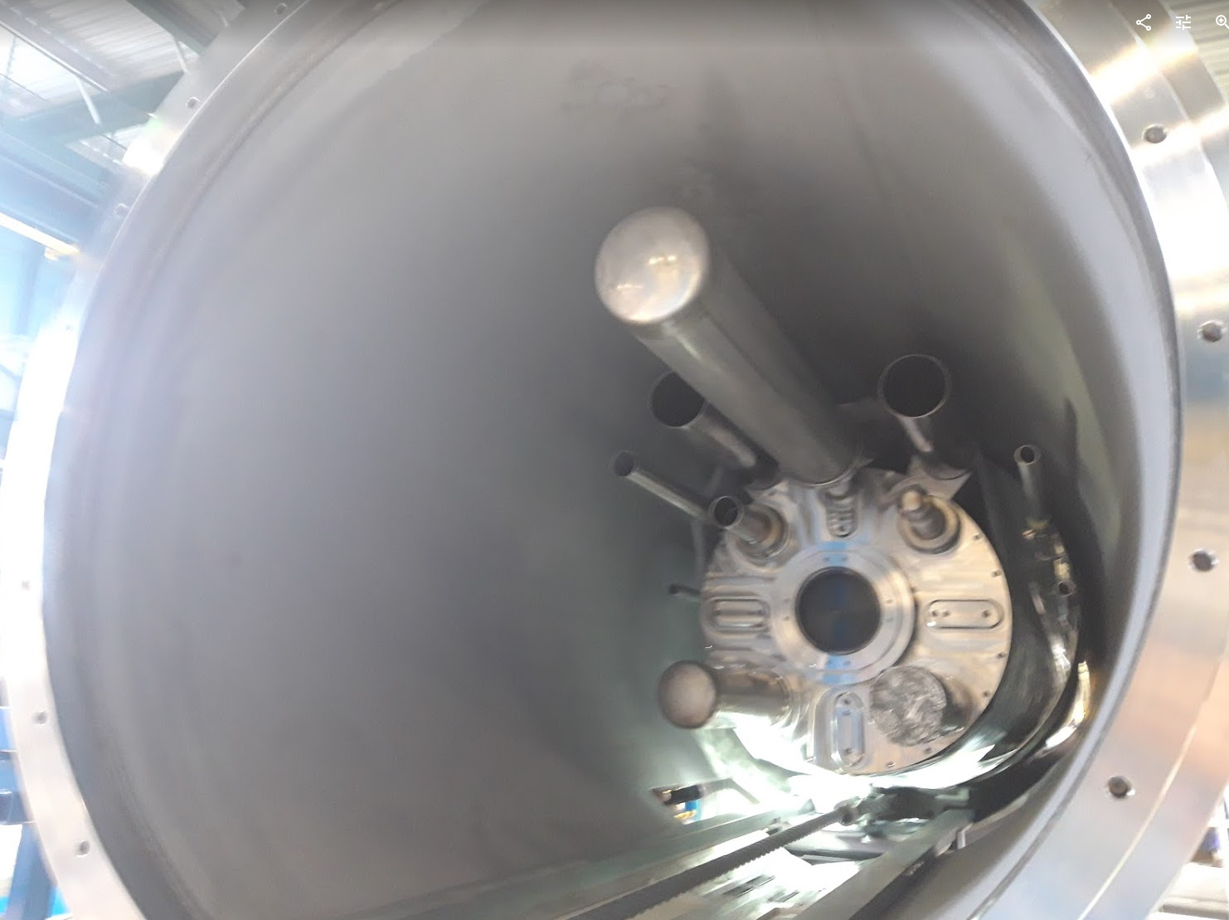
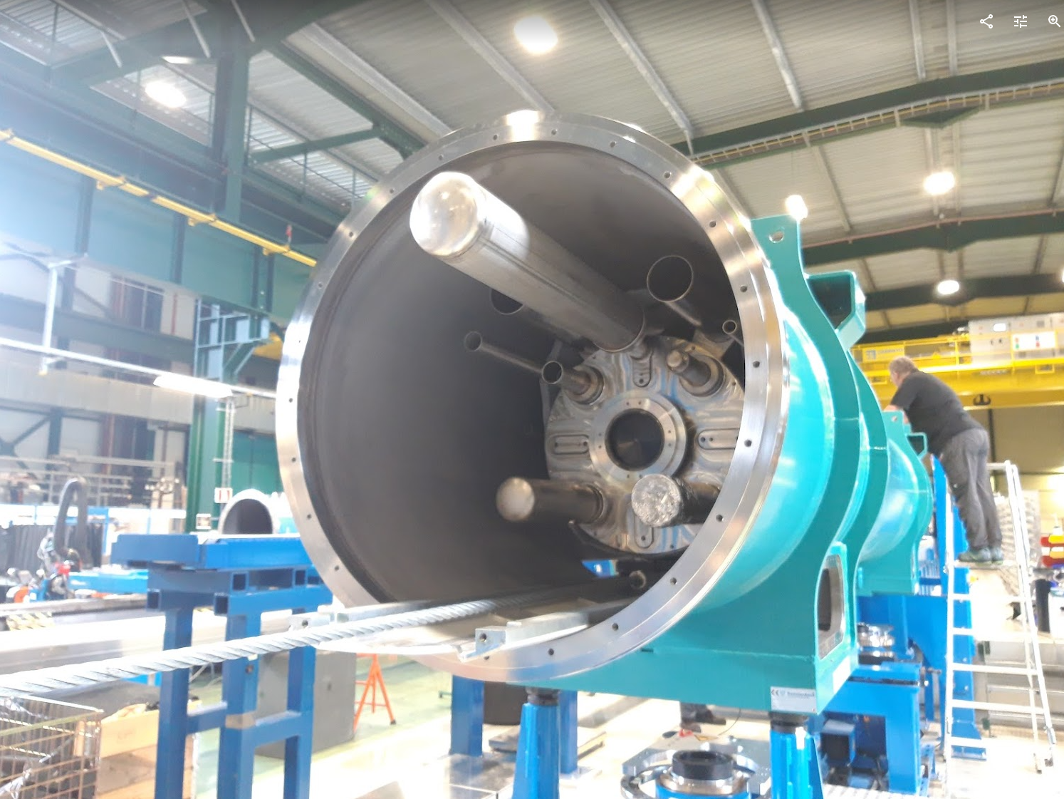
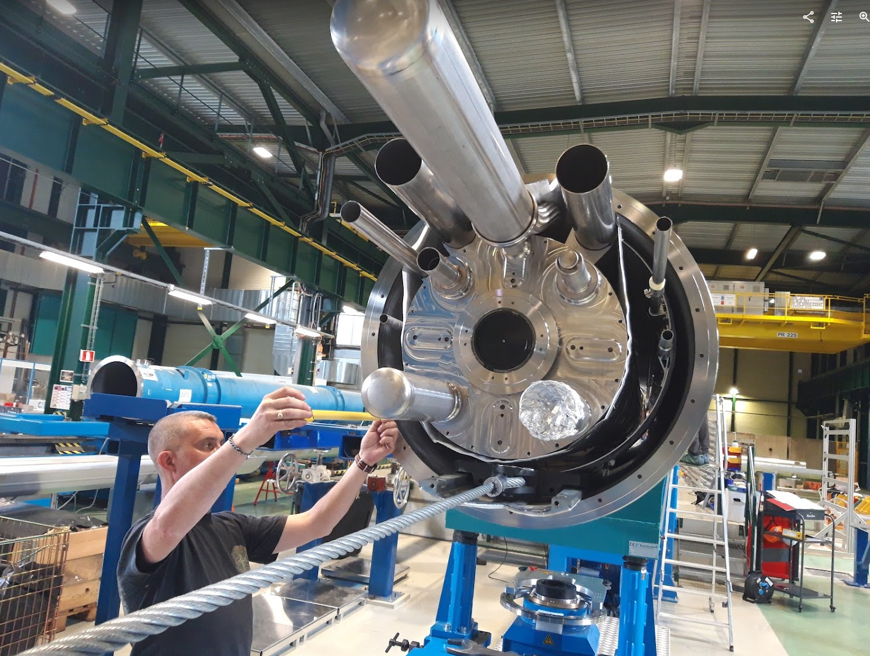
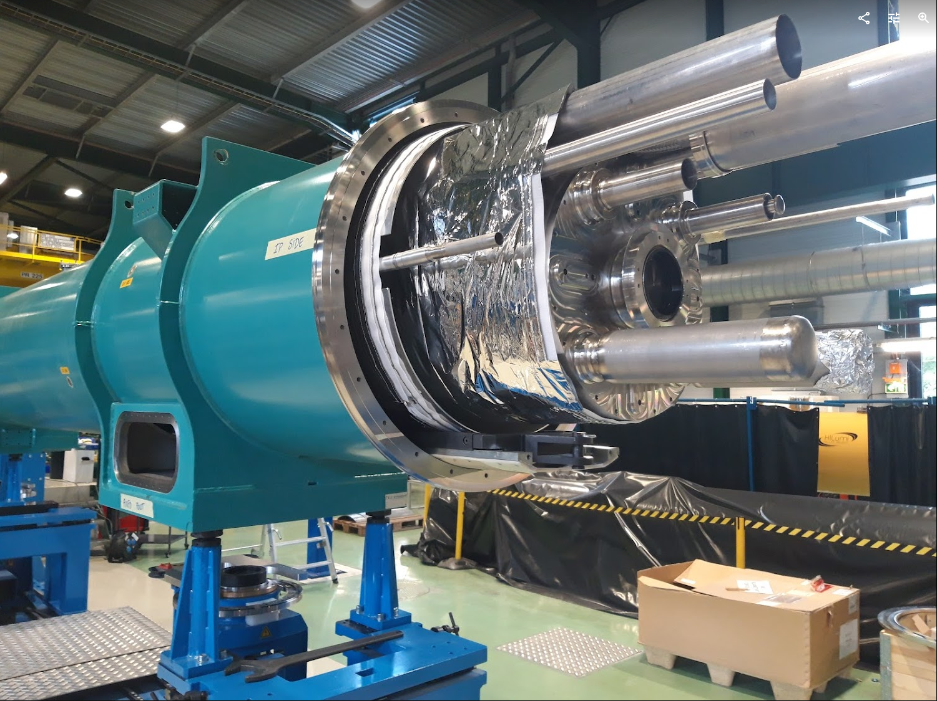
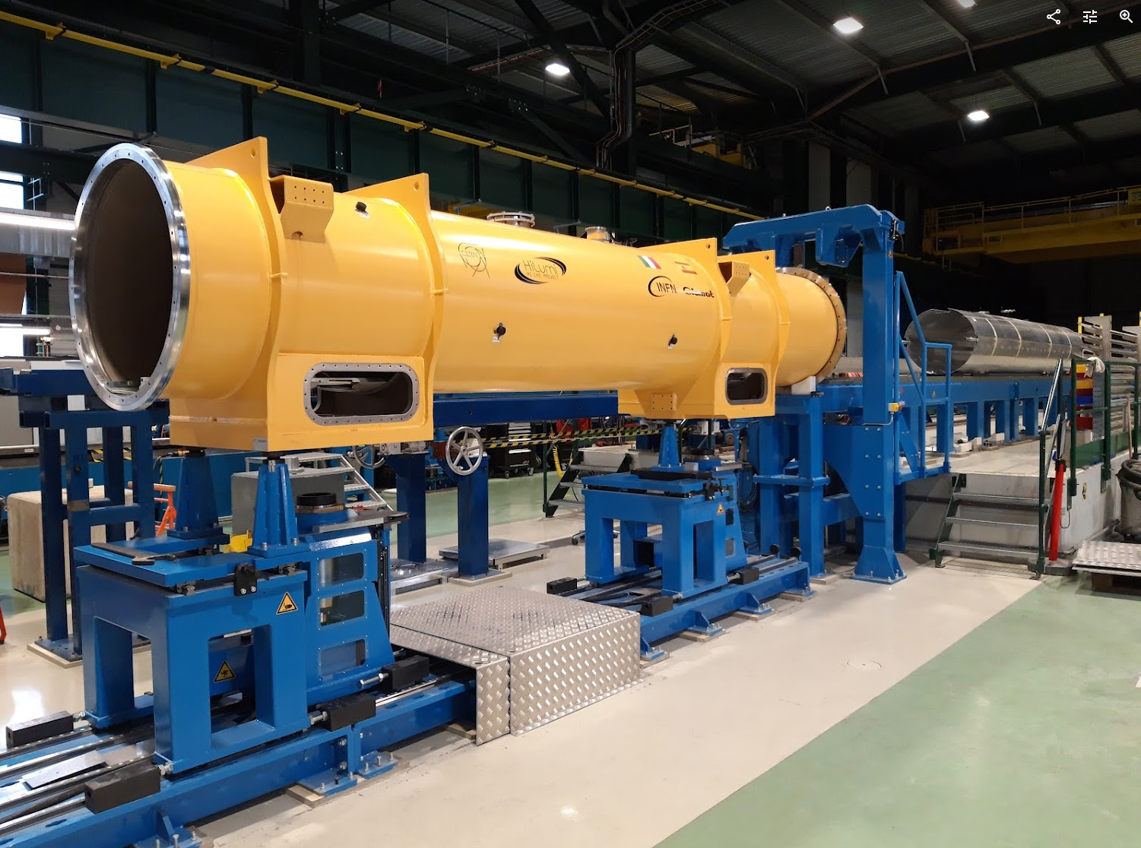
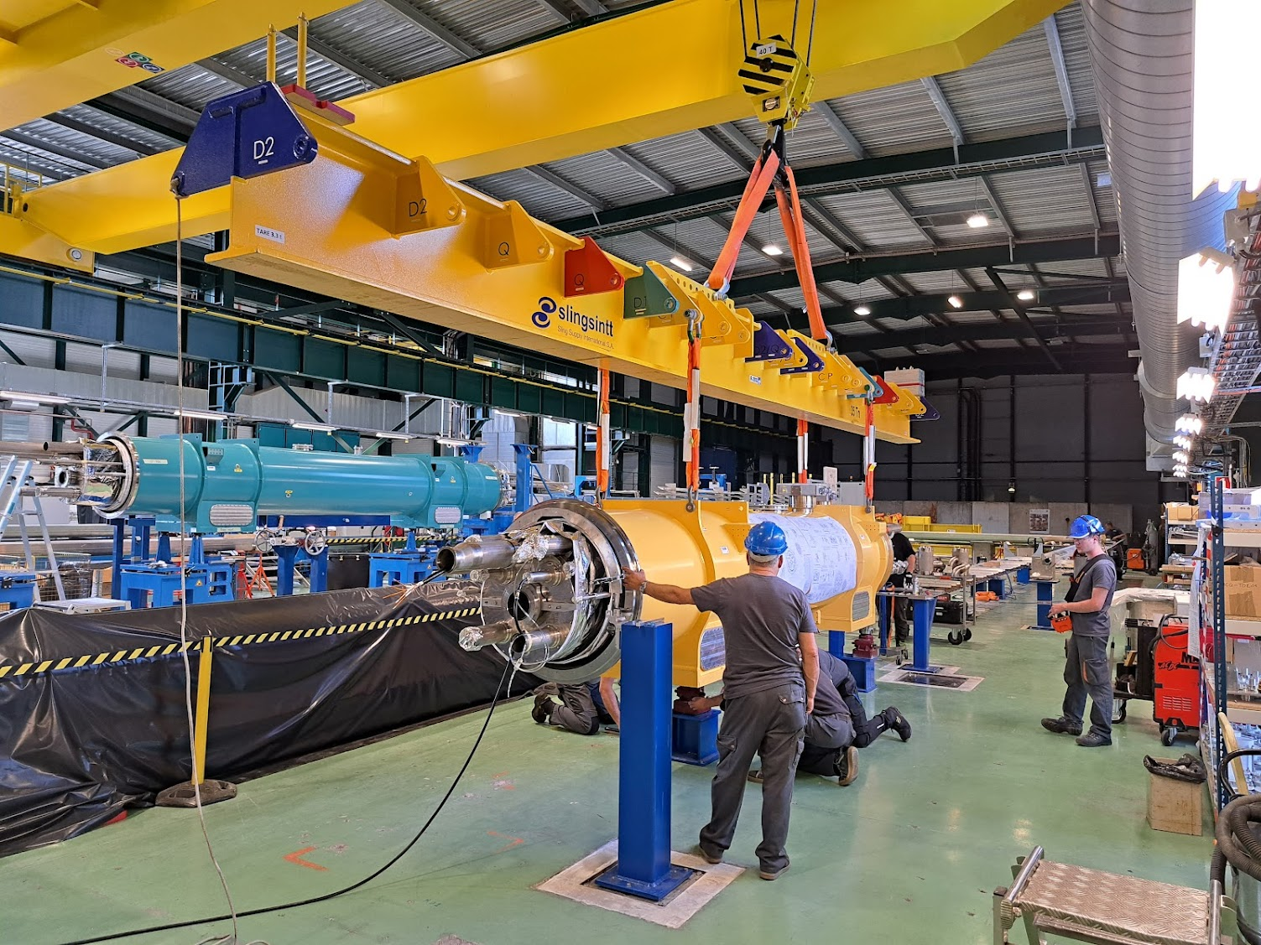
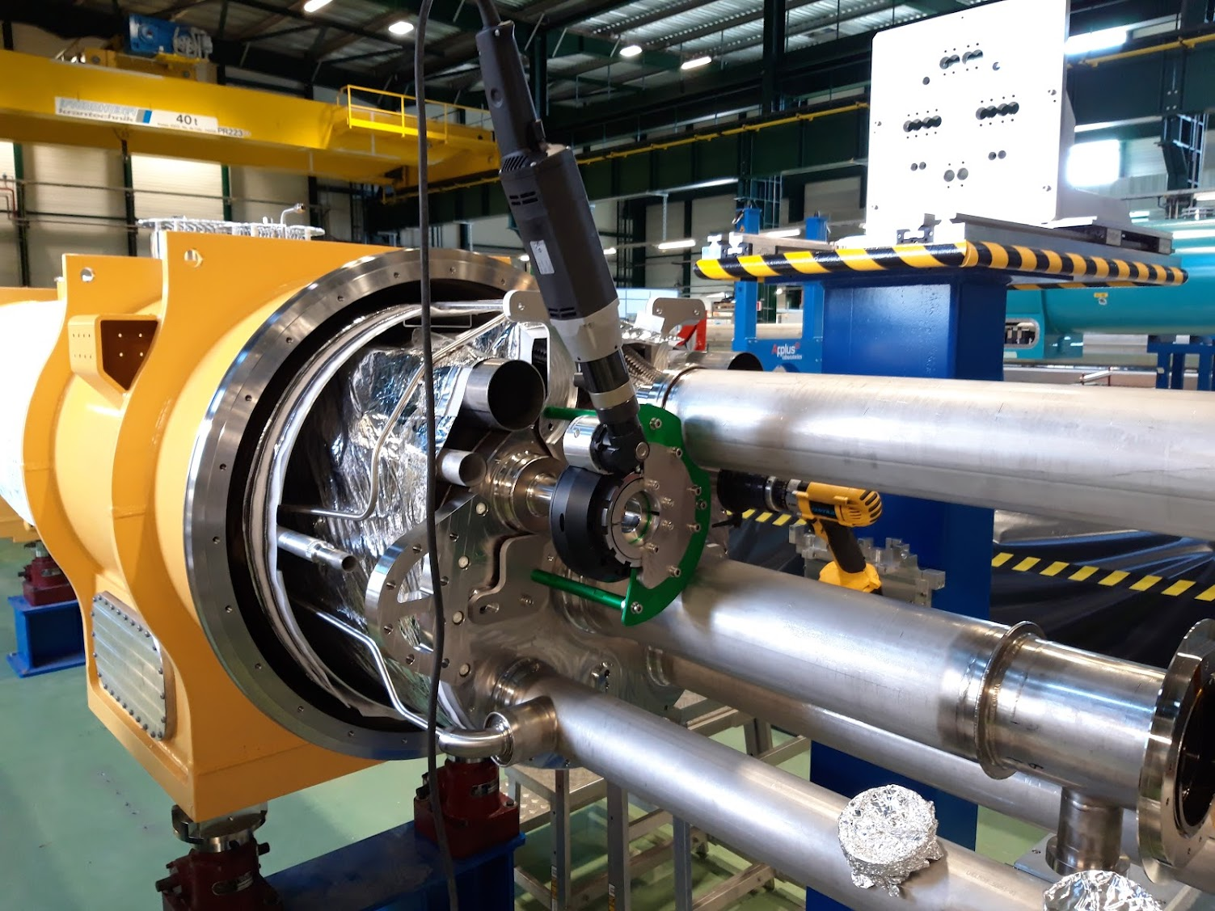

Slide 6
 | (Japan) | 180 | SMI2 | SMS18 | SM18 | SMA18 | Storage
D1
Cold mass
Cold mass reception
& finishing
Cryo-magnet standard section
Cold test
Installation of test equipment
Cryo-magnet service module & pipe interfaces
Removal of test equipment
Pressure test
Metrology of interfaces (Cartography)
Mech. fiducialisation
Cryo-magnet
end closure
STRING
KEK
TE-MSC
TE-MSC-CMI
TE-MSC-LMF
BE-GM-ASG
TE-MSC-TF
TE-VSC-DLM

Slide 7
 | 180 | SMI2 | SMS18 | SM18 | SMA18 | Storage
CP
Cold mass
Cryo-magnet standard section
Cryo-magnet service module
& pipe interfaces
Current lead module
Cold test
Installation of test equipment
Pressure test
Removal of test equipment
Stripping
Metrology of interfaces (Cartography)
Mech. fiducialisation
STRING
TE-MSC
TE-MSC-CMI
TE-MSC-LMF
BE-GM-ASG
TE-MSC-TF
TE-VSC-DLM

Slide 8
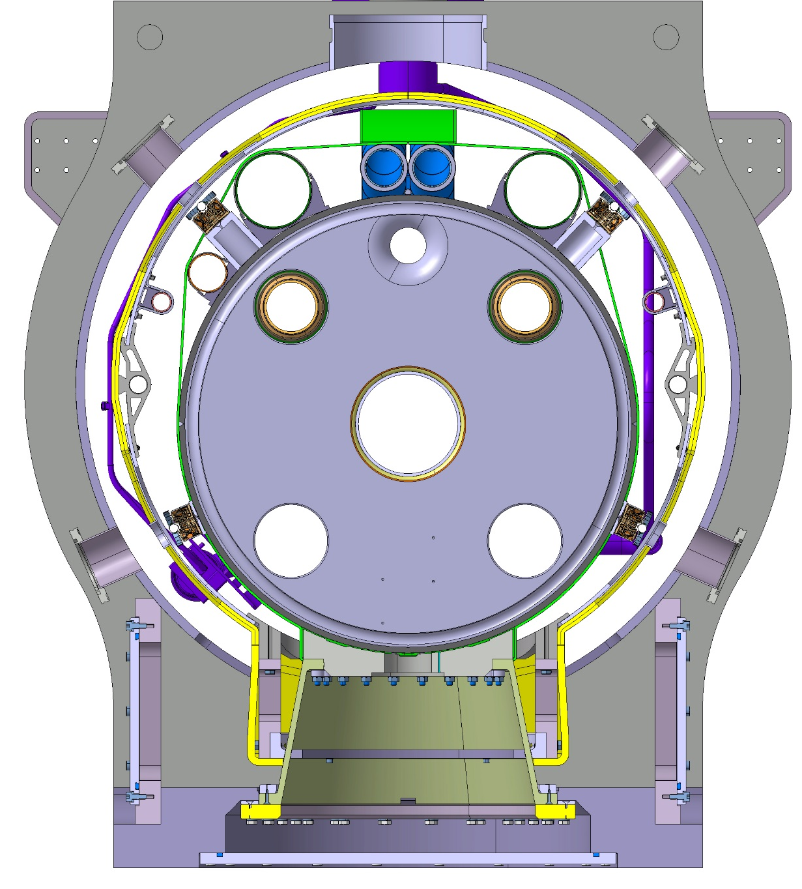
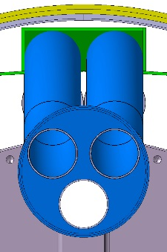
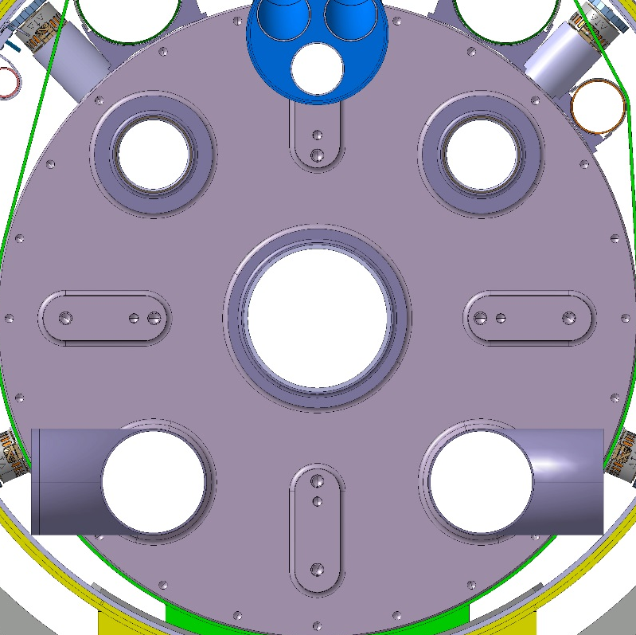
Alignment of cold mass relative to vacuum vessel
Alignment goal: <+/-1 mm
Cold mass and vacuum vessel geometry checked at the interfaces prior to assembly
Alignment shims can be replaced to lower or raise the cold mass. So far we had:
  Q2b: no adjustment needed
  D1: no adjustment needed
  CP: 4 mm shim to lift the cold mass up by 1 mm
  Q2a: 4 mm shim to lift the cold mass up by 1 mm
Alignment shim

Slide 9
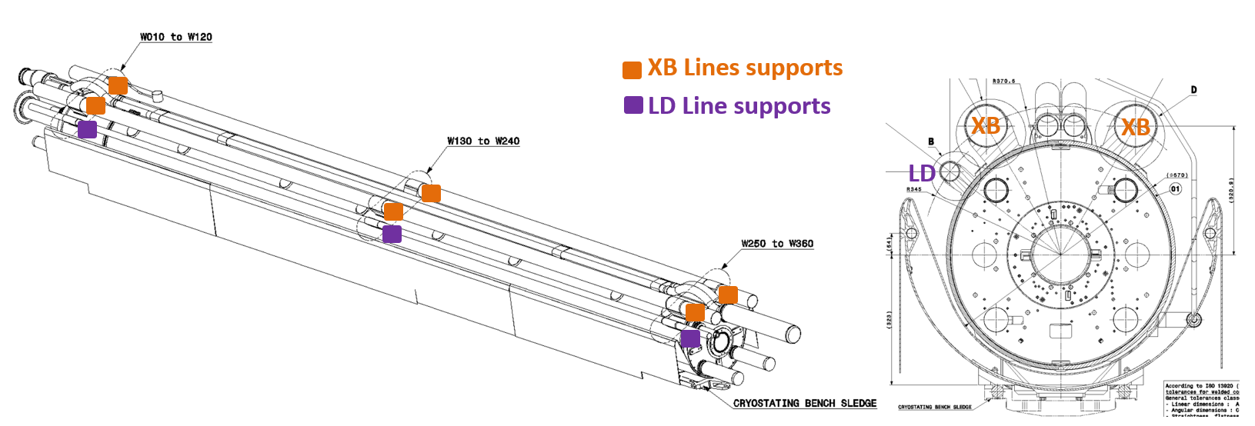
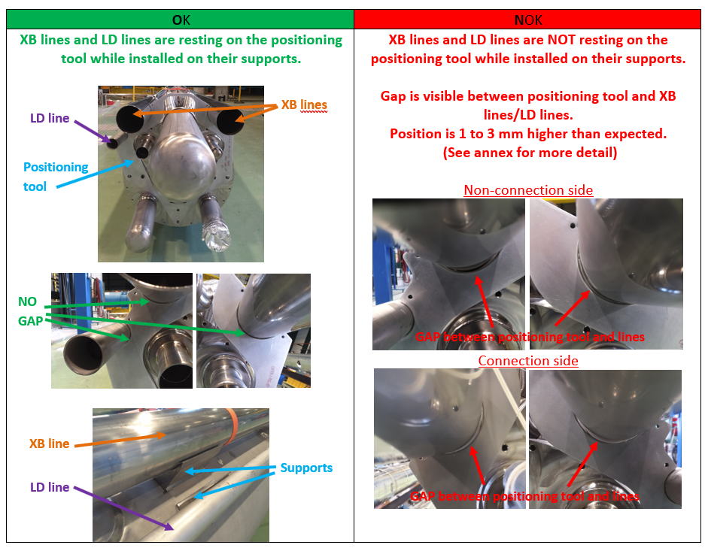
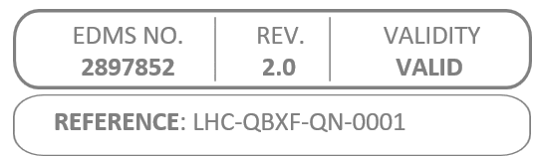
Deviations on D1 cold mass shape/diameter
https://edms.cern.ch/document/2897852
Pipes must be positioned relative to alignment references at the end covers (tooling)
Misalignment between end cover and cold mass shell up to 3 mm at some locations
Root cause being investigated
Pipe supports were re-machined according to actual cold mass shape

Slide 10
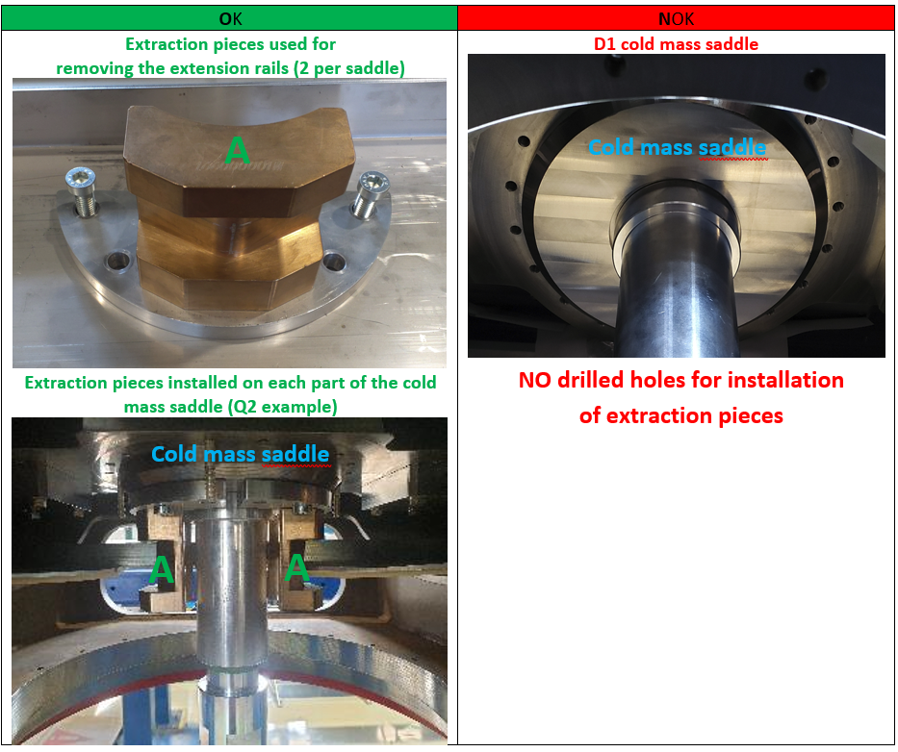
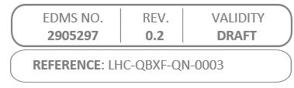
Missing holes on D1 cold mass saddles
Tooling used to extract the rails could not be bolted to the cold mass saddle because the threaded holes were missing
A work around was found but, for standardization reasons, it would be better to add the holes on the cold mass, if possible

Slide 11
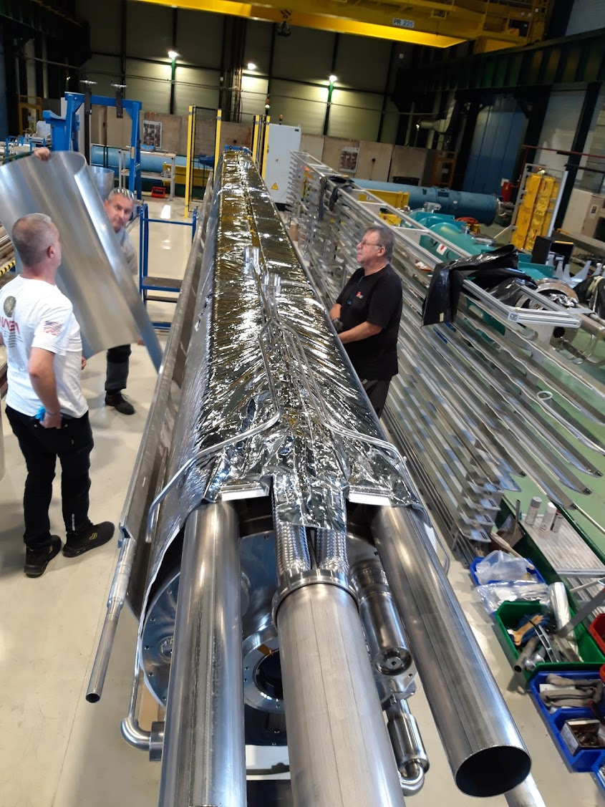
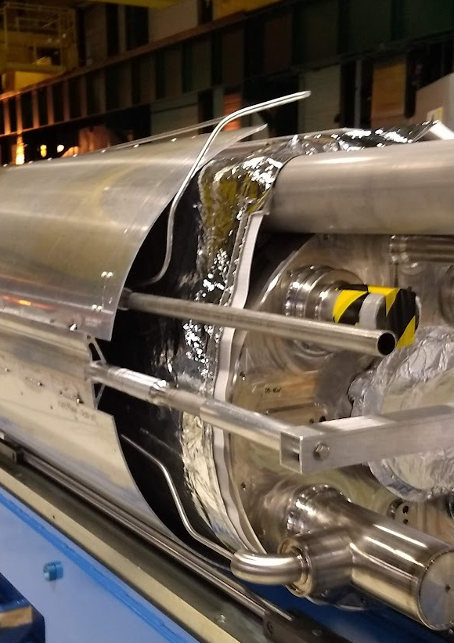
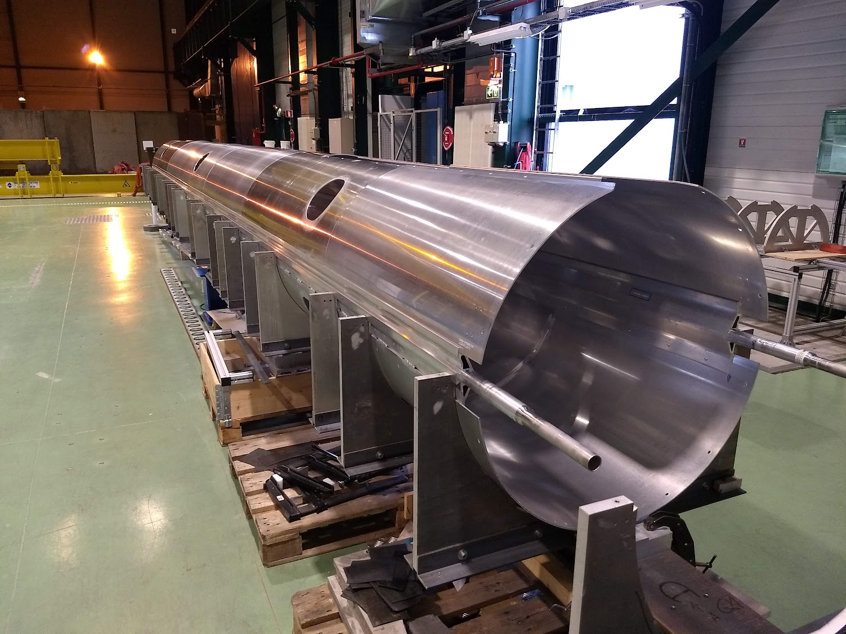
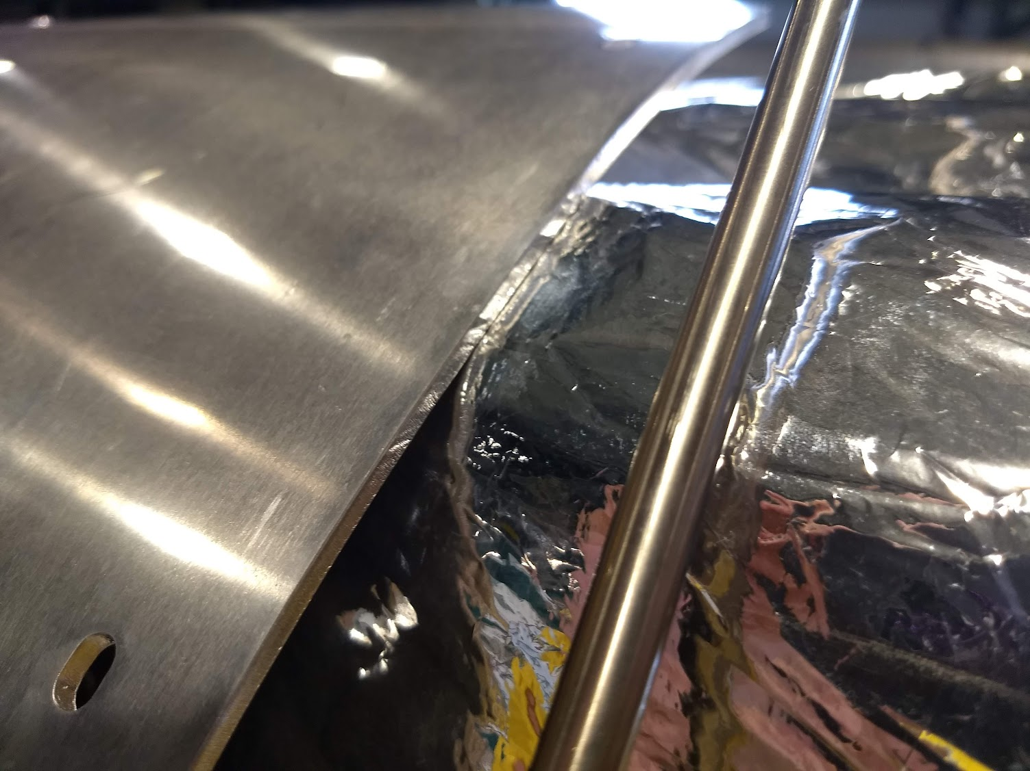
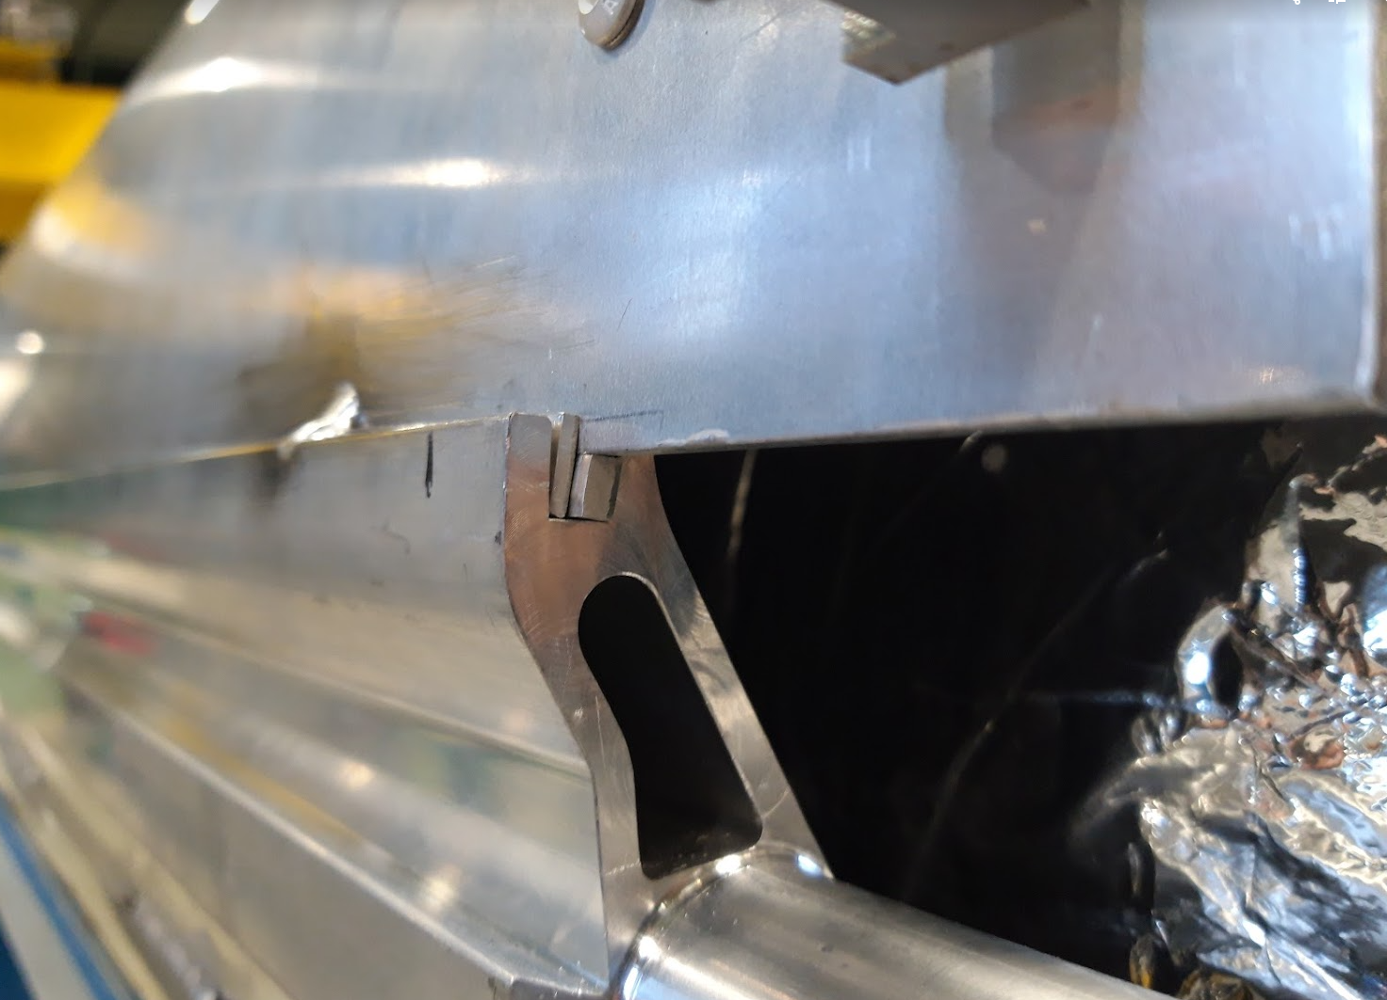
Thermal shield shape
Insufficient gap between thermal shield and pumping lines (XB)
  Systematic defect created by the pre-assembly tooling: tooling refurbishment on-going
  Shells rolled with diameter over specification: roll again aiming to compensate for both the upper and lower shell deviations
  Shimming to fine tune the gap
5 thermal shields Q1/3 (in the US), 1 Q2a, 1 Q2b, 2 CP and 1 D1 concerned by this issue. Following assemblies will have tighter QC on shell rolling, improved tooling and more developed pre-assembly procedure.

Slide 12
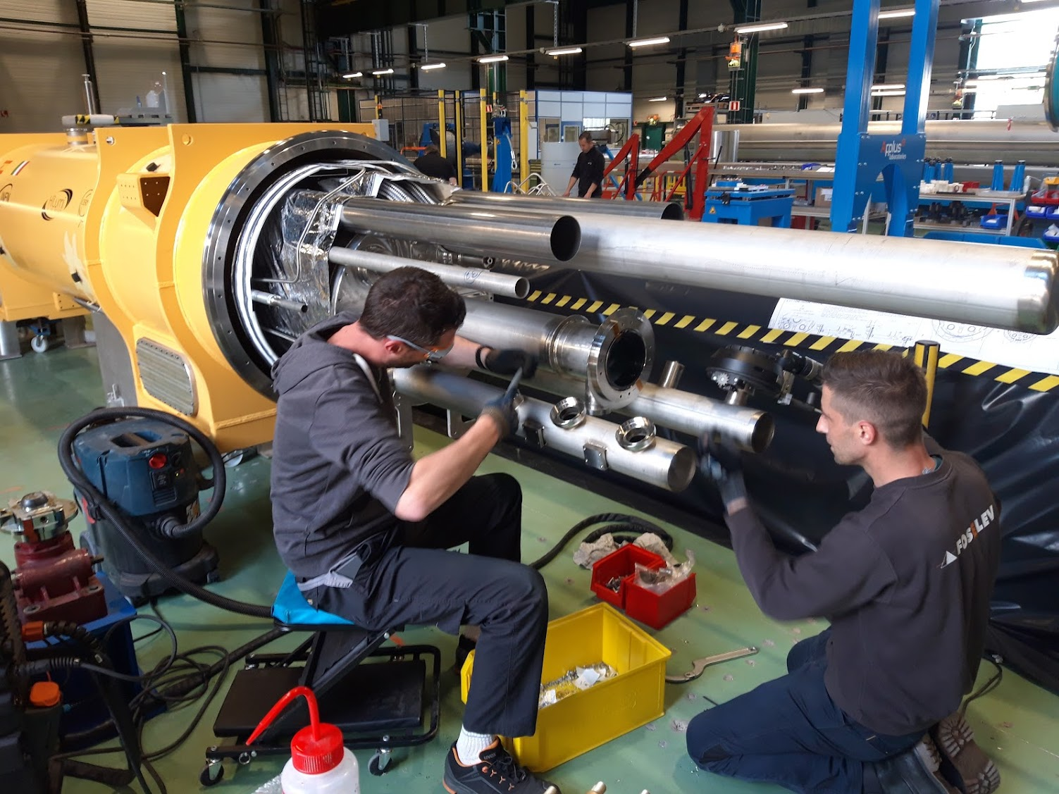
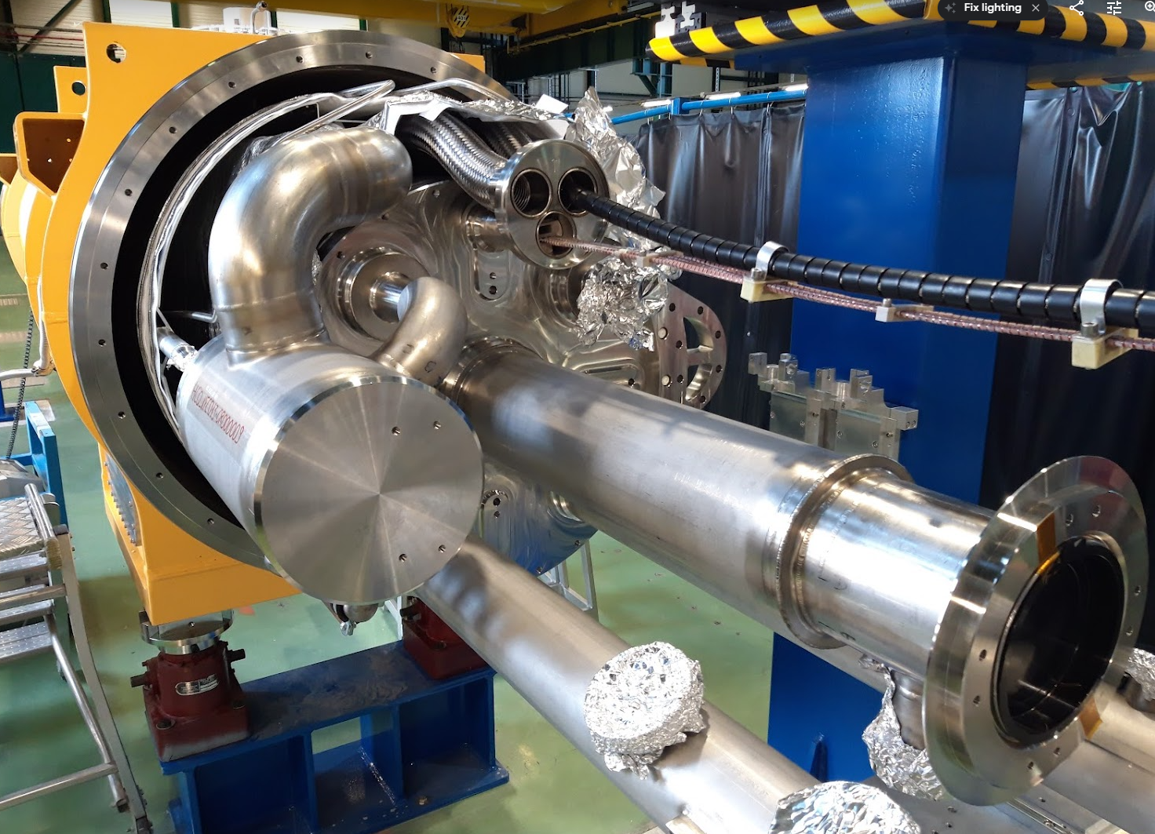
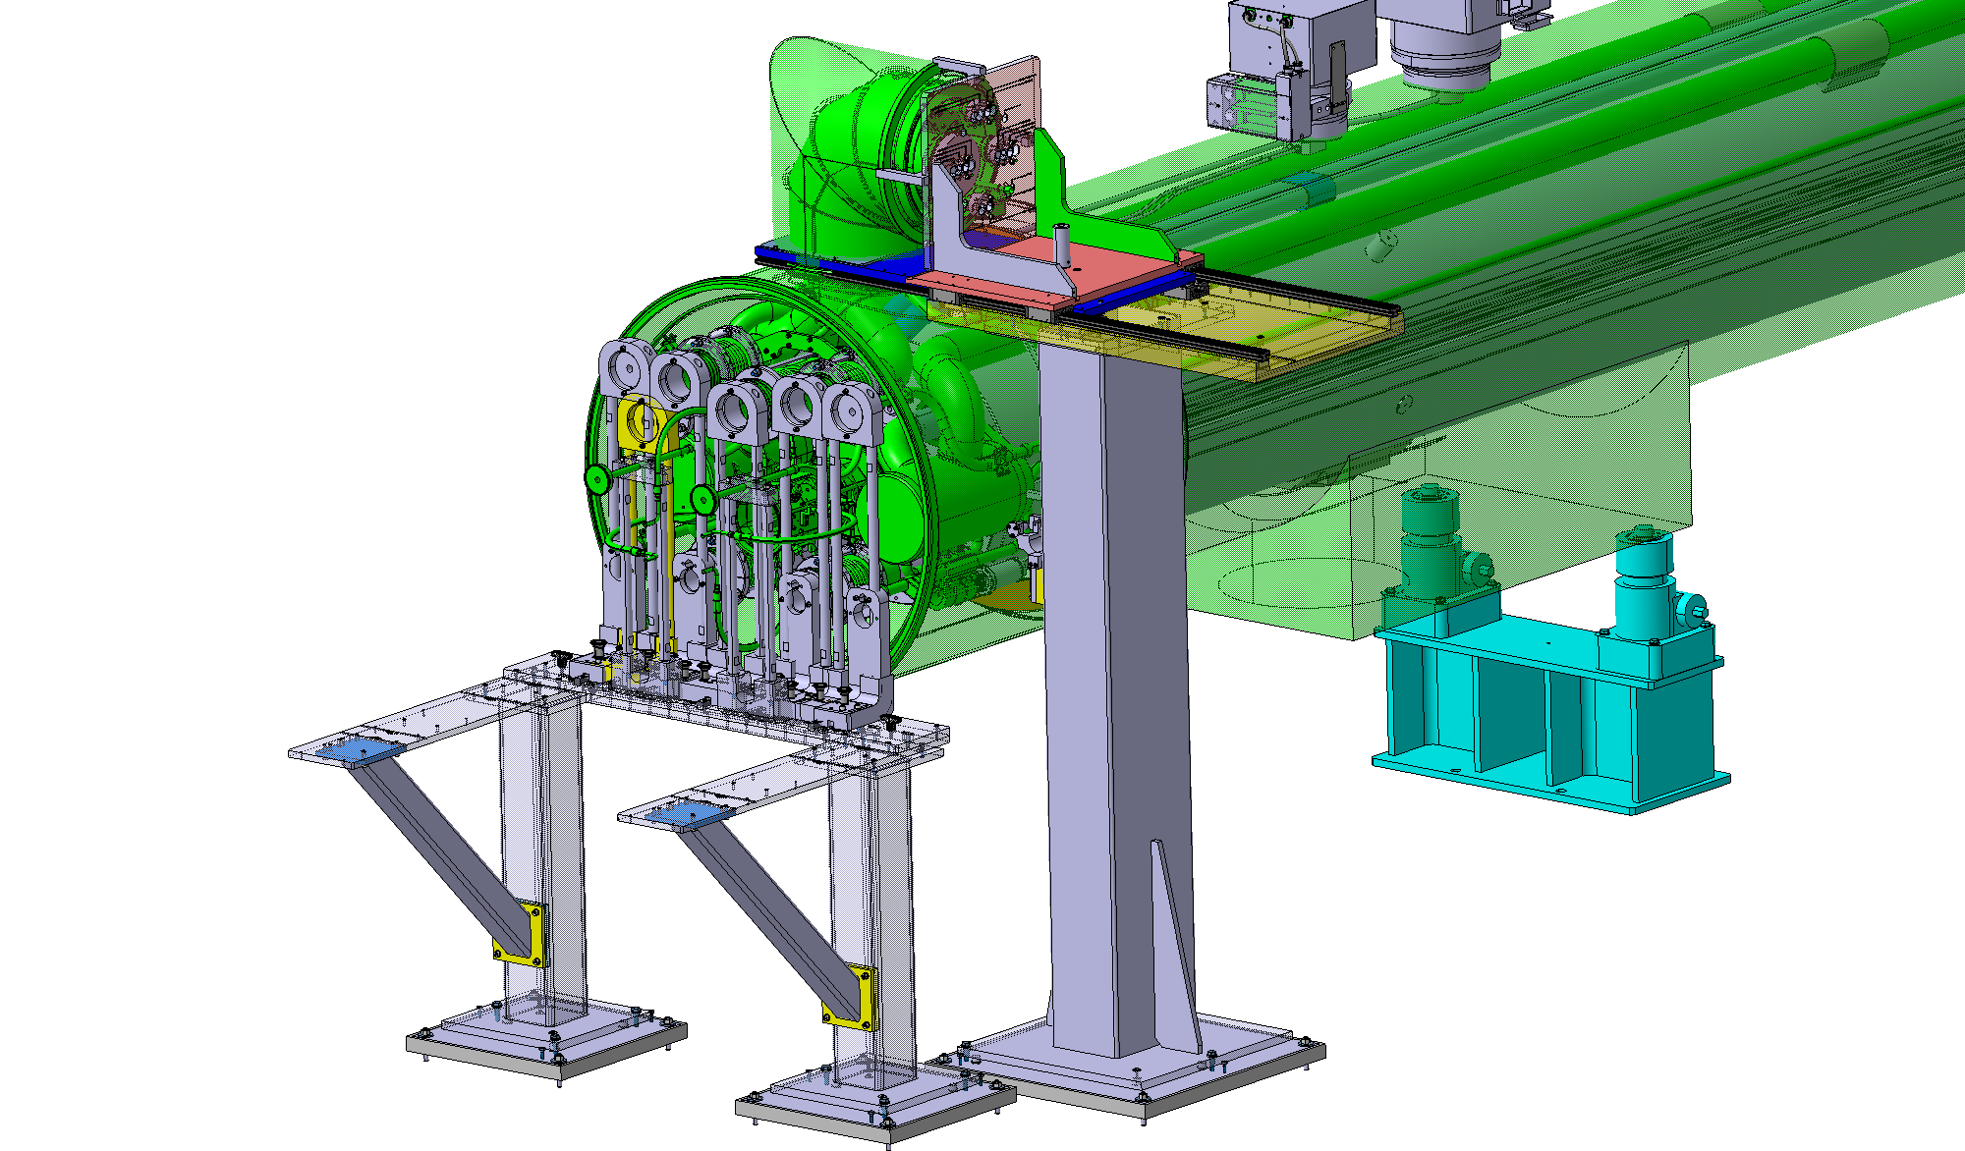
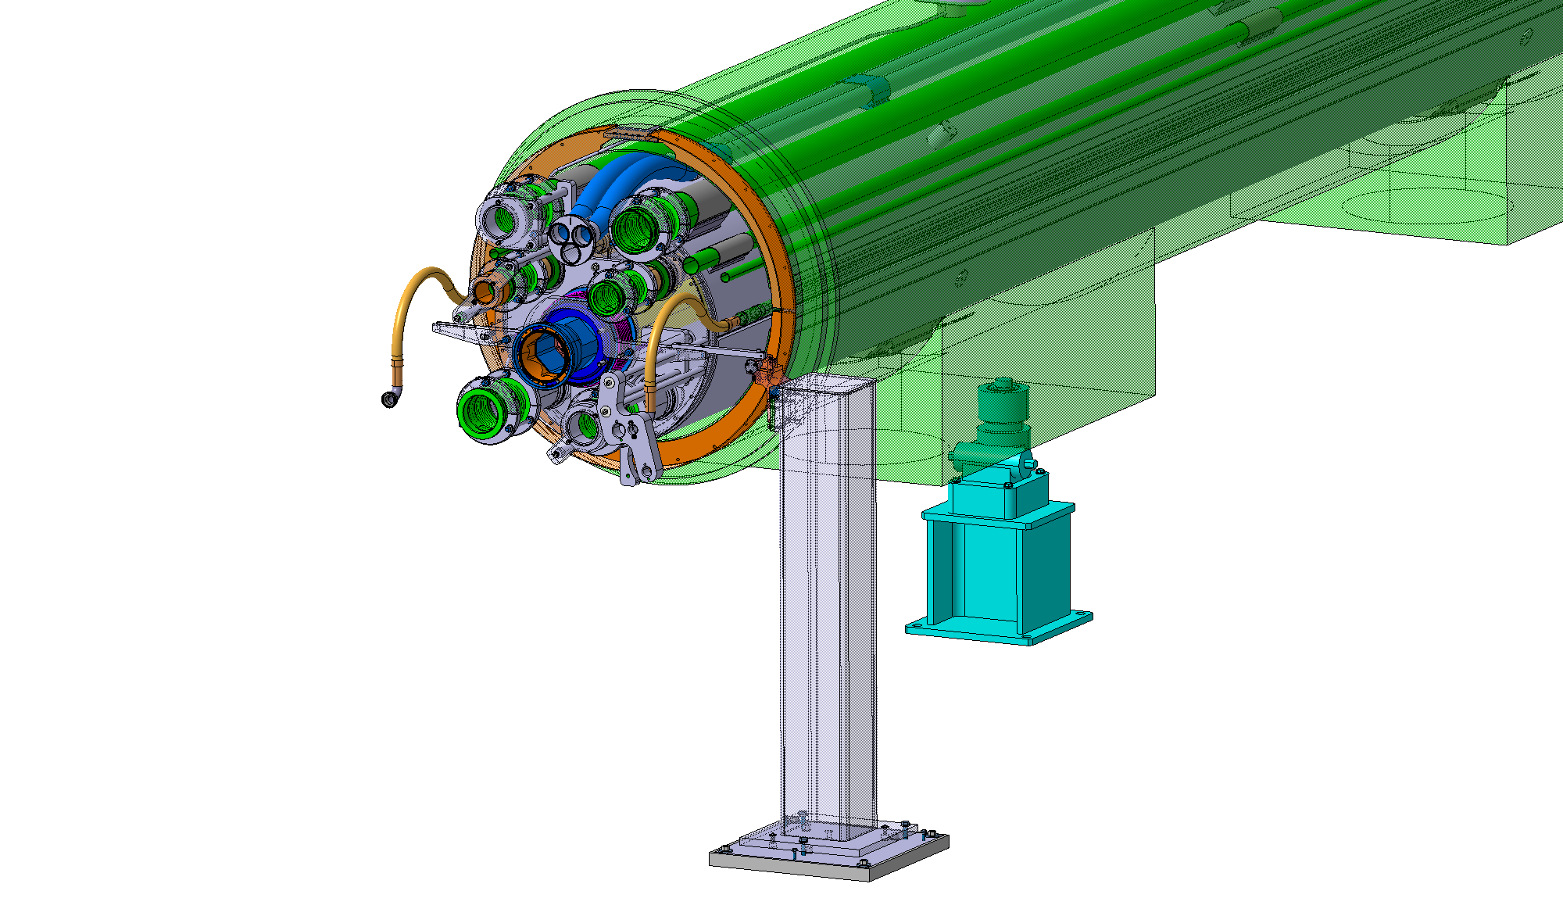
Service module assembly bench for
CP phase 2
Delay of ~3 weeks due to impossibility to align the CP on the assembly bench
ISR jacks being replaced by LHC jacks. Adaptation pieces under machining.
Preparation of pipe extremities has started but welding is pending on alignment to the tooling
Work on D1 advanced faster and Q2a started

Slide 13
Schedule
D1 phase 2, after cold test
  Installation of cryogenic service module and interconnects, including weld inspections: 12 work weeks
  Pressure test: 2 weeks
  Fiducialization and end cover installation: 1 week
  ~15 weeks total for delivery to the string
CP phase 2, before cold test
  Installation of cryogenic service module and interconnects, including weld inspections: 12 work weeks
  Installation of current lead modules and tests: 4 work weeks
  Pressure test: 2 weeks
  ~18 weeks total, i.e. expected ready for cold test in November
  After cold test, additional 2 weeks for “stripping” and fiducialization before delivery to the String

Slide 14
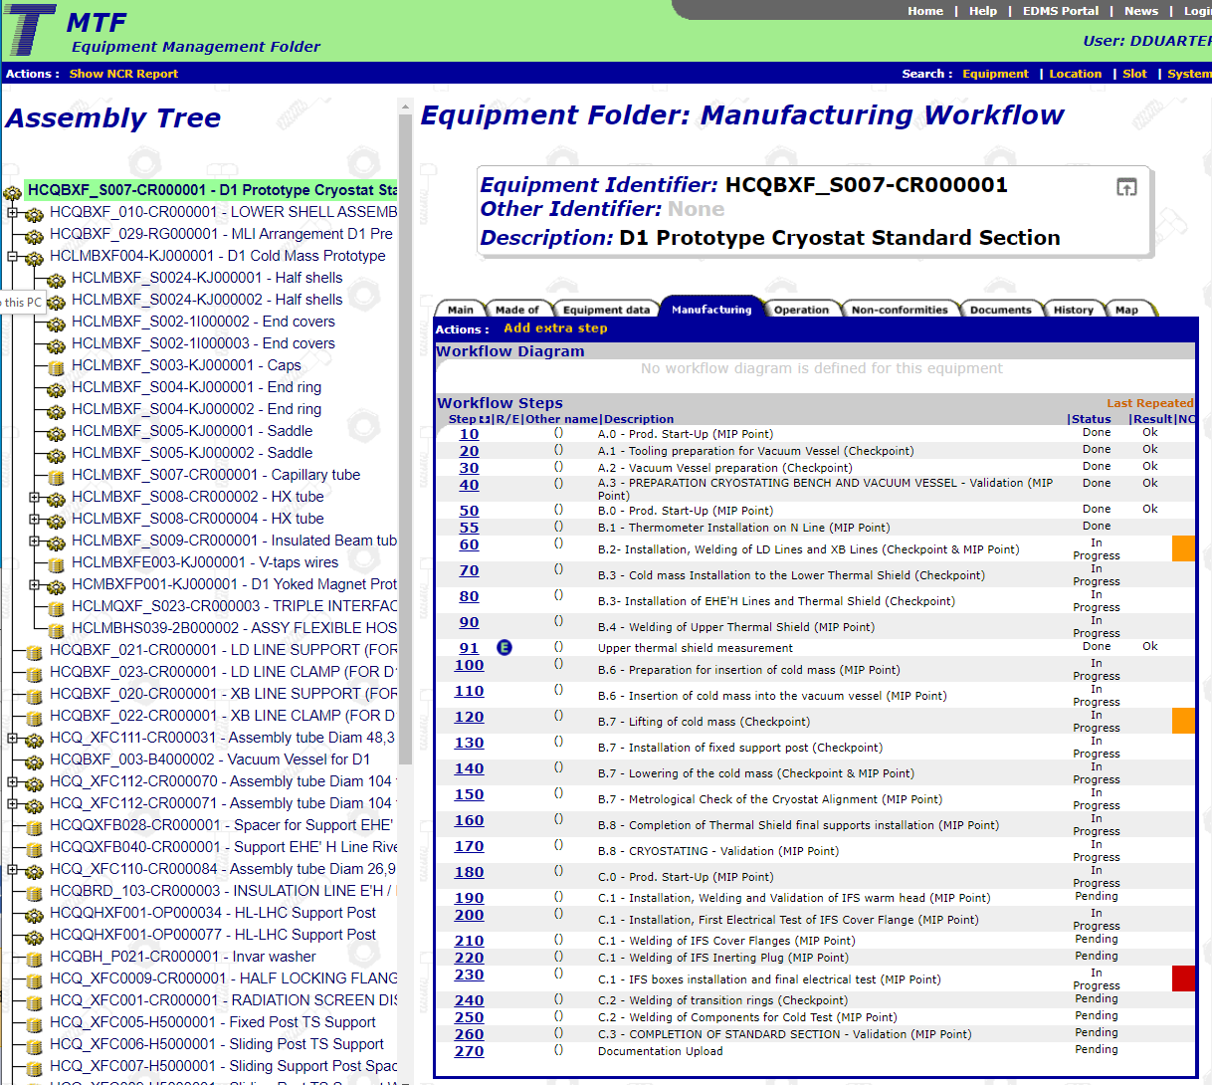
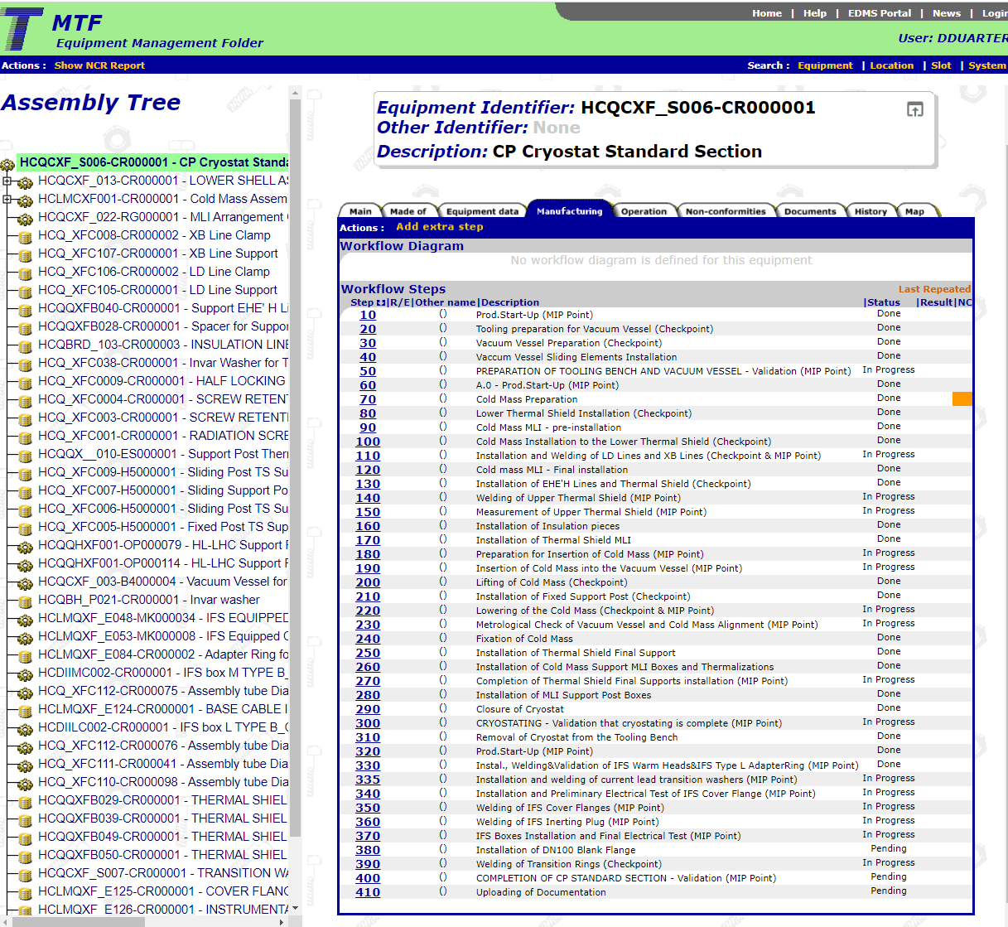
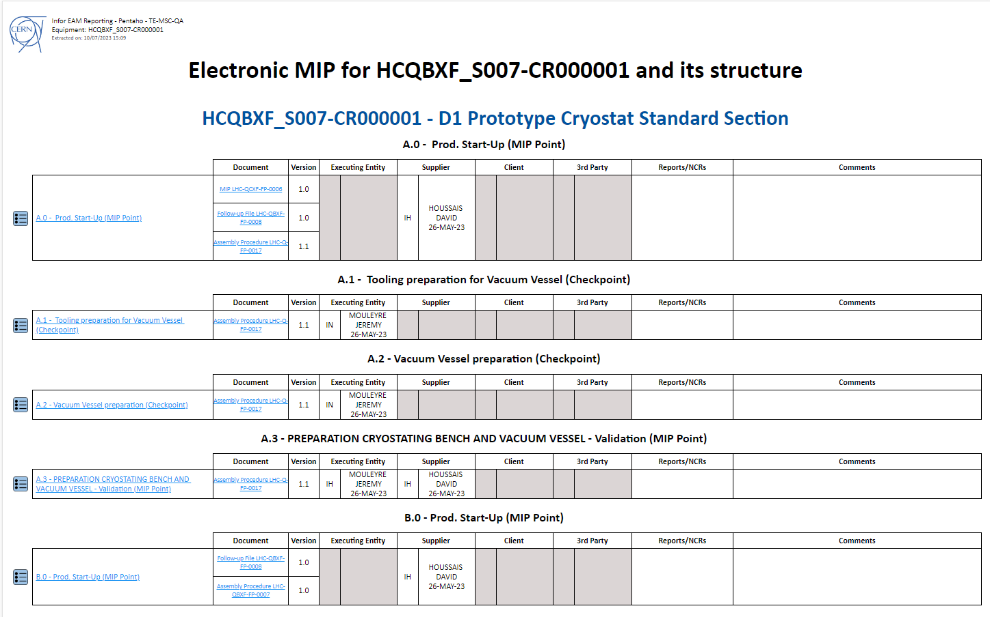
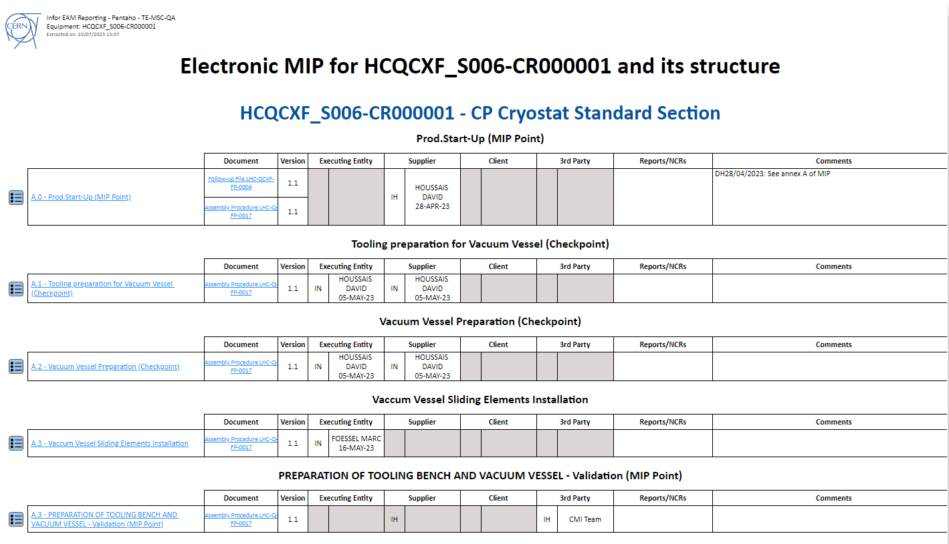
MTF
Detailed procedures for all cryostat types and assembly phases
Electronic manufacturing inspection plan (e-MIP)
All QA& QC documents attached to the asset number, accessible through MTF

Slide 15
Conclusion
D1
  Ready for connection to test bench
  Will return to SMI2 after cold test for phase 2 assembly
CP
  Very “smooth” assembly of phase 1.
  Only one non-conformity: a weld that will be cut-off after cold testing (NCR LHC-QCXF-QN-0002)
  First use of phase 2 assembly station. Alignment issue being solved
  Detailed assembly and welding procedures written

