Slide 1
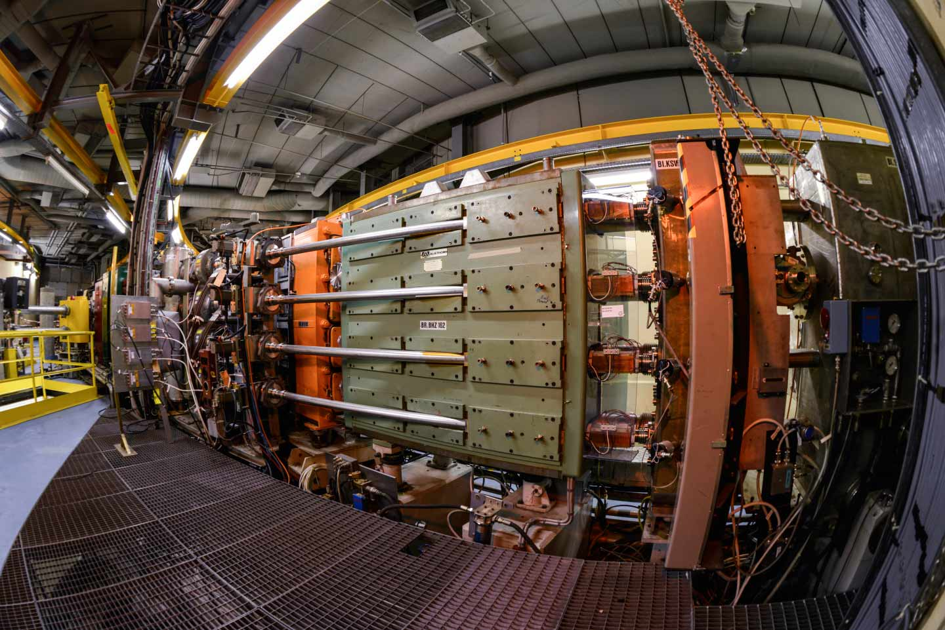




Optimization of the High-Brightness Beam Performance of the CERN PSB with $H^{−}$ Injection
Tirsi Prebibaj
In collaboration with:
F. Antoniou, F. Asvesta, H. Bartosik, G. Franchetti
BE Seminar
07/07/2023

Slide 2
Overview
Introduction
Part I: injecting beam from Linac4
Part II: maintaining beam properties in PSB
Part III: pushing the limits of PSB
Conclusions

Slide 3
Overview
Introduction
Part I: injecting beam from Linac4
Part II: maintaining beam properties in PSB
Part III: pushing the limits of PSB
Conclusions

Slide 4
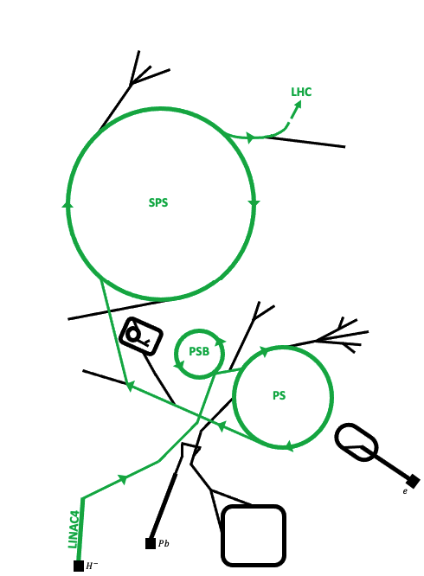
LHC Injectors Upgrade (LIU) project
LHC produces particle collisions for high-energy experiments.
LHC plans to increase collision rate.
Upgrade machine
Enhance incoming beams
HL-LHC project (2026-2028)
LIU project (2019-2021)
LHC requires brighter beams:
  More particles (i.e. higher beam intensity)
  Denser particles (i.e. smaller beam emittance)
(not in scale)
Injectors could not satisfy LHC requirements → major upgrades within LIU project.
BE Seminar 07/07/23
tirsi.prebibaj@cern.ch

Slide 5
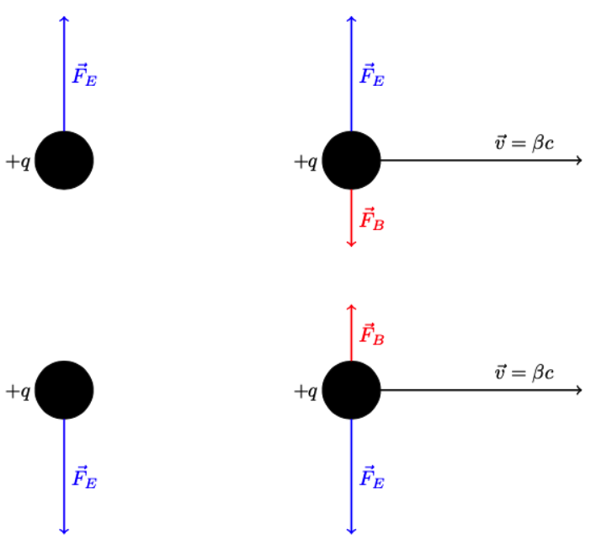
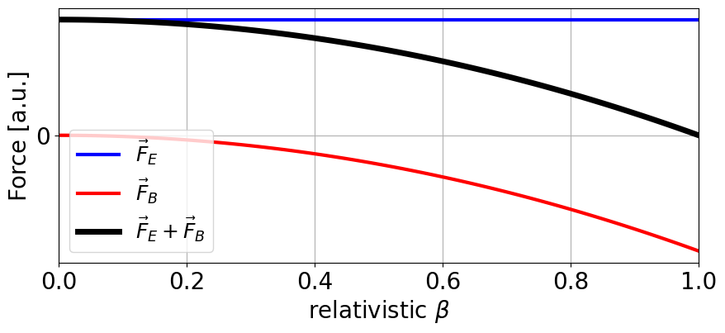
Injectors limitations
LIU upgrades essential: injectors operated in their brightness limit.
  Low energy accelerators (PSB, PS) mostly limited by space charge effects.
Space charge refers to the Coulomb interaction of charged particles.
  More particles/area → stronger space charge.
Space charge reduces at higher energies → energy upgrades for PSB & PS to double brightness for same space charge.
BE Seminar 07/07/23
tirsi.prebibaj@cern.ch

Slide 6
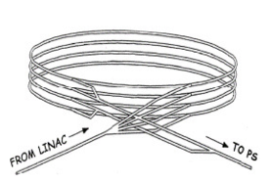

PSB upgrades
PSB: small, circular, $p^{+}$ accelerator with 4 identical rings.
PSB energy upgrade achieved by:
  Replacement of Linac2 ($50$ MeV) by Linac4 ($160$ MeV).
  Magnets power supply and extraction upgrade ($1.4$ GeV to $2$ GeV).
Linac4 accelerates $H^{−}$: new charge-exchange injection for PSB ($H^{−}→p^{+}$).
First time injection of Linac4 $H^{−}$ in entirely upgraded PSB:
New effects to study, new challenges to overcome: need of optimizations!
BE Seminar 07/07/23
tirsi.prebibaj@cern.ch

Slide 7
Overview
Introduction
Part I: injecting beam from Linac4
Part II: maintaining beam properties in PSB
Part III: pushing the limits of PSB
Conclusions
From PSB injection to extraction

Slide 8
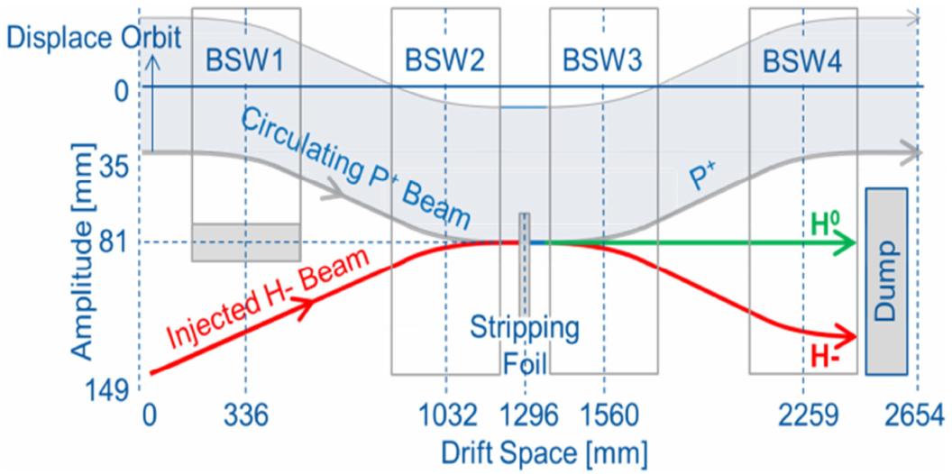

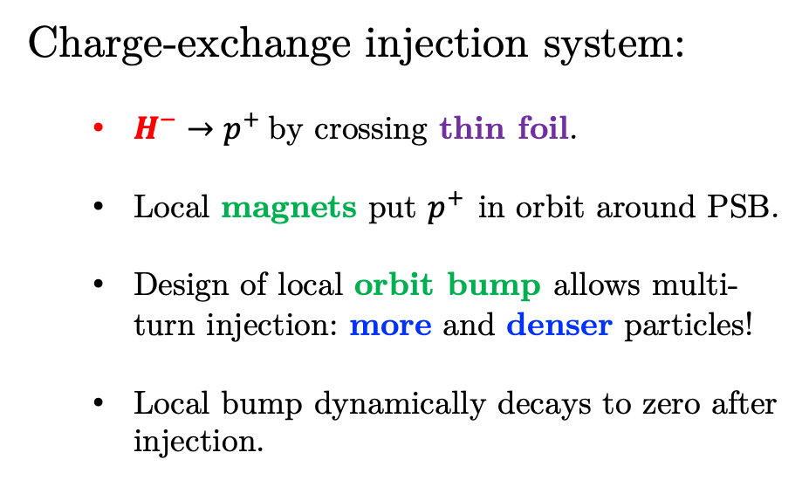
$H^{−}$ injection
Charge-exchange injection system:
  $H^{−}→p^{+}$by crossing thin foil.
  Local magnets put $p^{+}$ in orbit around PSB.
  Design of local orbit bump allows multi-turn injection: more and denser particles!
  Local bump dynamically decays to zero after injection.
First fundamental task: preserving beam properties (intensity and emittance) during $H^{−}$ injection.
BE Seminar 07/07/23
tirsi.prebibaj@cern.ch

Slide 9
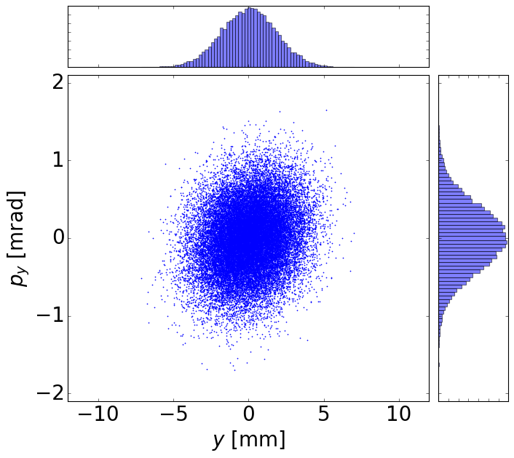



Preserving beam properties
Beam properties
Statistical properties of incoming ensemble of particles
$σ_{y}$ (beam size)
$N_{b}$ (intensity)
$ε_{y}$ (emittance)
BE Seminar 07/07/23
tirsi.prebibaj@cern.ch

Slide 10
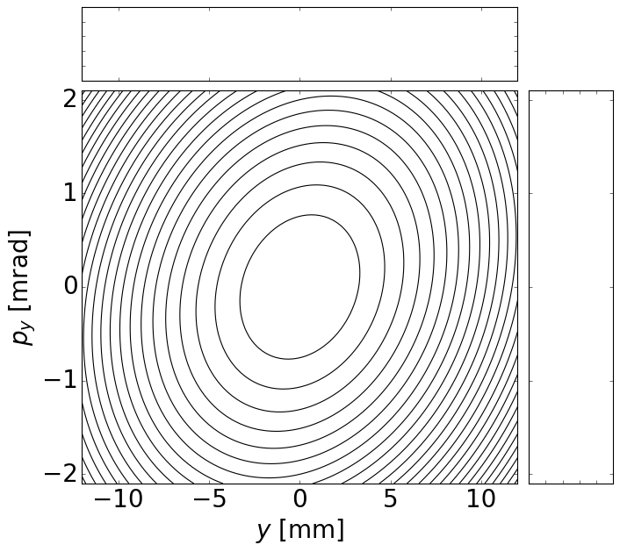
Preserving beam properties
Beam properties
Machine properties
Statistical properties of incoming ensemble of particles
Magnets configuration (known also as machine optics)
Shape and orienatation of phase space lines
BE Seminar 07/07/23
tirsi.prebibaj@cern.ch

Slide 11
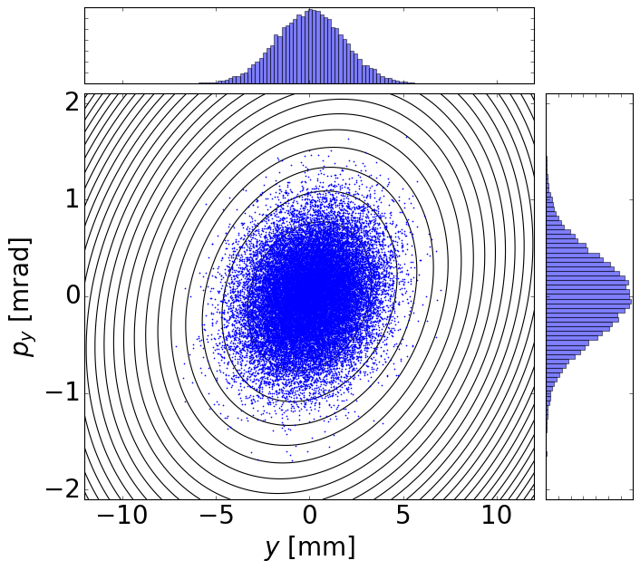
Preserving beam properties
Matched
Beam properties
Machine properties
Statistical properties of incoming ensemble of particles
Magnets configuration (known also as machine optics)
BE Seminar 07/07/23
tirsi.prebibaj@cern.ch

Slide 12
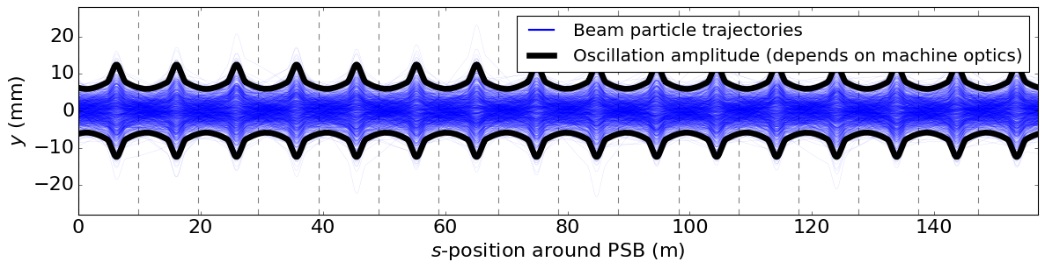
Preserving beam properties
Matched
Beam properties
Machine properties
Statistical properties of incoming ensemble of particles
Magnets configuration (known also as machine optics)
Particles perform transverse oscillations (betatron oscillations) as they circulate accelerator.
BE Seminar 07/07/23
tirsi.prebibaj@cern.ch

Slide 13
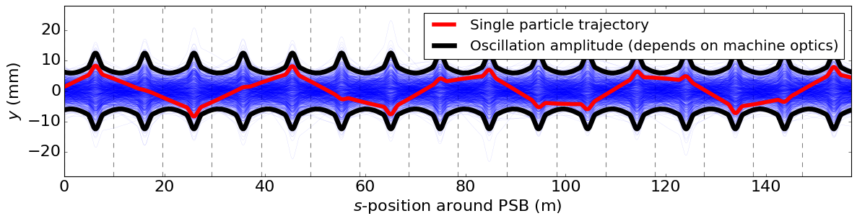
Betatron oscillations
During betatron oscillations, number (intensity) and density (emittance) of particles is preserved.
1
2
3
4
Betatron tune: number of oscillations per turn (here $Q_{y}=4.45$).
BE Seminar 07/07/23
tirsi.prebibaj@cern.ch

Slide 14
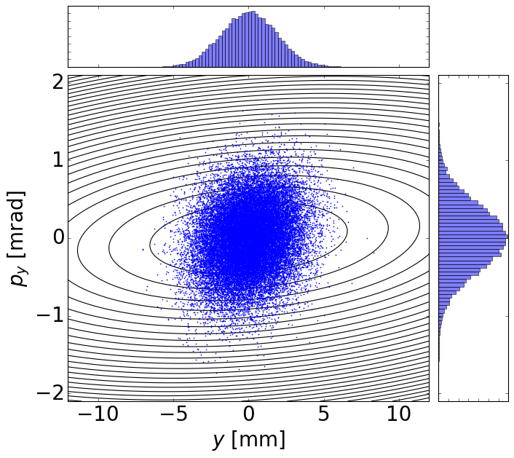
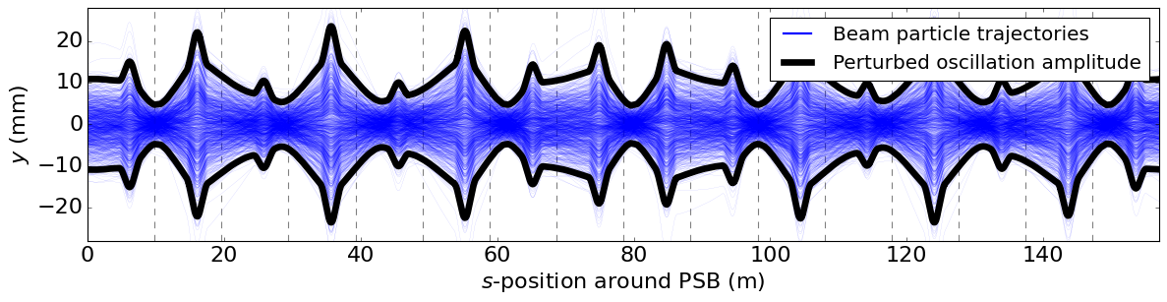
Injection perturbations
Injection bump induces fields errors → perturbs machine properties.
Mismatch
Larger oscillations
Perturbation increases oscillation amplitude→ emittance growth and losses.
During bump decay, perturbations dynamically change!
BE Seminar 07/07/23
tirsi.prebibaj@cern.ch

Slide 15
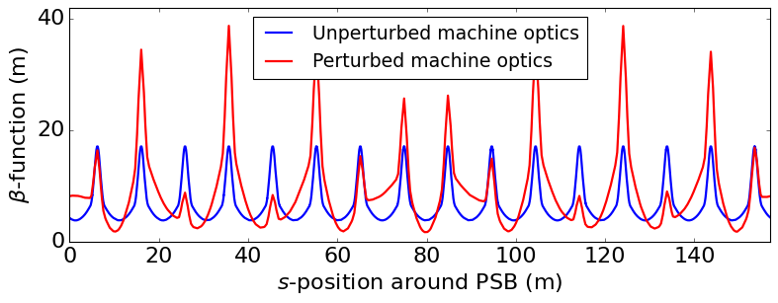
$β$-beating
Oscillation amplitude $∝\sqrt{β}$
$β$-function defined by machine optics
$β$-beating $=\frac{ δβ}{β}×100 (\%)$
BE Seminar 07/07/23
tirsi.prebibaj@cern.ch

Slide 16
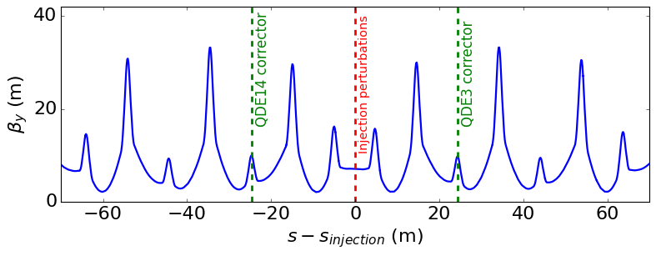
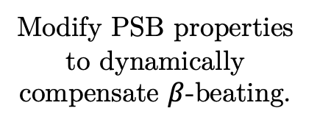
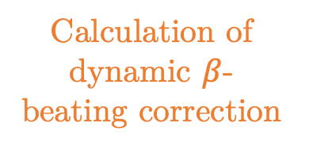
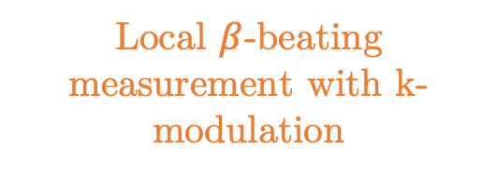
Method of measurement & correction
Devise method from theoretical understanding.
Identify local quadrupole corrector magnets
Modify PSB properties to dynamically compensate $β$-beating.
Calculation of dynamic $β$-beating correction
Interpolation to pre-defined response matrix
Local $β$-beating measurement with k-modulation
BE Seminar 07/07/23
tirsi.prebibaj@cern.ch

Slide 17
Method of measurement & correction
Devise method from theoretical understanding.
Modify PSB properties to dynamically compensate $β$-beating.
Simulation model to validate and test method.
Computationally reproduce realistic machine conditions.
Apply in accelerator and see experimental effects.
Operational implementation.
BE Seminar 07/07/23
tirsi.prebibaj@cern.ch

Slide 18
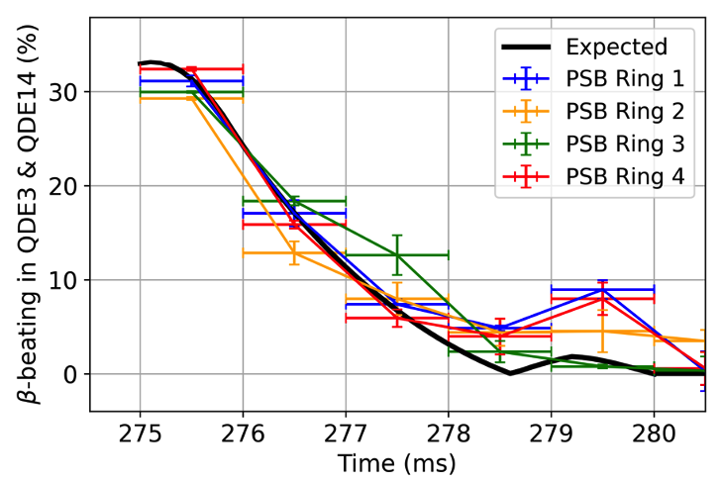
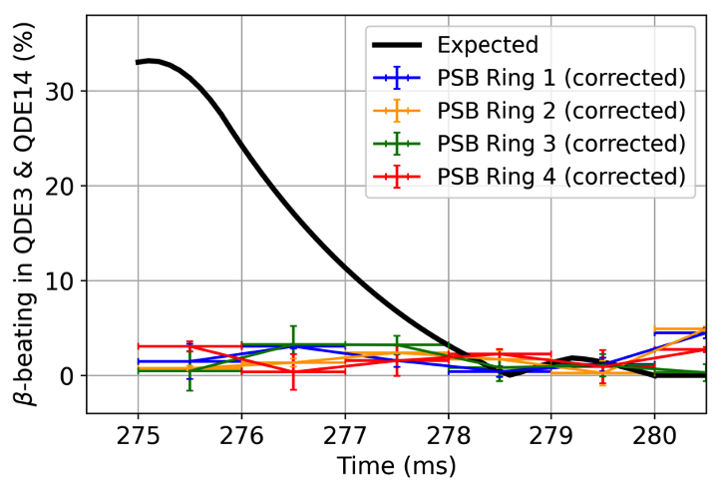
Experimental results
Before correction
After correction
Fast and dynamic $β$-beating correction from $>30\%$ to $<3\%$.
BE Seminar 07/07/23
tirsi.prebibaj@cern.ch

Slide 19
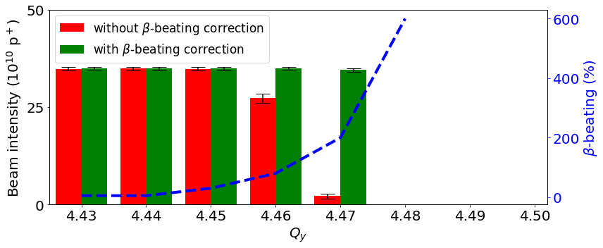
Experimental results
Strength of perturbation strongly depends on betatron tunes $Q_{x},Q_{y}$.
$β$-beating correction restores intensity and emittance at high tunes.
BE Seminar 07/07/23
tirsi.prebibaj@cern.ch

Slide 20
Overview
Introduction
Part I: injecting beam from Linac4
Part II: maintaining beam properties in PSB
Part III: pushing the limits of PSB
Conclusions

Slide 21
Beam evolution after injection
Field errors (like ones of injection) common in circular accelerators: perturb machine properties.
Injection effects take only $1\%$ of PSB time ($5/530$ milliseconds)!
In “longer” beam storage, space charge effects become important!
Second fundamental task: maintaining beam properties throughout full PSB cycle.
BE Seminar 07/07/23
tirsi.prebibaj@cern.ch

Slide 22
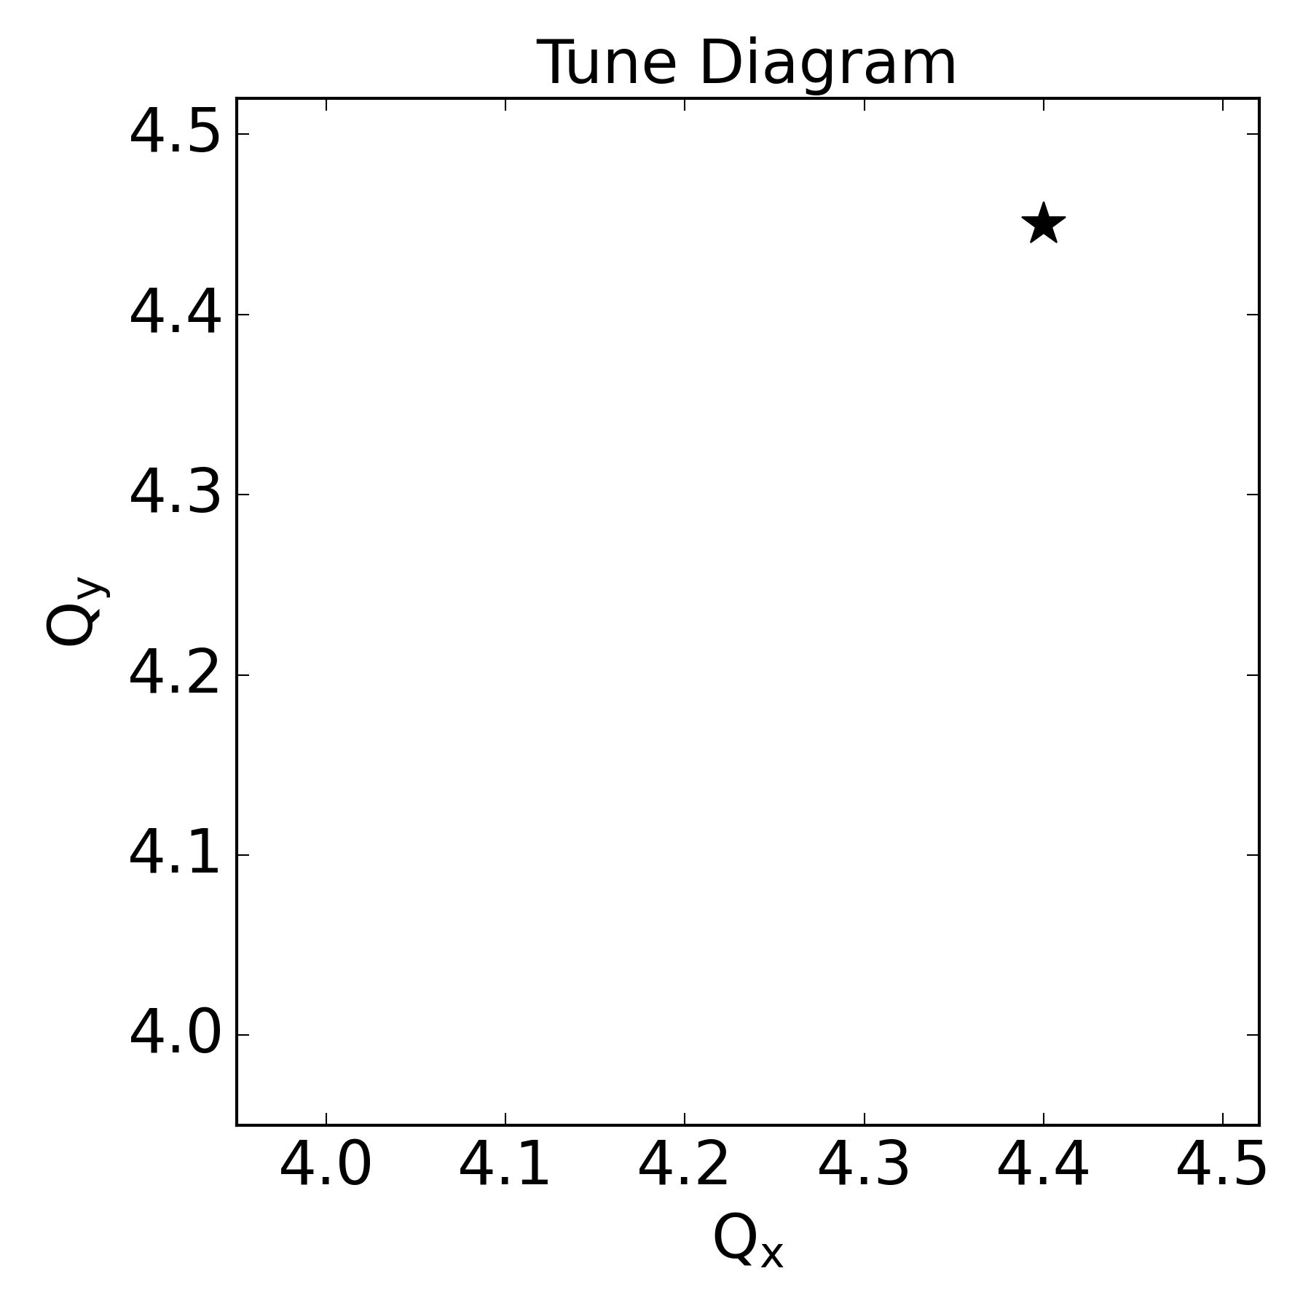
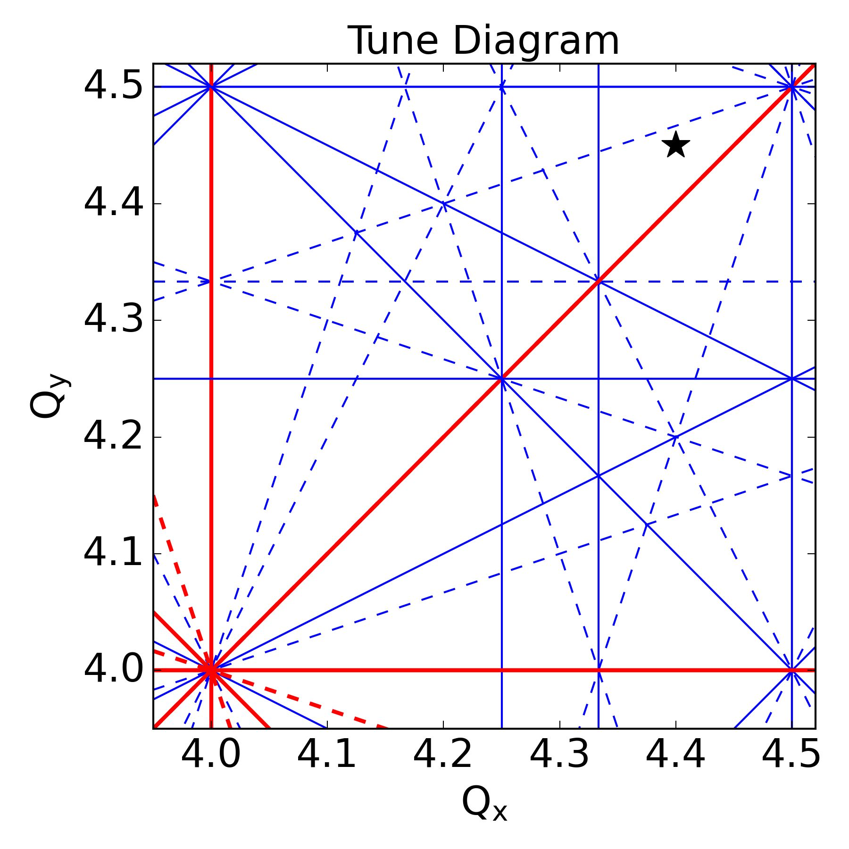
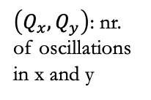
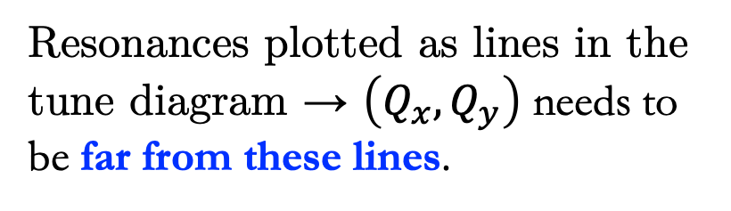
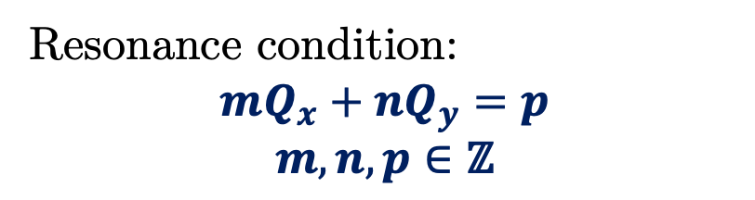
Resonances
Magnetic field errors seen periodically by the beam turn-by-turn.
  If betatron tune Q close to excited resonance→ resonant motion.
$\left(Q_{x},Q_{y}\right)$: nr. of oscillations in x and y
Resonance condition:
$$mQ_{x}+nQ_{y}=p$$
$$m,n,p∈\text{ℤ}$$
Resonances plotted as lines in the tune diagram → $\left(Q_{x},Q_{y}\right)$ needs to be far from these lines.
BE Seminar 07/07/23
tirsi.prebibaj@cern.ch

Slide 23
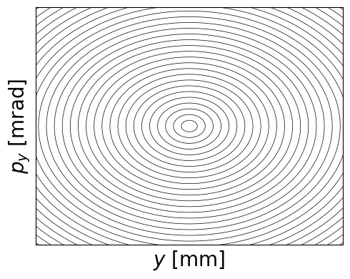
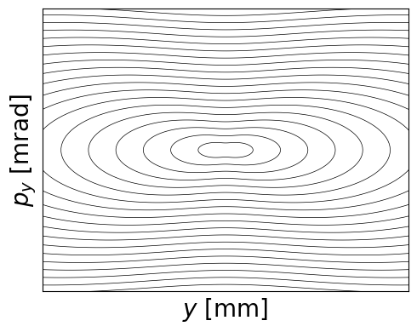
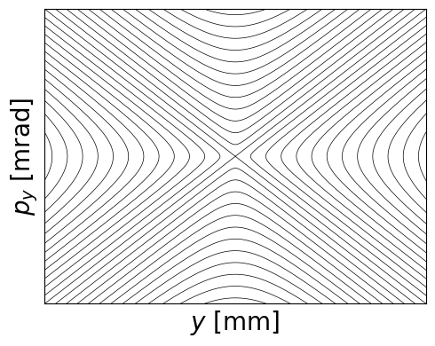
Resonances
Motion near resonance is perturbed and can become unstable.
Far from resonance:
stable
Near resonance:
perturbed
On resonance:
unstable
BE Seminar 07/07/23
tirsi.prebibaj@cern.ch

Slide 24
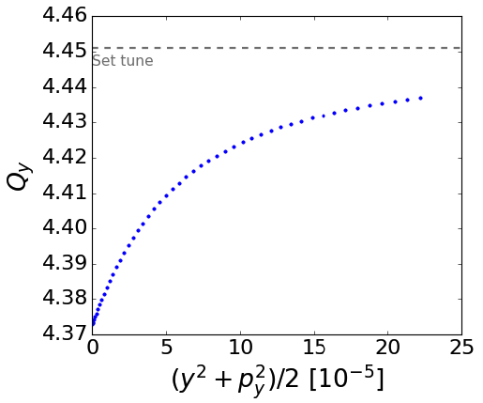
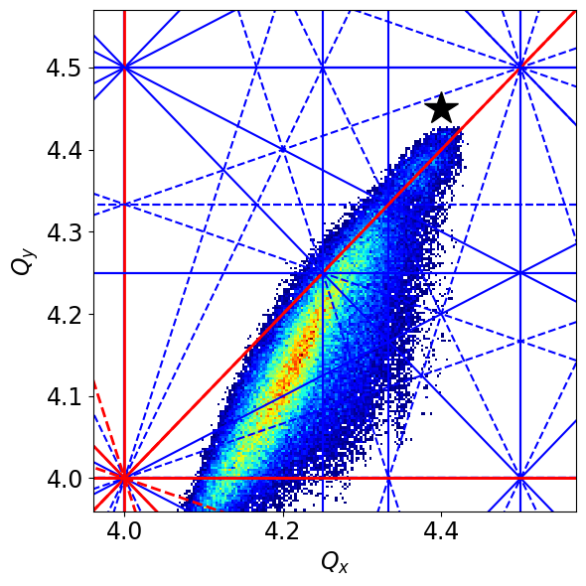
Space charge
Space charge induces non-linear force that defocuses particles depending on their transverse location from the center.
Defocusing induces an amplitude detuning.
Space charge drives particles to resonances:
beam degradation.
Amplitude detuning in 1D
Amplitude detuning in 2D
BE Seminar 07/07/23
tirsi.prebibaj@cern.ch

Slide 25
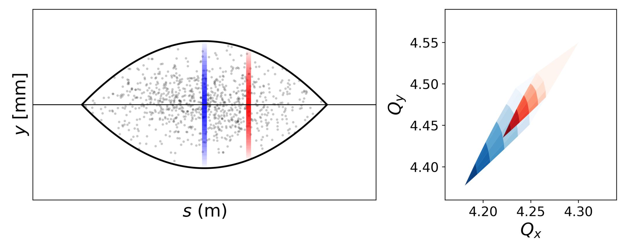
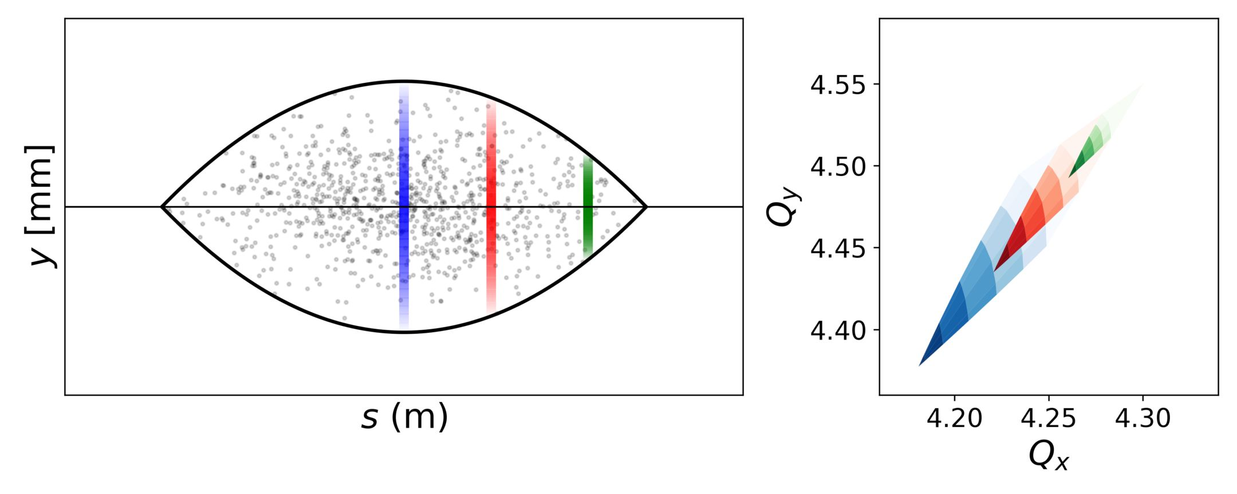
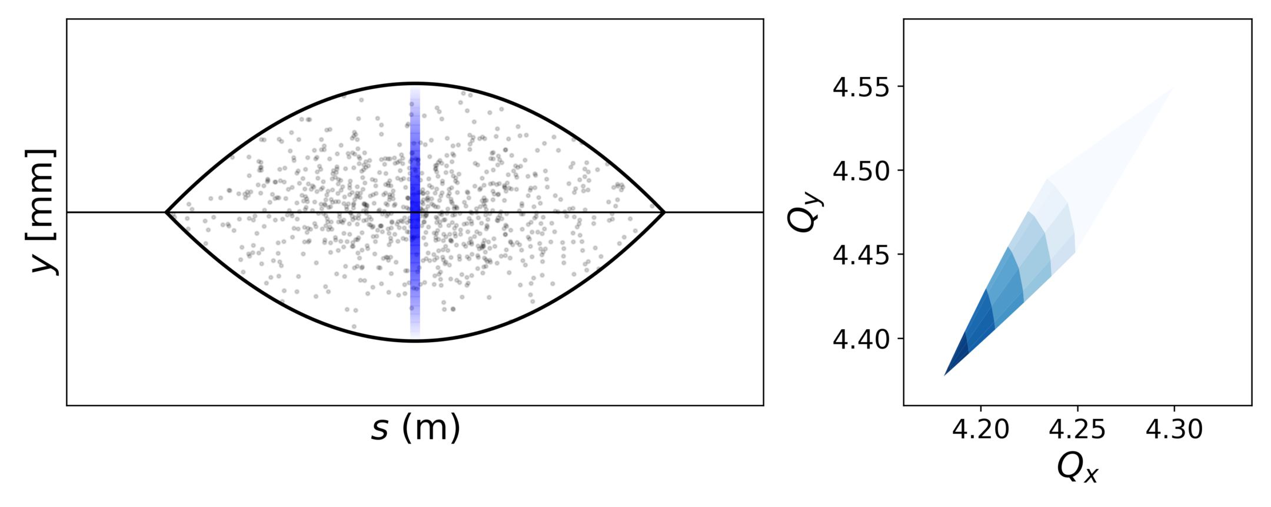
Beam degradation due to space charge
In bunched beams, the maximum tune spread depends on the local line density.
large line density: larger tune spread
smaller line density: smaller tune spread
near the tail of the bunch, the tune spread is very small
BE Seminar 07/07/23
tirsi.prebibaj@cern.ch

Slide 26
Beam degradation due to space charge
Particles oscillate also in longitudinal plane (synchrotron oscillations).
Local line density of a particle changes → tune modulation.
Tune modulation leads to periodic resonance crossing: particles drift outwards.
BE Seminar 07/07/23
tirsi.prebibaj@cern.ch

Slide 27
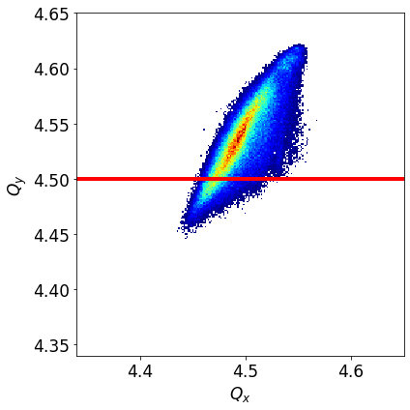
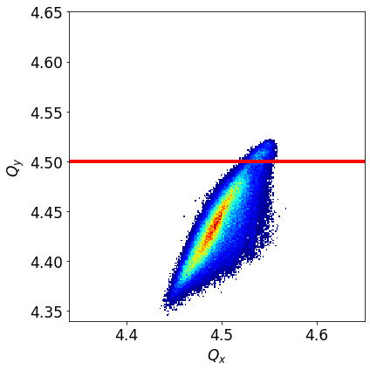
Beam degradation due to space charge
Low amplitude particles (beam core) interact with the resonance: emittance growth
High amplitude particles (beam tails) interact with the resonance: losses
BE Seminar 07/07/23
tirsi.prebibaj@cern.ch

Slide 28
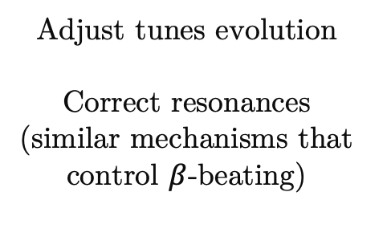
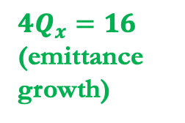
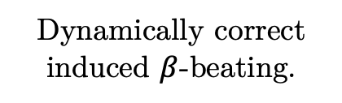

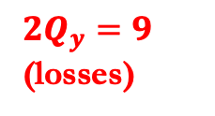
Optimizations along PSB cycle
Correct injection perturbations
$$4Q_{y}=16$$
$2Q_{y}=9$ (losses)
Dynamically correct induced $β$-beating.
Minimize beam degradation due to space charge
Adjust tunes evolution
Correct resonances (similar mechanisms that control $β$-beating)
$$4Q_{x}=16$$
(emittance growth)
BE Seminar 07/07/23
tirsi.prebibaj@cern.ch

Slide 29
Optimizations along PSB cycle
Correct injection perturbations
Dynamically correct induced $β$-beating.
Minimize beam degradation due to space charge
Adjust tunes evolution
Correct resonances (similar mechanisms that control $β$-beating)
Apply optimal settings to machine
Impact on brightness performance.
BE Seminar 07/07/23
tirsi.prebibaj@cern.ch

Slide 30
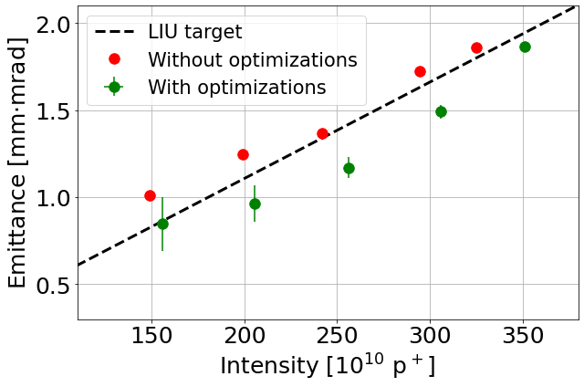
Experimental results
Brightness increase beyond LIU targets!
BE Seminar 07/07/23
tirsi.prebibaj@cern.ch

Slide 31
Overview
Introduction
Part I: injecting beam from Linac4
Part II: maintaining beam properties in PSB
Part III: pushing the limits of PSB
Conclusions

Slide 32

Pushing the limit of PSB
So far: PSB optimized for operation with maximum brightness performance.
Now: explore limits of PSB by injecting above half-integer resonance.
$$2Q_{y}=9$$
Needs understanding of half-integer resonance effects in combination with space charge.
Third fundamental task: study space charge effects near the half-integer resonance.
BE Seminar 07/07/23
tirsi.prebibaj@cern.ch

Slide 33

Half-integer resonance
Why half-integer resonance:
  Present in all circular accelerators
  Strong and difficult to control
  Bottleneck for most strong space charge machines (including PSB)
$$2Q_{y}=9$$
What was achieved in PSB:
  Excellent compensation
    using improved techniques
  Controlled excitation
    by deliberately degrading compensation
  Experimental measurement
    by characterizing unstable region
BE Seminar 07/07/23
tirsi.prebibaj@cern.ch

Slide 34
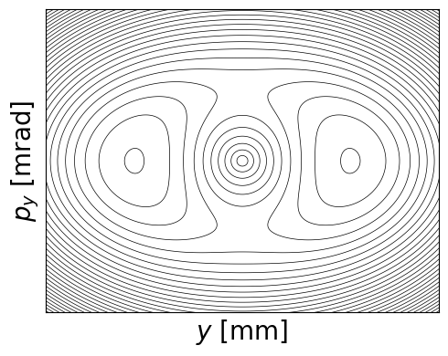
Non-linear phase space topologies
Non-linearities (like space charge) create more complicated phase space structures near resonances.
Linear phase space
Non-linear phase space
BE Seminar 07/07/23
tirsi.prebibaj@cern.ch

Slide 35
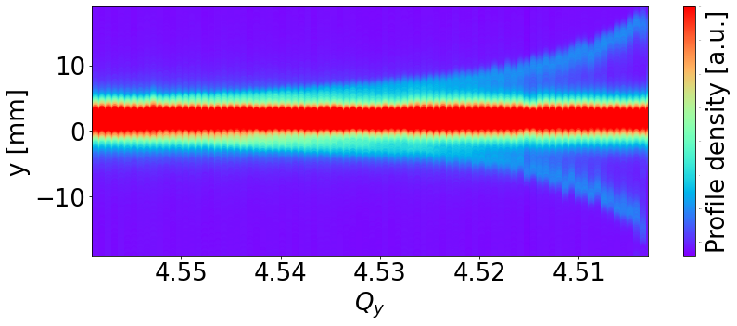
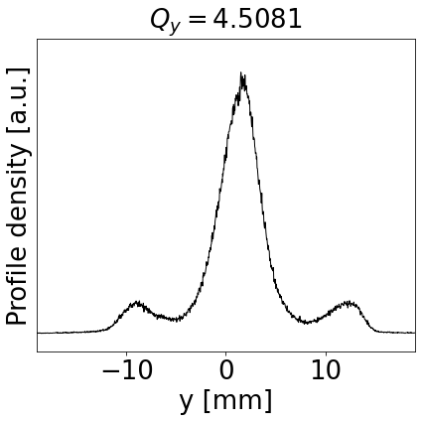
Experimental results
Adiabatic transition from linear to non-linear phase space.
Measurement of trapping in half-integer resonance due to space charge!
BE Seminar 07/07/23
tirsi.prebibaj@cern.ch

Slide 36
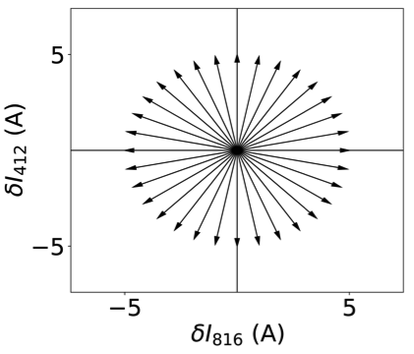
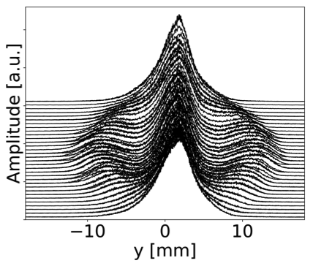
Experimental results
Controlling the phase space distribution by means of resonance excitation.
Rotation of resonance excitation
Beam profile measurement
Phase space rotation
Characterization of space charge effects near half-integer resonance.
BE Seminar 07/07/23
tirsi.prebibaj@cern.ch

Slide 37
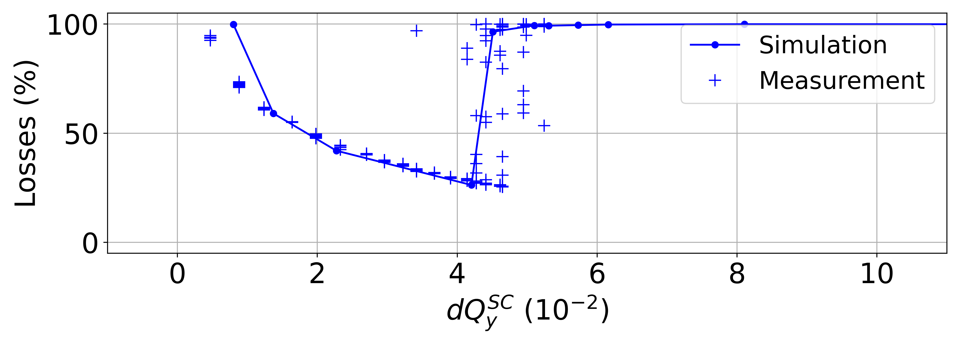
Benchmarking simulation models
Beam losses vs. space charge when crossing half-integer resonance.
Excellent agreement of measurements and tracking simulations.
BE Seminar 07/07/23
tirsi.prebibaj@cern.ch

Slide 38
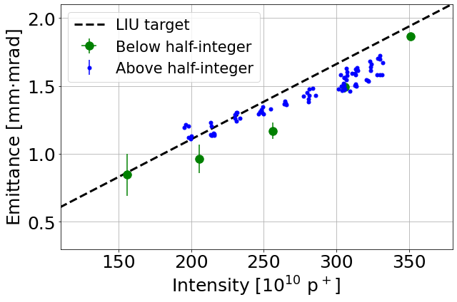
Beam brightness
The understanding & minimization of unwanted half-integer effects lead to the:
Feasibility of half-integer crossing with beyond LIU brightness!
BE Seminar 07/07/23
tirsi.prebibaj@cern.ch

Slide 39
Overview
Introduction
Part I: injecting beam from Linac4
Part II: maintaining beam properties in PSB
Part III: pushing the limits of PSB
Conclusions

Slide 40

Conclusions
PSB received upgrades within LIU to improve brightness performance.
Injection perturbations identified, measured and corrected and beam parameters optimized in PSB:
Contributed to beam brightness increase beyond LIU targets.
Space charge effects near half-integer resonance characterized experimentally for the first time:
Improved understanding and modelling of beam dynamics.
Optimized high-brightness beam performance and explored accelerator’s capabilities.
BE Seminar 07/07/23
tirsi.prebibaj@cern.ch

Slide 41
Thank you for your attention!
This work has been accomplished with the valuable contributions and assistance of:
S. Albright, F. Antoniou, F. Asvesta, H. Bartosik, C. Bracco, A. Calia, G. Franchetti,
G.P. Di Giovanni, D. Gamba, S. Kostoglou, T. Levens, K. Li, E. H. Maclean,
K. Paraschou, E. Renner, F. Roncarolo, G. Rumolo, P. Skowronski, G. Sterbini, PSB OP team

Slide 42
Supporting Material

Slide 43
References
[1]: T. Prebibaj et al., Injection Chicane Beta-Beating Correction for Enhancing the Brightness of the CERN PSB Beams, HB2021 (MOP18).
[2]: T. Prebibaj et al., “Beta-beat correction in the PSB during injection bump decay”, Presentation at ABP Injectors Working Group Meeting, CERN, Apr. 2020 [Online].
[3]: T. Prebibaj et al., “Status of the k-modulation application”, Presentation at Injectors Performance Panel Meeting, CERN, Geneva, Switzerland, Nov. 2020 [Online].
[4]: K-Modulation Application, Accelerating Python Q4 2020 Meeting (link).
[5]: T.Prebibaj et.al., Studies on the Vertical Half-Integer Resonance in the CERN PS Booster, IPAC22, June 2022 (MOPOST058).
[6]: PSB Half-Integer experiment, Space Charge WG Meeting 16/12/2021 (link)
[7]: Effects of Space Charge close to the Half-Integer Resonance in the PSB, INC Section Meeting 01/02/2022 (link).
[8]: Latest Space Charge Meeting
[9]: G. Franchetti and I. Hofmann, “Particle Trapping by Nonlinear Resonances and Space Charge”, in Nucl. Instr. and Meth. A 561, 2006, pp. 195-202.
[10]: T. Prebibaj et.al., Characterization of the Vertical Beam Tails in the CERN PS Booster, IPAC22, June 2022 (MOPOST057)
[11]: PSB profile observations: evolution along the cycle, Space Charge WG Meeting 22/04/2021 (link).
[12]: Wire scanner impact on the beam profile for the PSB, Space Charge WG Meeting 20/10/2021 (link).
PhD defense 2023
tirsi.prebibaj@cern.ch

Slide 44

Tomography in the transverse plane

Slide 45


Longitudinal motion
Realistic beams are not exactly monoenergetic: they have energy (momentum) spread $ΔE \left(Δp\right)$.
Coasting
Bunched
Different sets of longitudinal variables are used:
  $\left(z,ΔE\right), \left(φ, ΔE\right), \left(φ,Δp\right), …$
Beams can be bunched or unbunched (coasting).
Bunched beams perform synchrotron oscillations in the longitudinal phase space (energy-phase oscillations).
Transverse motion can be coupled to the longitudinal motion:
    Dispersion: orbit change with energy spread.
    Chromaticity: tune change with energy spread.
PhD defense 2023
tirsi.prebibaj@cern.ch

Slide 46




Toy-model of 1-D resonance crossing
1-turn map + space charge kicks (amplitude detuning) + quadrupolar error (half-integer excitation).
1-turn map
1-turn map + space charge kicks (amplitude detuning)
Appearance of stable resonance islands.
The size of the islands depends on the excitation amplitude and the detuning gradient [9].
PhD defense 2023
tirsi.prebibaj@cern.ch

Slide 47

Toy-model of 1-D resonance crossing
1-turn map + space charge kicks (amplitude detuning) + quadrupolar error (half-integer excitation).
1-turn map
1-turn map + space charge kicks (amplitude detuning)
Appearance of stable resonance islands.
The size of the islands depends on the excitation amplitude and the detuning gradient [9].
During the dynamic crossing of the resonance, the islands move towards larger amplitudes.
PhD defense 2023
tirsi.prebibaj@cern.ch

Slide 48

Stronger space charge
When the space charge is very strong and/or the crossing is very slow, the beam seems to get unstable both in measurements and simulations (beam is fully lost)!
The exact reasons for this are not yet fully understood, both for measurements and simulations.
Currently running simulations with other codes (Xsuite, Micromap, …).
PyOrbit simulation
PhD defense 2023
tirsi.prebibaj@cern.ch

Slide 49






Increasing complexity
Chromaticity induces adittional detuning.
Space charge
Chromaticity
Space charge + chroma
Appearance of multiple islands for different momentum offsets.
adiabatic region
non-adiabatic region
Beam effects change when crossing the resonance with different speeds.
PhD defense 2023
tirsi.prebibaj@cern.ch

Slide 50




Increasing complexity even more: operational conditions
Beam is accelerated: space charge constantly changes. Higher order resonances are also crossed.
Half-integer is compensated but not perfectly (~3% losses).
Beam is bunched and goes from double harmonic to single harmonic.
Chromaticity cannot be corrected in both planes simultaneously.
PhD defense 2023
tirsi.prebibaj@cern.ch

Slide 51





Modelling beam tails
Generalized Gaussian function [5]:
$$f_{qG}\left(x;q,β\right)=\frac{\sqrt{β}}{C_{q}}e_{q}\left(−βx^{2}\right)$$
Used in the past to model non-Gaussian profiles in the LHC [6].
PhD defense 2023
tirsi.prebibaj@cern.ch

Slide 52


Profile measurement when beam is unstable
WS measurement
Simulating the WS in PyOrbit
PhD defense 2023
tirsi.prebibaj@cern.ch

Slide 53

Effects of chromaticity
With non-zero chromaticity:
  More losses (the beam loss region increases).
  Beam not unstable for very strong space charge.
PhD defense 2023
tirsi.prebibaj@cern.ch

Slide 54





Modeling the Wire Scanner scattering
Apply the scattering kicks to the particles of the initial distribution that are within the wire width slice:
Final distribution: larger beam size because of the scattering.
apply wire kick $\left(\left\langle Θ_{RMS}\right\rangle \right)$
wire width ($d_{w}$)
Repeat
Track particles for one turn.
Note that: simulation model independent of the beam intensity.
Displace the wire according to $\vec{R}$.
PhD defense 2023

Slide 55

Modeling the Wire Scanner scattering
WS signal is proportional to the number of scattered particles → measured distribution (green) is between the initial and the final distribution
Scan from “negative” to “positive” (left to right)
In the first few turns of the scan, the WS signal coincides with the initial distribution.
As the scan progresses, the particles are being scattered: towards the last turns of the scan, the WS signal coincides with the final distribution → asymmetric measured profile (WS Signal)
PhD defense 2023
tirsi.prebibaj@cern.ch

Slide 56




Shape of the particle distributions
Experimental study on interplay between space charge and resonances on shape of particle distributions.
Modelling beam profiles’ shape with q-Gaussian function
$q=1.6$ Overpopulated tails
Undesirable!
$q=1$ Gaussian shape
Desirable!
Static tune scan
PhD defense 2023
tirsi.prebibaj@cern.ch

Slide 57

Operational implementation
Applicability of the method with respect to the:
  available instrumentation of the PSB
  hardware and software infrastructure
  technical limitations
PhD defense 2023
tirsi.prebibaj@cern.ch

Slide 58



Half-integer resonance compensation and excitation
Resonance compensation:
  Experimentally, using orthogonal quadrupole correctors.
  Traditional techniques rely on crossing the resonance and monitoring the beam losses.
  Improved techniques were found that rely on the deformation of the shape of particle distribution (more sensitive!).
Resonance controlled excitation:
  In terms of deliberately degrading the compensation scheme.
Resonance width measurement:
  Finding methods to experimentally measure how large is the unstable region of the resonance.
PhD defense 2023
tirsi.prebibaj@cern.ch

Slide 59


Universal scalling diagrams
Systematic scans on the half-integer dynamic crossing:
  Transmission: fraction of particles that survive the crossing
  $δQ_{y}^{SC}$: maximum space charge tune spread
  $δQ/turn$: vertical tune change over one turn (“crossing speed”).
PhD defense 2023
tirsi.prebibaj@cern.ch

