Slide 1
Reinforcement learning for automatic data quality monitoring in HEP experiments
6th Inter-experiment Machine Learning Workshop
?
?
Olivia Jullian Parra (CERN, Geneva)
Lorenzo Del Pianta (CERN, Geneva)
Julián García Pardiñas (CERN, Geneva)
Maximilian Janisch, (University of Zurich, Zurich)
Suzanne Klaver, (Nikhef, Amsterdam)
Thomas Lehéricy,(University of Zurich, Zurich)
Nicola Serra (University of Zurich/CERN, Geneva)

Slide 2
Index
1
Data quality monitoring
2
RLHF for data quality monitoring
3
Offline regime
4
Online regime
4
5
First simulations on toy dataset
6
Conclusions and future steps
5
5

Slide 3
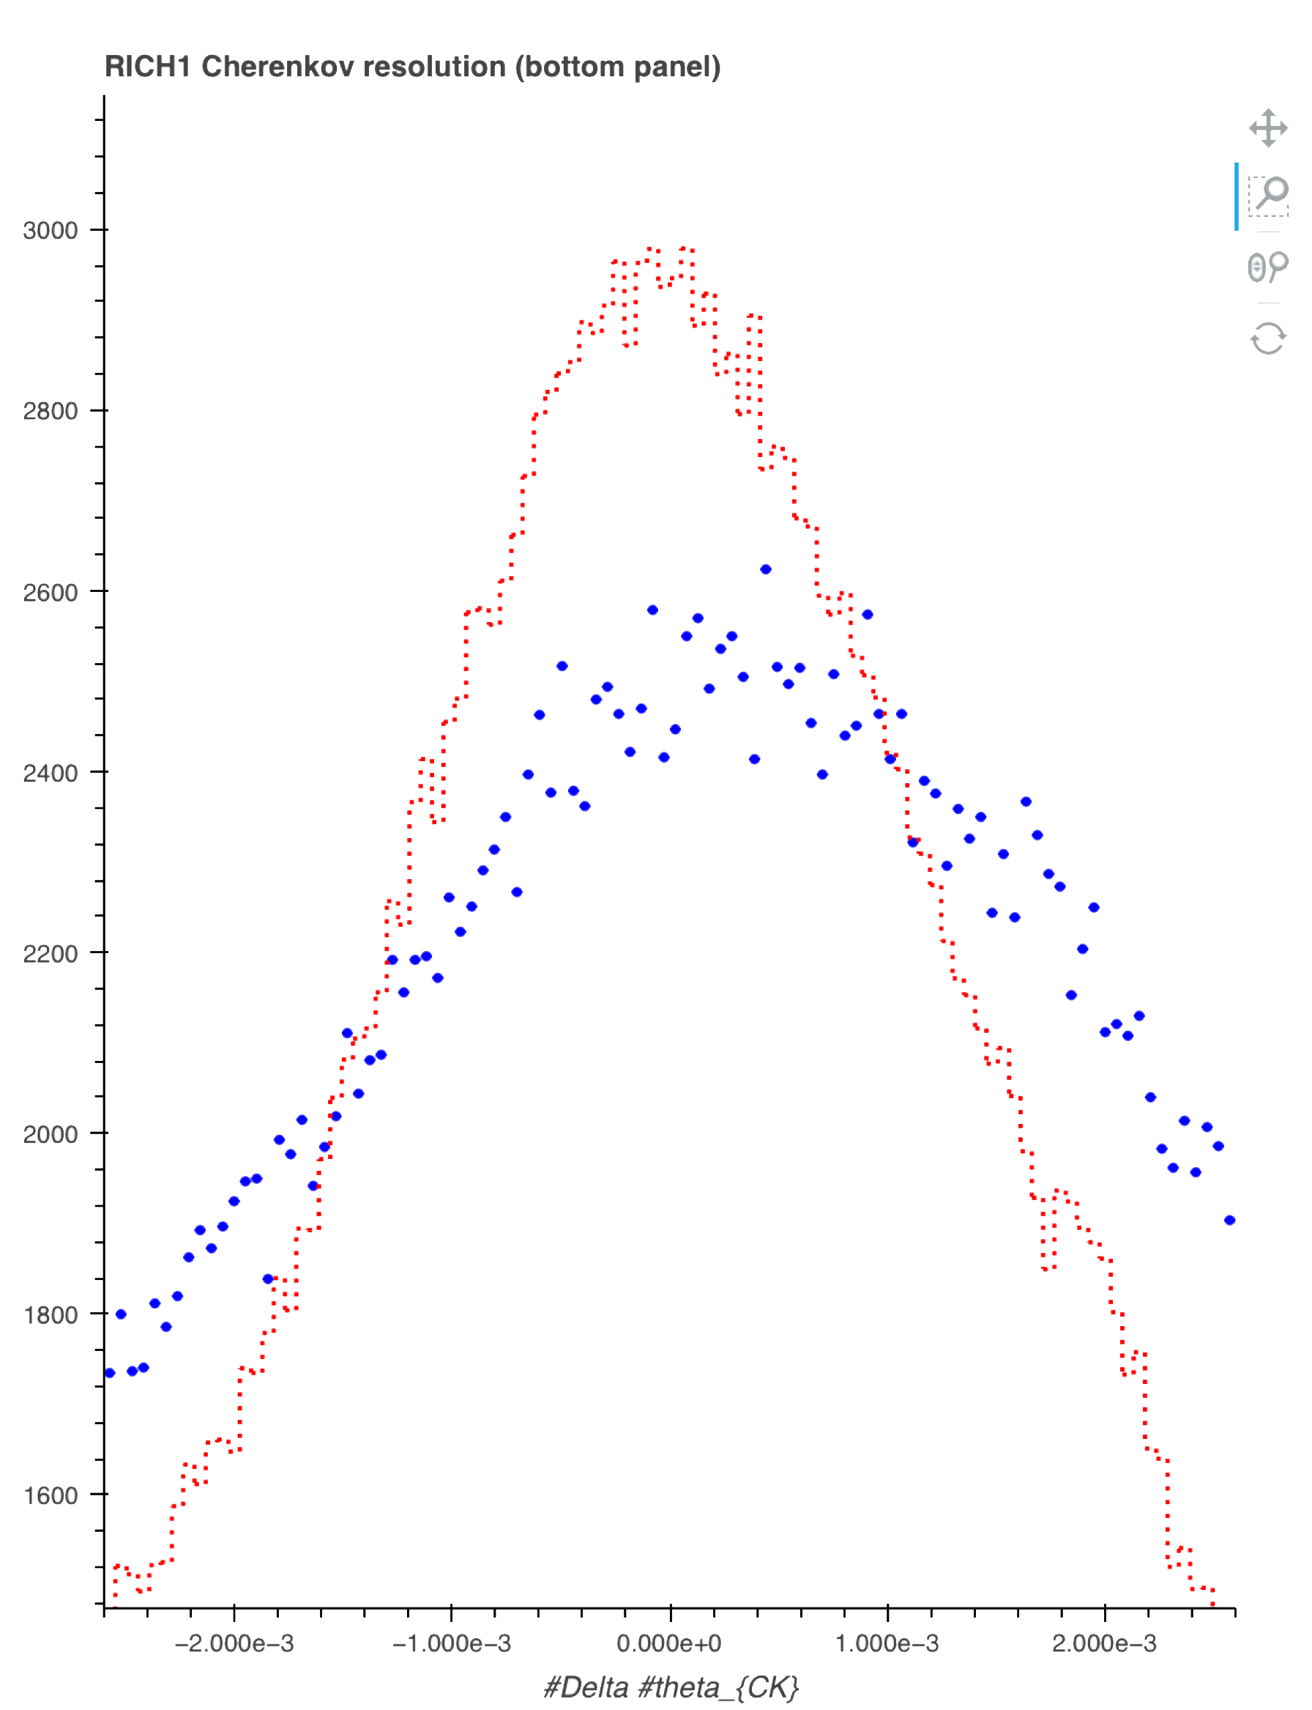
Data quality monitoring

Slide 4
Data quality monitoring
Reduce data bias and improve efficiency
The systems (subdetectors, triggers, etc.) are imperfect and may bias the collected data.
Detect and correct system errors
Goal
Measurements are biased when datasets are incorrectly classified as good.
Validate the data for physics analysis
Data collection efficiency reduces when datasets are incorrectly classified as bad.

Slide 5
Limitations
The work is done by a large pool of non-expert volunteering shifters.
New anomalies appear over time
New unseen detector problems could appear in the system over time forcing the monitoring to be able to adapt to new conditions
- Need for appropriate training.
- A lot of resources required (online and offline regimes).
- Human errors lead to inaccuracies in the classification.
Nominal status changes over time
Even the nominal reference can change. This is the case in a detector’s upgrade

Slide 6
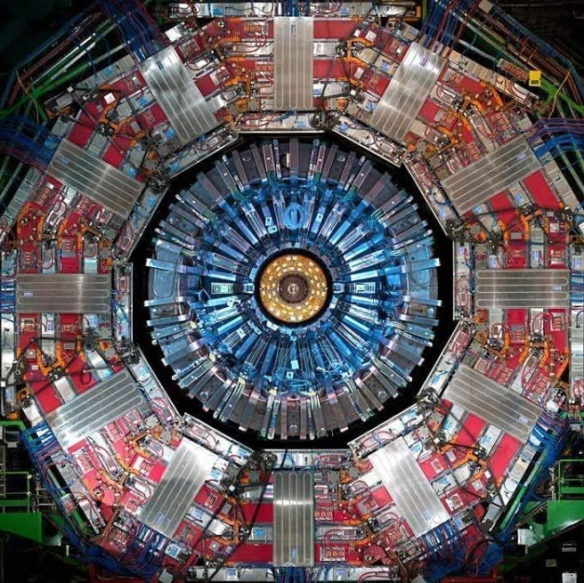

RLHF for Data quality monitoring

Slide 7
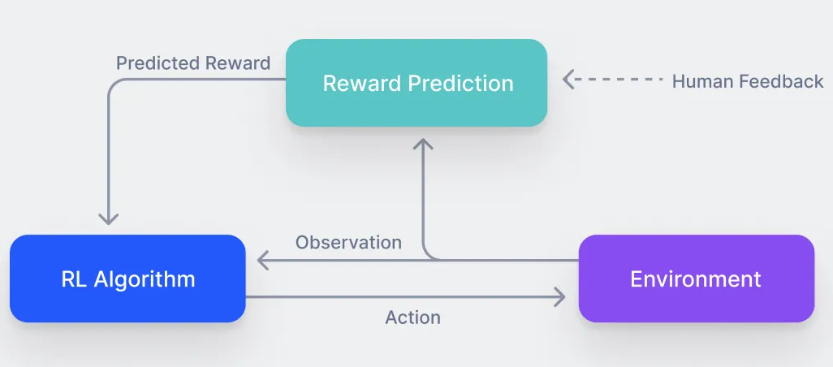
RL with Human Feedback (RLHF)
Reward
Based on the correctness and confidence level of the agent
Values set by a scheme reward
Learning agent
Environment
RL Goals
Single interaction with the environment (action).
Interacts with the human to adjust the given feedback to its policy.
May have influence on the initial state of the next episode (depending on the regime)
Representation of the system’s monitoring.
Each time step conforms an episode.
States in the episode are histograms collected by the system.
Flexibility: adapt to changes with the human’s guidance.
Improved Accuracy: complement the current human accuracy.
Enhance the reliability of the system

Slide 8
Reinforcement learning in the offline regime

Slide 9
Offline regime
          The RL goal is the improvement of the current shifter’s accuracy when detecting system changes. For that, the agent receives constant feedback.
    The agent’s actions do not have any influence on the next state of the episode.
The action space of the algorithm is only based on the definition of the system status: nominal or anomalous status.

Slide 10


Offline regime: Goals overview
Increase the current shifter’s accuracy
Adapt to changing conditions
Integrate the shifter’s feedback to the algorithm’s policy to avoid human’s mistakes (superhuman condition)
Adapt to new nominal status changes and detect unseen new problems

Slide 11
Offline RL algorithm
1
Environment set up
2
Agent interactions and episode ending
Single-step episode: vector composed by a set of bins (histogram)
The initial state is not influenced by the agent
The action space is the classification of the histogram as anomalous or nominal status
The human will always receive feedback from the agent
3
Reward scheme
The human will always give feedback to the agent
There is a reward/penalization for correct/incorrect status classification

Slide 12
Reinforcement learning in the online regime

Slide 13
Online regime
          The RL goal is to maximize the current shifter’s accuracy while reducing its interactions with the agent as least as possible. The agent must know when to get human feedback.
    The agent’s actions influence the next state, making the misclassified system status persistent until its correct detection.
The action space of the algorithm declares not only the status of the system but also defines the human feedback necessity.

Slide 14

Online regime: Goals overview
Reduce the shifter’s interventions
Adapt to changing conditions
Achieve superhuman condition while knowing when to ask for human feedback
Adapt to new nominal status changes and detect unseen new problems

Slide 15
Online RL algorithm
1
Environment setup
2
Agent interactions and episode ending
Infinite horizon episode: vectors composed by a set of bins (histogram)
The next states are influenced by the agent (the state persists if misclassified)
The action space is the classification of the histogram and the decision on asking or not human feedback
The human will always receive feedback from the agent
3
Reward scheme
The human will only give feedback to the agent when being called
There is a reward/penalization for correct/incorrect status classification dependent on time
There is a penalization for asking human feedback unnecessarily

Slide 16

First simulations on toy dataset

Slide 17
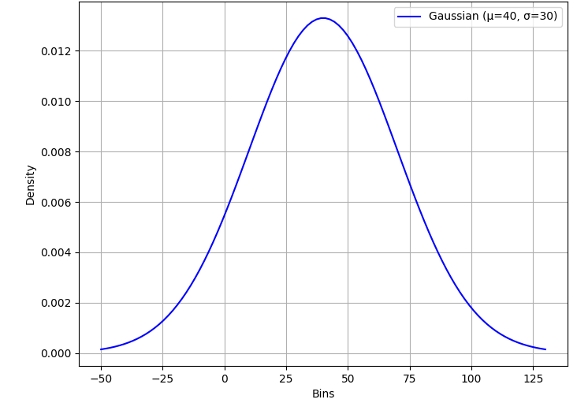

Design setup
    t0
    t1
Not tested
Train batch
Test batch
    Histogram distributions
    Sequential training

Slide 18
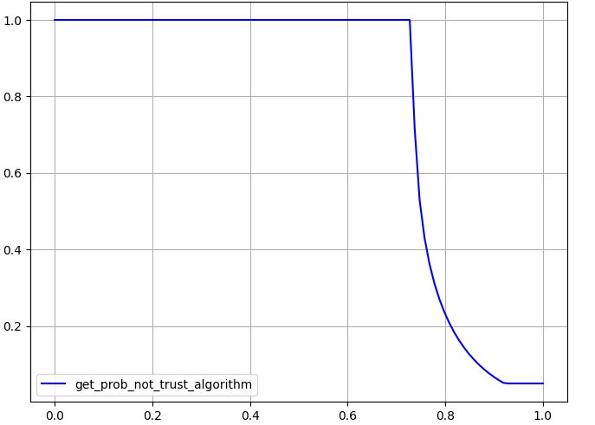


Superhuman condition
Proof of concept: What if we have access to the ground truth?
We create the toy dataset and we we falsify the labels with probability p (human error)
These labels are the feedback given to the agent
We stop giving feedback to the agent progressively based on its performance during training (shifter’s mistrust heuristic function)
Probability of giving human feedback
Model’s performance on the shifter’s labels
    Shifter’s “mistrust” heuristic function

Slide 19
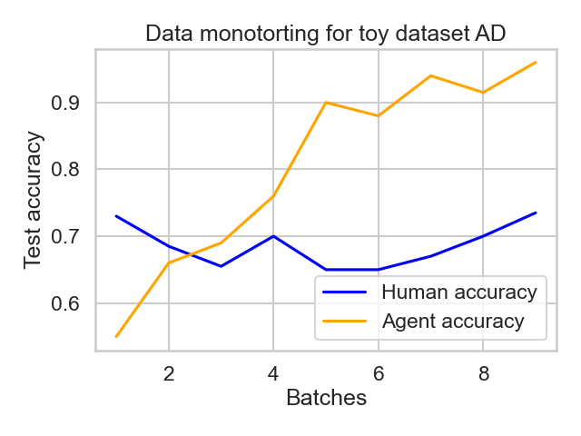

Results
We can achieve superhuman condition for the offline regime
How do we know when to rely on the machine? We are currently performing studies on the detection of superhuman condition during training, without having access to the ground truth$1$
Probability of human failure: 0.3
¹ Bar, O., Drory, A., & Giryes, R. (2022, May). A spectral perspective of DNN robustness to label noise. In International Conference on Artificial Intelligence and Statistics (pp. 3732-3752). PMLR.

Slide 20
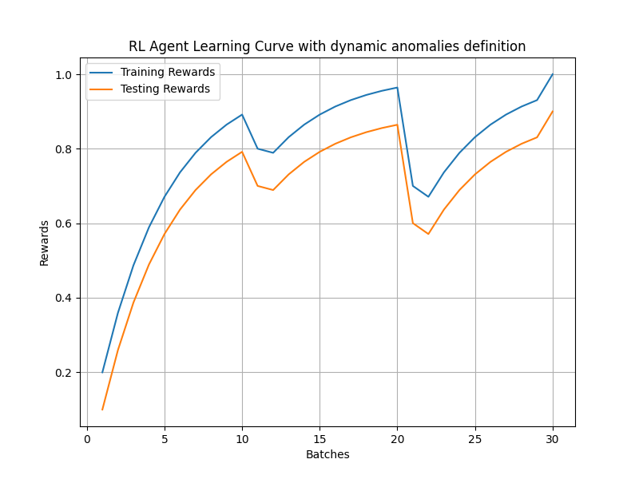
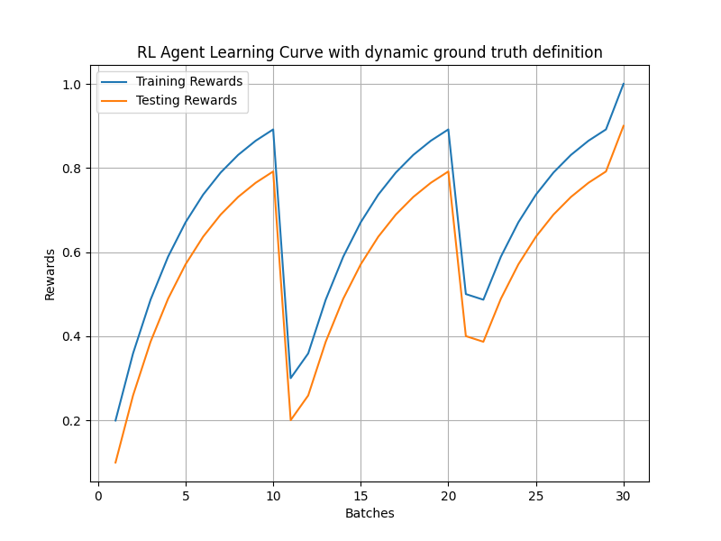
Adaptation to changing conditions
    Anomalies changing over time
    Nominals changing over time
Proof of concept: What happens when the anomaly changes over time?

Slide 21
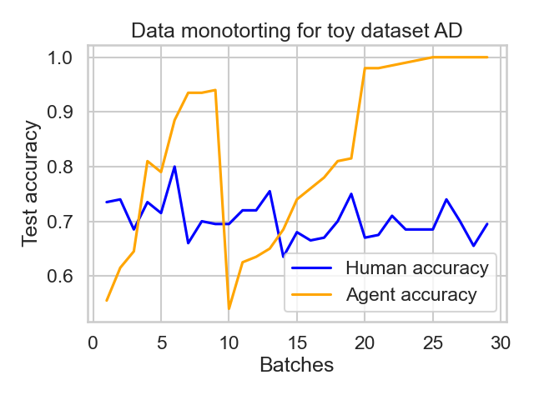
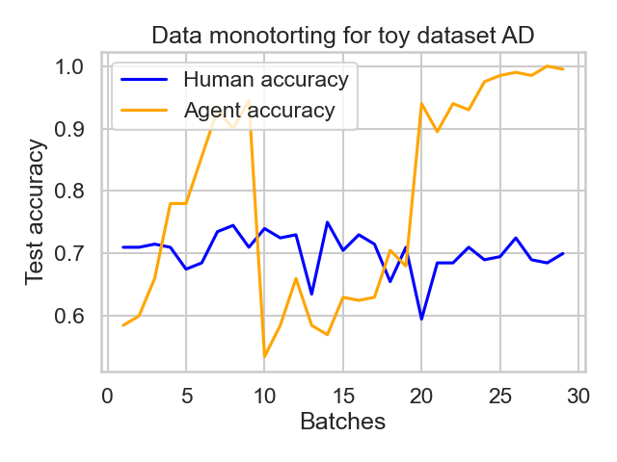

Results
    Anomalies changing over time
    Nominals changing over time
Probability of human failure: 0.3
Probability of human failure: 0.3
We adapt to changing conditions for the offline regime

Slide 22
Future steps
Achieve superhuman condition and adapt to changing conditions also in real time (online regime)
Assist the shifter decisions without necessity of their constant feedback and automatize some histograms checks
Implement data augmentation techniques to be able to use the algorithm with low statistics data (real case scenario)
Currently
Next
Next

Slide 23
Thanks
for your attention

Slide 24
Q&A
olivia.jullian.parra@cern.ch

