Slide 1
Linear colliders
Sustainability studies for LCs
Life Cycle Assessments
Steinar Stapnes
CERN 29.06.2023

Slide 2
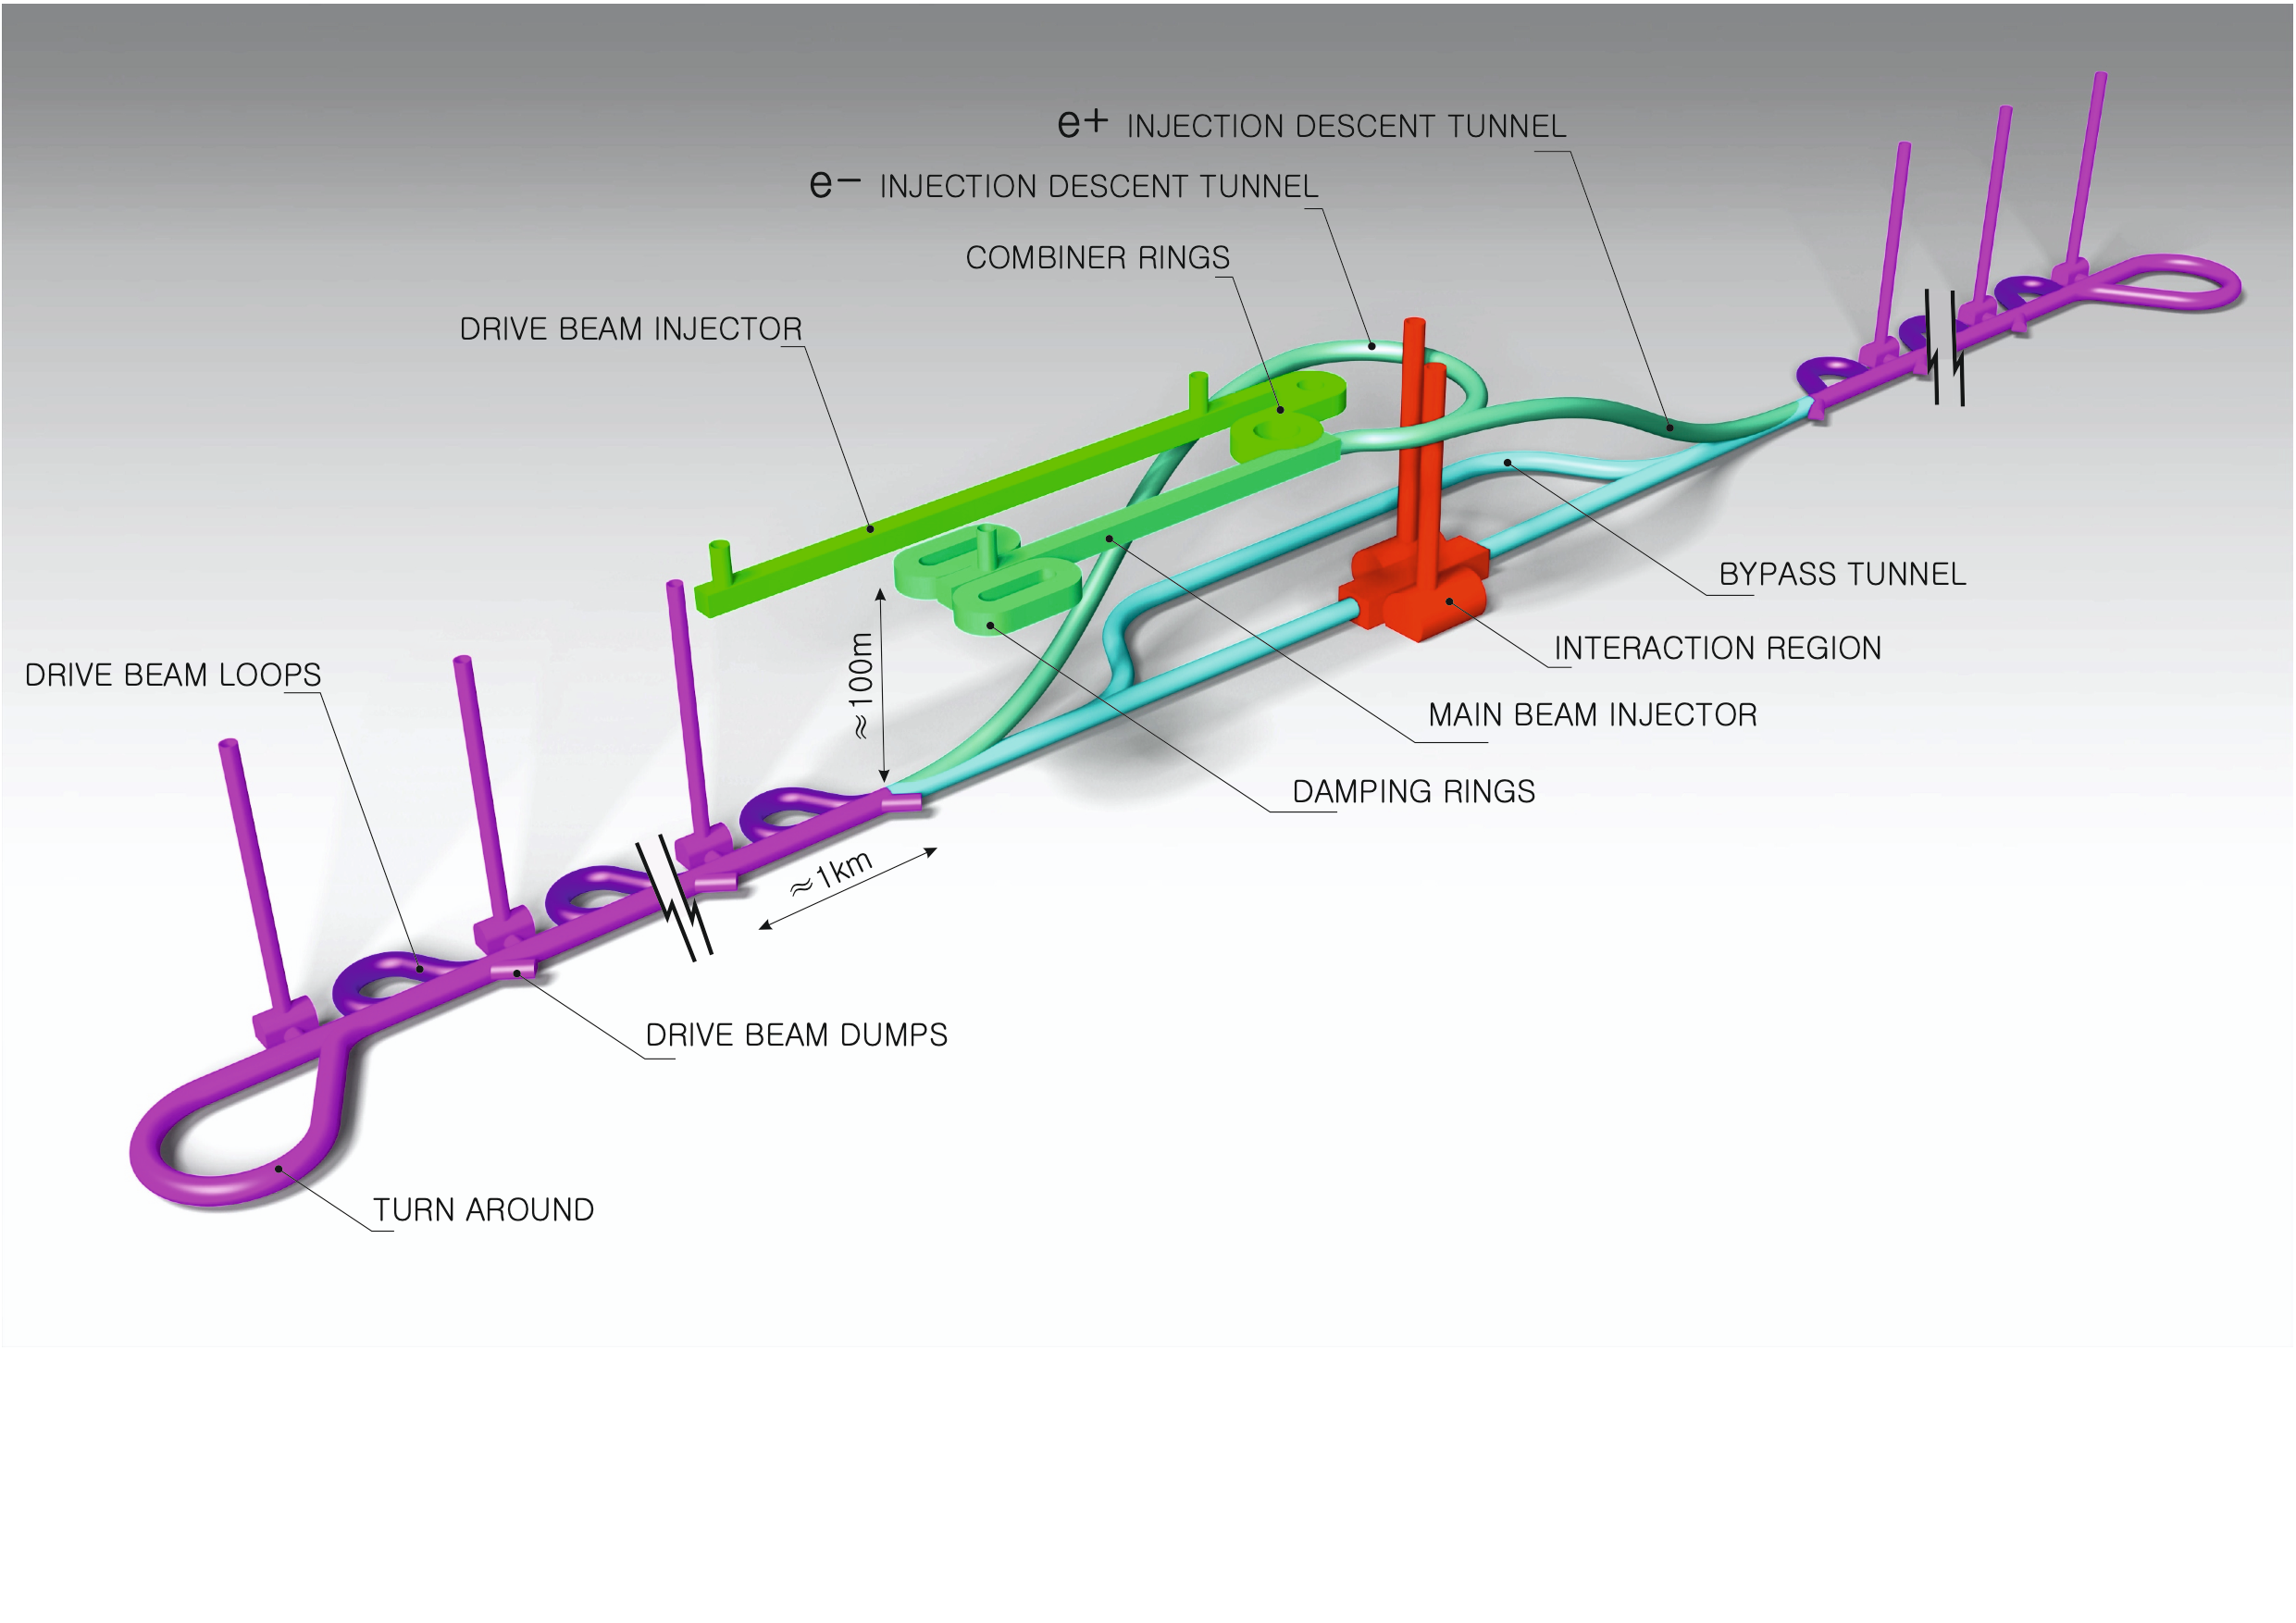
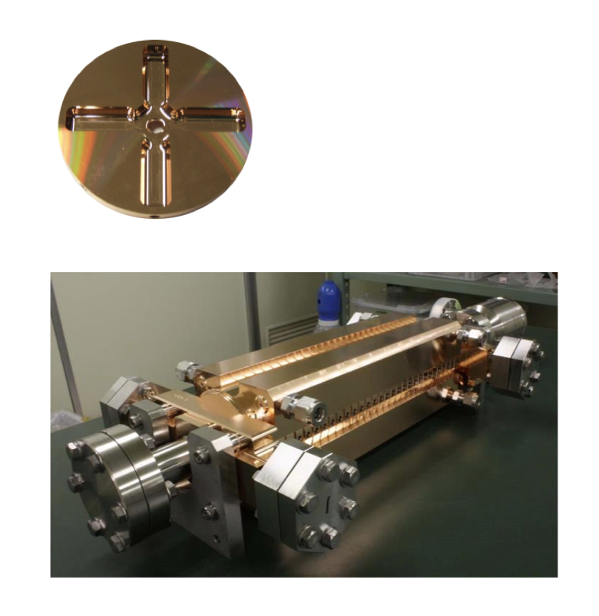
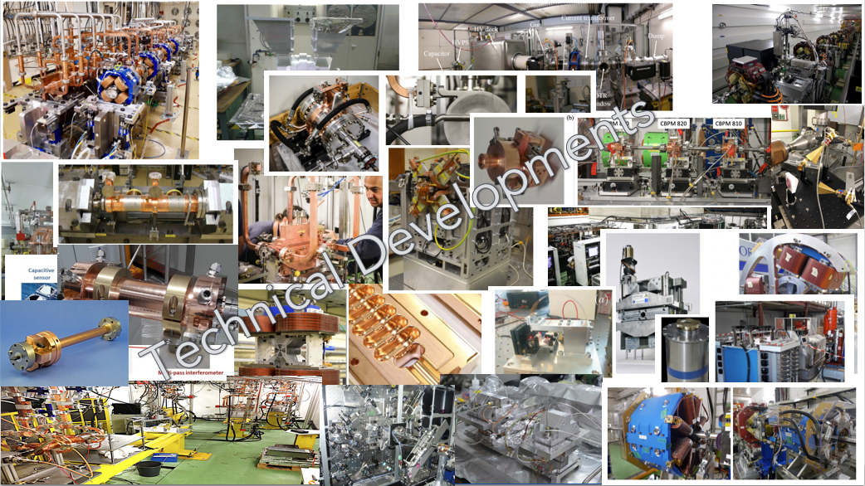
The Compact Linear Collider (CLIC)
  Timeline: Electron-positron linear collider at CERN for the era beyond HL-LHC
  Compact: Novel and unique two-beam accelerating technique with high-gradient room temperature RF cavities (~20’500 structures at 380 GeV), ~11km in its initial phase
  Expandable: Staged programme with collision energies from 380 GeV (Higgs/top) up to 3 TeV (Energy Frontier)
  CDR in 2012 with focus on 3 TeV. Updated project overview documents in 2018 (Project Implementation Plan) with focus 380 GeV for Higgs and top.
  Recent talks (with more references): eeFACT1 and eeFACT2
Accelerating structure prototype for CLIC: 12 GHz (L~25 cm)
The CLIC accelerator studies are mature:
Optimised design for cost and power
Many tests in CTF3, FELs, light-sources and test-stands
Technical developments of “all” key elements

Slide 3
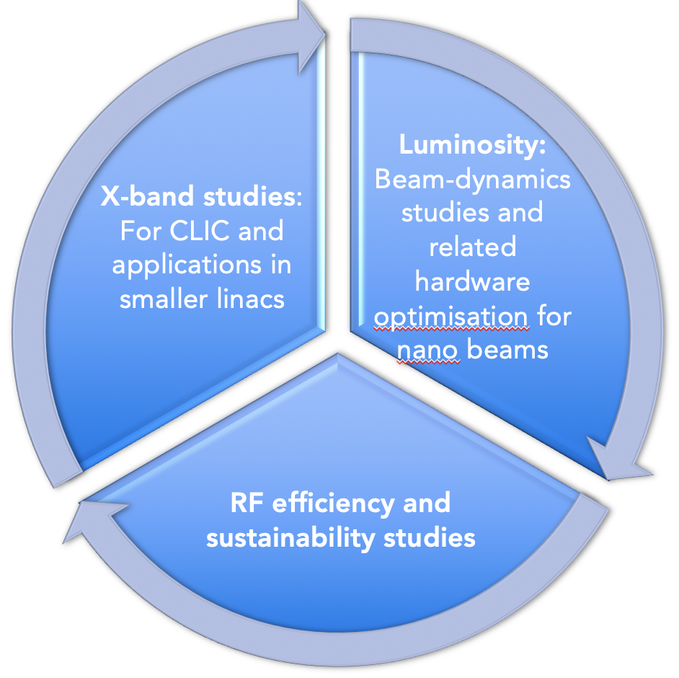
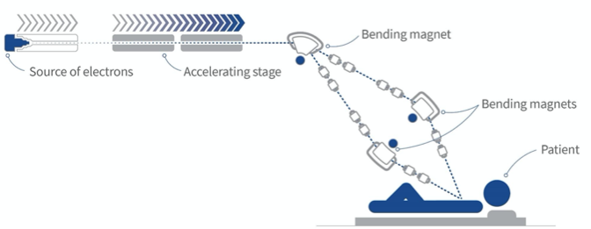
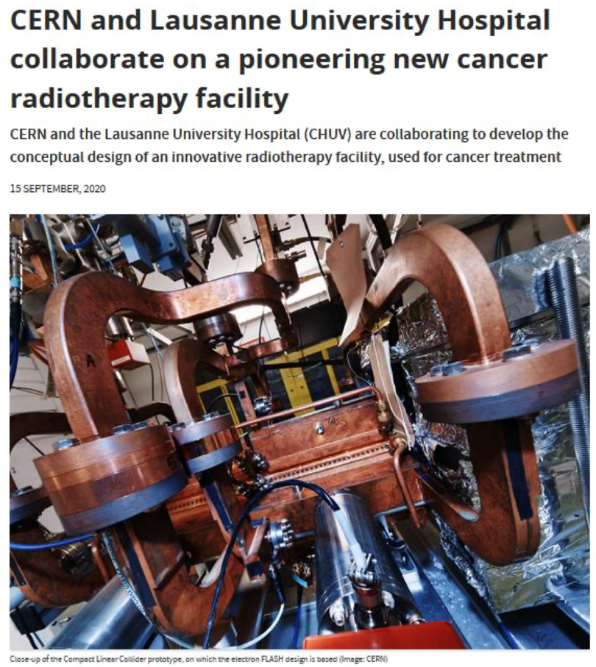
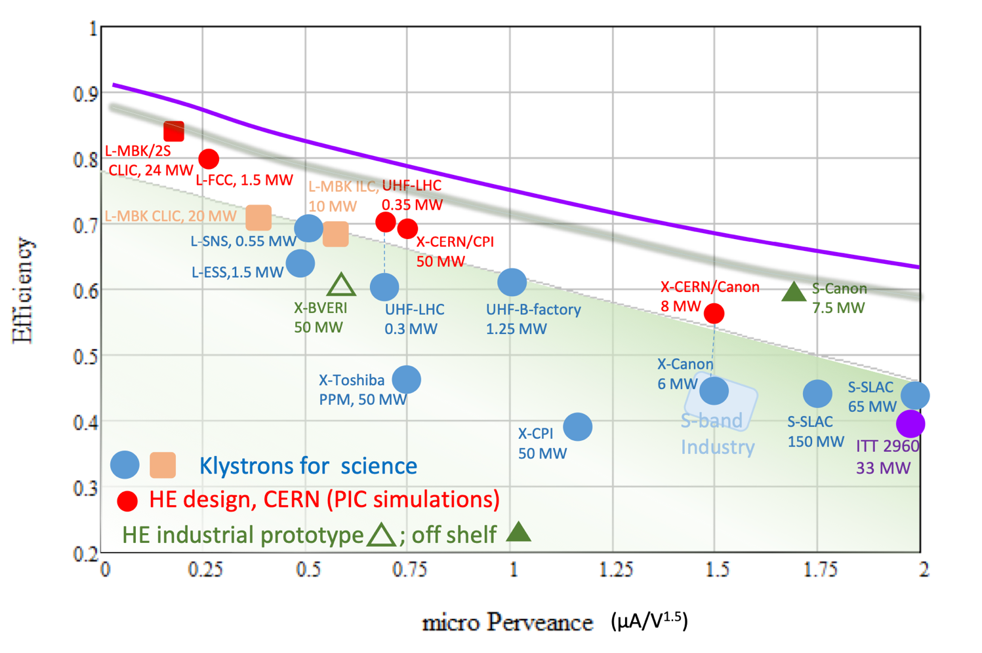
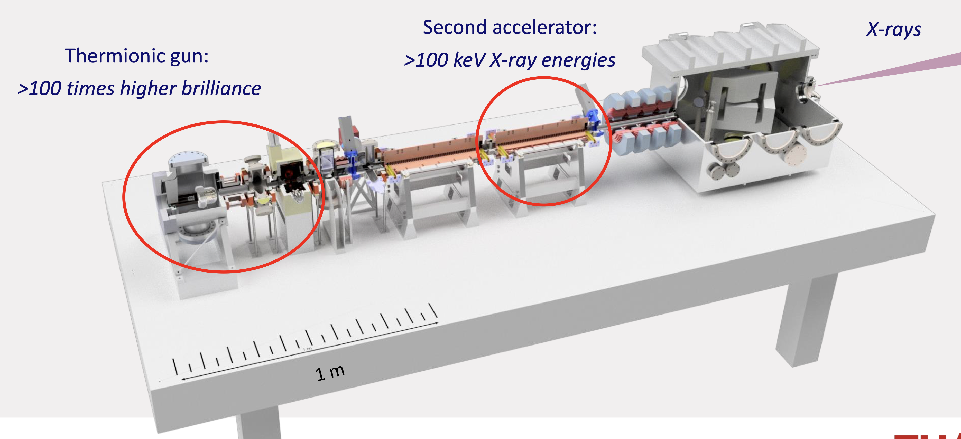
On-going CLIC studies towards next ESPP update
Project Readiness Report as a step toward a TDR
Assuming ESPP in ~ 2026, Project Approval ~ 2028, Project (tunnel) construction can start in ~ 2030.
Optimizing the luminosity at 380 GeV – already implemented for Snowmass paper, further work to provide margins will continue.
      Luminosity margins and increases:
    Initial estimates of static and dynamic degradations from damping ring to IP gave: 1.5 x 10³⁴ cm⁻² s⁻¹
    Simulations taking into accord static and dynamic effects with corrective algorithms give 2.8 on average, and 90% of the machines above 2.3 x 10³⁴ cm⁻² s⁻¹ (this is the value currently used)
The X-band technology readiness for the 380 GeV CLIC initial phase - more and more driven by use in small compact accelerators
Improving the power efficiency for both the initial phase and at high energies, including more general sustainability studies
Power estimate bottom up (concentrating on 380 GeV systems)
Very large reductions since the CDR, better estimates of nominal settings, much more optimised drivebeam complex and more efficient klystrons, injectors more optimized, main target damping ring RF significantly reduced, recent L-band klystron studies
Energy consumption ~0.6 TWh yearly, CERN is currently (when running) at 1.2 TWh (~90% in accelerators

Slide 4
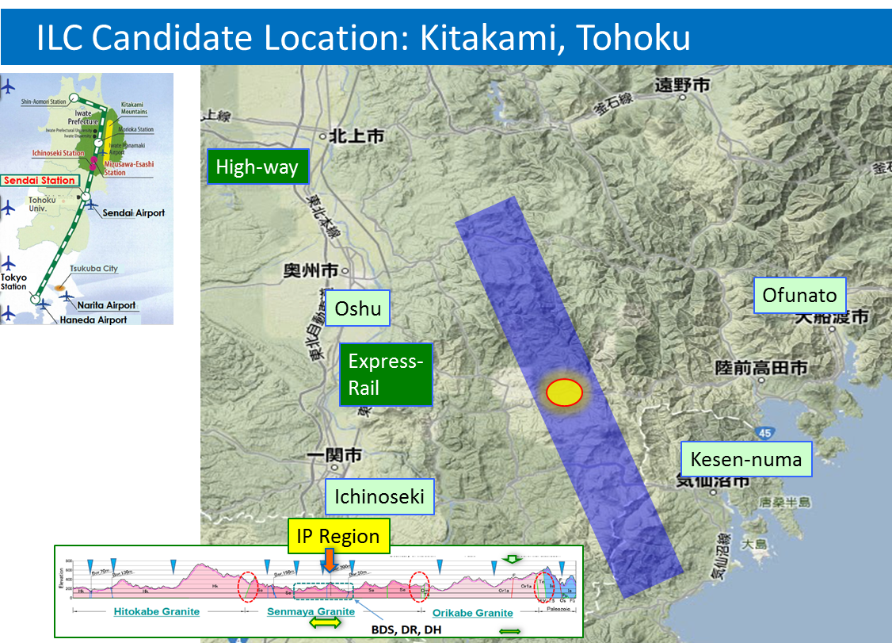
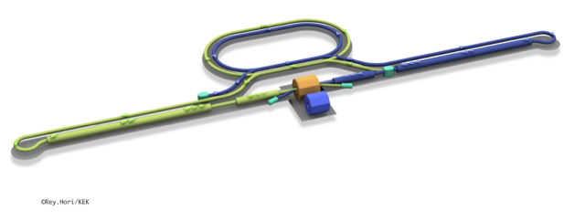
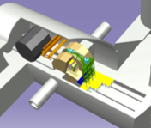
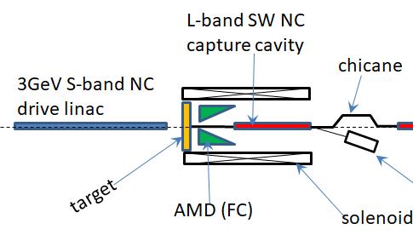
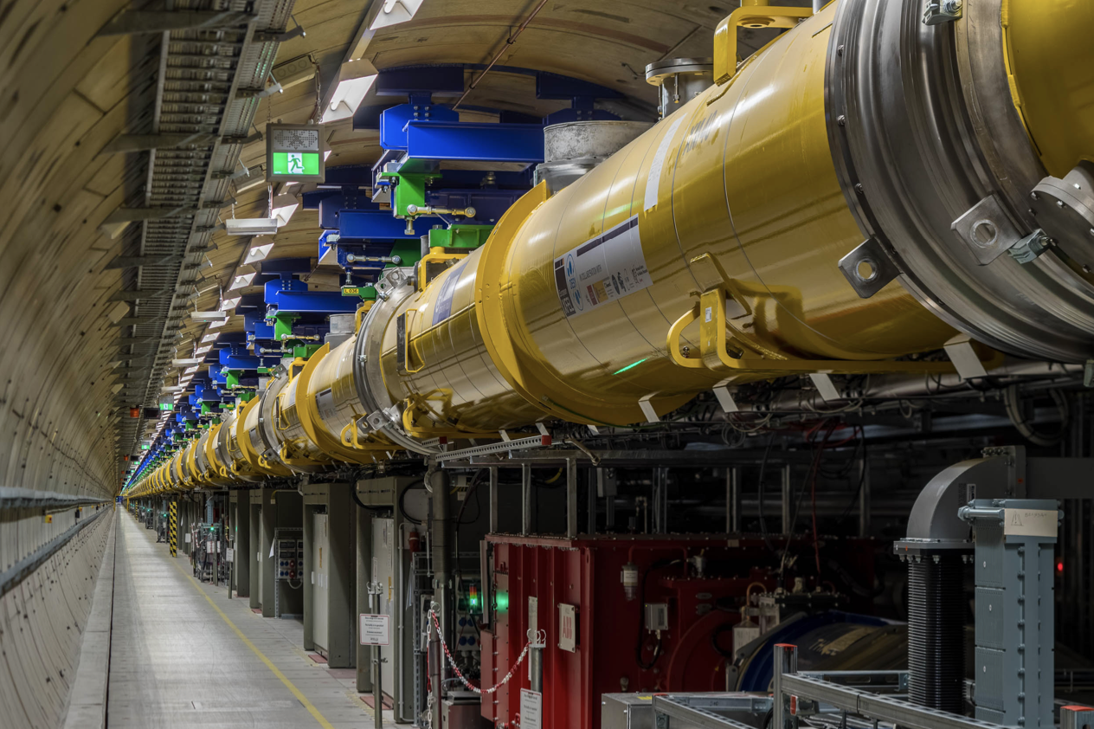
The ILC250 accelerator facility
Interaction point
Damping Ring
e+ Source
e- Source
e- Main Linac
Beam dump
Physics Detectors
e+ Main Liinac
Bunches of ~10¹⁰ e+/e-
Undulator positron source
Creating particles Sources
  polarized elections/positrons
High quality beam Damping ring
  low emittance beams
Acceleration Main linac
  superconducting radio frequency (SRF)
Collide them Final focus
  nano-meter beams
Go to Beam dumps
Electron driven positron source
  Recent talks (with more references): eeFACT-I1 and eeFACTI2

Slide 5
The European ITN activities – end May 2023
Personnel with interest and skills in European labs/Univ., local infrastructure.
See text left
Material funds as estimated (major/core part from KEK), in some cases complemented by local funding.
Agreement in final draft, KEK board discussion Friday
EAJADE, MC exchange project supporting Higgs factory personnel exchange to Japan and the US.
Started 1.3.2023
CERN LC, project office (within existing LC resources at CERN).
LC budget line in MTP until end 2028
European ITN studies are distributed on five main activity areas:
A1 with three SC RF related tasks
SRF: Cavities, Module – CEA/INFN/KEK: materials and single cell cavities
Crab-cavities – UK/CERN: programme after down-select to be discussed
A2 Sources
Pulsed magnet to production drawing level - Univ. Hamburg, DESY
Wheel/target: need to discuss more widely scope and plans (Europe and US)
A3 Damping Ring including kickers
Low Emittance Ring community – not yet addressed
A4 ATF activities for final focus and nanobeams
Many European groups very active in ATF – UK, France, Spain, DESY, CERN, Friday operation meetings restarted.
A5 Implementation including Project Office
Dump, CE, Cryo, Sustainability, MDI, others (many of these are continuations of on-going collaborative activities) – e.g. Spain/KEK: ML quads and cold BPMs (own funding), EAJADE started (EU funding), sustainability studies also (e.g. ARUP report) (CERN LC funding), etc
EAJADE: Information at LINK

Slide 6
Initial considerations
Resource optimization as traditionally done for accelerators:
  Length/complexity -> construction cost
  Power/energy consumption -> operating costs
  Traditionally we optimize for energy reach and luminosity wrt to cost and power
Sustainability in a wider sense adds new construction and operation optimization criteria:
  Energy use not only costs but also CO₂, embedded CO₂ in construction materials and components, rare earth usage, responsible sourcing in general for all parts, landscaping, integration in local communities, life cycle assessments including decommission and many more issues
Approaches to increase sustainability
Overall system design
  Compact accelerator -> high gradients, high field magnets
  Energy efficient -> low losses (wall-plug to beam)
  Effective -> small beam sizes to maximize luminosities
  Energy recovery concepts
  Civil engineering including landscaping and “community” integration
Subsystem and component design, e.g.
  High-efficiency cavities and klystrons
  Permanent magnets, HTS magnets
  Heat-recovery. e.g. in tunnel linings, possibly other components
  Responsible sourcing and material choices for all parts
Sustainable operation concepts
  Renewables
  Adapt to power availability
  Exploit energy buffering potential
  Recover energy
Good progress on the red points (was also part of the our radiational approach), initial progress/focus on the yellow/black ones

Slide 7
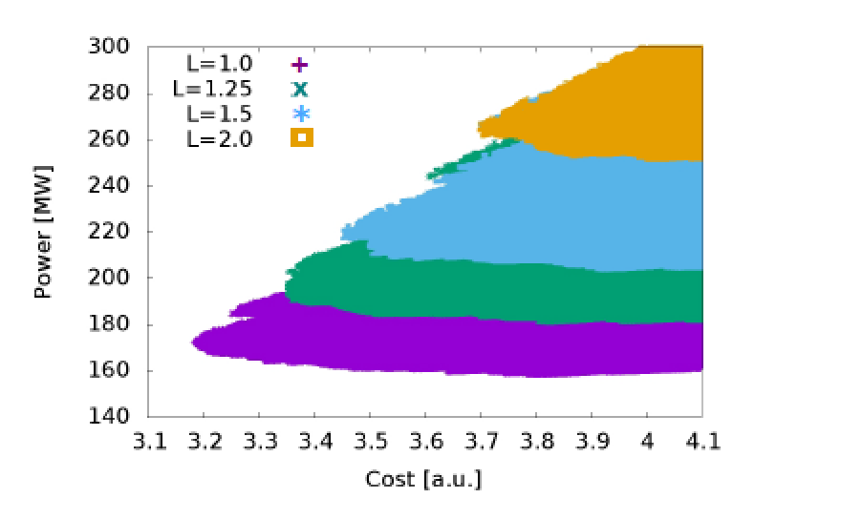
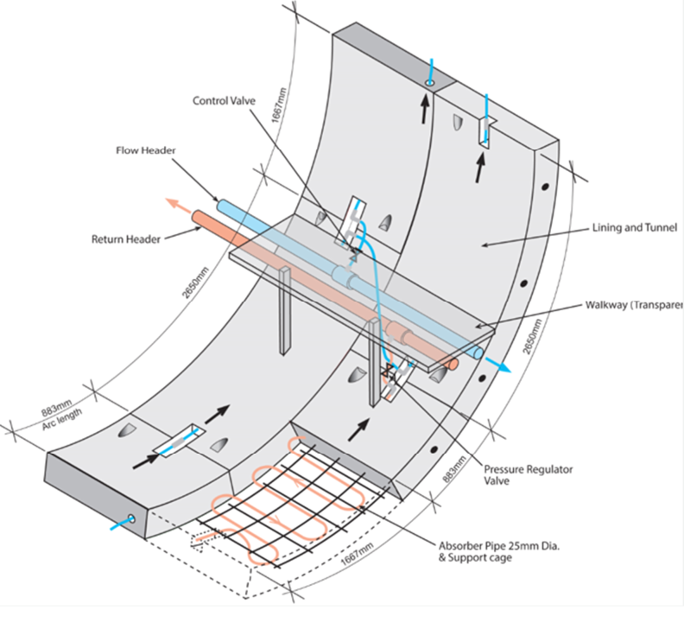
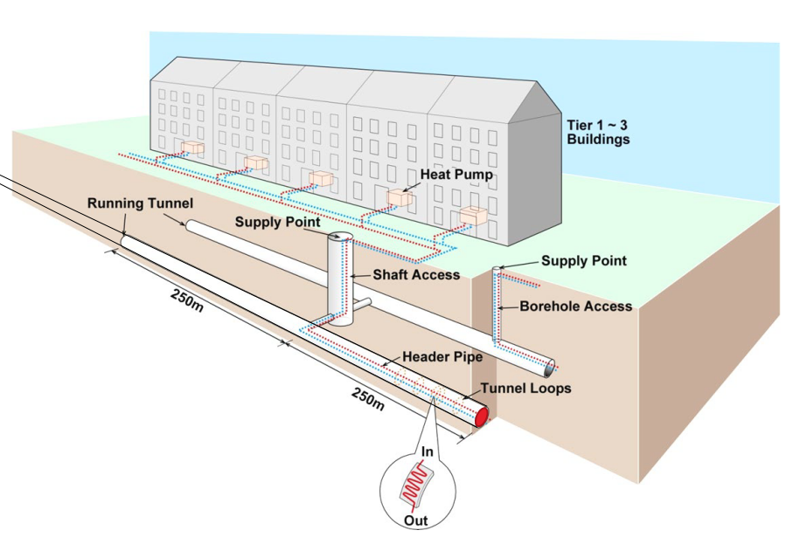
Power optimization – examples
Parameter scans to find
optimal parameter set, change acc. structure designs and gradients to find an optimum
Design Optimisation:
All projects aim to optimize – most often energy reach, luminosities and cost. Power is becoming at least as important, maybe even compromising ultimate performance for power saving.
Technical Developments:
Technical developments targeting reduced power consumptions at system level high efficiency klystrons and RF systems generally, RF cavity design and optimisation, magnets (traditional SC and HTS including cryo, and also permanents magnets).
Heat recovery:
Already implemented in point 8 for LHC
Tunnel heat recovery study by ARUP in 2022, results interesting but …
The designs of CLIC, including key performance parameters as accelerating gradients, pulse lengths, bunch-charges and luminosities, have been optimised for cost and power

Slide 8
Nanobeams
A very important part of increasing the energy efficiency of a collider is reducing the beamsizes at the collision point.
This involved optimisation of every part of the machine, from injectors to damping rings to main linacs/rings to beam-delivery/interaction point.
and covers in terms of design and technologies:
beam-dynamics, steering and feedback, precise instrumentation, alignment, stability (passive/active), injection, extraction, precise magnets, vacuum, studies of ground vibrations and stray-field, temperature control and more.
This has been extensively developed and prototyped in CLIC, ILC, FEL linacs.
Beyond studies and HW developments, test in beam facilities as ATF2, FACET, light sources and FEL linacs are essential.

Slide 9
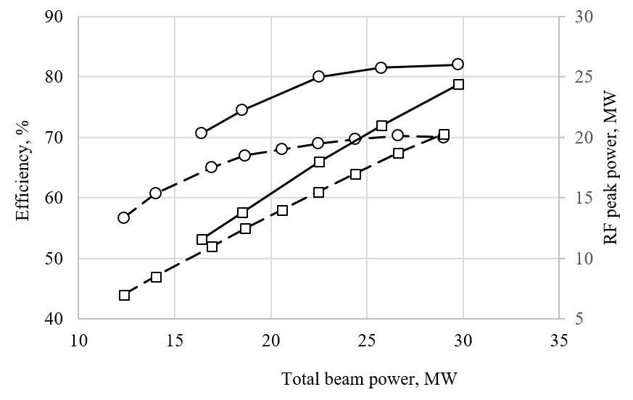
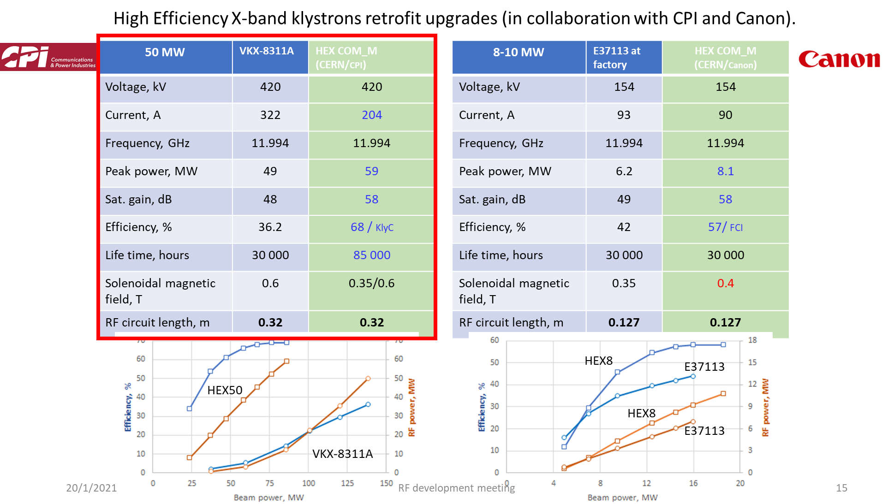
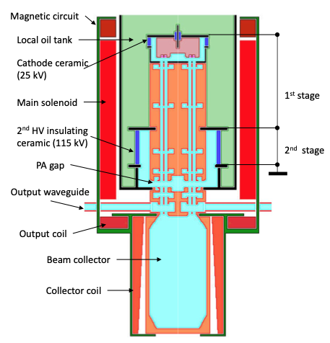
High Eff. Klystrons
L-band, X-band (for applications/collaborators and test-stands
High Efficiency implementations:
New small X-band klystron – recent successful prototype
Large X-band with CPI
L-band two stage, design done, prototype desirable
Drivebeam klystron: The klystron efficiency (circles) and the peak RF power (squares) simulated for the CLIC TS MBK (solid lines) and measured for the Canon MBK E37503 (dashed lines) vs total beam power. See more later.
Publication: https://ieeexplore.ieee.org/document/9115885

Slide 10
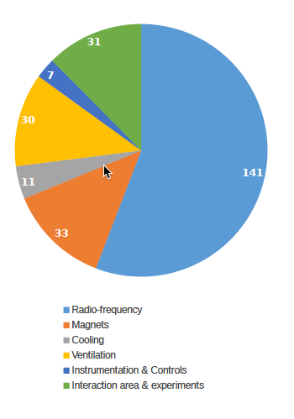
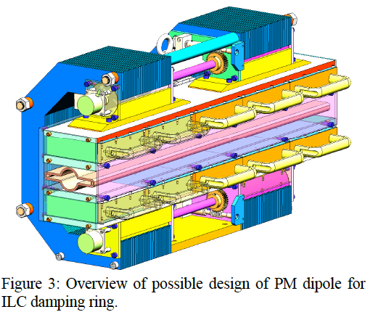
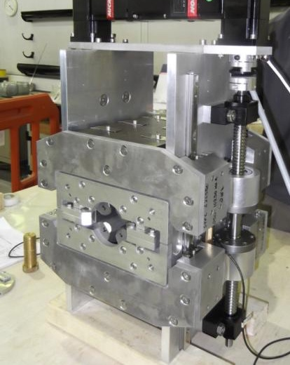
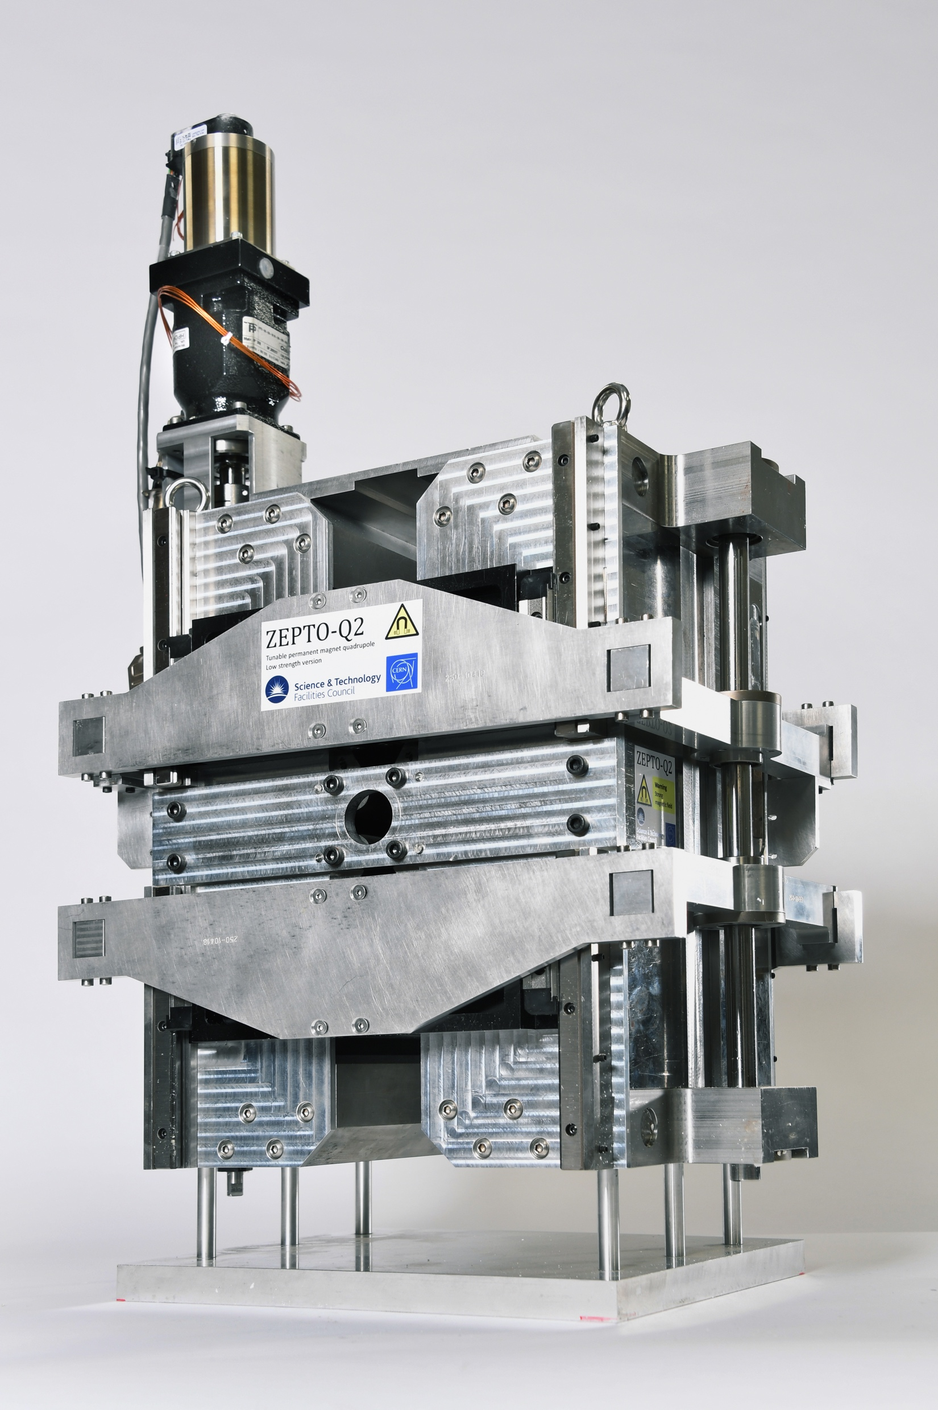
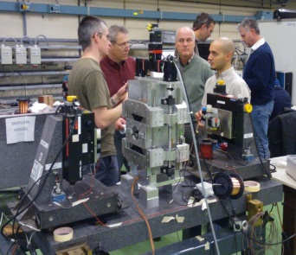
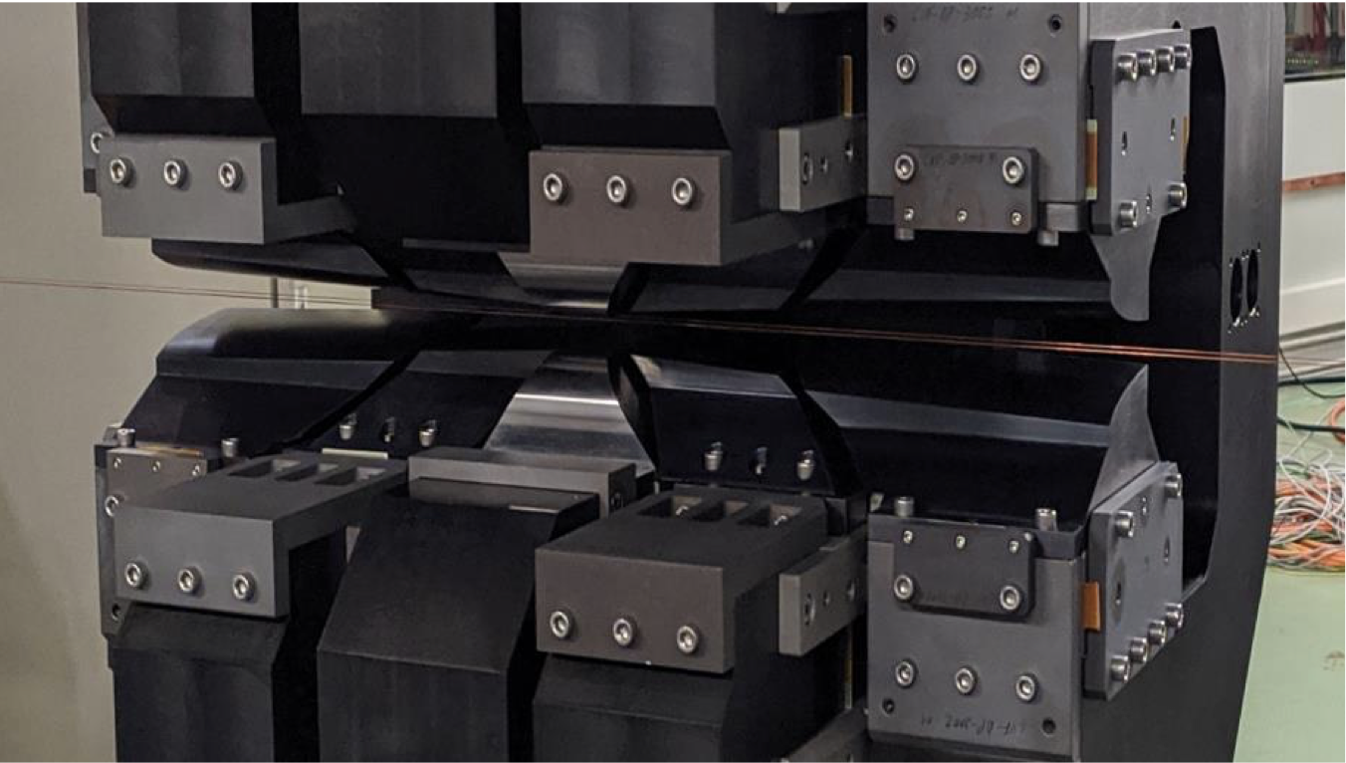
Magnets also important in Higgs factories
1.5 TeV CLIC power
Magnets second largest
ZEPTO (Zero Power Tuneable Optics) project is a collaboration between CERN and STFC Daresbury Laboratory to save power and costs by switching from resistive electromagnets to permanent magnets.
For CLIC the dominant power is in the drive-beam quadrupoles, successfully prototyped and tested as permanent (two different strengths) magnets, and also dipoles (in drivebeam turn arounds)
Longitudinal gradient dipole magnet for the CLIC DR (CIEMAT)
HTS magnets might be of interests in all circular and linear Higgs factories to reduce power.
doi:10.18429/JACoW-IPAC2018-MOPML048 CC-BY-3.0

Slide 11
R&D for Improved SRF Performance & Sustainability
Better surface treatments and cavity shapes improve cavity performance. Lots of progress in last 10 years
Raise gradient: fewer cavities for same beam energy.
Short term goal: 31.5MV/m -> 35MV/m
Medium term goal: 45MV/m
Lab record: 59MV/m
Improve Q₀: reduce cryogenic losses
(1W @ 2K requires ~750W AC power!)
Short term goal: 1E10 -> 2E10
New treatments reduce / avoid need for electropolishing treatments (involving aggressive chemicals)
R&D into replacement of bulk niobium cavities with Nb or Nb₃Sn coated copper:
reduce niobium consumption,
increase performance (arXiv:2203.09718)

Slide 12
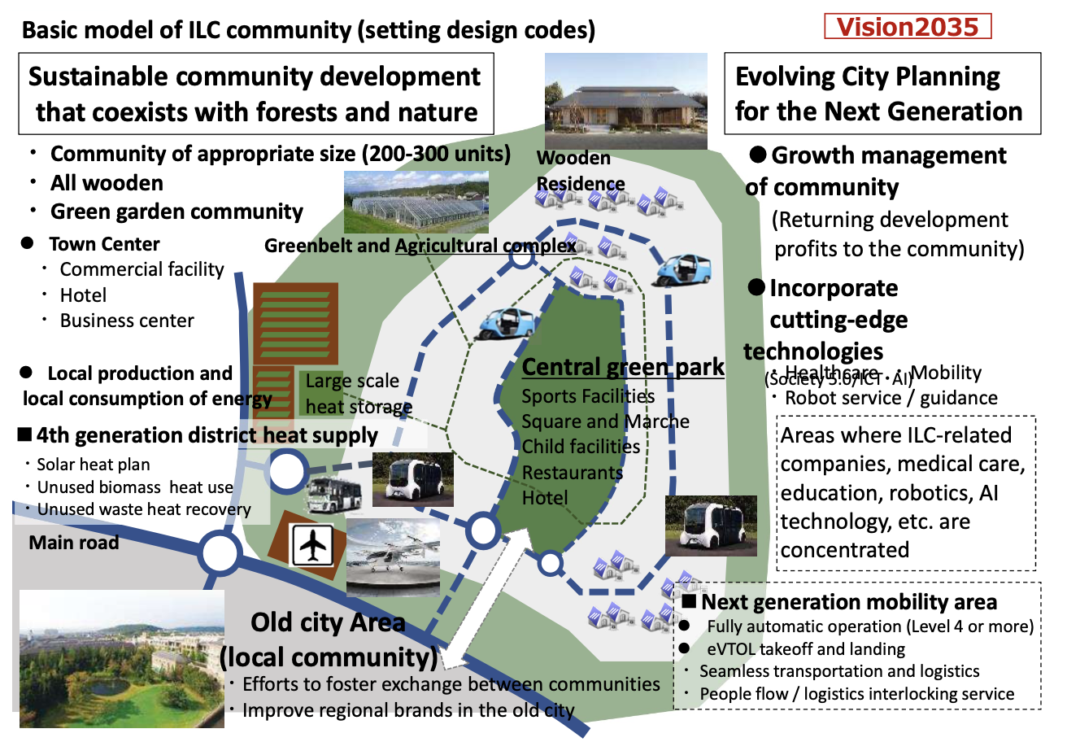
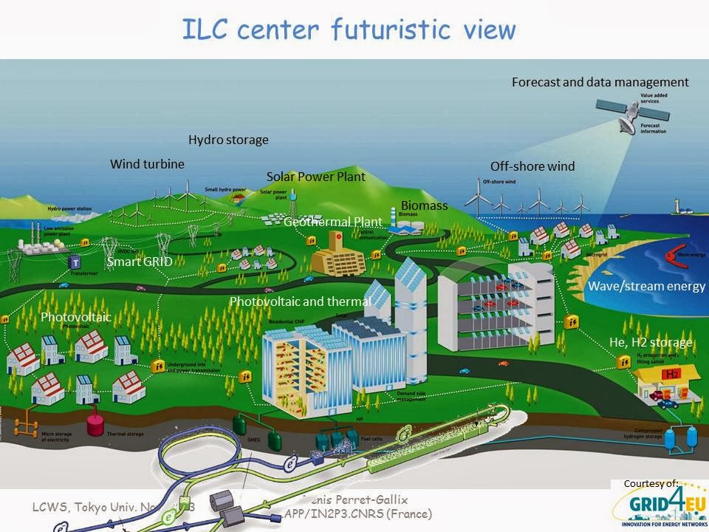
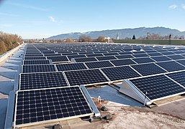
Green ILC
For ILC: renewable energy available (Tohoku Electric Power) in local grid at ~23% level, need 0.5-1 % for ILC. Additionally considers increased CO2 absorption to be fully neutral.
Asurnipal CC-BY-SA-4.0

Slide 13
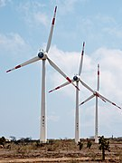
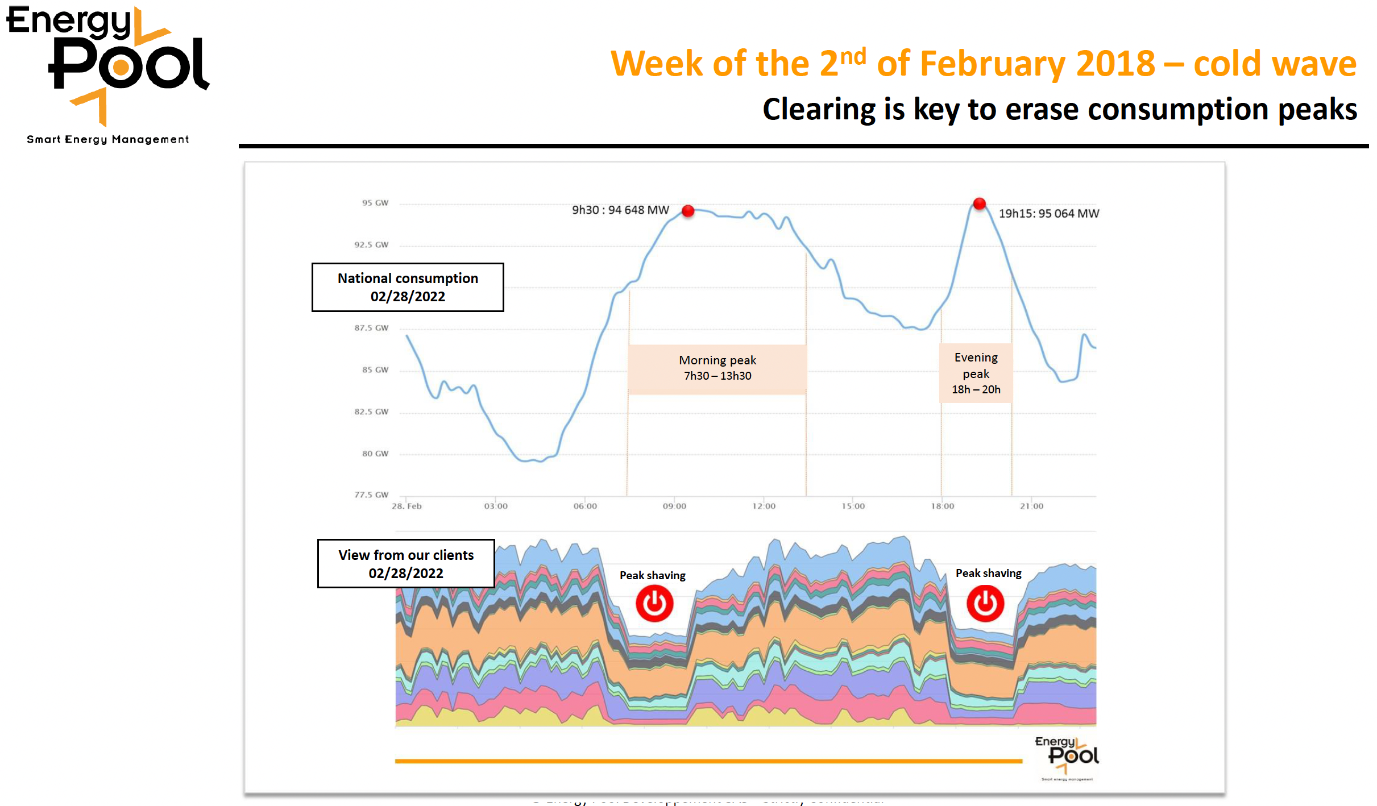
Running on renewables and when electricity is cheap
Two studies in 2017:
Supply the annual electricity demand of the CLIC-380 by installing local wind and PV generators (this could be e.g. achieved by 330 MW-peak PV and 220 MW-peak wind generators) at a cost of slightly more than 10% of the CLIC 380 GeV cost.
  Study done for 200 MW, in reality only ~110 MW are needed
Self-sufficiency during all times can not be reached but 54% of the time CLIC could run independently from public electricity supply with the portfolio simulated.
Can one run an accelerator as CLIC in a mode where one turn “on” and “off” depending prices (fluctuating with weather, demand, availability etc) ?
Specify transition times (relatively fast for a LC) and the annual luminosity goal
Significant savings – but the largest saving is the obvious one, not running in the winter.
Flexibility to adjust the power demand is expected to become increasingly important and in demand by energy companies.
More information (link)
Victor Gleim CC-BY-SA-4.0
(Regenerative) Power availability varies
Linear accelerators have no stored beam -> ideal for flexible operation
Study by Fraunhofer institute considered running
on renewables and participating in demand side flexibility
C. Gaunand, B. Remenyi: Introduction to Demand Side Flexibility
ESSRI Workshop 2022 https://indico.esrf.fr/event/2/contributions/94/

Slide 14
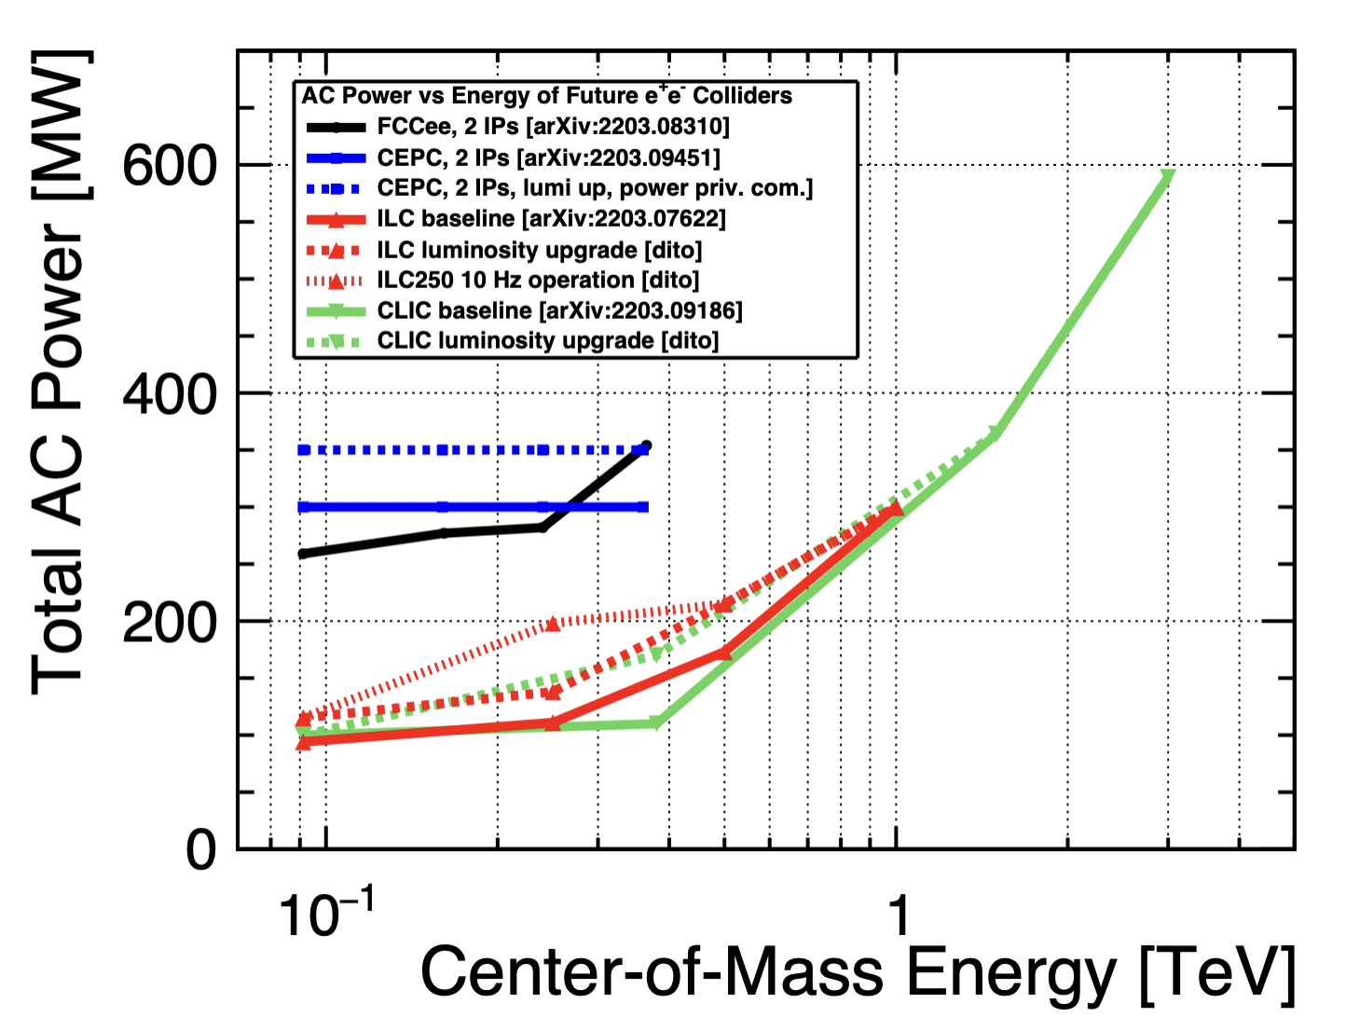
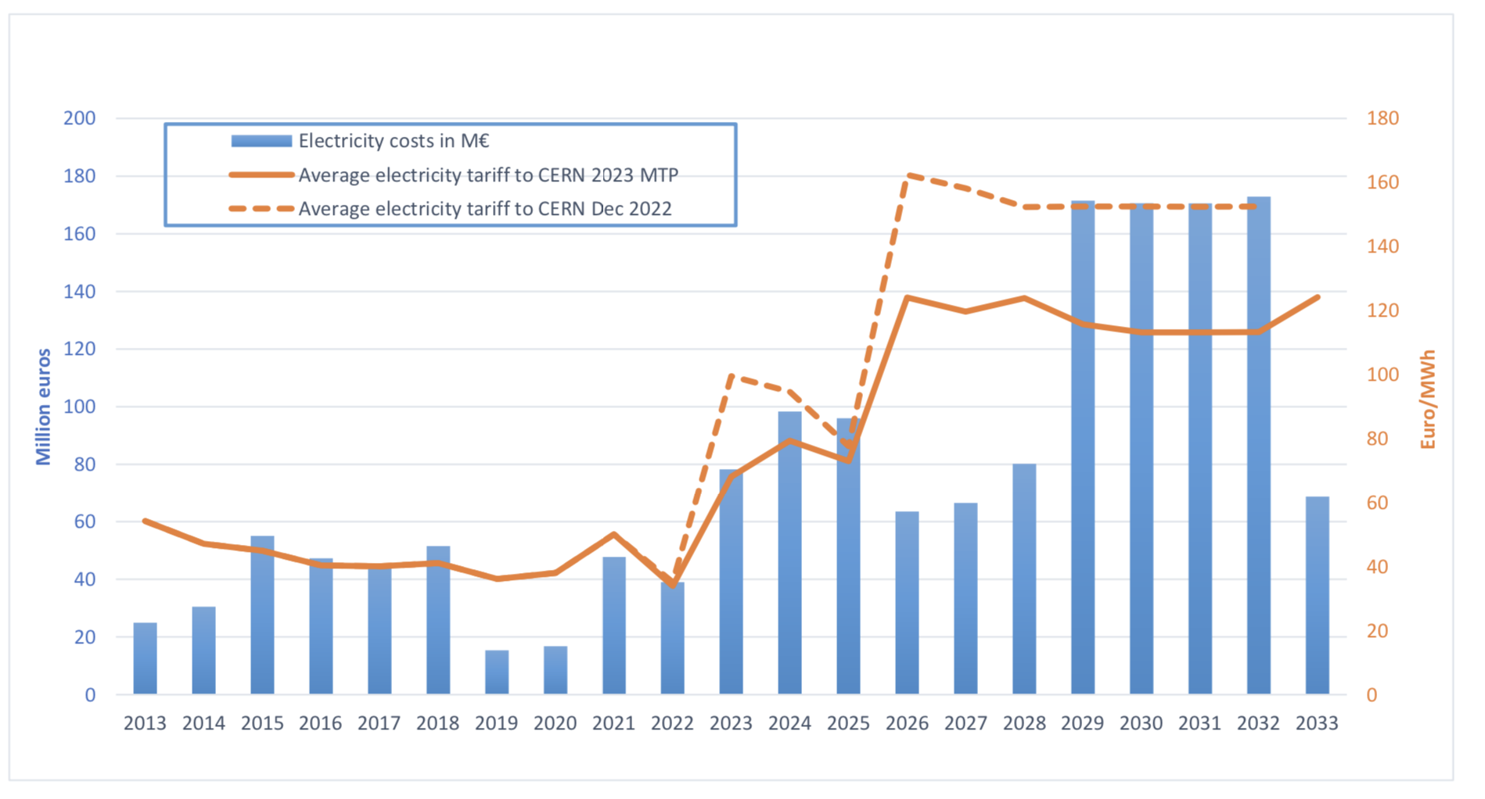
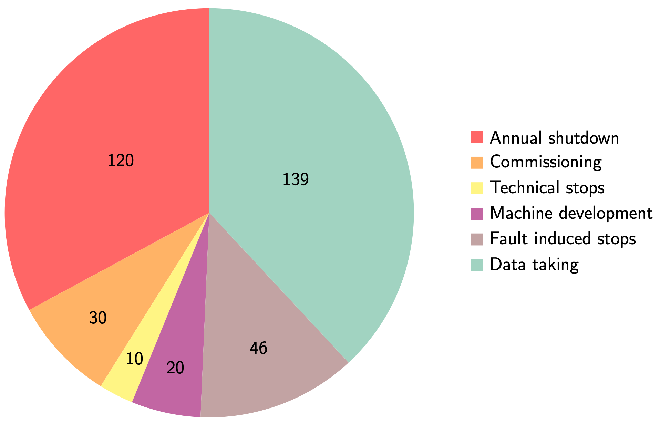
Power and energy
Typical power numbers for Higgs factories on the right – see also table on page above.
The CERN “standard” running scenario is shown below right, used to convert to annual energy needs.
Very uncertain but MTP assumes 120 MCHF/TWh beyond 2026.
With “standard” running scenario (on the right) every 100 MW corresponds to ~0.6 TWh annually, corresponding to ~75 MCHF annually.

Slide 15
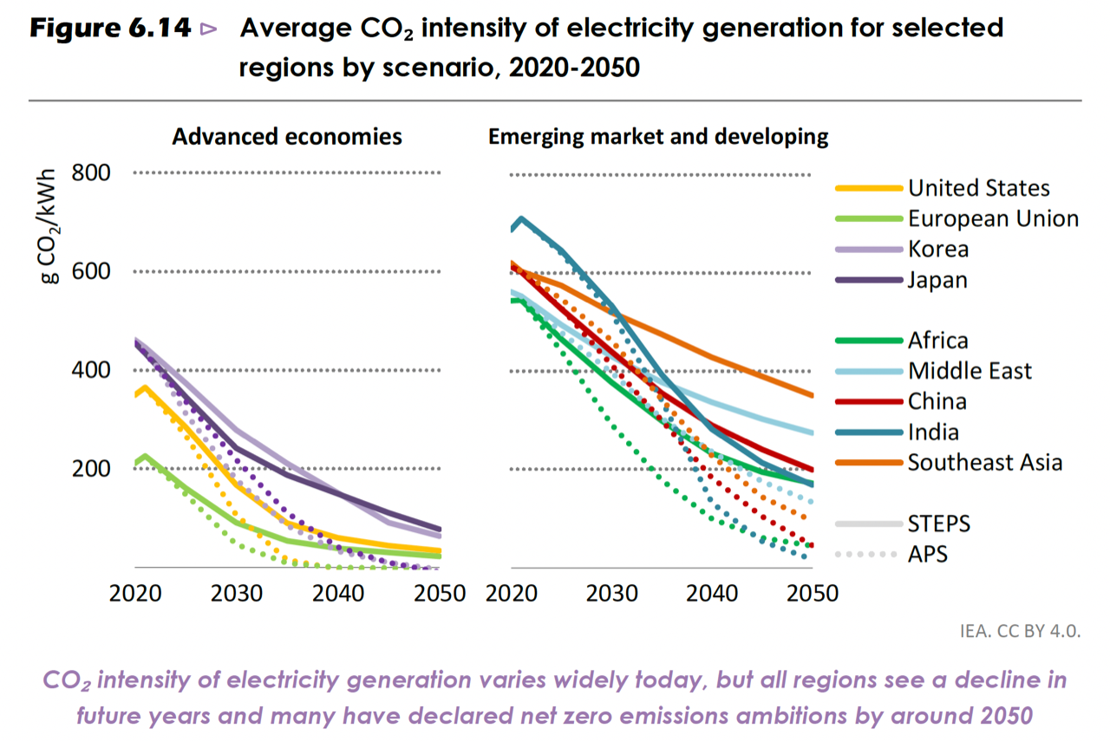
Sustainability during operation
Operation costs dominated by energy (and personnel, not discussed in the following)
Reducing power use, and costs of power, will be crucial. Other consumables (gas, liquids, travels … ) during operation need to be well justified. Align to future energy markets, green and more renewables, make sure we can be flexible customer and deal with grid stability/quality.
Carbon footprint related to energy source, relatively low already for CERN (helped by nuclear power), expected to become significantly lower towards 2050 when future accelerators are foreseen to become operational (in Europe, US and Japan).
Provided we can run on green mixtures (PPA example at CERN, also built fully into the green ILC concept) we can also contractually chose green options. LCs are very suited for this (variable power load).
A rough estimate, assuming ~50% nuclear and ~50% renewables (as wind/sun/hydro):
1 TWh annually equals ~12.5 ktons CO2 equiv. annually
(note: this is factor four below the current French summer month average)
CERN environmental report assumes 55 g/kWh -> reasonable to assume reductions by factors 2-3 in 30 years

Slide 16
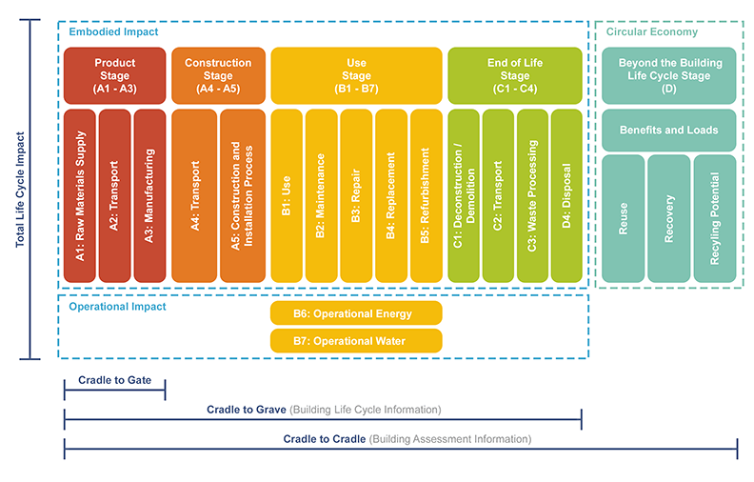
Sustainable Construction – Life Cycle Assessment
For carbon emission the construction impact will be much earlier and might be more significant (also rare earths and many other issues etc):
  Construction: CE, materials, processing and assembly – not easy to calculate
  Markets will push for reduced carbon, responsible purchasing crucial (see right) – construction costs likely to increase
Decommissioning – how do we estimate impacts ?
Responsible purchasing – and understanding the impact on our supply chain, costs and potential for changes – will be essentials for future projects (CERN implementation information from E.Cennini)

Slide 17
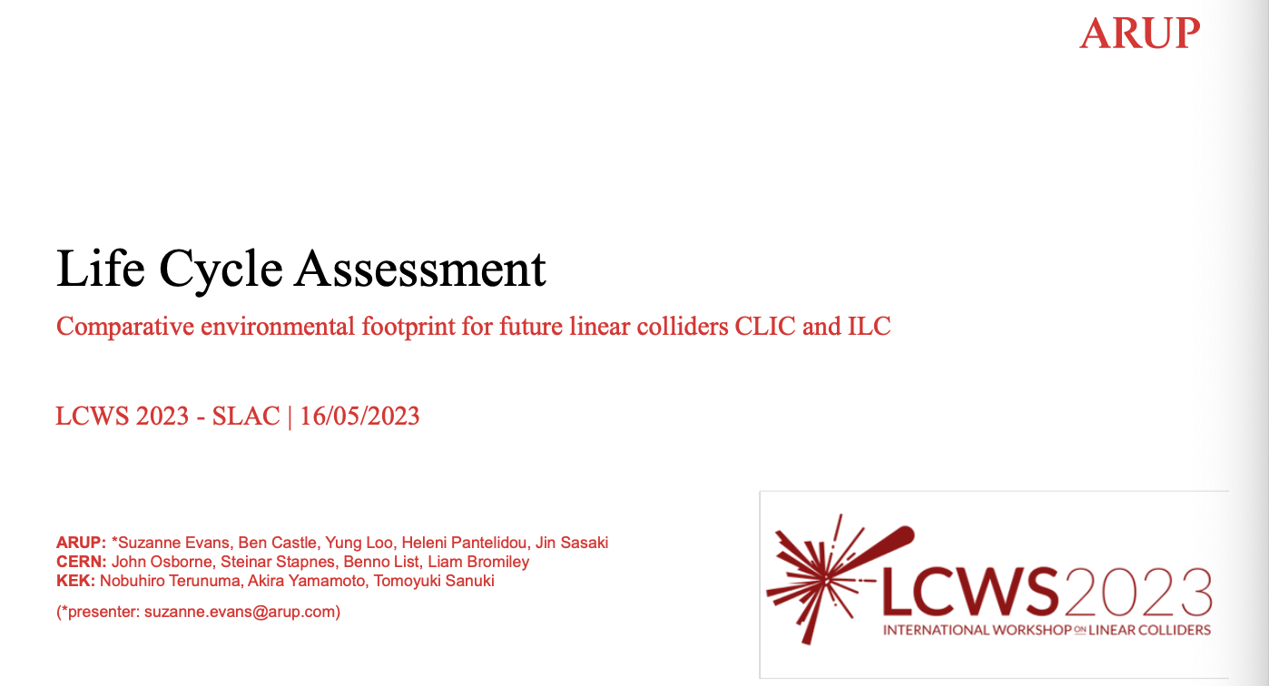
https://indico.slac.stanford.edu/event/7467/contributions/5902/attachments/2851/7968/ARUP_CERN_LCA_LCWS_-_2023.pdf
120 page final (almost) report now available

Slide 18
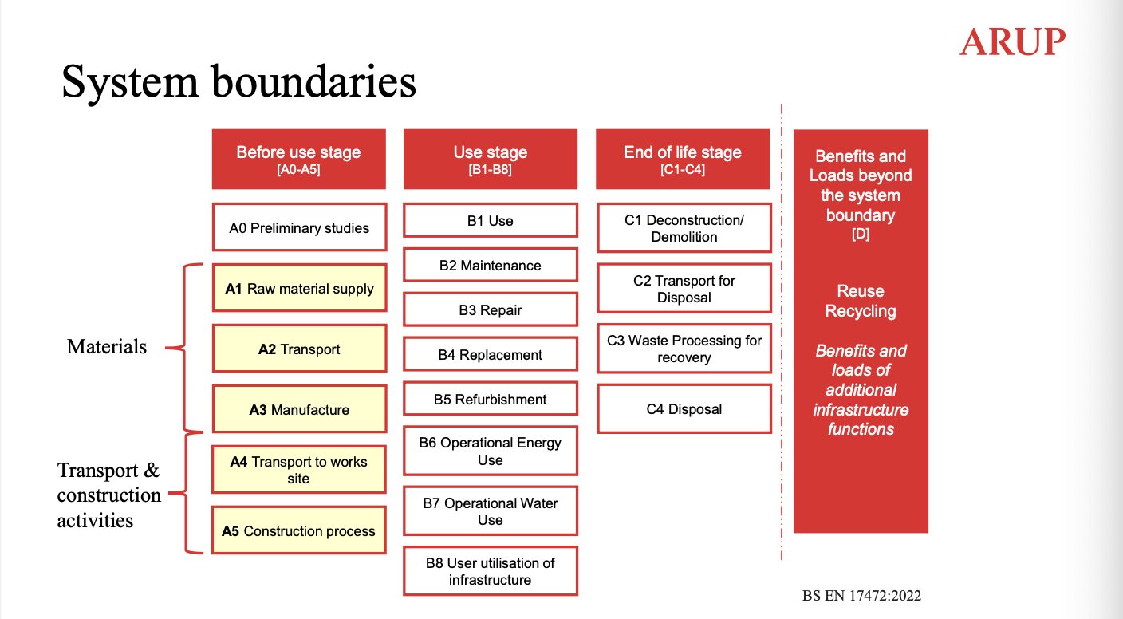
Only B6 discussed in all the slides above, now discuss A1-A5 for the CE
Missing A1-A5 for accelerator, some surface installations, all maintenance and upgrades, all EoL activities

Slide 19
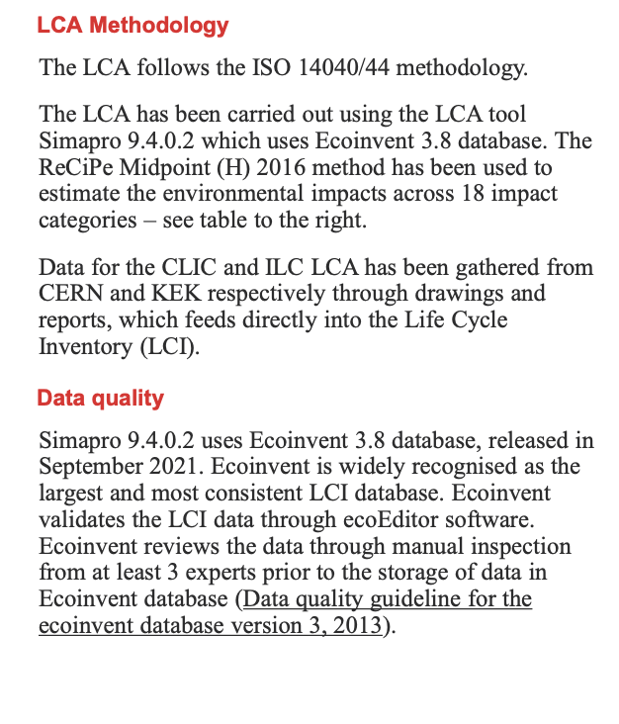
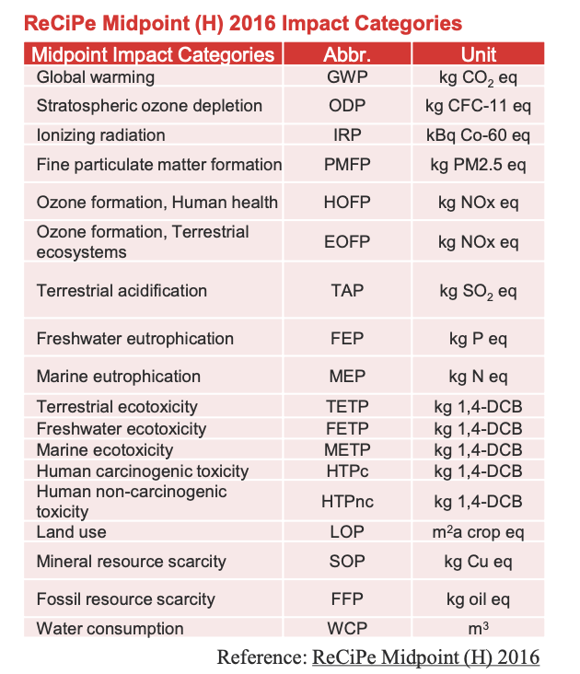

Slide 20
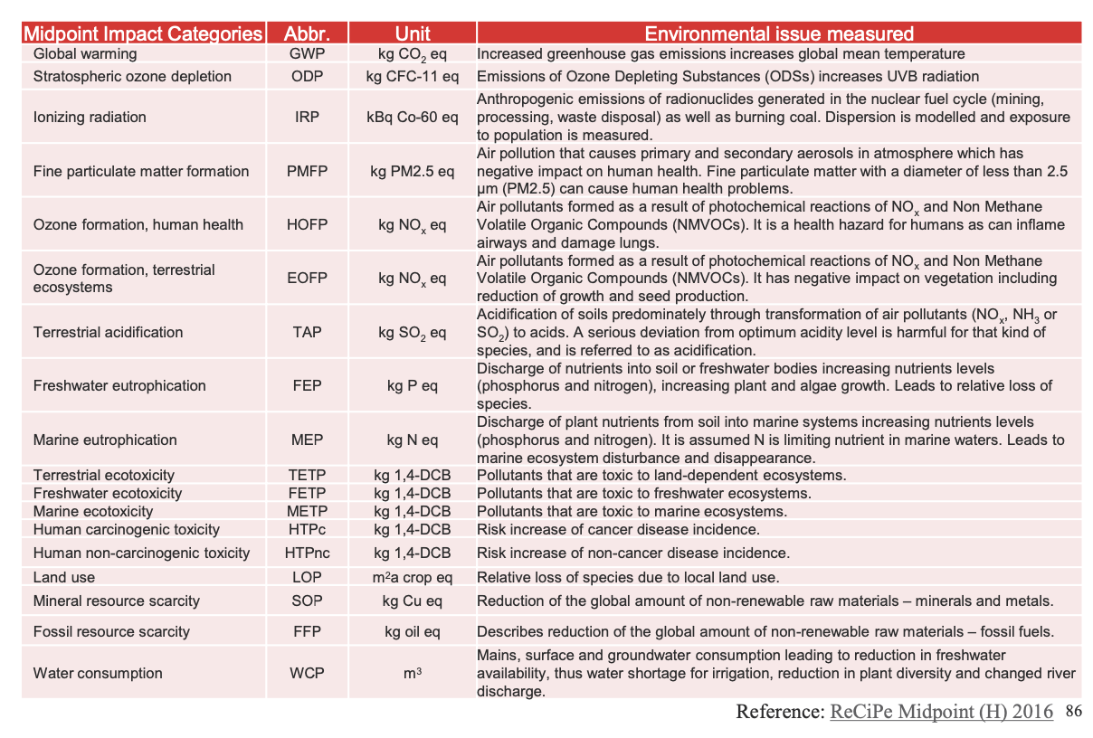

Slide 21
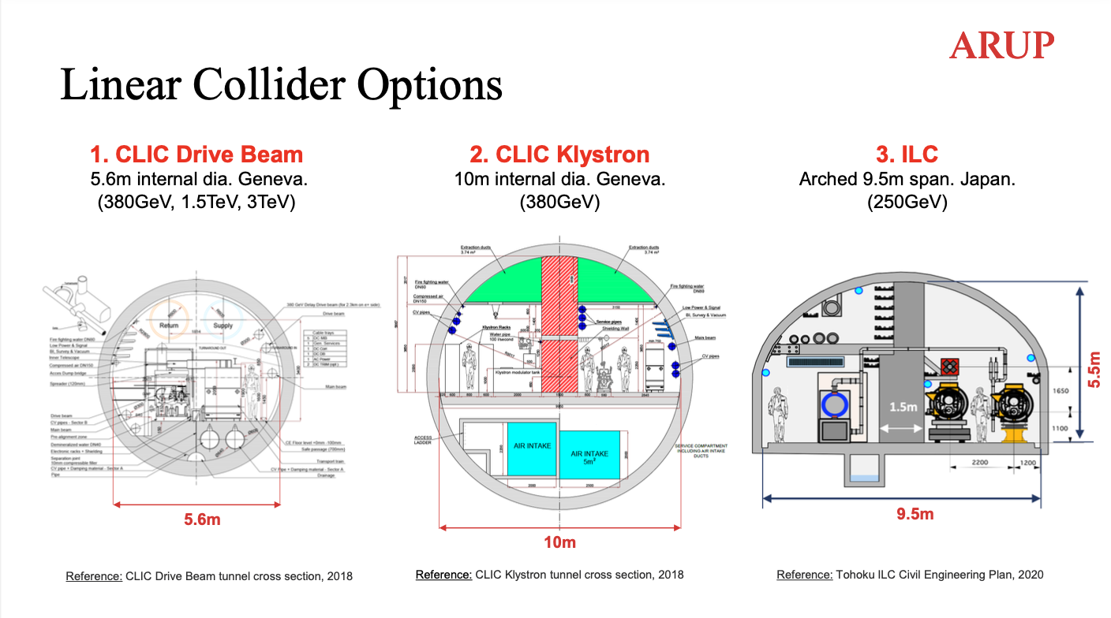

Slide 22
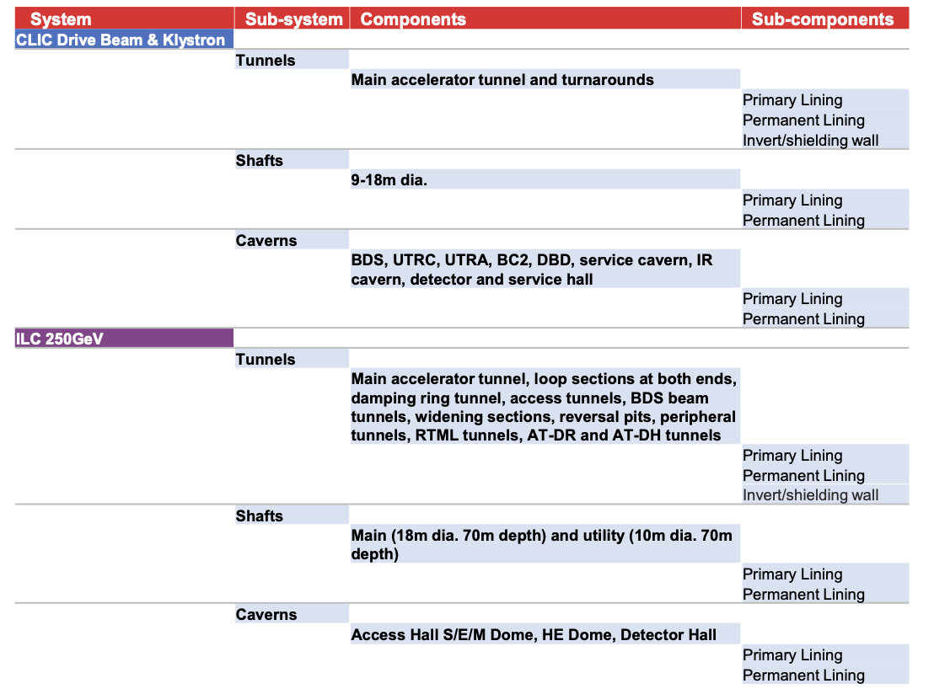

Slide 23
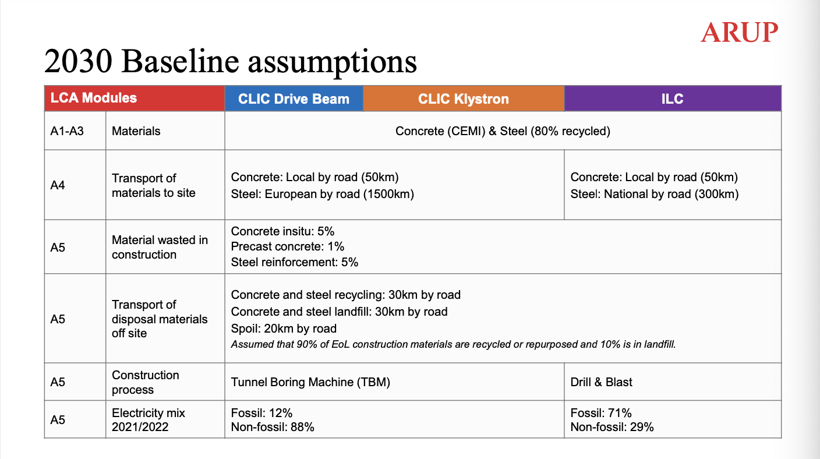

Slide 24
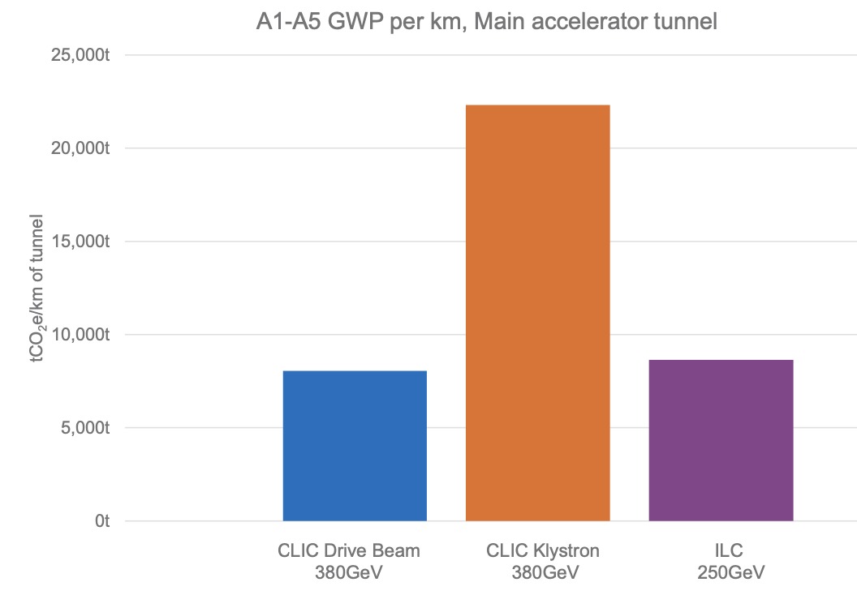
A1-A3 material only dominates
Around 6kton/km for CLIC DB and ILC
CLIC around 11km, ILC around 20 km

Slide 25
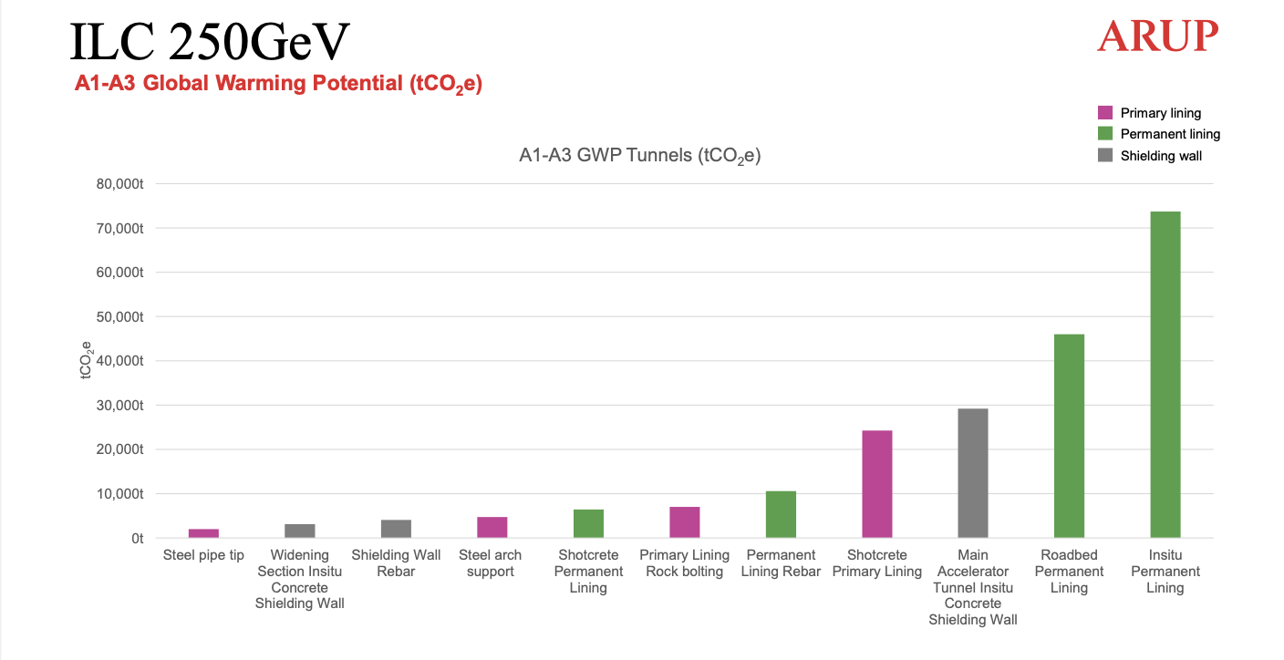

Slide 26
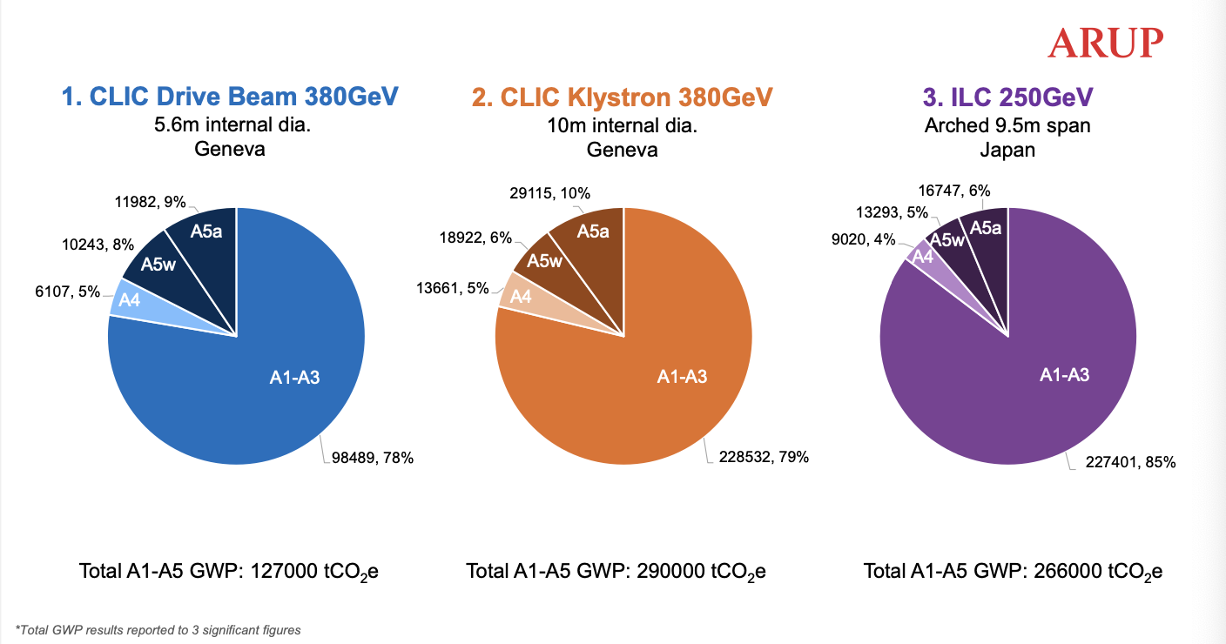

Slide 27
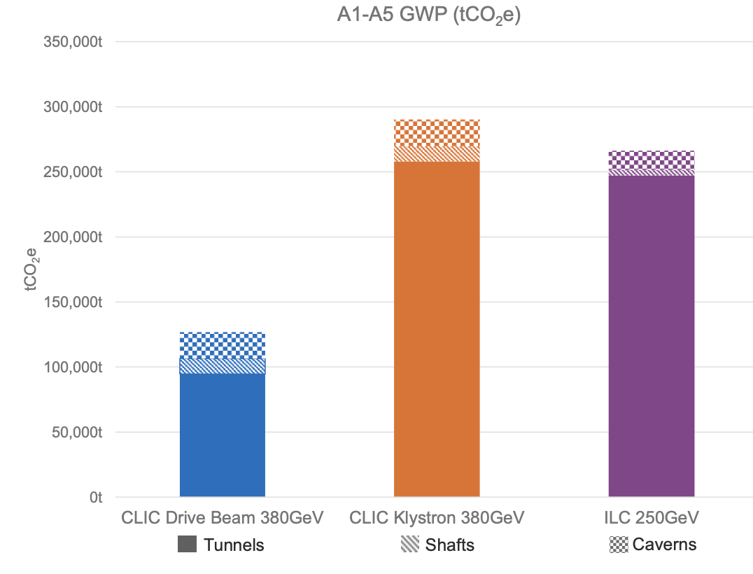
Include all tunnels (access, transfer, damping rings), shafts and caverns.
A1-A5
Scaling to main linac tunnel lengths we are now at 11-14 kton/km for the CLIC DB and ILC

Slide 28
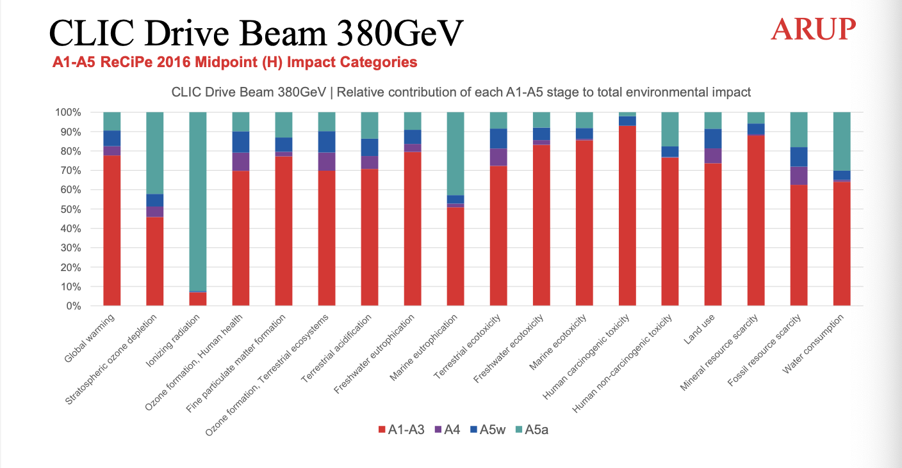

Slide 29
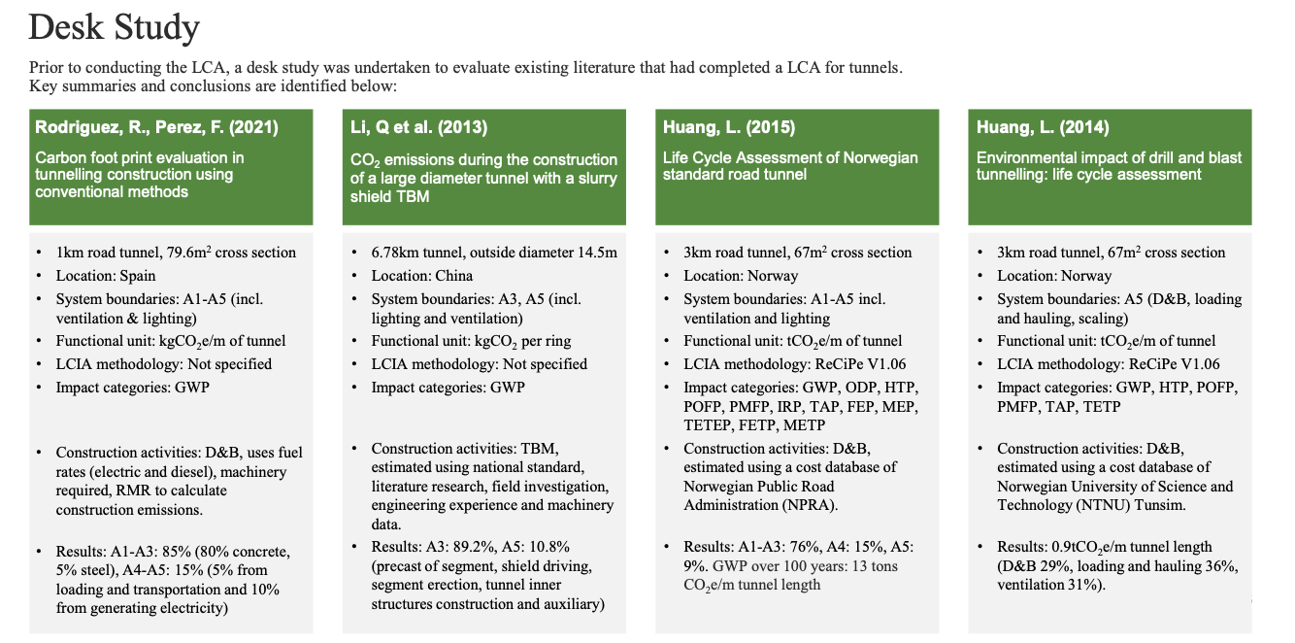
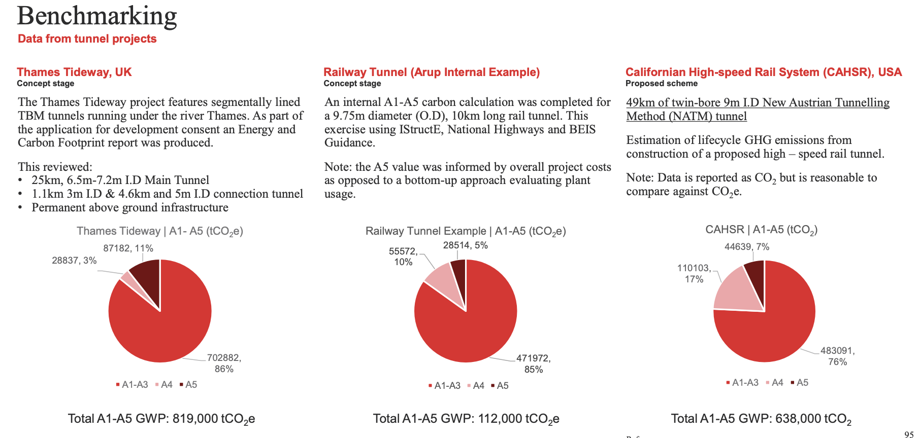

Slide 30


Slide 31


Looking at the impact of the accelerator components
Study to estimate the Green House Gas emissions from raw materials in CLIC 2-beam module, including waveguides and supports
~2.5t CO2-eq / m:
-> about half of CO2 for tunnel
Half of CO2 impact is steel for supports
-> optimization potential
Services (power, cabling, cooling, ventilation) not included
Situation in magnet-heavy sections (e.g. turn-arounds, bends, damping rings) may be different
CO2 impact of accelerator components is comparable to CO2 of main tunnel – to be studies but easily 5 kton/km

Slide 32

A1-A5: Tunnel construction (ILC and CLIC DB dimensions) is around 6kton/km
Add shafts, caverns , access tunnels, DR, etc + from 30 to 60%
Add transports, power used in construction, etc + 25%
= > ILC (20km) around 270 kton, CLIC (11 km) around 125 kton
Possible savings (but at a cost to be defined) of ~40%
Adding accelerator components and injectors more consistently (possibly 50% increase – very early days)
Operation (in ~2050)
Nuclear 5g/kWh and re-newables (sun/wind/hydro) 20g/kWh
Can be higher with poor energy mix, can be lower with good contracting (good mix)
Assume 50/50 mix => 1 TWh is 12.5 kton
CERN in current env. reports use 55g/kWh (Bellegarde)
Estimate factor 2-3 reduction towards 2050 ?
-> Energy emission estimated for LCs 0.6-0.8 TWh annually, i.e. around 10 kton CO2
-> Power nevertheless has huge cost impact, and secondary effects on CO2 (more material)
Concluding:
Construction in the 2030’ies the most (time)critical carbon emission to address (A1-A5)
LCA methodology is the way to go for sustainability studies, also for other parts (many missing) and other phases. Provides us with handles for optimisation
Upgrades removing components and decommissioning likely other major CO2 sources
All other factors to be considered, e.g. radiation, acidity, etc

Slide 33
Thanks:
CLIC and ILC teams
Benno List, Maxim Titov, Shin Michizono, Tomoyuki Sanuki, Nobuhiro Terunuma, Takayuki Saeki
John Osborne, Liam Bromiley and the the entire ARUP team
Among them slides from Suzanne Evans ARUP (talk at LCWS 2023)
more

