Slide 1


Dark matter searches at CMS
Conference on High Energy Physics,
Yerevan, Armenia, 11-14 September 2023
Maria Savina, JINR, Dubna
on behalf of the CMS Collaboration
Maria.Savina@cern.ch

Slide 2
Talk outline
Simplified dark matter models: DM portals (DM particles + mediators, “simplified models”
of DM/SM interaction)
Prompt DM production:
CMS HIG-21-007 – invisible Higgs decay
CMS PAS HIG-22-003 – exotic Higgs decays into a Za(a→ 2 gamma)
CMS PAS EXO-21-005 – prompt GeV-scale dimuon resonance
CMS EXO-19-020, JHEP 06 (2022) 156 – resonant production of strongly coupled DM with
semivisible jets
CMS PAS EXO-21-012 – DM production with a WW pair
LLP signatures:
CMS PAS EXO-21-008 – long lived decays in the muon system
CMS EXO-20-010 – inelastic dark matter with two displaced muons
Summary and outlook

Slide 3
Portals to DM: DM particle(s) + mediator(s)
Visible sector: SM
H, q, l, G, V…
mediator: S_{med}, M_{med}
Hidden sector: DM
Φ, S..,Ψ.., V’…
g_{f,V,H}
g_{DM}
only one/a few DM particle(s):
S_{DM} = 0, ½, 1…, M_{DM}
S=0,1/2, 1…
Model free parameters:
a mass of mediator(s) and DM particle(s), couplings to the visible and hidden sector, mixing angle(s)

Slide 4
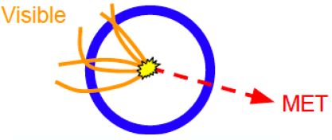
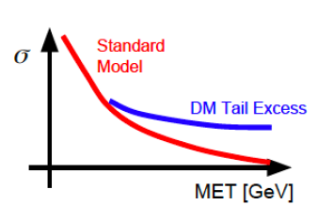
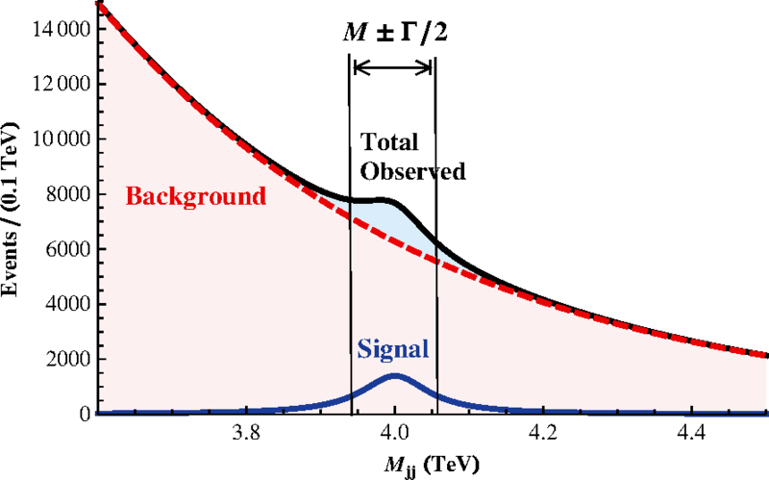
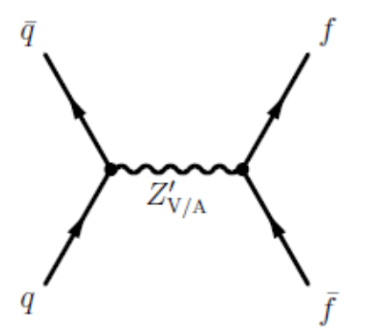
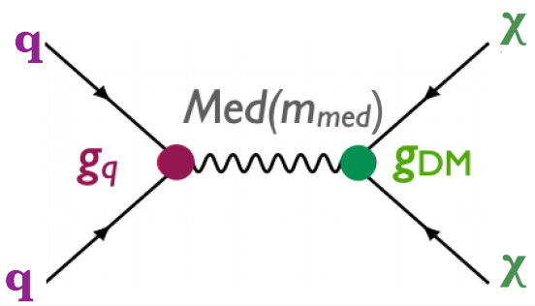
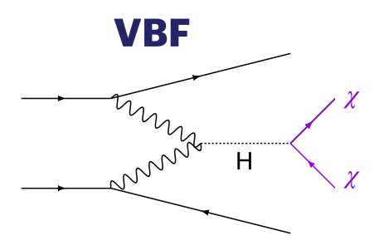
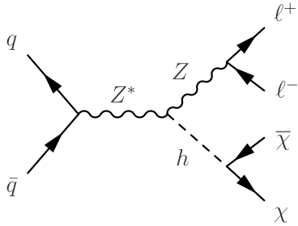
Prompt DM signatures, examples (see backup for a full list):
fully visible (a new resonance
in dijet/dilepton/diboson etc. spectra)
MET - decay to DM particle pair
(+ a visible “tag”
X(=jet/gamma/Z/H)
4 tops
V/VA
g_{q}
g_{q}
non-standard properties of SM particles
(higgs sector – higgs boson pair production,
h₁₂₅ to invisible…)
flavor violating processes
on-shell
off-shell
MET
Visible, sst

Slide 5

Combination of h₁₂₅ → invisible searches for ttbar and VH
resolved/boosted ttbarH
CMS HIG-21-007,
arXiv:2303.01214 [hep-ex]

Slide 6
Combination of h₁₂₅ → invisible searches
CMS HIG-21-007
ATLAS HIGG-2021-05

Slide 7
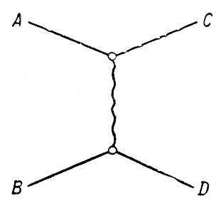
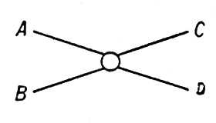

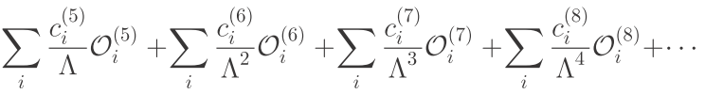








Exotic higgs decays h → Za, Z →ll, a →2 gamma
CMS PAS HIG-22-003
The first search of such type for axion-like particles (ALPs) at the LHC. Pseudoscalar portal, the light enough ALP, Z⁰-ALPs interactions
propagator
$$\overline{ψ}$$
$$\overline{q}$$
$$\overline{ψ}$$
$$\overline{q}$$
EFT
A
$$ψ$$
$$q$$
$$ψ$$
$$q$$
C_{i} are Wilson coefficients in the EFT approach that describe the ALP/SM couplings

Slide 8
Exotic higgs decays h → Za, Z →ll, a →2 gamma
CMS PAS HIG-22-003
The first search of such type for axion-like particles (ALPs) at the LHC. Pseudoscalar portal, the light enough ALP, Z⁰-ALPs interactions
propagator
$$\overline{ψ}$$
$$\overline{q}$$
$$\overline{ψ}$$
$$\overline{q}$$
EFT
A
$$ψ$$
$$q$$
$$ψ$$
$$q$$
C_{i} are Wilson coefficients in the EFT approach that describe the ALP/SM couplings

Slide 9
Exotic higgs decays h → Za, Z →ll, a →2 gamma
Limit on , when ALP decays
exclusively in a diphoton, Λ is large
CMS PAS HIG-22-003

Slide 10
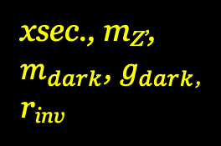
Resonant production of strongly coupled DM for semivisible jets
Hidden valley concept, hidden sector, new non-abelian
symmetries in DS, strongly interacting DM (“dark QCD”),
vector mediator Z’. A large-scale suppression of SM/DM
interactions, “semivisible” jet substructure
JHEP 06 (2022) 156
CMS EXO-19-020
semi-
visible jets
DM part
(visible) +
SM part
(invisible)
xsec., m_{Z’},
$m_{dark}$, $g_{dark}$,
r_{inv}

Slide 11
Resonant production of strongly coupled DM for semivisible jets
The first CMS study of jet ivsisible contribution with dark sector I
nterpretation. The fraction r_{inv} of stable invisible dark hadrons in between
0 (dijet, small MET) and 1 (large MET)
JHEP 06 (2022) 156
CMS EXO-19-020
See also backup for LLP dark showers – emerging jet signature

Slide 12
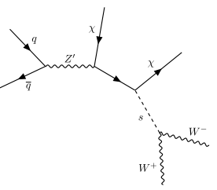
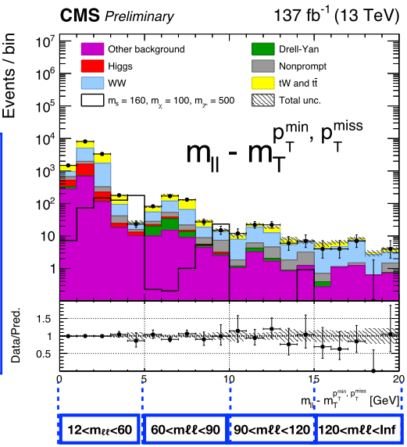
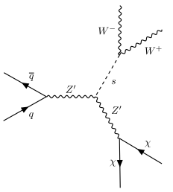


Dark Higgs model, resolved decay of s(W⁺W⁻) + $E_{T}^{miss}$
“Double portal”: both “dark higgs” s and massive $Z_{V}^{′}$
coupled to SM.
A new higgs state is weakly mixed with SM h,
a new U(1)’ → SSB(s) → massive $Z_{V}^{′}$ coupled to quarks
only
s → W⁺W⁻ decay dominates at large s mass values
arXiv:1701.08780
Model parameters : m_{s}, m_{Z’}, $m_{χ}$, g_{q}, $g_{χ}$, sinθ (h–s mix.)
CMS-PAS-EXO-20-012
Notes:
12

Slide 13
Dark Higgs model, resolved decay of s(W⁺W⁻) + $E_{T}^{miss}$
CMS PAS EXO-21-012

Slide 14


Search for dark photons, prompt/LLP
The coupling to SM particles
proportional to electric charge
1 or 2 loops: naively ${10}^{−5}≲ε≲{10}^{−3}$
$$α^{′}=ε^{2}α_{EM}$$
LLP

Slide 15
Search for prompt GeV-scale dimuon resonance
minimal dark photon model and
light scalar decay to dimuon (2HDM+S)
interpretations
CMS PAS EXP-21-005
See also backup for Higgs→
displaced muon pair analyses,
CMS PAS EXO-20-014

Slide 16
Dark sector with Long-Lived Particles at the LHC
LLP White Paper:
arXiv:1903.04497
LLP theory motivations:
arXiv:1806.07396
LLP:
a proper lifetime cτ₀ is greater than or comparable to the characteristic size of the (sub)detectors
small cτ₀ that
comparable to the
inner tracker size, no
displaced tracks →
“standard” prompt decay
intermediate cτ₀ → LLP
very large/infinite
large cτ₀ → stable particles, “standard” MET signatures
displaced jets
Notes:
16

Slide 17
LLP decays in the CMS Muon system
CMS PAS EXO-21-008
A unique technique for LLP decays reconstruction in the muon system
Sensitivity to long lived scalars with masses between 0.4 and 55 GeV
Decays in hadronic showers (bbbar, ddbar, K⁺K⁻, K⁰K⁰ , 2π, 2τ, 2γ etc.)
Interpretations for dark showers and twin Higgs models

Slide 18
LLP decays in the CMS Muon system
CMS PAS EXO-21-008
A unique technique for LLP decays reconstruction in the muon system
Sensitivity to long lived scalars with masses between 0.4 and 55 GeV
Decays in hadronic showers (bbbar, ddbar, K⁺K⁻, K⁰K⁰ , 2π, 2τ, 2γ etc.)
Interpretations for dark showers and twin Higgs models

Slide 19
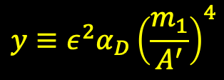
Search for inelastic DM with two displaced muons + MET
CMS EXO-20-010
Inelastic DM – dark photon A’ (m_{A’}, kinematic
mixing ε), and two closely degenerated by mass
DM states (mass splitting Δ, mass of χ₁ m₁),
LLP χ₂( lifetime cτ), dark gauge-fermion
coupling α_{D}
LLP
10-40% of m₁
$$y≡ε^{2}α_{D}{\left(\frac{m_{1}}{A^{′}}\right)}^{4}$$
The interaction strength
The first LHC search of such a type – mixed LLP + MET signature
A pair of displaced muons (soft, collimated)
Large MET collimated with muons
IS energetic jet as a tag

Slide 20
Search for inelastic DM with two displaced muons + MET
CMS EXO-20-010

Slide 21
Summary and outlook on DM searches
Wide variety and an extensive list of analyses on DM and hidden sector at CMS
Still no signals of new DM particles/mediator
Further development of an analysis (scouting triggers , new signatures like semivisible jets,
novel prompt/LLP reconstruction algorithms) and related theory/simplified model approaches,
new interaction channels, new frameworks
  CMS analyses summary on DM search and much more:
      https://twiki.cern.ch/twiki/bin/view/CMSPublic/PhysicsResultsEXO

Slide 22

There’s no point in describing what’s happening,
so I’ll just write: we’re fine

Slide 23
Thank you for your attention!

Slide 24
Backup slides
Notes:
24

Slide 25

Spin of DM mediator: Higgs/gauge (or both) portals to dark matter
Higgs portal: DM interacts with our world only through coupling with the Higgs sector →
special importance of Higgs connected studies
Additional higgs bosons needed to accommodate DM → an extended Higgs sector. How to extend?
SM style…
SM + one singlet (real/complex) – SM + S, the simplest singlet-doublet model (the doublet corresponds to the SM)
SM + one doublet (real/complex) – 2H(iggs)D(oublet)M(odel), flavor conserving 4 types (type II – MSSM), 5 physical states: h, H (CP-even), A (CP-odd), $H^{+/−}$ ; h–H mixing, “the aligment (decoupling) limit” → h₁₂₅ = h
SM + doublet + scalar singlet (r/c) – 2HDM+S or N(ext/non-minimal)2HDM, flavor conserving 4 types (type II – NMSSM), 7 physical states, one is the pseudoscalar → 2HDM+a in the simplified description
SM + 2 doublets – 3HDM etc.
and non-SM style (SM: isosinglet and isodoublet reps. under SU(2) weak symmetry group). Then how?
isotriplet representations of SU(3) for Higgs fields (Georgi-Machacek model etc.)…
Bright experimental signatures: extra Higgs states, neutral and (doubly)charged, CP-odd and CP-even ones, lighter and heavier than the SM Higgs h₁₂₅
Also: gauge portal → the (axial)vector mediator and double portal → both vector + scalar mediators

Slide 26
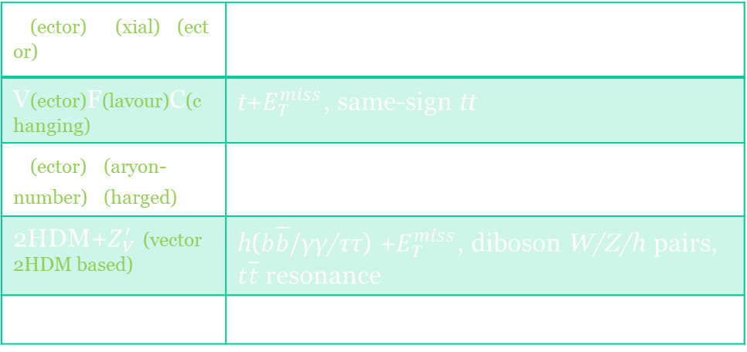
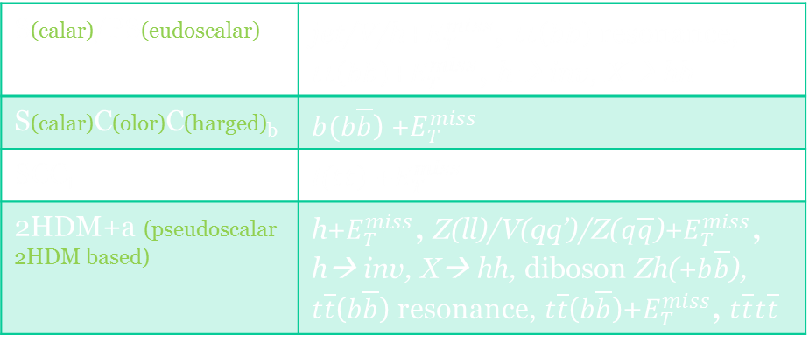
SDM models and prompt DM signatures
Generalized or model specific search, combinations of visible and MET signatures
The (axial)vector mediator
The (pseudo)scalar mediator
V(ector)/A(xial)V(ector) | dijet (dilepton), diboson hW/Z pair, $t\overline{t}$ resonance
V(ector)F(lavour)C(changing) | t+$E_{T}^{miss}$, same-sign tt
V(ector)B(aryon-number)C(harged) | h($b\overline{b}$/γγ/ττ) +$E_{T}^{miss}$
2HDM+$Z_{V}^{′}$ (vector 2HDM based) | h($b\overline{b}$/γγ/ττ) +$E_{T}^{miss}$, diboson W/Z/h pairs, $t\overline{t}$ resonance
Dark higgs $Z_{V}^{′}$+s | s($b\overline{b}$) +$E_{T}^{miss}$
S(calar)/PS(eudoscalar) | jet/V/h+$E_{T}^{miss}$, $t\overline{t}$($b\overline{b}$) resonance, $t\overline{t}$($b\overline{b}$)+$E_{T}^{miss}$, h→ inv, X→ hh
S(calar)C(olor)C(harged)_{b} | $b(b\overline{b}$) +$E_{T}^{miss}$
SCC_{t} | t($t\overline{t}$) +$E_{T}^{miss}$
2HDM+a (pseudoscalar 2HDM based) | h+$E_{T}^{miss}$, Z(ll)/V(qq’)/Z($q\overline{q}$)+$E_{T}^{miss}$, h→ inv, X→ hh, diboson Zh(+$b\overline{b}$), $t\overline{t}$($b\overline{b}$) resonance, $t\overline{t}$($b\overline{b}$)+$E_{T}^{miss}$, $t\overline{t}t\overline{t}$
A key: separation/reinterpretation and a wide complementary search with all available signatures

Slide 27
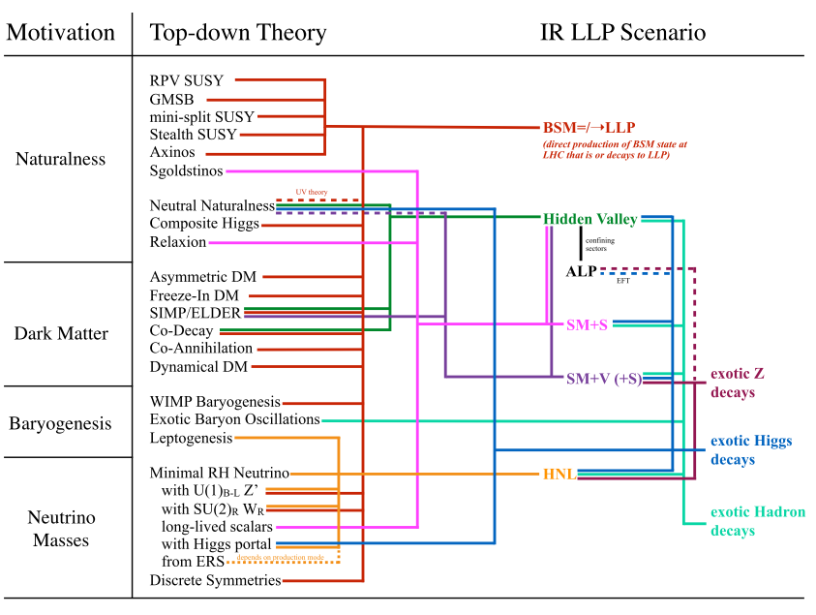
Inelastic dark matter at the LHC/LLP
https://arxiv.org/abs/1901.04040
Dark photon
Heavy neutral leptons (quarks)
Dark GB and/or Higgs(es)…
Higgs/GB/gluon/SUSY portals
    (Asymmetric DM/
    Baryogenesis)
      Dark SUSY
      Dark QCD
    Twin Higgs
    ALPs (CP-violation)…
DS: small couplings, compressed spectra, large hierarchy → large cτ
Notes:
27

Slide 28
Emerging jets/dark showers
Dark QCD
One of the most striking DM-targeted signatures
(Dark QCD → dark showers)
Tracks start near the edge of the tracker, in the
ECAL and HCAL and even in the inner muon stations
Notes:
28

Slide 29
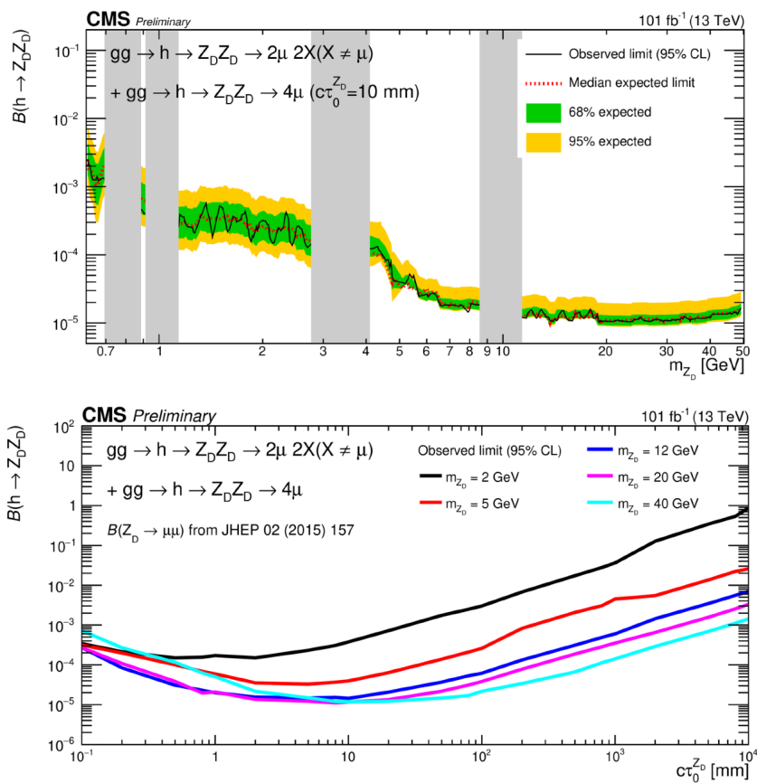
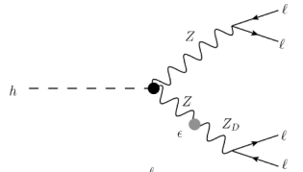
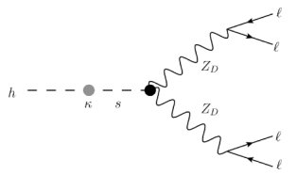
Higgs decay to dark photons: displaced muon jets
CMS-PAS-EXO-20-014
Z–Z_{D} conversion, ε²
Higgs – dark higgs conversion, κ
Notes:
29

