Slide 1





Detection 1
Logging and Traceability who, what, when, where, how
… why?
David Crooks
UKRI STFC
EGI CSIRT/IRIS Security team
david.crooks@stfc.ac.uk

Slide 2
Introduction
Logging basics
Central logging
Data Protection
Network logging

Slide 3
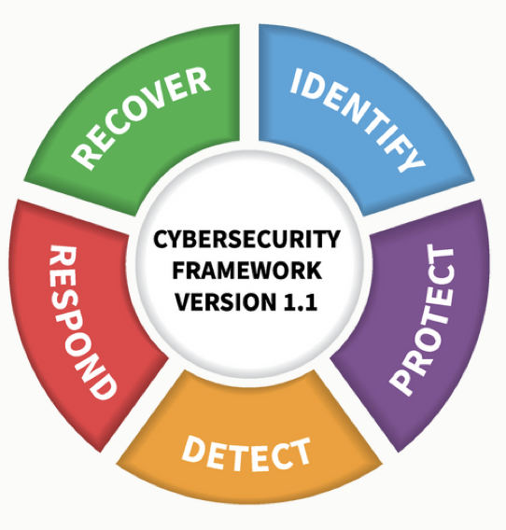
Preamble
Consider the NIST Cybersecurity elements from yesterday
Identify
Protect/Prevent
Detect
Respond+Recover

Slide 4
Preamble
Consider the NIST Cybersecurity elements from yesterday
Identify
Protect/Prevent
Detect
Respond+Recover

Slide 5
Preamble
Assessing your risk and having visibility of your services and systems is absolutely essential
Everything we’re about to discuss assumes that – to some extent – our area has been assessed for risk

Slide 6
Why do we log?
Input
To know what happened in as much detail as necessary
Often, security concerns are an extension of operations
  What happened?
  When did it happen?
  Where did it happen?
  How did it happen?
  Why did it happen?
?
Output

Slide 7
Examples
Why did this data transfer fail?
Why did this job only complete partially?
Which endpoints were involved in this process?
What did the attacker do?

Slide 8
Day to day life
Logs are an integral part of our technical lives
But as we head heard yesterday, with this ubiquity comes careful consideration

Slide 9
Host/service logs
Application logs
System logs
Application
System

Slide 10
Host/service logs
Application logs
  Apache
  Drupal
  Ceph
  Dcache
  ...
Application
System

Slide 11
Host/service logs
Application logs
These depend on the service
Talk about this again in traceability, but: service owners are best placed to understand what is useful!
Application
System

Slide 12
Host/service logs
System logs
Give us an understanding of the behaviour of the system itself
  Direct access via ssh
  System behaviour
  Auditing over time
(Paths will be for RHEL Distros)
Application
OS

Slide 13
Host/service logs
System logs
  /var/log/audit.log
type=USER_AUTH msg=audit(1655751006.984:3758): pid=26347 uid=0 auid=4294967295 ses=4294967295 subj=system_u:system_r:sshd_t:s0-s0:c0.c1023 msg='op=pubkey_auth rport=35186 acct="centos" exe="/usr/sbin/sshd" hostname=? addr=A.B.C.D terminal=? res=success'
type=USER_AUTH msg=audit(1655751006.984:3759): pid=26347 uid=0 auid=4294967295 ses=4294967295 subj=system_u:system_r:sshd_t:s0-s0:c0.c1023 msg='op=key algo=ssh-rsa size=4096 fp=SHA256:48:43:a1:08:47:36:a3:69:1a:d0:72:24:58:f3:e3:07:7d:99:ce:0b:bd:d5:cd:fb:10:bc:37:18:cf:f8:4a:a4 rport=35186 acct="centos" exe="/usr/sbin/sshd" hostname=? addr=A.B.C.D terminal=? res=success'
type=USER_ACCT msg=audit(1655751006.994:3760): pid=26347 uid=0 auid=4294967295 ses=4294967295 subj=system_u:system_r:sshd_t:s0-s0:c0.c1023 msg='op=PAM:accounting grantors=pam_unix,pam_localuser acct="centos" exe="/usr/sbin/sshd" hostname=X.Y.Z addr=A.B.C.D terminal=ssh res=success'
type=CRYPTO_KEY_USER msg=audit(1655751006.994:3761): pid=26347 uid=0 auid=4294967295 ses=4294967295 subj=system_u:system_r:sshd_t:s0-s0:c0.c1023 msg='op=destroy kind=session fp=? direction=both spid=26348 suid=74 rport=35186 laddr=A.B.C.D 6 lport=22 exe="/usr/sbin/sshd" hostname=? addr=A.B.C.D terminal=? res=success'
type=USER_AUTH msg=audit(1655751006.996:3762): pid=26347 uid=0 auid=4294967295 ses=4294967295 subj=system_u:system_r:sshd_t:s0-s0:c0.c1023 msg='op=success acct="centos" exe="/usr/sbin/sshd" hostname=? addr=A.B.C.D 6 terminal=ssh res=success'
type=CRED_ACQ msg=audit(1655751006.996:3763): pid=26347 uid=0 auid=4294967295 ses=4294967295 subj=system_u:system_r:sshd_t:s0-s0:c0.c1023 msg='op=PAM:setcred grantors=pam_env,pam_unix acct="centos" exe="/usr/sbin/sshd" hostname=X.Y.Z addr=A.B.C.D terminal=ssh res=success'
type=LOGIN msg=audit(1655751006.996:3764): pid=26347 uid=0 subj=system_u:system_r:sshd_t:s0-s0:c0.c1023 old-auid=4294967295 auid=1000 tty=(none) old-ses=4294967295 ses=215 res=1
type=USER_ROLE_CHANGE msg=audit(1655751007.128:3765): pid=26347 uid=0 auid=1000 ses=215 subj=system_u:system_r:sshd_t:s0-s0:c0.c1023 msg='pam: default-context=unconfined_u:unconfined_r:unconfined_t:s0-s0:c0.c1023 selected-context=unconfined_u:unconfined_r:unconfined_t:s0-s0:c0.c1023 exe="/usr/sbin/sshd" hostname=X.Y.Z addr=A.B.C.D terminal=ssh res=success'
type=USER_START msg=audit(1655751007.145:3766): pid=26347 uid=0 auid=1000 ses=215 subj=system_u:system_r:sshd_t:s0-s0:c0.c1023 msg='op=PAM:session_open grantors=pam_selinux,pam_loginuid,pam_selinux,pam_namespace,pam_keyinit,pam_keyinit,pam_limits,pam_systemd,pam_unix,pam_lastlog acct="centos" exe="/usr/sbin/sshd" hostname=X.Y.Z addr=A.B.C.D 6 terminal=ssh res=success'
Application
OS

Slide 14
Host/service logs
System logs
  /var/log/audit.log
aureport can be used to get summary information
Application
OS

Slide 15
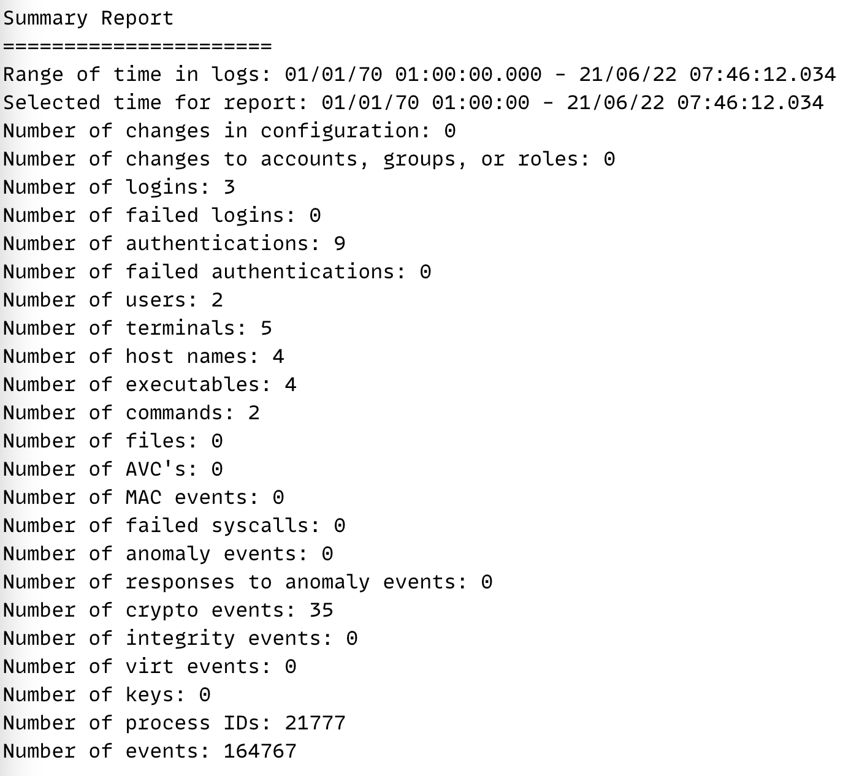
Host/service logs
System logs
  /var/log/audit.log
Application
OS

Slide 16
Host/service logs
System logs
  Auditbeat
Part of the elasticsearch Beats set of tools that can also extract and effectively parse audit data
Application
OS

Slide 17
Host/service logs
System logs
  /var/log/messages
Records global log messages, system notifications including those during boot
Application
OS

Slide 18
Host/service logs
System logs
  /var/log/secure
Records successes and failures for users using ssh to access the system
Application
OS

Slide 19
Host/service logs
System logs
  /var/log/secure
Jun 19 22:18:36 hostname sshd[26877]: Accepted publickey for user from A.B.C.D port 60096 ssh2: RSA SHA256:…
Success!
Application
OS

Slide 20
Host/service logs
System logs
  /var/log/secure
Jun 20 19:08:58 hostname sshd[7555]: Invalid user admin from A.B.C.D port 36844
Application
OS

Slide 21
Host/service logs
System logs
  /var/log/secure
Jun 20 19:08:58 hostname sshd[7555]: Invalid user admin from A.B.C.D port 36844
🧐
Application
OS

Slide 22
Host/service logs
System logs
  /var/log/secure
… this is why you harden your systems (although only a real problem if they succeed)
A primary source of checking for malicious access
Unless?
Application
OS

Slide 23
A successful attacker
Gains access via a weak password (password2023-2)
Installs a compiler, builds some code…
… hides their tracks by truncating the logs

Slide 24
Central logging
Logs are data
Vulnerable to deletion or corruption
Back them up!

Slide 25
Central logging

Slide 26
Central logging
One of the single most important things to do for the security of a service
Helps incident response
Helps correlate logs between hosts

Slide 27
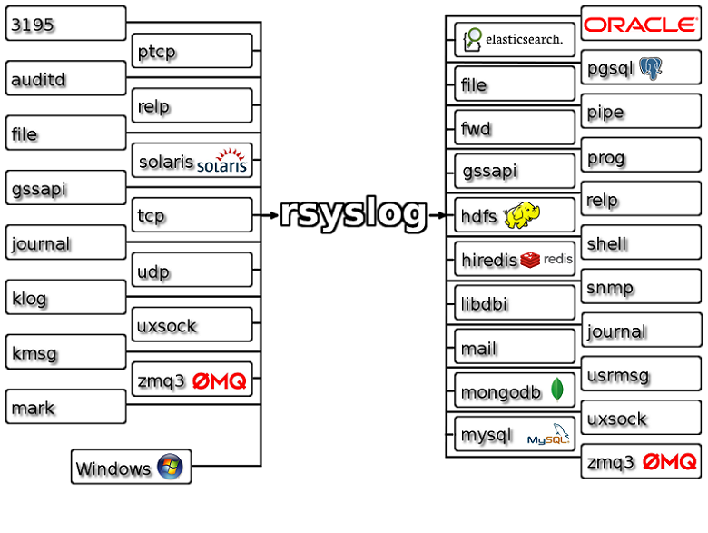
rsyslog
rsyslog is a well-featured logging engine
rsyslog and syslog-ng are both feature-rich successors to the original syslog
https://www.rsyslog.com

Slide 28
rsyslog and other tools
Especially at this point, storing raw logs is not the most useful
Use a tool like elasticsearch to allow better searching an querying of the data

Slide 29

OSSEC/Wazuh
OSSEC is a very nice host-based IDS that will aggregate logs in a server/client topology
Customisable rules
Very flexible
https://www.ossec.net

Slide 30

OSSEC/Wazuh
Wazuh is a modern development of OSSEC that integrates tightly with elasticsearch
Important when considering defence in depth – having one exactly one tool to monitor your system is not optimal (necessary ☺ )
https://wazuh.com/

Slide 31

Wazuh/OSQuery
Wazuh can monitor many useful things at the host level
  File integrity + checksums
  Configuration Assessment
  Extended Detection and Response
OSQuery is a nice tool that provides an SQL interface to system information
https://wazuh.com/
https://osquery.io

Slide 32
System + application logs
Discussed some key system logs
Application logs are best understood by their service owners: how to choose what you need?

Slide 33
System + application logs
We can’t store an infinite amount of logs
And we don’t want to
“too much data looks like noise”

Slide 34
Data protection
I am not a lawyer ☺

Slide 35
Data protection
GDPR
CERN OC11
Development of UK data protection laws
Working with laws in other countries
We are in an era where individual privacy rights are rightly taken particularly seriously
This is not something that should hinder our security work

Slide 36
GDPR and CSIRT activities
In GDPR and associated findings the exchange of logs for incident response is recognized as a useful activity
https://www.first.org/blog/20171211_GDPR_for_CSIRTs
We do need to be careful about what we store, why, and for how long

Slide 37
Log retention
In WLCG, for a long time 90 days was the retention period set by policy
Now moving towards 180 days or more: why?

Slide 38
Log retention
The number of incidents that have their beginning many months ago
Only having logs for 90 or 180 days means we lose visibility
12 – or 13 – months is where we might set our sights

Slide 39
Log retention: practical matters
Of course, there are practical matters
  Logs take up room
Central logging also makes capacity planning easier
  Build to a set of services that are logged
Continuous improvement is important

Slide 40
Log retention: practical matters
Our architecture will suggest where and how many logs we can keep
This can and should evolve over time
Focus on sustainable development

Slide 41
Traceability
For security, we want the logs that will help us piece together a set of events
  When did someone gain access?
  What did they do on the host?
  Where did they go next?
  What other hosts did they talk to?

Slide 42
Traceability
Traceability is the ability for us to trace the activity associated with a particular user and/or particular workflow
Want to be able to track the entire lifecycle
  Initiation
  Primary events
  (External) communications
  Closeout

Slide 43
Traceability
Core system logs are essential; for application logs we want anything that helps piece these together
Debug logs don’t help with this
It is likely that this will also evolve over time
Make a plan and iterate based on your risks and resources

Slide 44
Split traceability
Our the, current circumstances, it is highly likely that the logs from a particular service – or even facility – will not be sufficient to track the activity of a user or group
Why?

Slide 45
Split traceability
In research and education, invariably work as part of a bigger infrastructure, federation or federation of federations

Slide 46
Split traceability
Many (most!) of our activities involve many services composed together
  WLCG pilot jobs
  Cloud services
We can no longer rely on the logs on a single host/in a single facility to assemble the full picture of a user’s activity

Slide 47
grid jobs: before
Job
Site
logs

Slide 48
pilot jobs: after
Pilot
Job
Site
Identity Provider
CSIRT coordination

Slide 49
Cloud services
Individual code
Project services
Project infrastructure
OpenStack infrastructure

Slide 50
How do we check we our traceability?
Planning and policy
Collaboration and cooperation
Testing
Find use cases that are appropriate for you and try them out!

Slide 51
Network logging
We’ve talked about host based logs
What’s happening on the network?

Slide 52
Sources of network logs
Routers
Host-based generators
Monitoring

Slide 53
Netflow and sflow
Netflow and sflow are different but similar methods of storing metadata about network connections
  Endpoints/duration/…
Most switches we’ll use will generate one or the other
Can generate on-host
  hsflowd
Netflow came from Cisco
sflow came from InMon

Slide 54
Netflow and sflow
Pros
  Ubiquitous
  Easy to generate
Cons
  Sampled
In general, have sampled data from netflow and sflow
  Useful for long term connections but not forensically useful

Slide 55
Netflow and sflow
Netflows are especially useful at a high level
  NRENS
You can produce 1:1 data, but…

Slide 56
Deep Packet Inspection
Using a tool that analyses every packet it sees will yield rich information
  Metadata
  File information
  Certificate information…
Can’t see inside encrypted streams unless you do decryption

Slide 57
Zeek
Zeek is an example of a current network IDS in broad use in the US and EU
  Ingest data by taking tap of network traffic
  Optical, port spanning or packet broker
Single threaded, works by running a set of scripts against each packet
  Scale out by building a zeek batch farm
Network data
Zeek

Slide 58
Zeek
This gives us forensic level results
  Every packet is tracked
But this is computationally expensive
  Need care in choosing deployment
More on this soon
Network data
Zeek

Slide 59
Conclusions
We need to retain logs that describe the activity of our users and services
  For long enough to perform forensics
  Following our legislation
  Pragmatically for our environment

Slide 60
Conclusions
We can identify logs in our services that will help with this
  System
  Application
We can centrally log these
  And should!

Slide 61
Conclusions
We need to consider traceability in being able to piece together the events related to a particular user or activity
This is very likely to require composition with other sources including other sites

Slide 62
Conclusions
In addition to host-based logs, we can also log traffic from our networks
{Net,s}flow generally give sampled, high-level metadata
Deep packet inspection gives us greater, forensic detail
  But more computationally intensive

Slide 63
Questions?

