Slide 1
Welcome to the thematic CERN School of Computing
Alberto Pace, school director

Slide 2



CERN’s mission
Innovation
Education
CERN
uniting people
The CERN School of Computing is here …
Research
?
Discovery
Accelerating beams
(accelerators)
Detecting particles
(experiments)
Large-scale computing (Analysis)

Slide 3
A school with a long history
The school was created in 1970, 2023 has been the 44th edition
This is the 13th edition of the Thematic School
The school has visited 23 countries
  all member states (except Bulgaria, Slovak Republic)
  + Croatia, Cyprus, India
84 different nationalities
3145 students have followed the school

Slide 4
Mandate and mission
Create a common culture in scientific computing among young scientists and engineers involved in particle physics or other sciences, as a strategic direction to promote mobility and to facilitate the development of large computing-oriented transnational projects.
  http://cern.ch/csc
Participants come from worldwide laboratories and universities with typically 20 to 30 different nationalities (61 different nationalities in the past 10 years).
  http://cern.ch/csc/alumni

Slide 5
Bridging science and computing
The unprecedented technological evolution in computing has profited directly to several scientific research projects, in particular in high energy physics
  Computing is today the main strategy for many sciences to boost their research productivity
It is nowadays essential that:
  Scientists master computing technologies as the main tool for their research
  Computer scientists understand the scientific domain of the investigation to deliver computing services that meet the needs of the research project

Slide 6
An additional side effect …
… knowledge transfer of (CERN) skills and (CERN) know-how in computing to academic, national laboratories, research institutes, institutional and industrial circles in Member States and other countries
  With direct or potential applications up to all spheres of the society (as exemplified with the Web, and the Grid).

Slide 7



The CERN Schools of computing
The Main School
  Two weeks, ~ 60 participants (82 last year)
  Multiple topics on scientific computing
The Thematic schools
  Goes more in depth on a particular topic
  Smaller participation, shorter duration (one week), clear goals
  Last year, two schools 35 + 38 participants
  This school: 23 participants
The Inverted school
  It is frequent to find among students real experts on specific topics, and the cumulated knowledge of the students exceeds the one of lecturers.
  At the end of each school, we invite students to propose some lectures, and we organize an “inverted” school. “Where students turn into teachers”
  In 2023, the 14th edition had 14 lecturers and more than hundred participants

Slide 8
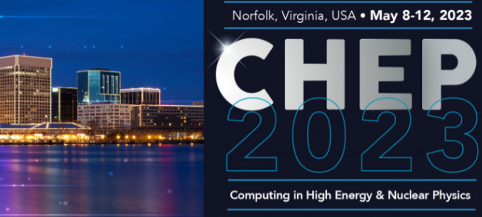
The School Academic Dimension
The school …
  … is not a conference
  … is not a place for lecturers to present their work, promote their projects
  Does not replicate of common training available at home institutes, or in member state’s universities
  Does not delivering “technical training” courses
Focus on persistent knowledge, less notions
and knowhow
Training
Programme
C++
Java
Oracle SQL
Oracle Forms
Python

Slide 9
Focus on Knowledge
Knowledge versus Knowhow
Knowledge | Knowhow
Articulated to other knowledge of the learner | Generally stand-alone information
By nature, when taken by the learner, different between learners | Initially, the same for every learner
Transferable, adaptable to other environments | Transfer requires effort
When taken by the learner, persistent | Will be forgotten if not practiced
Requires related knowledge pre-exist | Limited pre-requirements

Slide 10
A statement from Ivica …
https://www.facebook.com/1334424117/posts/10232249117833997/?mibextid=rS40aB7S9Ucbxw6v
“Another reason for your optimism is the fact that you go to school every day to learn something new. I know you are usually not exactly thrilled about going and being in school, but consider the following arguments. For thousands of years, millions of people have tried to understand various things about nature and society. Some of them spent their entire lives trying to understand the basic laws of nature, what our planet looks like, how the universe looks like, how stars, planets, people etc were created. You learn most of these things in a few hours of teaching and working at school or at home. From that perspective you know more after a few years of school than some of the greatest scientists in human history. And you find out more and more every day.”

Slide 11
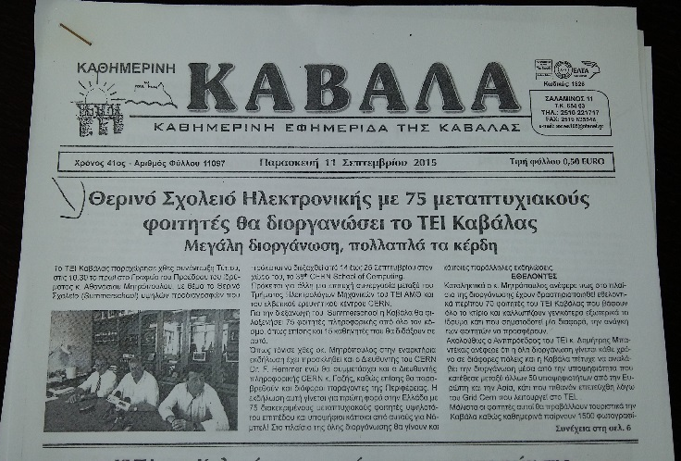
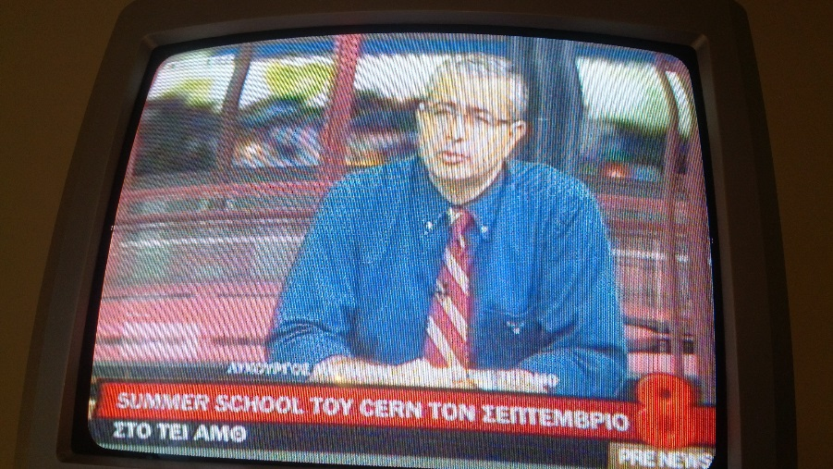
An outreach opportunity
For the local organizers

Slide 12
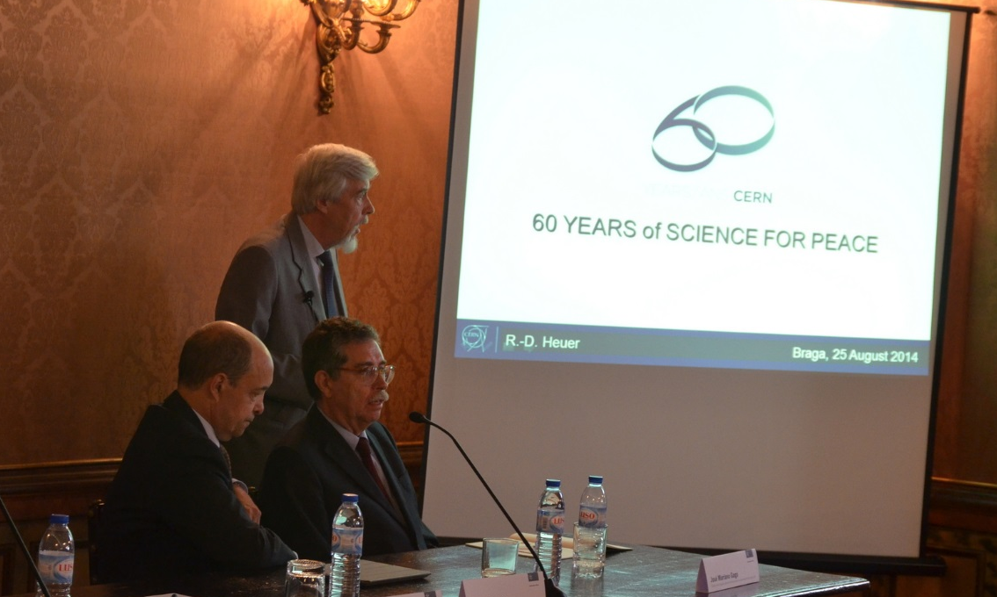
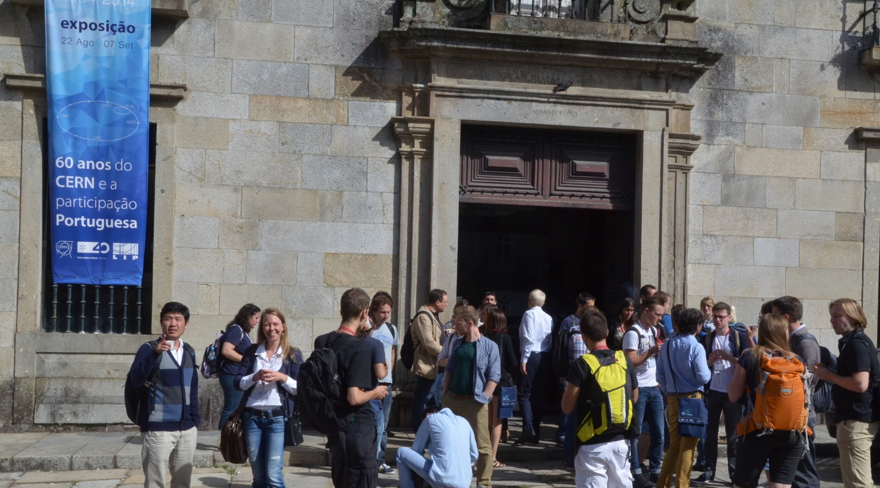
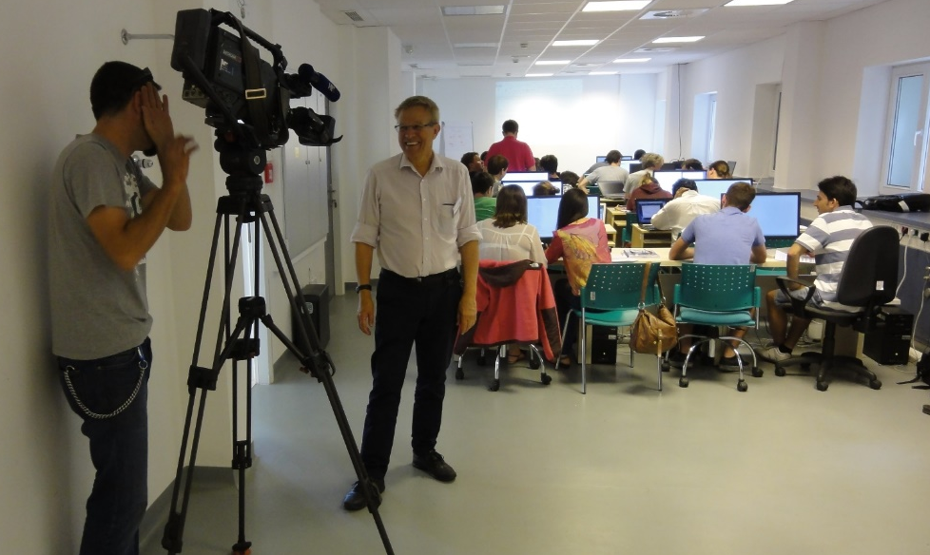
An outreach opportunity
For CERN

Slide 13
Thematic CSC 2023 on
“Security of research computing infrastructures”

Slide 14
The school learning process
Mandatory
Learning process
  Lectures
  Exercises
  Exam
Meet special persons,
Build trusts with colleagues across the world
  Lunches, dinners, coffee breaks, evenings
  Excursions
  Music events
  Sport programme
Optional

Slide 15
The school learning process
Mandatory
Learning process
  Lectures
  Exercises
  Exam
Meet special persons,
Build trusts with colleagues across the world
  Lunches, dinners, coffee breaks, evenings
  Excursions
  Music events
  Sport programme
Optional

Slide 16
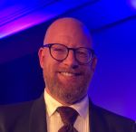
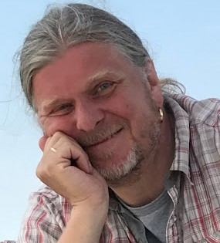
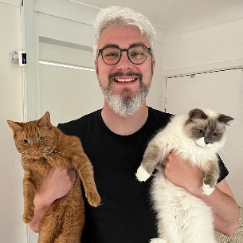
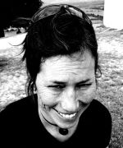
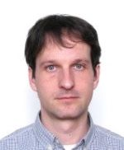
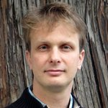
Your lecturers
Theme: “Security of research computing infrastructures”
  Introduction
  Track 1: Protection and prevention
  Track 2: Detection
  Track 3: Response
✓
Stefan Lueders
✓
Sven Gabriel
Tom Dack
✓
Barbara Krasovec
Daniel Kouřil
David Crooks
Sebastian Lopienski

Slide 17
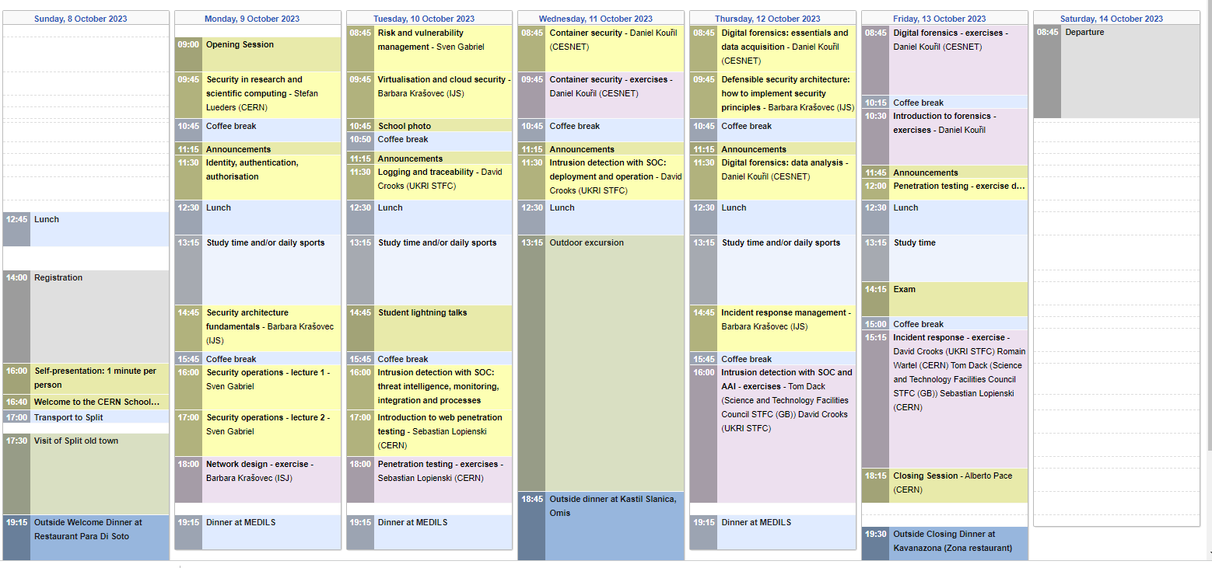
The tuition programme

Slide 18
The school governance
… is discussed at the School Advisory Committee
  http://csc.web.cern.ch/advisory-committe
  Includes several fulltime university professors
  from different countries
    Currently: Belgium, Estonia, Germany, Croatia, Italy, Norway, Poland, Spain
  Two meetings per year

Slide 19
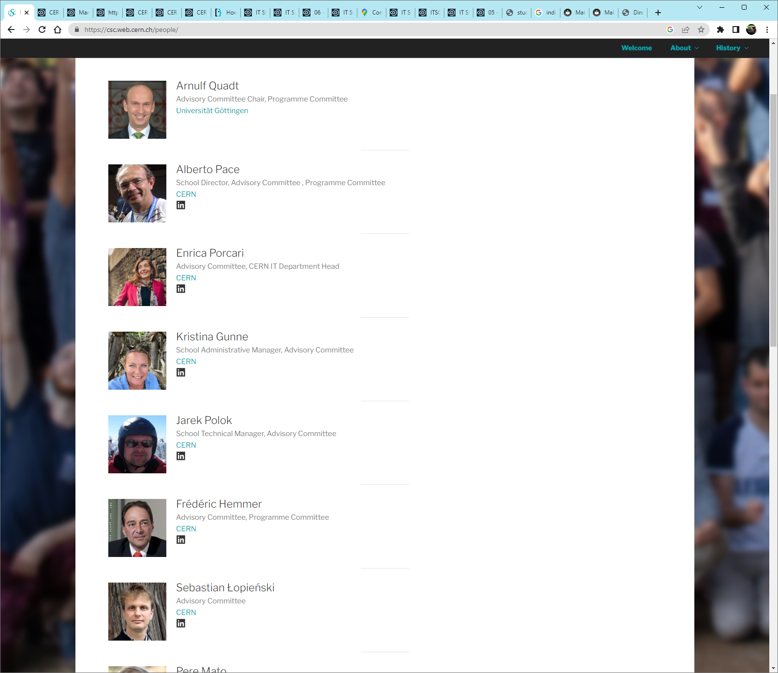
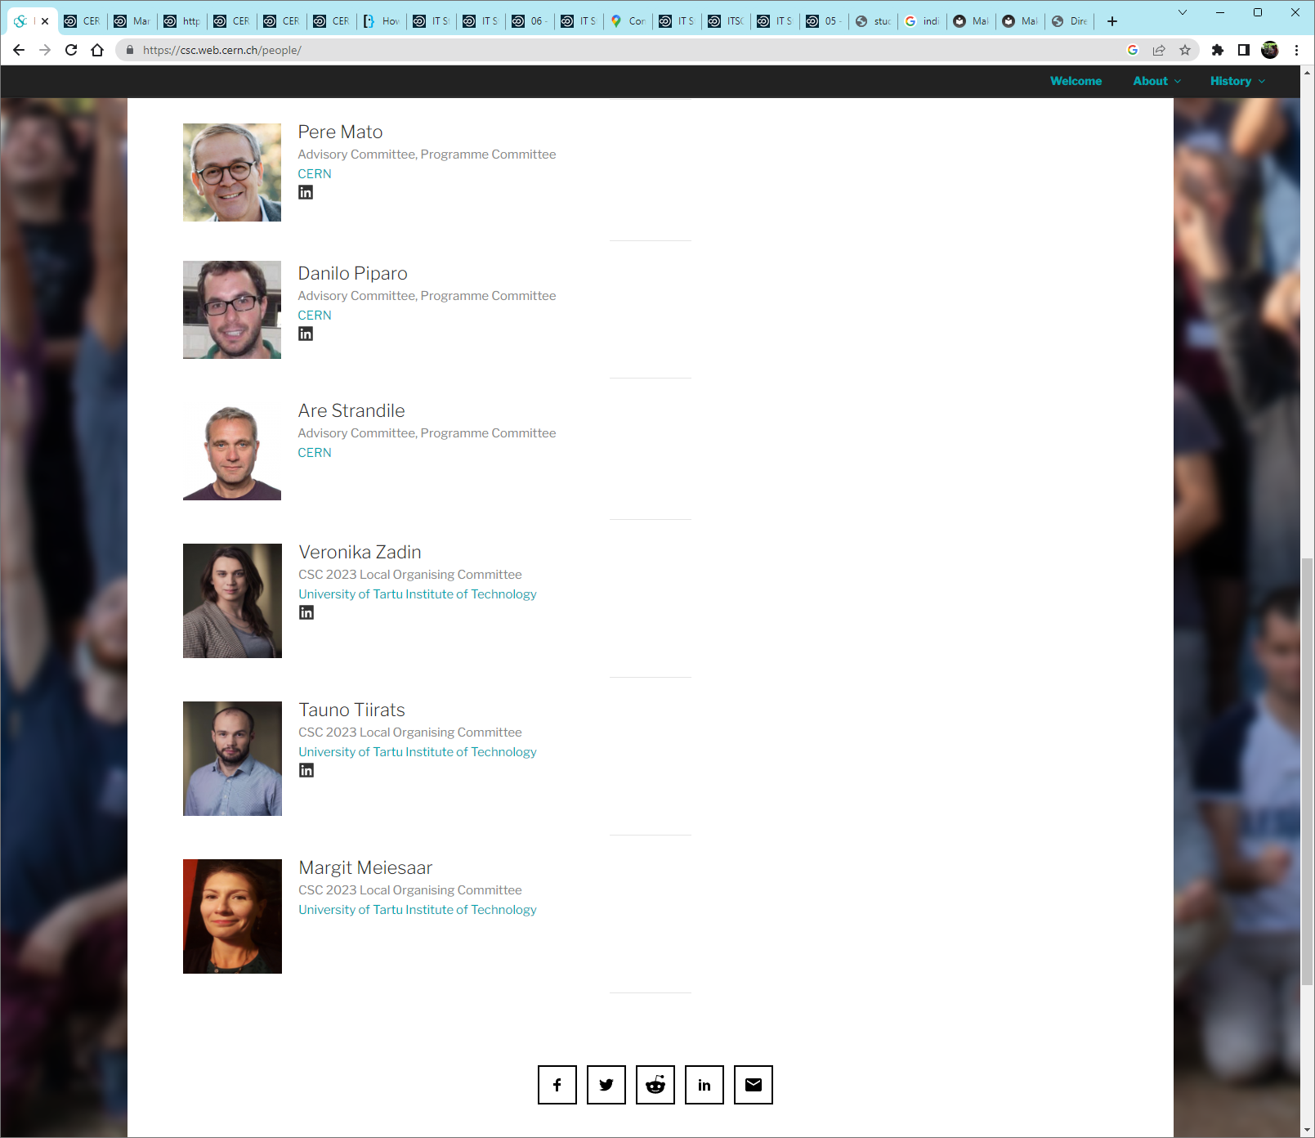
The School Advisory Committee

Slide 20
The school learning process
Mandatory
Learning process
  Lectures
  Exercises
  Exam
Meet special persons,
Build trusts with colleagues across the world
  Lunches, dinners, coffee breaks, evenings
  Excursions
  Music events
  Sport programme
Optional

Slide 21
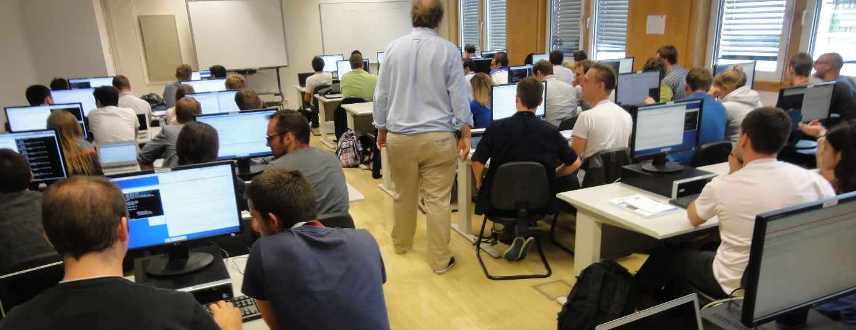
The School culture in “exercises”
The school has an entire computing infrastructure for exercises. Remotely accessible to the students
  The quality of the computing infrastructure is a shop window for CERN
Students works in pair (2-student teams). If possible:
  1 student with physics background
  1 student with computing background

Slide 22
The school learning process
Mandatory
Learning process
  Lectures
  Exercises
  Exam
Meet special persons,
Build trusts with colleagues across the world
  Lunches, dinners, coffee breaks, evenings
  Excursions
  Music events
  Sport programme
Optional

Slide 23
The exam
A serious and difficult exam, which delivers the diploma
Evaluate knowledge in two fields
  Physics
  Computing

Slide 24
An exam part of the learning process
In the process of hypotheses testing, we often define the null and the alternative hypotheses. The most robust final results are obtained for ...
  ... the acceptance of the alternative hypothesis.
  ... the rejection of the difference between null and alternative hypothesis.
  ... the acceptance of the ratio of null and alternative hypothesis.
  ... the rejection of the null hypothesis.

Slide 25
An exam part of the learning process
In the process of hypotheses testing, we often define the null and the alternative hypotheses. The most robust final results are obtained for ...
  ... the acceptance of the alternative hypothesis.
  ... the rejection of the difference between null and alternative hypothesis.
  ... the acceptance of the ratio of null and alternative hypothesis.
  ... the rejection of the null hypothesis.

Slide 26
The school learning process
Mandatory
Learning process
  Lectures
  Exercises
  Exam
Meet special persons,
Build trusts with colleagues across the world
  Lunches, dinners, coffee breaks, evenings
  Excursions
  Music events
  Sport programme
Optional

Slide 27
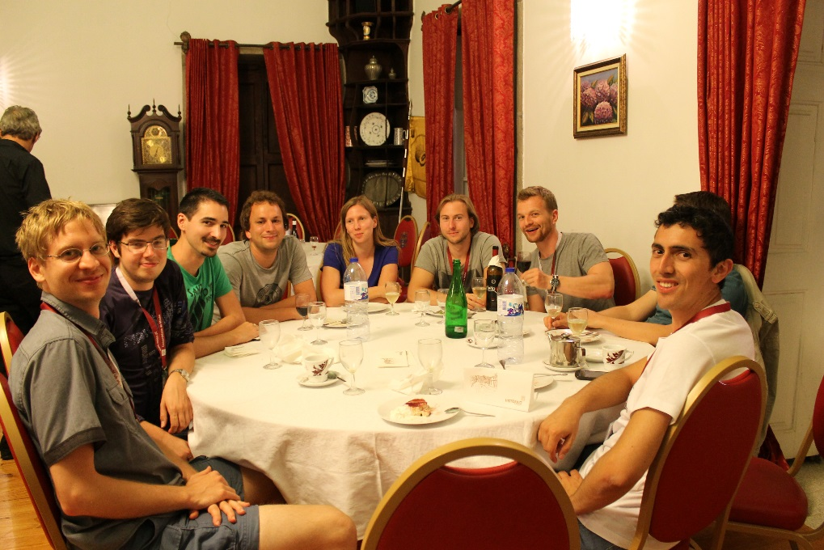
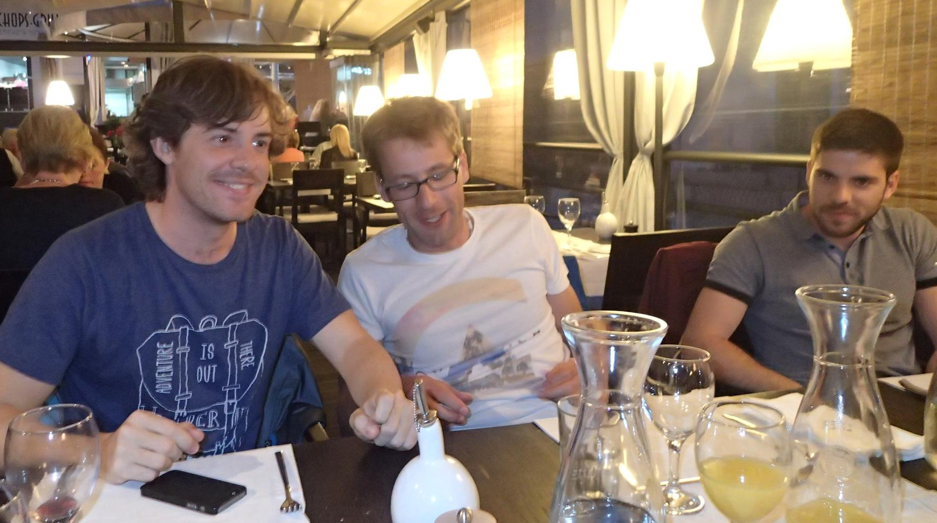
Lunch and Dinners
Mix of Students + lecturers
Tables of 8 - 12 persons

Slide 28
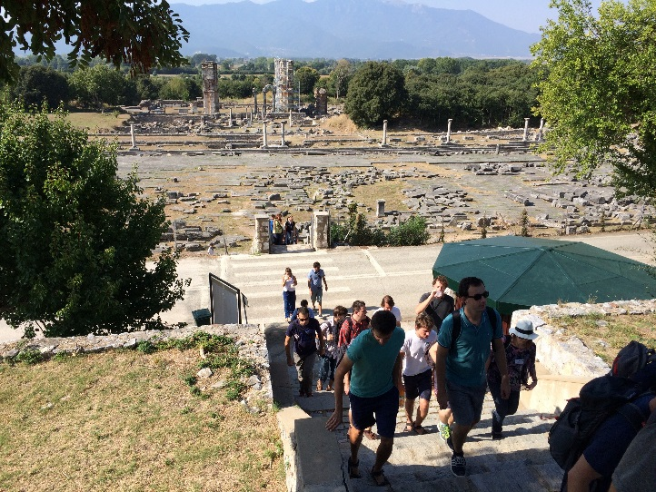
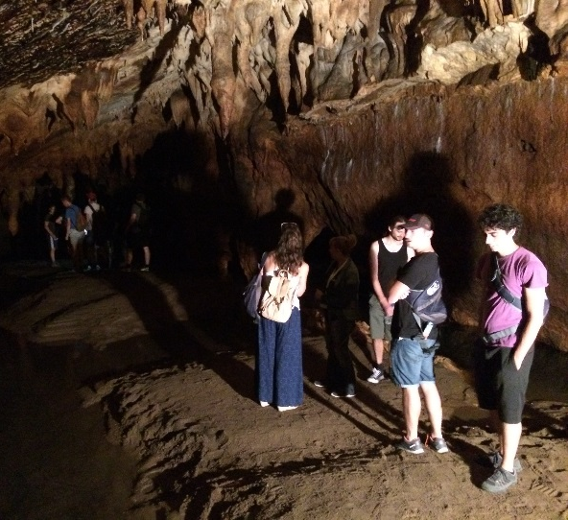
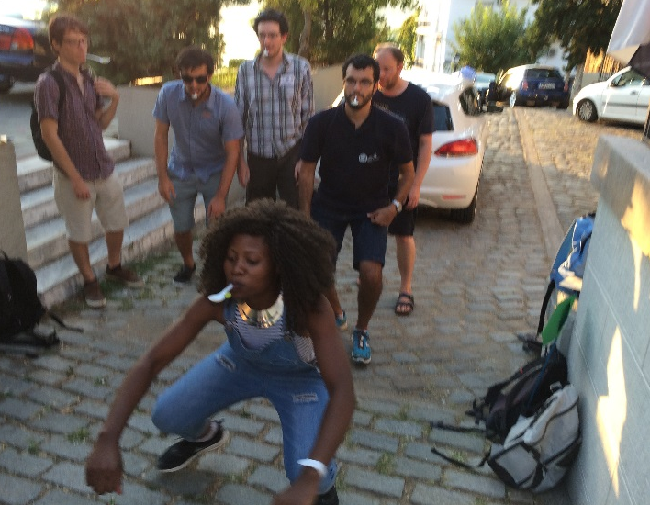
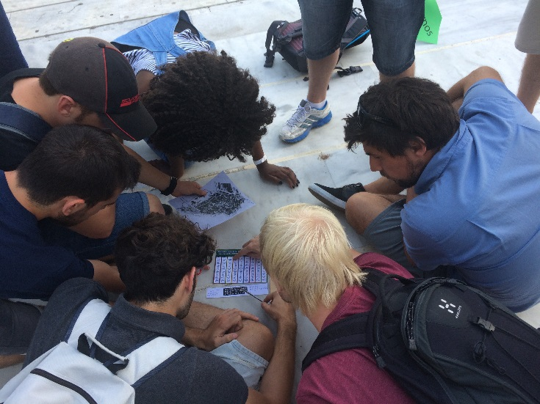
(Optional) Social programme
Excursions
  Culture
  History
  Nature
  Social games

Slide 29
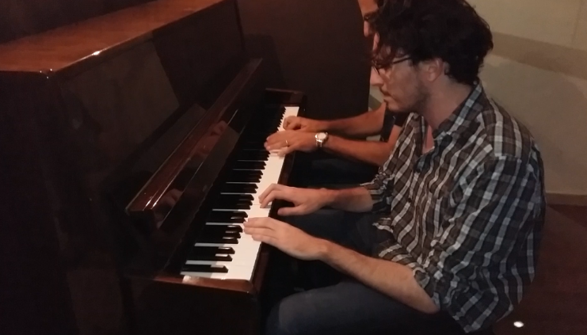
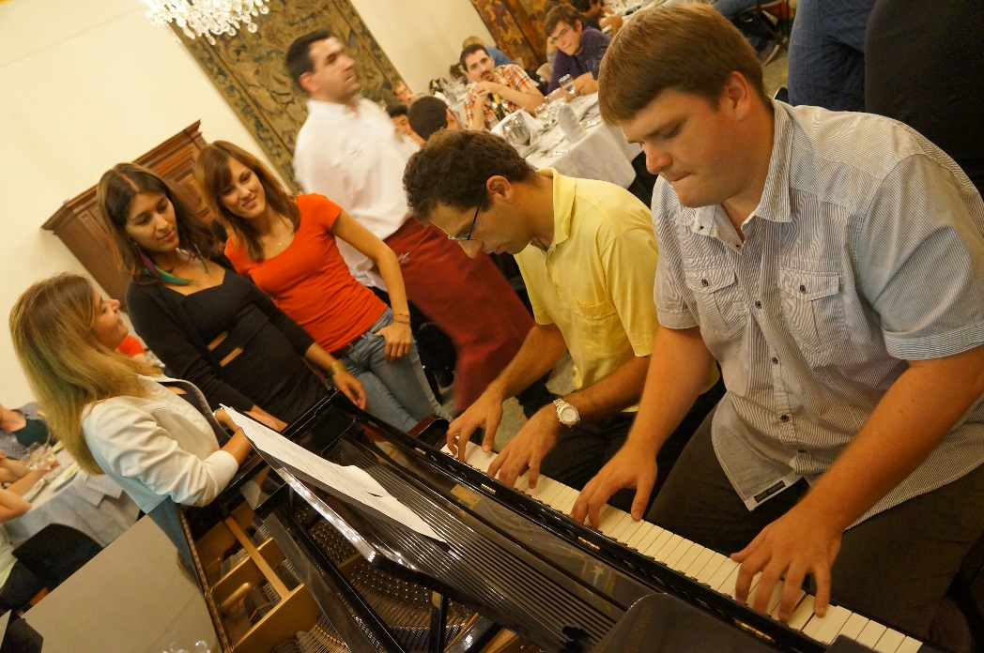
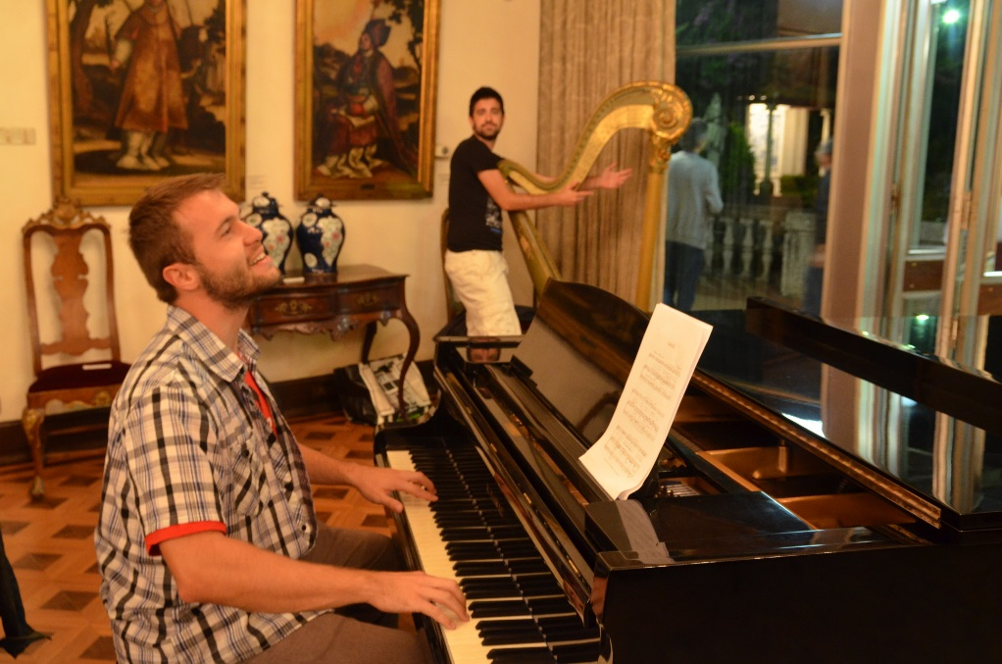
(Optional) Music events
Many students have
hidden talents
Music values are universal
across all cultures

Slide 30

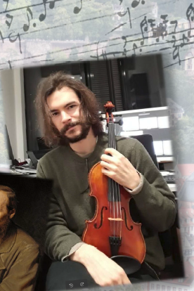
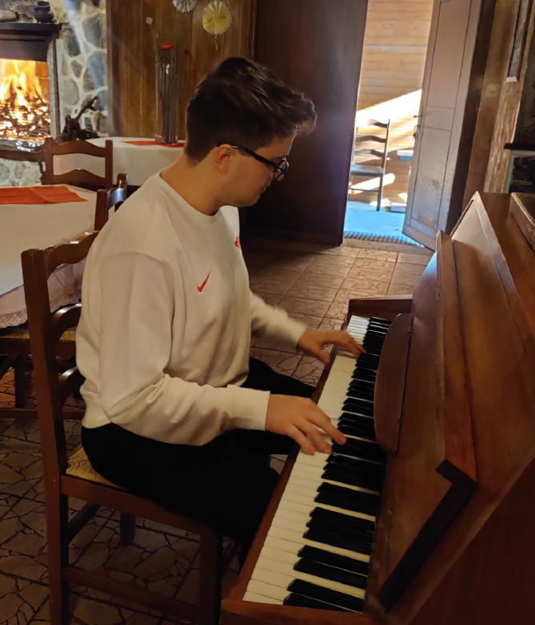
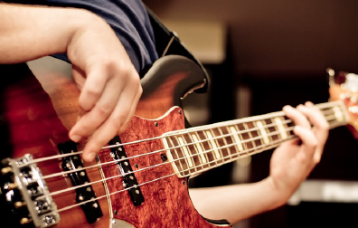
This year in the previous thematic school, here
Sten
Christof
Bernardo
Marcel

Slide 31
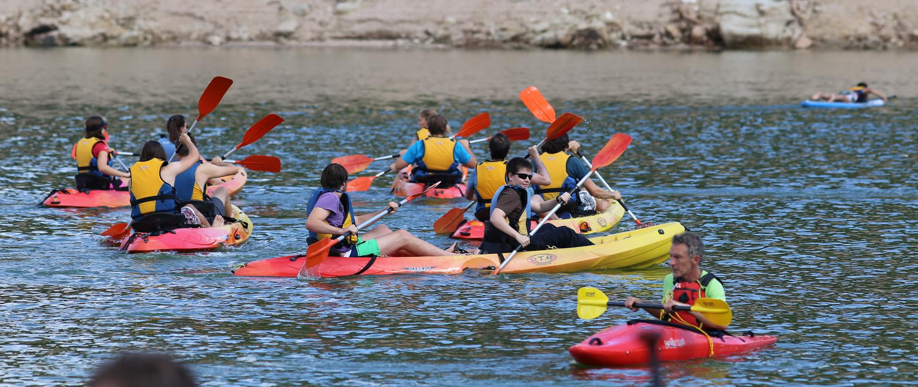
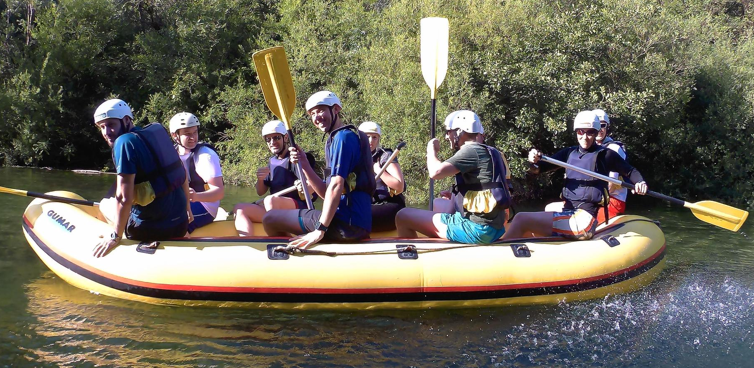
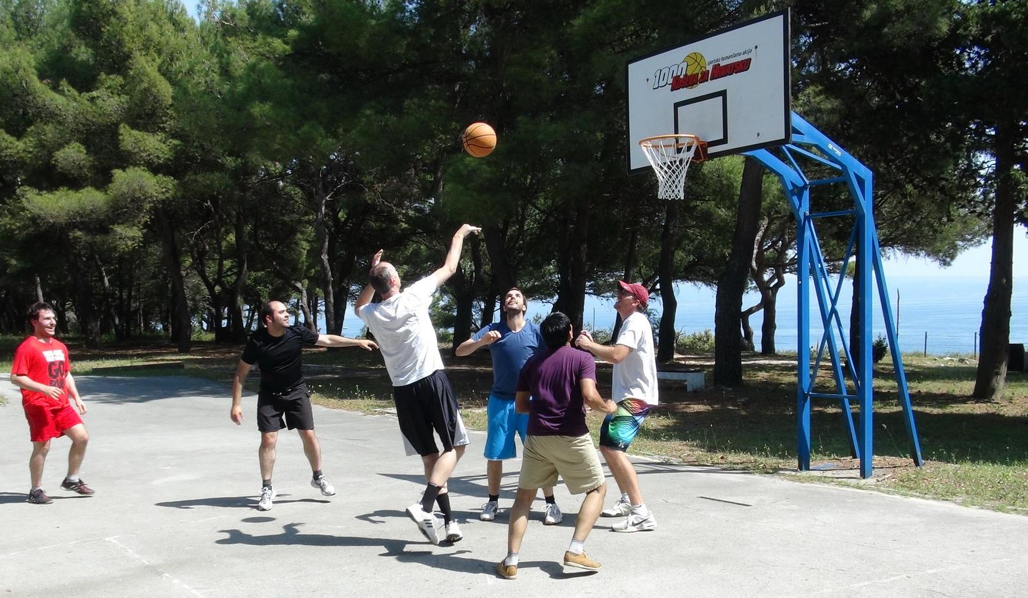
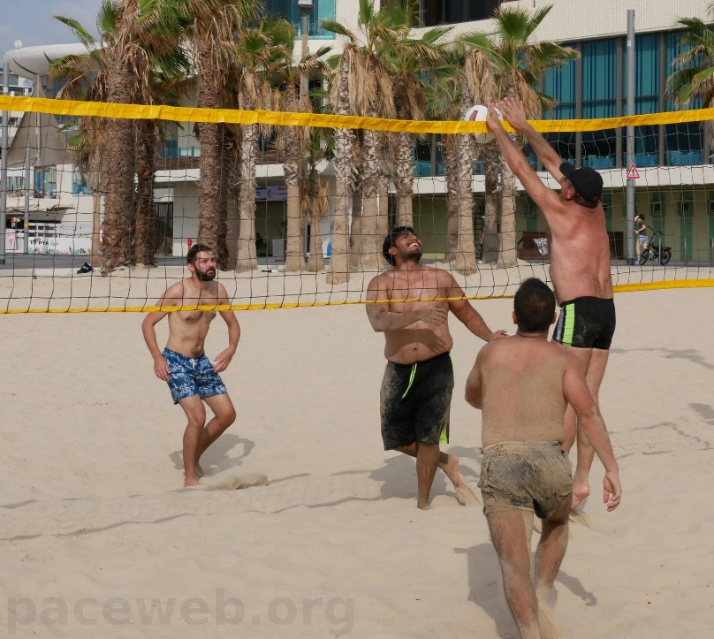
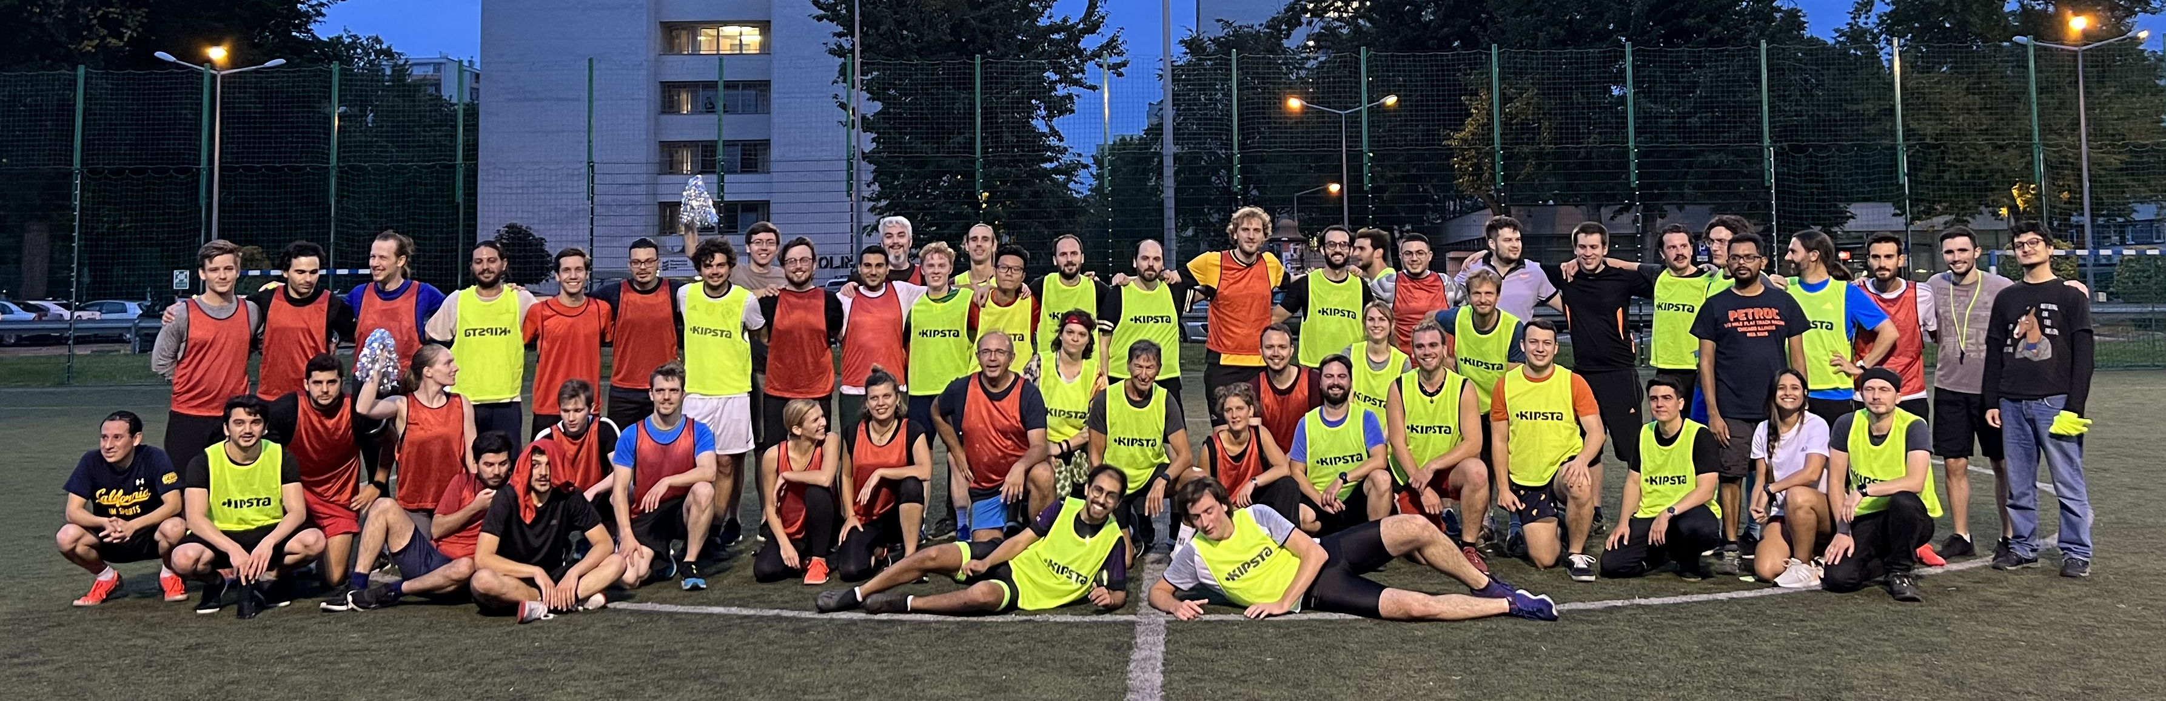
Optional Sports ….

Slide 32
the participants give the most value to the school !
Why ?

Slide 33
For example, this year main school (2023)
135 applicants participants, 42 nationalities
  Algeria, Austria, Belgium, Brazil, Canada, China, Croatia, Ecuador, Egypt, Estonia, Germany, Greece, India, Iran, Italy, Jordan, Lebanon, Malaysia, Mexico, Morocco, Netherlands, Oman, Pakistan, Palestinian Territories, Peru, Poland, Romania, Russia, Serbia, Slovakia, Slovenia, South Africa, Spain, Sri Lanka, Sweden, Switzerland, Thailand, Turkey, Uganda, Ukraine, United Kingdom, United States.
32 % female participants (43/135)
84 institutes !!

Slide 34
This school numbers
26 participants (26% female)
13 nationalities
  Belgium, Bulgaria, Canada, Estonia, Germany, Greece, India, Italy, Portugal, Romania, Spain, Ukraine, United Kingdom
10 institutes
  University of Münster, University Politechnica of Bucharest, Universität Hamburg, STFC, LIP, Ludwig-Maximilians-Universität, INFN CNAF, Frankfurt Institute for Advanced Studies, University of Bath, CERN

Slide 35
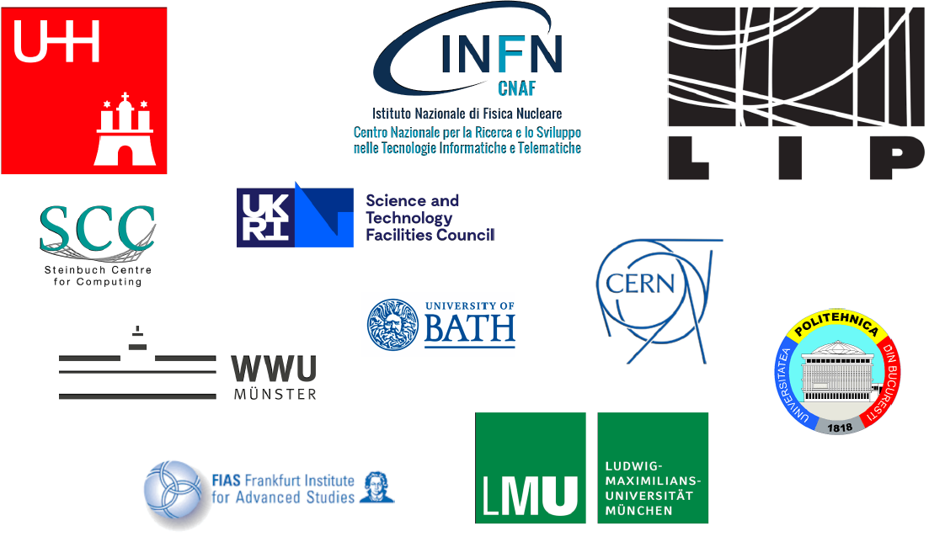

Slide 36
So …
We have quite some diversity
But where is the value?

Slide 37
Excerpts from reference letters (from the main school)
… I can indeed state that she is a top-level student, easily among the best 5% I ever met
He finished his master thesis with a mark of 1.1 (marks range from 1.0 (best) to 5 (failed) and he ranks among the best of the successful master students in Physics.
His diploma work was given the highest possible mark …
… compared to the PhD students in my group so far, he ranks among the very best, with exceptional maturity concerning computing and software and a clear view on and experience in data analysis.

Slide 38
Who are the CSC participants ?
You are young, diverse, come from many countries, from different institutes …
You have all an outstanding potential and a passion for both computing and science.
You will work together one weeks to widen your skills but also establish lifetime links with other participants and research institutes across the world that will be useful throughout your future career.
This is what gives the highest value to the school

Slide 39
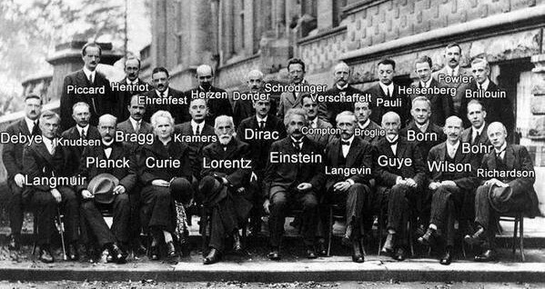
It is a small world …
All top scientists knows each other very well

Slide 40
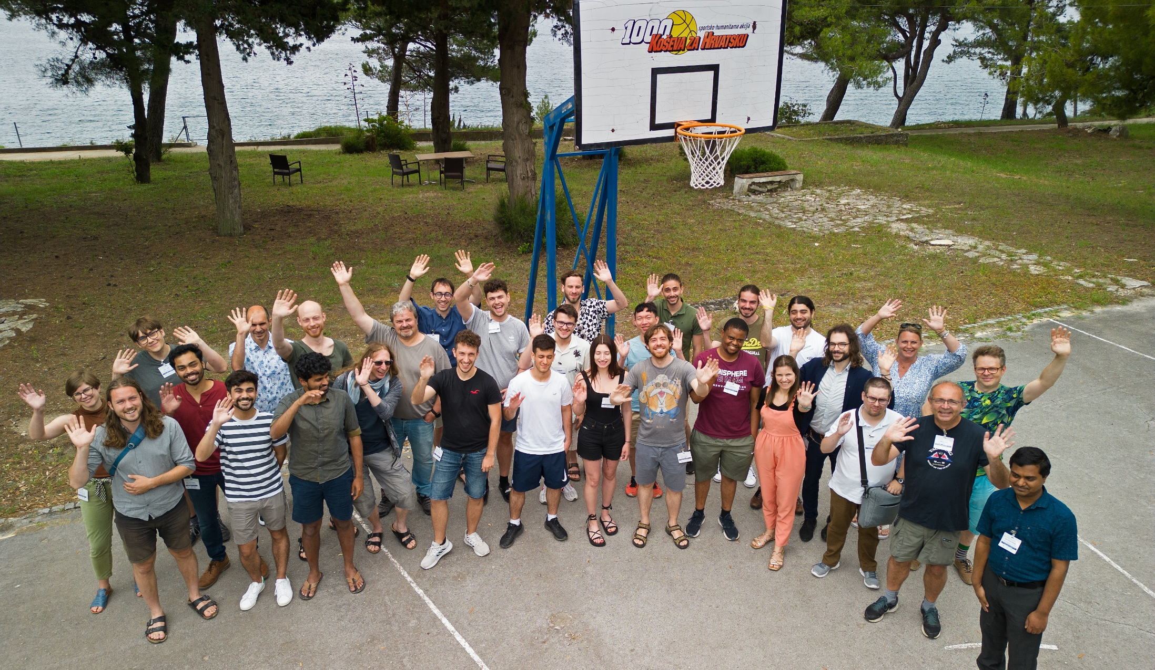
tCSC 2023, Split, Croatia

Slide 41

sCSC 2023, Split, Croatia
Are you ready to write history ?
School photo:
Tuesday at 10h45

