Slide 1
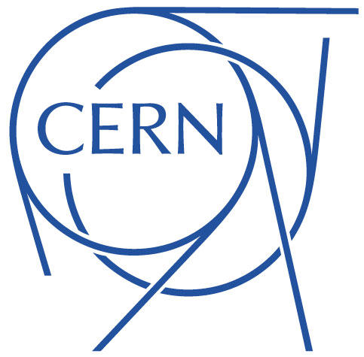
MBHDP301 Test preparation
Carmen Abad on behalf of 11Tesla team
June 2023

Slide 2
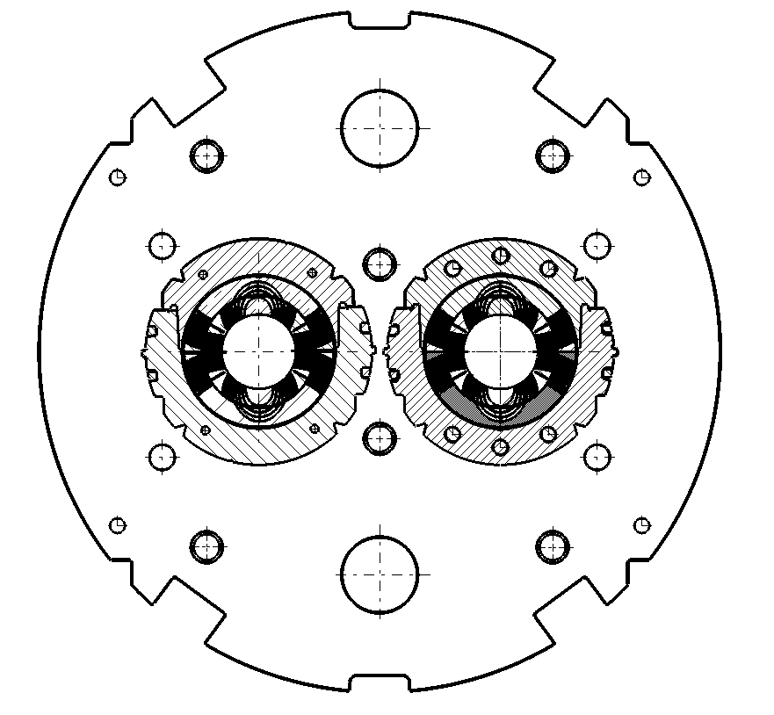


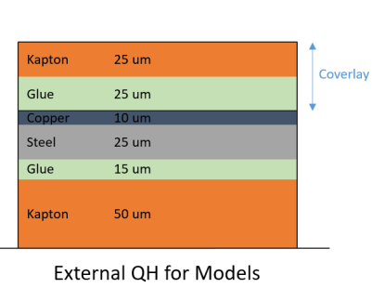
Magnet setup
This magnet is made of 2 apertures with external QH:
  Aperture 1 – SP301: coils 108 and 214 – target of 300 um
  Aperture 2 – SP302: coils 212 and 213 – target of 225 um (lower pre-stress, adjusted during several collaring attempts)
  Nominal current: 11.85 kA
  Ultimate current: 12.85 kA
11T Hybrid Short Magnet DP301
View from the connection side
APERTURE 2 SP302
With end cage
Composed of:
Coil #212 - 2nd generation
Coil #213 - 2nd generation
APERTURE 1 SP301
Without cage
Composed of:
Coil #108 - 1st generation
Coil #214 - 2nd generation
Coil #212
Coil #214
Cable characteristics
1st generation (RRP)
2nd generation (PIT)
Coil #213
Coil #108
NOTE:
Coils 108,212,213 already used in the past
Coil 214 new (spare)
Notes:
This magnet is made of 2 apertures with external QH:
Aperture 1 – SP301: coils 210 and 211 – target of 300 um??
Aperture 2 – SP302: coils 212 and 213 – target of 150 um (lower pre-stress)??
Nominal current:
Ultimate current:
Cable characteristic:
Type: PIT
RRR:
25 – 83 (C210),
25 – 70 (C211),
45 – 106 (C212),
37 – 127 (C213)
SS limit: ?

Slide 3
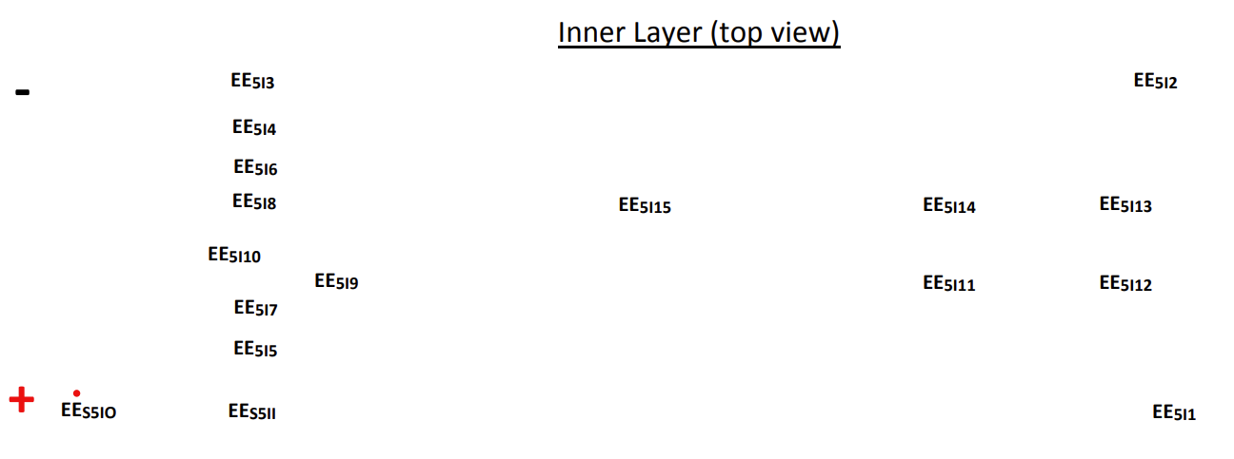
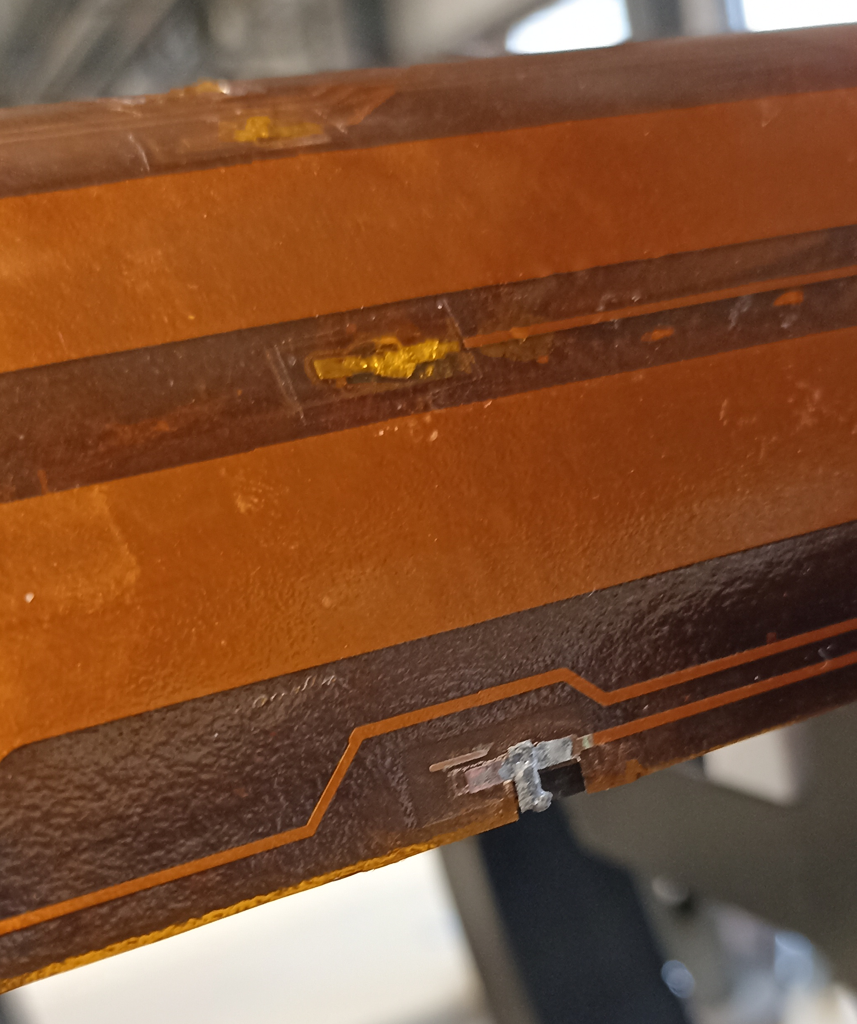
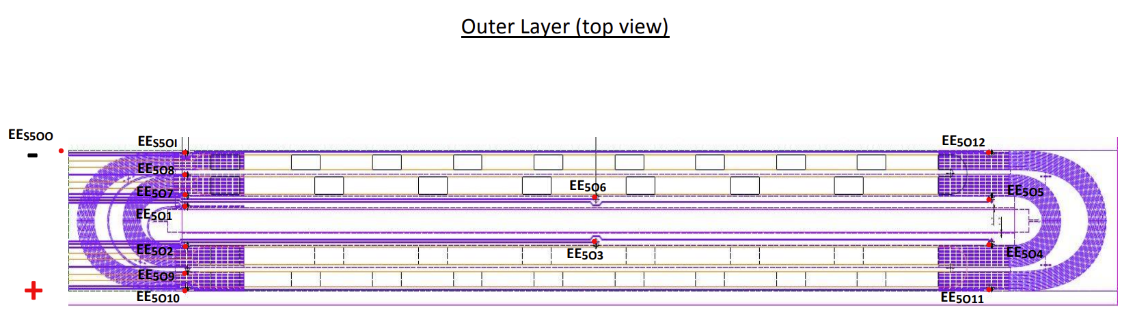
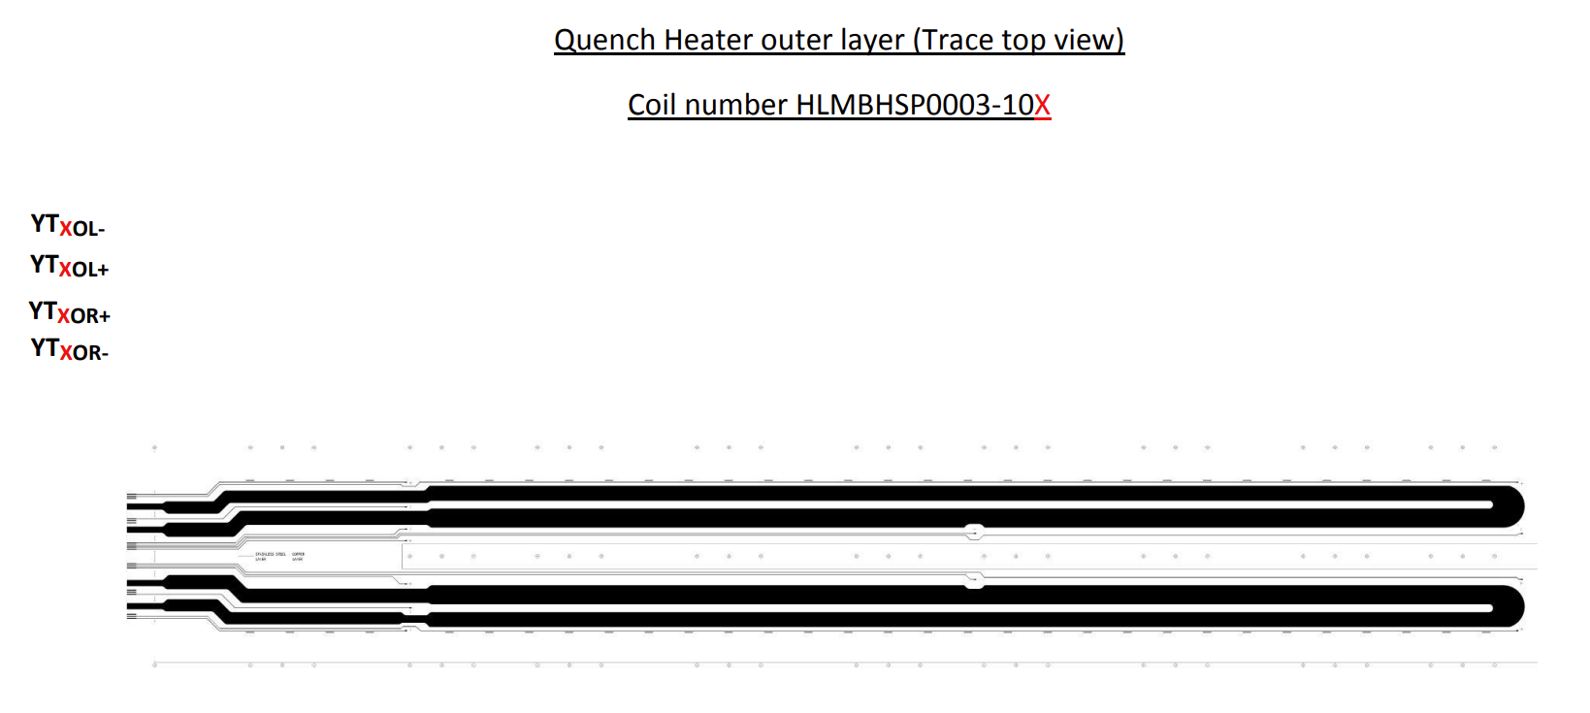
Coil instrumentation scheme
Voltage taps (Vtaps location EDMS 1838707)
  31 in inner and outer diameter per coil
Quench heaters

Slide 4
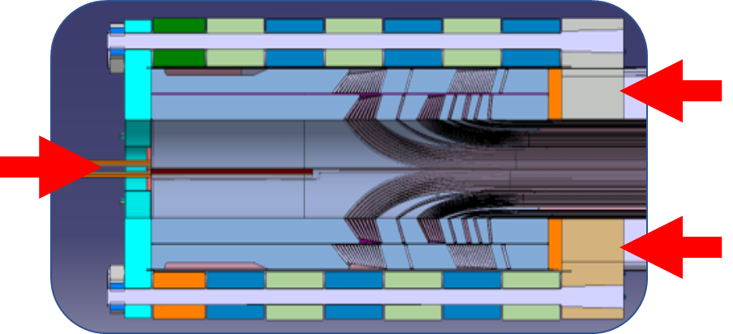
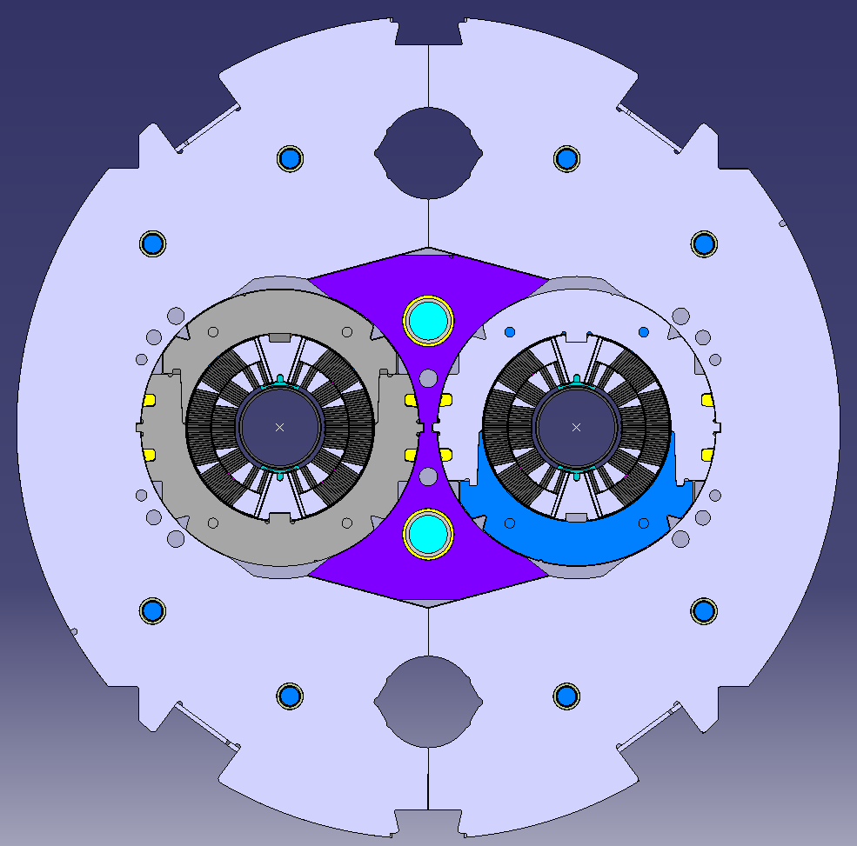
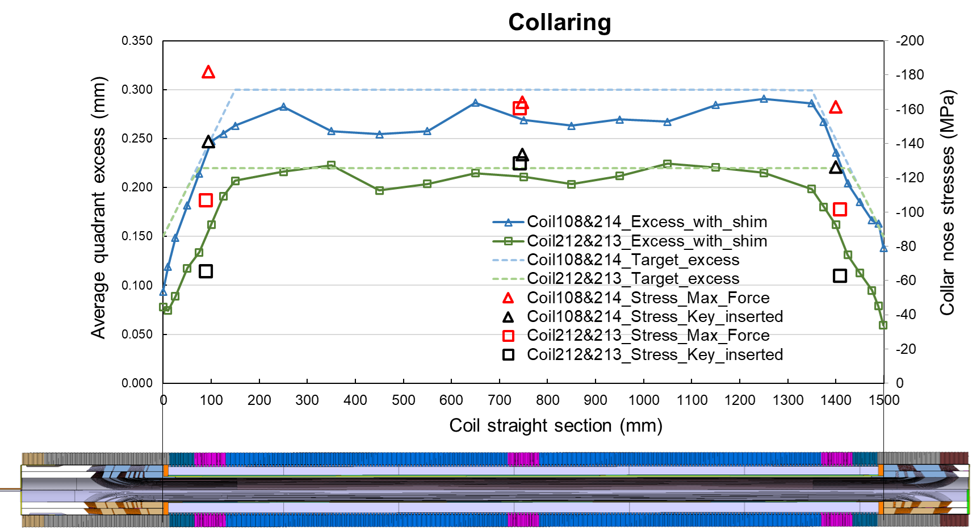
New features and objectives in the DP301 magnet
Austenitic stainless-steel pole → to reduce the stresses in the coil first turns.
Shimming plan with higher reduction of the excess in the ends (with respect to previous magnets) → to reduced peak stresses in coil ends.
One aperture (SP302) with end cage→ to improved coil end support and axial loading
Yoke shim → to improved support of surrounding laminated structure in magnet.
Shim thickness0.45 mm
(nominal 0.5 mm)

Slide 5
Test goals
Verify the powering performance of two types of apertures.
  Aperture SP301 with “conservative” improvements.
  Aperture SP302 with more “innovative” solution.
Validate new features on a short, twin-and-independently-powered-aperture model magnet with 3 re-used coils and 1 virgin coil.
…Future: implement new features on full-length, twin-and-independently-powered-aperture prototype with 4 virgin coils from series production (to limit uncertainty on state of coils).
Powering:
    Single powering SP301
    Single powering SP302
    Simultaneously SP301 and SP302 (if the test before are correct)
Endurance test (cycling)

Slide 6
THANKS FOR YOU ATTENTION

