Slide 1
MBHDP301
11T hybrid magnet
Instrumentation overview for SM18 tests
Mechanical Measurement Lab of EN-MME
EDMS #2711698

Slide 2
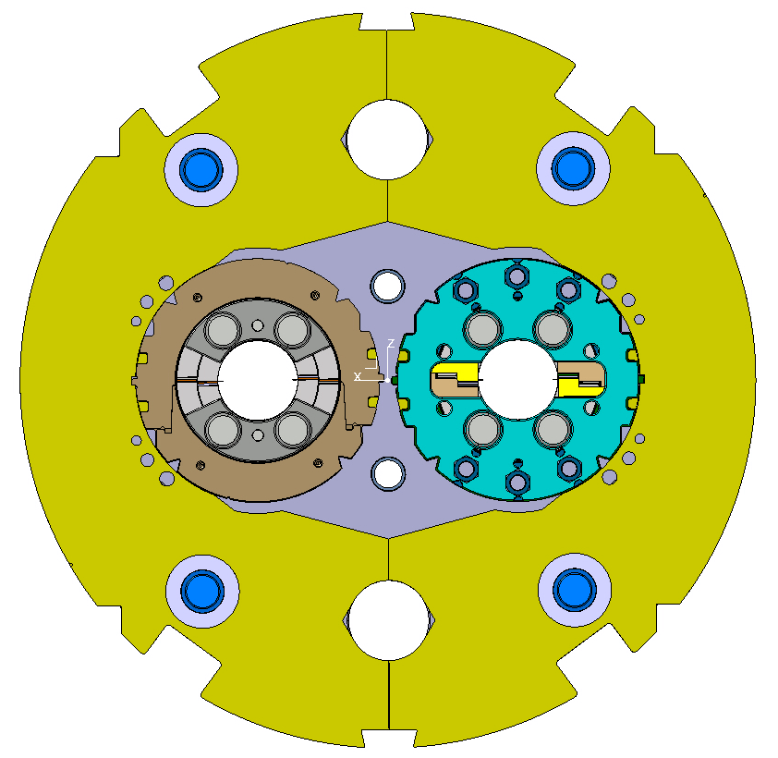
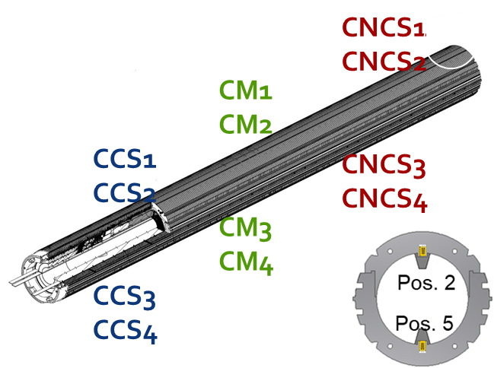
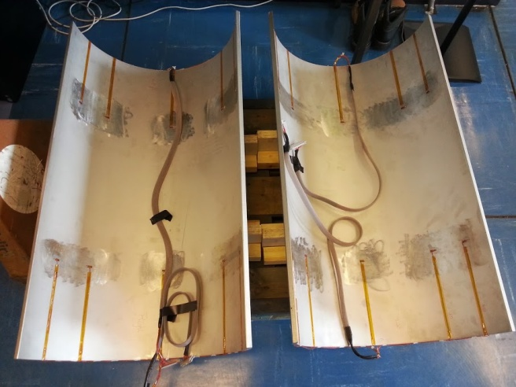
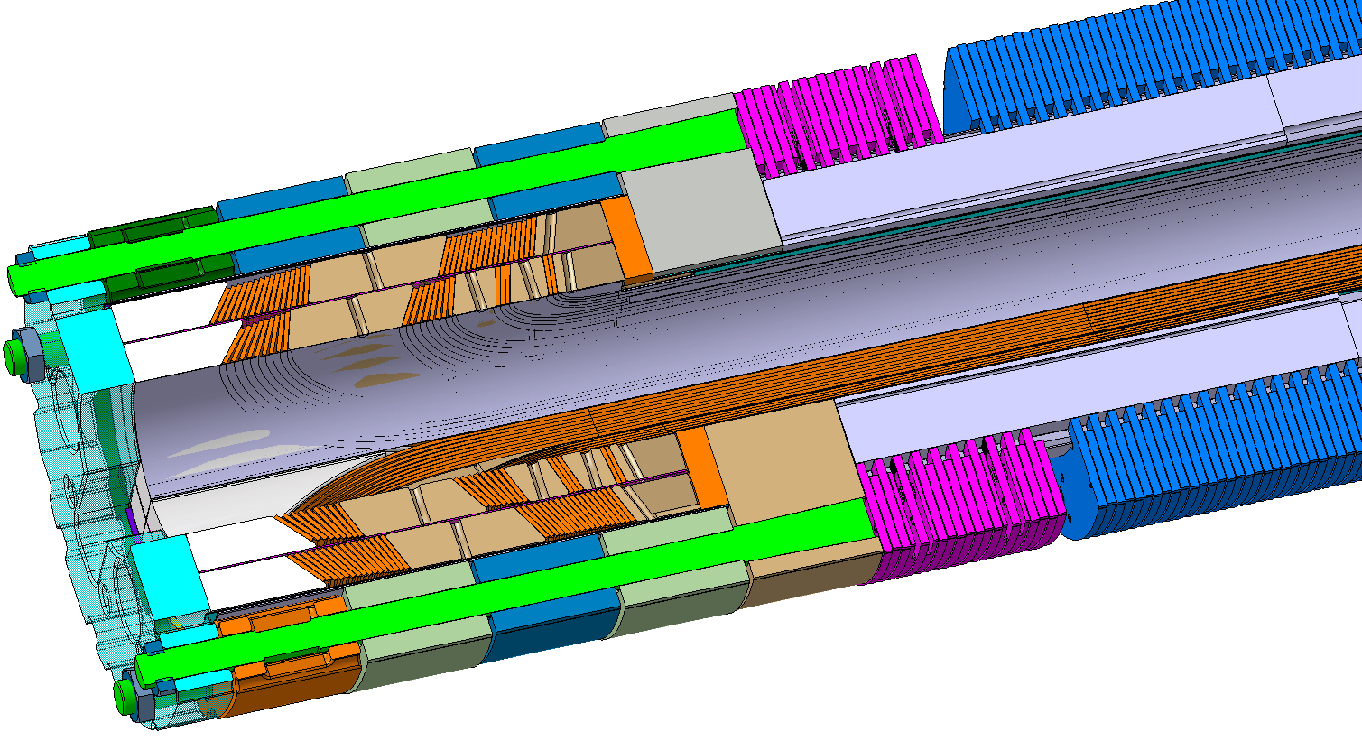
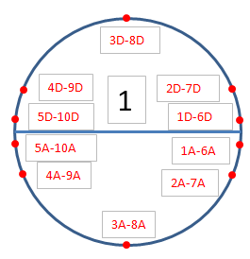
Instrumentation overview
SP301
12 instrumented collars;
8 Bullet gauges
Distributed fibers
SP302
12 instrumented collars;
8 Bullet gauges
12 Tie rods (End cage)
Distributed fibers
Instrumented SS Shell

Slide 3
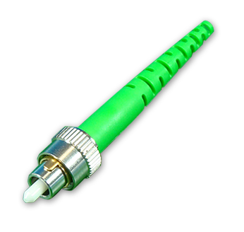
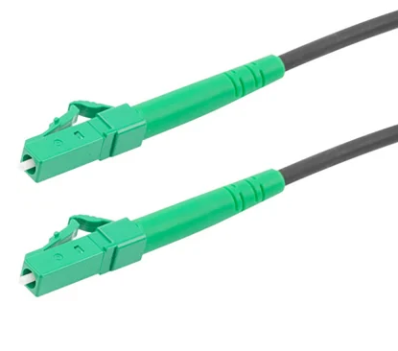
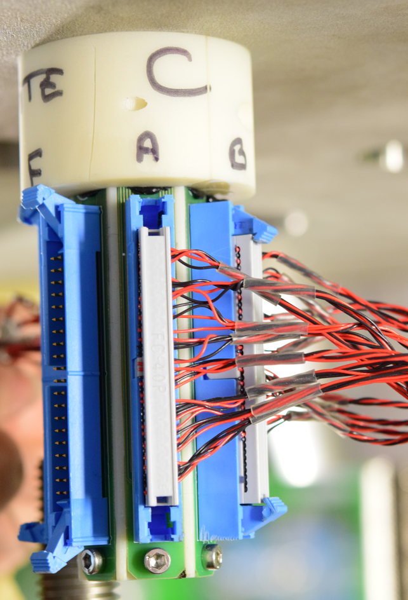
Instrumentation overview
Electrical strain gauges
Optical distributed fibers
Measurement point | Number of channels
SP301 collars | 24 CH
SP302 collars | 24 CH
Bullets | 16 CH
Stainless steel shell | 14 CH
SP302 tie rods (End cage) | 12 CH
TOTAL | 90 CH (468 wires)
Measurement point | Number of channels
Coils | 8 CH
8 optical patch cords required through the Cluster D cryostat
Magnet side FC/APC
DAQ side
LC/APC
13 connectors 3M 40 pins required inside the Cluster D cryostat
Time for electrical connections and validation : 2 days
Data available real time here : Grafana web page

Slide 4
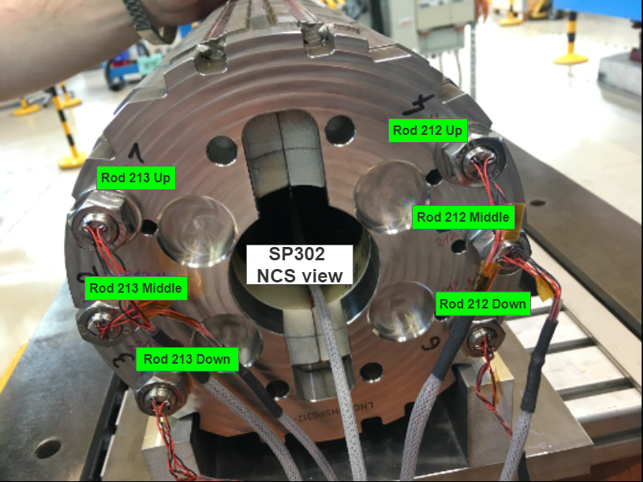
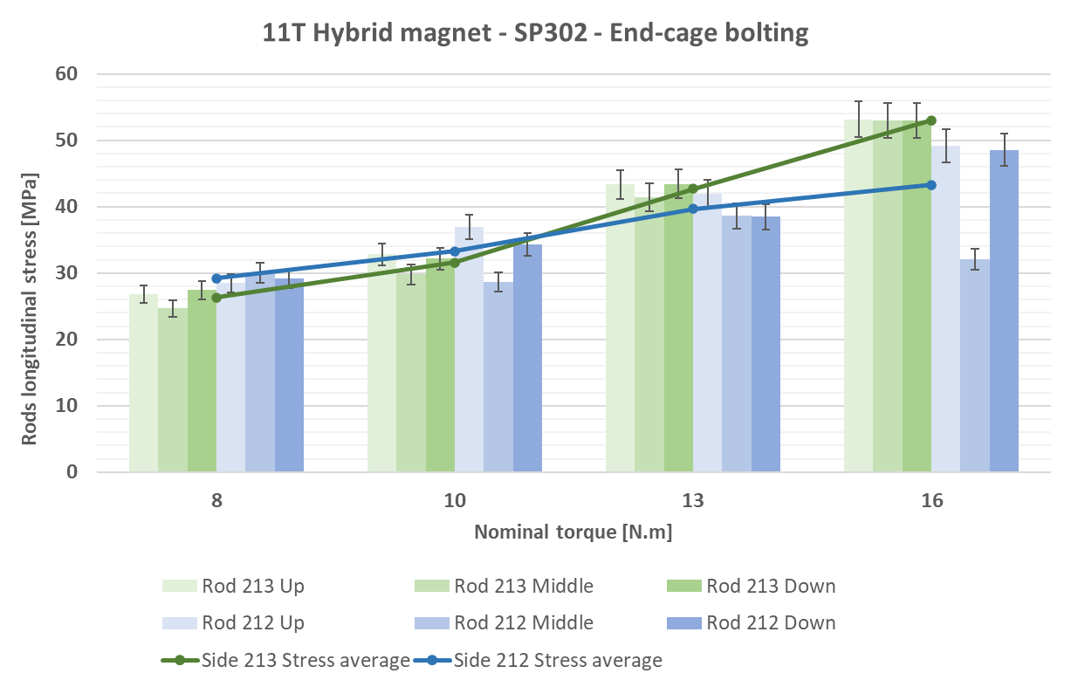
Stress State after loading
SP301 | Min. [MPa] | Average [MPa] | Max. [MPa]
CS | -122 | -139 | -154
MI | -114 | -130 | -146
NCS | -96 | -123 | -159
SP302 | Min. [MPa] | Average [MPa] | Max. [MPa]
CS | -48 | -65 | -83
MI | -104 | -128 | -145
NCS | -32 | -86 | -105

