Slide 1
MBHDP301 test plan discussion
7 June 2023
G. Willering

Slide 2
Conductors used:
Coil 108: H15OC0158A – Witness sample data in EDMS 2136281
Coil 214: H15EC0224B – Witness sample data in EDMS 2249669
Coil 212: H15EC0223A – Witness sample data in EDMS 2249670
Coil 213: H15EC0223B – Witness sample data in EDMS 2249668

Slide 3
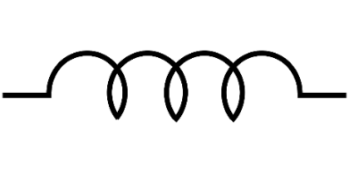
Test setup
HV test levels
 | Warm | Cold
Coil – GND | 500 V | 1 kV
Coil – QH | 500 V | 1 kV
Test stand: cluster D
Cooldown/warmup
  dT < 50 K
3 current leads
30 kA power supply
Protection:
  Base line protection: R_dump: 60 mohm
  OL QH: 900V, 150A
Quench detection:
  Potaim – differential signals
    Single powering: between coils and between coil inner and outer layers
    Both powering: between apertures and coils
  VT potaim - I < 6kA, 10 ms @ 500 mV; I > 6kA, 10 ms @ 100 mV
C108
C214
+
-
Lead A
Lead C
-
+
Lead B
Check order of coils
C213
C212

Slide 4
Instrumentation
Voltage taps
Quench Heaters
CLIQ
Rotating magnetic measurement shaft + Quench Antenna pickup coils
Mechanical measurements

Slide 5
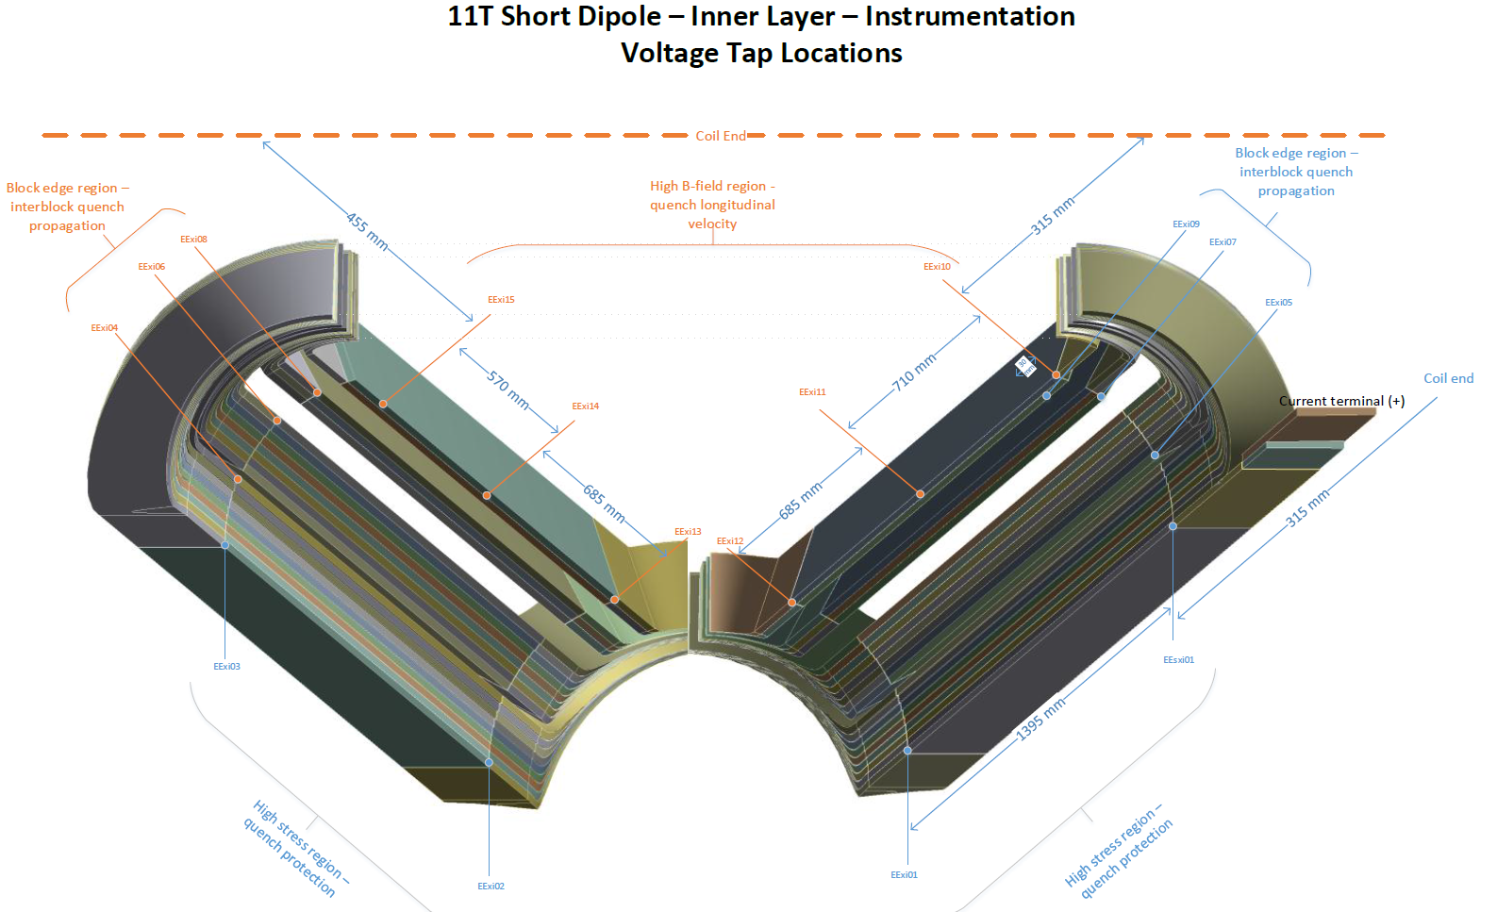
Voltage taps – Inner layer

Slide 6
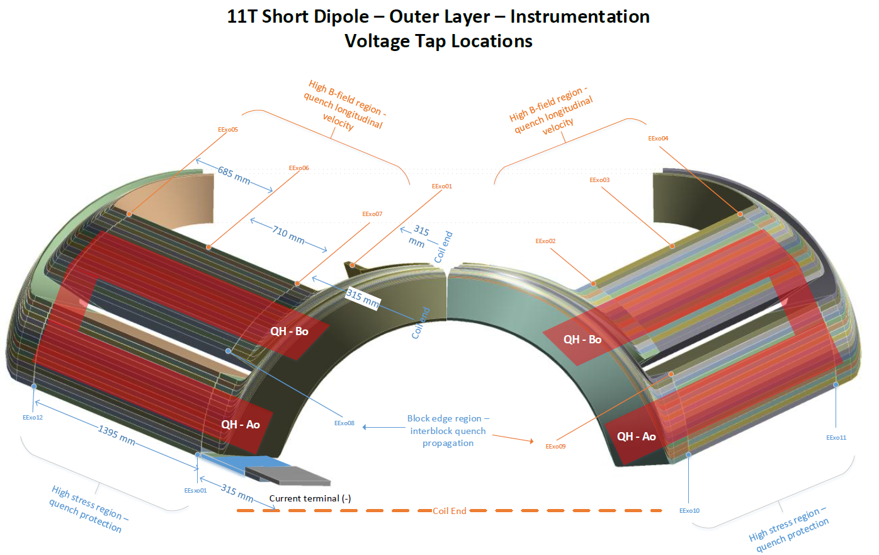
Voltage taps + Quench Heaters – Outer layer

Slide 7
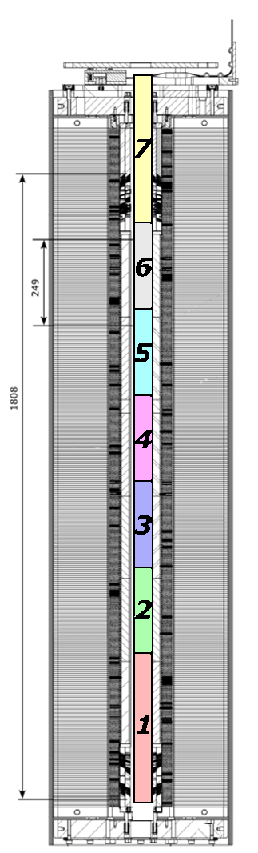
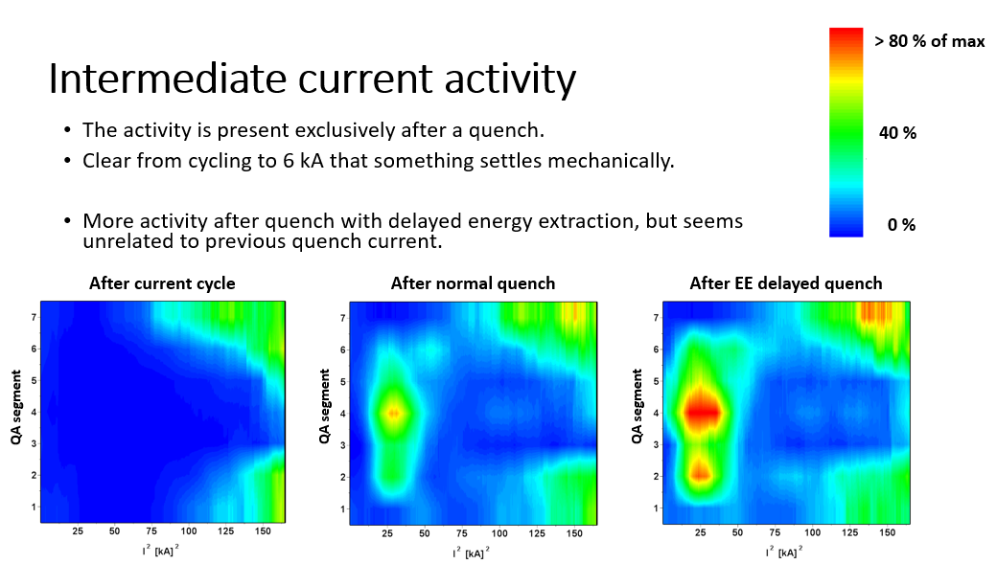
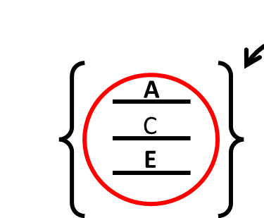
Rotating Magnetic Measurement shaft + Quench Antenna
Installed by MSC-TM
7 longitudinal segments
In rotating mode they measure field and field quality.
In static mode they act as pickup coils for fast magnetic perturbations in the magnet bore, from flux jumps, vibrations and quench.
Continuous measurement of vibration activity during ramp can give important info on motion during powering/training
See https://indico.cern.ch/event/738168/

Slide 8
CLIQ
Request by Franco to perform CLIQ studies in scope of HFM protection studies.

Slide 9
Mechanical instrumentation
See EN-MME

Slide 10
Test order
There can only be one first powering, so we need to chose what is the first powering cycle:
At 1.9 K or 4.5 K
Straight ramp to quench (identify maximum current for the test) or multiple cycles at lower current levels to study mechanics and the V-I.
Power aperture 1 and aperture 2 separately or combined

Slide 11
Test plan
For discussion. And we could decide to do combined aperture powering if both apertures reach the required level.
Ap1: Training 1.9 K (Ultimate 12.8 kA)
Ap1: RR 1.9 K
Ap2: Training 1.9 K
Ap2: RR 1.9 K
Ap2: Training 4.5 K
Ap2: RR 4.5 K
Ap2: V-I 4.5 K
Ap1: Training 4.5 K
Ap1: RR 4.5 K
Ap1: V-I 4.5 K
Magnetic meaurement cycles at 1.9 K
CLIQ
Endurance: Thermal cycles, powering cycles, quenches
Example of test plan for MBHDP201: EDMS 2331446

