Slide 1


Performance of
ME0 GEM Detectors with
Cosmic Rays and in Test Beam
Nicholas Kurth
Antonello Pellecchia, Ph.D.
June 22, 2023

Slide 2
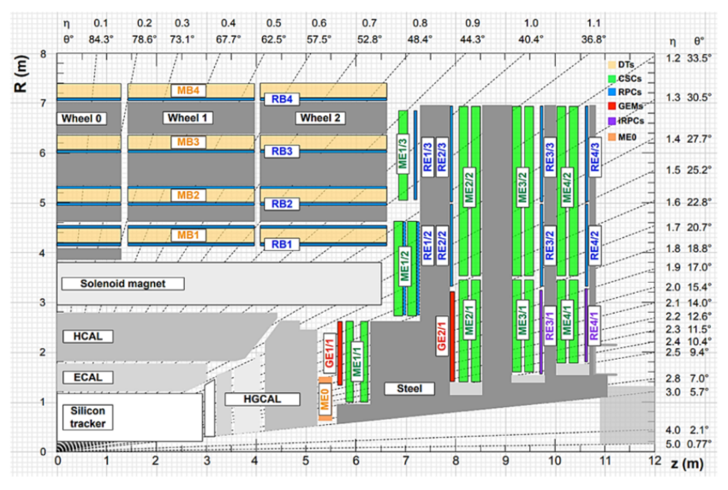
GEMs & CMS
Notes:
Lhc-b → has no end caps; only looks at forward collisions (have used GEMs in the past)
Cms → has end caps; first one to use gems for high scale ; wanted something withstand muons at high rate
Alice → is using gems in temperature. Is essentially a huge gas detector
Atlas → uses a cousin of GEMs

Slide 3
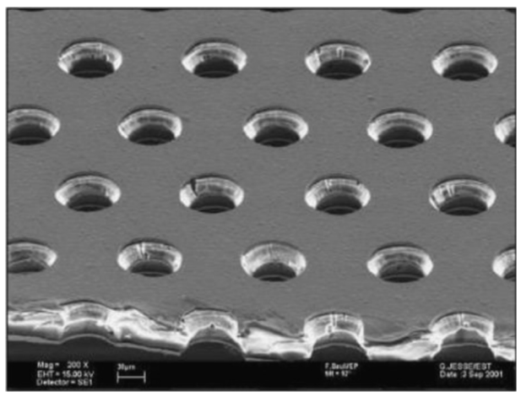
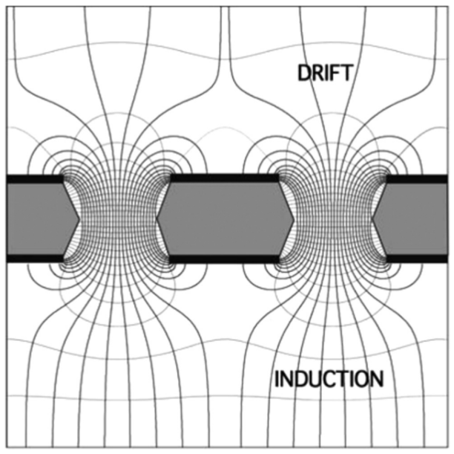
GEM Basics
-E
Readout
Notes:
Readout == chips
Orientation doesn’t really matter
Can just say muons
Write a slide about where the gem detectors are in cms
Located at end caps and are able to withstand high rates (are closest to collision in comparison to other detectors

Slide 4
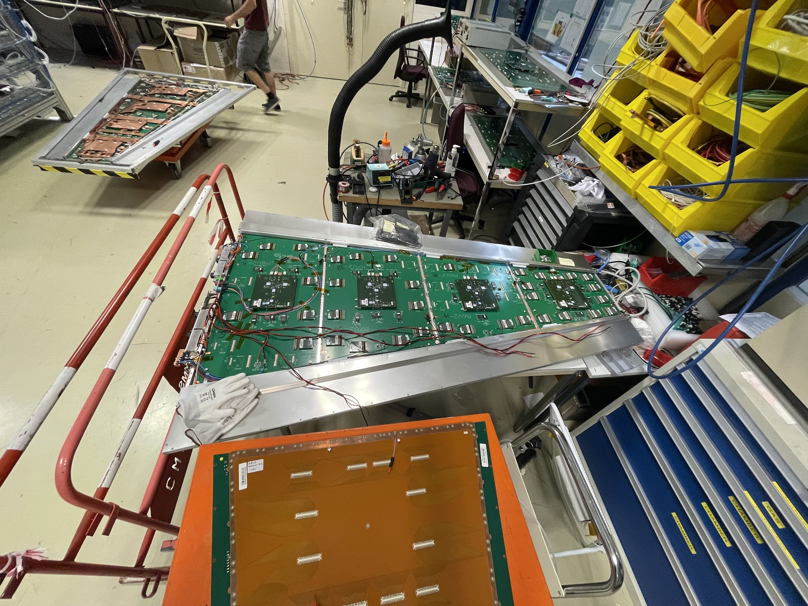
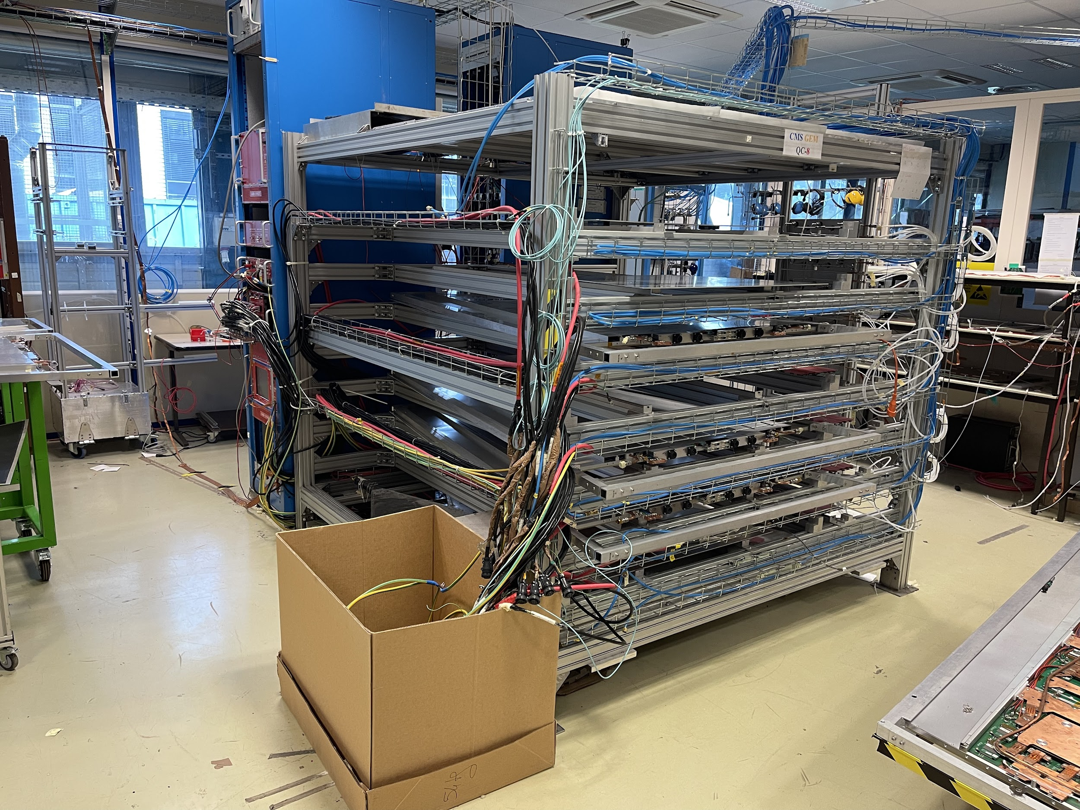
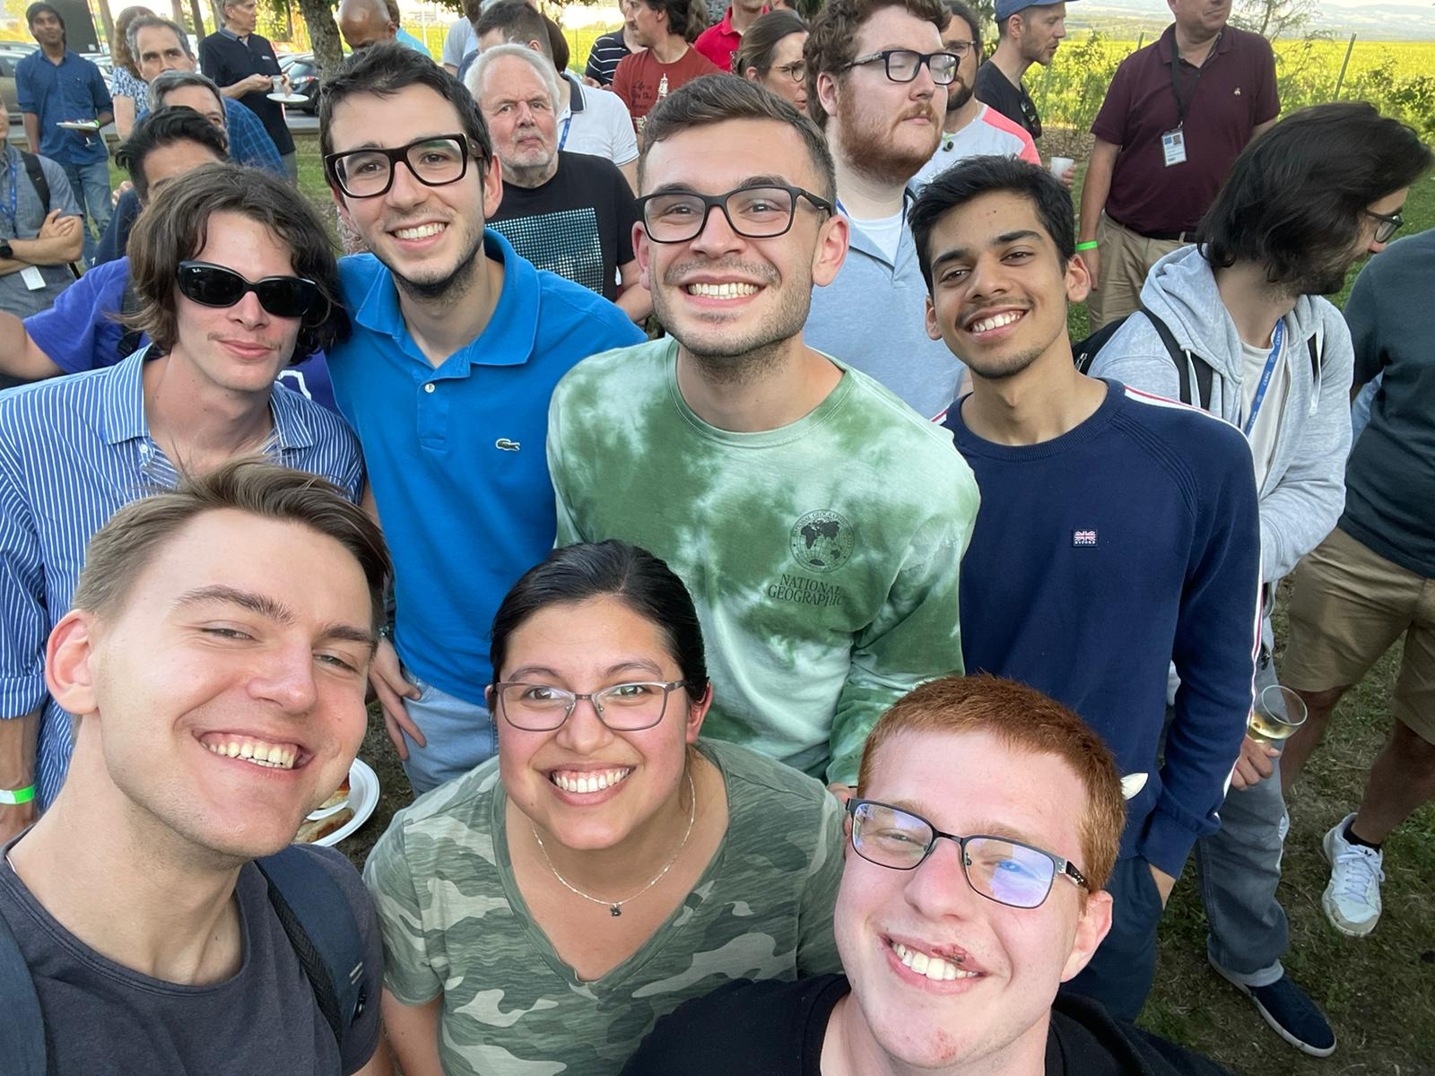
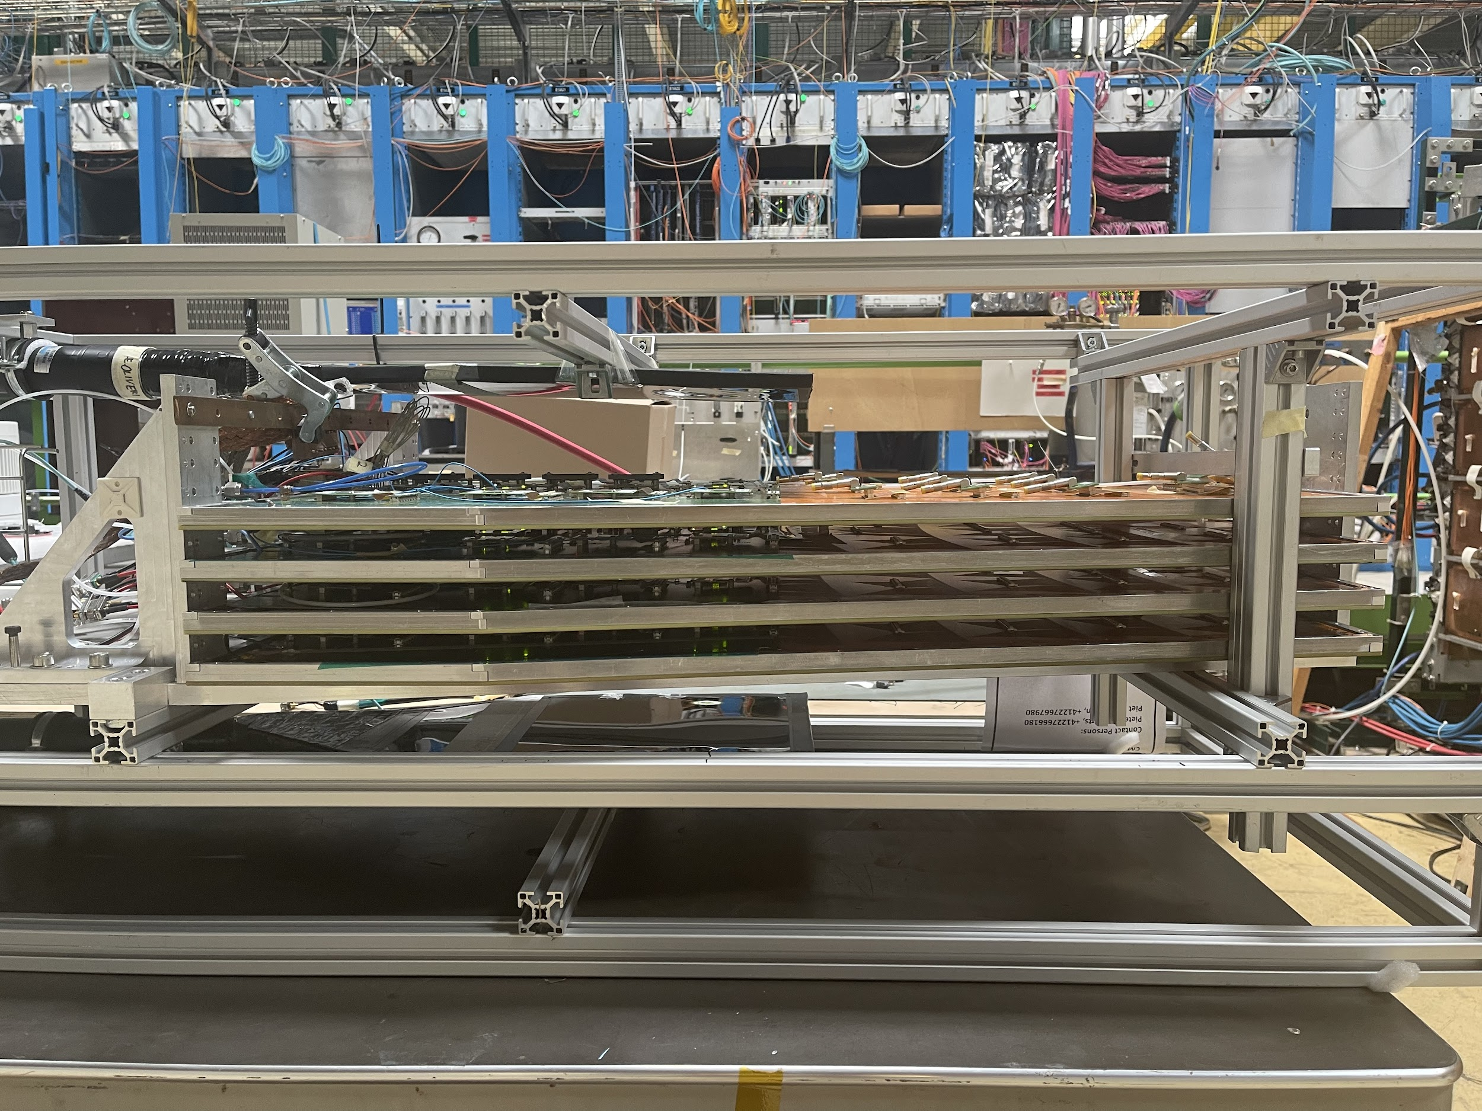
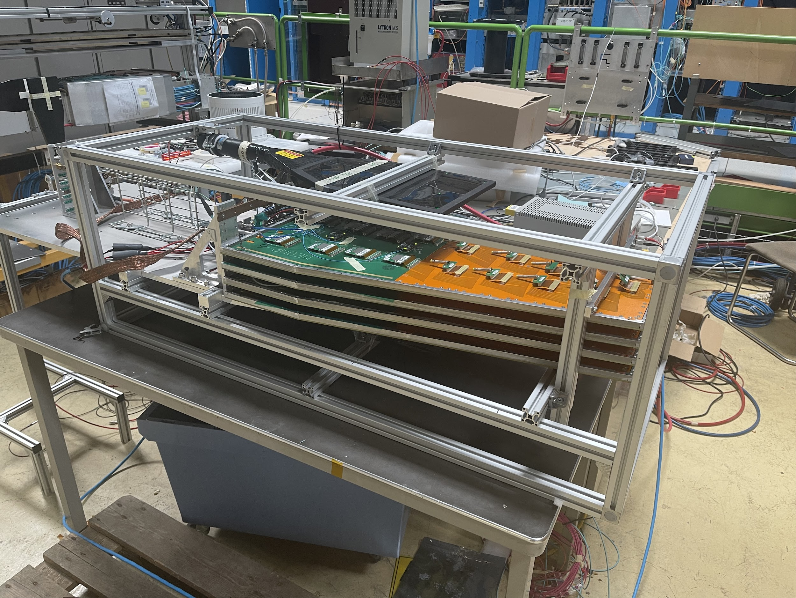
GEM Lab
💎
Notes:
G21 detector top left
Bottom right and left is ME0
Top right is cosmic stand where final G21 is going to be made

Slide 5
Research Project
Performance analysis of ME0 GEM detectors when irradiated with cosmic rays and a test beam
Progress Thus Far
Understanding the design, production, and quality control of GEM detectors
Using Uproot, MatPlotLib, Numpy, etc. for data analysis
Creating S-curves and understanding their relation to detector performance
Collection of data from exposure to cosmic rays

Slide 6
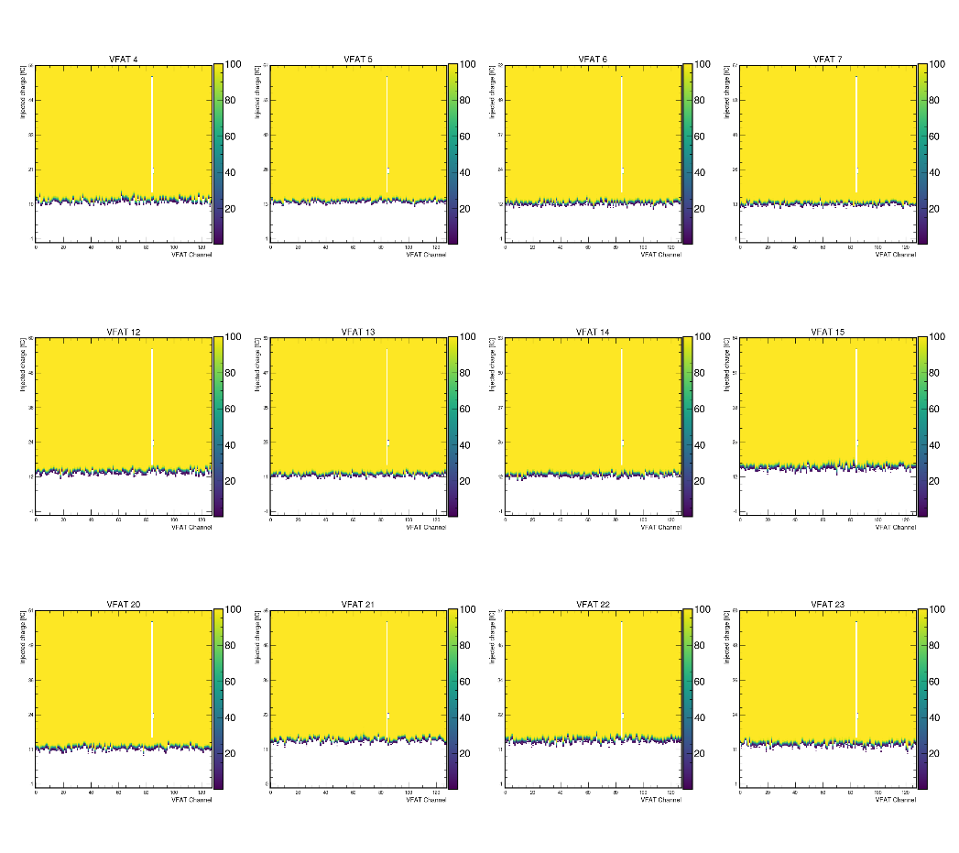
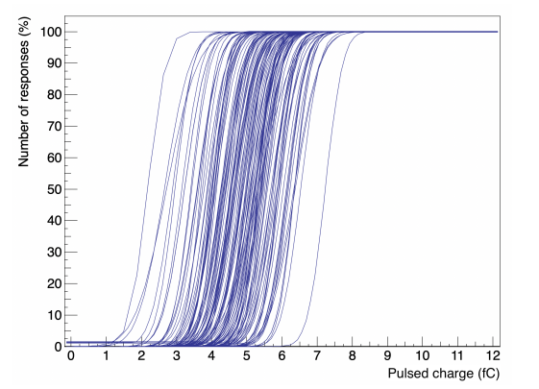
Progress Thus Far
Notes:
Split into 2 → one with S-curves and other with the data
Test beam analysis is in preparation for july
The double peaks can be due to misallighnment and can be corrected in the data → look for a single

Slide 7
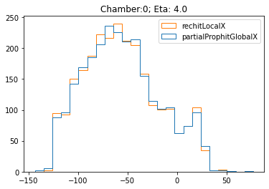
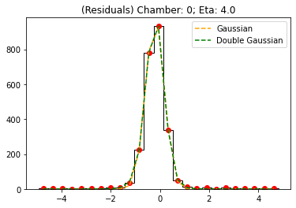
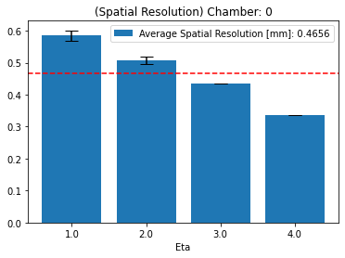
Progress Thus Far
Notes:
Split into 2 → one with S-curves and other with the data
Test beam analysis is in preparation for july
The double peaks can be due to misallighnment and can be corrected in the data → look for a single

Slide 8
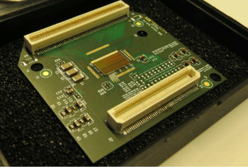
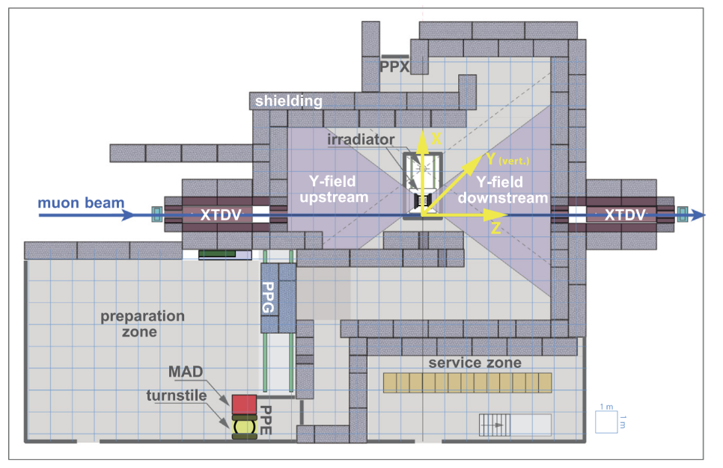
Future Challenges
Chips and
Test Beam
Notes:
Test beam → calibration, time, scale of analysis, technical challenges

Slide 9
Sources
Bianco, M. (2022). GEM Detectors for CMS Experiment [presentation]. Detector Seminar, Meyrin, Switzerland.
Bianco, M., Fallavollita, F., Fiorina, D., Pellecchia, A., Ramirez Garcia, L. F., Rosi, N., & Verwilligen, P. (2022). Rate capability of
large-area triple-GEM detectors and new foil design for the innermost station, ME0, of the CMS endcap muon system. arXiv.
Mocellin, G. (2021). Performance of the GE1/1 detectors for the upgrade of the CMS Muon Forward system [Master's thesis, RWTH
Aachen University].
Pfeiffer, D., Gorine, G., Reithler, H., Biskup, B., Day, A., Fabich, A., Germa, J., Guida, R., Jaekel, M., & Ravotti, F. (2017). The radiation
field in the Gamma Irradiation Facility GIF++ at CERN. Nuclear Instruments and Methods in Physics Research, 866, 91-103.
Preliminary VFAT3 User Manual (2020).
Sauli. F. (2016). The gas electron multiplier (GEM): Operating principles and applications. Nuclear Instruments and Methods in Physics
Research, 805, 2-24.

Slide 10
Performance of
ME0 GEM Detectors with
Cosmic Rays and in Test Beam
Questions?

Slide 11
Tell us what experiment you are working on, what your role is and what you have accomplished, so far, as well as any potential roadblocks you foresee.
Project: GEM detectors for CMS
Role: data analysis and acquisition
So far: re-learnd Python. How the detectors work and the associated electronics. How to collect and analyze data
Roadblocks ahead: test beam! → we have a short time frame to collect data

