Slide 1
RF Quadrupole at Offline 2
SY-STI-RBS

Slide 2

ISOLDE (Isotope Separator On-Line DEvice)
Isotope mass separator on-line facility
Takes proton beam from Proton Synchrotron Booster (PSB)
Directs beam into targets to produce RIBs
ISOLDE takes ~50% of CERN protons at 1.4GeV from the PSB
Notes:
https://cernbox.cern.ch/index.php/s/7z8cjK85HHV0IJu
https://home.cern/science/experiments/isolde

Slide 3
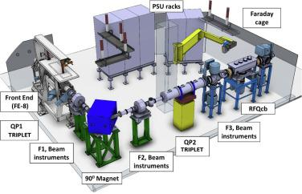
Offline 2
Off-line ion testing facility for ISOLDE
Equivalent testing environment specifically for Frontend and RFQcb to test targets and hardware
Non-radioactive
Notes:
https://www.ipac23.org/preproc/pdf/TUPA081.pdf
https://www.sciencedirect.com/science/article/pii/S0168583X2300191X#fig6

Slide 4
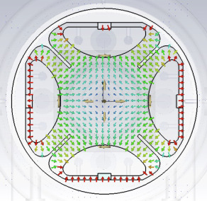
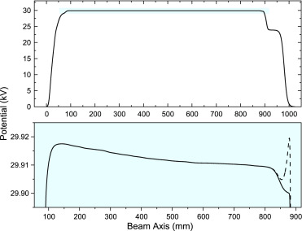
RF Quadrupole Cooler and Buncher at Offline 2
Copy of ISCOOL RFQcb
Improves beam quality by reducing energy spread and transverse emittance
At slightly lower voltage than Frontend and ions are decelerated as they move along the potential and buffer gas
At the end there is a small potential well to trap ions or it can be switched to ground potential to extract in bunches
Ions can be stored, cooled, released in the bunches
Notes:
https://www.sciencedirect.com/science/article/pii/S0168583X2300191X

Slide 5
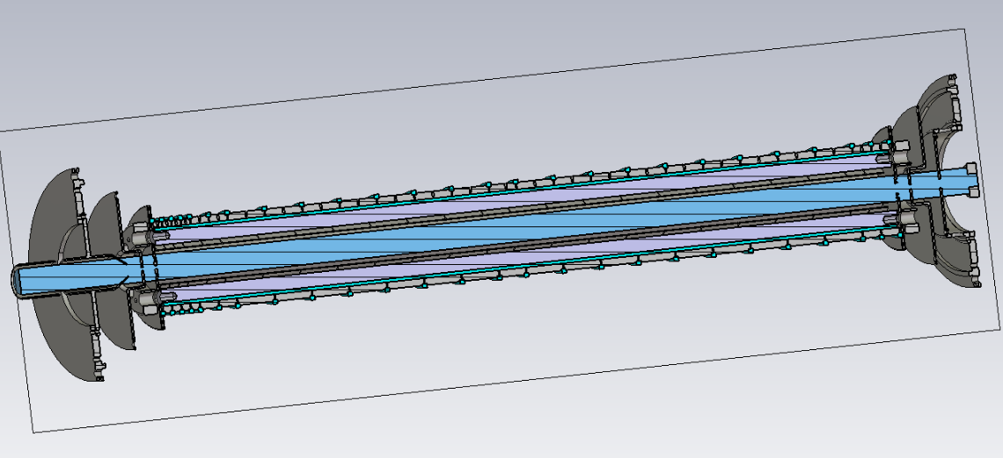
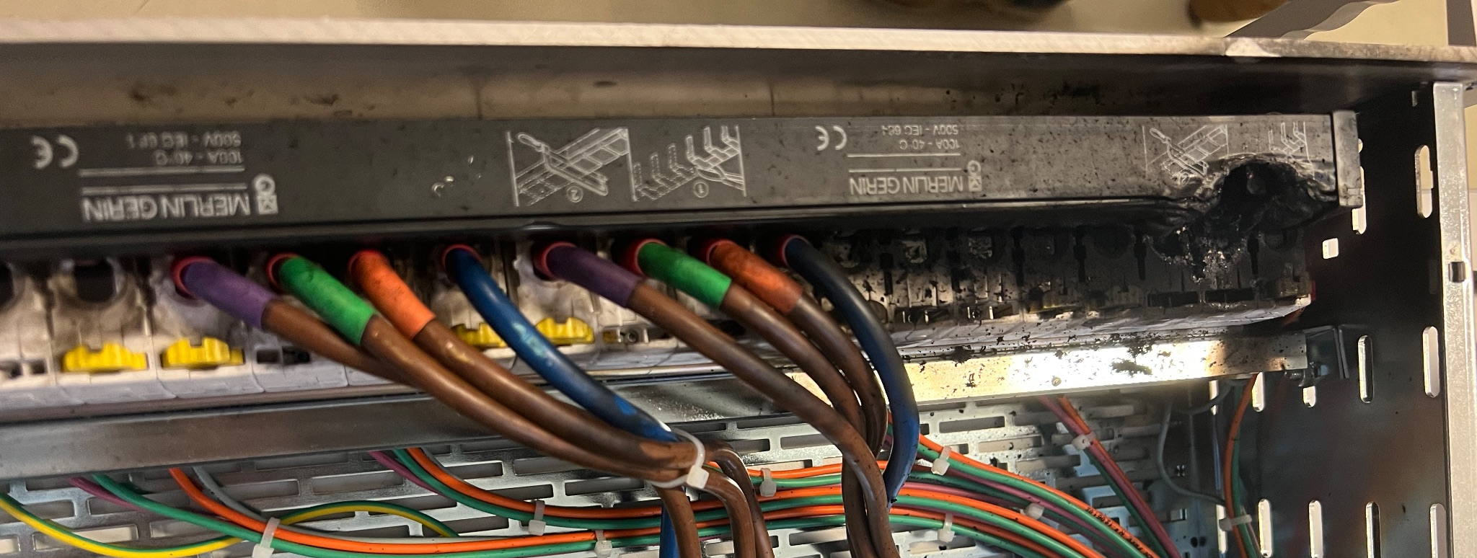
Goals and Challenges
Goals: Model and simulate the RFQ in SIMION with the buffer gas, work on Offline 2
Challenges: No experience with SIMION or lua, I find creating CAD type models very difficult, for some reason part of the controls melted

Slide 6
