Slide 1
Photodetachment of H⁻ at the GBAR Experiment
Lance Lampert
22-6-23

Slide 2

Mentors
Dr. Pauline Comini
Dr. Laszlo Liszkay

Slide 3
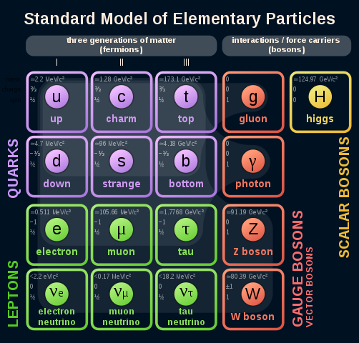
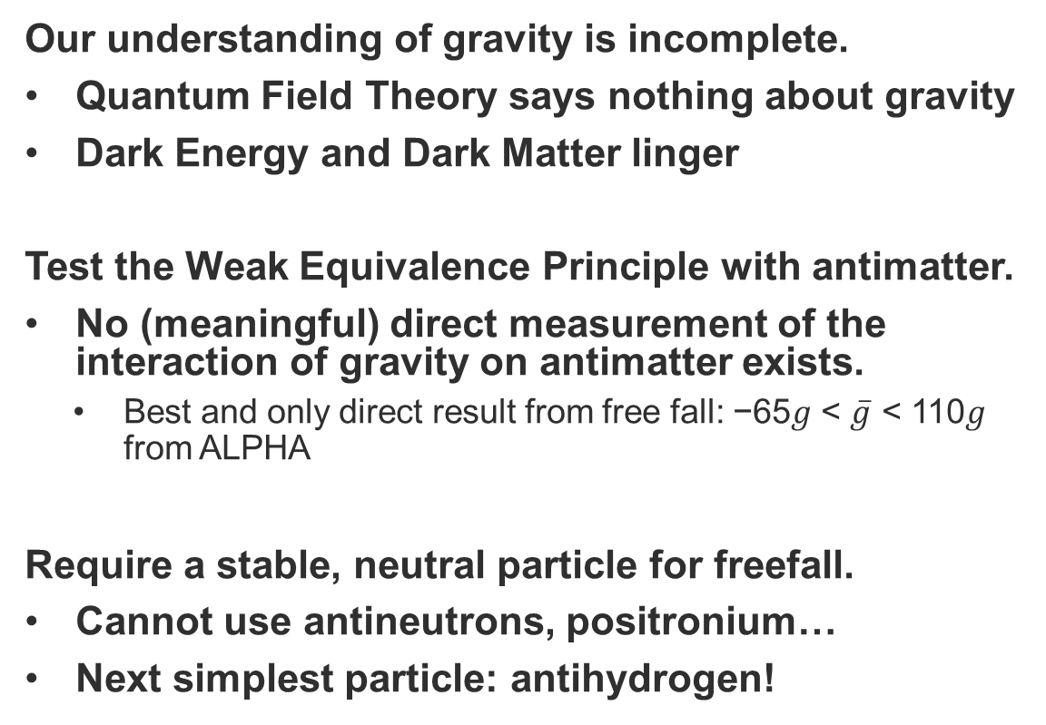
Motivation for GBAR Experiment
Our understanding of gravity is incomplete.
Quantum Field Theory says nothing about gravity
Dark Energy and Dark Matter linger
Test the Weak Equivalence Principle with antimatter.
No (meaningful) direct measurement of the interaction of gravity on antimatter exists.
  Best and only direct result from free fall: −65𝑔 < $\overline{g}$ < 110𝑔 from ALPHA
Require a stable, neutral particle for freefall.
Cannot use antineutrons, positronium…
Next simplest particle: antihydrogen!
Wikipedia

Slide 4
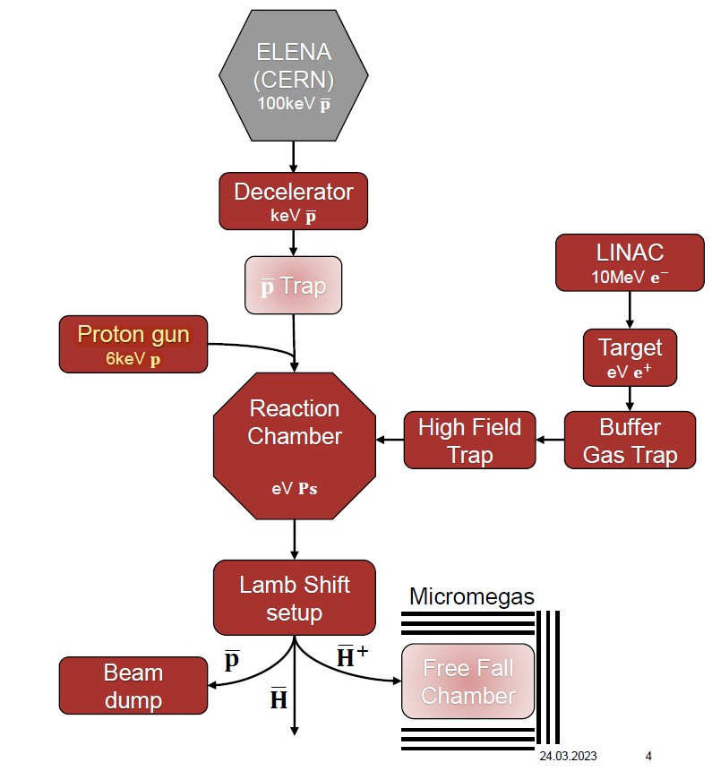
GBAR Experiment Overview
Excited positronium reacts with slow antiprotons
Several particles are produced and are directed based on their charge
Antihydrogen ions directed to free fall chamber
  Cooled, then photodetached, and finally, free-fall.
Philip Blumer, Moriond Gravitation (2023)

Slide 5
GBAR Collaboration,
CERN-SPSC-2023-008

Slide 6
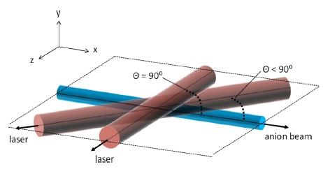
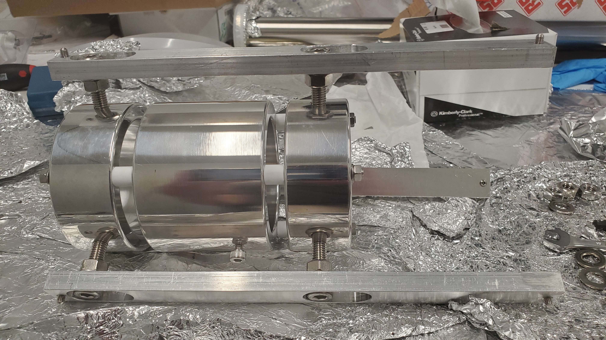
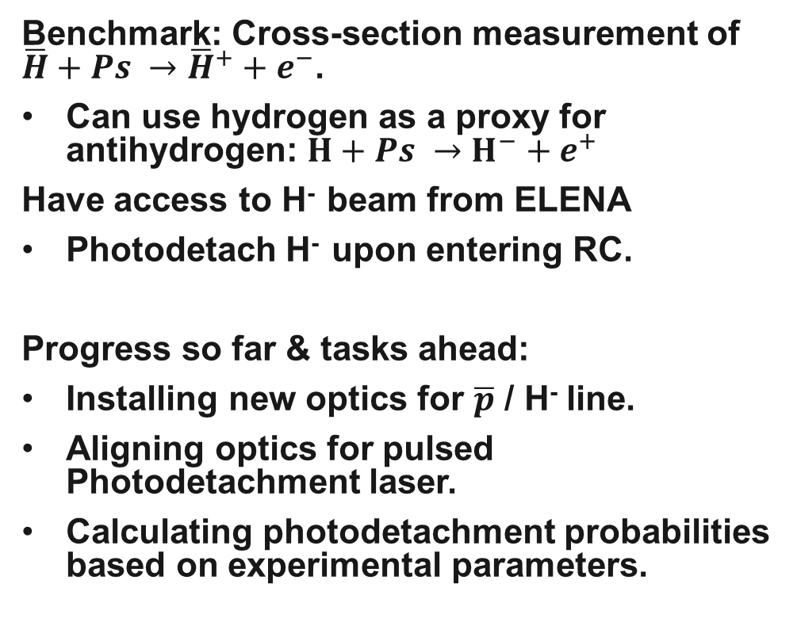
Photodetachment of H⁻
O’Connor et al., Rev. Sci. Instrum. (2015)
Benchmark: Cross-section measurement of $\overline{H}+Ps →{\overline{H}}^{+}+e^{−}$.
Can use hydrogen as a proxy for antihydrogen: $H+Ps →H^{−}+e^{+}$
Have access to H⁻ beam from ELENA
Photodetach H⁻ upon entering RC.
Progress so far & tasks ahead:
Installing new optics for $\overline{p}$ / H⁻ line.
Aligning optics for pulsed Photodetachment laser.
Calculating photodetachment probabilities based on experimental parameters.
Pulsed Nd:YaG
H⁻

Slide 7
