Slide 1
New Features in Detector Construction Application for CMS - HGCAL Database
Corbin Tinnon
Supervisors: Muhammad Imran & Hafeez Hoorani

Slide 2
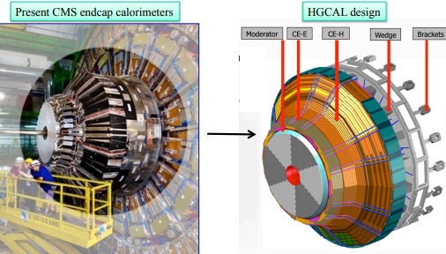
High-Granularity Calorimeter (HGCAL)
The HGCAL will replace the existing endcap calorimeters
Need to maintain excellent calorimetric performance under the HL-LHC operations with an expected to increase the Luminosity by a factor of 10, leading to a higher needed radiation tolerance and event pileup on detector
two major sections: the electromagnetic calorimeter (CE-E) and the hadronic calorimeter (CE-H)

Slide 3
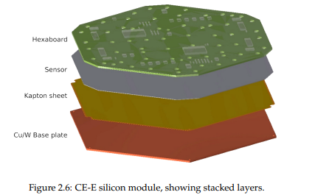
HGCAL Database(DB)
Component Tracking: The DB store and track all information related to the detector components. This includes everything from the moment of delivery to the integration into the detector itself, including shipping details.
Data Storage: The database will store all kinds of data associated with the detector components. This includes calibration data, conditions data, and configuration data.

Slide 4
HGCAL Database(DB)
Detector Construction: DB will use parent-child relationships to build higher-level objects. This allows for tracking of how smaller components (the "children") are used to construct larger ones (the "parents"). This process effectively builds a virtual model of the entire HGCAL detector within the database, with all readout channels mapped out.
Mapping Detector Channels to Readout Channels: Having a virtual model of the entire HGCAL detector in the database allows for easy mapping of detector channels to readout channels. This is important for understanding where the final measurement data is coming from within the detector.

Slide 5
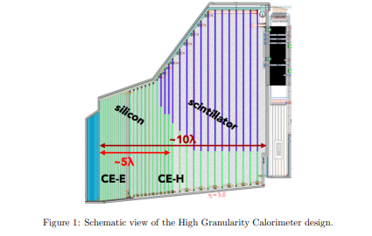
HGCAL Database(DB)
I will be directly working on different features including the detector assembly process. My main concern will to be to find solutions to errors present within this code.

