Slide 1
Deadtime Simulation for ATLAS Level 1 Central Trigger Mechanism
Sarah L. MacHarg
June 22, 2023
Notes:
Giving an overview of what I’ve learned and what I’m working on
Caveat that I’ve been here three days, and project scope has changed dramatically over those three days

Slide 2
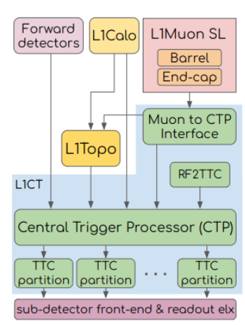
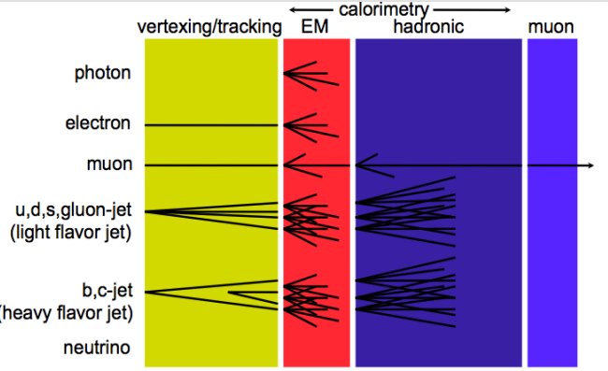
L1CT Mechanism
Notes:
ATLAS takes input from layers of calorimeters and muon detectors, as well as topological information – that is, information like where a particle passes through detectors – and reformats timing information
This information is then sent into the level 1 central trigger processor
The trigger processor determines, based on the data input, whether an event is physically interesting – if the trigger issues an “L1 Accept,” the event data is stored in a buffer to be read out by a CPU for further processing.

Slide 3
ATLAS & LHC – the Big Data Problem
LHC: Proton bunches
  3564 bunches per orbit, 25ns time separation → 40 MHz bunch crossing rate
  Cannot record all this data – time, money limitations → triggers (filter events), deadtime (ignore events)
Level 1 Central Trigger (L1CT) – Hardware, Level 2 High Level Trigger (HLT) - Software
  L1CT: First level of trigger filtration, high input rates mean need fast processing rates
  Increased complexity of trigger calculation as input rate decreases
LHC Bunch Crossings
L1CT
HLT
4*10⁷ Hz
1*10⁵ Hz
1*10³ Hz
Notes:
Why trigger? Data issue.
Time limitations: cannot read out data from the detectors at the rate that it is coming in

Slide 4
Deadtime Simulation
Simple
  Ex: Veto any L1 accepts for four bunch crossings after an accept
Complex
  Ex: Leaky bucket algorithm
Programmable
Total deadtime varies based on incoming events → simulator
→ Initial Project: Add existing simulator to online tool dashboard for experts-on-call

Slide 5
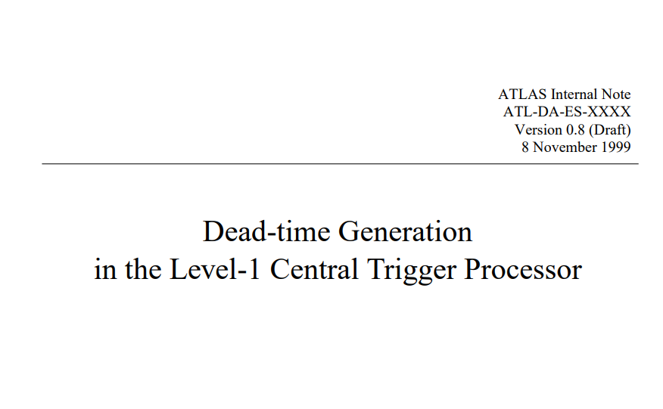

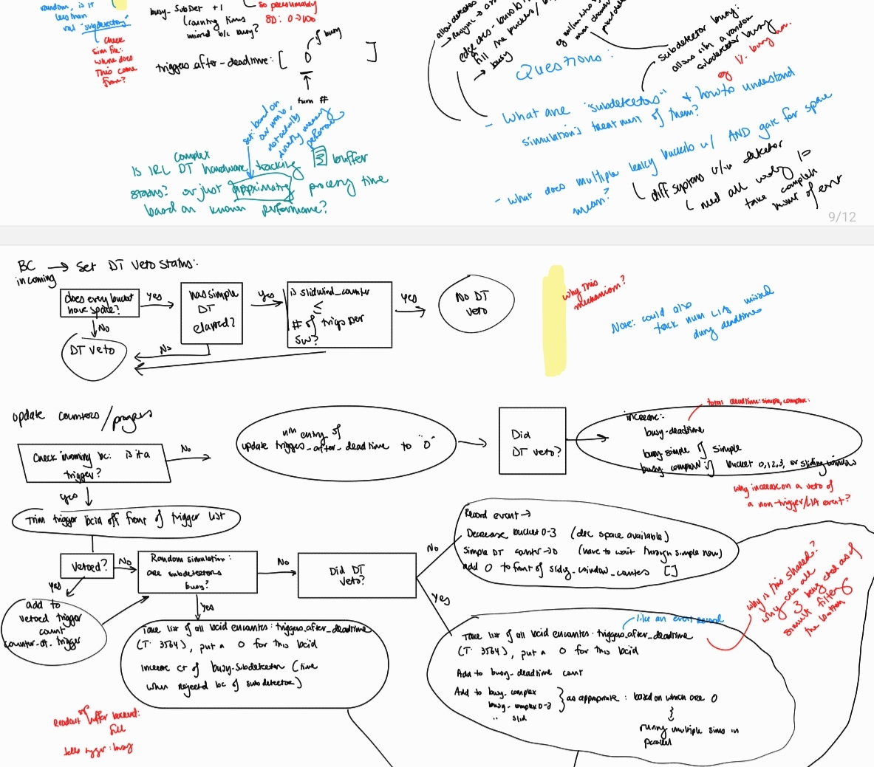
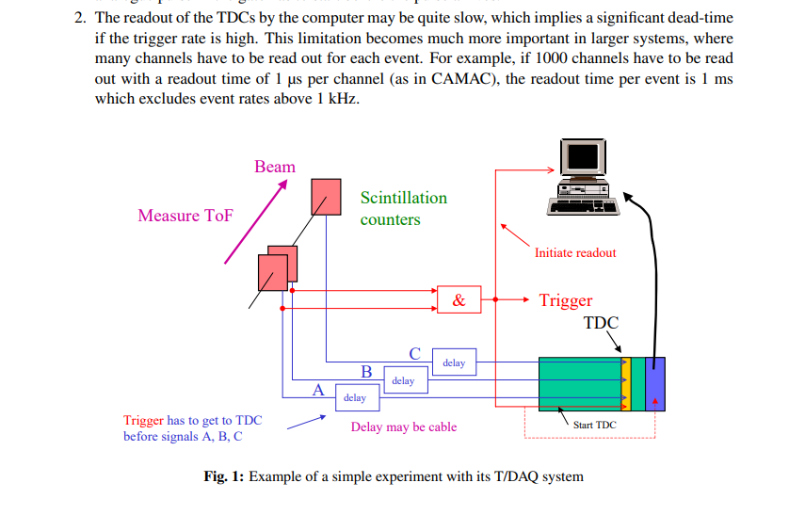
This week
Familiarize self with
  Trigger mechanisms, deadtime
  Simulation code repository
    Brainstorm changes
Aligning goals
  New projects
    Detector calibration
    Physics analysis (who/how TBD)

Slide 6
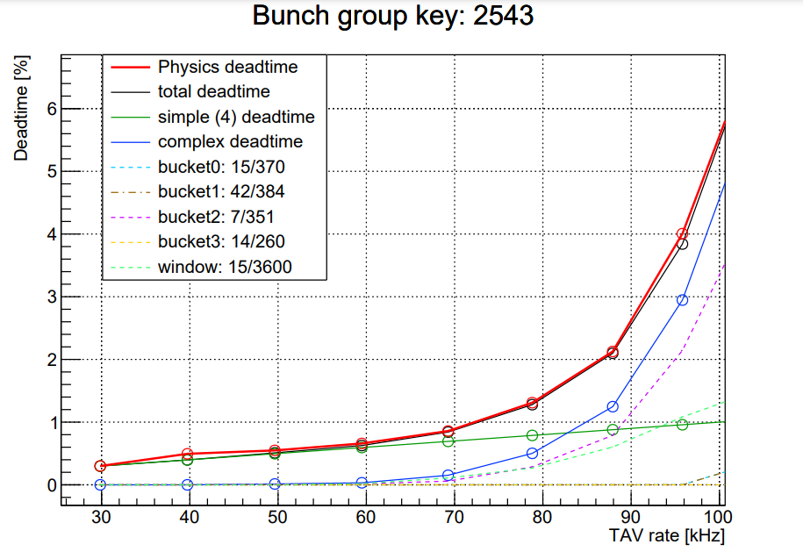
Up next
Get to know web dashboard repo
  Learn/refresh web app basics
Get app running
Side project tasks TBD
  Learn ROOT?

Slide 7
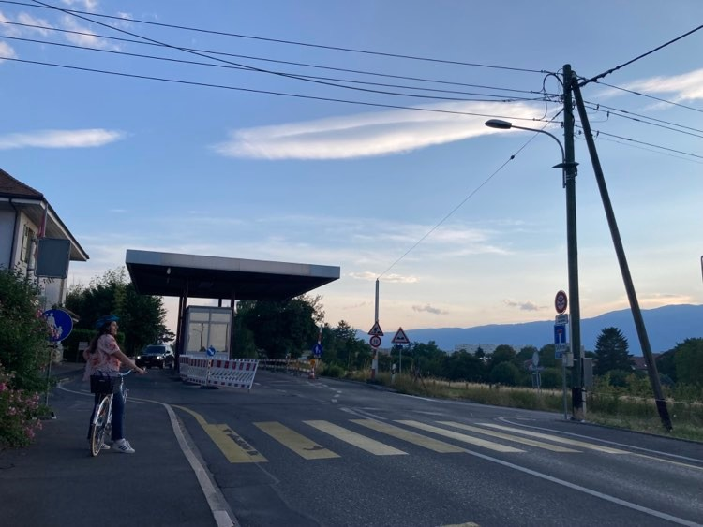


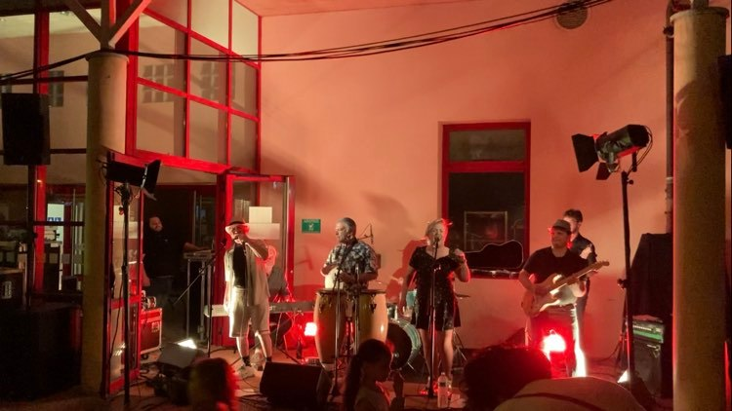

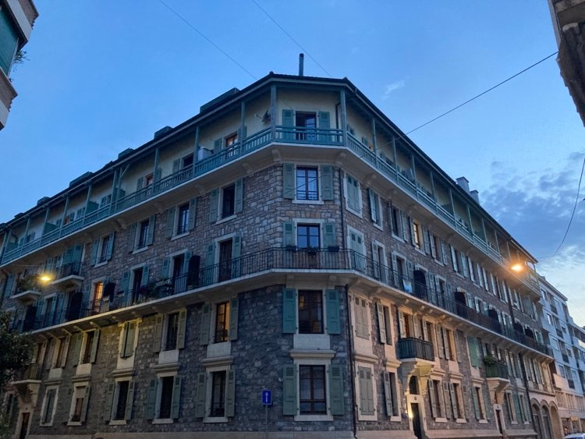
Pictures from the week

